Slide 1
Optimization problems in the development of a blimp for FCC-hh
Vedant Rautela
08/11/2022

Slide 2

Experiment/Goals
EP-DT Department
  Experimental Physics - Detector Technologies
  Development, construction and operation of particle detectors
    Optics, instrumentation and controls, gas + cooling systems, etc
Supervisor: Lorenzo Teofili
  Robotics and interfaces between robots and detectors
  HANDS-ON: surveys and operates on detectors
Goal: automation of future particle colliders

Slide 3
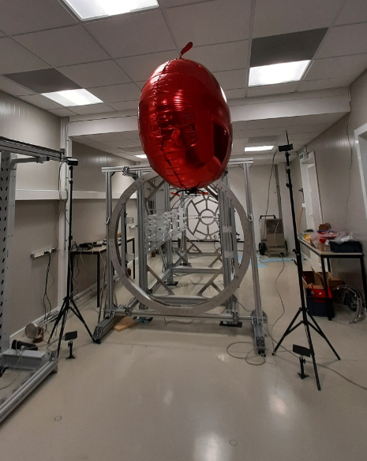
Project Description
Design/create a monitoring blimp
  Traverse detector cavern and map radiation + magnetic field
  Visually inspect detectors & locate detector components
  Inspect areas in case of alarm
Motivation
  Perform environmental inspection without endangering personnel
  Faster inspection of failures in case of alarm
Why is this difficult?
  Strong magnetic fields!
  Need to locate blimp precisely

Slide 4
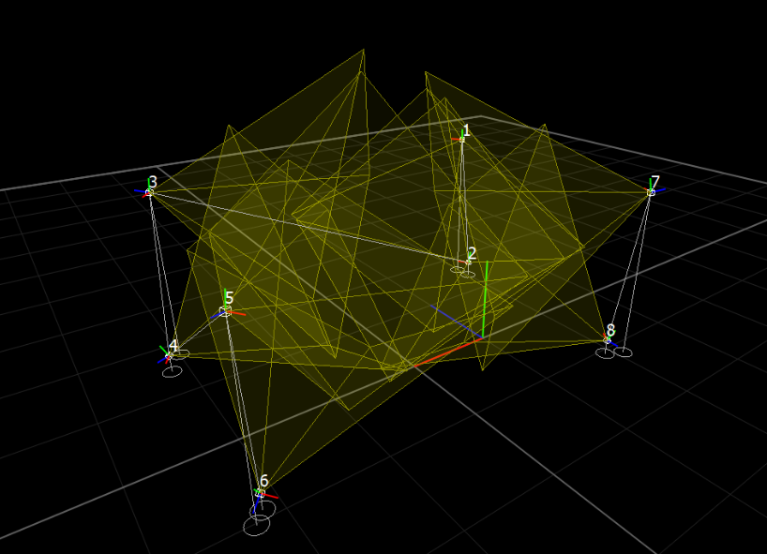
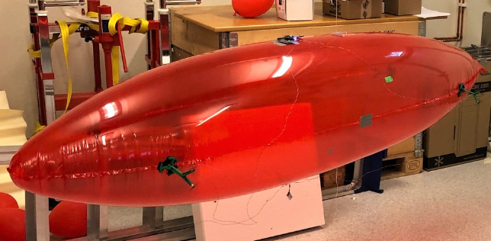
Project Goals
Motion capture
  Where is the blimp? How is it oriented?
  Write code to determine optimal placement of cameras in a volume
    Obstacles may be present
Real-time streaming
  Use PhaseSpace API to send position measurements to control system
    Allow a controller to track blimp in real-time and make corrections
Propeller placement optimization
  Blimp needs to counteract arbitrary magnetic disturbances
  Determine optimal placement/orientation of propellers

Slide 5
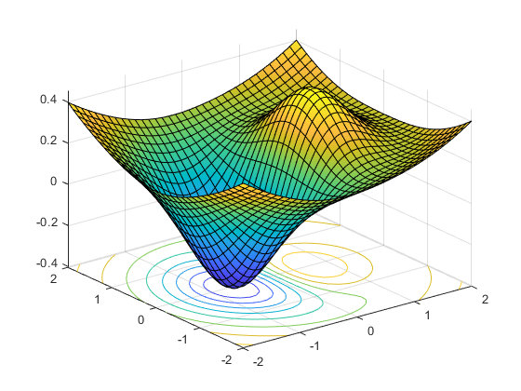
Motion Capture Problem
Can be framed as a visibility optimization problem
  Objective is to locate LED markers in the volume using N cameras
  Variables
    Positions (cartesian coordinates) of cameras
    Orientations (spherical angles) of cameras
  Constraints
    Cameras need to lie inside the volume
  Obstacles
    When seeing if a point is visible from a camera, check if the line segment intersects the obstacle
      Logic can be incorporated into any objective function

Slide 6
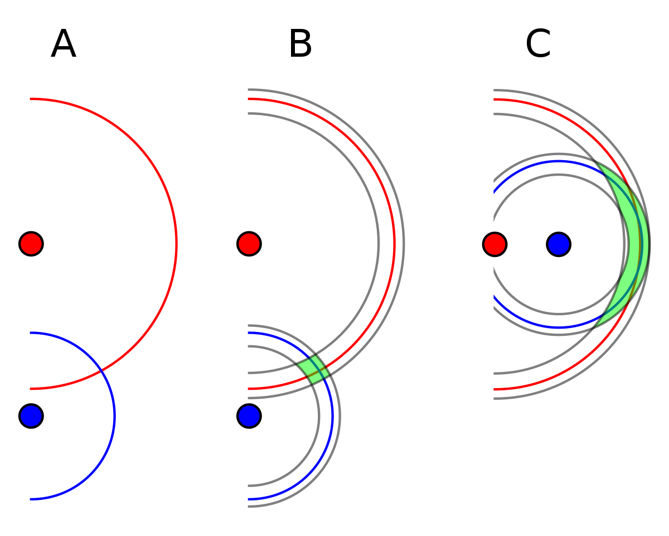
Motion Capture Problem (cont.)
Objective function
  Simplest objective function: number of points seen by two cameras
    Visibility does not correspond to triangulability
  Triangulability: GDOP (geometric dilution of precision)
    Used in GPS to measure error propagation due to satellite geometry
    Similar situation to camera placement (geometry affects error propagation)
    Low values are better than higher ones
  Average reciprocal GDOP
    Average value of reciprocal of GDOP function over volume
      Higher values mean better triangulability
    Reciprocal allows for invisible points to be ignored
Visualization
  Tools to visualize solutions, GDOP values of points in the volume, and visibility of points

Slide 7
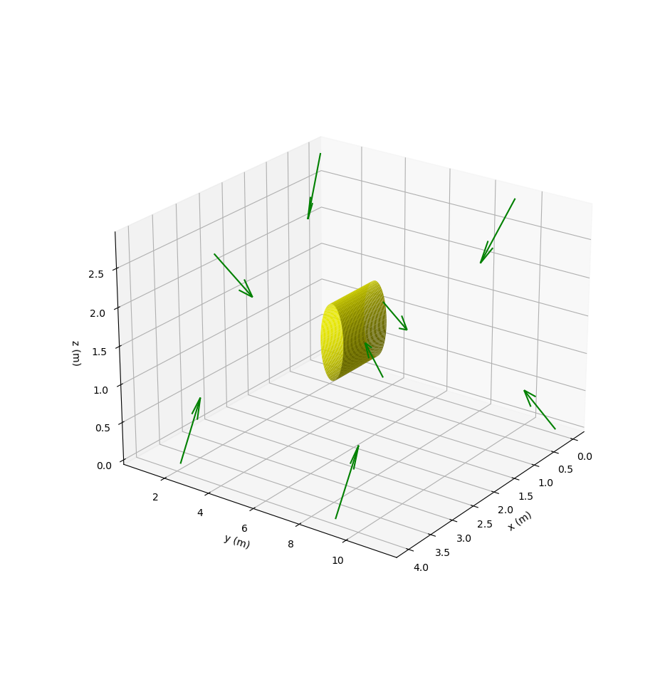
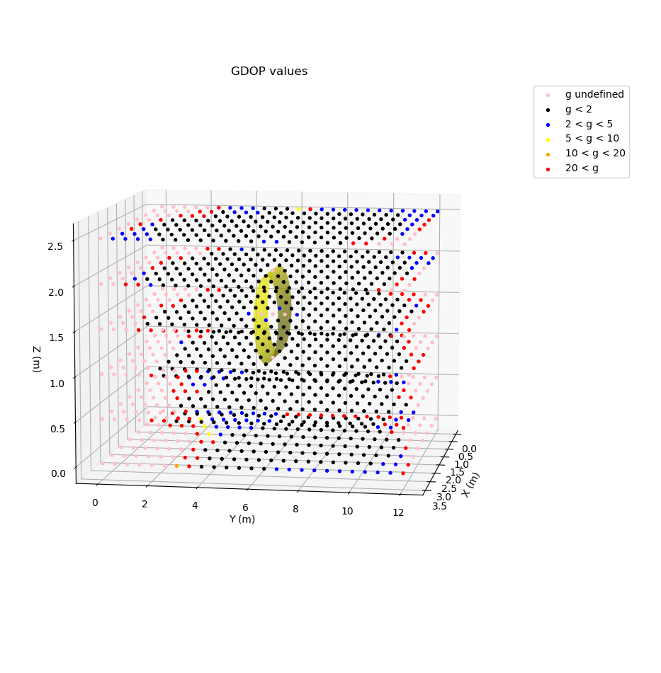
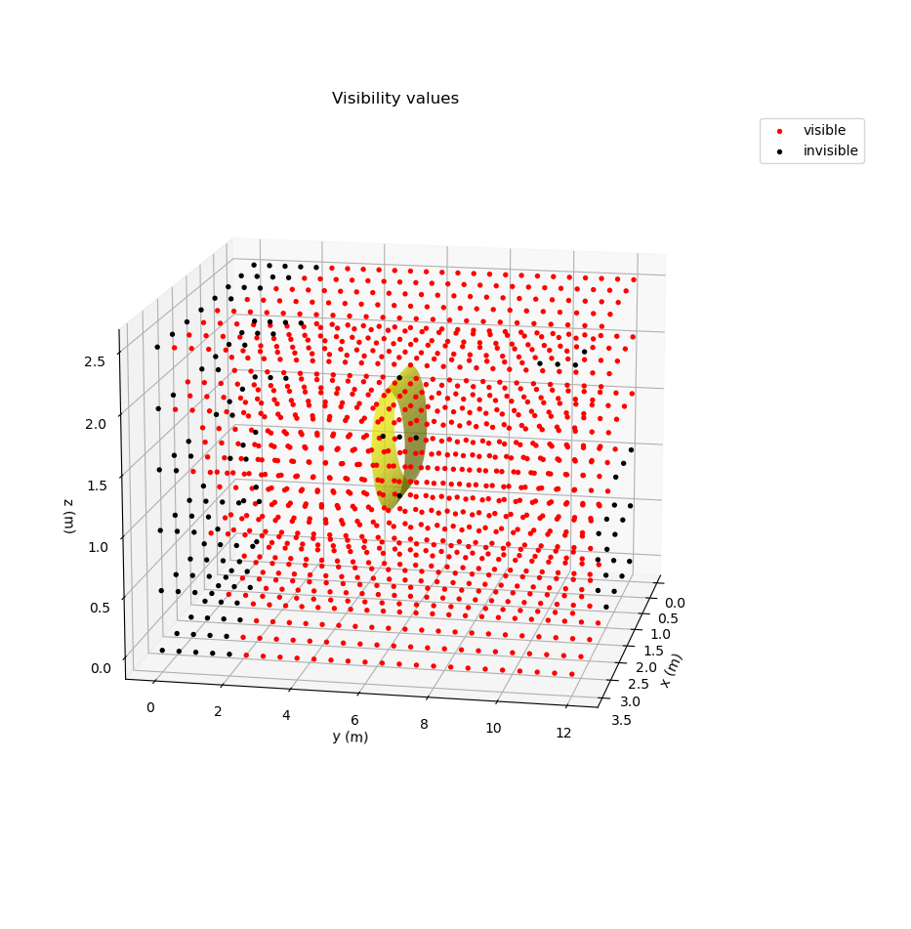
Application/Results
Solution (w/ out FOVs)
GDOP values of solution
Visibility values of solution

Slide 8
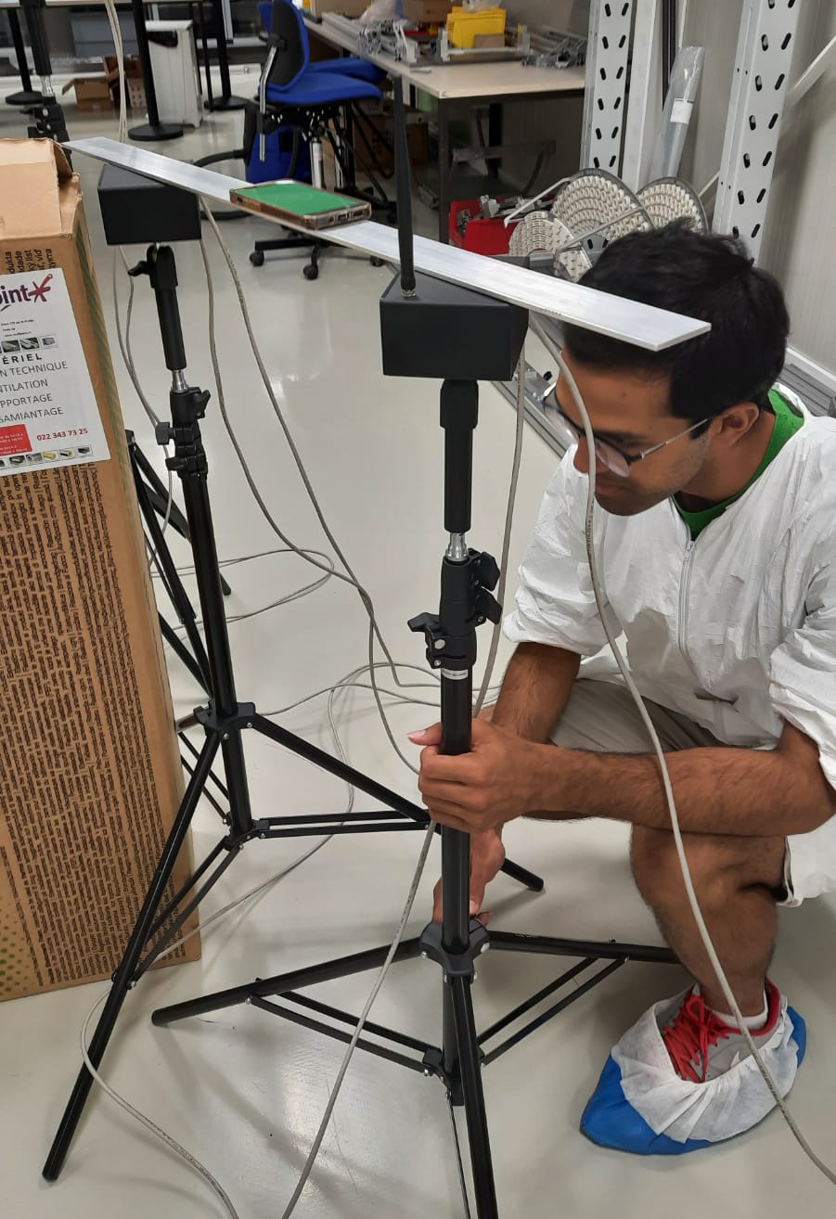
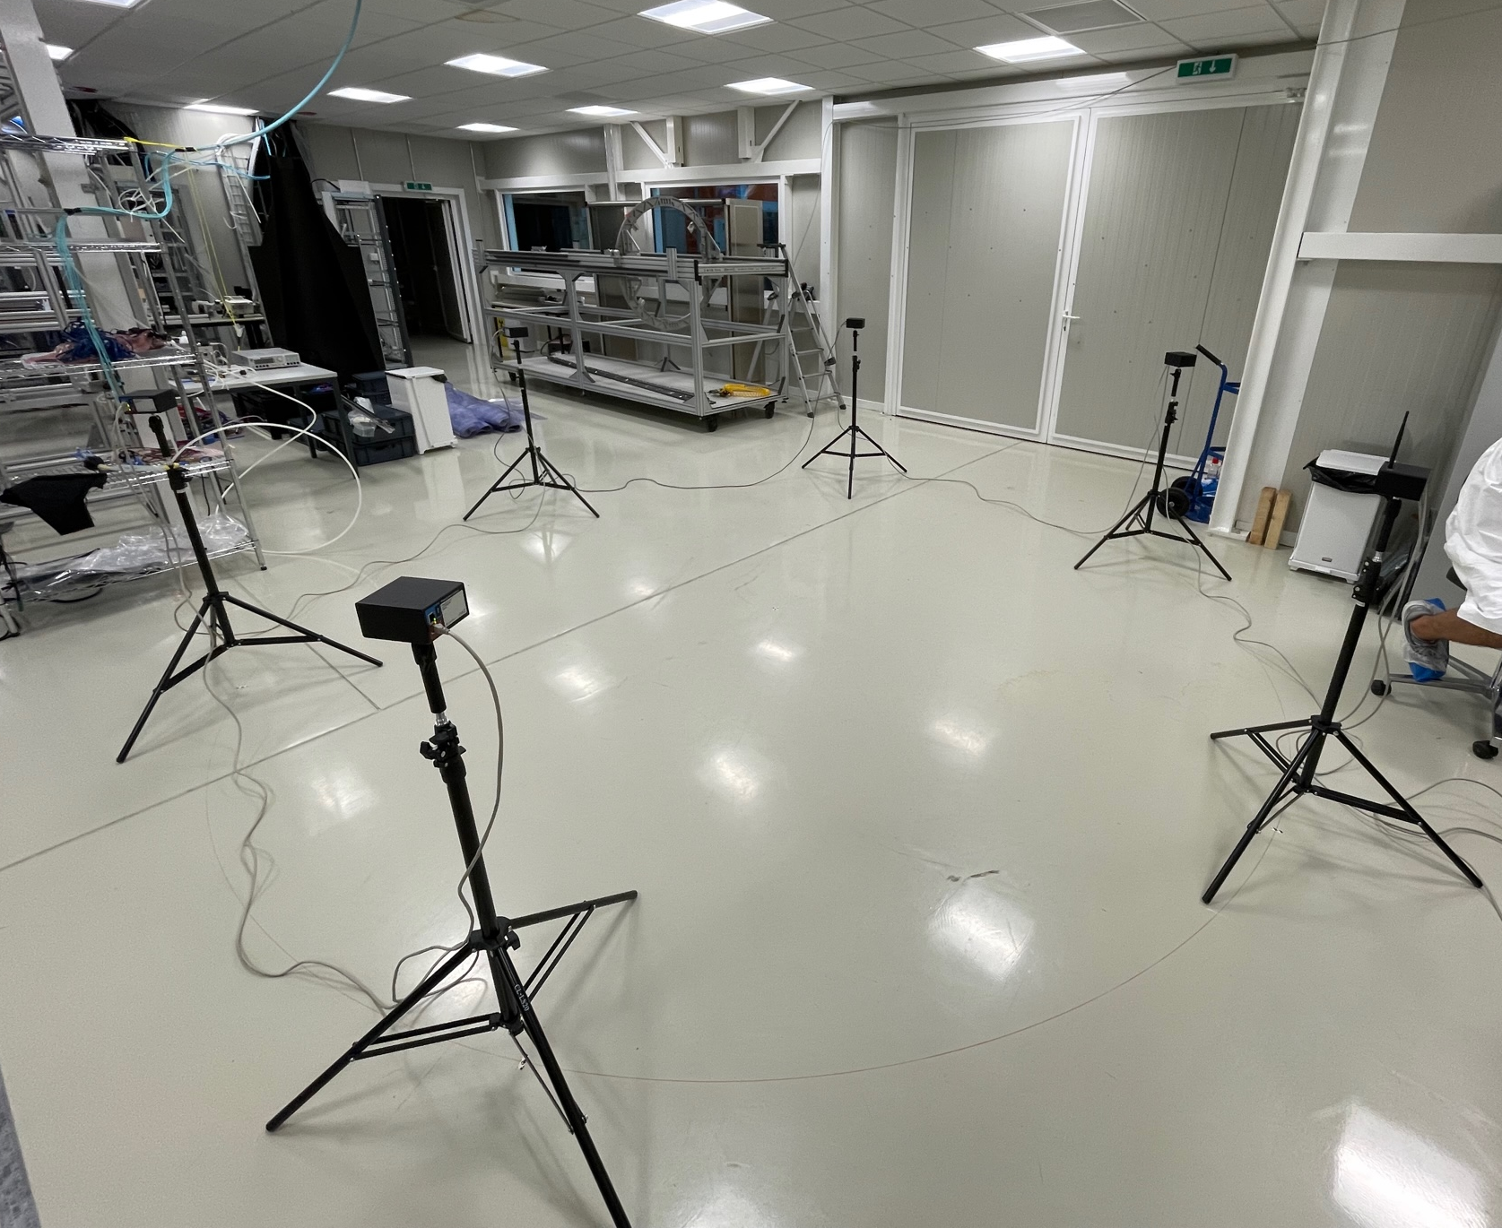
PhaseSpace System Tests
Optimization problem is highly dependent on the features of the PhaseSpace system
  # of sensors needed to triangulate a marker, FOV radius and angle, etc
  Use of GDOP in objective function
Perform tests to verify assumptions
  Tested various camera configurations to measure the condition number (quality metric) and compare with GDOP calculations
  In simple cases, optimal solution according to GDOP was also the configuration that yielded optimal condition number

Slide 9
PhaseSpace System Tests (cont.)
For the case of three coplanar cameras and a coplanar marker, the theoretical GDOP values agreed qualitatively with the cond number
3
6
Configuration | Cond number | GDOP value
1-2-3-4-5-6 | 3.73 | 0.99
1-3-5 | 3.92 | 1.41
1-2-3 | 3.98 | 2.88
1-3-4 | 6.75 | 2.27
2
5
1
4

Slide 10
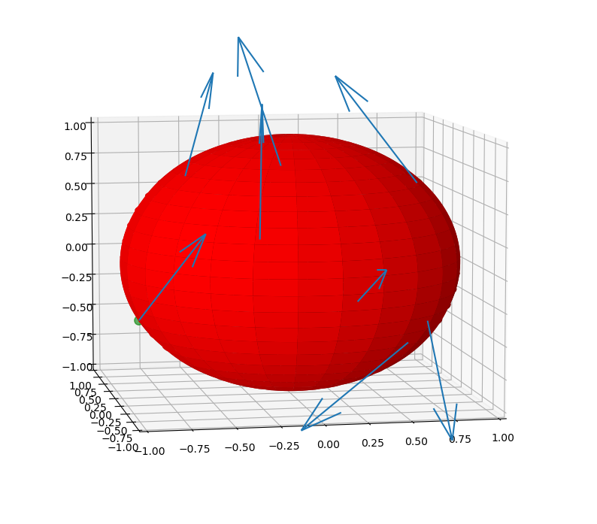
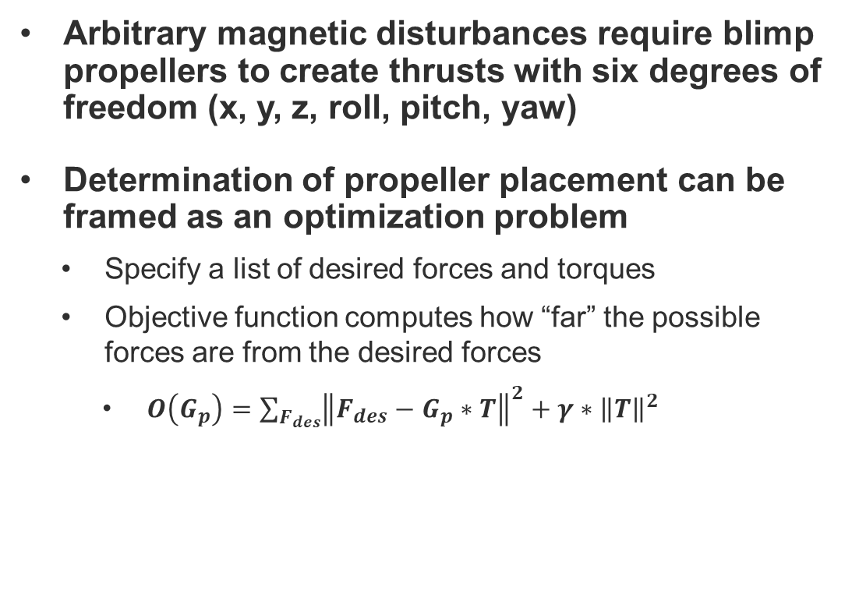
Propeller Placement Optimization
Arbitrary magnetic disturbances require blimp propellers to create thrusts with six degrees of freedom (x, y, z, roll, pitch, yaw)
Determination of propeller placement can be framed as an optimization problem
  Specify a list of desired forces and torques
  Objective function computes how “far” the possible forces are from the desired forces
    $O\left(G_{p}\right)=\sum_{F_{des}}{{\left\|F_{des}−G_{p}∗T\right\|}^{2}+γ∗{\left\|T\right\|}^{2}}$

Slide 11
Remaining Work
Camera placement optimization
  Add support for other kinds of obstacles
  Use camera optimization software to set up cameras in a lab to test out blimp system
  Improve efficiency of the camera optimization software
  Other camera placement related problems (i.e. # of cameras needed to monitor entire volume)
Propeller placement optimization
  Add more practical constraints to the optimization problem such as size and orientability of propellers
  Test propeller placements on blimp to see how they counteract arbitrary disturbances
  Evaluate solutions produced by the propeller placement optimizer
  Experiment with different objective functions to see how the optimal solutions change
Creation of real-time streaming software

Slide 12
