Slide 1

Analysis of the Phi Resonance using ATLAS Minimum Bias Data for √s = 13.6 TeV pp collisions
Aidan Nakhleh - University of Arizona
Supervisor - Mario Campanelli

Slide 2
Introduction
Studying soft scale Quantum Chromodynamics (QCD)
  Harder to parameterize using Monte Carlo (MC) methods
  Analysis helps constrain models
Repeat previous analyses with new data
  Expected result helps us test the new datasets from Run 3
  Updates our analysis algorithms
Strangeness Production: 𝝓(1020) → K+ K-

Slide 3
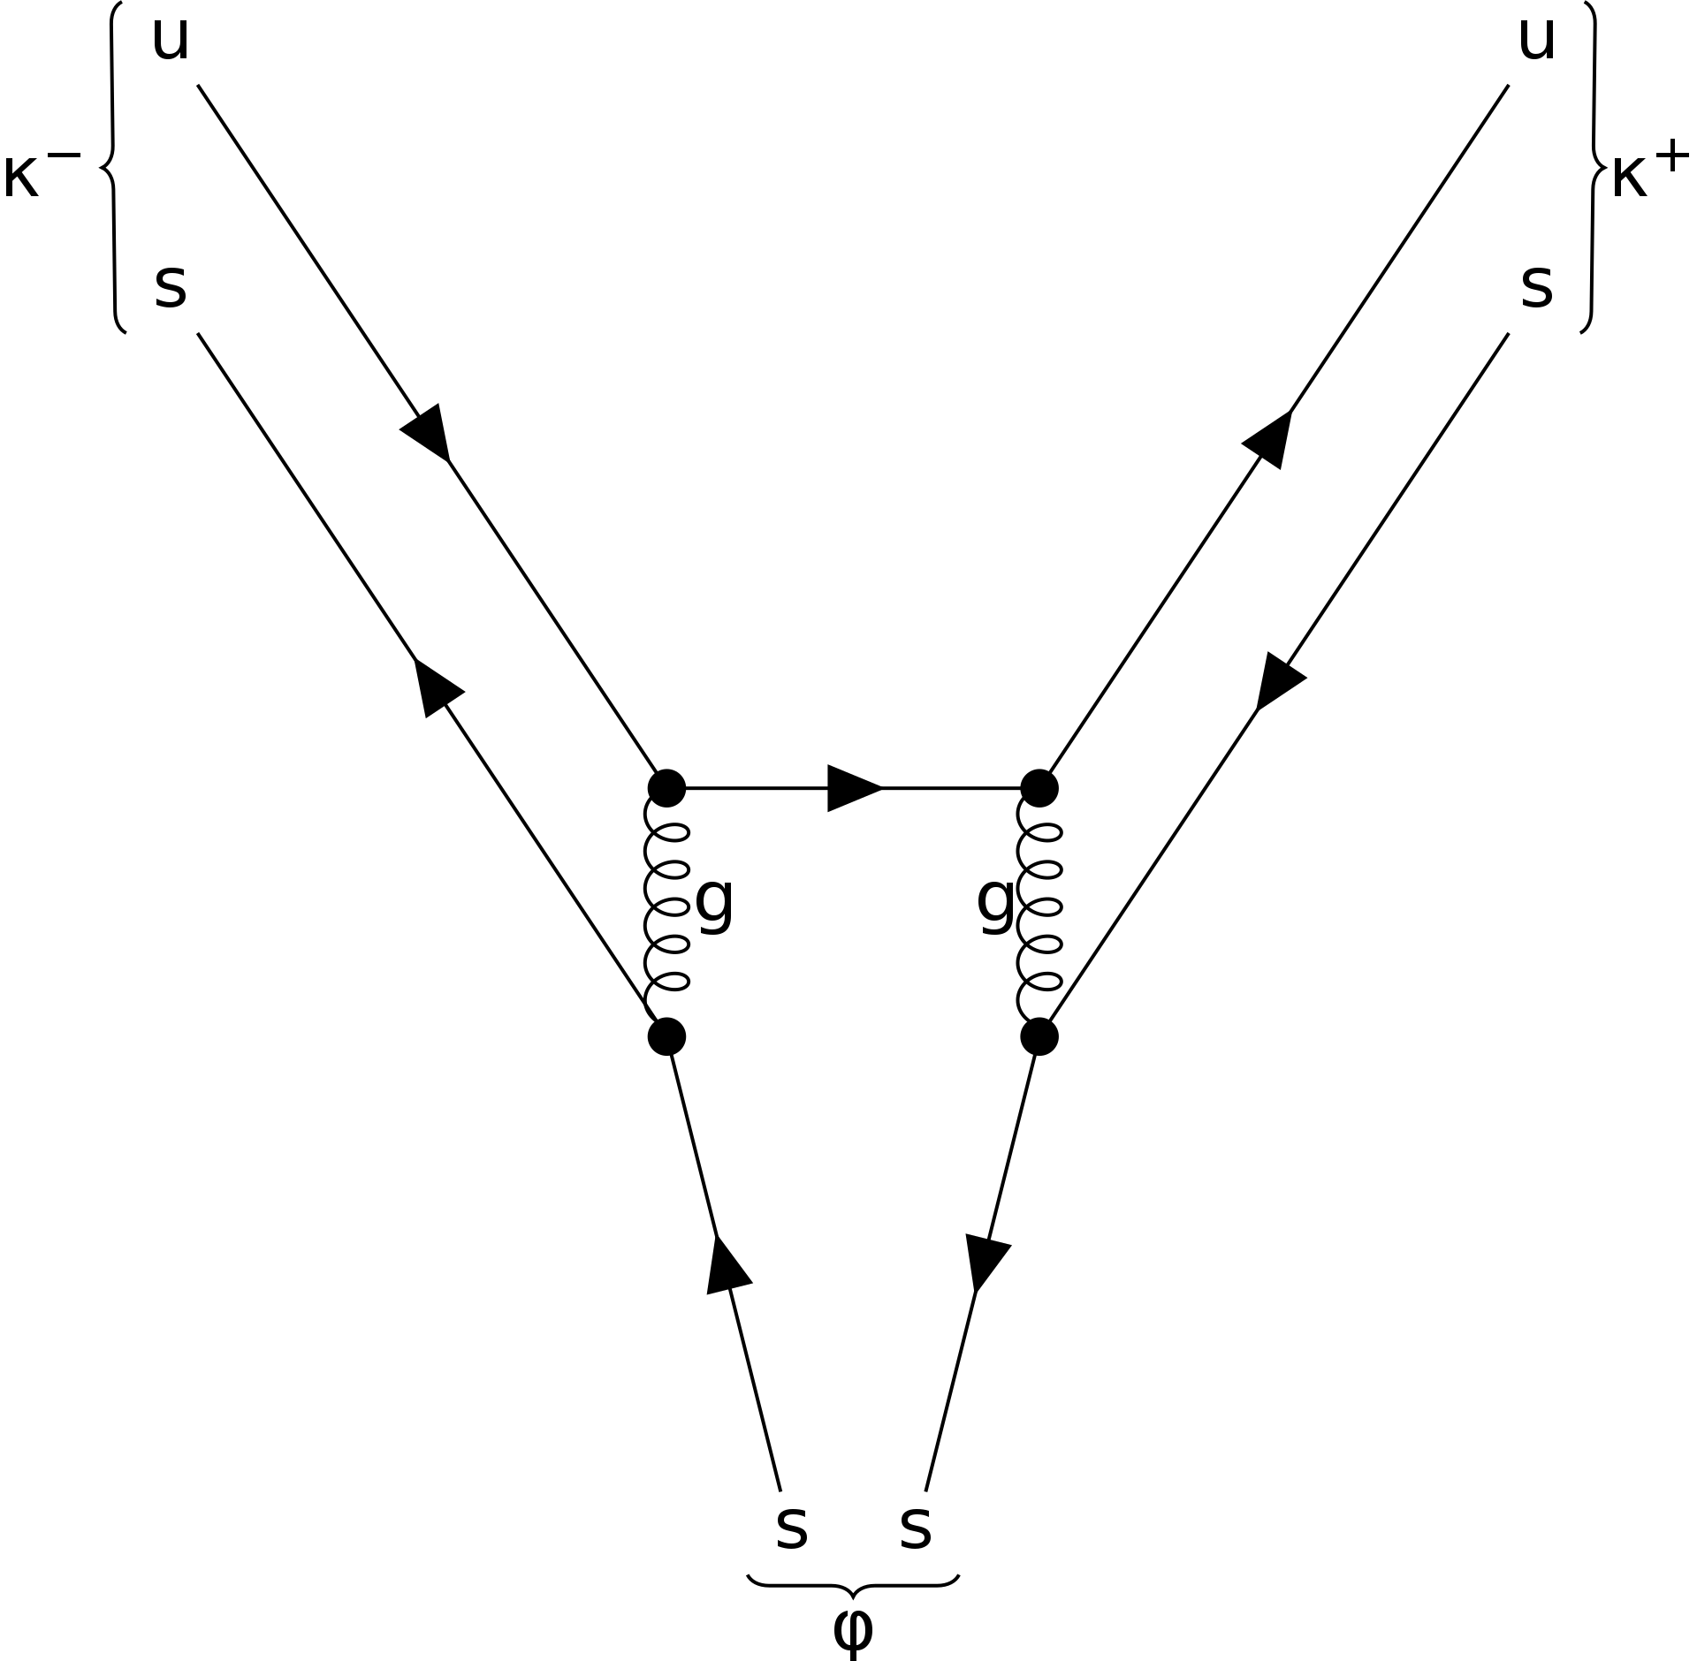
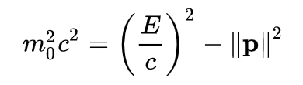
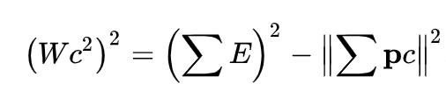
Dataset and Event Selection
𝝓 → K+ K- Dominant Decay mode
√s = 13.6 TeV pp collision Minimum Bias Data
  Loose kinematic requirements for recording
  Lots of soft QCD including 𝝓 meson decay
Choosing Events to Analyze
  𝝓 meson lifetime: 1.55*10^-22 seconds
  Decay assumed to be at the primary vertex
Hunting for Kaons
  To find 𝝓 resonance we must find the decay products
  Recombine the decay products to find the invariant mass
negative kaon
positive kaon
𝝓 meson
One particle:
multiple particles:

Slide 4
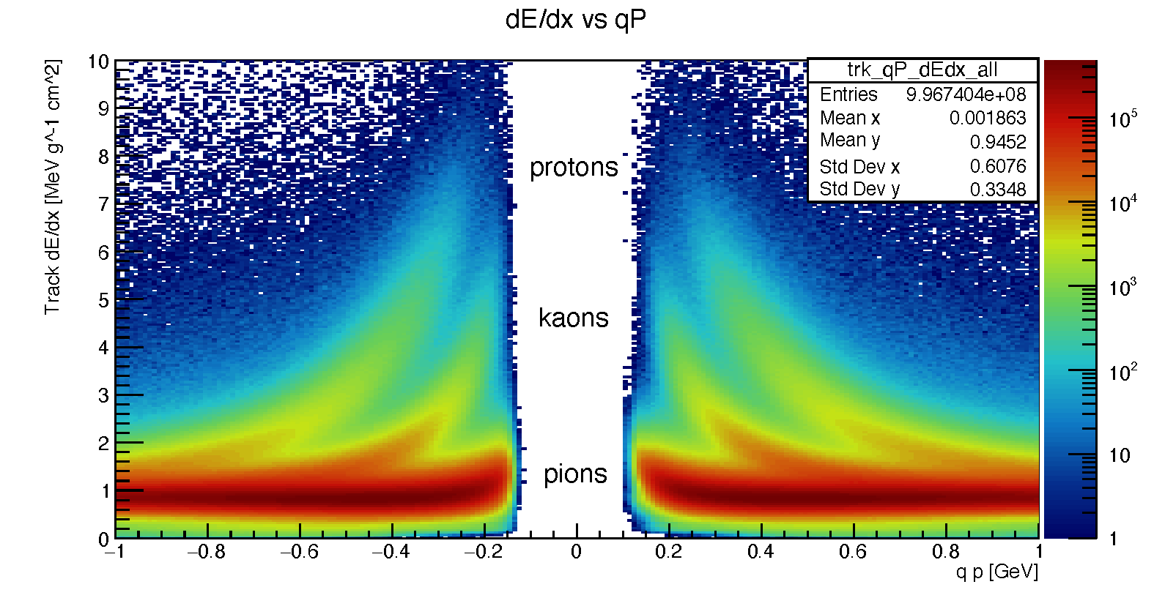
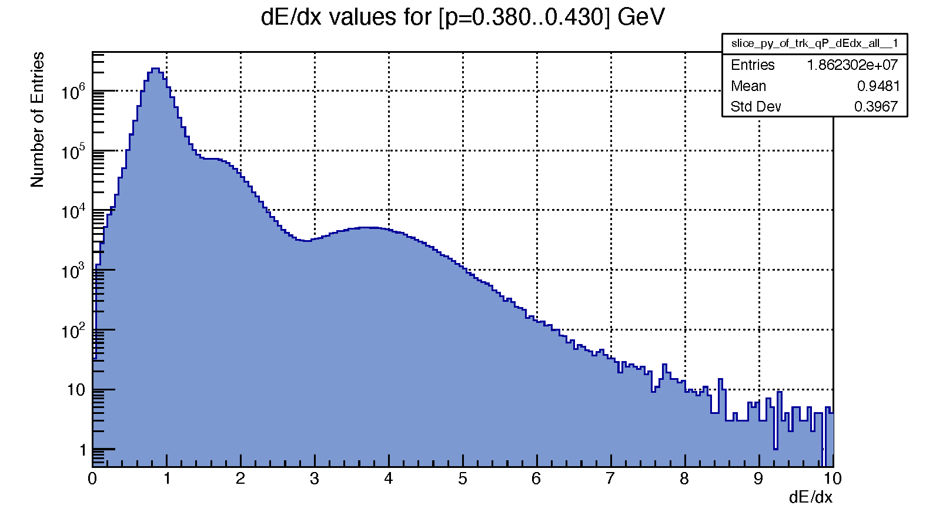
Particle Identification
Applying preliminary particle cuts
  p_T < 230 MeV, p < 1000 MeV, |η| < 2.0
Plot a 2D histogram of particle energy loss vs signed momentum
  Three unique channels for different particles
Methods to isolate kaons
  Take slices across momentum bins
{
pions
kaons
protons

Slide 5
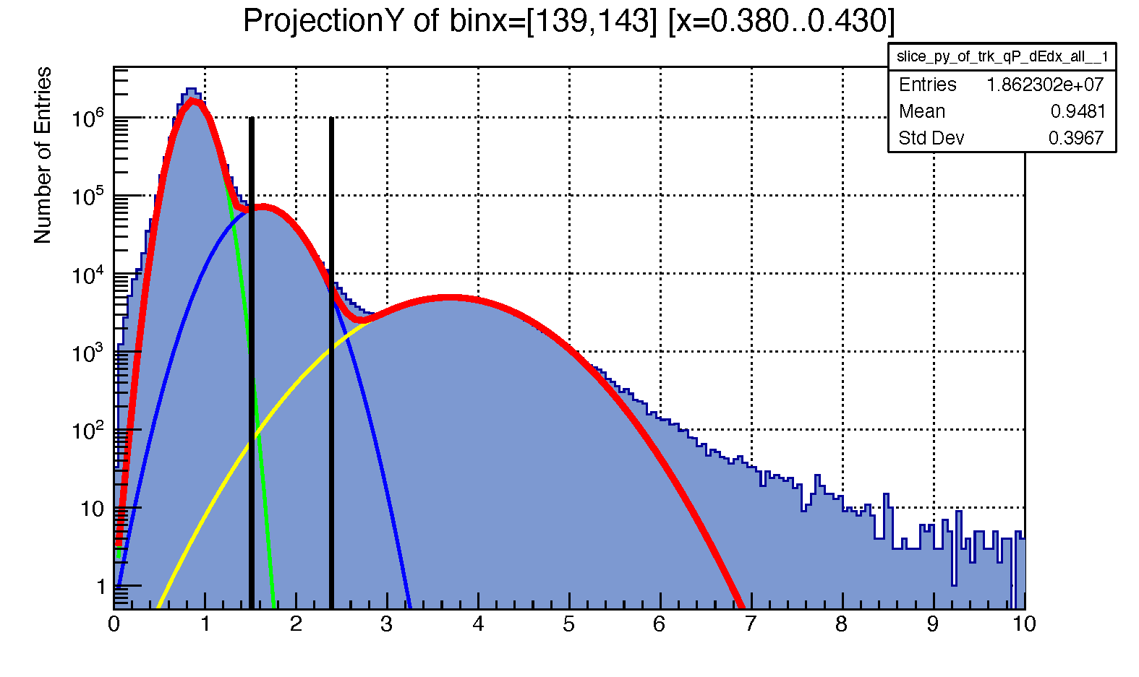
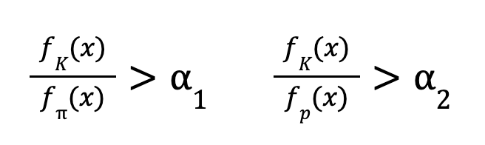
Particle Identification
pion fit 一
kaon fit 一proton fit 一
sum 一
Fit each peak with a Gaussian distribution
  Sum the three together to see the total fit
  Repeat for 10 momentum bins ranging from 220 MeV to 700 MeV
Make a confidence level cut
  Take the ratio of the Gaussians at a certain energy loss and set a confidence level for the ratio
Track dE/dx

Slide 6
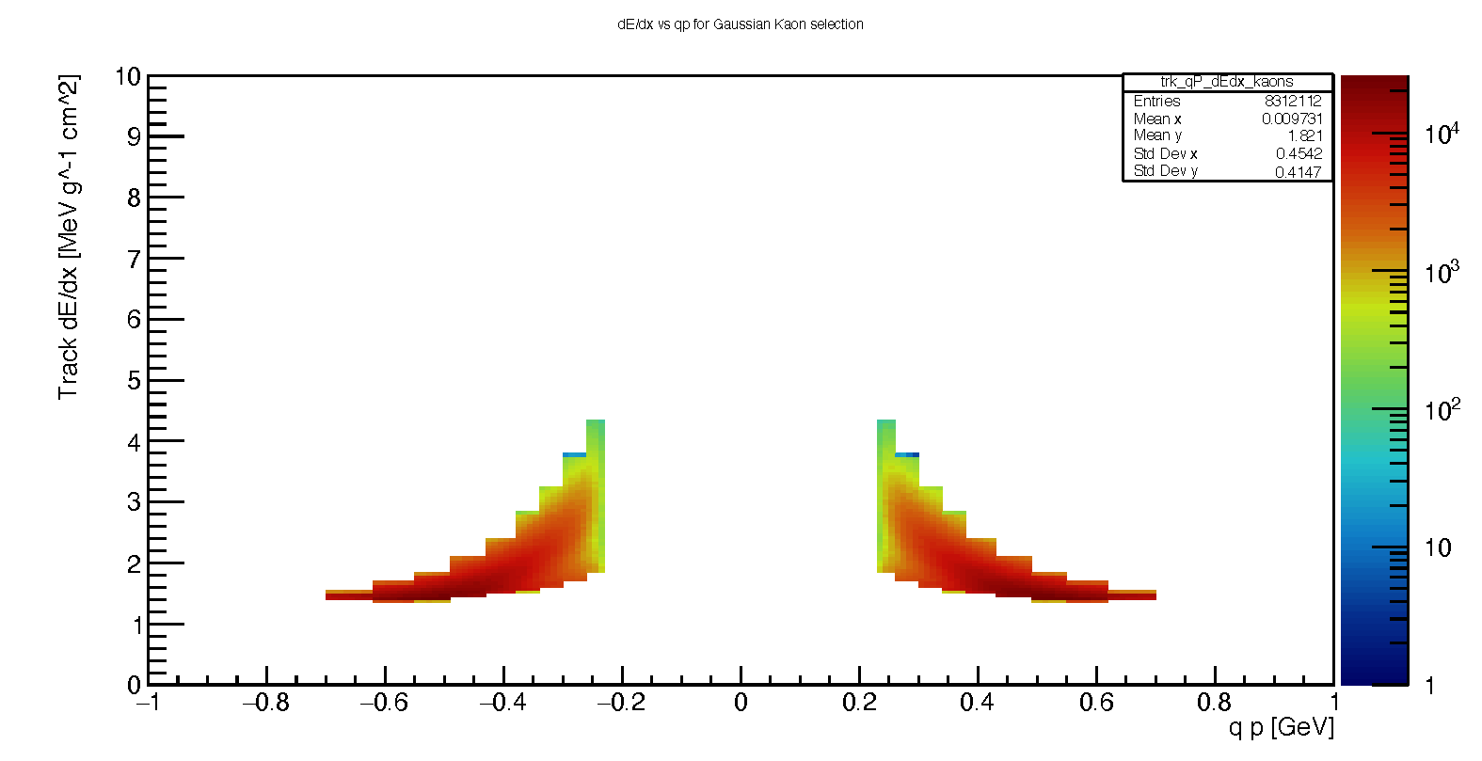
Particle Identification
Particles that make it past the cuts
  In isolation
  Projected onto total histogram

Slide 7
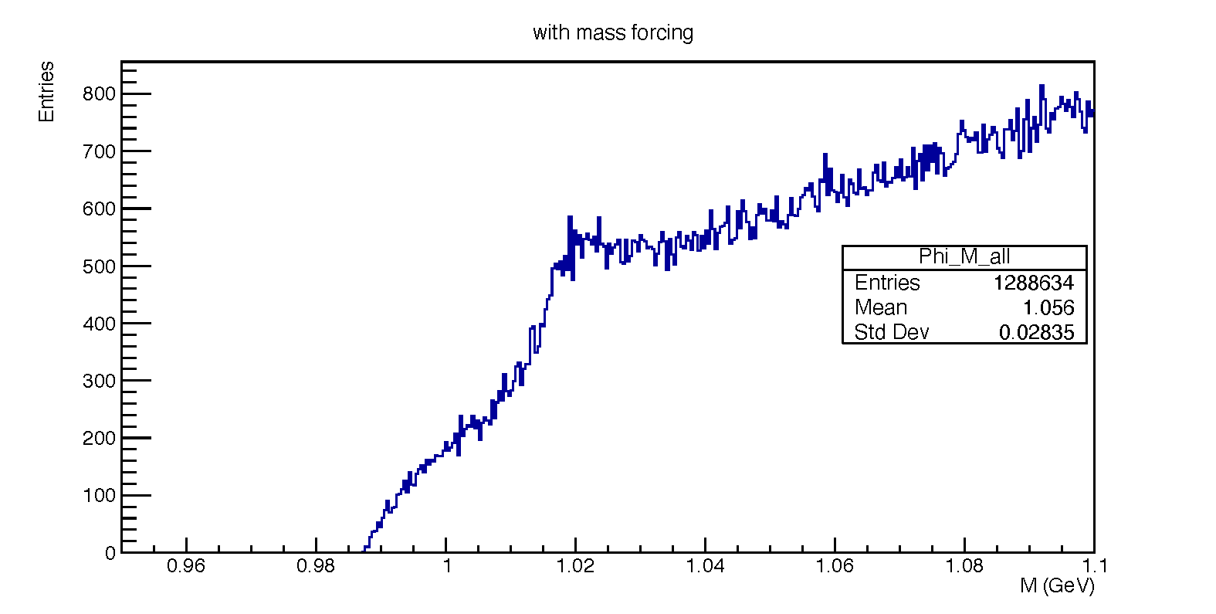
Particle Recombination
One particle:
recall:
m (K+ K-) spectrum
multiple particles:
Combine positive and negative particles
  All positive particles are paired with all negative particles
  Right selection yields the 𝝓(1020) mass
  Wrong selection = “combinatorial background”

Slide 8
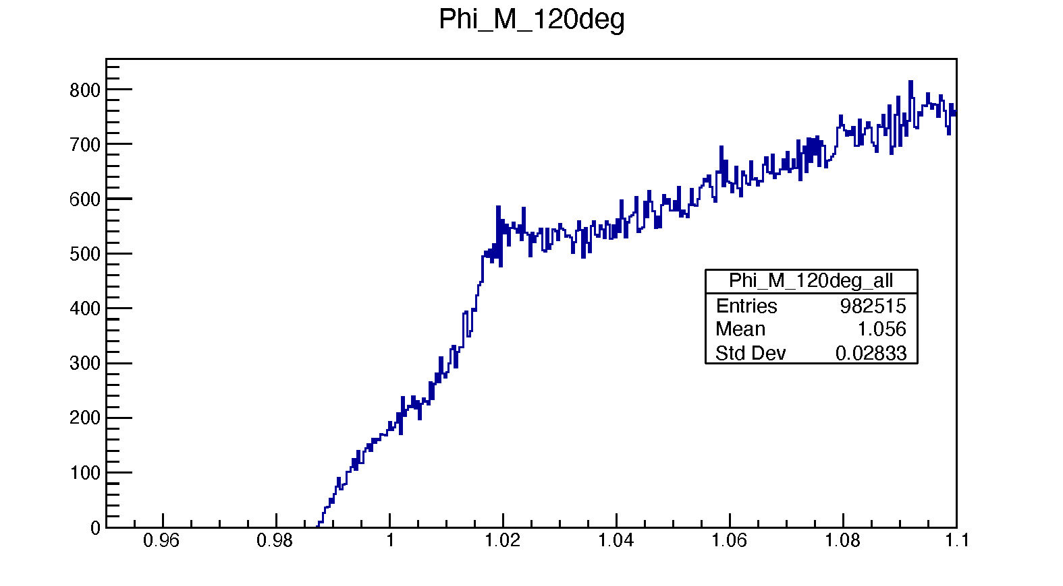
Extracting the Signal
K-
Apply an angular cut
  remove some larger than expected invariant masses
  no more than 120 degree particle separation
Fit the background and signal separately using RooFit software
  Apply a second degree Chebyshev polynomial for the background
  Apply a Gaussian signal
  Apply a non-relativistic Breit-Wigner (Lorentz) signal
120°
K+
m (K+ K-) spectrum

Slide 9
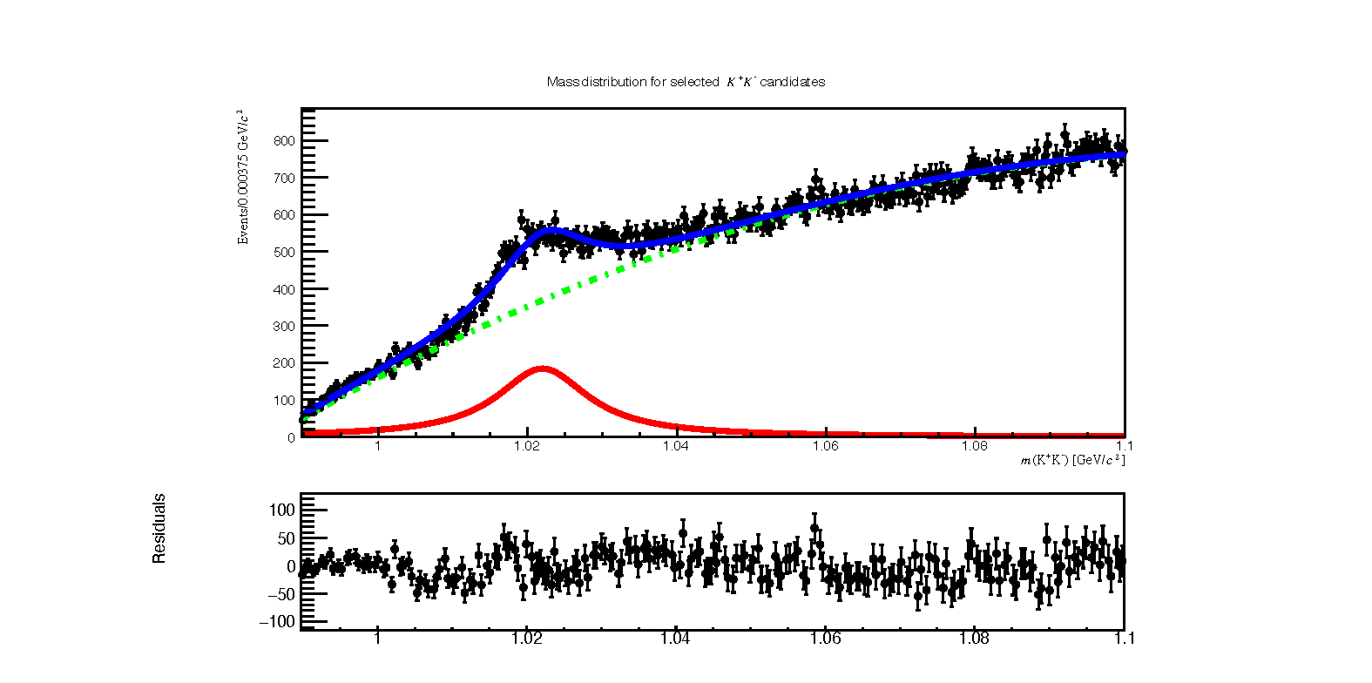
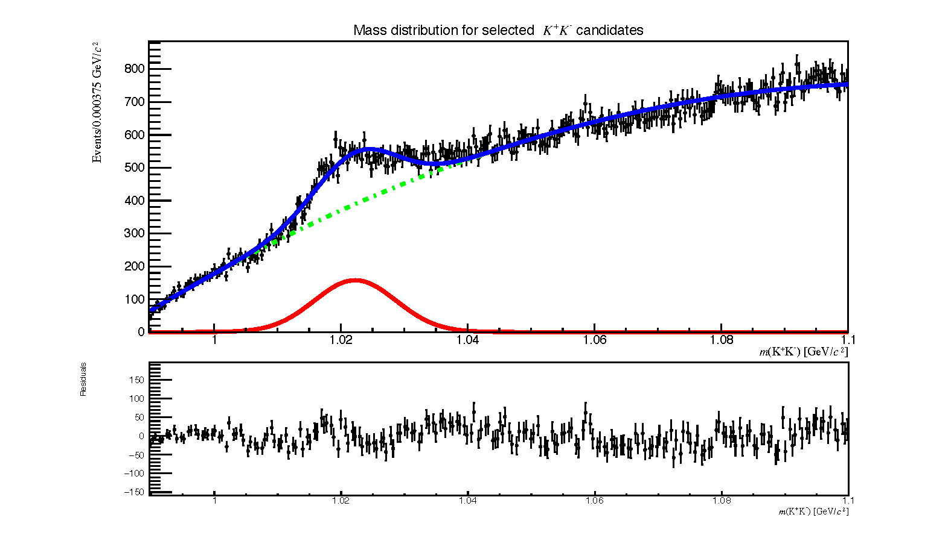
Extracting the Signal
Gaussian Signal
Chi square/ndof = 3.646
𝜇 = 1.0222 GeV
Breit-Wigner Signal
Chi square/ndof = 3.52
𝜇 = 1.02199 GeV
expected value: m = 1.019 GeV

Slide 10
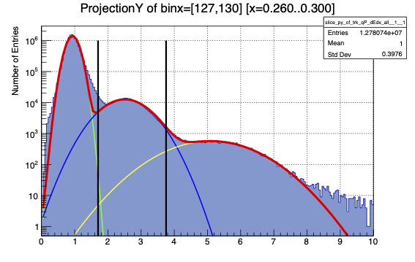
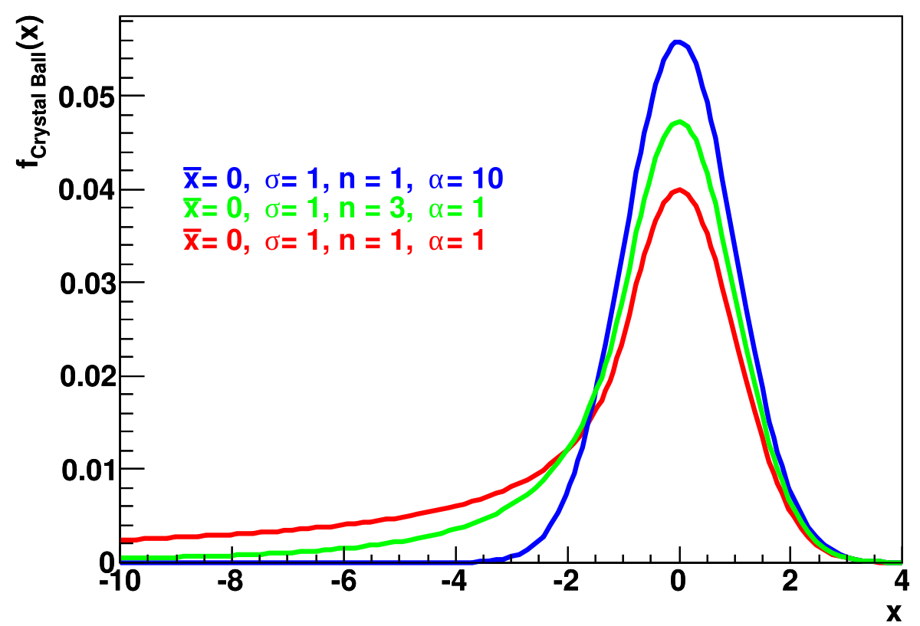
Conclusion and Next Steps
Given a preliminary selection analysis, good signal extraction exists
  Low error from the accepted value of 1.01945 GeV (0.25%)
Immediate next steps to be taken
  Refine kaon selection by fitting pion/kaon/proton fits with double shouldered crystal ball functions
  Use different datasets
Pileup and introduction of ATLAS Forward Proton (AFP) detector tagging
  New doorways to soft QCD hadroproduction models

Slide 11


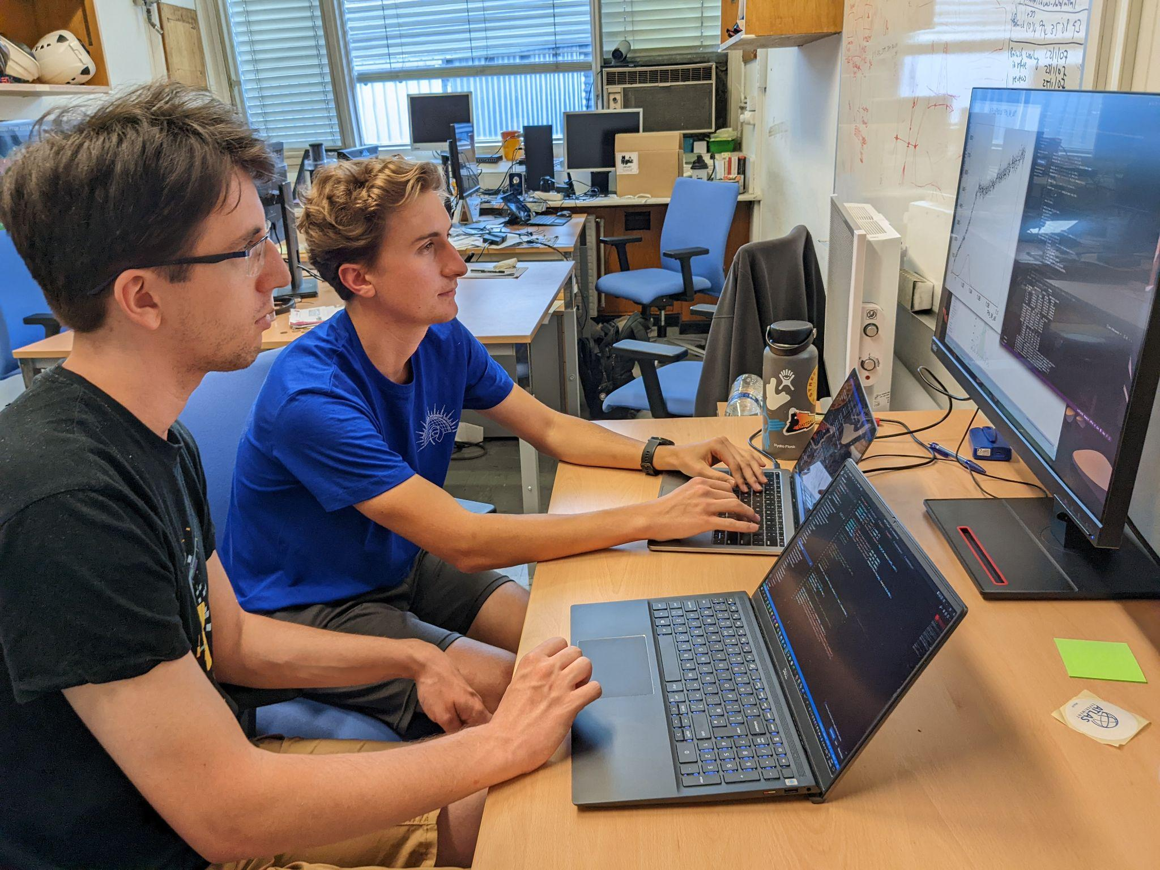

Work and Play :)

Slide 12
backups

Slide 13
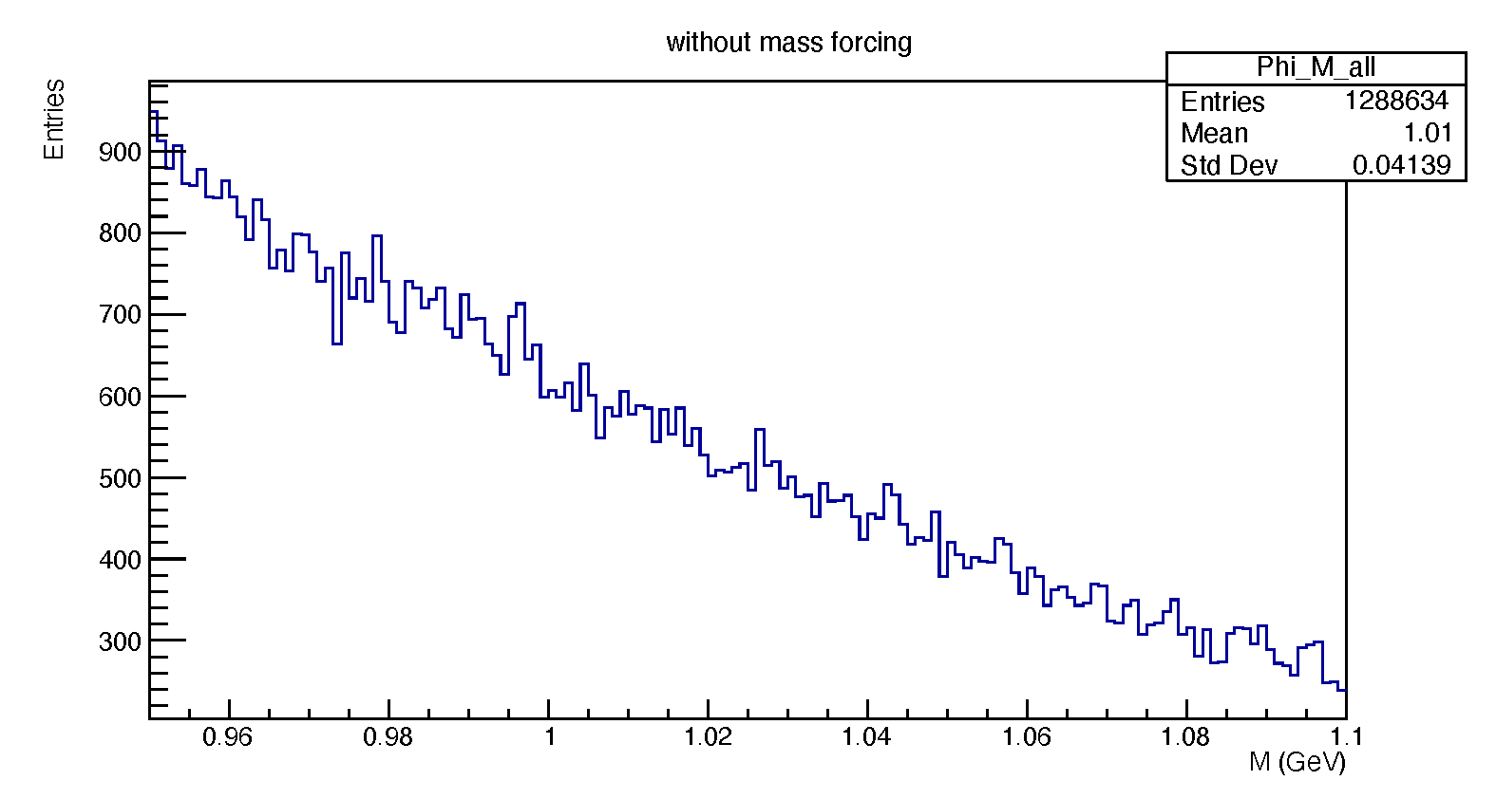
Particle Recombination
One particle:
recall:
multiple particles:
Combine positive and negative particles
  All positive particles are paired with all negative particles
Track energies determined by calorimeter measurements
  At low energies (minimum bias range) calorimeters are inaccurate
  Fit tracks with a kaon mass assumption

Slide 14
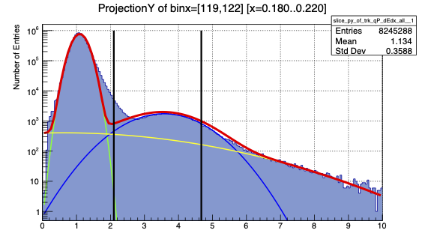
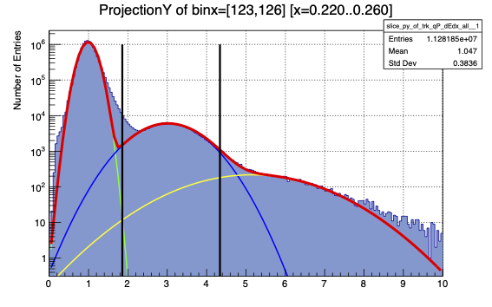
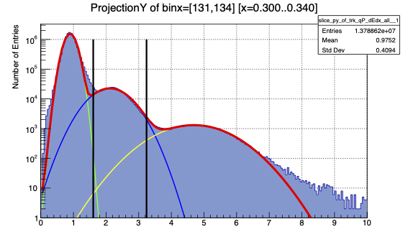
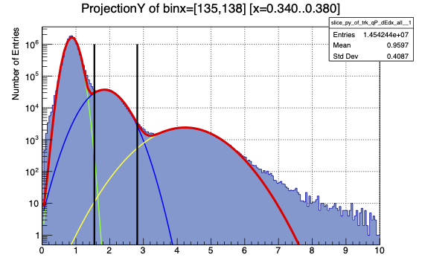
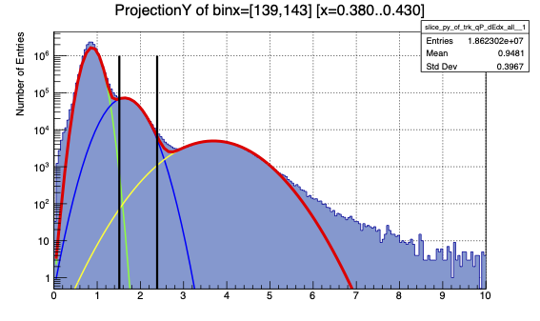
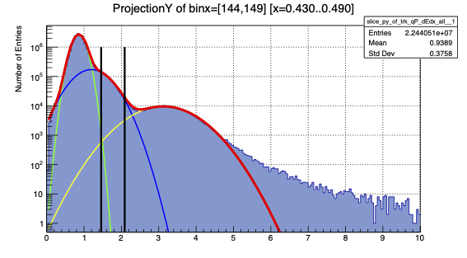
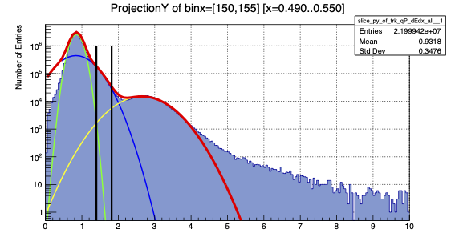
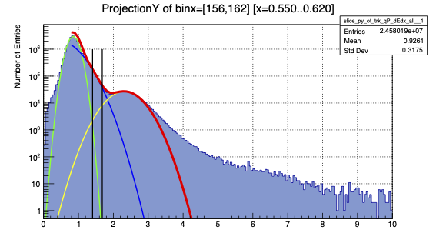
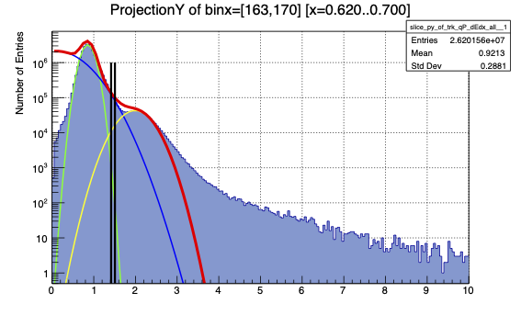
Particle Identification
Fit each peak with a Gaussian distribution
  Sum the three together to see the total fit
  Repeat for 10 momentum bins ranging from 220 MeV to 700 MeV
Make a confidence level cut
  Take the ratio of the Gaussians at a certain energy loss and set a confidence level for the ratio
All ten momentum bins
  Certain fitting trade offs

