Slide 1






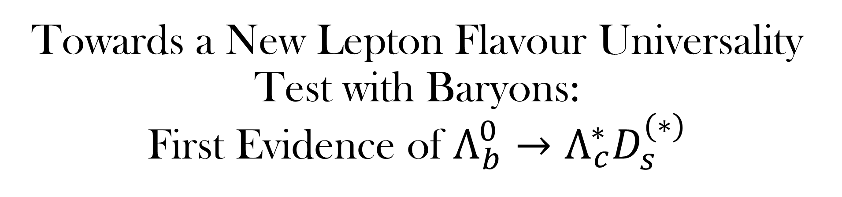
Towards a New Lepton Flavour Universality Test with Baryons:
First Evidence of $Λ_{b}^{0}→Λ_{c}^{∗}D_{s}^{(∗)}$
Sebastian Rocks
Supervisors: Anna Lupato, Gabriele Simi, Marcello Rotondo

Slide 2
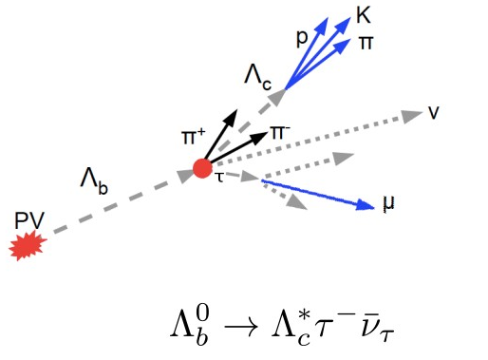

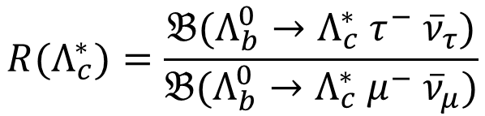

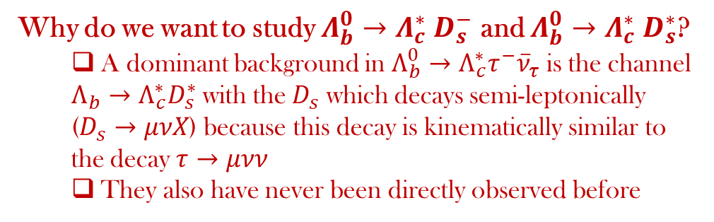
Lepton Flavour Universality and $Λ_{b}^{0}→Λ_{c}^{∗} D_{s}^{(∗)}$ Studies
LFU is a characteristic of the Standard Model for which the branching fractions are irrespective of the flavor of the lepton.
$$R(Λ_{c}^{∗})=\frac{𝔅(Λ_{b}^{0}→Λ_{c}^{∗} τ^{−} {\overline{ν}}_{τ})}{𝔅(Λ_{b}^{0}→Λ_{c}^{∗} μ^{−} {\overline{ν}}_{μ})}$$
Lepton Flavour Universality tests with semi-leptonic $Λ_{b}^{0}→Λ_{c}^{∗}$ decays are important to:
  Corroborate the present anomalies on decays with charmed mesons
  Provide complementary constraints on possible origins of these anomalies beyond the Standard Model compared to b-meson decays
  Examine the $Λ_{b}$ decay, which allows us to probe different spin dynamics
Why do we want to study $Λ_{b}^{0}→Λ_{c}^{∗} D_{s}^{−}$ and $Λ_{b}^{0}→Λ_{c}^{∗} D_{s}^{∗}$?
  A dominant background in $Λ_{b}^{0}→Λ_{c}^{∗}τ^{−}{\overline{ν}}_{τ}$ is the channel $Λ_{b}→Λ_{c}^{∗}D_{s}^{∗}$ with the $D_{s}$ which decays semi-leptonically ($D_{s}→μνX$) because this decay is kinematically similar to the decay $τ→μνν$
  They also have never been directly observed before
Notes:
LFU is a characteristic of the Standard Model for which the branching fractions are irrespective of the flavor of the lepton. Present anomalies the D* channel and Lambda_c in semi-leptonic decays. Other anomalies in the rare decays. other anomalies in this channel b->cll

Slide 3
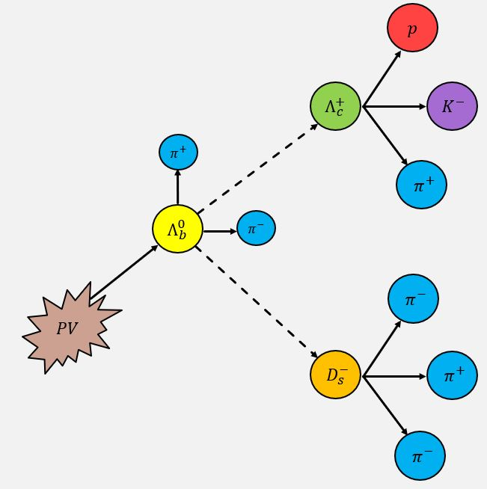
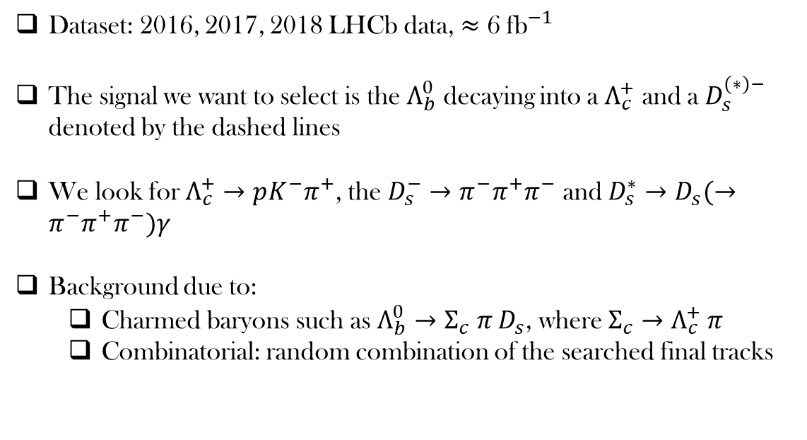
Signal Decay
Dataset: 2016, 2017, 2018 LHCb data, $≈$ 6 ${\text{fb}}^{−1}$
The signal we want to select is the $Λ_{b}^{0}$ decaying into a $Λ_{c}^{+}$ and a $D_{s}^{(∗)−}$ denoted by the dashed lines
We look for $Λ_{c}^{+}→pK^{−}π^{+}$, the $D_{s}^{−}→π^{−}π^{+}π^{−}$ and $D_{s}^{∗}→D_{s}(→π^{−}π^{+}π^{−})γ$
Background due to:
  Charmed baryons such as $Λ_{b}^{0}→Σ_{c} π D_{s}$, where $Σ_{c}→Λ_{c}^{+} π$
  Combinatorial: random combination of the searched final tracks
Notes:
6 inverse femtobarns or around 600 trillion proton-proton collisions

Slide 4
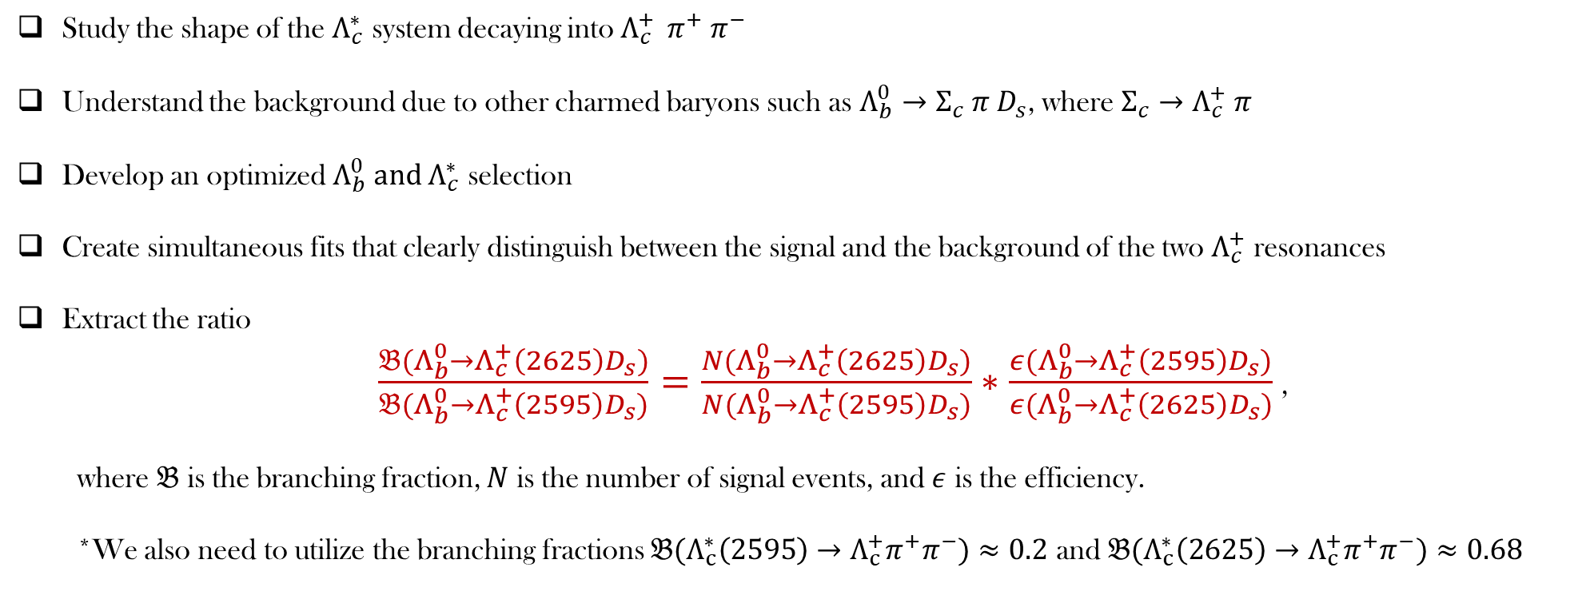
Strategy
Study the shape of the $Λ_{c}^{∗}$ system decaying into $Λ_{c}^{+ } π^{+} π^{−}$
Understand the background due to other charmed baryons such as $Λ_{b}^{0}→Σ_{c} π D_{s}$, where $Σ_{c}→Λ_{c}^{+} π$
Develop an optimized $Λ_{b}^{0} and Λ_{c}^{∗}$ selection
Create simultaneous fits that clearly distinguish between the signal and the background of the two $Λ_{c}^{+}$ resonances
Extract the ratio
  $\frac{𝔅(Λ_{b}^{0}→Λ_{c}^{+}\left(2625\right)D_{s})}{𝔅(Λ_{b}^{0}→Λ_{c}^{+}\left(2595\right)D_{s})}=\frac{N(Λ_{b}^{0}→Λ_{c}^{+}\left(2625\right)D_{s})}{N(Λ_{b}^{0}→Λ_{c}^{+}\left(2595\right)D_{s})}∗\frac{ε(Λ_{b}^{0}→Λ_{c}^{+}\left(2595\right)D_{s})}{ε(Λ_{b}^{0}→Λ_{c}^{+}\left(2625\right)D_{s})}$ ,
  where $𝔅$ is the branching fraction, $N$ is the number of signal events, and $ε$ is the efficiency.
  *We also need to utilize the branching fractions ${𝔅(Λ}_{c}^{∗}\left(2595\right)→Λ_{c}^{+}π^{+}π^{−})≈0.2$ and ${𝔅(Λ}_{c}^{∗}\left(2625\right)→Λ_{c}^{+}π^{+}π^{−})≈0.68$
Notes:
Why do we need the branching fractions: we only reconstructed with pi+ and pi-. But there are also contributions in the pi0 pi0.

Slide 5
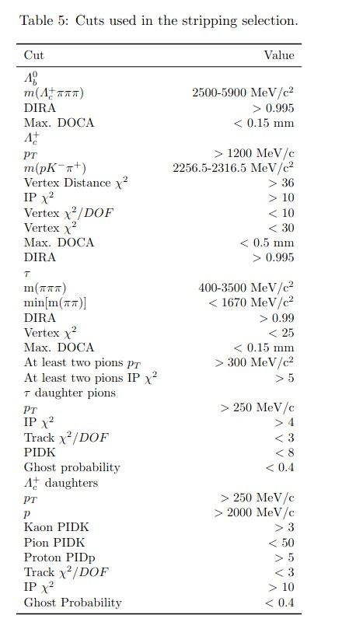
Stripping & Trigger Lines
The stripping selection is:
  The first stage of the LHCb selection
  A set of loose cuts that selects events that are of interest to physics analyses
  A method employed during the central offline processing of the data samples to maintain computational inexpensiveness
  Stripping line: StrippingB2XTauNu
The trigger system is:
  Of crucial importance to discriminate the interesting b hadron decays against the dominant background from inelastic pp-scattering
  Based on a two-level system and exploits the fact that b-flavored hadrons are relatively heavy and long lived
  What ensures the correct selection of events where the trigger decision was made on signal (TOS) or on other particles present in the event (TIS):
    (((Lambda_b0_L0Global_TIS)||(Lambda_b0_L0HadronDecision_TOS))
    &&((Lambda_b0_Hlt1TwoTrackMVADecision_TOS)|(Lambda_b0_Hlt1TrackMVADecision_TOS)))
    &&((Lambda_b0_Hlt2Topo2BodyDecision_TOS)||(Lambda_b0_Hlt2Topo3BodyDecision_TOS)||(Lambda_b0_Hlt2Topo4BodyDecision_TOS))
Notes:
Nice if I say the cuts of the stripping selection. Here are the cuts on the left that were

Slide 6
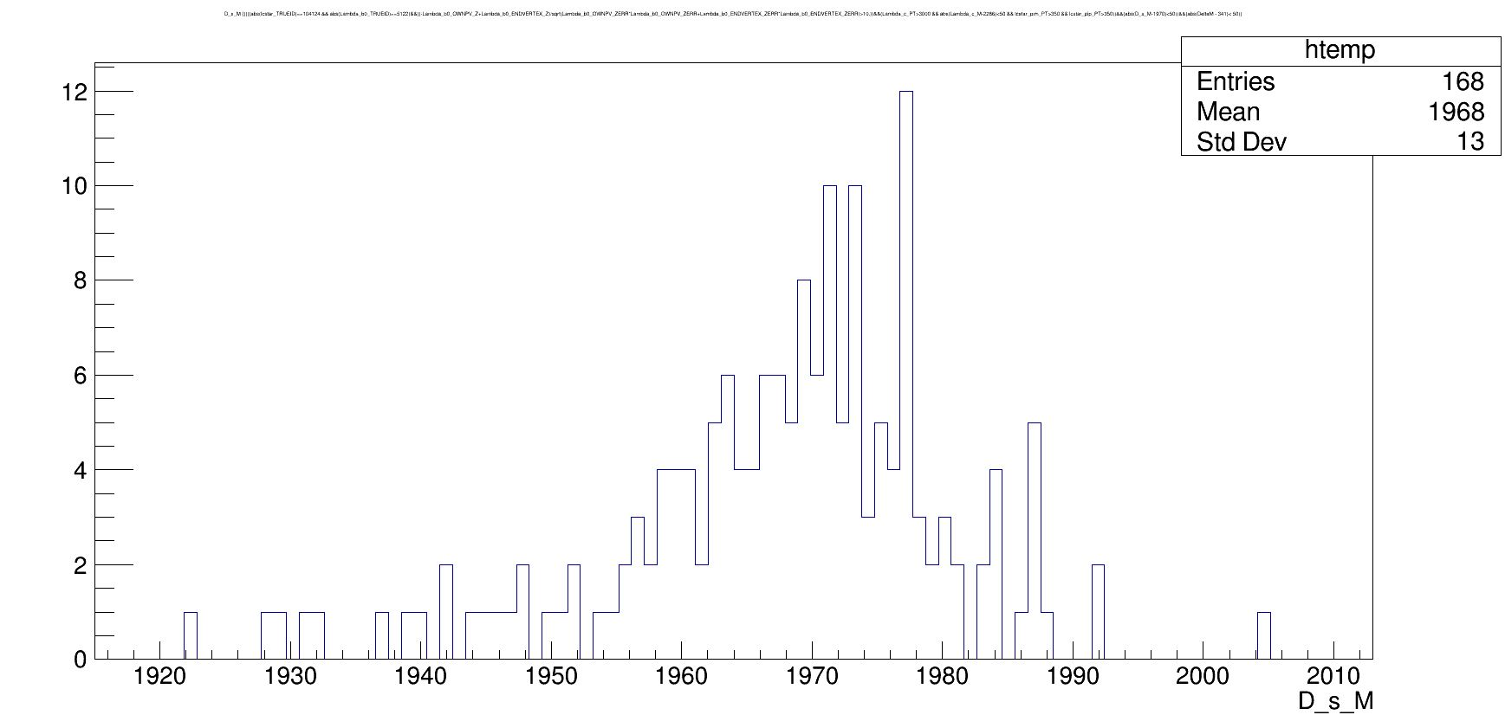
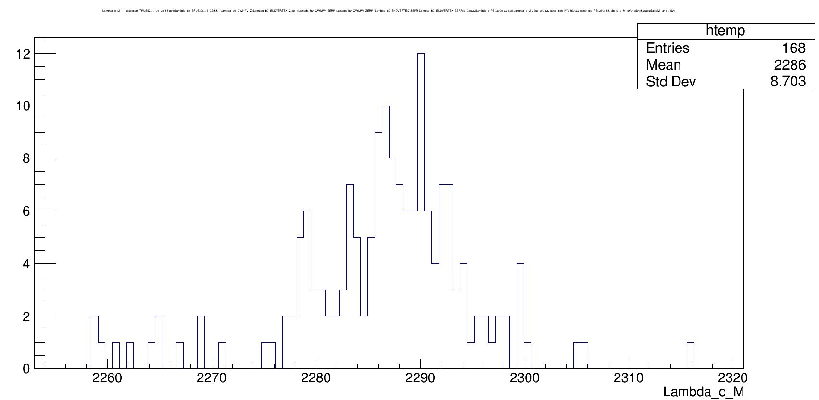

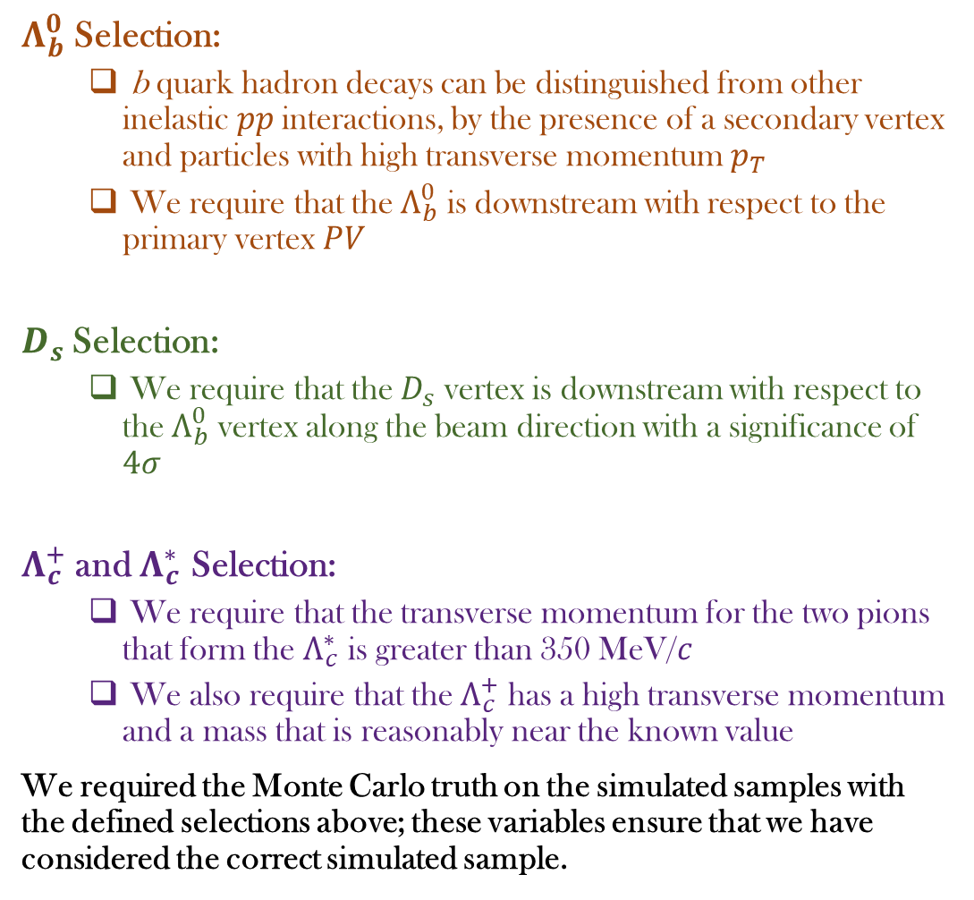



Selection
$Λ_{b}^{0}$ Selection:
  b quark hadron decays can be distinguished from other inelastic $pp$interactions, by the presence of a secondary vertex and particles with high transverse momentum $p_{T}$
  We require that the $Λ_{b}^{0}$ is downstream with respect to the primary vertex $PV$
$D_{s}$Selection:
  We require that the $D_{s}$ vertex is downstream with respect to the $Λ_{b}^{0}$ vertex along the beam direction with a significance of $4σ$
$Λ_{c}^{+}$ and $Λ_{c}^{∗}$ Selection:
  We require that the transverse momentum for the two pions that form the $Λ_{c}^{∗}$ is greater than 350 MeV/$c$
  We also require that the $Λ_{c}^{+}$ has a high transverse momentum and a mass that is reasonably near the known value
We required the Monte Carlo truth on the simulated samples with the defined selections above; these variables ensure that we have considered the correct simulated sample.
$$D_{s}^{−}→π^{−}π^{+}π^{−}$$
$m\left(D_{s}\right)\frac{MeV}{c^{2}}$
$$Λ_{c}^{+}→pK^{−}π^{+}$$
$m\left(Λ_{c}^{+}\right)\frac{MeV}{c^{2}}$
Notes:
“Upstream” means the direction following LHC beam 2 towards the CMS experiment, while the “downstream” direction respectively follows beam 1 towards the ATLAS experiment, i. e. in the direction of the LHCb acceptance for physics measurements.

Slide 7
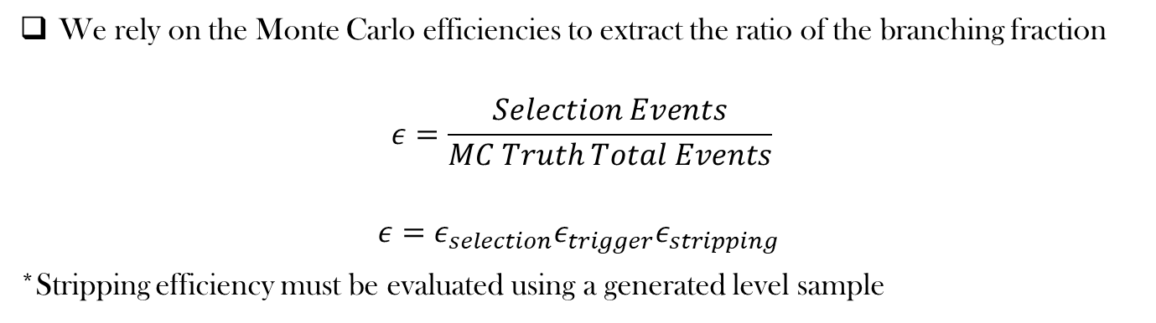
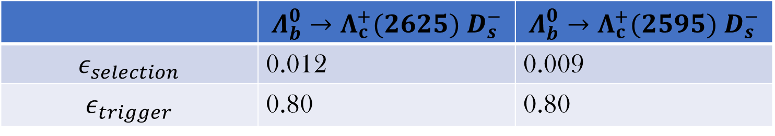
Efficiencies
We rely on the Monte Carlo efficiencies to extract the ratio of the branching fraction
$$ε=\frac{Selection Events}{MC Truth Total Events}$$
$$ε=ε_{selection}ε_{trigger}ε_{stripping}$$
*Stripping efficiency must be evaluated using a generated level sample
 | $$Λ_{b}^{0}→Λ_{c}^{+}(2625) D_{s}^{−}$$ | $$Λ_{b}^{0}→Λ_{c}^{+}(2595) D_{s}^{−}$$
$$ε_{selection}$$ | 0.012 | 0.009
$$ε_{trigger}$$ | 0.80 | 0.80
*Error estimations should be added
Notes:
Since we need to be sure that it is our decay

Slide 8
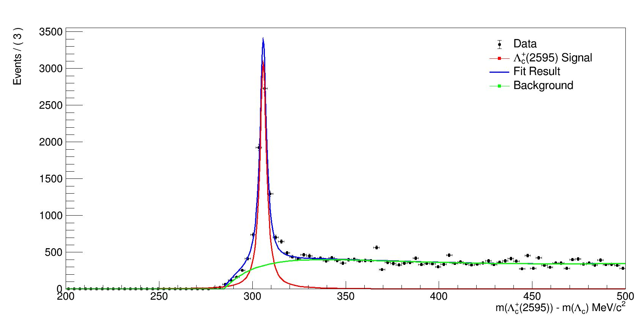
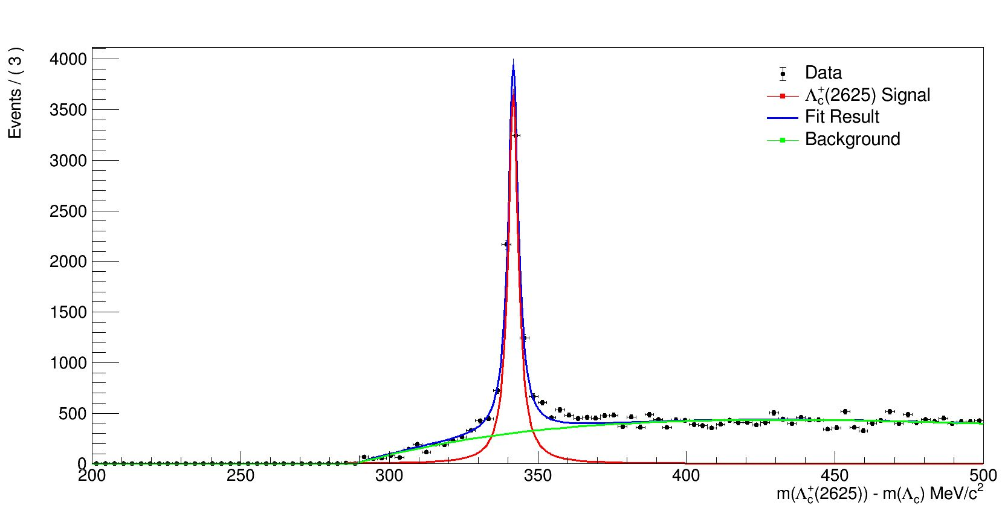
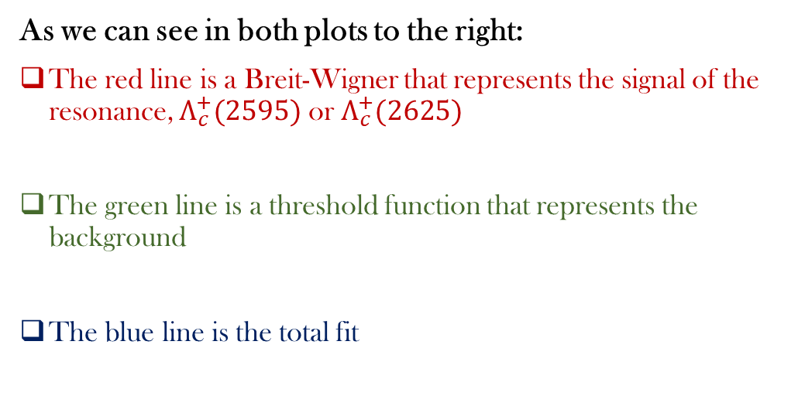

Extracting the Shape of the$Λ_{c}^{∗}$ Resonances
MC 2016
As we can see in both plots to the right:
The red line is a Breit-Wigner that represents the signal of the resonance, $Λ_{c}^{+}(2595)$ or $Λ_{c}^{+}(2625)$
The green line is a threshold function that represents the background
The blue line is the total fit
MC 2016

Slide 9
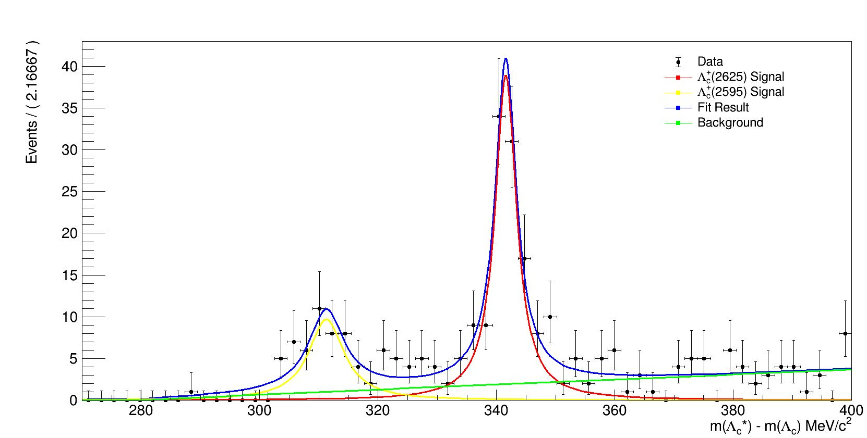

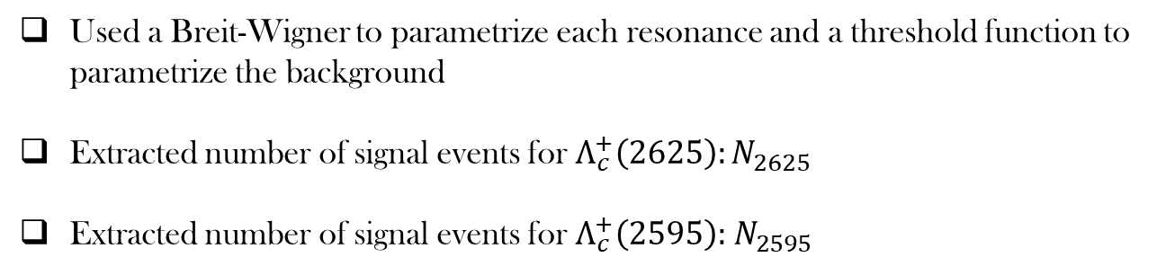
Fitting and Extracting $Λ_{c}^{∗}$ Yields
LHCb Preliminary
Used a Breit-Wigner to parametrize each resonance and a threshold function to parametrize the background
Extracted number of signal events for $Λ_{c}^{+}\left(2625\right):N_{2625}$
Extracted number of signal events for $Λ_{c}^{+}\left(2595\right):{ N}_{2595 }$

Slide 10
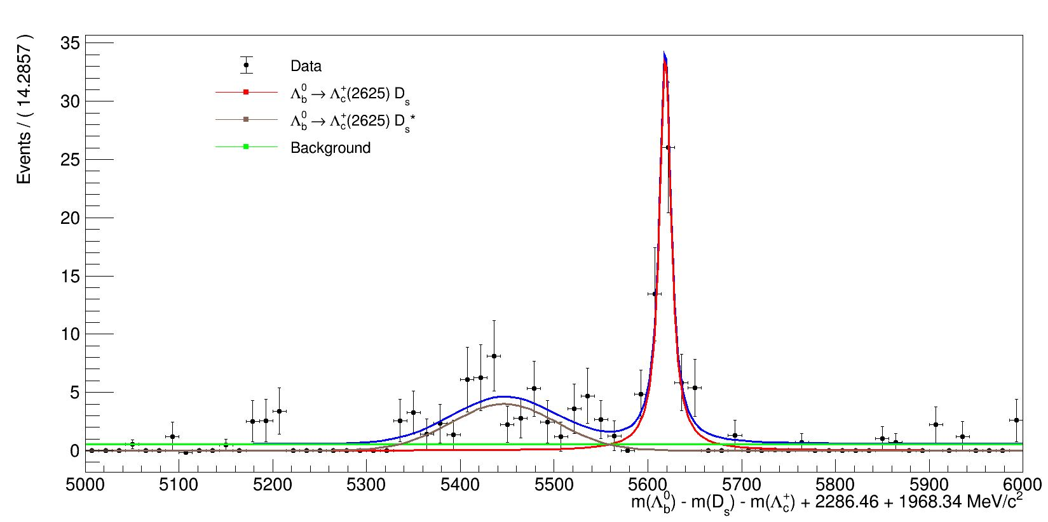
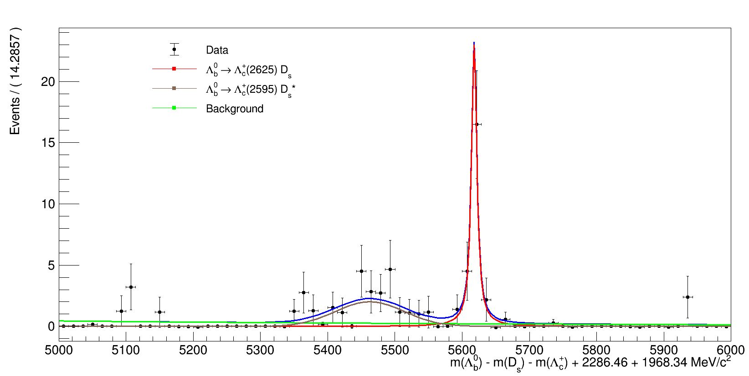

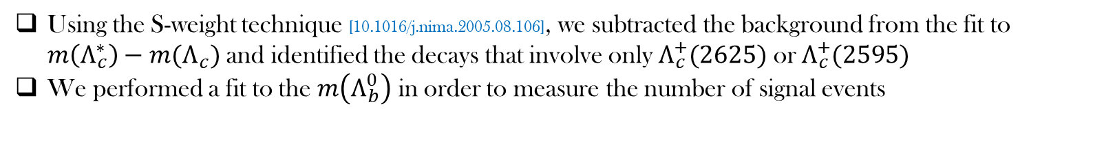
${Λ_{b}^{0}→Λ}_{c}^{∗}D_{s}^{(∗)}$ Yields & Ratio of the Branching Fraction
Using the S-weight technique [10.1016/j.nima.2005.08.106], we subtracted the background from the fit to $m\left(Λ_{c}^{∗}\right)−m(Λ_{c})$ and identified the decays that involve only $Λ_{c}^{+}(2625)$ or $Λ_{c}^{+}(2595)$
We performed a fit to the $m\left(Λ_{b}^{0}\right)$ in order to measure the number of signal events
LHCb Preliminary
LHCb Preliminary
$$\frac{𝔅(Λ_{b}^{0}→Λ_{c}^{+}\left(2625\right)D_{s})}{𝔅(Λ_{b}^{0}→Λ_{c}^{+}\left(2595\right)D_{s})}=\frac{N(Λ_{b}^{0}→Λ_{c}^{+}\left(2625\right)D_{s})}{N(Λ_{b}^{0}→Λ_{c}^{+}\left(2595\right)D_{s})}∗\frac{ε(Λ_{b}^{0}→Λ_{c}^{+}\left(2595\right)D_{s})}{ε(Λ_{b}^{0}→Λ_{c}^{+}\left(2625\right)D_{s})}$$
This is the first evidence of the $Λ_{b}^{0}→Λ_{c}^{∗}D_{s}^{∗}$ and $Λ_{b}^{0}→Λ_{c}^{∗}D_{s}$ !

Slide 11
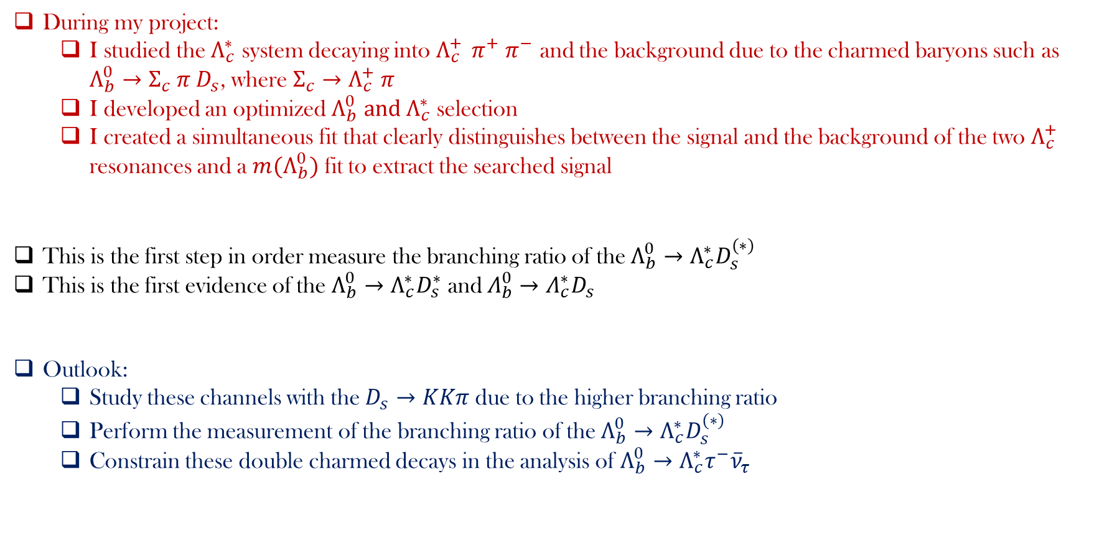
Conclusion
During my project:
  I studied the $Λ_{c}^{∗}$ system decaying into $Λ_{c}^{+ } π^{+} π^{−}$ and the background due to the charmed baryons such as $Λ_{b}^{0}→Σ_{c} π D_{s}$, where $Σ_{c}→Λ_{c}^{+} π$
  I developed an optimized $Λ_{b}^{0} and Λ_{c}^{∗}$ selection
  I created a simultaneous fit that clearly distinguishes between the signal and the background of the two $Λ_{c}^{+}$ resonances and a $m(Λ_{b}^{0})$ fit to extract the searched signal
This is the first step in order measure the branching ratio of the $Λ_{b}^{0}→Λ_{c}^{∗}D_{s}^{(∗)}$
This is the first evidence of the $Λ_{b}^{0}→Λ_{c}^{∗}D_{s}^{∗}$ and $Λ_{b}^{0}→Λ_{c}^{∗}D_{s}$
Outlook:
  Study these channels with the $D_{s}→KKπ$ due to the higher branching ratio
  Perform the measurement of the branching ratio of the $Λ_{b}^{0}→Λ_{c}^{∗}D_{s}^{(∗)}$
  Constrain these double charmed decays in the analysis of $Λ_{b}^{0}→Λ_{c}^{∗}τ^{−}{\overline{ν}}_{τ}$

