Slide 1
SND Real-Time Online Monitoring
Rebecca Osar
Advisor: Federico Cindolo

Slide 2
Overview
SND is a new detector designed to study neutrinos from ATLAS collisions
Need good monitoring infrastructure to oversee detector elements
Now, we have monitoring where histograms have delays of about 20 minutes
My job: produce real-time histograms to allow shifters to see data as it comes in

Slide 3
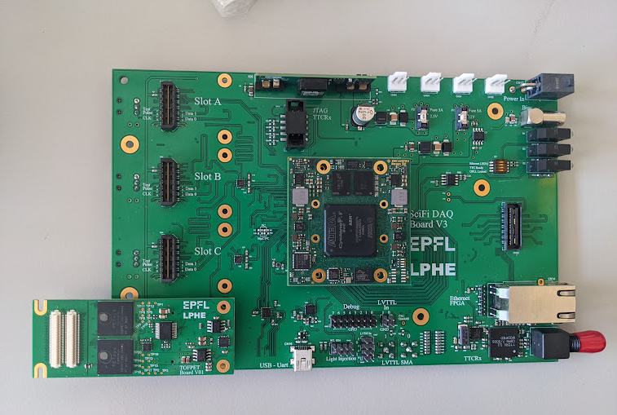
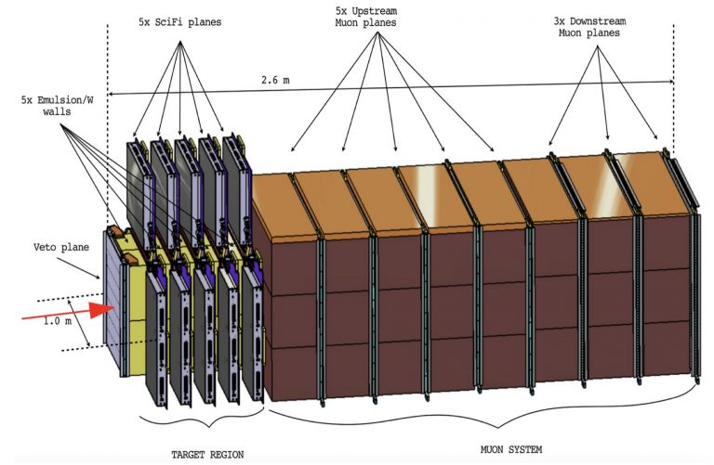
DAQ Structure
Each detector piece is connected to TOFPET boards for collecting data
Each board has 64 channels
Boards and channels can be monitored to ensure detector pieces and boards are functioning properly
SND Detector Scheme
TOFPET2 ASIC board

Slide 4
Veto
1 wall
2 planes per wall
1 board total
SciFi
5 walls
2 planes per wall
3 boards per plane
30 boards total
Upstream
5 walls
2 planes per wall
3 boards total
Downstream
3 walls
2 (3) planes per wall
3 boards total

Slide 5
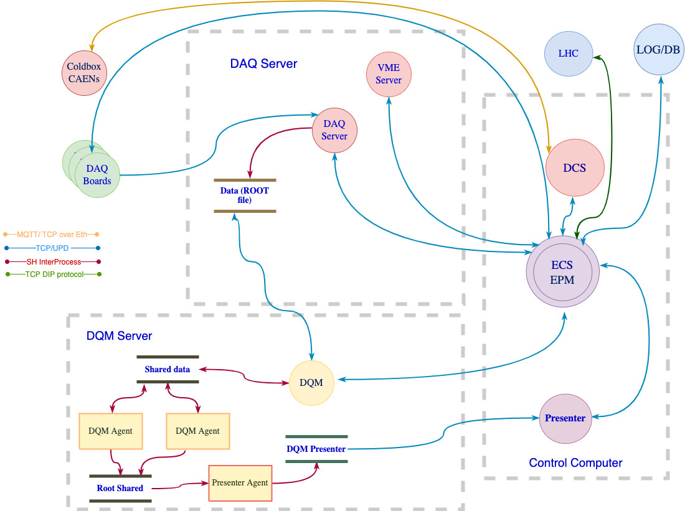
DAQ Structure

Slide 6
Real-Time Monitoring: How it works
Startup:
Currently operated from the terminal
  eventually, may have it run automatically from ECS
Arguments:
  run number, file number, server number, and beam mode
On start, the beam mode sets reasonable values for:
  bin width, time range, and refresh rate
  eventually, this may become customizable from the SND webpage
The code should be restarted when the beam mode has a major change
The code can be run on active or finished files

Slide 7
Real-Time Monitoring: How it works
Event-by-event analysis:
A file is loaded in with a tree of events
The code iterates over the events in the tree in order
When the code runs out of events, it waits before updating the file
If it finds more events, it continues where it left off
This allows the code to read an active file

Slide 8
Real-Time Monitoring: How it works
Multiple threads reading one ROOT file can cause memory errors
Safeguards for this include:
flagging when the file is being read by a thread and making the other threads wait for access
checking to make sure two threads are not accessing the same event at the same time

Slide 9
Real-Time Monitoring: How it works
Plots:
By default, the following plots run:
  global rate plots
  hits per board of the whole detector
  select board rates (e.g. veto)
When there is stable beam, the ATLAS luminosity is also plotted
Other plots can be added manually
  eventually this may become customizable from the SND webpage

Slide 10
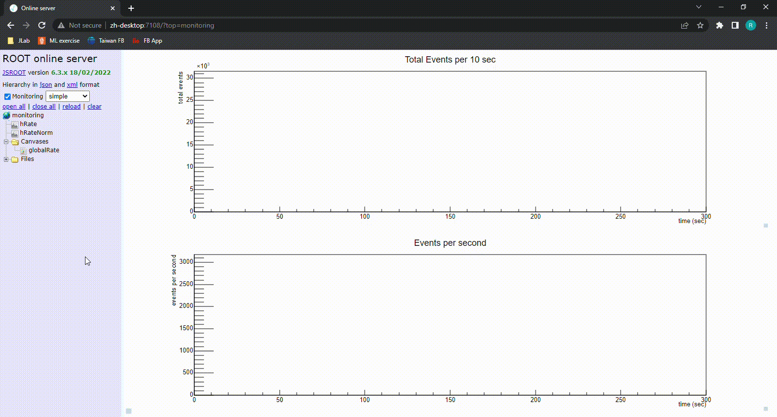
Rate plots: global
Global rate (top: net; bottom: normalized)

Slide 11
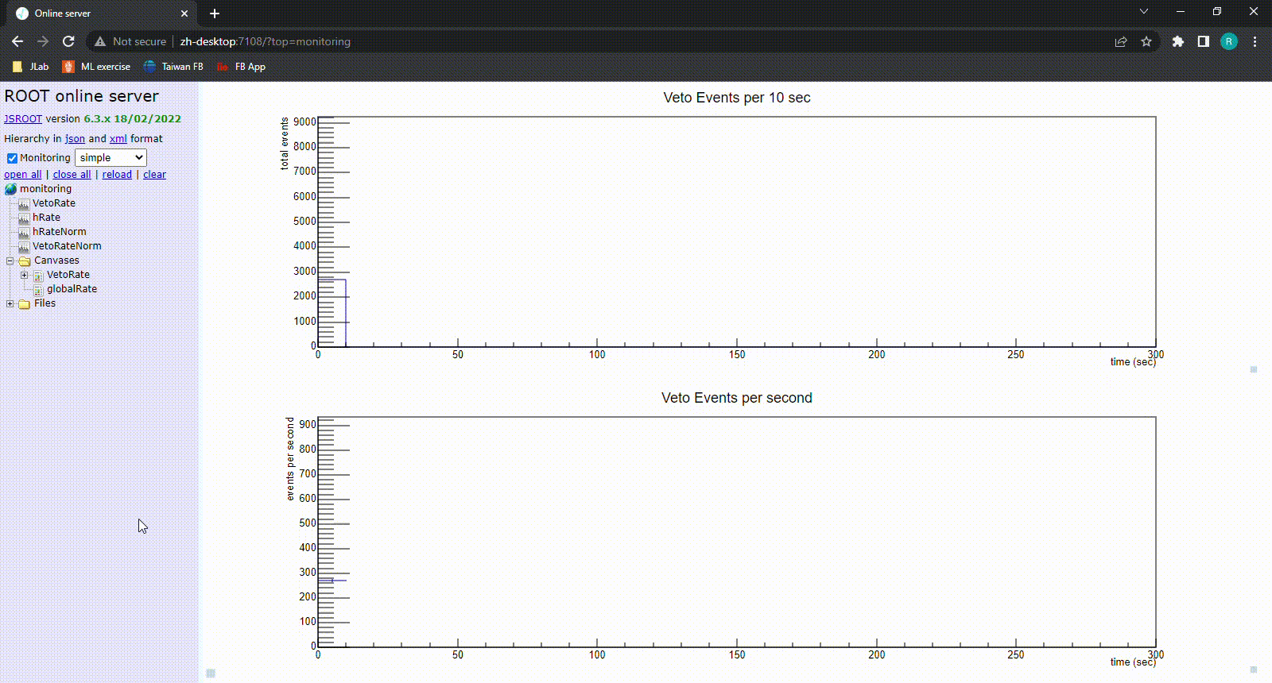
Rate plots: veto
Veto rate (top: net; bottom: normalized)

Slide 12
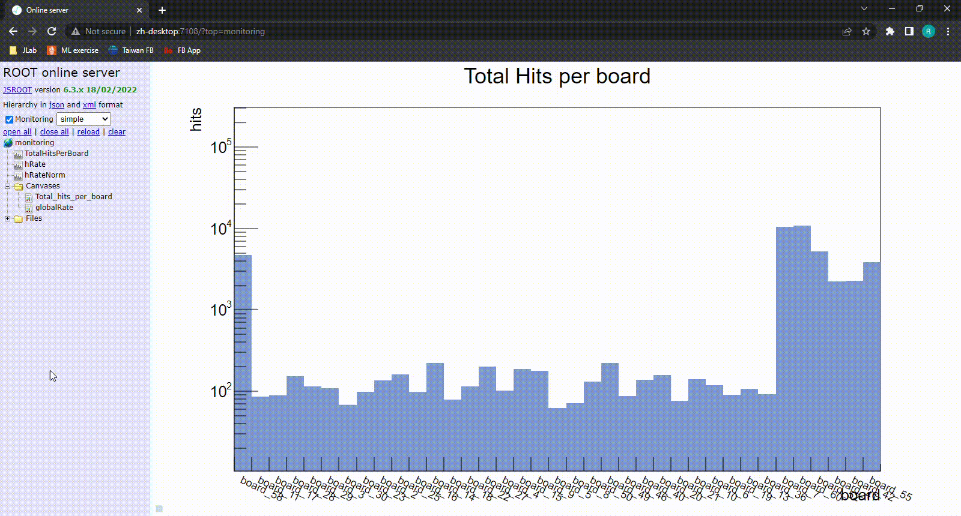
Hit plots: hits per board
Total hits per board - Log scale to easily see if a board is not filling

Slide 13
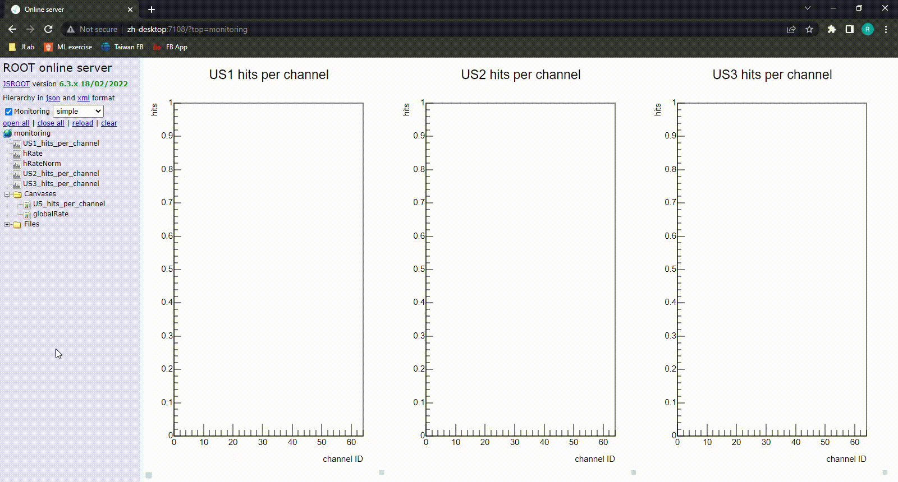
Hit plots: hits per channel of a detector

Slide 14
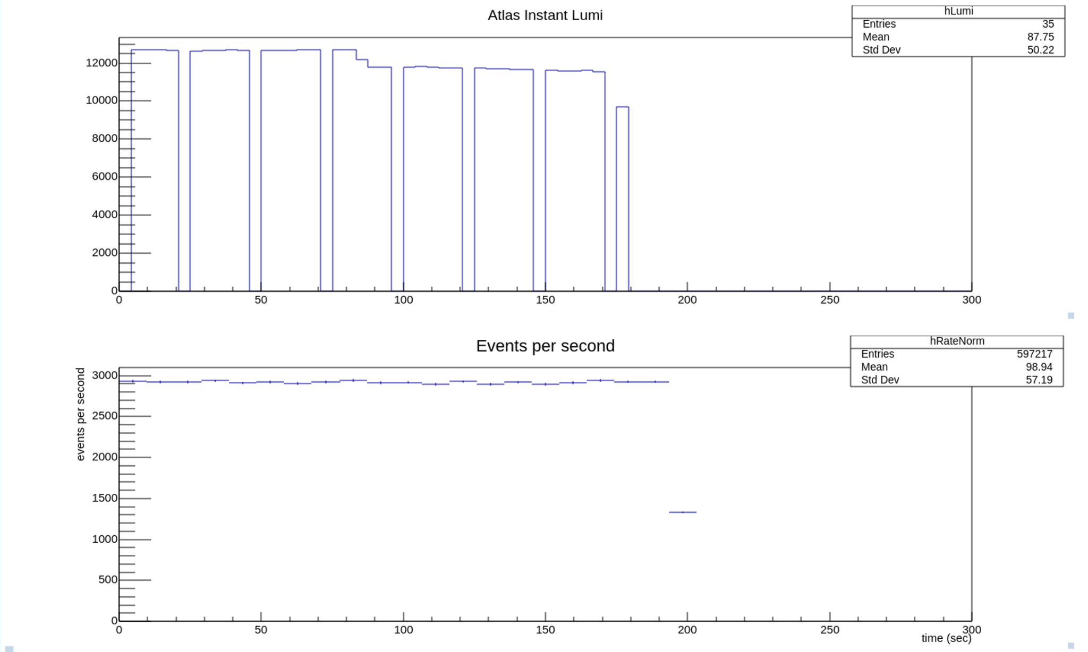
Luminosity plots: luminosity and global rate
Luminosity (Hz/ub)
time (sec)

Slide 15
Future of the Project
Implement ECS automatic control
Integrate histograms into SND online webpage
Implement features on SND online:
  choose plots to show
  adjust range of events to show
  adjust histogram parameters

Slide 16
Thank you

Slide 17

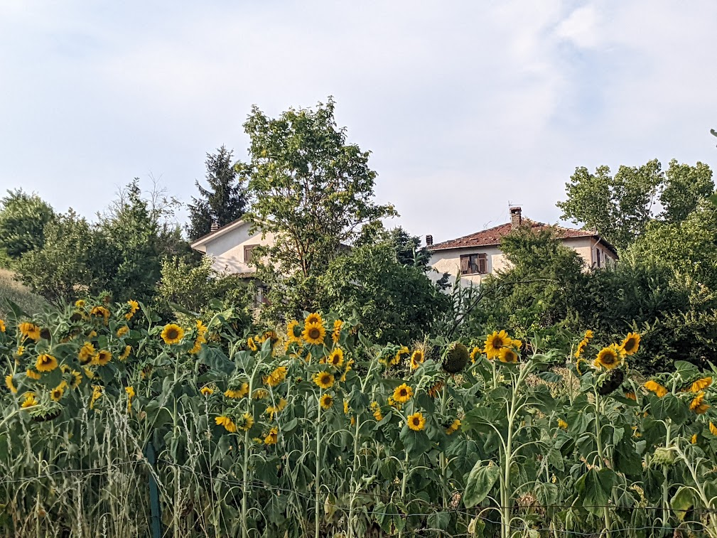

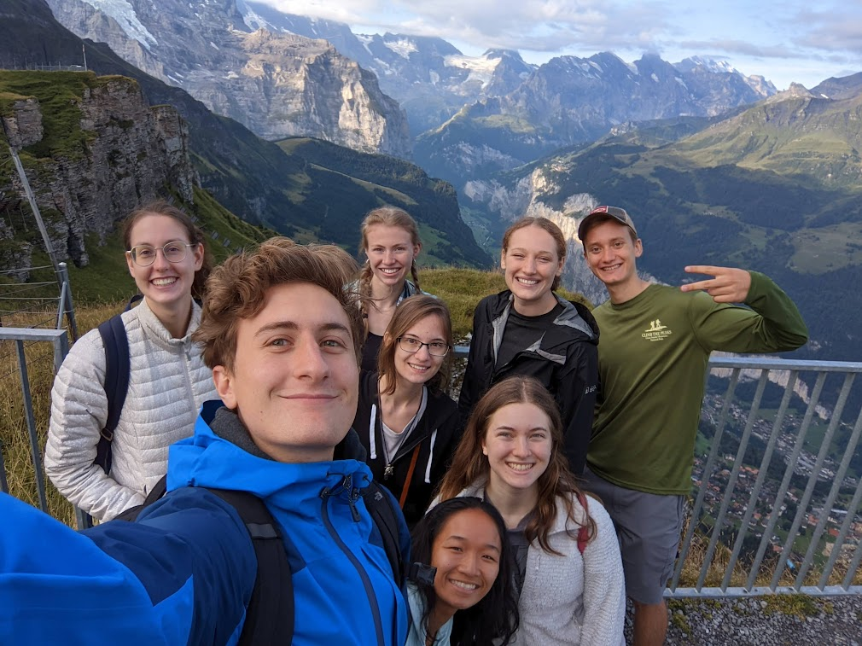

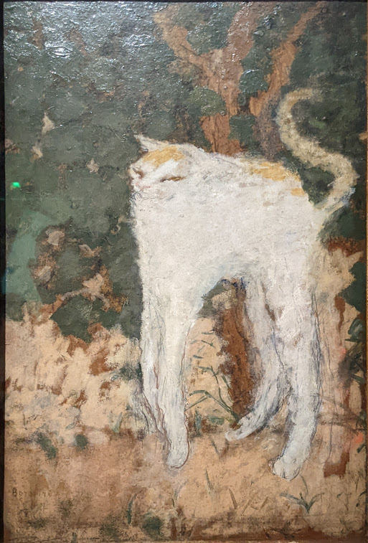


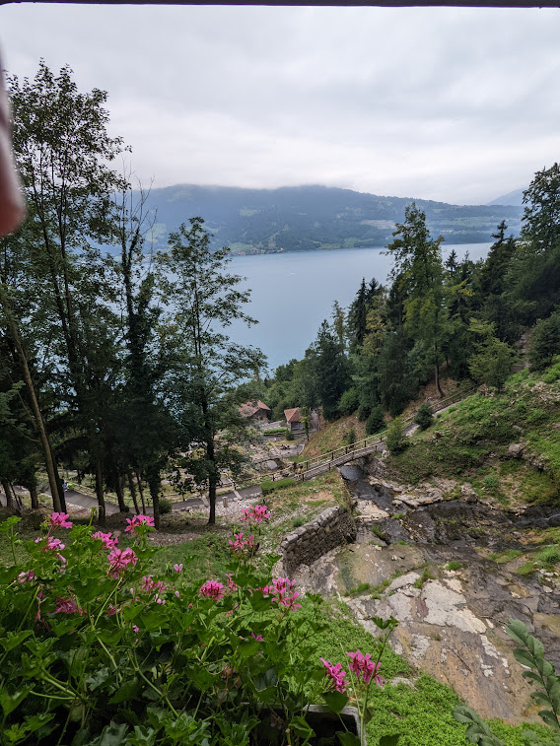
Genoa
Cantalupo
Lauterbrunnen
Paris
Interlaken
Notes:
cantalupo, iltaly

