Slide 1

CERNBox Monitoring from the User’s Point of View
Tyler Hellstern – Washington and Lee University
University of Michigan REU Program
Advisor: Samuel Alfageme Sainz

Slide 2
The Big Picture
Practical Monitoring – Mike Julian
What does it mean to monitor from the user’s PoV?
  Why is this so useful and important?
Notes:
Start monitoring how users interact with the interface because that is what matters to the user. Is the application working? How fast or slow is it at certain tasks? How much are people using certain features? This gives you a good idea of where the problems are and keeps you from getting stuck staring at the specifics and spending all your time on something that doesn’t necessary effect the user.
Monitoring is a multi-faceted problem that cannot be solved by one tool (one type of exporter for ex). There is a danger in monitoring efforts becoming too specialized or focused on specialized tools. There is no golden tool that is going to fix all monitoring problems, it takes an understanding of the system being monitored to monitor effectively
Because monitoring requires an understanding of the system being monitored, the book recommended that everyone be responsible for monitoring, not just a specific monitoring team.
There can be a tendency to monitor for the sake of monitoring. This is probably happening if something keeps going wrong and the metrics do not shed any light into what is going wrong.
These are all things that I have seen come into play at CERN

Slide 3


Setting up My Development Environment
First Experience with Docker
Learn how Bash, YAML, and API’s all work together

Slide 4
The Details of my Project

Slide 5
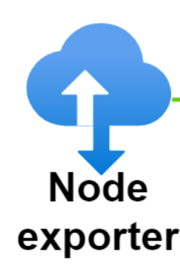


Prometheus PULL model
Pull
Query
Notes:
Doesn’t have to be node exporter: EOS, Blackbox, NGINX

Slide 6



Prometheus can PUSH Metrics
API
Data Source
Prometheus Pushgateway
Normal Prometheus Client

Slide 7
Prometheus Pushgateway
Use cases:
  capturing the outcome of a service-level batch job.
Downsides:
  Potential bottleneck
  Lose health monitoring metrics
  Never forgets data – overwrites existing metrics
Credit: (https://prometheus.io/docs/practices/pushing/#)

Slide 8
Why is it Necessary?
We use a script to create EOS project spaces (not a daemon)
  Can NOT use a normal exporter
So the script needs to push the metrics
  cURL
Notes:
Fix point 2 and 3

Slide 9
What Metrics Should we Push?
Num_projects_created
Quota_allocated
  Monitoring From The User’s Point of View:
Aggregate Pushgateway
Notes:
Fix point 2 and 3

Slide 10
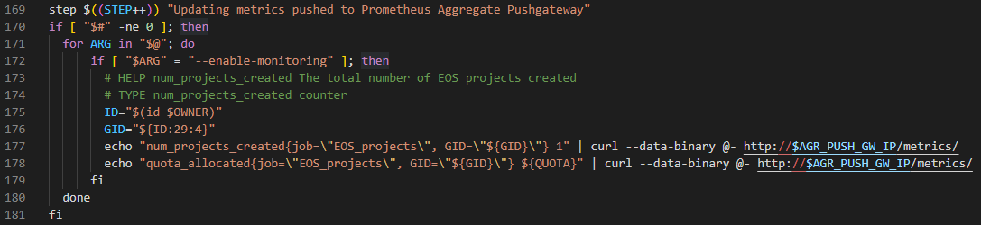
Addition to the Script
Cernbox-create-project-space.erb
Dimensions: 2 (job, GID)
UID?

Slide 11
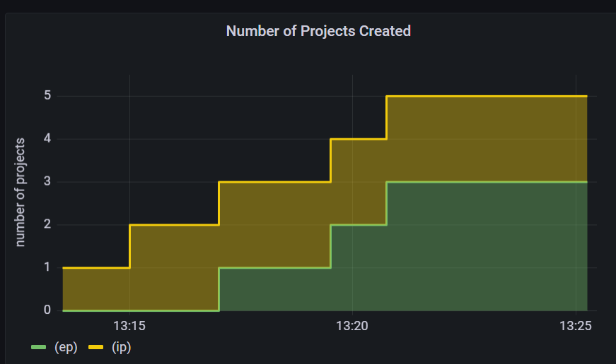
Grafana Dashboards
Notes:
Point out GID
**Mention why UID was NOT included

Slide 12
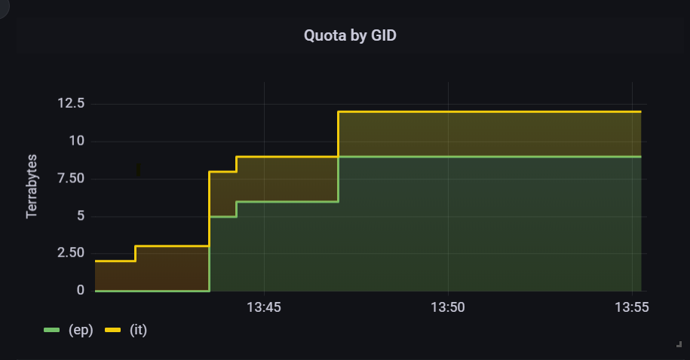
Grafana Dashboards
Notes:
Show how it doesn’t increase by one anymore
Point out GID again
**Mention why UID was NOT included (briefly)

Slide 13
Project 2.0

Slide 14
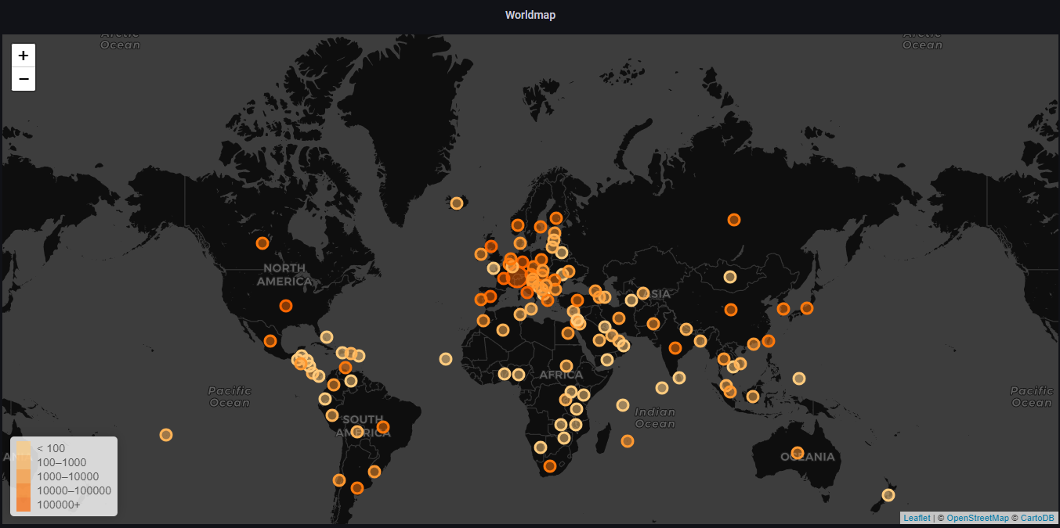
A Closer Look at Grafana Dashboards
Polish CERNBox Delta Reports Dashboard

Slide 15
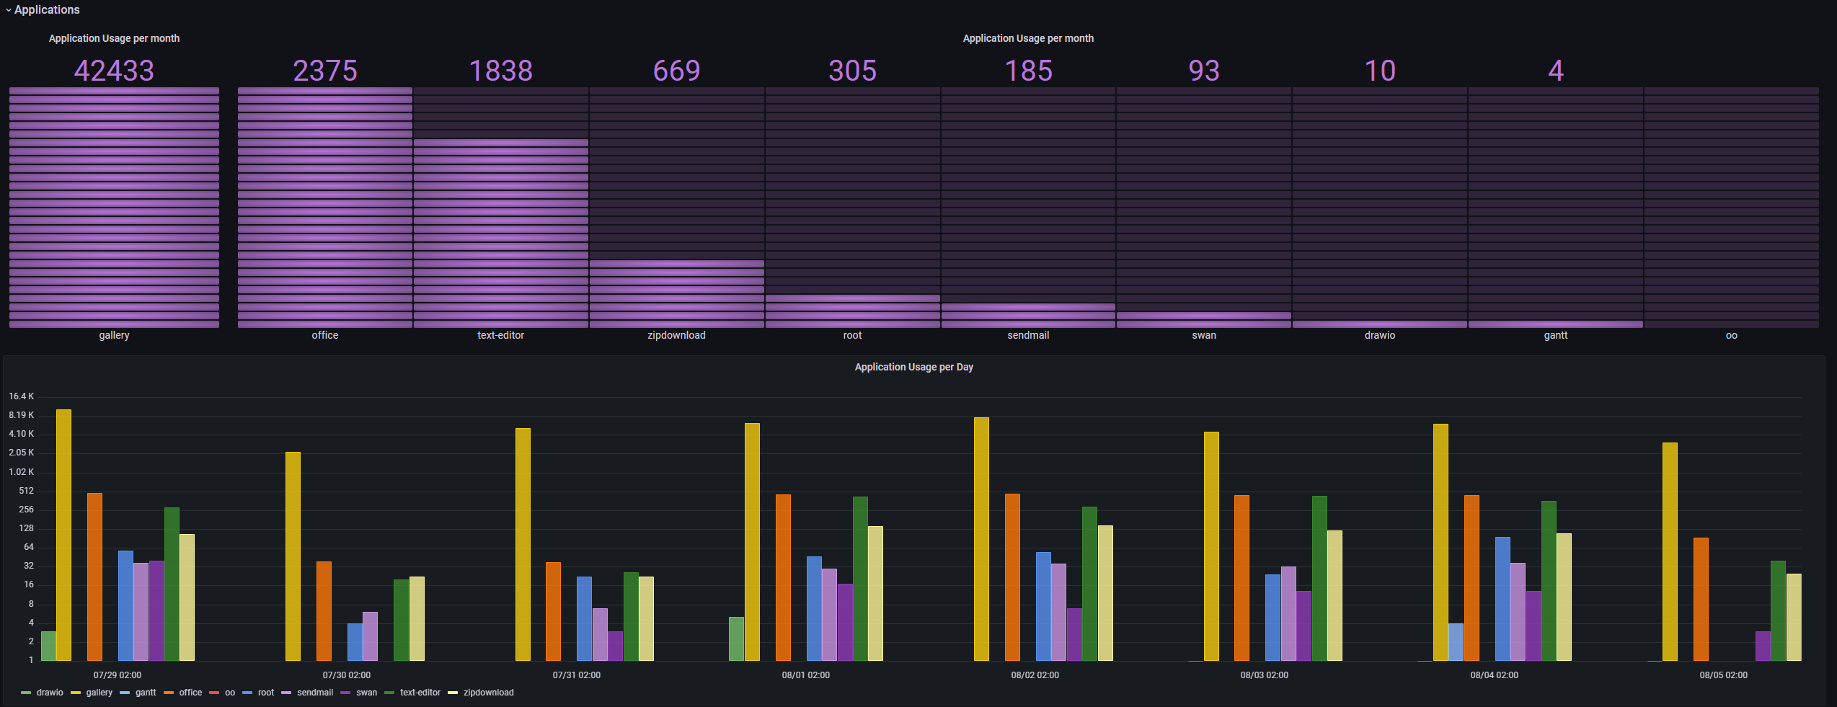
A Closer Look at Grafana Dashboards

Slide 16
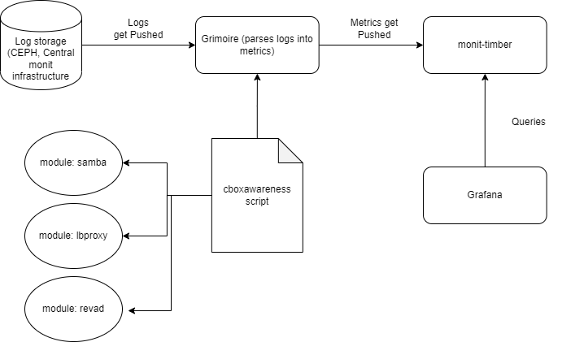
A New Data Source
Connect Dashboard to metrics for new service (OCIS) through Grimoire and monit-timber
Can We Simplify?
Notes:
Describe how I edited the modules in cboxawareness to look for the correct key words in the correct places
Talk about connection to Pushgateway

Slide 17
The Future for CERNBox
Future uses for pushgateways:
  Time elapsed - between project space requests and creation
  Consolidating other push systems into Prometheus
Continue building up Monitoring
Release OCIS

Slide 18




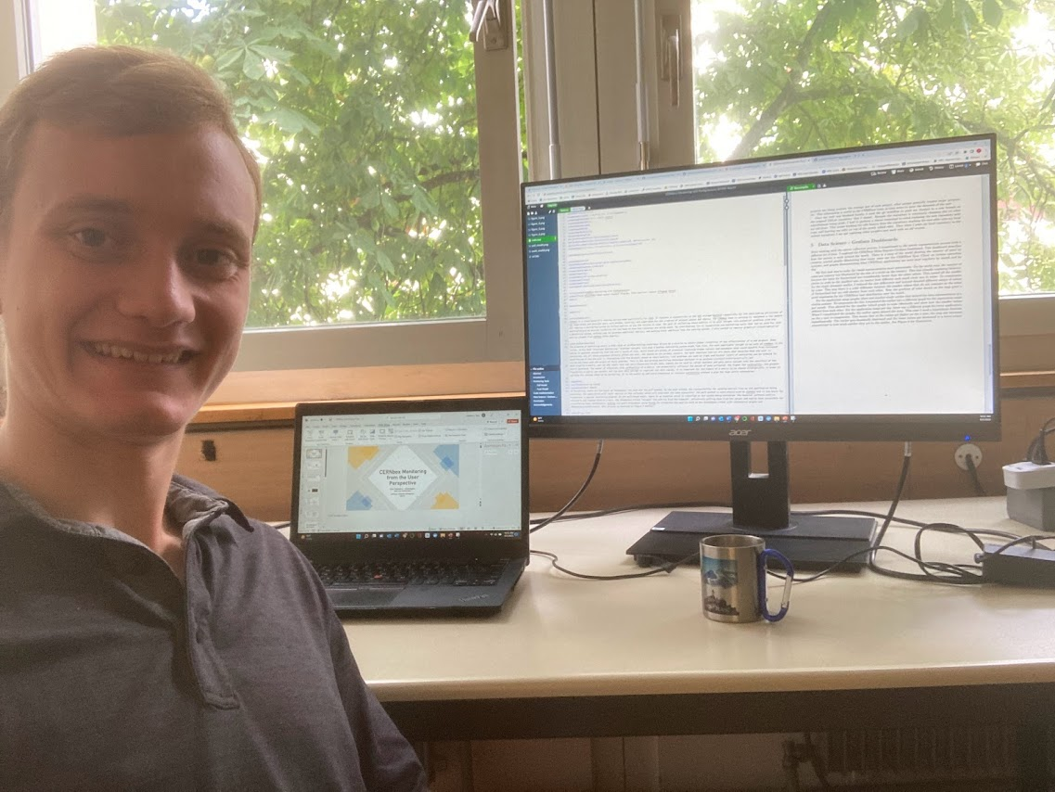

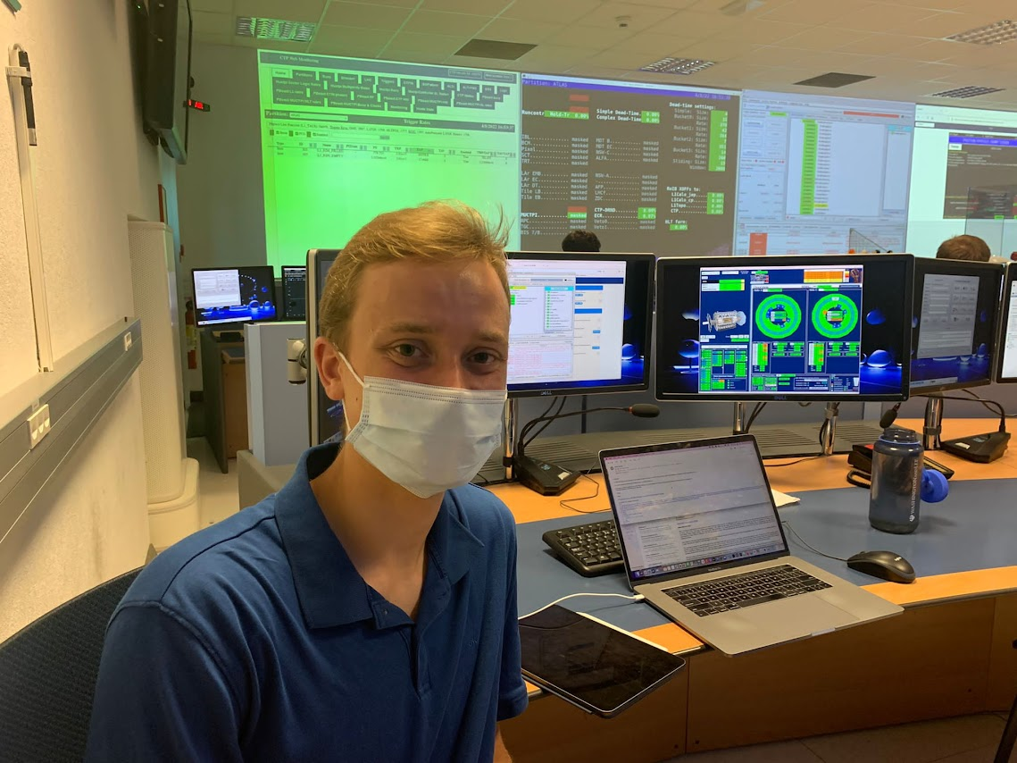






Pictures!

Slide 19
Thank you!
Acknowledgement to my advisor: Samuel Alfageme Sainz

