Slide 1
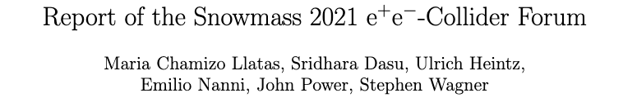
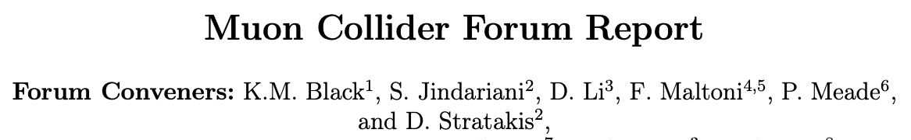
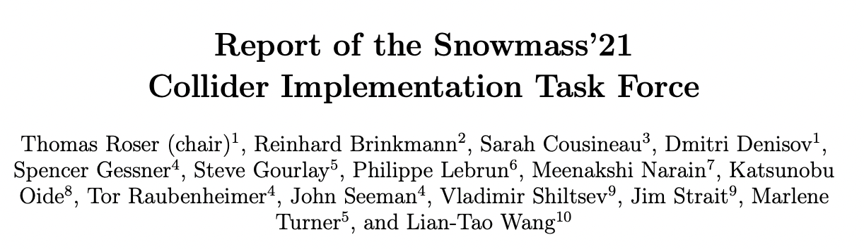
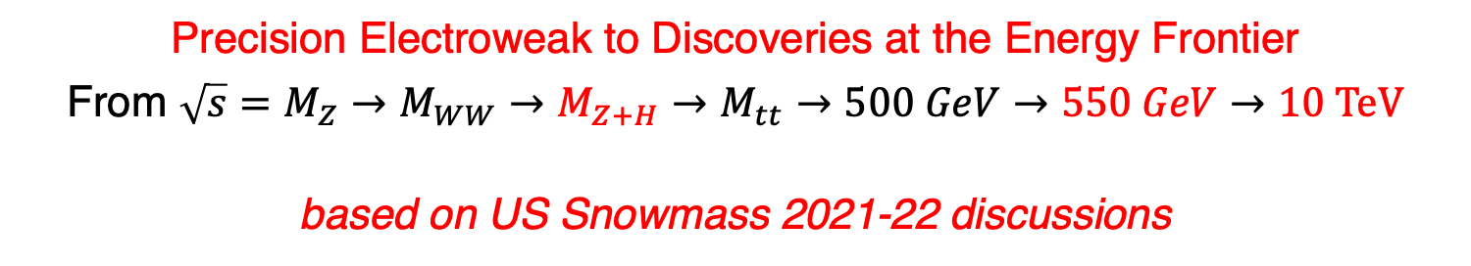
Collider Of Tomorrow:
The Cool Copper Collider & The Muon Collider
Precision Electroweak to Discoveries at the Energy Frontier
From $\sqrt{s}=M_{Z}→M_{WW}→M_{Z+H}→M_{tt}→500 GeV→550 GeV→10 \text{TeV}$
based on US Snowmass 2021-22 discussions
https://www.muoncollider.us/
https://muoncollider.web.cern.ch/

Slide 2
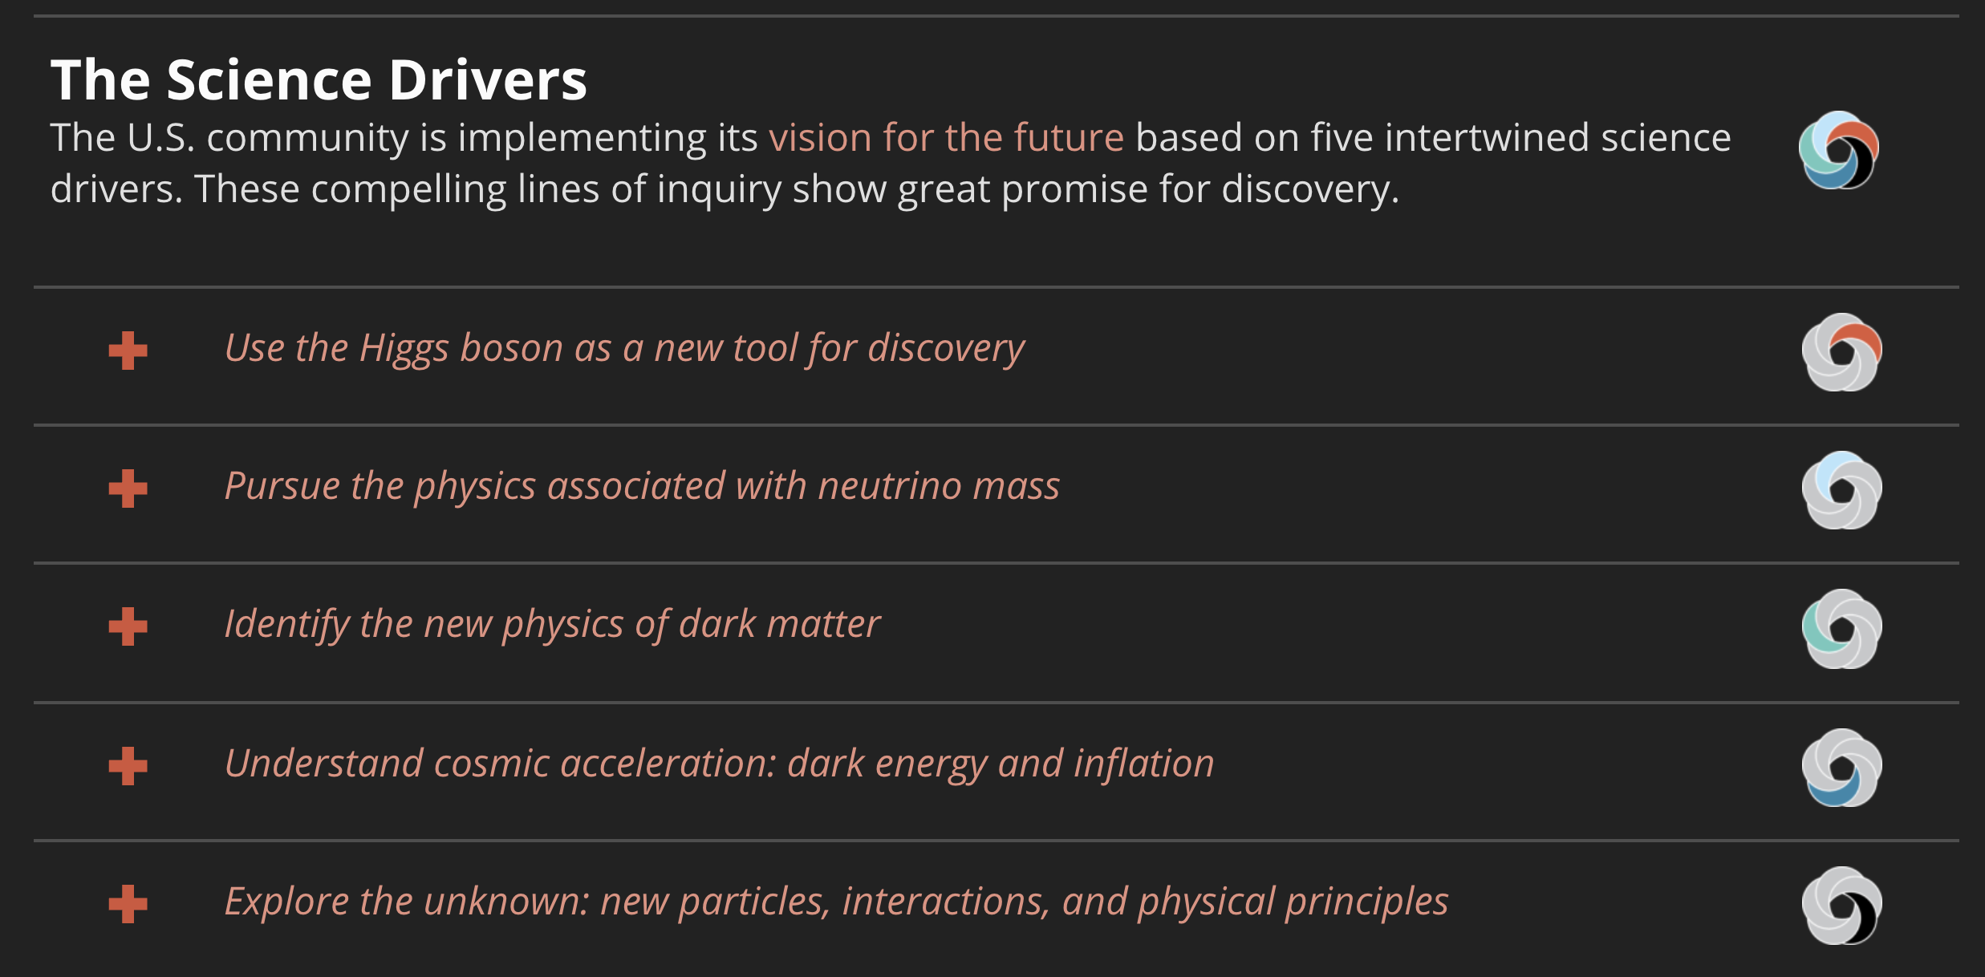
Physics Case for the Energy Frontier
From $\sqrt{s}=M_{Z}→M_{WW}→M_{Z+H}→M_{tt}→500 GeV→550 GeV→15 \text{T}\text{eV}$
Higgs Factory
Shovel Ready
O(10) TeV
Further Research

Slide 3
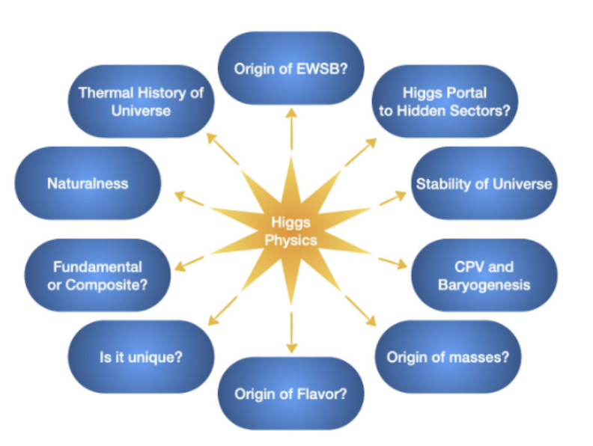
Higgs Central to Many Fundamental Topics
Percent level Higgs couplings deviations from SM values ➔ BSM physics at 10 TeV
e⁺ e– Higgs Factory ➔ Energy Frontier (10 TeV) Muon Collider

Slide 4
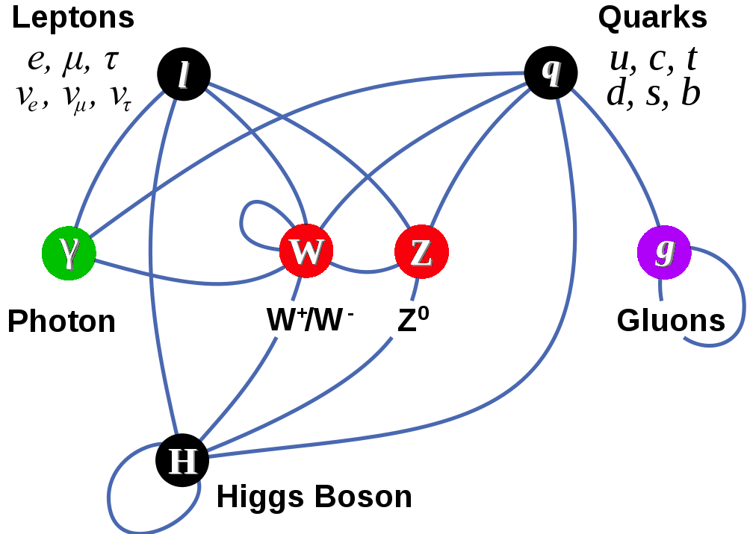
Particles & Interactions of
The Standard Model
Matter Particles (fermions)
Interactions by exchange of vector bosons
The edifice on which SM is built: The complex scalar doublet, with non-zero VEV, results in masses for W⁺/W– and the Z & massive Higgs. Fermions also get mass interacting with H.

Slide 5
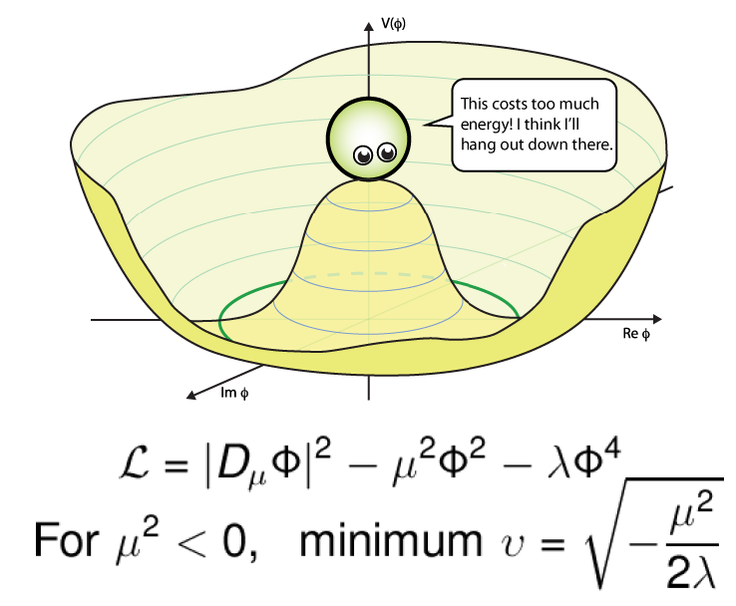
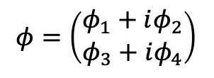
Higgs Field is Special
Electro-Weak Symmetry Breaking
50 years ago, gauge theory unified electro-weak interactions, but could not
accommodate non-zer
masses for W± & Z
$$φ=\left(\begin{matrix}φ_{1}+iφ_{2} \\ φ_{3}+iφ_{4}\end{matrix}\right)$$
Introduction of a doublet
of complex scalar fields
with peculiar potential
provided masses for W± & Z and left γ massless!
The remnant fourth field degree of freedom is the Higgs Boson discovered in 2012
Coupling to Higgs field provides masses to matter particles!!
Asserting the form of the potential requires measuring di-higgs production

Slide 6
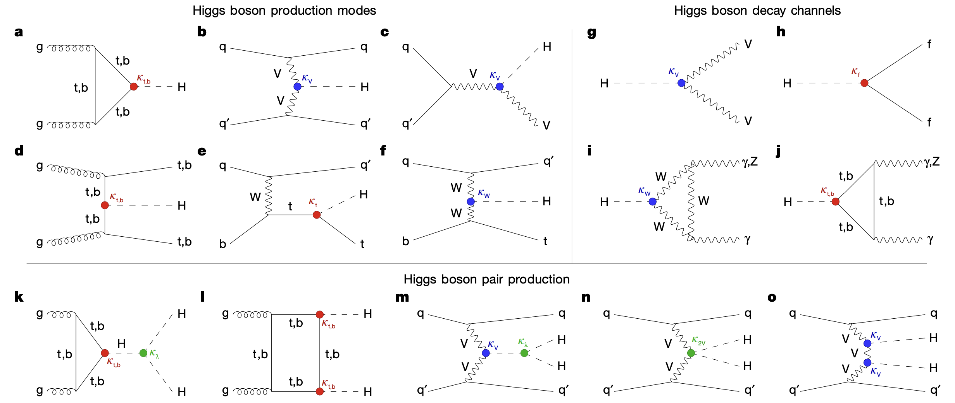
Higgs Boson Couplings, Production and Decays
(At the LHC)
μ⁺
ν_{μ}
e⁺
μ⁻
ν_{μ}
e⁻
(At Muon Colliders)
(At e+e- factories)
μ⁺
ν_{μ}
μ⁻
ν_{μ}
(At Muon Colliders)

Slide 7
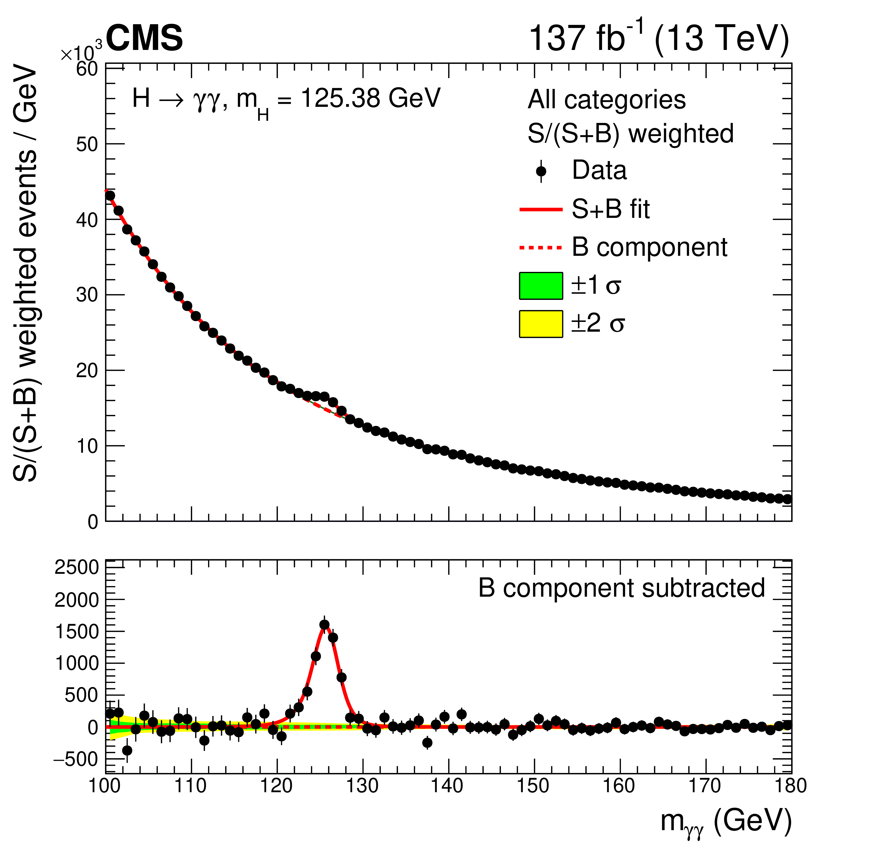
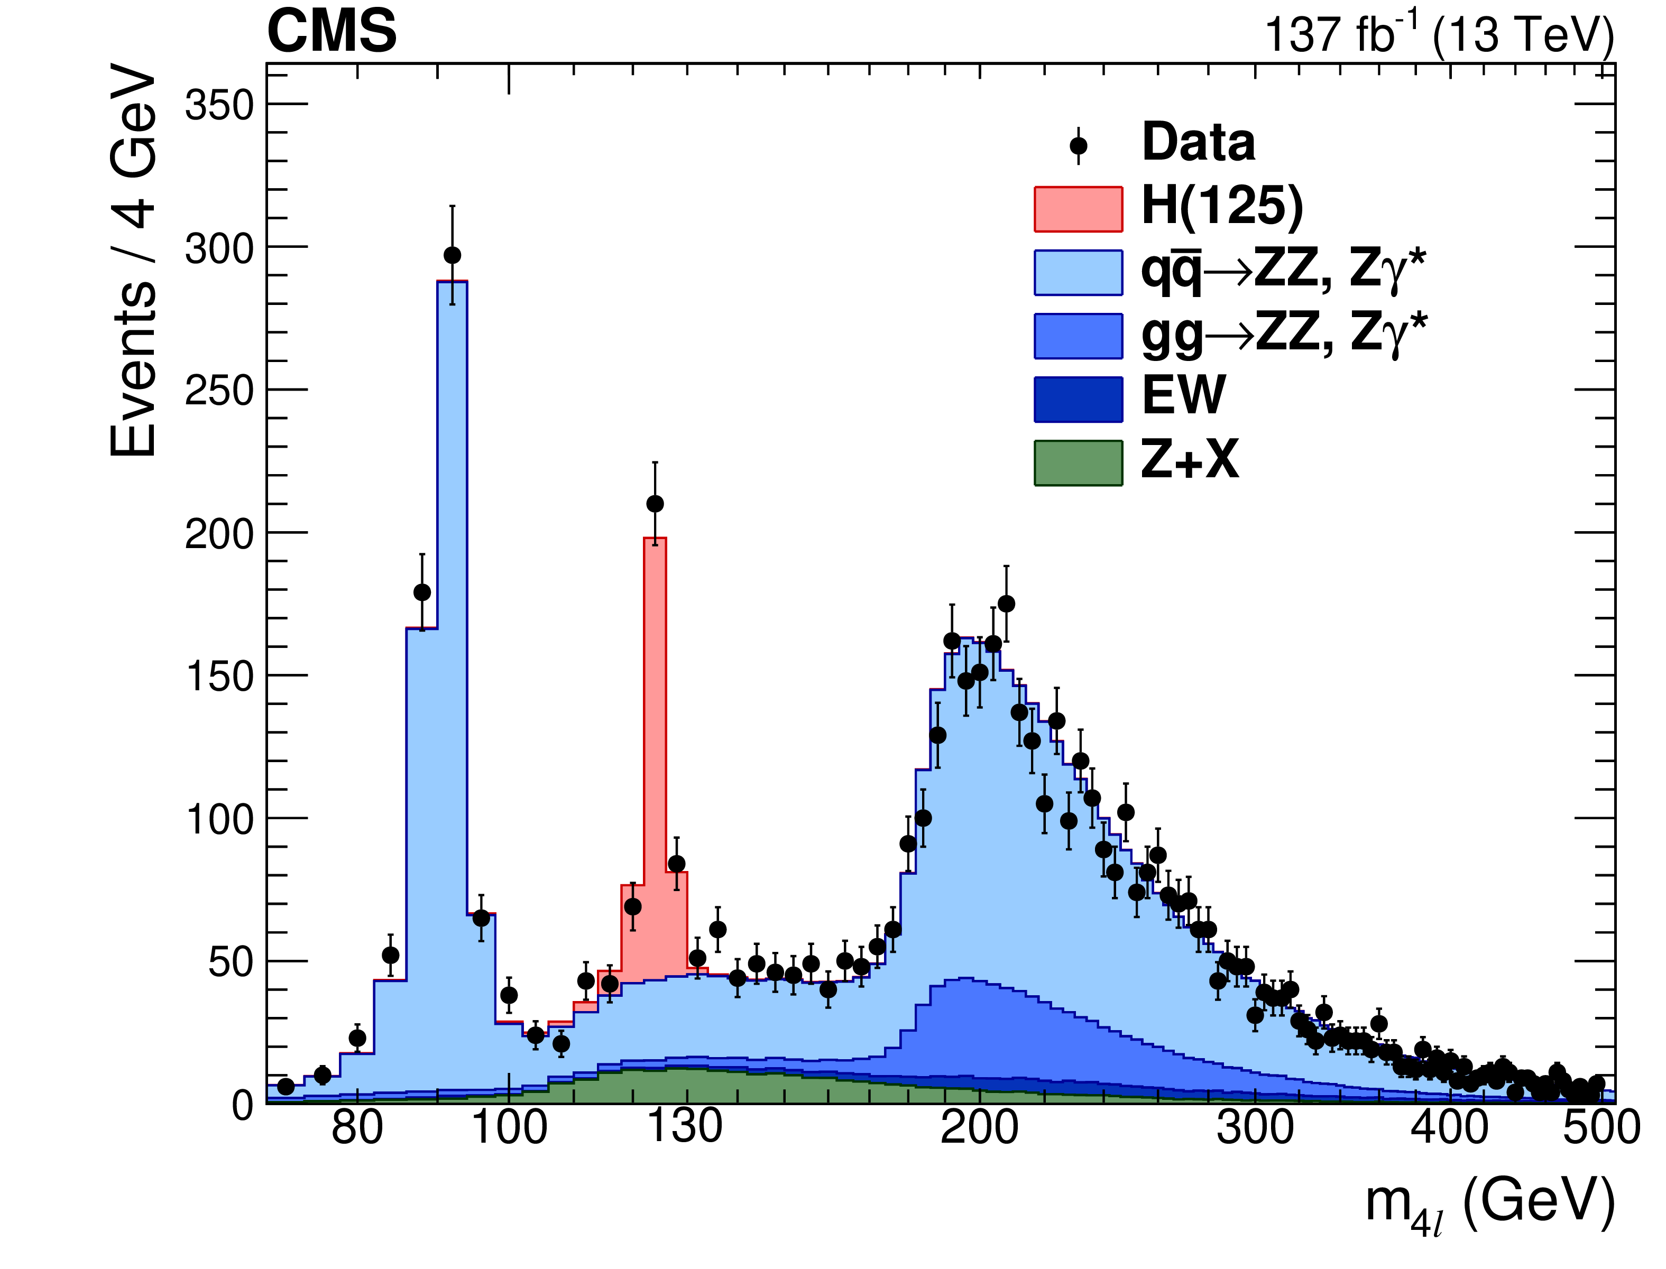
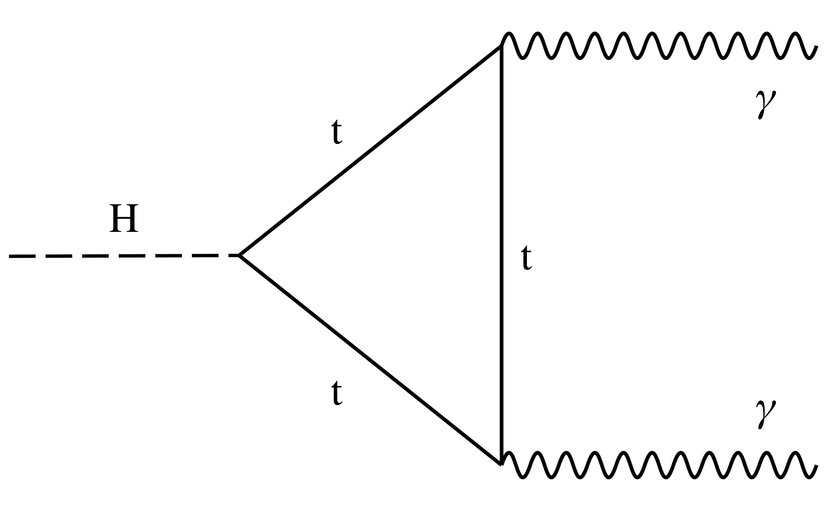
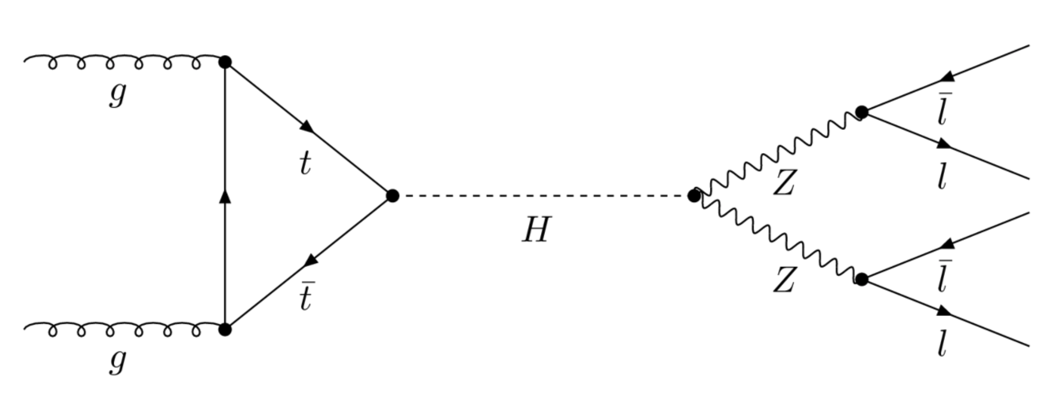
Current Status of Golden Channels @ LHC
Our Higgs boson data sets are enabling detailed studies of the SM

Slide 8
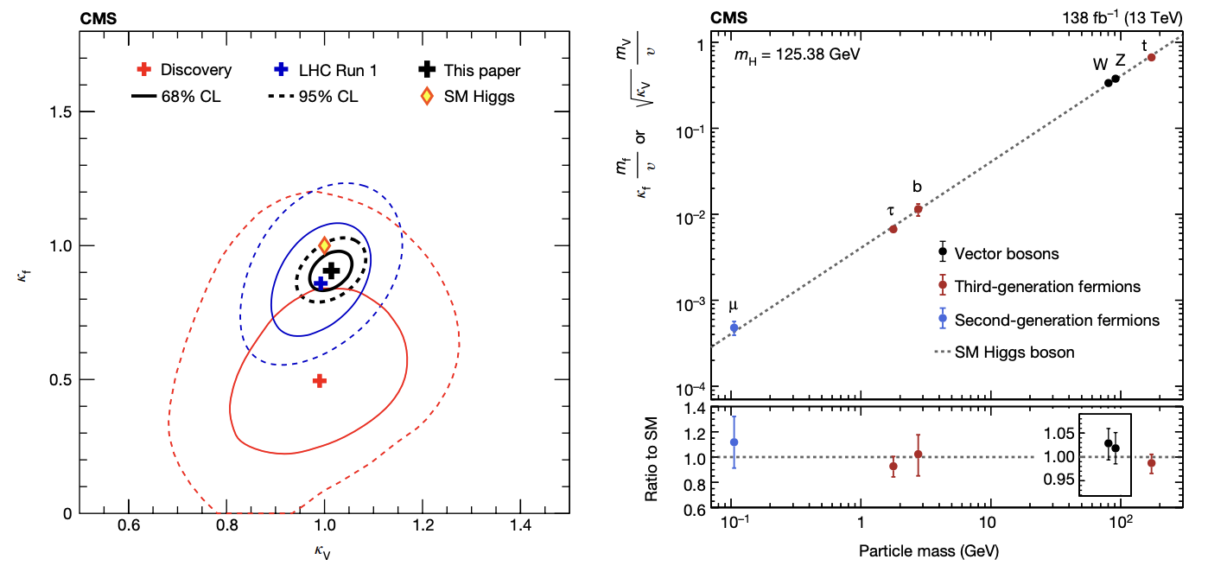
Current Status of Higgs Couplings

Slide 9
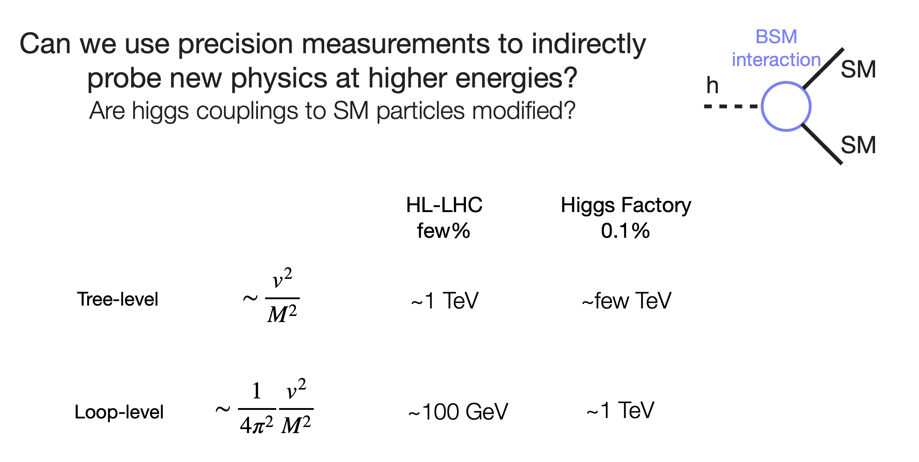
What’s Next?
Sub-percent Level Higgs Couplings → 10 TeV BSM
Couplings Deviations found at
C³ e⁺e–Higgs Factory
→
BSM @ 10 TeV Muon Collider

Slide 10

Colliders Of Tomorrow
Many Opportunities at the Energy Frontier
FCC-pp, SPPS 100 km 100 TeV ~ E_{qq}~15 TeV 500 - 3000 fb⁻¹sy⁻¹
FCC-ee, CEPC 100 km 240, 365 GeV 850, 155 fb⁻¹sy⁻¹
CLIC-ee 50 km 0.38,1.5, 3 TeV 150, 370, 590 fb⁻¹sy⁻¹
ILC-ee 31 km 250, 500 GeV 75, 180 fb⁻¹sy⁻¹
C³-ee 7 km 250, 500 GeV 100, 200 fb⁻¹sy⁻¹
HL-LHC 27 km 14 TeV ~ E_{qq}~ 2 TeV 200 - 500 fb⁻¹y⁻¹
μCol ~27 km 10, 15 TeV 1000 - 2000 fb⁻¹sy⁻¹
μCol 6 km 3, 6, 10 TeV 200, 500 fb⁻¹sy⁻¹
μCol 0.3 km 125 GeV 1 fb⁻¹sy⁻¹
snowmass year = 10⁷s

Slide 11
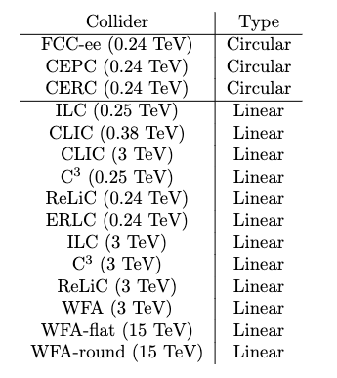
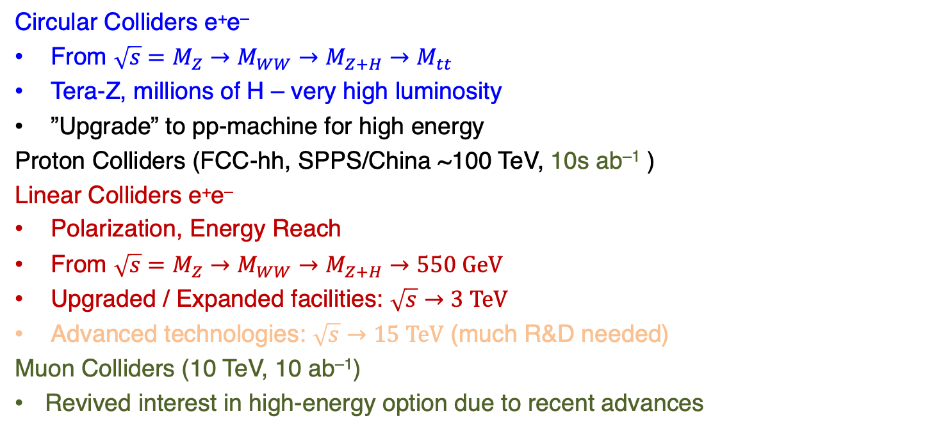
Implementation Task Force
Evaluated Collider Types
Circular Colliders e⁺e–
From $\sqrt{s}=M_{Z}→M_{WW}→M_{Z+H}→M_{tt}$
Tera-Z, millions of H – very high luminosity
”Upgrade” to pp-machine for high energy
Proton Colliders (FCC-hh, SPPS/China ~100 TeV, 10s ab^{–1} )
Linear Colliders e⁺e–
Polarization, Energy Reach
From $\sqrt{s}=M_{Z}→M_{WW}→M_{Z+H}→550 \text{GeV}$
Upgraded / Expanded facilities: $\sqrt{s}→3 \text{T}\text{eV}$
Advanced technologies: $\sqrt{s}→15 \text{TeV}$ (much R&D needed)
Muon Colliders (10 TeV, 10 ab^{–1})
Revived interest in high-energy option due to recent advances

Slide 12
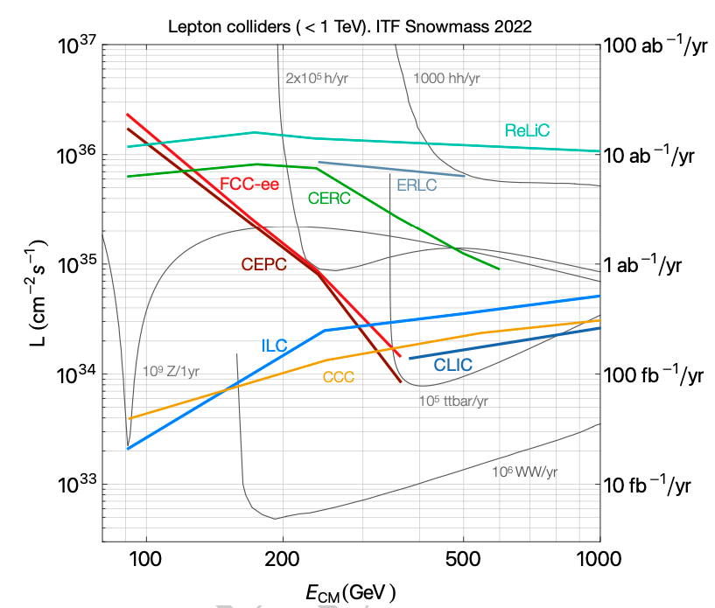
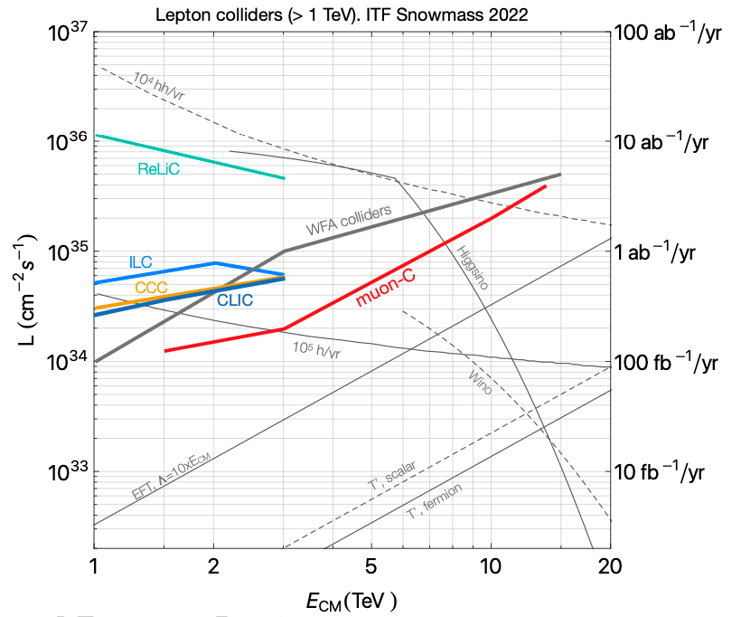
Lepton collider Luminosity vs $√s$ Landscape

Slide 13
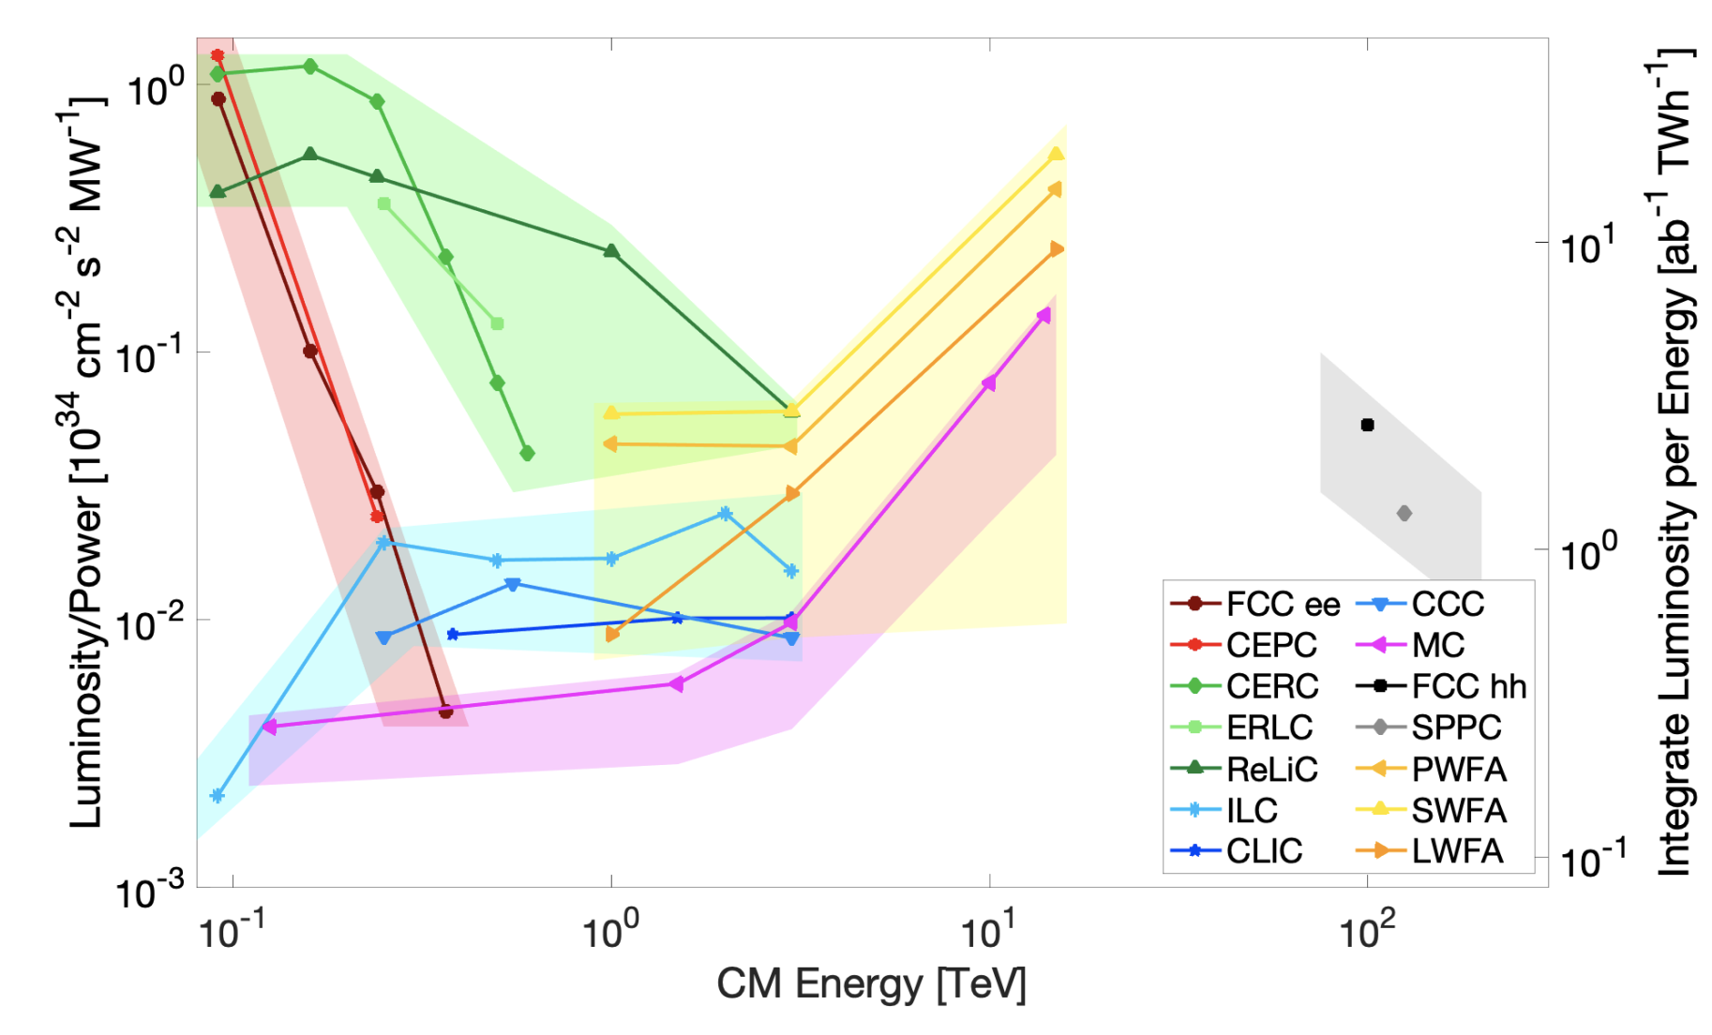
Luminosity / Power vs Energy from ITF
Points computed from proponent submitted parameters table
Uncertainty band is ITF judgement based on many considerations: technical design status, risk assessment, …

Slide 14
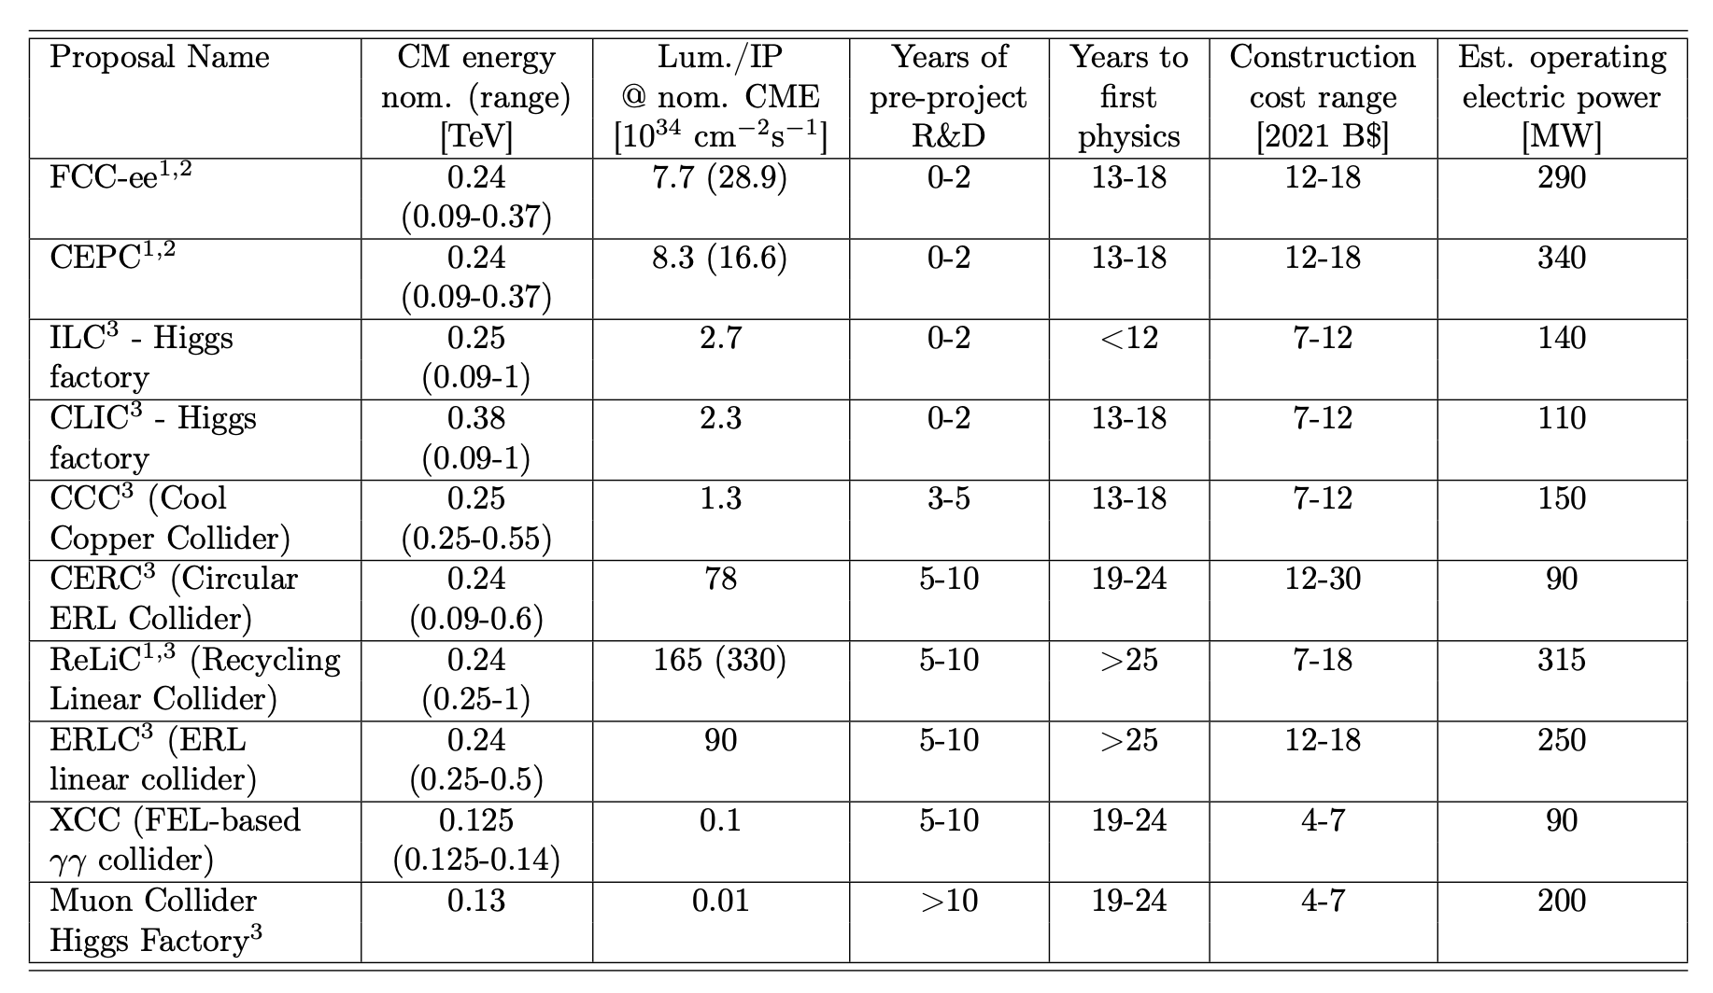
Higgs Factories
With 5 y R&D could get physics rolling by 2040 for ~$10B

Slide 15
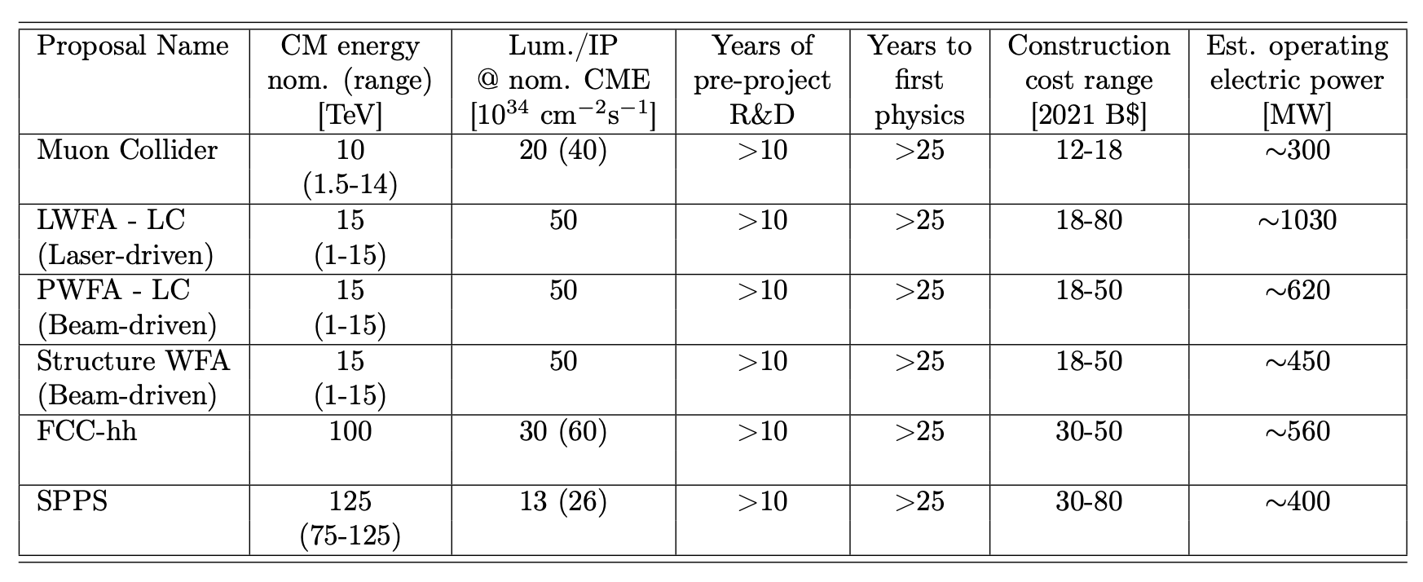
Energy Frontier Machines
With 10 y R&D could get physics rolling by 2045 for ~$18B

Slide 16
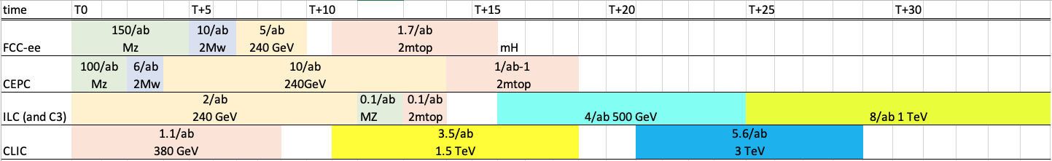
Higgs Factory Physics Timeline vis-à-vis Integrated Luminosity
Caveat – run plans are adjustable; start of physics times are different
  Technically feasible times: ILC < 12y, FCC-ee, CLIC, CEPC, C3 : 13-18y
    ILC “shovel ready” + C3 Short R&D –potential for earliest start
    FCC-ee, CLIC – post HL-LHC
  Circular colliders have shorter runs, higher luminosity
  Linear collider runs have access to polarization and higher energy
  Both provide good precision on Higgs Couplings & EWK

Slide 17
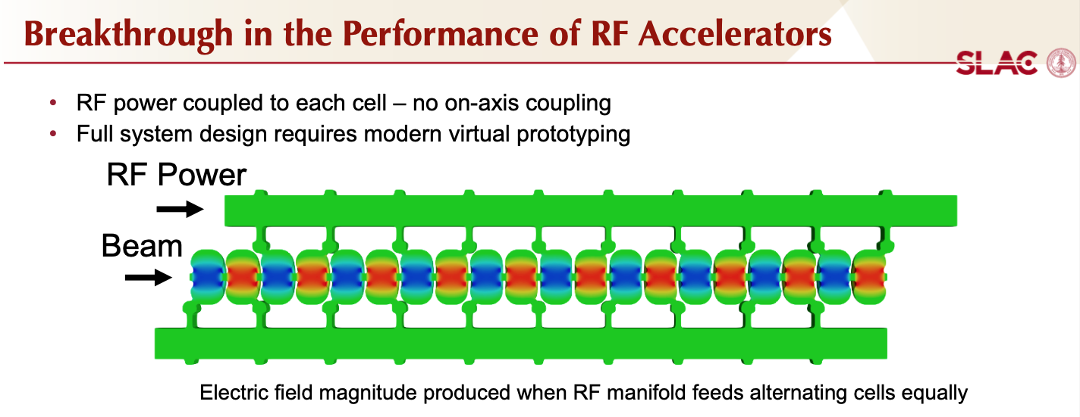
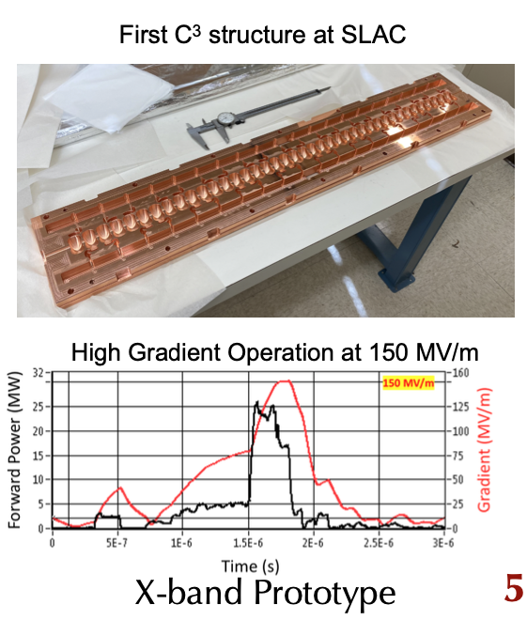
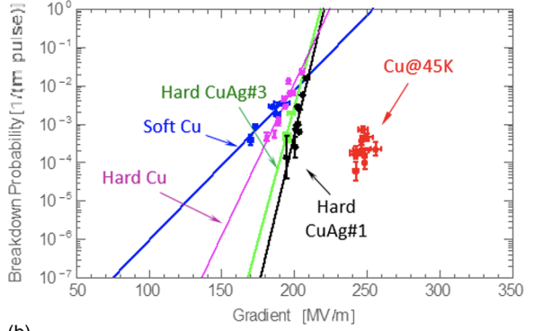
C3 – Cool Copper Collider – New Option
Cryogenic operation improves performance
Cahill et al,
PRAB 21.10 (2018): 102002
Bane et al, arXiv 1807.10195

Slide 18
Synergies With X-Ray Photon Sources
The vast majority of ~30,000 currently operating accelerators globally are electron accelerators.
Electron accelerator R&D ranges from industrial applications to the cutting-edge development of ultimate storage rings and linear accelerator based XFELs.
This fortunate situation allows e⁺e– colliders to leverage these global efforts to provide a viable path to a collider reducing the R&D costs to the HEP budget.

Slide 19
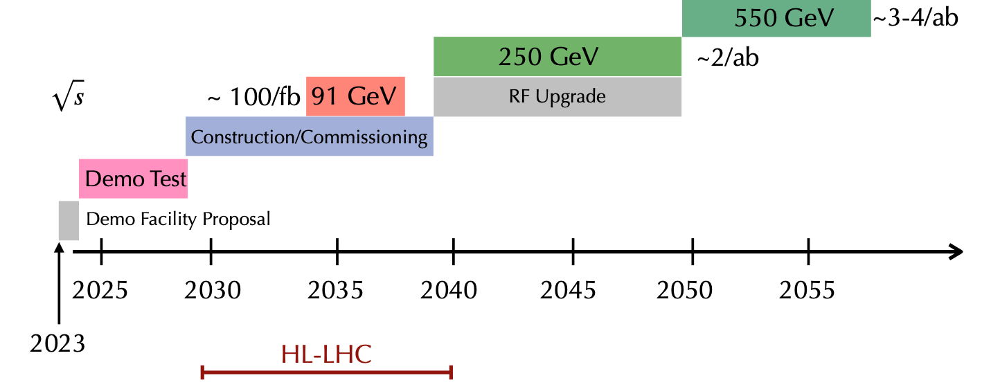
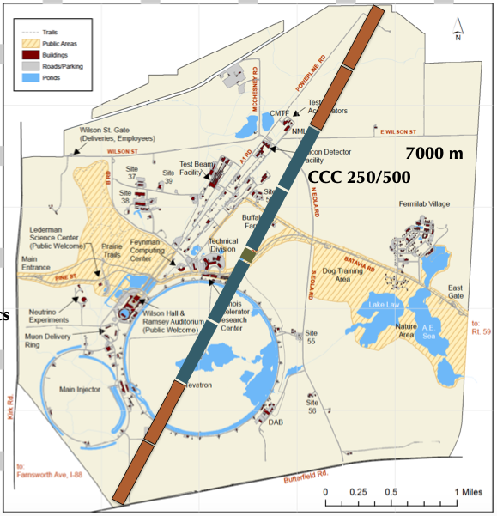
C³ – $\sqrt{s}=250−550$GeV – Potential Coordinates
O(10)% Higgs Self Coupling
1% H couplings - precision
Optional
LINAC 2km
BDS ~3km
BDS – similar to ILC design for 1-TeV – redesign optimally.
LINAC 2km
Can fit in FNAL site with BDS improvements

Slide 20
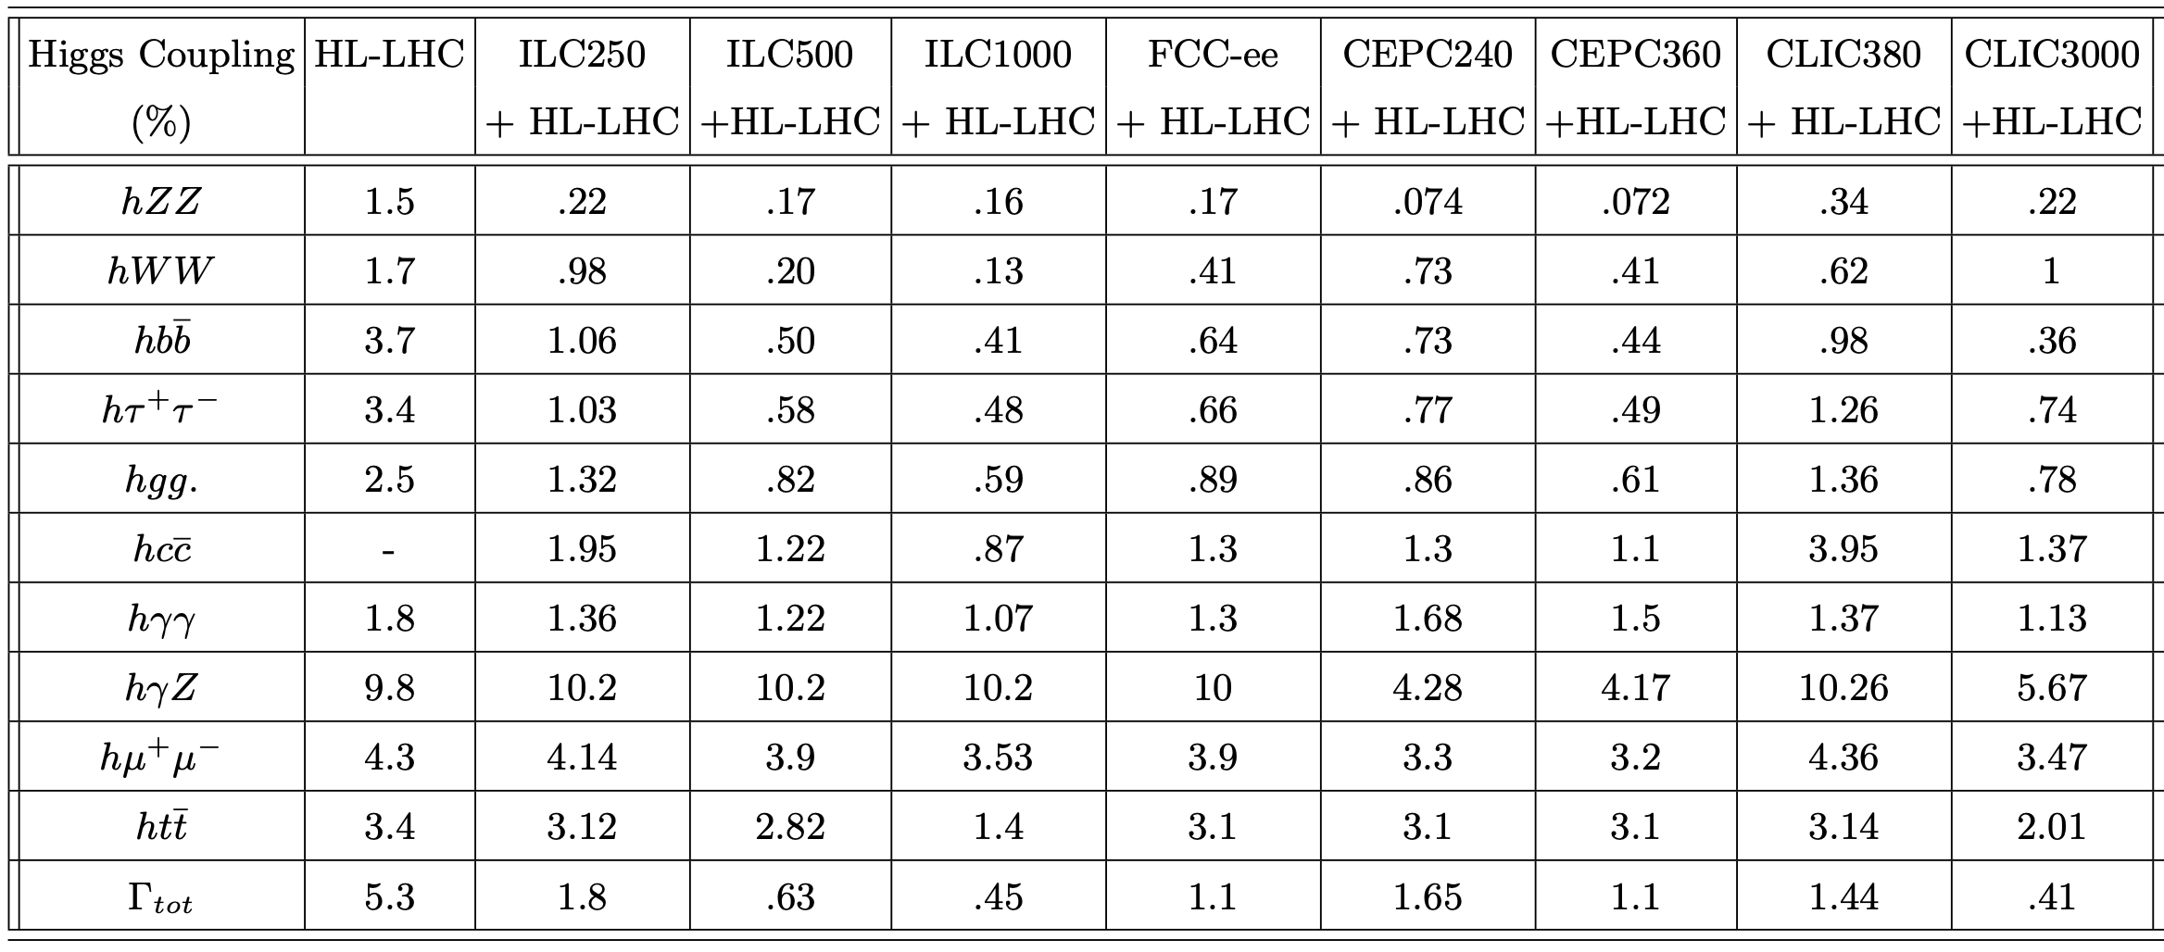
Higgs Couplings from Factories

Slide 21
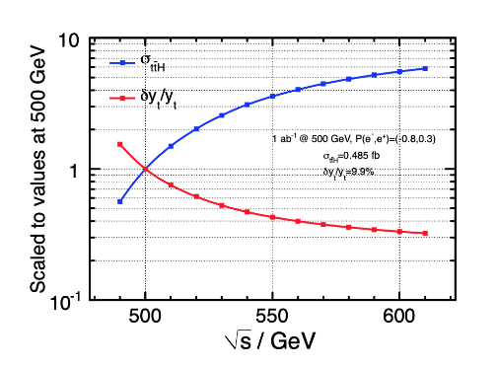
Top-Yukawa and Higgs Self-Coupling
Advantages of Energy Reach
Double Higgs production
E_{CM} (TeV) | Precision of λ_{HHH}
HL-LHC | 50%
ILC 0.5, C3 0.55 | 20%
CLIC 1.5 | 36%
CLIC 3 | 9%
μC10, FCC-hh | 4%

Slide 22
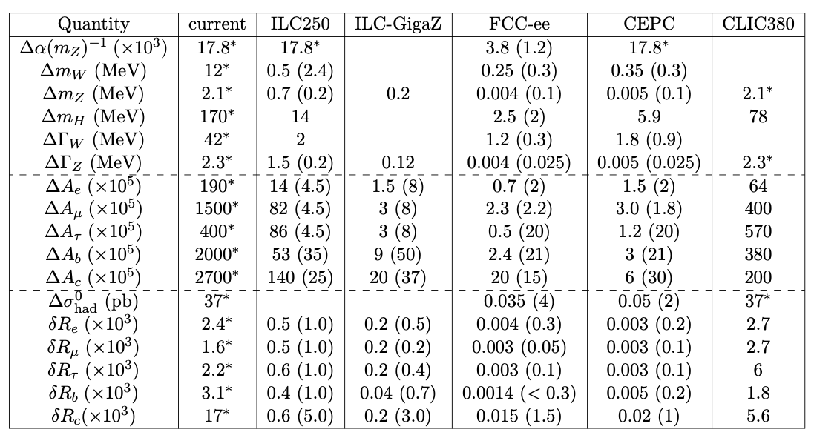
Electroweak Observables
GigaZ is a big improvement over current status
FCC-ee TeraZ suggests even bigger leap forward in precision

Slide 23
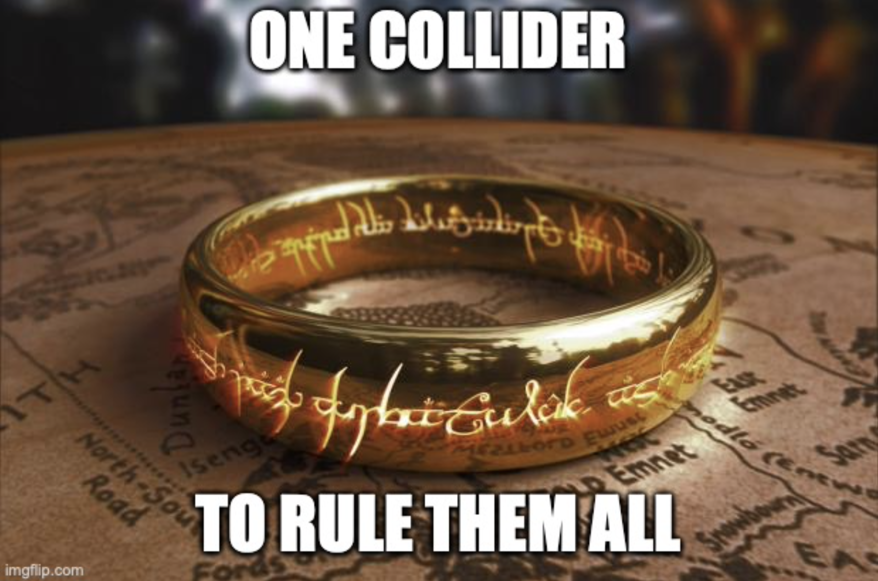
Oh! Lord of Rings!!
Can’t we get to 10 TeV in one swoop?

Slide 24
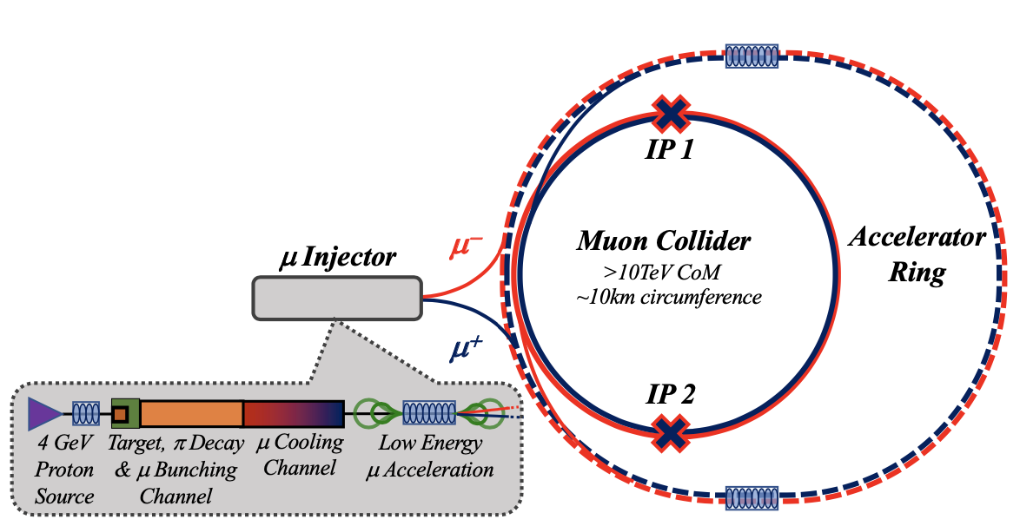
Innovative Muon Collider Concepts
Energy Efficient Path to O(10)-TeV Colliders
Accelerator Ring
LHC Tunnel?
Or FNAL Site Filler?
Minimize civil engineering cost.

Slide 25
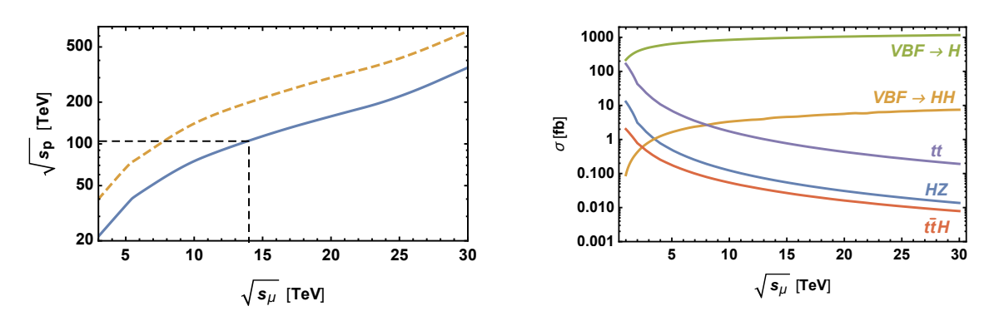
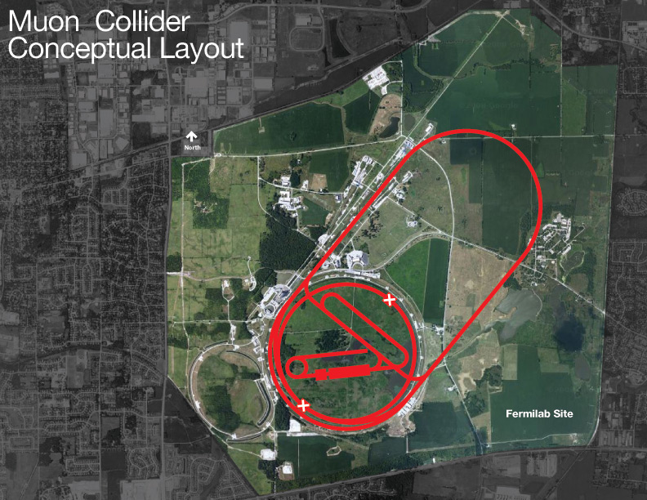
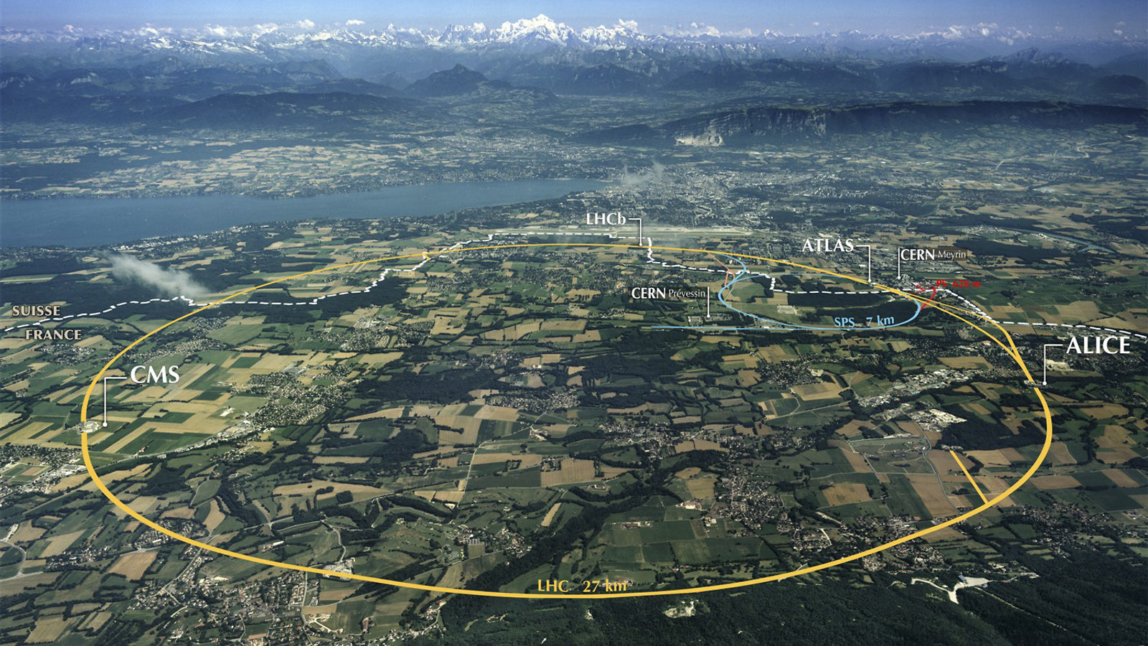
Muon Collider Advantages
arxiv:1901.06150
6-10 TeV machine can fit on Fermilab site
15 TeV machine can fit in LHC/CERN tunnel

Slide 26
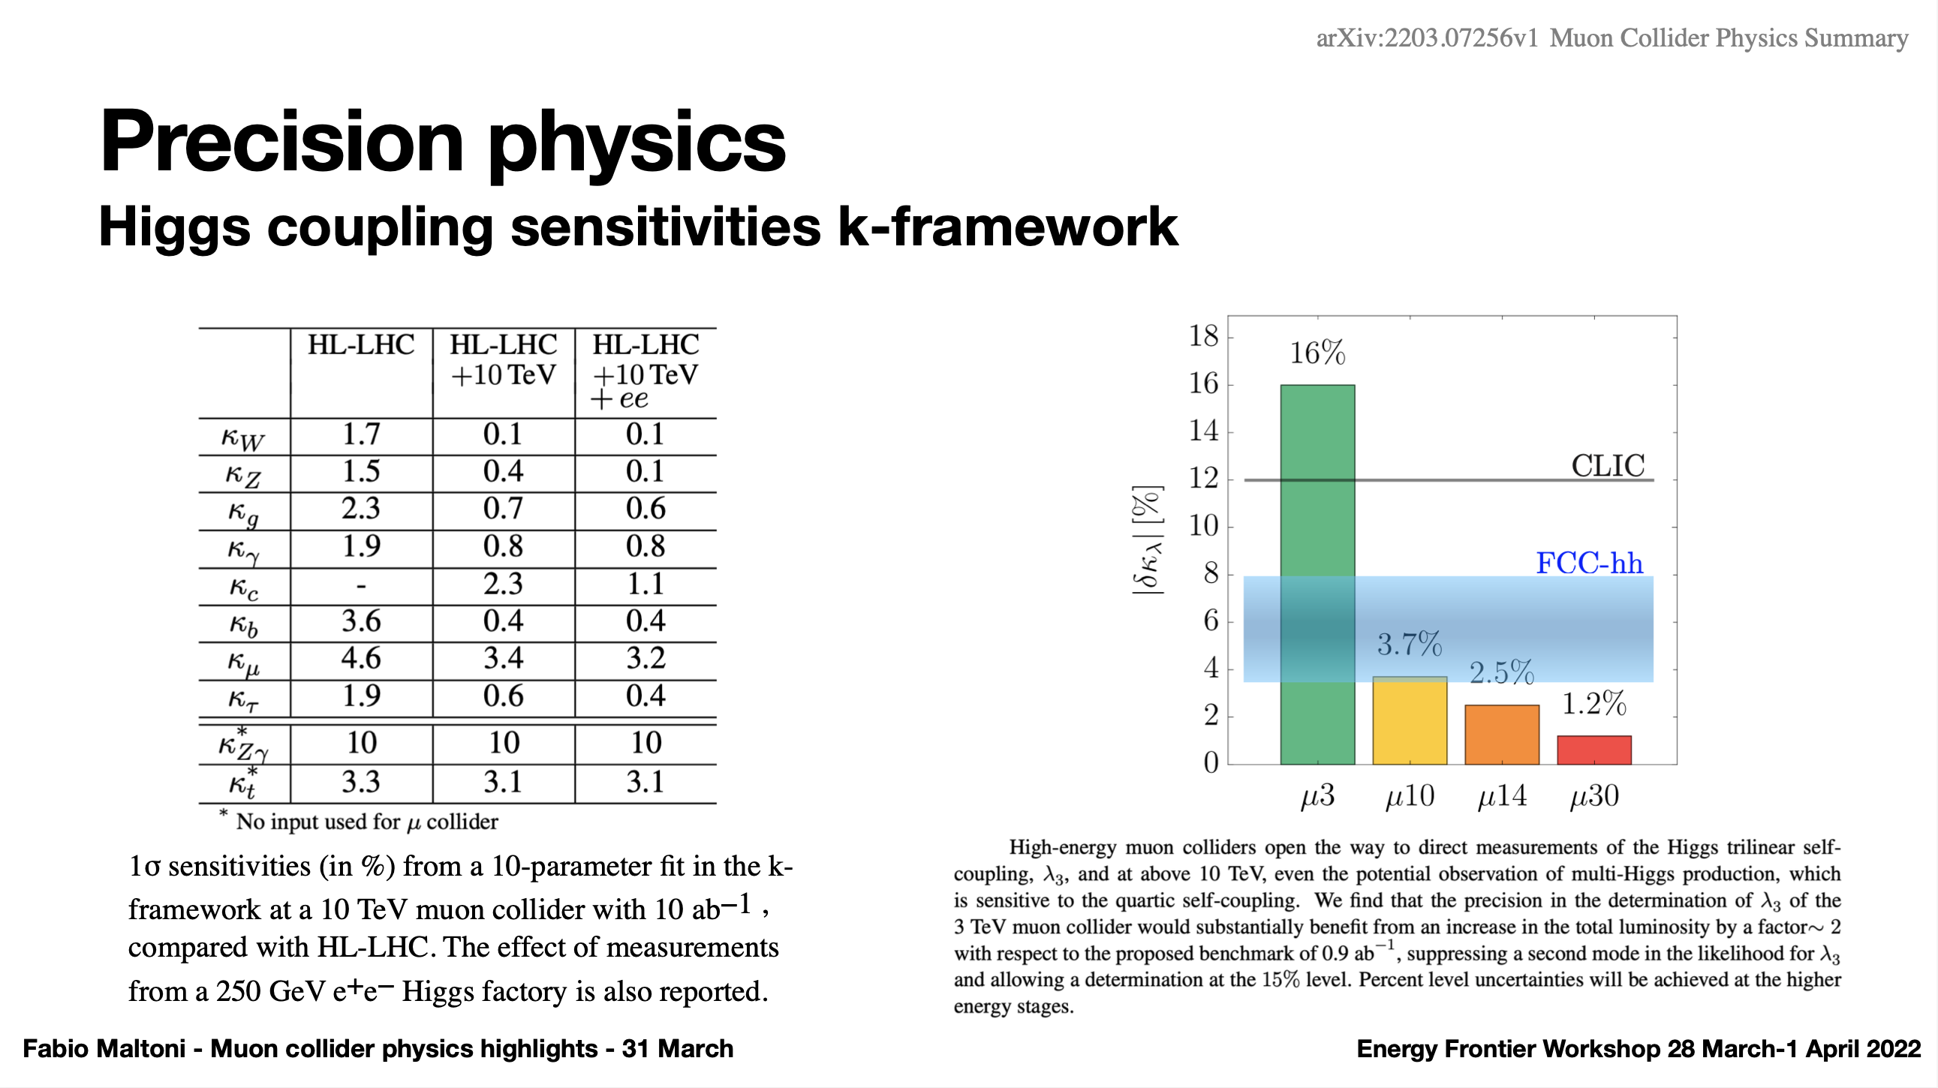

Slide 27
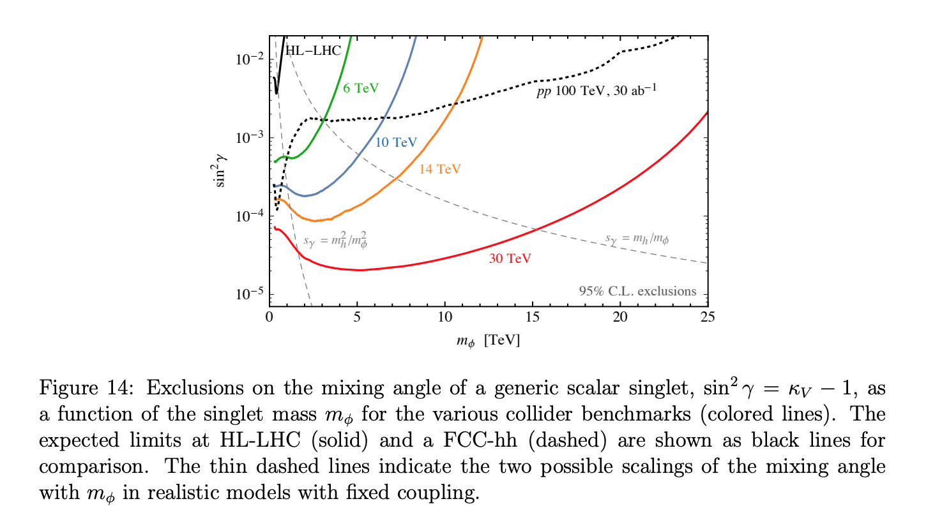
Muon Collider Prospects: Heavy Scalar Singlet
Higgs Smashers Guide, arXiv: 2103.14043
People are correct when they claim one should not assume
pp100 ~= muCol10

Slide 28
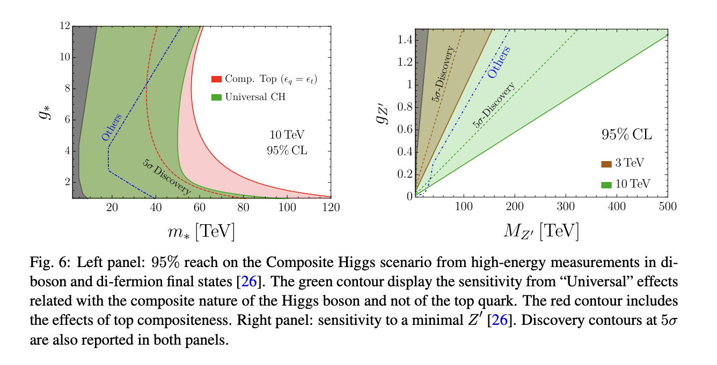
Higgs Compositeness & Minimal Z’ –
Another place where Muon Collider Shines

Slide 29
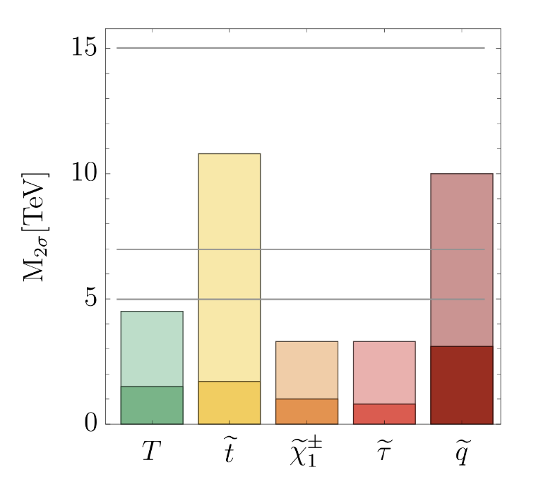
SUSY sparticle Searches
E_{cm}= 30 TeV
E_{cm}= 14 TeV
FCC-hh
E_{cm}= 10 TeV
Of course, FCC-hh wins in colored particle case over 10 TeV μCol
HLLHC

Slide 30
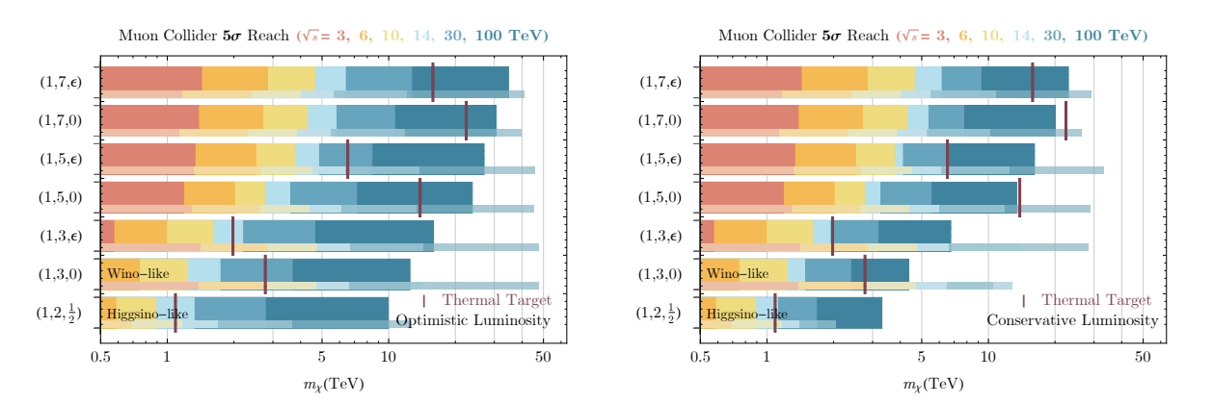
Dark Matter Reach
Higgs Smashers Guide, arXiv: 2103.14043
Discovery potential for 10-TeV scale WIMPs for a variety of color/ew/hypercharge multiplets
Conservative == 10ab^{–1}

Slide 31
Towards Muon Collider
Critical concepts now demonstrated
  Target Solenoid
    Similar LTS parameters to ITER Central Solenoid
    Performance can be improved with a radiation resistant HTS or Cu insert
  Muon 6D Cooling
    MICE Demonstration of Emittance Cooling
    High gradient demonstration of RF operating in Tesla-class magnetic fields
    Cooling channel concepts and detailed simulation consistent with operational targets
  Muon Final Cooling
    Advances in HTS conductor/cable/magnet technology
    High Field User Magnet program operationally demonstrating magnet parameters that are rapidly approaching the MC requirements

Slide 32
Towards Muon Collider …
Critical concepts now demonstrated
  Muon Acceleration
    Significant recent advancement in HTS-based fast-ramping magnets
    Focused effort on studying the integrated magnet/power supply efficiency issues for TeV-scale acceleration
  Collider and Detector
    Detailed studies of backgrounds that may impact physics
    Detector performance studies now demonstrate the ability to successfully measure key processes
    Concepts in development to manage off-site neutrino radiation issues
See dedicated JINST Volume for key references:
Muon Accelerators for Particle Physics (MUON)

Slide 33
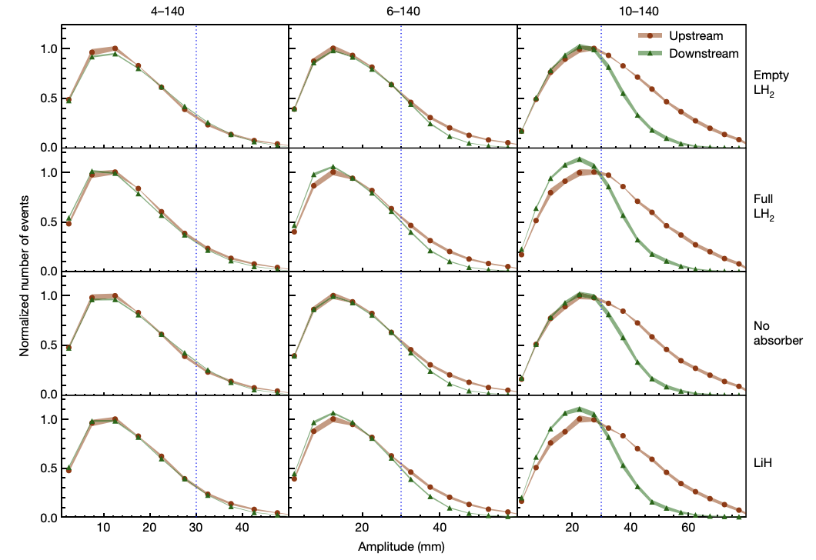
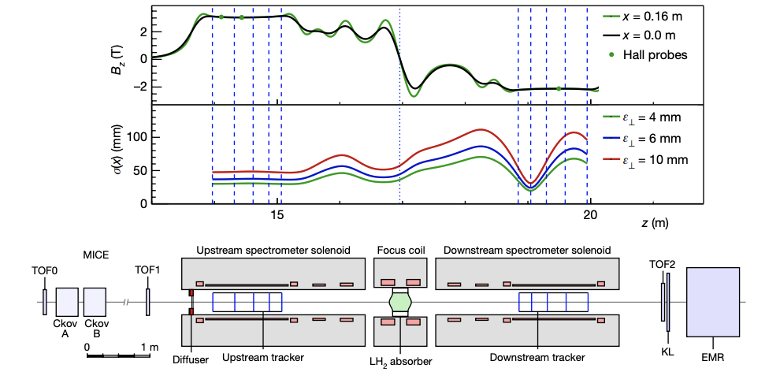
Muon Collider Accelerator Challenges
Beam Production : Demonstration of Ionization Cooling
Nature, Vol 578, P53
MICE
Increase in particle counts at smaller amplitude with low-Z absorber in place

Slide 34
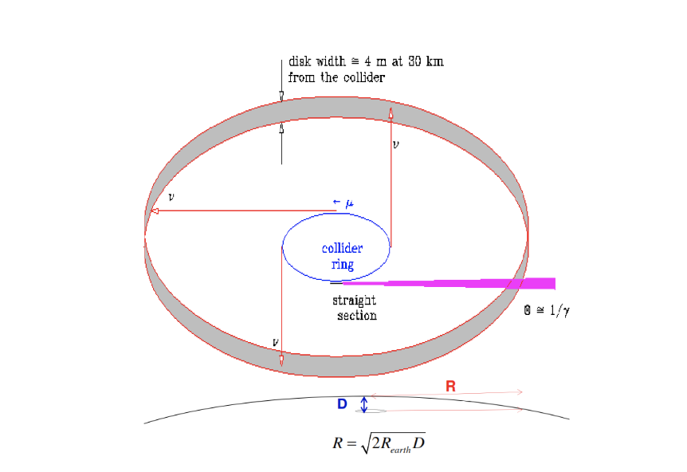
Neutrino Background?

Slide 35
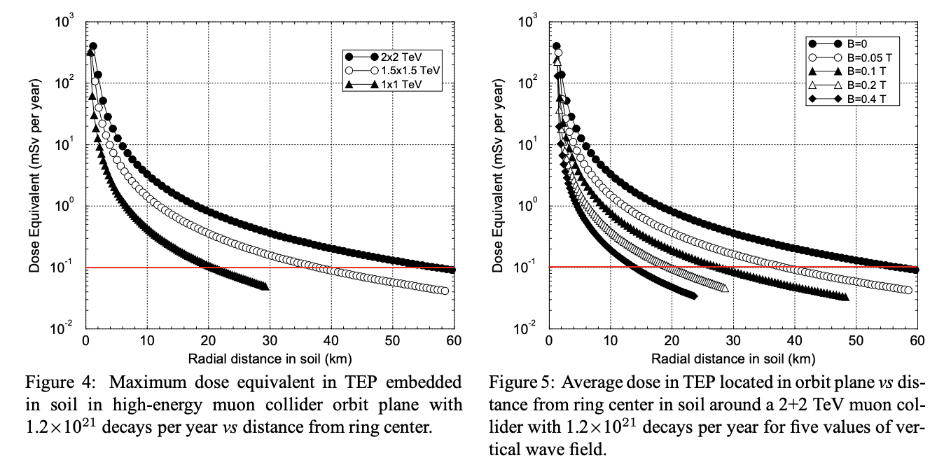
Muon Collider Accelerator Challenges
Neutrino Radiation Mitigation
Mokhov & Van Ginneken
Higher the collider energy the deeper the ring needs to be.
Magnetic field to dither the orbit also helps.
LHC Tunnel is 100m deep.

Slide 36
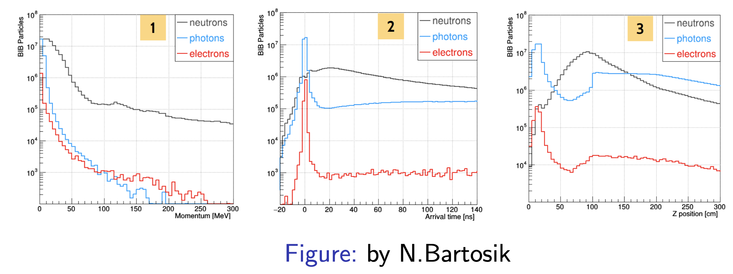
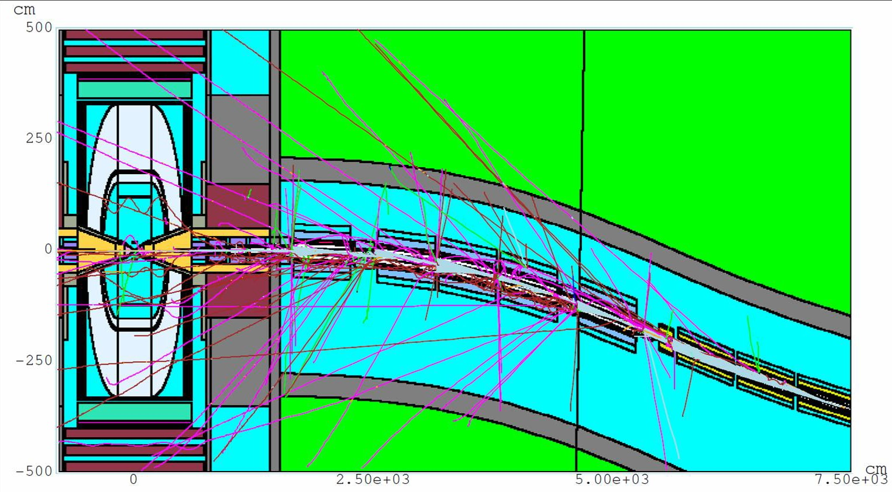
Muon Collider Challenges –
Beam Induced Background
Mitigation Strategies needed in spite of the optimized conical absorber
  Highly segmented detectors
  Timing cuts and energy cuts
  Doublet tracker design a la CMS tracker

Slide 37
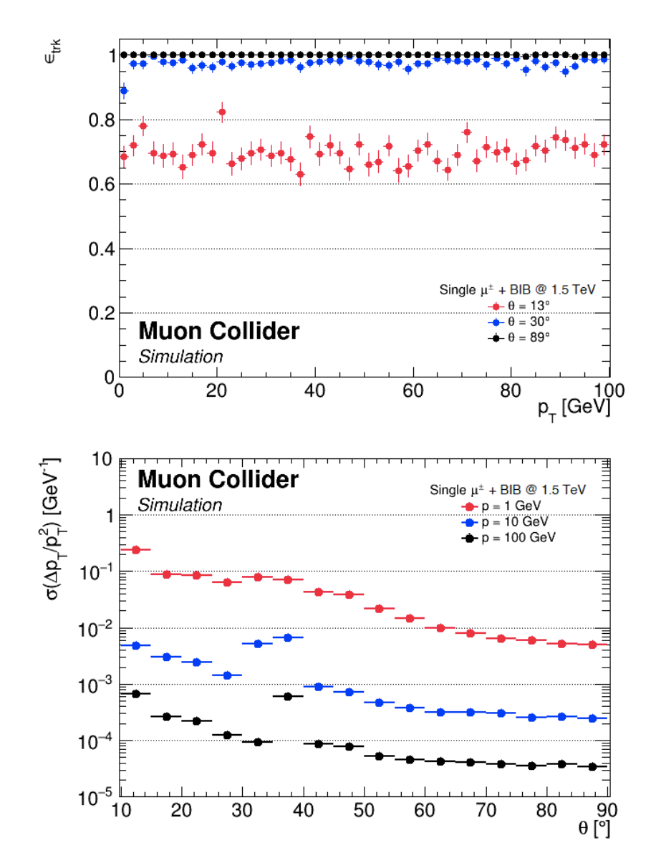
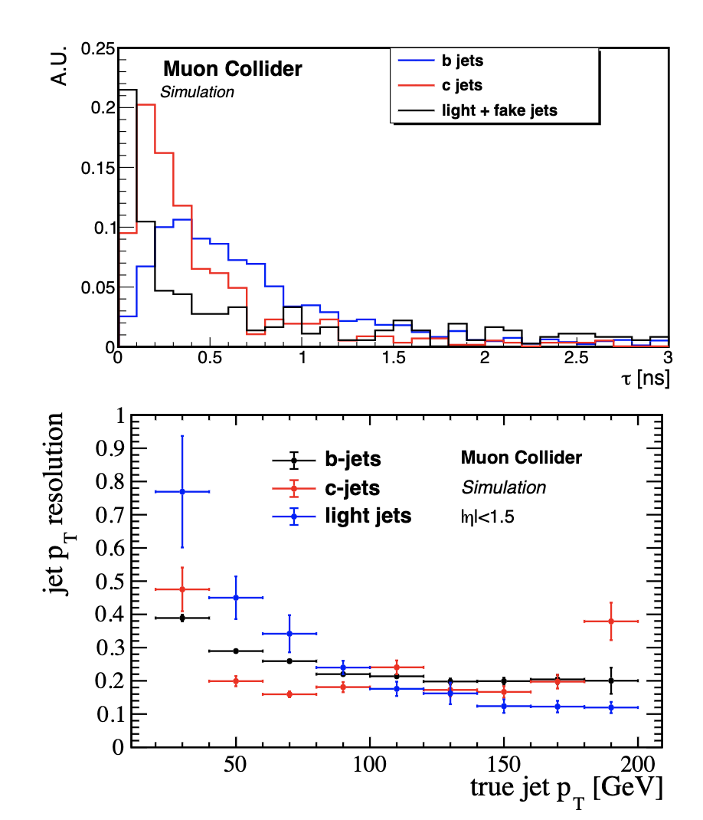
Can we reconstruct stuff?

Slide 38
Muon Collider Challenges …
10+ TeV is NEW Territory a Key Areas of Investigation:
Evaluation of physics potential (including detector technology)
  Impacts of beam induced background
Neutrino Flux Mitigation
  Straight accelerator sections produce intense ν beam - safety
High Energy Systems
  Acceleration sections can impact the energy reach due to cost, power, technical risk, and impact on beam quality
  10+ TeV Collider designs must be developed and fully evaluated
Cooling string demonstration to verify high brightness μ beam delivery

Slide 39

Path Forward

Slide 40

Summary – Asia & Europe

Slide 41

Summary – US Snowmass EF Addition

Slide 42
Spare Slides

Slide 43


