Slide 1
Trigger Electronics & Data Acquisition
Sridhara Dasu
Original slides & graphics “stolen” from:
Wesley Smith, Sergio Cittolin, Tom Gorski, Ales Svetek,
Maria Cepeda, Sascha Savin, Varun Sharma, Piyush Kumar, Pallabi Das, Isobel Ojalvo, Kevin Stenson, Phil Harris, …

Slide 2
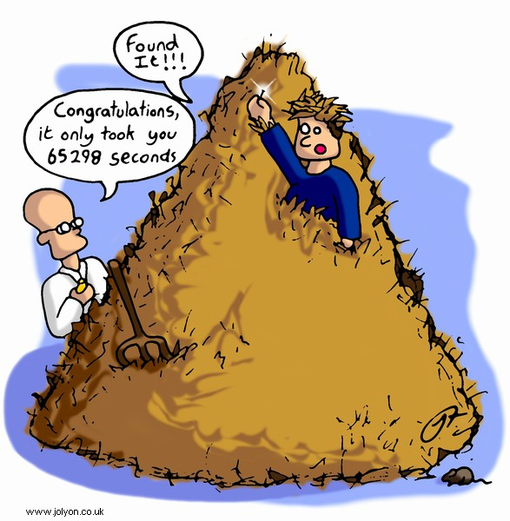



The Scientific Process
The Detector
Trigger Electronics
&
Data Acquisition
Software
&
Computing
SCIENCE
Journal Publications
Petabyte per
second
Petabytes get reduced to a social media post!
Petabytes
per year

Slide 3
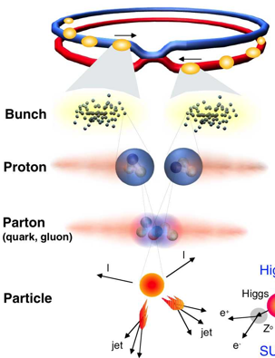
Proton-Proton Collisions at the LHC
 | Run-2 | Run-1
Beam energy | 6.5 TeV | 4.0 TeV
Bunches/ beam | 2556 | 1380
Protons/ bunch | 2.5x10¹¹ | 2.2x10¹¹
N pp Collisions Created | ~10¹⁶ | 3.5 x 10¹⁴
N Higgs Events | ~10⁴ | ~few 10²
Fetch me my needle buried in those
hay stacks –
And, do it
As Soon As Possible
1 event in 10 000 000 000 000 !
Notes:
1 barn = 10⁻²⁴ cm-²
Proton c.s 40mb/110mb@7TeV

Slide 4
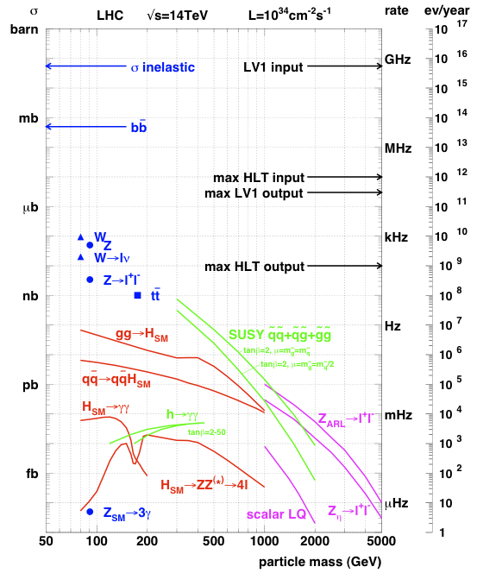
LHC Physics & Event Rates
L = 2 x10³⁴cm⁻²s⁻¹
  50 pp events/25 ns crossing
    ~ 1 GHz input rate
    “Good” events contain
    ~ 50 background overlap
  1 kHz W events
  10 Hz top events
  < 10⁴ detectable Higgs/year
Can store ~ 1000 Hz events
Select in stages
  Level-1 Triggers
    1 GHz (pp-interactions) to 100 kHz
  High Level Triggers
    100 kHz to 1000 Hz

Slide 5
(HL) LHC Physics – Trigger Challenge
Low ≅ 30 GeV
Electroweak Symmetry Breaking Scale
  Higgs (125 GeV) studies and higgs sector characterization
  Quark, lepton Yukawa couplings to higgs
New physics at TeV scale to stabilize higgs sector
  Spectroscopy of new EWK produced resonances (SUSY or otherwise)
  Find dark matter candidate
Multi-TeV scale physics (loop effects)
  Indirect effects on flavor physics (mixing, FCNC, etc.)
    B_{s} mixing and rare B decays
  Lepton flavor violation
    Rare Z and higgs decays
Planck scale physics
  Large extra dimensions to bring it closer to experiment
  New heavy bosons
  Blackhole production
Low P_{T} γ, e, μ
Low P_{T} B, τ jets
Multiple low P_{T} objects
Missing E_{T}
~ Dedicated triggers (CMS) or experiment (LHCB)
Low P_{T} leptons
High P_{T} leptons and photons
Multi particle and jet events

Slide 6
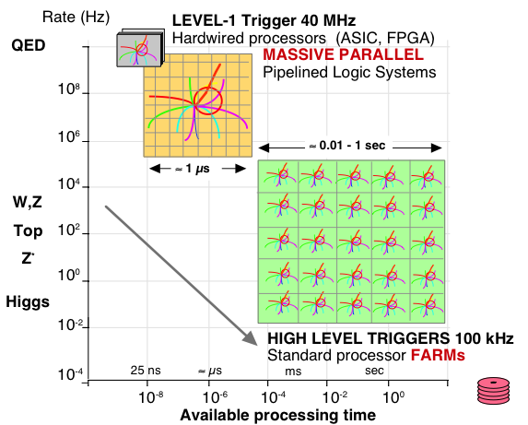
LHC Data Processing to Trigger
QCD

Slide 7
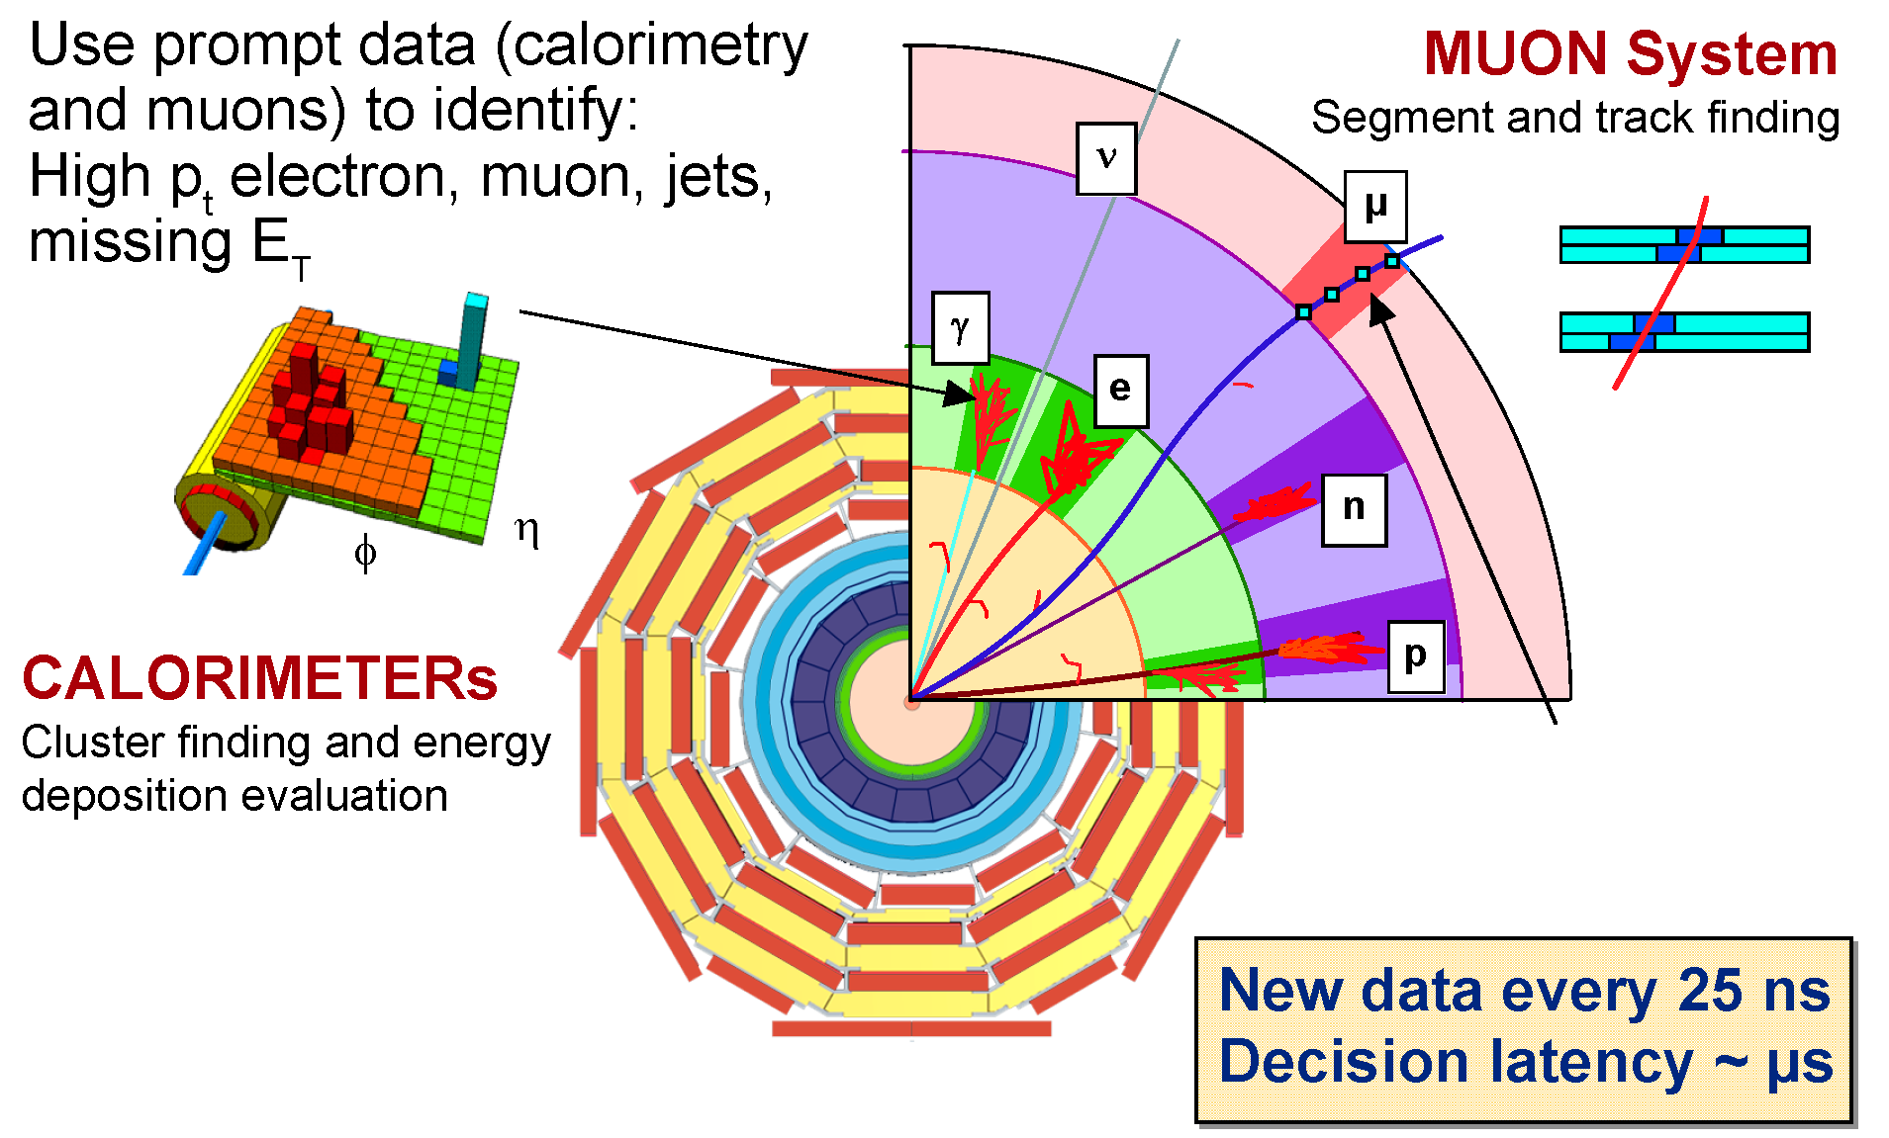
Level 1 Trigger Data

Slide 8
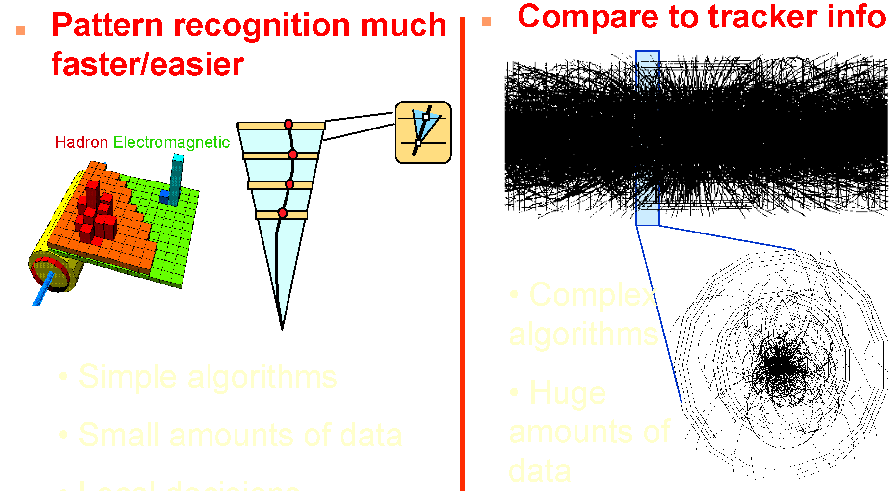
L1 @ LHC: Only Calorimeter & Muon – HLT@LHC: Key additional feature - Tracker
New tracker and level-1 track trigger envisioned for HL-LHC
L1T
HLT
Complex
Algorithms
Huge
amounts of
data
Simple Algorithms
Reduced amounts of data

Slide 9
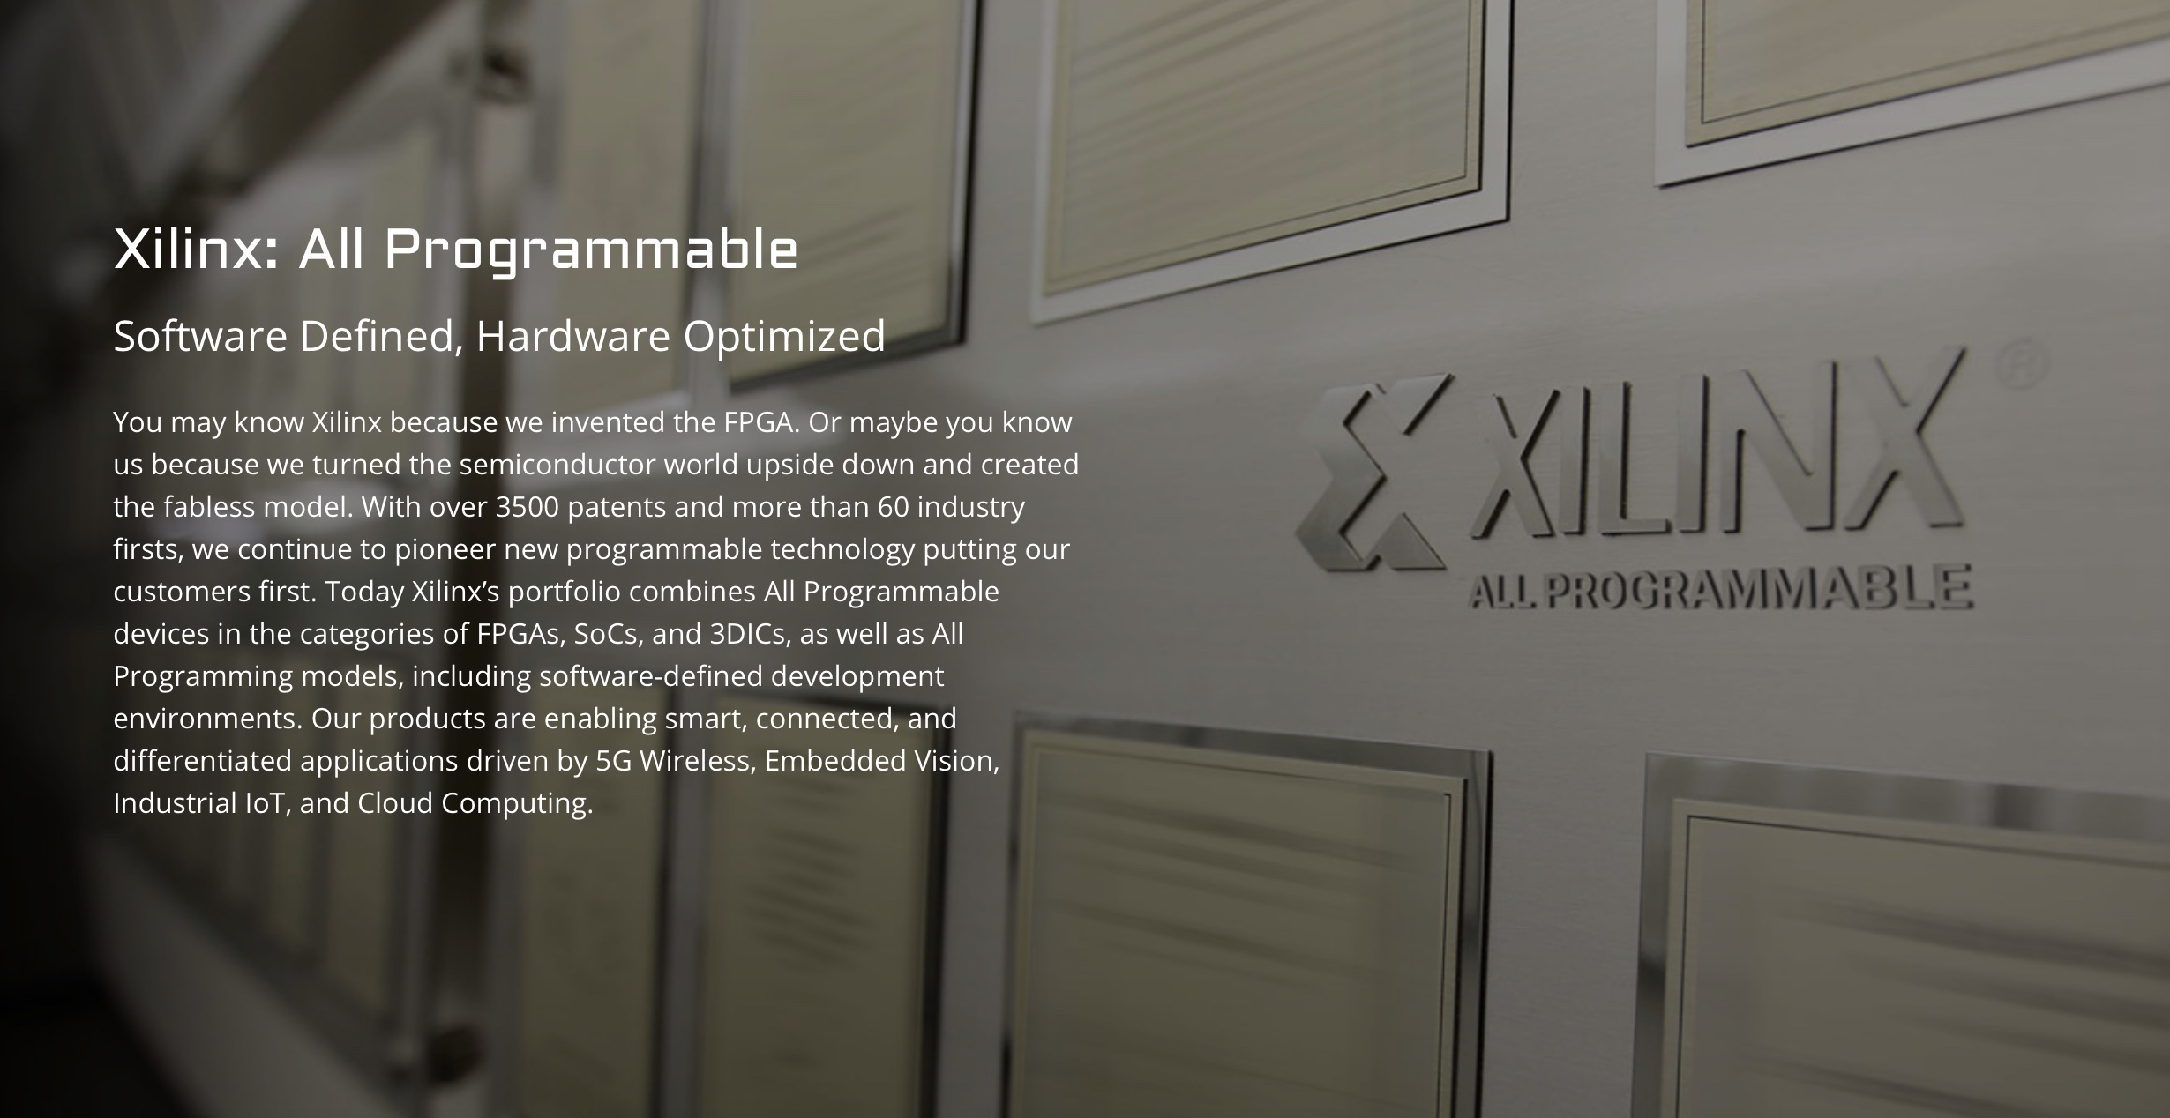
Xilinx Field Programmable Gate Arrays

Slide 10
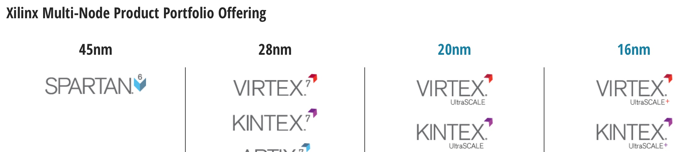
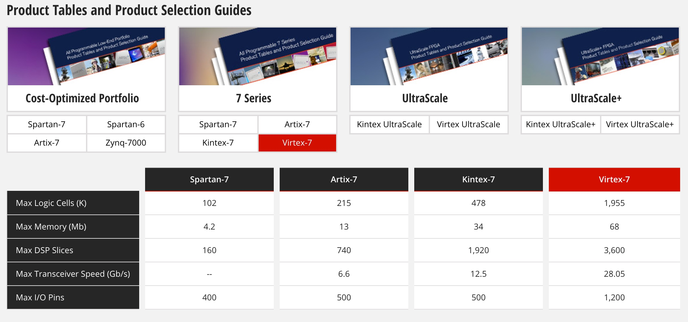
Xilinx FPGAs – Phase-1 Choice: V7 690T
Currently Deployed
HL-LHC
Prototypes

Slide 11
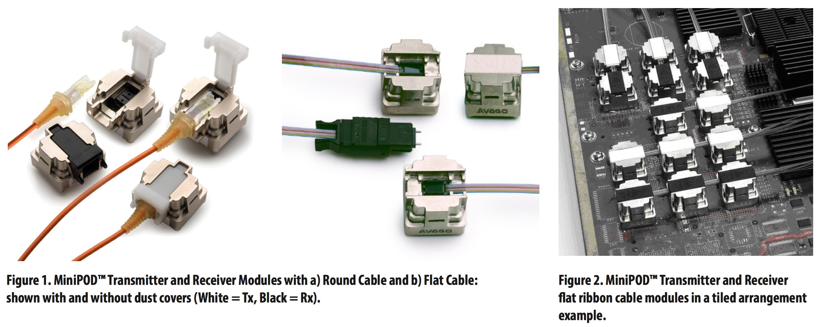
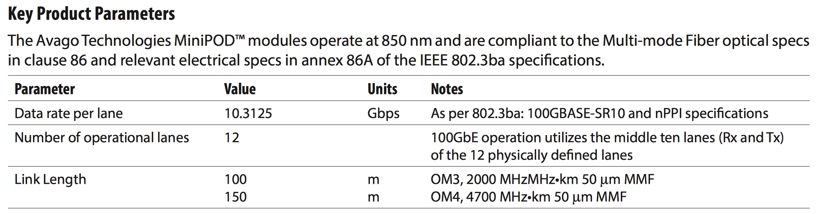
Key element - Multi-gigabit Opto-electronics

Slide 12
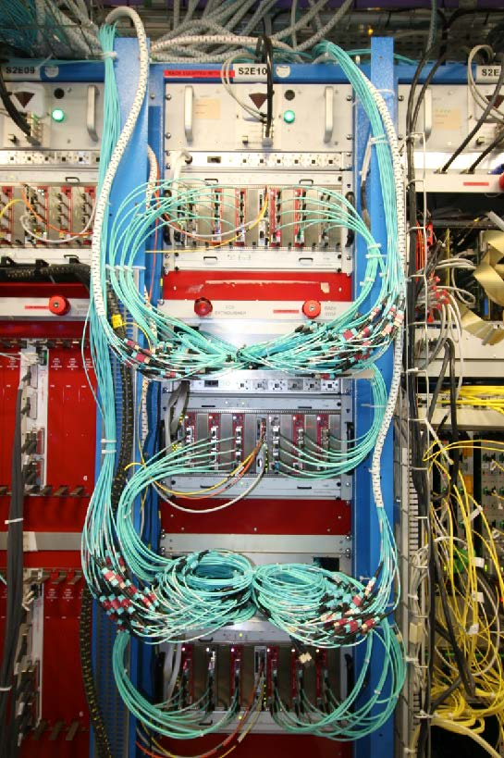
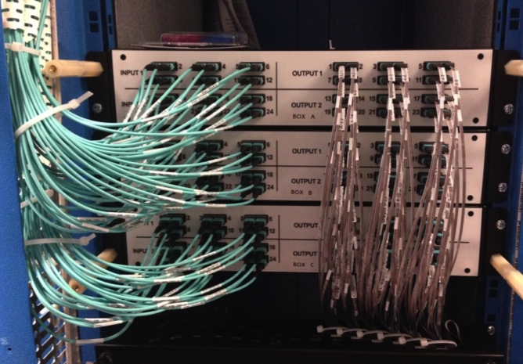
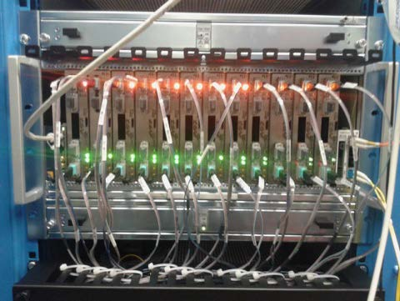
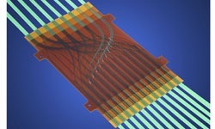
CMS Calorimeter Trigger Run-2
Installed and commissioned in 2015, fully operational in 2016
  Connections to CTP7 from Layer-1 patch panels completed in 2015
  Connections from Layer-1 to Layer-2 via compact patch panel
    3 “pizza box” sized patch panels instead of full 56U rack with LC connectors
  Layer 2 to demux to new μGT connected
Layer-1 CTP7
Layer-1 to Layer-2
Patch Panel
Layer-2 MP7
MOLEX
FlexPlane

Slide 13
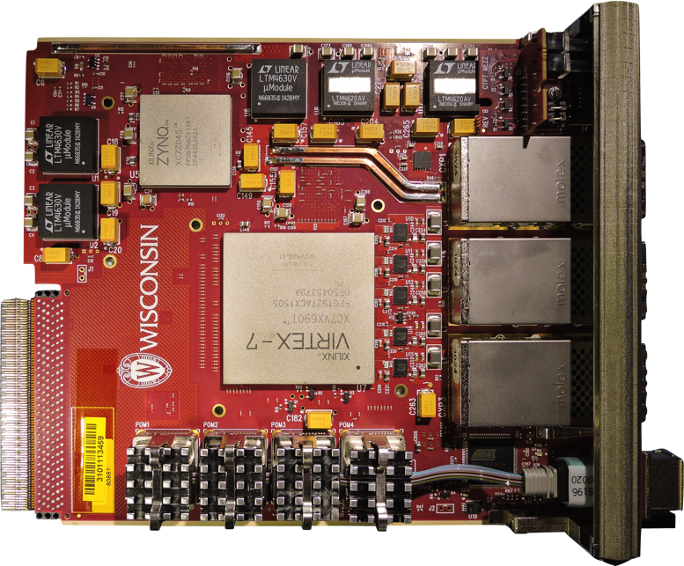
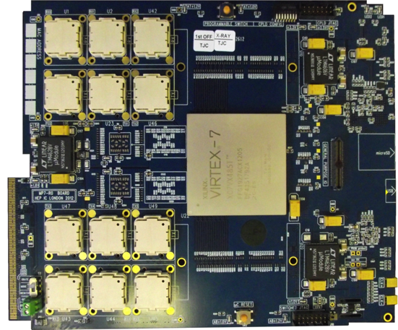
Level-1 Calorimeter Trigger Electronics
JTAG
USB
Interface
Power Supplies
Rx
Tx
ZYNQ
2V5
3V3
μSD
3 CXP modules
1V5
1V8
2xQDR
(Bottom)
FPGA
FPGA
USB
Rx
Tx
μC
(Bottom)
MiniPODs
MMC
MiniPod modules
1V0
Calorimeter Trigger Processor(CTP7 – left), and Master Processor (MP7 - right)
  CTP7 (Layer-1) – μTCA Single Virtex 7 FPGA, 67 optical inputs, 48 outputs, 12 RX/TX backplane
    Virtex 7 allows 10 Gb/s link speed on 3 CXP(36 TX & 36 RX) and 4 MiniPODs (31 RX & 12 TX)
    ZYNQ processor running Xilinx PetaLinux for service tasks, including virtual JTAG cable
  MP7 (Layer-2) – μTCA Single Virtex 7 FPGA, up to 72 input & output links
    Virtex 7 has 72 input and output links at 10 Gb/s
    Dual 72 or 144MB QDR RAM clocked at 500 MHz
Notes:
oRSC – optical Receiver Summary Card
CTP7 – Calorimter Trigger Processor
MP7 ?

Slide 14
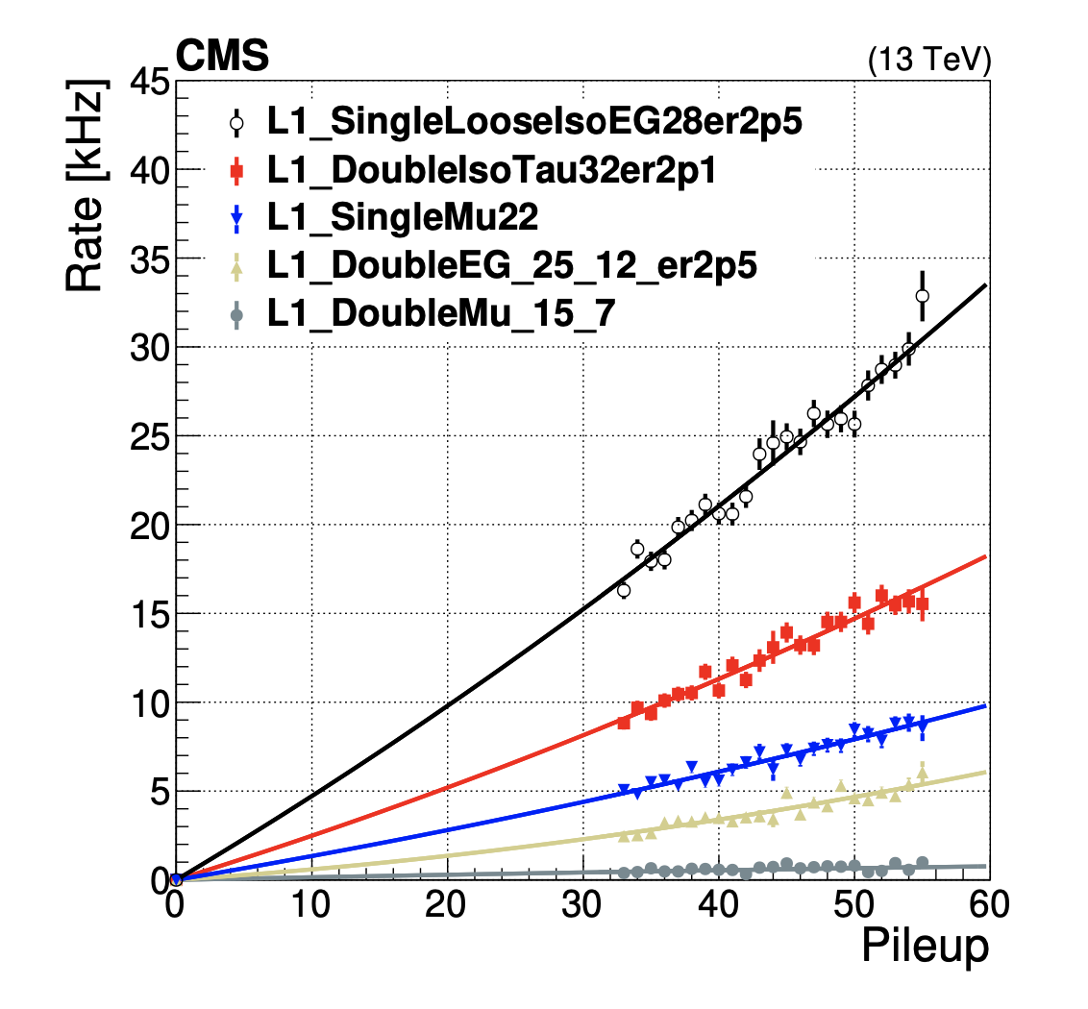
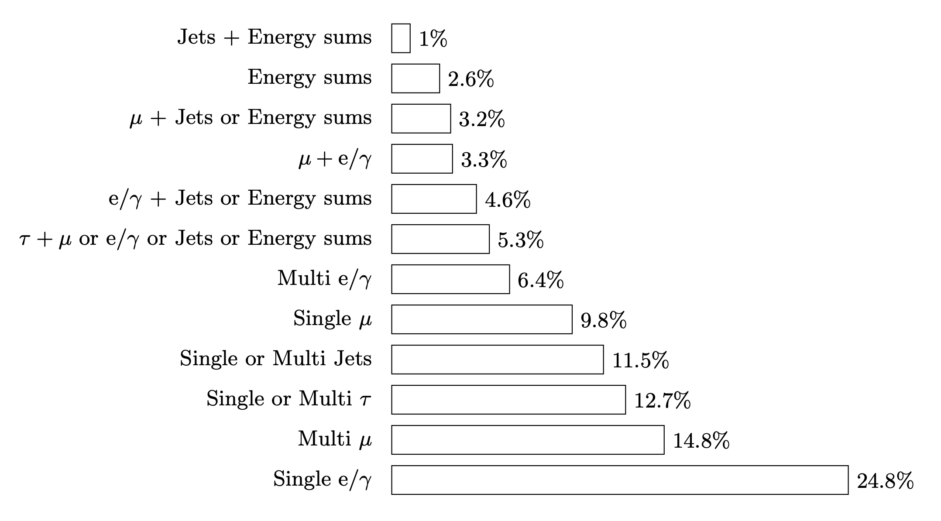
L1 Trigger Summary from Run-2,3
We capture the physics of interest within 100 kHz bandwidth, while discarding majority of 32 kHz of collisions

Slide 15
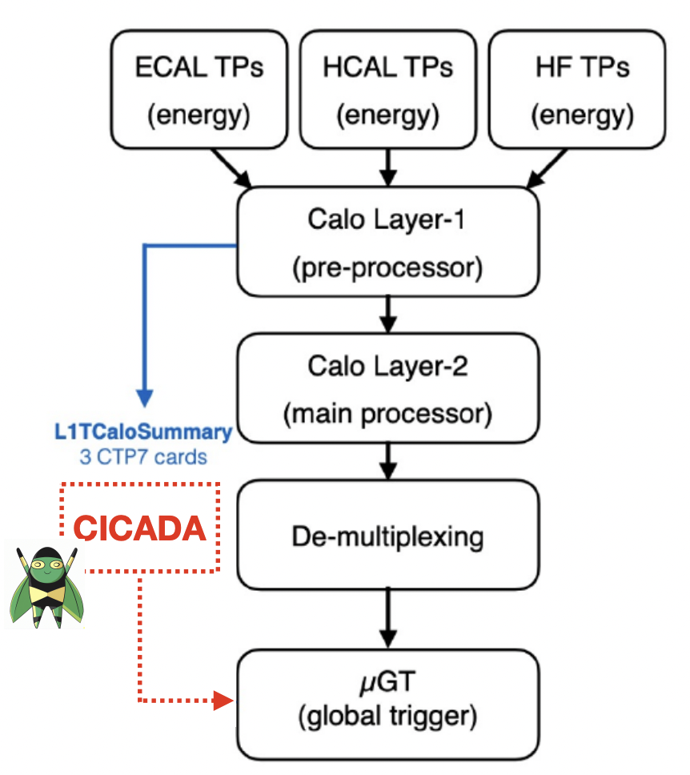
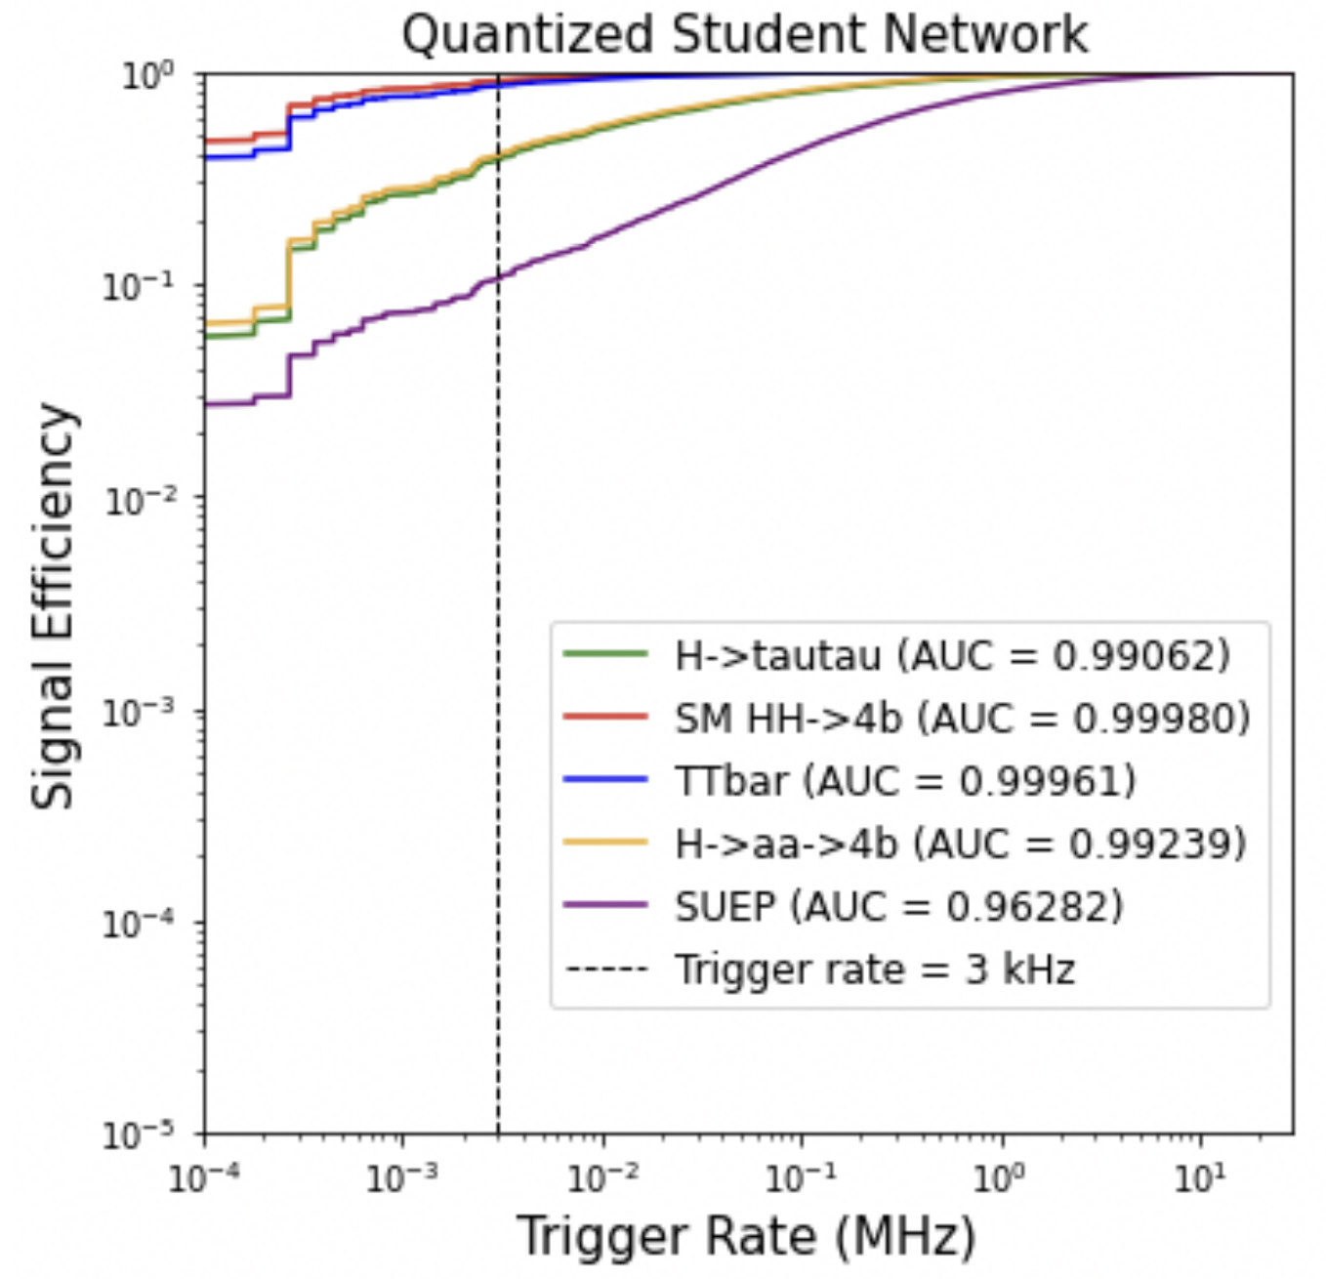
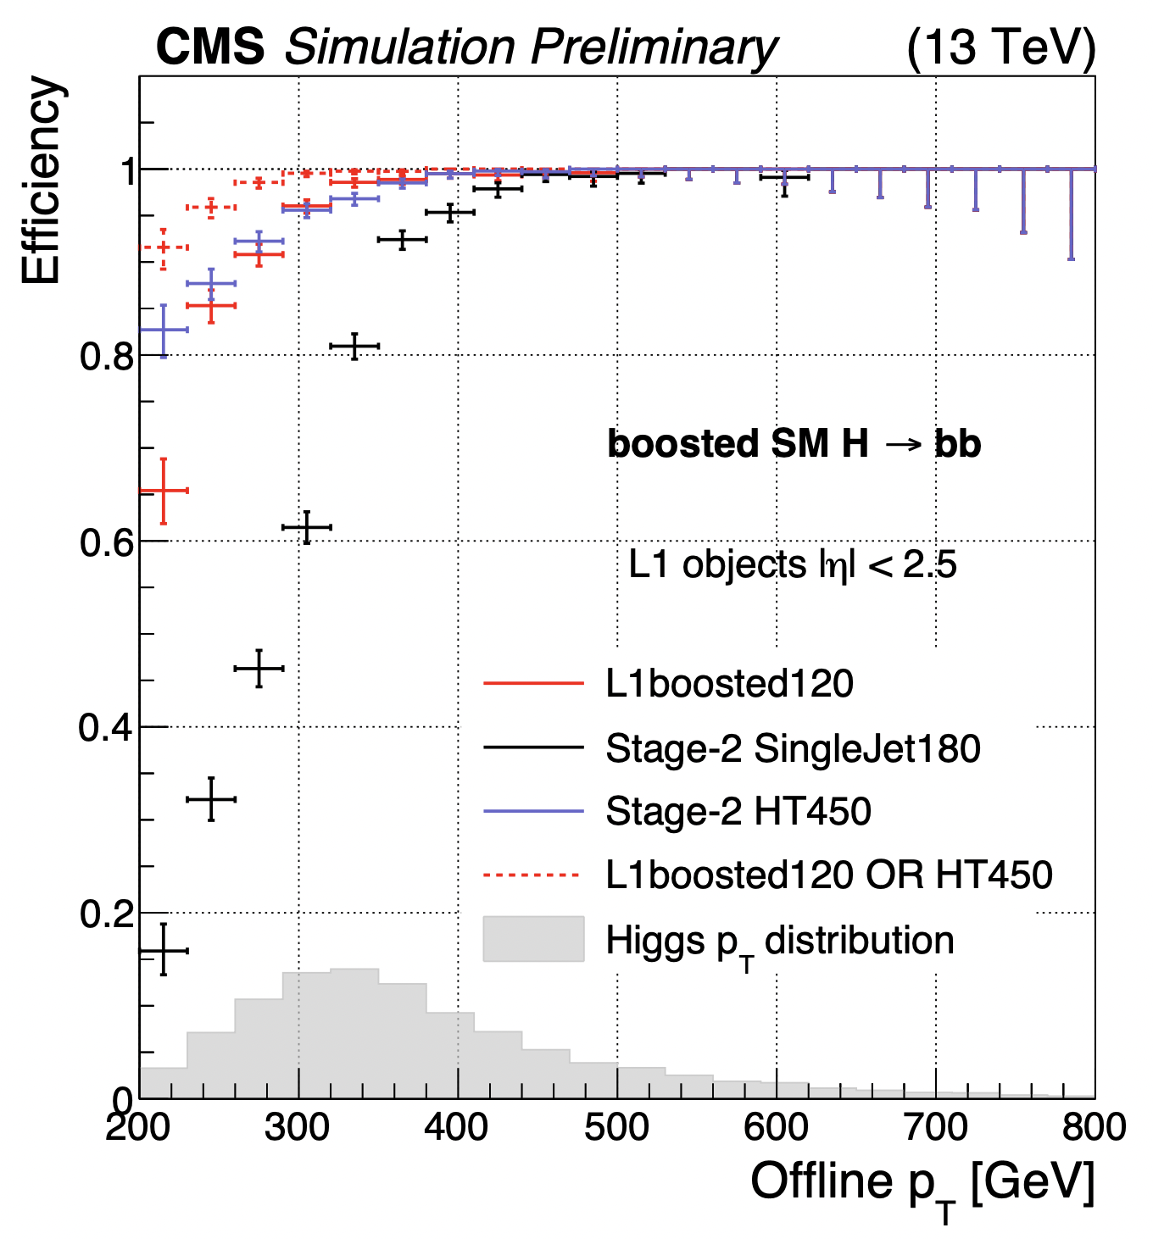
CICADA – Machine Learning in L1T
Unsupervised learning
“Anomaly Detection”
Ho-Fung Tsoi
Also includes new (but traditional) boosted object algorithm
Pallabi Das

Slide 16
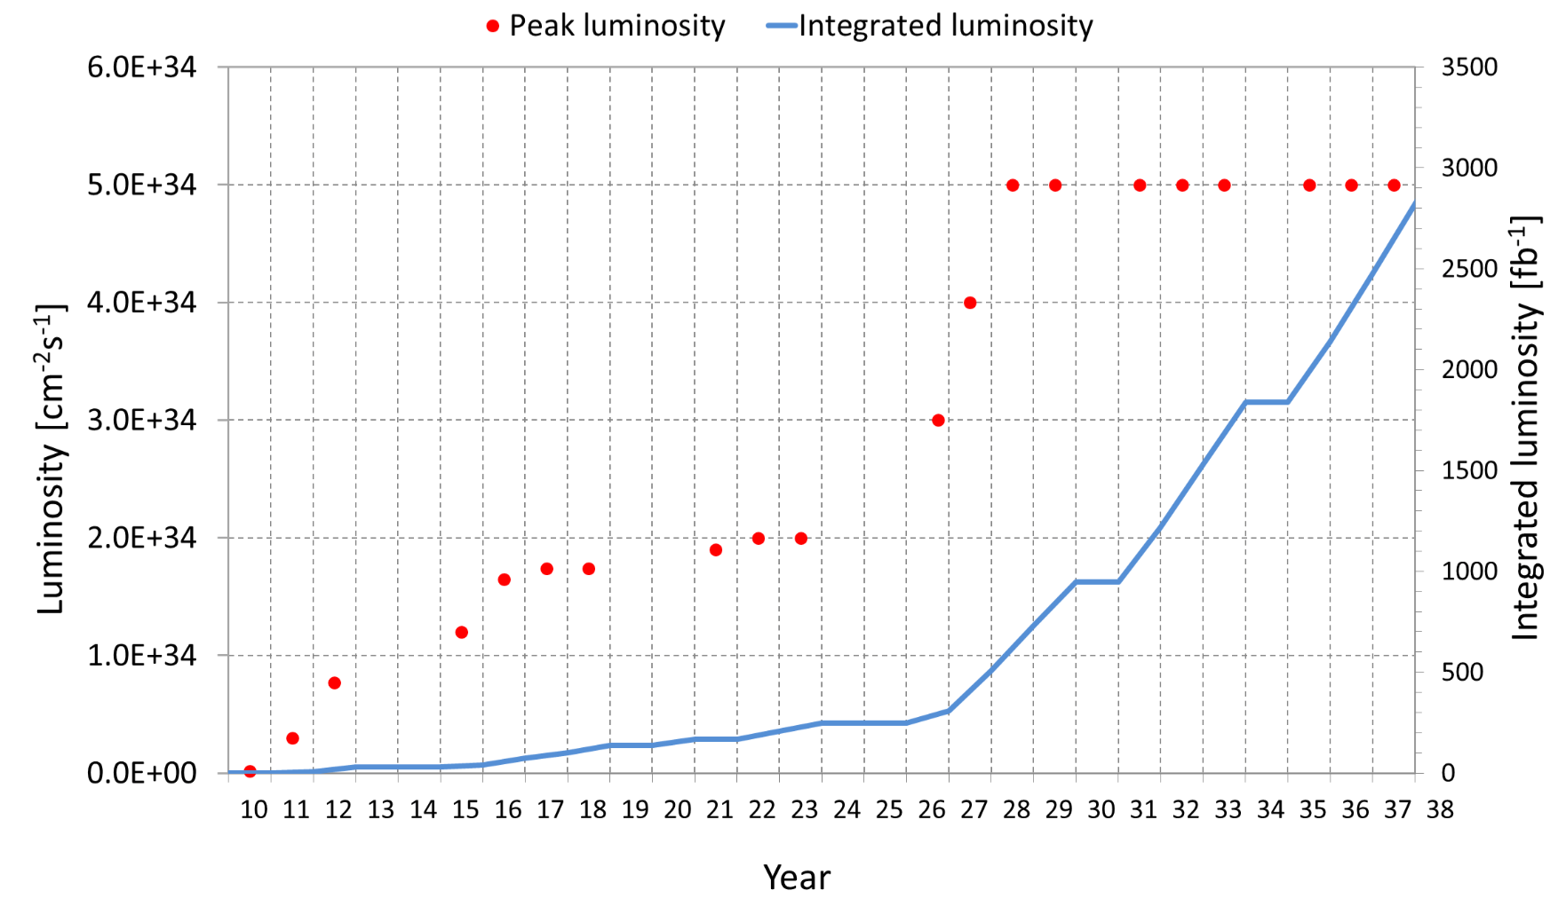
LHC Now ➔ HL-LHC in the Future
LS2
LS4
HL-LHC
LS1
LS3
LS5
Run 1
Run 2
Run 3
Run 4
Run 5
Run 6
Trigger-Rate: ~500 Hz
Trigger-Rate: ~1 kHz
Trigger-Rate: ~1 kHz
Trigger-Rate: ~7.5 kHz
Trigger-Rate: ~7.5 kHz
Trigger-Rate: ~7.5 kHz
CMS will be on path to exabytes of data acquired in the HL-LHC era

Slide 17
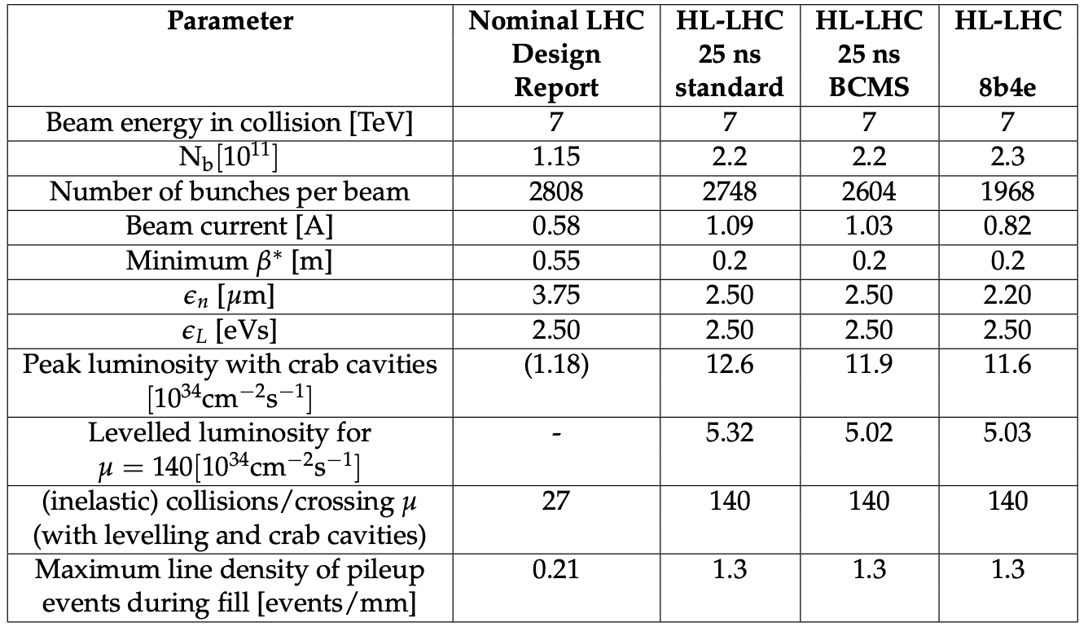
HLLHC Parameters
Operating at 2x now
Expect Operating at 7.5x ultimately
μ=200

Slide 18
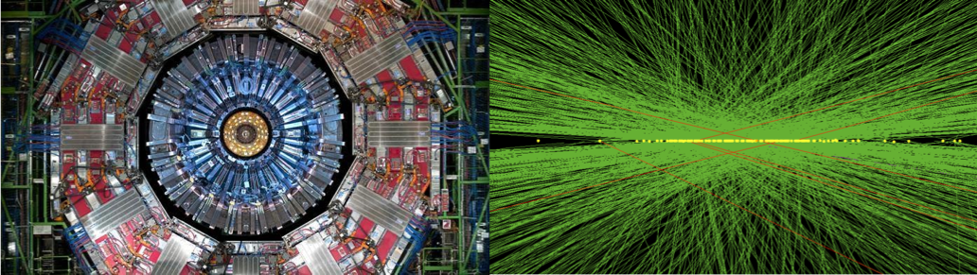
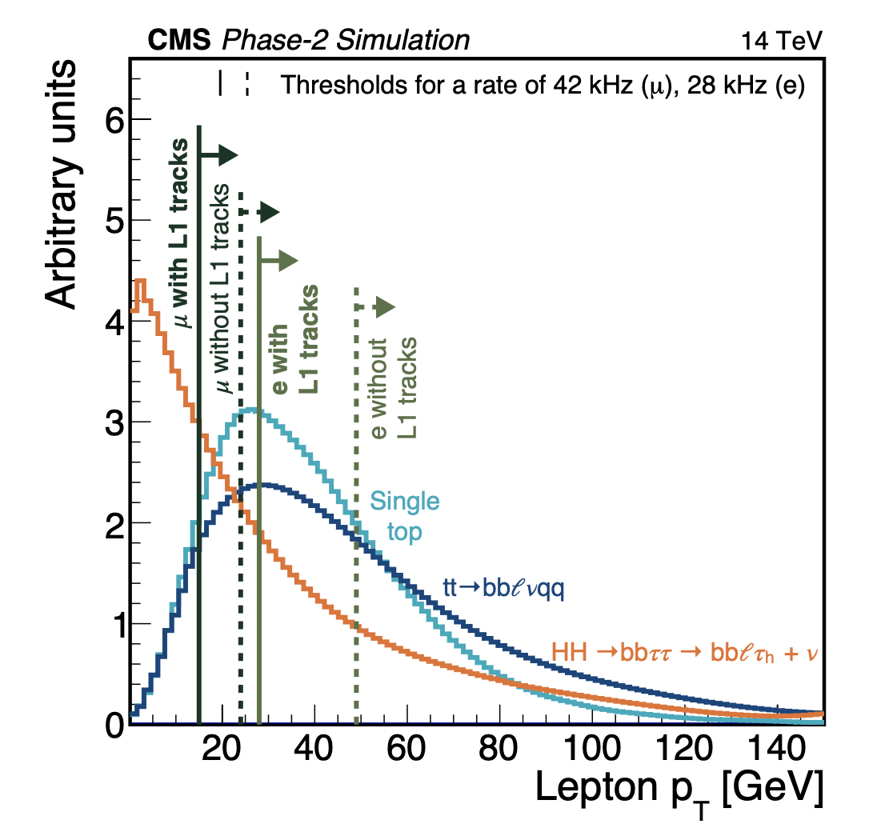
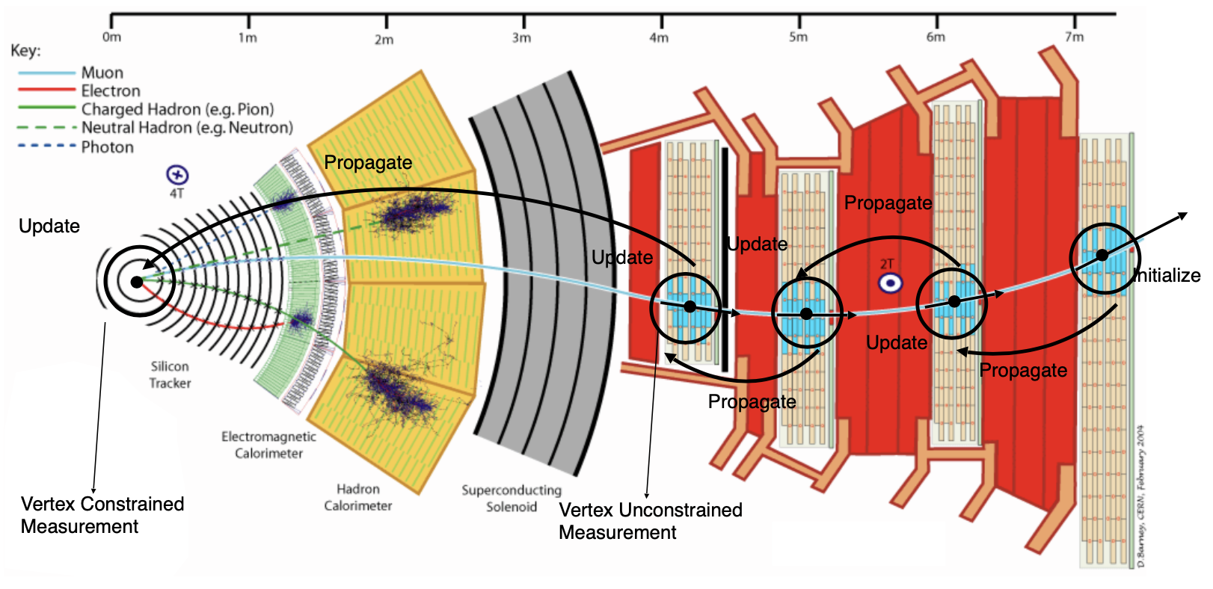
Collisions (p-p) at HLLHC
Can not afford to go any higher in thresholds!
Selecting high P_{T} clusters and tracks

Slide 19
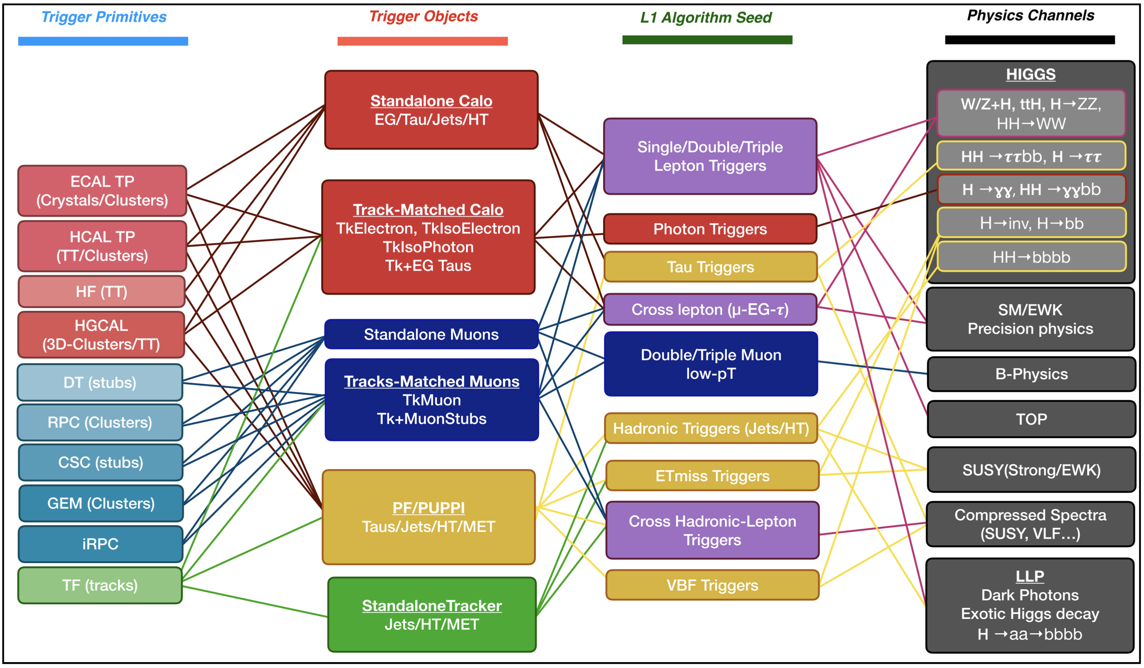
Triggers → Physics

Slide 20
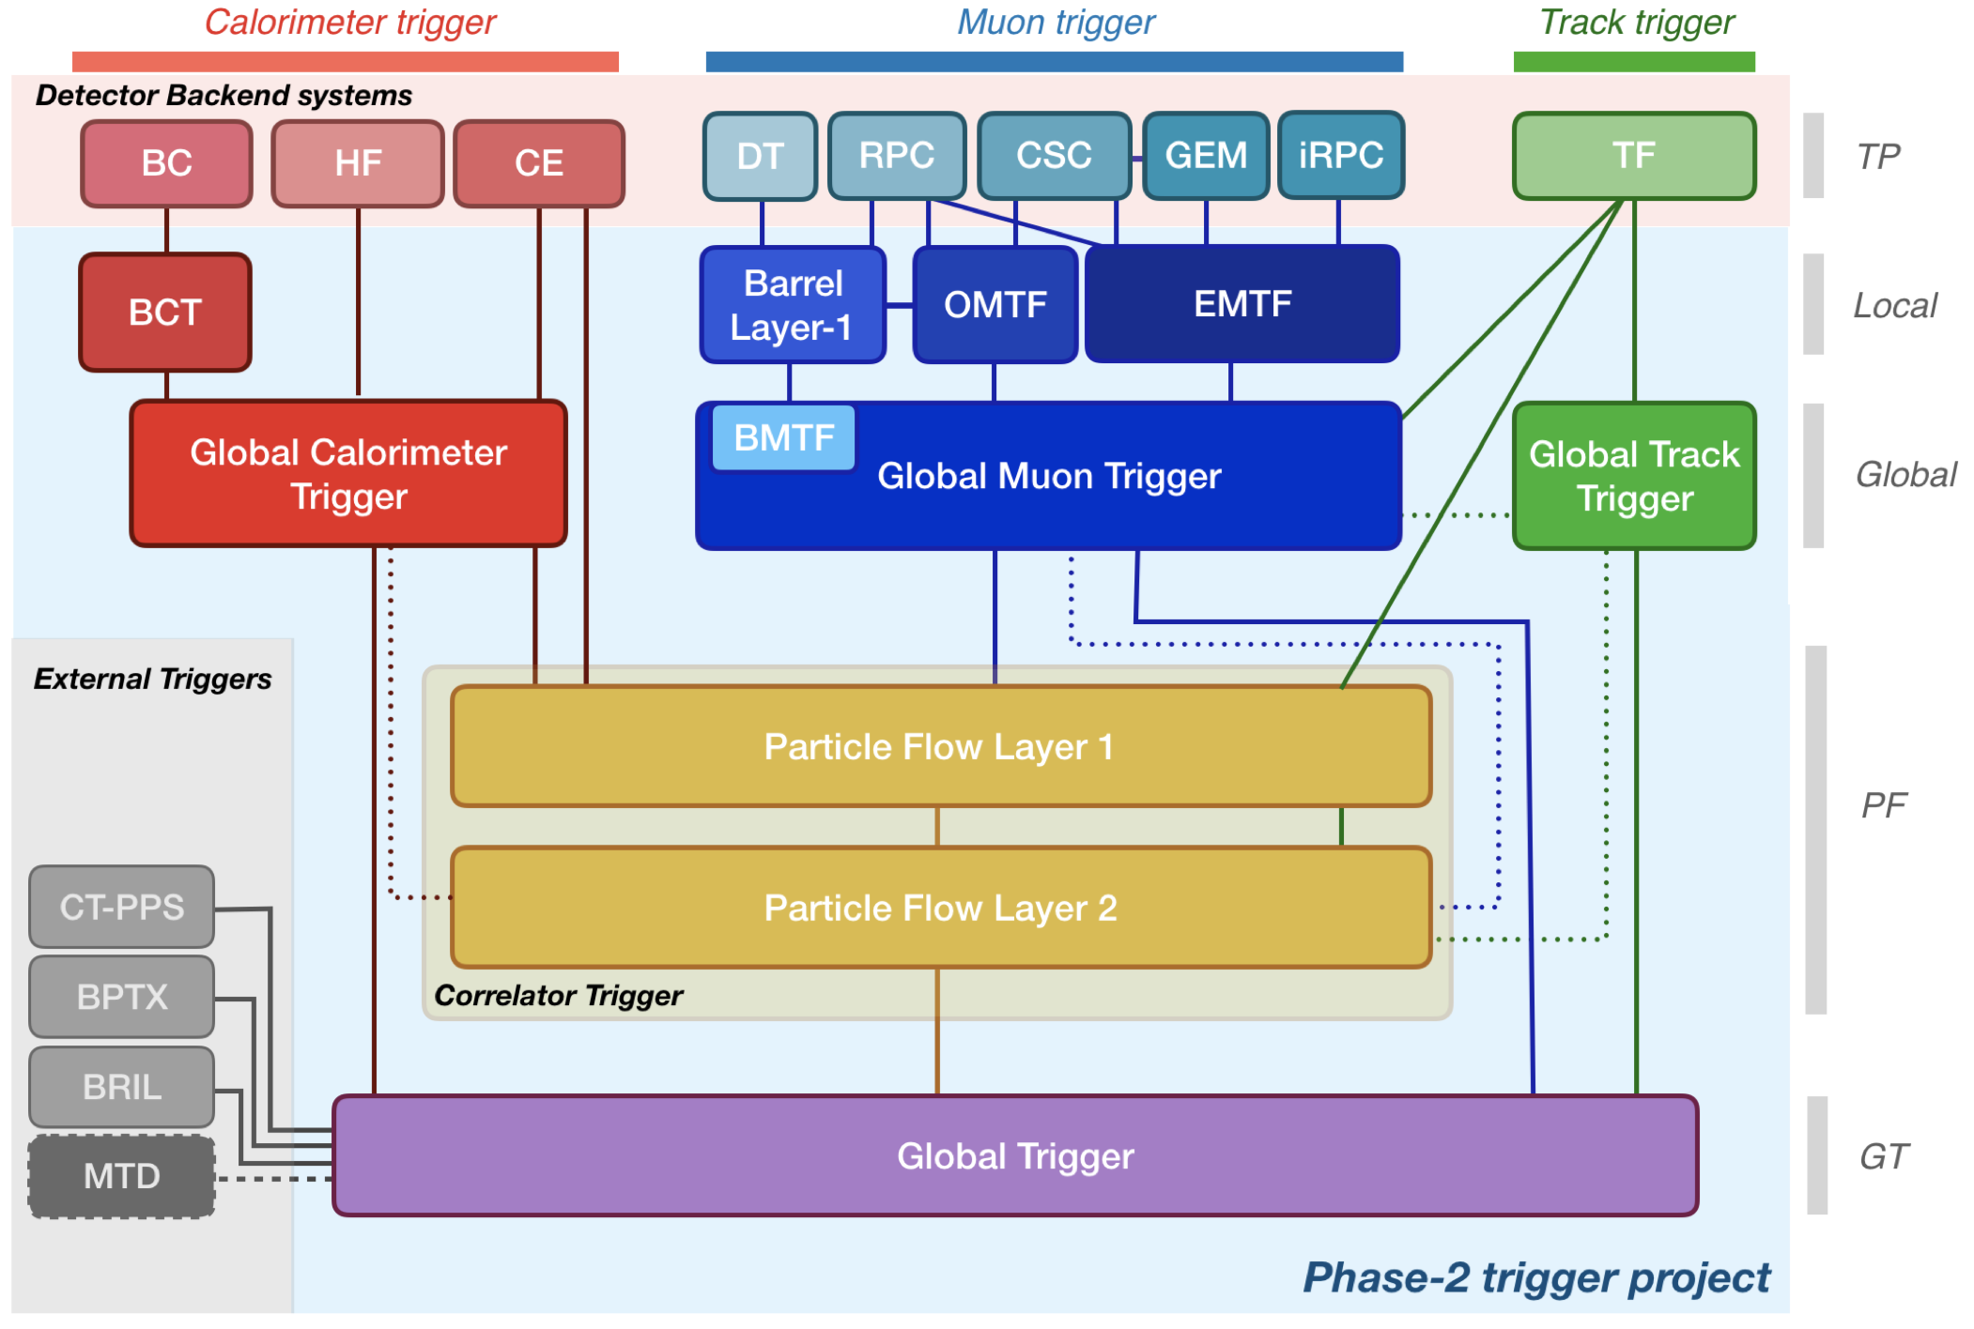
CMS HLLHC Level-1 Trigger 2020
New for HLLHC

Slide 21
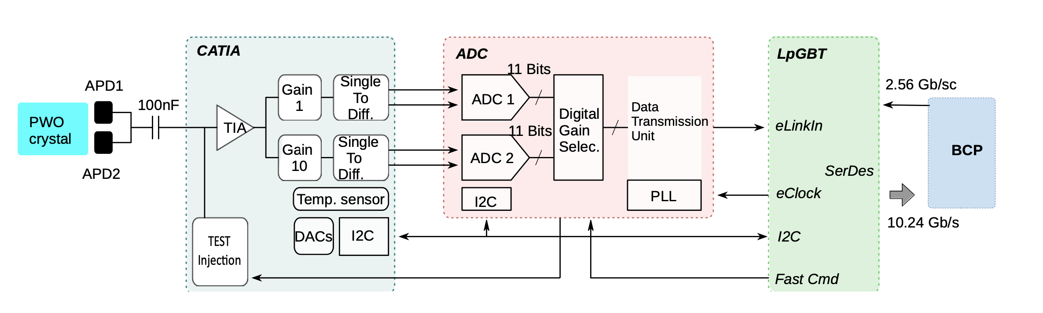
Getting the crystal data out
(New for HLLHC)
There are 61200 crystals to be processed – packing 25 crystals per link out of BCP you still have 2448 links at 16 Gbps to contend in the calorimeter trigger path!

Slide 22
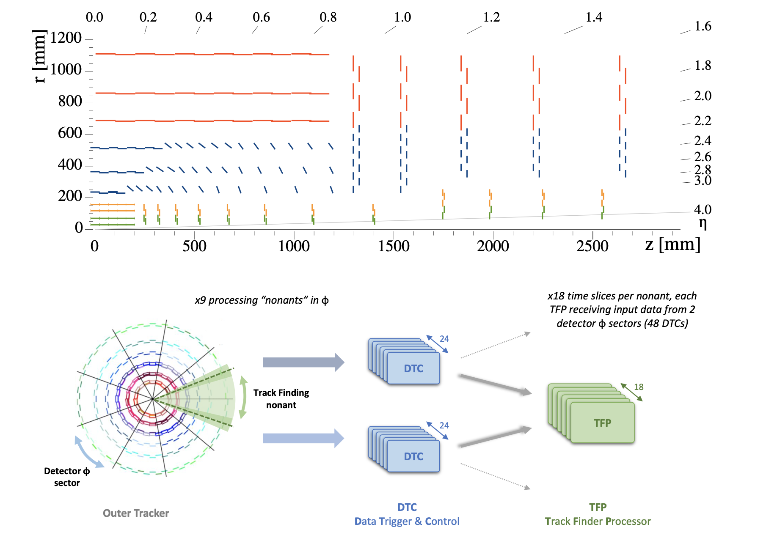
Getting the tracks out
(New for HLLHC)
Outer tracker double layers allow track stub readout
Tracklets formed in TFP consistent with >2GeV P_{T}. Tracks propagated in-out, matched to form track candidates
Tracklets are then fit to make a track

Slide 23
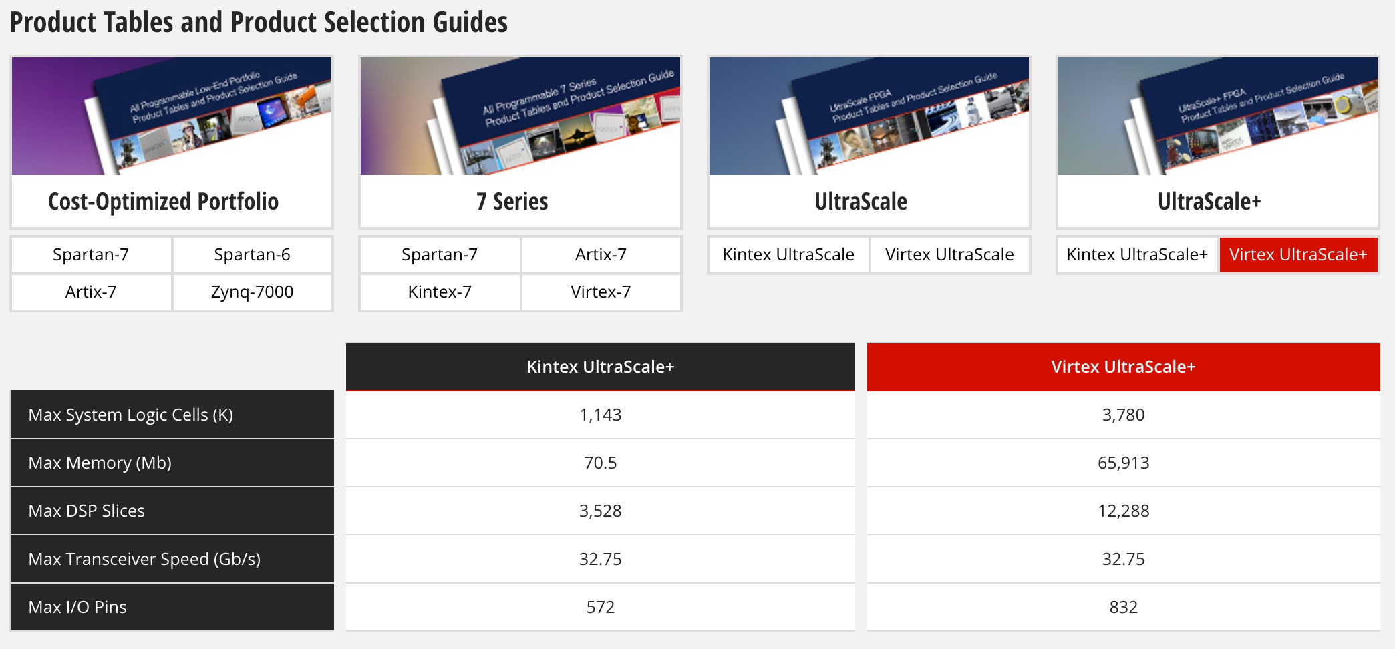
HL-LHC L1 Trigger Challenge
Xilinx – Ultrascale+ Processors
Times 2
Many times
Times 3
Times 2.5

Slide 24
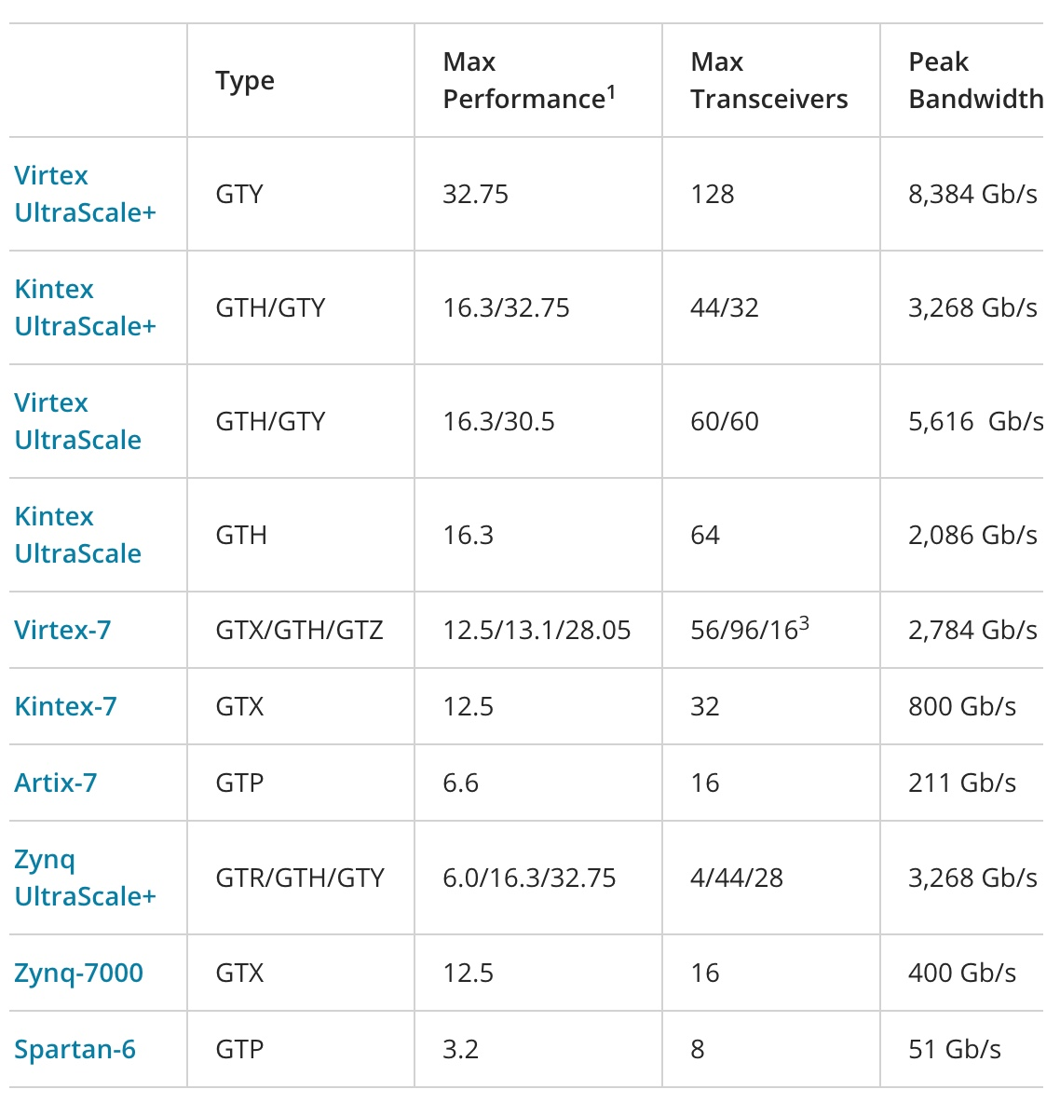
Multi-gigabit-per-second serial links
HL-LHC
25 Gbps
LHC
10 Gbps

Slide 25
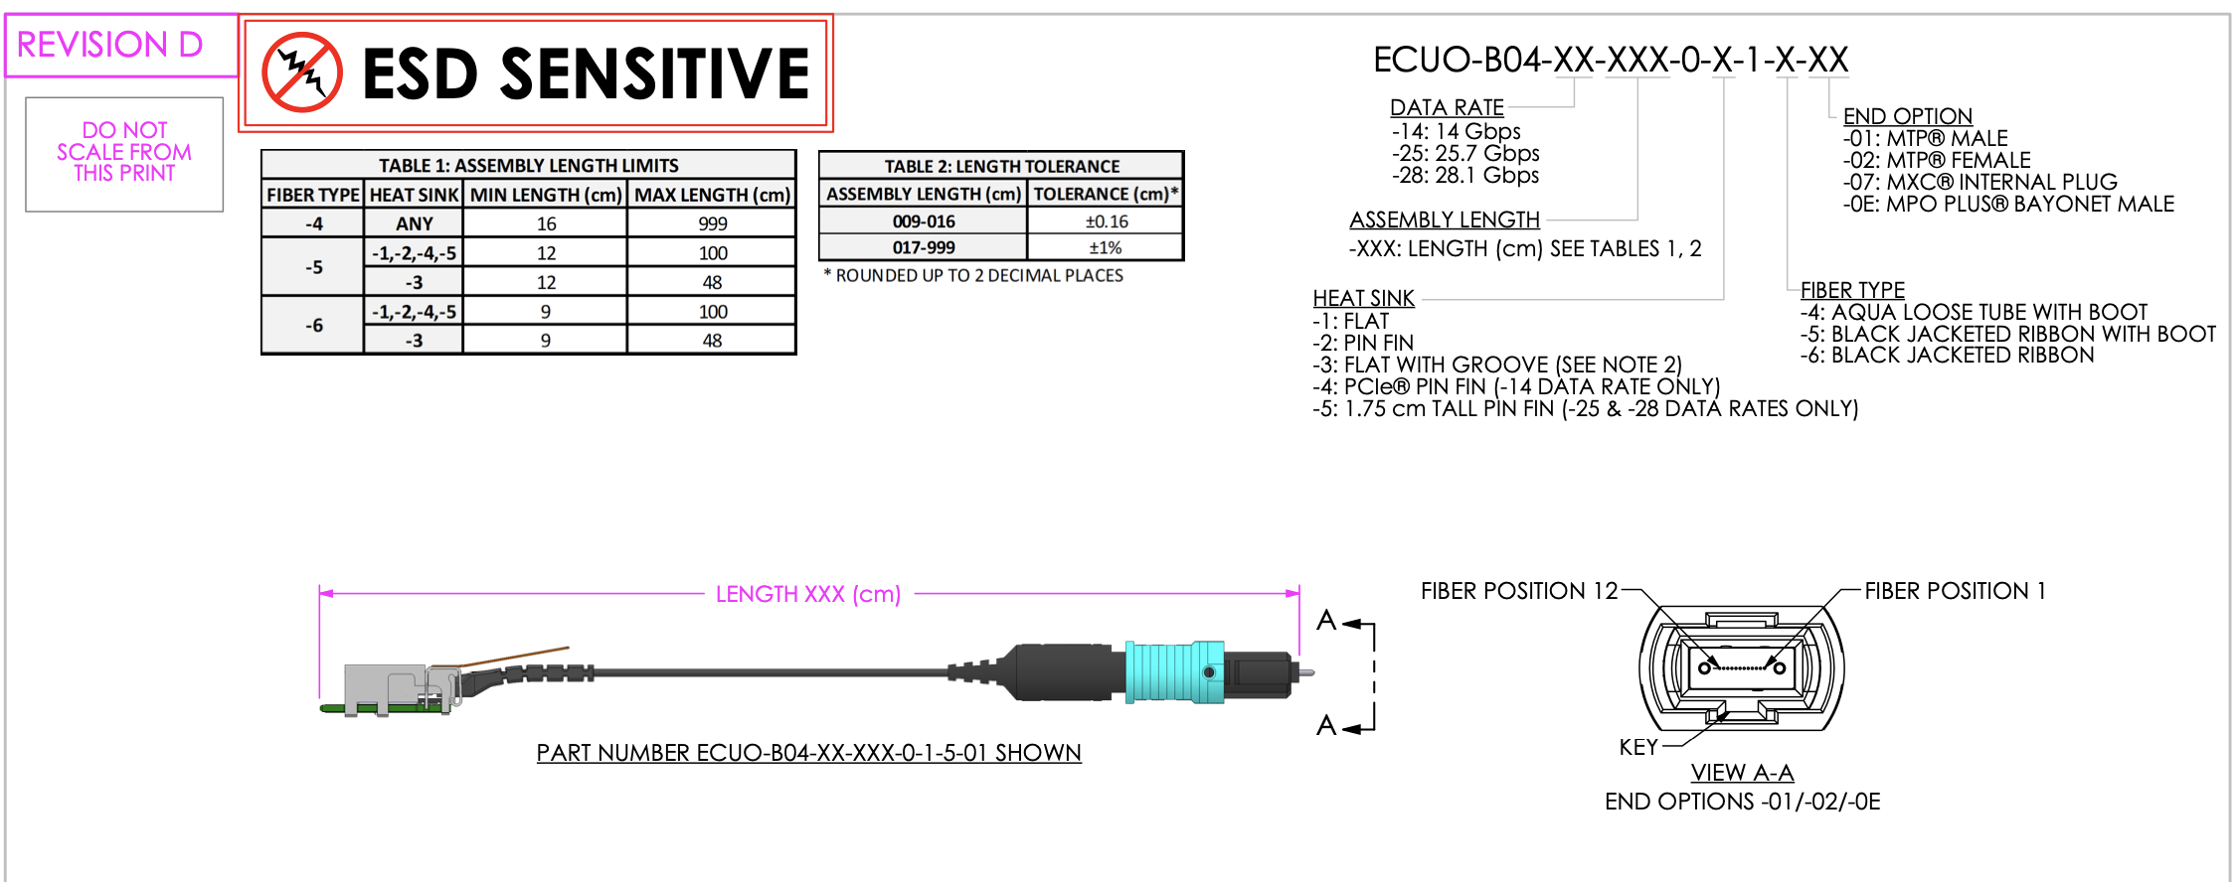
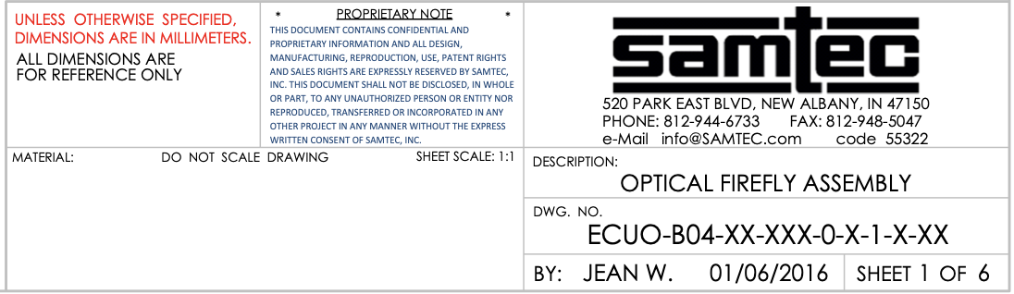
Key element - Multi-gigabit
Opto-electronics

Slide 26
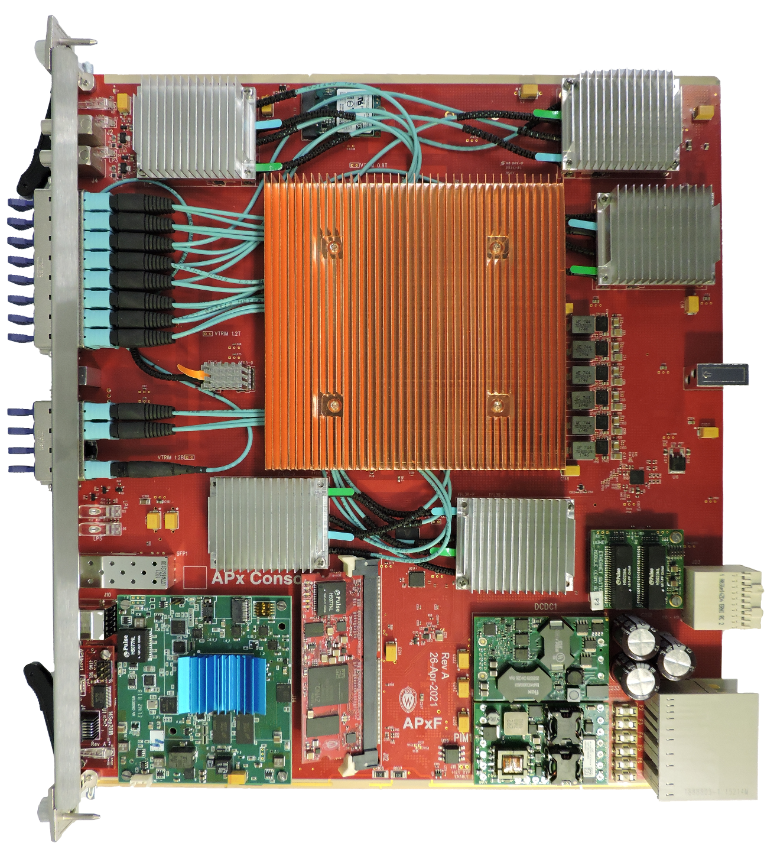
Advanced Processor Prototype for HL-LHC
Wisconsin APxF Board
Xilinx VU13P or VU9P FPGA
ZYNQ-IPMC
(ATCA IPMI controller)
ELM (ZYNQ-based embedded Linux endpoint)
ESM (GbE switch)
High efficiency heatsinks
Front-panel inputs
25G Samtec Firefly positions loaded – 10x12 + 1x4
(124 25 Gbps links)
TIFR built IPMC & ESM mezzanines

Slide 27
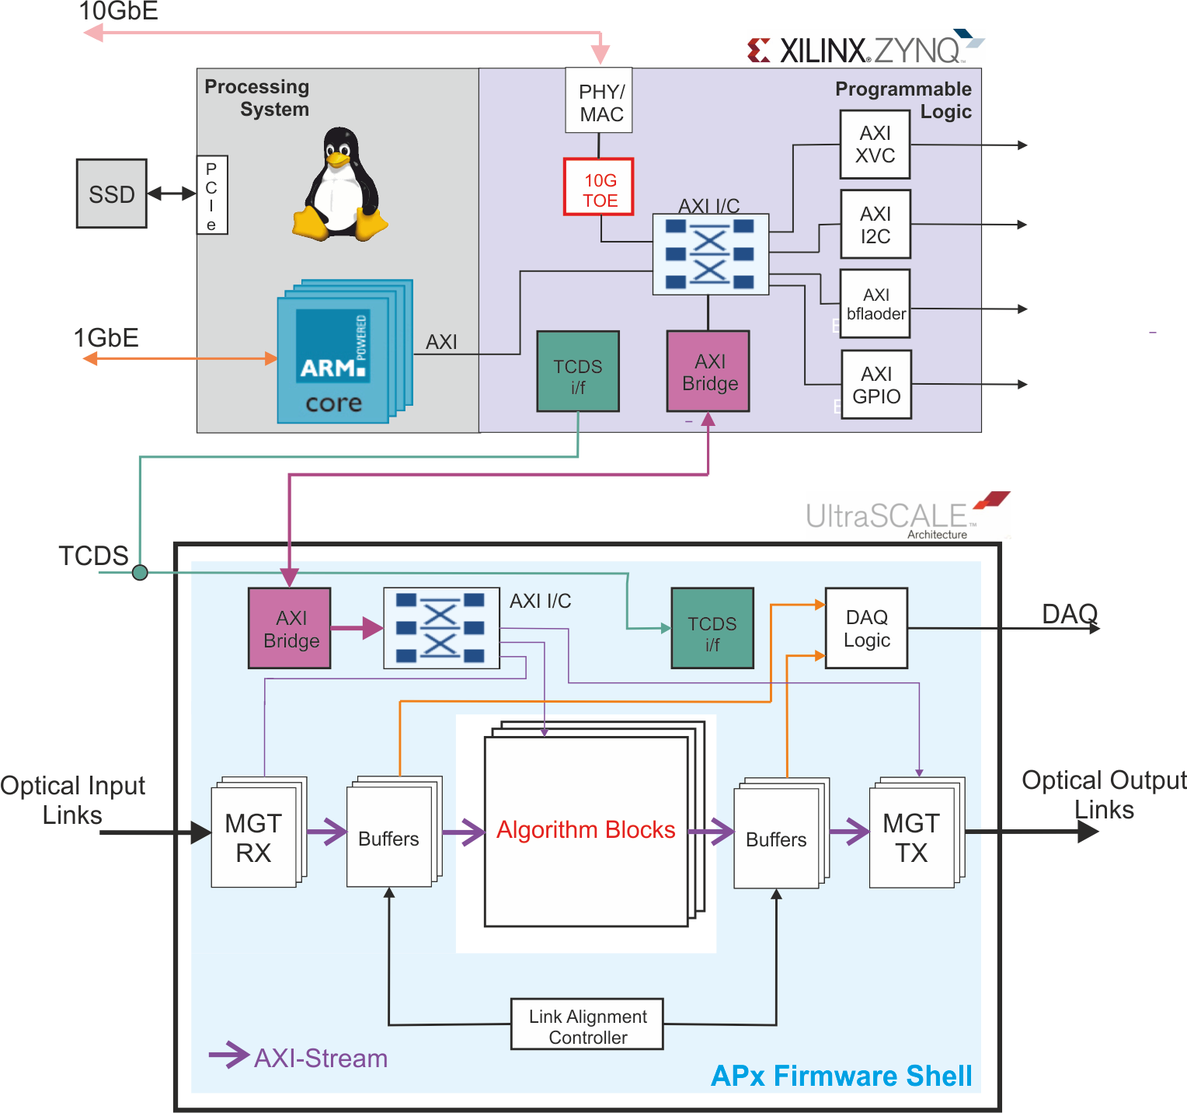
APx – Firmware/Software
A new paradigm for firmware development
  Core firmware written in VHDL by engineers
  Gigabit link support
  Data exchange between SLRs within chip
  Test buffers
  Clock and control
Physics
  Algorithmic firmware in high-level languages like C++ written by physicists
ELM:
Control endpoint,
providing complete
board overhead
functionality
Processing FPGA:
I/O
data processor
DAQ

Slide 28
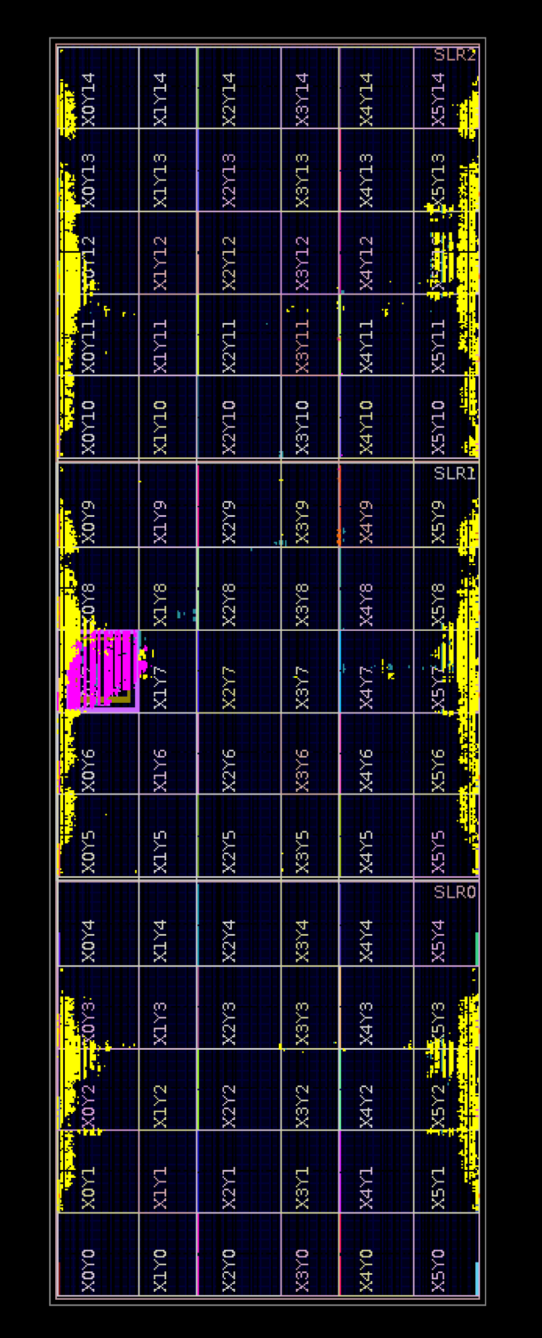
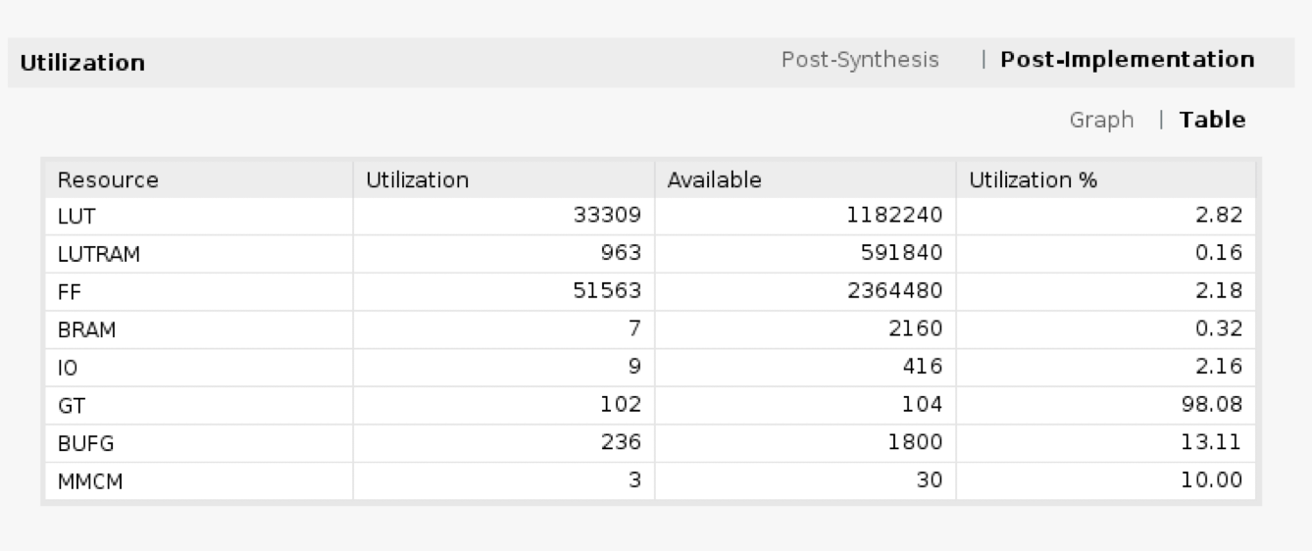
APx-FS Resource Utilization
VU9P build
100x 25G GTY links w/ support infra
Central AXI infra with MGT-based Chip2chip core
APd1 VU9P FPGA floorplan

Slide 29
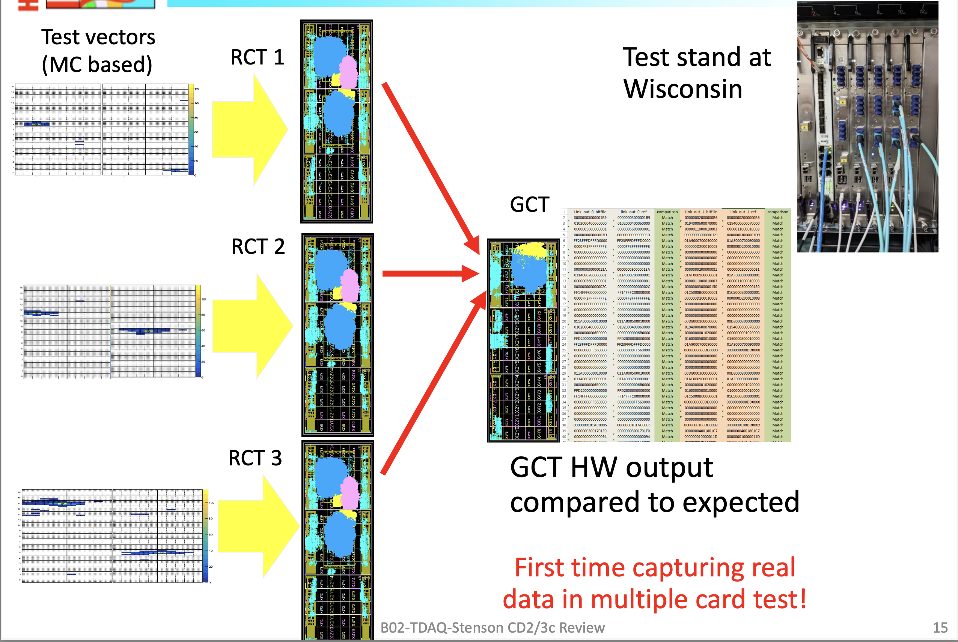
Calorimeter Firmware Tests
Firmware prepared and tests conducted by U of Hyderabad student Piyush Kumar

Slide 30
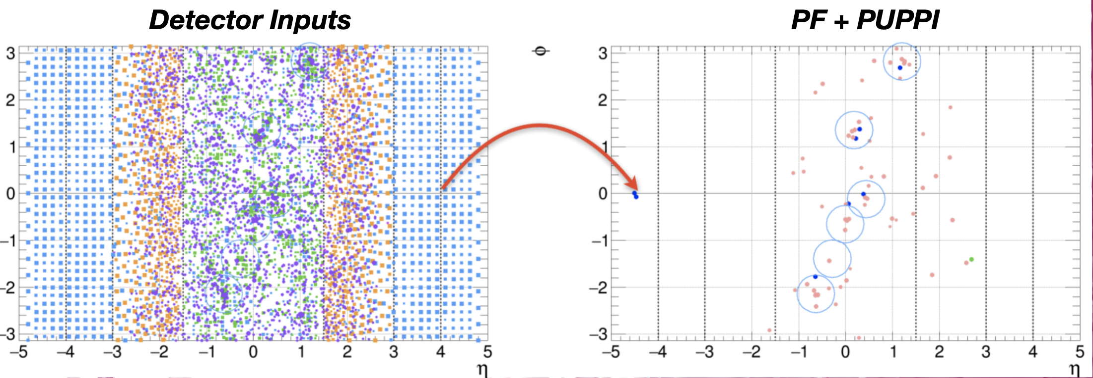
Particle Flow Reconstruction on FPGAs

Slide 31
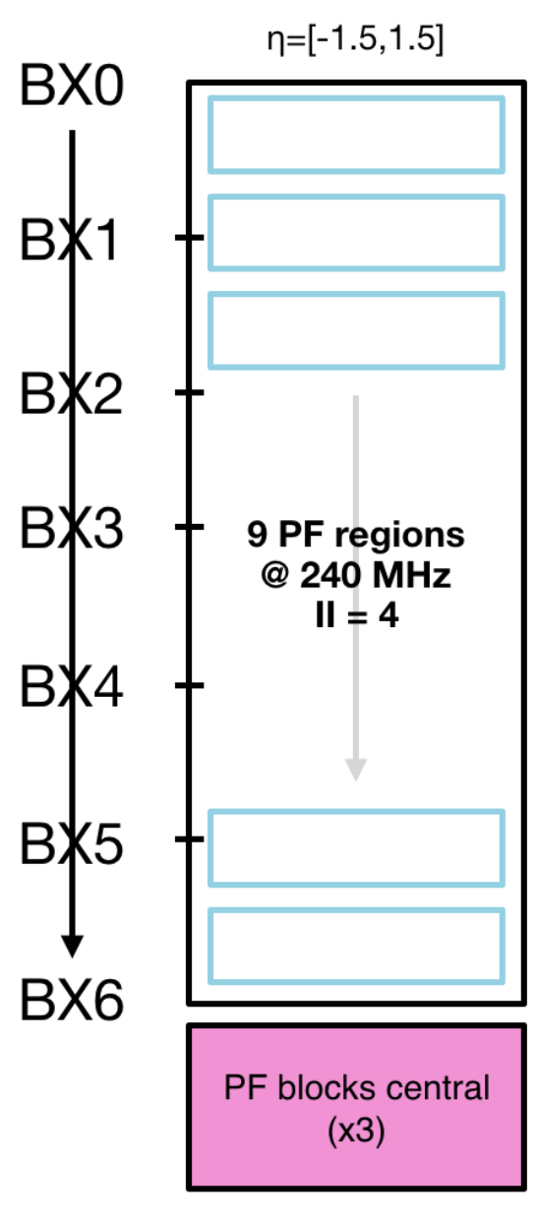
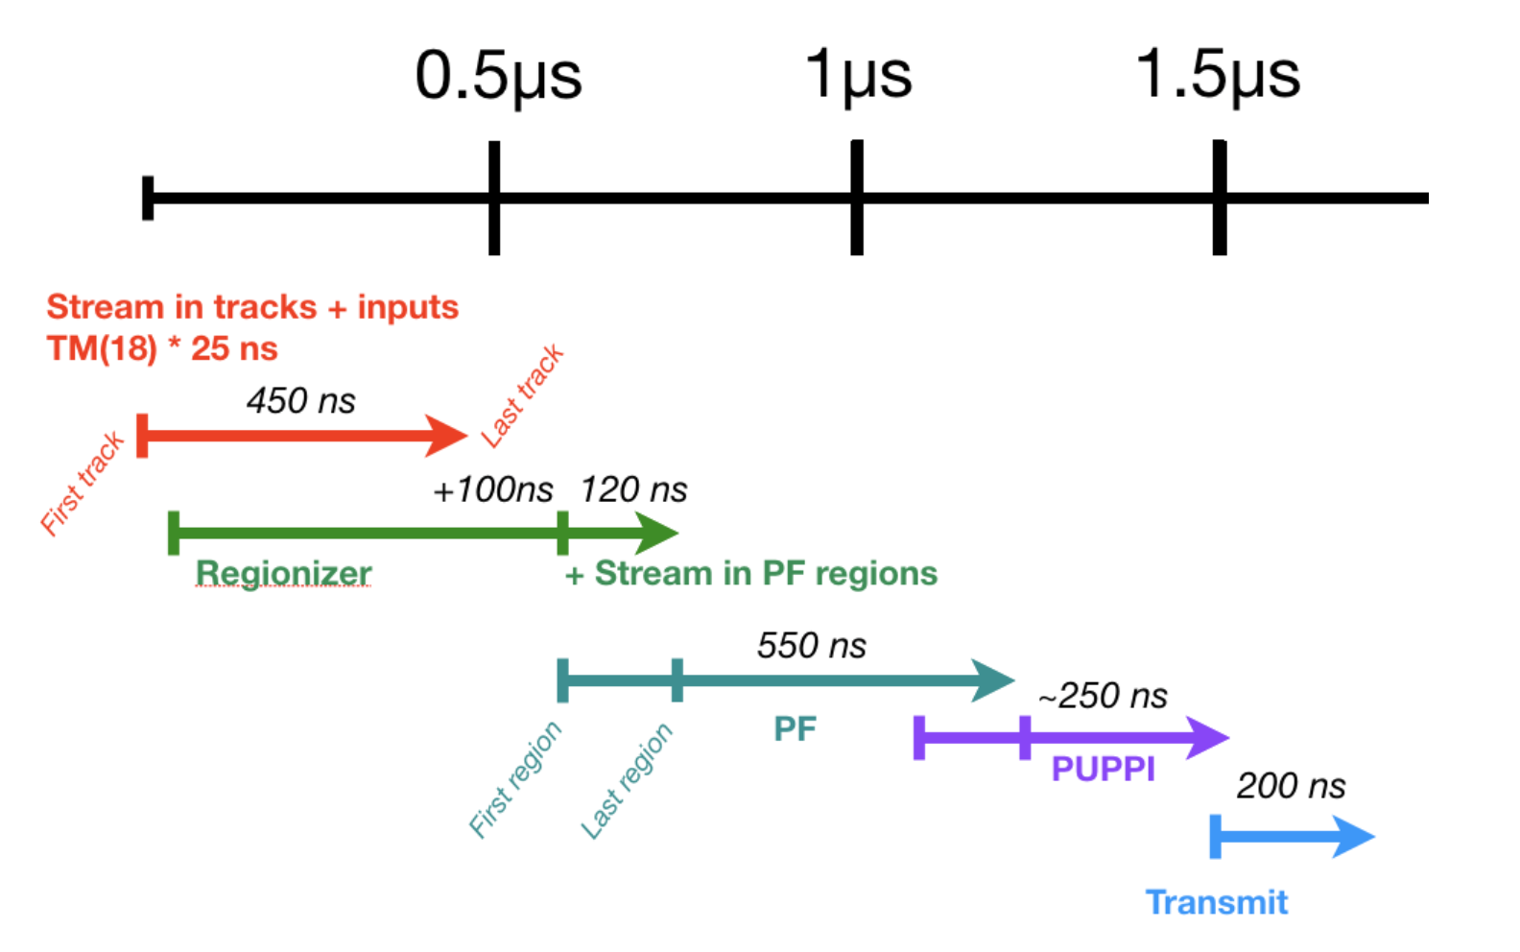
Particle Flow Implementation

Slide 32
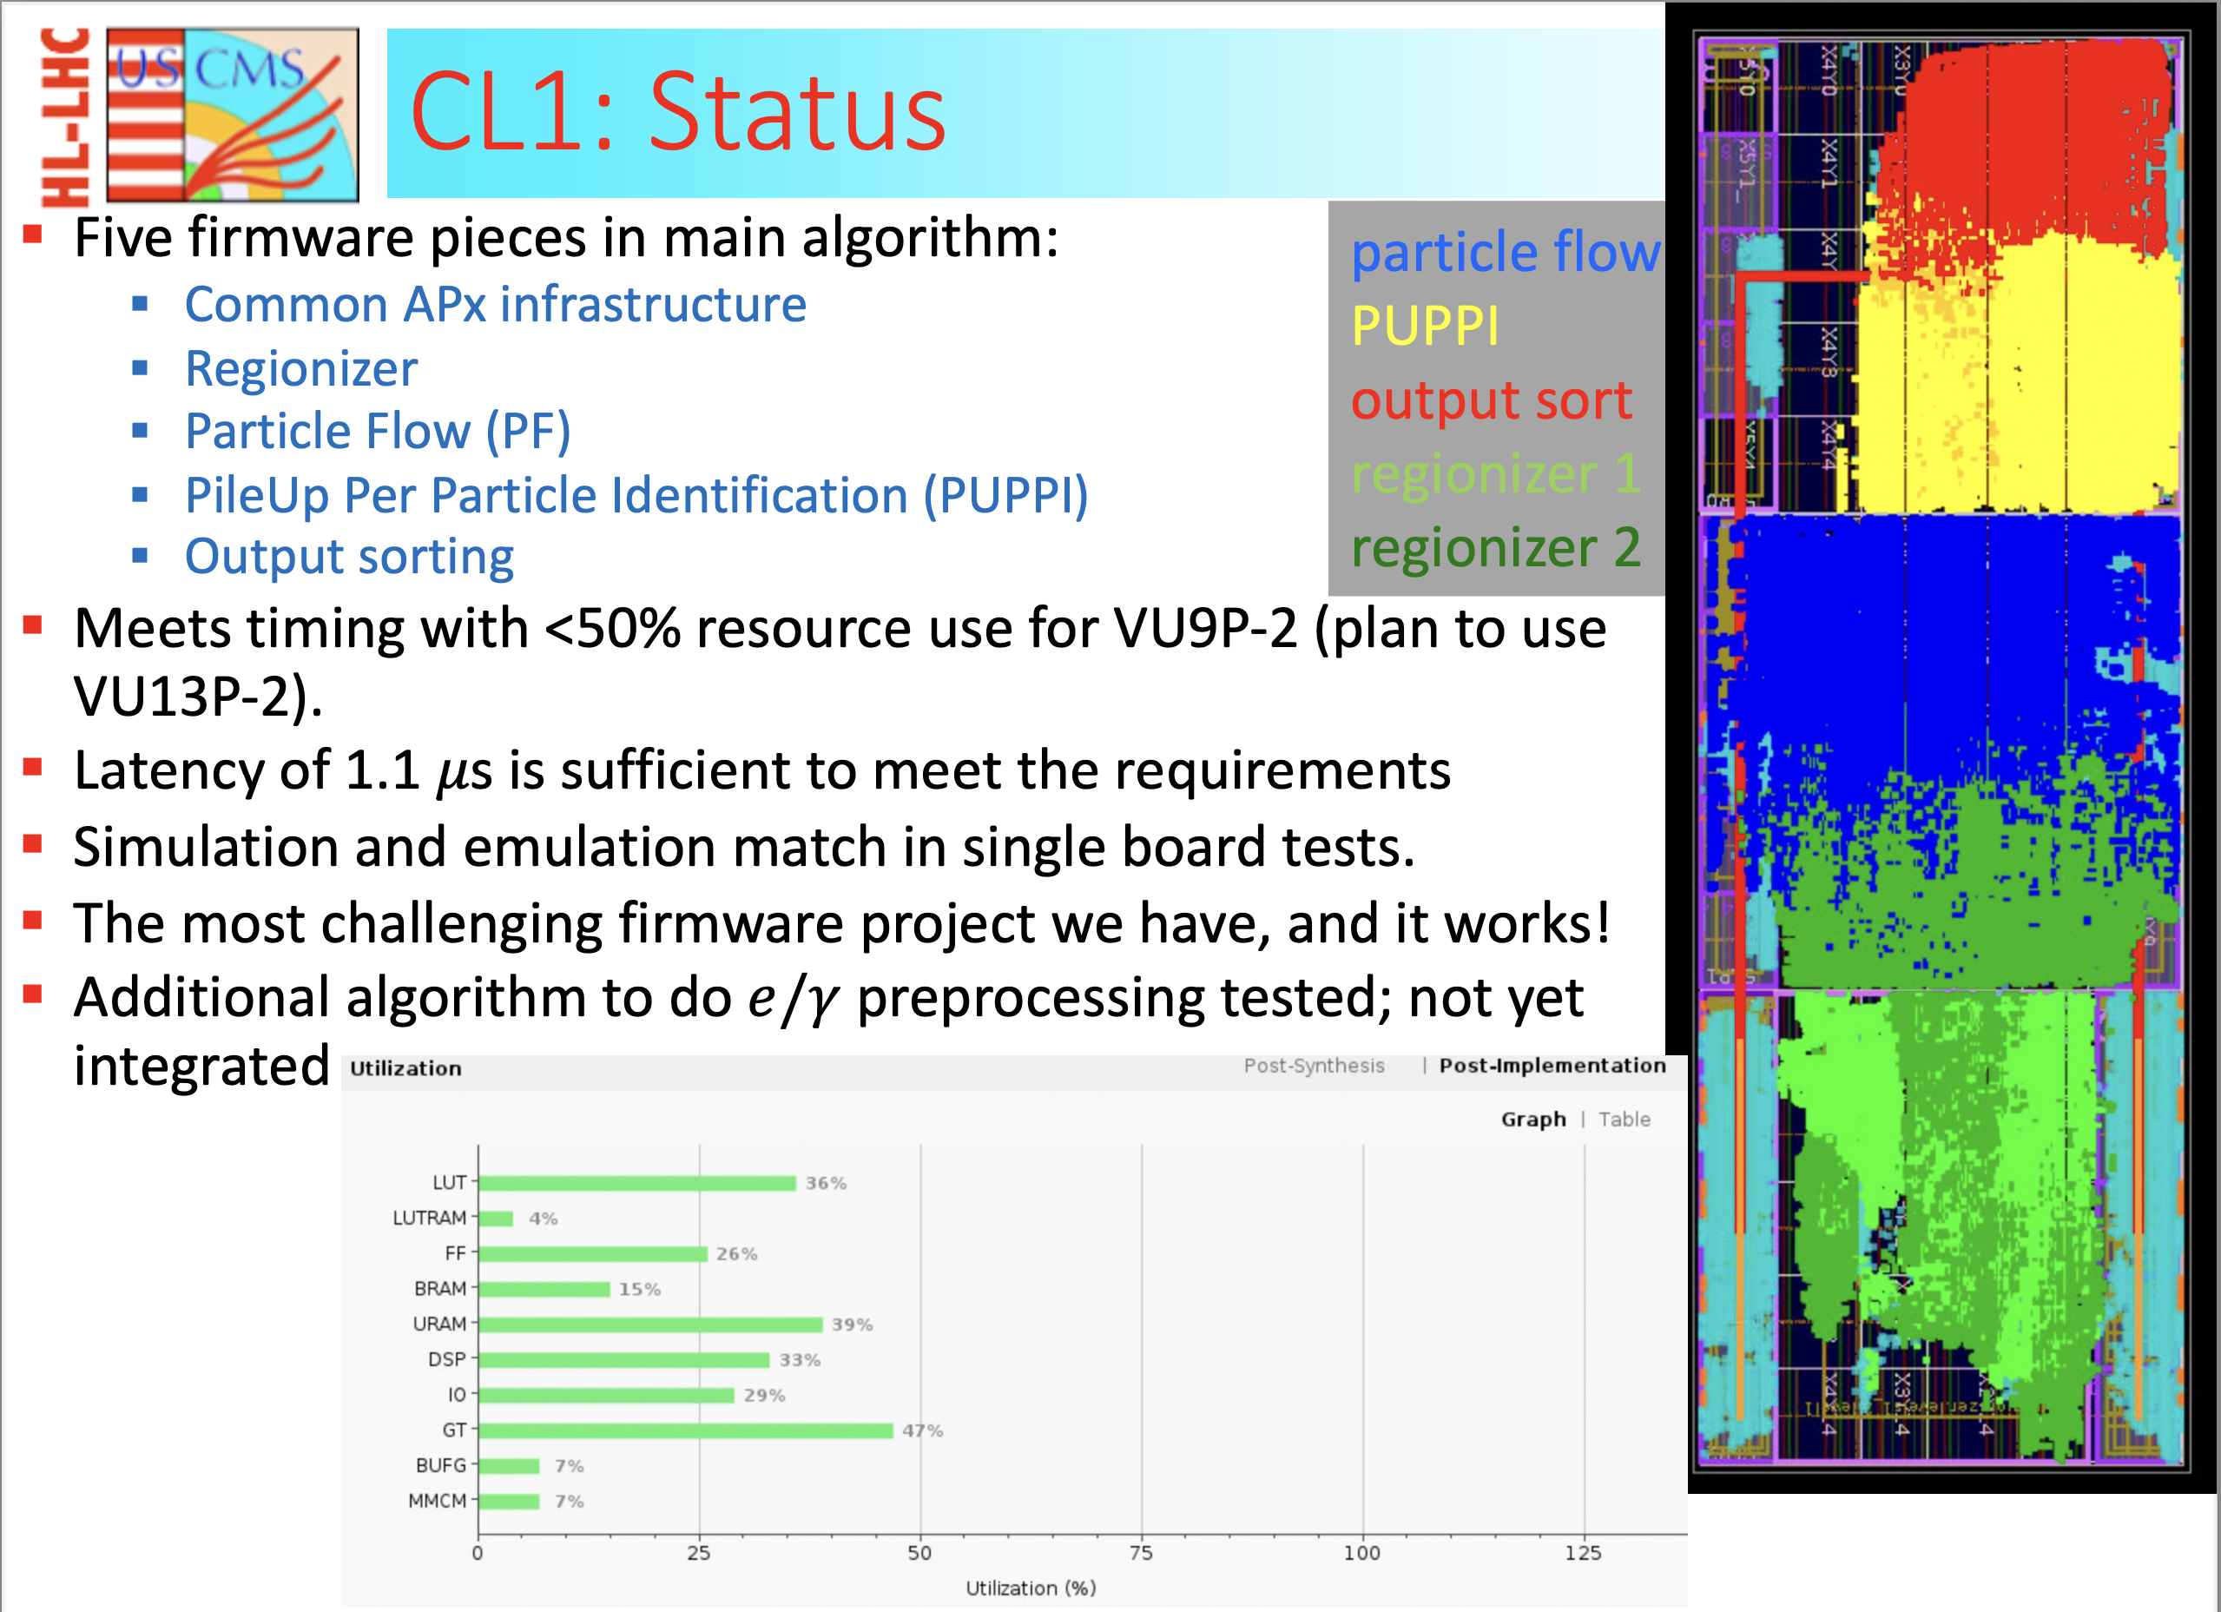
Particle Flow – Correlator Layer 1

Slide 33
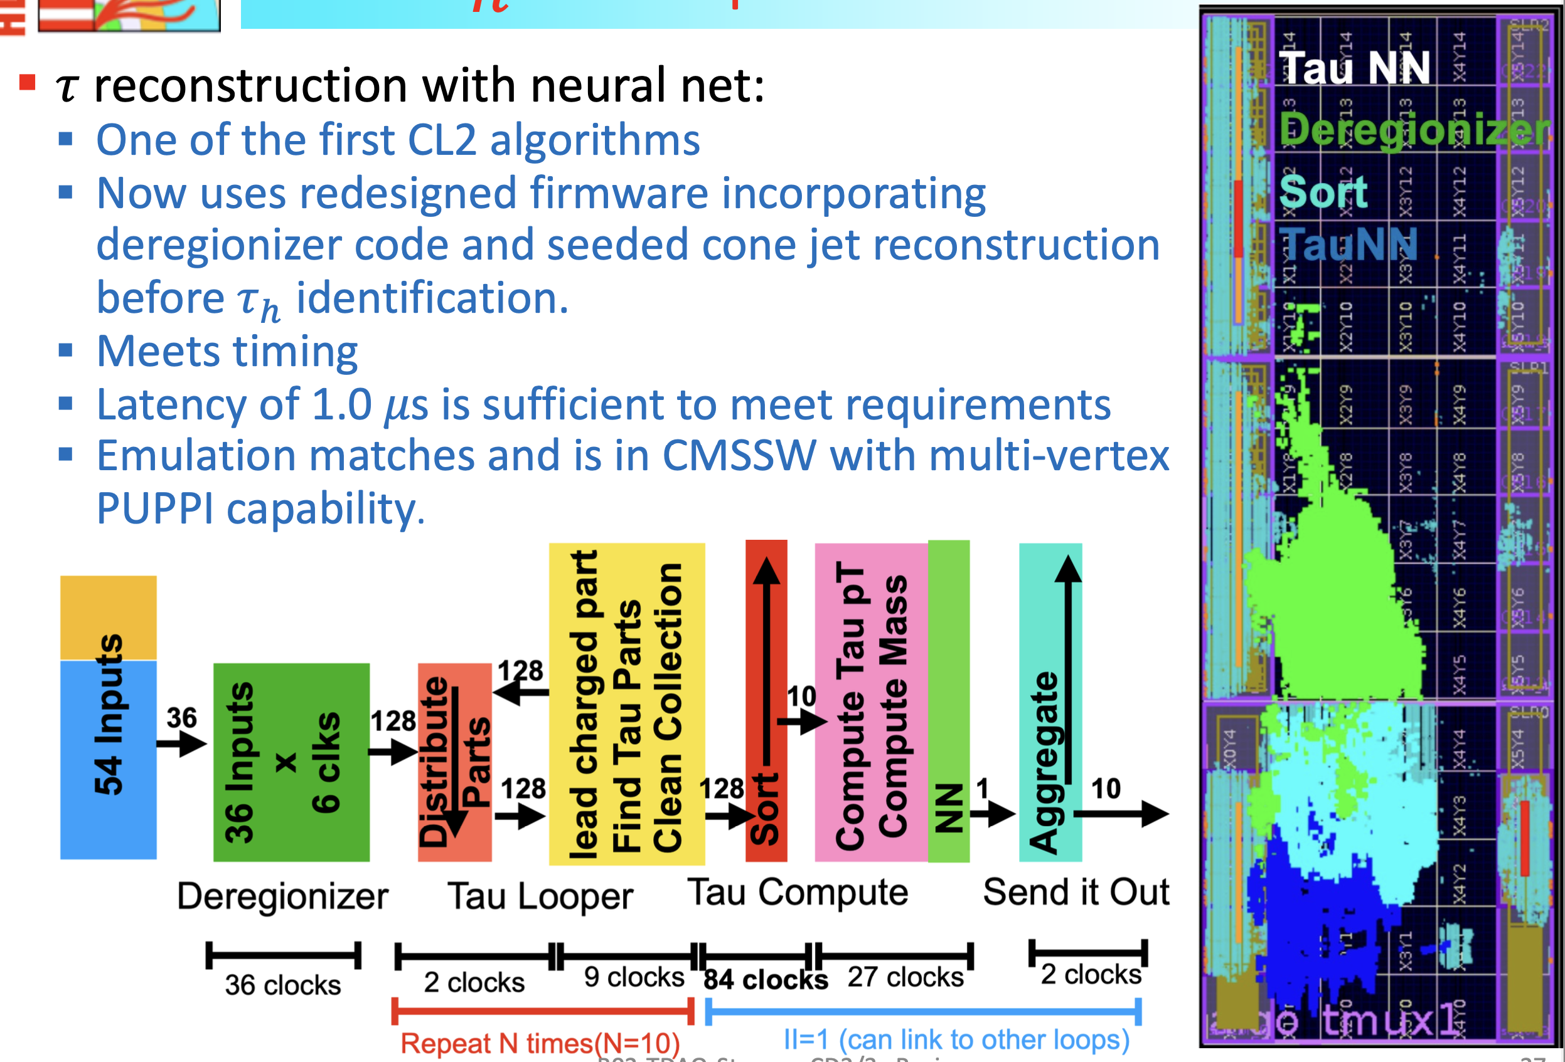
Particle Flow – Correlator Layer 2 τ_{h}

Slide 34
Concluding Thoughts
We in HEP are not innovators of modern computing technologies but we are amongst those who push it the most.
A team of engineers and physicists have tamed the LHC data deluge with intelligent use of telecommunications and computing technologies to enable fundamental physics discoveries.
We continue to push the technologies to the limit.
Advances in telecommunications and computing technologies are continually adapted to track increasing data volumes.
Students and postdocs are getting good training, especially in operations and firmware, for potential careers in both academia and industry – We invite you to join us in the HL-LHC adventure!

