Slide 1


Pressure distribution inside nucleons in a Tsallis-MIT bag model
M. A. Matías Astorga
G. Herrera Corral
Gerardo Herrera Corral
LISHEP 2023 - Rio de Janeiro, Brasil

Slide 2
Overview
Introduction and motivation
B. Quick overview of the MIT bag Model
C. Non extensive Tsallis statistics in the MIT bag Model
D. Pressure in the T - MIT bag Model

Slide 3
Introduction and motivation
A detailed description of hadron structure is needed to disentangle the basic mechanisms behind strong interaction
Recent Lattice QCD calculations …

Slide 4
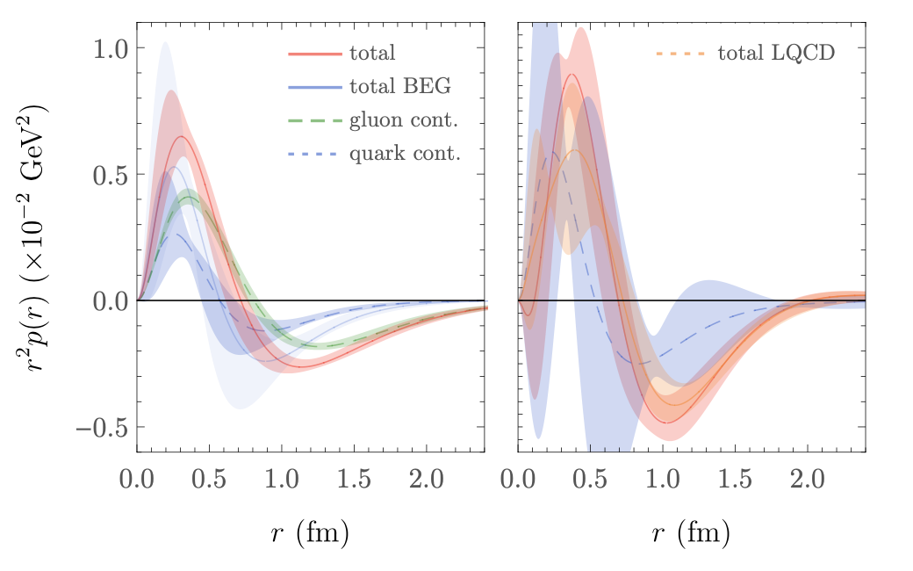
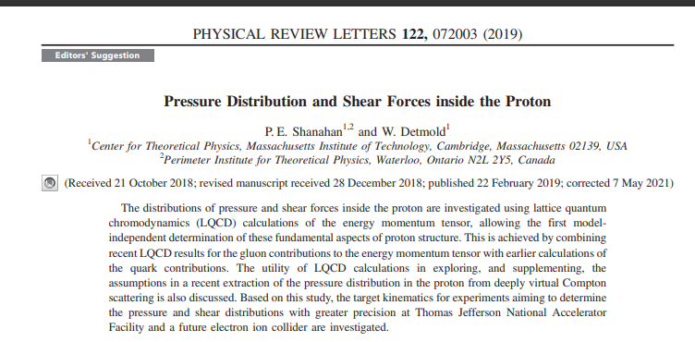
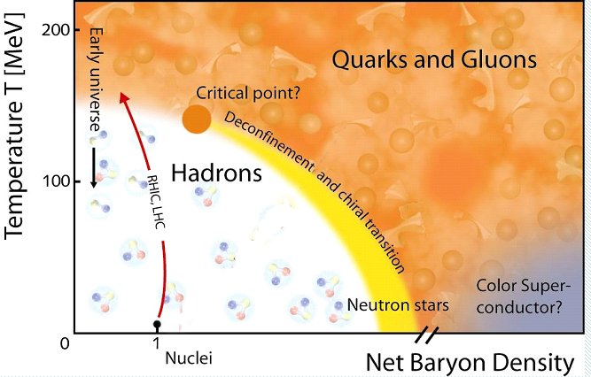
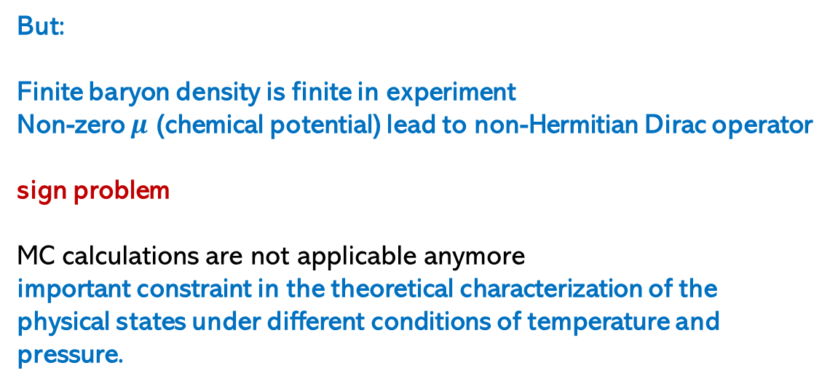
Lattice QCD
first model independent
determination of pressure
But:
Finite baryon density is finite in experiment
Non-zero $μ$ (chemical potential) lead to non-Hermitian Dirac operator
sign problem
MC calculations are not applicable anymore
important constraint in the theoretical characterization of the physical states under different conditions of temperature and pressure.
The Phase Diagram of QCD Matter
LATTICE
QCD

Slide 5
Introduction and motivation
A detailed description of hadron structure is needed to disentangle the basic mechanisms behind strong interaction
Recent Lattice QCD calculations …
Future projects aiming to a better understanding of the 3D structure of protons e.g. Electron Ion Collider - EIC

Slide 6
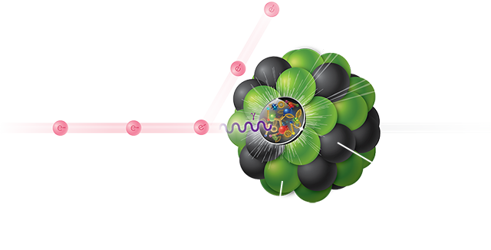
EIC science
The Electron-Ion Collider (EIC), a powerful new facility to be built in the United States at the U.S. Department of Energy’s Brookhaven National Laboratory in collaboration with Thomas Jefferson National Accelerator Facility
Precision 3D imaging of the internal structure of protons and atomic nuclei.
High-energy electrons will interact with the internal microcosm to reveal unprecedented details—zooming in beyond the simplistic structure of three valence quarks bound by a mysterious force.
We know that gluons multiply and play a significant role in establishing key properties of protons and nuclear matter.
EIC will reveal features of this “ocean” of gluons and the “sea” of quark-antiquark pairs that form when gluons interact—allowing the mapping the distribution and movement within protons and nuclei.
Construction is expected to start around 2024, with operations beginning in the early 2030s

Slide 7
Introduction and motivation
A detailed description of hadron structure is needed to disentangle the basic mechanisms behind strong interaction
Recent Lattice QCD calculations …
Future projects aiming to a better understanding of the 3D structure of protons e.g. Electron Ion Collider - EIC
Modeling of heavy astrophysical objects, matter under extreme conditions

Slide 8

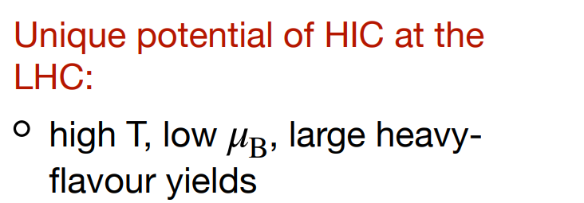
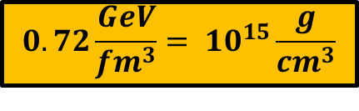
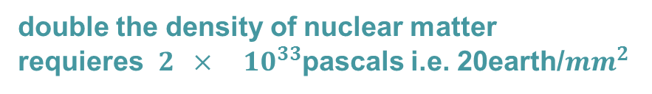
The Phase Diagram of QCD Matter
FAIR
NICA
Notes:
This essentially confirms the QCD phase transition in the phase diagram of QCD, which was conjectured shortly after the discovery of the asymptotic freedom on QCD.

Slide 9

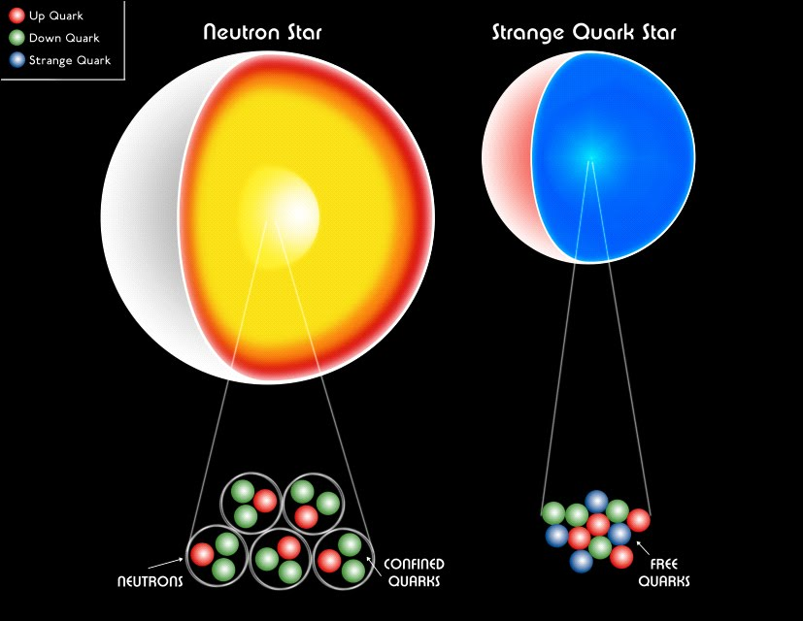
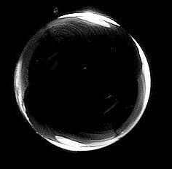

Neutron stars
Quark stars
Hybrid stars
Black holes
confined
quarks
free
quarks
free quarks +
hadrons
neutrons

Slide 10
Introduction and motivation
A detailed description of hadron structure is needed to disentangle the basic mechanisms behind strong interaction
Recent Lattice QCD calculations …
Future projects aiming to a better understanding of the 3D structure of protons e.g. Electron Ion Collider - EIC
Modeling of heavy astrophysical objects, matter under extreme conditions
Recent measurements by the ALICE collaboration of final state interactions between hyperons
and proton - neutrons

Slide 11

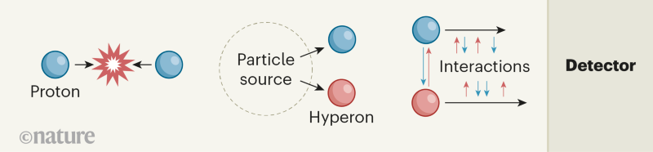
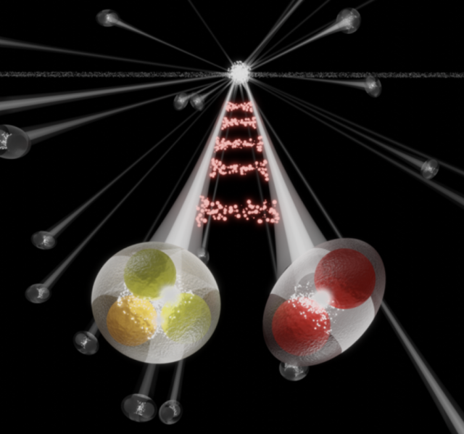
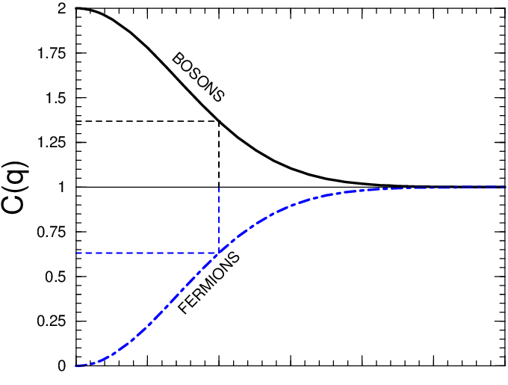

proton proton collisions
$\sqrt{s}$ = 13 TeV
FINAL STATE INTERACTION
two particle
correlation
function

Slide 12
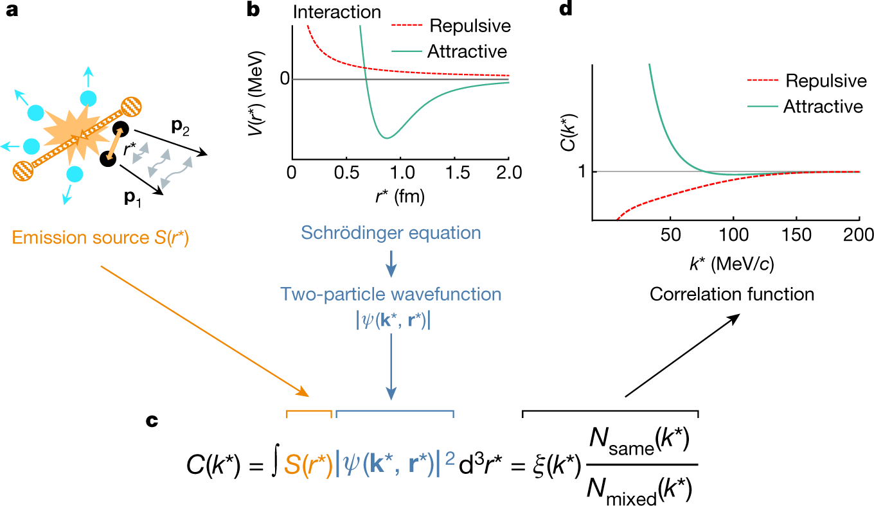
Repulsiva
Atractiva
fuente de emisión
Ecuación de Schrödinger
función de onda de dos partículas
función de correlación

Slide 13
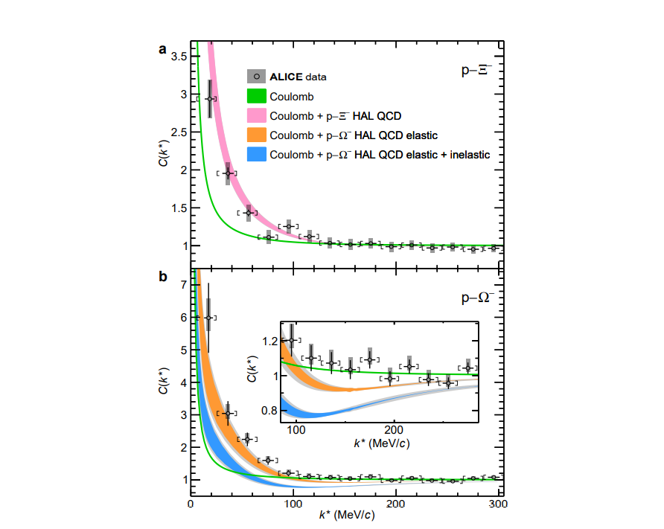

Slide 14
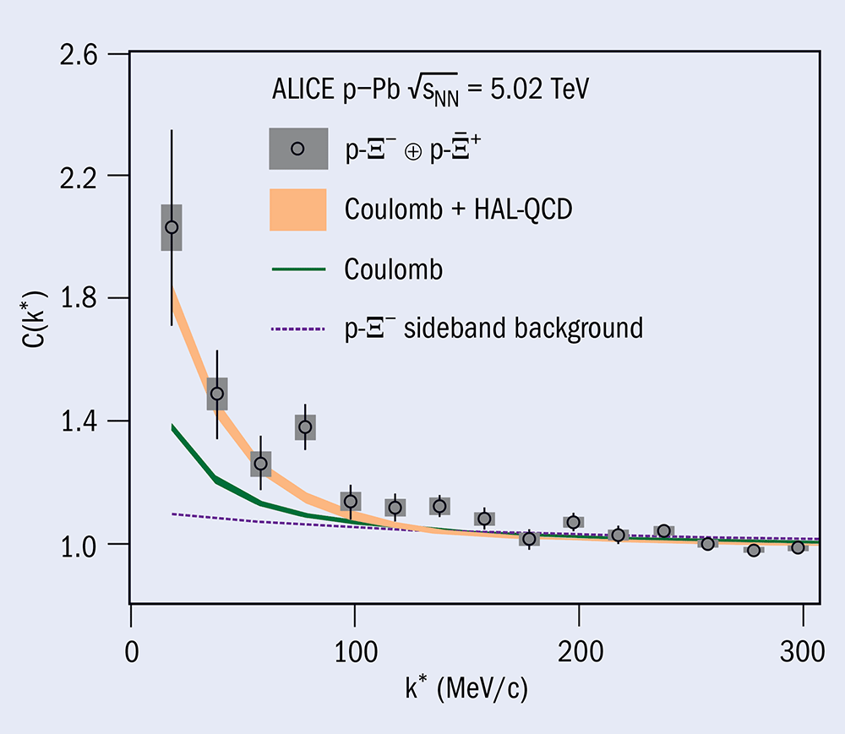
Studying neutron stars in the laboratory
10 July 2019
A report from the ALICE experiment
CERN Courier
ALICE Collaboration 2019
arXiv:1904.12198.
p-Ξ– correlation as a function of relative momenta between proton and Ξ–

Slide 15
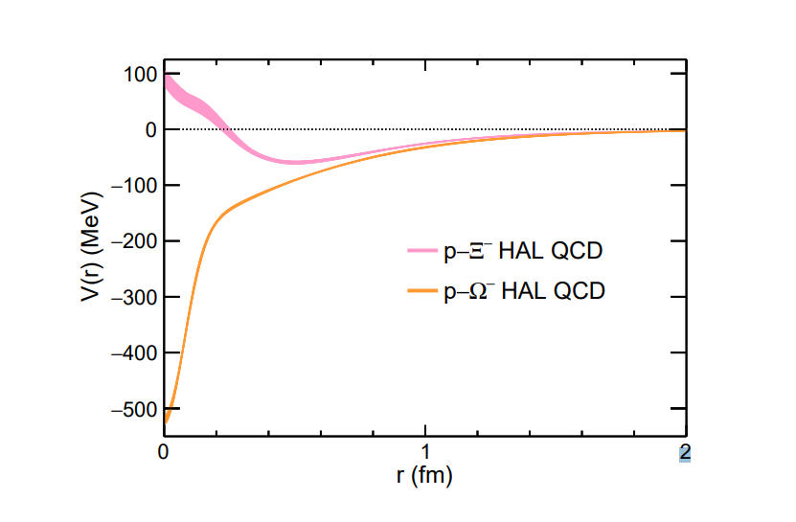
Potential p–Ξ and p–Ω
HAL QCD collaboration
HAL (Hadrons to Atomic nuclei from Lattice) QCD Collaboration

Slide 16
Overview
Introduction and motivation
B. Quick overview of the MIT bag Model

Slide 17



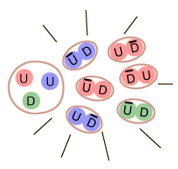
Quick overview of the MIT bag model
What´s in model´s bag
What´s in a bag´s model
nothing
massles quarks

Slide 18
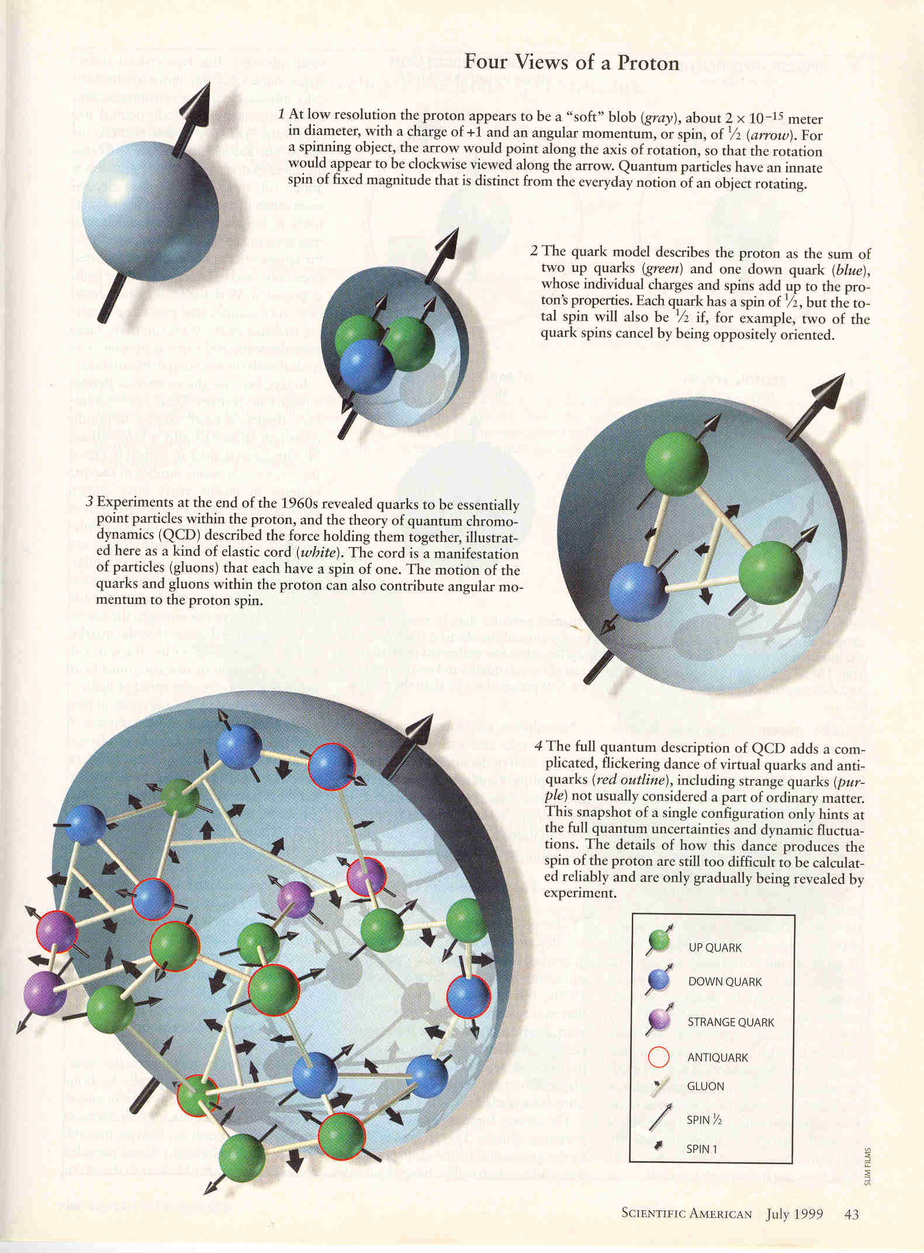
MIT Bag Model
A. Chodos, et al. Phys. Rev. D9 (1974) 3471
Dirac eq.
spherical bag with radius
R
quarks with mass=0:

Slide 19
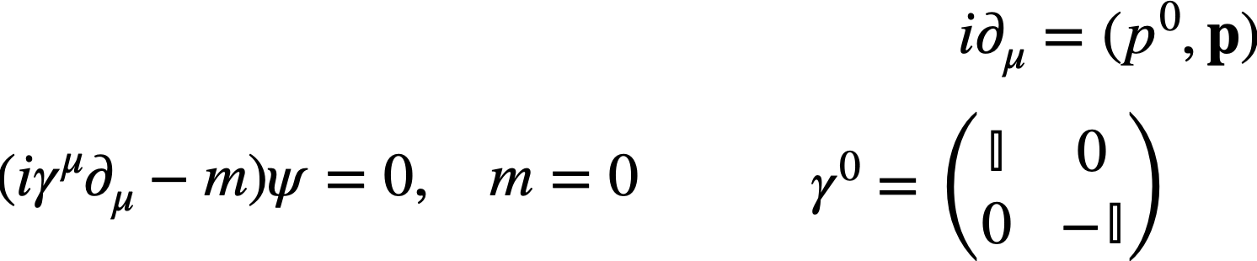
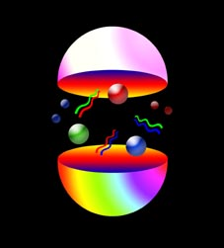
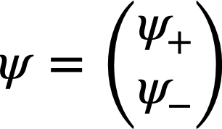
MIT bag model
Using the Dirac representation
of the matrices
and a two component spinor

Slide 20
MIT Bag Model
lowest energy
solution
Spherical Bessel
function

Slide 21
current flux through
the surface of the sphere = 0
Confinement
i.e. the normal component of
energy of N quarks:

Slide 22
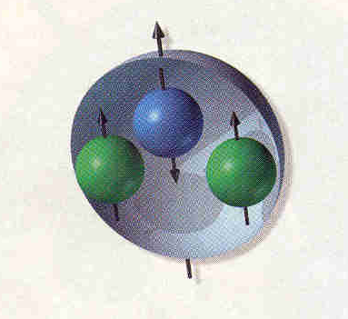
Bag pressure
B
energy of N quarks in the bag with presure B:

Slide 23
Equilibrium
for a proton
with three quarks

Slide 24
Equilibrium
for a proton
with three quarks

Slide 25
The phase space volume of quarks in a spatial volume V with momentum p in
the interval dp is
since each state occupies a phase space volume of
the number of
A
non
correlated
estimate
of
pressure
from
the
subsystems
in
the
proton
states characterized by a momentum p in the interval dp is
The ocupation probability is given by the Fermi –Dirac distribution
The number of quarks in a volume V with momentum p within the interval dp is
chemical
potential
quark degeneracy
Fermi-Dirac distribution
The presence of anti-quarks corresponds to the absence of quarks in the
negative energy states

Slide 26
In our case the number of quarks is the same as the antiquarks,
Relativistic massless quark gas
The energy of a quark in a system of Volume V and temperature T
mean value
pressure
due
to
quarks

Slide 27
The energy of the system due to quarks is therefore
for massles fermions and bosons pressure and energy are related:
so that, pressure due to quarks
anti-quarks

Slide 28
the pressure due to gluons
gluon degeneracy
Bose-Einstein distribution
pressure
due
to
gluons
and
so that, the total pressure is

Slide 29
High Temperature
Consider a quark gluon system in thermal equilibrium
Quarks and Gluons are non interacting and massles
degeneracy number of gluons quarks anti-quarks
gluons polarization
3 2 2 or 3

Slide 30
We have therefore an energy density of
at
If quark matter is
heated to a
the quark gluon matter
in the bag will have
pressure greater that
the bag-pressure
bag breaks
deconfined QGP

Slide 31
High Baryon Density
deconfinement may happen even at T = 0 →
at which baryon density ?
The number of states in a volume V with momentum p in the interval dp
The number of quarks is
The number density of quarks is

Slide 32
The energy of the quark gas in a volume V
energy density
from the relation between the pressure and the energy density
Change of state →

Slide 33
this corresponds to a CRITICAL quark number density
i.e. Critical Baryon Number
Let’s take ordinary nuclear matter as composed only of u and d quarks
For a Bag pressure
The critical baryon number density
at T=0

Slide 34
Phase Diagram of QCD Matter
Notes:
This essentially confirms the QCD phase transition in the phase diagram of QCD, which was conjectured shortly after the discovery of the asymptotic freedom on QCD.

Slide 35
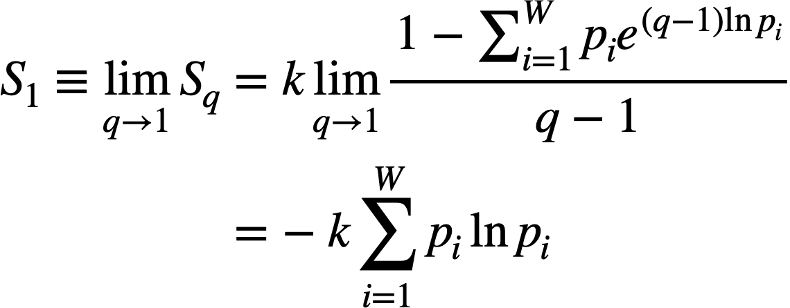
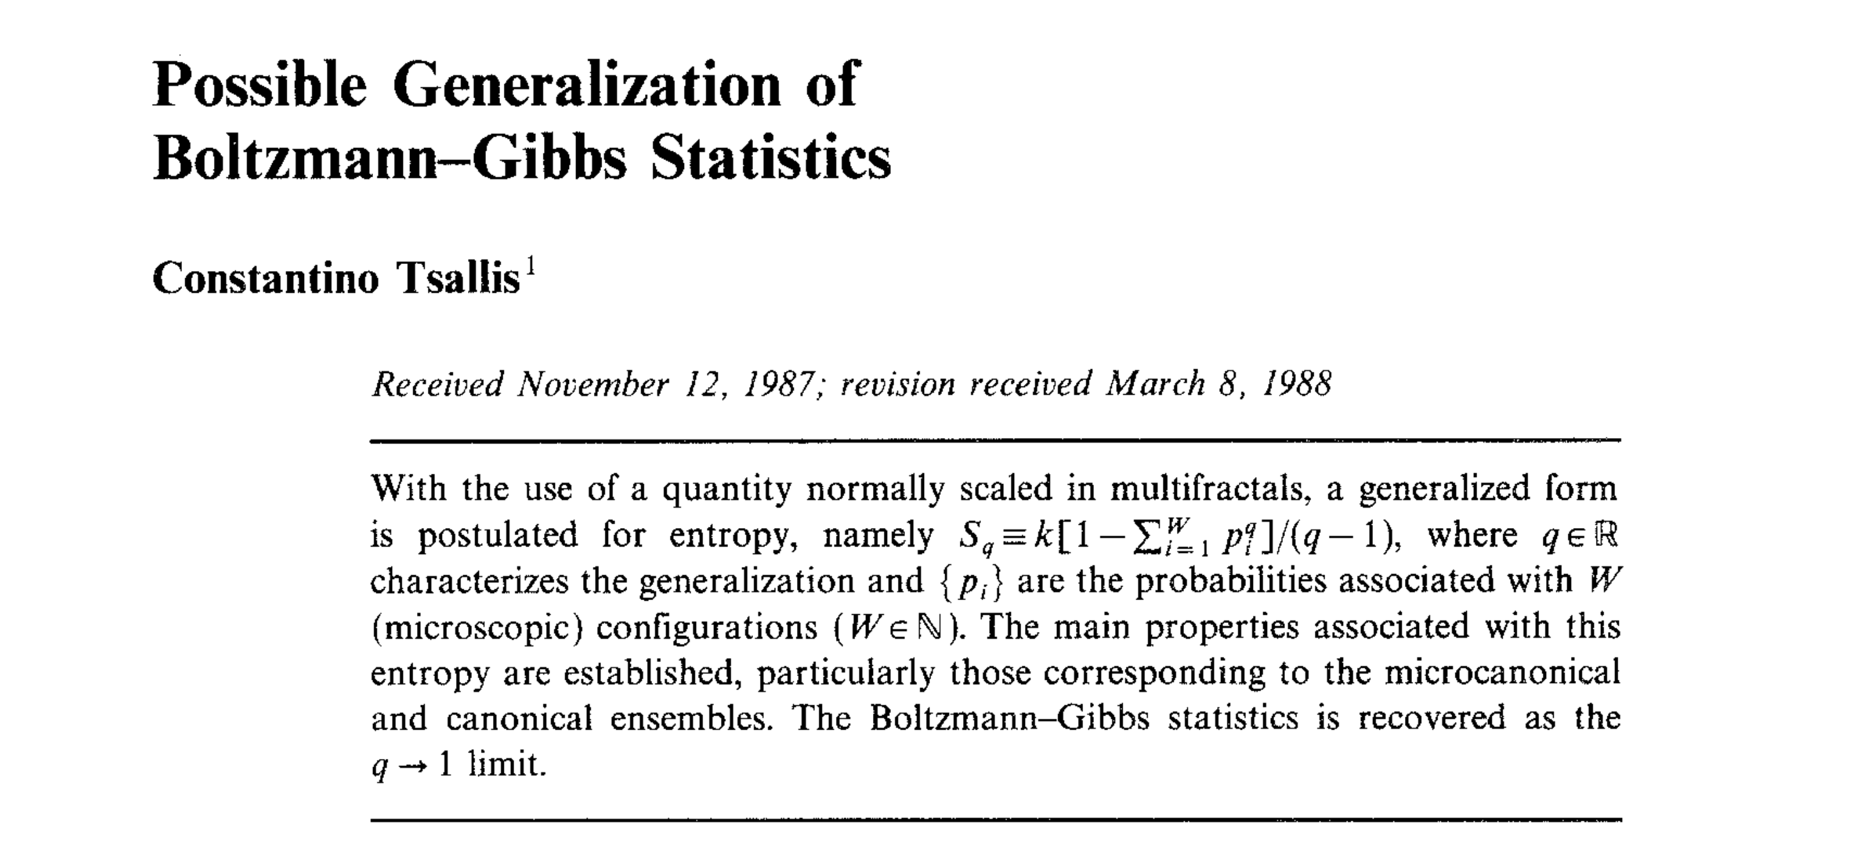
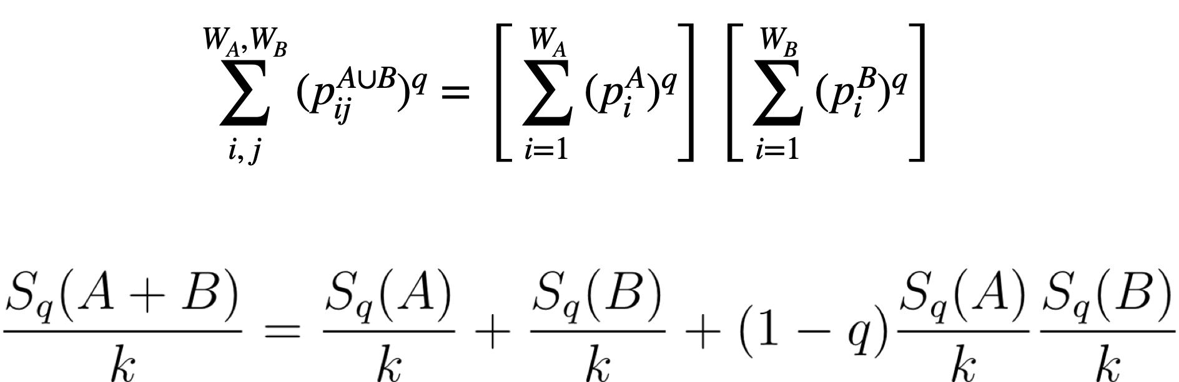
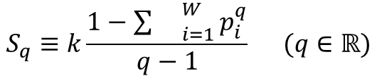
Tsallis statistics
$$S_{q}≡k\frac{1−{\sum{}}_{i=1}^{W}p_{i}^{q}}{q−1} (q∈ℝ)$$
Journal of Statistical Physics 52(1988)
Additivity
correlated systems
Notes:
La estadística de Tsallis define una entropía no extensiva como
Aquí q es un número real, un índice fijo que caracteriza un sistema no extensivo. W representa el número de configuraciones microscópicas del sistema, pi es la probabilidad de la configuración i. Así, para dos sistemas independientes que no interactúan A y B, una mezcla llevaría a la relación
Suponiendo dos sistemas independientes A y B con probabilidades dadas.

Slide 36
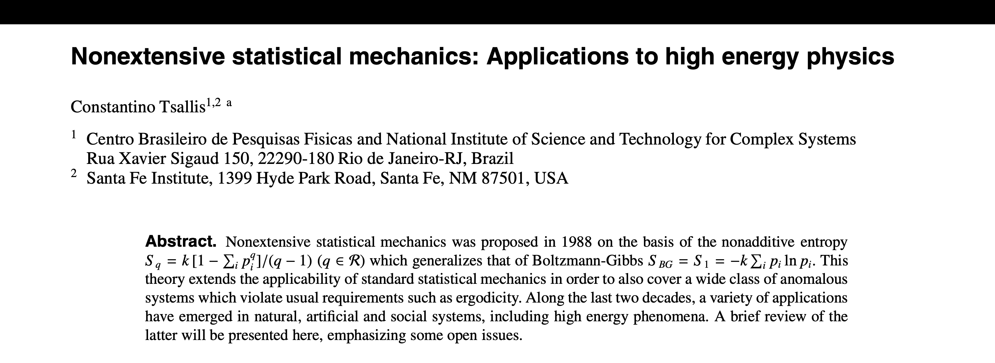
Successfully applied to high energy physics
Journal of Statistical Physics 52(1988)
EPJ Web of Conferences
Volume 13, 2011
HCBM 2010 – International Workshop on Hot and Cold Baryonic Matter
Notes:
La entropía no aditiva Sq y su mecánica estadística no extensiva ha sido aplicada a una amplia variedad de sistemas naturales, artificiales y sociales
Para dinámica no lineal de sistemas de muchos cuerpos el requerimiento usual es ergodicidad, que es garantizado por el caos fuerte. Para sistemas no ergodicos, que es bastante frecuente el caso de los llamados sistemas complejos, no hay razón legitima para usar la teoría BG.
Es frecuentemente referida como mecánica estadística no extensiva porque la energía total de tales sistemas típicamente es no extensiva (no proporcional al número total de elementos del sistema). La no aditividad para q≠1 permitirá sea extensiva.

Slide 37
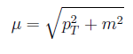
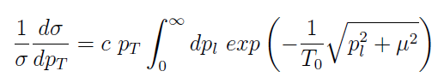
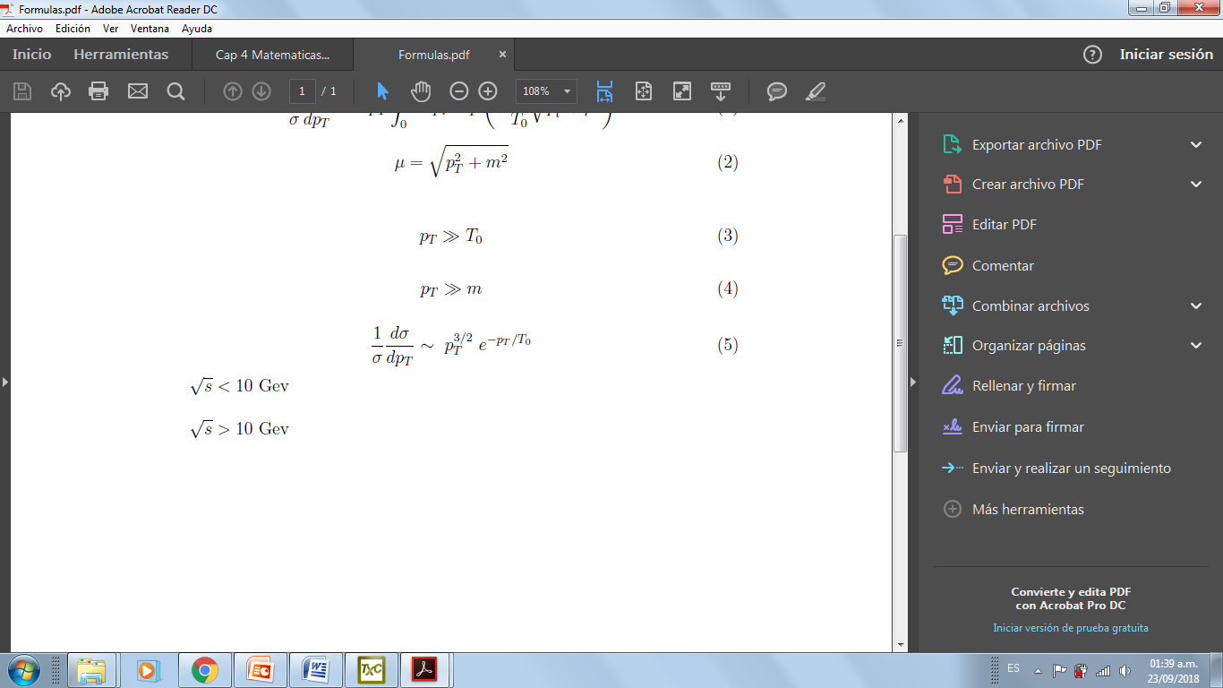
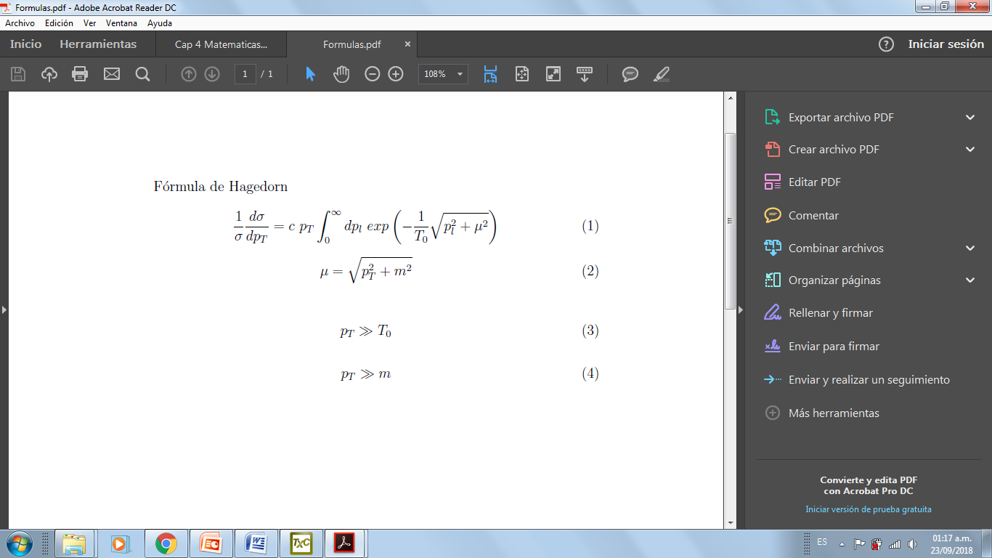
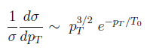
Tsallis in high energy physics
Fitting parameter
Hadronization temperature
Hagedorn theory
Exponential asymptotic behavior

Slide 38
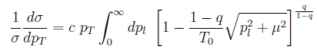
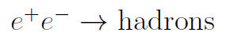
T0 should not depend on the center of mass energy
c depends on the average multiplicity of the events →
same shape for all
energies spectrum
Tsallis distribution
First time in HEP
Deviations from exponential decay were observed → Polynomial decay (Higher PT)
Non-extensivity Parameter
I. Bediaga et al (2000)
I. Bediaga, E. M. Curado and J. M. de Miranda, Physica A 286, 156 (2000).

Slide 39
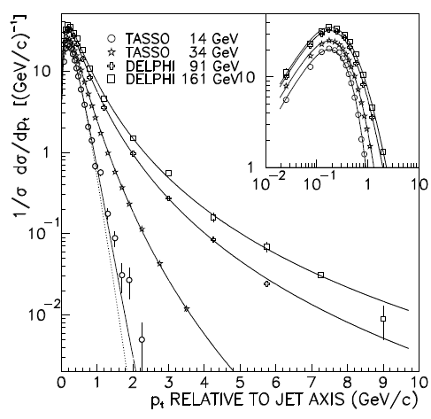
Findings
The Hagedorn predicted exponential behavior is shown by the dotted lined.
The deviation of the exponential behavior increases when the energy increases.
The continuous lines are the Tsallis fits.
Good description of the transverse momentum.
TASSO, Z. Phys. C 22, 307-340 (1984).
DELPHI data get from: PhD Thesis from Oliver Passon, 1997, Wuppertal University-Germany
Transverse momentum distribution of charged hadrons in the e+e- interaction

Slide 40
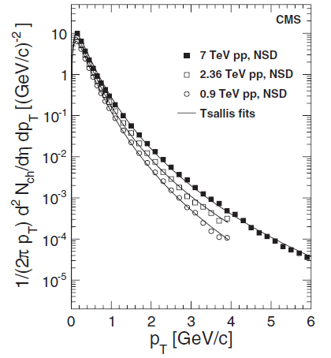
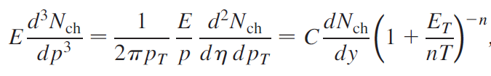
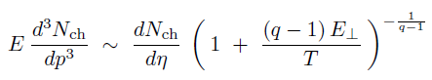
The power law associated with Tsallis statistics (Tsallis distributions) is being widely used in pp collisions
CMS
q-exponential function
Fitting parameters: T, q
Charged-hadron yield as a function of pT in pp collisions
V. Khachatryan et al. (CMS Collaboration) Phys. Rev. Lett. 105, 022002 (2010)

Slide 41
Other references
pp collisions
Transverse momentum and rapidity distributions for different identified particles.
PHENIX, ALICE, CMS (0.2 → 7 Tev)
L. Marques, J. Cleymans, and A. Deppman Phys. Rev. D 91, 054025 (2015)
T. Bhattacharyya, J. Cleymans, L. Marques, S. Mogliacci and M. W. Paradza, J. Phys. G 45 no.5, 055001 (2018)
Transverse momentum for identified particles (pions, kaons and protons).
ALICE (0.9, 2.76 and 7 Tev)
Transverse momentum for strange and mutil-strange particles.
LHC at 7 Tev
A. Khuntia, S. Tripathy, R. Sahoo and J. Cleymans. Eur. Phys. J. A (2017) 53: 103.

Slide 42
Heavy ions collisions
Tsallis distributions with some modifications to include the transverse flow
Transverse momentum of charged hadrons. LHC at 13 Tev
Transverse momentum of hadrons in pPb and PbPb collisions (different centralities) . CMS at 5.02 Tev.
K. Saraswat, P. Shukla, V. Singh. J. Phys. Commun. 2 (2018) 035003
K. Saraswat, P. Shukla, V. Kumar and V. Singh, Eur. Phys. J. A 53 (2017) 84.
Transverse momentum of the strange hadrons in pPb (5.02 Tev) and PbPb (2.76 Tev) collisions at CMS
all this may indicate a universal underlying mechanism in the hadron structure

Slide 43
Tsallis MIT bag model
all this may indicate a universal underlying mechanism in the hadron structure
We present a phenomenological framework based on the MIT bag model to estimate the pressure due to the gluons as well as the total pressure inside nucleons. To do so, a non-extensive Tsallis statistics of quarks and gluons is implemented
T-MIT - Tsallis MIT Bag Model

Slide 44
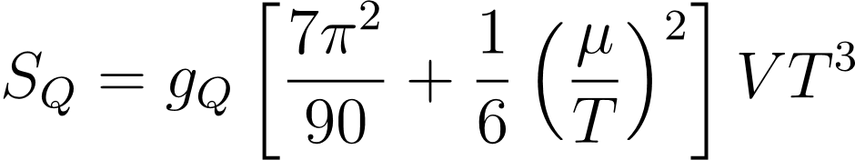
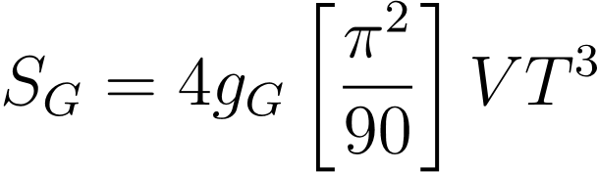

Pressure in the MIT bag model with a non extensive Tsallis statistics
Quarks and gluones are two correlated systems in the hadron structure.
The correlation is represented effectively by the q Tsallis parameter. The non extensive entropy for the hadron is then given by
where S_{Q} y S_{G} están dados por
$$S=\frac{1}{T}\left(E+PV−\underset{i}{∑}μ_{i}N_{i}\right)$$

Slide 45
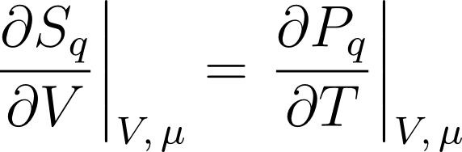

One may obtain entropy from the Maxwell relations:
And then integrating this expresión with respect to Temperature and requiring that
q →1, the Tsallis pressure is simply P_{q} = P_{Q} + P_{G}

Slide 46
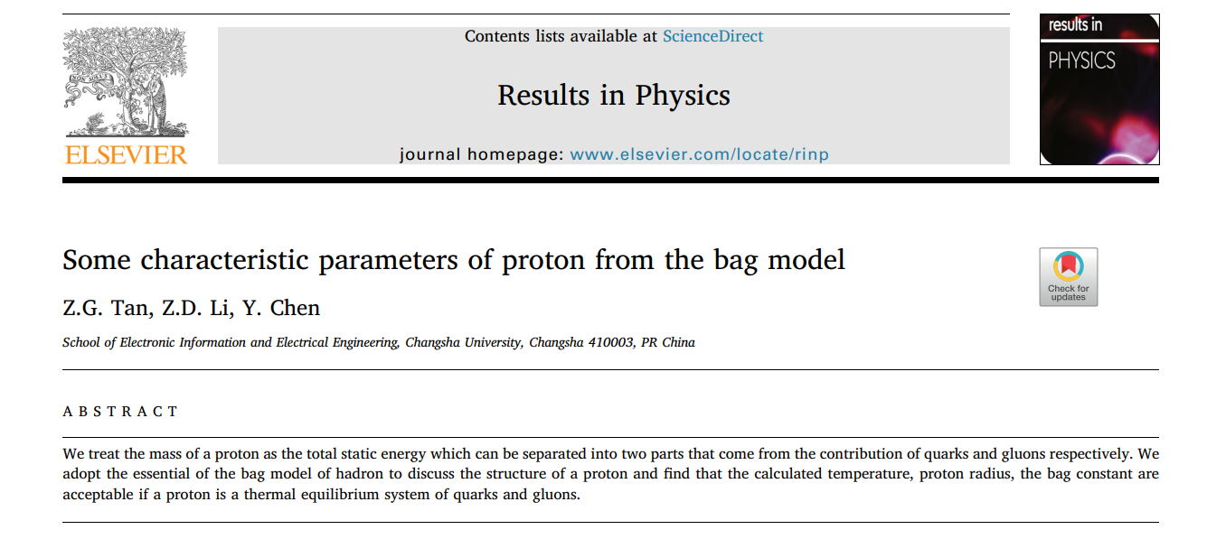
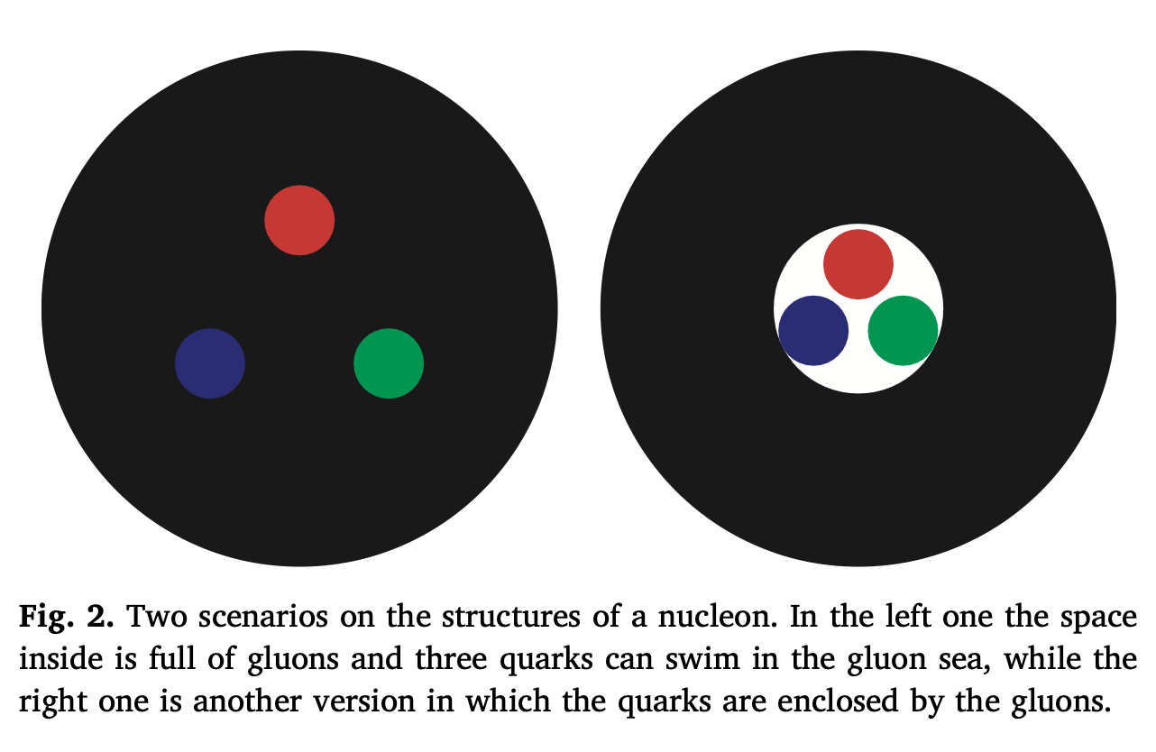


Parameters for the proton in a Bag Model
$$(iγ^{μ}∂_{μ}−m)ψ=0,m=0$$
$${\overline{ψ}ψ|}_{r=R}=[j_{0}(p^{0}R)]^{2}−σ⋅\overset{̂}{r}σ⋅\overset{̂}{r}[j_{1}(p^{0}R)]^{2}=0$$
$$p_{m}^{0}=\frac{2.04}{R}$$
Notes:
La energía de mis gluones proporciona el efecto de presión dirigida desde la región exterior de la bolsa.

Slide 47
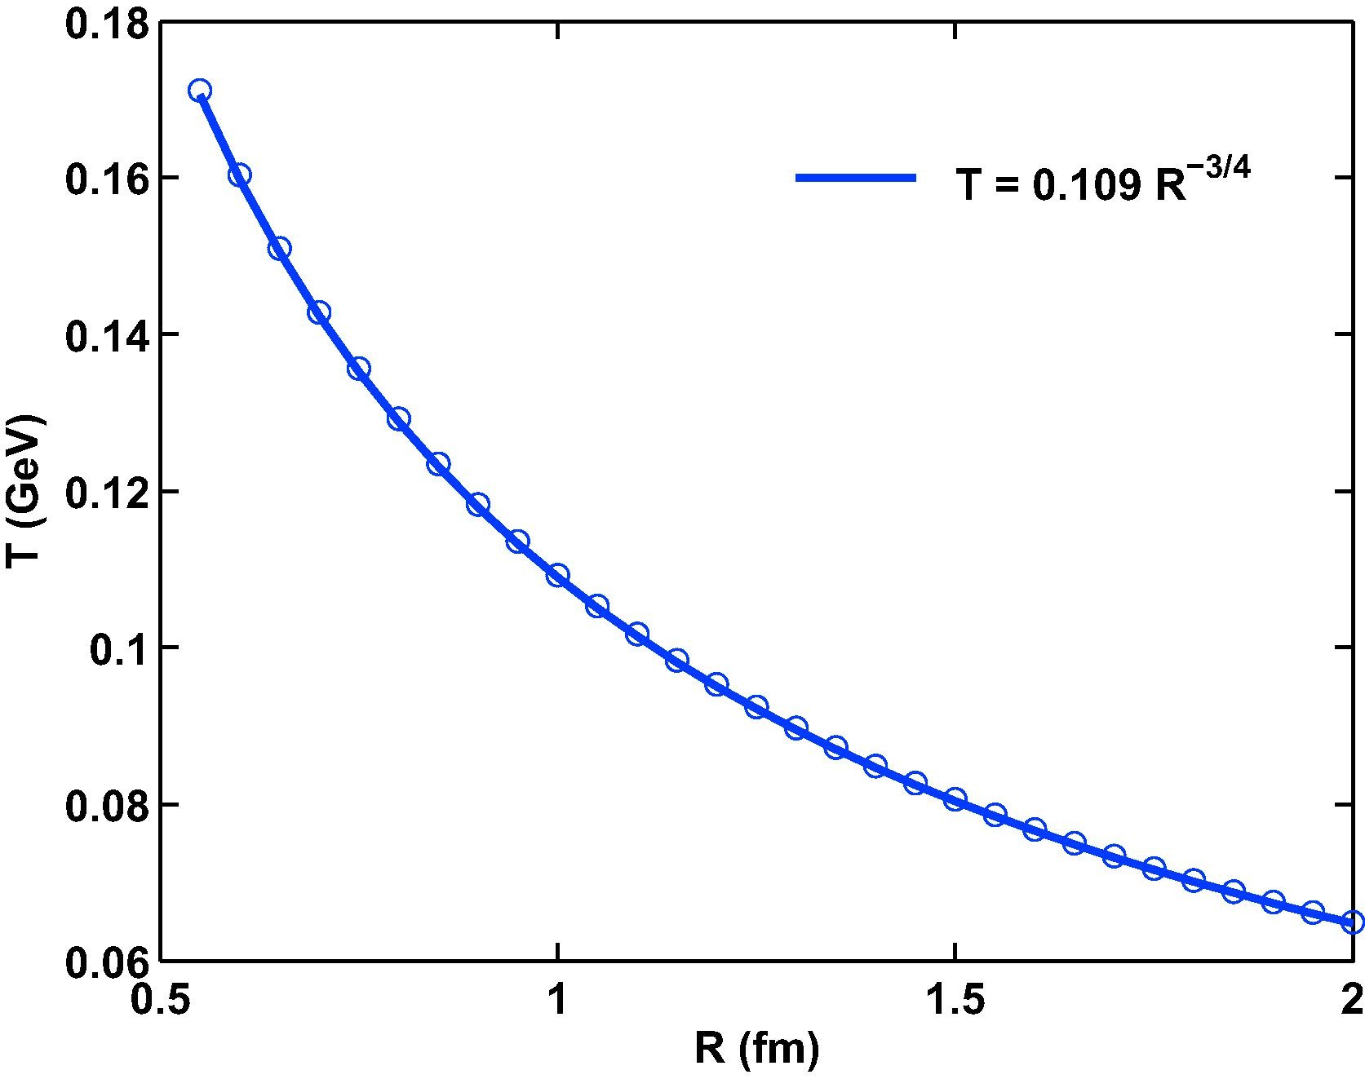

Temperature as a function of radii
  By considering the mass of the nucleon as the totalenergy
  E_{t} = M
  Taking the proton as a system in termic equilibrium
  Neglecting the chemical potential µ_{q}=0
Notes:
En colisiones de iones pesados relativistas (relativistic heavy ion collisions RHIC), muchos núcleos son depositados en un pequeño espacio cuya densidad de energía está cerca del valor crítico. Ahora,
si tomamos la masa de un nucleón (por ejemplo un protón) como la energía total, Et = M,
tomamos el protón como un sistema en equilibrio térmico local, y
despreciamos el potencial químico, µq=0,
Podemos entonces calcular sus cambios de temperatura interna con el radio del protón. A partir de datos experimentales, se consigue la fórmula simulada numérica
Cuando el radio es menor de 0.6 fm, la temperatura será casi 170 MeV, que es cercana a la temperatura crítica que rompe el hadrón a quarks.

Slide 48
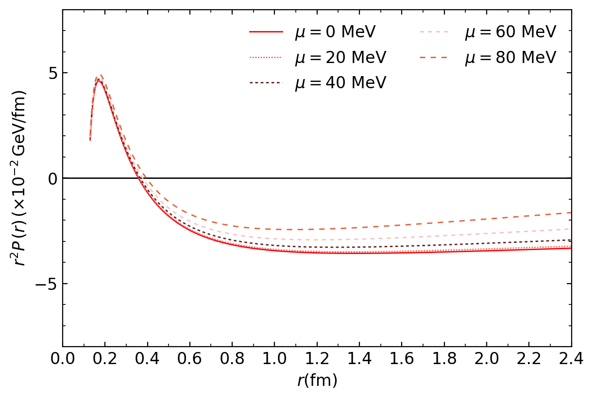
Pressure distribution in the
T-MIT bag model
Tsallis parameter: q=1.002

Slide 49
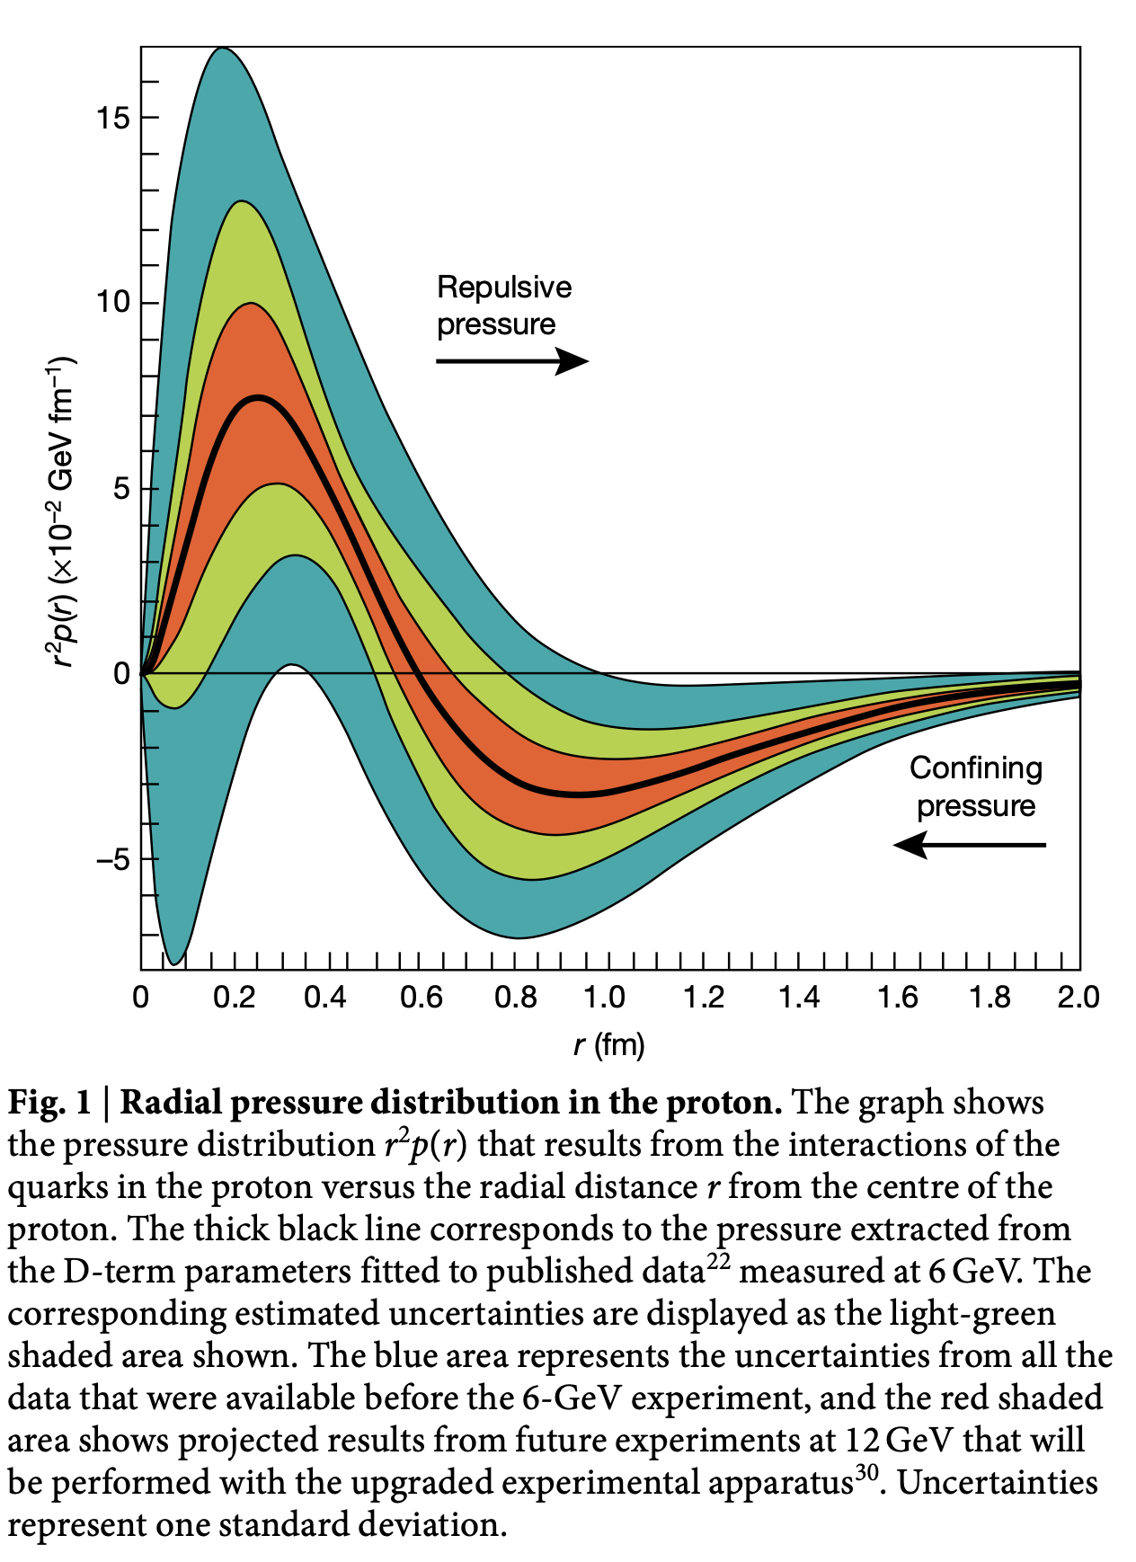
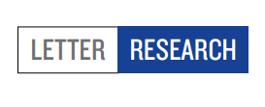
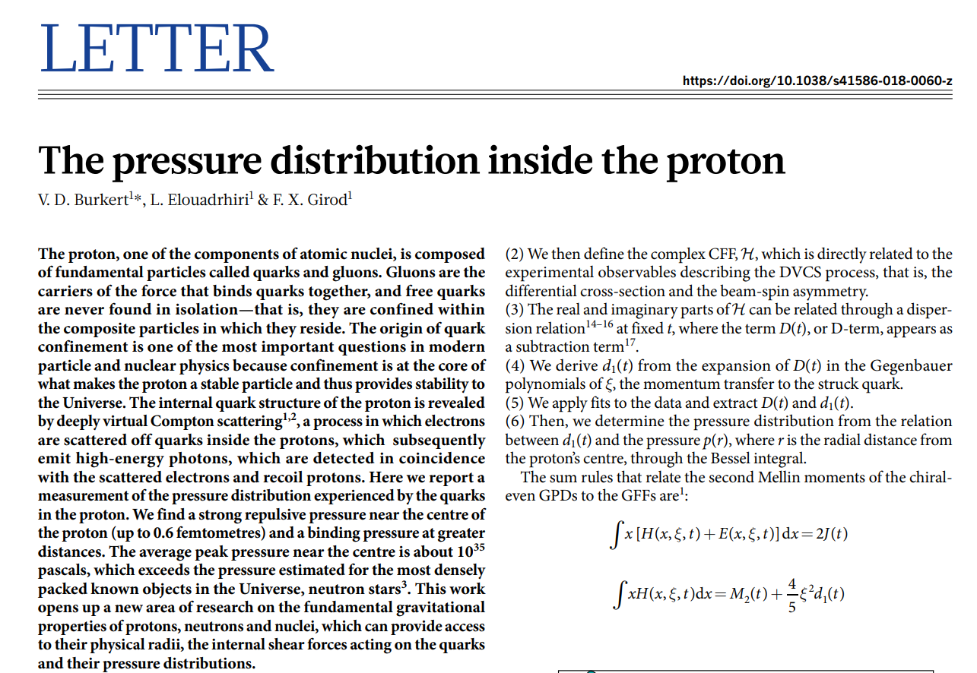
The pressure of quarks
NATURE | VOL 557 | 17 MAY 2018
Notes:
Los autores usan datos experimentales de Dispersión Profunda Virtual de Compton (Deeply Virtual Compton Scattering - DCVS).
El análisis yace sobre el desarrollo de Distribuciones de partones generalizados (Generalized Parton Distributions - GPD) y los factores de forma de Compton (Compton Form Factors CFFs). Se concluye que hay una presión repulsiva de los quarks cerca del centro del protón y una presión confinante a distancias por encima de los 0.6 fm desde el centro. Sin embargo, no se considera en este análisis la presión debida a los gluones.

Slide 50
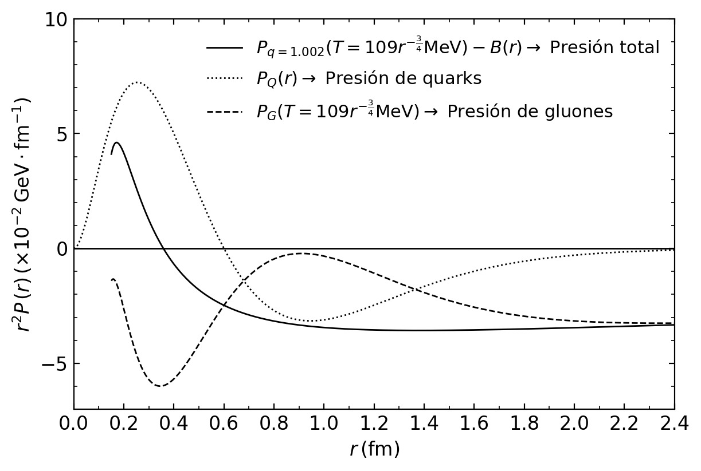
(Burkert et al.)

Slide 51

Total and gluon distributions

Slide 52


Slide 53
Conclusions
A Tsallis Statistics treatment of the interacting subsystems in a hadron
has been implemented
In the new frame one may obtain the QCD phase diagram, masses and
the pressure inside hadrons … as well as an interpretation of the “q”
Tsallis parameter
C. A quick calculation gives a total pressure which describes general aspects
of the one obtained with LQCD calculations
The gluon pressure may be obtained using previous results together
with the T - MIT bag Model

Slide 54
Backup

Slide 55


Slide 56


Slide 57




Bag pressure
Notes:
Tomando pm0 como el límite superior, podemos separar la energía de los quarks del total de un protón
Por simplicidad, despreciamos el potencial químico, y tratamos a los quarks como sin masa. gq = gq =NcNsNf = 3 X 2 X 2 = 12.
La energía de la contribución de gluones proporciona la presión efecto dirigida desde la región externa de la bolsa
Así, podemos encontrar la fórmula numérica para la presión de bolsa como
The bag pressure change with the radium of proton. The open circle is calculated with Eq. (14), the line is its numerical simulation results, while the star is with the scenario that three quarks are surrounded by gluons.

