Slide 1
MD6823: Evaluate impact of UPS noise on LHC beam spectrum
(ADTObsbox & MIM) M. Soderen, T. Levens
(EN/EL) J. H Emonds-Alt, P. Villetton Pachot
(EIC) M. Hostettler
(BE-ABP) S. Kostoglou, G. Sterbini, E. Rose Lamb
LSWG 21/07/2022

Slide 2
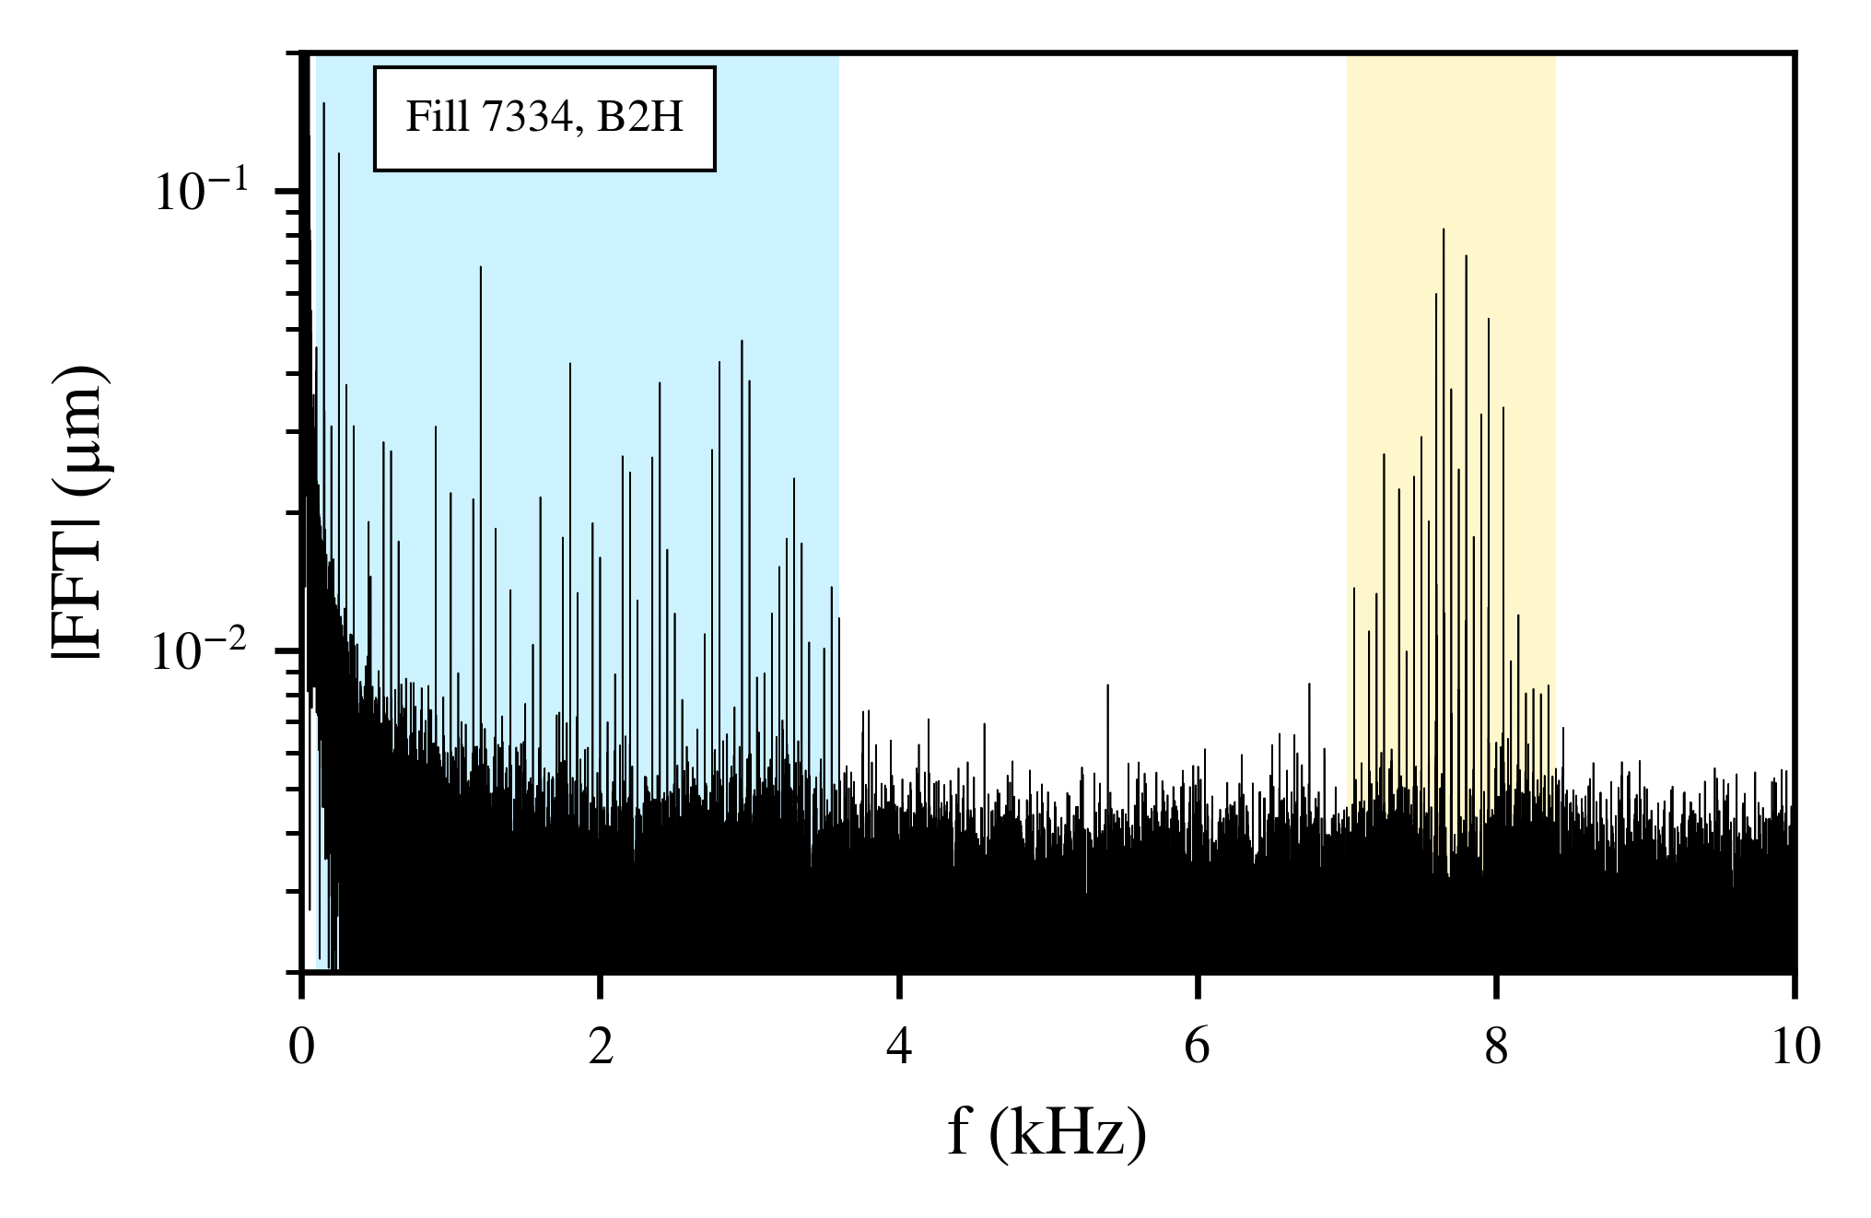
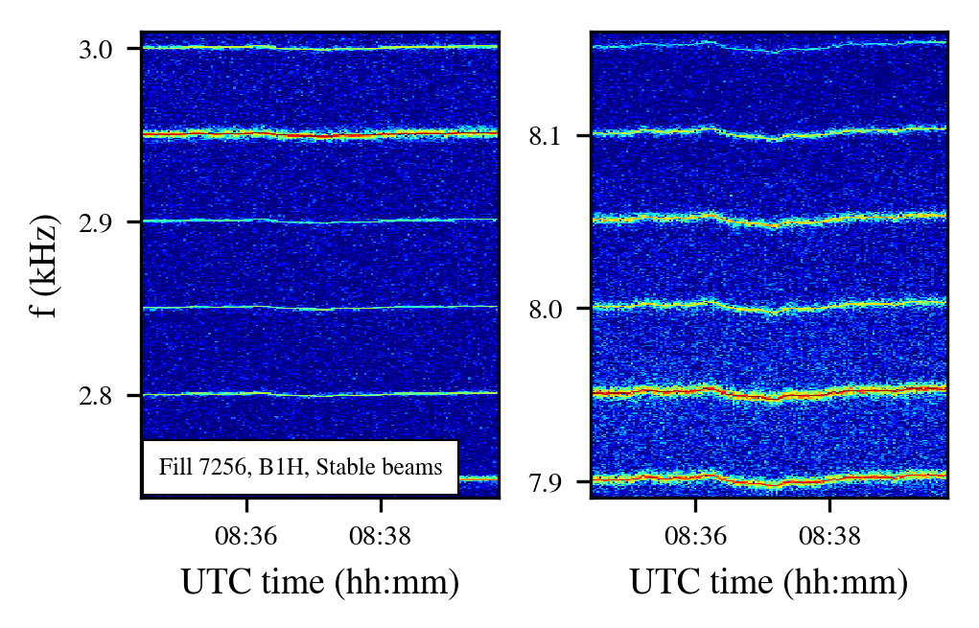
Motivation
LHC transverse spectrum features 50 Hz harmonics appearing in
low (0-3.6 kHz) & high (around 8 kHz) frequency clusters, with frequencies flunctuating in time (due to stability of 50 Hz network frequency) as shown on spectrograms.
Origin of low frequency → associated with main dipoles (see active filters in Run 2 MDs).
Simulations indicate that high frequency cluster has an impact on beam lifetime → need to identify origin as first step to possible mitigation.

Slide 3
MD6823 tried to address two questions
Can the UPS’s connected to the ADT introduce an effect on the beam?
If yes, are these UPS’s acting on the 8 kHz region?

Slide 4
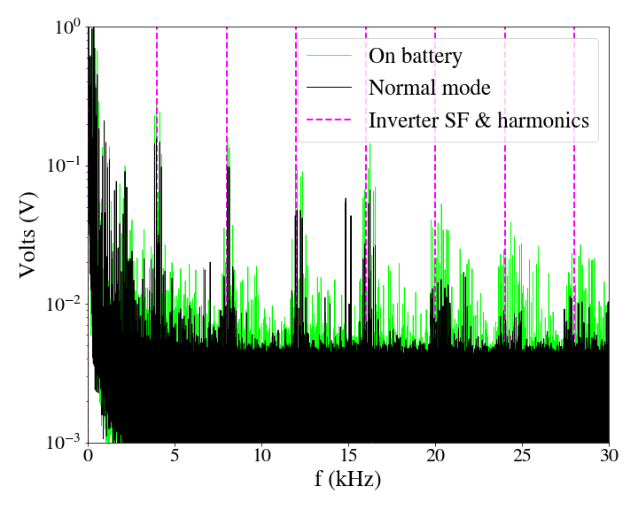
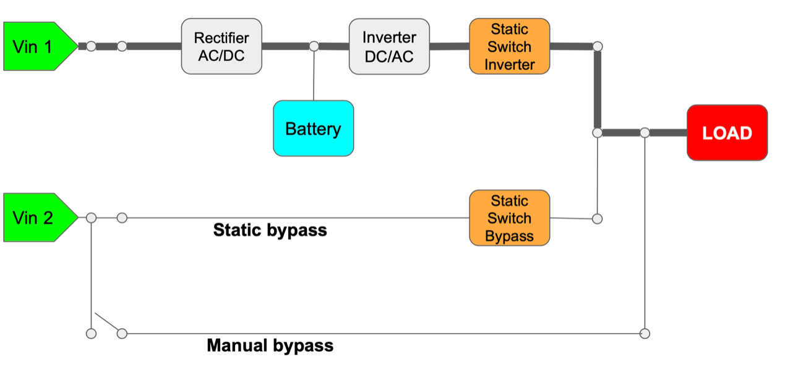
Few words on UPS voltage spectra
Measurements of spare UPS in SM18 during LS2.
UPS output voltage spectrum: 50 Hz harmonics around 4 and 8 kHz following network frequency fluctuation in time→ similar to 50 Hz harmonics on the beam spectrum.
UPS operation modes: nominal, on battery, static and manual bypass.
UPS noise spectrum
UPS modes of operation
Link for UPS noise measurements in SM18

Slide 5
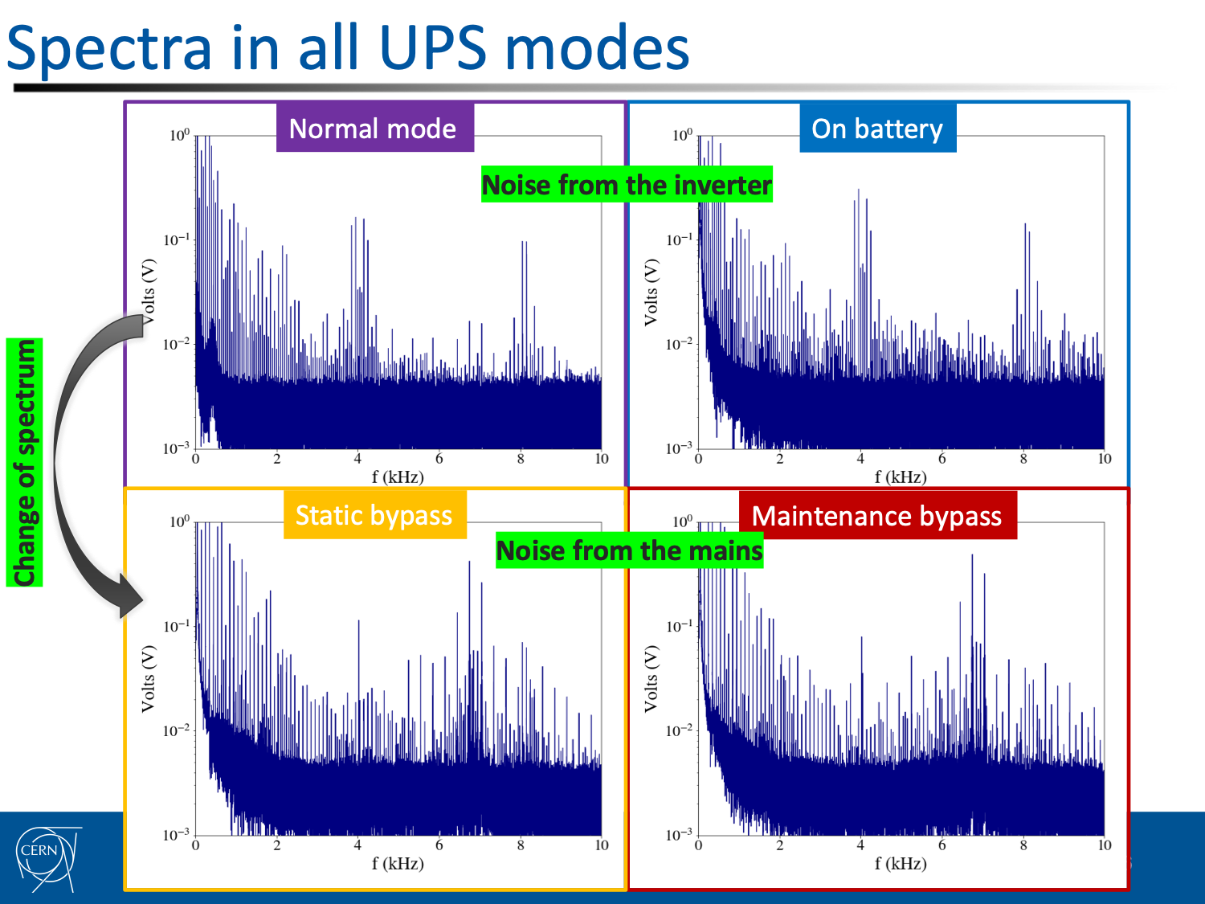
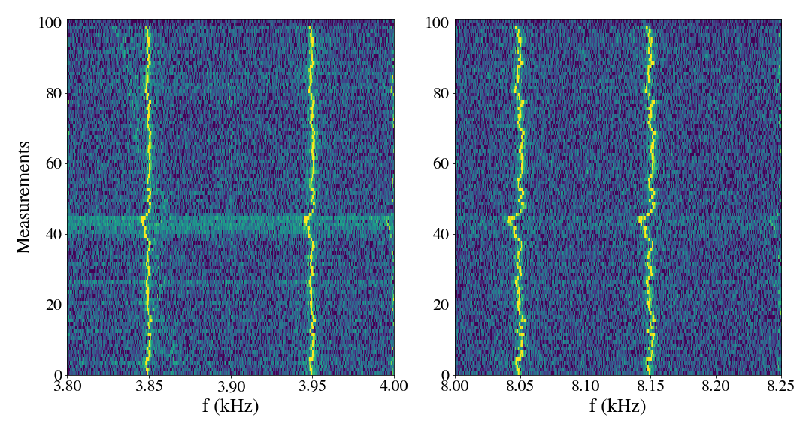
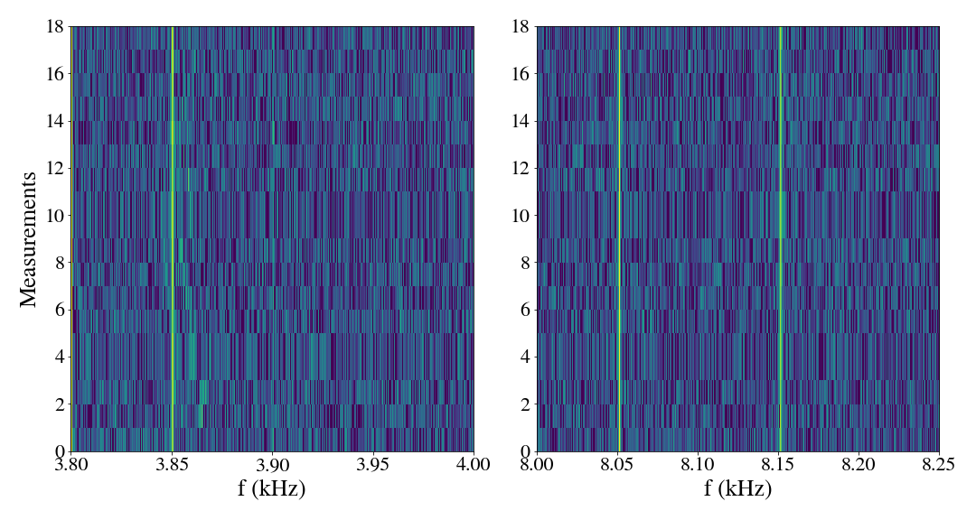
Measurements in SM18
On battery with Vin1 and Vin2 disconnected: harmonics synchronized with internal clock, rather than mains, appear as fixed lines in the spectrograms (change that can be easily detected on beam spectrum).
Static & manual bypass: change of harmonics’ amplitude (not easily detected on beam spectrum).
Nominal to battery mode

Slide 6
MD overview
MD took place on 01/07/2022 15:05-22.05 (CET), Fills 7896 & 7897 [3 h lost due to PC fault]
Filling scheme & beam conditions: longitudinally equidistant bunches (first 6 pilots & then 4 nominals) at injection energy.
Tools for observation of beam spectrum: continuous ADTObsBox circular buffer.
UPS modifications from EN/EL:
EBS11/4R in SR4 (no access needed) switched from “nominal” configuration to “battery”, “static bypass”, “manual bypass” and back to “nominal”.
  UPS connected to (H. Timko): ADT, LHC beam control (RF frequency generation, beam phase loop, synchronisation etc.), longitudinal diagnostics in SR4 (APWL, beam spectra, longitudinal ObsBox)
EZS1/45X and EZS11/45X (in cascade) in UX45 (access needed) switched from “nominal” configuration to “manual bypass” and then back to “nominal”. Not possible to switch to “battery mode” without remote control.
  UPS connected to (H. Timko): ADT, racks for klystrons, LLRF crates for cavity control and longitudinal diagnostics in UX45.

Slide 7
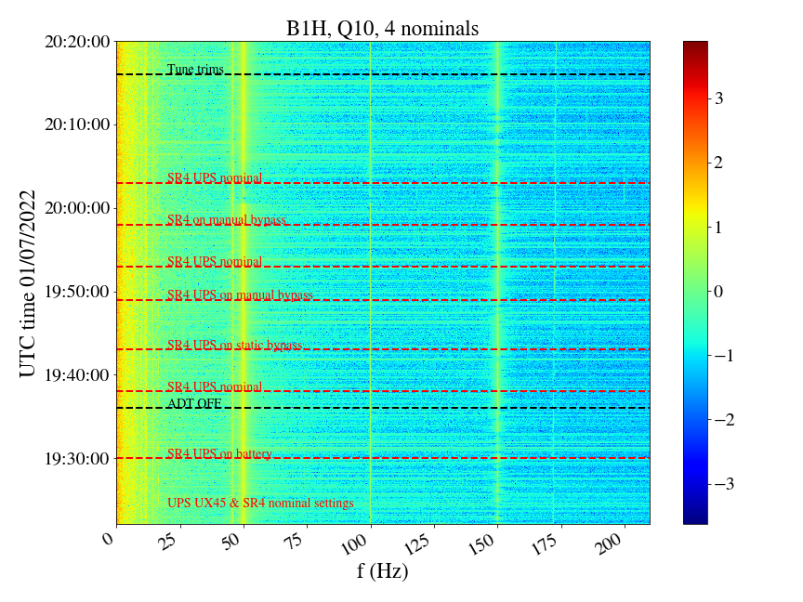
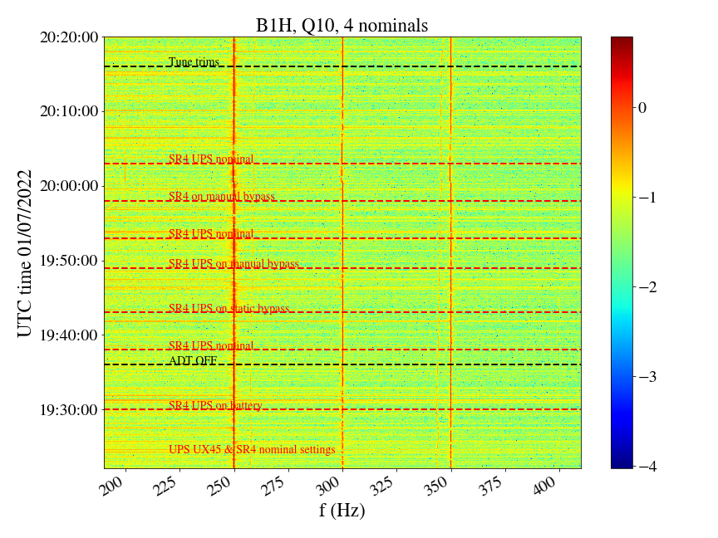
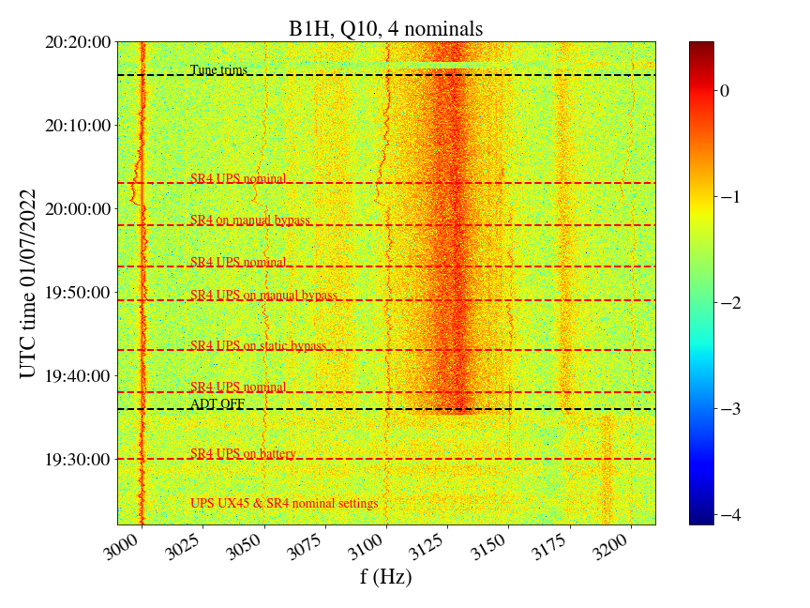
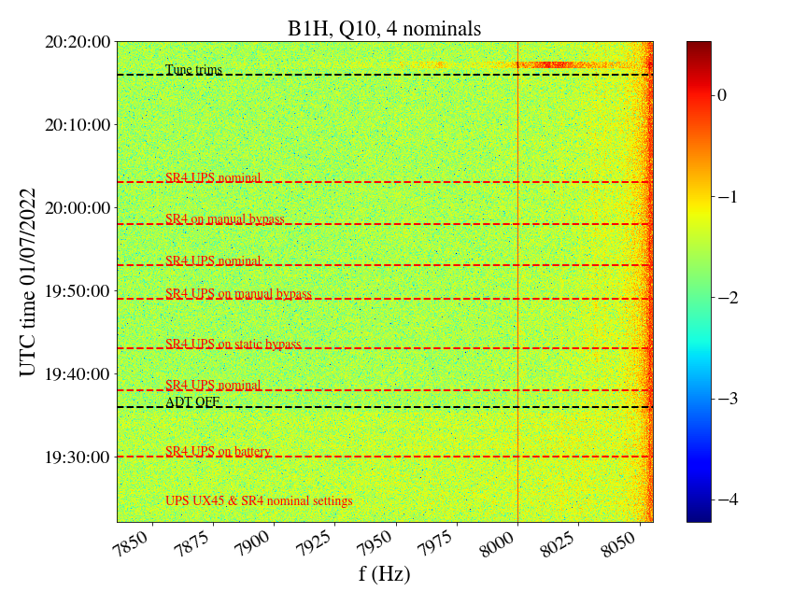
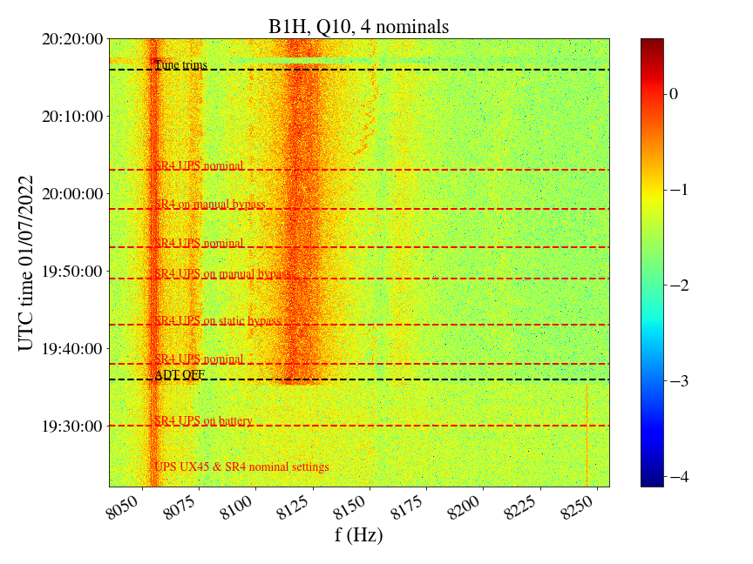
ADTObsBox spectra in MD, UPS in SR4 tests
Conclusion:
No visible impact when switching UX45 UPSs from “manual bypass” to “nominal” with 4 nominal bunches
8 kHz cluster not visible, so impact cannot be excluded.
4 nominals

Slide 8
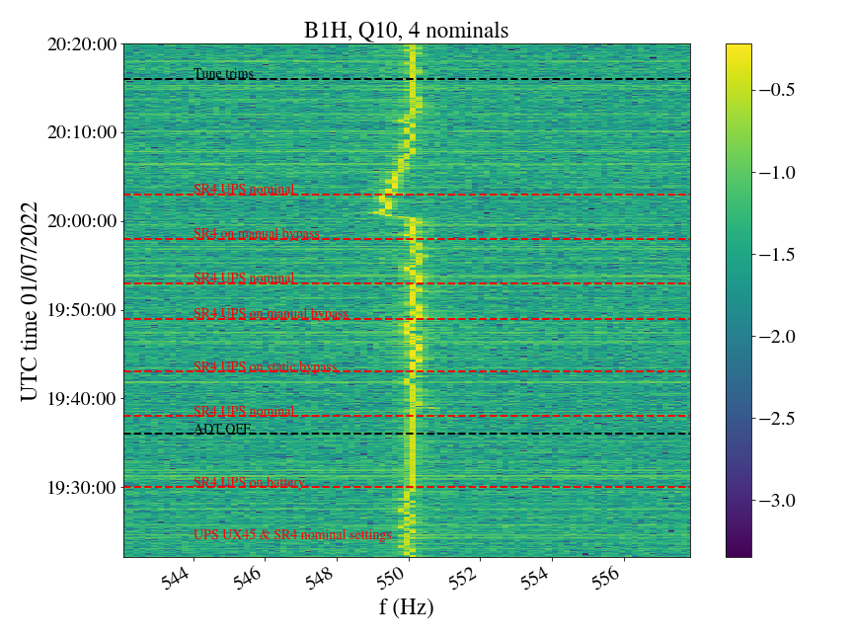
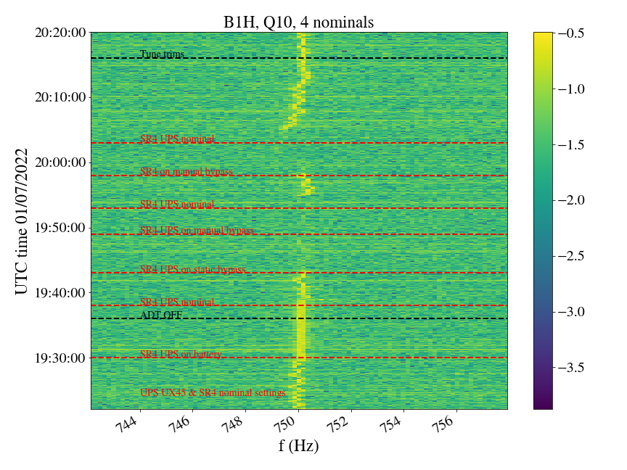
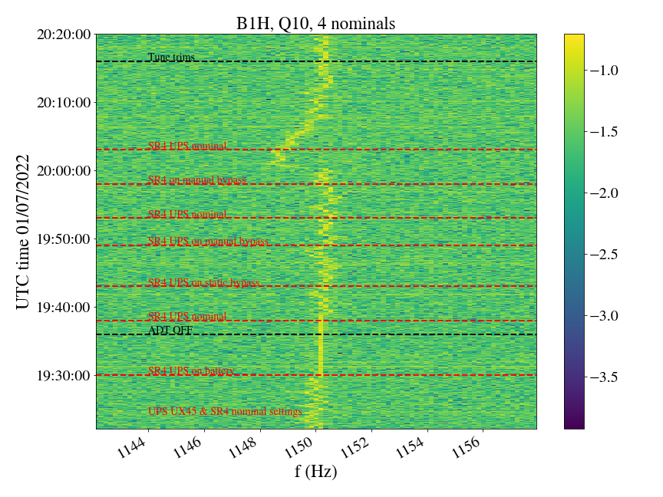
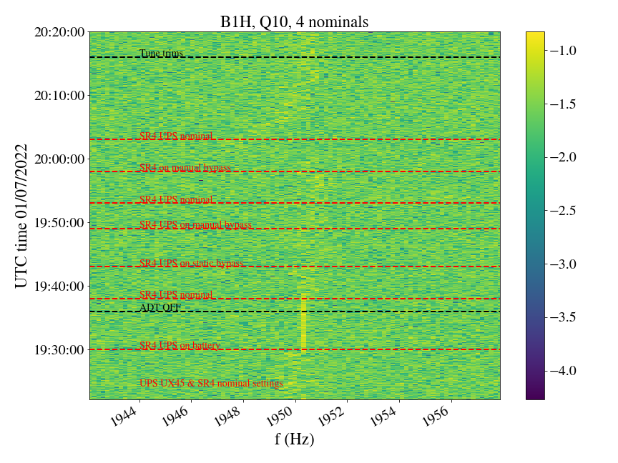
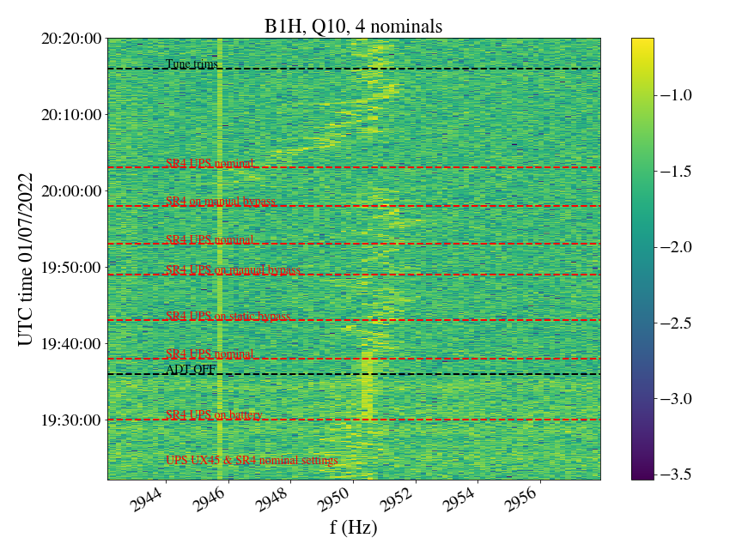
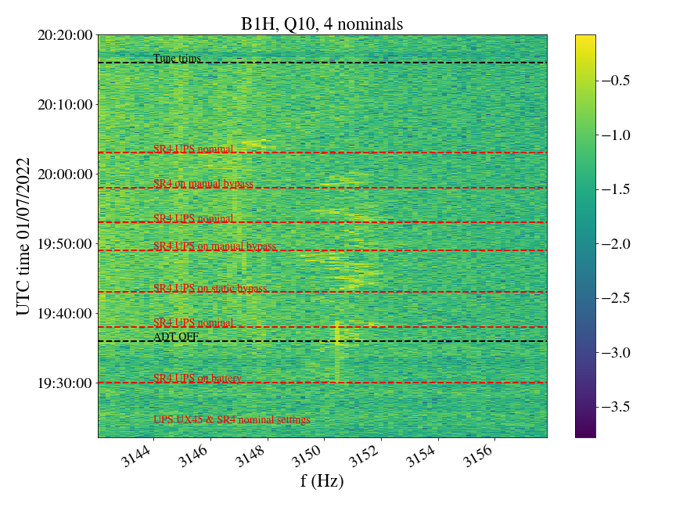
ADTObsBox spectra in MD, UPS in SR4 tests

Slide 9
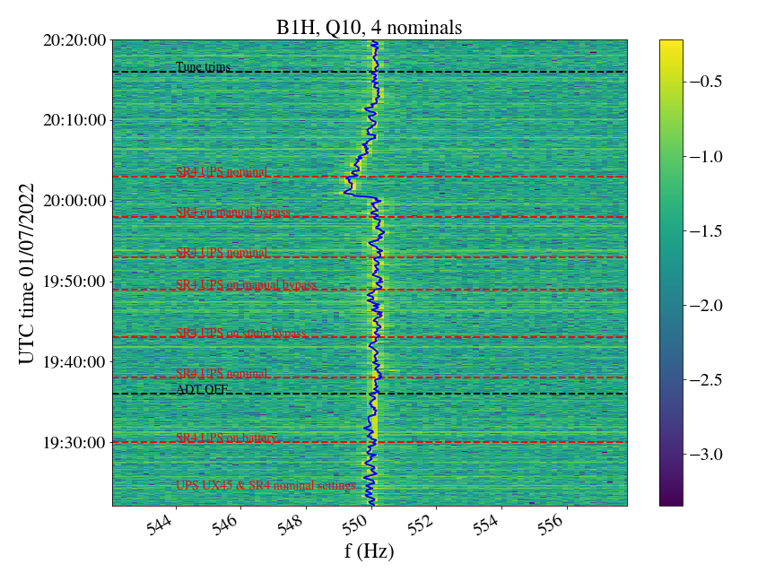
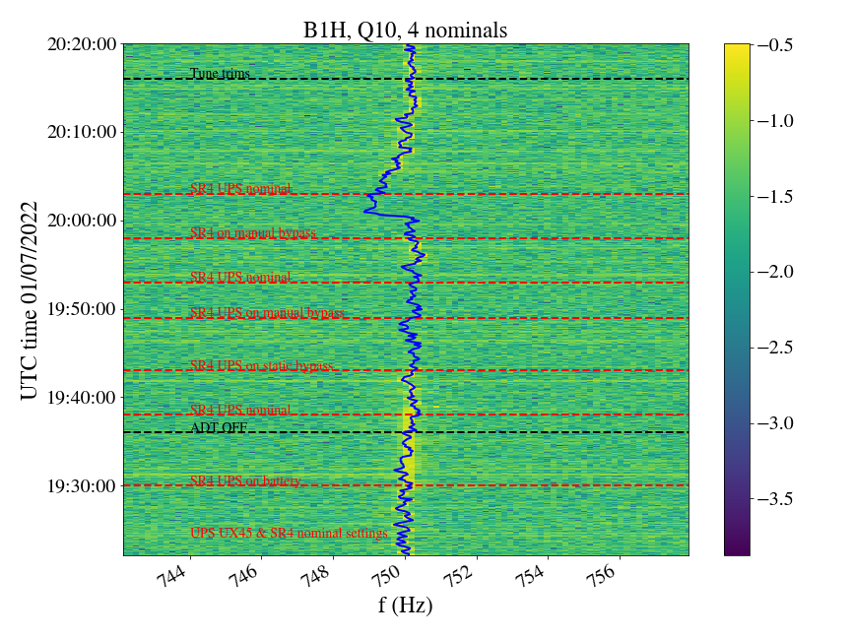
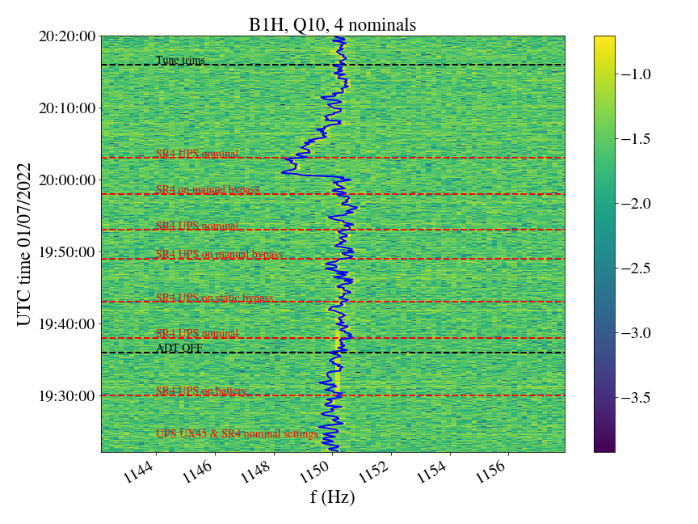
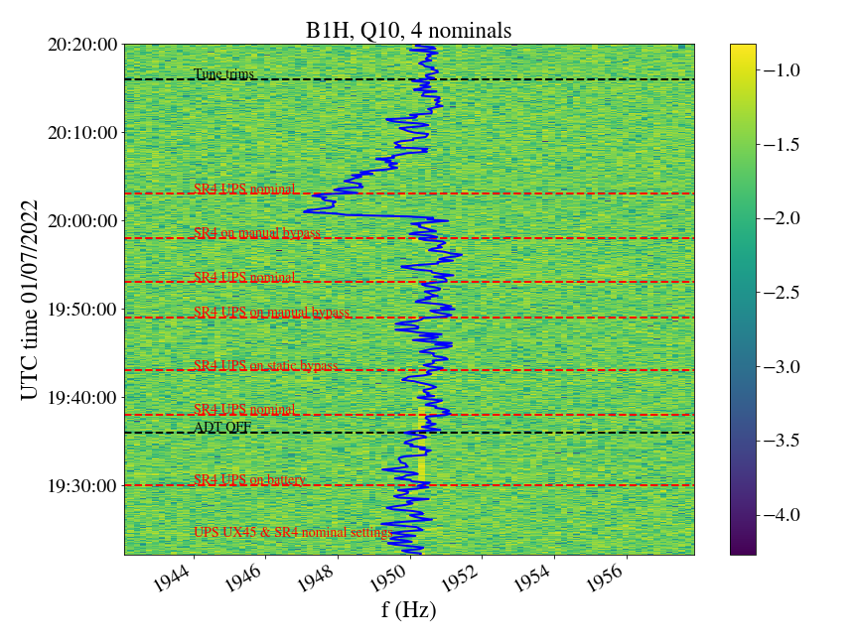
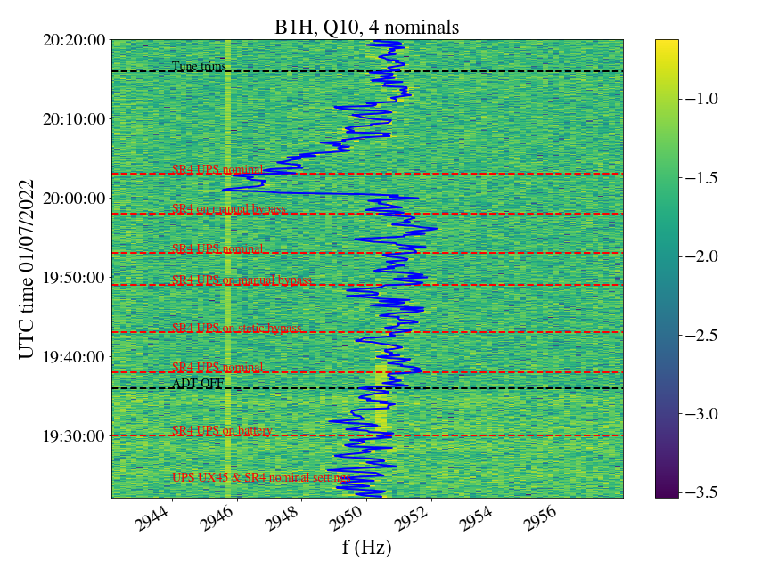
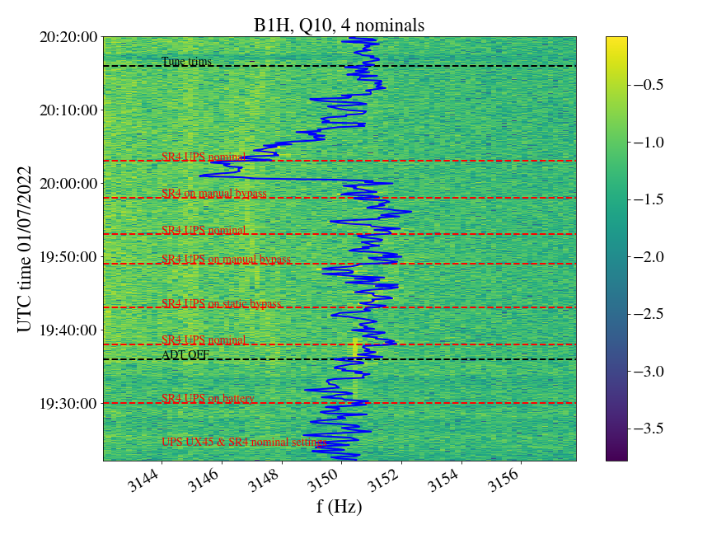
ADTObsBox spectra in MD, UPS in SR4 tests
Data from Réseau de Transport d'Électricité
Conclusion:
Clear loss of synchronization with mains when UPS in SR4 is switched to “battery” mode for some harmonics on the beam spectrum (e.g. 550, 750, 1150, 1950, 2950, 3150 Hz).
8 kHz cluster not visible so impact from SR4 UPS cannot be excluded.
Clear amlitude change during static bypass
No synchronization with mains when on battery

Slide 10
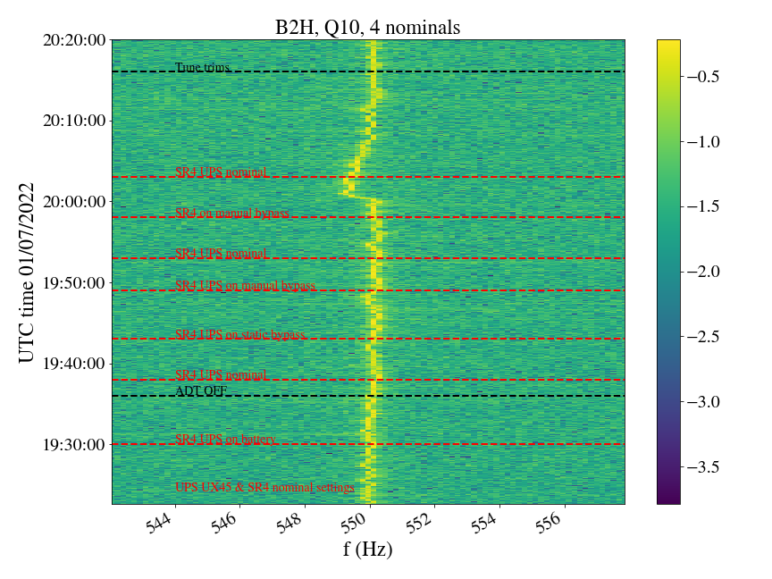
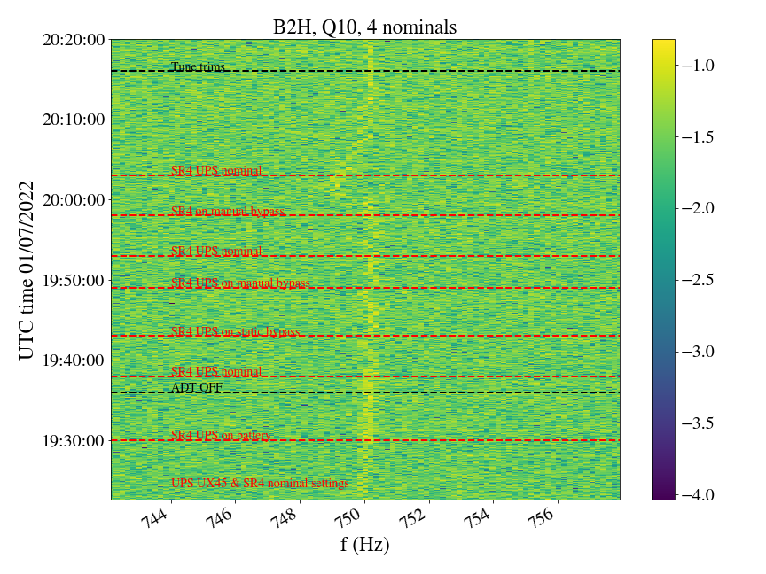
B1
B2
Conclusion:
Loss of synchronization with mains when UPS in SR4 is switched to “battery” mode observed only in B1 and not B2.

Slide 11
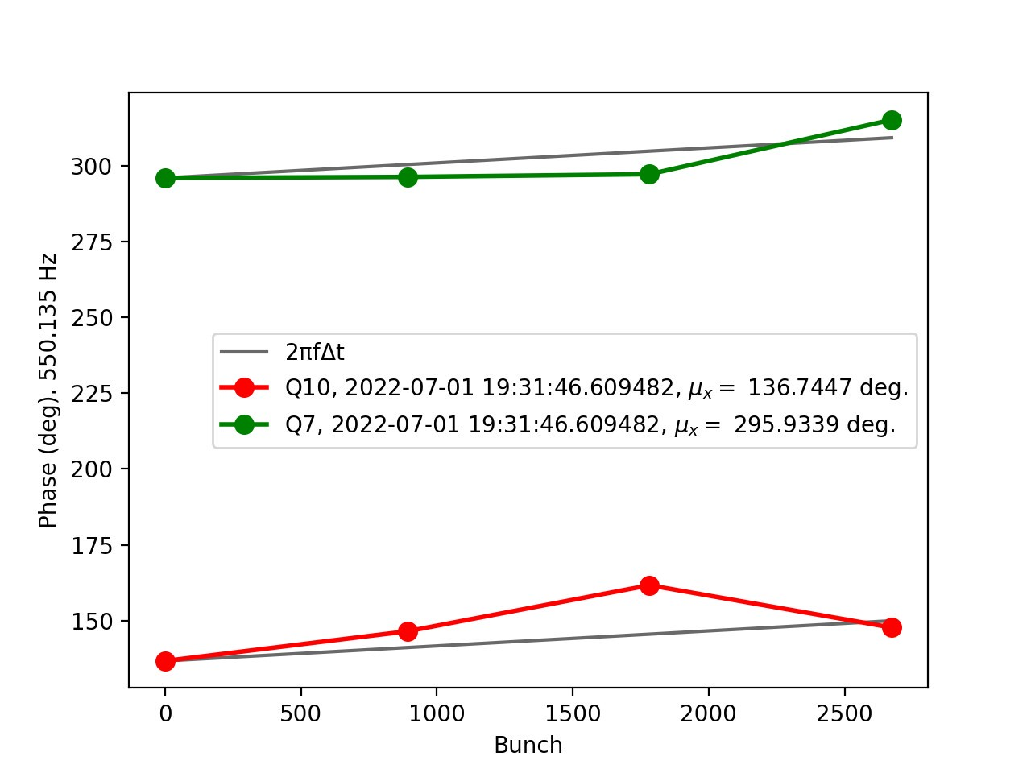
Is it an instrumental effect or a real beam oscillation?
The observed phase is NOT compatible with the B1 betatron phase.
We thinks it is instrumental.

Slide 12
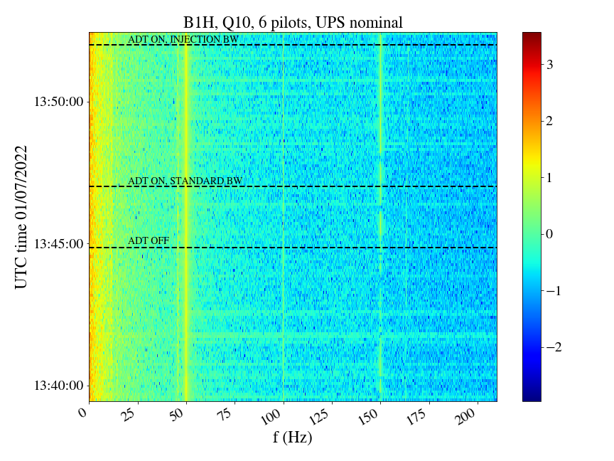
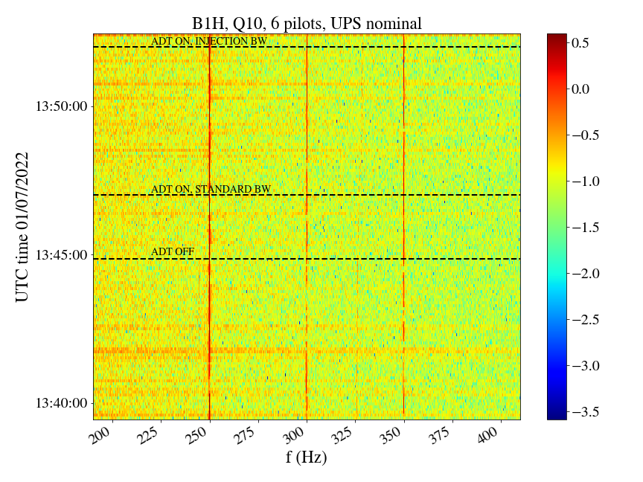
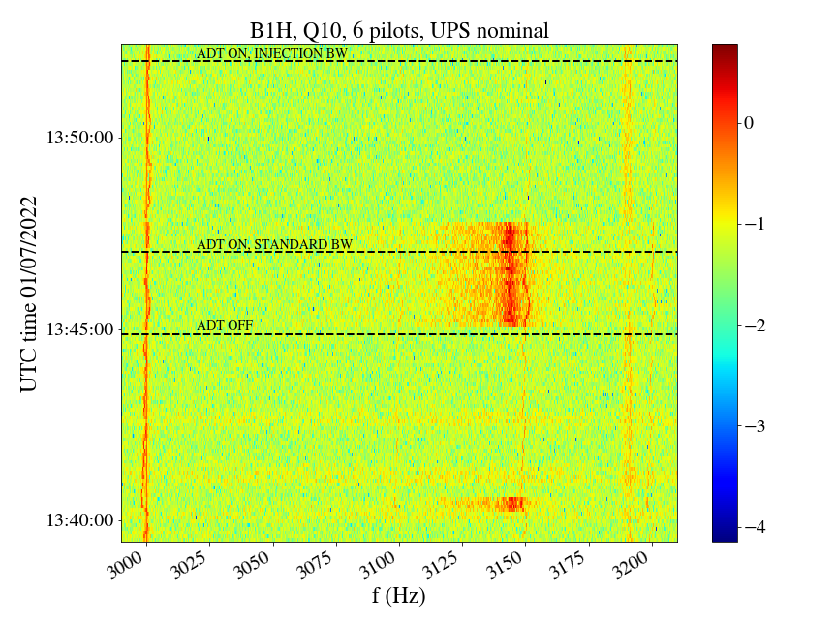
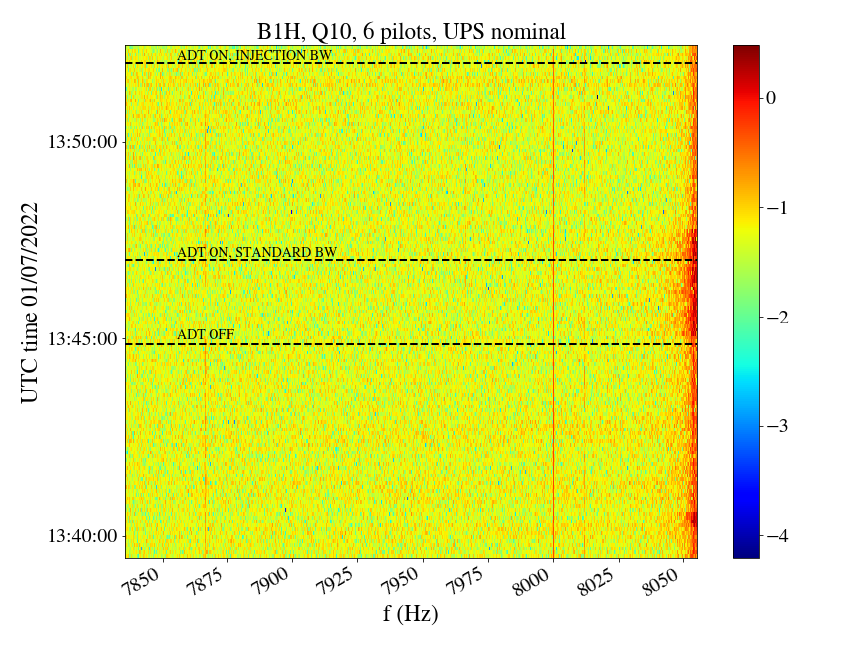
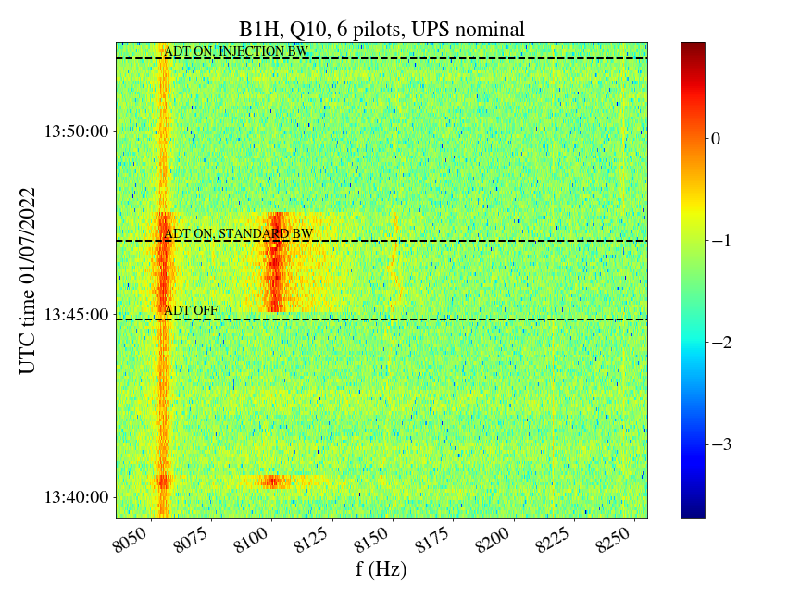
ADTObsBox spectra in MD: Reference spectrum
Conclusion:
8 kHz cluster not visible with 6 pilots at injection.
6 pilots
UPS to nominal configuration

Slide 13
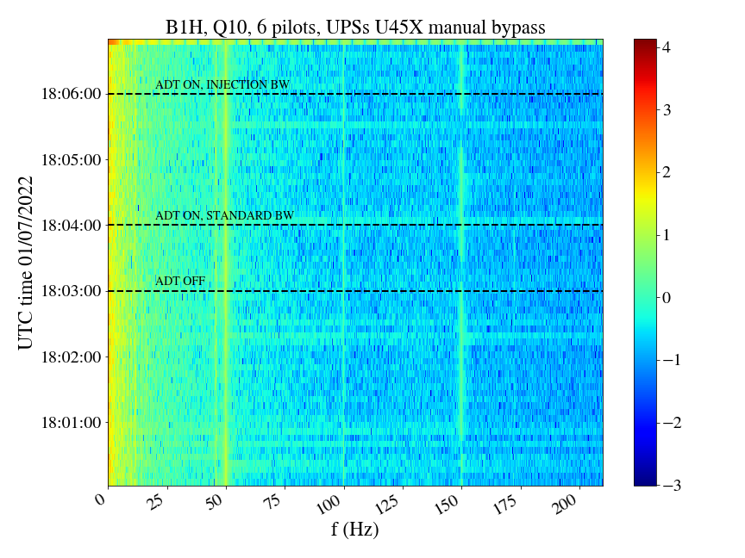
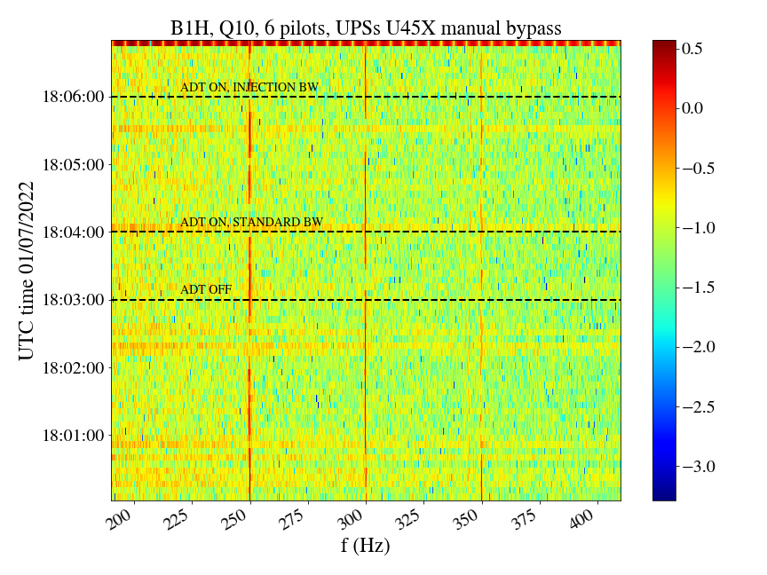
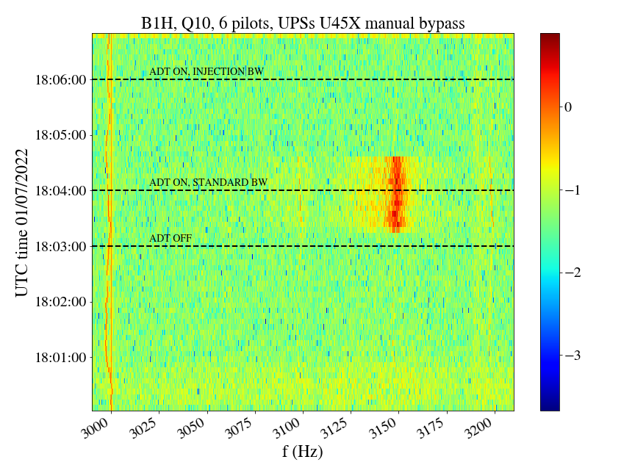
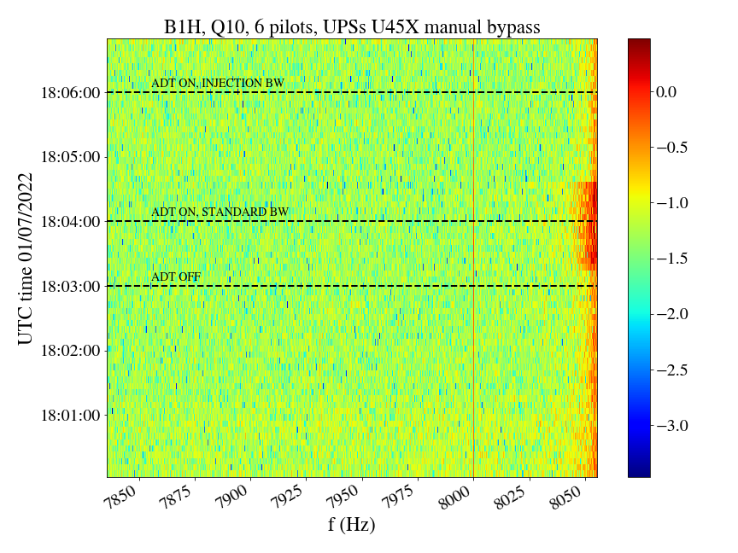
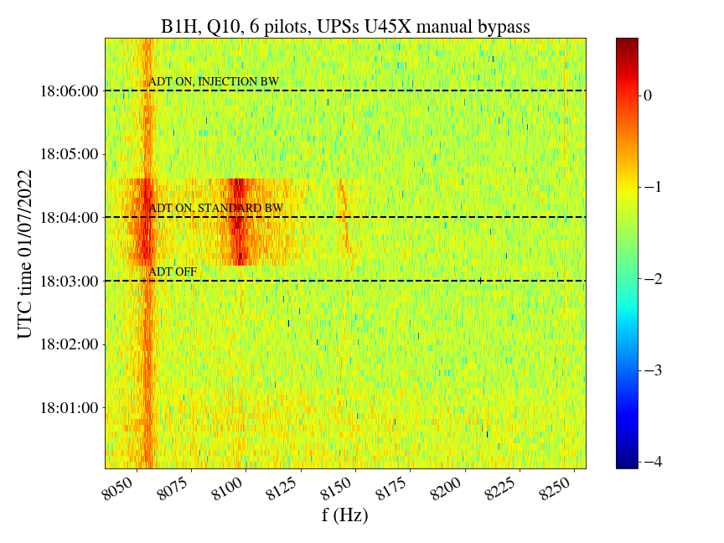
ADTObsBox spectra in MD: U45X UPSs in manual bypass
Conclusion:
No change observed on beam spectrum when U45X UPSs were switched to manual bypass.
8 kHz cluster not visible so impact cannot be excluded.
6 pilots,
UPSs U45X in manual bypass

Slide 14
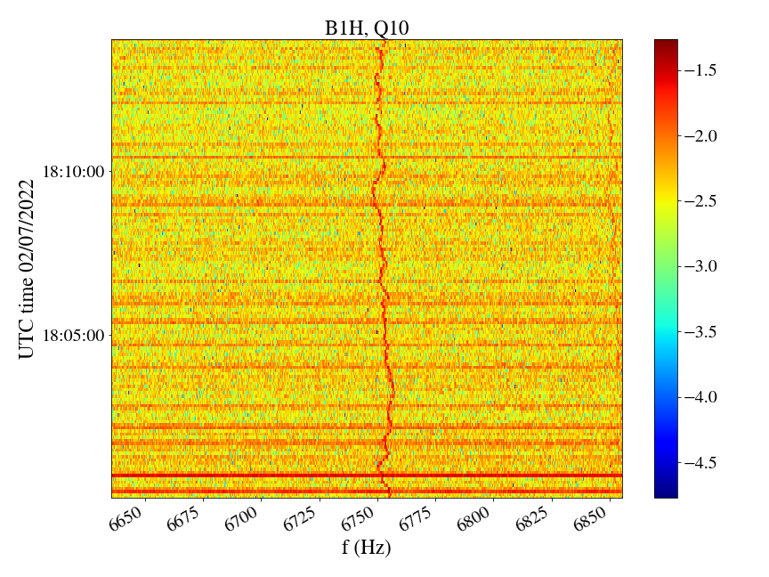
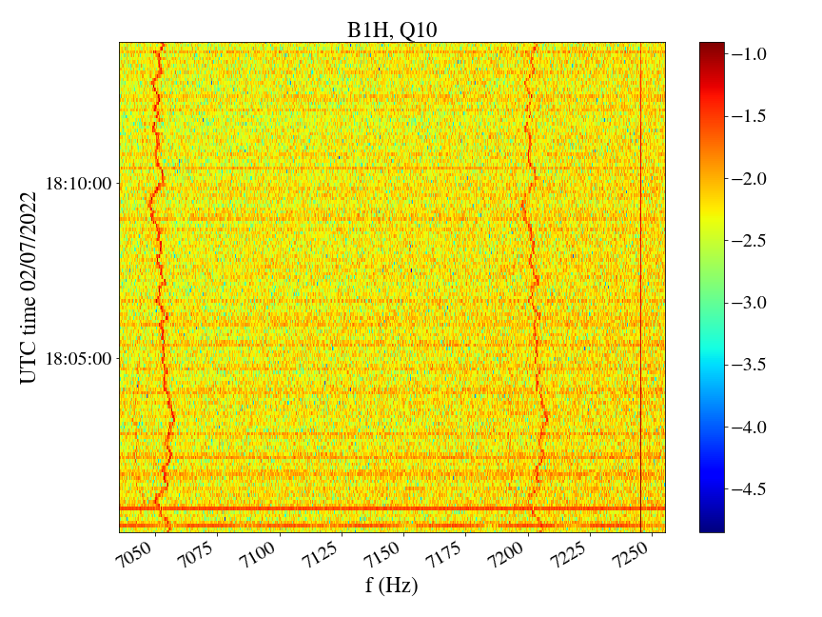
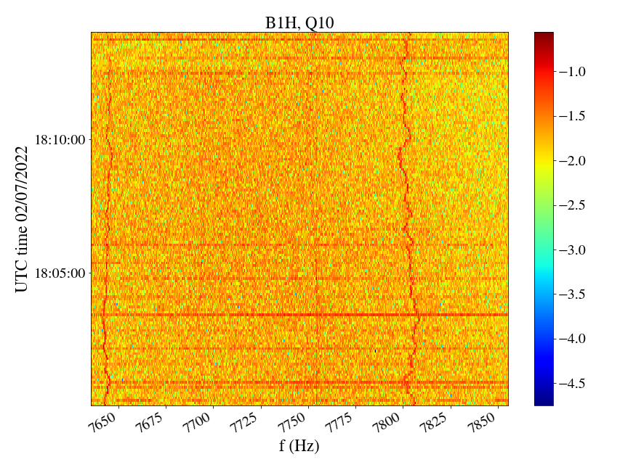
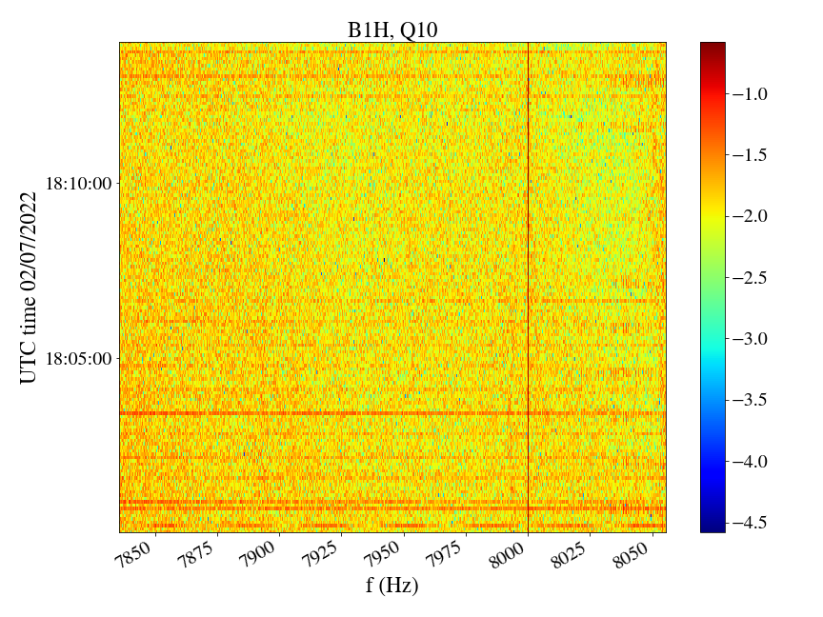
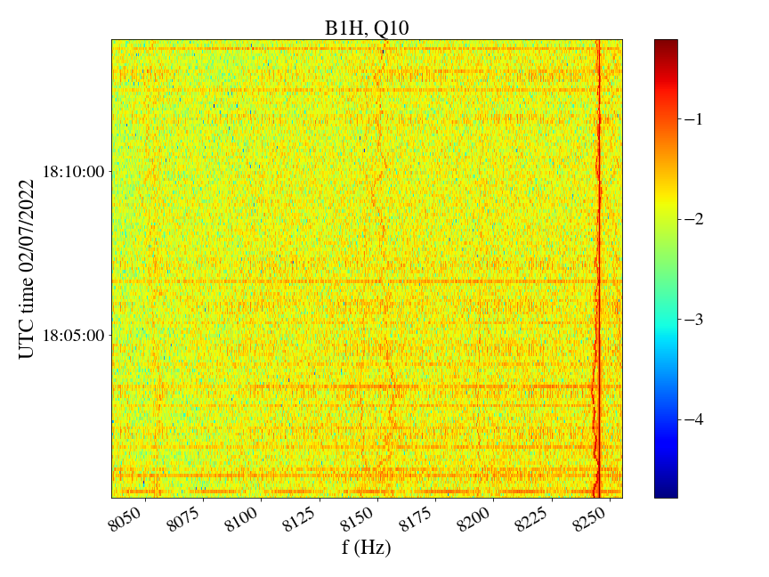
ADTObsBox spectra, 02/07/2022 ~2400 bunches
Conclusion:
8 kHz cluster visible with 2400 bunches at injection thanks to signal averaging.
Harmonics at 8 kHz observed when averaging with 2400 bunches

Slide 15
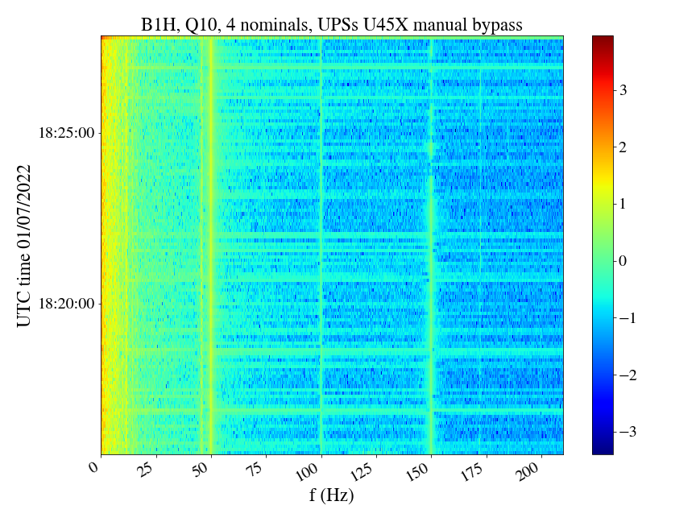
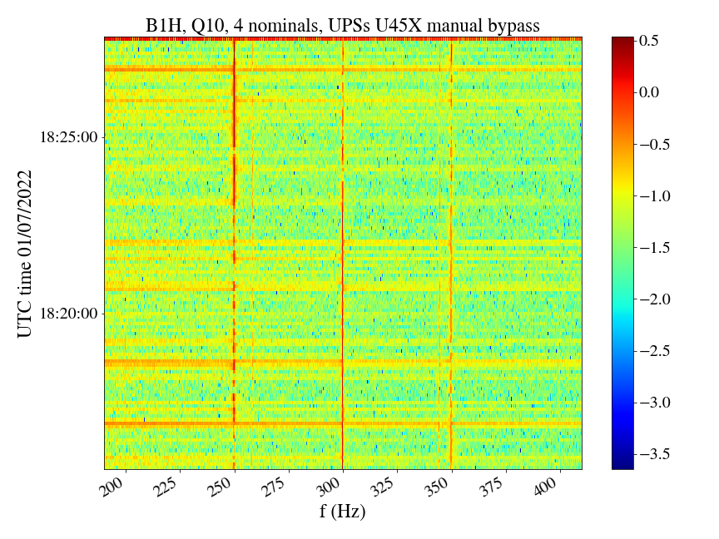
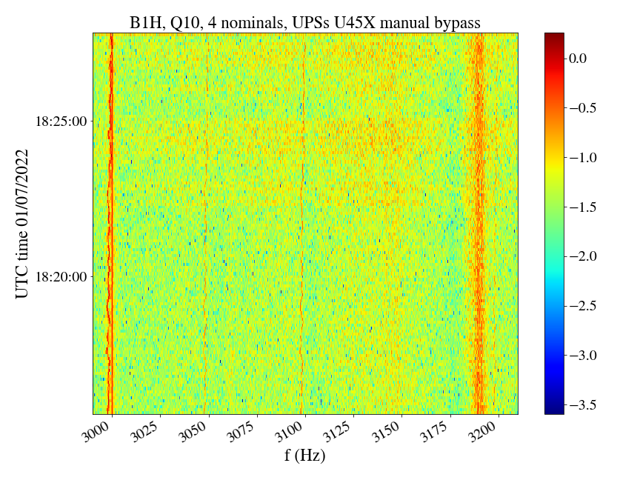
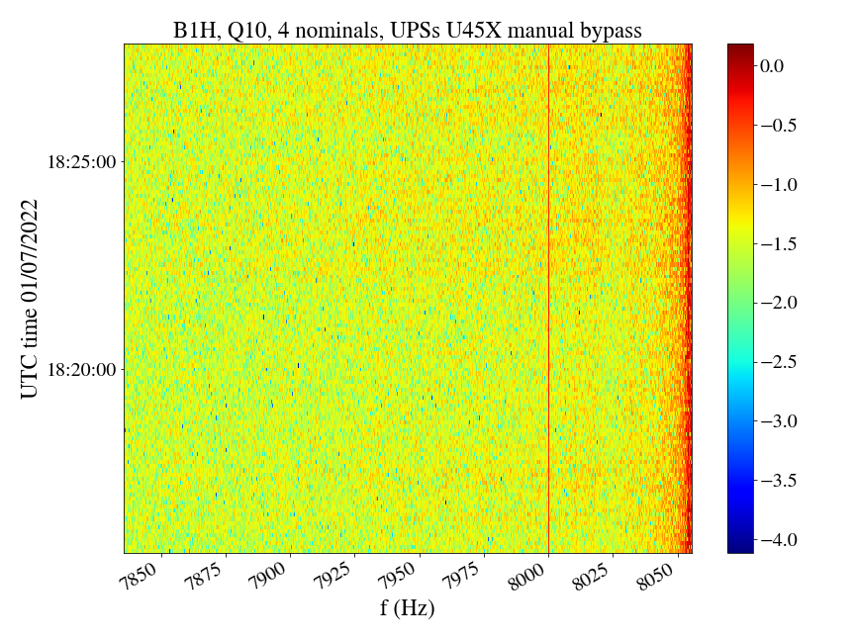
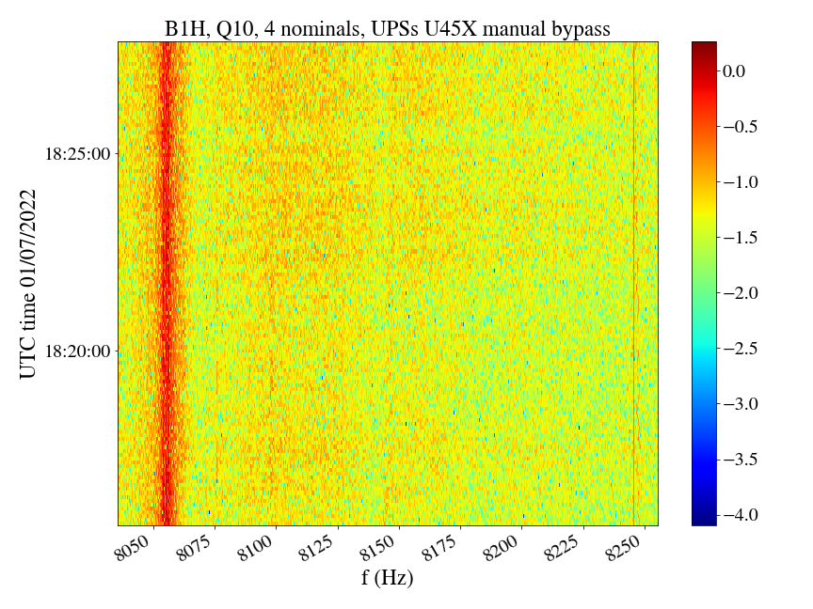
ADTObsBox spectra in MD with 4 nominals
Conclusion:
Better signal with 4 nominals but 8 kHz cluster still not visible.
4 nominals,
UPSs U45X in manual bypass

Slide 16
Spectrograms 05/07/2022 (injection-Stable beams,
3 bunches)

Slide 17
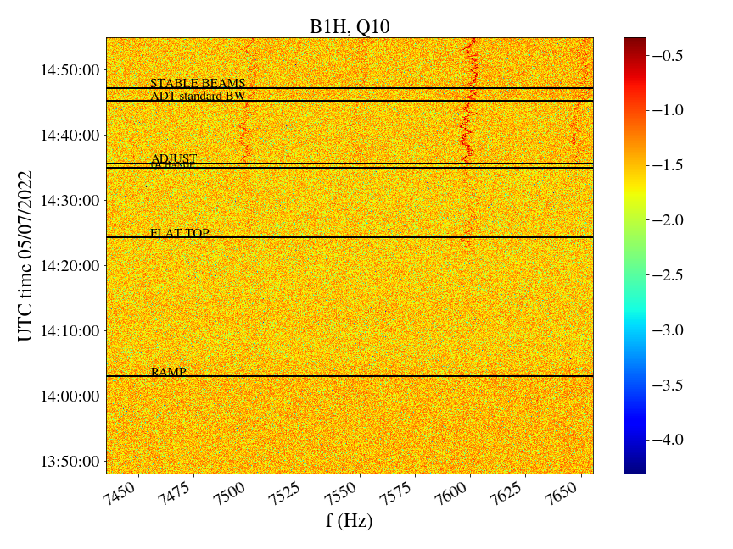
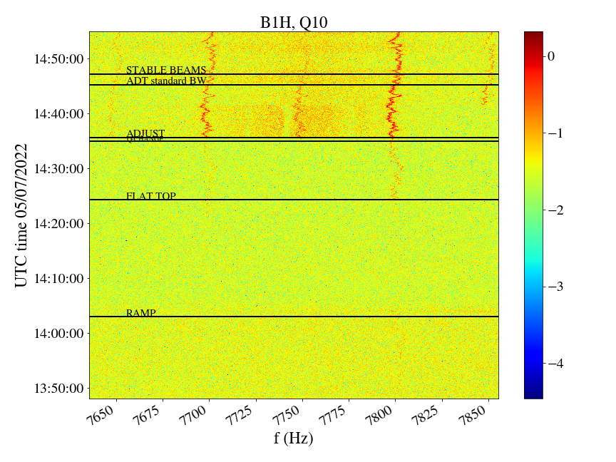
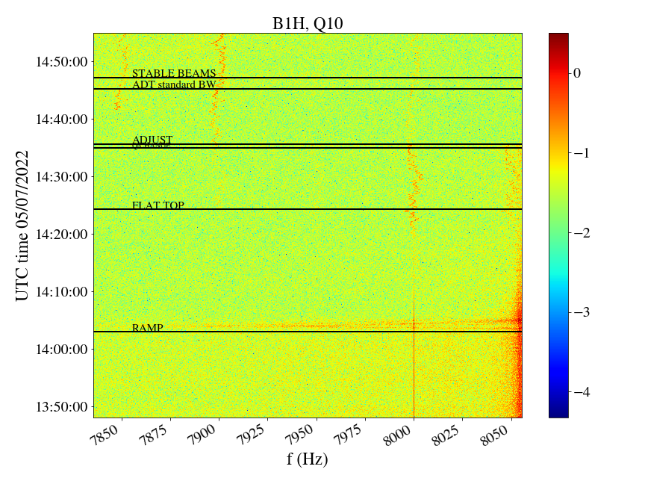

ADTObsBox spectra, 05/07/2022, 3 bunches

Slide 18
ADTObsBox spectra, 05/07/2022, 3 bunches
Conclusion:
First observations from Run3 indicate that the 8 kHz cluster increases in amplitude after ramp, clearly visible even with 3 bunches → best moment in cycle to study impact from UPSs…

Slide 19
Summary
Collected important new insights concerning 50 Hz harmonics during the MD thanks to ADTObsBox continuous buffer combined with UPS tests:
  As a first attempt, UPS tests performed at injection with low intensity beams.
Can the UPS’s connected to the ADT introduce an effect on the beam? Impact from UPS in SR4 on a few low-order harmonics (550, 750, 1150, 1950, 2050, 3150 Hz), it is the first time that we observe a clear signature when UPS in SR4 is switched to battery mode, effect observed only on B1.
Are these UPS’s acting on the 8 kHz region? No clear impact of UPS in UX45 on any 50 Hz line, however 8 kHz cluster not observed during MD and thus UPS impact cannot be excluded.
8 kHz cluster not visible during MD with a few bunches at injection:
  → Proposal: repeat “SR4 UPS on battery” after Ramp as an End of Fill MD when largest amplitudes of 8 kHz cluster are observed.

Slide 20
Backup

Slide 21



Noise MD in Run 2

Slide 22


Slide 23
Measurements in SM18
https://indico.cern.ch/event/939642/contributions/3947990/attachments/2079053/3491788/BB_lumi_17072020.pdf
Measurements of spare UPS in SM18 during LS2.
UPS output voltage spectrum: 50 Hz harmonics around 4 and 8 kHz following network frequency fluctuation in time→ similar to 50 Hz harmonics on the beam spectrum.
UPS operation modes: nominal, on battery, static and manual bypass.
Switching UPS operational modes leads to change in the UPS noise spectrum → apply changes in UPS configuration during LHC operation with beam and observe beam spectrum.

Slide 24


Slide 25




ADTObsBox spectra
Run 3
Run 2
Note: arbitrary units, calibration not yet implemented
Injection
Stable beams

Slide 26
MD overview
21:30 UPS SR4 on battery
21:36 ADT OFF
21:38 UPS SR4 back to nominal
21:43 UPS SR4 on static bypass
21:49 UPS SR4 on manual bypass
21:53 UPS SR4 back to nominal
21:58 UPS SR4 on manual bypass
22:03 UPS SR4 back to nominal
22:16 Tune trims
22:20 Beam dump
15:36 injection of 6 pilots
15:44 ADT OFF
15:46 changed to standard ADT BW
15:52 changed to injection ADT BW
15:59 EN-EL access to U45X to switch 2 UPSs in manual bypass
20:00 injected 6 pilots with injection ADT BW
20:04 changed to standard ADT BW
20:06 changed to injection ADT BW
20:15 injection of 4 nominal bunches
20:27 Beam dump
20:30 EN-EL access to U45X to switch back 2 UPSs to nominal configuratiom
21:22 injection of 4 nominal bunches

Slide 27
ADTObsBox spectra, 02/07/2022 ~2400 bunches
Harmonics at 8 kHz observed when averaging with 2400 bunches

Slide 28

ADTObsBox spectra, 02/07/2022 ~2400 bunches
https://www.services-rte.com/en/download-data-published-by-rte.html?category=public_transmission_system&type=network_frequencies

Slide 29






ADTObsBox spectra, 05/07/2022, 3 bunches
50 Hz harmonics low-f cluster attenuate during ramp
Some increase in amplitude during ramp..

Slide 30





ADTObsBox spectra, 02/07/2022 ~2400 bunches
Confirms that these are actually 50 Hz harmonics around 8 kHz!

Slide 31


B1
B2

