Slide 1
MD #7008 – Summary
Validation of method to measure aperture margin between IR6 and TCTs with non-nominal phase advance
Cédric Hernalsteens, Christoph Wiesner, Daniel Wollmann
LSWG

Slide 2
Method and objectives
Method to validate the retraction of the TCT in IR5 with respect to the TCDQ / TCSP
  Validate correct protection of the TCT from direct impact in case of asynchronous dump
  Uses a long closed-orbit bump extending from IR6 to IR5 for Beam 2 with circulating beams
  Provides aperture margin measurement
  Validates that the phase advance requirement from MKD to TCTH in IR5 is satisfied (must be < 30 degrees)
Objectives of the MD
  Extend results from MD #2186 (2018) where the method was tested for a nominal optics configuration
  Validate the method with intentionally detuned phase advance between IR6 and IR5. Two configurations:
    Using the MQTs in Arc 56 to detune the phase advance
    Using the MQs in Arc 56 (and Arc 45) to change the phase advance while limiting the beta-beating wave

Slide 3
Requested machine and beam parameters
Time required per MD [h] | 8h
Beams required | Beam 2 only
Beam energy [GeV] | 6.8 TeV
Optics (injection, squeezed, special) | Collisions (β* = 60 cm, tele-index = 1, nominal crossing angle)
Bunch intensity and number of bunches | 3 pilots distributed in the B2 ring (buckets 1, 8911, 17851)
Optics change [yes/no] | Yes. Phase advance detuning in S56
Orbit change [yes/no] | Yes. Closed 4 corrector-bump from IP6 to IP5
Collimation change [yes/no] | Yes.
RF system change [yes/no] | No.
Feedback changes [yes/no] | Yes. Orbit feedback to be switched off at flat top.
What else will be changed? | ADT excitation of pilots (as for loss maps).

Slide 4
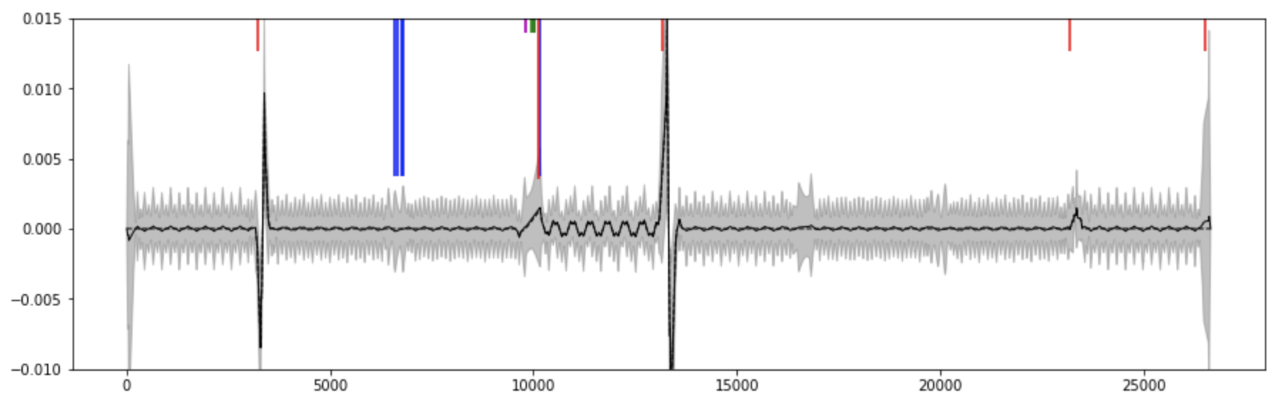
Long-orbit bump
Open the bump upstream of MKD and close downstream of TCTPH in IR5
  MCBH.11R6.B2, MCBCH.9R6.B2, MCBCH.9L5.B2, MCBCH.7L5.B2
  Correct the leakage in the rest of the ring manually using YASP and a few correctors L5 (feedback off)
  Increase amplitude in steps of 0.5 sigma up to 2 sigma then in steps of 0.1 sigma until reaching 3 sigma (ensuring that the TCDQ / TCSP defines the aperture - TCDQ@7.3 and TCP@5.0 )
Expected leakage for non-nominal optics (see next)
22-Aug-22
Floating MD preparation - MD #7008
4

Slide 5
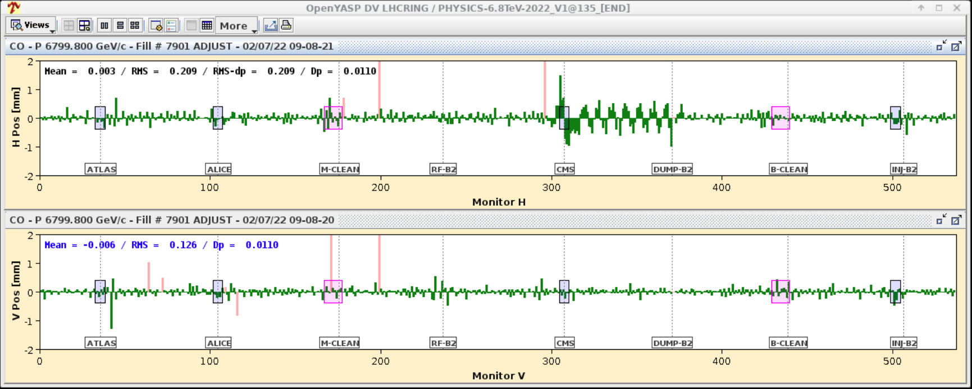
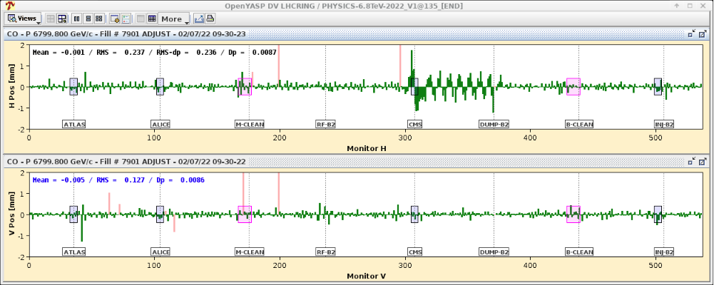
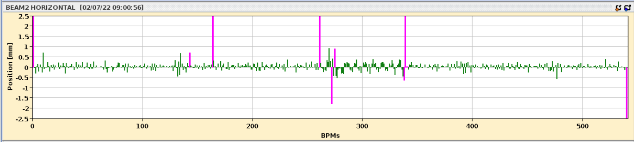
Long-orbit bump validation
Bump put in place in steps of 0.1 sigma up to 1 sigma, then 2 sigma and 2.5 sigma.
No clear sign of leakage, well computed bump!

Slide 6
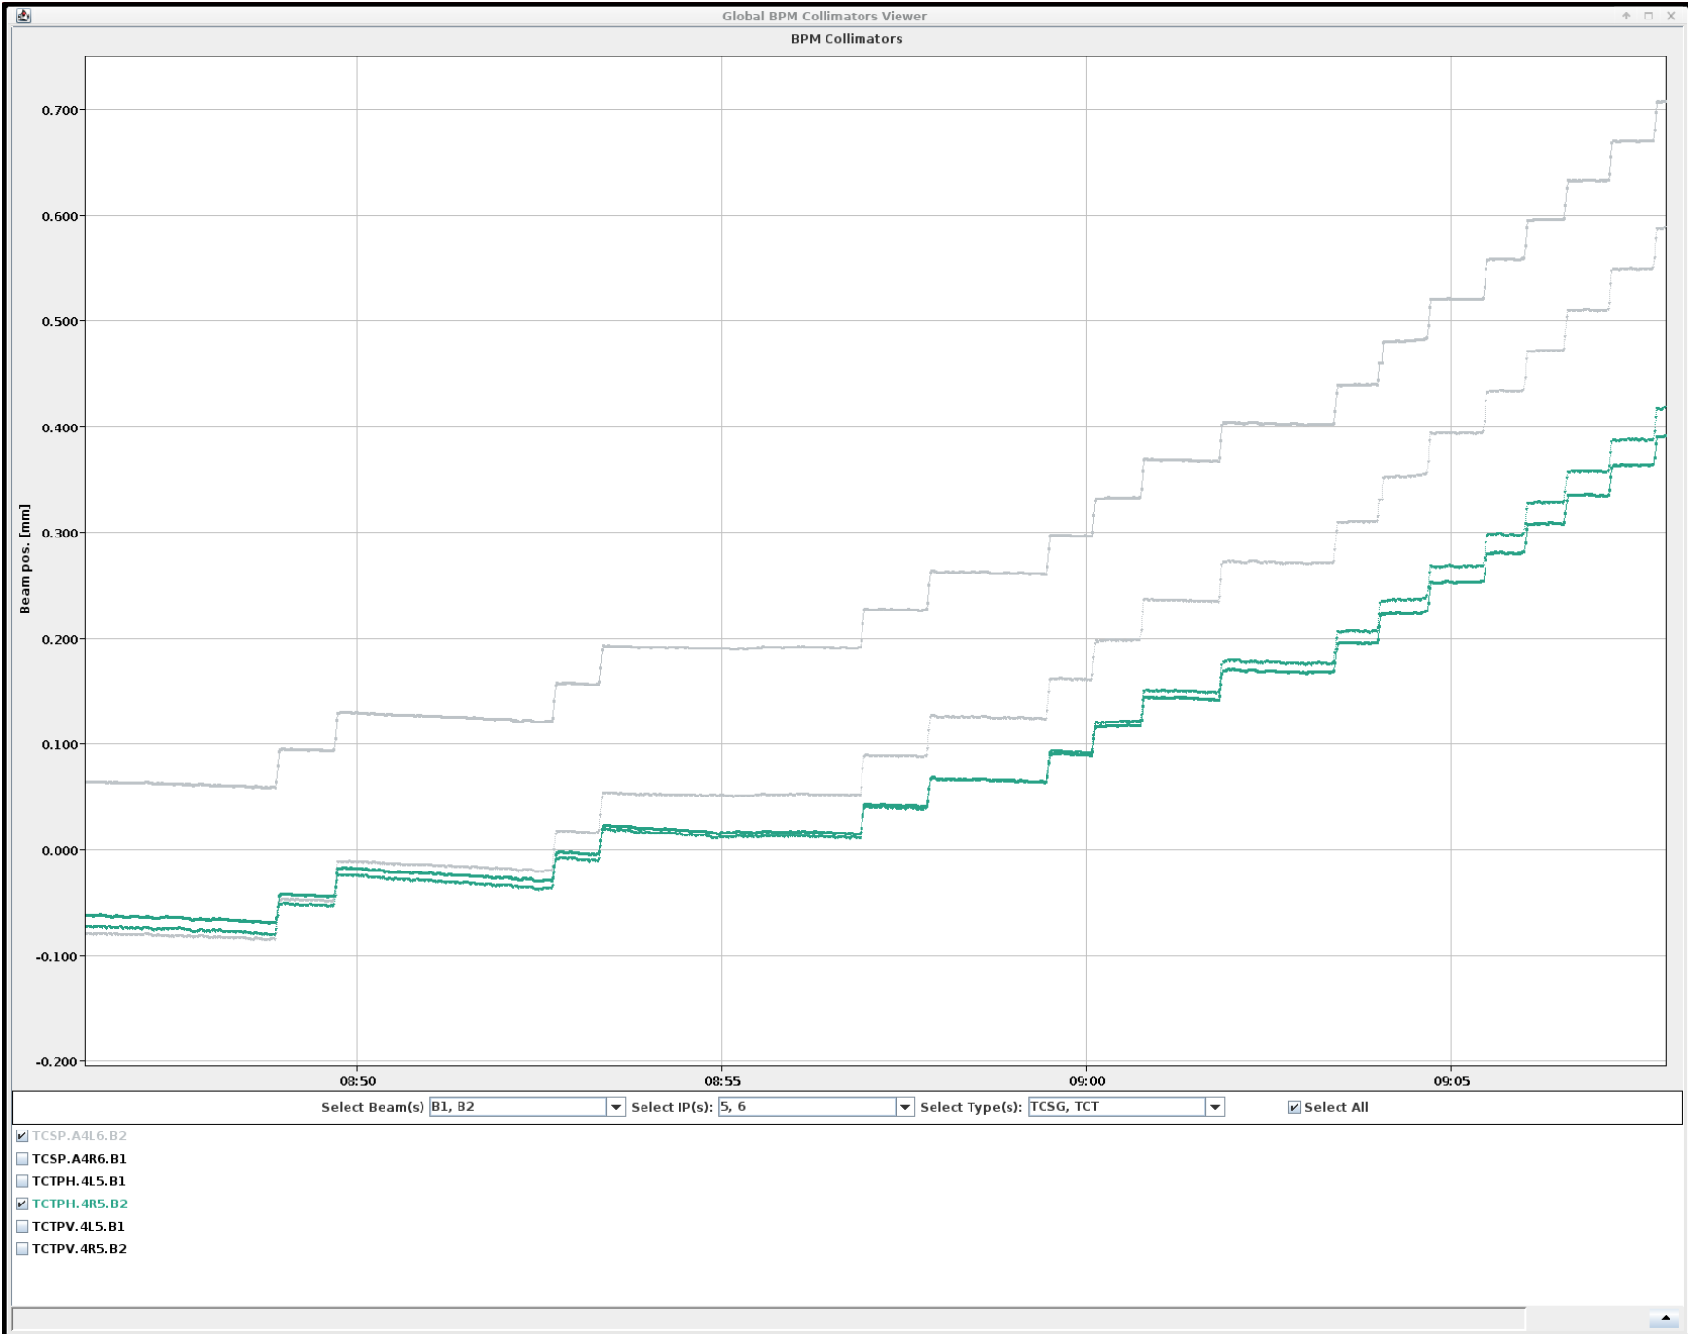
Long-orbit bump validation
Effect on the TCP centers
At this point the TCSP should be the aperture bottleneck: 7.3 - 2.5 = 4.8 sigma (TCP is at 5 sigma).

Slide 7
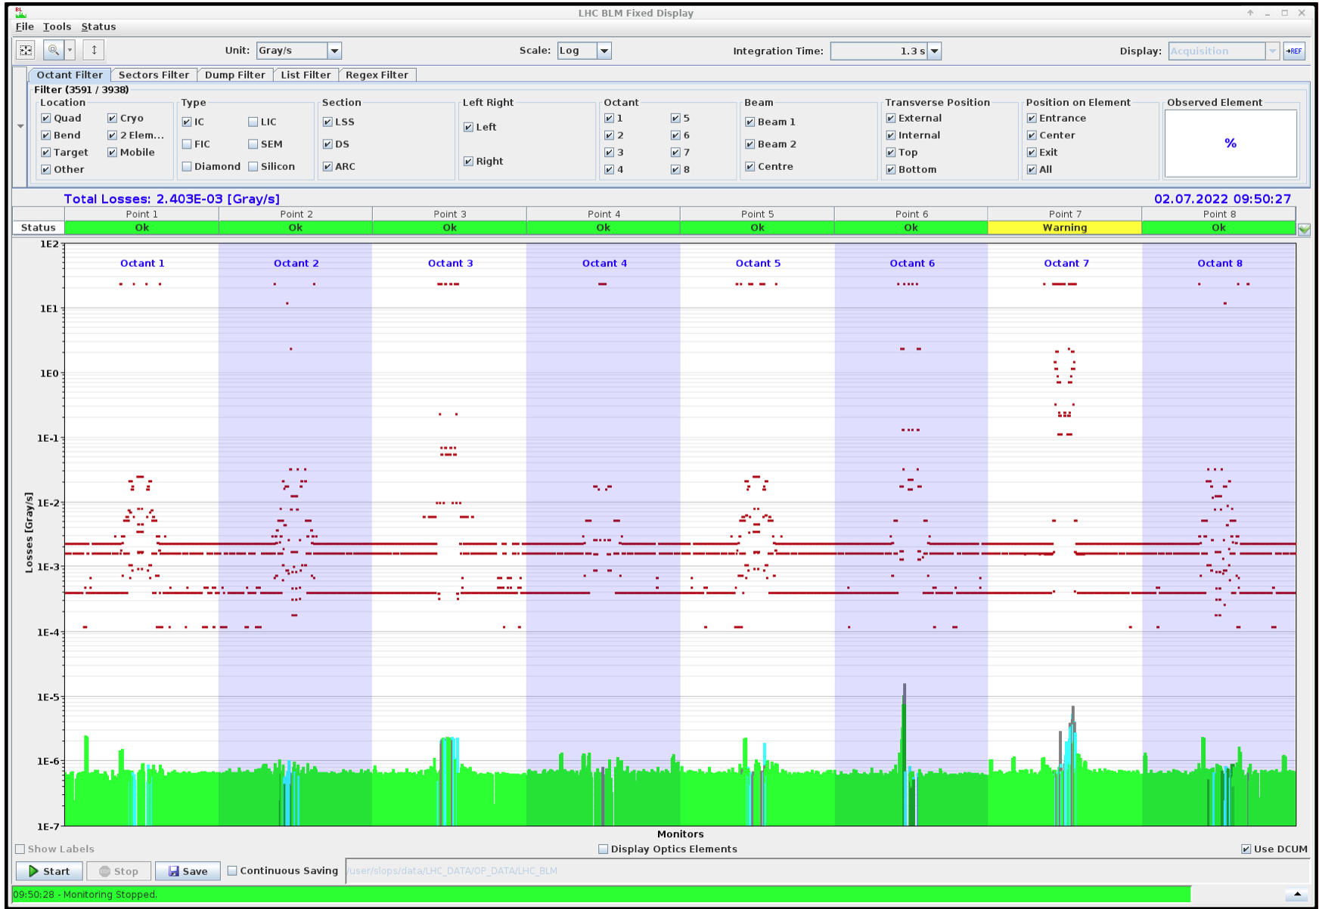
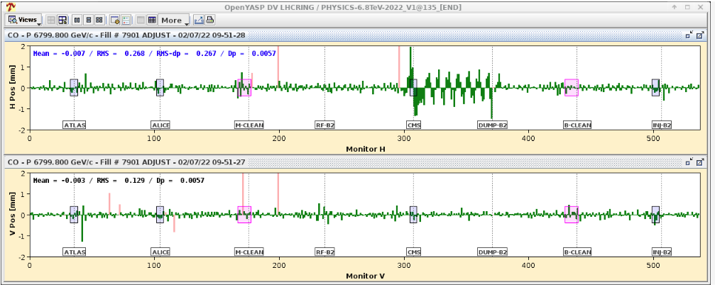
Verification of TCSP retraction with nominal optics
Beam blow—up with the ADT.
Increase the bump to 3 sigma to identify the bottleneck at the TCSP.

Slide 8
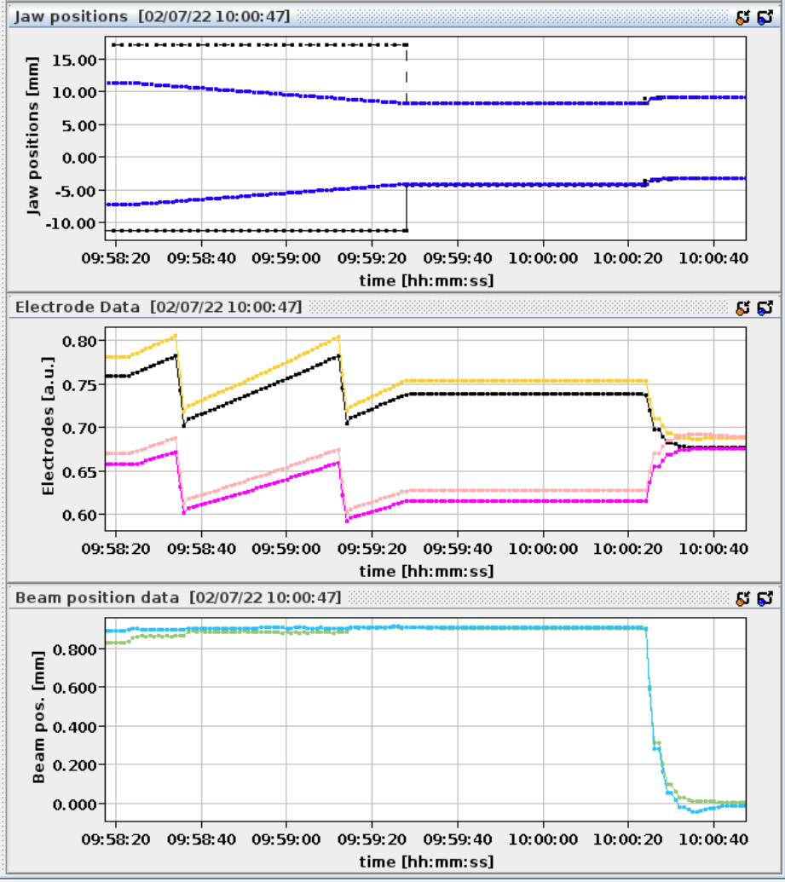
TCT alignment around the final bump

Slide 9
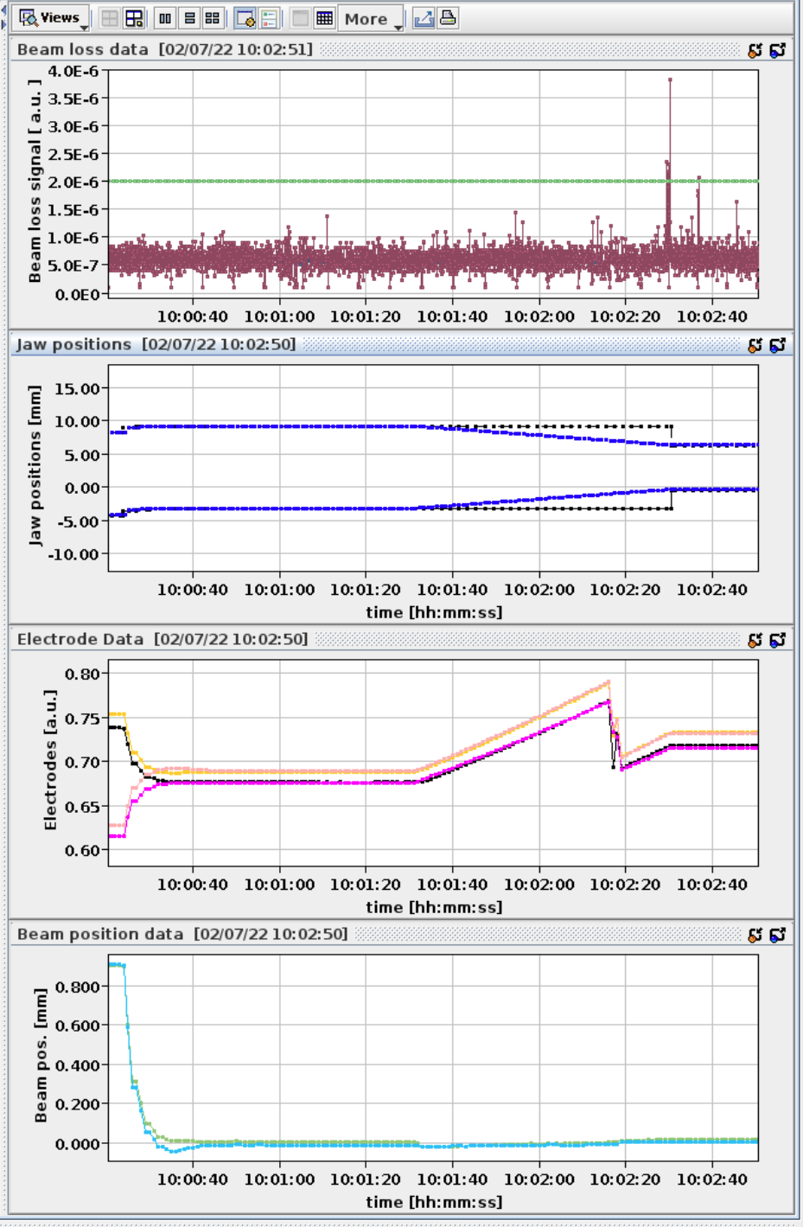
Measured (centered) aperture at the TCT
Beam touched at 4.3 sigma
We had to increase the bump to 3 sigma to have the TCSP as primary bottleneck.
So the aperture at the TCSP was 7.3 - 3 = 4.3 sigma.
The offset at the TCT was 1.2 sigma. Meaning that for the alignment the closer jaw should move by 6.5 sigma (5mm).
We first performed the BPM alignment so that the two jaws would be symmetrical before doing the BBA. Then we performed the BBA and we indeed found 4.3 sigma.
First part of the MD done.

Slide 10
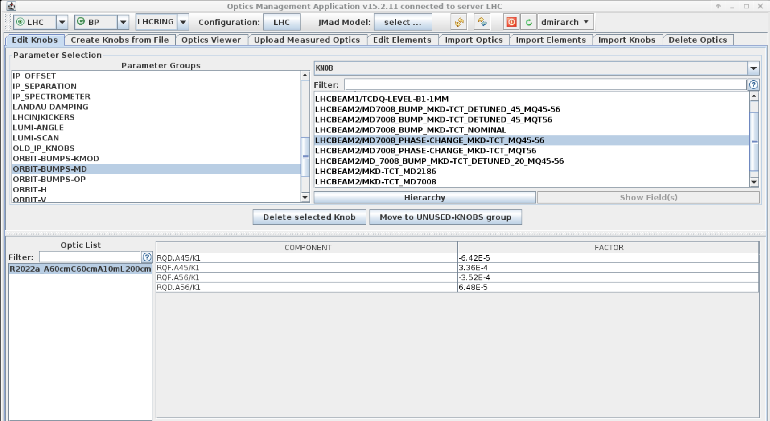
Optics detuning
Is the method able to reveal insufficient retraction in case of non-nominal optics?
  Nominal horizontal phase advance from MKD to horizontal TCT : 28 degrees
  Voluntarily increase the phase advance to increase the trajectory excursion at the TCT, in turn reducing the effective aperture margin
We started with the detuning using the MQF and MQD in Arc45

Slide 11
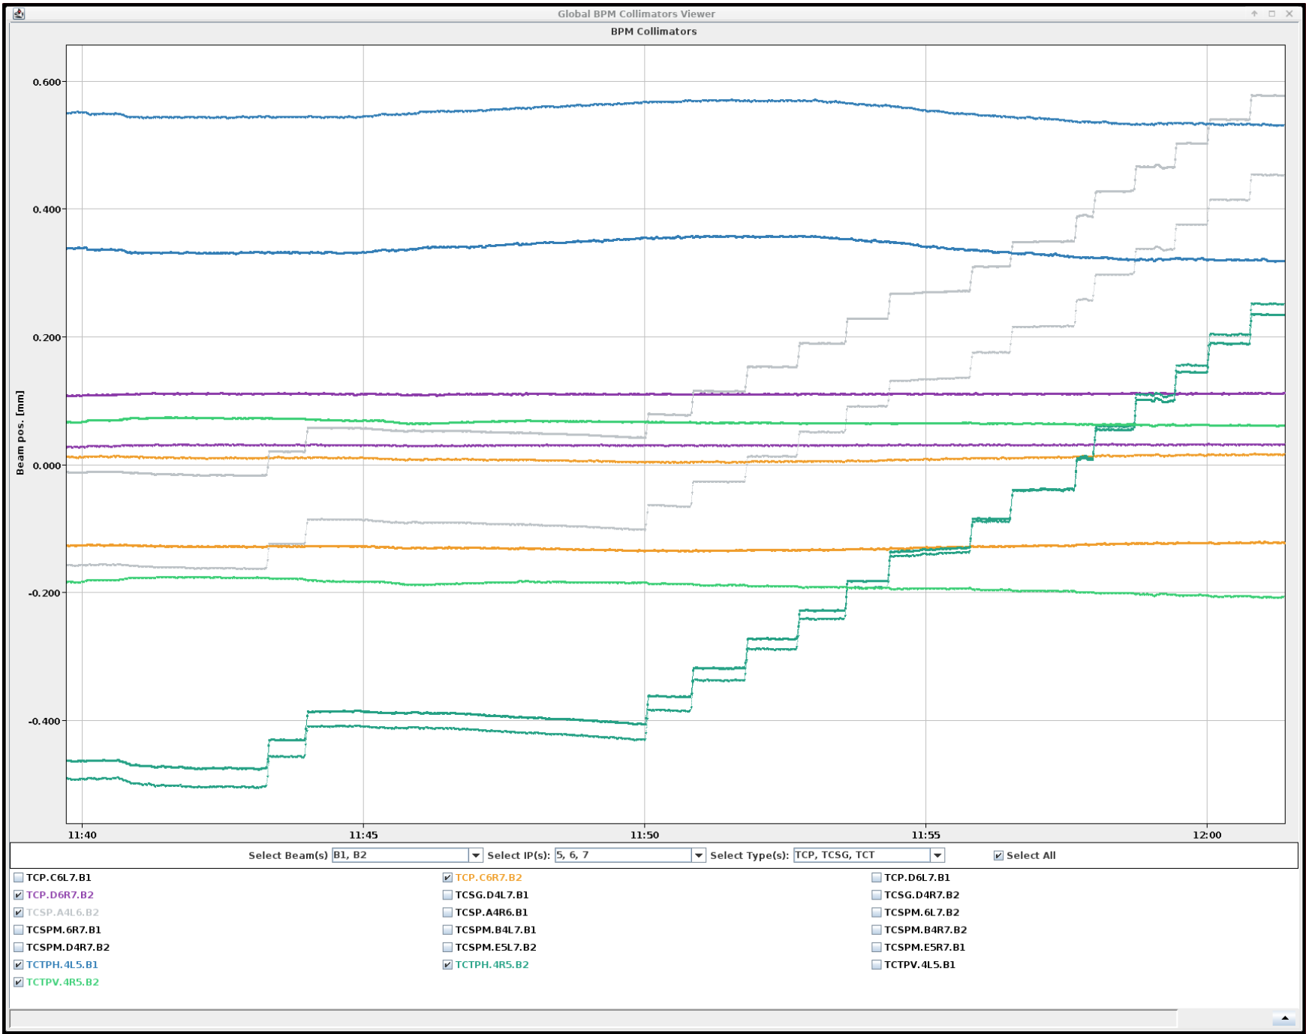
Optics detuning
And the bump is put back step-by-step
Next steps:
- the phase advance change has a large effect on the orbit due to the dispersion bump ('on_disp' knob) so we reduce the strength of the trim to only 0.25 to give a phase advance change of roughly 5 degrees
- the coupling and the tunes are corrected, QFB on
- due to the effect on the dispersion bump we have an orbit shift at the location of the TCT and TCSP. We decided to realign the TCSP with the BPM; the change was minimal, so we keep it and we don't move the TCDQ
From there we proceed putting in place the nominal orbit bump.

Slide 12
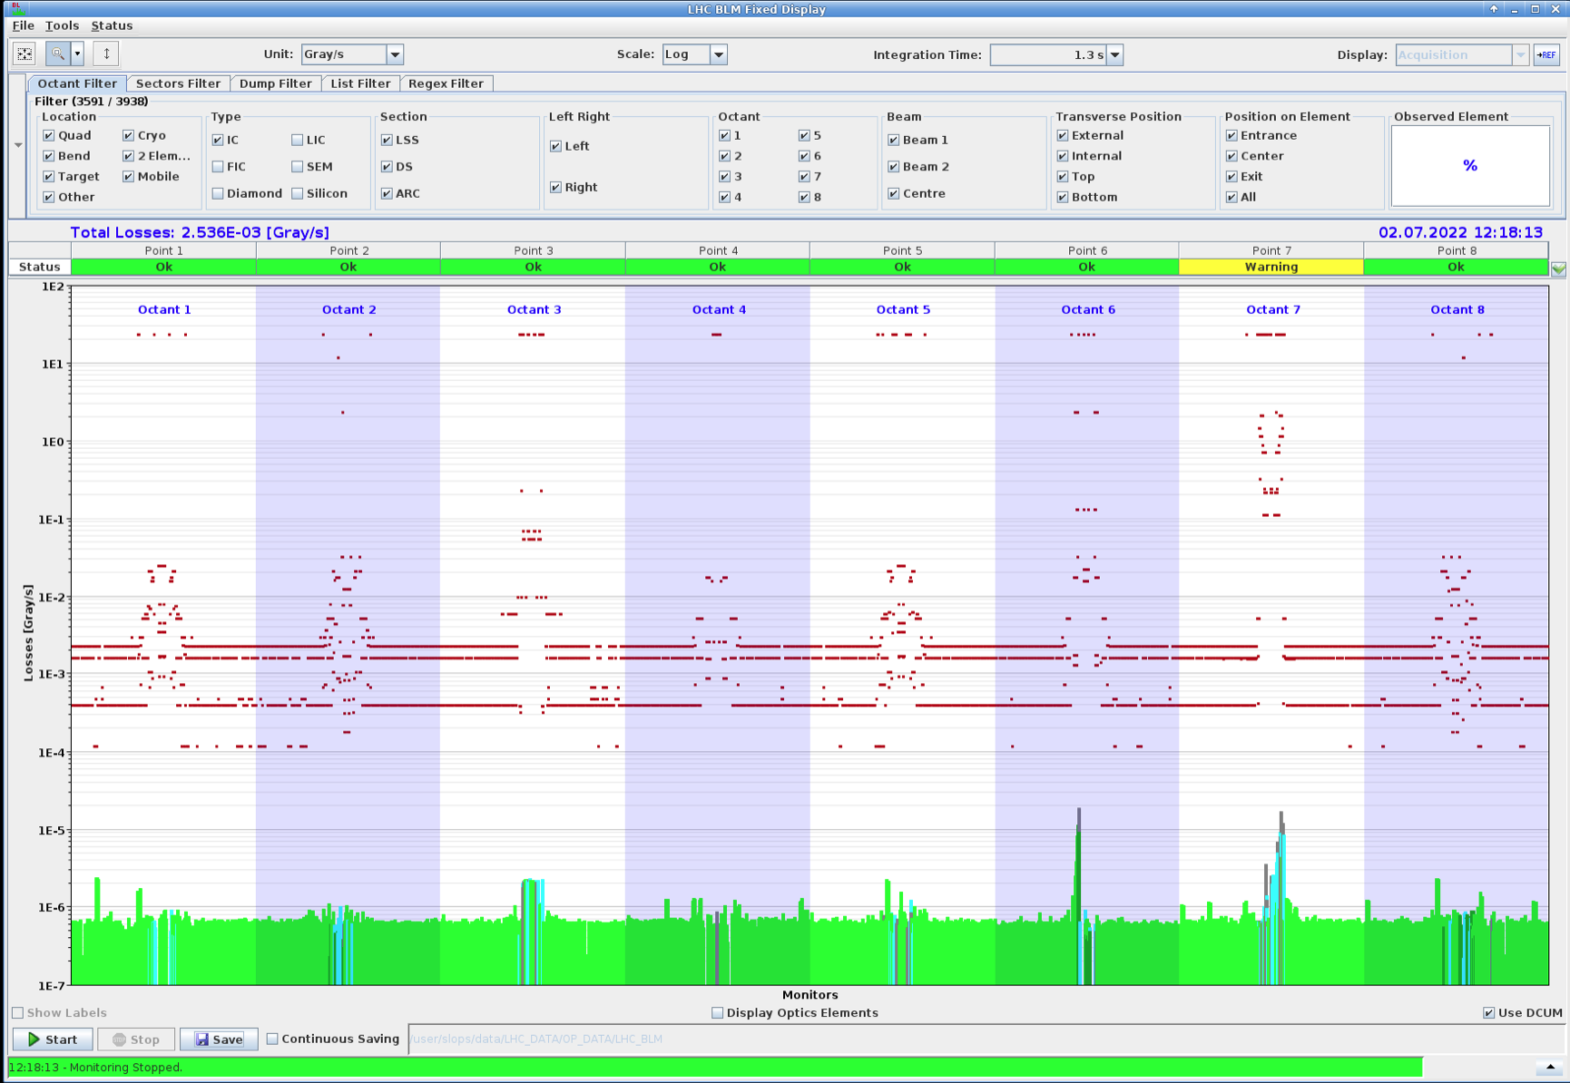
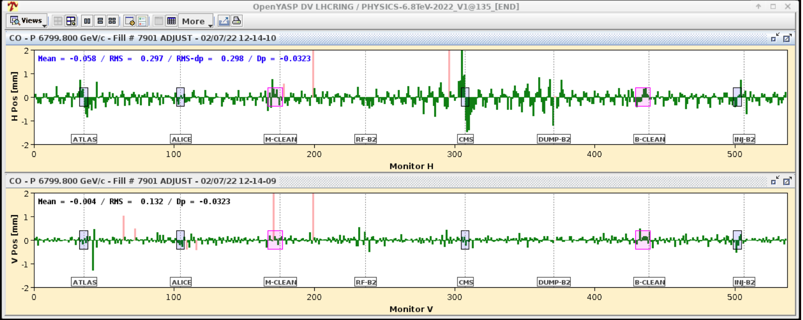
Bump with detuned optics
Bump amplitude increase to 2.9 sigma until TCSP is the bottleneck

Slide 13
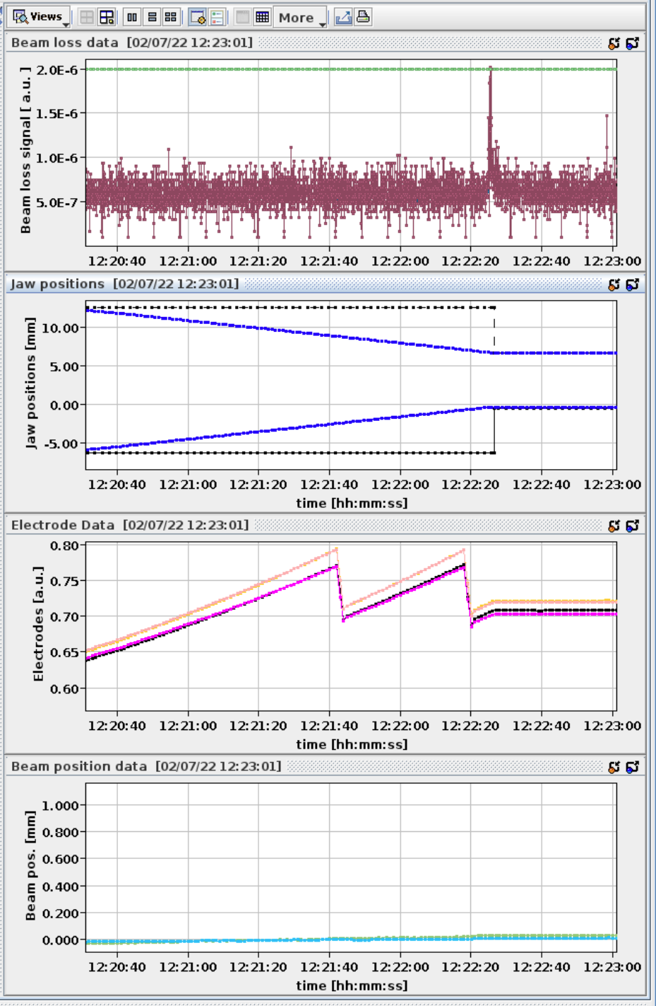

Aperture at the TCT with bump in place
- the BBA shows that the beam sizes are consistent between the nominal and detuned optics, we conclude that the beta-beat does not play a large role in this analysis (for this value of the detuning knob)
- for the nominal optics we measurement, for a given position at the TCDQ due to the bump, a shift at the TCT : 1.2mm
- we measured this shift also for the detuned optics : 1.7mm
- from there we can normalize in sigma and obtain the loss in term of retraction
Step 2 done !

Slide 14
Optics detuning with the MQT
We reached 0.24 in strength for the phase shift knob before running out of strength in the MQT
Orbit then corrected with 40 eigen-values
We’ll reproduce the same steps with this new optics configuration

Slide 15
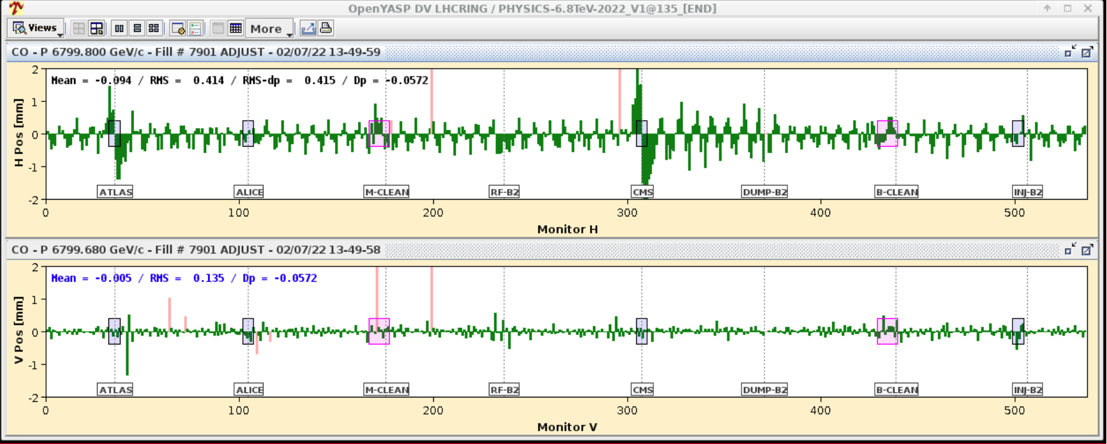
Optics detuning with the MQT
We reach 2 sigma for the bump amplitude
Clear leakage observed as expected !

Slide 16
Closing the bump
The new method is based on a closed bump. So we need to close the bump without changing its shape between 5 and 6. We use MCBCH.7L5.B2 and MCBCH.9L5.B2

Slide 17
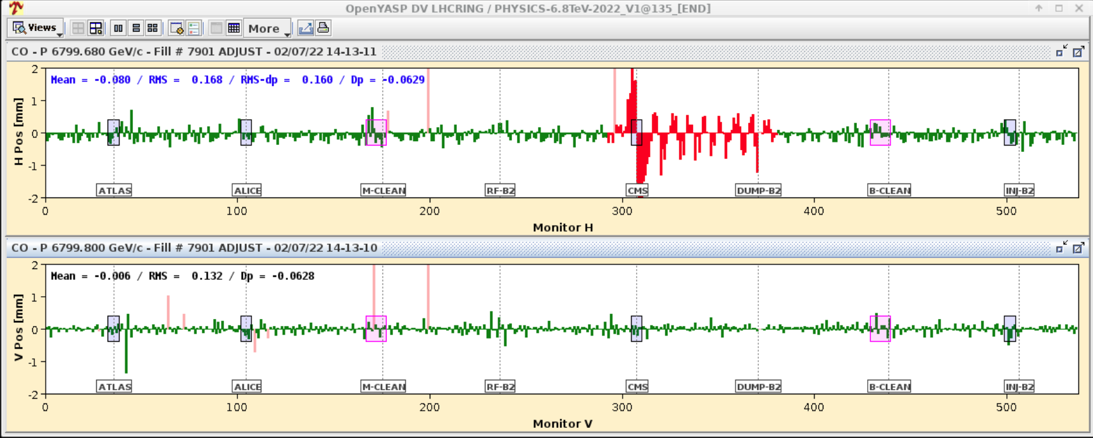
Closing the bump
The new method is based on a closed bump. So we need to close the bump without changing its shape between 5 and 6. We use MCBCH.7L5.B2 and MCBCH.9L5.B2

Slide 18
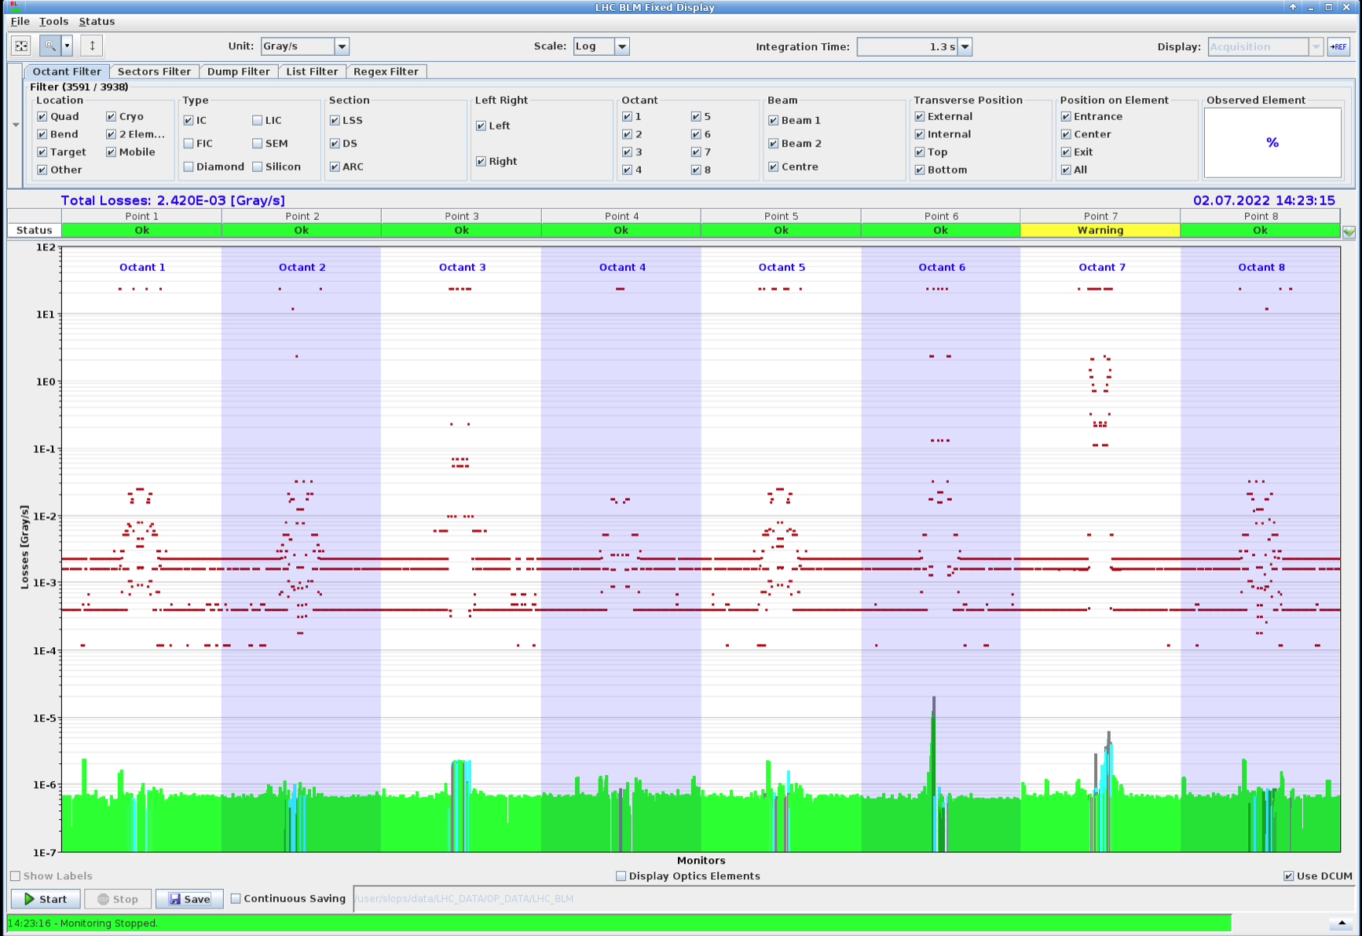

Aperture and TCSP/TCT retraction
Bump increased to 2.9 sigma with leakage corrected to make TCSP the bottleneck
Aperture at the TCT found

Slide 19
Summary
Summary of MD7008
As planned, we performed the MD in 3 steps:
1) Bump of up to 3 sigma at the TCDQ/TCSP with nominal optics.
2) Bump of up to 2.9 sigma with local optics in IR5/6 detuned by using the MQ45-56
3) Bump of up to 2.9 sigma with local optics in IR5/6 detuned by using the MQT56
Prelimiary results:
1) Worked as expected. Confirmed nominal settings.
2) Observed large coupling after detuning. Managed to stabilise the beams after switching off the QFB. Bump leakage small and did not have to be corrected. Reached up to ~5 deg of change of phase advance. Using the orbit bump, we could clearly observe the change of aperture margin. Details to be checked offline.
3) We could achieve of up to ~10 deg of change of phase advance. Tune was stable with QFB on. Larger leakage from bump as expected. Corrected succesfully with two correctors in L5. Again, the change of aperture margin could be clearly observed. Details to be checked offline.
Cedric, Christoph, Daniel, Daniele, David

Slide 20
Conclusions
MD proceeded smoothly according to the plan and we finished on time
Long-bump was successfully put in place for the 3 configurations (nominal optics, detuning with MQ and detuning with MQT)
Bump leakage in non-nominal optics conditions was successfully corrected with YASP without assuming a known-optics model
  Essential for the applicability of the method during commissioning
Nominal optics: re-validated the method
Optics detuning with MQ: small orbit leakage, proceeded to assess the method to measure the retraction in unknown conditions with success! Difference measured!
Optics detuning with MQT: orbit leakage corrected with success without assuming a known-model, retraction measured with success and difference observed!

