Slide 1


CERN – Latvia
Personnel return status
From HR Department, 20 September 2022

Slide 2
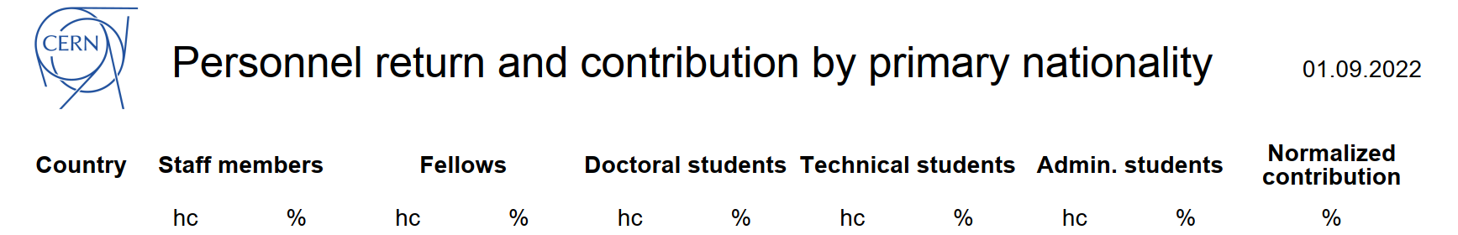
Latvia @ CERN

Slide 3
Latvia @ CERN – a closer look on today’s representation
Notes:
3 TRNE STAG

Slide 4
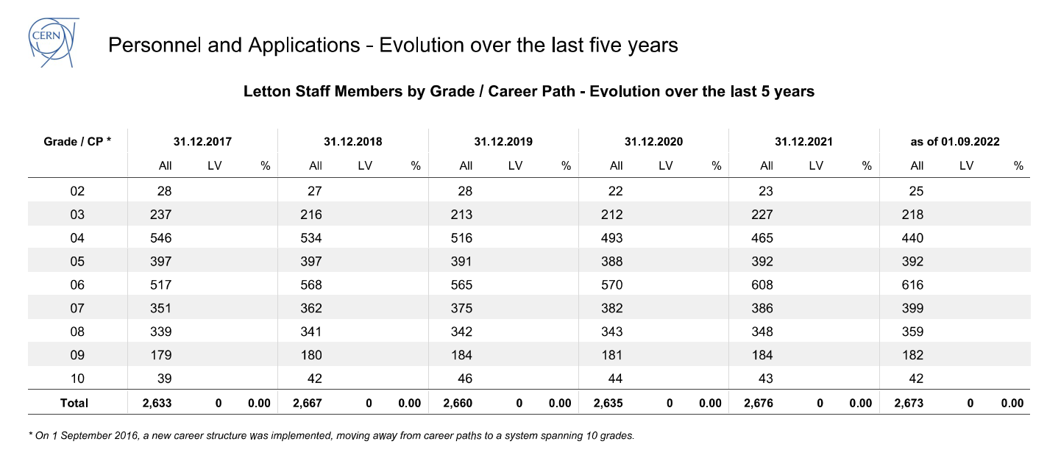
Latvia @ CERN – a closer look on staff members

Slide 5
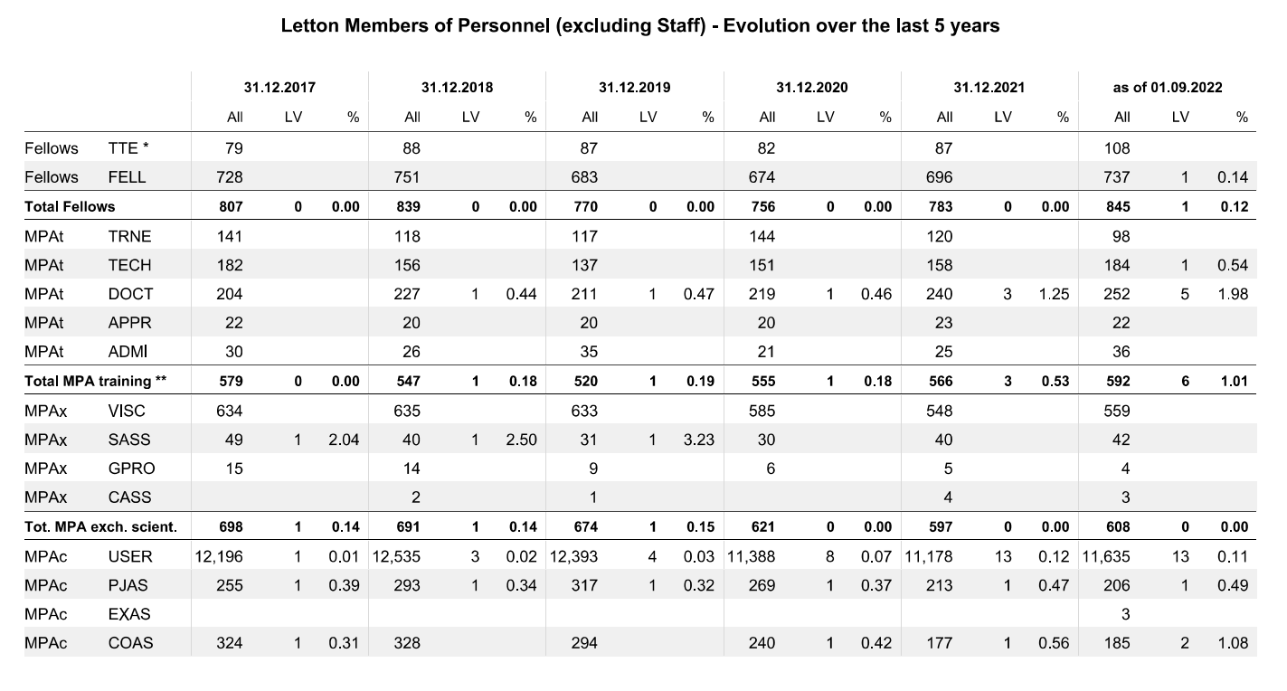
Latvia @ CERN – a closer look excluding staff members

Slide 6
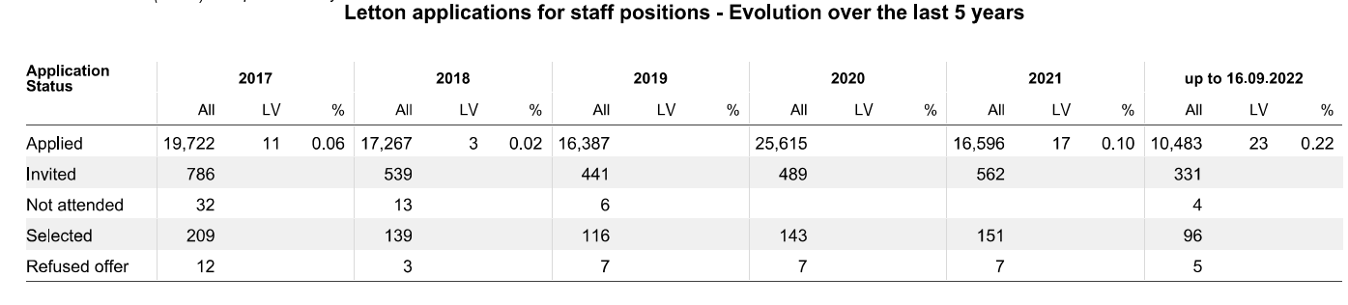
Latvia @ CERN – applications evolution: staff positions

Slide 7
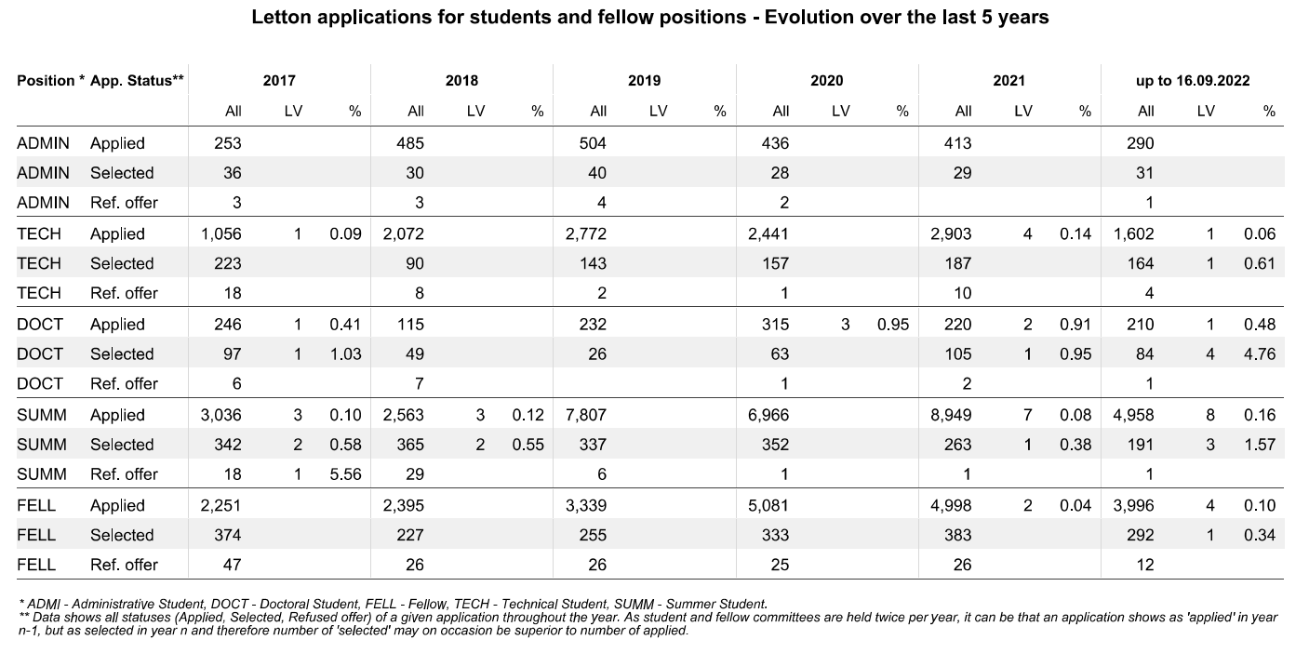
Latvia @ CERN – applications evolution: programmes

Slide 8

We look forward to attracting more candidates from Latvia with your input and support
Thank you!

Slide 9
Staff Positions
Fields: Physics, engineering, computing, and administrative
Length: Up to 5 year initial limited duration contract
Eligibility: From apprenticeship to PhD
Features: Relocation, installation benefits, training (language courses, technical training)
150 positions / year

Slide 10



Opportunities for
Graduates
We hire over 300 graduates every year!

Slide 11






Early Career Professionals
ORIGIN: the point or place where something begins.
”
DURATION? 6 – 36 months
WHEN? 4x/year selection moments: November – March – May – August
WHO? Member States and Associated Member States candidates
HOW? 2 jobs (Technical/administrative certificate & Bachelor/Master)
WHAT? On-the-job learning with support and guidance from supervisor and team
The smartest way to kick-start your career and give it real momentum.
ORIGIN (eligibility) | Total stipend | CHIS contribution | PF contribution | Take-home
Specialised studies/technical degree < 2 years (! incl. admin profiles) | 4500 | 216 | 699 | 3535
Bachelor degree < 2 years | 5000 | 243 | 699 | 4058
Master degree < 2 years | 5500 | 267 | 699 | 4534

Slide 12

Project Graduates
QUEST: an intellectual pursuit of knowledge.
“
DURATION? 6 – 36 months
WHEN? 2x/year selection moments: March – October
WHO? Member State and Associated Member State candidates
(Non-Member State exceptionally possible)
HOW? Specific job description for one project
WHAT? Work on well-defined project from A to Z with clear deliverables
Deepen your expertise
Expand your professional network by working with the best
Opportunity to supervise student
Deepen your knowledge and expertise faster than anywhere else.
QUEST (eligibility) | Total stipend | CHIS contribution | PF contribution | Take-home
Master degree 2 – 4 years | 6050 | 294 | 699 | 5057
Master degree 4 – 6 years or PhD 0 – 3 years | 6650 | 323 | 699 | 5628

Slide 13
Research Fellows
DURATION? 6 – 36 months
WHEN? 2x/year selection moments: November – May
WHO? Member State and Associated Member State candidates, limited number for Non-Member State
HOW? Research topic to be submitted, 2 jobs (Cat. 1: PhD + 6 & Cat. 2: PhD + 3)
WHAT? Establishing credibility and gaining international exposure
Research Fellows (eligibility) | Total stipend | CHIS contribution | PF contribution | Take-home
PhD 0 – 3 years | 6650 | 323 | 699 | 5628
PhD 3 – 6 years | 7050 | 343 | 699 | 6009

Slide 14


Opportunities for Students

Slide 15
Short-term Internship Programme
Fields: Applied physics, engineering, computing
Length: up to 6 months
Eligibility: be a full-time student at undergraduate level (post-secondary)
This includes: Technical/Vocational qualifications, Associate degree, Bachelor and Masters' degrees.
Features: A technical project with a CERN supervisor, and a living allowance of 1,516 Swiss Francs per month.
Timeline: Applications will re-open in November 2022
100 positions / year

Slide 16
Technical Student Programme
Fields: Applied physics, engineering, computing
Length: 4 to 12 months
Eligibility: Completed 18 months of undergraduate studies before applying
Features: A technical project with a CERN supervisor, and a living allowance, incl. health insurance, 3319chf/month
Timeline: Applications will re-open at the end of August 2022 with a deadline on November 7th 2022
200 positions / year

Slide 17

Technical Student Programme
Mechanical Engineering
Human Robot Interface Development
HL-LHC collimators technical support
Applied Physics
Electron Cooling studies in AD and ELENA
Vacuum design and simulations for a Hollow Electron Lens in the LHC
IT, Mathematics, Robotics
Full-Stack Developer
Evolution of Software Tools
Material and Surface Science
Thermo-mechanical characteristics of advanced materials up to 2000°C
Vacuum compatibility studies of mild steel
Electrical or Electronics Engineering
FPGA development for radiation testing
Modeling of LHC superconducting magnet circuits
General and Civil Engineering
Geographical Information System for FCC

Slide 18
Administrative Student Programme
Fields: translation, human resources, advanced secretarial work, logistics, law, finance, library and information science, engineering management, science communication, education, audiovisual, communication and public relations are some examples!
Length: 2 to 12 months
Eligibility: Completed18 months of undergraduate studies before applying
Features: Living allowance incl. health insurance, training, on-the-job learning, 3319chf/month
Timeline: Applications will re-open at the end of August 2022 with a deadline on November 7th 2022
30 positions / year

Slide 19
Summer Student Programme
Fields: Physics, engineering, computing
Length: 8 to 13 weeks, during the summer
Eligibility: 3 years of full-time undergraduate studies
Features: High-quality lecture programmes, visits, and workshops, 90chf/day
Timeline: Applications will re-open in November 2022 with a deadline to apply in January 2023 and the selection will be confirmed in April 2023.
300 positions / year

Slide 20
Doctoral Student Programme
Fields: Applied physics, engineering, and computing
Length: 6 months - 3 years
Eligibility: Enrolled in a doctoral programme
Features: A technical project, leading to a PhD thesis co-supervised by the university thesis advisor and a CERN staff member. A living allowance, incl. health insurance. 3719chf/month
Timeline: Applications will re-open at the end of August 2022 with a deadline on November 7th 2022.
80 positions / year

