Slide 1

VERTICAL ELECTRO-POLISHING (VEP) FOR PROTON CAVITY APPLICATION
F. Eozénou

Slide 2
OUTLINE
CONTEXT
STATUS
MODELLING OF VERTICAL ELECTRO-POLISHING

Slide 3
CONTEXT

Slide 4
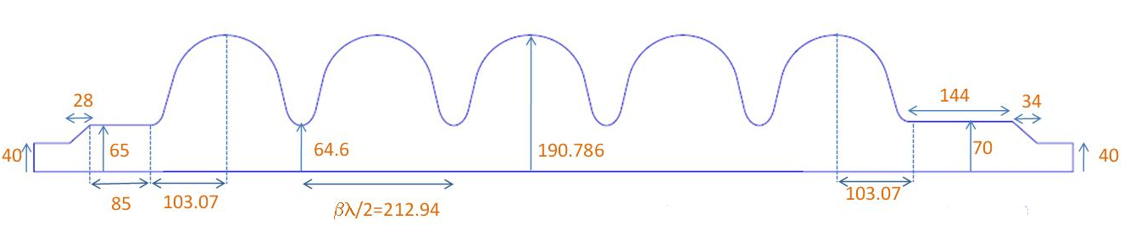
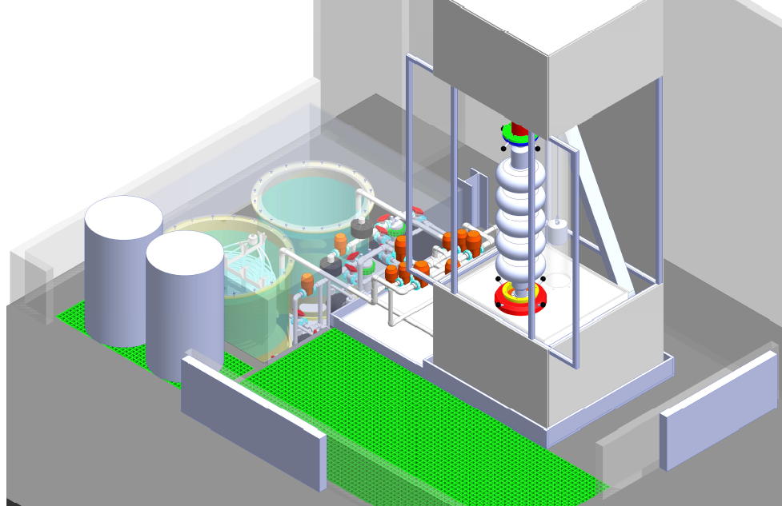

CHARACTERISTICS OF 5CELL CAVITIES TO BE TRATED / VERTICAL ELECTRO-POLISHING (VEP) ADAPTED
Ø382mm L>1430mm 1,76 m² 88L
(Tesla: Ø=211mm L=1283mm)
β = 1 cavity Eacc = 25 MV/m
Need for an efficient surface treatment→ Choice for Electro – Polishing
Large Cavity: Vertical configuration well adapted
Precise design of the set-up by:
Status at last Eucard Meeting:
Reception of all the drawings
Preparation of the call for tender for the fabrication

Slide 5

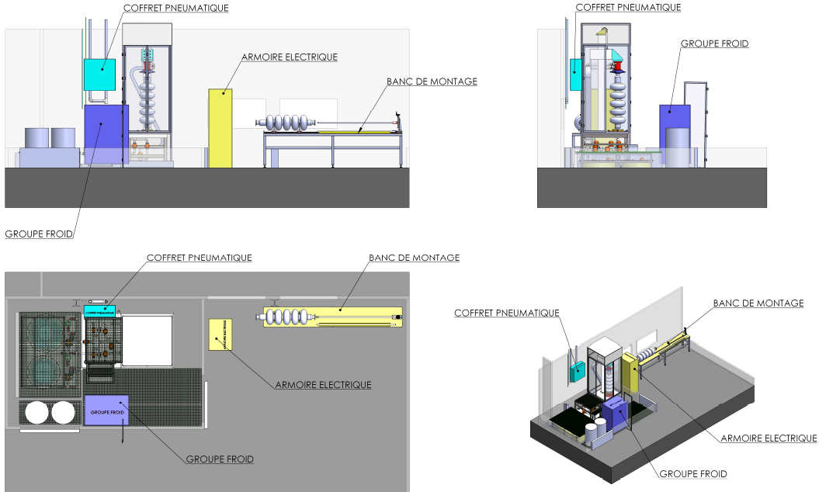
VIEW OF THE SET-UP AND OF THE PREPARATION AREA

Slide 6
STATUS

Slide 7
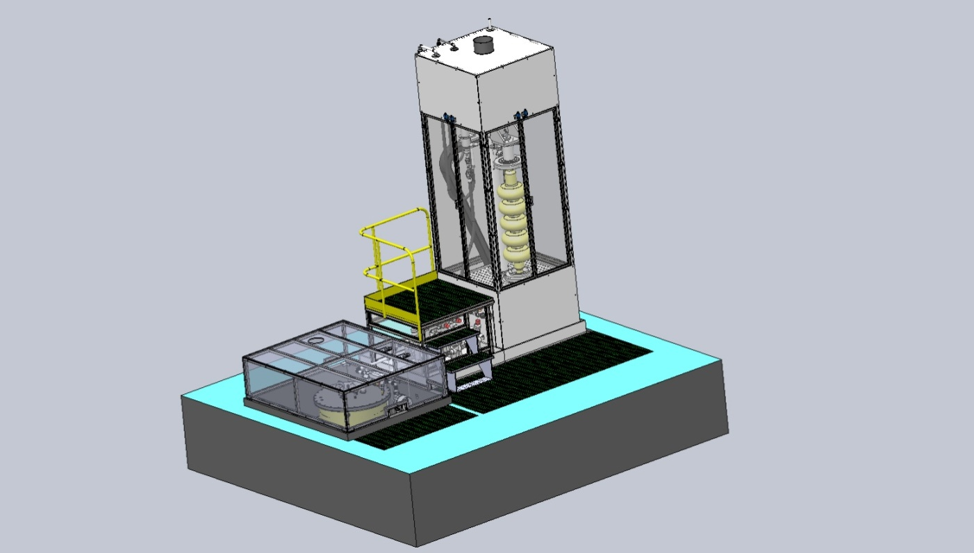
UPDATE
CORELEC Industries chosen for the set-up fabrication
3 companies have answered the call for tender
CORELEC has submitted the best offer (cost and delivery date)
Contract signed on november 2010
Single-tank set-up has been chosen
CORELEC satisfied with the study by Auxitec: only few corrections (tank)
Local Safety Meeting on May 10th.
Commissioning: June 11

Slide 8
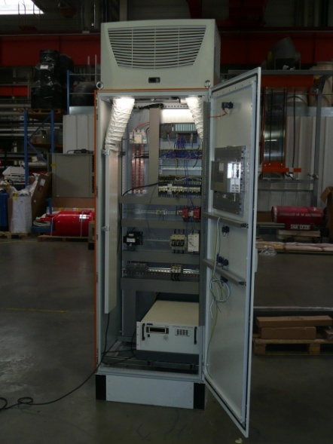
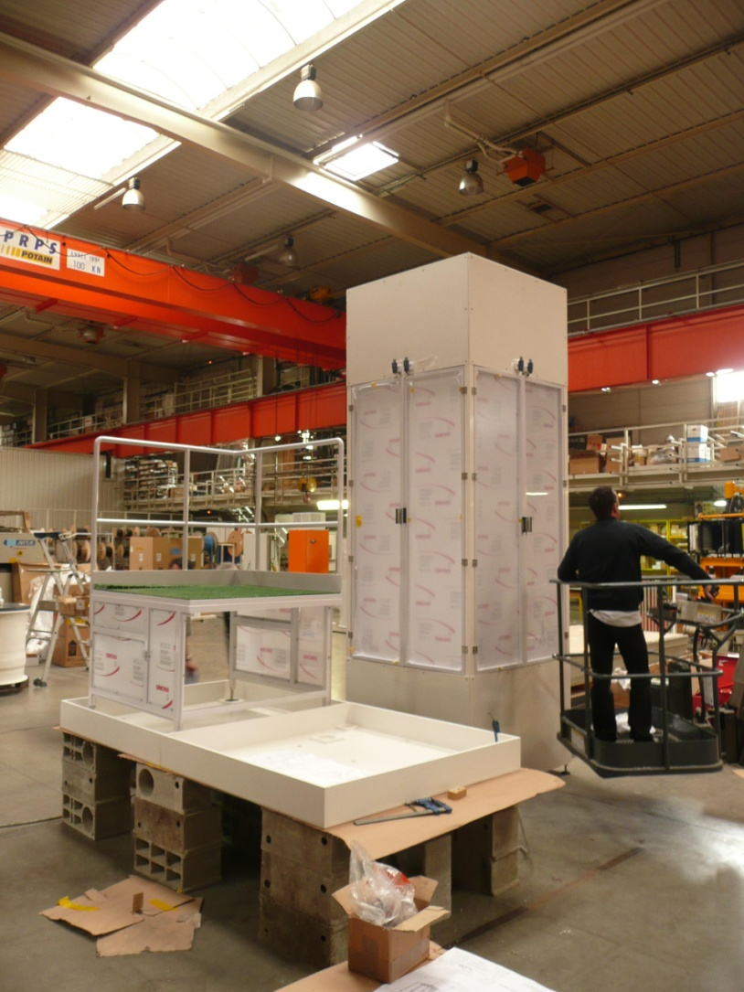
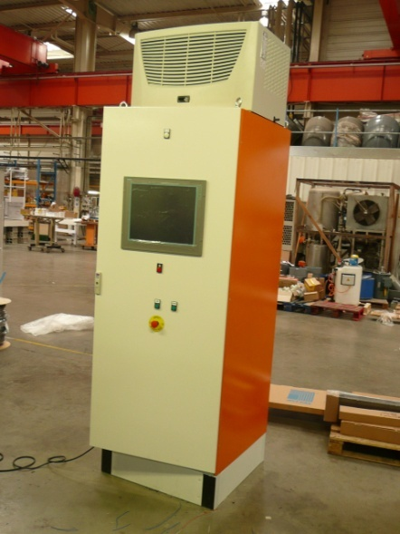
CONSTRUCTION PROGRESS @ CORELEC
Electric cabinet
Main cabinet

Slide 9
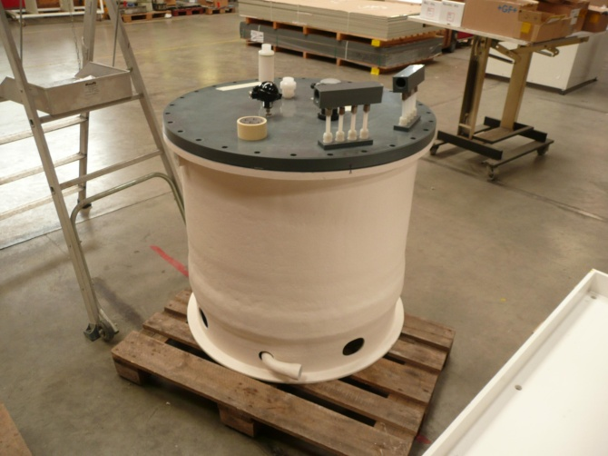
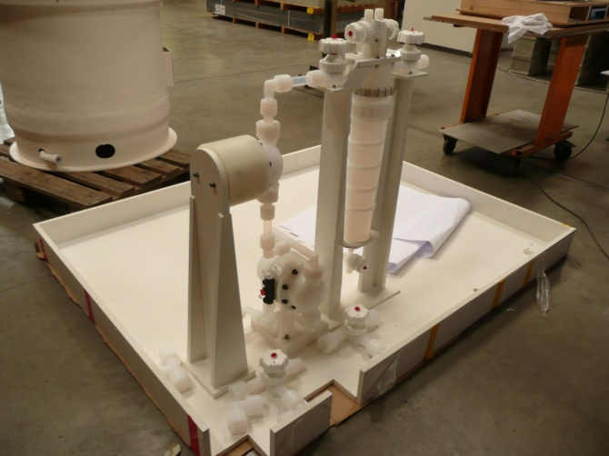
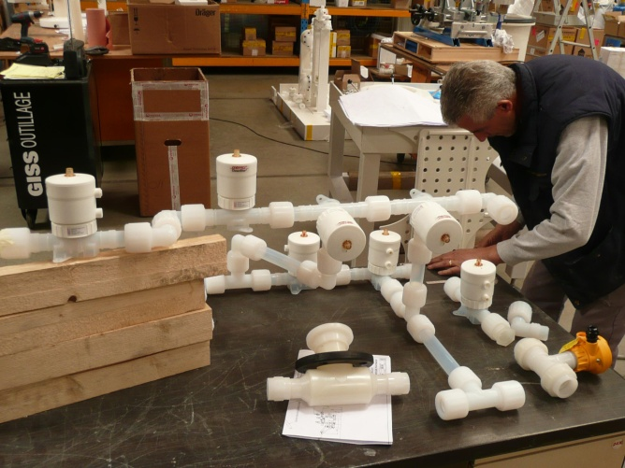
CONSTRUCTION PROGRESS @ CORELEC
acid tank with teflon inner coating
pump + filter
fluid distribution valves (PFA)

Slide 10
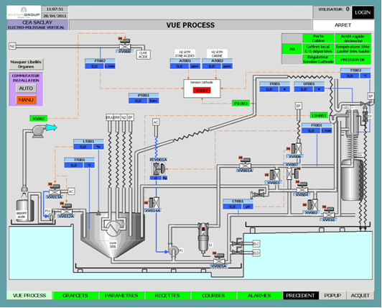
PROGRAMMING OF THE AUTOMAT
Automated process piloted through a touch screen
Manual mode or programmed sequences

Slide 11
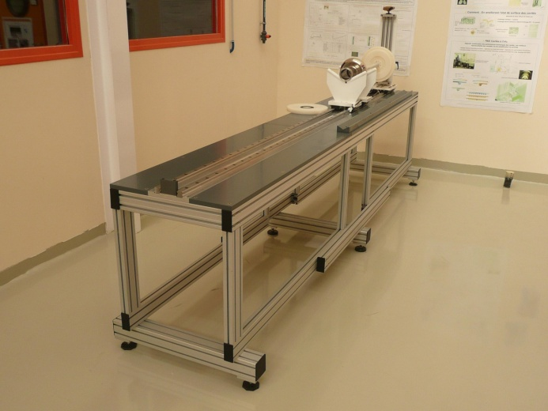
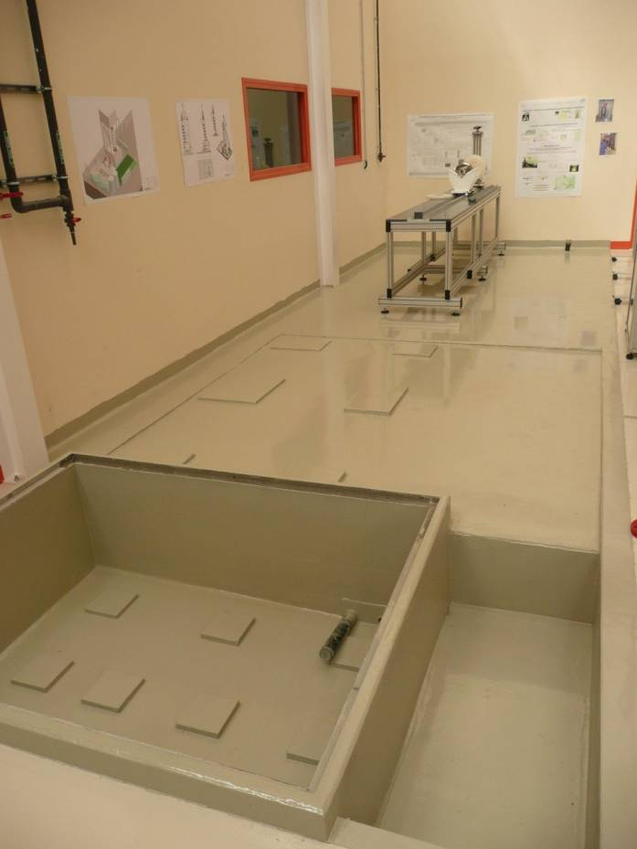
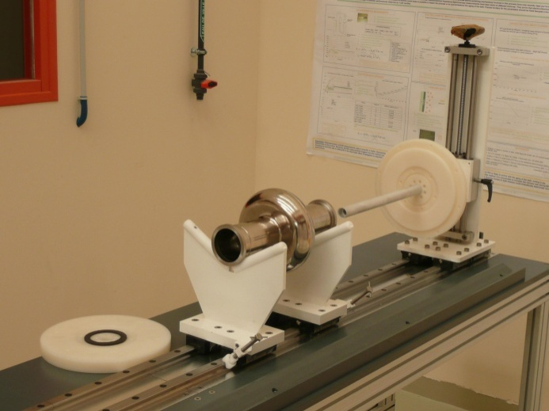
PREPARATION OF THE AREA AT CEA
Set-up for cavity preparation
Civil engineering and floor covered with acid-resistant painting

Slide 12
MODELLING OF THE PROCESS
Z. Wang

Slide 13
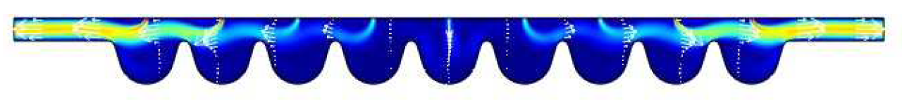
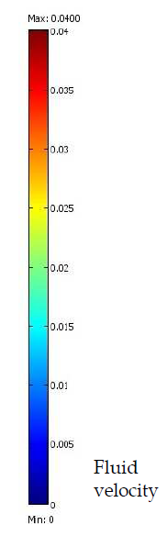
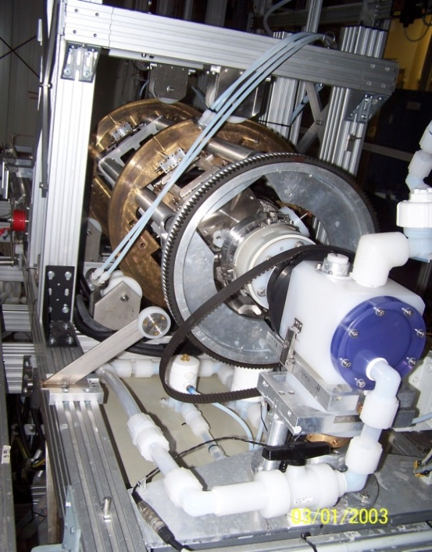
PREVIOUS STUDIES WITH COMSOL Software
Horizontal EP
Hydrodynamic, acid concentrations
2D-Geometry
→fluid velocity depends on the cell position
→non uniform process
Notes:
Insérer les fluides par les trous de la cathode
Sous la Géo 2 D

Slide 14
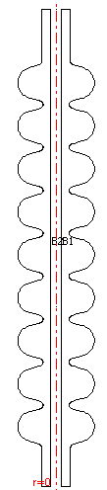

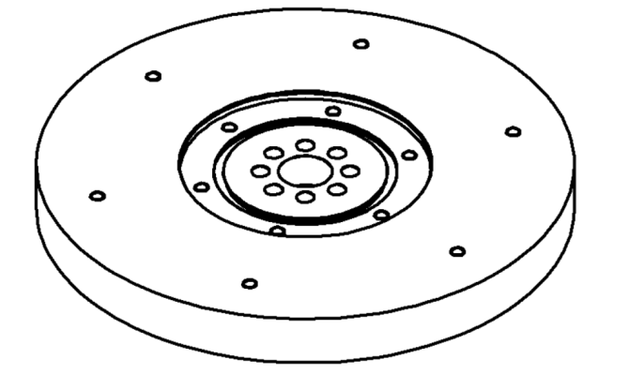
VERTICAL CONFIGURATION
Z
r
Cathode
Fz
Symmetry according to z-axis
→ 2D axisymmetry model
Notes:
Gravité est invariant en rotation autour de l’axe z
15 volts appuyé entre la cavité et la cathode

Slide 15
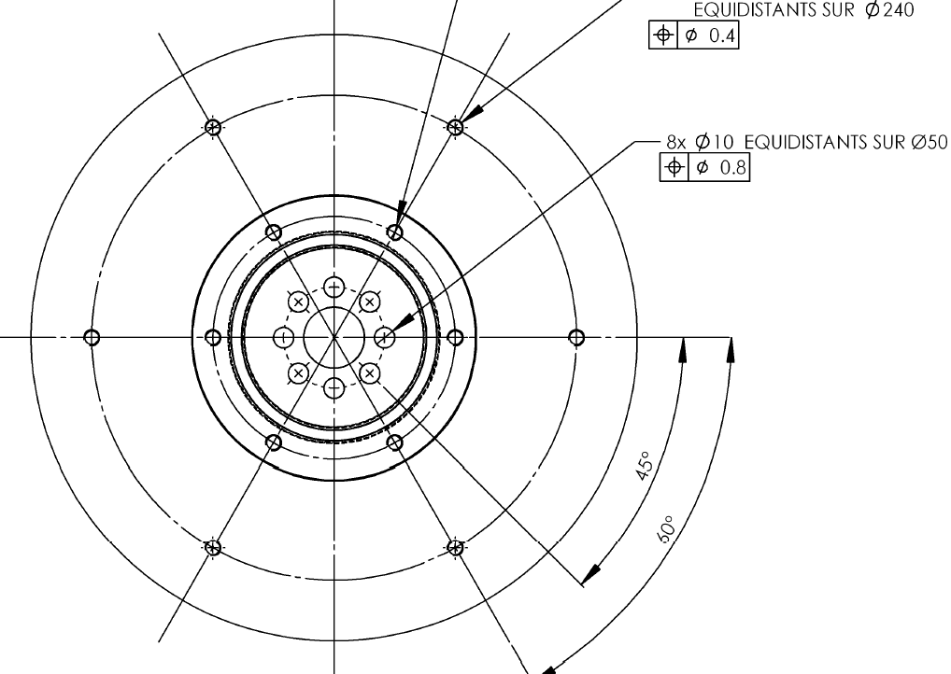
acid « crown » modelled
Notes:
En vérité, les acides entrée par les trous
On a simplifié l’installation par l’entrée couronne.
Le débit est pareille.

Slide 16
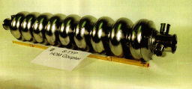
RESULTS WITH 9-CELL TESLA CAVITIES
Notes:
Résultats obtenus par les modélisations avec la cavité TESLA 9 cellules

Slide 17

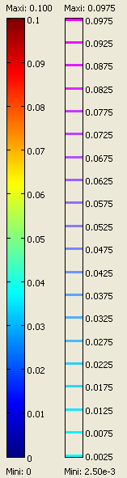
HYDRODYNAMICS MODELLING
Modelling in stationnary regime
« Navier-Stokes laminar » equations
No slip at the cavity and cathode surfaces
Parabolic profile for entering flow
Cathode
24 mm
Cavity
vo
Fluid injection in cavity
v=0
v=0
Contrary to horizontal EP, flowrate does not depend on the cell location
→ Study of the central cell #5
Notes:
1, Re<2300----on va utiliser la module de Navier-Stokes laminaire
2, conditions aux limites
3, l’entrée des acides parabolique
4, étudier la cellule centrale pour étudier l’effet des paramètres plus facilement

Slide 18
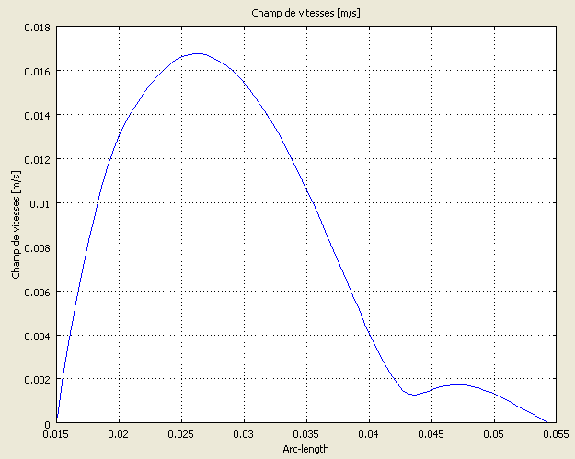
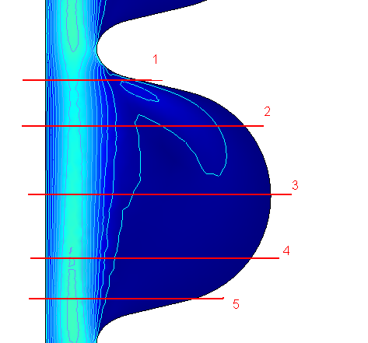
LOW ACID FLOWRATE AT THE CAVITY SURFACE
General shape of the fluid profile for each line
→ Higher flow close to the cavity
→ Different shapes tested to increase flow at the cavity surface
Notes:
Modéliser avec la cathode cylindrique
2ème crête nous intéresse beaucoup; D; les flux faible prés de la cavité

Slide 19
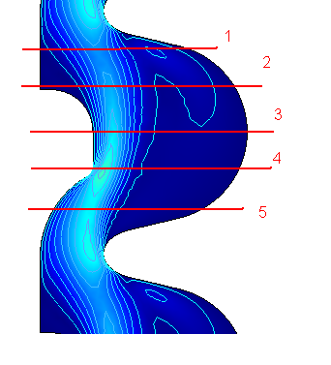
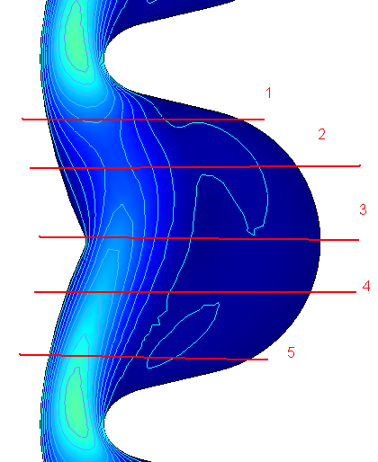
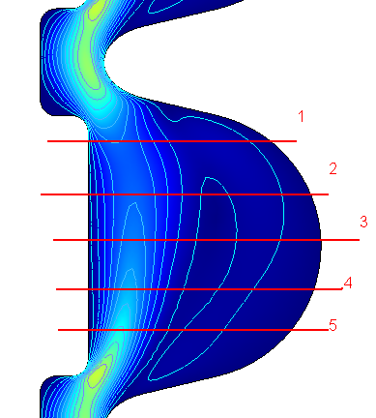
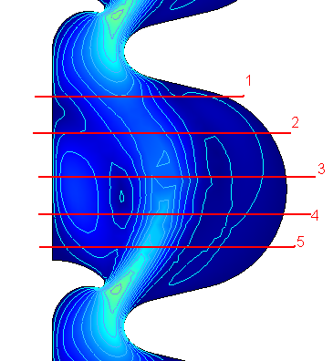
FOUR SHAPES TESTED
flowrate at cavity surface: +39%
flow uniformity: +33%

Slide 20
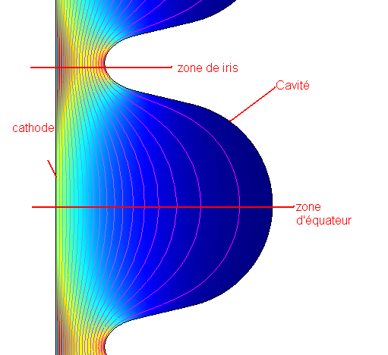
ELECTRIC FIELD MODELLING
→ rod cathode
Field Ratio: EIris/EEquator = R > 41
… Needs optimization:
→ Iris insulation
→ Alternative cathode shapes
Iris
Cavity
Equator
0V
15V

Slide 21
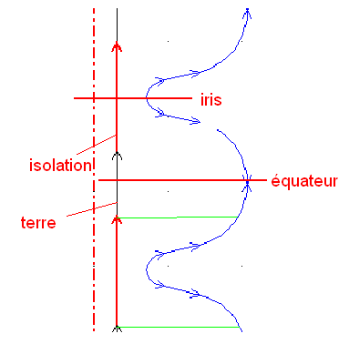
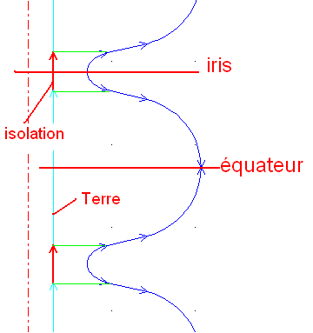
INSULATED ROD CATHODE
Iris
Iris
insulation
Equator
insulation
Equator
ground
ground
By increasing the insulation, R decreases from 31 to 4
… But removal rate will decrease
Notes:
La vitesse de réaction va baisser a cause du moyen du champ électrique

Slide 22
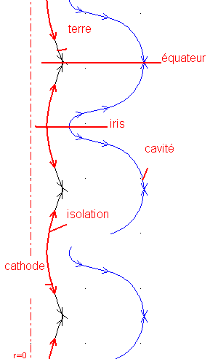
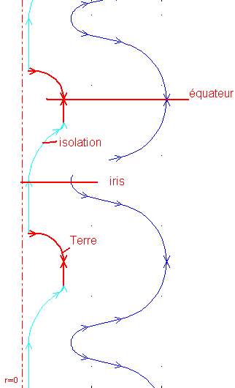
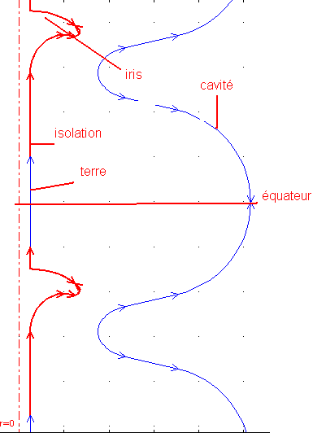
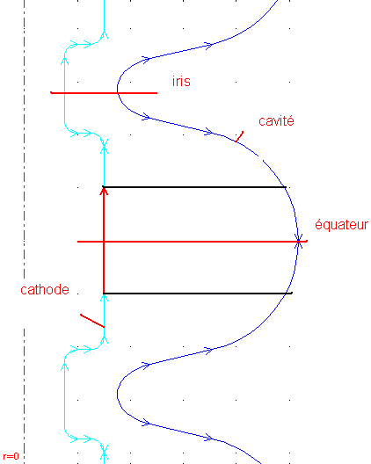
RESULTS WITH ALTERNATIVE SHAPES
R=7,5
R=7,5
R=6,4
R=3,7
Notes:
3 isolation + sans isolation
La zone le plus élargie, le R le plus pettit

Slide 23
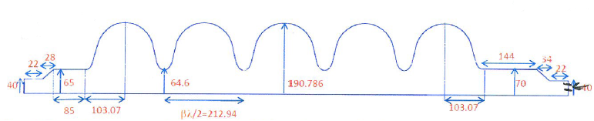
RESULTS WITH 5-CELL SPL CAVITY
Larger cavity compared to TESLA
Shrinking

Slide 24


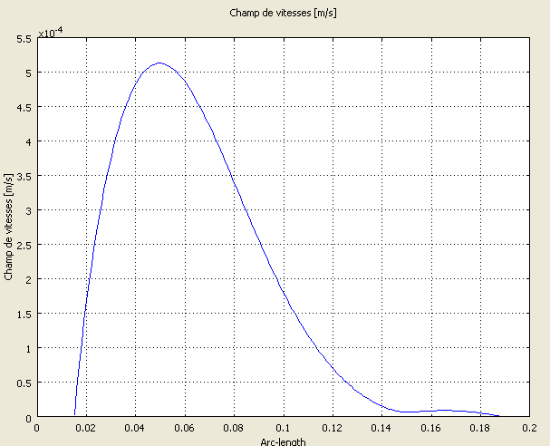
HYDRODYNAMICS MODELLING
Flow profile from the cathode to the cavity:
Electrolyte velocity: m/s
Area close to the cell poorly swept
Possible improvement limited by taper
Modelling with cylindrical beam pipe

Slide 25

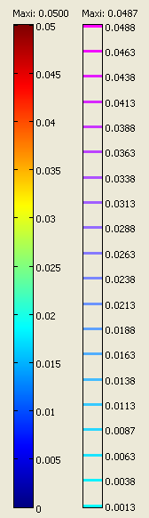
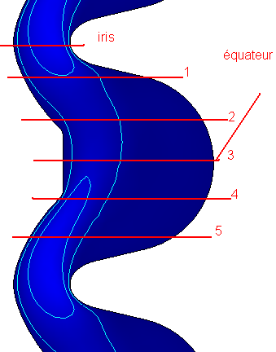
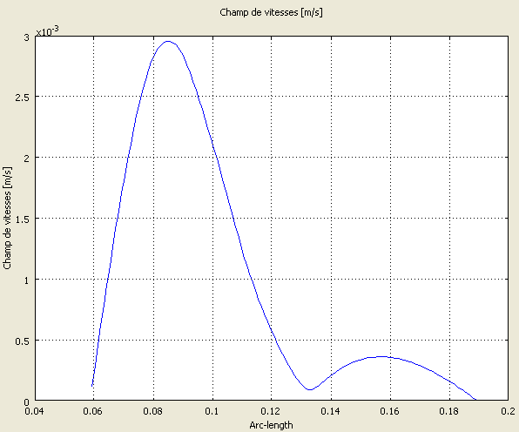
PROPOSAL: ALTERNATIVE SHAPES
Shaped cathode makes it possible to improve the fluid distribution in the cells

Slide 26
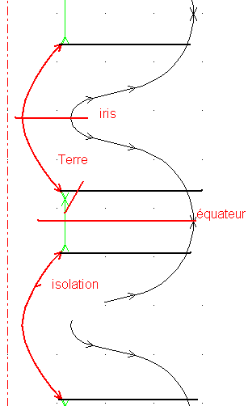
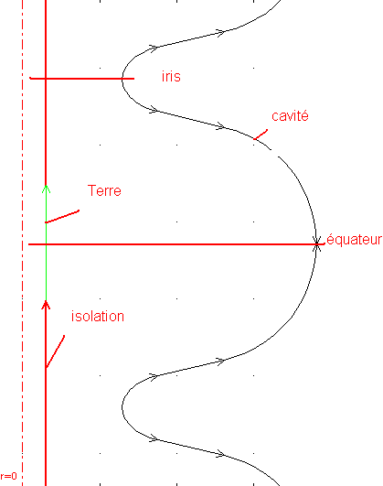
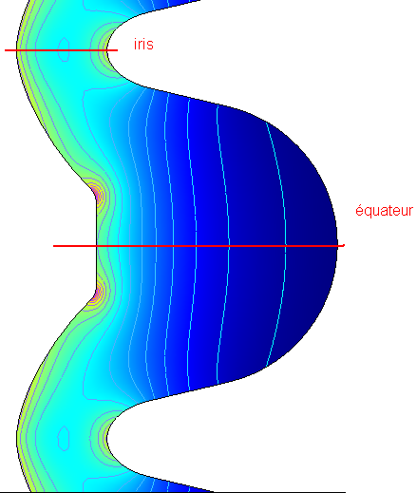
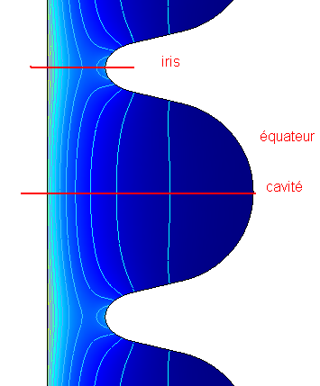
ELECTRIC FIELD MODELLING
Rod Cathode + insulation
Modified shape + insulation
Rod Cathode
Modified shape
R=36.14
R=14.06
R=18.87
R=5.88
Conclusion:
Less favourable configuration compared to TESLA cavity
Optimization possible
Gaz flow (N₂, O₂) not studied in the model
Possibility to use stirring (rotating cathode) to improve VEP

Slide 27
CONCLUSION
Fabrication of the set-up is on going
CORELEC makes a good impression
Safety report delivered to local safety authorities
Commissioning expected for June 2011
VEP modelled for 9-celles and 5-cells
Process more challenging for large cavities
Several leads investigated to optimize the process

Slide 28
THANK YOU FOR YOUR ATTENTION!

