Slide 1
Design of a test Cryomodule for the
Superconducting Proton Linac of CERN
Patricia DUCHESNE (IPNO)
Patxi DUTHIL (IPNO)
Sébastien ROUSSELOT (IPNO)
Vittorio PARMA (CERN)
Arnaud VANDE CRAEN (CERN)

Slide 2
contents
Context of the SPL
CERN’s expected new LHC injection line
CERN’s new scientific strategy: the High-Power SPL
Goal & motivations of the short cryomodule
Goal & motivations
Cryostat specific main objectives
β=1 cryo-module in a possible SPL layout
Segmented configuration, dimensions
β=1 cavity layout
Heat loads
From 8 to 4 cavities
The cryomodule design strategy
The short cryomodule development: a collaboration effort
Short cryomodule: layout sketch
Short cryomodule cryogenic scheme
The cryomodule vacuum vessel
Coupler geometric constrain
Vacuum vessel alternatives
Cavity Supporting System
The supporting system concept
Alignment requirements (transversal positions specification)
Cavity-to-vacuum vessel tolerances
The supporting system implementation
The vacuum vessel/coupler interface
The inter-cavity supporting system
Assembly tooling - Principles
Concepts
Example
Summary

Slide 3
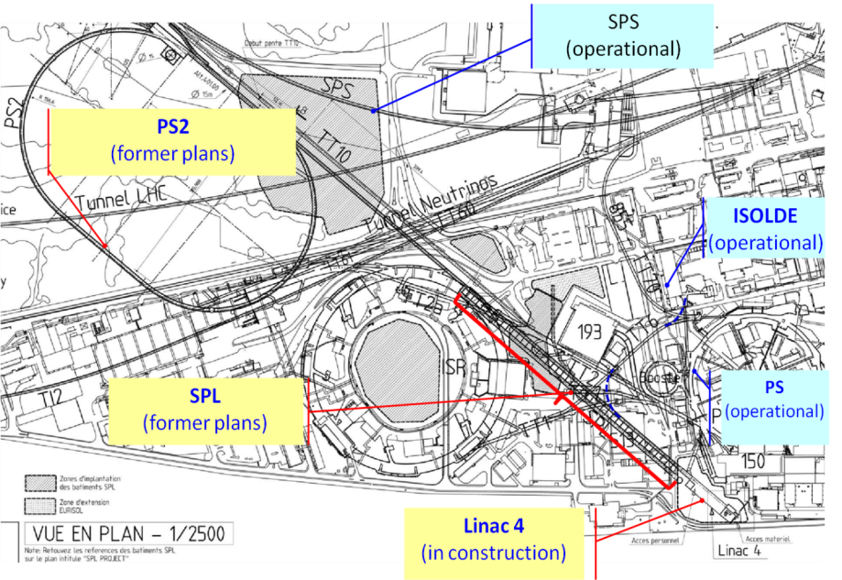
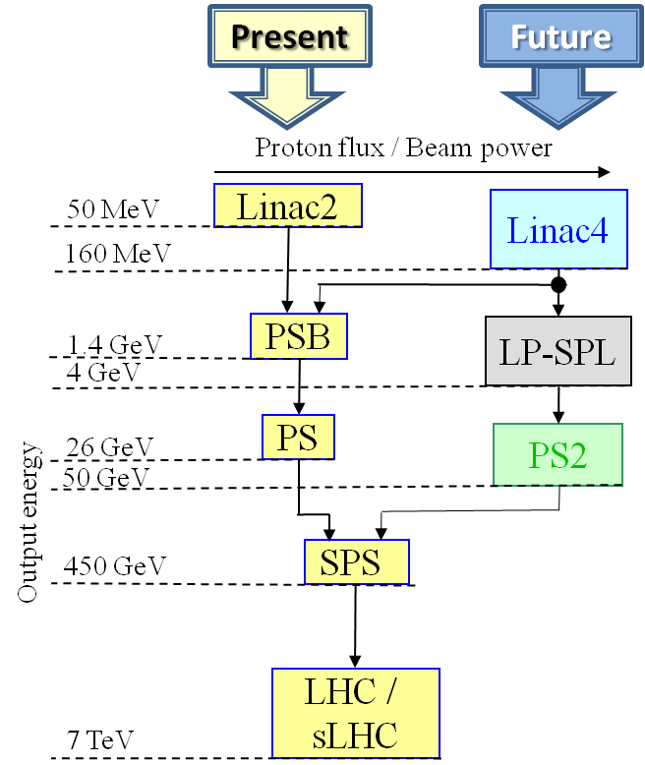
Context of the spl
CERN’s expected new LHC injection line (former plans)
LP-SPL: Low Power-Superconducting Proton Linac (4 GeV)
PS2: High Energy PS (~ 5 to 50 GeV – 0.3 Hz)
sLHC: “Super-luminosity” LHC (up to 10³⁵ cm⁻²s⁻¹)

Slide 4
Context of the spl
CERN’s new scientific strategy: R&D for a High Power SPL (HP-SPL)
General orientation:
Focus on R&D for key technologies for a high-intensity proton source (HP SPL) for a neutrino facility
In particular, for the cryo-module development:
Development, construction and test of β=1 elliptical cavities, 704 MHz
Development, construction and test of RF couplers
Test of a string of 4 β=1 cavities in a machine-type configuration
This program calls for the design and construction of a short cryo-module for testing purposes

Slide 5
Goal & motivations of the short cryomodule
Goal
Design and construct a ½-lenght cryo-module for 4 β=1 cavities (as close as possible to a machine-type cryomodule)
Motivations
Test-bench for RF testing on a multi-cavity assembly driven by a single or multiple RF source(s)
Enable RF testing of cavities in horizontal position, housed in machine-type configuration (helium tanks with tuners, and powered by machine-type RF couplers)
Validate the design of critical components like RF couplers, tuners, HOM couplers in their real operating environment

Slide 6
Goal & motivations of the short cryomodule
Cryostat specific main objectives
Learning of the critical assembly phases:
From clean room assembly of cavities to a cryomodule
Alignment/assembly procedure
Proof of concept of “2-in-1” RF coupler/cavity supporting:
Fully integrated RF coupler: assembly constraints
Active cooling effect on cavity alignment
Operation issues:
Cool-down/warm-up transients, thermo-mechanics, heat loads
Alignment/position stability of cavities
Cryogenic operations (He filling, level controls, RF coupler support tube cooling)

Slide 7
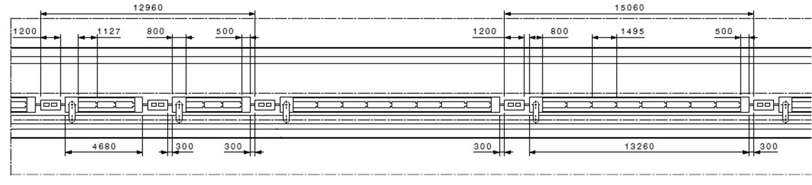
β=1 cryo-module in a possible SPL layout
« Segmented » architecture with warm quads and a cryo distribution line
Warm quadrupole
Cryogenic Distribution Line
β=0.65 cryomodule (3 cavities)
β=1 cryomodule (8 cavities)
Jumper

Slide 8
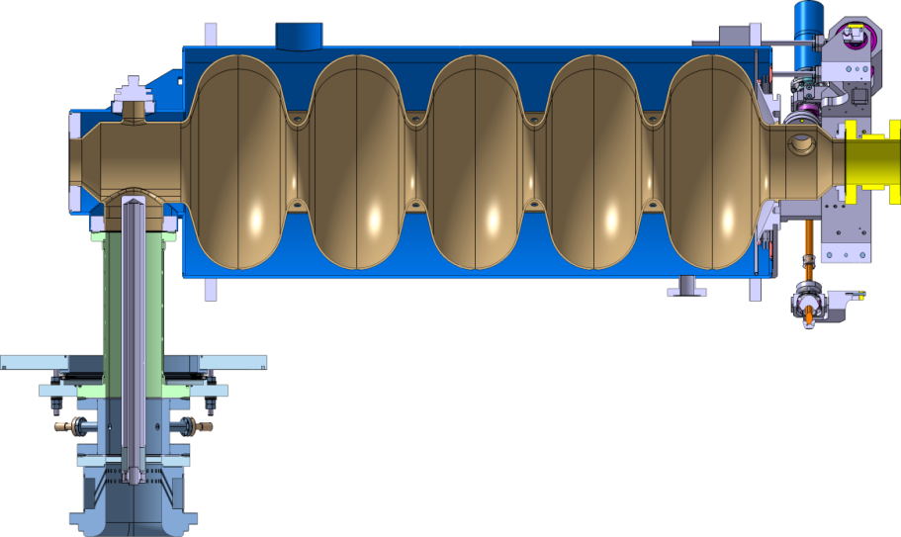
β=1 cryo-module in a possible SPL layout
β=1 cavity layout
Cryogenic connection to He bi-phase pipe
HOM port
~540 mm
CEA Tuner
HP coupler | 1000 kW pulsed 50 Hz (20 ms) 100 kW average
Stainless steel He vessel
(Eucard : Titanium He vessel)
The He vessel includes specific interfaces for the cryomodule integration (Eucard cavity interfaces for Cryolab-CEA not compatible with SPL integration):
Inter-cavity supports
Cryogenic feeds
External magnetic shielding via cryoperm™ (not shown)
Tooling (in/outside the clean room)
Requirement | Value
β | 1
Frequency | 704.4 MHz
Qo | 10 x 10⁹
Gradient | 25 MV/m
Operat. T | 2 K

Slide 9
β=1 cryo-module in a possible SPL layout
2K Heat Loads (per β=1 cavity)
Operating condition | Value
Beam current/pulse lenght | 40 mA/0.4 ms beam pulse | 20 mA/0.8 ms beam pulse
cryo duty cycle | 4.11% | 8.22%
quality factor | 10 x 10⁹ | 5 x 10⁹
accelerating field | 25 MV/m | 25 MV/m
Source of Heat Load | Heat Load @ 2K (per cavity)
Beam current/pulse lenght | 40 mA/0.4 ms beam pulse | 20 mA/0.8 ms beam pulse
dynamic heat load per cavity | 5.1 W | 20.4 W
static losses | <1 W (tbc) | ~ 1 W (tbc)
power coupler loss at 2 K | <0.2 W | <0.2 W
HOM loss in cavity at 2 K | <1 | <3 W
HOM coupler loss at 2 K (per coupl.) | <0.2 W | <0.2 W
beam loss | 1 W | 1 W
Total @ 2 K | 8.5 W | 25.8 W

Slide 10
From 8 to 4 cavities: the short cryomodule concept
The short cryomodule design strategy
4 cavities less
Short Cryomodule designed to be compatible with a full-length 8 cavities cryomodule
  Mechanical design
  Cryogenics (Heat loads, T and P profiles, segmented machine layout)
  Designed for 0%-2% test (for 1.7% expected tunnel slope)
The short cryomodule development: a collaboration effort
Institute | Supply
CEA – Saclay (F) | Design of β=1 cavities (EuCARD task 10.2.2) Design & construction of 4 helium vessels for β=1 cavities* Supply of 4 (+4) tuners* Testing of RF couplers*
CNRS - IPNO – Orsay (F) | Supply of prototype cryomodule cryostat components* Design & construction of cryostat assembly tools*
Stony Brook/BNL/AES team | (Under DOE grant) Designing, building and testing of 1 β=1 SPL cavity.
CERN | 4 (+4) β=1 cavities (supplied from European industry)
CERN | 4 (+4) RF couplers (2 types)
* Special French in-kind contribution to CERN

Slide 11
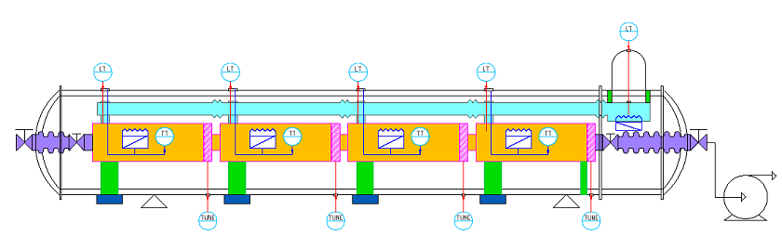
From 8 to 4 cavities: the short cryomodule concept
Short cryomodule: layout sketch
Connection to cryo distribution line
End
Module
Cryomodule
Technical Service
Module
Cryo fill line (Y), top left
Phase sep.
Cold-warm transition
RF coupler
1.7% Slope (adjustable 0-2%)

Slide 12
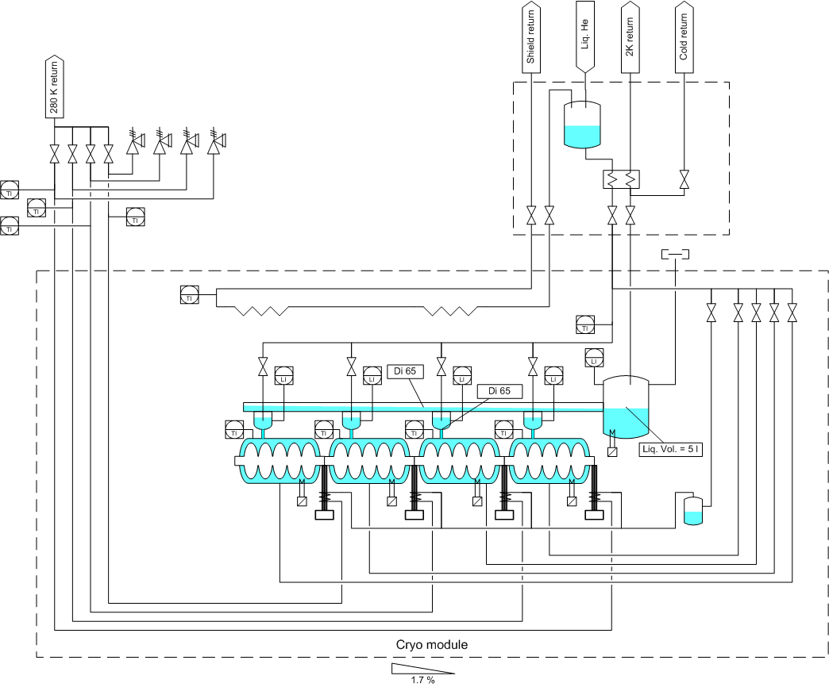
From 8 to 4 cavities: the short cryomodule concept
Short cryomodule cryogenic scheme
Coupler
cooling
Thermal shield (50-75K)
Pumping line
Cavity top supply
Cavity cooling down lines
Bi-phase pipe
Coupler
cooling

Slide 13
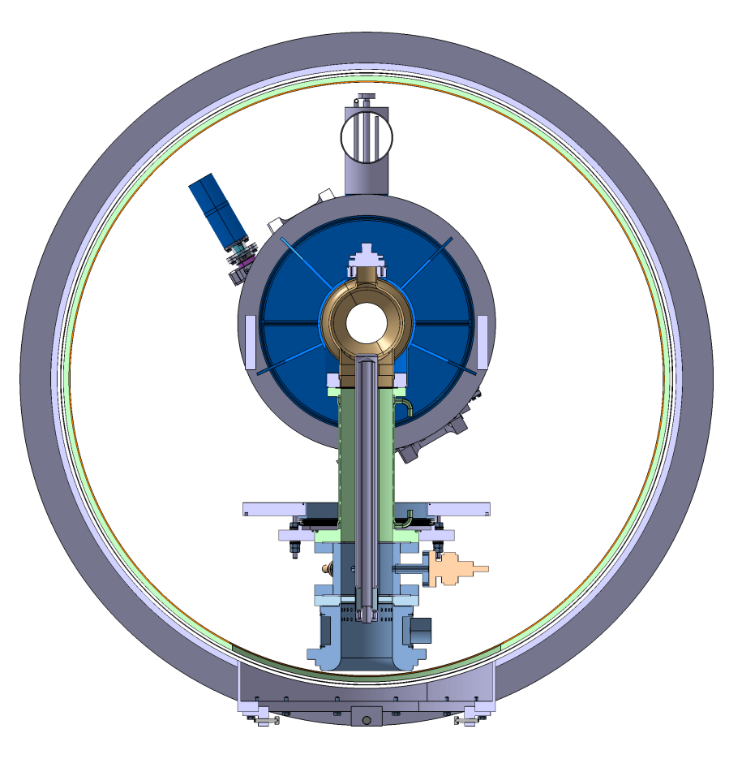
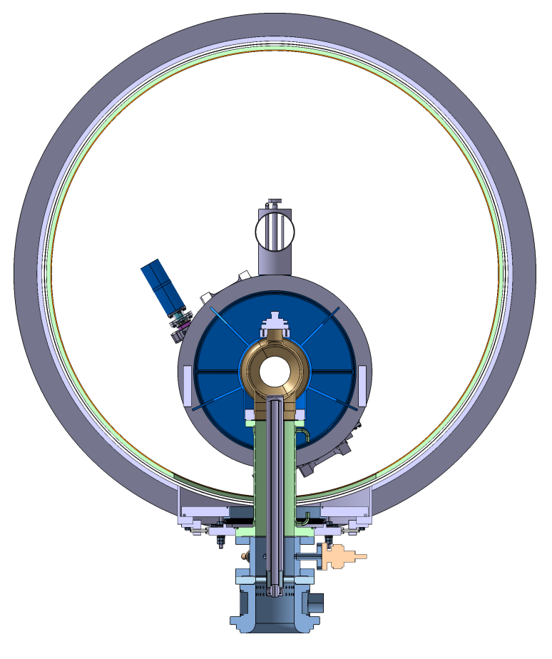
The Cryomodule vacuum vessel
Coupler geometric constrain
~1200
250
The coupler lenght imposes the vessel diameter
The doorknob and part of the antenna air cooling are removed for the cryostating in order to reduce this length.
⇒ Vessel diameter is reduced from 1500 mm to 1200 mm.

Slide 14
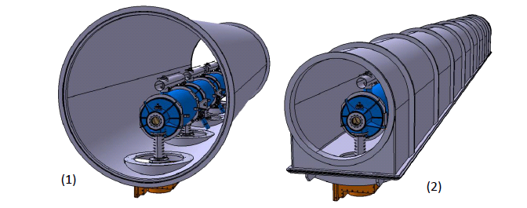
The Cryomodule vacuum vessel
Vacuum vessel alternatives
Tube type (longitudinal cryostating)
Intrinsic better mechanical behavior (inertia, vacuum)
Simpler construction
Larger diameter of the tank : 1200 mm
Needs of windows for the accessibility of the cryostat components (corrective, repair actions)
Involves a more complex set of tooling
(needs of lateral displacement)
U type (vertical cryostating)
More complex vessel design
(need of a large opened window)
Simpler tooling for cryostating
(to be discussed)
Smaller tank diameter : 1020mm

Slide 15
The Cavity Supporting System
The supporting system concept
Intercavity supports
Z
Y
X
RF coupler double-walled tube flange fixed to vacuum vessel
The RF coupler (its double-walled tube) provides:
fixed point for each cavity (thermal contractions)
mechanical supporting of each cavity on the vacuum vessel
The intercavity support provides:
a 2nd vertical support to each cavity (limits vertical self-weight sag)
relative sliding between adjacent cavities along the beam axis
enhancement of the transverse stiffness to the string of cavity
(increases the eigenfrequencies of first modes)

Slide 16
The Cavity Supporting System
Alignement requirements
Transversal position specification
BUDGET OF TOLERANCE
Step | Sub-step | Tolerances (3σ) | Total envelopes
Cryo-module assembly | Cavity and He vessel assembly | ± 0.1 mm | Positioning of the cavity w.r.t. beam axis ± 0.5 mm
 | Supporting system assembly | ± 0.2 mm
 | Vacuum vessel construction | ± 0.2 mm
Transport and handling (± 0.5 g any direction) | N.A. | ± 0.1 mm | Stability of the cavity w.r.t. beam axis ± 0.3 mm
Testing/operation | Vacuum pumping | ± 0.2 mm
 | Cool-down
 | RF tests
 | Warm-up
 | Thermal cycles
Construction precision
Long-term stability

Slide 17
The Cavity Supporting System
Cavity-to-vacuum vessel tolerances
 | Stack of construction tolerances
# |  | Angular tolerance (planarity or perpendicularity) |  | Radial tolerance induced by angular tolerance | Radial tolerance | Angle | Δz (@ cavity extremity 1100mm)
1 | Cavity flangeø152 | 0.3 mm (cavity design) |  | ± 0.6 mm | ± 0.1 mm (Th.Renaglia) | 0.122° | 3.5 mm / 3.1 mm
2 | Double-walled tube top flange ø152 | 0.02 mm (drwg SPLACSMC0024) |  | ± 0.04 mm
3 | Cu RF gasket ø152 | N.A. |  | N.A. | ± 0.05 mm (drwg SPLACSMC0025)
4 | Double-walled tube top flange ø500 | 0.02 mm (drwg SPLACSMC0024) |  | ± 0.02 mm |  | 0.06° / 0.037°
5 | Vac.vessel flange ø500 | 0.5 mm / 0.3 mm (experience LHC) |  | ± 0.42 mm / ± 0.25 mm | ± 0.25 mm (experience LHC)
 | TOTAL ΔXY |  |  | ± 1.48 mm / ± 1.31 mm
For each cavity, needs of:
- on the coupler side
± 1.48 mm
- on the tuner side
Longitudinal compensation
ΔX, ΔY, ΔZ
Angular compensation
θ_{X}, θ_{Y}, θ_{Z}
Longitudinal compensation
ΔZ (weight) (sag = 2.5 mm)
ΔY (thermal contraction)
Z
3.5 mm
Y
X

Slide 18
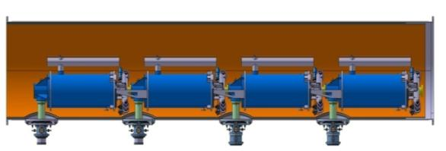
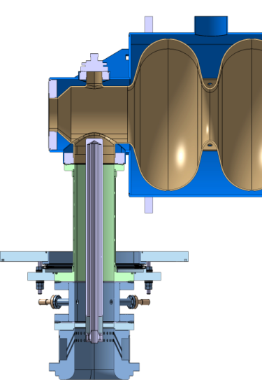
The Cavity Supporting System
The supporting system implementation
Cavity additional support
Coupler double walled tube
Inter-cavity Support
Longitudinal
compensation
ΔZ, ΔY
Vacuum vessel interface
Longitudinal compensation
ΔX, ΔY, ΔZ
Angular compensation
θ_{X}, θ_{Y}, θ_{Z}
Fixation (rigid connexion)

Slide 19
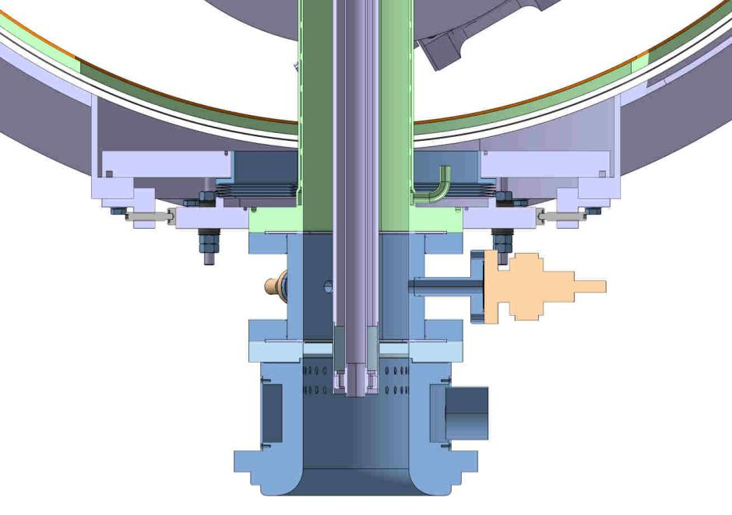
The Cavity Supporting System
The vacuum vessel/coupler interface (1/3)
Components
Coupler flange welded to the coupler bi-tube
Coupler sealing flange
(flexible connection to the coupler by use of a bellow)
Vacuum vessel sealing flange
Adjustable bolts with curved washers (for angular and longitudinal compensation)
Adjustable stop (X,Y plane)

Slide 20
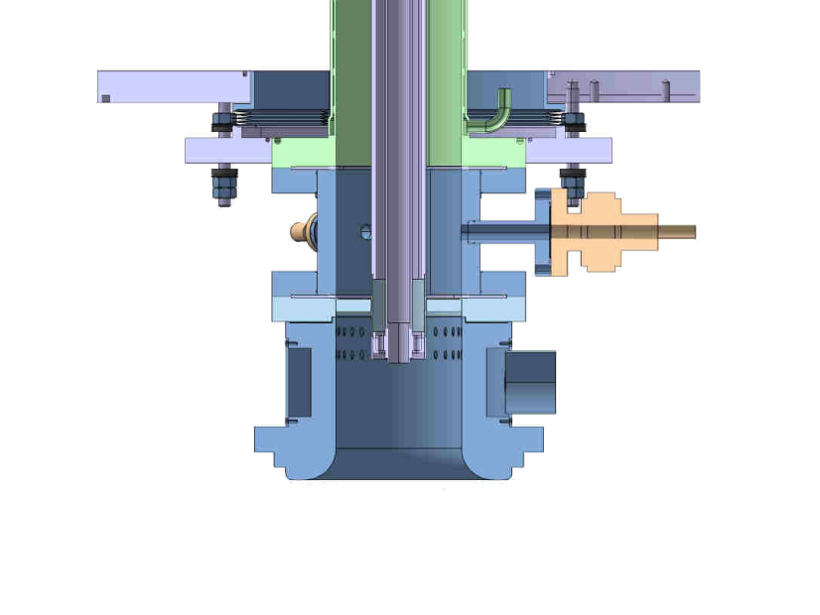
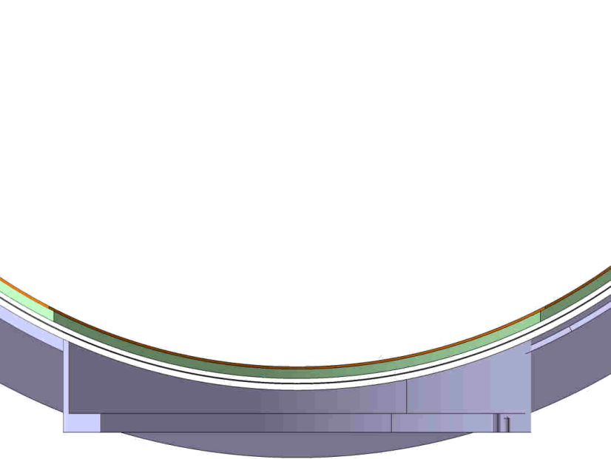
The Cavity Supporting System
The vacuum vessel/coupler interface (2/3)
Assembly procedure
Vacuum vessel lift of
Contact of the 4 coupler sealing flanges to the 4 bearings of the vacuum vessel
And fixing
defaults located at the level of the 4 bearing plans are compensated by the flexibility of the bellows.

Slide 21
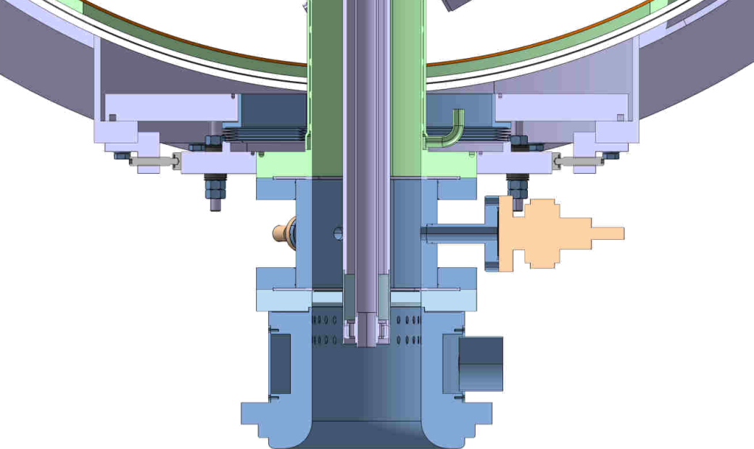
The Cavity Supporting System
The vacuum vessel/coupler interface (3/3)
Assembly procedure
Fixation of the coupler flange
Lower curved washers and nuts are put in contact to the coupler flange and blocked.
Upper nuts can be clamped .
X,Y adjustable stops are blocked.
→ No motion is allowed between the coupler flange and the vacuum vessel bearing (translation nor rotation).

Slide 22
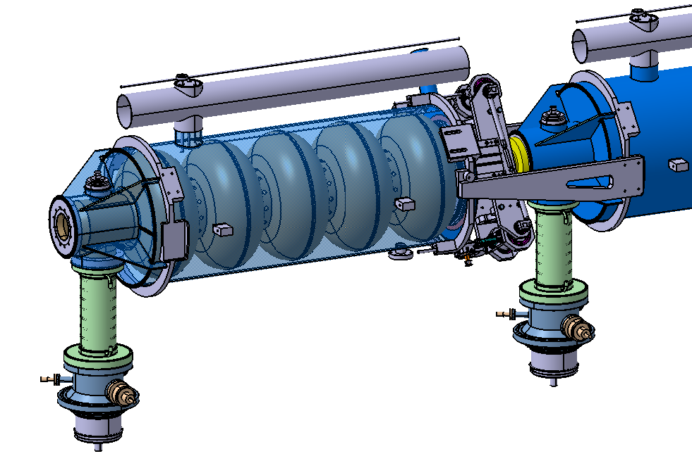
The Cavity Supporting System
The inter-cavity supporting system (1/3)
Functionalities
Second vertical support (alignement) ⇒ Stiffness
Sliding interface along Y axis ⇒ Contact interface
 | Components |  |  | Weight (Kg)
1 | Cavity |  |  | 55
2 | Helium tank |  | Envelope | 36
 |  |  | Anneaux (2) | 15
3 | Tuner |  |  | 18
4 | Cryogenic pipes |  |  | 6
5 | Magnetic shield (estimated) |  |  | 17
6 | Coupler | Bi-walled tube |  | 8
 |  | Others |  | 35
7 | Inter-cavity connections |  |  | 15
Distribution of loads for the first cavity :
4
450 N
450 N
7
620 N
1
3
2
6
1 set :
Cavity + He Tank + tuner + Cryo pipes+ magnetic shield + bi-walled tube = 155 Kg

Slide 23
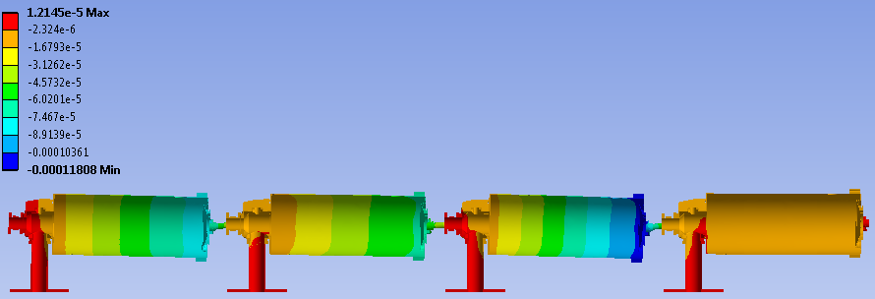
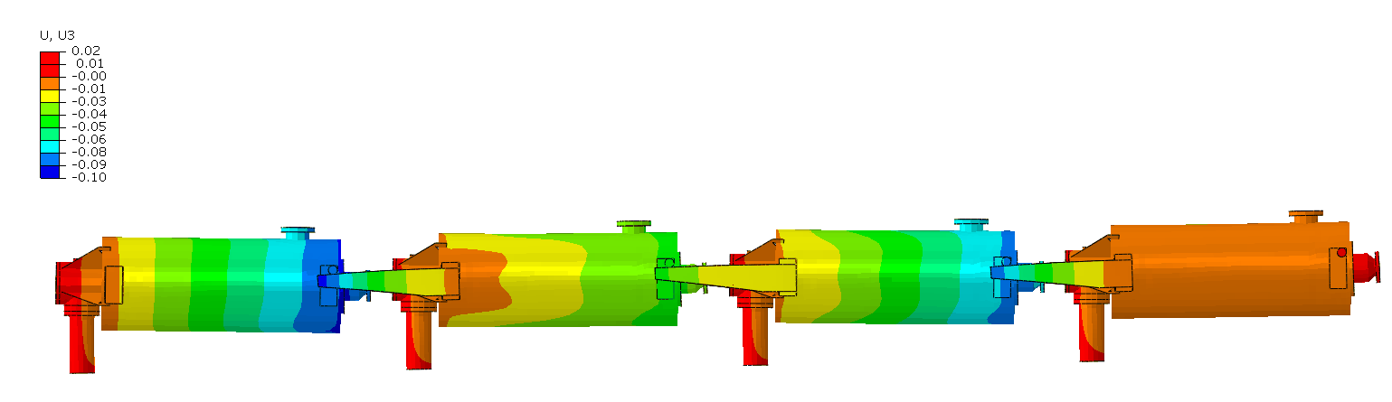

The Cavity Supporting System
The inter-cavity supporting system (2/3)
Deflection under gravity
Example with sliding pivot:
Body deformation amplified 300x
Max: 0.12 mm
Example with linear support:
Body deformation amplified 300x
Max: 0.10 mm
Whatever the principle chosen, finding an acceptable solution is possible in term of deflection

Slide 24
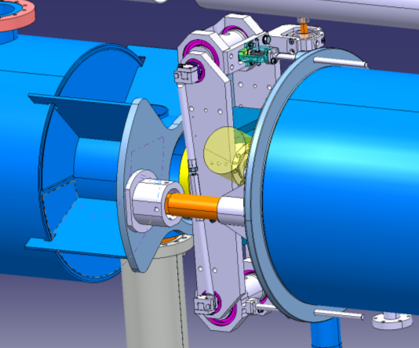
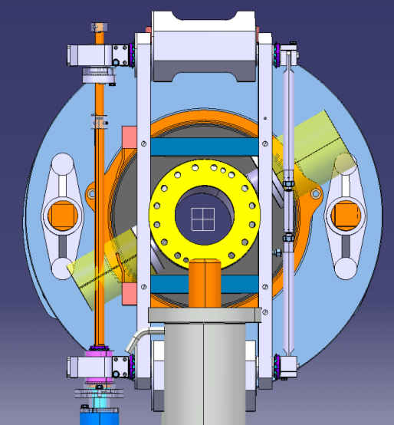
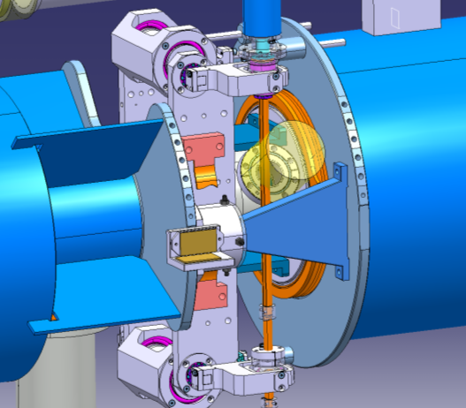
The Cavity Supporting System
The inter-cavity supporting system (3/3)
Optimization
Modification of the orientation of the tuner (vertical position)
Modification of the helium tank :
  Ti ➔ Stainless steel
  Fixation of the supports on the face plate of the helium tank
Reduction of the lenght of intercavity supports
Examples:
The extremity of the rod is supported by 4 spherical bearings
➔ Sliding in Y axis allowed
➔ Rotations not locked

Slide 25
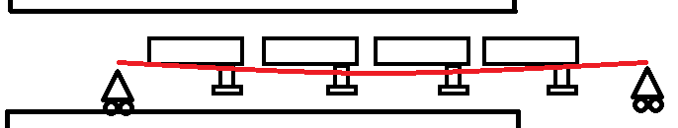
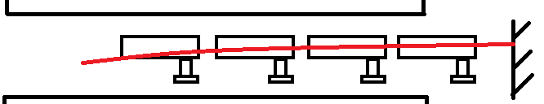
Assembly tooling – Principles
Concepts
Cavities are aligned on the alignment tooling before cryostating.
Same tooling used for the cryostating ⇒ String alignment should not be altered during the insertion.
Length of the beam: ~7 m for 4 cavities short cryo-module, ~14 m for 8 cavities cryo-module.
①
① Critical points:
Sliding on the wall of the vacuum vessel (in the presence of the shields)
Overall dimensions (string + tooling + sag) in regards with the vessel diameter
② Critical point:
Overall dimensions (string + tooling + sag) in regards with the vessel diameter
②
③ Critical point:
- Positioning the tooling within (along) the vacuum vessel (openings)
③

Slide 26
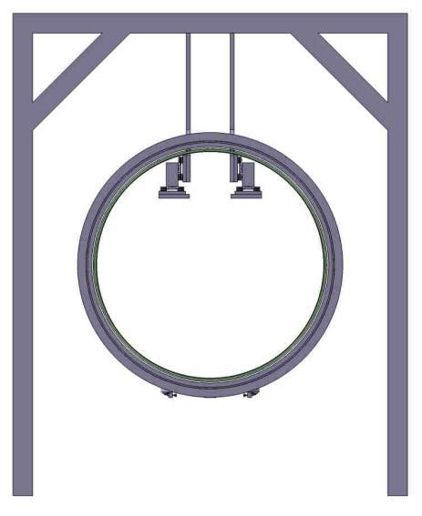
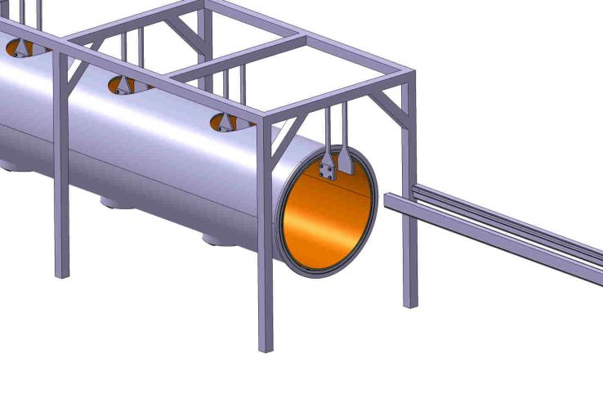
Assembly tooling – Principles
Example (1/3)
Vertical supports
Railways
Rollers
Fix tooling (around the vacuum vessel) :
Vertical supports are equipped with rollers allowing the insertion of railways within the vacuum vessel.
The vacuum vessel is supported by a dedicated tool allowing its displacement and lift of.

Slide 27
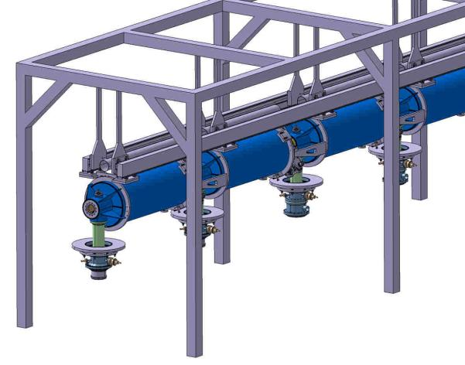
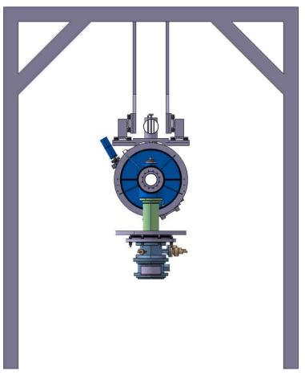
Assembly tooling – Principles
Example (2/3)
Railways
Vertical supports
The string of cavities is supported by the same type of vertical supports and rails than for the fix tooling.
Cavities are guided by the rails and can roll on them.
Transfer and alignment tooling

Slide 28
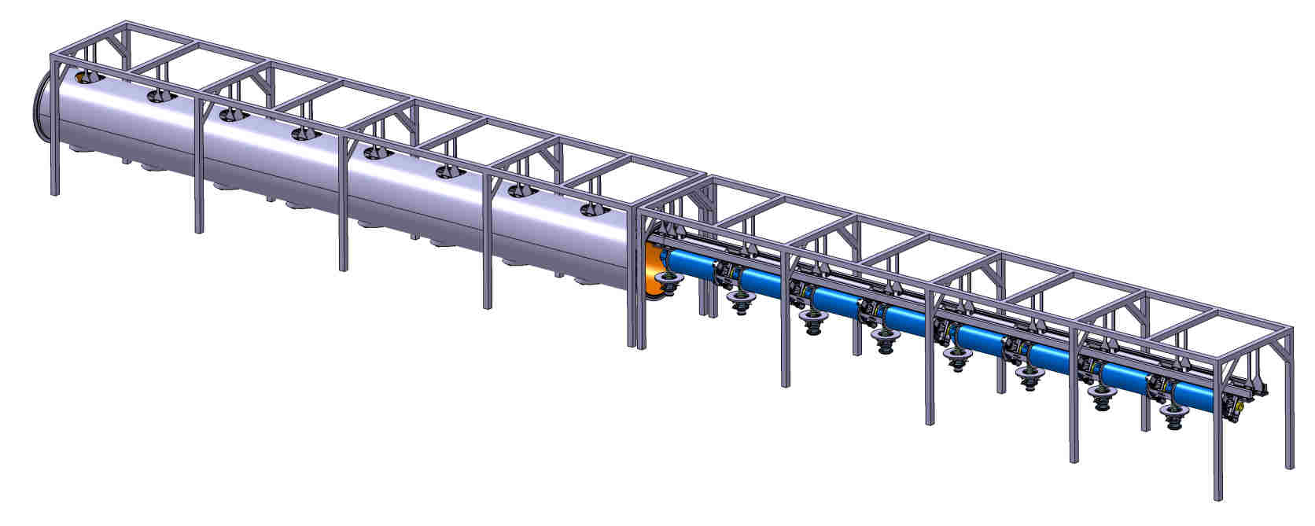
Assembly tooling – Principles
Example (3/3)
Fix tooling
Transfer and alignment tooling
Connection zone between the rails of the fix tooling and the transfer tooling
The string of cavities is moved along the rails inside the vacuum vessel
Investigation ⇒ Common tooling for the assembly inside the clean room and alignment outside

Slide 29
SUMMARY
A ½-lenght cryomodule for the full test of 4 β=1 cavities is being design for the CERN
Issued from a collaboration between different institutes, it will be as similar as possible to a machine-type cryomodule for a future SPL
For now:
Most of cryo-module requirements are settled
Most of the conceptual choices are made (cavity supporting system, cryogenic scheme…)
Still needing conceptual design work: magnetic shielding, thermal shield
Vacuum vessel: 2 concepts are being compared
- Tube-type, large diameter (radial space constraint from cavity/tuner)
- U type, construction complexity (=cost)
Assembly tooling concepts are under progress
Calendar:
Preliminary design review will take place in Summer 2011
Detailed design review End 2011
Procurement of cryostat components starting in 2012
Assembly of cryomodule in second half of 2013, followed by testing

Slide 30
Thank you for your attention

