Slide 1


A Four Rod Compact Crab Cavity for LHC
B Hall
Lancaster University / Cockcroft Institute

Slide 2
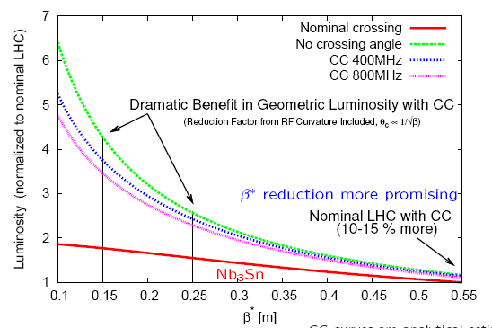
LHC Crabbing upgrade
Crabbing provides significant Luminosity advantages.
Local crabbing scheme has been chosen for LHC upgrade.
Compact size needed do to limited space (~150mm space available compared to ~350 needed for orthodox cavity).
194mm

Slide 3
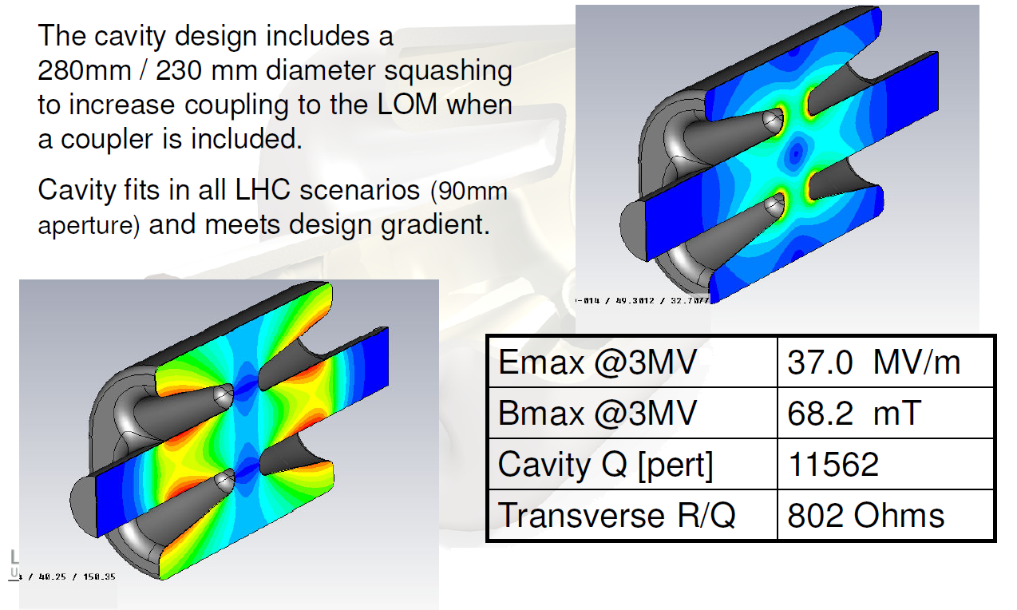
Previous design
E field
B field

Slide 4
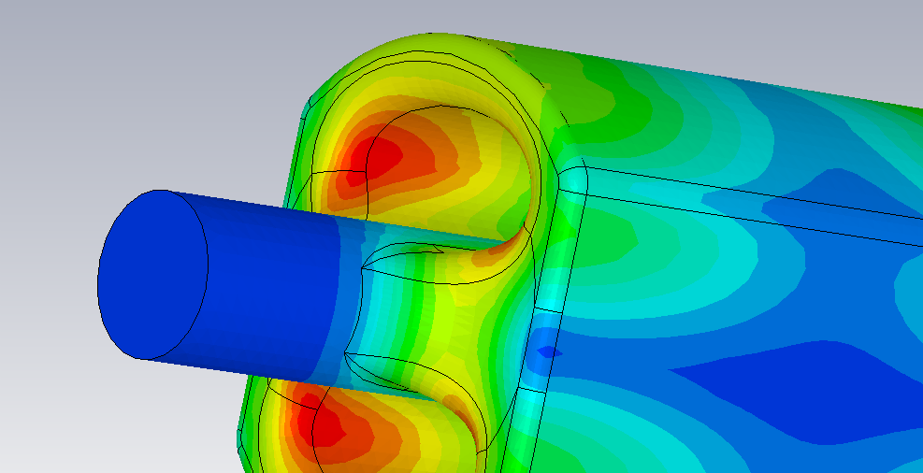
Rod cross-section
If the rod is shaped around the beam-pipe a higher gradient can be obtained as the current is spread over a larger area.
The peak magnetic field also moves to the side of the rods away from the beampipe

Slide 5
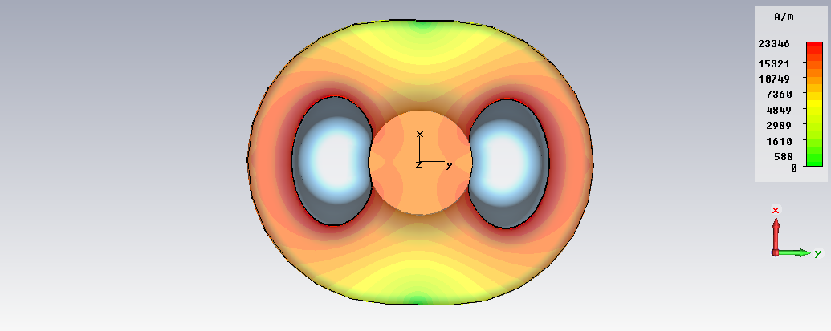
Variation in Original Transverse Voltage
In the original design there was some variation in transverse voltage across the cavity aperture which would result in a varying kick across the beam
E field

Slide 6
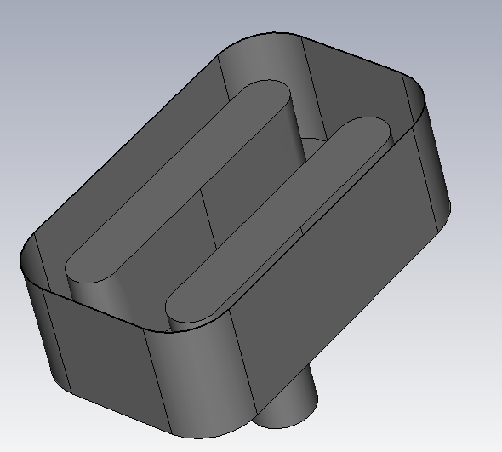
Plate-like rods
Flatness only a concern across aperture
Wide flat rods are preferred for minimal voltage variation.
Wide rods however have high surface fields which makes this design unsuitable.

Slide 7
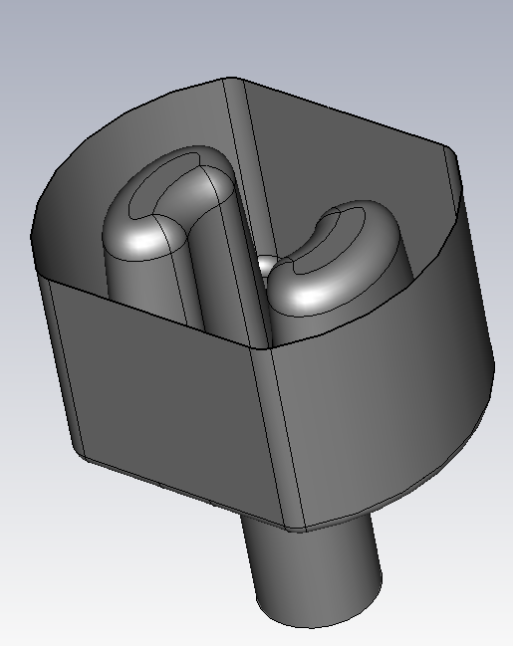
New shape
Adding focussing electrodes to narrow rods, can however provide parallel equipotential lines emulating the wider rods.
superfluous
Useful
superfluous

Slide 8
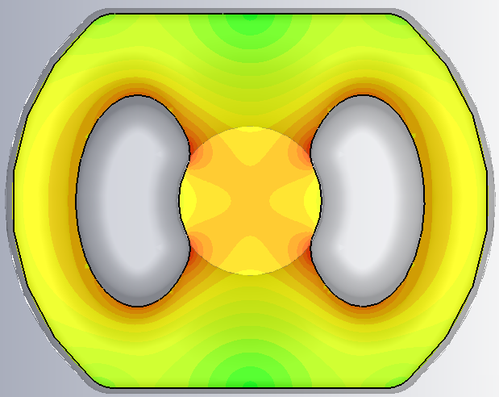
Horizontal variation
Old
New

Slide 9
Vertical variation
Old
New

Slide 10
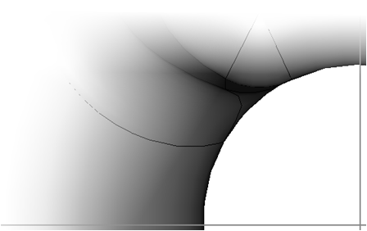
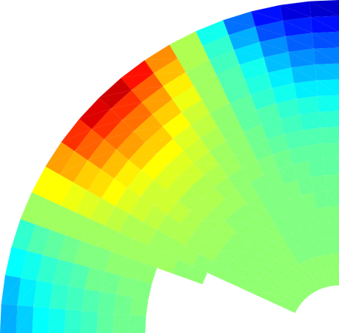
Voltage Variation - deflecting
Transverse voltage is relatively uniform for the first 20mm [<1% variation]
Rises to 3.8% at 35 mm (compared to 3.3% for a pillbox cavity)
Variation at large offset is due to field enhancement at the edge of the rods.
Azimuthal variation seen primarily at large radii.
Angle
High
Low

Slide 11
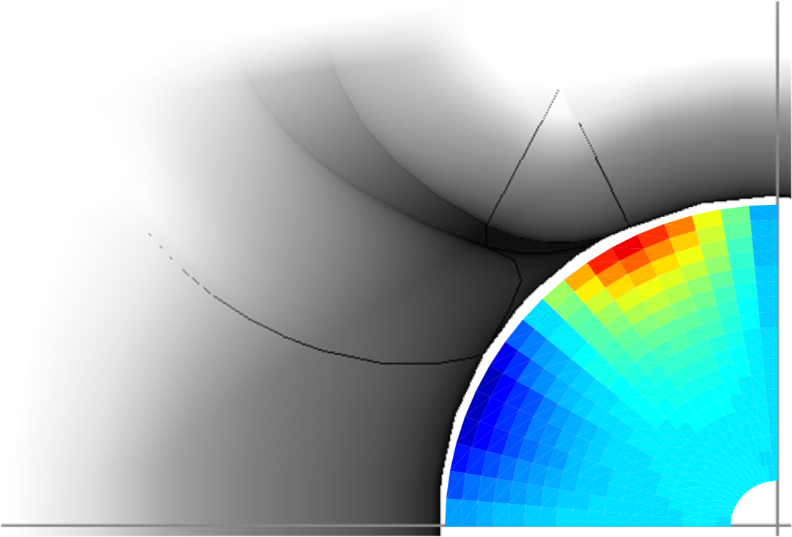
Voltage Variation – parasitic(vertical)
There is some unwanted kick in the vertical direction.
Large vertical kick near the edges of the rods due to field enhancement but small away from the rod edges.
Angle
High
Low

Slide 12
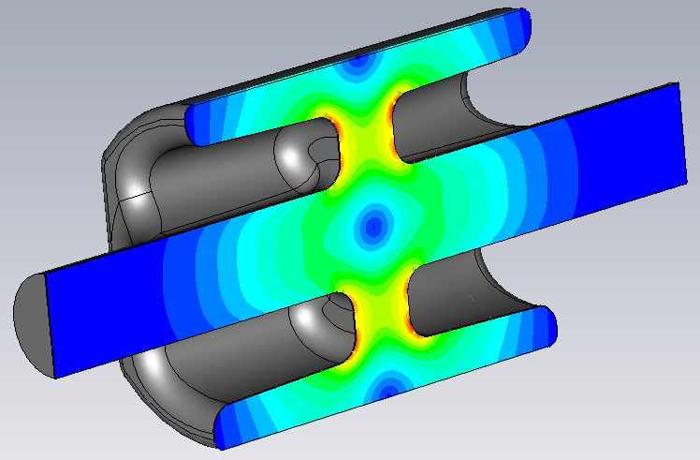
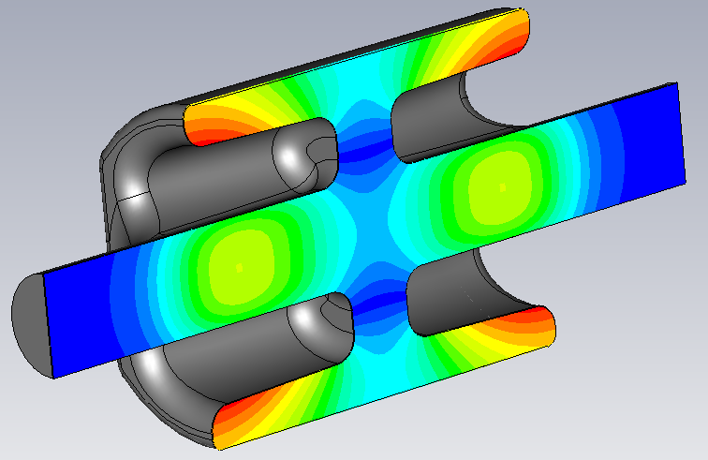
Final Cavity Shape
The cavity design includes a 280mm / 230 mm diameter squashing to increase coupling to the LOM when a coupler is included.
Cavity fits in all LHC scenarios (84mm aperture) and meets design gradient.
E field
Emax @3MV | 32.0 MV/m
Bmax @3MV | 60.5 mT
Transverse R/Q | 764.6 Ohms
B field

Slide 13
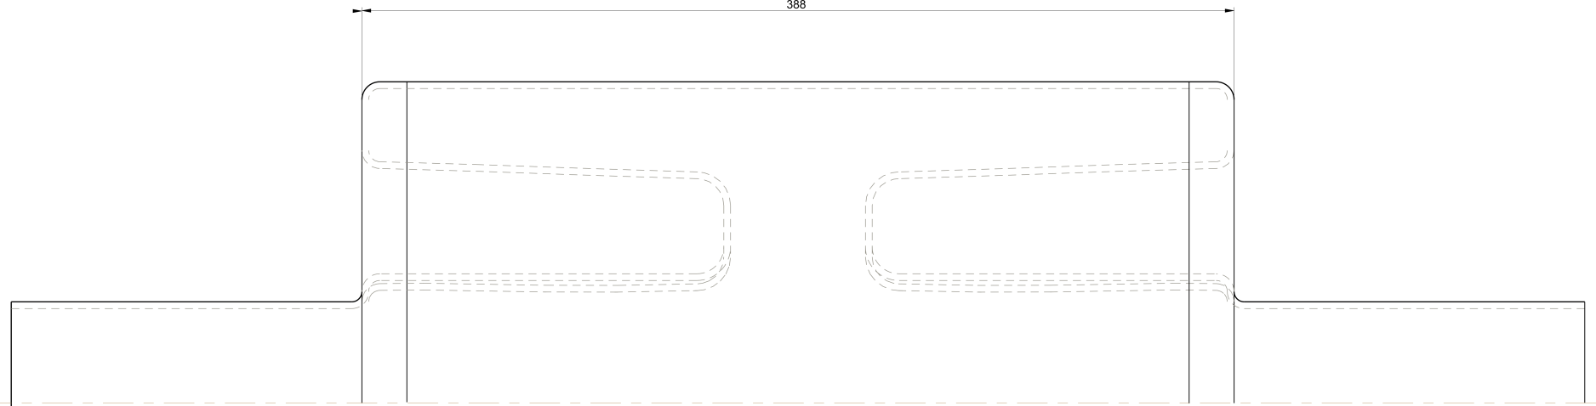
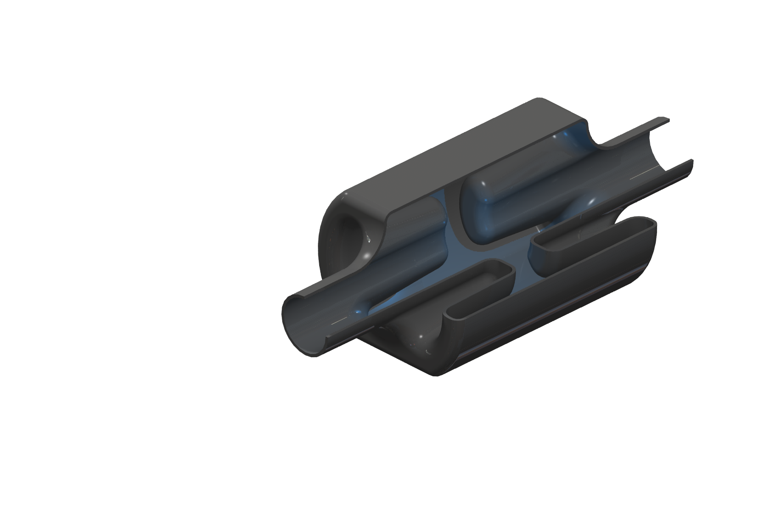
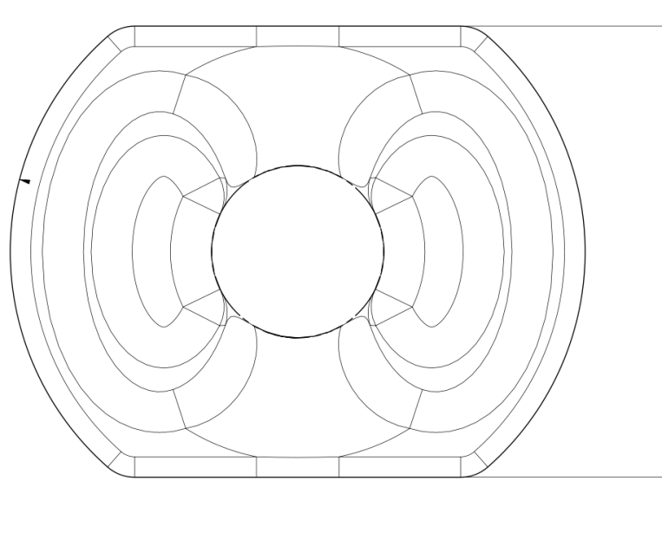
Final Cavity Design
406mm
Cut away of final design showing rods,
286 mm
84 mm
236 mm
Notes:
We have 7mm spare for bp of other pipe {~3mm?} and gap{4mm?},

Slide 14
Four TEM modes
+
+
+
-
-
-
-
+
There are two parallel bar TEM modes, only one interacts with the beam and this is our operating mode
+
-
+
+
+
-
+
+
There are also two co-axial like TEM modes (potential difference between rods and outer can), only one of these interacts with the beam, this is our wrong or lower order mode (W/LOM)

Slide 15
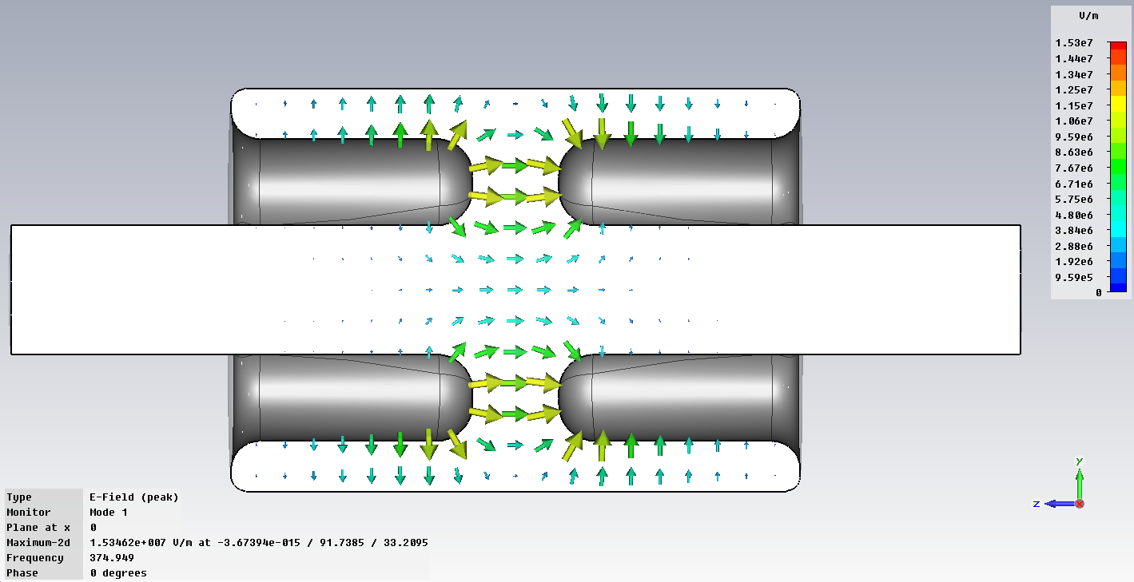
Lower Order mode
The four-rod cavity also has a lower order mode (LOM).
This mode has an azimuthal magnetic field flowing around the outer can which is ideal for waveguide coupling.
The fields are weaker far from the rods so the squashed shape enhances coupling.
LOM Frequency | 375.18 MHz
R/Q | 62.2 Ohms
LOM coupler reduces the frequency of this mode by 20 MHz.

Slide 16
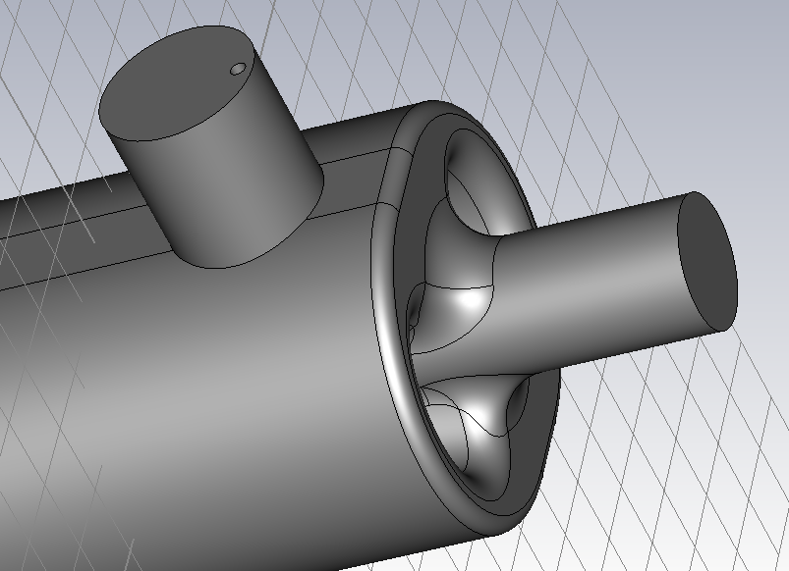
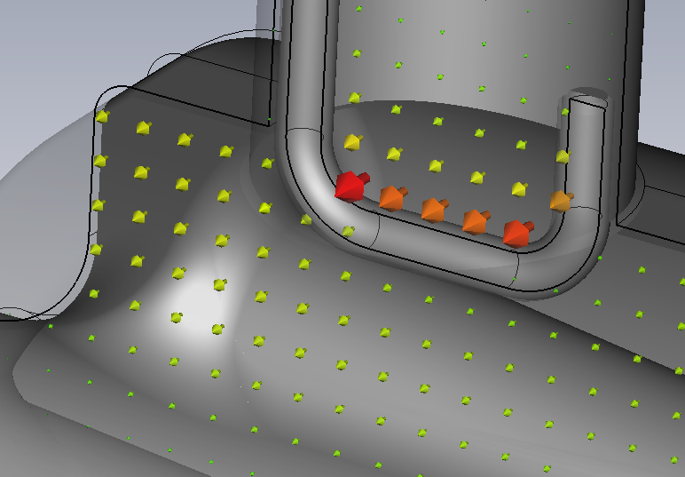
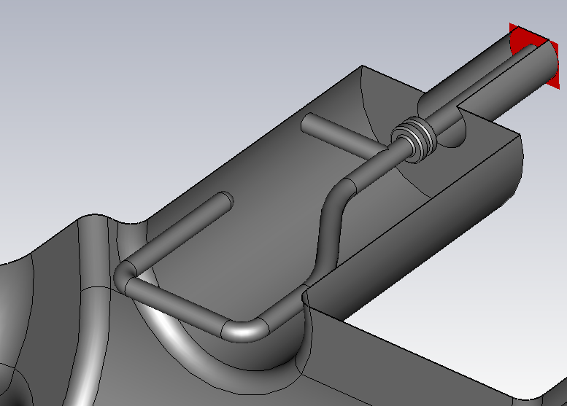
Demountable Coaxial coupler
Demountable HOM style coupler based of the LEP design.
Pull-out for coupler provides additional access to cavity for cleaning.
External-Q’s down to 67 have been achieved for 2 couplers, depending on the penetration of the hook into the cavity.
To ensure symmetric fields the couplers can be placed on opposing sides of the can.

Slide 17
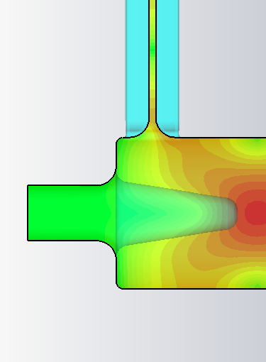
Cavity Cleaning
HPR nozzle
Beam-pipe is large and can be used as access for cleaning.
Large demountable LOM couplers can also be used for cavity cleaning and/or draining acid.

Slide 18
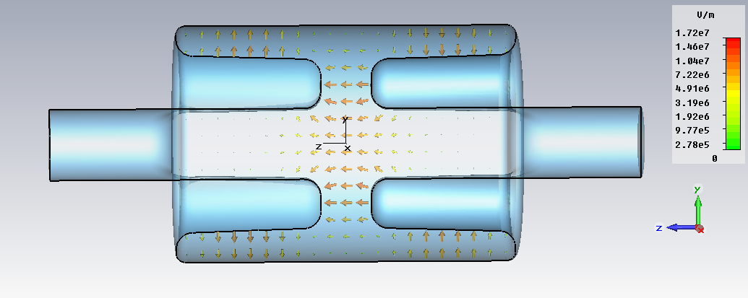
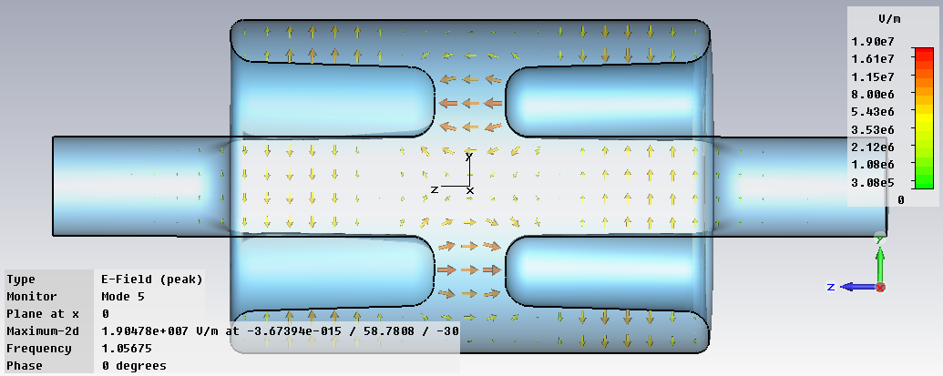
Higher Order Modes
We also have some TEM HOMs.
As the cavity is compact in the vertical plane most of the TM modes are at higher frequencies, and the TE modes have low shunt impedances.
Monopole 3π/4 resonator
Dipole 3π/4 resonator

Slide 19
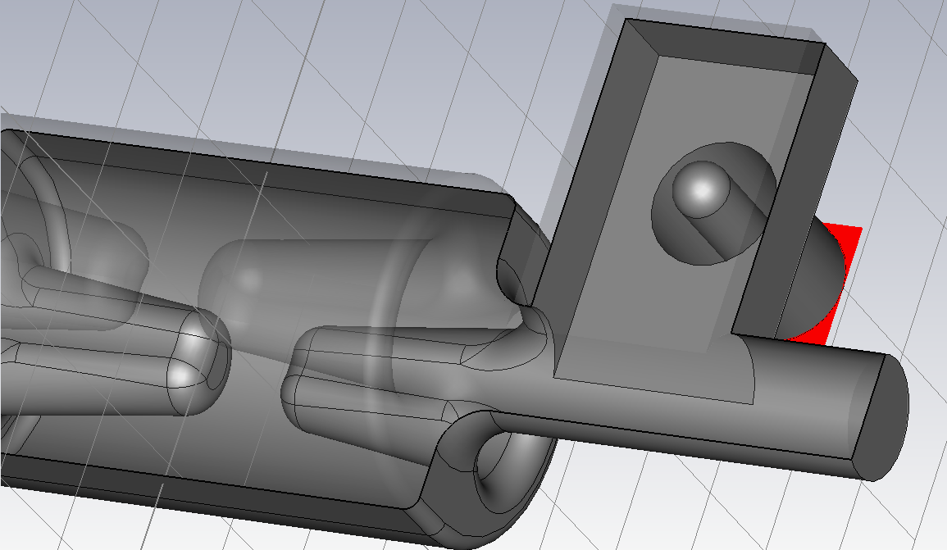
Input coupler
Capacitive coupling would require a horizontal electrode which would interfere with the opposing beamline.
Magnetic coupling is required (either a loop or waveguide)
A waveguide coupler at 400 MHz would be large compared to the cavity and would have a large heat leak.
Instead we propose a cut-off waveguide to couple to the cavity and then use a waveguide to coaxial transition.

Slide 20
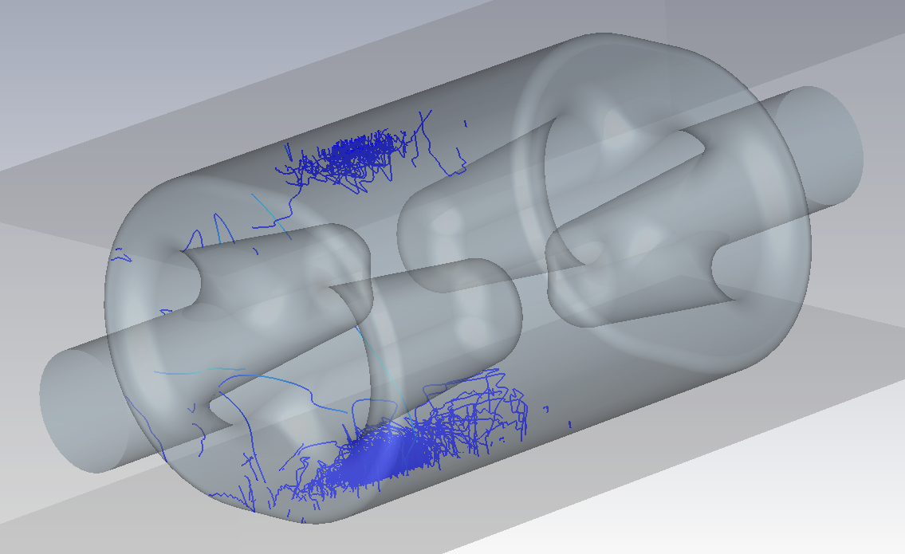
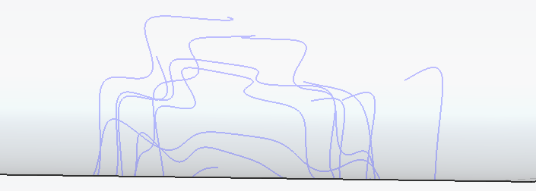
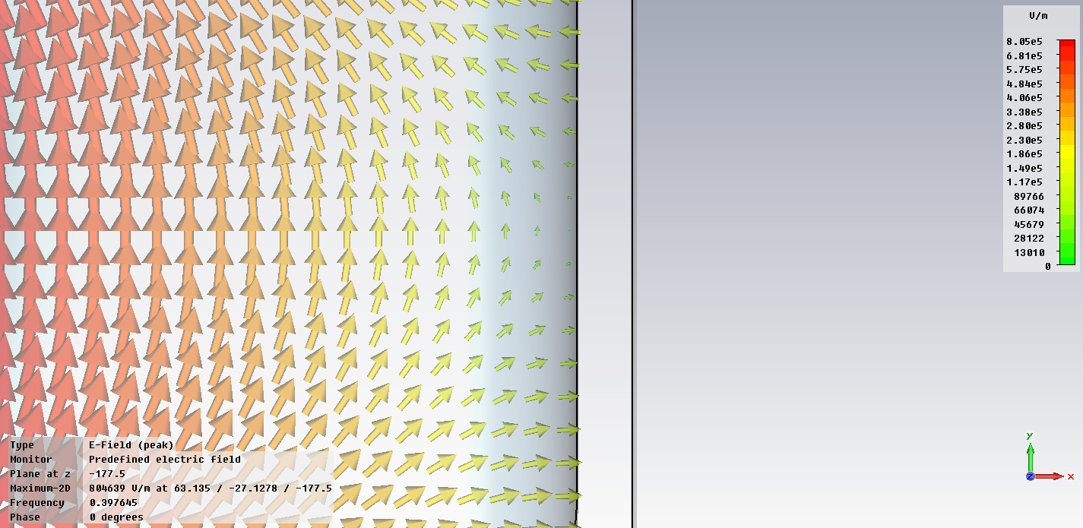
Multipacting
Some multipacting on the outer can has been found at low E field. V_{t} ~ 150 kV.
As cavity voltage increased the multipacting is pushed towards the base of the rods.
This is close to the region where we plan to place the LOM coupler so this may disrupt the multipactor.
Outer can trajectories follow a square step like path over several phases. There are 3rd and 7th order trajectories.

Slide 21
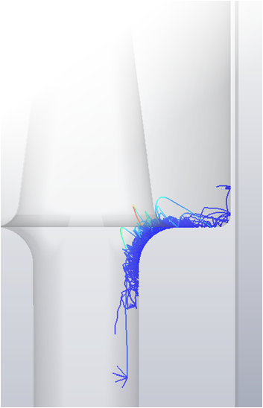
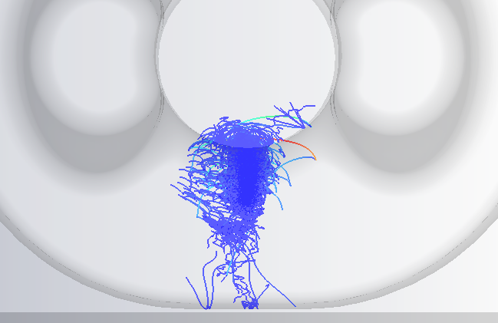
Multipactor Trajectories
Multipacting on the beam pipe was found in the racetrack model ~1.6MV.
Methods of removing the multipacting are being looked into, including;
  Altering the beam pipe shape,
  Adding ridges to disrupt local field patens.

Slide 22
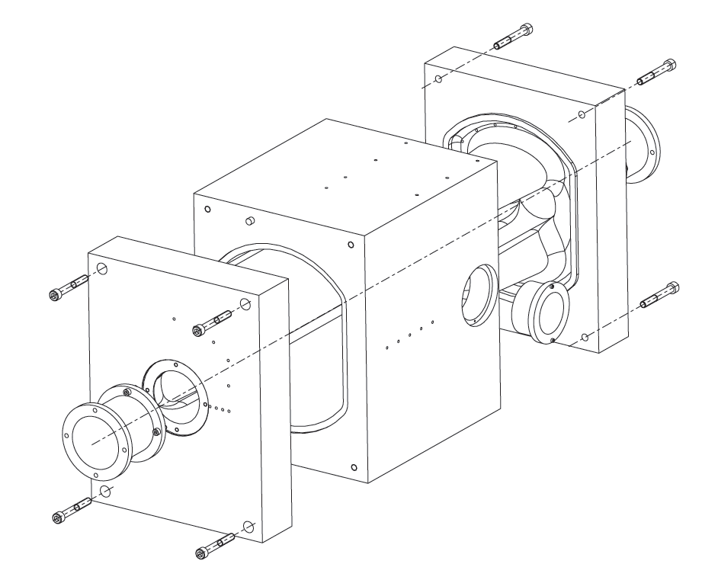
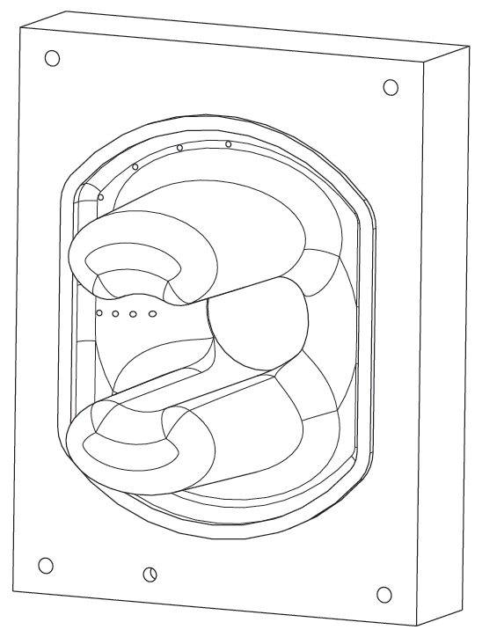
Cavity Prototype
UK have placed an order for an aluminium cavity.
Bead pull and coupler verification will be preformed on the aluminium cavity.

Slide 23
Niobium cavity construction (without couplers)
Beam-pipe (rolled)
Rods x 4 (pressed or hydroformed)
Rods and base may be deep drawn or extruded as 1 piece.
Some components could possible be machined from solid Nb instead
Shell (rolled)
End caps would be pressed

Slide 24
Conclusion
A new cavity shape is proposed for the LHC.
The crabbing TEM mode allows a very transversely compact design.
The compact size does not impact of the cavity fields greatly.
Coupler designs are under investigation.
A prototype is on order.

