Slide 1
Virtualisation
Working Group
Report
Tony Cass
HEPiX Spring 2011
May 6th 2010

Slide 2
Organisation
Slow start, mostly due to re-org @ CERN.
66 people on mailing list; core of ~10 regular participants, but many more join meetings on occasion.
  Many thanks to Ian Gable for taking notes during meetings.
Group identified 5 work areas
  Image Generation Policy
    Dave Kelsey & Keith Chadwick
  Image Exchange
    Owen Synge
  Image Expiry/Revocation
    Later agreed to be part of policy & exchange area
  Image Contextualisation
    Sebastien Goasguen
  Multiple Hypervisor Support
    Andrea Chierici

Slide 3
Policy for Trusted Image Generation
You recognise that VM base images, VO environments and VM complete images, must be generated according to current best practice, the details of which may be documented elsewhere by the Grid. These include but are not limited to:
  any image generation tool used must be fully patched and up to date;
  all operating system security patches must be applied to all images and be up to date;
  images are assumed to be world-readable and as such must not contain any confidential information;
  there should be no installed accounts, host/service certificates, ssh keys or user credentials of any form in an image;
  images must be configured such that they do not prevent Sites from meeting the fine-grained monitoring and control requirements defined in the Grid Security Traceability and Logging policy to allow for security incident response;
  the image must not prevent Sites from implementing local authorisation and/or policy decisions, e.g. blocking the running of Grid work for a particular user.
http://www.jspg.org/wiki/Policy_Trusted_Virtual_Machines

Slide 4
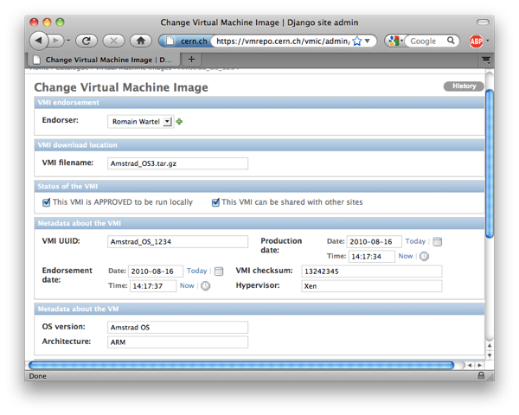
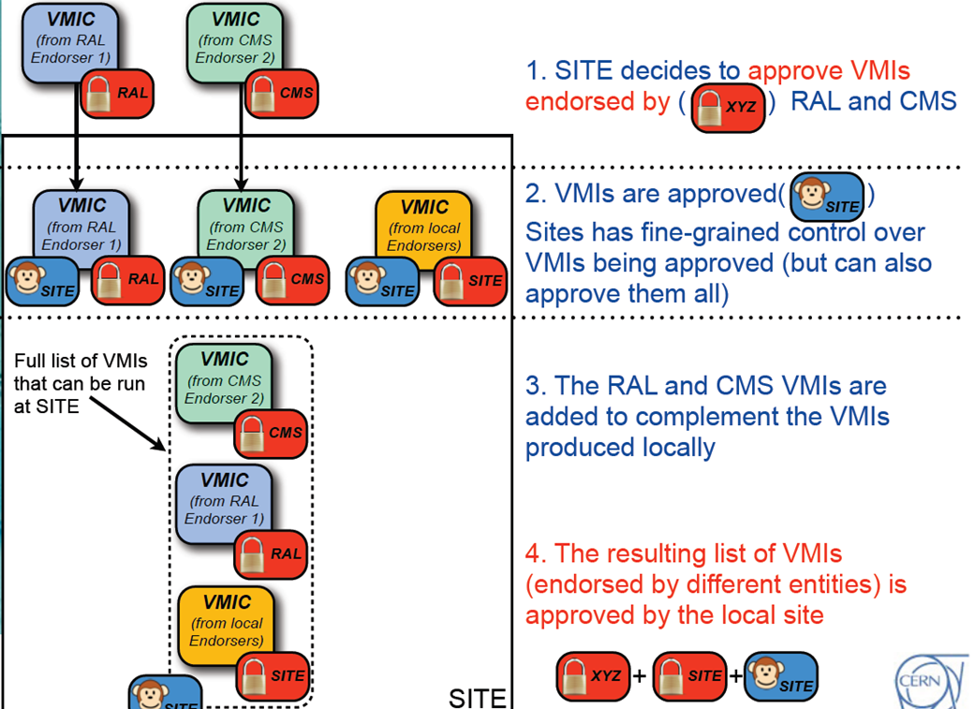
Image Cataloguing and Exchange

Slide 5
Image Contextualisation
Contextualisation is needed so that sites can configure images to interface to local infrastructure
  e.g. for syslog, monitoring & batch scheduler.
Contextualisation is limited to these needs! Sites may not alter the image contents in any way.
  Any site are concerned about security aspects of an image should refuse to instantiate it and notify the endorser.
Contextualisation mechanism
  Images should attempt to mount a CDROM image provided by the sites and, if successful, invoke two scripts from the CDROM image:
    prolog.sh before network initialisation
    epilog.sh after network initialisation

Slide 6
Multiple Hypervisor Support
Andrea
  Surveyed sites; results show that kvm and Xen dominate as hypervisors, especially in batch virtualisation area.
  Documented method to produce VM image that can be used with both kvm and Xen
    Method tested by Sebastien Goasguen and Abdeslem Djaoui (RAL)

Slide 7
Current Status @ HEPiX in Cornell
Generation policy
  Clear, but probably needs to be formally approved by JSPG?
Contextualisation & kvm/Xen support
  Also clear.
Image Cataloguing & Exchange
  Ideas sound, and working internal catalogue @ CERN, but we need functioning inter-site exchange!
  Key issue is lack (to date) of working group member(s) with management support to deliver (and support!) a solution.
  Stratus Lab, as Michel will report later this week, has developed similar ideas.
    Joint intention to explore collaboration, but no opportunity to do so before late November.
DK: Wait until we have real experience
Interest in Xen waning

Slide 8
Progress in 2011
Owen funded to work on virtualisation
Stratus Lab discussion

Slide 9
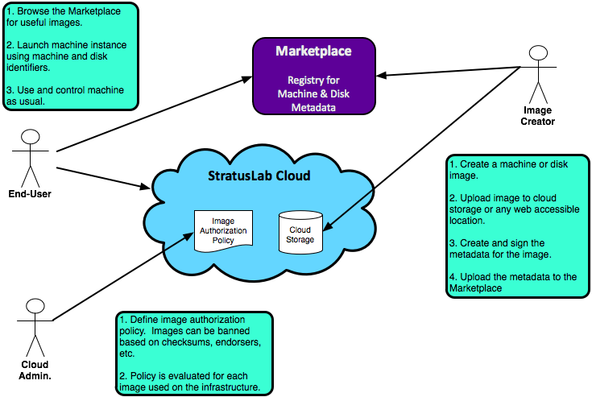
Stratus Lab Workflows
5: Tell sites the images you
endorse
1: Find & download
images
2: Instantiate as
required
Site
Admin

Slide 10
Progress in 2011
Owen funded to work on virtualisation
Stratus Lab discussion
Victoria->CERN image distribution

Slide 11
Other thoughts
The CernVM filesystem offers an attractive way to ensure sites have the correct VO software, reducing the need for VM images as a mechanism for this.
  See Ian Collier’s presentation shortly.
  CVMFS team have asked Romain Wartel to lead security audit
    This should allay any fears from sites about using CVMFS.
Virtualisation is an area with much scope for communication failures!
  We must be clear that “image endorsement” is a very rapid process
    The person creating endorses an image which is then immediately available for instantiation by all sites who trust the endorser; there is no need for a lengthy process of verification at sites.
  Some sites talk about restricting instantiated VM images but the actual impact for end-users is likely small
    e.g. VM images would have no need to connect to a NFS-based shared storage area, so it would not matter if “isolated from the rest of the network” just means “no access to our NFS servers”.
      This appears to be the likely situation at NIKHEF, one of the sites the most reluctant to enable instantiation of remotely generated images.

Slide 12
Summary
The working group has made good progress in establishing policies to allow the exchange of VM images…
… but not such good progress in delivering a distributed catalogue of endorsed images.
CVMFS is probably the neatest solution to the problem of VO software distribution…
… but VM exchange remains interesting
  as an option for sites to run hypervisors not OSes and automatically migrate to latest patched system as images instantiate, and
  if the VM images can contact pilot job frameworks directly, simplifying the scheduling problems at sites.
✓
Work
in Progress!
There has been progress in this area over the past
few months—c.f. talks by Owen Synge and Cal Loomis.
Also, images created at one site (Victoria) have been
instantiated and contextualised at another (CERN).
However, work in different places is only loosely
coupled at present and needs to be brought together
more coherently.
✓
This will be feasible by Fall HEPiX!
Who is interested? Contact us now!
Something I would like to see…
Still trying to bring expt on board. ATLAS?
Video conference “days” planned to achieve this.

