Slide 1
Ivan Koop
Messages Parallel Wednesday 21, WP1
EPOL-2022, September 22, 2022

Slide 2
4 session talks presented +1 by Guy:
EIC e-Injector Polarization, Speaker: Vahid Ranjbar (BNL)
EIC esr Polarization, Speaker: Eliana Gianfelice (Fermilab)
EIC ESR Tracking Studies, Speaker: Matthew Signorelli (Cornell)
LEP Polarization, Speaker: Jorg Wenninger (CERN)
Requirements for polarization measurements,
Speaker: Guy Wilkinson (University of Oxford (GB))

Slide 3
Concept Overview: Spin Resonance Free Lattice – by Vahid Ranjbar
Both the strong intrinsic and imperfection resonances occur at:
  K = nP +/- Qy
  K = nP +/- [Qy] (integer part of tune)
To accelerate from 400 MeV to 18 GeV requires the spin tune ramping from
  0.907 < Gϒ < 41.
If we use a periodicity of P=96 and a tune with an integer value of 50 then our first two intrinsic resonances will occur outside of the range of our spin tunes
  K1 = 50+ν_{y} (ν_{y} is the fractional part of the tune)
  K2 = 96 – (50+ν_{y} ) =46-ν_{y}
  Also our imperfection will follow suit with the first major one occurring at K2 = 96 – 50 = 46

Slide 4
Summary of Vahid Ranjbar
Resonances in RCS lattice are driven by imperfections
Intrinsic resonances are so weak that even large field distortions don’t hurt.
Resilient to misalignments, dipole rolls and orbit distortions:
- Up to 0.4 mm quadrupole misalignments and 2.5 mrad dipole rolls are tolerable provided the orbit is corrected to 0.5 mm RMS level.
- Assume orbit correction using SVD algorithm with a corrector and a BPM next to each quadrupole.
- within state-of-the art orbit control hard-and software
This will result in > 95% polarization transmission.
To provide additional margin we show that fixed orthogonal imperfection bumps are capable of removing any residual polarization losses.
Using intrinsic resonance canceling arc cells one can build up a whole ring with all sorts of broken symmetry and still avoid strong intrinsic depolarization. One of the challenges is to build these cells in such a way that the beta functions and dispersion are controlled. Additionally, their natural dynamic aperture and chromatic features should be studied to better understand the optimal configuration.

Slide 5
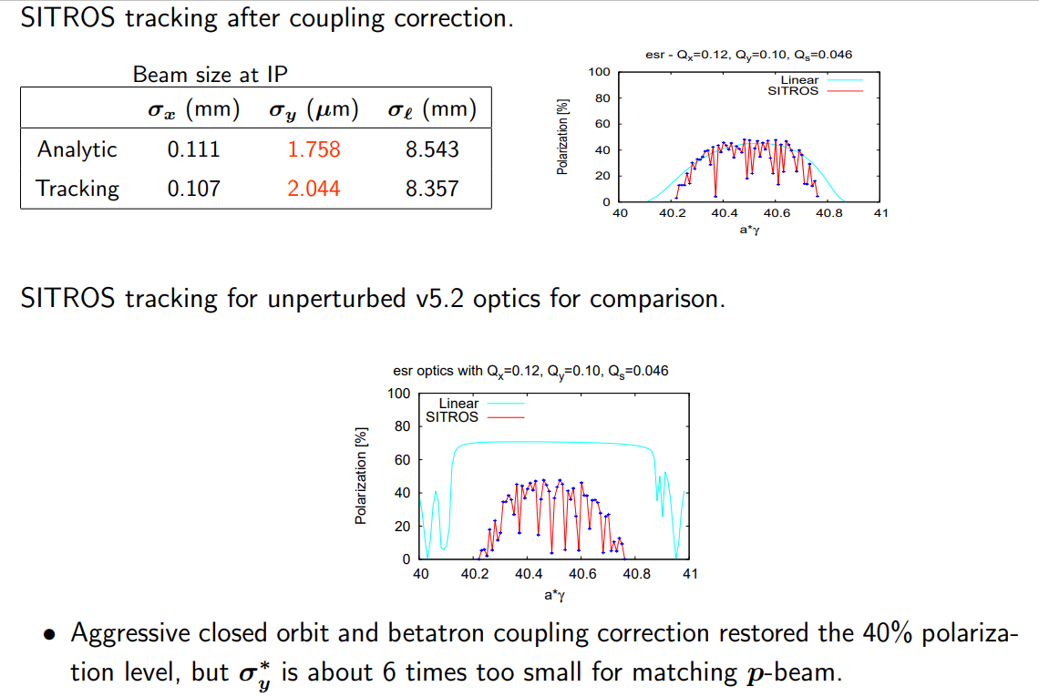
Eliana – EIC - polarization simulation in esr:

Slide 6
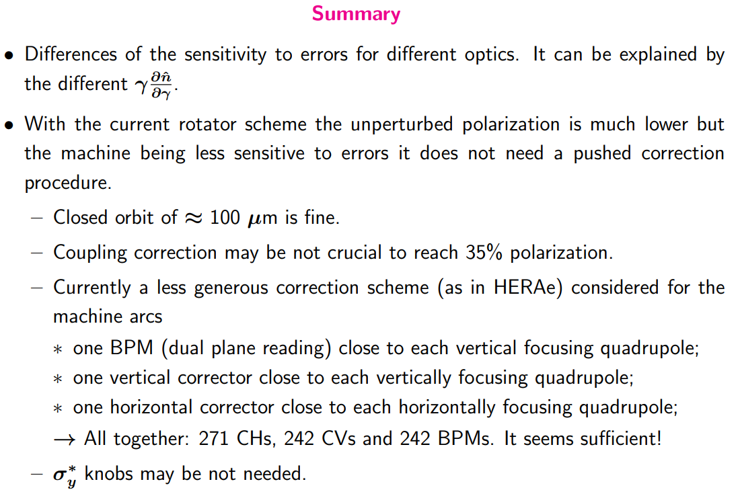
Eliana – EIC - polarization simulation in esr:

Slide 7
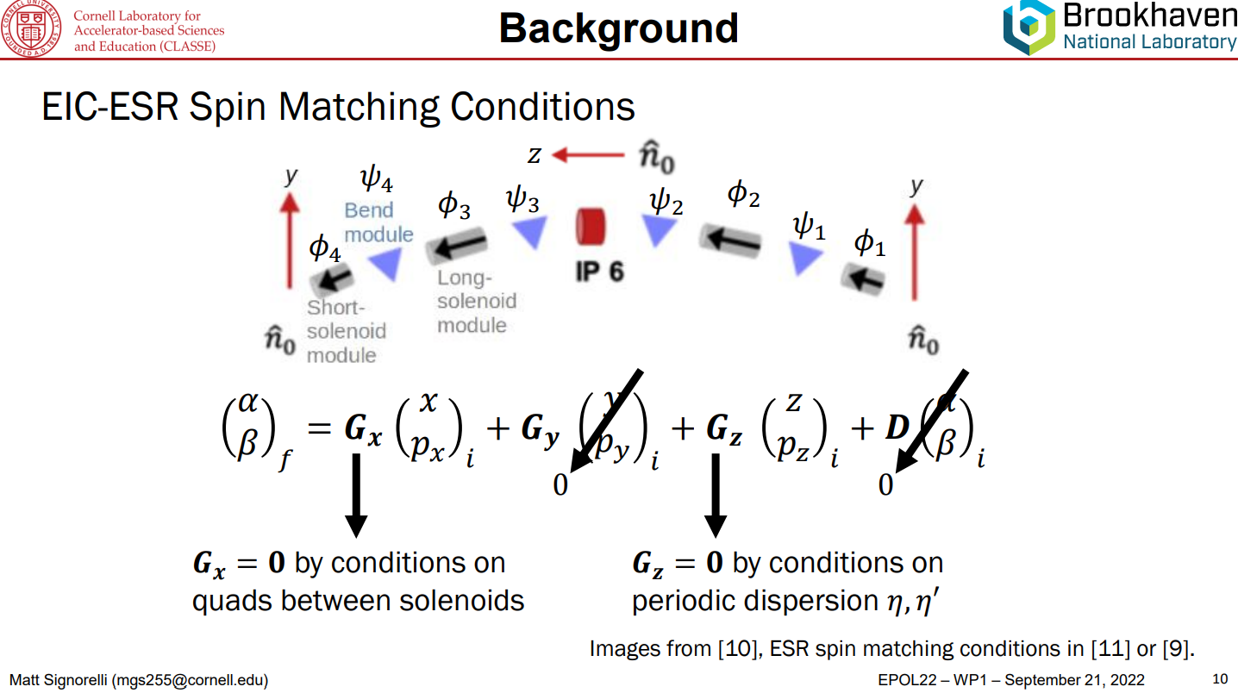
Matt – EIC - polarization simulation in esr:

Slide 8
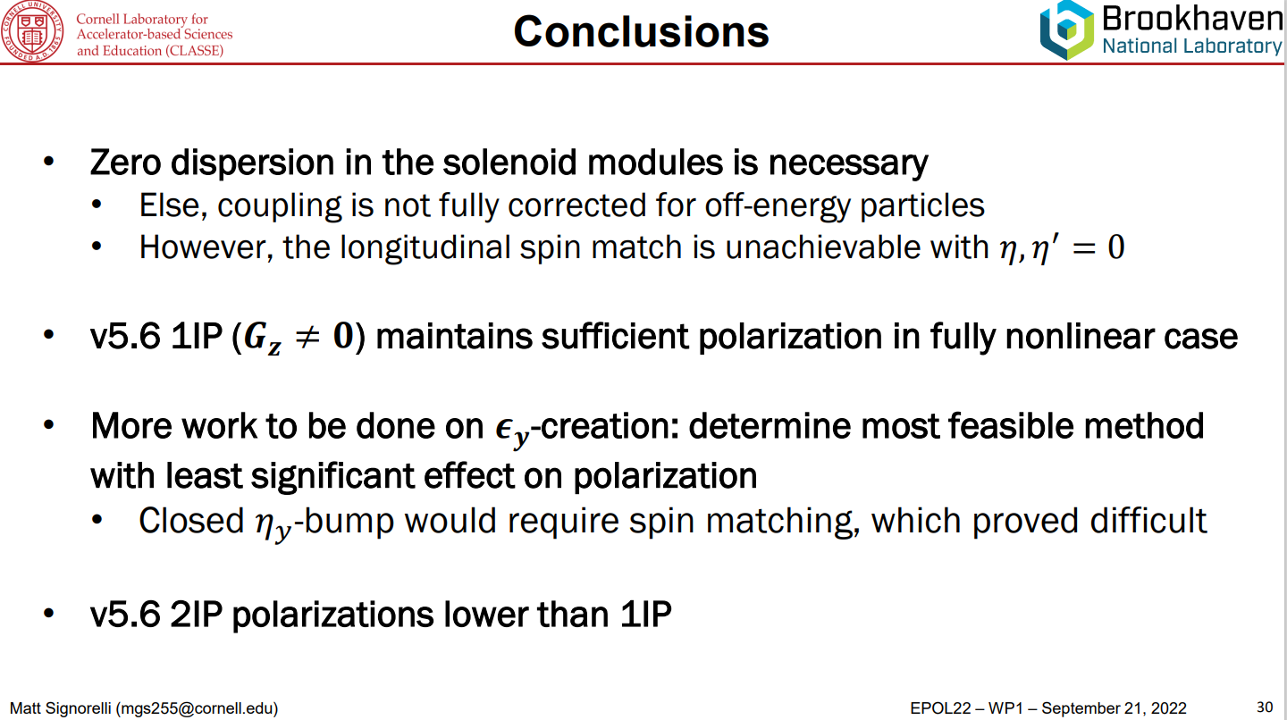
Matt – EIC - polarization simulation in esr:

Slide 9
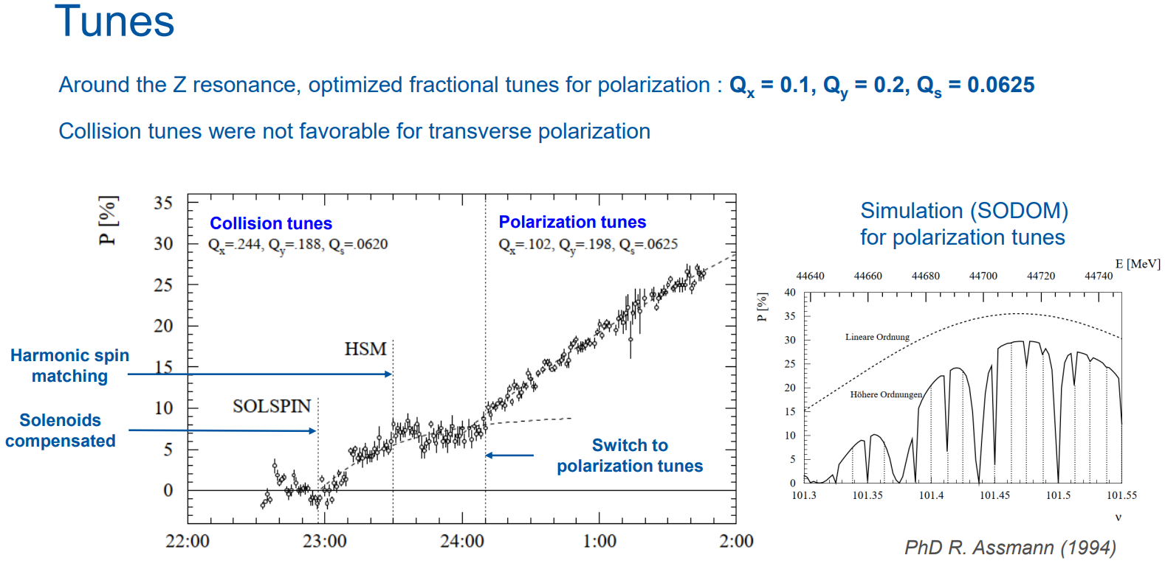
Jorg – LEP Polarization setup:

Slide 10
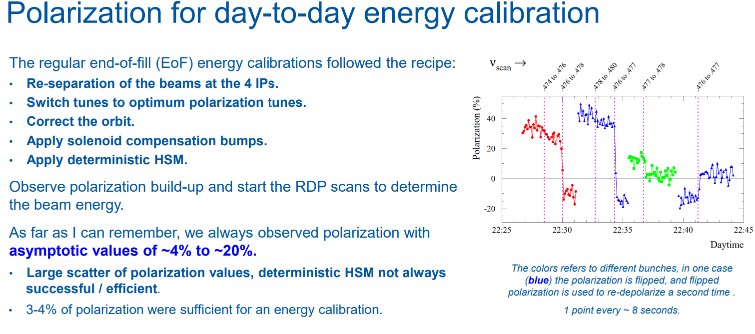
Jorg – LEP – Spin Flip:

Slide 11
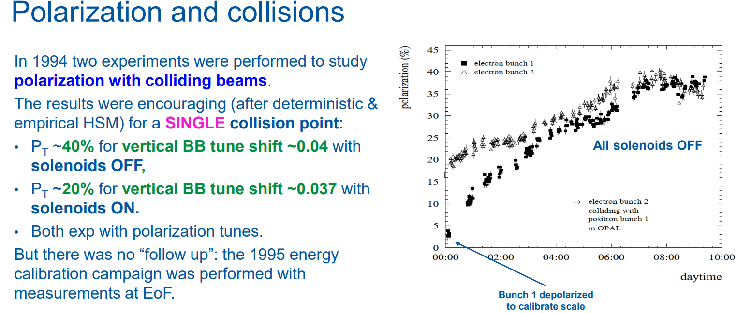
Jorg – LEP - Collisions:

Slide 12
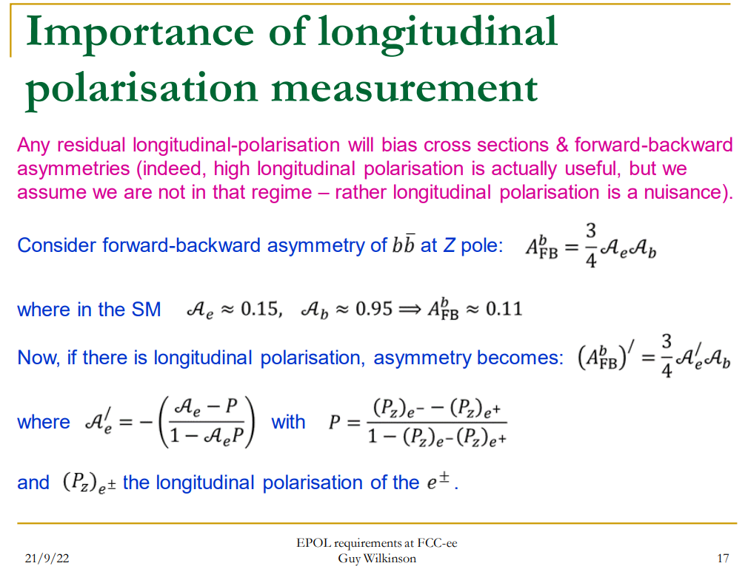
Guy – Polarization Requirements:

Slide 13
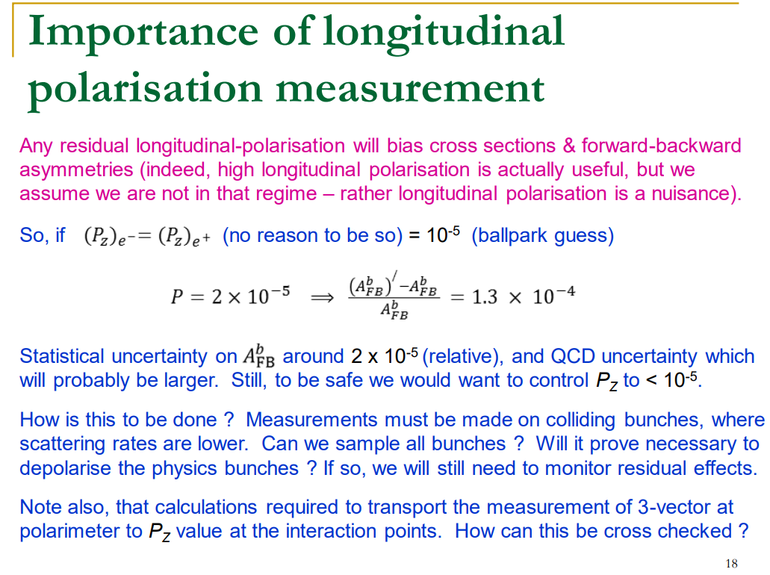
Guy – Longitudinal Polarization measurements:

Slide 14
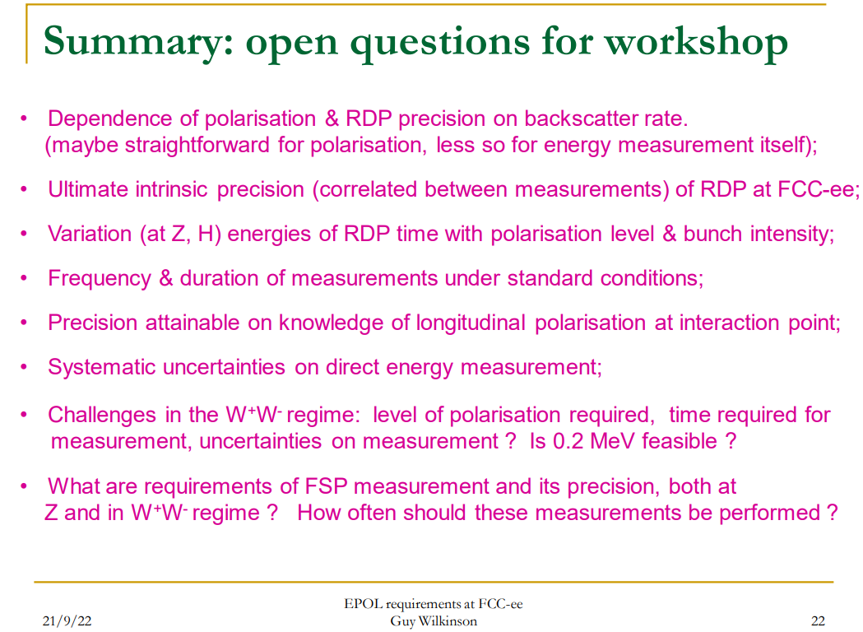
Guy – Open questions:

