Slide 1
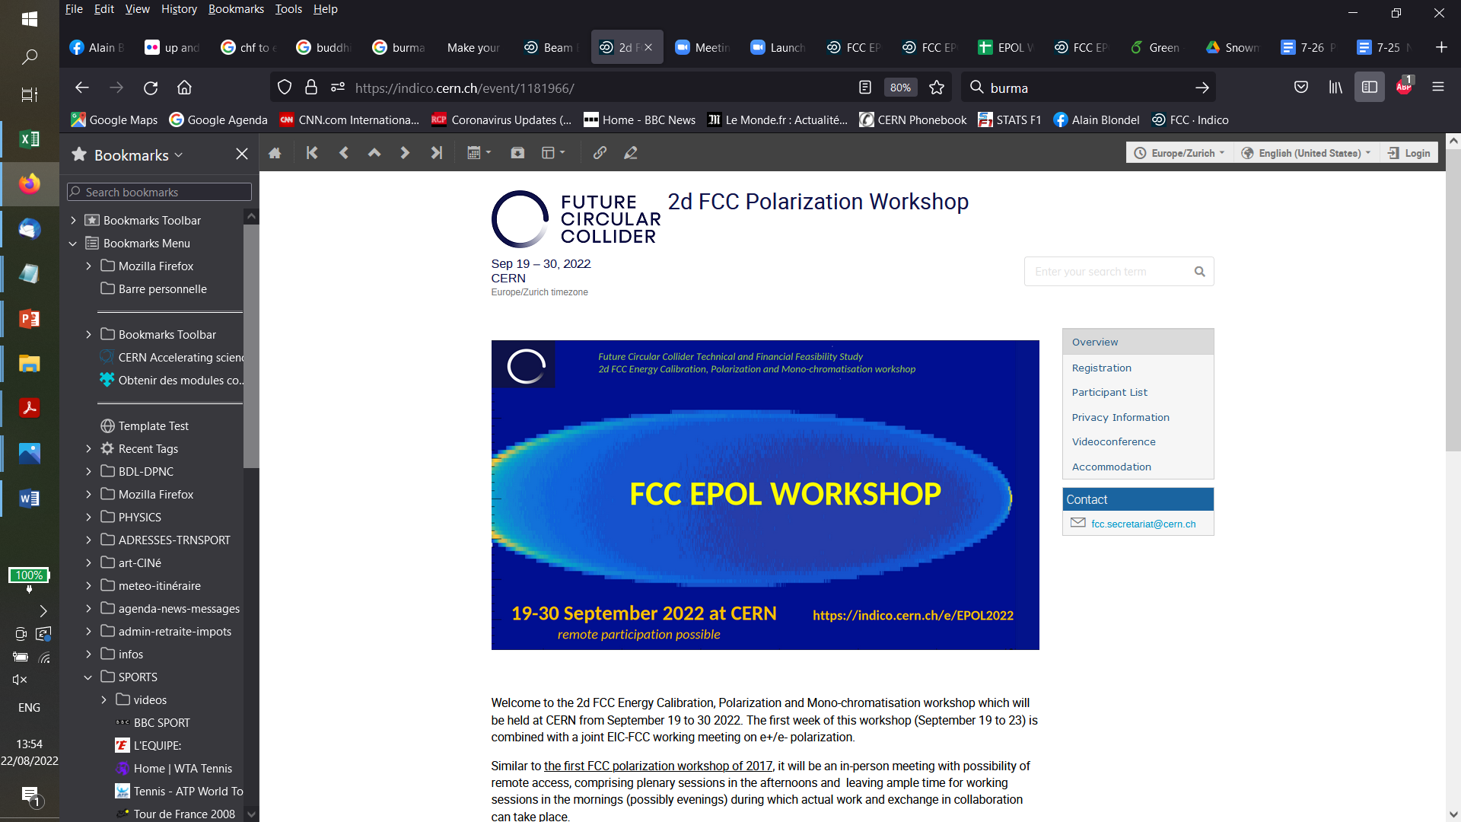
-- week 2
113 registered participants from many participating institutes from different continents (> success)

Slide 2
Considerable amount of information was exchanged on first week already – and its only a start!
A few particular points that we learned
-- We have three high energy physics projects involving electron (e- and/or e+) polarization in storage rings
-- different physics motivations
-- center-of-mass calibration for ~on-shell EW physics at FCC
-- chirality control for off shell physics at SuperKEKb
-- chirality control for understanding spin distribution among proton constituants at EIC
-- different emphasis on transverse vs longitudinal, high precision vs high polarization etc...
We will think and propose a follow-up organization to build on synergies
-- polarization of electron beams in a storage ring is a complex matter, and not so easy to understand
-- many thanks to Georg for the luminous introduction to te topic.
-- and yes, it is worth investigating kinetic polarization of colliding beams arising from beam beam forces!
-- Nevertheless considerable know-how is being developed and tuned into codes
-- exchange between projects emphasizes synergies – different goals but similar issues
-- controling spin resonances to increase polarization or eliminate interference with spin precession

Slide 3
FCC-ee overall goal
target: match systematic precision on centre-of-mass determination
with the statistical capability of the machine
A big question: what is the motivation for measuring things so precisely? ➔ Grojean
with the discovery of the Higgs boson, the matrix of particles and their interactions, called ‘Standard Model’ ,
is complete.
This theory reproduces remarkably well the experimental results with a few notable exceptions
-- the neutrino masses
-- the Baryon Asymmetry of the Universe
-- the existence and nature of Dark Matter
-- and many other questions of theoretical nature.
and in the present situation ‘SM has nowhere to go’. -- any deviation = discovery
The main question that precision measurements address is: can we detect any evidence of the new phenomena that
can explain the above questions. Or put more simply
‘are there any more particles that couple to, or mix with, the particles that we already know’.
this is not a forgone conclusion
precision = discovery potential

Slide 4
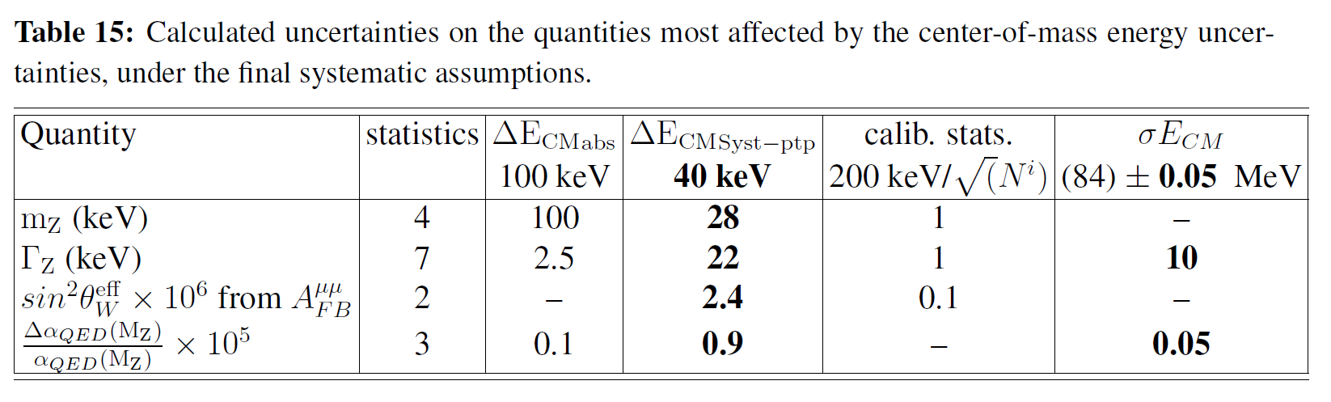
First set of results obtained in the FCC Design Study:
Polarization and Centre-of-mass Energy Calibration at FCC-ee, arXiv:1909.12245
stat/present
500
400
75
15 (qualitiative!)
40
4
4
2
3
m_{W}(MeV) 0.200 -- 0.300 --
matching these statistical errors implies the following uncertainties (or better) (luminosity integrated averages)
absolute energy scale error at Z 6 keV can be relaxed some since Z mass is input
point to point E_{cm} uncertainty in Z scan 4 keV ⬅ this is most significant, highest priority
E_{cm} spread 15 keV NB highly variable quantity (factor 3-5 between low lumi and highest lumi running)
Absolute energy scale at H <1-2 MeV requirement at all times in running
Energy spread at H joint requirement on energy spread and luminosity performance
development of scheme should be possible already during Z running
absolute E_{cm} energy scale error at W 100 keV seems « easier » because of faster polarization

Slide 6
WP1 simulations of polarization and spin-tune vs beam energy relation
-- we now have three proposals for beam energy measurements
-- resonant depolarization → simulation of possible deviations of spin-tune vs beam energy relation
-- spin precession measurement → ibid.
-- polarimeter beam energy {from electron end point to backscattered photon distance}
-- to which one can add
-- the calculation of energy losses in the ring or in the beam-beam interaction (beamstrahlung)
-- the boost and E_{cm} measurements in IPs
-- the control of beam-beam collision offsets and opposite sign dispersion @ IPs
QUESTIONS
• How to speed up spin tracking simulations? Maps vs element by element?
• Do we need a special optics or only tunes to measure the spin tune as in LEP?
• Harmonic spin matching to increase polarization level?
• Pi-bumps to avoid losing polarization level over IPs?
• Can we inject already polarized electron beams? At which cost? (what is the cost of a 500Tm solenoid?)
• How can we avoid polarization for colliding bunches?
• Can one design experiments testing the concepts somewhere, e.g. KARA?
• Can one design operation and Ecm points to identify/correct/eliminate non-linear ν_{spin} to E_{cm} relation?

Slide 7
WP2 from beam energy to center-of-mass energy
considerable proress but a lot of work in sight.
• Is there sufficient aperture to inject in Pilot Bunches with the booster/main-rings configurations?
• (How) Can we assure that the colliding bunches are +/- 5 % of the nominal intensity?
• Which dispersion can we except at the IP? → link to tuning studies
• How can we control and correct dispersion and offsets at the IP?
-- Vernier scans
-- beam-beam deflection scans
-- each time: compare colliding with pilot bunches in given + other IPs ?
• Can we have non-colliding bunches with the same intensity as colliding ones?
is it important? (see Manfred Wendt)
• What is the best scheme of low-intensity, nominal intensity, (non-) colliding bunches?

Slide 8
WG3 Polarimeter and polarization measurement
Polarimetry
-- several designs for polarimeters in different projects, some with very different aims
resonant depolarization,
precise measurement of high polarization
precise measurement of zero polarization
fast measurement of spin precession
➔ can one set-up realize all of these goals in FCC?
-- things that seem impossible (10⁻⁵ measurement!!) may not be so impossible after all ☺

Slide 9
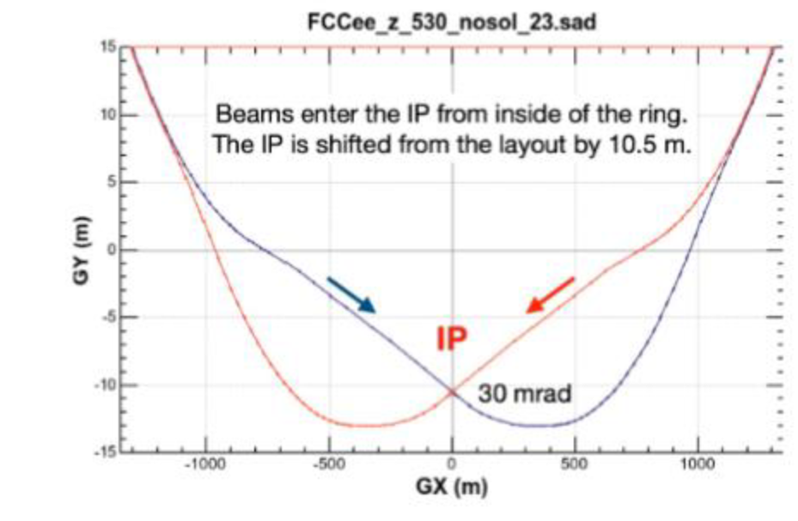
more burning questions for FCC (I)
1. How many polarimeters for FCC-ee?
-- baseline: at least two, one e+ and one e-
-- if more are really needed, consider last strong magnet before the experiments on incoming lines.
++ this might make it easier to propagate the 3D polarization measurement to the IPs.
-- lets evaluate cost and operational issues and understand the possible gains before changing the baseline of
2 (e+ and e-) polarimeters!
-- a nice place anyway. Investigate with M. Hofer, K. Hanke if this is a feasible location.
(
)
x4
polarimeters?

Slide 10
Polarimeter detectors
to be considered:
-- backgrounds
-- space resolution
-- photon vs electron detector
-- multi vs single event mode?
this is only ±1mm at 100 m distance

Slide 11
nice table by Aurélien (from FCC week)
do we really want
-- multi-photon for pilot bunch
and
-- single photon for colliding bunches
???
would we not prefer similar conditions
(# scatterings per shot)
for pilot and colliding bunches
given that they will be using
the same detector?

Slide 12
more burning questions for FCC (II)
2. How feasible is it to depolarize the colliding bunches continuously?
The need to control the longitudinal polarization of the colliding bunches to better than 10⁻⁵ was stressed by G. Wilkinson
Beam polarization grows by 10⁻⁶ every second [second=10⁻⁶ x (250 hours= 0.9 10⁶ s)]
➔ < 10⁻⁵ requires depolarizing every 10 seconds
Beam polarization grows by 10⁻⁶ every [second=10⁻⁶ x (250 hours= 0.9 10⁶ s)]
➔ 10⁻⁵ requires depolarizing every 10 seconds !!
Can the RF kicker actually take this additional charge?
3. How feasible is it to manipulate the polarization vector in the horizontal plane to measure precession frequency?
what are the specs for the depolarizaer and are they feasible with the envisaged (LHC transverse feedback) kickers

Slide 13
WG4 measurements in particle physics experiments
principle well established with dimuons in the design study paper
-- need to verify that one can match the requirements set by the statistical precision
-- can one use e+e- final state (low angle scattering) to improve the precision esp at high energies (and 125 point)
-- experiments can measure
-- x, z and t and boost event by event better than beam sizes.
Ecm spread, E+-E- monitor depolarization
-- explore more dimensions (x’, y’, E_{cm}) ?
-- develop idea of energy model and quantify Ecm determination requirements esp at WW.

Slide 14
WP5 monochromatization
still very much uncharted territory.
• Can we have a sufficient monochromatization optics at the Higgs?
(development started!)
• How much can we reduce the background for the experiments using more info from the beam parameters?
• Can we test monochromatization scheme for Higgs-mode already at the Z-pole?
• Do we need crab-cavities for monochromatization?
etc. etc.

Slide 15
-- this is all pressing hard/stimulating on the machine physics, alignments, diagnostics, correction procedures and
optimization methods. (WG2) Huge progress since LEP times!
A considerable amount of very reliable information comes from the HEP experiments themselves. Examples:
-- measurement of beam polarization from final state tau helicity measurements (SuperKEKb)
-- measurement of energy spread (and other beam parameters) from μμ/ee pairs (even within beam phase space)
Lots of subtle questions were discussed about monochromatization
-- only possible when we are face to face!
Let us continue our investigations this coming week!

Slide 16
