Slide 1
WP3 – Monday, September 26
Main focus on backgrounds
  Dave Gaskell: Background sources and synchrotron radiation issues at JLAB
  Hiroyuki Nakayama: Beam background and Machine-Detector Interface Design at KEKB/Belle-II
  Ciprian Gal: Expected background sources, synchrotron radiation issues at EIC
  Zhengqiao Zhang: Detector integration and dipole design at EIC

Slide 2
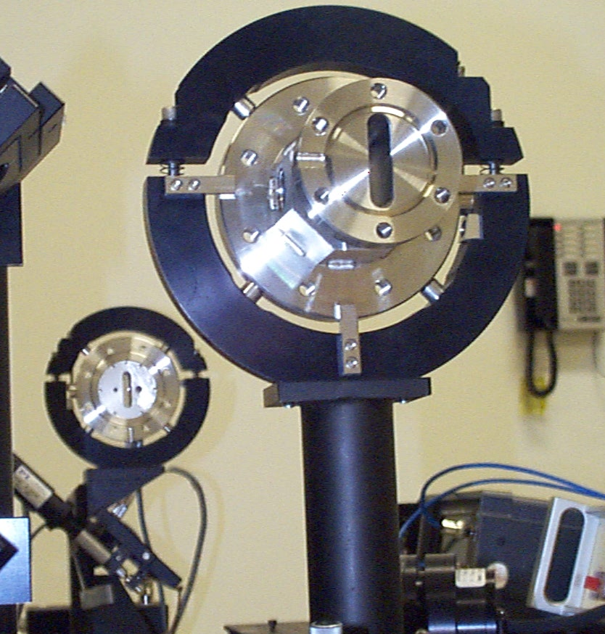
Compton Polarimeter Backgrounds at JLab
Backgrounds at JLab typically dominated by beam (halo) interactions with material in beamline
Narrow apertures near Fabry-Perot cavity problematic
Mitigation sometimes requires extensive beam tuning
Bremsstrahlung contributes, but typically not significant compared to real Compton rate
No shim
At higher energies (after 12 GeV upgrade) synchrotron radiation becomes more significant
Two components to mitigation:
→ Shims added to dipoles in chicane to extend effective length of ~1 m dipoles
→ Remotely controlled collimation system to optimize signal/background
As-built shims

Slide 3
SuperKEKB/Belle-II
Sources of background:
Single-beam BG: Touschek, Beam-gas Coulomb/Bremsstrahlung, Synchrotron radiation, injection BG
Luminosity BG: Radiative Bhabha, two-photon BG, etc..
Beam background mitigation via movable collimators and tungsten shielding at main beam loss points near detector
31 movable collimators
Gradual reduction in background over 1+ year
Original final focusing quad design - no room for shielding. Had to redesign once background simulations became more mature
Extensive background measurements – allow comparison with detailed simulation
Instabilities in initial injection of top-off bunches lead to significant backgrounds

Slide 4
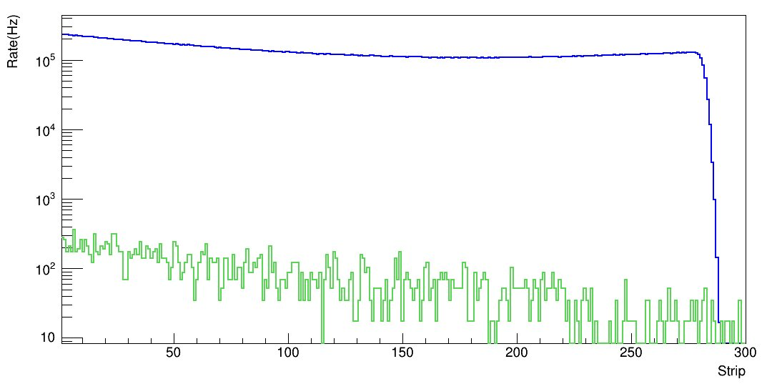
Expected Compton Polarimeter Backgrounds at EIC
Bremsstrahlung not expected to be dominant concern at EIC
Synchrotron radiation a significant concern
→ Two dipoles upstream of detectors that could contribute
→ Initial calculations performed w/GEANT4 – some cross cross-checks using semi-analytical methods (Mike Sullivan (SLAC)
No direct synchrotron radiation on electron detector
Synchrotron power impinging on photon detector about 6.9 W/mm²
Cooling needed for exit window – shielding for detector
Compton BS signal
Bremsstrahlung
Simulation from JLEIC design – to be updated
SR power on photon detector
Electron beam position
Detector position

Slide 5
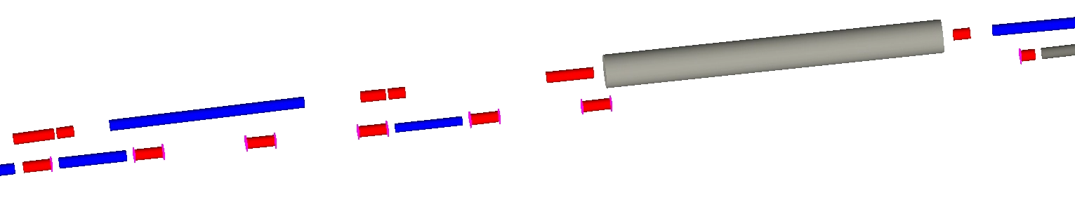
Detector Integration at EIC
Hadron beamline
Q3EF
electron beamline
Q4EF
γ−Det
(front of quad)
Q6EF
Q5EF
Q8EF Xfocusing
Q7EF
D3EF4
D2EF4
E-Det
(front of quad)
Laser IP
Q9EF
Laser IP 72 m upstream of detector IP – significant spin precession to detector
Electron detector 9.7 m downstream of laser IP
Photon detector 29 m from laser IP
  Photon exit likely at end of dipole (D2EF4)
  Simulations of exit window thickness/materials (Al, Be)
Photons will need to pass through gap/hole in yoke – EIC machine group indicates this should be ok
Detailed detector response simulations to be done

