Slide 1
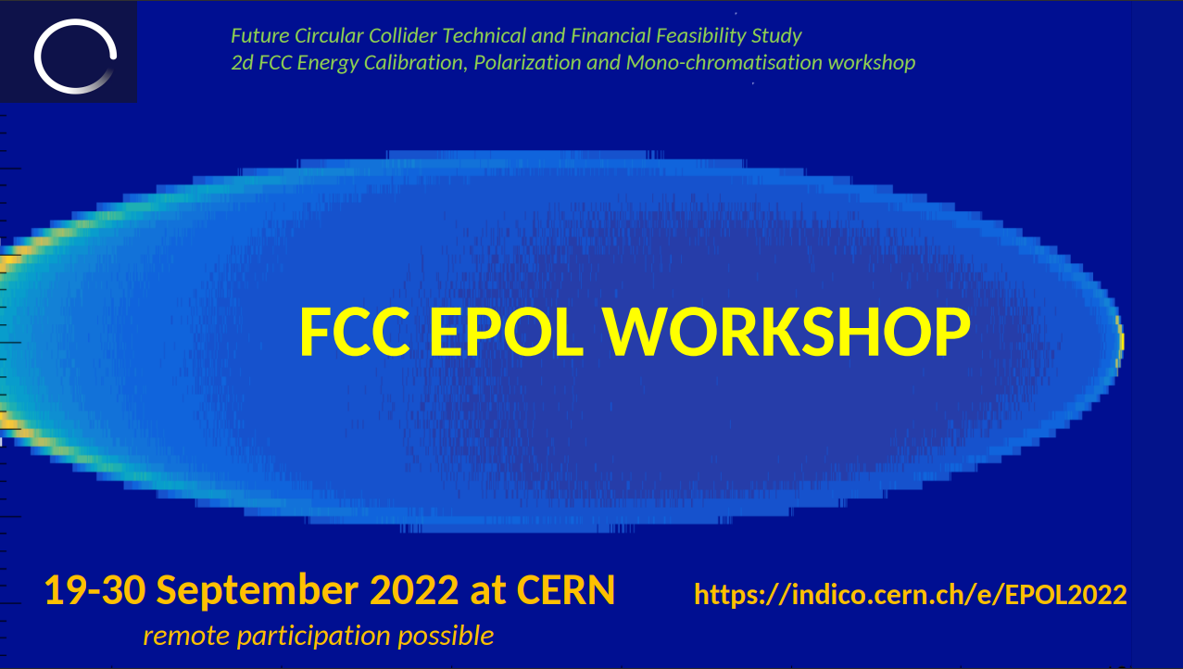


A short story around the beam orbits at LEP and LHC
Jörg Wenninger
CERN Beams Department
Operation Group / LHC

Slide 2
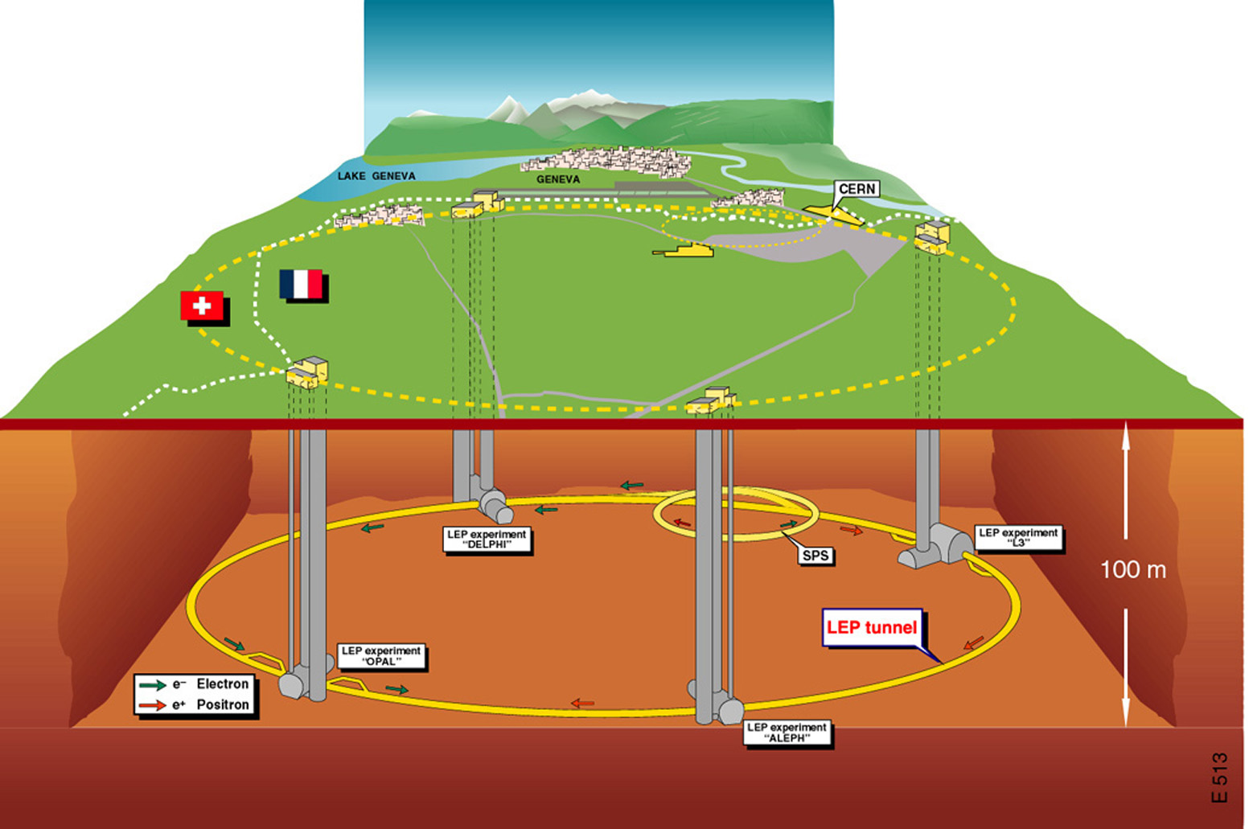
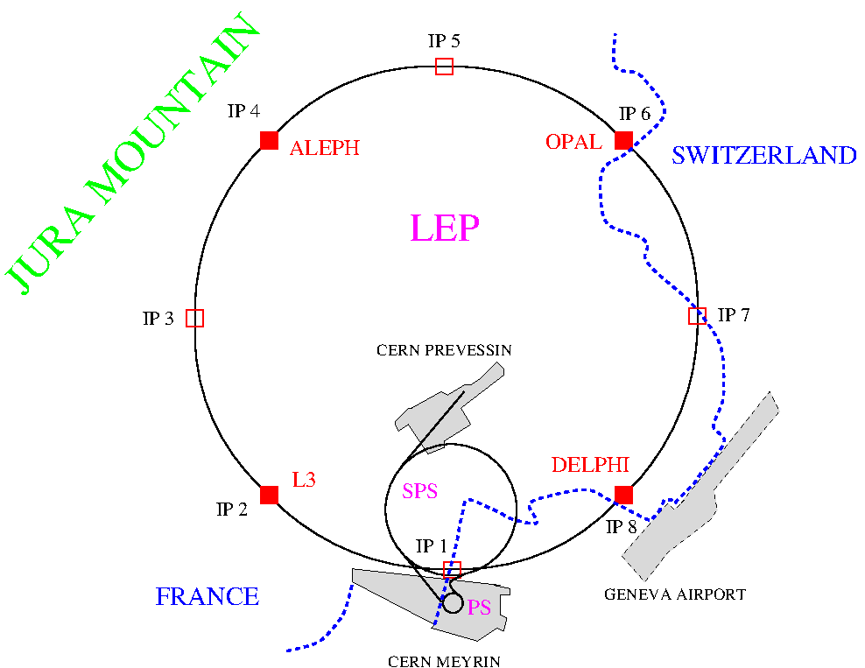
LEP overview
LEP was installed in what is now the LHC tunnel with a circumference of 26.7 km.
The tunnel had(s) 8 access points arranged symmetrically around the ring.
  4 experiments installed at the even points.
LEP operated colliding beams over a beam energy range of ~43 GeV to 104.5 GeV.
  4-12 bunches per beam.
  e+ and e- beams shared a common vacuum chamber.

Slide 3
LEP orbit measurement
System designed in the mid 1980s.
All but a few BPMs based on signal normalization – no gain.
Possible due to the large separation of the bunches in most of the ring despite single vacuum chamber.
This choice proved to be very reliable.
By 1992 it took 12-15 seconds to acquire an orbit – remained like this until LEP switched off.
Due to the slow system, no ‘real-time’ controls was possible (LEP came a bit early for this).
No possibility to control power converters during ramp / squeeze phase – only predefined function could be executed.
The LEP system provided turn-by-turn data: opened the window for first beta-beating / optics measurements with turn-by-turn data!

Slide 4
Orbit correction for highest luminosity
At LEP1 the machine was beam-beam limited at ξ ~ 0.03-0.04 depending on the configuration.
Performance very sensitive to details of the vertical orbit (through vertical emittance).
Random search for a “golden” orbit, using MICADO based corrections – not very deterministic.
Orbits could be re-used from fill to fill, with some re-tuning.
At LEP2 the beam-beam limit was lifted by the strong damping, ξ ~ 0.08 could be reached.
Combined corrections with dispersion free steering (DFS, combined orbit+dispersion correction) using the SVD (or MICADO) algorithms led to orbits with good performance – much more deterministic.
Final tuning of the performance again with random corrections on top of orbit obtained with DFS.

Slide 5
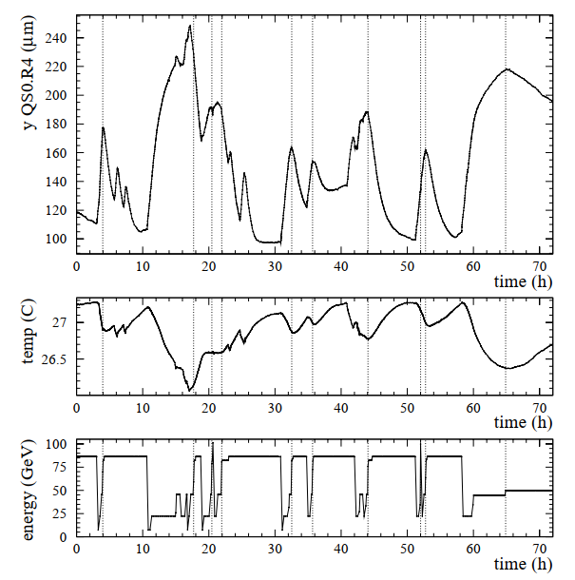
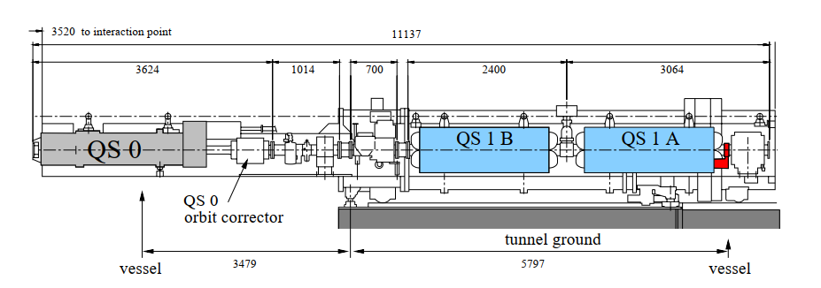
LEP low-beta quadrupoles
100 μm
Vertical quadrupole movement
The last vertically focusing super-conducting low-beta quadrupole in front of the IP was on a cantilever support.
Quad was inside the experiments.
LEP suffered from large temperature driven vertical movements of those quadrupoles (8) due to support design.
The movements had a huge impact on availability:
Large vertical orbit drifts over time.
Coupled to the absence of real-time orbit control, many beams were lost during the ramp or squeeze due to excessive vertical orbit excursions (→ anti-damping due to V dispersion).
Once in collision, a slow orbit feedback could stabilize the orbit.
LEP probably lost ~20-30% of integrated performance due to this effect (aborted cycles).
Cavern temperature
Beam energy
IP
Final vertical low-beta quadrupole

Slide 6
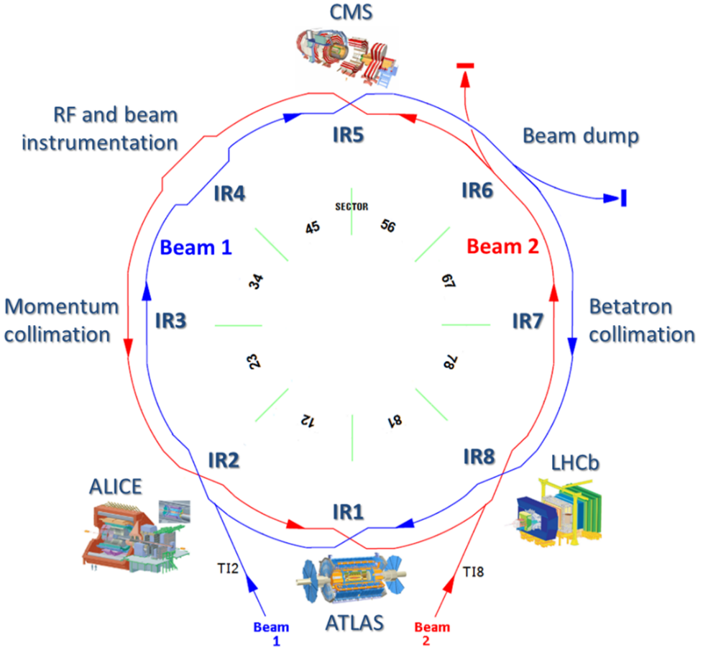


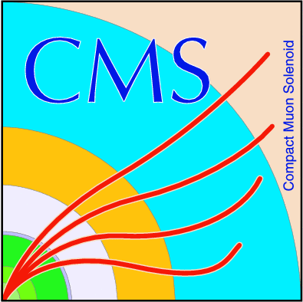



LHC
ATLAS & CMS : high luminosity experiments, L ~ 2x10³⁴ cm⁻²s⁻¹.
LHCb : medium luminosity experiment, L ~ 2×10³³ cm⁻²s⁻¹.
ALICE : low luminosity / ion experiment, L ~ 10³¹ cm⁻²s⁻¹.
2-in-1 magnet design with separate vacuum chambers.
Almost fully superconducting magnet system.
Operating energy 6.8 TeV.
The 2 rings are magnetically coupled.
The two beams cross in the 4 experiments.
  ~200 m common vacuum chamber.

Slide 7
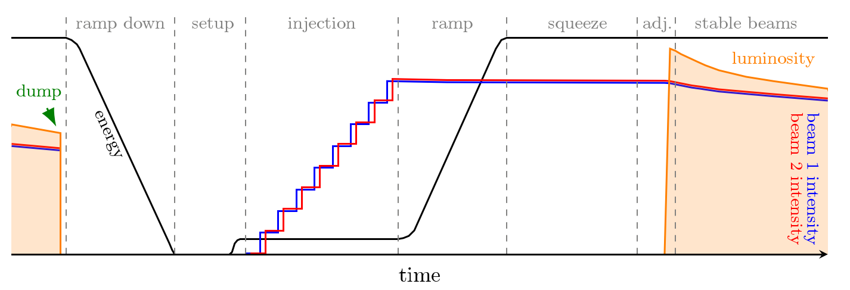
LHC cycle
Beams are injected and accumulated at 450 GeV (up to ~2750 bunches) with a detuned optics.
The beams are accelerated to 6.8 TeV in 20 minutes combined with partially squeezed (lower β*).
At higher energy the final beta squeeze is applied and the beam are brought into collision for ~ 12-15 hour long physics data taking.
≥ 2 hours

Slide 8
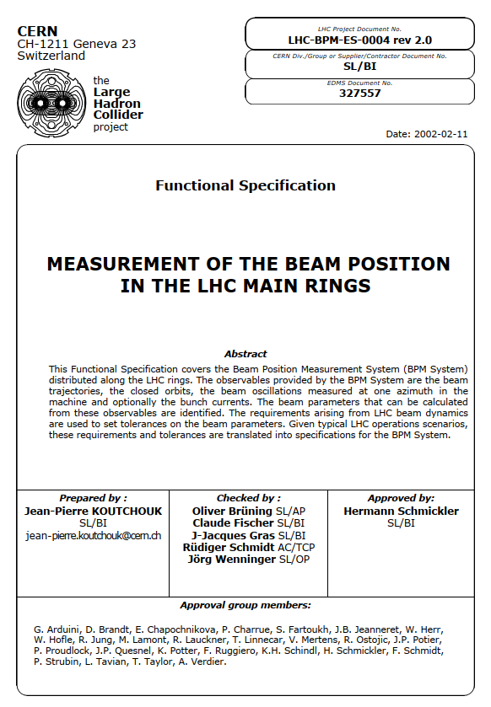
LHC orbit measurement
The start was much better than for LEP: specification of the BPM system performance, written by members of accelerator physics, beam operation and beam instrumentation groups.
Specified the system performance:
Resolution, accuracy, alignment,
Modes: closed orbit, turn-by-turn, bunch-by-bunch,
Orbit feedback,
Beam parameter ranges,
Etc…

Slide 9
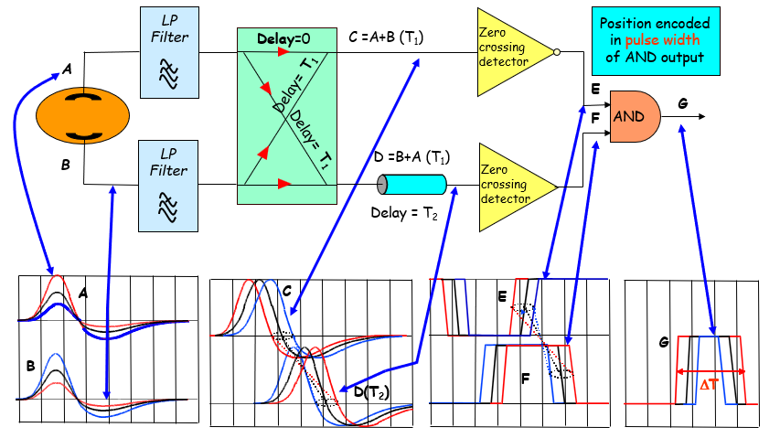
BPM electronics design
Following the LEP example, the BPM electronics has no gain, the intensity is normalized out (Wide Band Time Normalization – WBTN) and the system is intrinsically bunch-by-bunch (25 ns min spacing).
Turn-by-turn and bunch-by-bunch data come for free, closed orbit is just the average of selected bunches over a given time interval.
Extra complication for experimental IRs:
In the low beta sections both beams travel in the same vacuum chamber over ~200 m, directional couplers are used to separate the beam signals – some residual cross-talk.
Residual beam pattern systematics (single bunch versus trains of different structures) after BPM calibration:
~50 μm rms residual systematics when switching beam type.
Sort of OK, but not very nice.

Slide 10
LHC orbit system architecture
The advent of powerful gigabit ethernet links around 2005 opened the possibility to use a standard communication network for data transmission.
Centralized architecture with data concentration of the complete 2-ring orbits – data exchange over accelerator controls gigabit ethernet.
Closed orbit data at 25 Hz for orbit feedback.
200 Hz acquisition rate could be achievable.
Fb closed loop period limited to 12.5 Hz by field bus link to orbit corrector power converters. Adequate for a SC machine like LHC.
  Super-conducting orbit correctors with large inductance – intrinsically “slow” actuators.
Turn-by-turn data is triggered and concentrated following on-demand requests.
Injection steering, optics measurements etc.
~2000 position readings
BPM data
Collection time < 2 ms
Orbit sampling rate 25 Hz
Orbit concentrator
Power Converter data
~1100 orbit corrector circuits
data transfer over standard gigabit ethernet

Slide 11
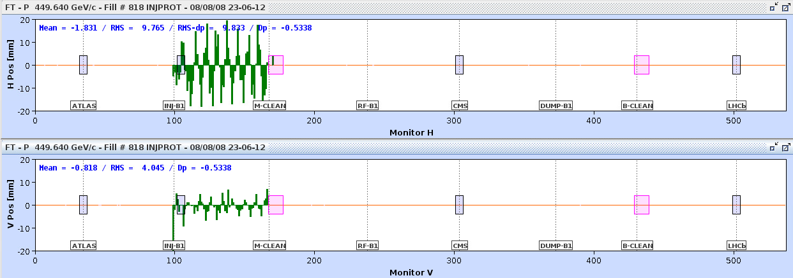
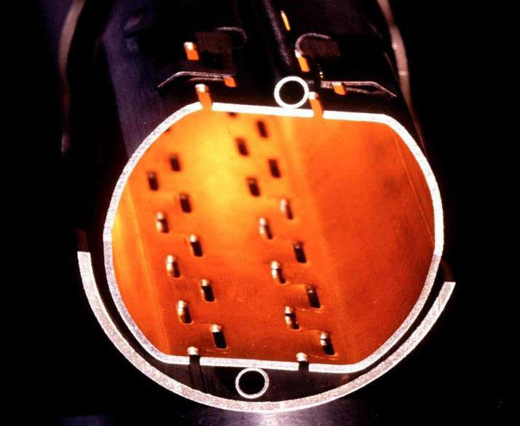
And it worked !
BPM system work on day 1 – hour 1 – min 1 – second 1.
One of the first trajectory measurements in LHC during the first sector test – August 8th 2008 !
Self-triggered acquisition mode – no external clock required !
Observation of some of the first protons to probe the fields of LHC magnets
40 mm
34 mm
44 mm
p beam
Beam stopped on collimators
Injection point

Slide 12

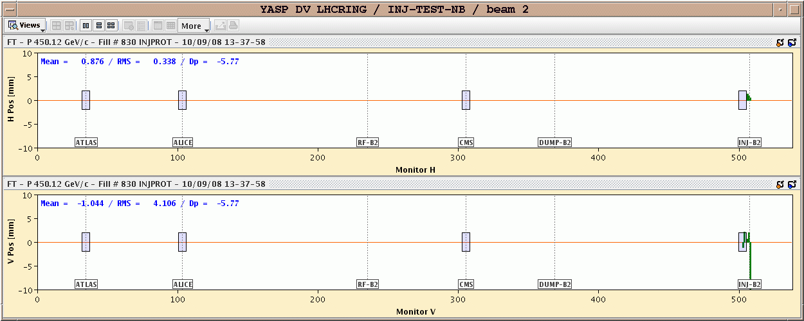
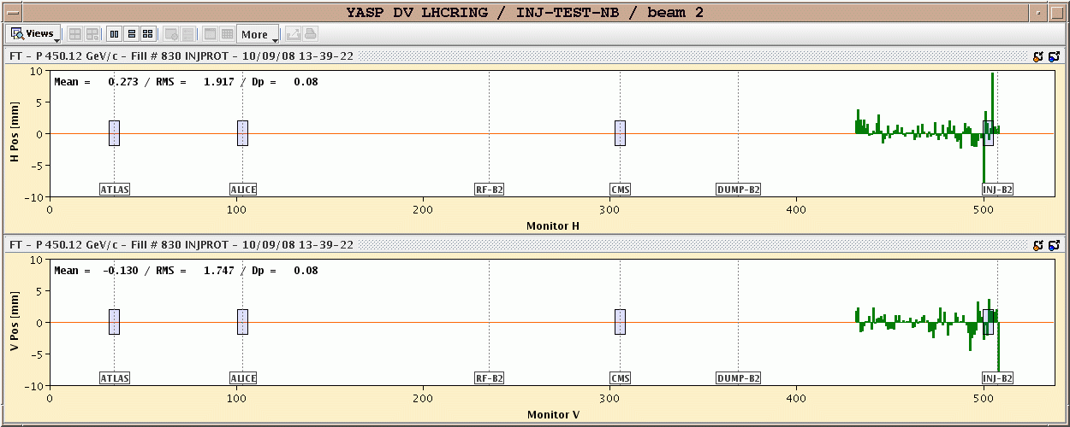
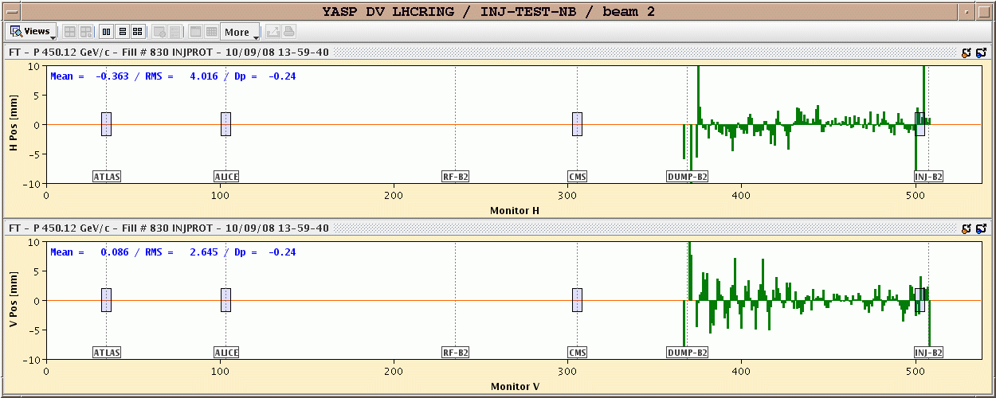
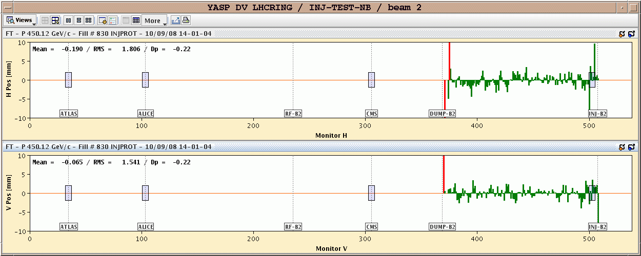
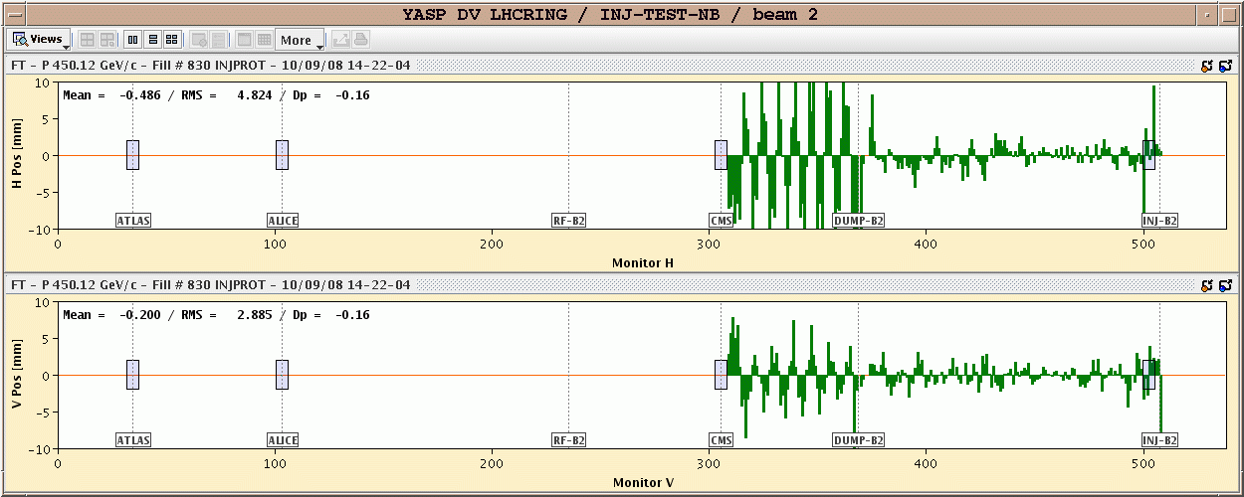
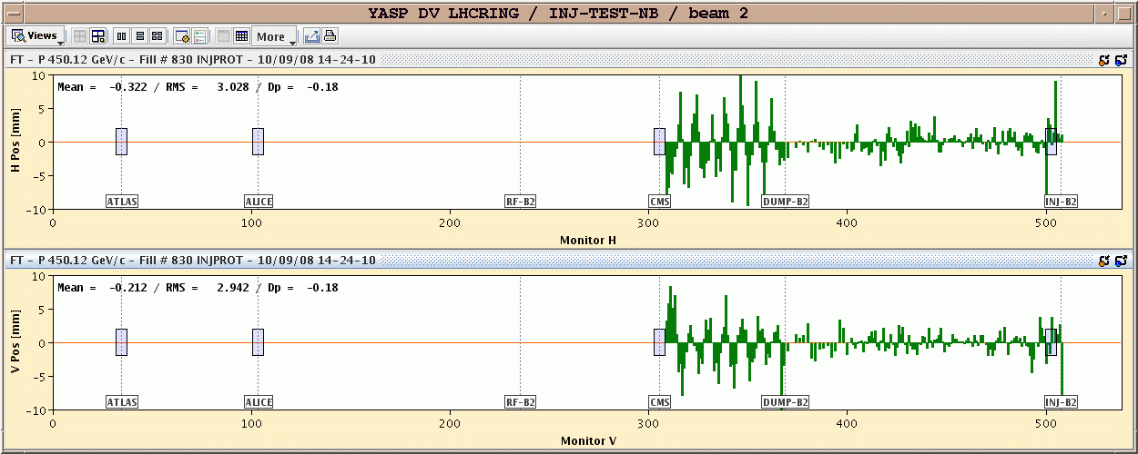
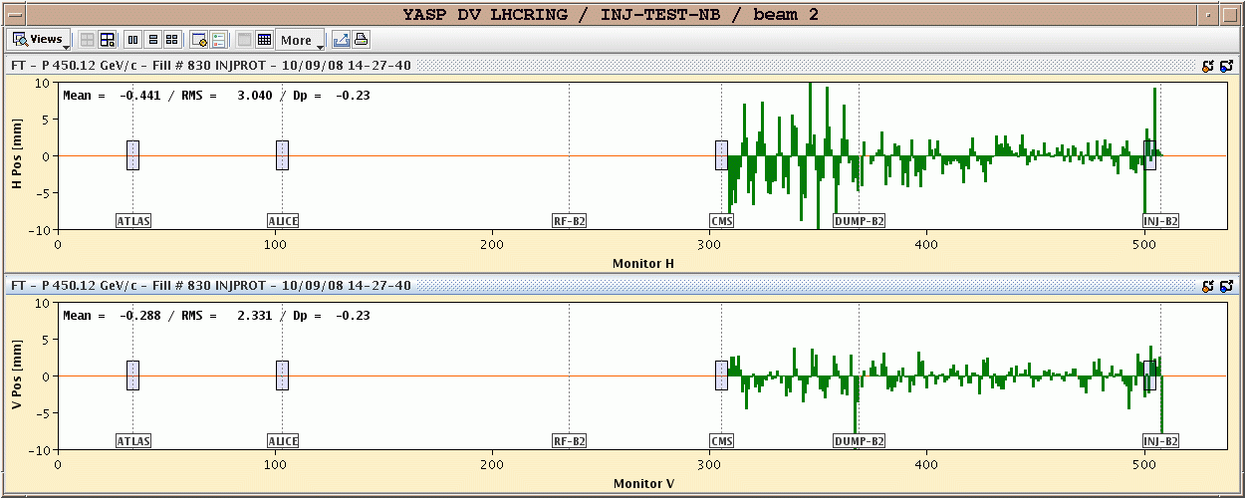
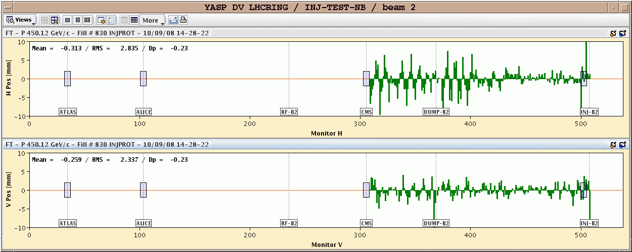
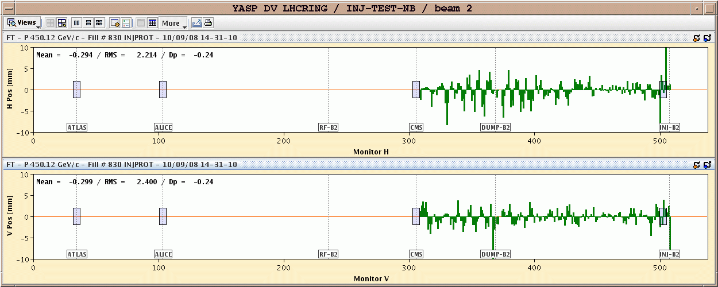
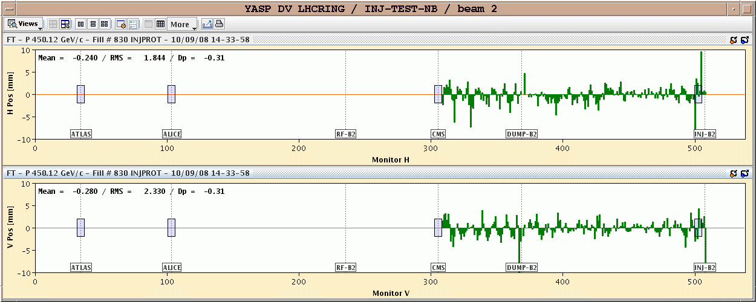
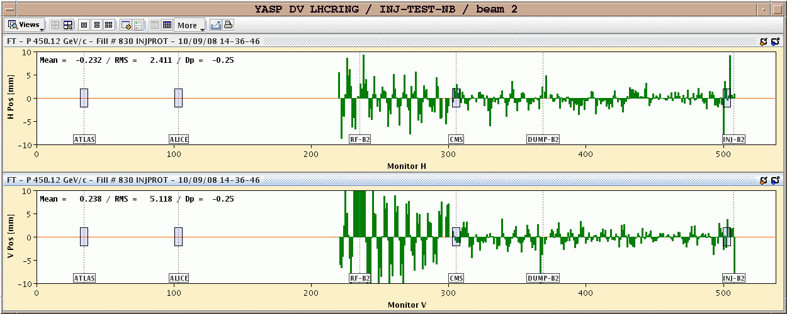
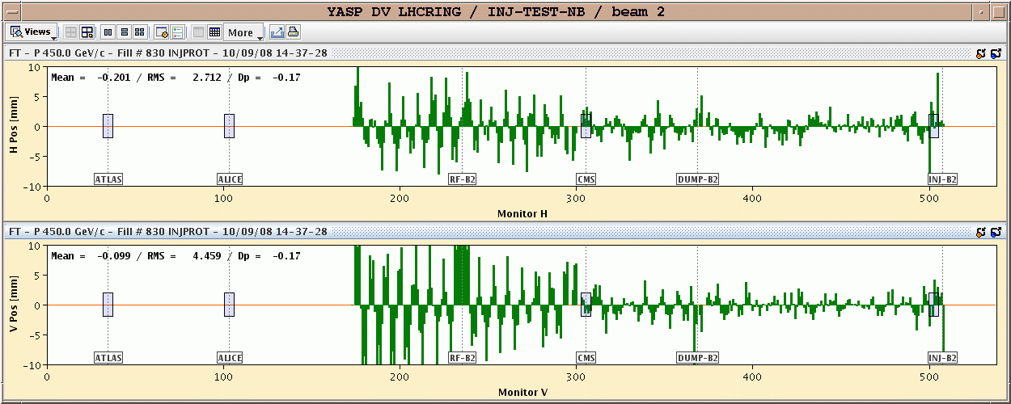
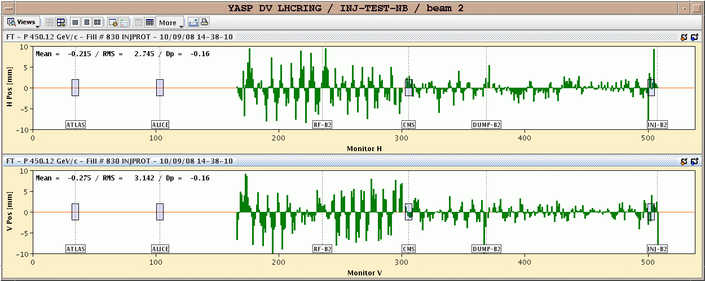
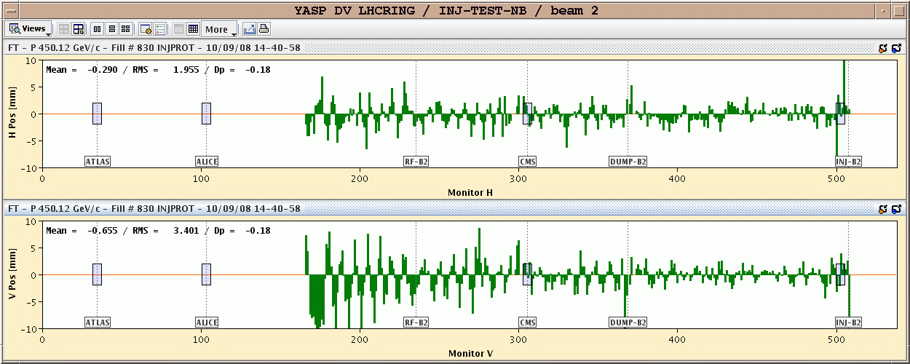
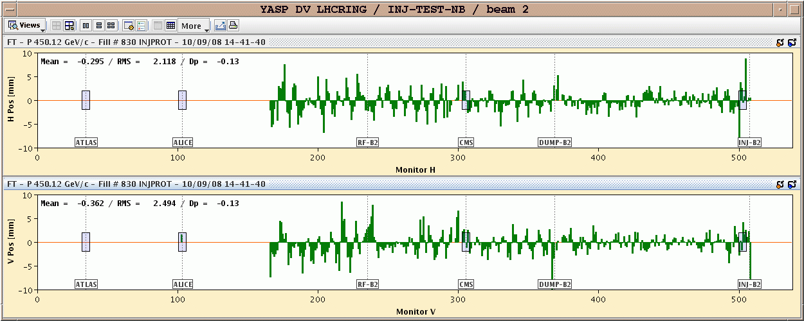
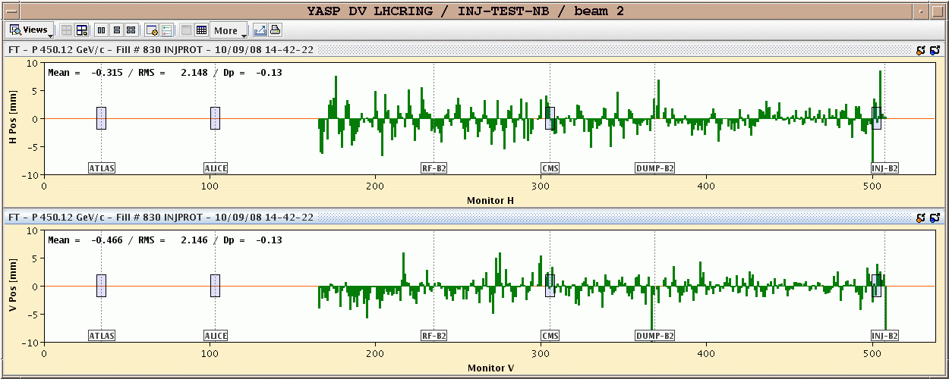
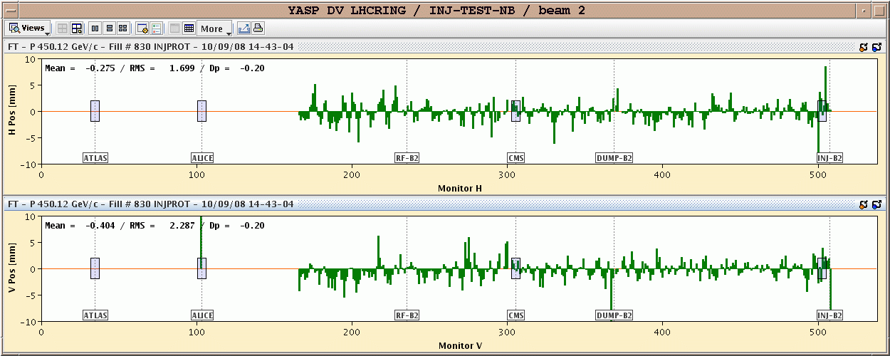
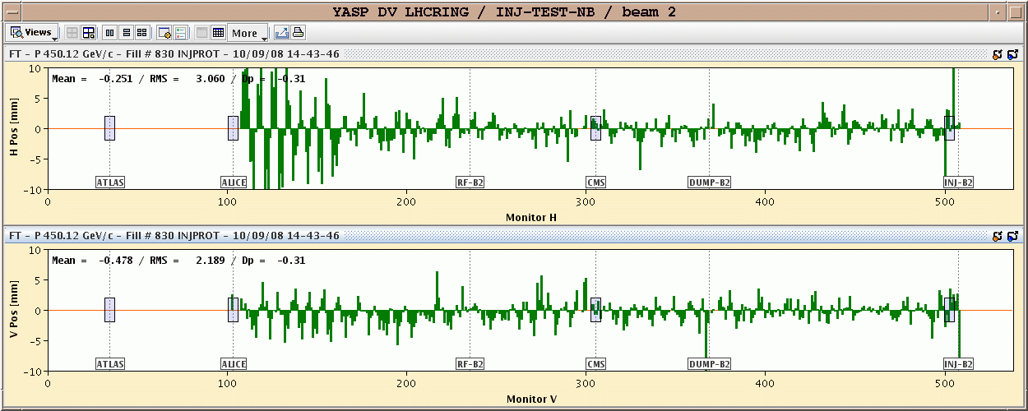
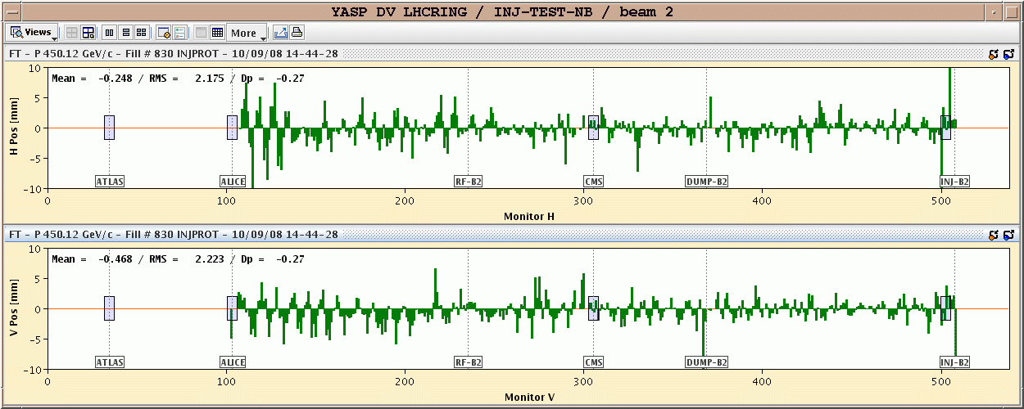
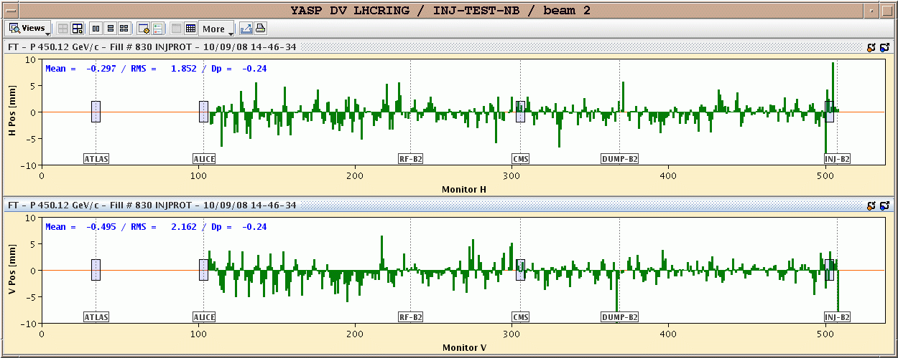
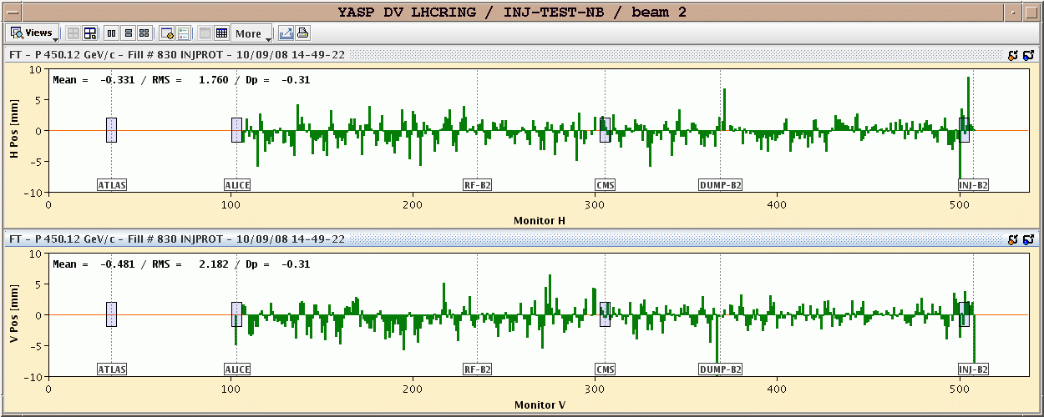
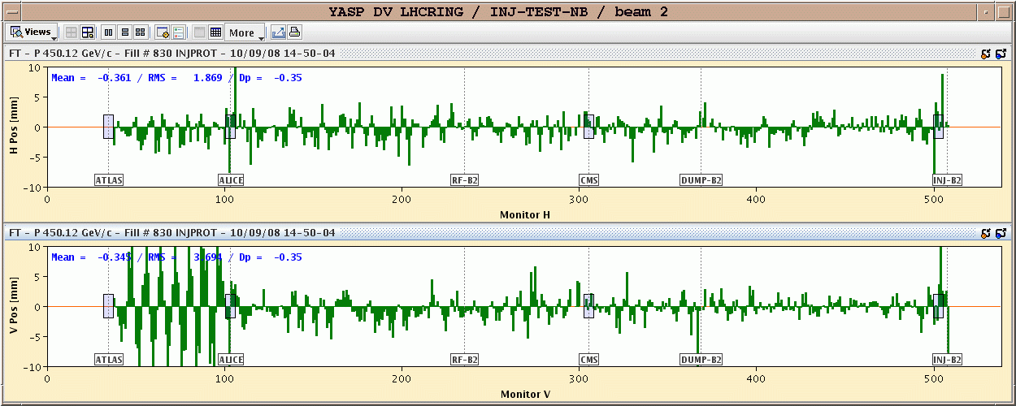
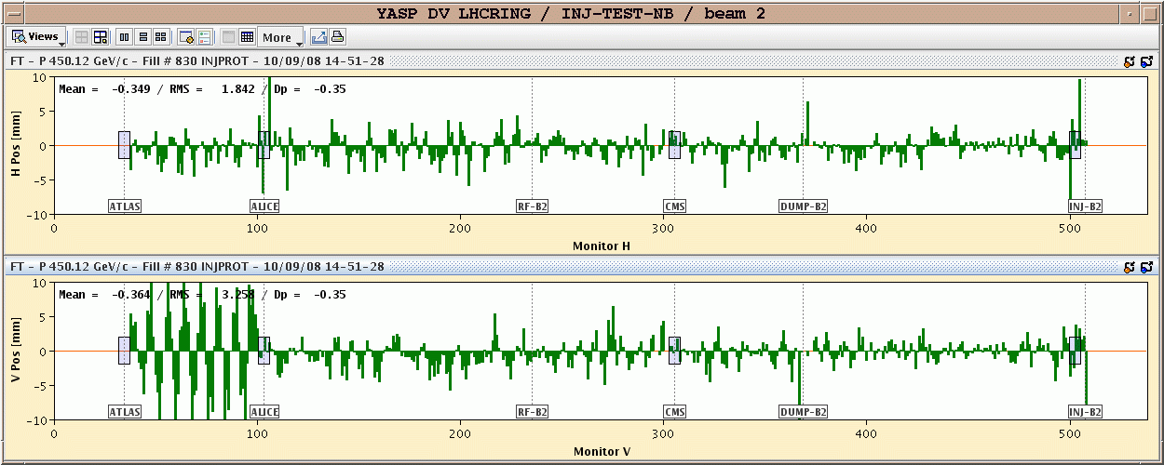
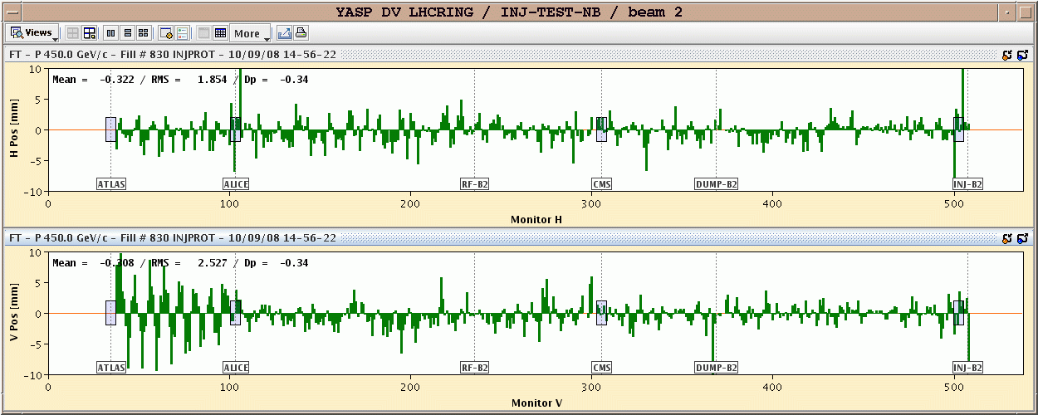
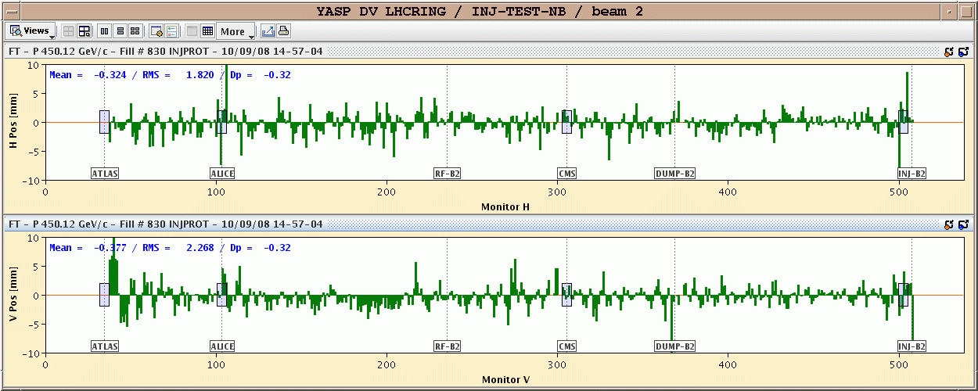
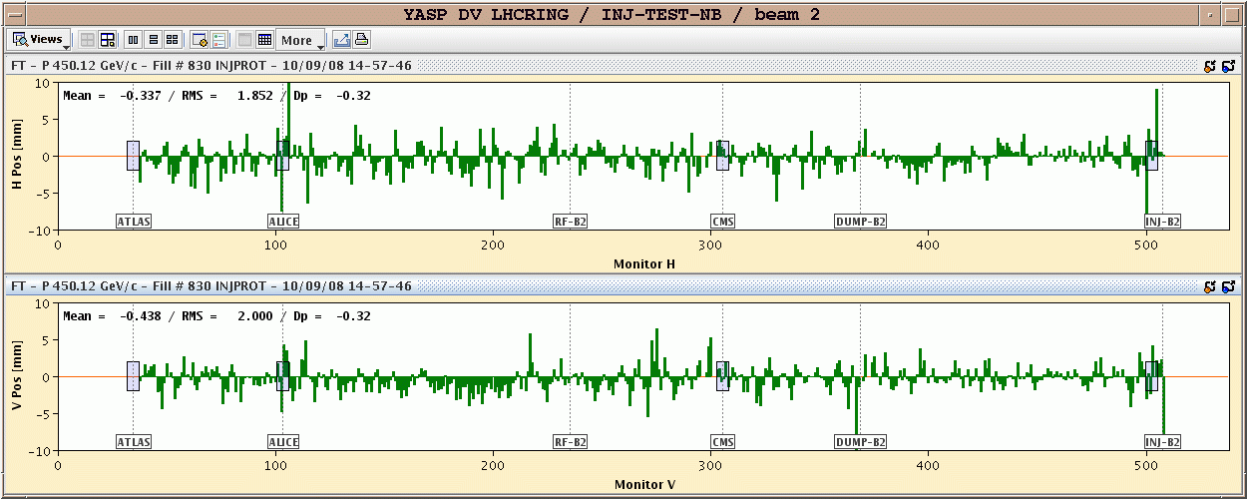
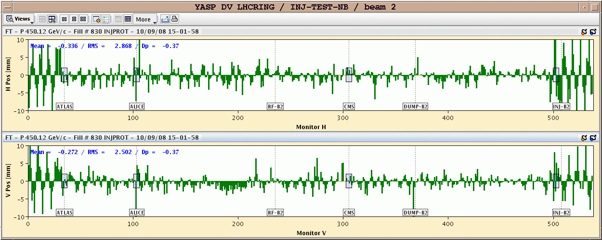
First turn of beam 2…
On the 27 km path, the beam accumulates too many kicks to make it around without corrections – ‘thread’ the beam sector by sector (stop on collimators)
Beam 2 threading
BPM availability ~ 99%

Slide 13
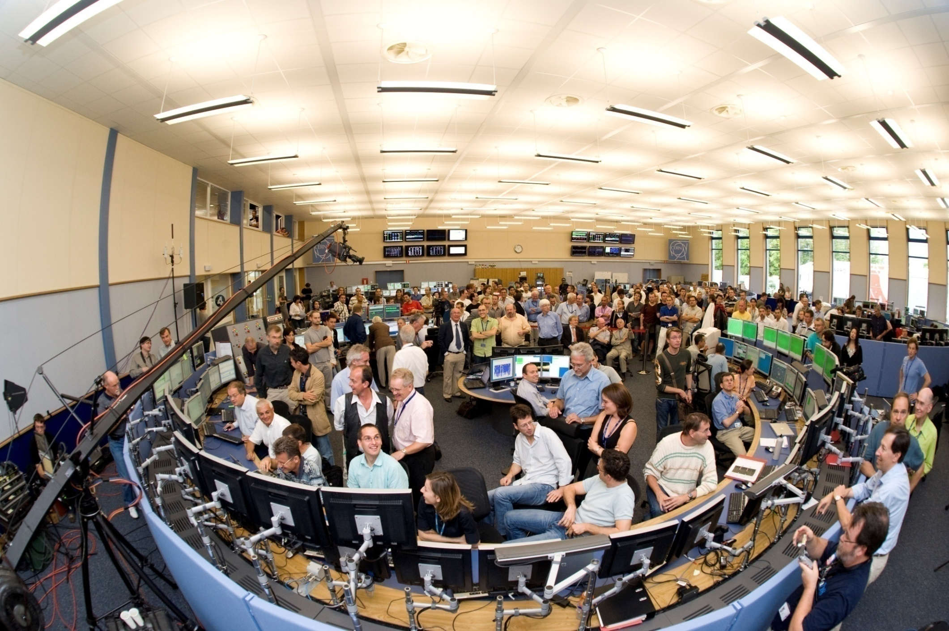
… in a control room full of bystanders !
5 former CERN director generals
The guys who have to get the beam around

Slide 14
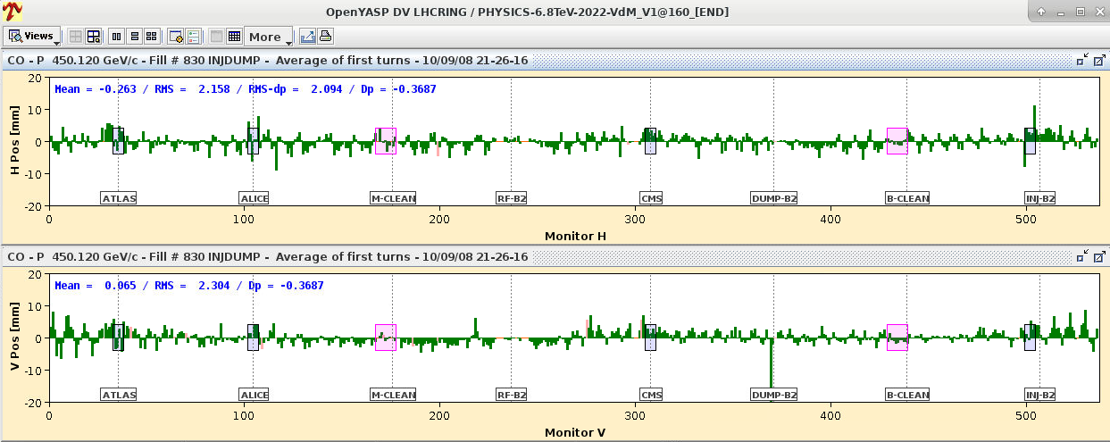
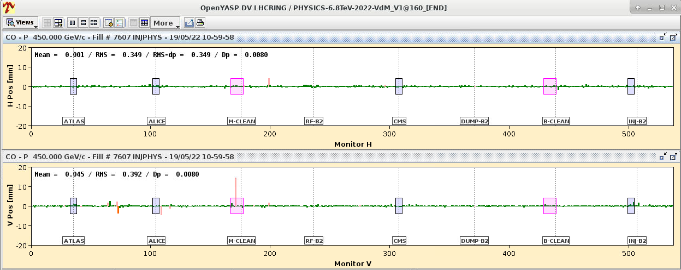
First LHC circulating beam
In the early evening first day both beams were captured by the RF system and circulating !
September 10th 2008
Best orbit correction at LHC with rms of ~300-350 μm.
May 2022

Slide 15
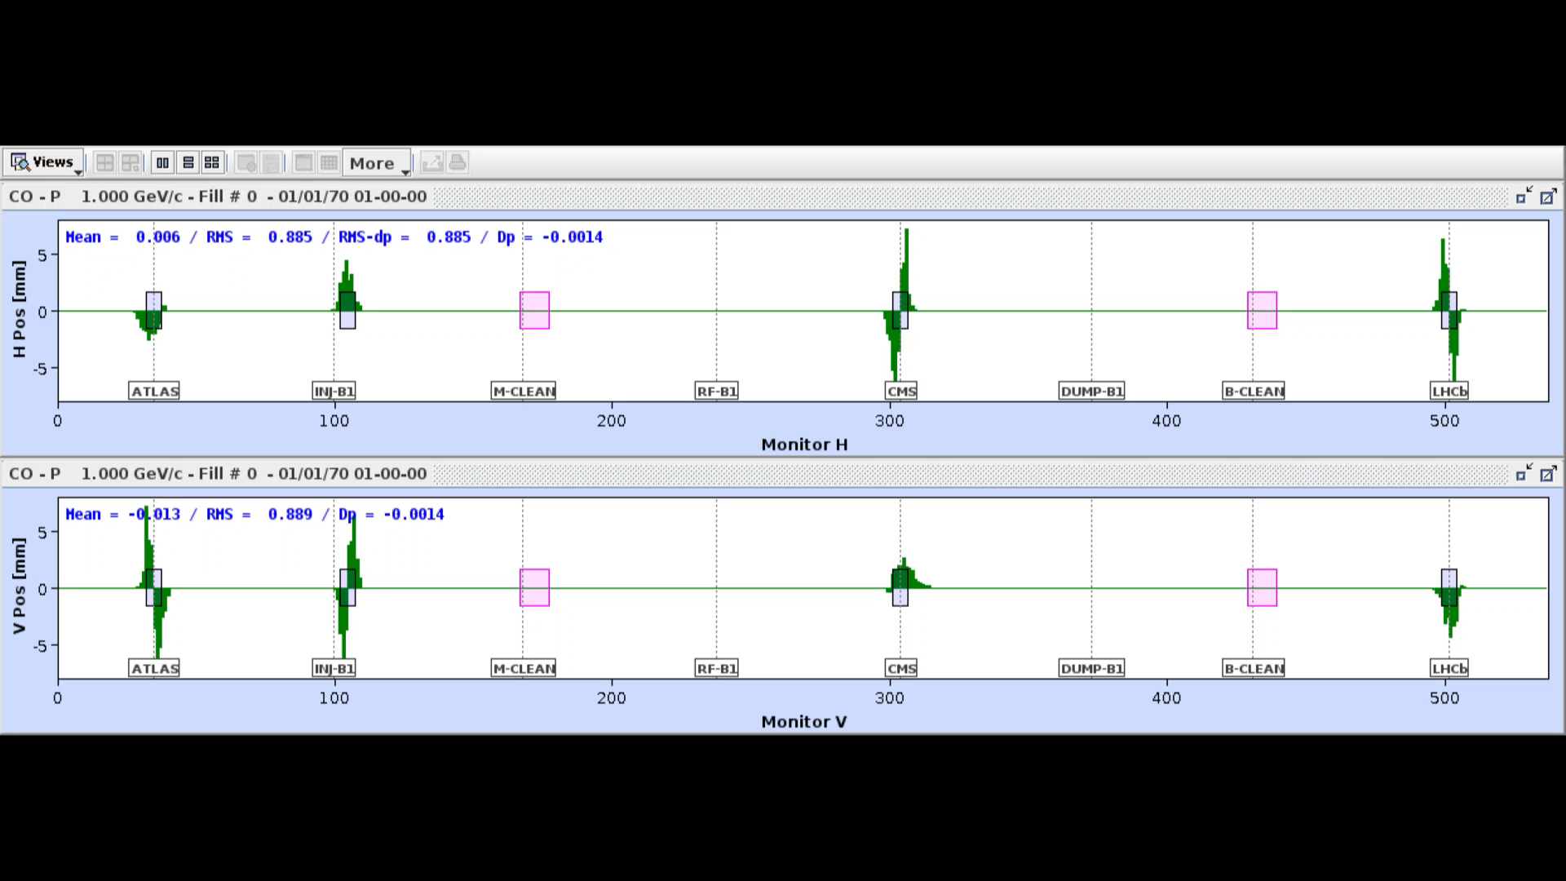
Hadron collider orbit control
Like in most hadron machine, the main aim of orbit correction is to keep the beam within the aperture. No concern about dispersion if it does not impact the beam size too much.
The orbit is flattened with SVD algorithms, and a unique flat reference is used for an entire operation year.
Year to year changes are small.
Bumps to separate the beams, crossing angles and other orbit bump features are added as overlays on the flat reference.
Bump amplitude and composition vary along the cycle. Flat orbit + overlay bumps are used by the feedback as dynamicc target orbits through ramp, squeezes etc.
Orbit feedback essential to ensure ~50 μm rms orbit stability from injection to collisions.

Slide 16
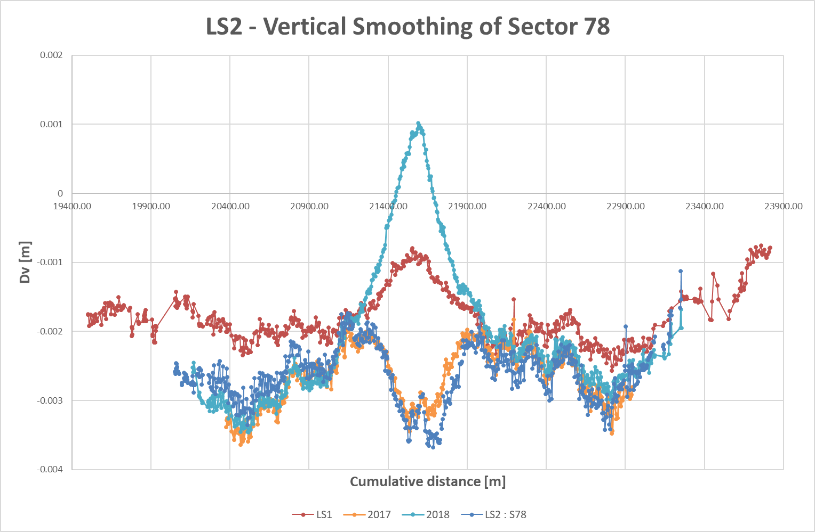
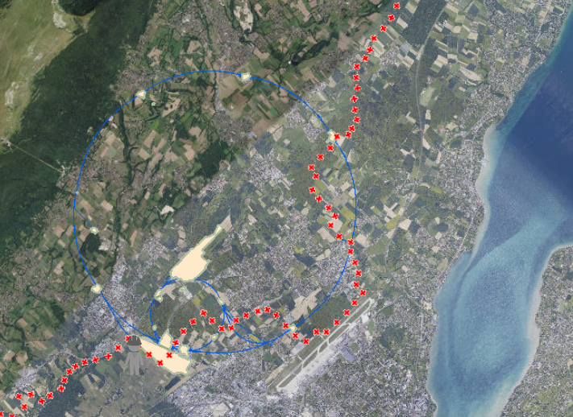
Alignment
Large rings like LEP/LHC pass through different geological layers – including active fault lines.
While LEP was re-aligned to ~0.1 mm vertically every year, at LHC only the straight sections are realigned every year.
(most of) the arcs are left to drift over the 3-4 year long runs, which is not an issue.
A very active fault line – already causing trouble to LEP – is crossed by one arc, with vertical movements of 1-3 mm per year.
Preventive mis-alignment to obtain on average a reasonable alignment over one year.
4 mm

Slide 17
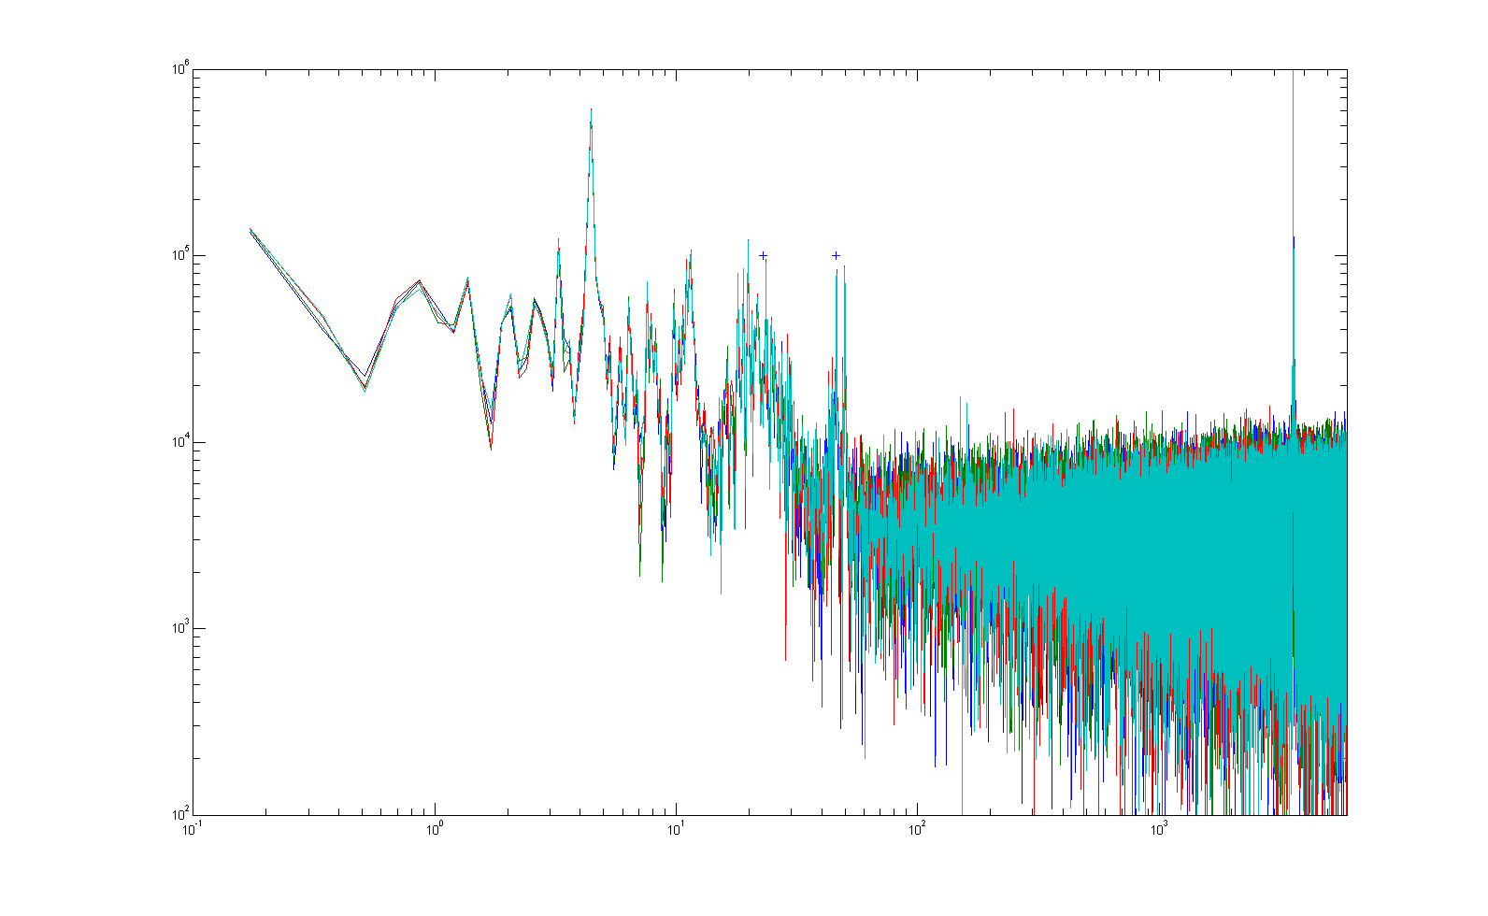
Vibrations
Despite its installation in a deep (50-140 m) tunnel, the beam oscillation spectrum exhibits residual cultural noise.
The LHC magnet assemblies have mechanical resonances in the frequency range of 5-35 Hz. The girder resonance lines are clearly visible in the beam spectra.
Orbit feedback (and magnet system) too slow to counter-act.
Some lines of unknown origin (for ex 4 Hz in vertical plane).
Magnet girder resonances
Amplitude (A.U.)
1
10
100
1000
frequency in Hz
Typical LHC proton beam oscillation spectrum

Slide 18
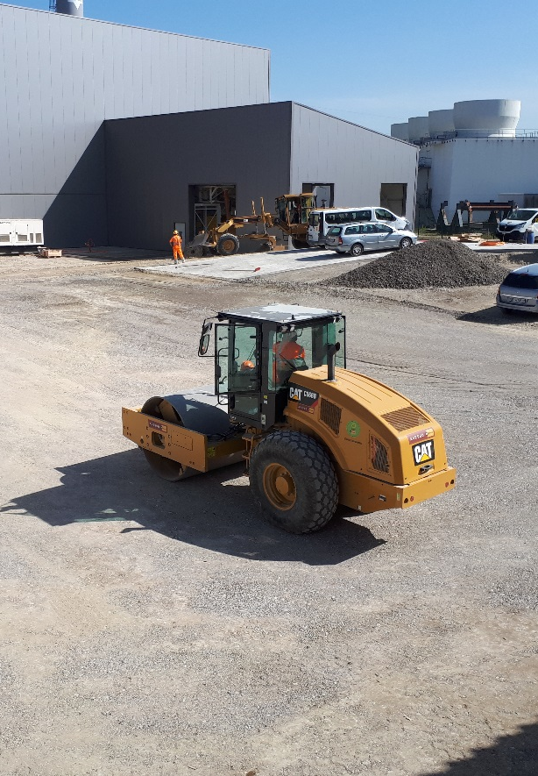
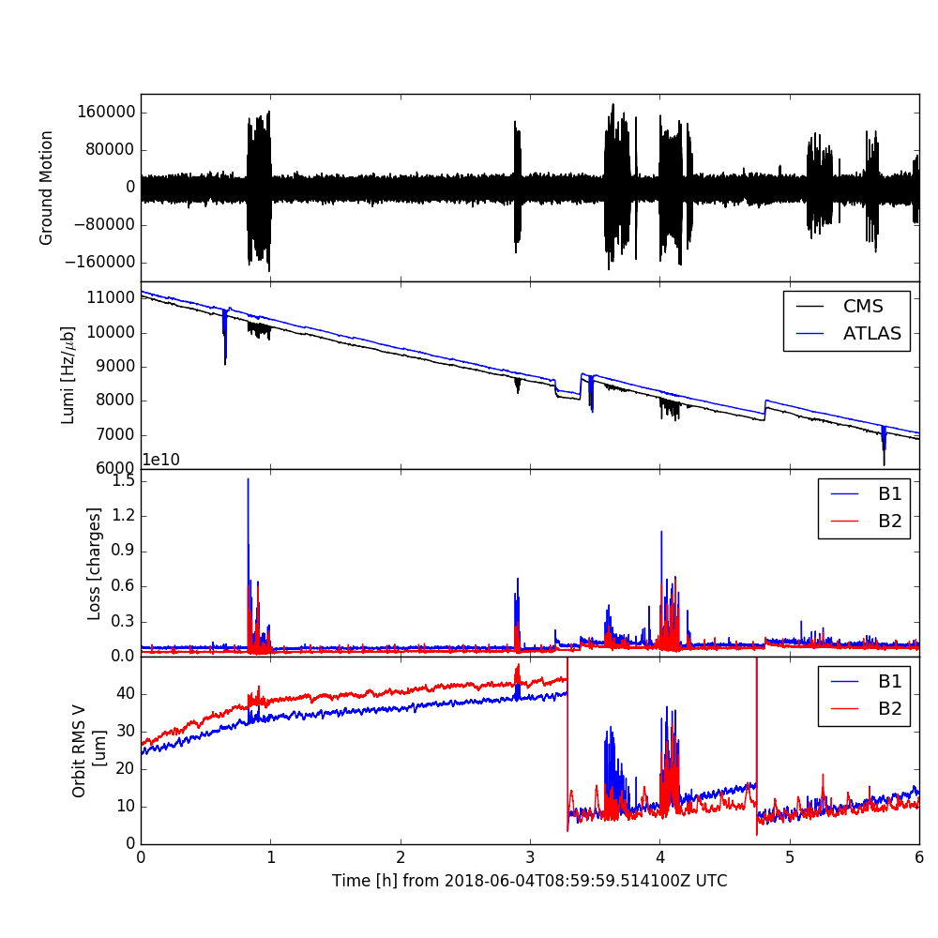
Civil engineering for LHC upgrade
~100 m below
In the early part of the CE work, an important volume of soil was moved around and compacted during LHC operation.
Ground compactors compact soil by vibrating, they managed to shake beams colliding at the IP ~100 m underground.
Vibrations with frequencies ~20 Hz were transmitted through 100 m of rock to the tunnel magnets and their supports that resonate in the frequency range 8-22 Hz.
Low-beta quadrupoles, very large betatron function.
The resonant excitation generated micrometer amplitude beam movements that were clearly visible on the CMS experiment luminosity.
Ground motion
Luminosity
Beam loss @ primary collimator
Orbit rms

Slide 19
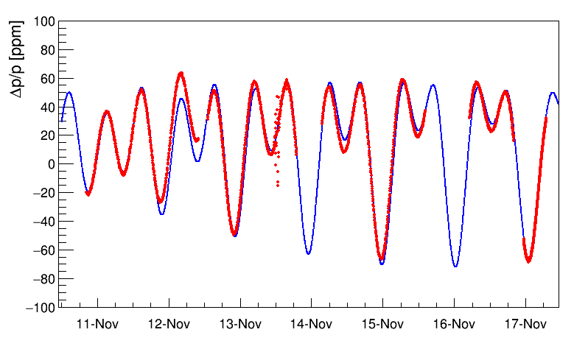
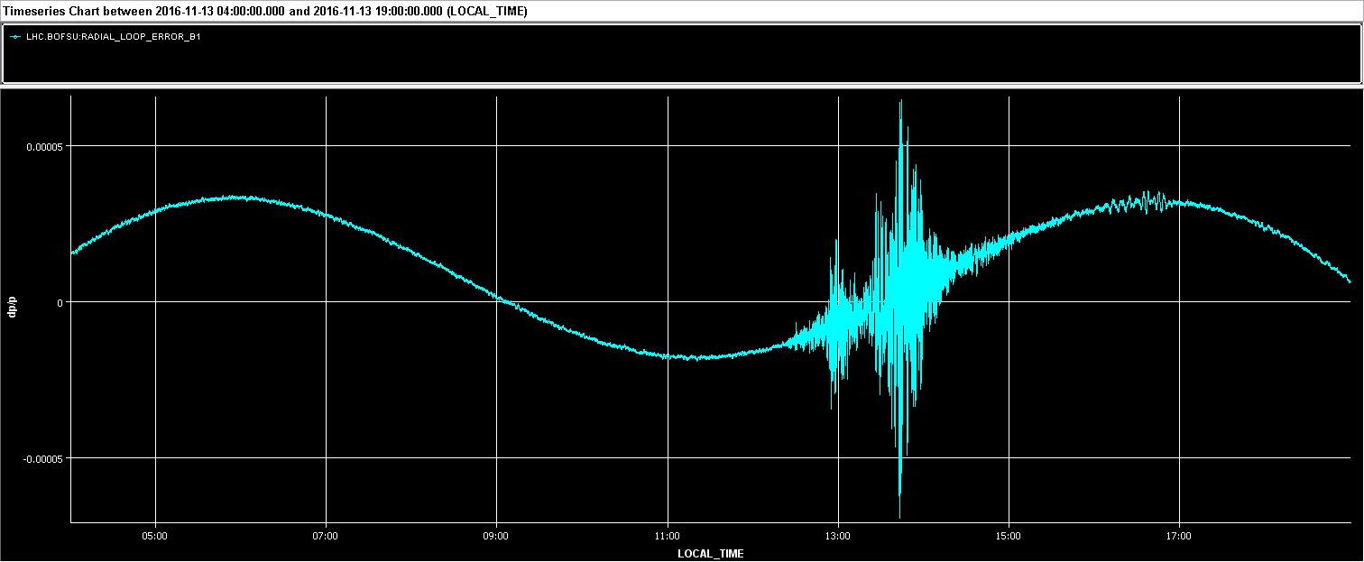
Tides – not just @ LEP
LHC feels the tides like LEP. A long stable period with long fill thanks to low luminosity provided one of the nicest and cleanest tide measurements @ LEP/LHC (measured with BPMs).
Measurements
(simple) Model
Tide observations (from orbit changes) over one week at 4 TeV in 2016
(expressed in energy change Δp/p)
Earthquake in New Zealand
The pressure waves induce a modulation of the circumference similar to tides
dp/p
10⁻⁴

Slide 20


Earthquakes
Various types of body (Pressure, Shear) and surface waves (Raleigh, Love), multiple paths and reflections between core and mantle produce a complex signature of earthquakes at seismic measurement stations – also at the LHC.
L. Braille (Purdue U.) / The IRIS (Incorporated Research Institutions for Seismology) consortium

Slide 21


Record earthquake
cc
The main impact of large earthquakes is a radial oscillation due to surface pressure waves – like tides.
At the peak of the wave, a stable period of 20 seconds : corresponds to a wavelength of ~80 km (v = 4 km/s).
Observed in all strong & far distance earthquakes (M >= 7).
This example shows the earthquake with the strongest signal at LHC so far: twice the amplitude of the strongest tides.
None of the earthquakes observed so far led to a beam abort.
For FCC-ee @ Z such an earthquake amplitude would correspond to an energy modulation of ~ ±300 MeV.
~1 hour !
8.3 magnitude earthquake near Illapel (Chile) 16 Sept 2015 22:54 UTC.
Distance to LHC ~ 12’000 km (on Earth surface)

Slide 22
Summary
There was a generation change in the performance of the orbit systems from LEP to LHC.
The LHC BPM system is adequate for a hadron collider, orbit reproducibility is limited by systematic effects due to bunch pattern dependance. Complex orbit manipulations can be performed thanks to a flexible control system and orbit feedback.
But it is not a sub-micron BPM system required for FCCee – was not designed like that !
Due to their size large machine are more affected by the geology, alignment is an issue at large scales (resources and time) – see presentation by H. Mainaud last week.
Cycled machine like LEP and LHC clearly encounter different issues than a steady state machine like FCC-ee, but the experience will be relevant for the booster.
The magnetic cross-talk booster – collider could have a significant impact for FCCee.
FCCee will be a mix between a synchrotron light source (constant energy operation, top up, emittances etc) and LEP/LHC (size) – some of the LHC experience is relevant, others is not !

