Slide 1
ILC, SuperKEKB and GammaFactory laser systems
Aurélien MARTENS (IJCLab Orsay)

Slide 2
Introduction
Overview of what has been proposed for various other Compton (-like) projects
My take away remarks for FCC-ee

Slide 3
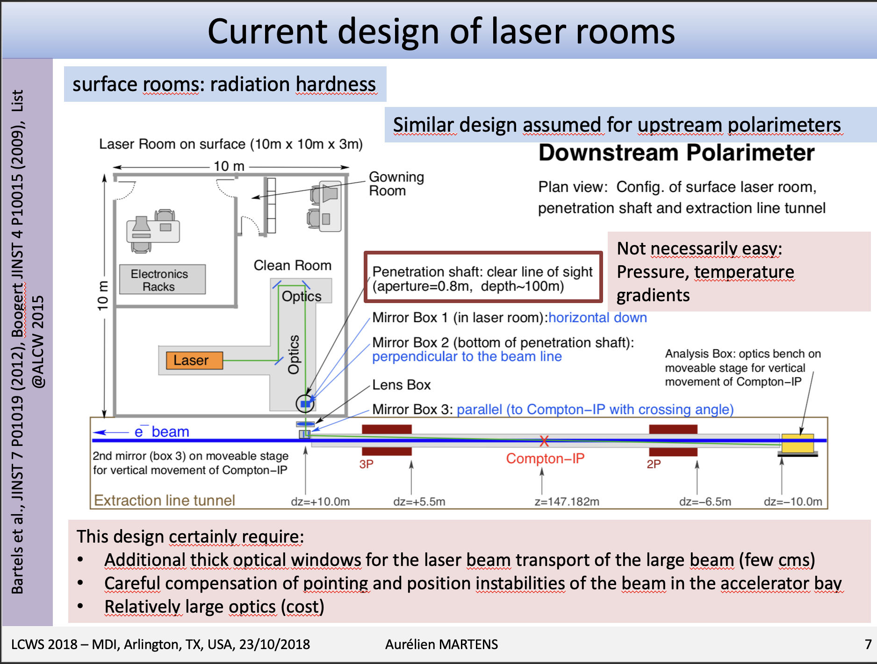
ILC polarimeter(s) laser and challenges

Slide 4
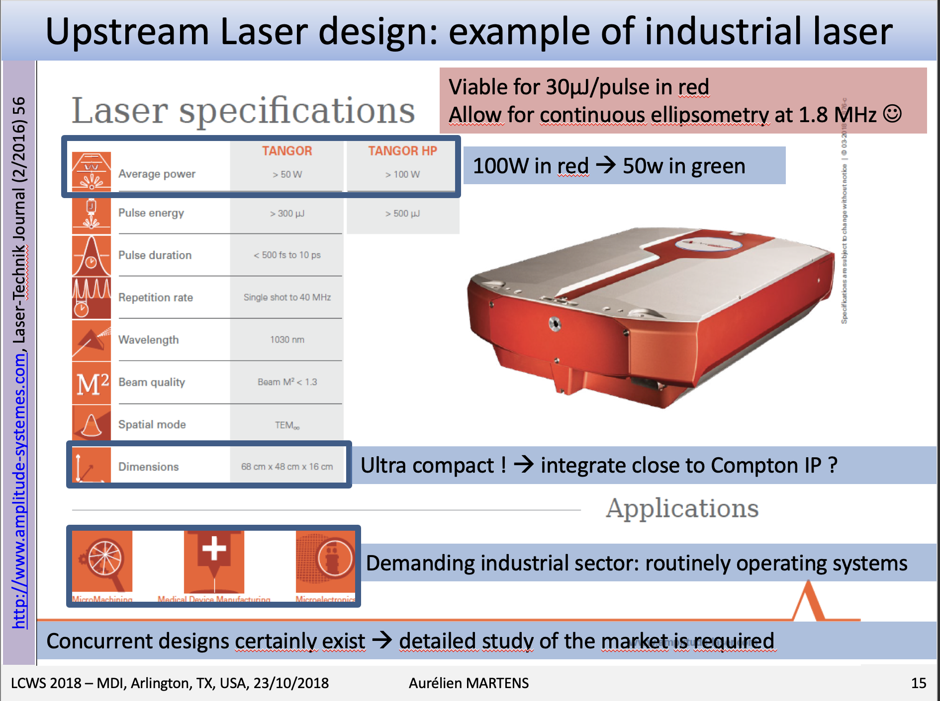
ILC polarimeter(s) laser and challenges

Slide 5
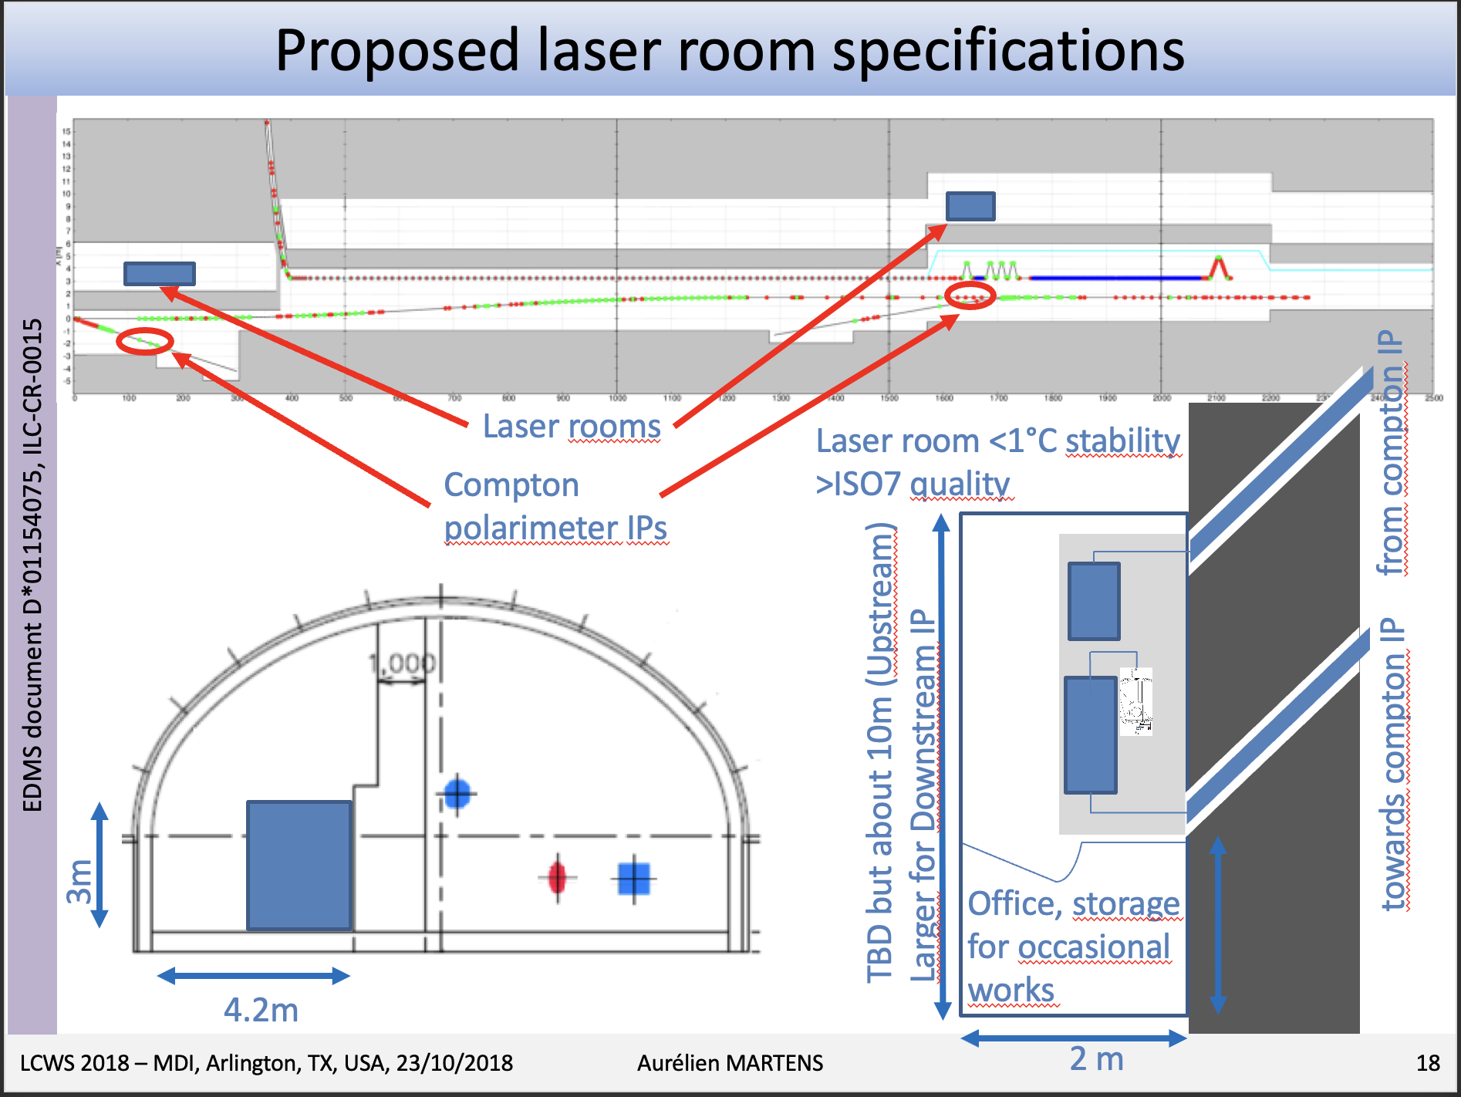
ILC polarimeter(s) laser and challenges

Slide 6
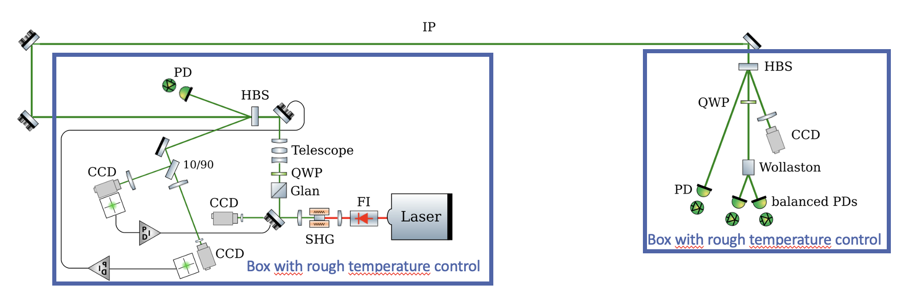
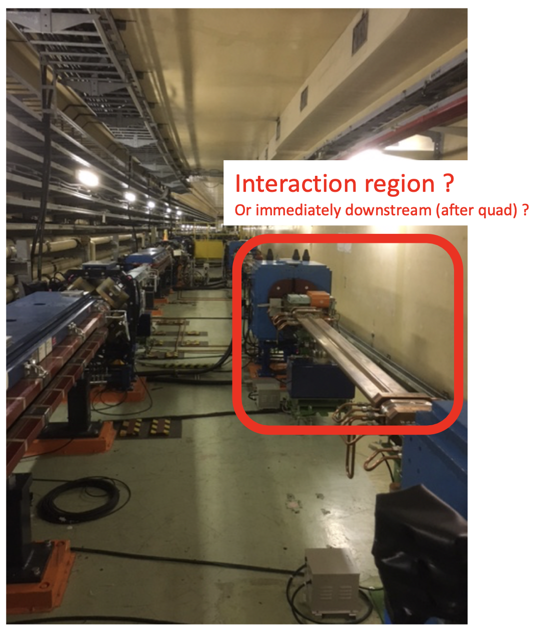
SuperKEKB laser
Laser could be placed in accelerator bay below beam line
Pulsed 250MHz green laser with a couple of Watts
Automatic beam alignment and stabilization
Currently working on real-time laser polarimetry based on photo-elastic modulation (on-going at IJCLab)

Slide 7
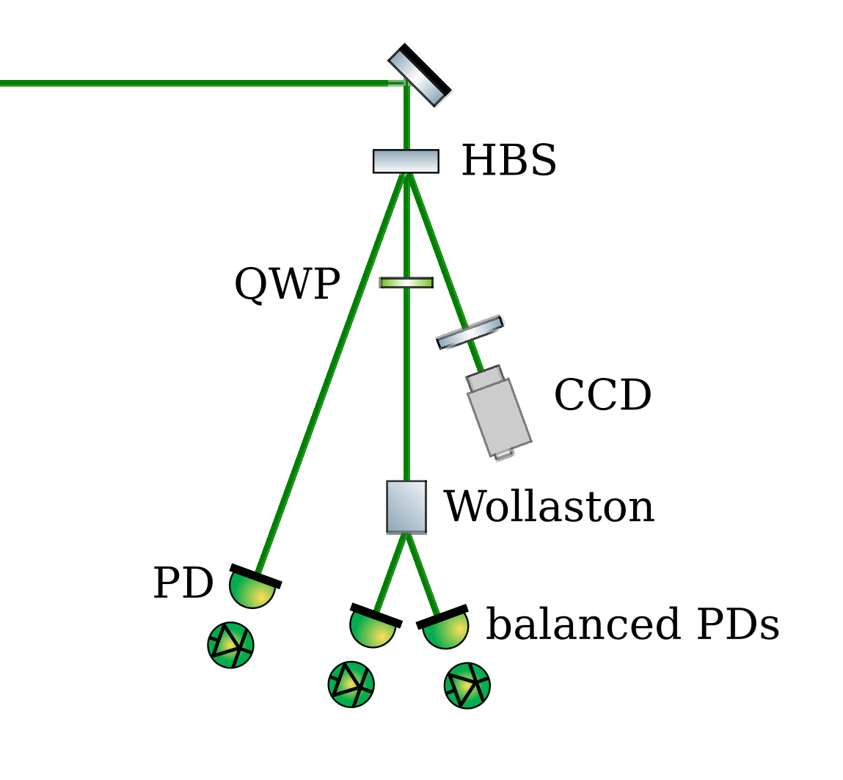
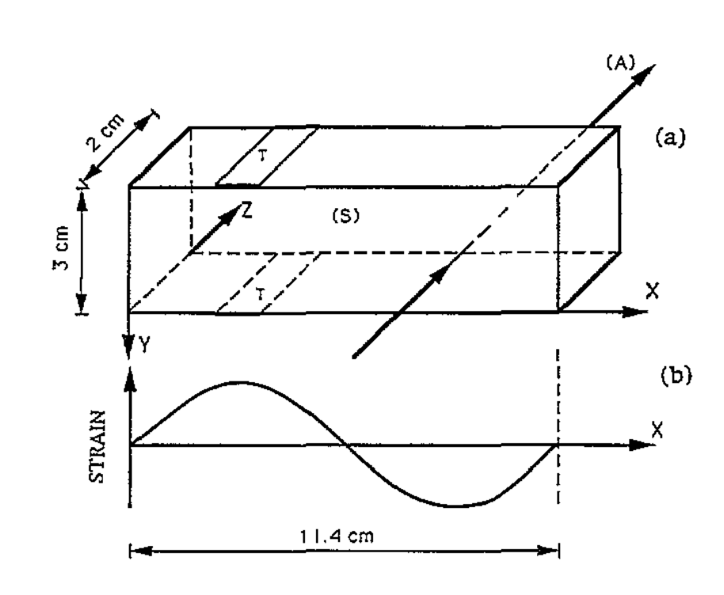
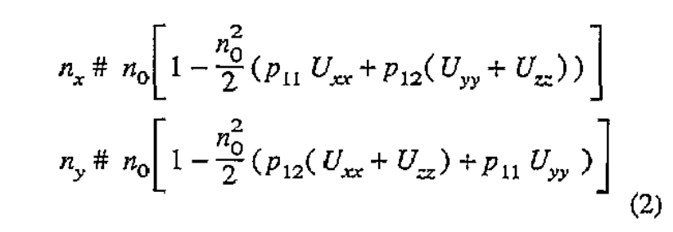
Current developments with PEM
Replace motorized QWP by PEM (photo-elastic modulator)
Piezo-excited glass
Modulated difference of refraction indices
Modulation of phase of waveplate

Slide 8
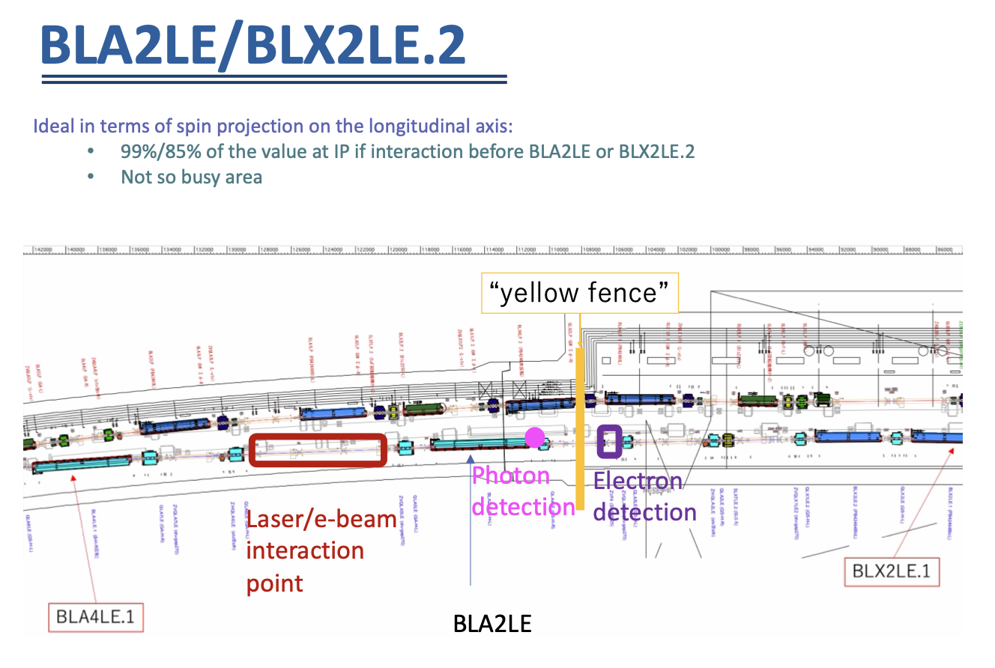
SuperKEKB integration

Slide 9
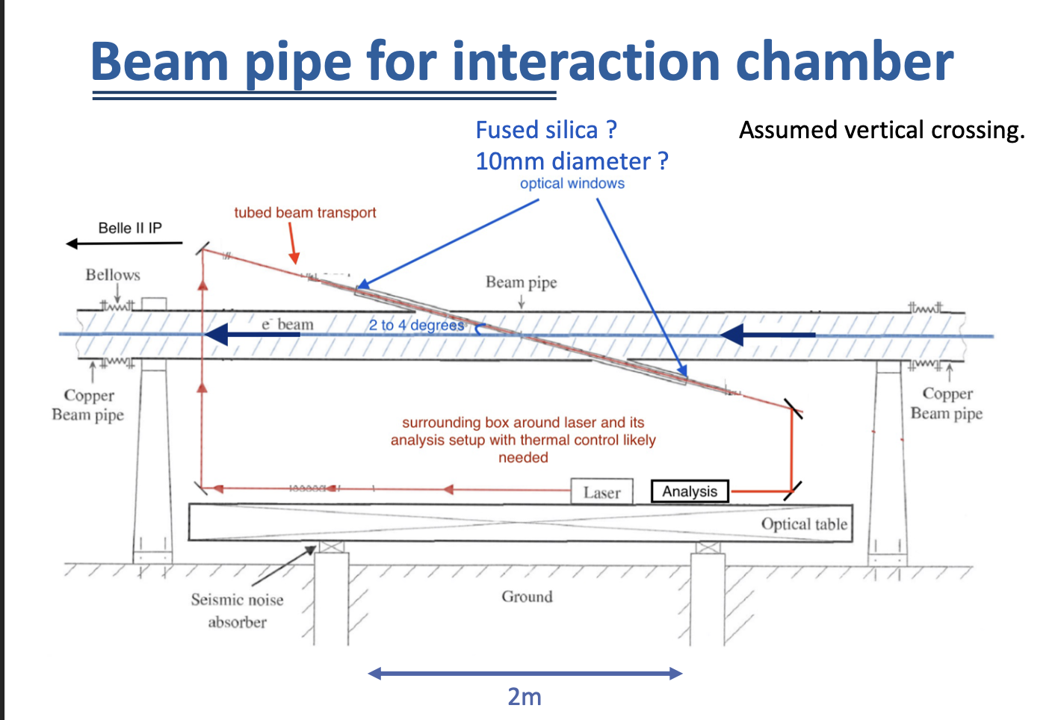
SuperKEKB laser chamber
Short beam transport, under air but tubed (at this stage)
Out of vacuum mirrors

Slide 10
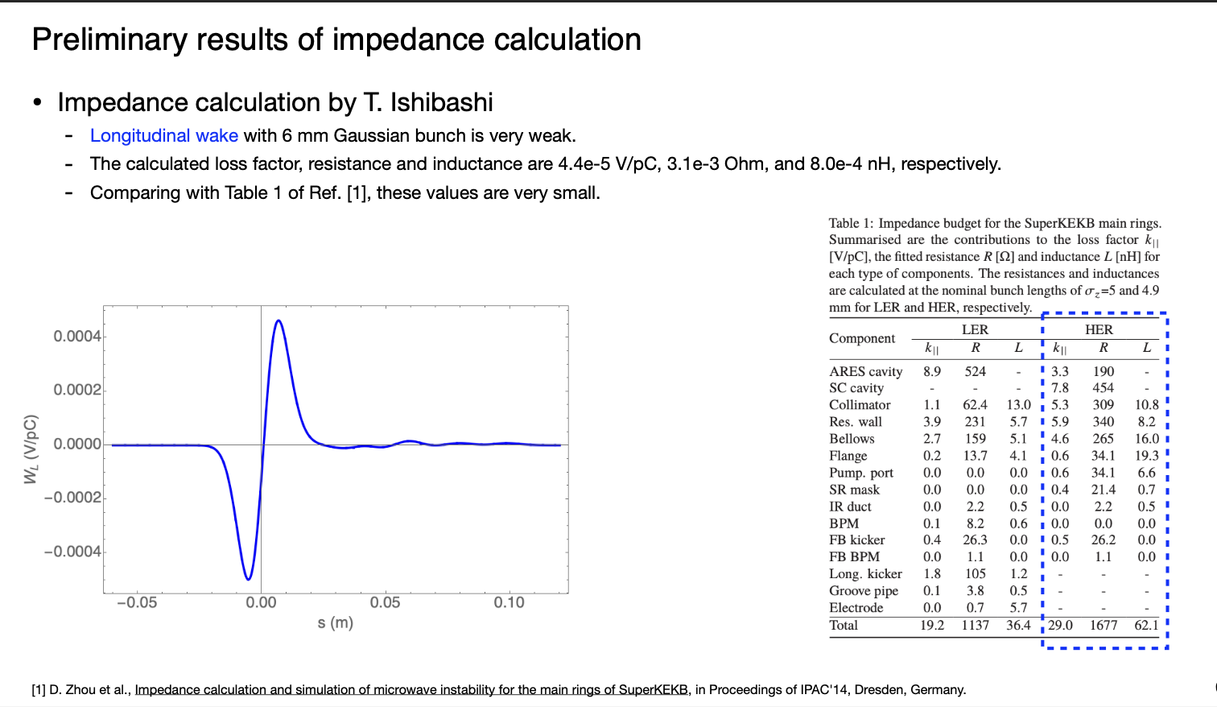
SuperKEKB: impedance
Zhou, Ishibashi

Slide 11
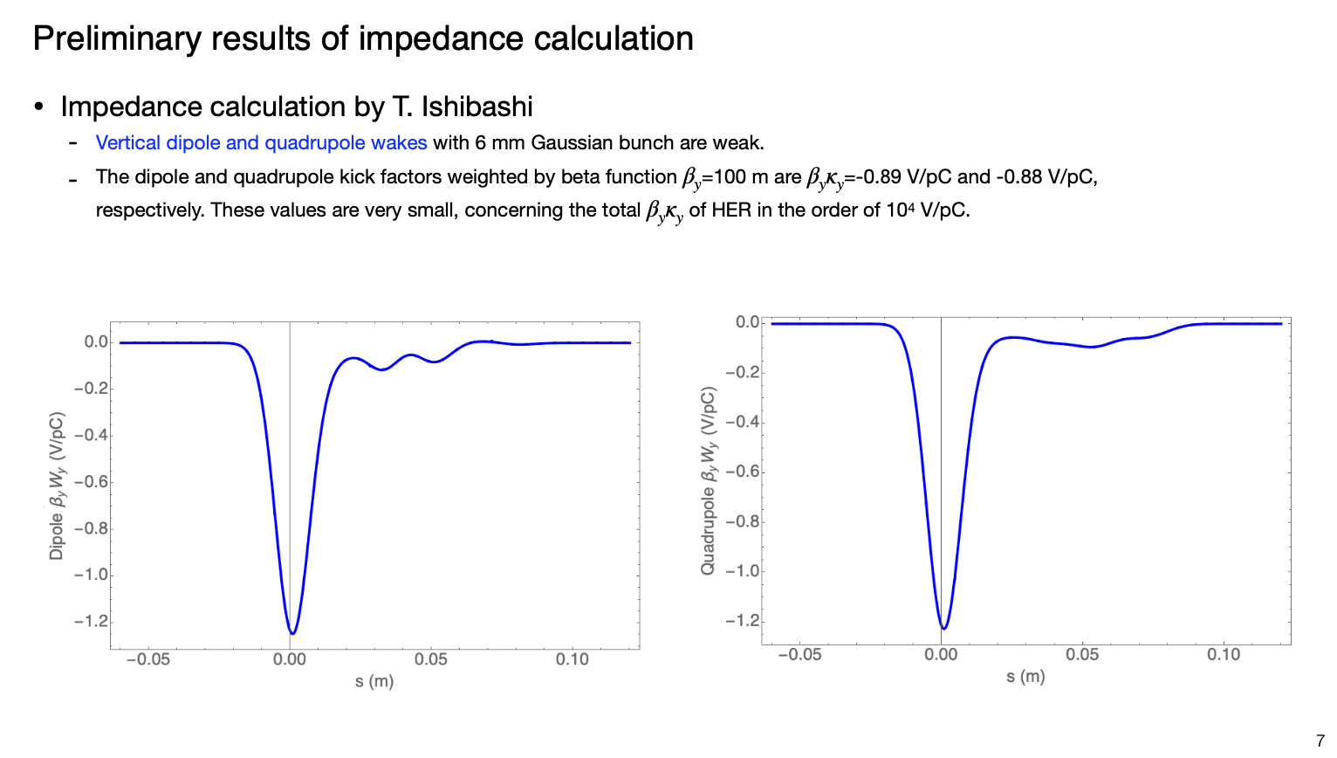
SuperKEKB: impedance
Zhou, Ishibashi

Slide 12
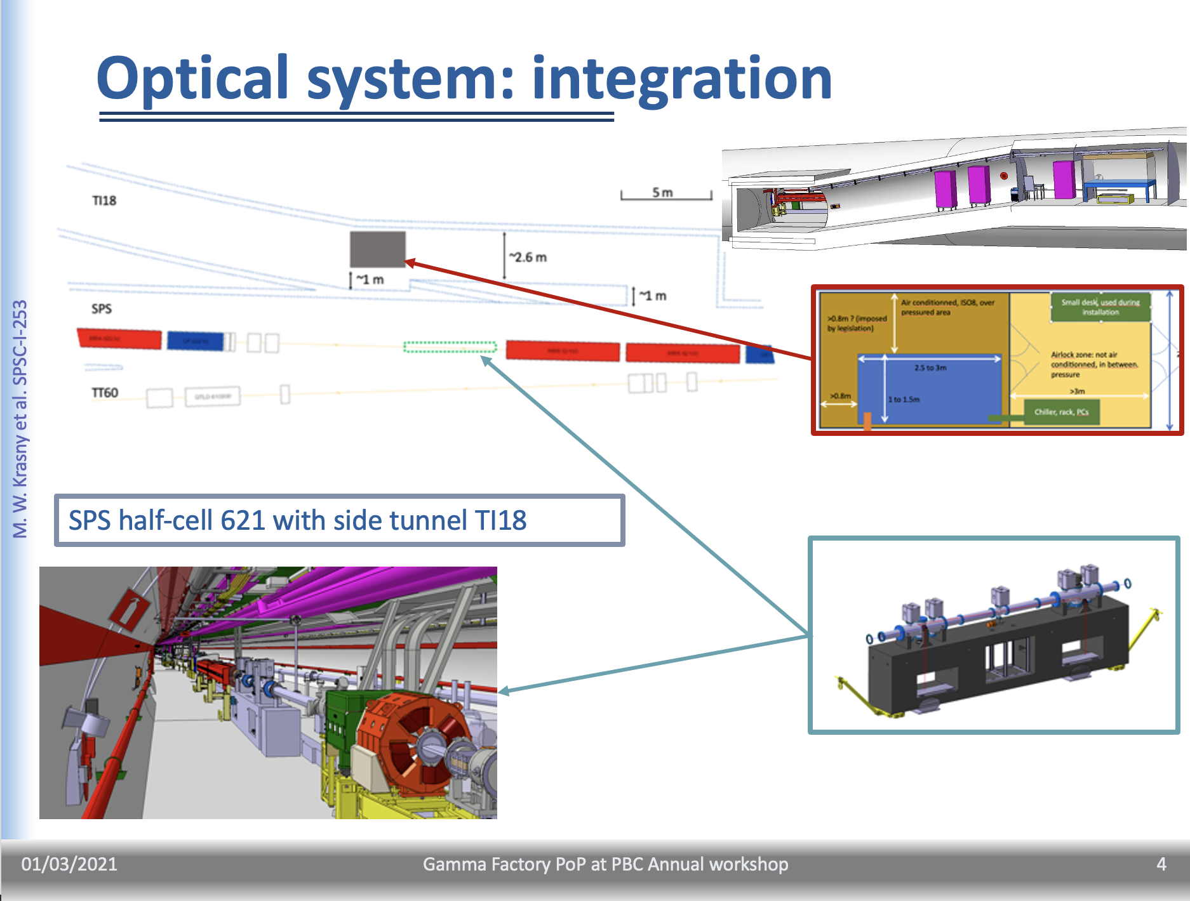
GammaFactory beam transport

Slide 13
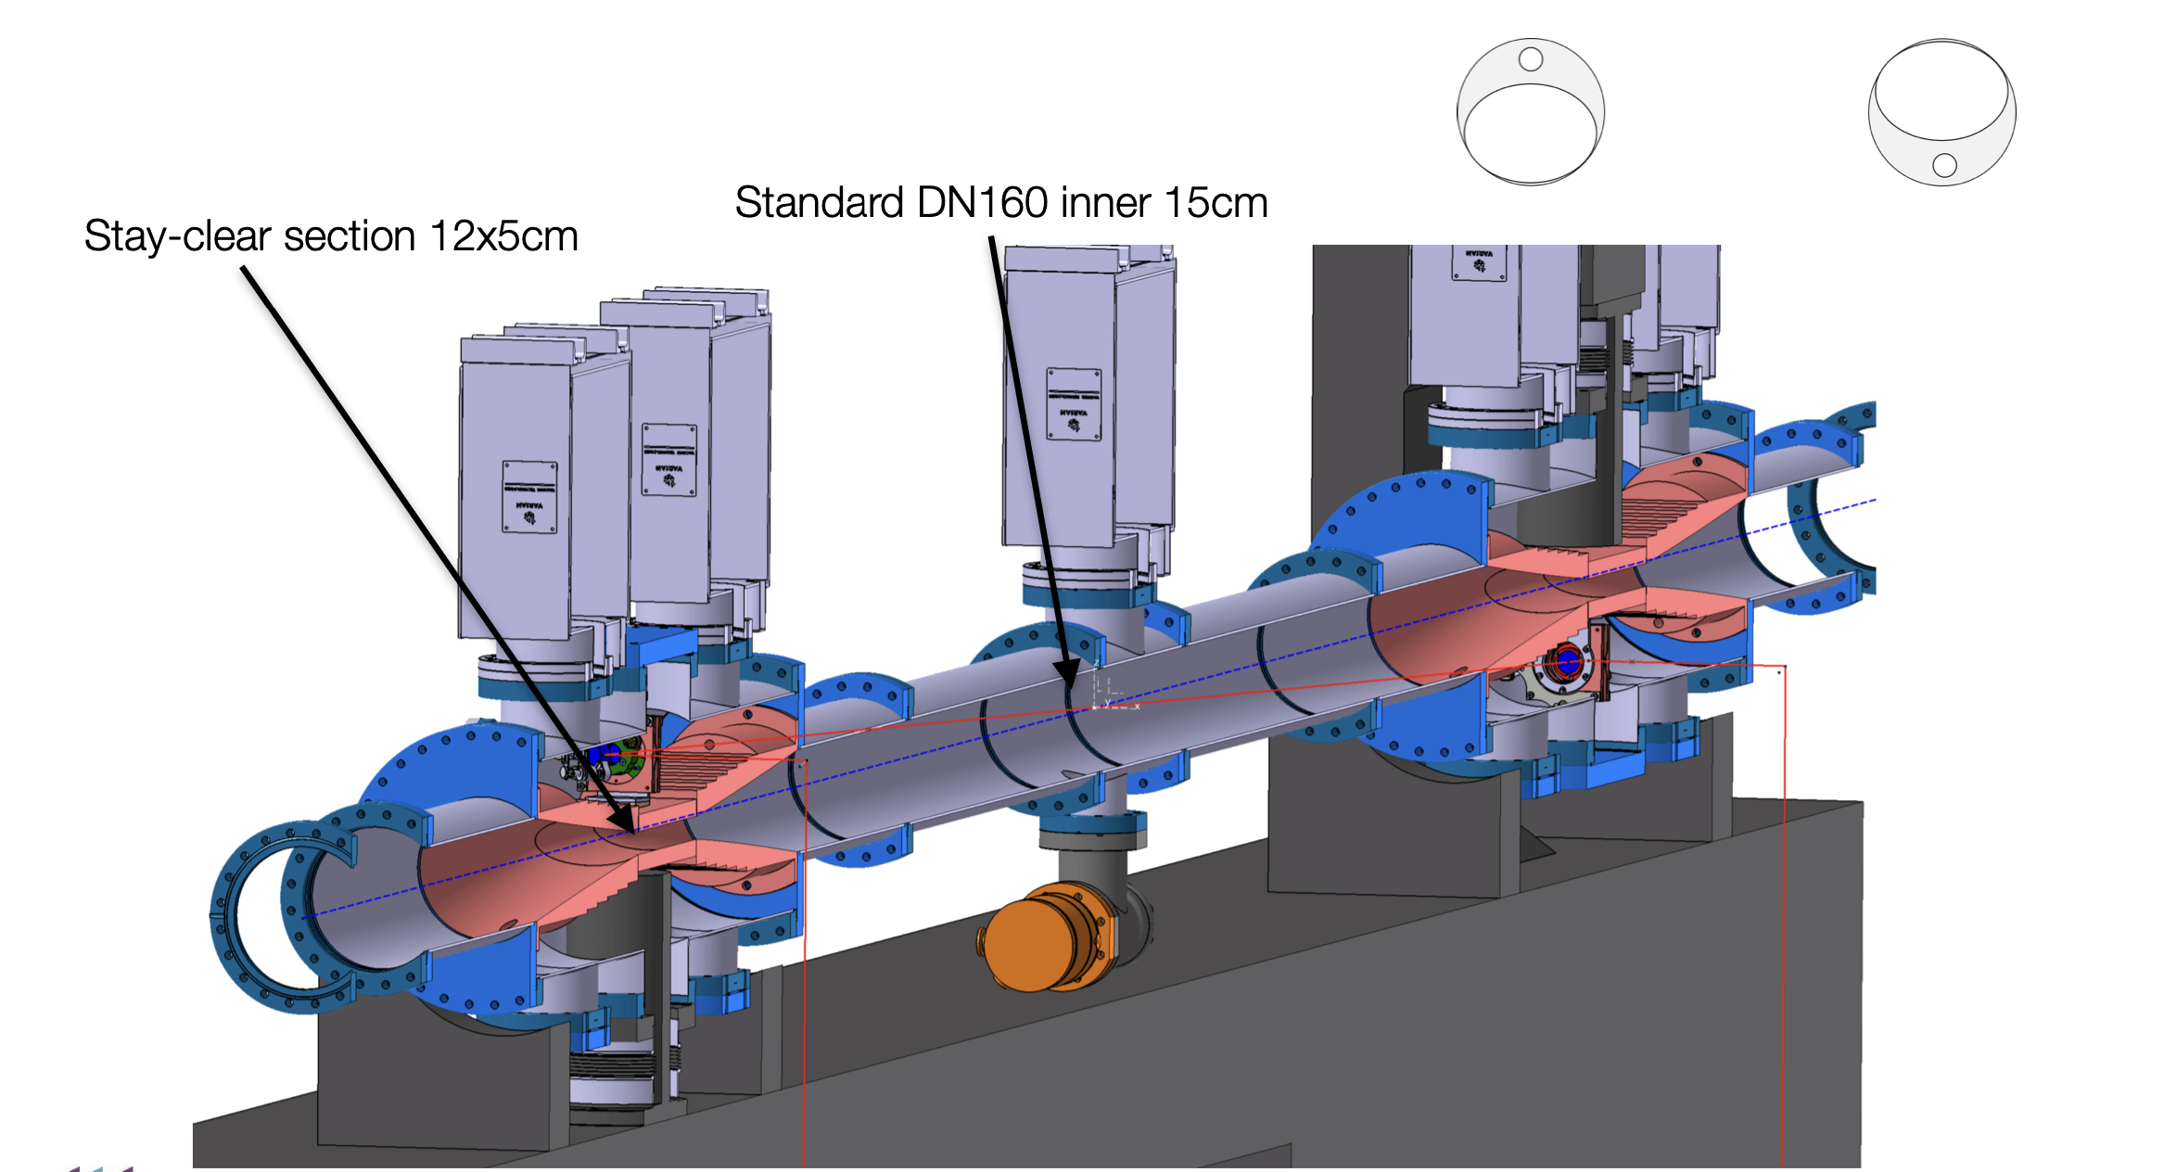
Gamma Factory Laser injection
Gamma Factory SPS proof of principle optical cavity mechanical design could be adapted ?
Interaction point
Vertically asymmetric drilling
Beam shield
Gamma Factory Proof of Principle LOI SPSC-I-253
Laser system and diags below ground
(in excavation) or send them up in a dedicated room

Slide 14
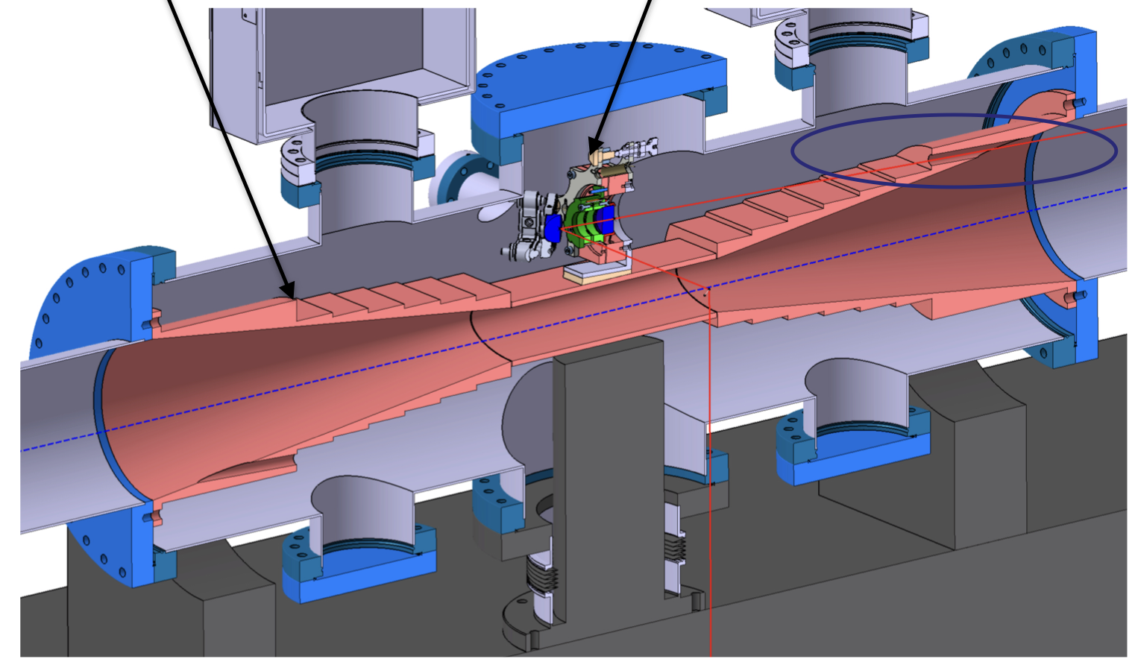
Gamma Factory Laser injection
Impedance and currents shield
To be removed in present case
Maintenance port
Gamma Factory Proof of Principle LOI SPSC-I-253
Cantilevered support (not drawn) directly on ground
Decoupling to pipe
Deport beam aside

Slide 15
Conclusion
Personal guess on what could be the laser and integration for FCCee polarimeters
A close-by laser room
  Accessible during operation, even if remote operation is the goal it may be needed to have access from time to time – speaking about 24/7 laser operation
A short laser beam transport
  Likely under vacuum (secondary probably for less vibrations, easier maintenance)
  If possible on the floor (reduce vibrations).
  Integrated motors, for auto-alignment/stabilization, few diag. cameras
A vertical crossing angle vacuum chamber similar to that of SuperKEKB (inspired from HERA cavity LPOL2),
  no mirror in vacuum of the accelerator
  radiation tolerance of windows need to be investigated
  Injection mirrors supported directly on ground (decoupling to tubes) but placed in optical turning boxes in the vacuum of the transport line
Use modern modelock Yb laser systems
  technology is industrially mature,
  sync to accelerator is also customary for these systems (industry can sell),
  can be burst amplified (pulse-picking + single pulse amplification)
  May seed several different amplifiers in // if needed

Slide 16
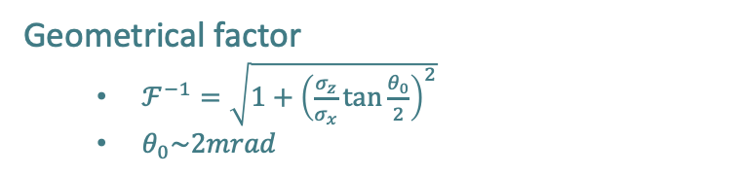
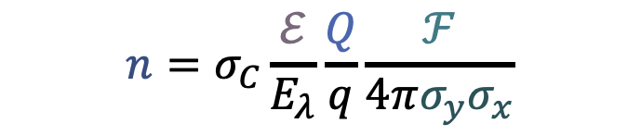
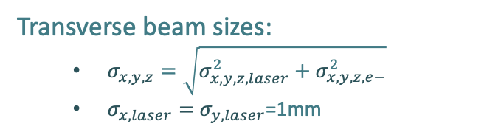
Scattered photon rate
Laser-beam single pulse energy
Compton cross-section
pilots
Electron bunch charge (25nC or 6nC)
Geometrical factor
  $ℱ^{−1}=\sqrt{1+{\left(\frac{σ_{z}}{σ_{x}}\tan{\frac{θ_{0}}{2}}\right)}^{2}}$
  $θ_{0}\sim 2mrad$
$$n=σ_{C}\frac{ℰ}{E_{λ}}\frac{Q}{q}\frac{ℱ}{4π{σ_{y}σ}_{x}}$$
Photon rate
Transverse beam sizes:
  $σ_{x,y,z}=\sqrt{σ_{x,y,z,laser}^{2}+σ_{x,y,z,e−}^{2}}$
  $σ_{x,laser}=$ $σ_{y,laser}$=1mm
Laser photon energy
(2.4eV for 0.5µm wavelengths)
From K. Oide

Slide 17
Some possible laser systems
Nikolai’s baseline
Laser param. | 1 pilot | 1 pilot v2 | All colliding bunches (at Z)
Repetition rate | 3 kHz | 3 kHz | 50 MHz
Pulse energy | 1 mJ | 1 mJ | 100 nJ
Pulse duration | 5 ns | 5 ps ^{(**)} | 5 ps ^{(**)}
Average power | 3 W | 3 W ^{(***)} | 5 W ^{(***)}
Scattering rate | 1x10⁵/s ^{(*)} | 8x10⁵/s ^{(****)} | 1x10⁶/s ^{(****)}
Scattering rate per bunch | 1x10⁵/s ^{(*)} | 8x10⁵/s | 0.9x10²/s
Same oscillator may be used but two different amplification schemes
^{(*)} Large piwinski contribution, nearly scales as crossing angle, very dependent on laser beam size (was 2x10⁶/s in ref. paper)
^{(**)} Short pulse duration → broader laser spectrum, energy measurement from threshold more difficult
^{(***)} Can be increased to typically ~100W (nowadays) but requires operational validation, management of thermal effects…
^{(****)} not limited by Piwinski contribution → significantly increases when decreasing laser beam size

Slide 19
backup

Slide 20
Photo-elastic modulator
Replace motorized QWP by PEM
Piezo-excited glass
D. Yang et al., J. Optics (Paris) 26 (1995) 151
Modulated difference of refraction indices
Modulation of phase of waveplate

Slide 21
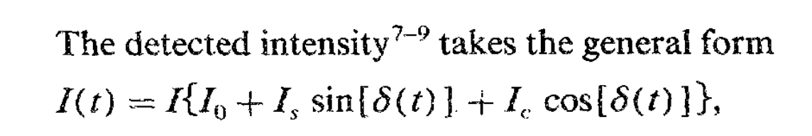
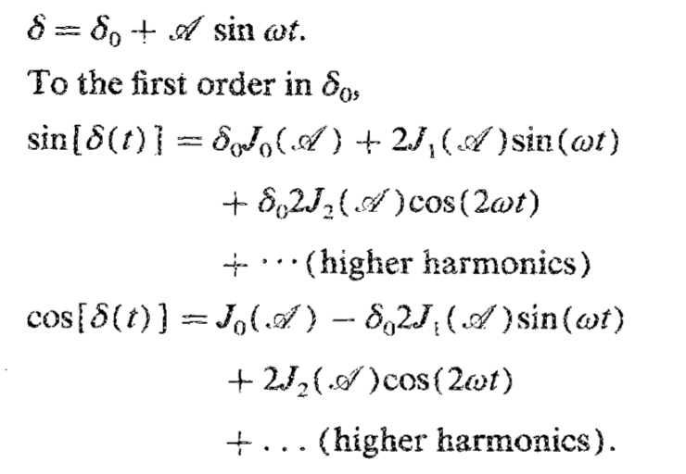
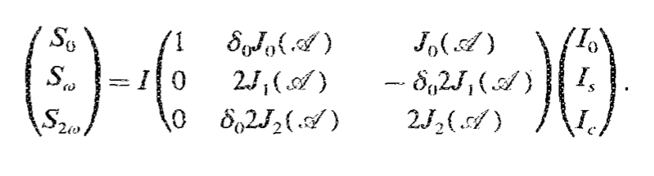
PEM: principle for polarimetry
Intensity modulation on Photodetectors
Static birefringence
Harmonic contribution may also be required
O. Acher et al., Rev. Sci.lnstrum. 60 (1989) 65
Characteristic bessel expansion
More harmonics may be used

Slide 22
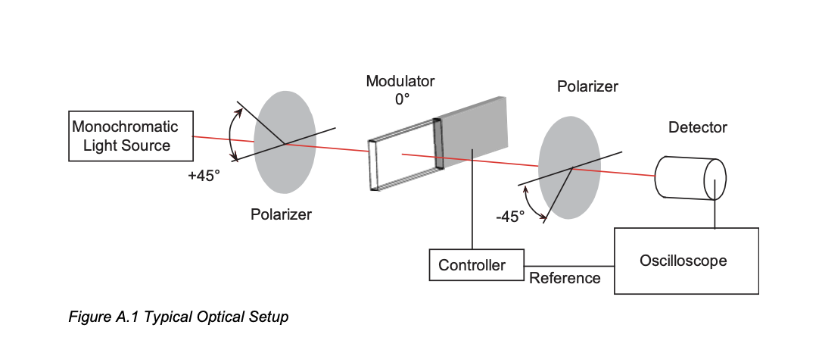
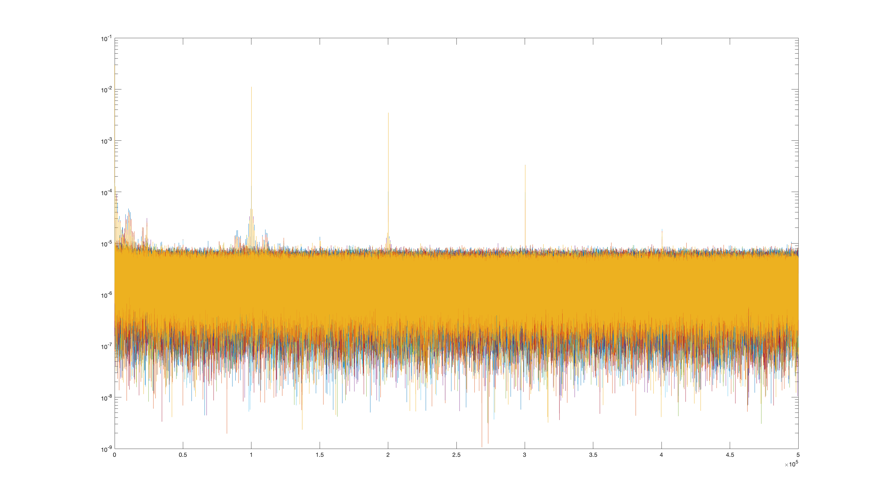
PEM calibration setup
https://www.hindsinstruments.com/products/photoelastic-modulators/pem-200/
2f
4f
6f
Acquire waveforms and then DFT
Simulation w/ measured intensity noise

Slide 23
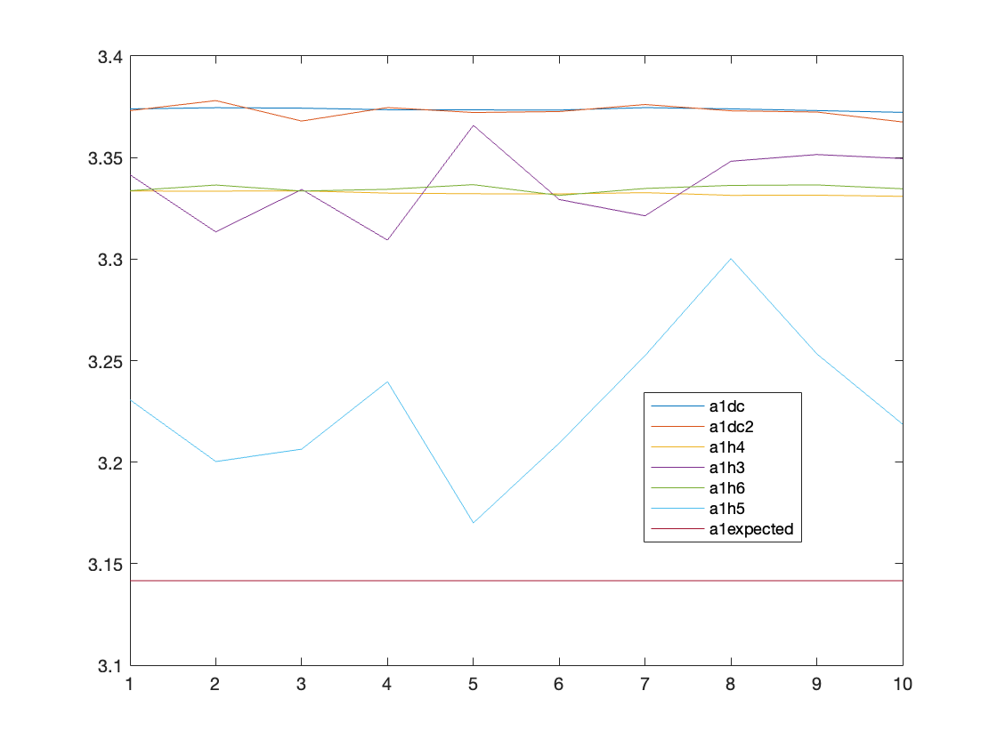
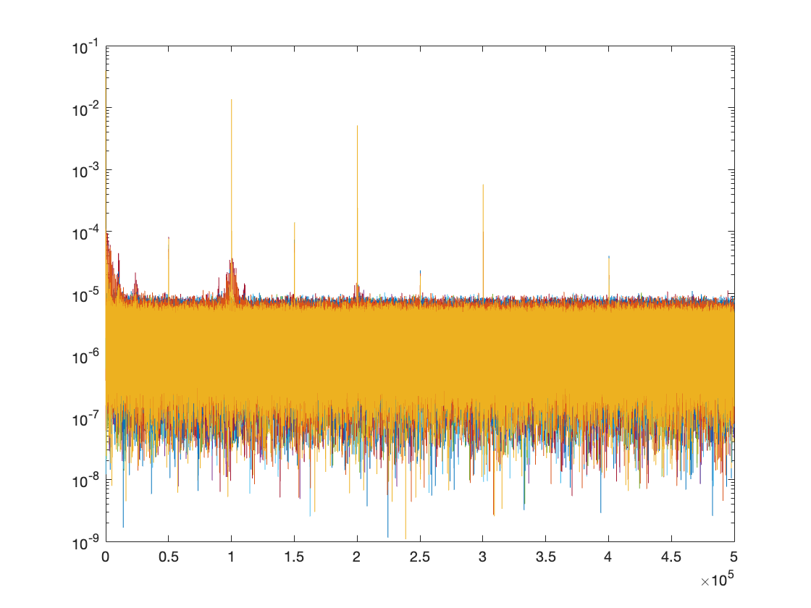
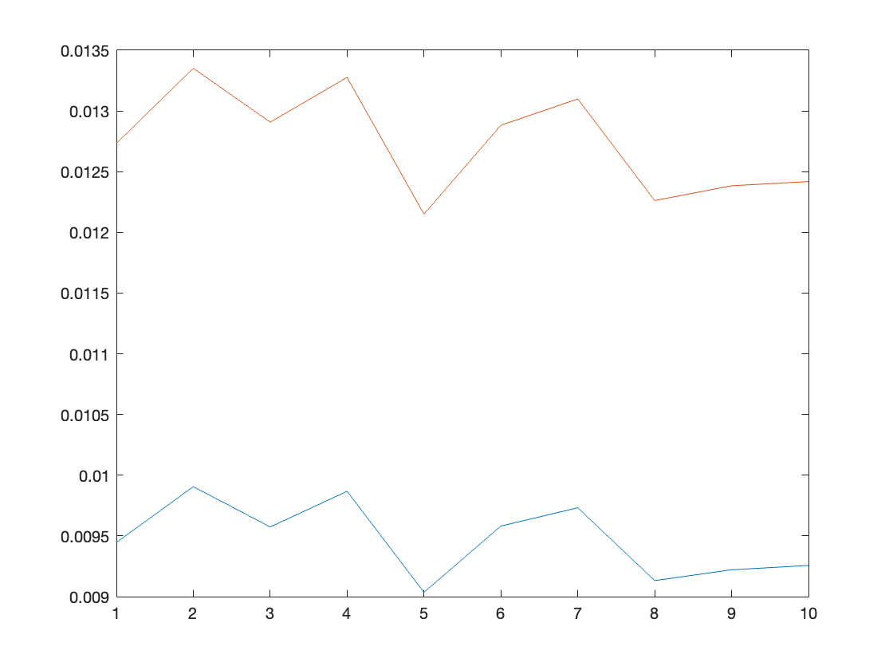
Data
A1 precision (repeatability) ~0.03%
Accuracy comparing h4/h2 and h2/dc ~ 1%
Accuracy of calibration (?) ~ 6%
A0, red: using extracted a1 (h4/h2)
Blue: using expected a1
Sign of a drift… why ???

