Slide 1

SLD Compton Polarimeter
Mike Woods / SLAC Laser Safety Officer
FCC EPOL Workshop 19-30 September 2022 at CERN

Slide 2
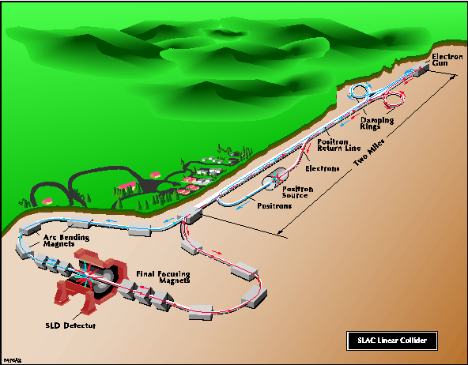
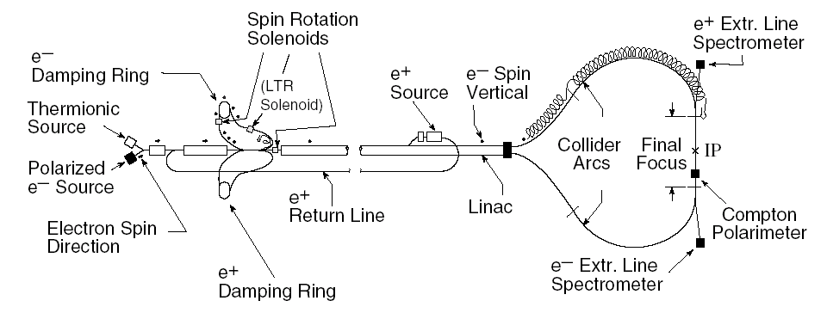

SLD Experiment at the SLAC Linear Collider, 1992 -1998

Slide 3
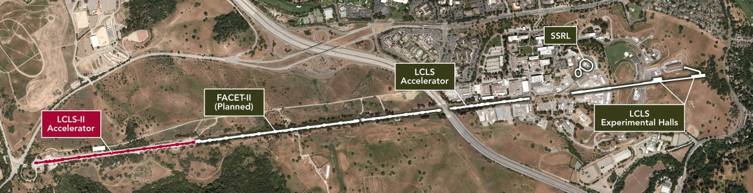
SLAC’s Linear Accelerator Facility
SLD
FACET-II
LCLS Accelerator (and FACET-II) operate at 120 Hz
LCLS-II Accelerator operates at 1 MHz
First x-ray light from LCLS-II beam to Experimental Halls scheduled for early 2023

Slide 4
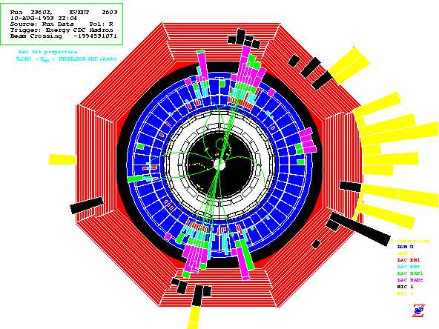
A_{LR} Measurement at SLD
Simple Counting Experiment
  can use all final states (no particle ID)
  no kinematic reconstruction
  no need to distinguish fermion from
anti-fermion
  no final state interaction effects
Simple Cuts to select hadronic Z events
    Energy imbalance < 0.6
    >22 GeV energy in calorimeter
    3 or more charged tracks

Slide 5
SLD A_{LR} Result and Systematics
 | 1992 | 1993 | 1994-5 | 1996 | 1997-8
Polarimetry | 2.7% | 1.3% | 0.64% | 0.50% | 0.50%
Energy Scale | - | - | 0.33% | 0.37% | 0.39%
Chromatic Effects | - | 1.1% | 0.17% | 0.16% | 0.15%
Bkg., detector,… | 2.4% | 0.1% | 0.06% | 0.05% | 0.07%
Total Systematic | 3.6% | 1.7% | 0.75% | 0.63% | 0.64%
Statistics | 44% | 4.3% | 2.8% | 3.7% | 1.6%
A_{LR} Statistics and Systematic Errors

Slide 6
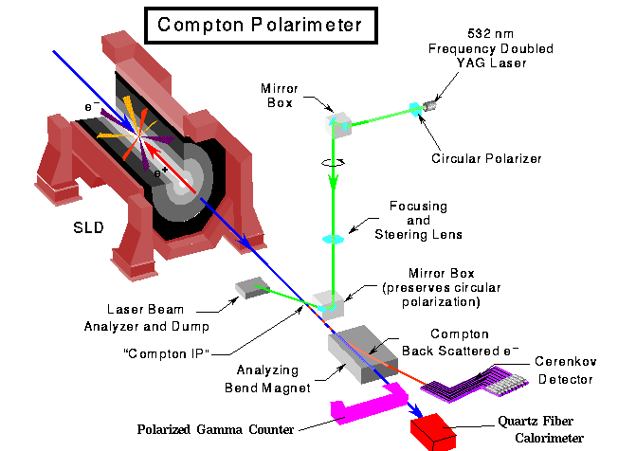
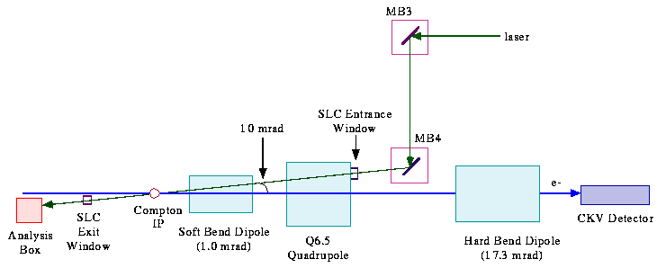
SLD Compton Polarimeter

Slide 7
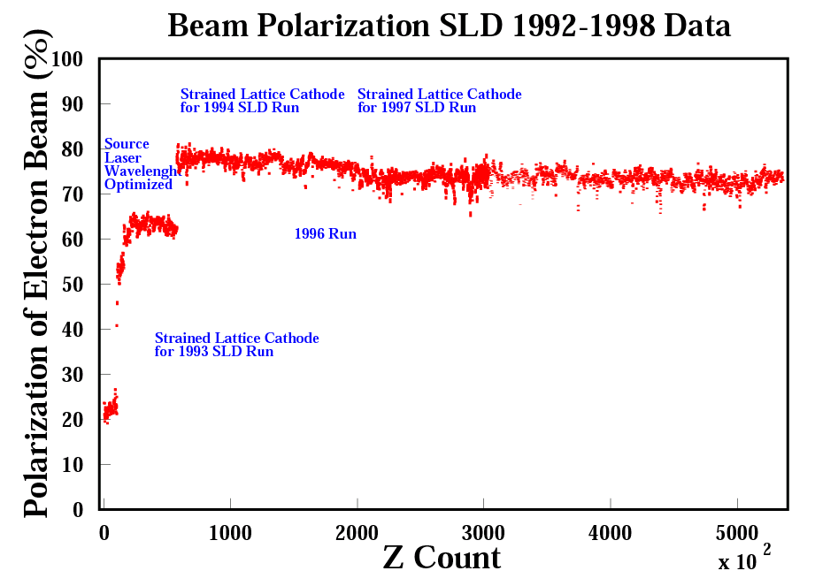

Slide 8
Features of SLD Compton Polarimeter
Physics is well understood QED; radiative corrections <0.1%
  no atomic or nuclear physics corrections (ex. Levchuk effect in Moller polarimetry)
  reference for O(α³) corrections: M. Swartz, Phys.Rev.D58:014010,1998
Electron beam backgrounds measured with laser off pulses
Polarimetry data taken parasitic to physics data (electron detector only)
Scattering rate is high; ~1% polarization determination in a few minutes
Laser helicity selected with a pseudo-random sequence
Laser polarization determined to 0.1%
Beam-beam depolarization effects can be measured by
comparing measurements with and without collisions

Slide 9
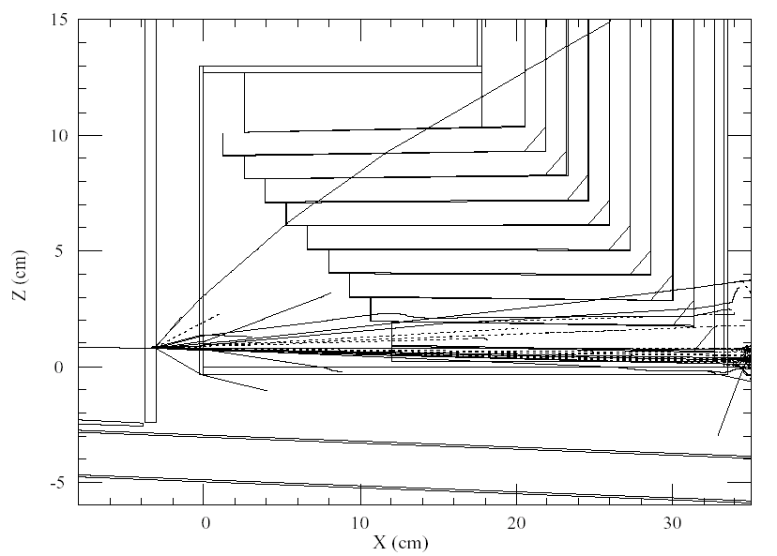
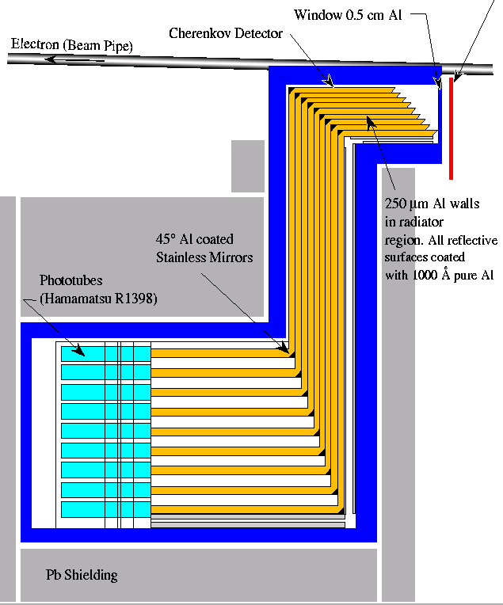
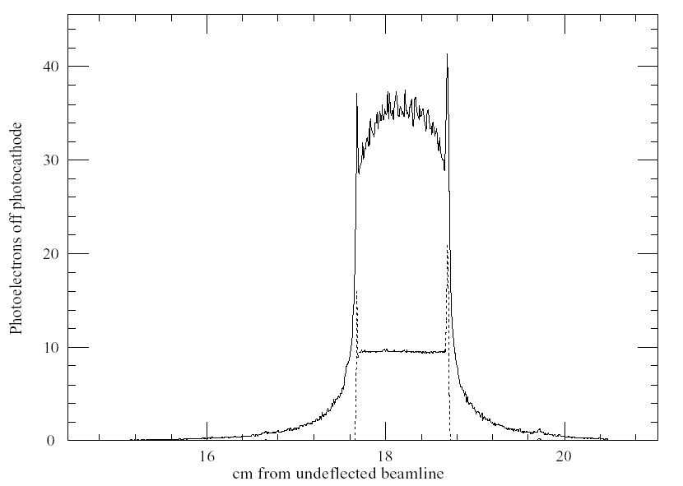
Electron Cherenkov Detector (CKV)
8mm Pb radiator
EGS4 simulation for shower from 1 electron
Gas is propane at 1atm; 11 MeV threshold
EGS-generated response function for CKV-7, with (solid line)
and without (dashed line) 8mm lead pre-radiator.

Slide 10
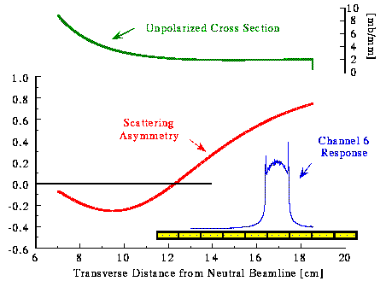
Compton Scattering Kinematics
The cross section for Compton scattering is
where
The measured asymmetry in a channel is
Where the analyzing power is calculated from the Compton
Cross section and the channel response function, R_{i}.

Slide 11
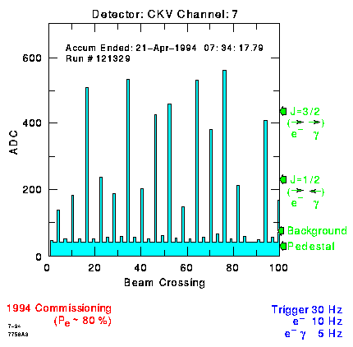
Raw Data from CKV Detector (during e- only running)

Slide 12
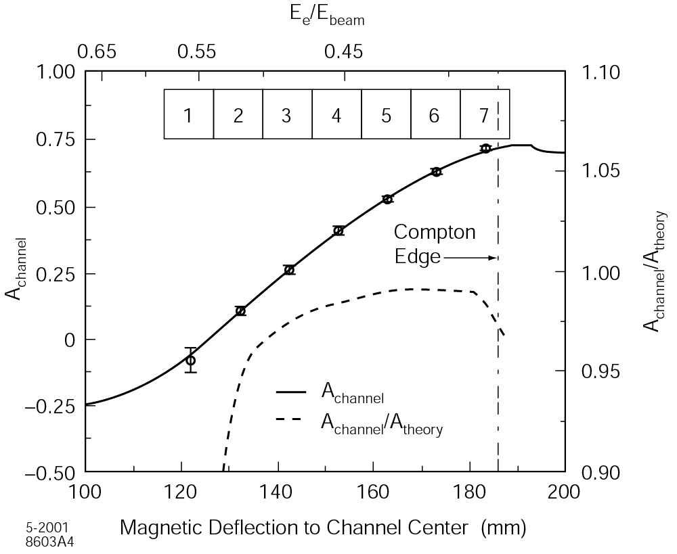
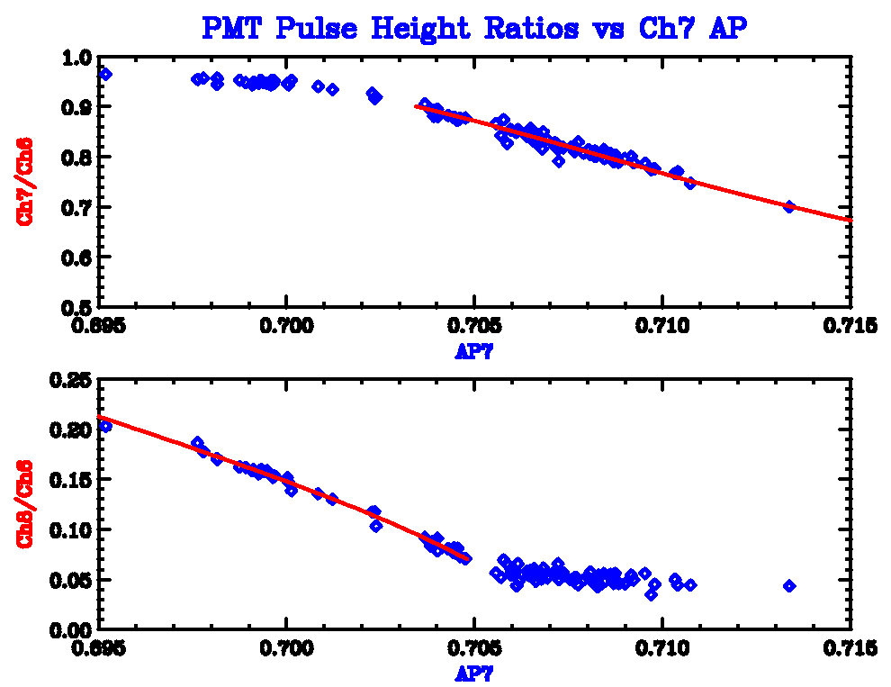
CKV Analyzing Power Determination (Table Scans)
Detector resolution modifies theoretical analyzing
power by <2% for CKV7 at Compton Edge
  11 MeV detector threshold ensures EGS-based
simulation is reliable
Table scans sweep detector channels thru Compton Edge
  done daily
  give spectrometer calibration, locate Compton edge,
track detector channel gains
  determine CKV7 analyzing power to 0.2%
Use pulse height ratios for CKV7/CKV6 and
CKV8/CKV6 to track analyzing powers
between table scans. Resulting uncertainty
in CKV7 AP is 0.3%.
References: SLD Physics Note 50;
E. Torrence Ph.D. thesis, SLAC-Report-509.

Slide 13
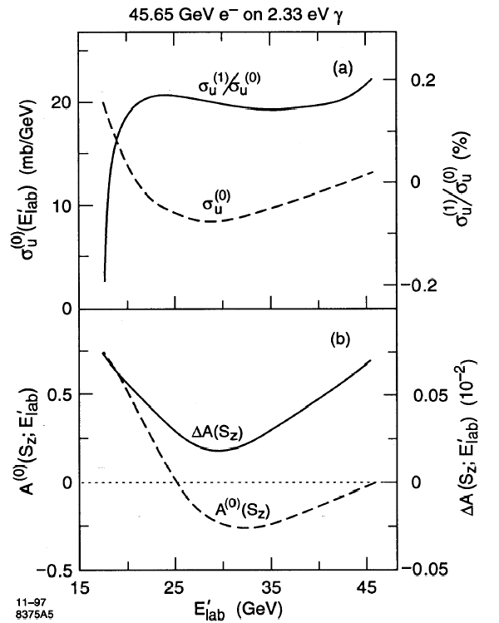
Radiative Corrections to Analyzing Powers
1st-order (α³) corrections
<0.2% corrections to cross section
<0.1% correction to analyzing power
at Compton Edge
See M. Swartz, Phys. Rev. D58, 014010 (1998)

Slide 14
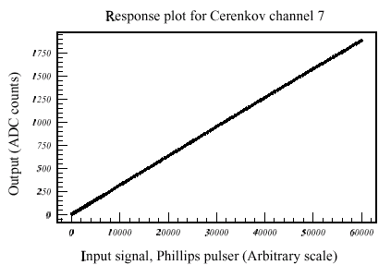
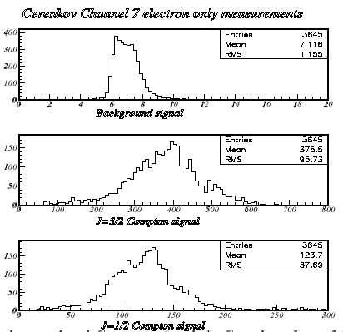
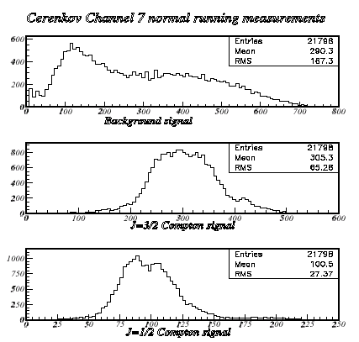
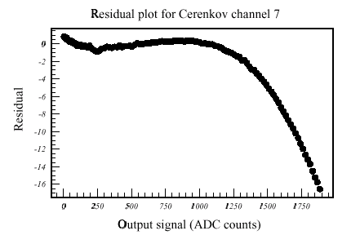
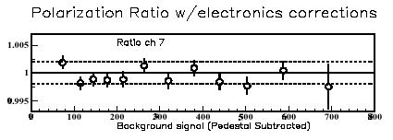
CKV Linearity
Compton asymmetry measured as a
function of background level
Electronics linearity measured
with pulser
0.2% linearity systematic

Slide 15
Compton Laser System in Laser Room
λ/2
plate
Spectra Physics GCR-130
Remote Intensity Control
Remote Steering,
Focusing Control
λ/2
plate
Polarizer
Polarizer
Laser
Photodiode
L,R
Photodiodes
CCD Camera
Calcite Prism
λ/4
plate
Laser
Transport Line
Polarizer
PS
CP
Pockels Cells
Intensity
Photodiode
Remote Polarization Control

Slide 16
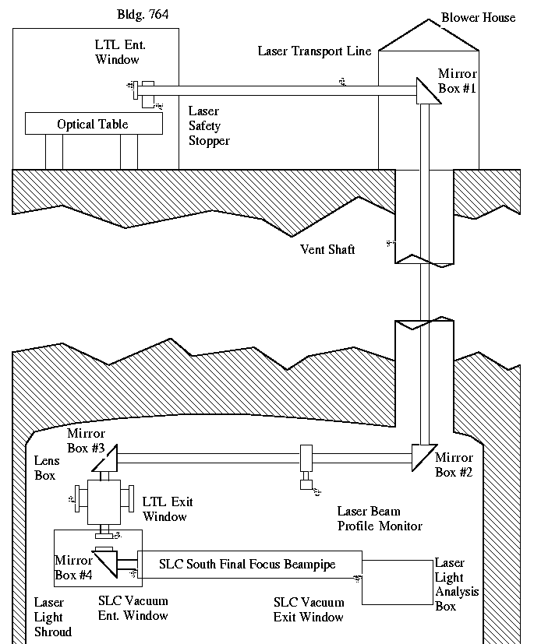
Compton Laser Transport System
40 meters from laser to Compton IP
Each Mirror Box has 2 helicity-compensating mirrors
Transport line operates at +3psi nitrogen
Laser focused to ~0.5mm rms at Compton IP
  (50mJ in 7ns FWHM pulse)

Slide 17
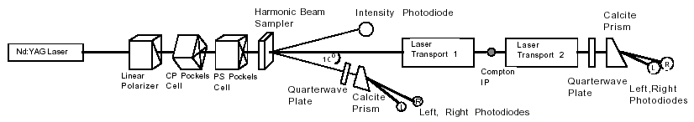
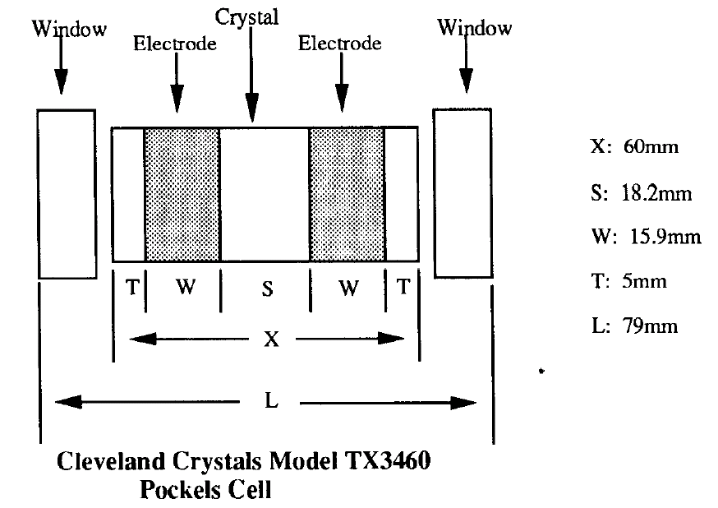
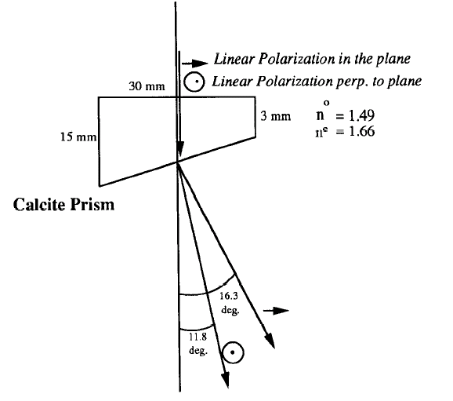
Laser Polarization Control and Analysis
Pockels Cell used for CP, PS
Calcite Prism used in Helicity Filter

Slide 18
Laser Polarization Control
Electric Field Vector after PS Cell
in Jones Matrix notation
Remote Polarization Control
Polarizer
PS
CP
Pockels Cells
Stokes parameters
for laser polarization:
Allow for imperfect Pockels cells and
phase shifts in downstream optics

Slide 19
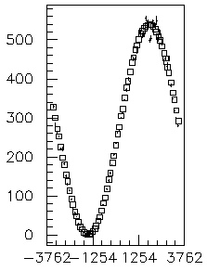
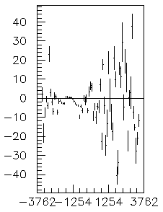
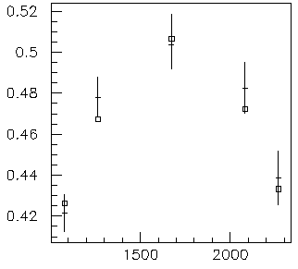
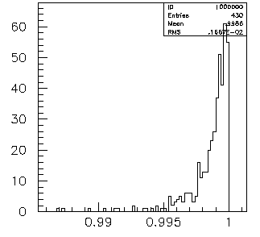
Laser Polarization Scans and the laser polarization systematic error
LPSCANS
done once per hour; readout photodiodes only
ability to extinguish laser light after Helicity Filter
determines polarization purity
Abox PD (adc counts)
Residuals (adc counts)
CP Voltage (Volts)
CP Voltage (Volts)
ESCANS
monitor phase shifts in laser
Polarization with continuous
Pockels cell scans
only 1/3 of data is at
nominal voltages
CKV7 Raw Asymmetry
Laser Polarization at Compton IP (%)
CP Voltage (Volts)
0.1% systematic error

Slide 20
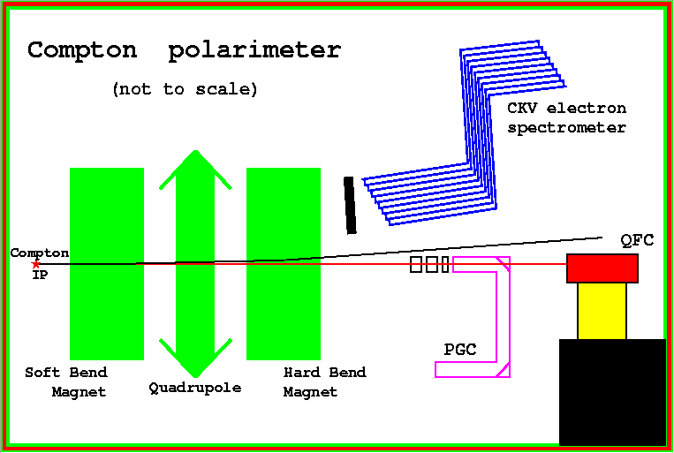
Photon Cross-check Polarimeter Detectors
Insertable
Pb pre-radiators
PMT
24 PMTs
PGC (polarimeter gamma counter) - threshold gas (14 MeV; 1 atm ethylene) Cherenkov counter
- insertable lead pre-radiator; 1 PMT
QFC (quartz fiber calorimeter) - quartz fibers with tungsten radiators; 0.2 MeV threshold
(34 longitudinal sections, each 1 radiation length)
- 24 PMTs (10X, 10Y, SUMX, SUMY, 2 Bkgd)

Slide 21
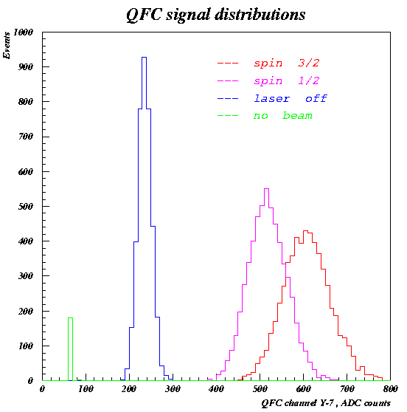
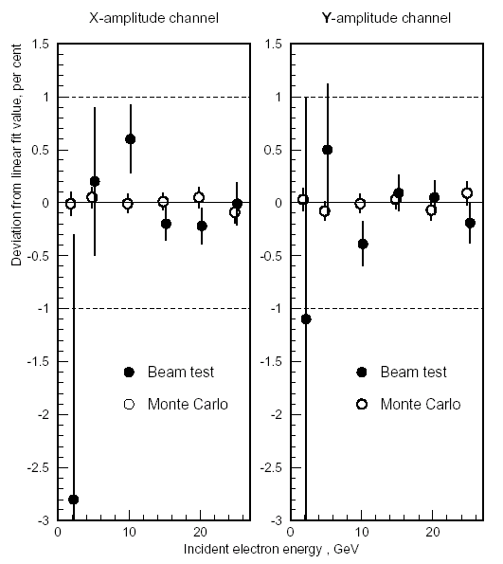
QFC Data and Systematics
Systematic | Error | Method
Energy Response | 0.2% | Beam test, MC
Detector non-uniformity | 0.3% | Beam test, MC
Detector mis-alignment | 0.1% | Beam test, MC
Angular acceptance, beam size | <0.1% | MC simulation
Optical cross talk | <0.1% | Measurement, MC
Re-scattered electrons | <0.1% | MC, in situ study
Electronics linearity | 0.5% | LED study, beam test
Electronics cross-talk | 0.1% | In situ study
Laser pickup | 0.1% | In situ study
Total | 0.6%
D. Onoprienko, SLD-Note-267, 1999
and Ph.D. thesis, SLAC-Report-556, 2000

Slide 22
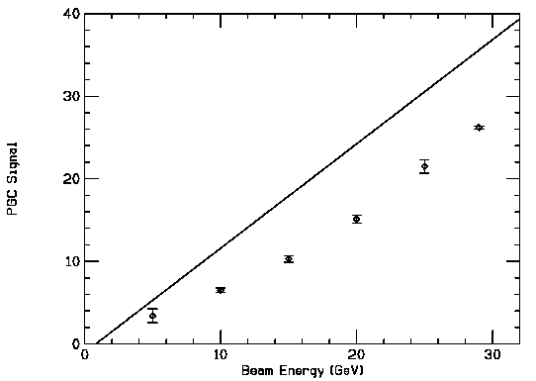
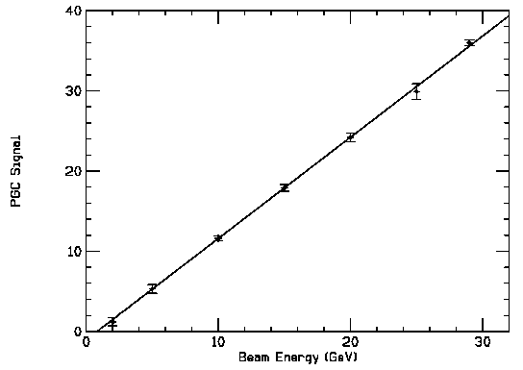
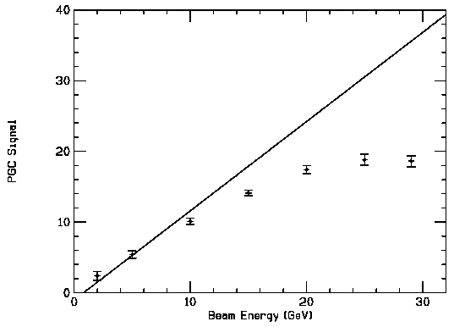
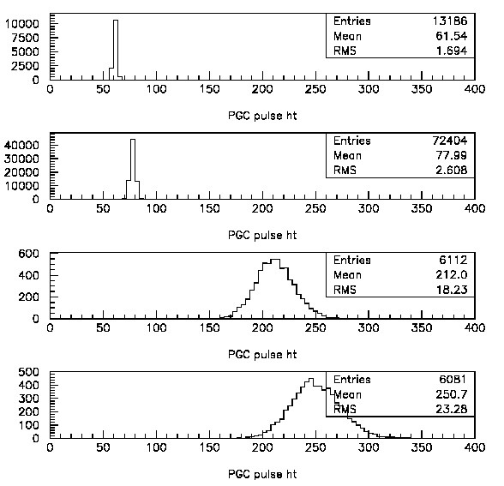
PGC Data and Systematics
T-410
0.5” Pb
T-410
1.0” Pb
T-410
1.5” Pb
No e⁻
Systematic | Error | Method
Energy Response | 0.5% | Beam test, MC
Detector effects (uniformity, geometry, linearity) | 0.3% | In situ study
Laser pickup | 0.1% | In situ study
Total | 0.6%
e⁻, no laser
J_{z} = 1/2
J_{z} = 3/2
PGC analysis described in R. Frey, SLD-Note-266, 1999
and IEEE Trans. Nucl. Sci. 45, 670, 1998
SLC data with e⁻ only, 1” Pb

Slide 23
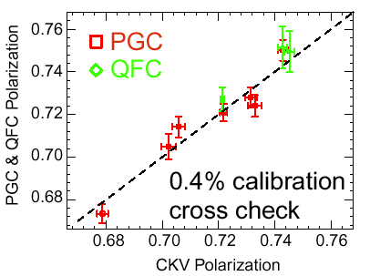
Analyzing Power Systematic Error
CKV7 systematic error in analyzing power estimated at 0.3%
from table scan data that determines location of Compton edge
and accuracy of modeling detector response function
Results from cross-check Polarimeters
Residual of CKV7 polarization to results from
PGC and QFC was ΔP/P=(0.30±0.39)%.
0.4% AP systematic error

Slide 24
Polarization Summary for all SLD Runs
 | 1992 | 1993 | 1994/95 | 1996 | 1997/98
Lum-wted Polarization | 22.4 ± 0.6 % | 63.0 ± 1.1% | 77.23 ± 0.52 % | 76.16 ± 0.40 % | 72.92 ± 0.38 %
Systematic | 1992 | 1993 | 1994/95 | 1996 | 1997/98
Laser Polarization | 2.0% | 1.0% | 0.2% | 0.1% | 0.1%
Detector Linearity | 1.5% | 0.6% | 0.5% | 0.2% | 0.2%
Analyzing Power | 1.0% | 0.6% | 0.3% | 0.4% | 0.4%
Laser Pickup | 0.4% | 0.2% | 0.2% | 0.2% | 0.2%
Lum-wting Correction | 0.2% | 1.1% | 0.17% | 0.16% | 0.15%
TOTAL | 2.7% | 1.7% | 0.67% | 0.52% | 0.52%
Ph. D. Students: R. Elia, SLAC-Report-429, 1994; R. King, SLAC-Report-452, 1994
A. Lath, SLAC-Report-454, 1994; T. Junk, SLAC-Report-476, 1995
E. Torrence, SLAC-Report-509, 1997; J. Fernandez, SLAC-Report-519, 1999
P. Reinertsen, SLAC-Report-537, 1998; D. Onoprienko, SLAC-Report-556, 2000.

Slide 25
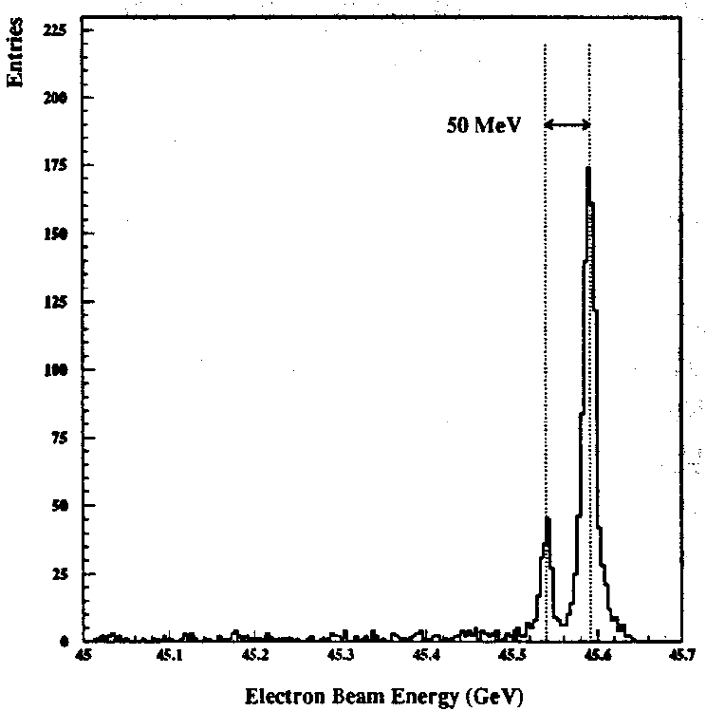
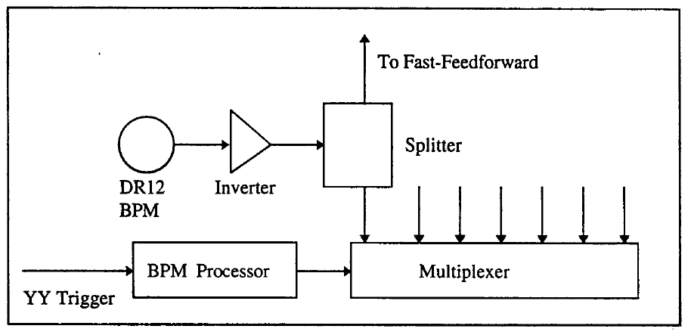
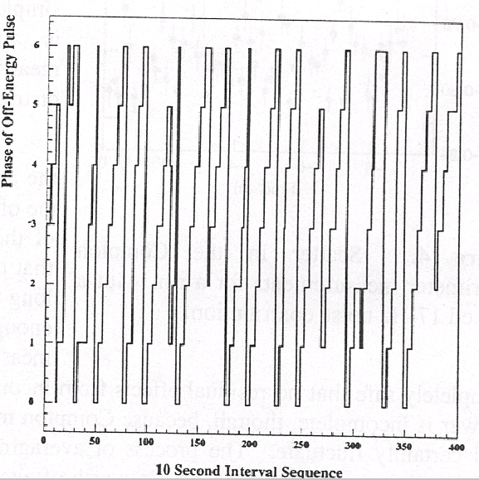
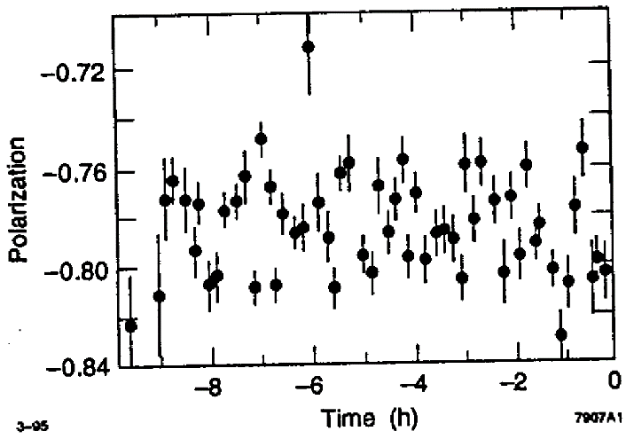
“17 Hz Problem” in the 1994 Run
Reflection from inverter (added due to BPM miswiring in downtime)
causes every 7th pulse to be off-energy
Observe i) phasing of off-energy pulse wrt laser pulse shifts every 40s
ii) large scatter in electron polarization measurements
Implemented triggering of laser on 6th machine pulse rather than the 7th
every ~10 seconds, to ensure beam
backgrounds for laser off pulses identical
to beam backgrounds for laser on pulses.

Slide 26
Arc Spin Rotation
Spin precession in the SLC arc is nearly resonant
with vertical betatron oscillation
1. Vertical betatron oscillation in a quadrupole string
electron trajectory
axis perpendicular
to trajectory
2. Vertical betatron oscillation with horizontal dipoles added
Spin
SLC arc consists of 23 achromats.
Each achromat
  20 combined function magnets
  Spin precession of 1085⁰
  Betatron phase advance of 1080⁰
SLC arc spin bumps
  Launch into arc with electron spin vertical
  Two orthogonal ‘spin bumps’ allow arbitrary control
  Optimize spin bumps to minimize total precession in
  the arcs reducing polarization dependence on energy

Slide 27
Luminosity-weighted Beam Polarization
1. Chromatic Effect
- determine n(E) from automated wire scans (every 4 hours) at point of high dispersion
  P(E) by varying beam energy (optimize spin bumps to minimize)
  L(E) from optics models and measured dependence of Z production on beam energy
  ξ=(+0.12 ± 0.08)% for 1997/98 Run
Spin Diffusion
- incoming beam divergence
- disruption angles
  ξ=(-0.24 ± 0.08)% correction for 1997/98 run
Depolarization due to beamstrahlung spin flip
- expect effect to be <0.1%
- effect measured to be <0.001 by comparing polarization measurements with and
  without positrons present
  ξ=(0.0 ± 0.1)%

Slide 28
Summary
  0.5% precision achieved
  CKV table scans + laser Pockels Cell voltage scans for optimization, calibration + determining systematics
  many systematic checks performed (e.g. with QFC and PGC detectors)
  enabled SLD’s precise parity violation measurements
  data taken parasitic to physics data
  some dedicated beam time needed for systematics studies
  polarimeter measures average beam polarization, so need to address luminosity-weighted polarization
  many details are in references given, including 8 Ph.D. theses

