Slide 1
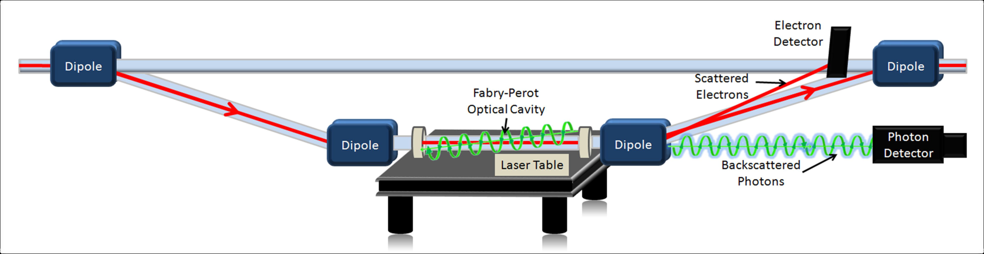
Compton Polarimetry at Jefferson Lab
Dave Gaskell
Jefferson Lab
FCC EPOL Workshop
September 19-30, 2022

Slide 2
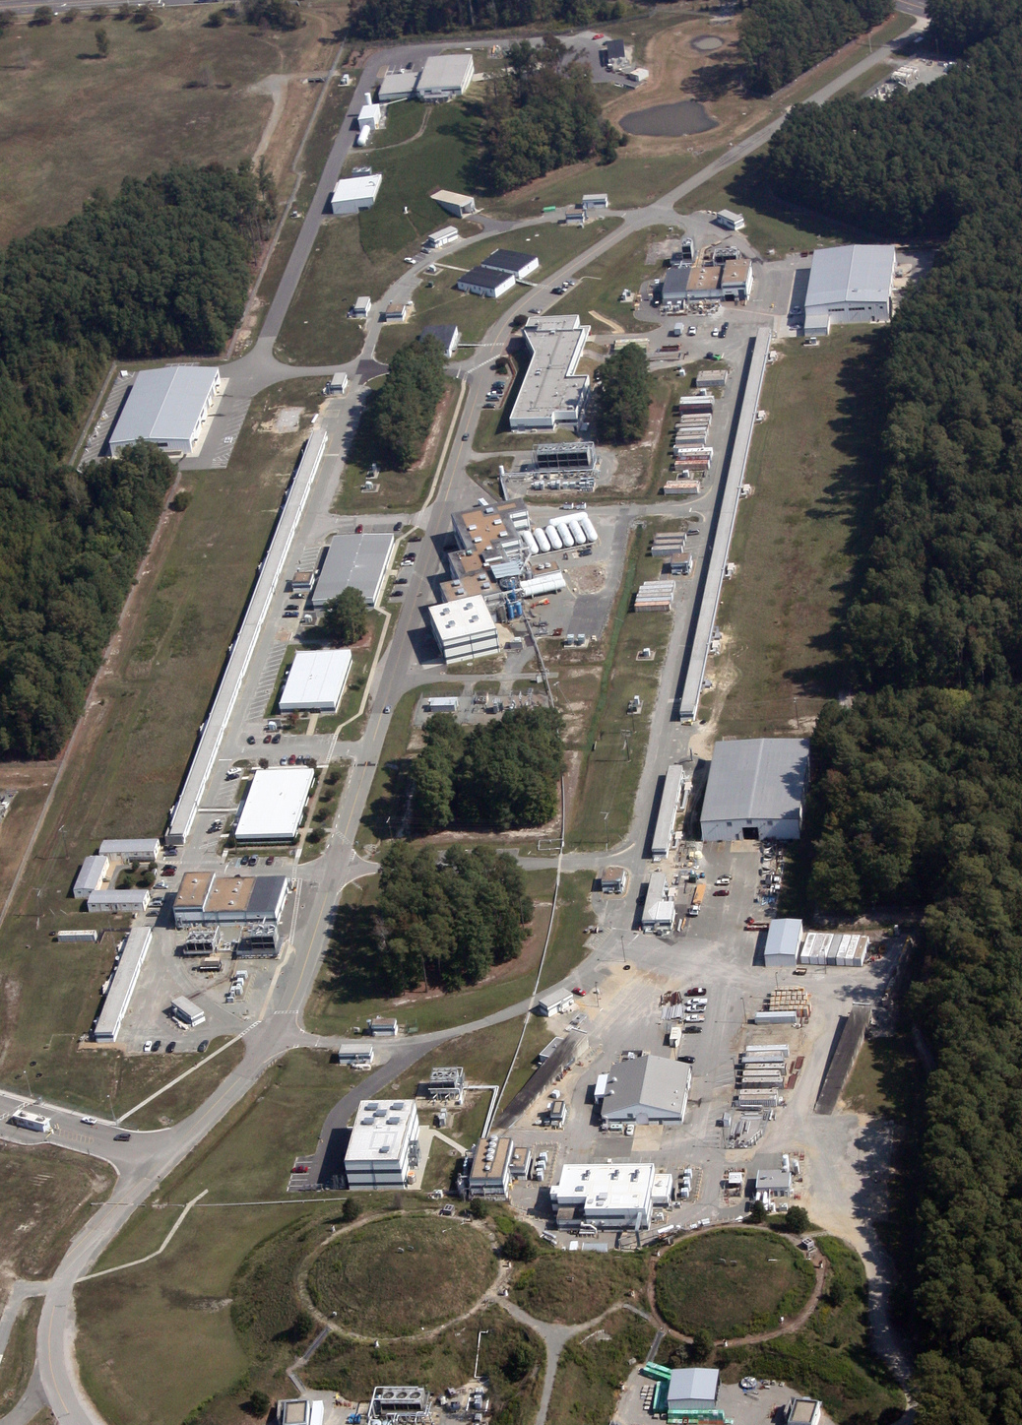
Jefferson Lab Polarimetry Map
E_{beam}=1-12 GeV
I_{beam} ~ 100 μA
P=85-90%
D
Hall C
Compton Polarimeter
Installed 2010 (Q-Weak)
Møller Polarimeter
Out of plane saturated iron foil
Injector
5 MeV Mott Polarimeter
Hall A
Compton Polarimeter
IR → Green laser
Møller Polarimeter
In plane, low field target → out of plane saturated iron foil
Injector
Hall B
Møller Polarimeter
In plane, low field target
A
B
C

Slide 3
Compton Polarimeter Overview
h
L
Halls A and C have similar but not identical Compton polarimeters
Both designed for measurement of longitudinal polarization
Common layout → 4-dipole chicane to deflect electrons to laser system and back to nominal beam path
Hall A Compton built as part of original Hall A beamline (1998 first use) by Saclay/JLab
Hall C Compton built in 2010 by JLab/MIT/UVa/Manitoba/Winnipeg/William and Mary
Dimensions:
  Hall C: Overall length: L=11 m. Vertical deflection: originally h=57 cm (6 GeV), now h=12 cm (11 GeV)
  Hall A: Overall length: L=15 m. Vertical deflection: originally h=30 cm (6 GeV), now h=21.5 cm (11 GeV)

Slide 4
Compton Polarimeter Subsystems
Laser – both Hall A and Hall C use Fabry-Perot cavities to store >1 kW of laser power
  Hall A: Originally used 1064 nm narrow linewidth laser alone. Later upgraded to a frequency-doubled (532 nm) system → modest input power (up to 1 W), high Finesse cavity
  Hall C: Started with 532 laser (Coherent Verdi) → higher input power (10 W), modest Finesse cavity
Photon detector
  Hall A: started with multi-channel lead-tungstate detector. Now use GSO (low energy) or ”single channel” lead-tungstate in integrating mode
  Hall C: lead tungstate, integrating mode
Electron detector
  Hall A: silicon strip, Hall C, diamond strip
  Both will be upgrading detectors to larger area diamond strip

Slide 5
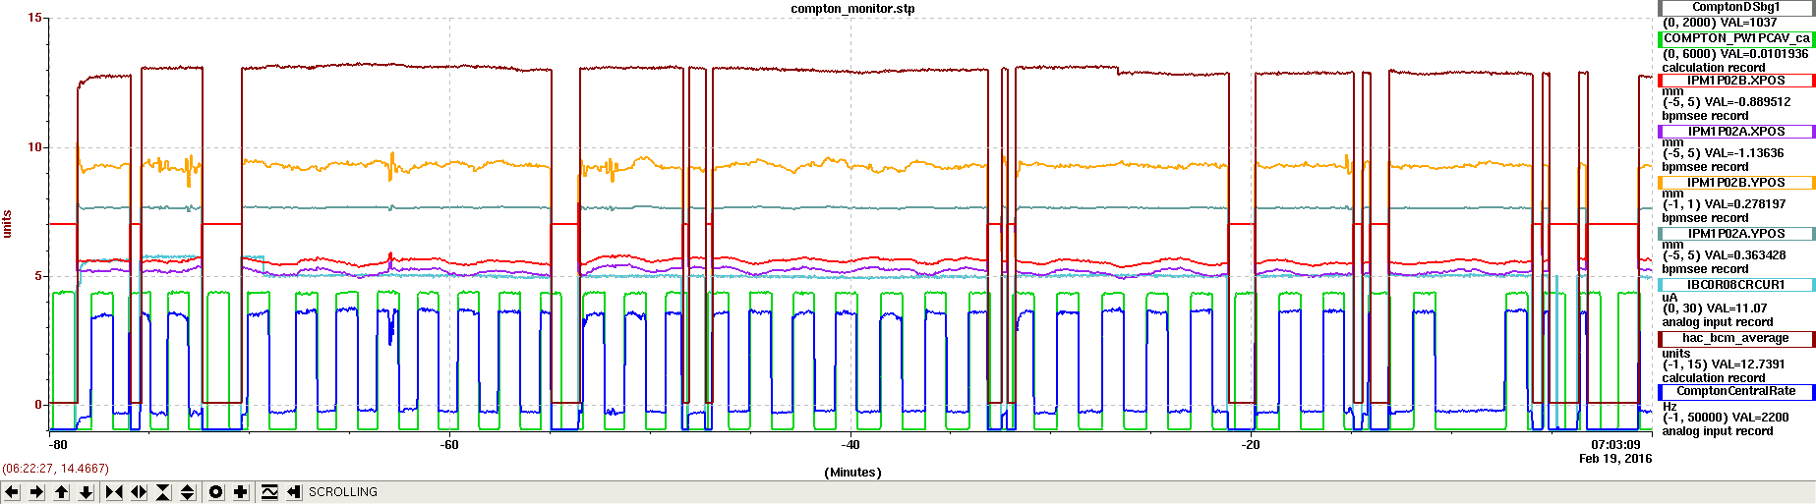
Compton Operation Mode
Beam current
Beam positions
Photon detector rates
Laser locks and unlocks regularly to allow measurement of backgrounds
Backgrounds highly dependent on beam quality
Sometimes extensive tuning is required to achieve good backgrounds – dominant background from beam interaction with apertures in beamline

Slide 6
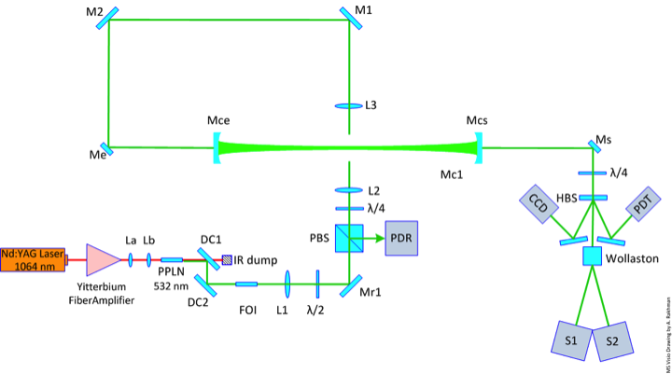
Hall A Laser System
Main components:
Narrow linewidth 1064 nm seed laser
Fiber amplifier (>5 W)
PPLN doubling crystal
High gain Fabry-Perot cavity
Polarization manipulation/monitoring optics
Properties:
1 W laser power from doubling system
Mirror reflectivity > 99.98%
Cavity finesse >=13,000
Stored power 2-10 kW

Slide 7
Hall C Laser System
Key differences with Hall A system:
Higher power green laser → 10 W (Coherent VERDI)
Large linewidth (1 MHz) means laser can’t be used with narrow linewidth cavity
Cavity mirrors = 99.5%
Cavity gain = 200, stored power ~ 1.7 kW
Drawbacks:
1.7-2 kW is the ultimate upper limit without increasing laser power
At 10 W, already ran into issues with distortion of beam shape when used with optical components
Apparent thermal effects became significant towards end of Q–Weak run – possible damage to vacuum windows or mirrors
Will replace Hall C system with one similar to Hall A → higher powers, better reliability

Slide 8
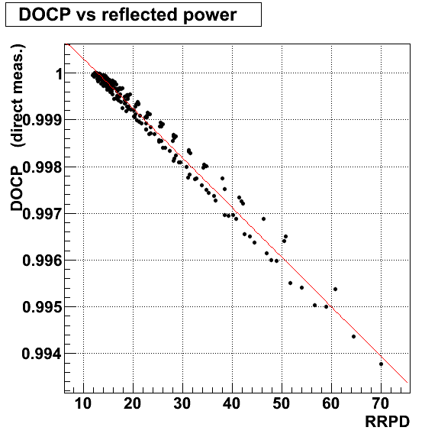
Polarization Measurement and Cavity Birefringence
Both Hall A and C mitigate impact of birefringence due to vacuum entrance window (and other elements) by monitoring light reflected back from cavity when unlocked
Leverages optical reversibility theorems: J. Opt. Soc. Am. A/Vol. 10, No. 10/October 1993, JINST 5 (2010) P06006
Birefringence in cavity cannot be ignored – resulted in non-negligible effects in Hall A
Circular polarization at cavity entrance
Measurements of cavity birefringence
Hall A
x
x
F. Bielsa et al. Appl. Phys. B (2009) 97: 457

Slide 9
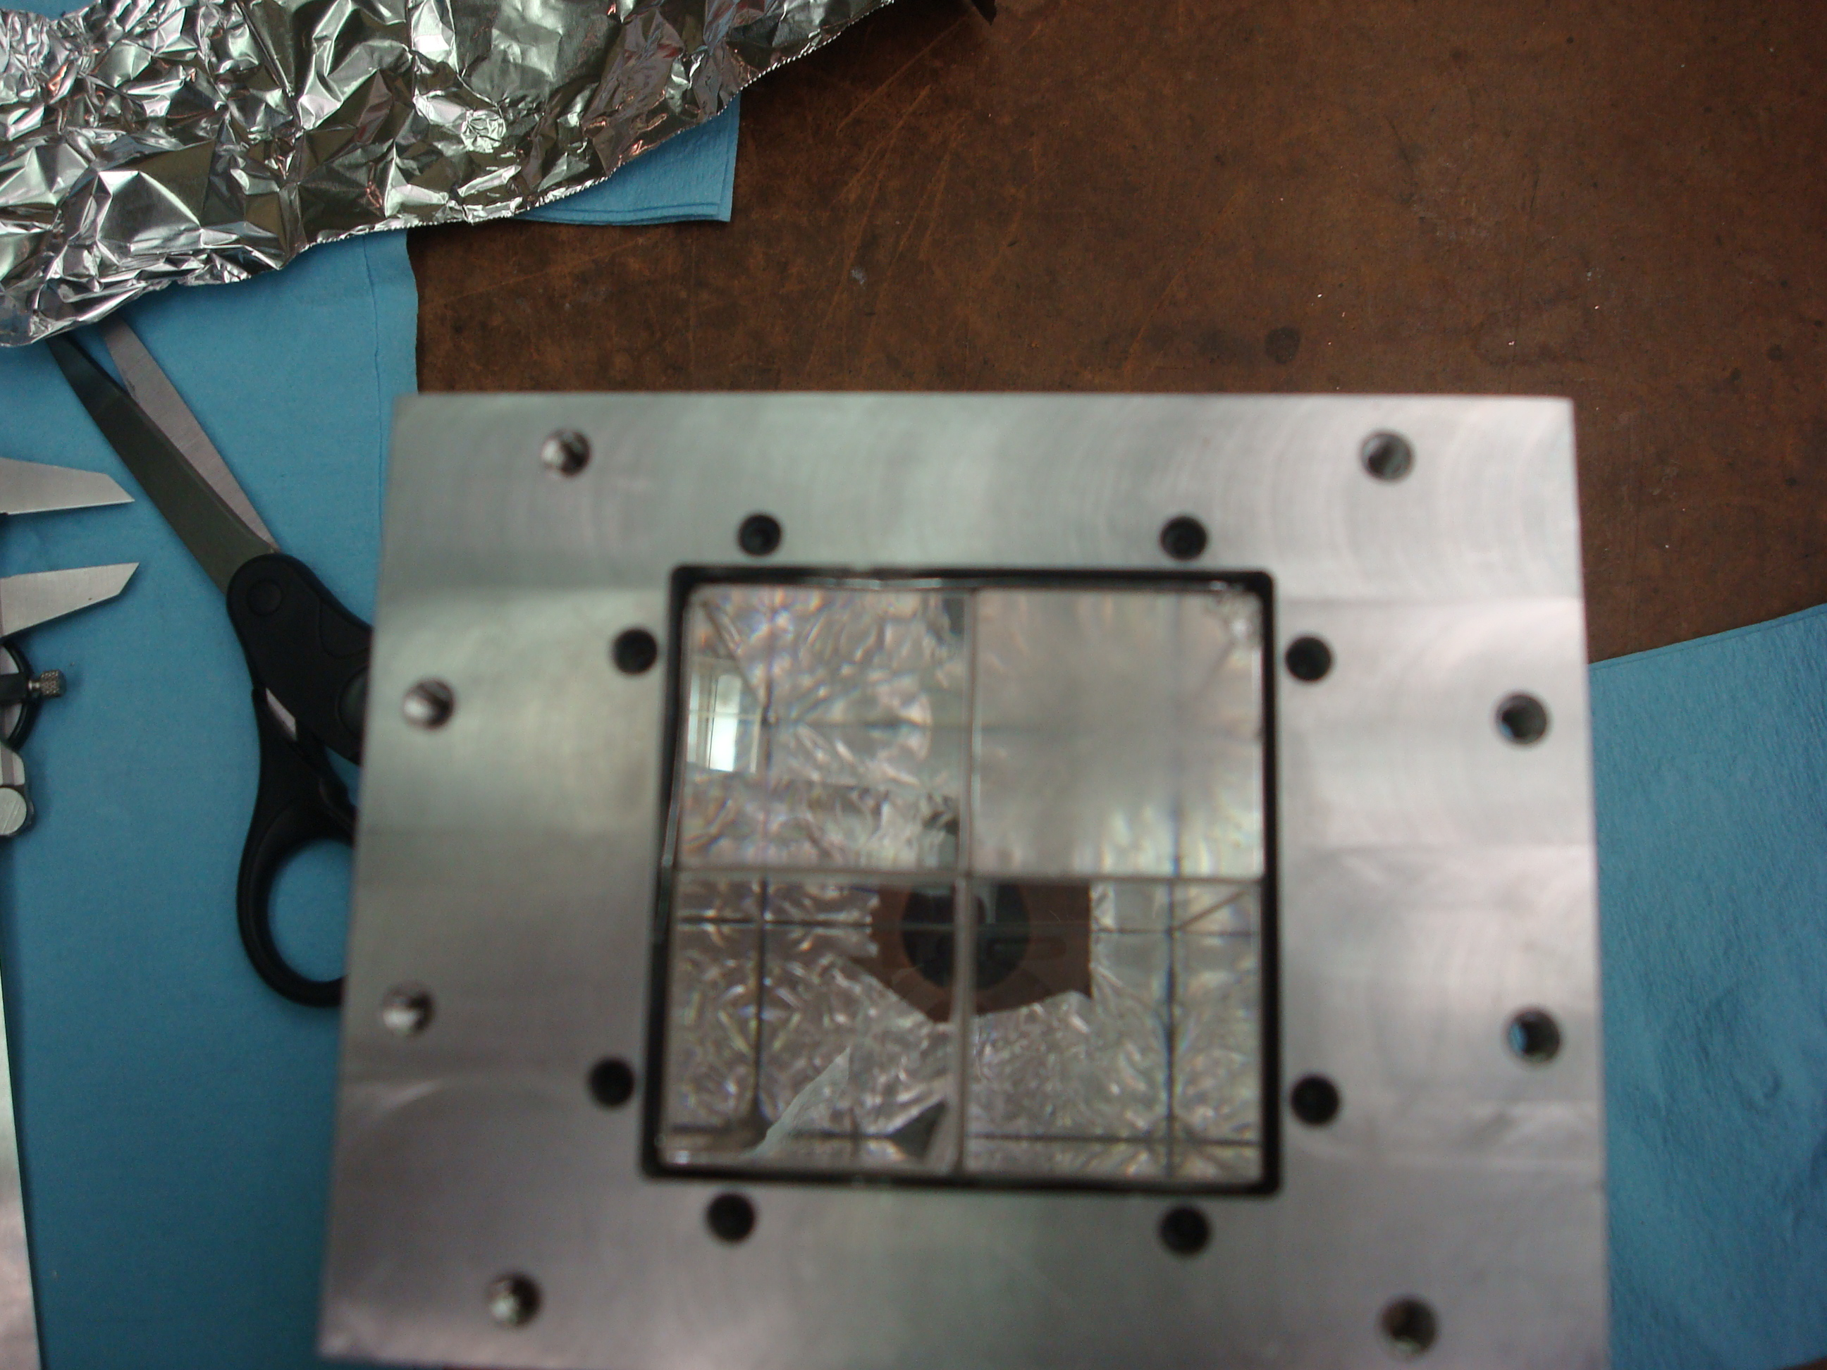
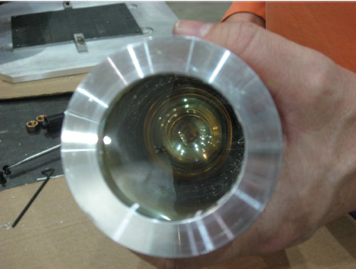
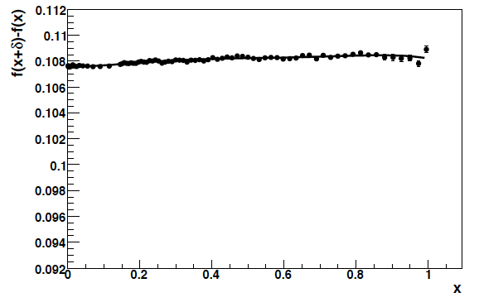
Photon Detectors
Hall A originally extracted polarization by fitting asymmetry vs. energy using lead-tungstate detector
→ Carnegie-Mellon group suggested measured energy-weighted asymmetry – asymmetry integrated over helicity window
Same technique used in Hall C
No threshold, so analyzing power well understood
Less sensitive to understanding detector resolution
Understanding detector non-linearity over relevant range of signal size most significant challenge → LED pulser system
Lead-tungstate – high energy
Linearity measurement
GSO - low energy

Slide 10
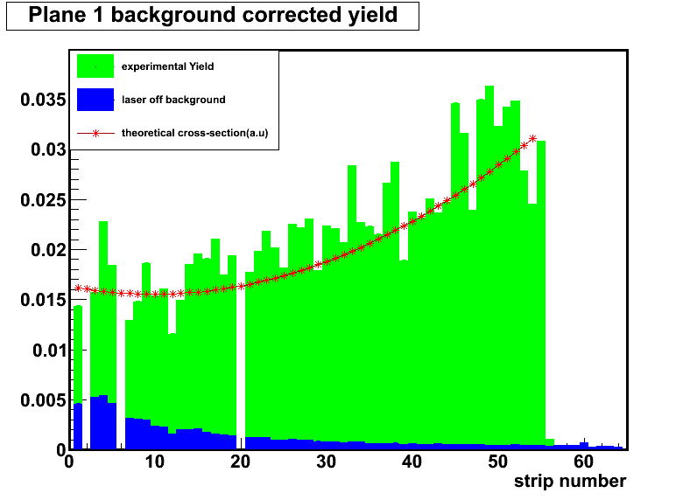
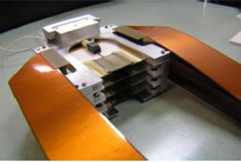
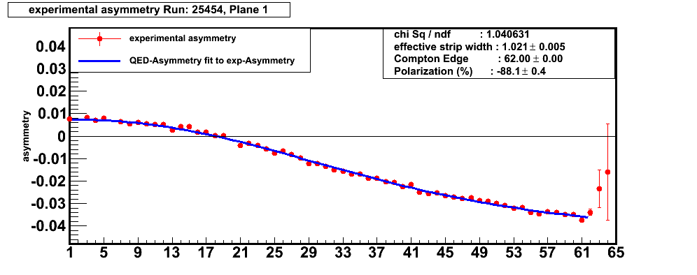
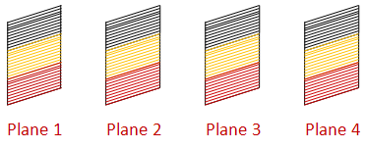
Hall C Compton Electron Detector
Diamond microstrips used to detect scattered electrons
Four 21mm x 21mm planes each with 96 horizontal 200 μm wide micro-strips.
Rough-tracking based/coincidence trigger suppresses backgrounds
Detector inside vacuum can – electronics outside → efficiency ok (>80%), but some variation strip-to-strip

Slide 11
Hall A Compton Electron Detector
Silicon strip electron detector worked well for most of 6 GeV → replaced around the same time as upgrade of laser system
Updated system did not perform well – excess noise required
high thresholds, resulting in low efficiency
→ Likely due to excess capacitance in signal path
In preparation for upcoming MOLLER experiment will be replaced
With diamond strip with ASIC on detector plane
Hall A: silicon strip
4.6 cm vertical coverage
→ 192 strips, 240 μm pitch

Slide 12
Hall C Compton Systematic Uncertainties (electron detector)
Scale uncertainty = 0.42%
Point-to-point uncertainty = 0.41%
Total systematic uncertainty = 0.59%
Hall C Compton performance summarized in:
Narayan et al, Phys.Rev.X 6 (2016) 1, 011013
Photon detector had significantly larger systematic uncertainties – difficult to constrain non-linearity under load

Slide 13
Hall C Compton Performance
Q-Weak Run 2 (2011-2012)
Statistical + point-to-point uncertainties
Normalization uncertainties
Compton and Møller results agree to ~ 0.7% → combined norm. unc. = 0.77%
Used weighted average of both polarimeters, polarization unc. for Q-Weak = 0.61%

Slide 14
Polarimetry at Low and High Currents in Hall C
Measurements with Møller and Compton at same current to check systematic → agree within uncertainties (<1% relative)
Combination of low current (Møller + Compton) and high current (Compton) measurements limits current dependence to <1% over range of 175 μA
Magee et al, Phys.Lett.B 766 (2017) 339-344
86.92 +/- 0.53%
87.44 +/- 0.88%
87.16 +/- 0.59%
86.16 +/- 0.63%

Slide 15
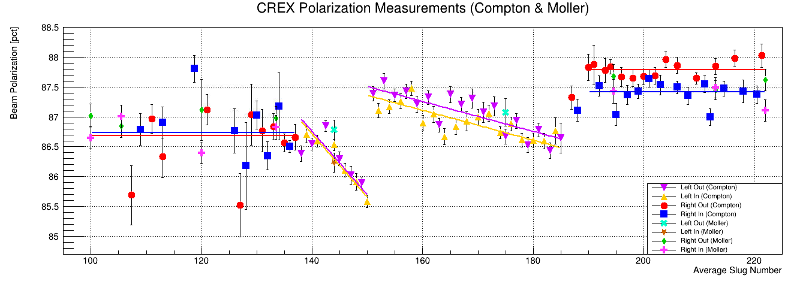
Hall A Compton Polarimeter – Recent Results
CREX Experiment – 2019-2020
CREX Compton analysis: dP/P = 0.52% Photon detector only (electron detector not fully functional)

Slide 16
CREX Compton Systematic Uncertainties
Photon detector for polarization measurements
Electron detector installed, but used primarily for tests and commissioning new VETROC-based DAQ
Photon detector measurements made using threshold-less, energy-integrating technique
Results in reduced sensitivity to absolute detector response

Slide 17
Summary
Hall A and C have leveraged many years of polarization measurements to incrementally improve polarimeters to achieve high precision
Moving towards more common systems (laser, electron detectors) to simplify maintenance
Strong User support and involvement throughout the program
More details on laser, detectors, backgrounds in talks later this week

