Slide 1

Opposite sign dispersion and collision offsets at the interaction points
J. Wenninger
20/09/2022
Acknowledgements:
A. Blondel, J. Keintzel, K. Oide, D. Shatilov

Slide 2
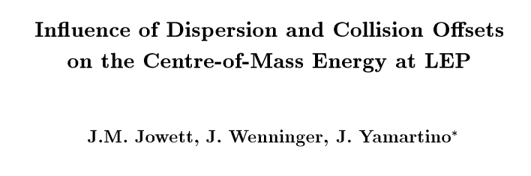

Opposite sign dispersion - LEP
The impact on the center-of-mass energy of opposite sign dispersion – more generally of dispersion differences – of the beams at the IP was identified at LEP in 1995.
  LEP had switched to operation with short bunch trains in 1995.
  This scheme involved separation of the trains (4 trains of 3 bunches) in the vertical plane by electrostatic separators installed in the straight sections on either side of each IP.
  The separation bumps generated by design a dispersion difference at the IP of up to 2 mm between e+ and e- beams (for β* = 5 cm).
Details on the derivation of the equations – for head-on collisions:

Slide 3
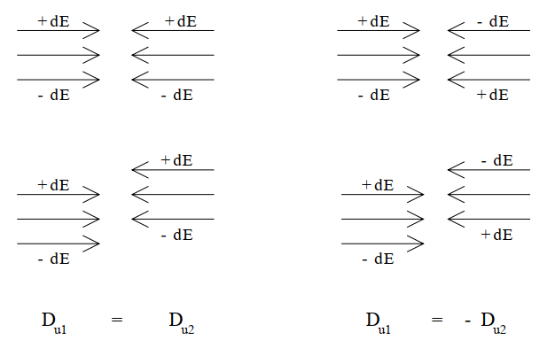
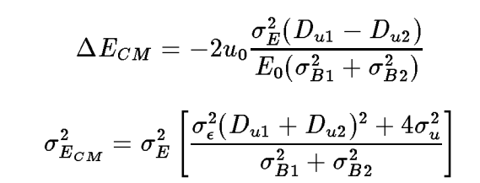

Opposite sign dispersion and CM energy
While the impact of dispersion on the CM energy spread depends on
  the dispersion at the IP (D_{ui}),
  the beam energy spread (σ_{ε}= σ_{E}/E₀),
  the betatronic beam size at the IP (σ_{u}),
… the CM energy shift depends also on
  the separation of the two beams (total separation = 2u₀).
I =1,2 labels the two beams
u = x,y labels the planes
Total beam size
for head-on collisions !

Slide 4
Opposite sign dispersion and CM energy
Lower energy spread helps
Only the difference in dispersion matters, not the average value !
Separation between the two beams
To control the impact on ECM:
Minimize the dispersion @ IP
No beam offset (at least on average)

Slide 5
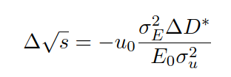

Dispersion @ FCCee IPs
Simulations on machine errors + correction at the time of the publication of the paper on energy calibration resulted in a typical IP dispersion of 10 μm with peaks of 30 μm (by beam).
Going back to the CM energy error:
for ΔD* = 1 μm, σ_{E}/E = 0.13%
For ΔD* = 10 μm, the CM error is ~1 MeV/nm, i.e., the uncertainty on / average separation must be below u₀ < 0.1 nm to limit the systematic errors < 100 keV.
  Even closer to 0.01 nm for σ ~ 20 nm → at the level of a % of the beam size.
A measurement and a subsequent correction of ΔD* is the key to relax the tolerances on control of the beam separation → an uncontrolled bias of the beam separation at a very small level (<% of beam size) can generate an uncontrolled CM energy bias.

Slide 6
Objectives to minimize the CM energy uncertainty
Minimize (zero on average !) the collision offsets at the IP
Measure and minimize (opposite sign) dispersion at the IP

Slide 7
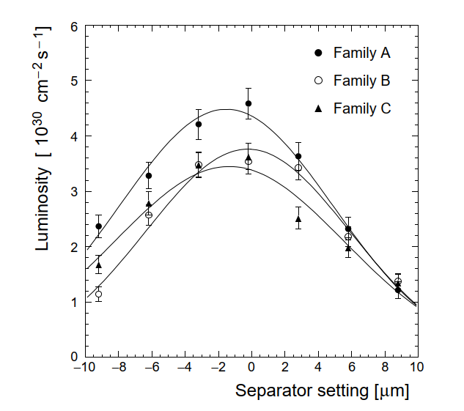
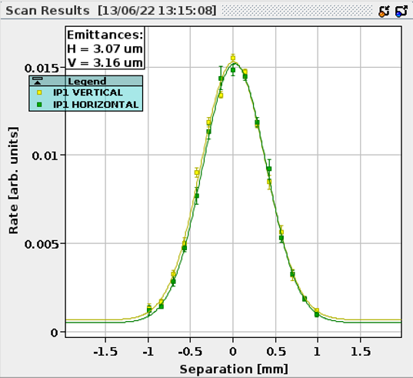
Luminosity scan – beam separation corrections
LEP
Beam separation scans to minimize collision offsets are a simple tool to optimize the luminosity (beam overlap).
  Luminosity versus beam separation in selected plane.
Scans must be performed regularly to ensure no offsets develop; frequency depends on the machine stability.
  Stability probably more critical for large machine due to the larger number of orbit drift sources !
This method was adequate for LEP1 (45 GeV), scans were performed at the beginning of physics data taking periods and repeated every few hours. The same applies at LHC.
  But the tolerance on offsets were/are quite relaxed compared to FCCee energy calibration needs !
Neither LEP nor LHC aim(ed) to control of the average offset at a level below ~0.1σ – impact on luminosity negligible.
LHC

Slide 8
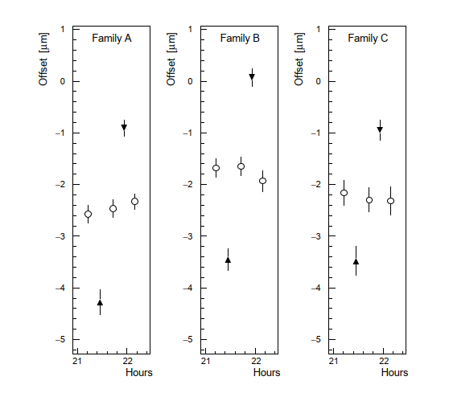
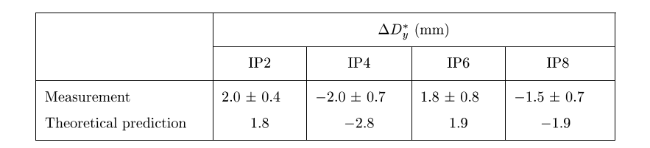
IP Dispersion @ LEP
At LEP1 the dispersion differences at the IPs were measured by applying a RF frequency change (→ change of dp/p) and measuring the change of the optimum separation settings using a luminosity scan.
  Direct access to the difference in dispersion at IP.
  Insensitive to the same sign dispersion (as beam movement is the same for e+ and e-).
Example of separation scan optimum settings for dp/p = 0 (circles) and dp/p > or < 0, (triangles).
For the 3 bunches in the train.
Measured and predicted IP opposite sign vertical dispersion

Slide 9
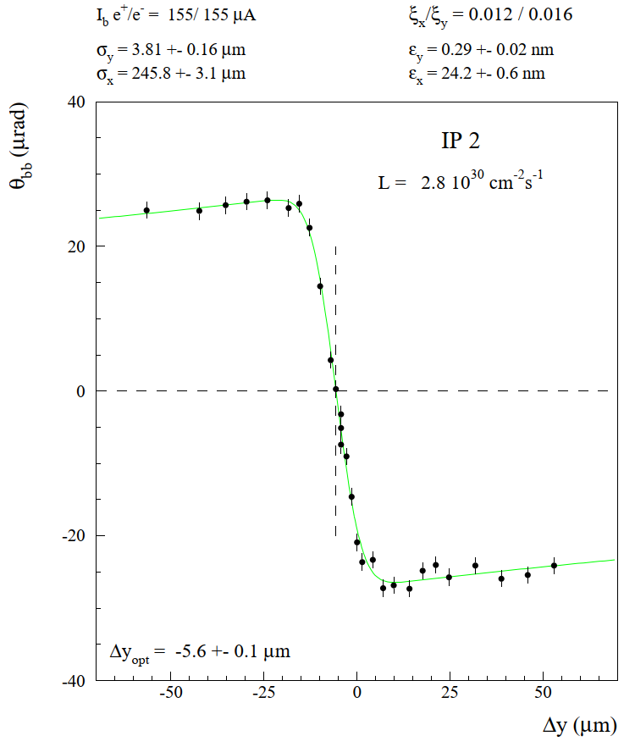
Beam-beam deflection scan – beam separation correction
Beam-beam deflection scans – pioneered at SLC – are an alternative to luminosity scans to measure and correct beam separation offsets.
In general, much faster to acquire an orbit reading than to integrate some luminosity.
  But also more indirect: beam angle and not luminosity.
BB scans however require to scan over a much larger separation, typically ±3σ with respect to expected optimum: reach the kink of the deflection curve.
LEP beam-beam scan

Slide 10
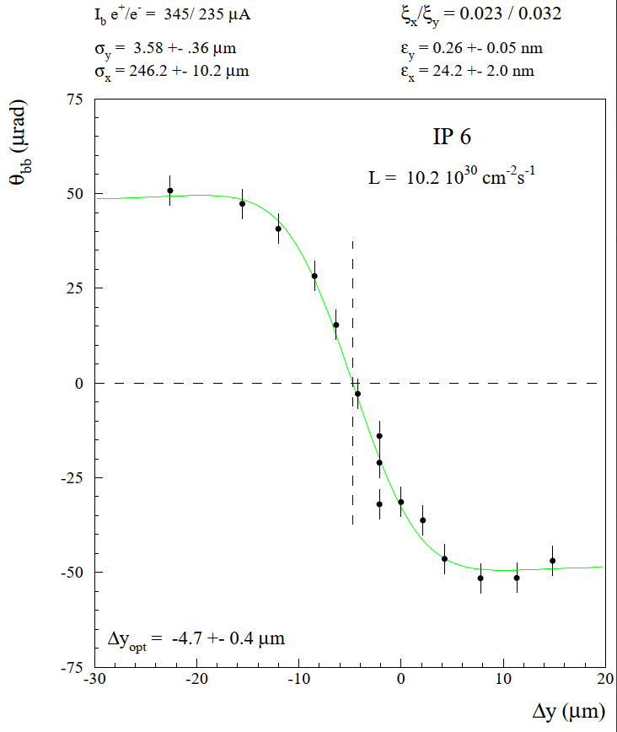

Beam-beam deflection
A clean and quite bias-free method relies on reconstructing the difference in deflection between the e+ and e- beam, i.e.:
L,R = left/right side of IP
+,- = e+ / e- beam
θ_{L}⁺
θ_{R}⁺
θ_{L}⁻
θ_{R}⁻
The angles θ are reconstructed using 2 BPMs on either side of the IP (1 BPM is not sufficient !).
  Only the relative angle changes are relevant, absolute angles / offsets of the angles are irrelevant.
  In the plot to the right the fitted offset of θ_{BB} has been removed.

Slide 11

Impact of beam-beam kicks
The naïve picture of scanning the beam by applying a separation at the IP must be corrected due to the presence of the coherent BB kick – valid for luminosity and beam-beam kick scans.
Apply a separation δ of the beams at IP
Δy
Beam-beam kick due to the separation δ
The beam-beam kick induces a closed-orbit change δ_{y}, leading to an effective separation that is smaller than Δy (for an attractive bb force and fractional Q in [0,0.5]).
δ_{y}
Δy
This first order estimate is only valid for δ << Δy, small BB kick.

Slide 12
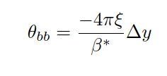
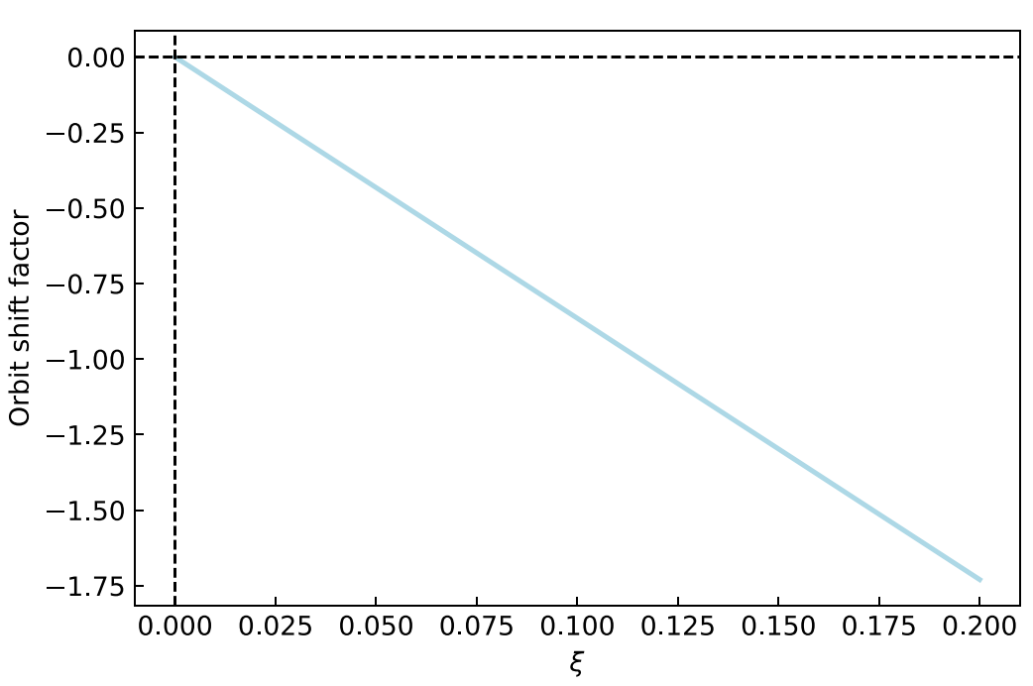




Impact of beam-beam kicks (2)
The beam-beam kick induces a change of the externally imposed separation Δy.
With a beam-beam kick(*)
The orbit change at the IP is
For fractional tune δQ = 0.2
For large BB tune shifts, a self-consistent calculation is required for the real separation Δy_{s}:
The (naïve) correction reaches 100% for ξ ~ 0.1
for ξ ~0.1, Δy_{s} ~ Δy/2
Those estimates do not consider dynamic beta-beat… leading to a change of ξ and β∗.
Not to forget, IP-to-IP cross-talk !
(*) assuming we are in the linear regime

Slide 13
Minimizing the separation
Separation optimization by luminosity scans has the advantage of relying on the primary observable – the luminosity – to define the optimum.
  High accuracy (statistics) and low systematics (very tiny beam movements),
  Modest scan range of 0.5-1σ could be sufficient.
Separation optimization by BB kick reconstruction requires much larger amplitudes (±3σ) and does not use the primary observable which is the luminosity.
  Bias from BPM system cannot be excluded.
  Realistic simulations of such scans required to better evaluate possible biases.
The impact of the BB kick (and dynamic beta) on the applied separation leads to a deformation of scan curve but should not affect the optimum (i.e head on) setting.
A realistic BB tracking simulation must be performed to get a better understanding of the dynamics of luminosity and BB separation scans – as a function of the BB tune shift.

Slide 14

IP dispersion measurements @ FCC-ee
For an energy change of dp/p = ±0.1% and ΔD* = 10 μm
The separation change at the IP is Δy = 10 nm – without BB ! – measurable with a separation scan since we must be able to control the separation << 1 nm.
The BB kick due to such a change is
→ y_{s}’ = -6 μrad for ξ = 0.1, β* = 1 mm (self-consistent).
At the first BPMs (~2 m), the displacement due to the BB kick is ~12 μm to which one must add the shift due to the local dispersion at the BPM → no direct extraction of the dispersion from the BPM readings.
δ2, δ1, δ2, δ1, Δ
receive contributions from the local dispersion and from the BB kick @ IP.
δ1
Δ
δ2
δ1
δ2
Vertical plane

Slide 15
IP dispersion measurements
To disentangle position shift due to local dispersion @ BPMs from the BB kick, one must subtract a reference without the BB kick.
  Assumes that non-colliding and colliding bunches have the SAME dispersion: to what level is that statement true? Cannot answer at this stage → have to study.
A few non-colliding bunches in the filling scheme – preferably of same intensity than the colliding bunches to limit systematic errors – could provide that reference.
  Reconstruct the BB kick due to the IP separation shift by subtracting at each BPM the readings of the non-colliding bunches → still requires to disentangle effect of BB kick to obtain the dispersion.
  Systematic effects difficult to assess at this stage, but at equal intensity they could be minimized.
If a measurement of the angle y’ with an accuracy of 1 μrad (or better) is achievable, ΔD* could be determined to within ~1 μm directly from the BB kick (no scanning).
For a short-term BPM accuracy of 0.1 mm, ΔD* can be determined << 1 μm.

Slide 16
Dispersion measurement
Direct measurement: the shift in optimum separation at the IP with dp/p offset can be determined with the luminosity or the BB kick separation scans. The difference in optimum defines the opposite sign dispersion.
  Accuracy of scans – which should be high – will define accuracy on dispersion together with dp/p range. For dp/p ~ ±0.1%, a measurement of ΔD* to 1 μm or less should be feasible.
Indirect measurement: avoid the optimization scan of the direct measurement but extracting the dispersion from a reconstructed BB kick after applying a dp/p change.
  Requires a reference measurement of the dispersion at the BPMs, obtainable from non-colliding bunches.
    Need an excellent understanding of the BB kick to be able to infer the initial perturbation from the dispersion.

Slide 17
Summary
Scans of the optimum separation – whether by luminosity of BB kick – will be important to minimize the collision offsets feeding into the CM energy error.
  Advantage of luminosity: it is a direct indicator of optimum overlap; scans require a smaller range.
With either scan method the opposite sign dispersion can be measured.
  Once the dispersion is determined, a correction should be attempted to better control the CM energy uncertainty and relax tolerances on the knowledge of the separation.
A determination of the dispersion directly from the BB kick – without any scan – may also be possible.
  Large corrections due to the BB kick must be considered.
  This method could on the other hand provide a fast method to set an upper bound to the dispersion or ensure the stability of the dispersion.
A lot of work ahead of us to control this uncertainty !!

