Slide 1


LabVIEW
ISOTDAQ 2023
Gary Boorman
19th June 2023

Slide 2
Agenda
Introduction to LabVIEW
Application Development
LabVIEW Integration for Hardware and Software
LabVIEW for Accelerators and Detectors
Summary

Slide 3
LabVIEW
What is it?
Notes:
Abstraction is what allows seemless integration.

Slide 4
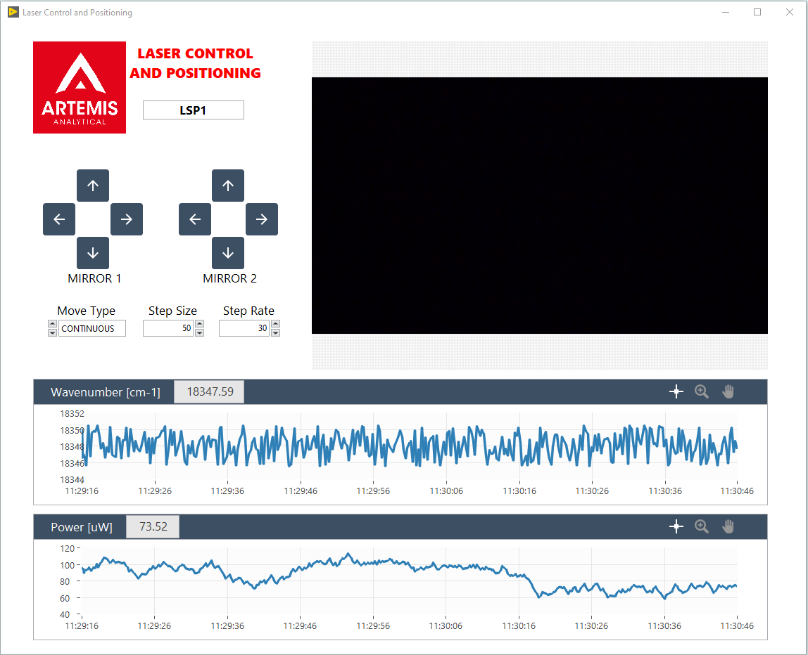
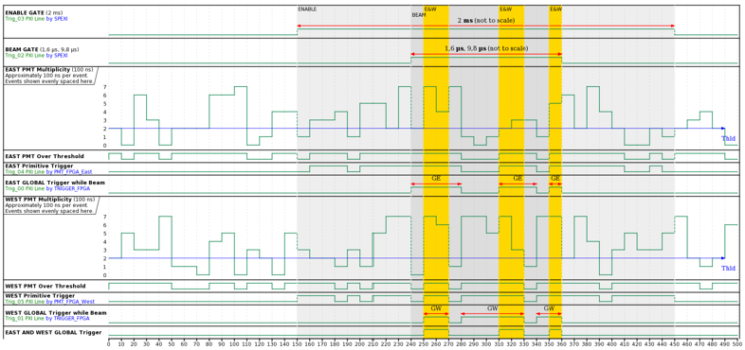
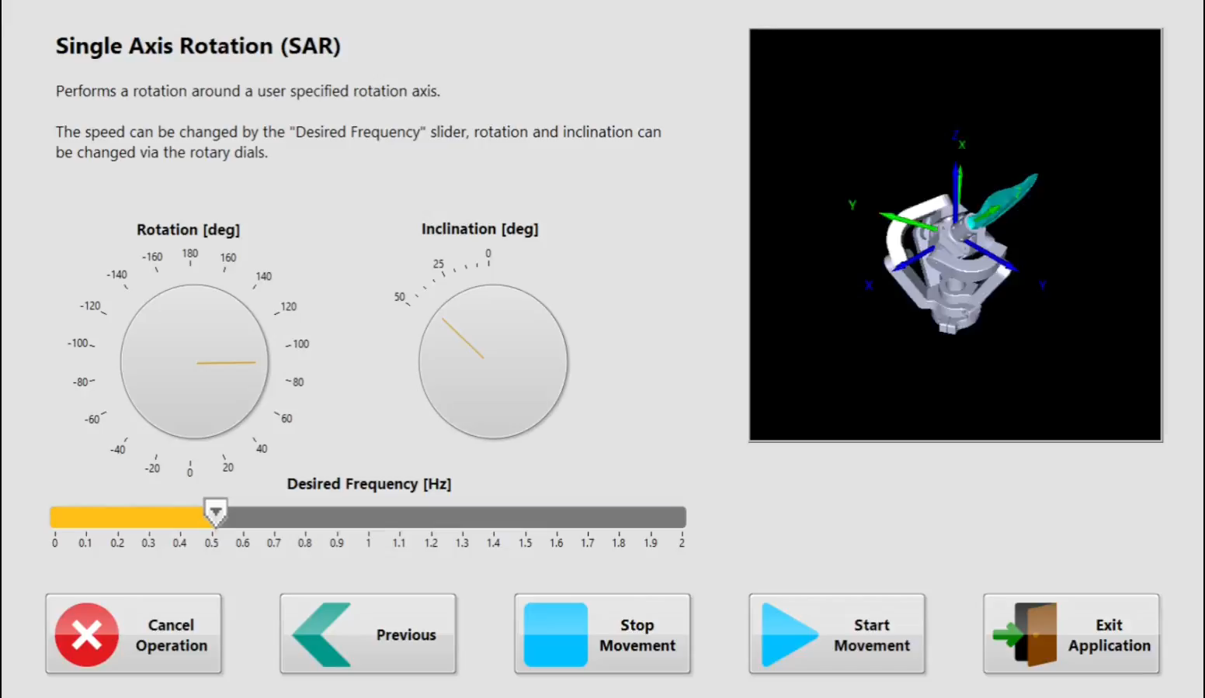
What is LabVIEW?
LabVIEW is a graphical programming environment used by scientists and engineers to develop automated research, validation and test systems

Slide 5


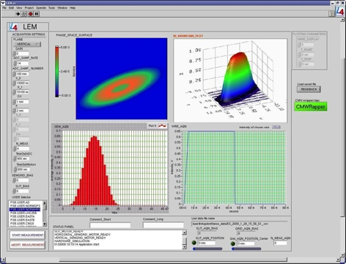
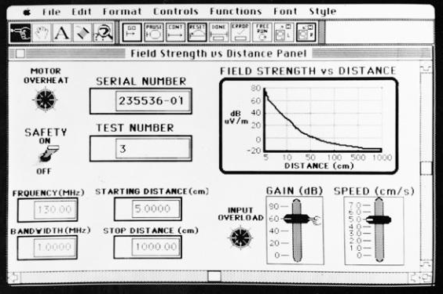
Background
NI was started by a couple of physicists….
NI created hardware in 1970s, then added an easy way to program it in 1986 – LabVIEW
Notes:
Like every great story it started with a couple of guys in their garage back in the 70s that decided there was a better way of just getting some measurements done. There needed to be a better way of getting measurements from a bunch of equipment together. Fast forward 30 years and its become a multinational industry standard. Needed easier way to get measurements from sensors, and to reconfigure acquisition.
Dr James Truchard PhD in physics (acoustics), and Jeff Kodosky.
LabvIEW is a software development tool from them their product, which grew to industry standard but unfortunately it
They provide
Stree the ch
So lets just get this out of the way: it is a commercial product. But there are 2 parts of their business model: hardware and software. Most of their revenue is from hardware, they do have quite good state of the art DAQ equipment, but I wanted to avoid talking about their products and instead start with how did they become popular instead, what set them apart and …>
but its Im all about open source and free I mean I use free Spotify
But there are some good aspects as well, they build it maintain it provide support, off the self plug and play type of thing. But why is it that they specifically got popular.

Slide 6
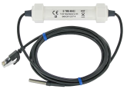


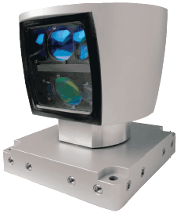
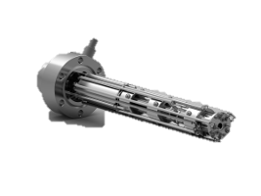
Measurement challenges
Conflicting programming approaches
Disparate drivers
Timing, triggering, and synchronization
Fixed soft/hardware
Changing requirements
…
Temperature
Heterogeneous
systems
Storage
LiDAR
RGA
Notes:
To do that, lemme throw a boring enumerated list of things for you. Lets say you are designing a DAQ system – from scratch. What are the things you’ll need to worry about. What are your challenges.
Plain vanilla approach here: I guess you don’t do it by hand and right it on a piece or paper. You start by understanding your system, get a right piece of hardware, lets say just a high frequency sampling. So you have your data. Now you also need data from another device that works with another system altogether. And this system is programmed or controlled in an entirely different way, and you also need to get this data treated doing an FFT and sent to a database. But wait: all your requirements just changed, so you need to adapt the system again.
My point is, integration is key. Agility to cope with the challenges of taking a measurement is essential

Slide 7
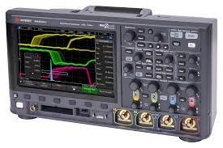
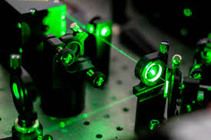
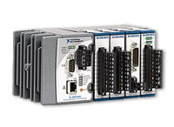
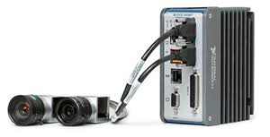
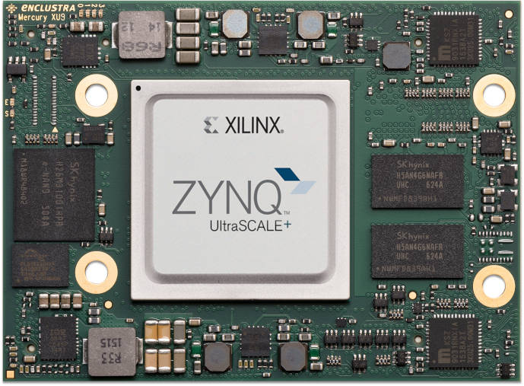
HW and SW Integration
Integration is the key to efficiently creating a control and measurement system.
LabVIEW effortlessly joins together hardware and software.

Slide 8
DAQ Comparison
Software Used for Data Acquisition and Instrument Control
OPTIONS | C++/C#/JS/VB | LabVIEW | MATLAB | DASYLab
Ease of programming (novice) | Difficult | Easy | Medium | Easy
Programming Community size | Very large | Large | Large | Medium
Complex Applications | Yes | Yes | No | No
Built-in DAQ Support | No | Yes | Some | Yes
Built-in Analysis | No | Yes | Yes | Yes
Notes:
Add images of old versions of labview (mac 1.0)
Check source of chart
As they themselves are not shy to say they are a leading standard in industry fir measurement software but why is that?
So lets just get this out of the way: it is a commercial product.
Im all about free software so if you have the resources and time can grow your own, by all means, but unfortunately, we cant build everything , but there are some positives in a commetcial solution off the shelf: they maintain it, developd we just
But there are 2 parts of their business model: hardware and software. Most of their revenue is from hardware, they do have quite good state of the art DAQ equipment, but I wanted to avoid talking about their products and instead start with how did they become popular instead, what set them apart and …>
but its Im all about open source and free I mean I use free Spotify
But there are some good aspects as well, they build it maintain it provide support, off the self plug and play type of thing. But why is it that they specifically got popular.
I wanna see what is it that made them special?

Slide 9
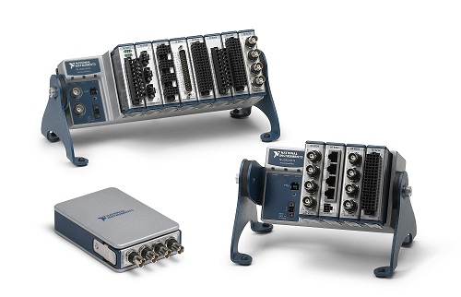
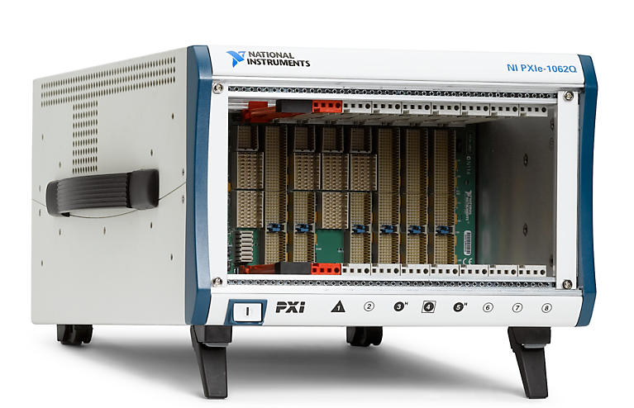
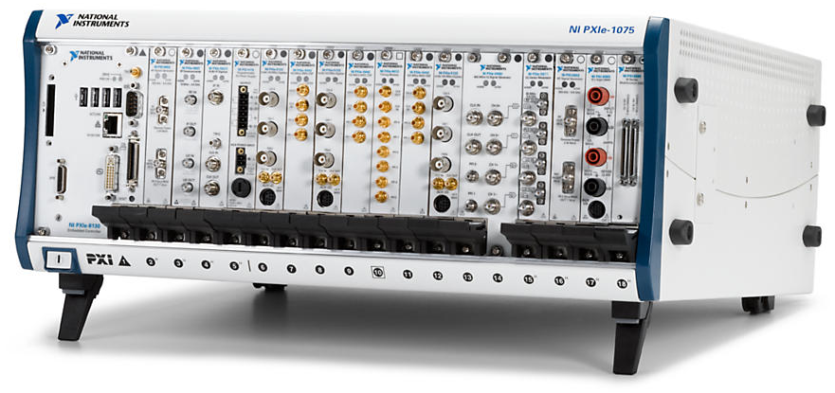
NI Modular Instruments
PXI
PXI/PXIe modules
Compact DAQ
Compact
RIO
chassis
Notes:
If you have all this integration and a lot of industry manufacturers behind you, you can use that power to provide a modular design. Markus already did an amazing part on the merits of this design so its easy to see why many of NI’s platforms are all modular based like this. BE it a bigger one like a PXI crate or smaller like a Compaq rio,
Alliance partners
Expensive tradeoff with state of the art and
This is where it gets interest: you have a platform is modular, and can integaret with mostly anything.
Make them yourselves – integration with PXI express

Slide 10
Application
Creating Code
Notes:
Abstraction is what allows seemless integration.

Slide 11
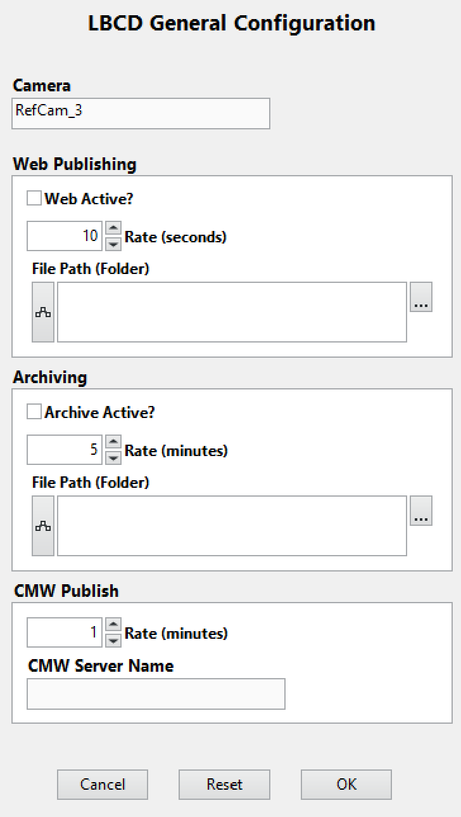
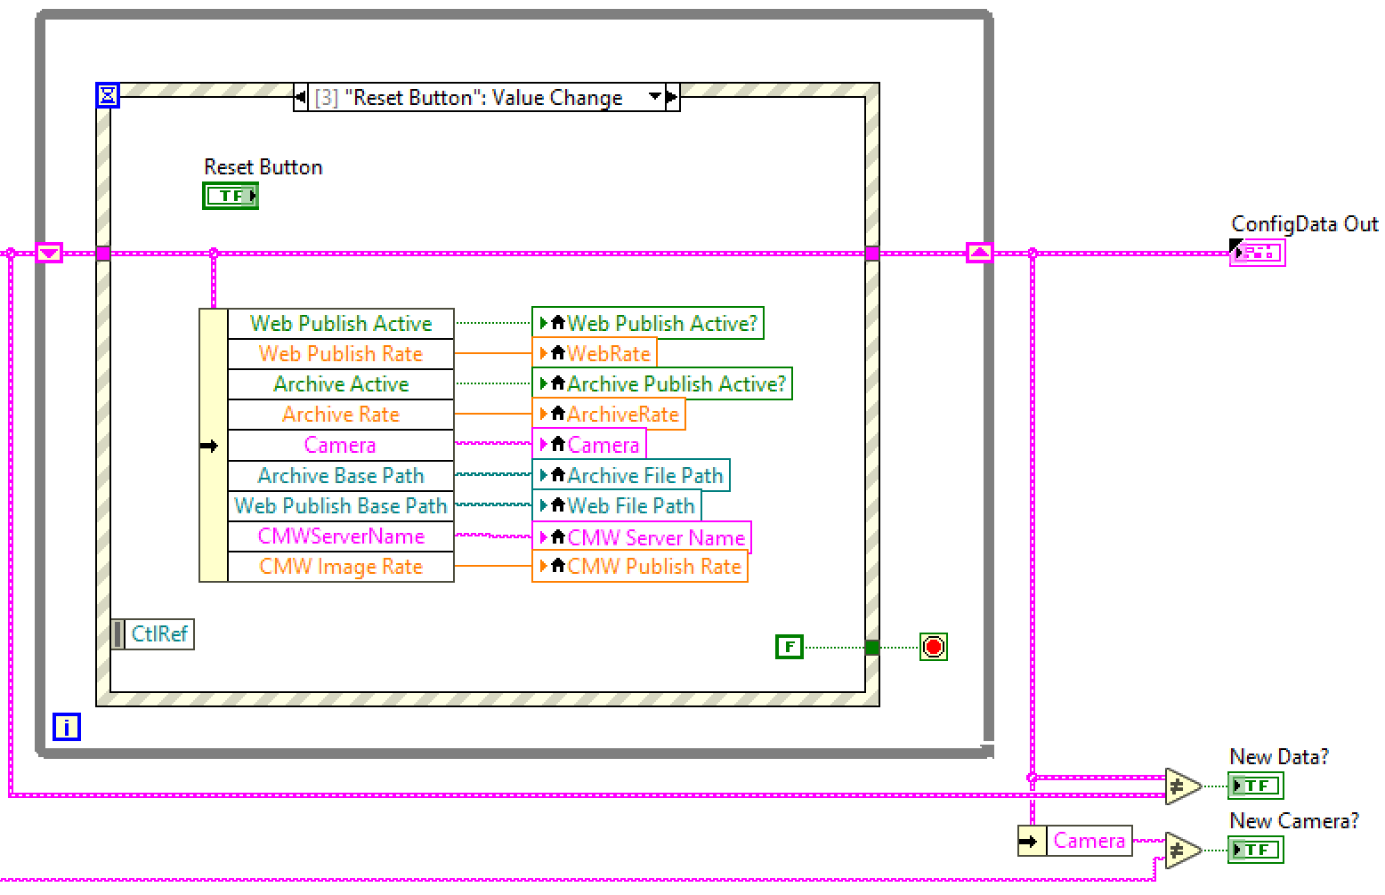
LabVIEW Environment
Together the Front Panel and the Block Diagram create a VI – a virtual instrument
LabVIEW Block Diagram
(the source code)
LabVIEW Front Panel
(the user interface)
Notes:
Alright lets move to a concrete example:
The way you program a function, a Virtual instrument is made up of two thingsL a block diagram where you put your code and other function blocks, and it also comes free with a graphical interface.

Slide 12
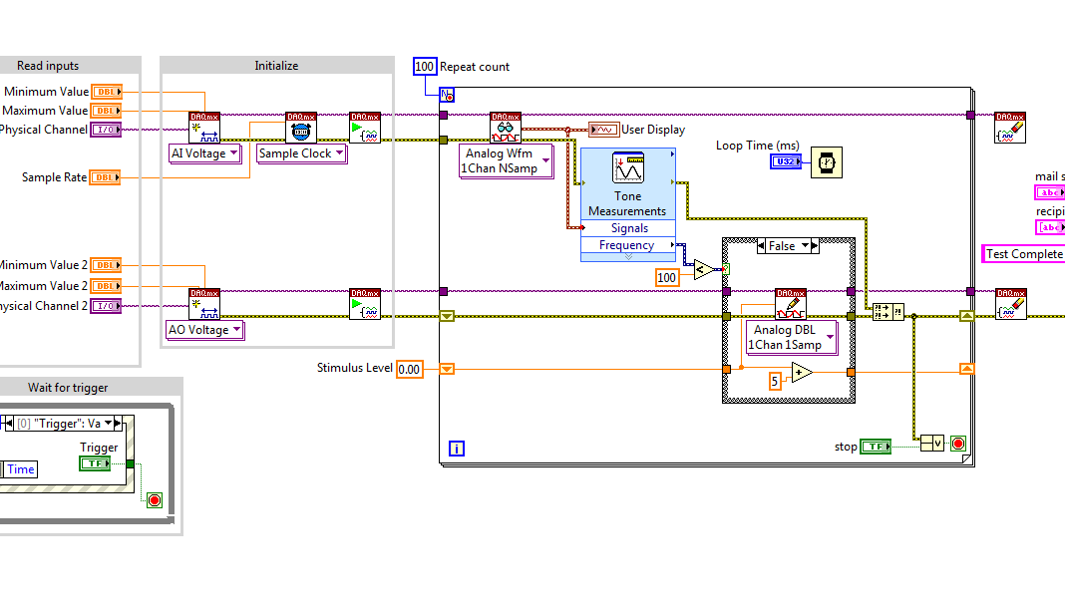
Application development
Program as you think
Notes:
Now there is another important step feature that came about. The guys that made this, weren’t computer scientists – they were electrical engineers. Worse - they were mac fanboys (lbaviwe was first developed for mac) so they wanted something more.
So let me ask you a I’ll ask you a question. What do you do when you want to design an algorithm or a sysmte, whats the first things you do.
Graphical programming paradigm
Big debate with computer science
Semanthics over syntaxe, what you mean notg how you say it, and the software is key in integration
Fast development time to market
Efficiency
Semanthics over syntaxe, what you mean not how you say it, and the software is key in integration

Slide 13
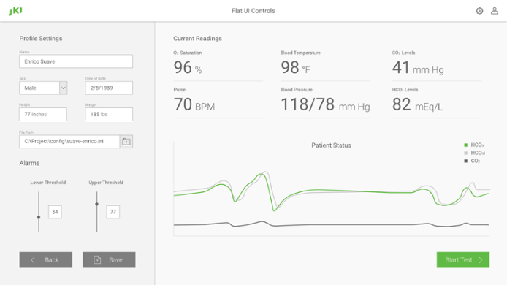
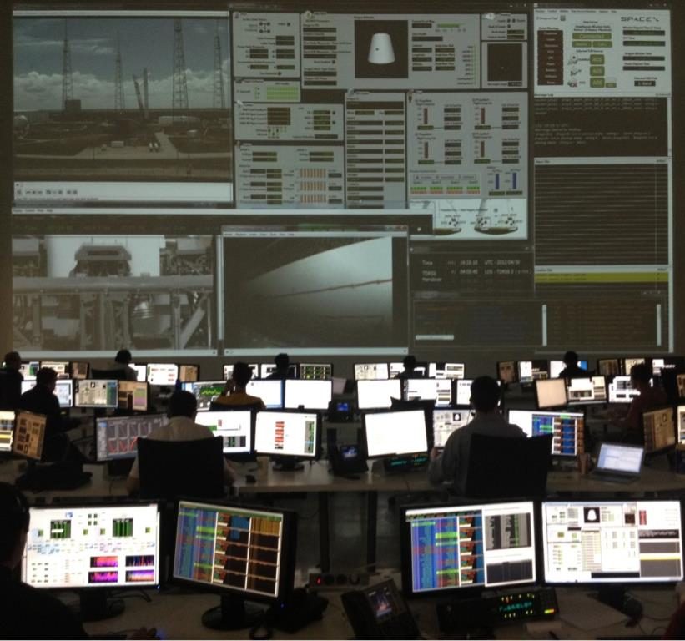
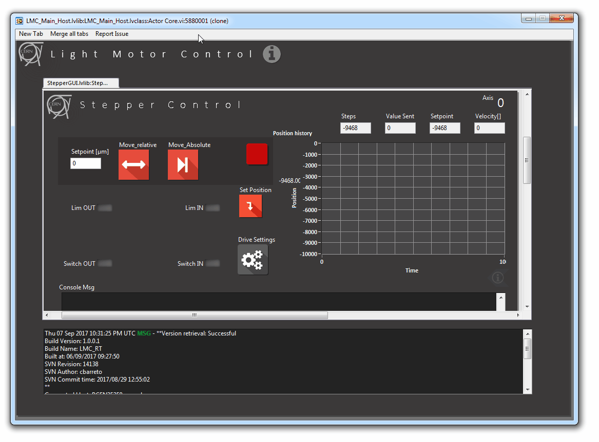
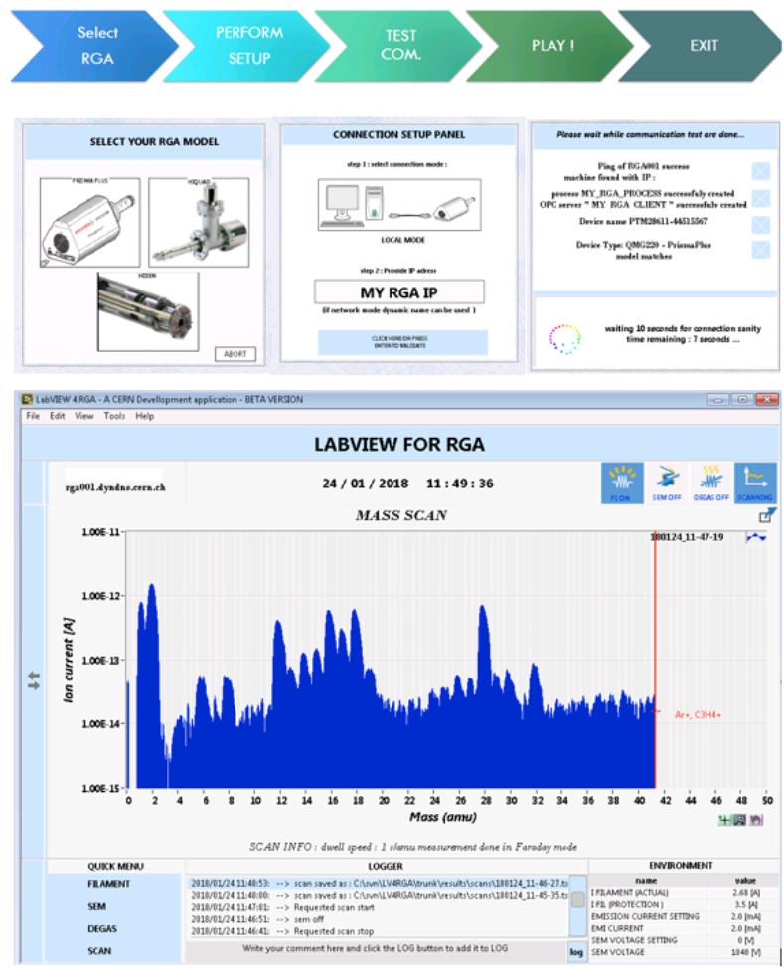
Graphical interface
Notes:
here are a couple of them so you can see you can pretty much do what you want now I promised myself I would only show CERN applications but any fellow musketeers in the audience? No?
Heres a picture ofspace X/s control room and many applications you see there are labview ones I thought that was cool. Just to show you that you can build from the smaller prototype to larger scale ones.

Slide 14
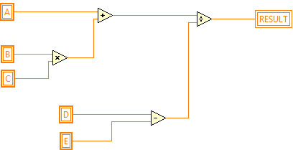
Dataflow I
Data driven execution
Intrinsic Parallelism
Notes:
Alright dataflow.
Now in practice, this works by means of a mechanism that called dataflow that drives the execution of your code. Again if you are an electrical engineer, this makes a lot of sense to you. If you are a computer scientist, you might consider this heresy.
So by looking at this piece of code. I bet that you already see how this is going to play out.
The logic is executed in sequence to the connections
Natural expression of parallelism

Slide 15
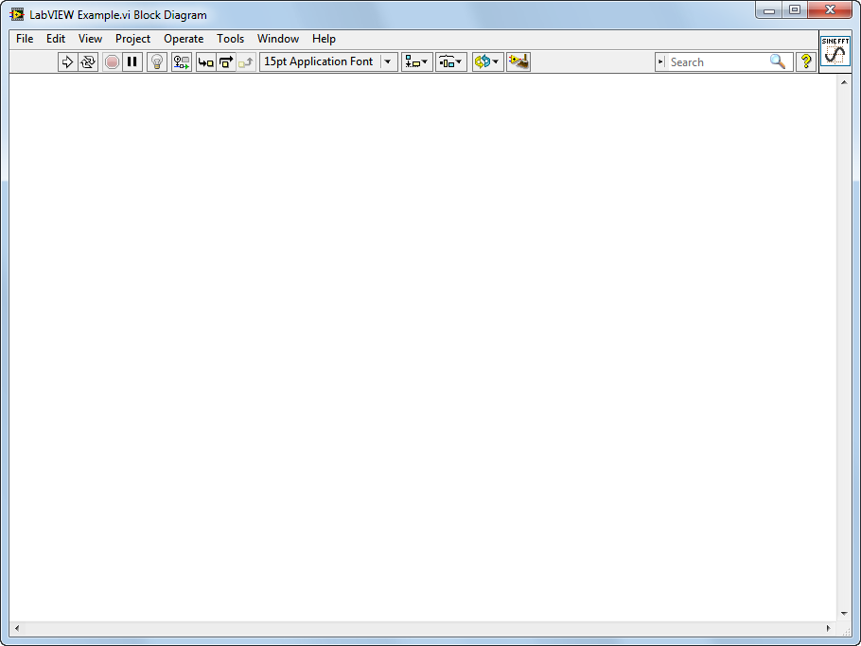
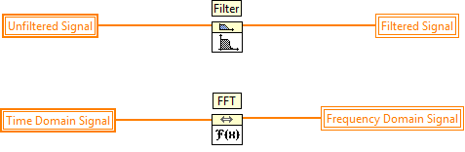
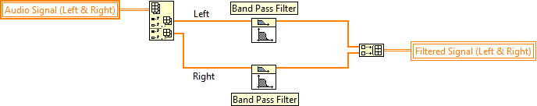
Dataflow II
Data driven execution
Multi-threaded (no explicit commands required, just careful code design)
Intrinsic Parallelism
Notes:
Natural expression of parallelism
It does take it a step further by being higher level language; you will find modern computer science paradigms object oriented, advanced patters and so on.
Talk about threads, cores etc

Slide 16
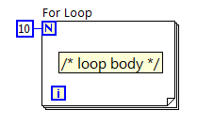
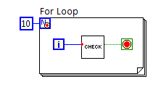
Comparison with text
for (i = 0; i < 10; i++)
{
/* loop body */
}
for (i = 0; i < 10; i++)
{
if(check(i)) break;
}
Notes:
Natural expression of parallelism

Slide 17
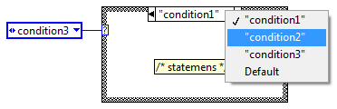
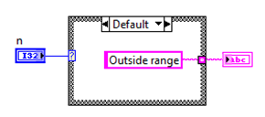
Comparison with text
if condition1 then
-- statements;
elseif condition2 then
-- more statements
elseif condition3 then
-- more statements;
else
-- other statements;
end if
switch (n) {
case 5:
printf(“Small number.");
break;
case 100:
printf(“Large number.");
break;
default:
printf(“Outside range”);
break;
}
Notes:
Natural expression of parallelism

Slide 18
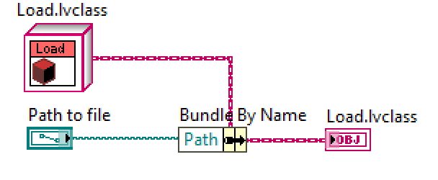
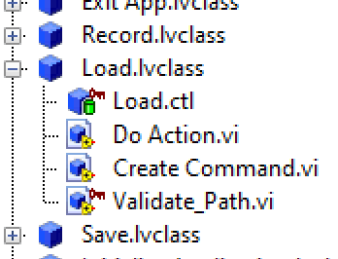
LabVIEW OOP
LabVIEW has object-oriented capabilities – encapsulation and inheritance
But BEWARE
  LabVIEW is a by-value language, including its objects
    Most other OO environments use by-reference objects
  All data is private
    Explicit accessor methods must be used to access the data
Methods are public by default but can be made private (called by class’s methods only) or protected (called by child classes too)
LabVIEW objects are supported on Desktop, RT and FPGA
Objects can be by-reference if needed
Class
Private data
Public method
Private method
Notes:
Natural expression of parallelism

Slide 19
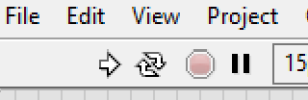
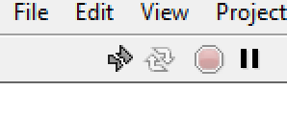
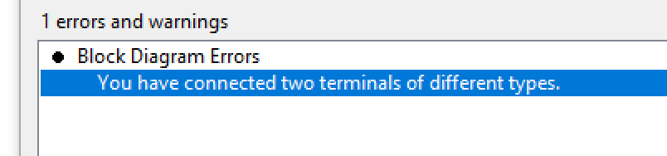
The LabVIEW Compiler
The LabVIEW environment continually parses the block diagram
  Valid code ->
  Invalid/incomplete code ->
If code is valid, clicking on the RUN button causes LabVIEW to compile the code and then execute it
Click on a broken RUN button to get detailed information on the error
Solid RUN button
Broken RUN button
Notes:
Continual parsing of code – apart form async calls

Slide 20
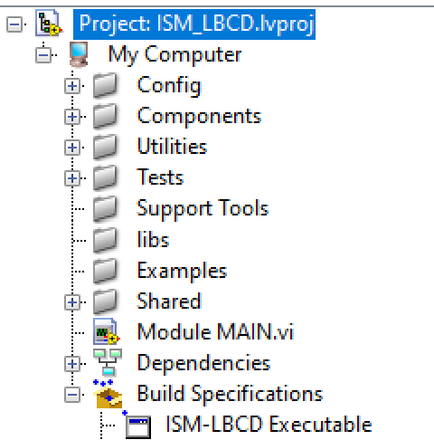
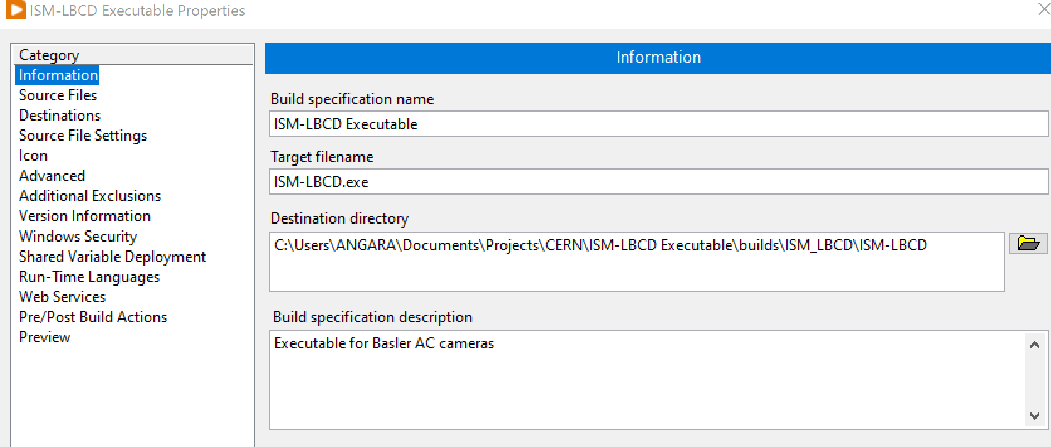
Creating Executables
When developing/debugging LabVIEW code it can be run and tested within the LabVIEW environment
Once the code is working as desired it can be compiled into an executable (.exe etc), then launched like any other program
  LabVIEW supports both 32 and 64-bit OS: Windows, Linux and IOS
Notes:
Run time engine needed to run an .exe
CIN

Slide 21
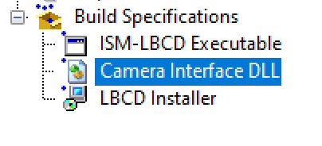
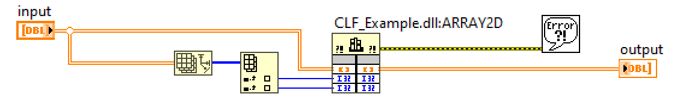
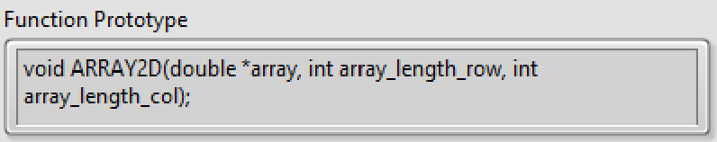
Creating/Calling DLLs & SOs
Code can also compile into a windows library (.DLL) or Linux library (.SO)
  Calls to DLL or SO require knowledge of the function prototypes – LabVIEW will generate the appropriate documentation
LabVIEW can call functions within other DLL and SO libraries

Slide 22
Integration
Bridging hardware and software
Notes:
Integration is the first highlight keyword that I would like us to retain here, it really is a key to an efficient system. So how do they tackle it?

Slide 23

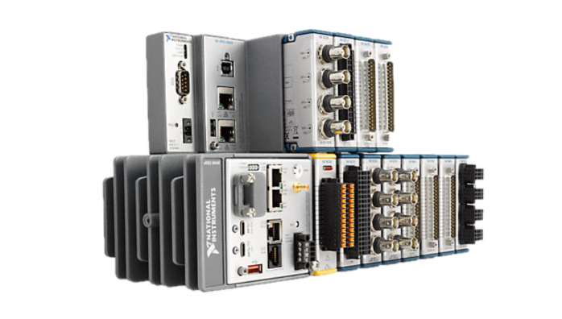
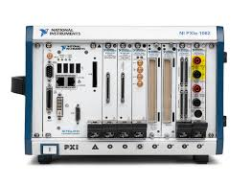
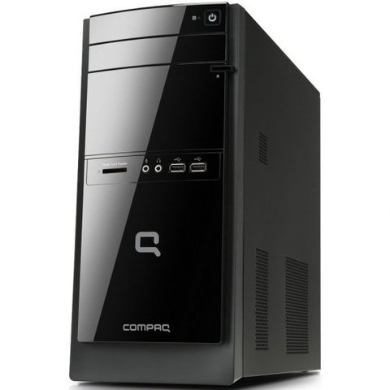
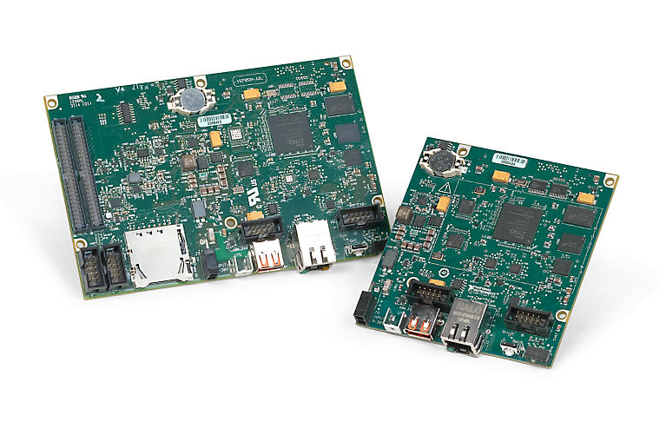
Real-time Systems
Deterministic code operation
Create distributed control/test/acquisition systems
LabVIEW real-time (LabVIEW RT)
  Linux with the real-time patch
LabVIEW RT
cRIO
PXI
sbRIO
Vision System
Desktop PC

Slide 24
Compiling LabVIEW for RT Systems
LabVIEW can run RT code within the development environment
  Code is executed on the RT system
  User interface is on the desktop/development system
Code can usually be run on different RT targets with only minimal changes (file paths, hardware interfaces etc)
Once the code is running as expected, compile the code into an RT executable
  Executable can be deployed on RT system
  Executable starts running once the RT has powered up and loaded its operating system
  Code is usually designed for running 24/7
Notes:
RT usually headless – use non-UI communication

Slide 25
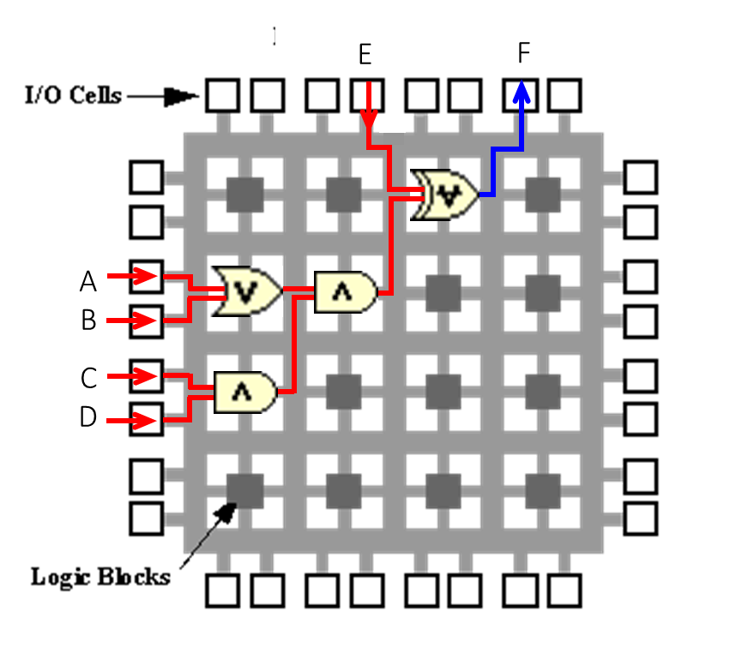
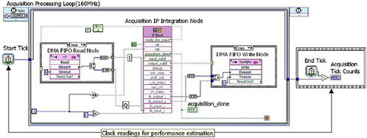
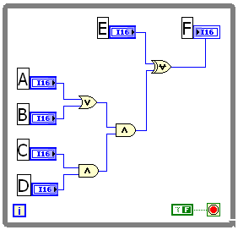
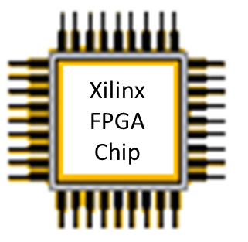
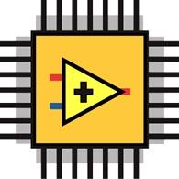

LabVIEW FPGA
LabVIEW first generates VHDL then uses the VIVADO compiler to make a bitfile

Slide 26
Compiling LabVIEW for FPGA
Many LabVIEW functions are available for FPGA
  Some exceptions:
    Unbound arrays, queues, strings
    Double precision numbers (Single is permitted)
    Non-homogeneous arrays of objects
Can add pre-existing HDL to LabVIEW FPGA code
The RT system accesses the FPGA using:
  Front panel controls and indicators (fairly slow)
  Direct memory access, DMA (very fast, up to GB/s depending on backplane)
  Interrupts (latency in order of µs)

Slide 27


FPGA Example
ICARUS Detector at Fermilab
Based on PXIe chassis, all programmed with LabVIEW
Trigger system uses three FPGA cards acquiring data at 40 MS/s
Triggers are time-stamped using White Rabbit; global trigger sent to readout electronics

Slide 28



LabVIEW and Python
The Python node
Call a function from a Python module

Slide 29
LabVIEW in the Physics Lab
Notes:
Find logo Cern and EN-SMM-MTA

Slide 30












LabVIEW at CERN
CERN LabVIEW
Support
Training
550 LabVIEW Users
30+ Project clients

Slide 31









RADE – Rapid Application Development Environment
The LabVIEW solution at CERN to develop expert tools, machine development analysis and test facilities integrated with the CERN control infrastructure.
Contains a middleware interface for accessing instruments/processes on CERN network
Logging
CMW
RBAC
Timing
Front ends

Slide 32




ISOLDE Suite of Tools
Consistent code structure for all modules (20+) based on custom template
Average LabVIEW developers can modify code
Uses RADE palette for logging, CMW

Slide 33




LabVIEW and Middleware
EPICS support built-in
  Create EPICS IOCs to run (usually) on Embedded systems
  Create EPICS Clients on both Embedded and Desktop systems
  Several third-party solutions that improve performance or the scope of data-types (LNLS, ANL etc)
Example
  Vibration monitor at Diamond – cRIO system with EPICS interface
Notes:
EPICS, TANGO, cf Cern CMW

Slide 34
Other Applications
Notes:
Find logo

Slide 35




LabVIEW Web Module
Compile LabVIEW and run within web-page (Javascript)
View compiled code on any device
Try www.webvi.io
Notes:
Use Next Gen for web-based code.
Generate example of web
Webvi.io
Any platform

Slide 36








Custom hardware
CTRP-PMC
(CERN)
PMC carrier
(Kontron)
White rabbit timing (CERN)
PXI
cRIO
Fine delay-FMC
(CERN)
FMC carrier (INCAA)
Fibre-based triggering (ANGARA Technology)
Notes:
You can develop your own custom hardware and go commercial with it; at CERN there is already a couple of examples for NI front end platforms like the PXI and the cRIO including white rabbit you can already get this from the cenr open hardware repo.
Cern-developed cards and some contracted to external companies
As well as using HW from NI and other vendors

Slide 37



Summary
One development tool – multiple platforms: Desktop, RT, FPGA, GPU, Web
Full integration between hardware and software
The power of LabVIEW Integration

Slide 38

Thank you
Contact me: gary.boorman@angaratech.ch

Slide 39

Credits
National Instruments
CERN EN-SMM group

