Slide 1
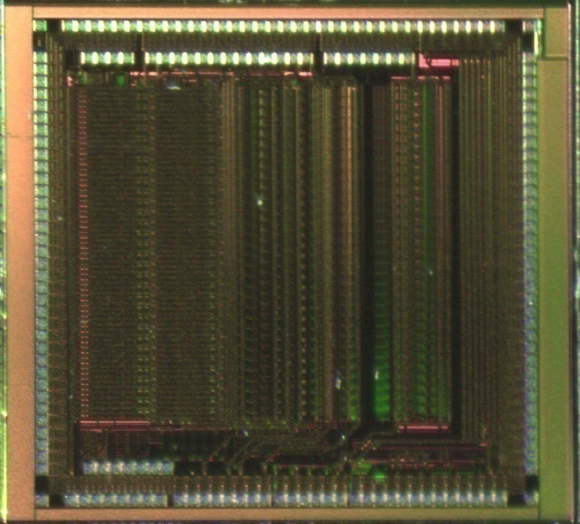
Outline
SPIROC-A Measurements
& Implementation in PEBS Tracker
Introduction
measurements
new readout board for PEBS Tracker
summary

Slide 2
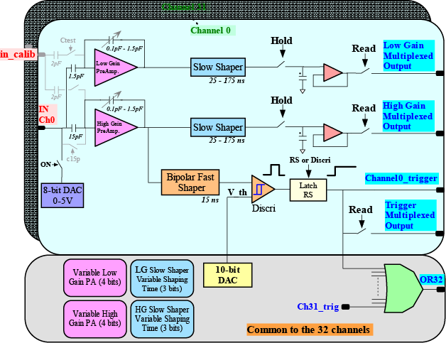
SPIROC-A
charge measurement from 1 pe to 2000 pe (at SiPm gain of 1 x 10⁶ ) in two linear scales
32 channels
each channel is equipped with :
  input DAC for SIPMs gain adjustment
  range up to 4.5V, resolution 8 bit
  high gain amplifier
  low gain amplifier
  the gain of amplifiers tuned in 16 steps
  variable shapers tuned in 7 steps
  track and hold cell
  multiplexed analogue output
  fast shaper
  discriminator with 10 bit DAC for threshold
  individual digital output with latch
multiplexed output and OR of all outputs
power pulsing to switch off unused stages
slow control data (456 bits) located in a register, must be downloaded after each power up
total Power Consumption ~ 2.2 mW/channel @ 1 MHz readout frequency
Dimensions 4,1mm x 4,2mm

Slide 3
Measurements of all 32 channels of one chip
measurements performed at high gain=150 and peaking time slow control value =1 (≈ 75ns)
Gain amounts to ≈ 35mV/s.p.e
Gain variation ≤ 1%
S/N ≈9/1 for s.p.e.
Small pedestal spread; RMS ≈ 2.4 mV

Slide 4
Measurements SPIROC-A
Qin low gain = 30pC, f=1 kHz
Qin high gain = 3pC, f=1 kHz
peaking time can be set in 7 steps from ≈ 75ns to 175ns
small difference between high and low gain

Slide 5
Linearity Measurements
strong reduction of the gain linearity if the input charge > 3pC and the injection frequency ≤ 100 Hz
analogues measurements with SiPms in preparation
simulations of the circuit ongoing

Slide 6
Linearity Measurements High Gain

Slide 7
Linearity Measurements High Gain

Slide 8
Linearity Measurements High Gain

Slide 9
Linearity Measurements Low Gain

Slide 10
Linearity Measurements Low Gain

Slide 11
Linearity Measurements Low Gain

Slide 12
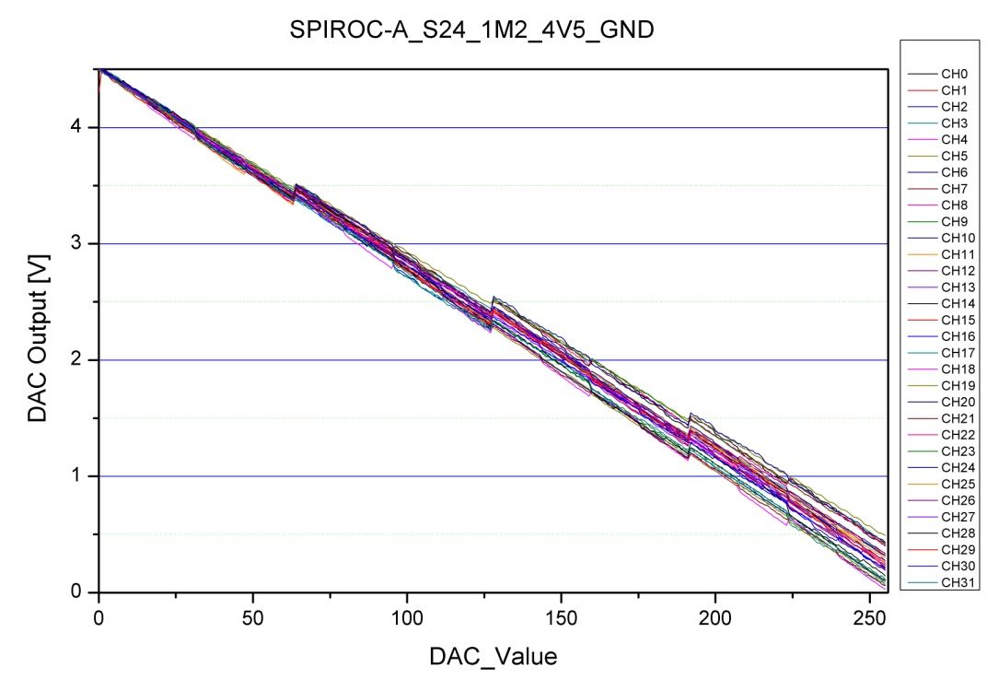
Input DAC
32 DACs, one per channel
range up to 4.5V range, 8 bit, LSB ~18mV
very low power consumption ~1µW/ch
can absorb up to 10 µA leakage current from SiPm
large spread between channels ~ 0.5V
DNL amounts to 70 mV on average, max. 120 mV

Slide 13
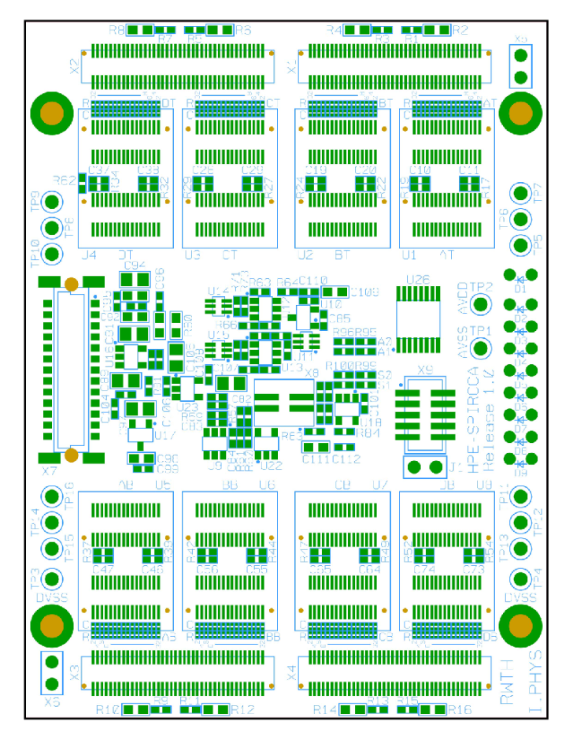
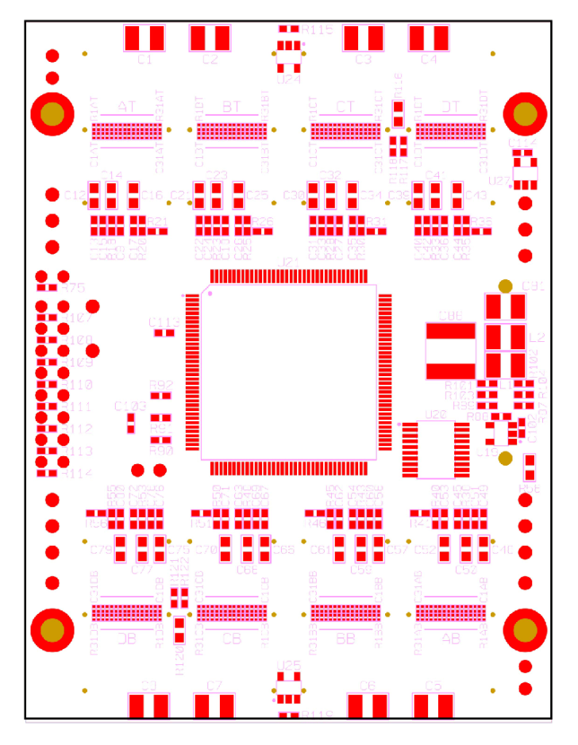
HPE-SPIROCA-256
analog, multiplexed readout of 256 channels, 8 SPIROC-A Chips
SPIROC-A chips mounted on new chip carrier with smaller size
The chips located of the front side to improve the thermal behaviour of the board
Dimensions: 60mm x 80mm

Slide 14
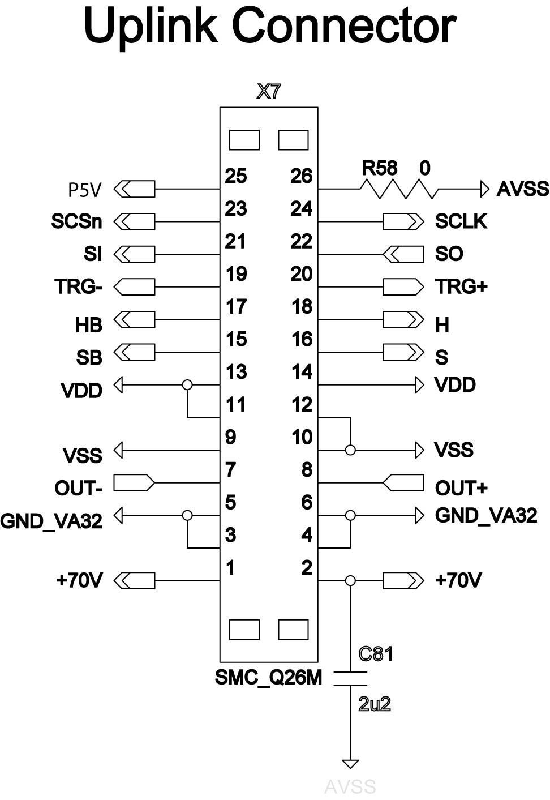
HPE-SPIROCA-256
slow control parameters of all SPIROC-A stored locally in an UFM block of the CPLD
after power up the parameters automatically downloaded to SPIROCs and the contents of the registers are automatically compared with contents of the UFM block
the control parameters can be downloaded from higher DAQ to CPLD and read back from CPLD using SPI
each board has an address (2 bits) to allow daisy chain of up to four boards
two current- and two voltage monitors are implemented
to control leakage current and bias voltage of two optohybrids
  resolution 12 bit , readout via SPI
  penalty; current consumption ~0.16mA
gain stabilization of the SiPMs with thermistors
  penalty; current consumption ~0.28mA
SPI readout of two temperature sensors located on
optohybrids
Input DAC range 0-4.5V to adjust the gain of SIPMs
New connector assignment

Slide 15
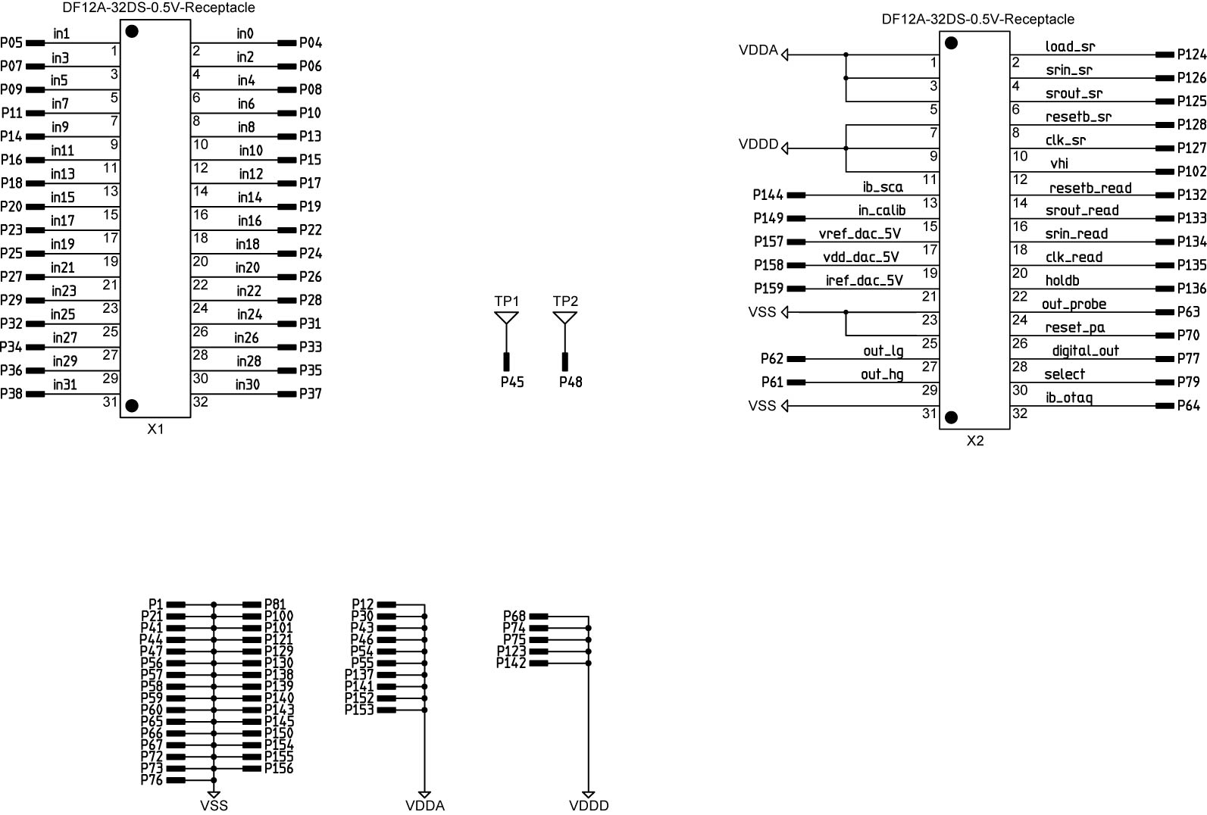
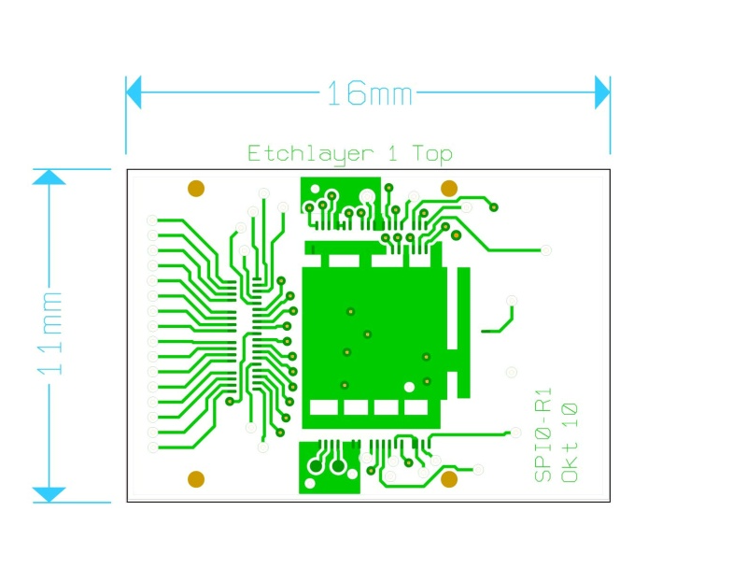
New SPIROCA-Socket
Dimension: 11 mm x 16 mm
32 pin connector, new pin assignment

Slide 16
Summary
charge measurement from 1 pe to 2000 pe (at SiPm gain of 1 x 10⁶ ) in two linear scales
S/N of 10 w/o noise contribution from the detector,
good pedestal and gain uniformity between channels on one chip
  Ultra low power, 8bit input DAC for SiPM gain adjustment on each
  channel, range 4.5V, must be calibrated channel by channel
  Linearity dependence on signal frequency at the input
  The investigations are ongoing
  New readout board and new chip carrier for SPIROC-A are designed
  The production will be started after clarification of open questions:
    gain dependency vs. signal frequency at the input
    pin assignment of the uplink connector
    pin assignment of the chip socket

Slide 17
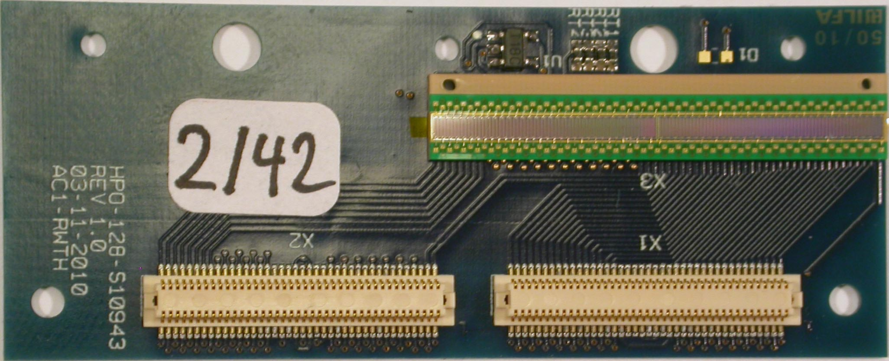
New optohybrid
New optohybrid with Hamamatsu SiPM array S10943

Slide 18
back up

Slide 19
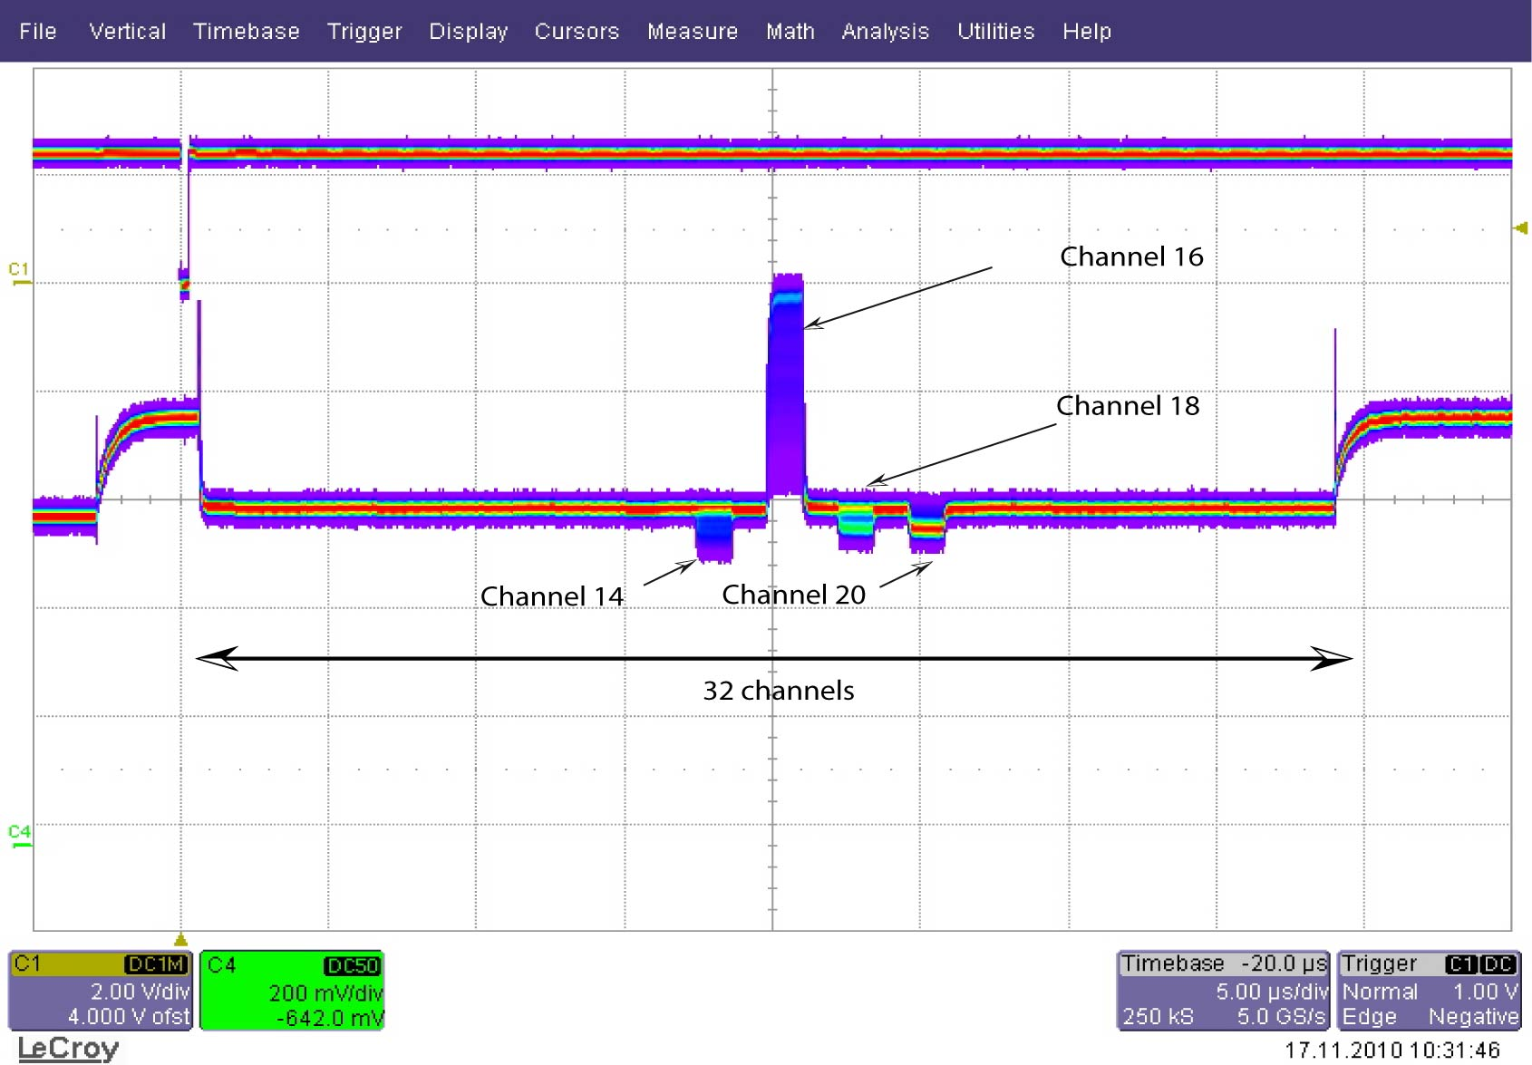
Problems which we do not observe
oscillations of the baseline and response to the large signals are eliminated using filter capacitor on pin iref_dac_5V
lost of the response and dead time for large signals is not observed, if the falling edge of test pulse is slow (e.g. 100 µs)
output dependence on DAC value is not observed

