Slide 1
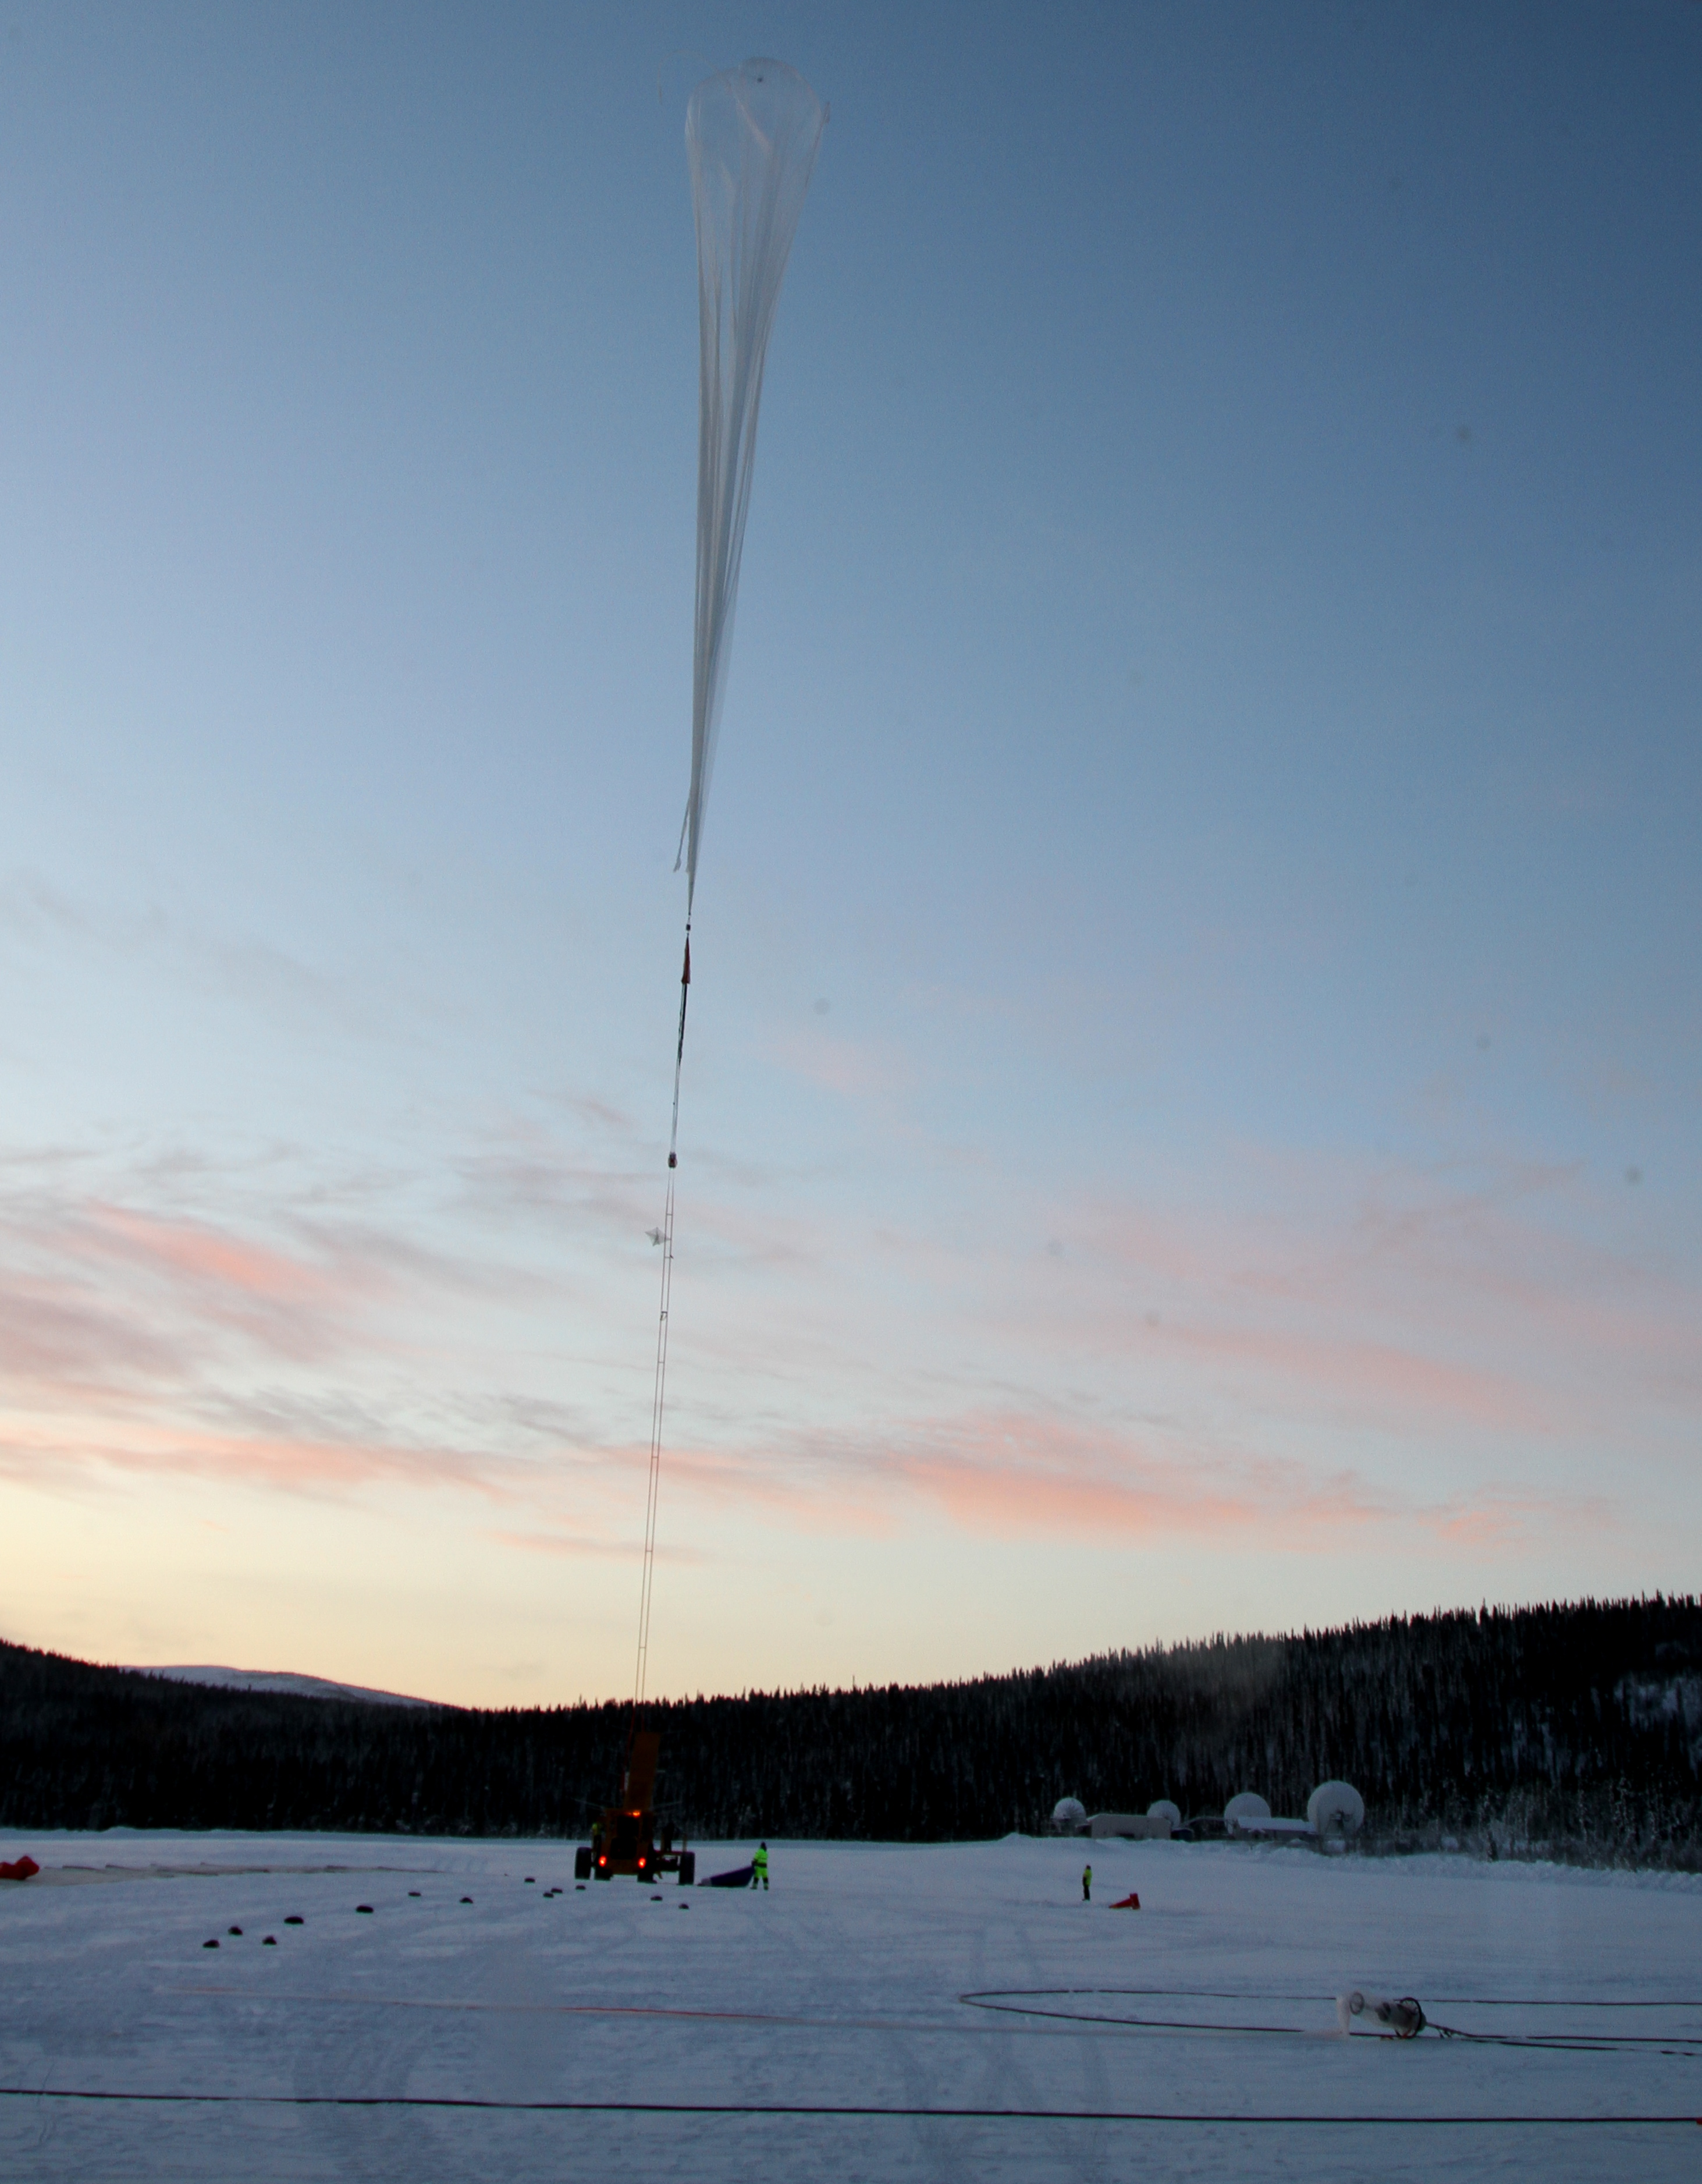
PEBS Prototype PERDaix was launched in October 2010 from Kiruna, Sweden

Slide 2
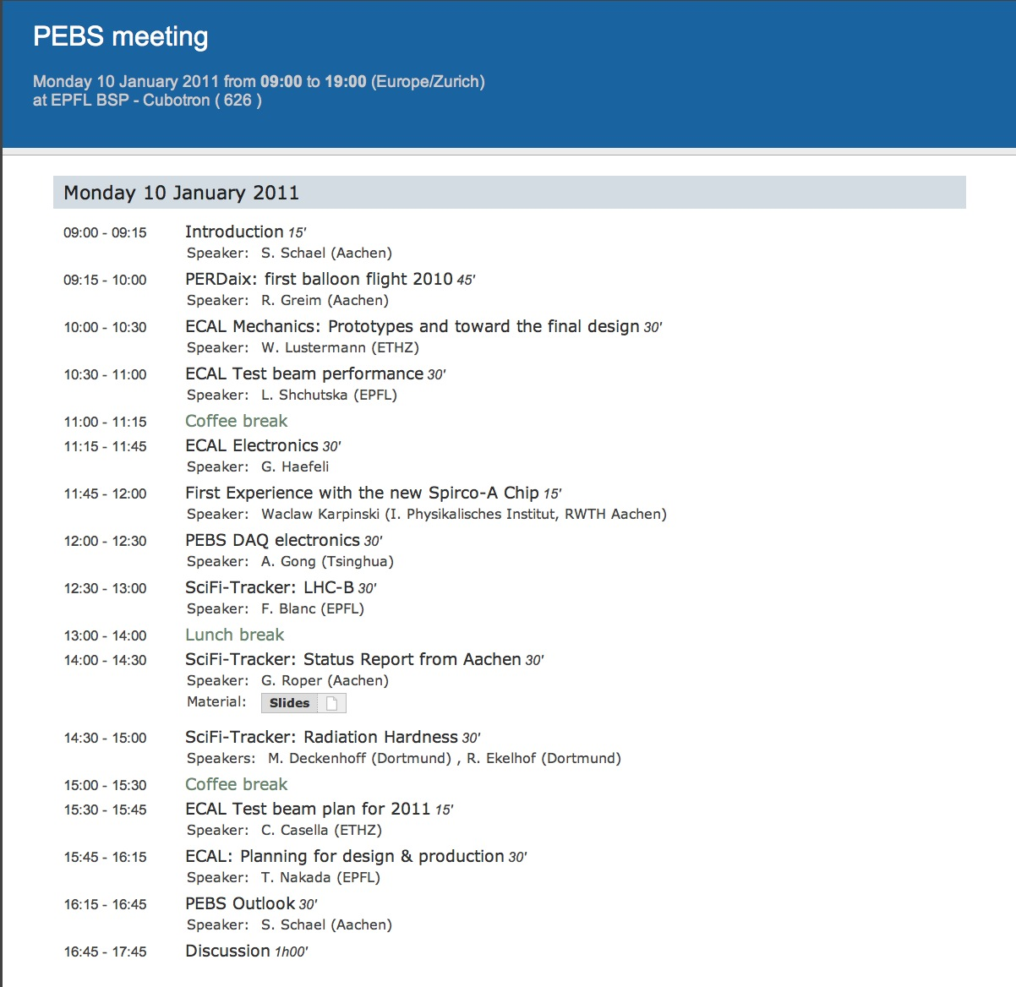

Slide 3
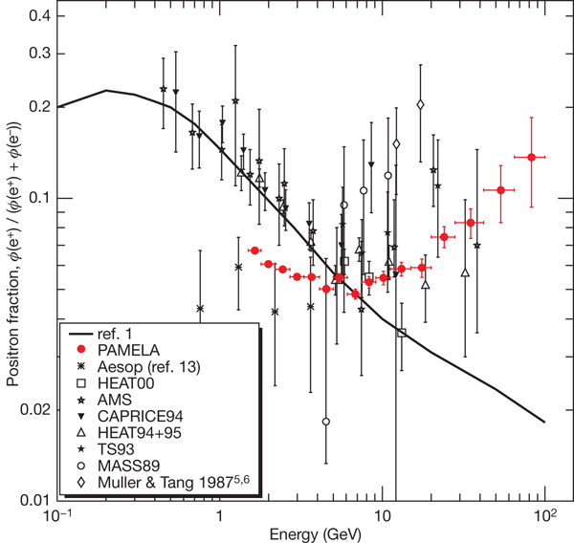
Dark Matter ?
Astrophysics ?
Solar Modulation ?
Galprop
Adriani+’08

Slide 4
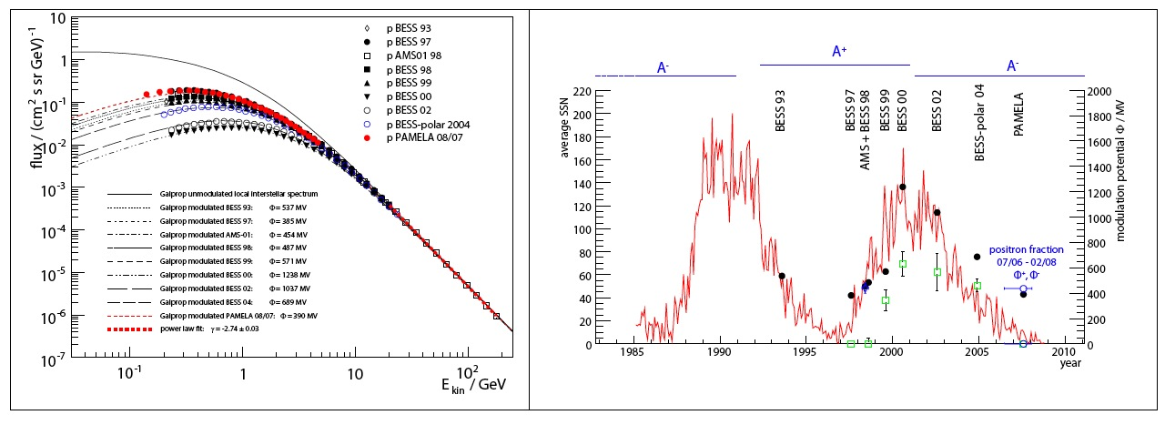
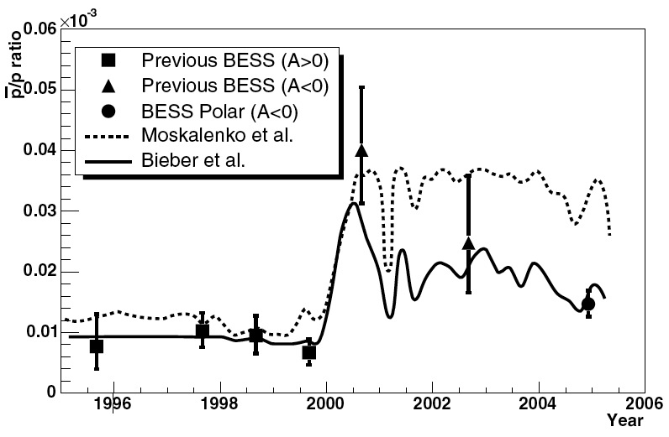
Charge-Sign dependent Solar Modulation ?
Proton
Anti-Proton

Slide 5
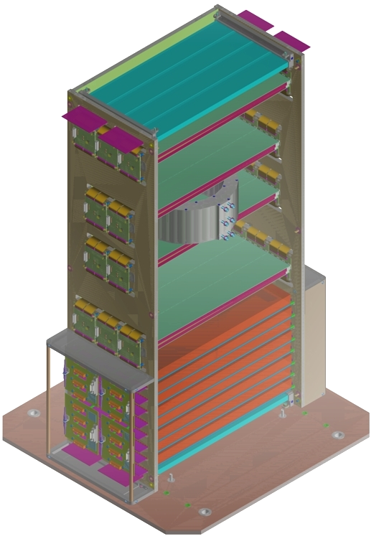
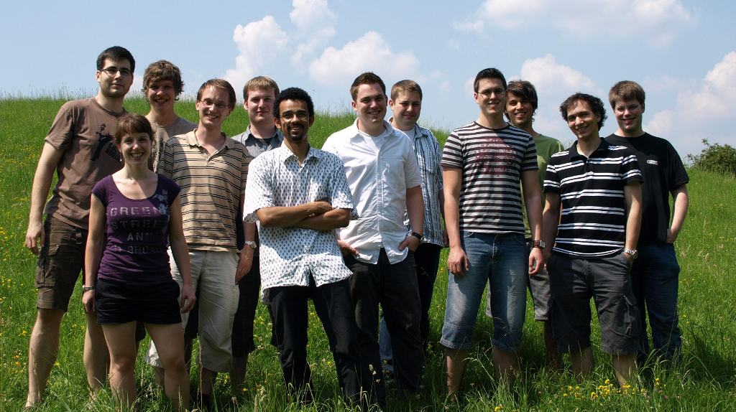

PEBS Prototype: PERDaix
Acceptance ~40 cm²sr
weight ~40kg
power ~90W
200mm
420mm
Proton Electron Radiation Detector Aix-La-Chapelle
Balloon-borne spectrometer
Measurement of cosmic rays up to 5 GeV
First successfull balloon flight in October 2010
800mm

Slide 6
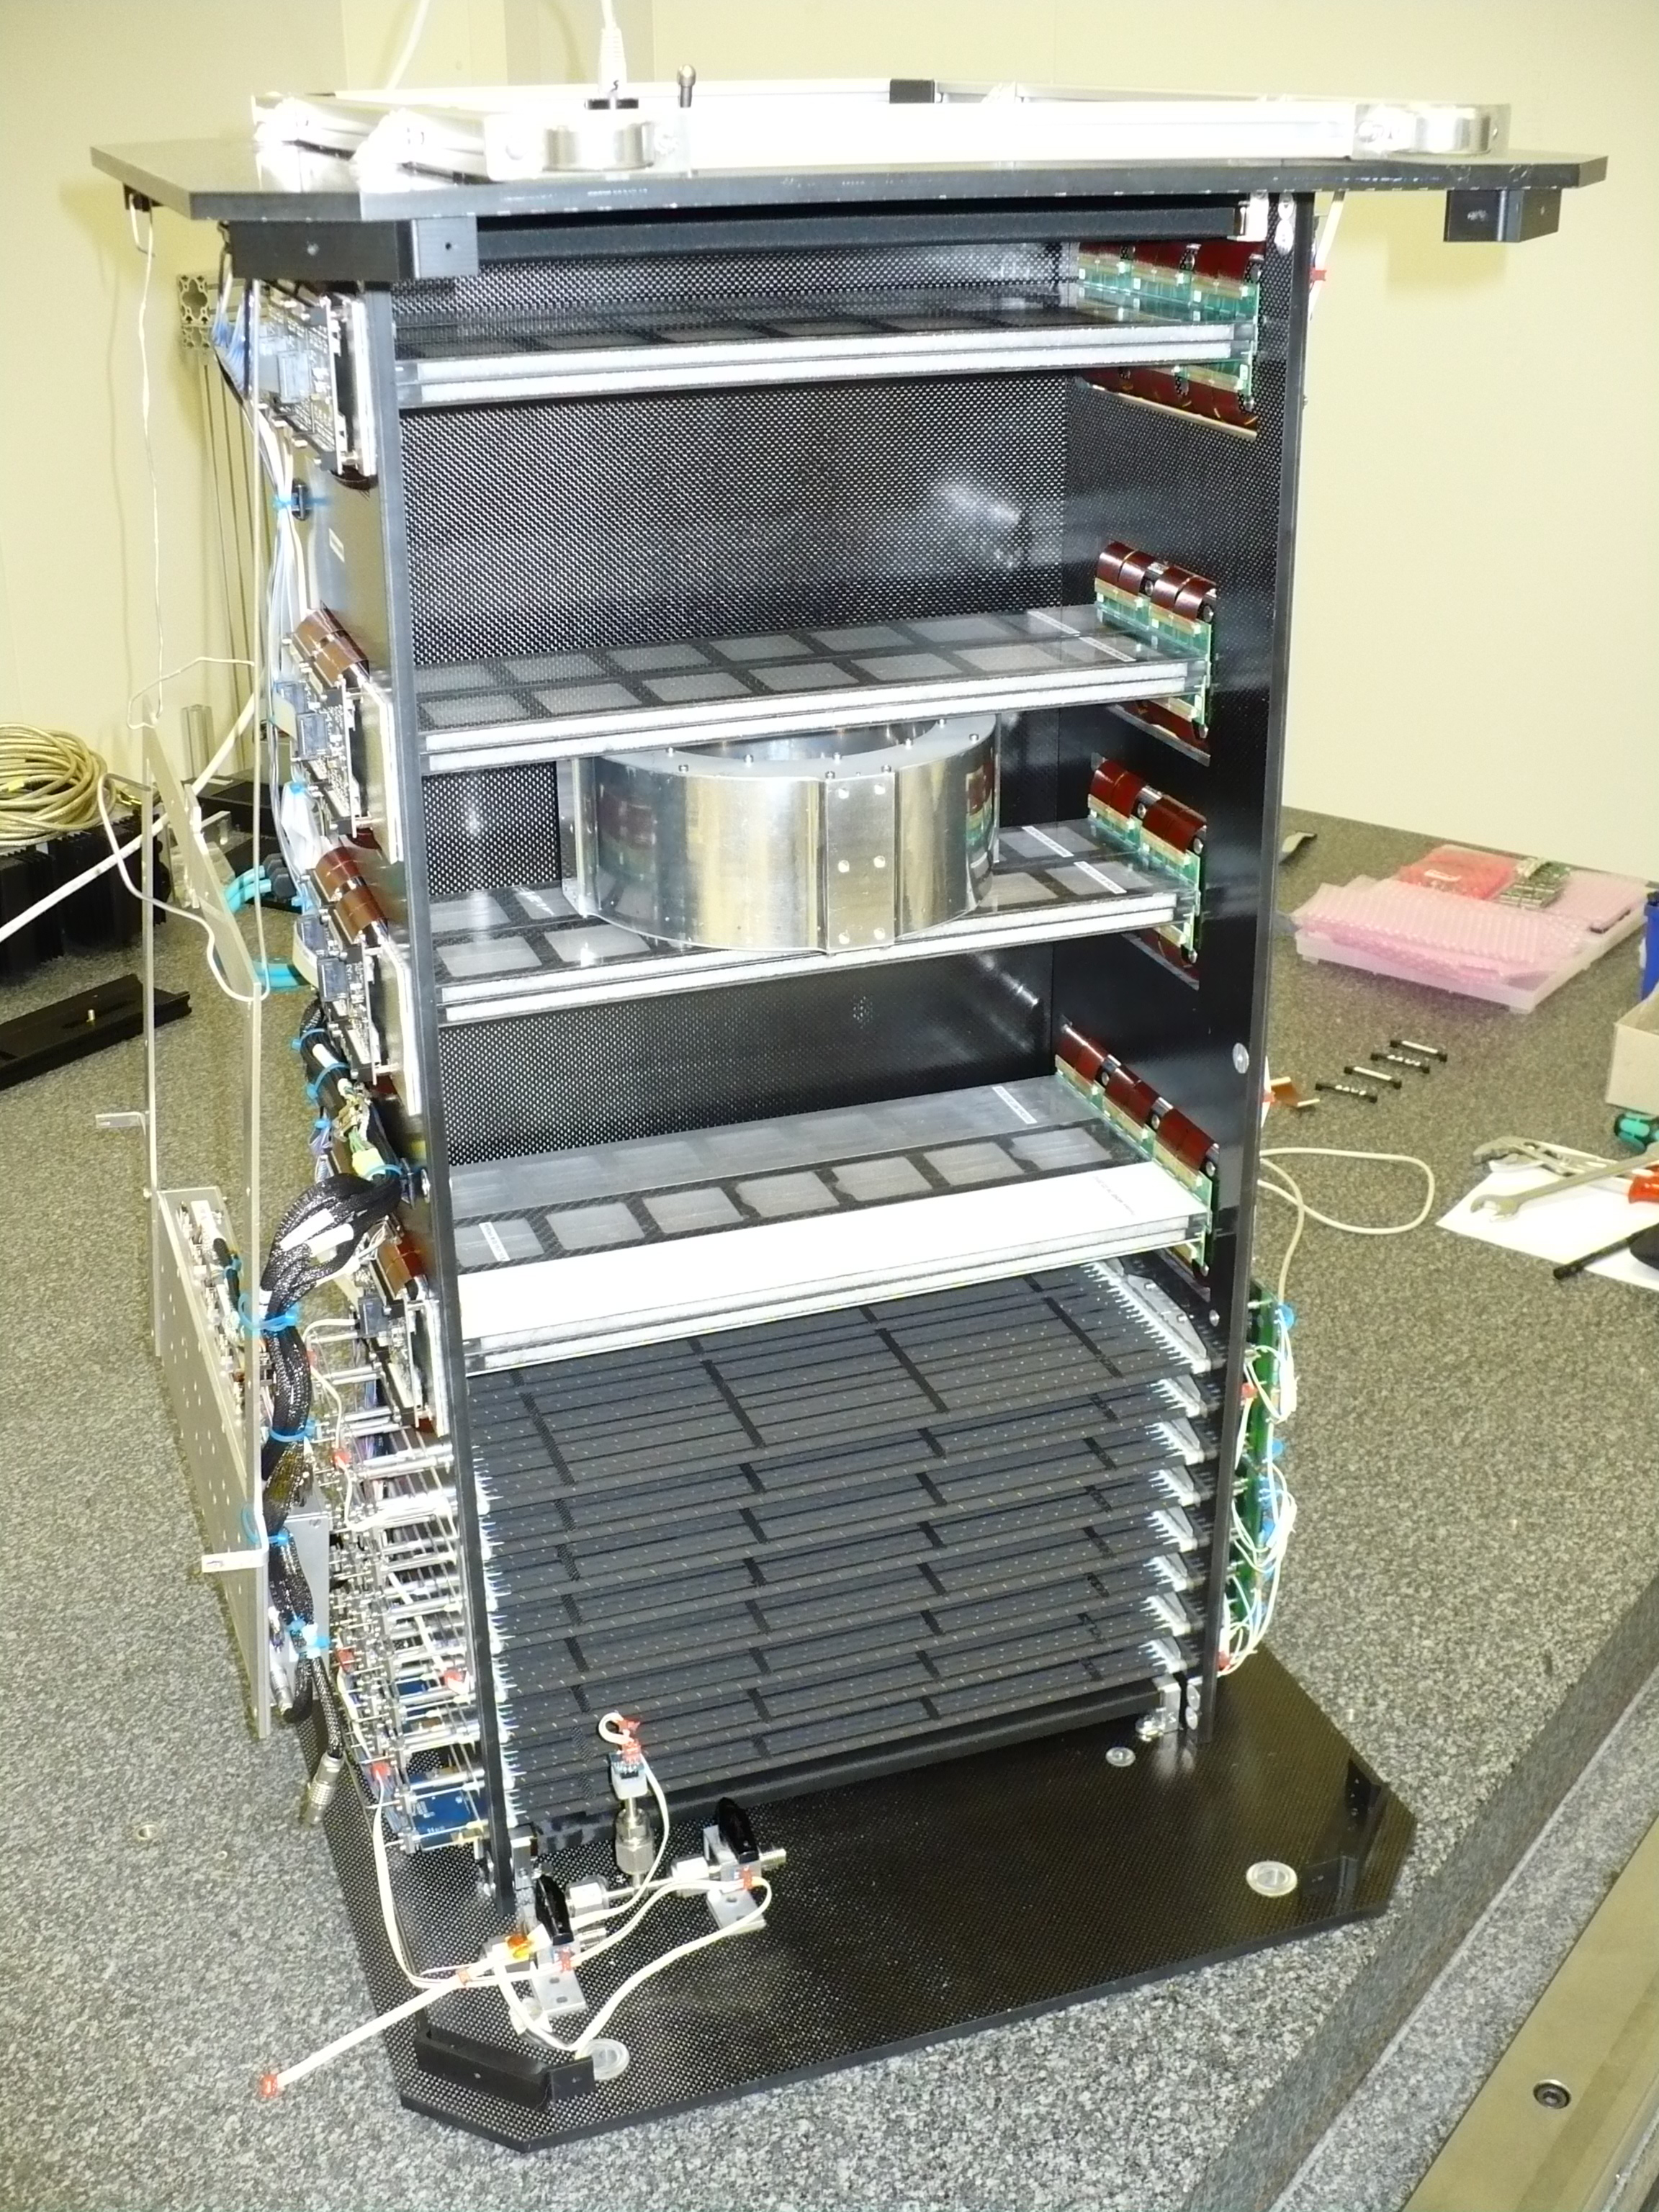
PEBS Prototype: PERDaix
Acceptance ~40 cm²sr
weight ~40kg
power ~90W
Proton Electron Radiation Detector Aix-La-Chapelle
Balloon-borne spectrometer
Measurement of cosmic rays up to 5 GeV
First successfull balloon flight in October 2010

Slide 7
B/C - data
Dark Matter ?
Astrophysics ?
B.Beischer et al., New Journal of Physics 11 (2009) 105021(15pp).
Galprop

Slide 8
(5 years)
PEBS-02, 1 GeV – 2 TeV
Pulsar
400 GeV WIMP
Galprop
AMS-02, 1 GeV – 1 TeV
PAMELA, 1 GeV – 0.5 TeV

Slide 9
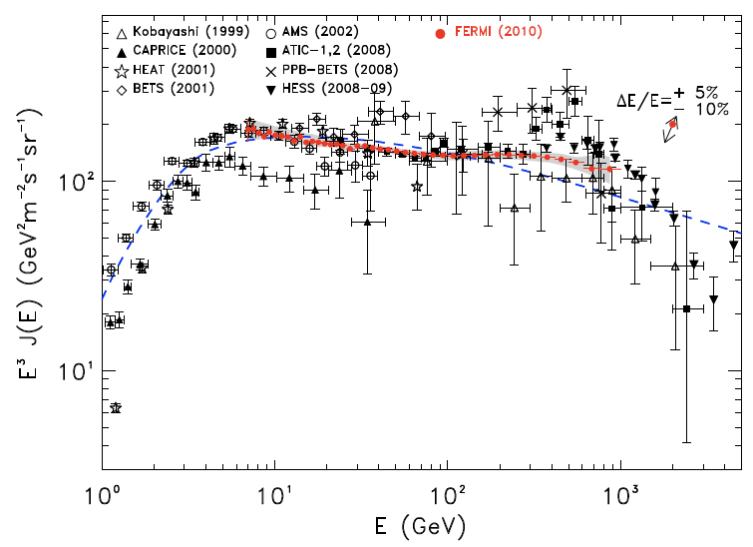
PEBS-02, e⁻ 1 GeV – 2 TeV
Fermi
What’s here?
Electrons + Positrons
HESS
I.Moskalenko, COSPAR 2010, Bremen
AMS-02, e⁻ 1 GeV – 1 TeV
PAMELA, e⁻ 1 GeV – 0.5 TeV

Slide 10



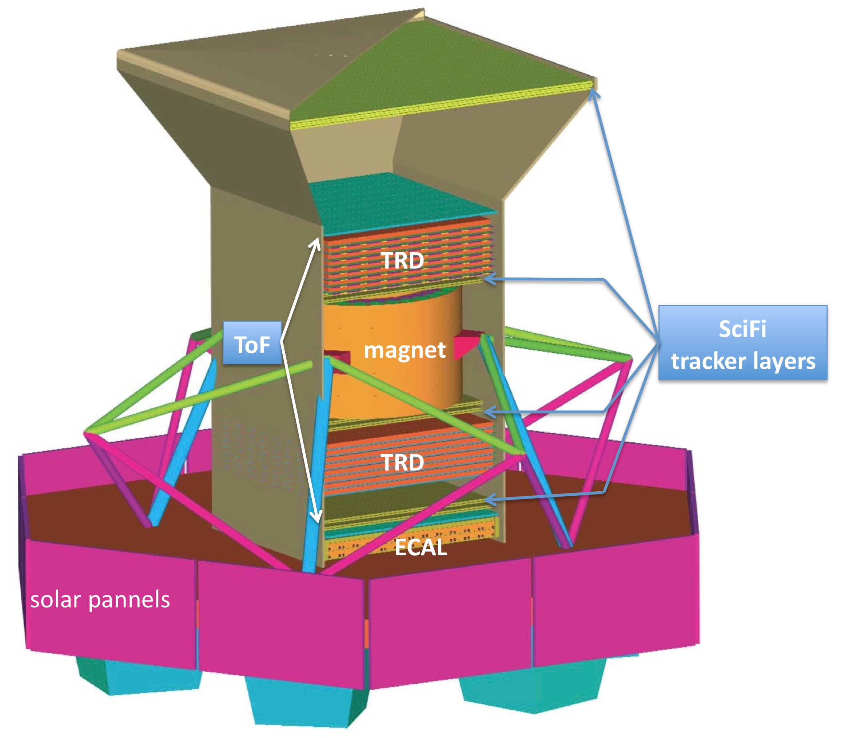
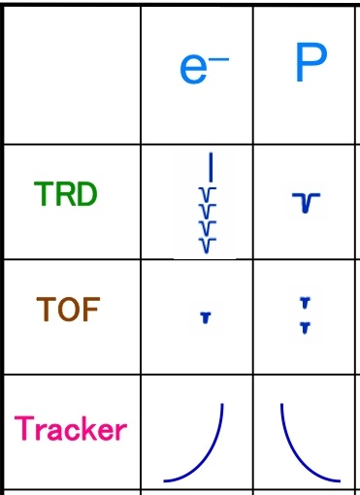
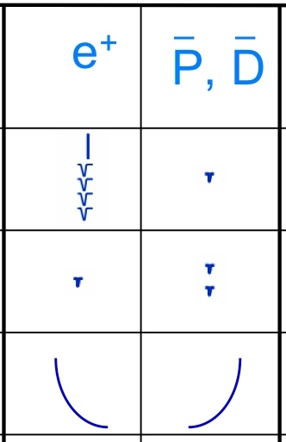
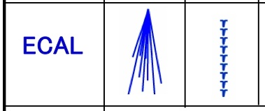
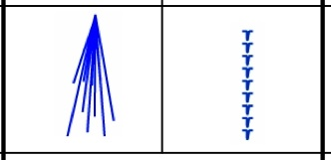
PEBS Experiment
The overall height, including the lower crush pads, is 2.7 m and the overall width is 3.3 m. The total weight of the instrument is 2000 kg.

Slide 11
Outer SciFi Tracker 1
PEBS-1
The magnetic spectrometer has a
geometrical acceptance of 1200 cm² sr
for electrons.
The most important contributions to the
overall weight are the magnet (890 kg) and
the calorimeter (650 kg),
The power consumption is dominated by
the 250 W needed for the tracker which
has roughly 60,000 individual readout
channels.
The lower detector combination of TRD
and ECAL, which can be used for the
measurement of the combined electron-
positron spectrum at high energies, has an
acceptance of 6000 cm² sr.
TRD 1
Inner SciFi Tracker
B=0.34 T
Permanent
Magnet
ToF
TRD 2
Outer SciFi Tracker 2
ECAL

Slide 12
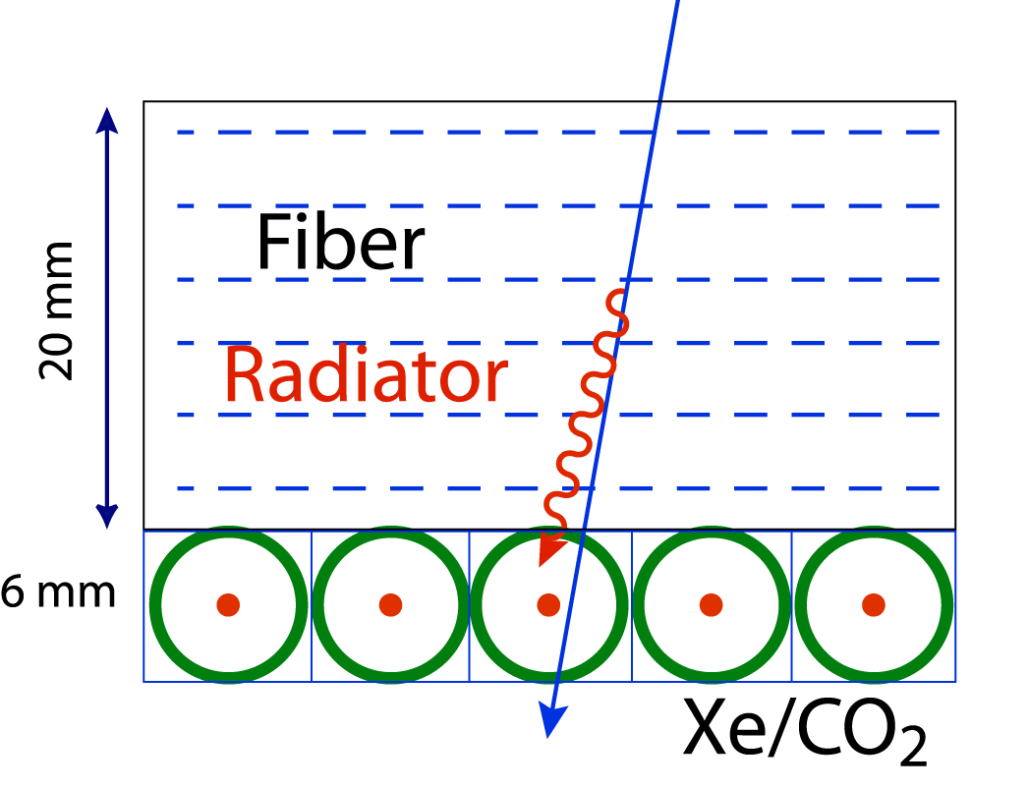
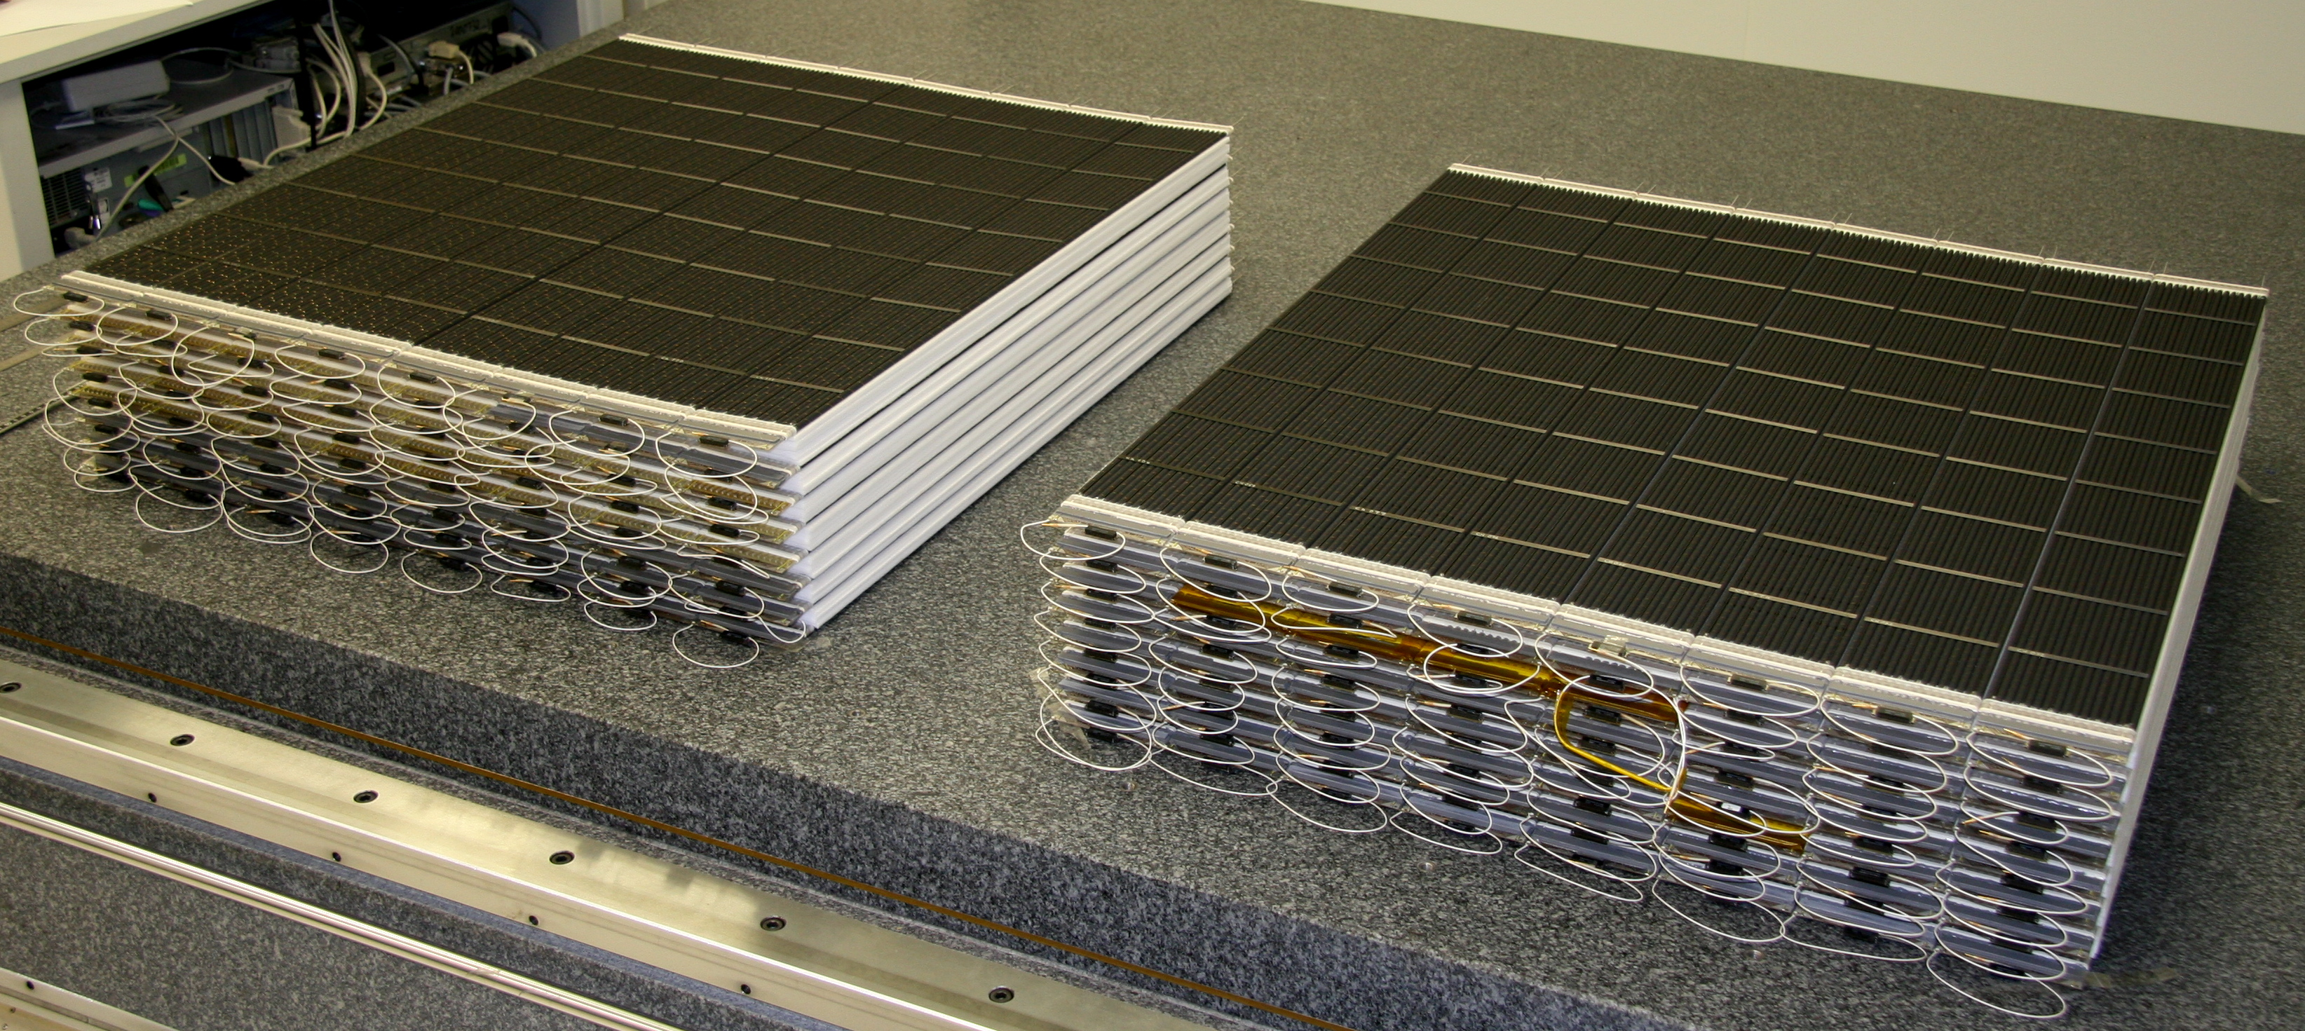
PEBS TRD
2x8 Layers each existing of:
20 mm fibre fleece
Ø 6 mm straw tubes filled with Xe/CO₂ 80%/20%
HV 1450 V
e
p
TRD 1
TRD 2
production of 128 TRD modules
completed

