Slide 1

Modelling of beam separation scan for q-Gaussian beams
Mohamed Abed
School of Nuclear Science and Engineering, TPU, Tomsk. Russia
Faculty of Science, ASU, Cairo, Egypt
abedmohamed@tpu.ru
atef0101431@sci.asu.edu.eg
2022

Slide 2
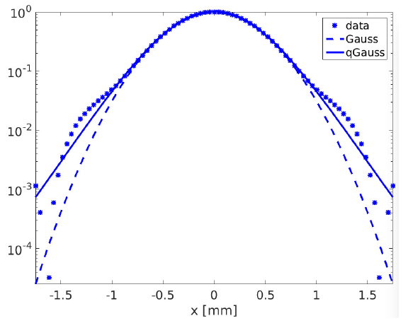


Motivation
$$q =1.12±0.01$$
High energy colliders such as LHC has non-Gaussian tails due to several effects (IBS, SR, B-B, e-cloud, non-linearities……).
In [1], H. Timko et al. observed that the actual bunch profile does not follow the exact Gaussian distribution, but they have a different tail’s population than Gaussian.
In [2,3], M. Fitterer et al. and S. Papadopoulou observed that the q-Gaussian provides a more realistic model for the bunch profile for LHC and also for the HL-LHC upgrade.
Fig. 1: A horizontal bunch profile at the 6.5 TeV energy, as measured by the BSRT, is denoted by blue stars. It is fitted with the Gaussian (dashed line) and the q-Gaussian (solid line) functions [3].
2

Slide 3
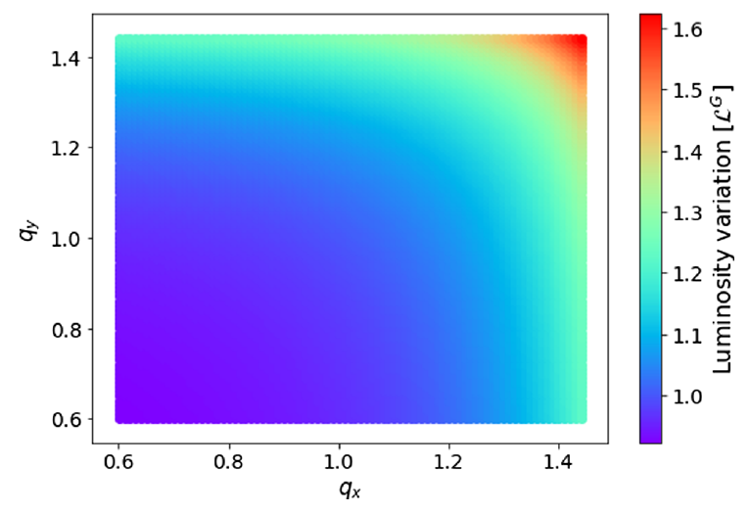

Motivation
In [4], S. Papadopoulou et al. studied the impact of the non-Gaussian beams profile on luminosity and on the emittance evolution using q-Gaussian to consider the beam size modification and particle distribution for IBS and SR effects, and it is compared to Gaussian.
As the beam separation scan is the method for beam luminosity calibration (van-der-Meer) => it is of interest to develop the method of this scan with q-Gaussian beams.
Fig. 2: Luminosity of q-Gaussian beams w.r.t. Gaussian beams, where the tail’s weight of transverse bunch profile are $q_{x}$ and $q_{y}$ [4].
3

Slide 4
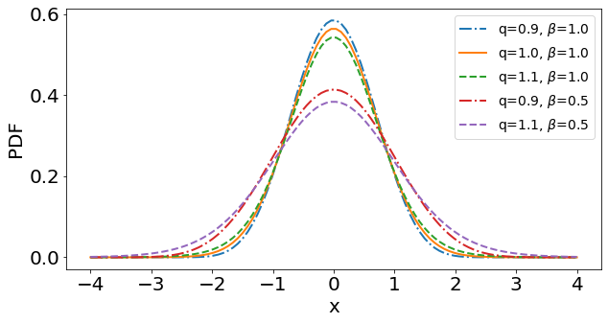

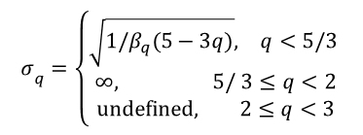
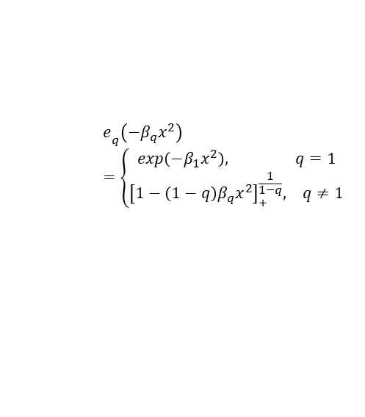
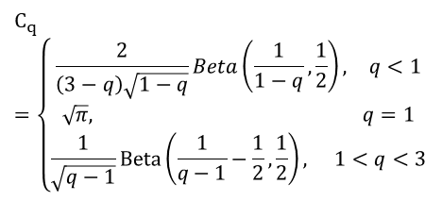

Q-Gaussian distribution
$$QG\left(x;q,β_{q}\right)=\frac{\sqrt{β_{q}}}{C­_{q}}e­_{q}\left(−β_{q}x^{2}\right)$$
(1)
$$e­_{q}\left(−β_{q}x^{2}\right)=\left\{\begin{aligned}\begin{matrix}exp\left(−β_{1}x^{2}\right), & q=1\end{matrix} \\ \begin{matrix}{\left[1−\left(1−q\right)β_{q}x^{2}\right]}_{+}^{\frac{1}{1−q}}, & q≠1\end{matrix}\end{aligned}\right.$$
(2)
q: weight of tails
$$C_{q}=\left\{\begin{aligned}\begin{matrix}\frac{2}{\left(3−q\right)\sqrt{1−q}}Beta\left(\frac{1}{1−q},\frac{1}{2}\right), & q<1\end{matrix} \\ \begin{matrix}\sqrt{π}, & q=1\end{matrix} \\ \begin{matrix}\frac{1}{\sqrt{q−1}}Beta\left(\frac{1}{q−1}−\frac{1}{2},\frac{1}{2}\right), & 1<q<3\end{matrix}\end{aligned}\right.$$
Fig. 3: q-Gaussian distribution for different q and $β$ values.
(3)
Standard deviation
$$σ­_{q}=\left\{\begin{aligned}\begin{matrix}\sqrt{1/β_{q}(5−3q)}, & q<5/3 \end{matrix} \\ \begin{matrix}∞, & 5/ 3≤q<2\end{matrix} \\ \begin{matrix}undefined, & 2≤q<3\end{matrix}\end{aligned}\right.$$
(4)
4

Slide 5
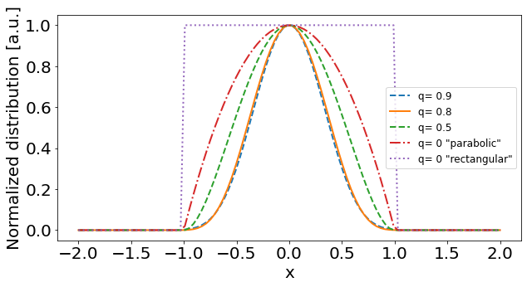
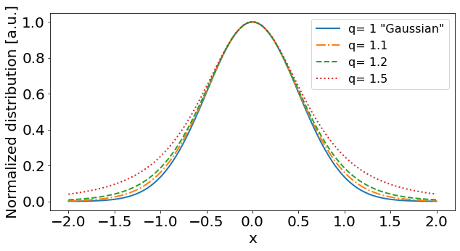
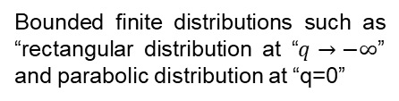
Why q-Gaussian beams?
The q-Gaussian distribution has diverse applications in generalized statistical theory, laser, plasma, and astronomy.
The q-Gaussian distribution is known for its remarkable ability to represent a vast of distributions:
Bounded finite distributions such as “rectangular distribution at “$q→−∞$” and parabolic distribution at “q=0”
Heavy-tailed infinite distributions such as “Student’s t-distribution”.
(a)
(b)
5
Fig. 4: finite (a) and infinite (b) q-Gaussian distribution.

Slide 6
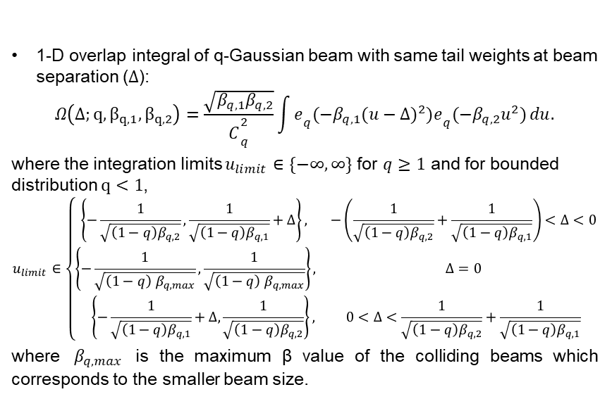
Overlap integral for q-Gaussian beams
1-D overlap integral of q-Gaussian beam with same tail weights at beam separation ($Δ$):
$$Ω\left(Δ;q, β_{q,1},β_{q,2}\right)=\frac{\sqrt{β_{q,1}β_{q,2}}}{C­_{q}^{2}}\int{e­_{q}(−β_{q,1}{(u−Δ)}^{2})e­_{q}(−β_{q,2}u^{2})}du.$$
where the integration limits $u_{limit}∈\{−∞,∞\}$ for $q≥1$ and for bounded distribution $q<1$,
$$u_{limit}∈\left\{\begin{aligned}\begin{matrix}\left\{−\frac{1}{\sqrt{\left(1−q\right)β_{q,2}}},\frac{1}{\sqrt{\left(1−q\right)β_{q,1}}}+Δ\right\}, & −\left(\frac{1}{\sqrt{\left(1−q\right)β_{q,2}}}+\frac{1}{\sqrt{\left(1−q\right)β_{q,1}}}\right)<Δ<0 \\ \left\{−\frac{1}{\sqrt{\left(1−q\right){ β}_{q, max}}},\frac{1}{\sqrt{\left(1−q\right){ β}_{q,max}}}\right\}, & Δ=0\end{matrix} \\ \begin{matrix}\left\{−\frac{1}{\sqrt{\left(1−q\right)β_{q,1}}}+Δ,\frac{1}{\sqrt{\left(1−q\right)β_{q,2}}}\right\}, & 0<Δ<\frac{1}{\sqrt{\left(1−q\right)β_{q,2}}}+\frac{1}{\sqrt{\left(1−q\right)β_{q,1}}}\end{matrix}\end{aligned}\right.$$
where ${ β}_{q, max}$ is the maximum β value of the colliding beams which corresponds to the smaller beam size.
(5)
(6)
6

Slide 7
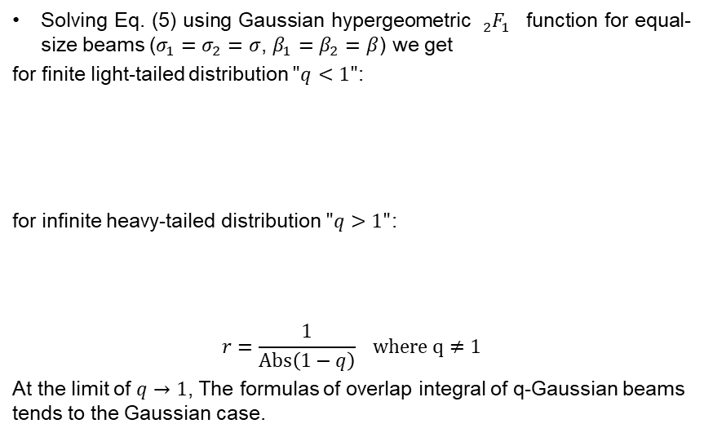
Analytical formalism for the overlap integral of q-Gaussian beams
Solving Eq. (5) using Gaussian hypergeometric ${{}_{2}^{}F}_{1}^{}$ function for equal-size beams ($σ_{1}=σ_{2}=σ$, $β_{1}=β_{2}=β$) we get
for finite light-tailed distribution $"q<1"$:
for infinite heavy-tailed distribution $"q>1"$:
$$r=\frac{1}{Abs\left(1−q\right)} where q≠1$$
At the limit of $q→1$, The formulas of overlap integral of q-Gaussian beams tends to the Gaussian case.
(7)
(8)
7

Slide 8
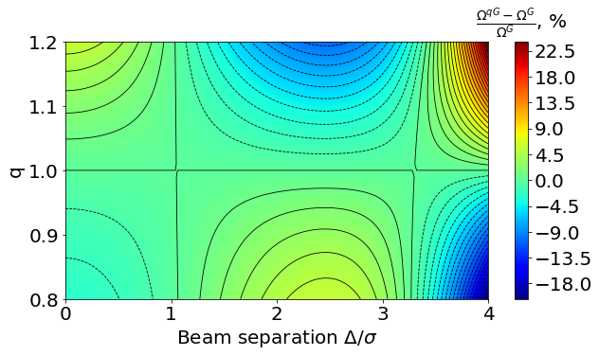

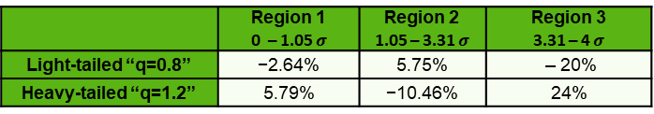
Overlap integral of Gaussian vs. q-Gaussian
Table 1: The limits of the deviation of the $Ω_{qG}$ from $Ω_{G}$ in different dependency regions during the vdM scan.
 | Region 1 0 – 1.05 $σ$ | Region 2 1.05 – 3.31 $σ$ | Region 3 3.31 – 4 $σ$
Light-tailed “q=0.8” | −2.64% | 5.75% | – 20%
Heavy-tailed “q=1.2” | 5.79% | −10.46% | 24%
region-1
region-2
region-3
Heavy-tailed
1
a
a
2
b
b
3
Light-tailed
Fig. 5: The deviation map of $Ω_{qG}$ from $Ω_{G}$during the vdM scan in the range 0 to 4 $σ_{q}$ for fixed beam size$σ_{q}$=100 μm with q in the range 0.8 to 1.2 obtained by numerical integration of Eq. (5).
8

Slide 9
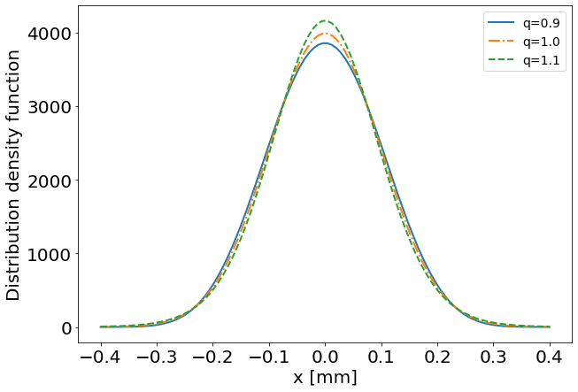
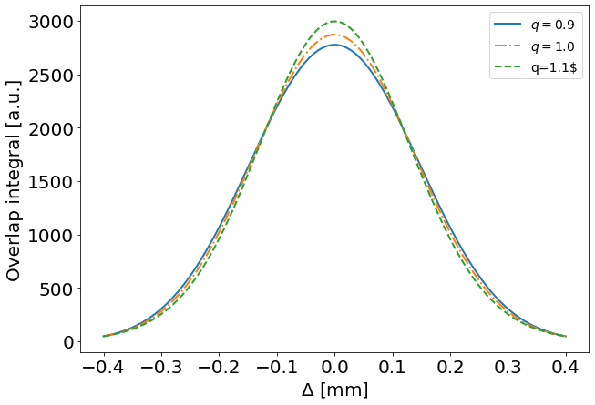
Overlap integral of Gaussian vs. q-Gaussian
a
b
(a)
(b)
Fig. 6: The bunch profile (a) and the respective overlap integral (b) for different tail weights q.
9

Slide 10
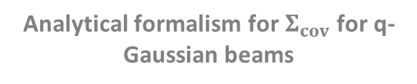
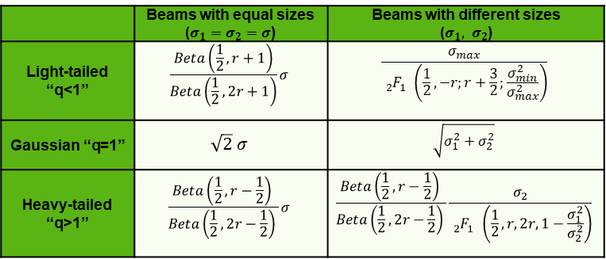

Analytical formalism for $Σ_{cov}$ for q-Gaussian beams
Since the overlap integral Ω(Δ) and the reaction rate R(Δ) follows the same dependence on the beam separation
$$Σ_{conv}=\frac{1}{C}\frac{∫R\left(Δ\right)dΔ}{R(0)}≡\frac{1}{C}\frac{∫Ω\left(Δ\right)dΔ}{Ω\left( 0\right)}$$
where for q-Gaussian
$$C=\sqrt{5−3q}{ C}_{q}$$
Table 2: Analytical formalism for $Σ_{conv}$of q-Gaussian beams
(9)
(10)
 | Beams with equal sizes ($σ_{1}=σ_{2}=σ$) | Beams with different sizes ($σ_{1}, σ_{2}$)
Light-tailed “q<1” | $$\frac{Beta\left(\frac{1}{2},r+1\right)}{­Beta\left(\frac{1}{2},2r+1\right)}σ$$ | $$\frac{σ_{max}}{{{}_{2}^{}F}_{1}^{}\left(\frac{1}{2},−r;r+\frac{3}{2};\frac{σ_{min}^{2}}{σ_{max}^{2}}\right)}$$
Gaussian “q=1” | $$\sqrt{2} σ$$ | $$\sqrt{σ_{1}^{2}+σ_{2}^{2}}$$
Heavy-tailed “q>1” | $$\frac{Beta\left(\frac{1}{2},r−\frac{1}{2}\right) }{Beta\left(\frac{1}{2},2r−\frac{1}{2}\right) }σ$$ | $$\frac{Beta\left(\frac{1}{2},r−\frac{1}{2}\right) }{Beta\left(\frac{1}{2},2r−\frac{1}{2}\right) }\frac{σ_{2}}{{{}_{2}^{}F}_{1}^{}\left(\frac{1}{2},r,2r,1−\frac{σ_{1}^{2}}{σ_{2}^{2}}\right)}$$
where r is defined as: $r=1/Abs\left(1−q\right),where q≠1$
10

Slide 11
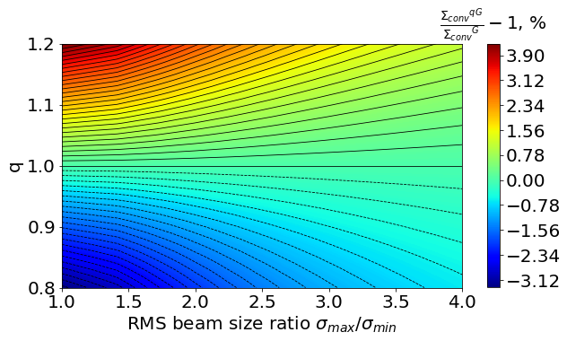

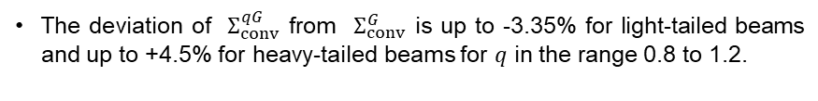
$Σ_{conv}$ for Gaussian vs. q-Gaussian
The deviation of $Σ_{conv}^{qG}$ from $Σ_{conv}^{G}$ is up to -3.35% for light-tailed beams and up to +4.5% for heavy-tailed beams for $q$ in the range 0.8 to 1.2.
Heavy-tailed
Light-tailed
Fig 7: The deviation map of $Σ_{conv}^{qG}$ from $Σ_{conv}^{G}$ for $q$ in the range 0.8 to1.2 and different beam size ratios in the range 1 to 4 obtained by numerical integration of Eq. (9).
11

Slide 12
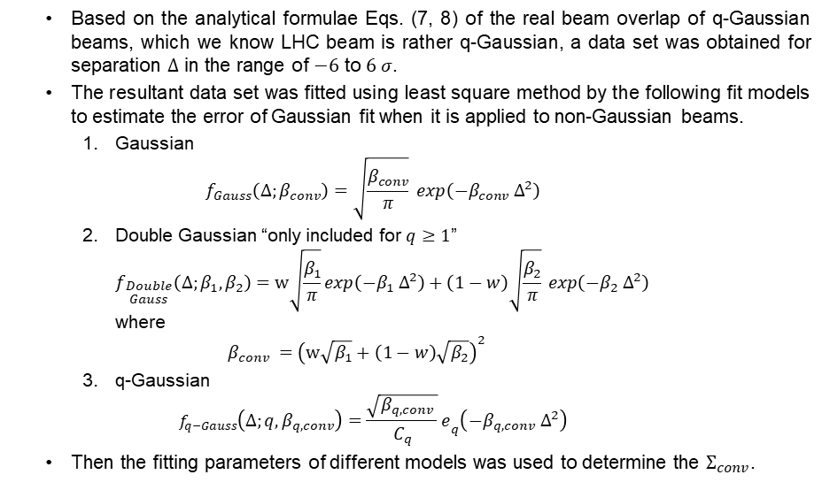
“Toy” vdM scan using q-Gaussian beams
  Based on the analytical formulae Eqs. (7, 8) of the real beam overlap of q-Gaussian beams, which we know LHC beam is rather q-Gaussian, a data set was obtained for separation $Δ$ in the range of $−6$ to $6 σ$.
  The resultant data set was fitted using least square method by the following fit models to estimate the error of Gaussian fit when it is applied to non-Gaussian beams.
    Gaussian
    $f_{Gauss}\left(Δ;β_{conv}\right)=\sqrt{\frac{β_{conv}}{π}} exp\left(−β_{conv} Δ^{2}\right)$
    Double Gaussian “only included for $q≥1$”
    $f_{\begin{aligned}Double \\ Gauss\end{aligned}}\left(Δ;β_{1},β_{2}\right)=w\sqrt{\frac{β_{1}}{π}}exp\left(−β_{1} Δ^{2}\right)+\left(1−w\right)\sqrt{\frac{β_{2}}{π}} exp\left(−β_{2} Δ^{2}\right)$
    where
    $β_{conv} ={\left(w\sqrt{β_{1}}+\left(1−w\right)\sqrt{β_{2}}\right)}^{2}$
    q-Gaussian
    $f_{q−Gauss}\left(Δ;q,β_{q,conv}\right)=\frac{\sqrt{β_{q,conv} }}{C_{q}}e­_{q}\left(−β_{q,conv} Δ^{2}\right)$
  Then the fitting parameters of different models was used to determine the $Σ_{conv}$.
(11)
(12)
(13)
12

Slide 13
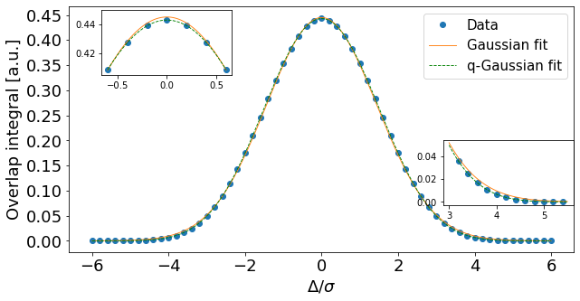
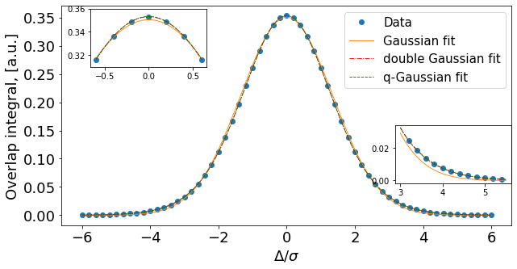
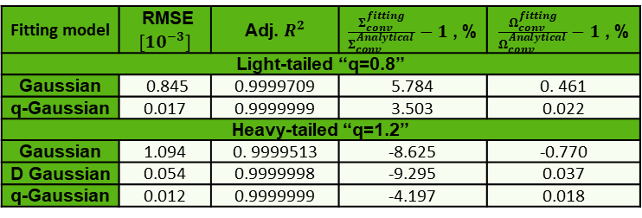

Results of “toy” vdM scan
(a)
(b)
Fig. 8: Fitting of toy scan data for light-tailed “q=0.8” (a) and heavy-tailed “q=1.2” (b) q-Gaussian beams.
Table 3: R statistics and results of the toy scan fitting.
Fitting model | RMSE $[{10}^{−3}]$ | Adj. $R^{2}$ | $\frac{Σ_{conv}^{fitting}}{Σ_{conv}^{Analytical }}−1$ , % | $\frac{Ω_{conv}^{fitting}}{Ω_{conv}^{Analytical }}−1$ , %
Light-tailed “q=0.8”
Gaussian | 0.845 | 0.9999709 | 5.784 | 0. 461
q-Gaussian | 0.017 | 0.9999999 | 3.503 | 0.022
Heavy-tailed “q=1.2”
Gaussian | 1.094 | 0. 9999513 | -8.625 | -0.770
D Gaussian | 0.054 | 0.9999998 | -9.295 | 0.037
q-Gaussian | 0.012 | 0.9999999 | -4.197 | 0.018
13
RMSE: Root mean square error.
Adj. $R^{2}$: Adjustable. $R^{2}.$

Slide 14
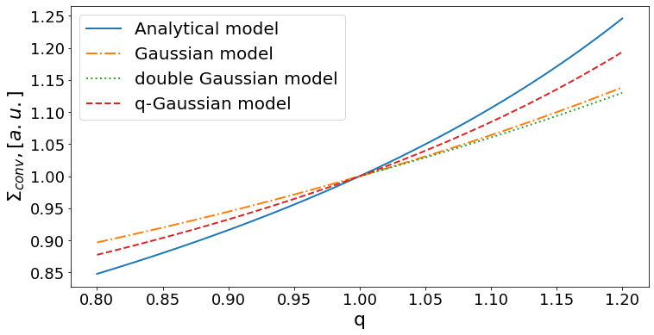
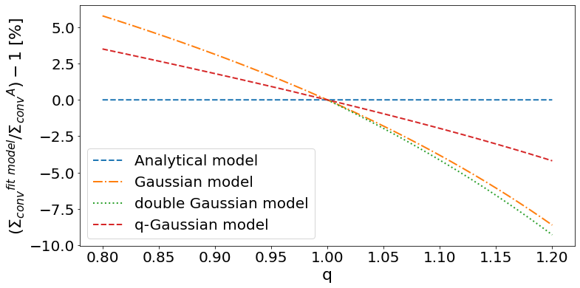
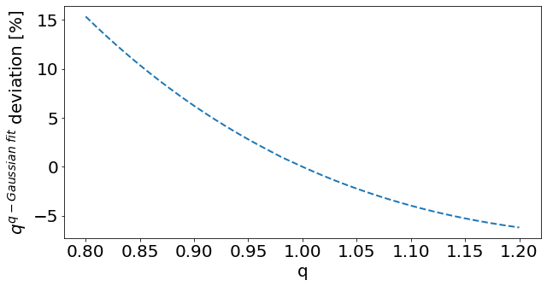
Results of “toy” vdM scan Cont.
(a)
(b)
Fig.9: The dependency of $Σ_{conv}^{fit model}$ (a) and its’ deviation from $Σ_{conv}^{Analytical }$ (b) on q.
14
Fig. 10: the deviation of q predicted by q-Gaussian fit model from q of the “toy” scan.

Slide 15
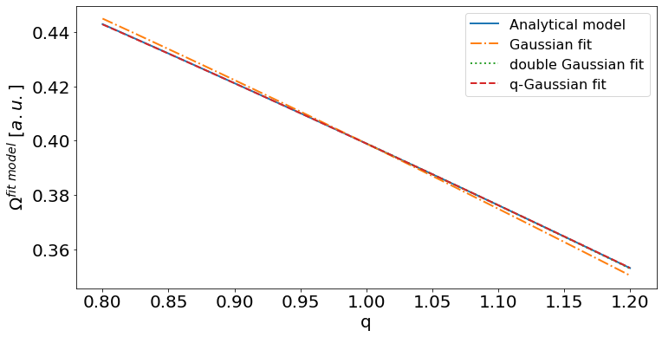
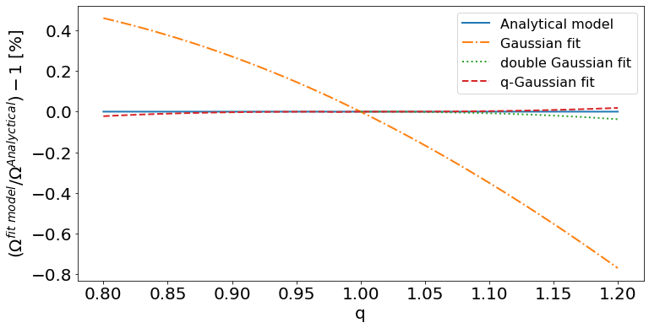
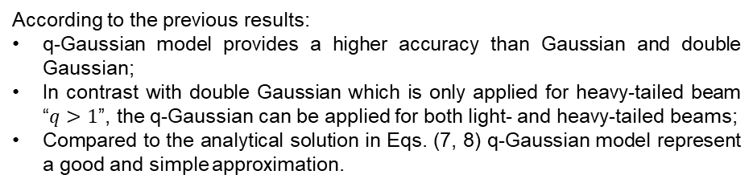
Results of “toy” vdM scan Cont.
(a)
(b)
Fig. 11: The dependency of $Ω^{fit model}$(a) and its deviation from $Ω^{Analytical}$ (b) on q.
According to the previous results:
q-Gaussian model provides a higher accuracy than Gaussian and double Gaussian;
In contrast with double Gaussian which is only applied for heavy-tailed beam “$q>1$”, the q-Gaussian can be applied for both light- and heavy-tailed beams;
Compared to the analytical solution in Eqs. (7, 8) q-Gaussian model represent a good and simple approximation.
15

Slide 16
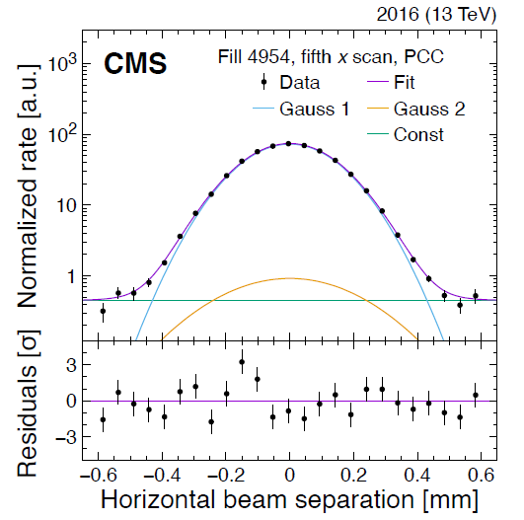
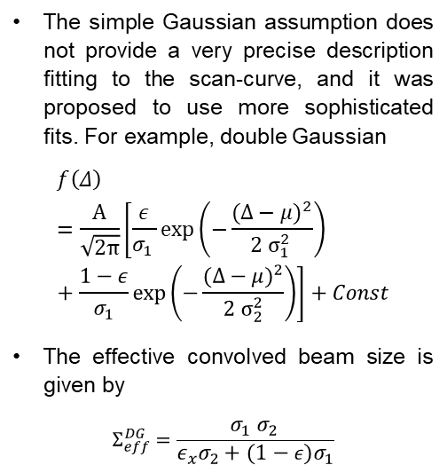
Current VdM scan fit model.
The simple Gaussian assumption does not provide a very precise description fitting to the scan-curve, and it was proposed to use more sophisticated fits. For example, double Gaussian
$$f\left(Δ\right)=\frac{A}{\sqrt{2π}}\left[\frac{ε}{σ_{1 }}\exp\left(−\frac{{(Δ−μ)}^{2}}{2 σ_{1 }^{2}}\right)+\frac{1−ε}{σ_{1}}\exp\left(−\frac{{(Δ−μ)}^{2}}{2 σ_{2}^{2}}\right)\right]+Const$$
The effective convolved beam size is given by
$$Σ_{eff}^{DG}=\frac{σ_{1} σ_{2 }}{ε_{x}σ_{2}+(1−ε)σ_{1}}$$
(14)
Fig. 12: Horizontal vdM scan at CMS at LHC using double Gaussian fit [5].
(15)
16

Slide 17
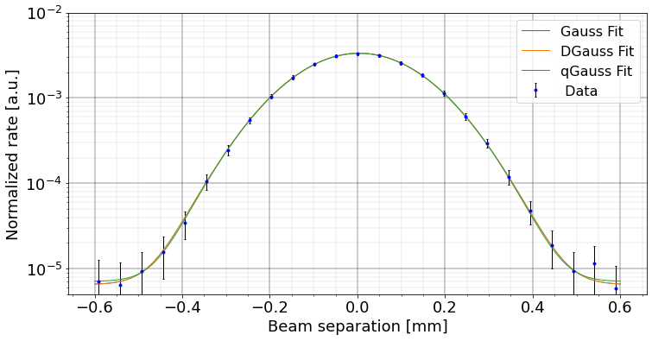
Real vdM scan at CMS
Two cases was considered:
  PLT_Fill=4954_BCID=2734_Scan_9_X
  PLT_Fill=4954_BCID=2734_Scan_10_Y
  Fig. 13: PLT_Fill=4954_BCID=2734_Scan_9_X
17

Slide 18
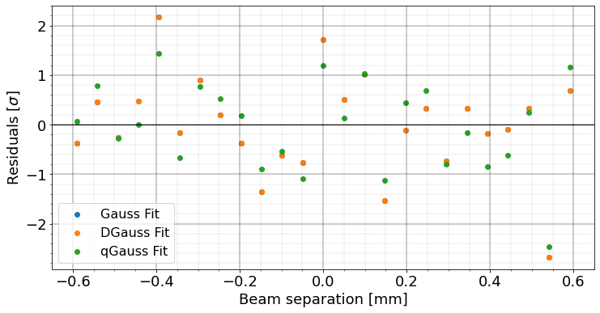

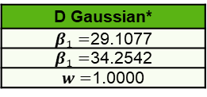

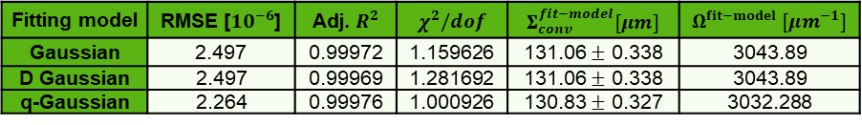


PLT_Fill=4954_BCID=2734_Scan_9_X
Gaussian
$β=$29.1077 $±$ 0.1504
D Gaussian*
$β_{1}=$29.1077
$β_{1}=$34.2542
$w=$1.0000
q-Gaussian
$q=$0.9849 $±$ 0.0073
$β=$28.5625 $±$ 0.2929
Fig. 14: Residuals of PLT_Fill=4954_BCID=2734_Scan_9_X
Table 4: Fitting parameters and statistical analysis.
Fitting model | RMSE [$10^{−6}$] | Adj. $R^{2}$ | $χ^{2}/dof$ | $Σ_{conv}^{fit−model}[μm]$ | $Ω^{fit−model} [μm^{−1}]$
Gaussian | 2.497 | 0.99972 | 1.159626 | 131.06 $±$ 0.338 | 3043.89
D Gaussian | 2.497 | 0.99969 | 1.281692 | 131.06 $±$ 0.338 | 3043.89
q-Gaussian | 2.264 | 0.99976 | 1.000926 | 130.83 $±$ 0.327 | 3032.288
RMSE: Root mean square error.
Adj. $R^{2}$: Adjustable. $R^{2}.$
$χ^{2}/dof$: Reduced $χ^{2}$.
18

Slide 19
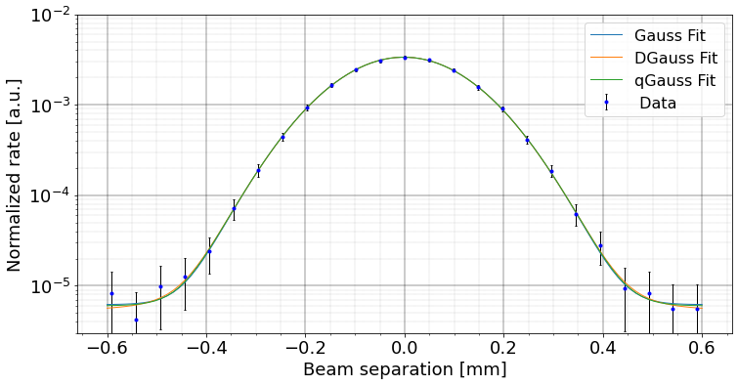
PLT_Fill=4954_BCID=2734_Scan_10_Y
  Fig. 15: PLT_Fill=4954_BCID=2734_Scan_10_Y
19

Slide 20
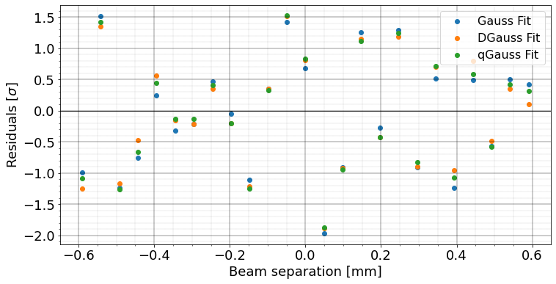

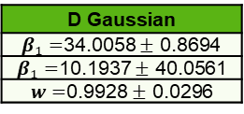


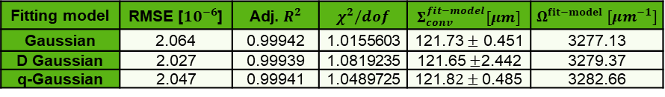

PLT_Fill=4954_BCID=2734_Scan_10_Y
Gaussian
$β=$33.7394 $±$ 0.2501
D Gaussian
$β_{1}=$34.0058 $±$ 0.8694
$β_{1}=$10.1937 $±$ 40.0561
$w=$0.9928 $±$ 0.0296
q-Gaussian
$q=$1.0064 $±$ 0.0111
$β=$34.0175 $±$ 0.5507
Fig. 16: Residuals of PLT_Fill=4954_BCID=2734_Scan_10_Y
Table 5: Fitting parameters and statistical analysis.
Fitting model | RMSE [$10^{−6}$] | Adj. $R^{2}$ | $χ^{2}/dof$ | $Σ_{conv}^{fit−model}[μm]$ | $Ω^{fit−model} [μm^{−1}]$
Gaussian | 2.064 | 0.99942 | 1.0155603 | 121.73 $±$ 0.451 | 3277.13
D Gaussian | 2.027 | 0.99939 | 1.0819235 | 121.65 $±$2.442 | 3279.37
q-Gaussian | 2.047 | 0.99941 | 1.0489725 | 121.8$2±$ 0.485 | 3282.66
RMSE: Root mean square error
Adj. $R^{2}$: Adjustable $R^{2}$
$χ^{2}/dof$: Reduced $χ^{2}$
20

Slide 21
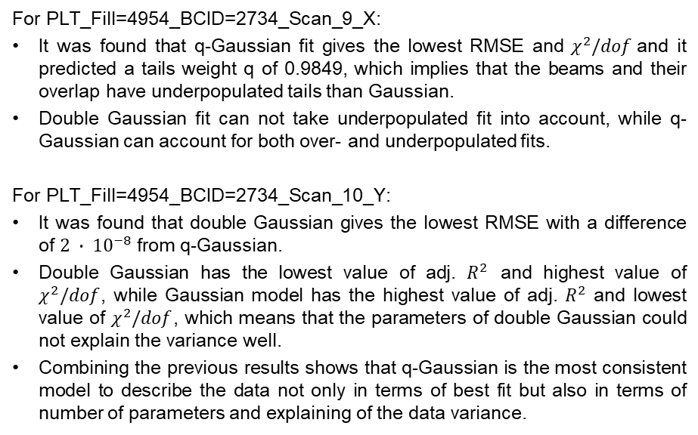
Results on real vdM scan at CMS
For PLT_Fill=4954_BCID=2734_Scan_9_X:
It was found that q-Gaussian fit gives the lowest RMSE and $χ^{2}/dof$and it predicted a tails weight q of 0.9849, which implies that the beams and their overlap have underpopulated tails than Gaussian.
Double Gaussian fit can not take underpopulated fit into account, while q-Gaussian can account for both over- and underpopulated fits.
For PLT_Fill=4954_BCID=2734_Scan_10_Y:
It was found that double Gaussian gives the lowest RMSE with a difference of $2 ∙ {10}^{−8}$ from q-Gaussian.
Double Gaussian has the lowest value of adj. $R^{2}$ and highest value of $χ^{2}/dof$, while Gaussian model has the highest value of adj. $R^{2}$ and lowest value of $χ^{2}/dof$, which means that the parameters of double Gaussian could not explain the variance well.
Combining the previous results shows that q-Gaussian is the most consistent model to describe the data not only in terms of best fit but also in terms of number of parameters and explaining of the data variance.
21

Slide 22
Discussion and conclusions
In modern colliders, particles in the beam experience several effects that slightly deviate the beam density from the exact Gaussian distribution; hence, using a general distribution function such as q-Gaussian can describe the beam profiles more realistic.
The new luminosity models should be developed to consider the effects of the non-Gaussian tails on the luminosity estimation.
It was shown that in case of non-Gaussian beams. A more precise models is needed for preforming vdM scan since using Gaussian or double Gaussian models might results into a misestimation of the calibrated luminosity.
It was shown that the q-Gaussian fits not only the overpopulated fits but also the underpopulated fits more precisely than current models.
It was found that q-Gaussian model represent a good approximation of the analytical model with simpler form.
Models based on q-Gaussian is advised to be further studied and tested on more actual scan data since it can be useful to be applied for the HL-LHC upgrade.
22

Slide 23
References
H. Timko, P. Baudrenghien, J. E. Müller, and E. Shaposhnikova, “Operational and beam dynamics aspects of the RF system in 2015,” Proc. 6th Evian Work. Evian, Fr., 2015.
M. Fitterer et al., “Effect of a resonant excitation on the evolution of the beam emittance and halo population,” CERN-ACC-NOTE-2017-0037, pp. 1–42, 2017.
S. Papadopoulou, F. Antoniou, T. Argyropoulos, M. Fitterer, M. Hostettler, and Y. Papaphilippou, “Modelling and measurements of bunch profiles at the LHC,” IPAC 2017 - Proc. 8th Int. Part. Accel. Conf., pp. 2167–2170, 2017.
S. Papadopoulou, F. Antoniou, T. Argyropoulos, M. Hostettler, Y. Papaphilippou, and G. Trad, “Impact of non-Gaussian beam profiles in the performance of hadron colliders”, Phys. Rev. Accel. Beams 23, 101004, 2020.
A. M. Sirunyan et al., Precision luminosity measurement in proton–proton collisions at √s=13TeV in 2015 and 2016 at CMS, vol. 81, no. 9. 2021.
23

Slide 24
THANK
FOR YOUR
ATTENTION!

Slide 25
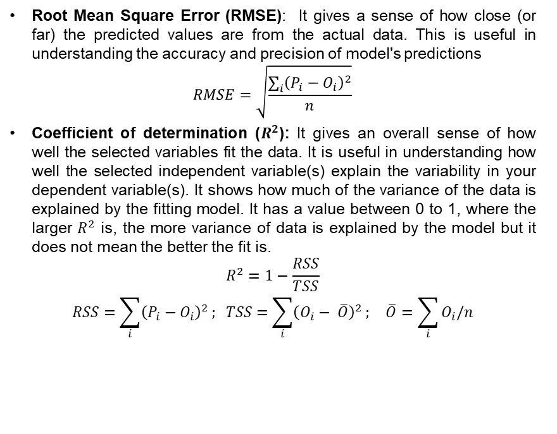
Appendix
Root Mean Square Error (RMSE): It gives a sense of how close (or far) the predicted values are from the actual data. This is useful in understanding the accuracy and precision of model's predictions
$$RMSE=\sqrt{\frac{\sum_{i}{{\left(P_{i}−O_{i}\right)}^{2}}}{n}}$$
Coefficient of determination ($R^{2}$): It gives an overall sense of how well the selected variables fit the data. It is useful in understanding how well the selected independent variable(s) explain the variability in your dependent variable(s). It shows how much of the variance of the data is explained by the fitting model. It has a value between 0 to 1, where the larger $R^{2}$ is, the more variance of data is explained by the model but it does not mean the better the fit is.
$$R^{2}=1−\frac{RSS}{TSS}$$
$$RSS=\sum_{i}{{\left(P_{i}−O_{i}\right)}^{2}}; TSS=\sum_{i}{{\left(O_{i}− \overline{O}\right)}^{2}}; \overline{O}=\sum_{i}{O_{i}/n}$$
I

Slide 26
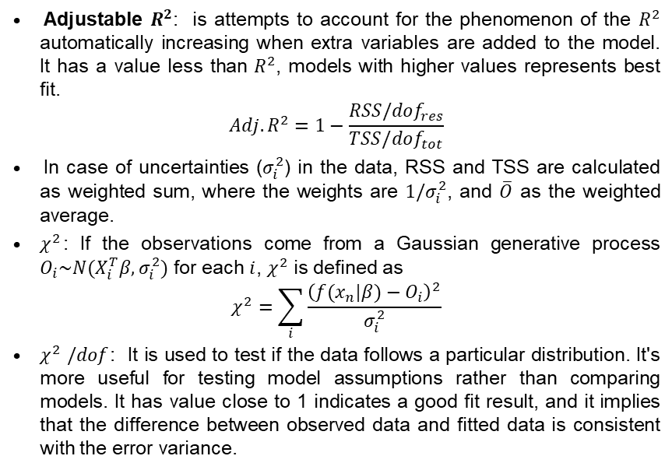
Appendix
Adjustable $R^{2}$: is attempts to account for the phenomenon of the $R^{2}$ automatically increasing when extra variables are added to the model.
It has a value less than $R^{2}$, models with higher values represents best fit.
$$Adj. R^{2}=1−\frac{RSS/dof_{res}}{TSS/dof_{tot}}$$
In case of uncertainties ($σ_{i}^{2}$) in the data, RSS and TSS are calculated as weighted sum, where the weights are $1/σ_{i}^{2}$, and $\overline{O}$ as the weighted average.
$χ^{2}$: If the observations come from a Gaussian generative process $O_{i}\sim N(X_{i}^{T}β,σ_{i}^{2})$ for each $i$, $χ^{2}$ is defined as
$$χ^{2}=\sum_{i}{\frac{{\left(f(x_{n}|β)−O_{i}\right)}^{2}}{σ_{i}^{2}}}$$
$χ^{2}$ $/dof$: It is used to test if the data follows a particular distribution. It's more useful for testing model assumptions rather than comparing models. It has value close to 1 indicates a good fit result, and it implies that the difference between observed data and fitted data is consistent with the error variance.
II

Slide 27
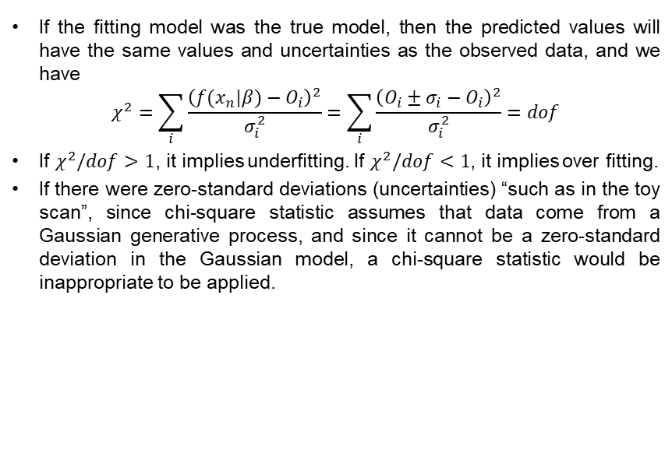
Appendix
If the fitting model was the true model, then the predicted values will have the same values and uncertainties as the observed data, and we have
$$χ^{2}=\sum_{i}{\frac{{\left(f(x_{n}|β)−O_{i}\right)}^{2}}{σ_{i}^{2}}}=\sum_{i}{\frac{{\left(O_{i}±σ_{i}−O_{i}\right)}^{2}}{σ_{i}^{2}}=dof}$$
If $χ^{2}/dof>1$, it implies underfitting. If $χ^{2}/dof<1$, it implies over fitting.
If there were zero-standard deviations (uncertainties) “such as in the toy scan”, since chi-square statistic assumes that data come from a Gaussian generative process, and since it cannot be a zero-standard deviation in the Gaussian model, a chi-square statistic would be inappropriate to be applied.
III

