Slide 1


The evolution of single-particle states along N=127 using the d(²¹²Rn, p)²¹³Rn reaction at the ISOLDE Solenoidal Spectrometer (ISS)
Daniel Clarke
ISOLDE Workshop and Users Meeting 2022

Slide 2


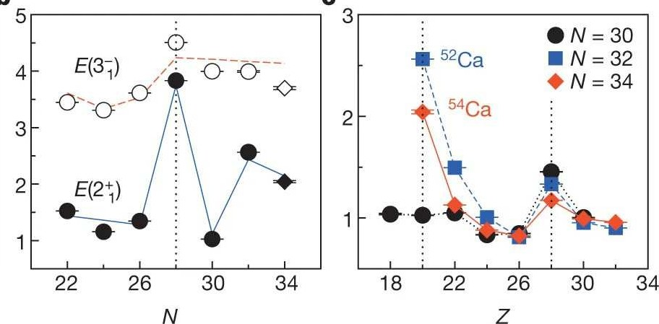
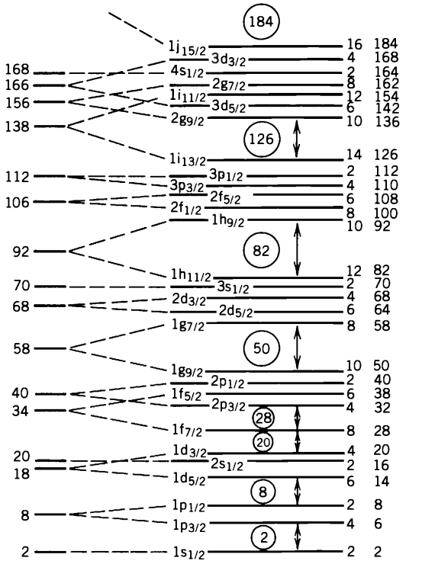

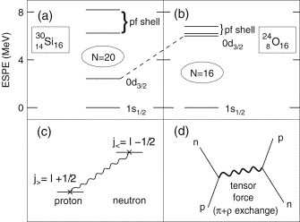
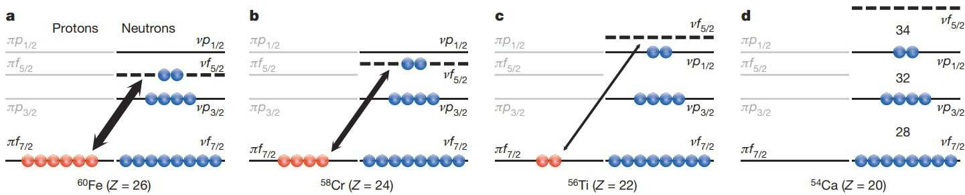
Single-particle evolution in nuclei
Far from stability, shell closures have been shown to evolve for systems with imbalances of protons and neutrons
Studies of light neutron-rich system have led to the discovery of new shell closures
T.Otsuka and D. Abe Prog. In Particle and Nuclear Physics 59 425 (2007)
D. Steppenbeck et al, Nature 502 207 (2013)

Slide 3
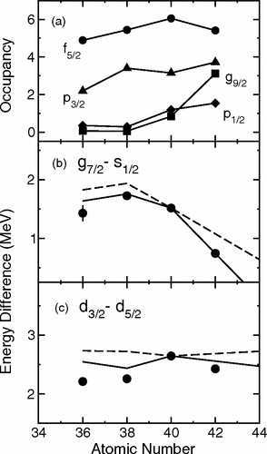
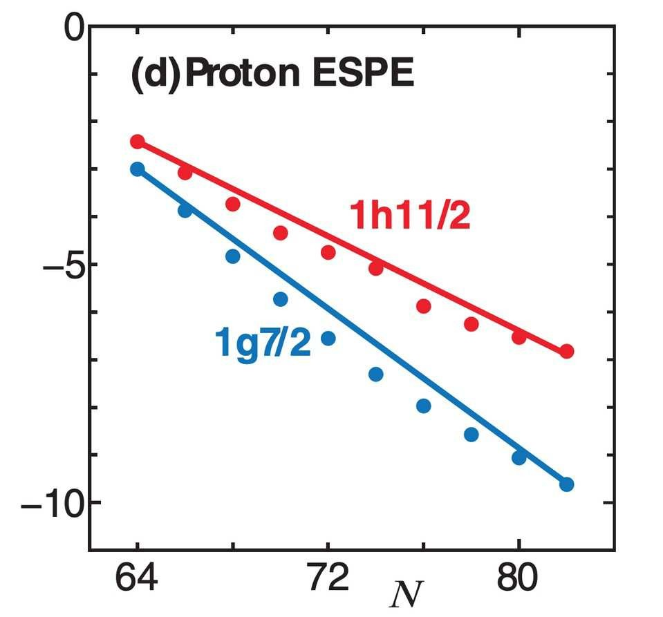
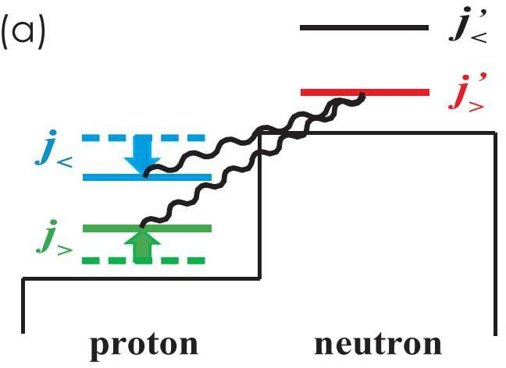
Single-particle evolution – heavy nuclei
In heavier stable nuclei trends have also been observed, particularly in high-j states as other high-j states fill with nucleons
Studying chains of isotopes/isotones near closed shells have pointed to the inclusion of a tensor interaction to explain systematics
Energy (MeV)
Otsuka et al. Phys. Rev. Lett. 95, 232502 (2005)
D.K. Sharp et al, Phys.Rev.C 87 014312 (2013)

Slide 4
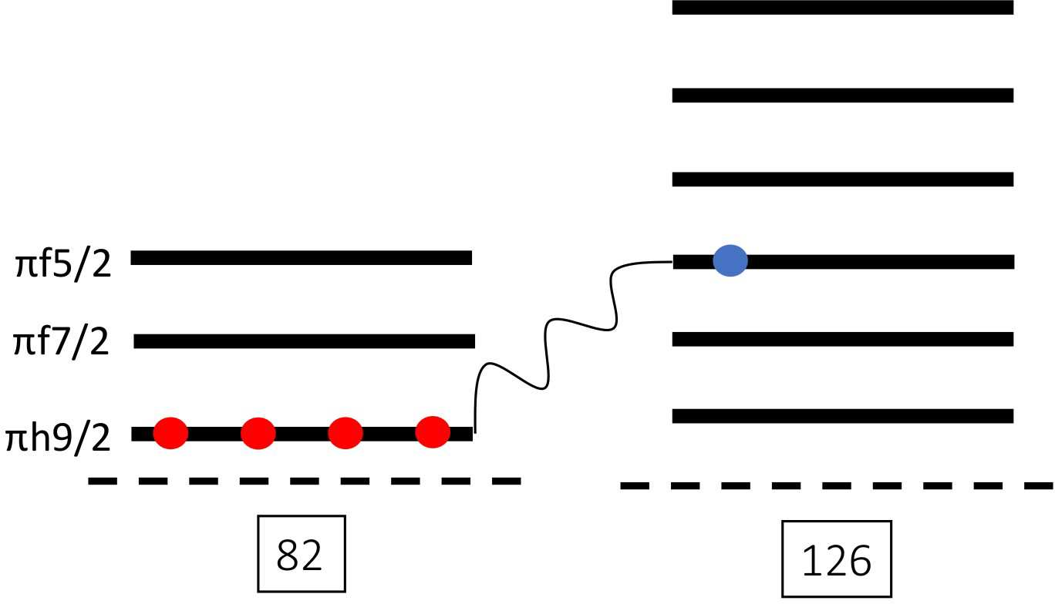
Single-particle evolution along N=126
3.5
Radioactive beams at HIE-ISOLDE allow new closed-shell systems to be studied
Studies can be extended to N=126 isotones
Currently, spectroscopic information on states up to Z=84 (²¹¹Po) is known
The location of nuclei with one neutron outside the N=126 closed shell makes them ideal testing grounds for modern shell-model calculations
Aim is to probe the strength of neutron orbitals in this region which will be interacting with protons in the πh_{9/2} orbital
3
Excitation energy (MeV)
2.5
2d
3/2
^{1g}7/2
^{3s}1/2
2
1.5
2d
5/2
0j
15/2
1
^{0i}11/2
0.5
0
^{1g}9/2
207_{Hg}
209_{Pb}
211_{Po} 213_{Rn} 215_{Ra}
D. K. Sharp et al. INTC-P-594 (2020)
217_{Th}

Slide 5



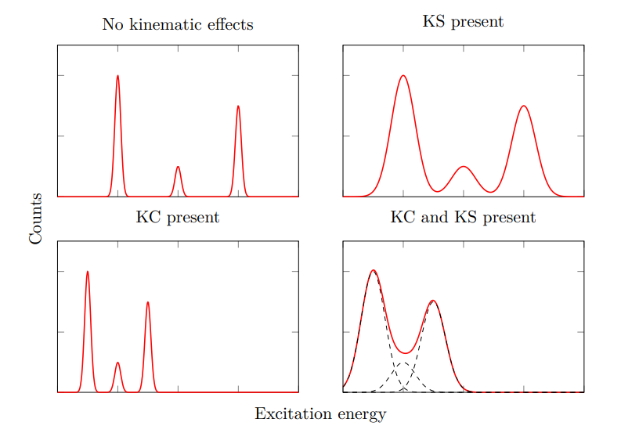
Direct transfer reactions – inverse kinematics
NK
Information:
  Yields - cross sections
  θ - angular momentum
  Proton energy - excitation energy of nucleus.
d
θ
p
IK
212Rn
n
212Rn
d
d(²¹²Rn, p)²¹³Rn:
  Need to consider lab to CM transformations
Problems:
  Kinematic compression – reduces energy difference between states
  Kinematic shift – broadens peaks
p
P. T. MacGregor, Ph.D. Thesis (2021)

Slide 6
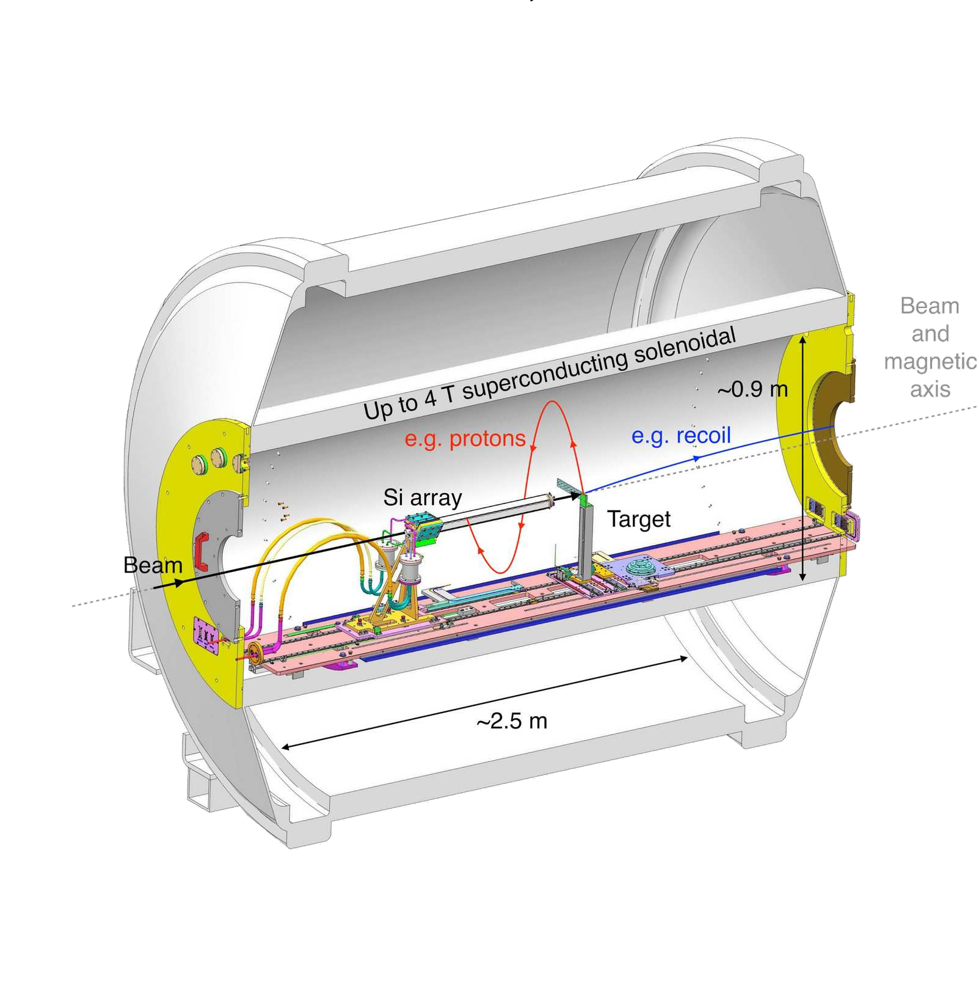
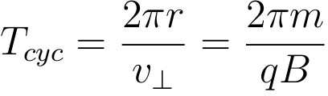
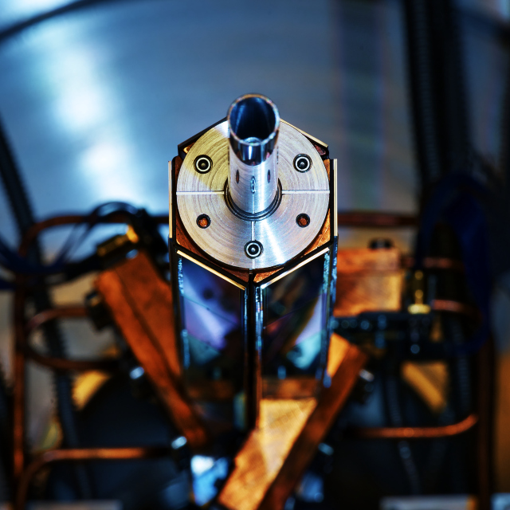
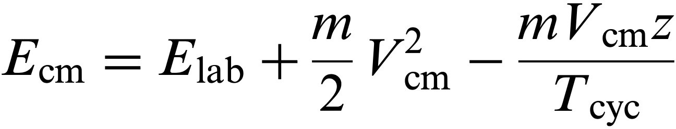
ISOLDE Solenoidal Spectrometer (ISS)
Potential solution using a solenoid (2.5 T).
Particles from target follow helical orbits and return to the axis after one cyclotron period
Measure protons in position-sensitive array
Position, E_{lab} ∝ E_{cm.}
No compression in the solenoid – better resolution

Slide 7
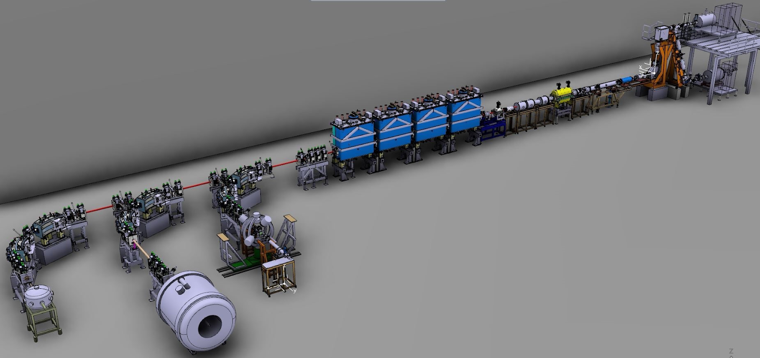
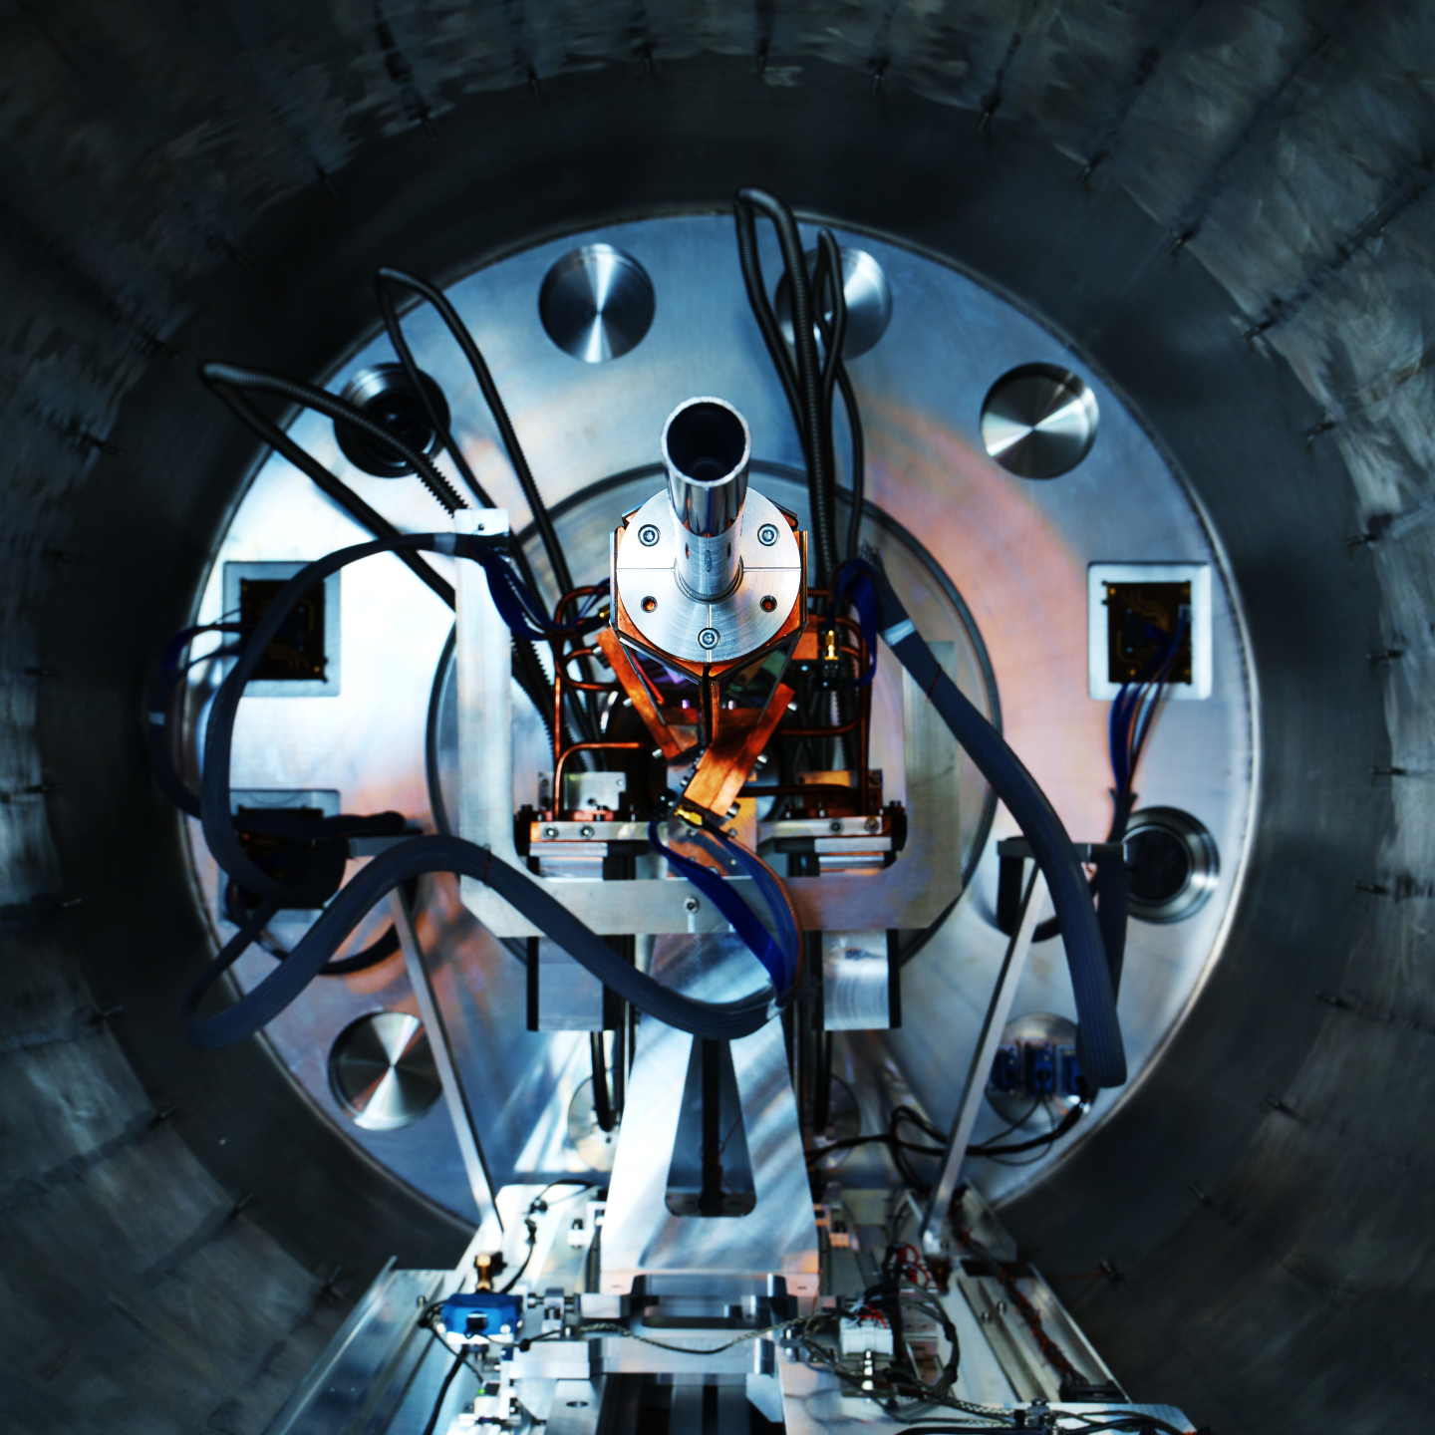
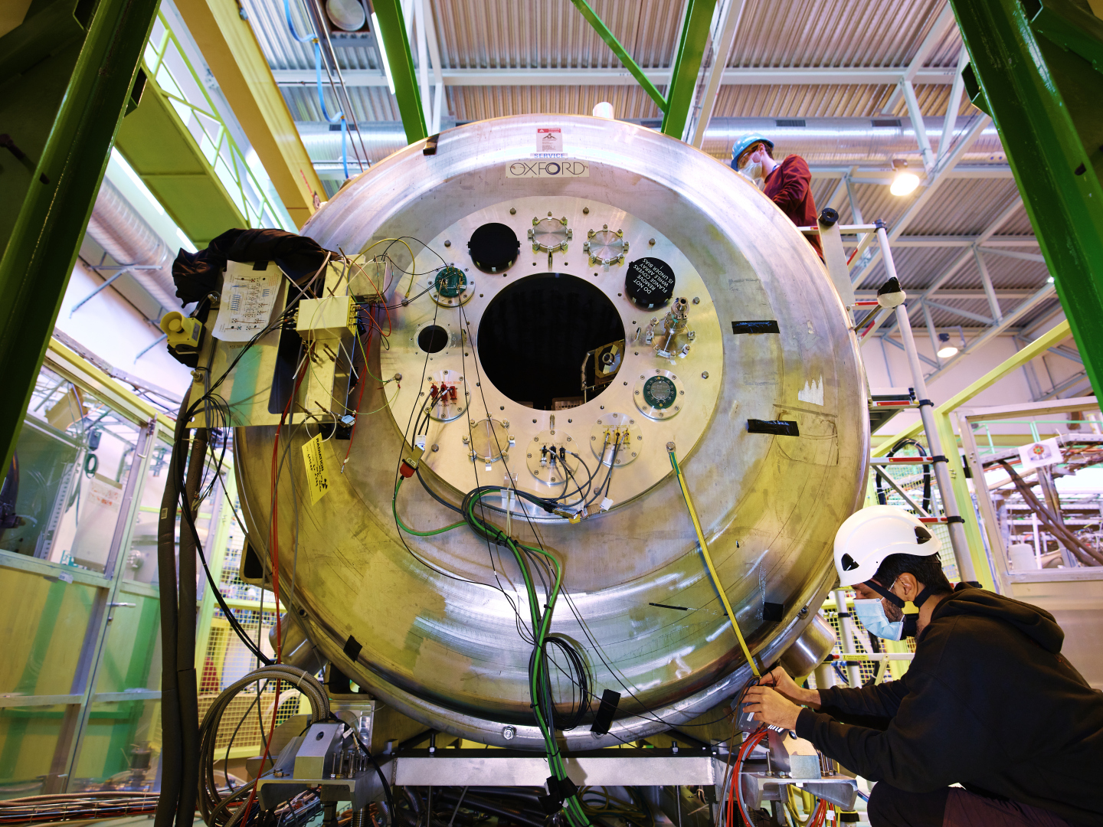
HIE-ISOLDE
Experiment performed using HIE-ISOLDE:
Protons from the PSB (1.4 GeV) impinged on a heated UC_{x} target
VADIS ion-source
Transfer line between ion source and target cooled to capture reactive products
d(²¹²Rn,p)²¹³Rn reaction:
7.63 MeV/u
~10⁶ pps
Grid of ≈125 μg/cm² targets
https://hie-isolde-project.web.cern.ch/hie-isolde-project
7

Slide 8
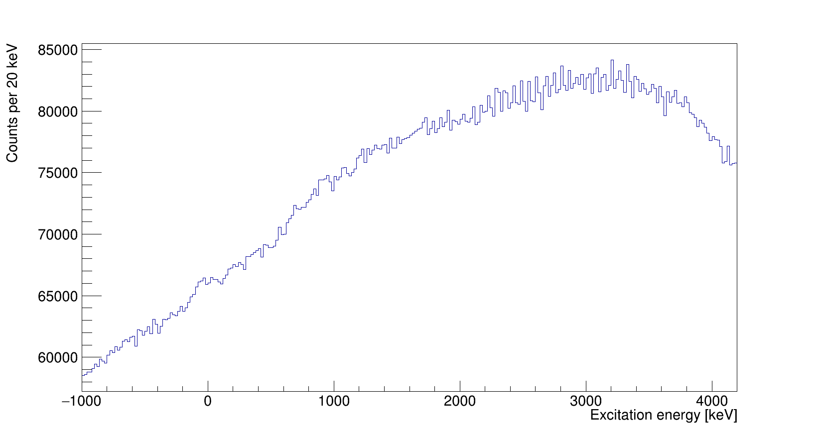
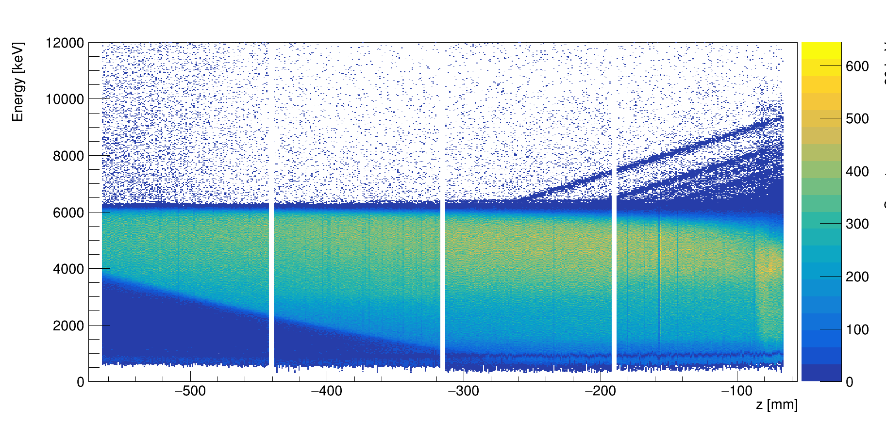
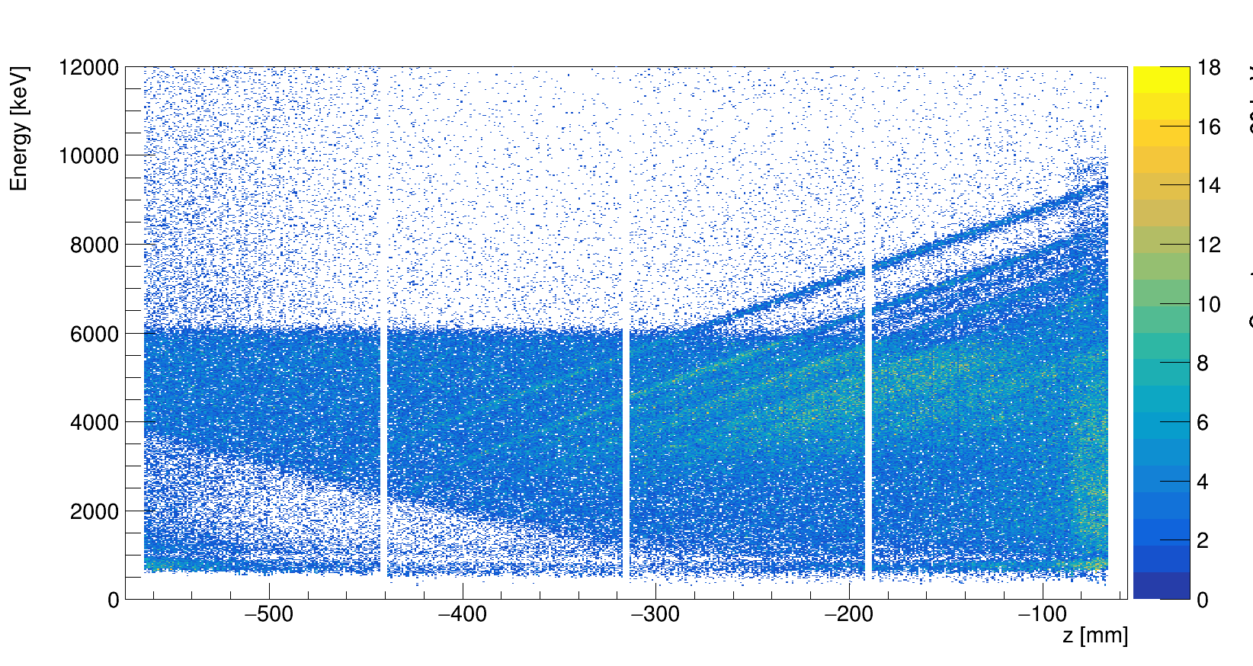
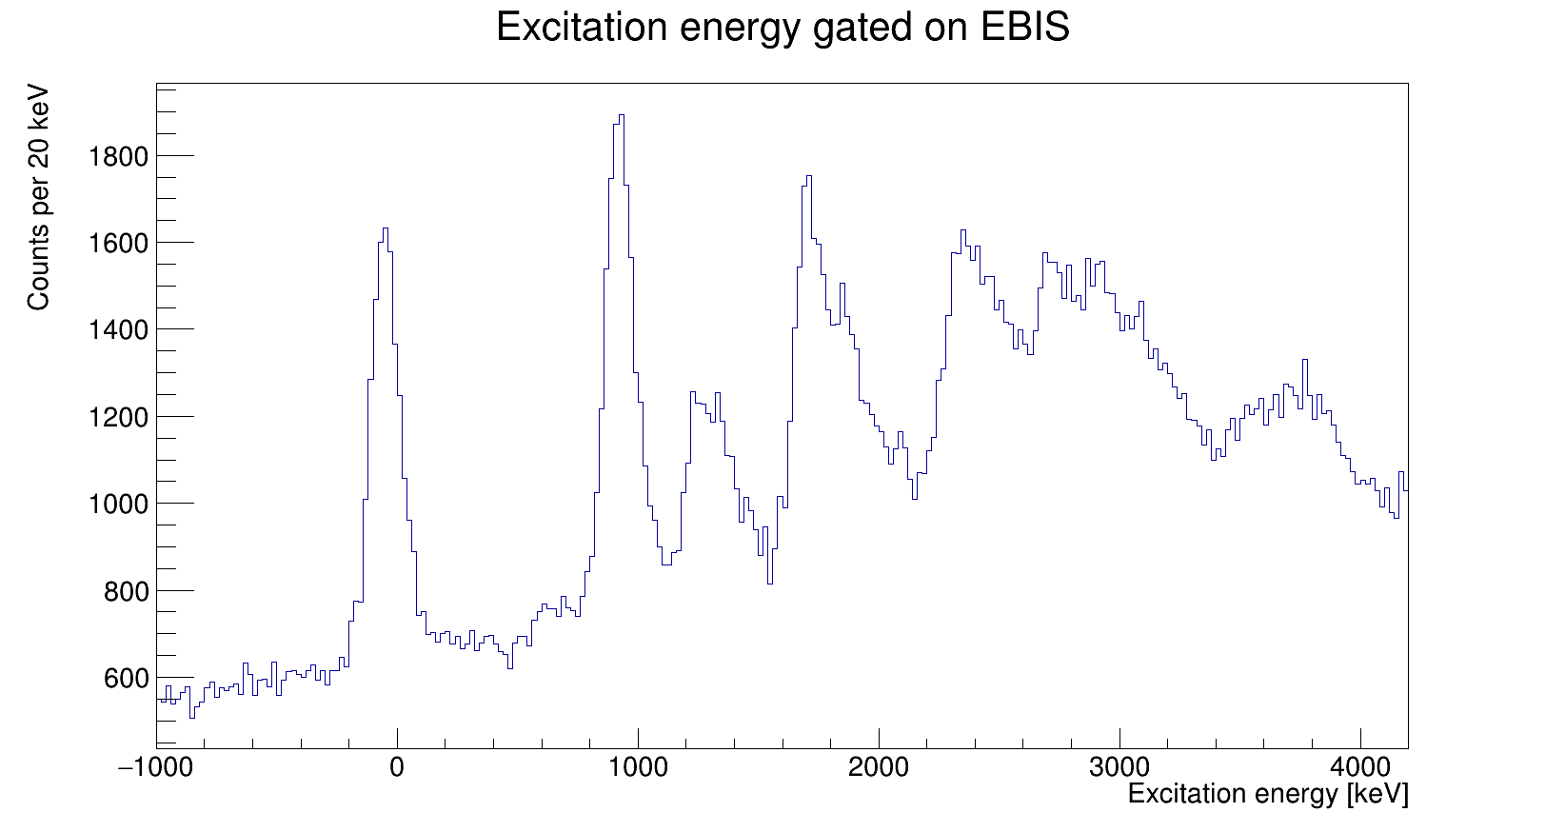
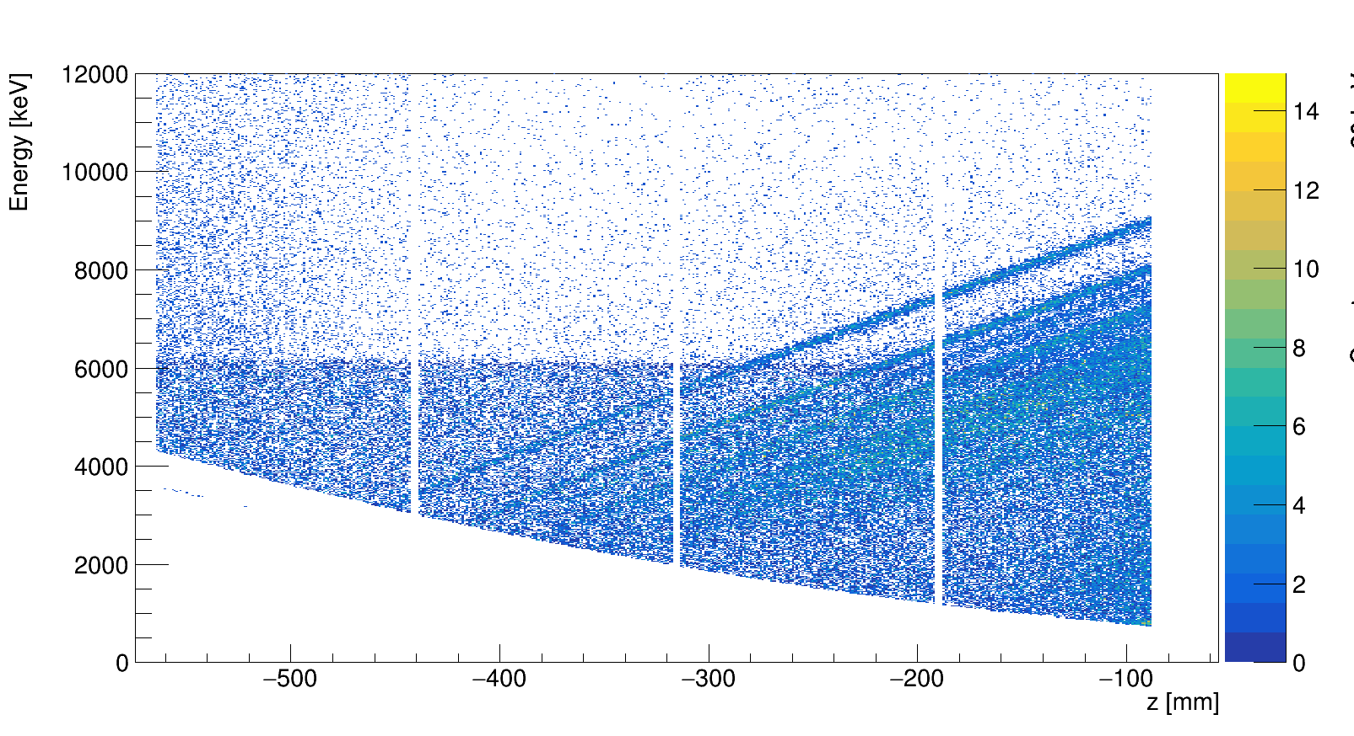
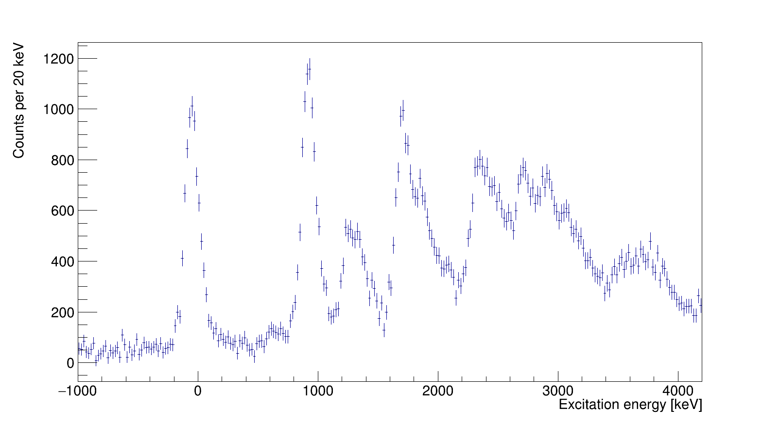

Preliminary data analysis
Singles
Gating on EBIS-on time
g.s
Subtracting EBIS-off time
$θ$_{cm} and $z$ cuts

Slide 9
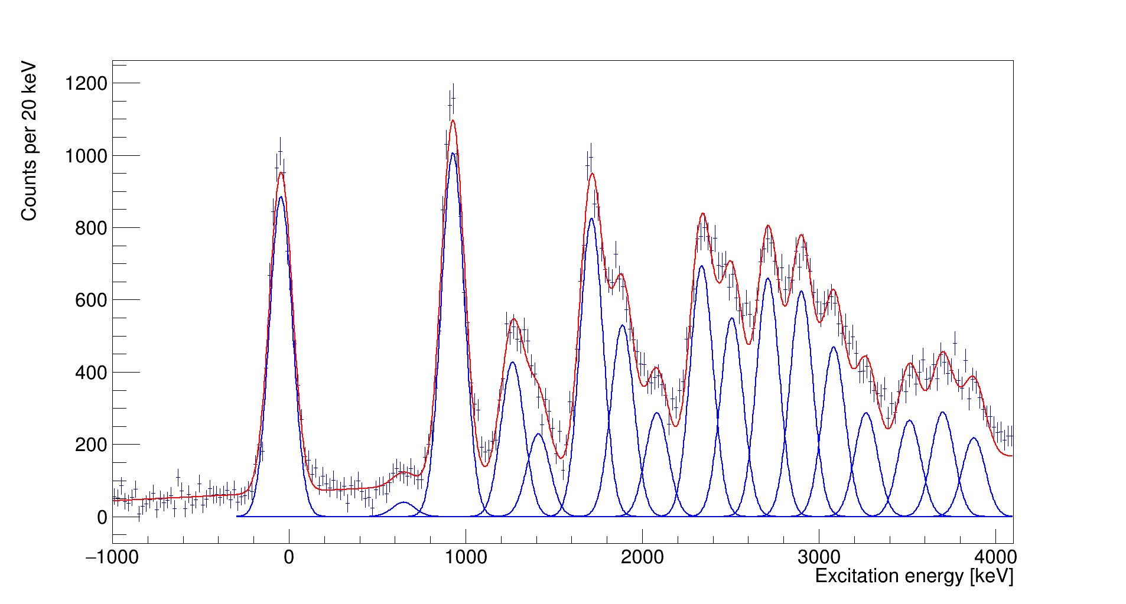
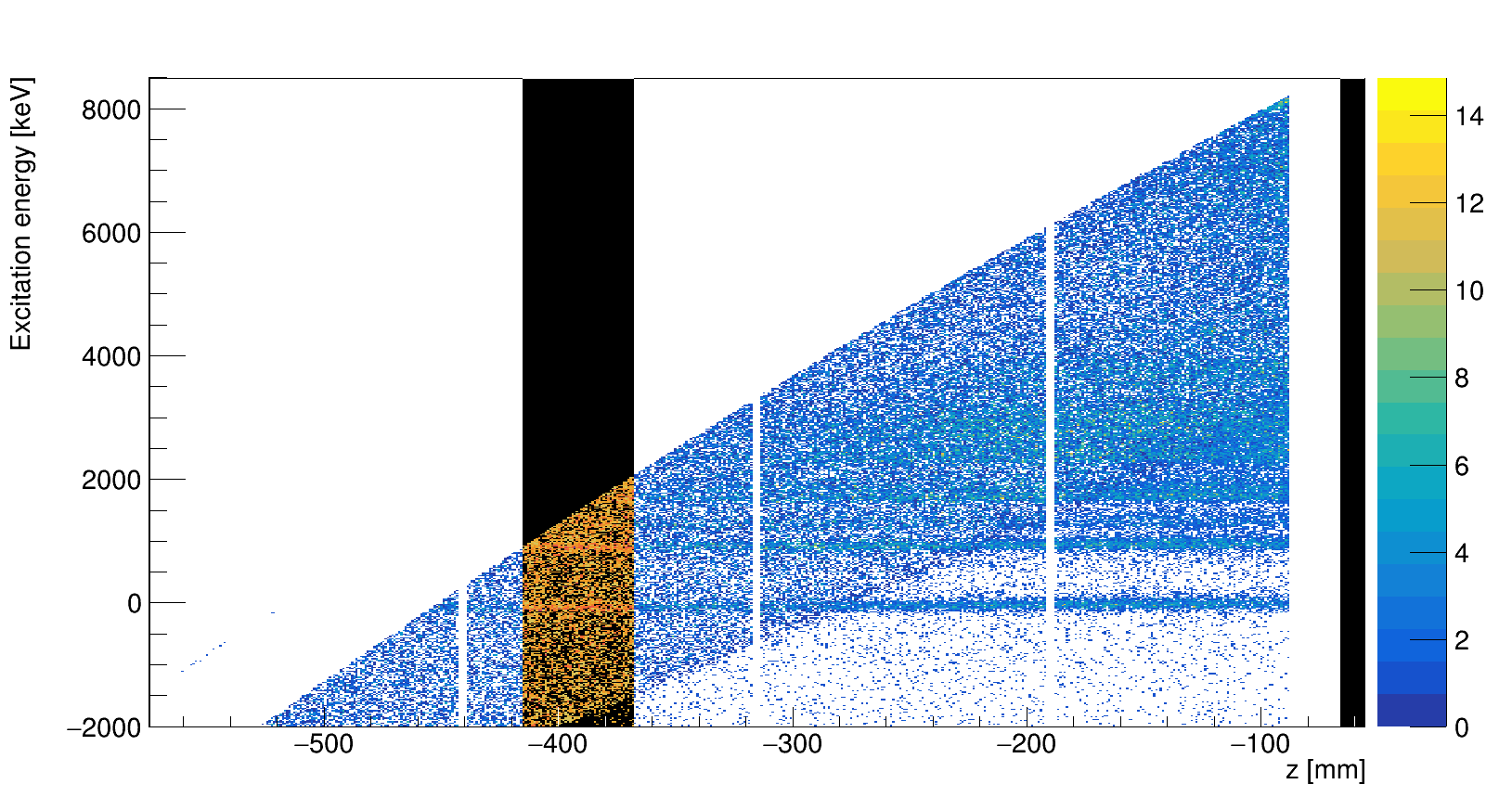
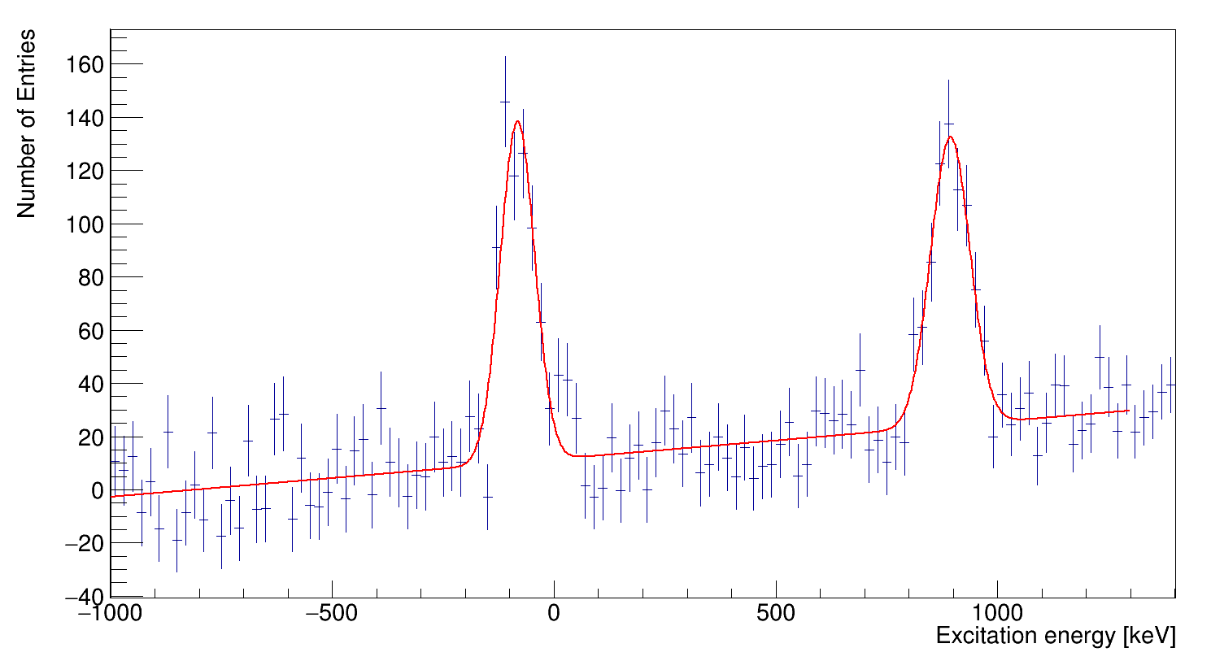
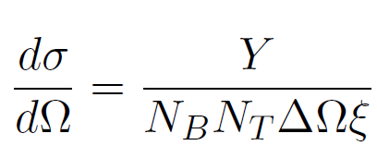
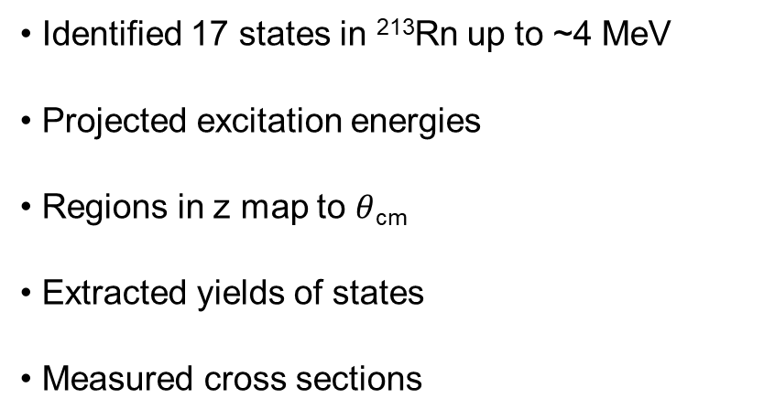
Preliminary excitation energy spectrum
973
Identified 17 states in ²¹³Rn up to ~4 MeV
Projected excitation energies
Regions in z map to $θ$_{cm}
Extracted yields of states
Measured cross sections
g.s
1758
1937
2380
2758
2551
2951
3141
1311
2132
3334
1462
3774
3572
3967
681
g.s

Slide 10
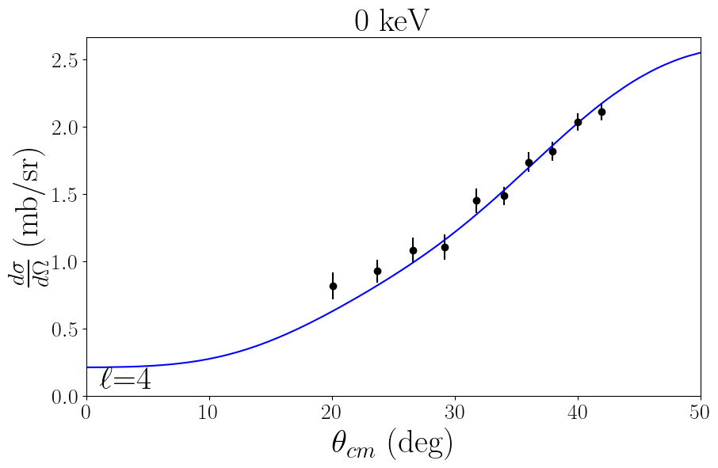
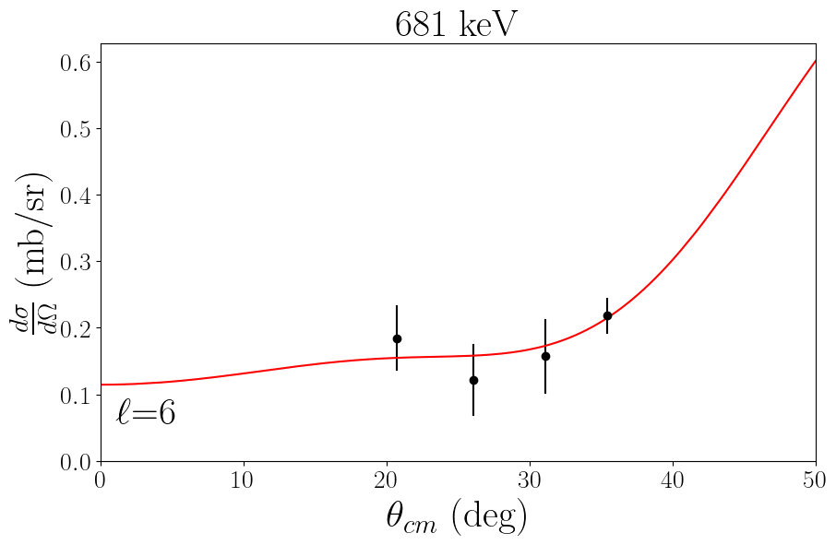
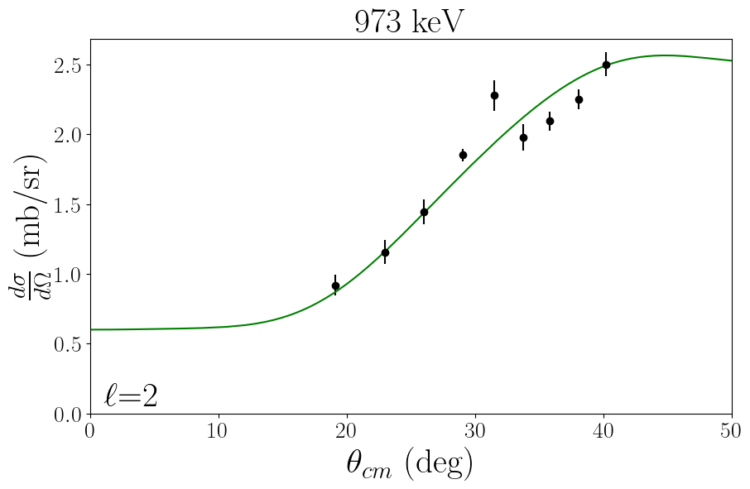
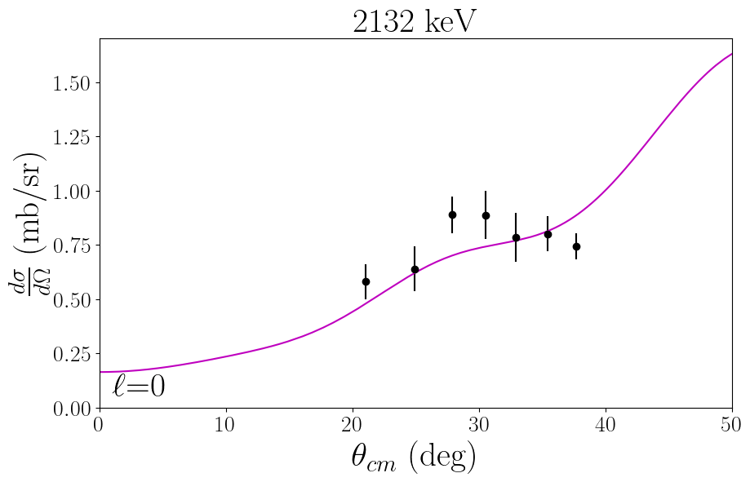
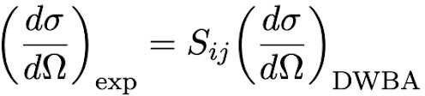
Preliminary angular distributions
Energy / keV | L | nlj | S
0 | 4 | 2g_{9/2} | 1.00(2)
681(16) | 6 | 1i_{11/2} | 2.26(23)
973(1) | 2 |  | 0.31(3)
1311(5) | 0 | 4s_{1/2} | 0.27(2)
1462(10) | 2 |  | 0.08(1)
1758(2) | 2 |  | 0.27(1)
1937(4) | 0 | 4s_{1/2} | 0.37(1)
2132(4) | 0 | 4s_{1/2} | 0.22(1)
2380(3) | 2 |  | 0.22(1)
2551(5) | 2 |  | 0.17(1)
PTOLEMY used to calculate angular distributions
Measured angular distributions compared to calculations and assignments made for states up to 2.5 MeV
L | Orbital | Sum SF
0 | 4s_{1/2} | 0.86(2)
2 |  | 1.05(4)
4 | 2g_{9/2} | 1.00(2)
Relative spectroscopic factors extracted by comparing with DWBA calculations
Summed strength should equal one for a completely empty orbital as is outside a closed shell
*Normalized to the 2g_{9/2} ground state

Slide 11
Conclusions
New states identified in ²¹³Rn
Preliminary spin-parity assignments have been made up to 2.5 MeV
Extracted relative spectroscopic factors for these states
Some work to do to extract spectroscopic information for high-lying states above 2.5 MeV
Determine effective single-particle energy centroids and characterise how they are changing along N=127
Compare to modern shell-model calculations

Slide 13
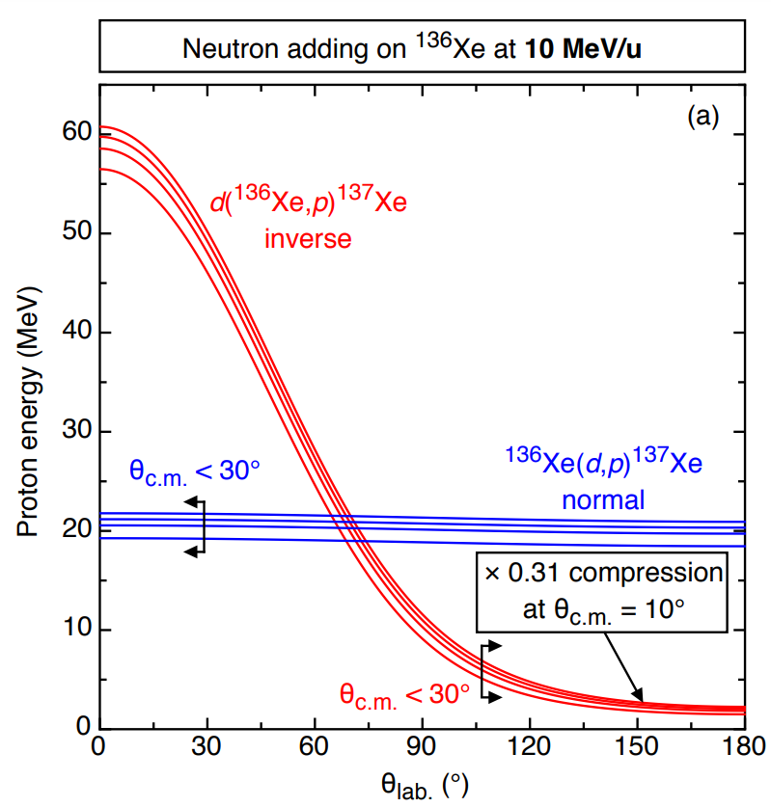


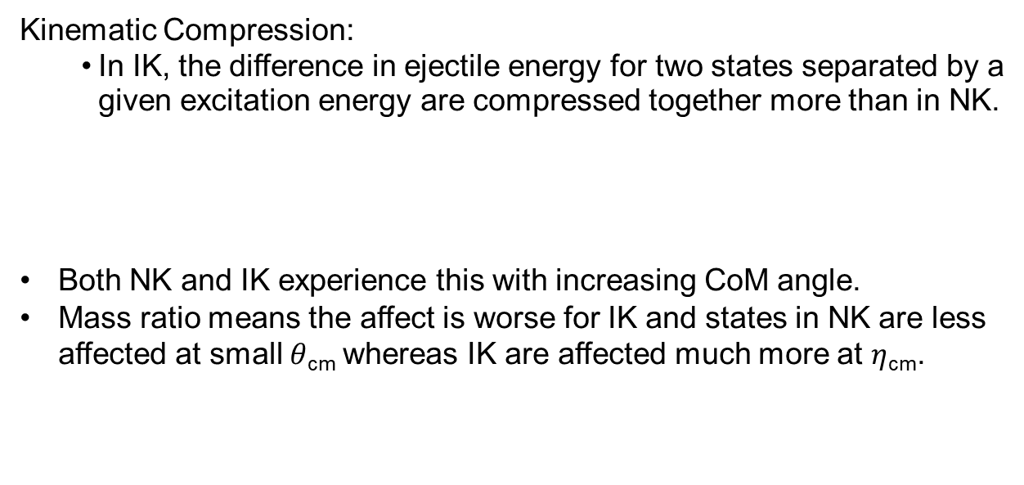
Inverse kinematics
Kinematic Compression:
In IK, the difference in ejectile energy for two states separated by a given excitation energy are compressed together more than in NK.
Both NK and IK experience this with increasing CoM angle.
Mass ratio means the affect is worse for IK and states in NK are less affected at small $θ$_{cm} whereas IK are affected much more at $η$_{cm}.
$η\text{cm}$ = $θ$_{cm} $− π$
Kinematic Shift:
Gradient of proton energy with angle is greater in the inverse case when compared to NK
Finite angular acceptance allows detection of a range of energies. Peaks are broader in IK
B P Kay et al 2012 J. Phys.: Conf. Ser. 381 012095

Slide 14

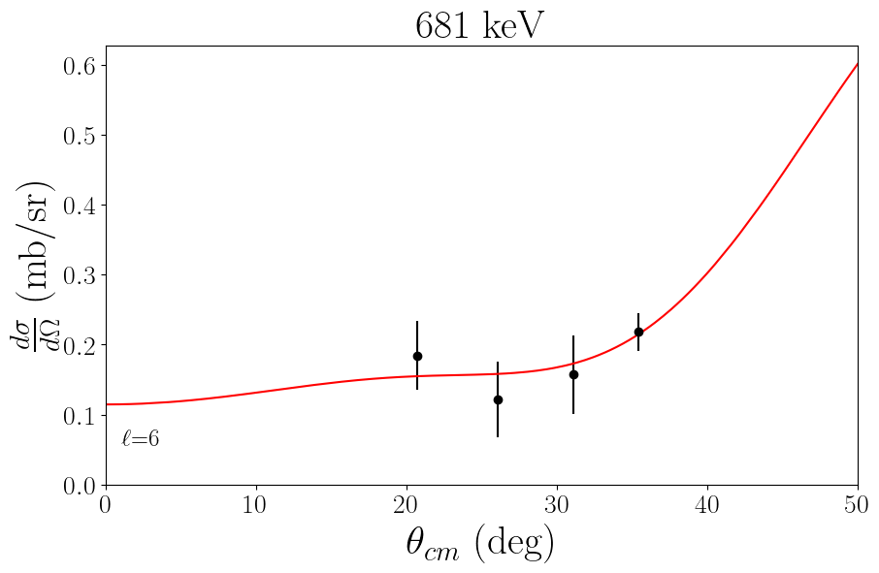
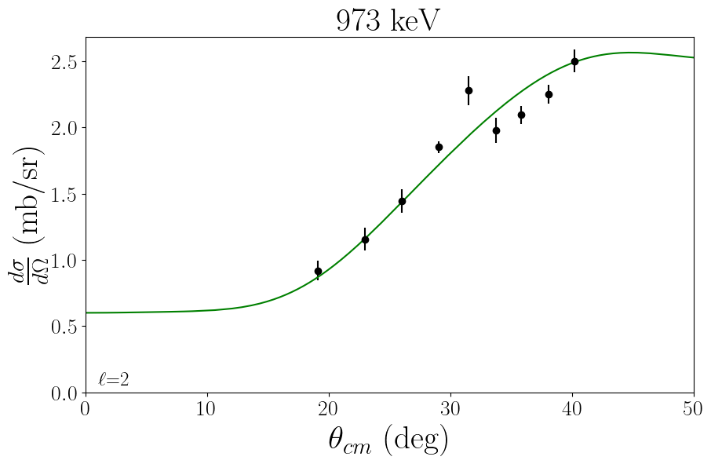
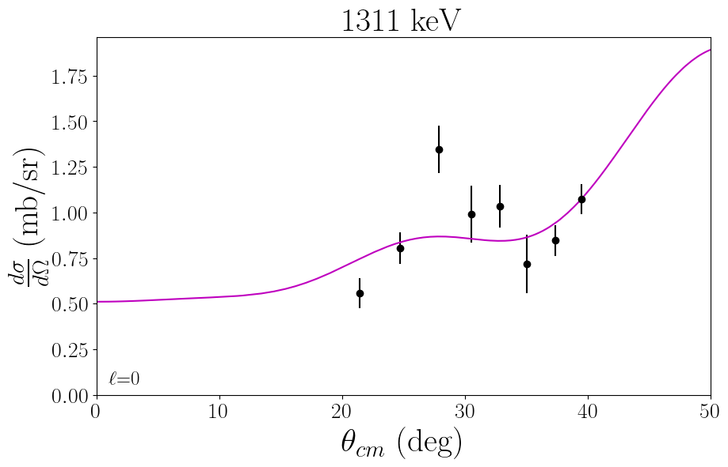
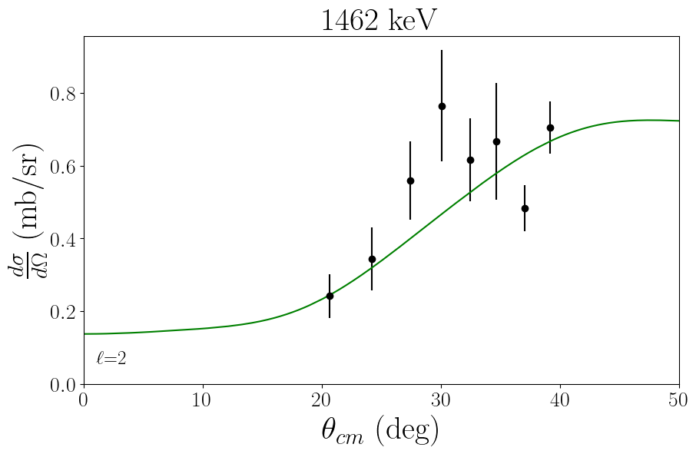
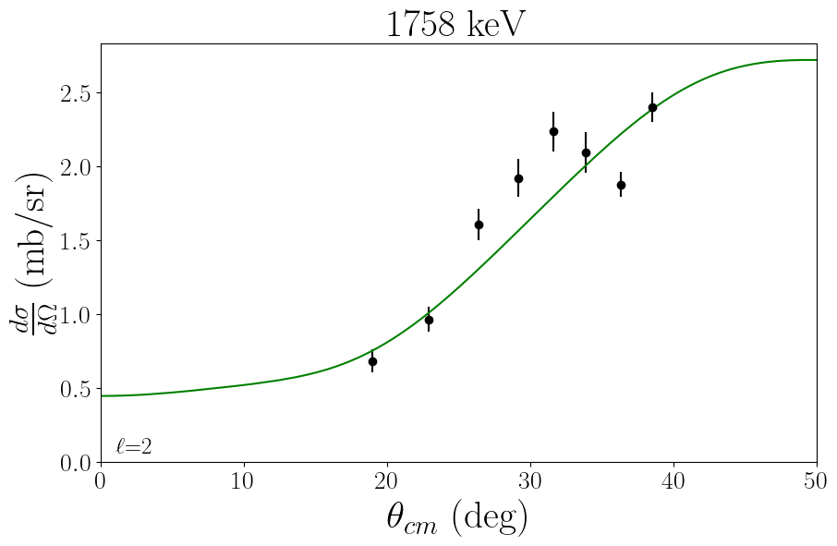
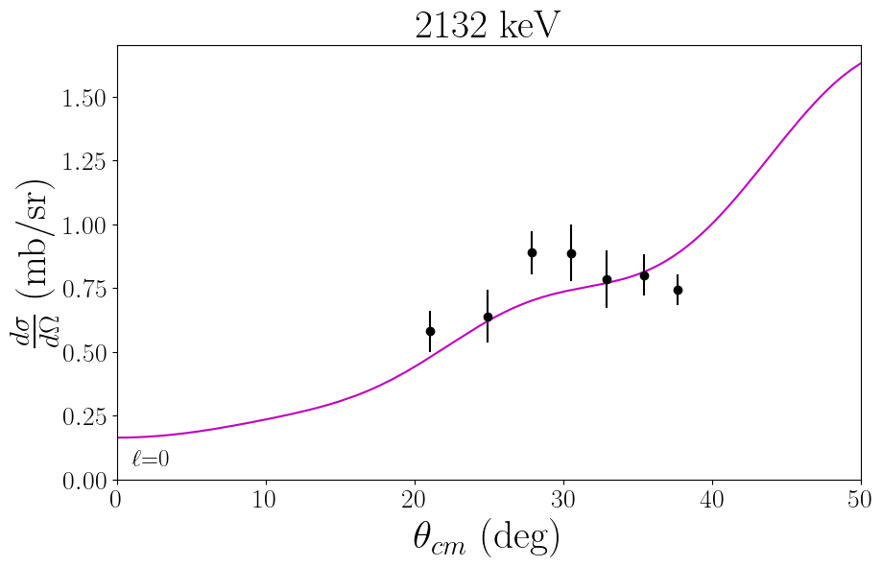
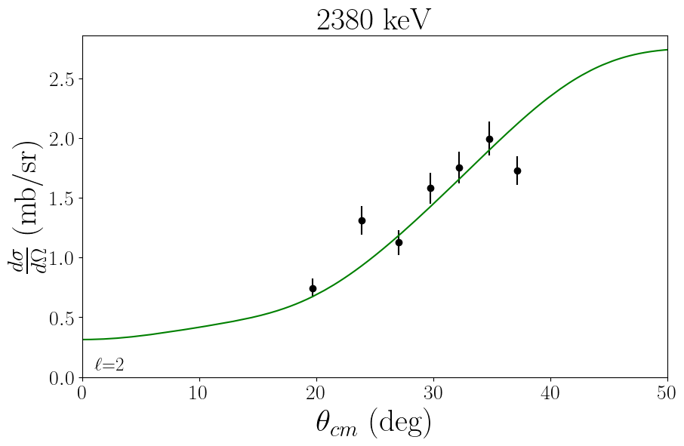
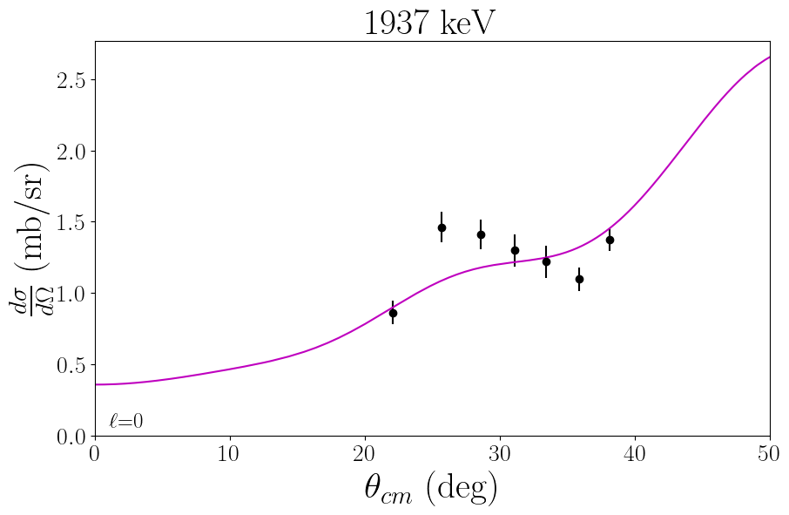
Preliminary angular distributions

Slide 15
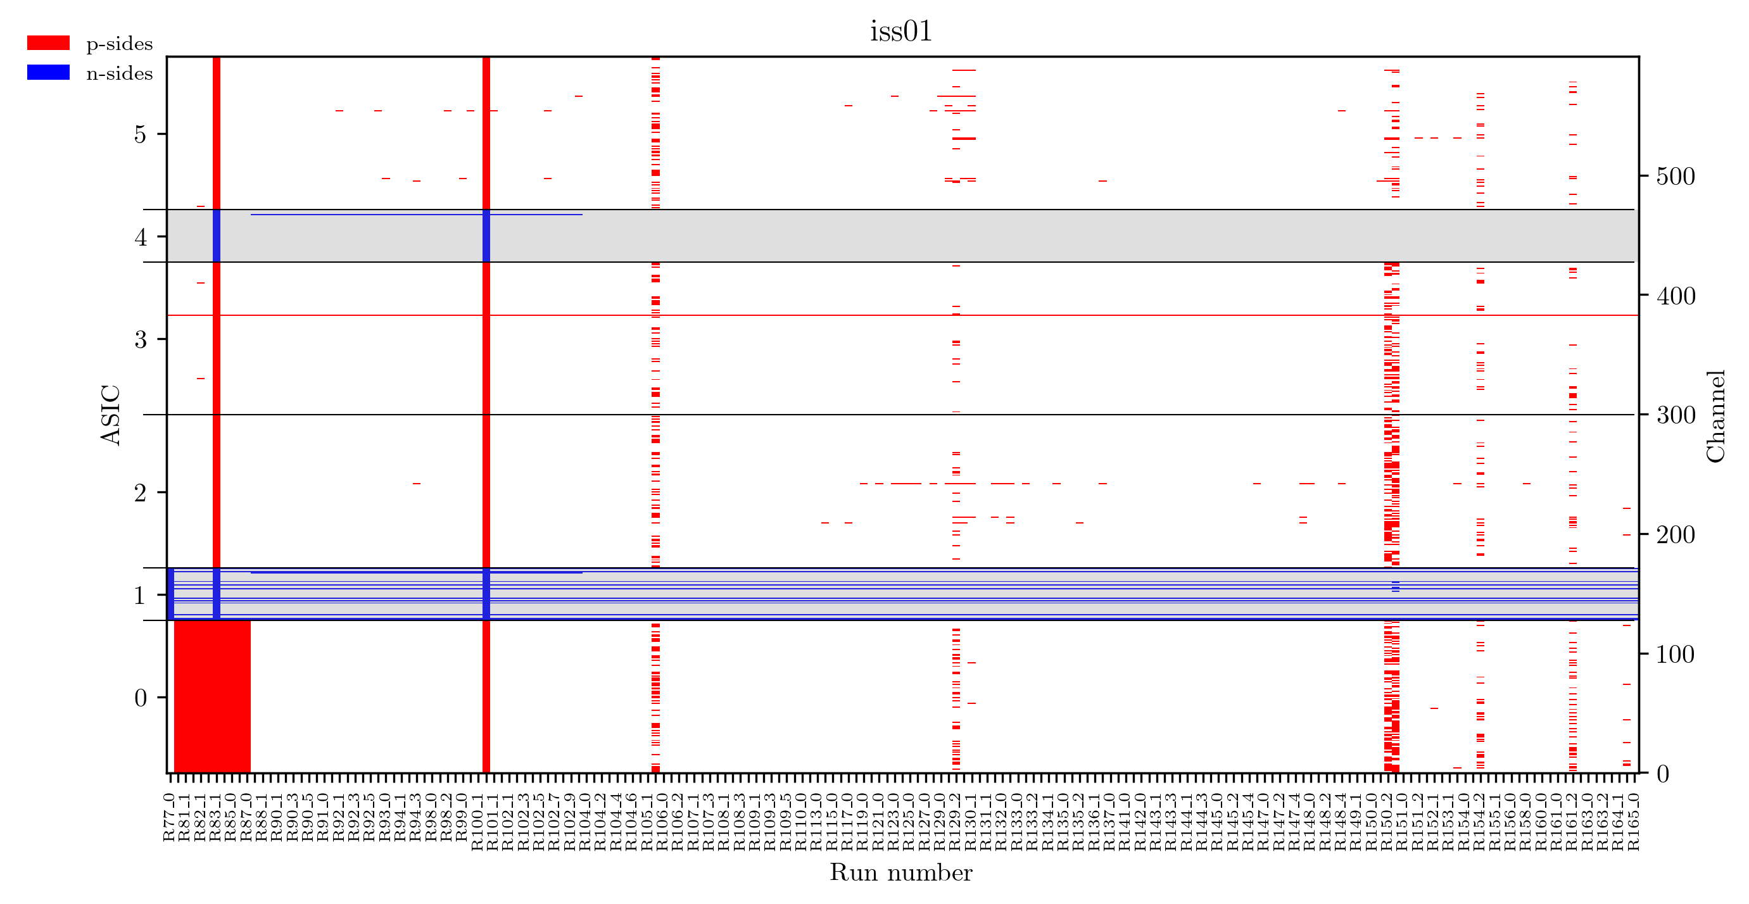
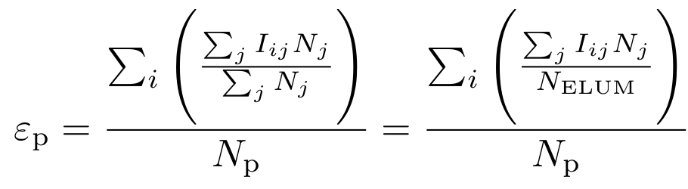
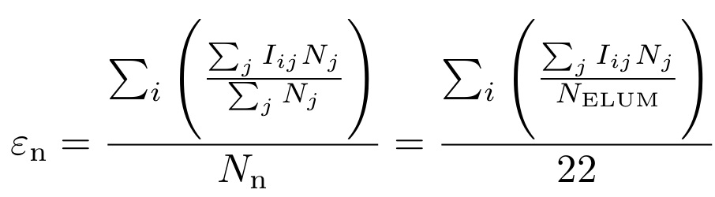
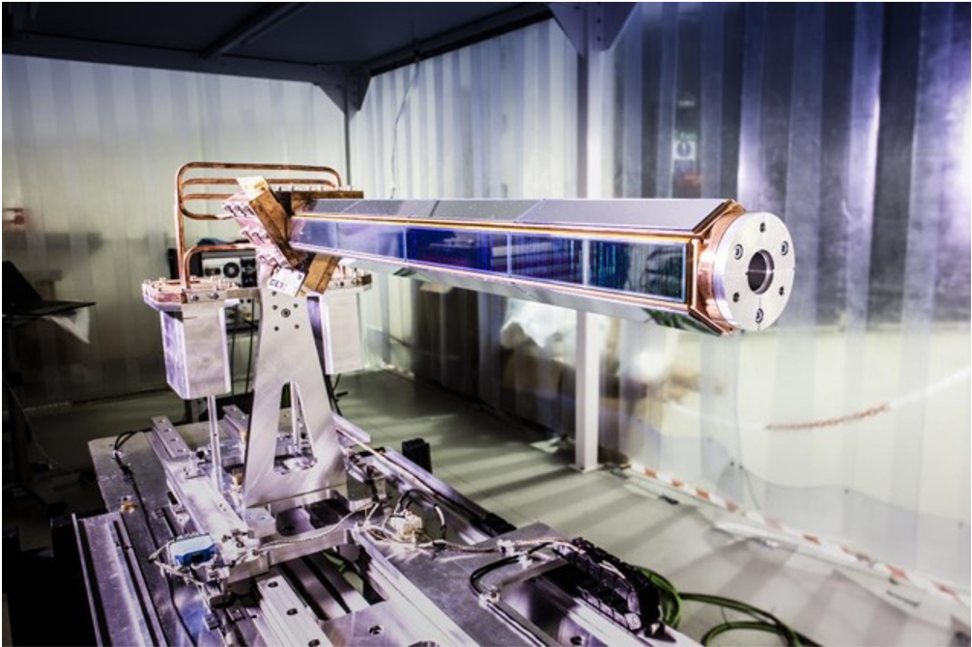
Solid angle corrections

Slide 16
Resolution
Calculations for the ground state
Intrinsic Si energy resolution was 45-50 keV for alphas
Target-energy loss:
  CD2 Stopping power ≈ 160 MeV/mgcm²
  Target thickness ≈ 125 µg/cm²
  Beam entering = 1618 keV, Beam leaving ≈ 1598 MeV
  74 keV proton energy difference in lab => 145 keV excitation difference at θ_{CM} = 40°
Beam spot size ≈ 3mm:
  Particles ejected above the beam axis due to beam spot size return to axis at a higher z than those on axis.
Beam energy spread of ± 0.4 % => 7.63(3) MeV/u:
  E_{Beam} = 7.60 => 7.66 MeV/u
    θ_{CM} = 10°; proton ΔE_{lab} = 12 keV
    θ_{CM} = 40°; proton ΔE_{lab} = 50 keV
Contribution to energy resolution | At 10 degrees CM (keV) | At 40 degrees CM (keV)
Target-energy loss | 50 | 145
Intrinsic silicon energy | 50 | 50
Position resolution 1mm | 15 | 15
Beam spot 3mm | 88 | 8
Beam energy spread ± 0.4% | 12 | 50
Total in quadrature | 115 | 162

