Slide 1

STEAM
Simulation of Transient Effects in Accelerator superconducting Magnet circuits
Emmanuele Ravaioli and Mariusz Wozniak
on behalf of the STEAM team:
Lennard Bender, Bernardo Bordini, Marvin Janitschke, Tim Mulder, Emmanuele Ravaioli,
Erik Schnaubelt, Arjan Verweij, Andrea Vitrano, Mariusz Wozniak
with thanks to all the past STEAM members
19th July 2022
https://espace.cern.ch/steam

Slide 2

What drives the development?
Vision
Achieve specialized, trusted, consistent, repeatable and sustainable software tools and models for rapid Simulation of Transient Effects in Accelerator superconducting Magnet circuits.
Mission
Develop capability and know-how for simulation with an appropriate utilization of established and modern technology. Engage community in framework adaptation and validation by sharing well documented tools and models. Support tools that are part of STEAM and welcome integration with externally developed code.
Values
continuity, readiness, simplicity, recognition, completeness, maintainability

Slide 3
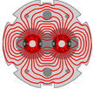



Simulation of Transient Effects in superconducting Accelerator Magnets circuits
Challenges / Opportunities:
Multi-domain – need to include thermal, electromagnetic and circuit domains
Multi-physics – need to couple above domains, often between software tools
Multi-rate – need to include fast transient effects in long time scale simulations
Multi-scale – need to account for small scale effects in large scale simulations
STEAM is being used in several flagship projects at CERN:
LHC

Slide 4
STEAM framework
Input Data*
Conductor
Magnet
Circuit
(Consecutive) Analysis
Parametric (analysis)
(comparison to)
Measurements
Conductor
BBQ
FiQuS
PSPICE**
STEAM SDK
STEAM SDK
STEAM SDK
Magnet
LEDET
LEDET
STEAM SDK
Dakota***
Circuit
PyBBQ
ProteCCT
SING
Co-sim.
SIGMA
Analysis
Materials properties
PSPICE library
Parametric
Cooperative-simulation
Meas. config
COSIM
STEAM SDK
Meas. data
STEAM SDK
some functionality is under active development
* Text based (YAML) and Roxie files, and tdms files, ** Commercial circuit solver, *** Tool from Sandia Labs

Slide 5








STEAM framework
Input Data*
Conductor
Magnet
Circuit
(Consecutive) Analysis
Parametric (analysis)
(comparison to)
Measurements
Conductor
BBQ
Gmsh+GetDP
FiQuS
PSPICE**
STEAM SDK
STEAM SDK
STEAM SDK
Magnet
LEDET
LEDET
STEAM SDK
Dakota***
Circuit
PyBBQ
ProteCCT
SING
Co-sim.
SIGMA
Analysis
Materials properties
PSPICE library
C
Parametric
Cooperative-simulation
Meas. config
COSIM
STEAM SDK
TDMS
Meas. data
STEAM SDK
some functionality is under active development
* Text based (YAML) and Roxie files, and tdms files, ** Commercial circuit solver, *** Tool from Sandia Labs

Slide 6
STEAM project in the last few years and future trends
STEAM
60%
Applications
Develop circuit or magnet models, validate them, perform simulations,…
40%
Development
Develop new program features, code maintenance, enhance automation…
30%
LHC
50%
HL-LHC
5%
HFM
15%
Other
10%
Physics
10%
Matlab
5%
Java
35%
Python
5%
COMSOL
35%
Gmsh
GetDP
Note: All figures are only meant to give a rough estimation

Slide 7




Key points on software development
Separate input files (data) and software (code)
The above is versioned in separate repositories on CERN GitLab
Input files are text based – a must for version control of models
Code repositories have good test coverage. We use CI with CERN Gitlab
Single Source of Truth (SSOT) for model inputs – common input file - YAML
SSOT for material properties – write it once for all the tools and repackage
Due to point 1., we aim to keep to minimum the use of Jupyter notebooks
However, we are compatible as a user friendly GUI / “frontend”, although with limited functionality
We maintain tools in a few languages, but aim to maximize python use
We use commercial tools, but long term aim to only use free software
C
Gmsh
GetDP

Slide 8
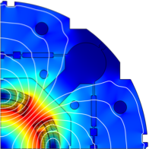
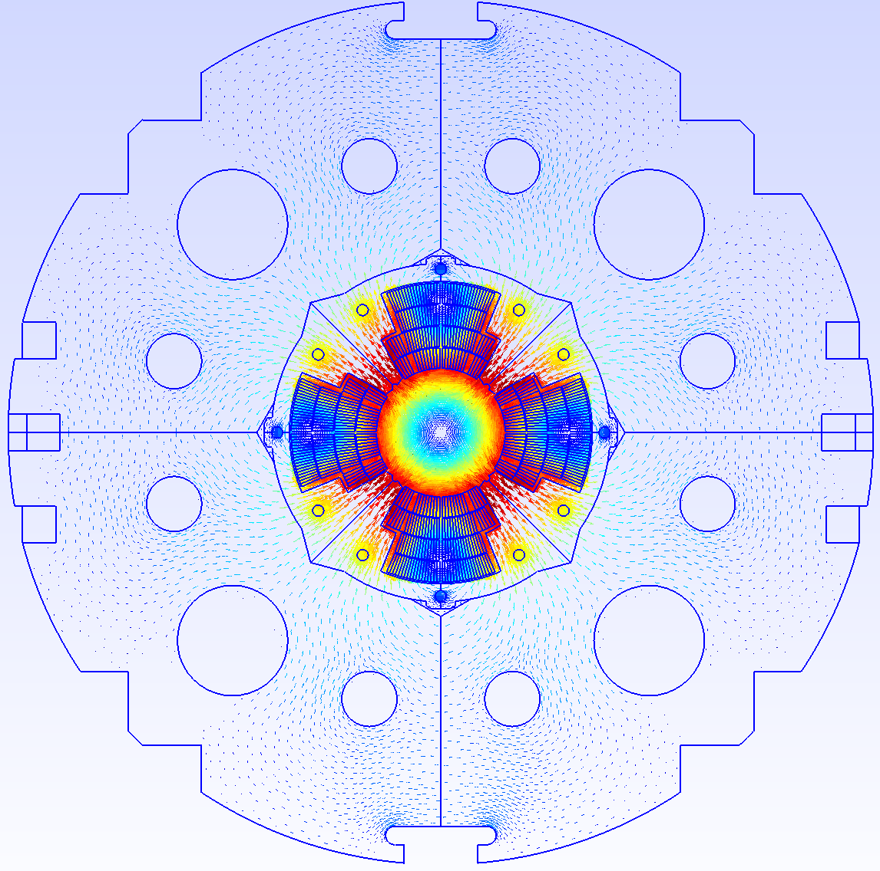
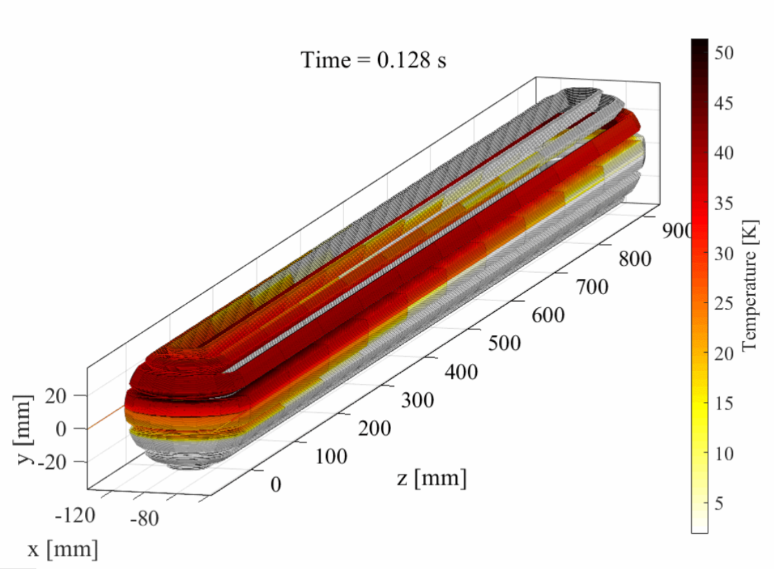
Integration of tools
Comsol model
Quench model
Comsol
compiler
ROXIE files
STEAM SDK
.data
COMSOL
.iron
ROXIE
files parser
Conductor,
Geometry,
Circuit,
Mesh,
Solution,
Options,
data
SIGMA
SIGMA model
.mod
.cadata
Java script
.bhdata
.map2d
FiQuS input file
FiQuS
Gmsh API
FiQuS (GetDP)
ModelData
Show real example and IDE
LEDET input file
LEDET
and more…
LEDET

Slide 9
Scope of STEAM framework
TRANSIENTS
Energy extraction and quench-back
Quench heater induced quench
CLIQ induced quench
Powering
Electrical arc
Frequency transfer measurement
No-Insulation coils
CIRCUIT TYPES
Stand-alone magnets
Nested circuits
Series-connected magnets
…many combinations of those
CONDUCTOR TYPES
Nb-Ti
Nb₃Sn
Bi-2212
YBCO
MAGNET TYPES
Cos-theta
Block-coil
Common coil
Canted Cos-Theta (CCT)
Solenoid, pancake coils
LEVEL OF DETAIL
Circuit → Magnet → Cable → Wire → Filament
No single tool can do it all. Therefore, we have many tools connected by the framework.

Slide 10
Which physics is included in the STEAM models – and which isn’t
ELECTRICAL CIRCUITS
Electrodynamics
Non-linear components (Diodes, thyristors)
Empirical model of magnet eddy-currents
Parasitic capacitance to ground
Cold Diode heating effect
Busbar self-inductance
Power converter control
Dependence of inductance on current
Heating effect in EE resistor
Mutual coupling between busbars of different circuits
…
MAGNETS
Non-linear material properties
Quench development and ohmic loss
1D, 2D and 3D thermal diffusion
Inter-filament coupling loss
Inter-strand coupling loss
Iron-yoke saturation effect on self-inductance
Cooling to thermal sink (collars, bore, wedges)
3D magnetic field
Persistent-currents loss
Mechanics
Eddy currents in metal elements
Accurate helium cooling
Hysteresis in iron yoke
…
Main takeaways: 1. Transients in superconducting circuits are complex. 2. We try to include as much relevant physics as it is practical in each tool, but each includes simplifications. 3. We can’t simulate everything (yet ;))

Slide 11
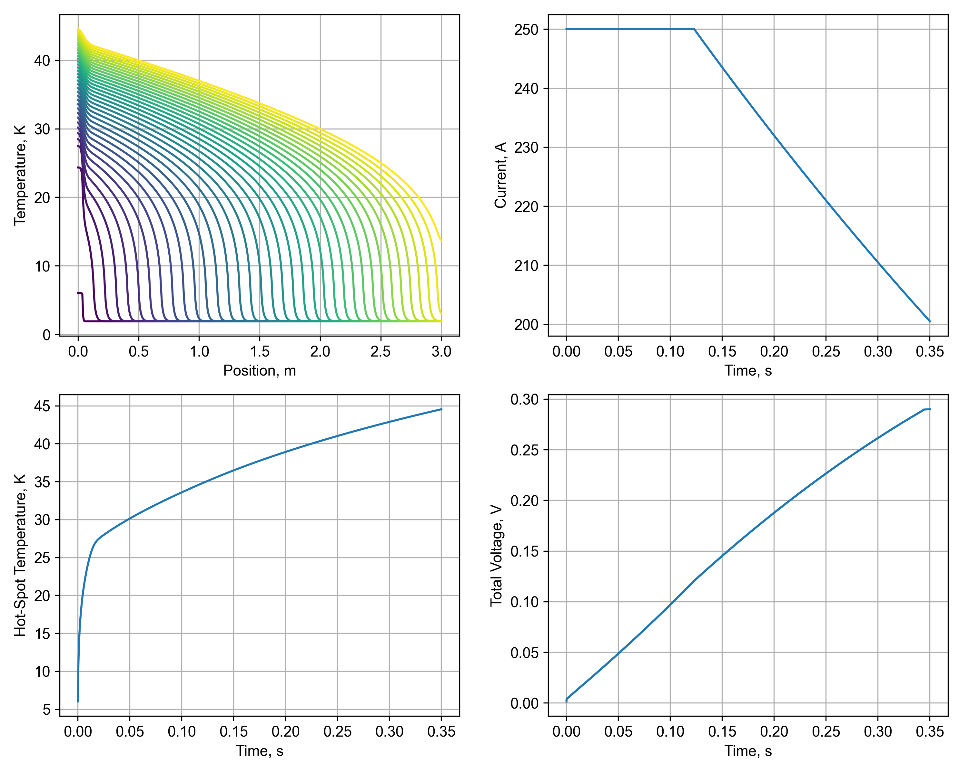
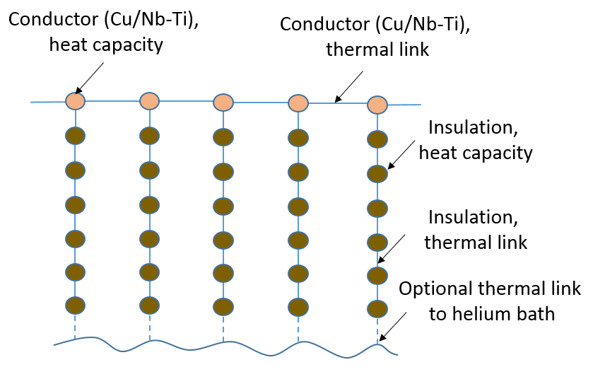
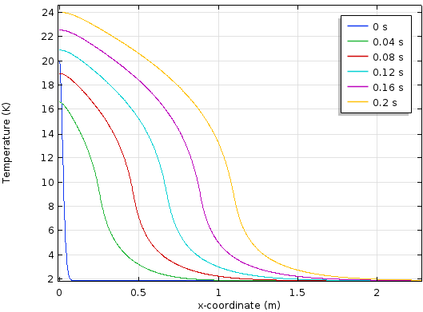
BBQ (BusBar Quench)
Comsol (FE) based BBQ tool drawbacks (mainly commercial licence and lack of input file) are being addressed.
Finite difference BBQ coded in python (PyBBQ) is being developed
Finite difference LEDET can be used for BBQ simulation
Finite element tool based on GetDP is planned to be developed
Temperature [K]
v_{Q}
x [m]
Temperature-development along
length of conductor
→ To simulate 1D+1D quench propagation in superconducting busbars
→ New development: PyBBQ (Python program, finite difference solver)
→ Future development: BBQ based on GetDP

Slide 12

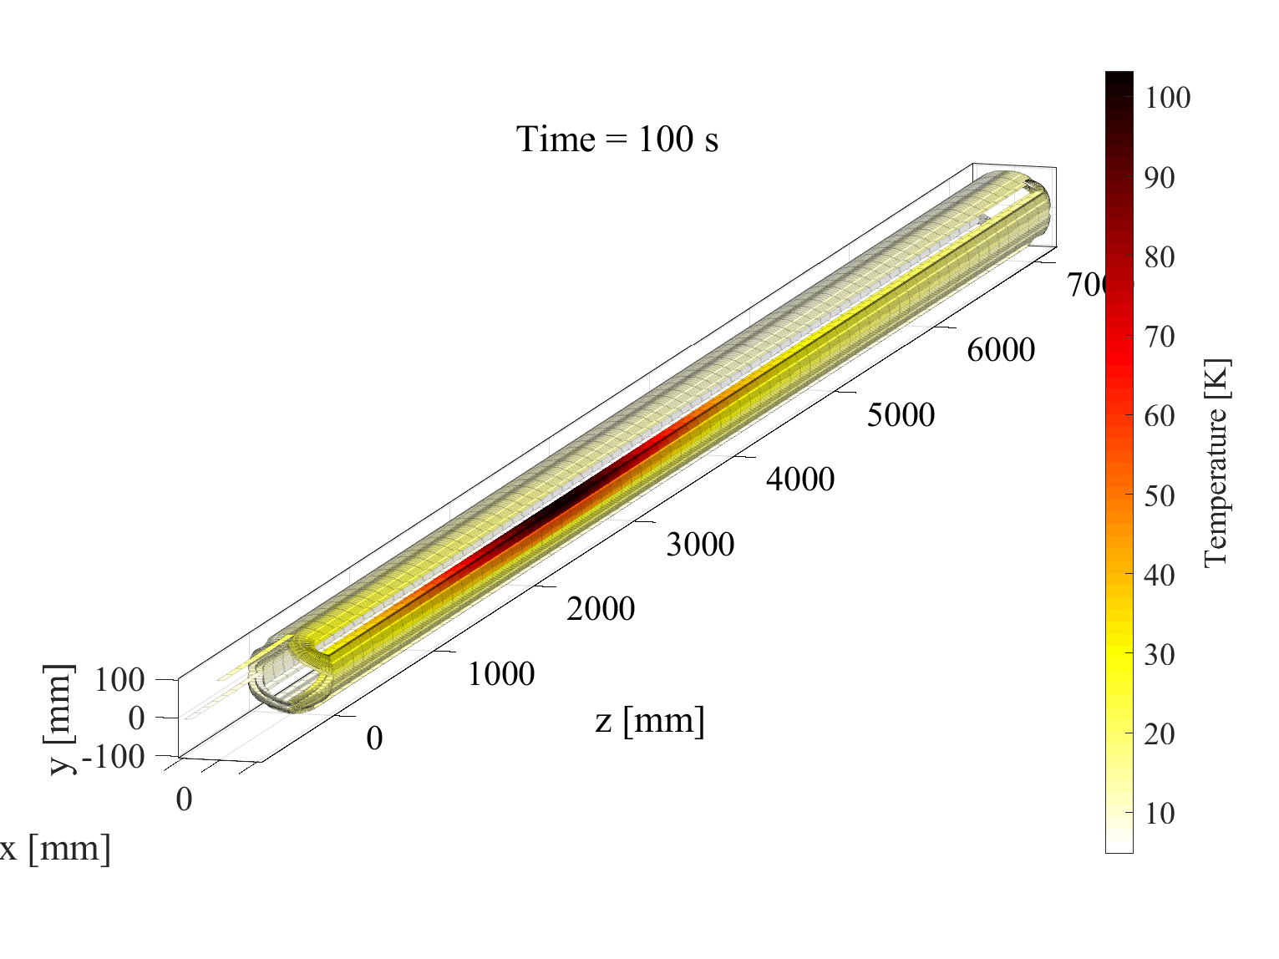

LEDET (Lumped-Element Dynamic Electro-Thermal)
→ To simulate electro-magnetic and thermal transients in superconducting magnets in 2D and 3D geometry using finite-differences method

Slide 13

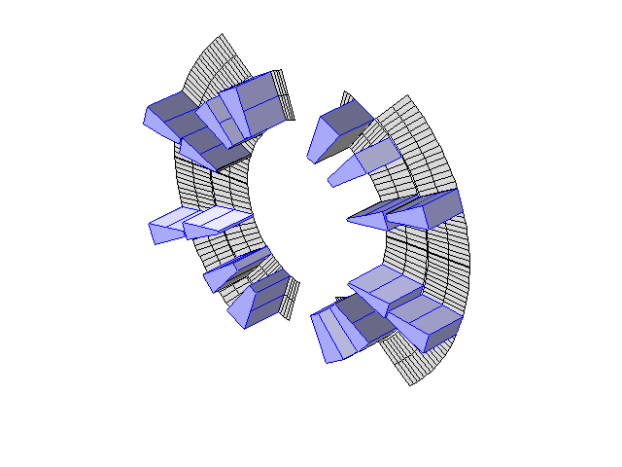
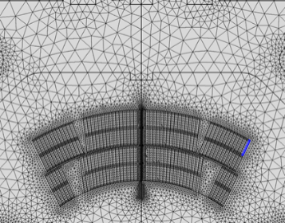
SIGMA (STEAM Integrated Generator of Magnets for Accelerators)
→ To simulate electro-magnetic and thermal transients in superconducting magnets in a 2D geometry using a finite-elements (FE) model

Slide 14

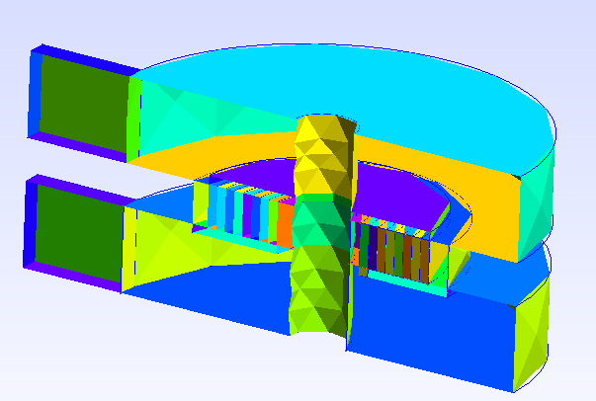
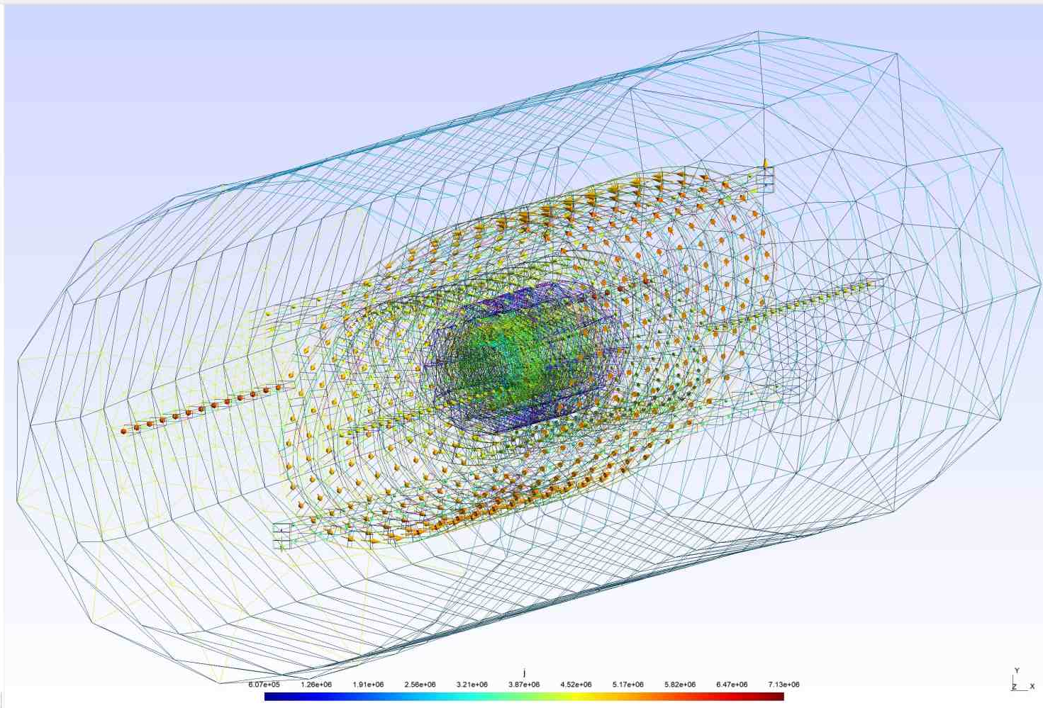
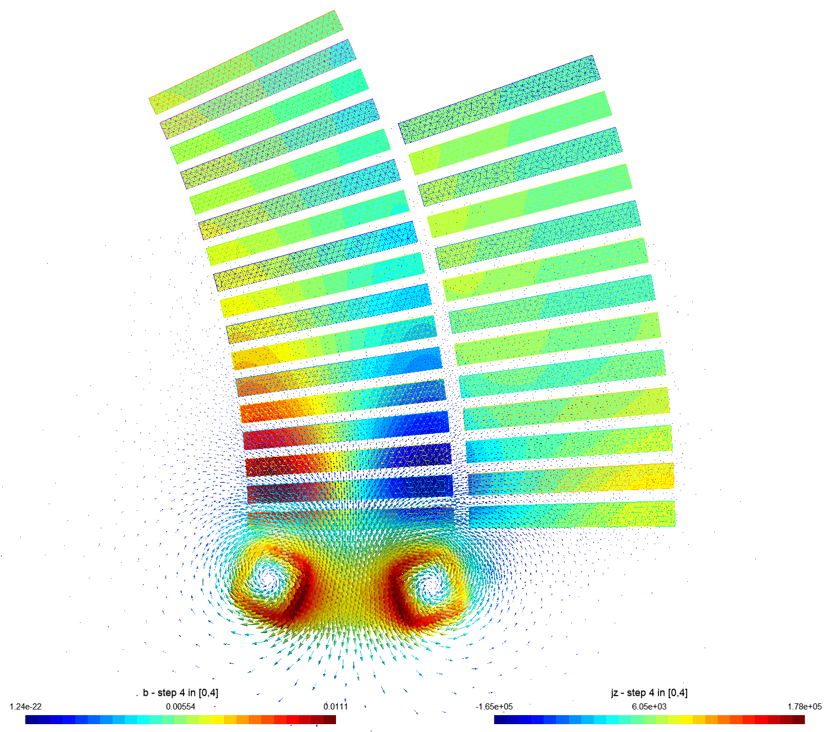
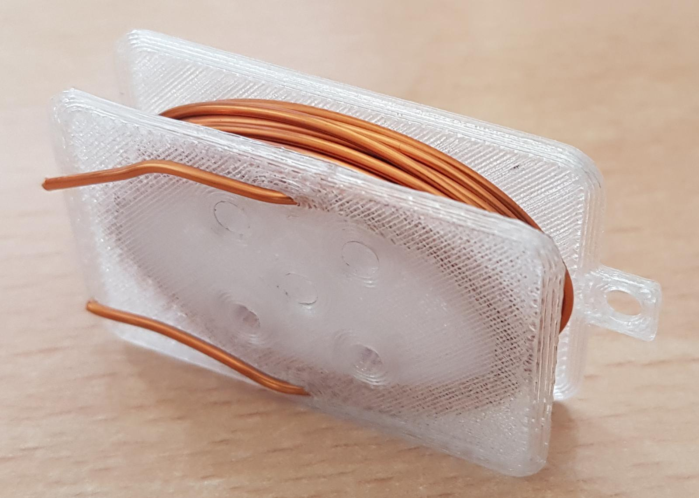
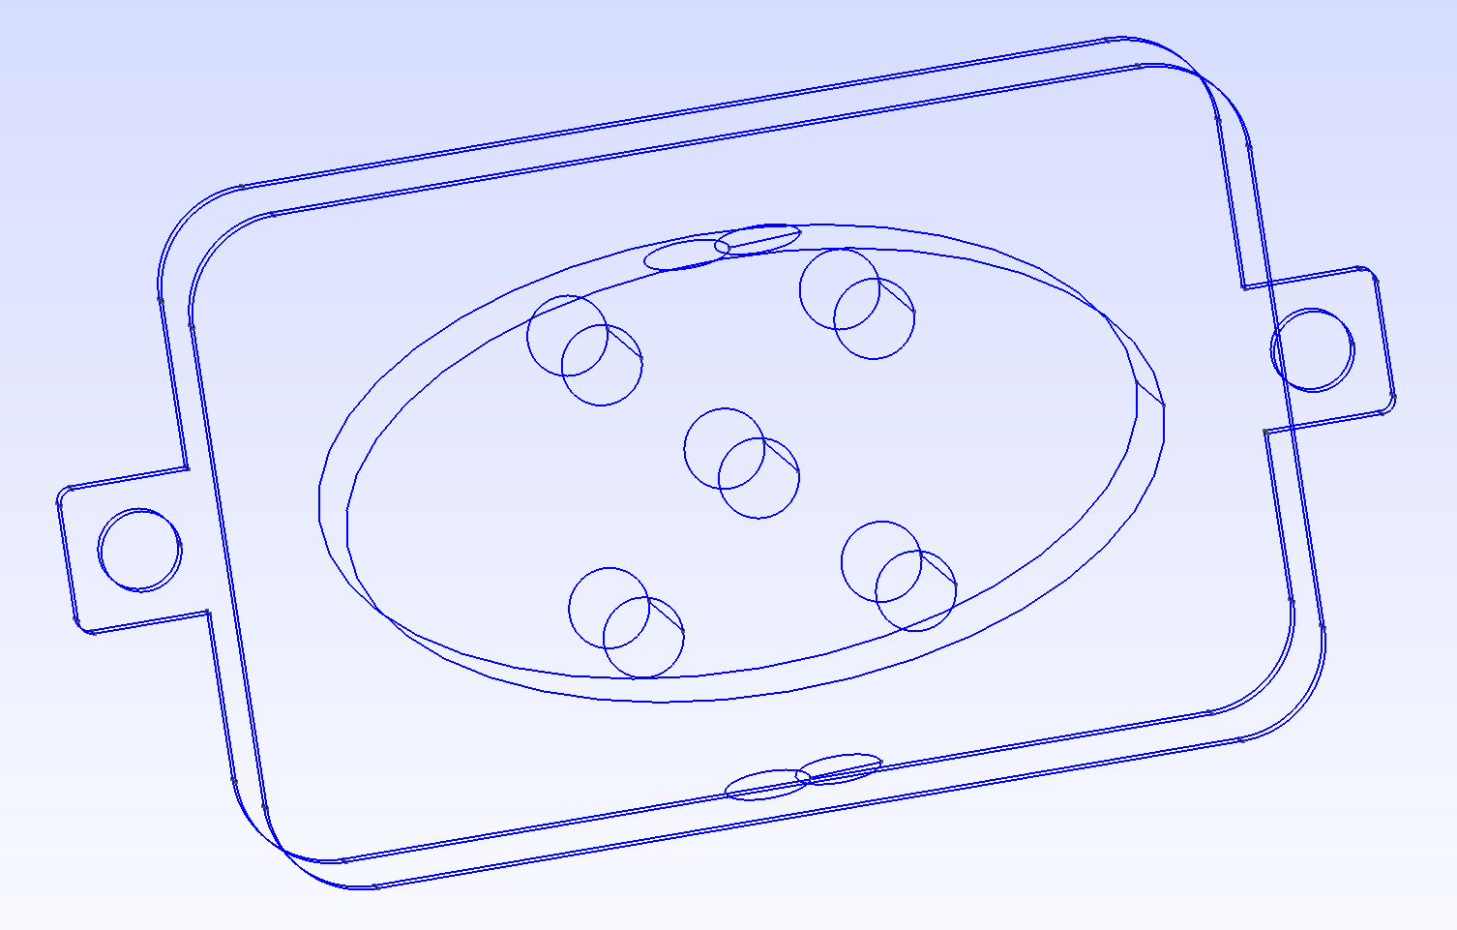
Finite Elements Quench Simulator (FiQuS)
2D Example for quadrupole MQXA
3D Example of a NI HTS coil
3D Example of a CCT magnet
B and M calculation for LEDET
Stand-alone quench simulations
Thermal transient and steady state sim.
HTS coils ramp up and down simulations
HTS coils quench simulations
Coils with insulation, no-insulation, partial- insulation.
B and M calculation for LEDET
Eddy currents in the formers
Temperature of the formers
No plans for a stand alone quench simulation
Gmsh
GMSH for E-CLIQ
<- 2D coupled Th-EM for E-CLIQ
Gmsh used to create 3d models of small demonstrator formers that can be 3d printed.
GetDP
Induced currents in all metal parts.
Joule heating due to induced currents.
IFCC and ISCC to be introduced.

Slide 15
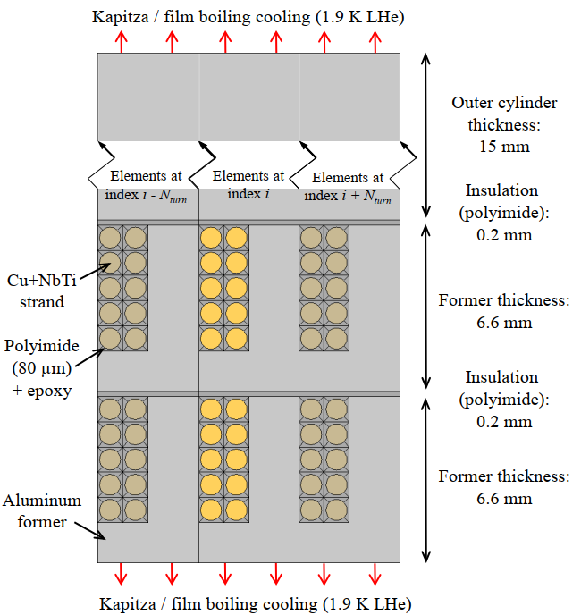
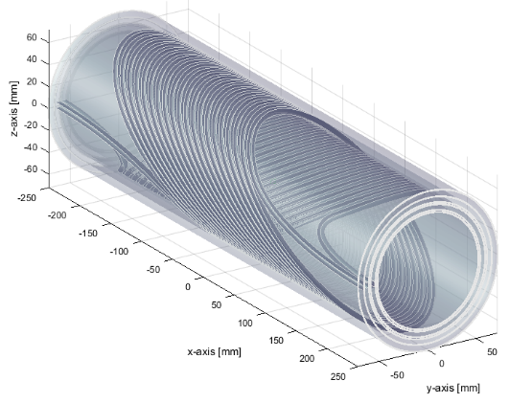
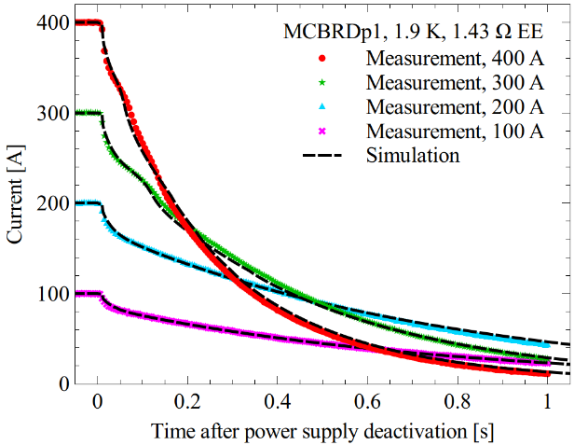
ProteCCT (Protection of Canted-Cosine-Theta) type magnets
→ To simulate electro-magnetic and thermal transients in canted-cosine-theta (CCT) using finite-differences method

Slide 16
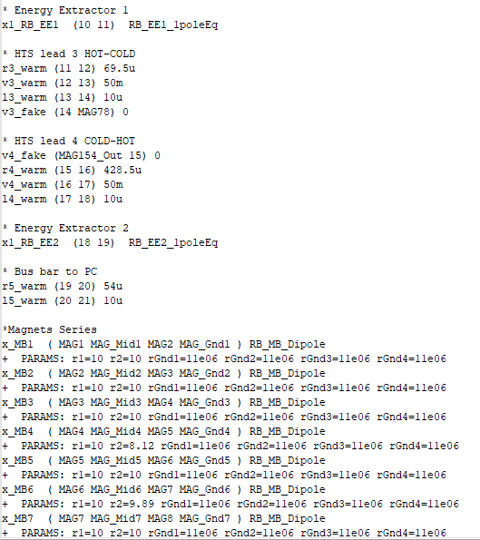
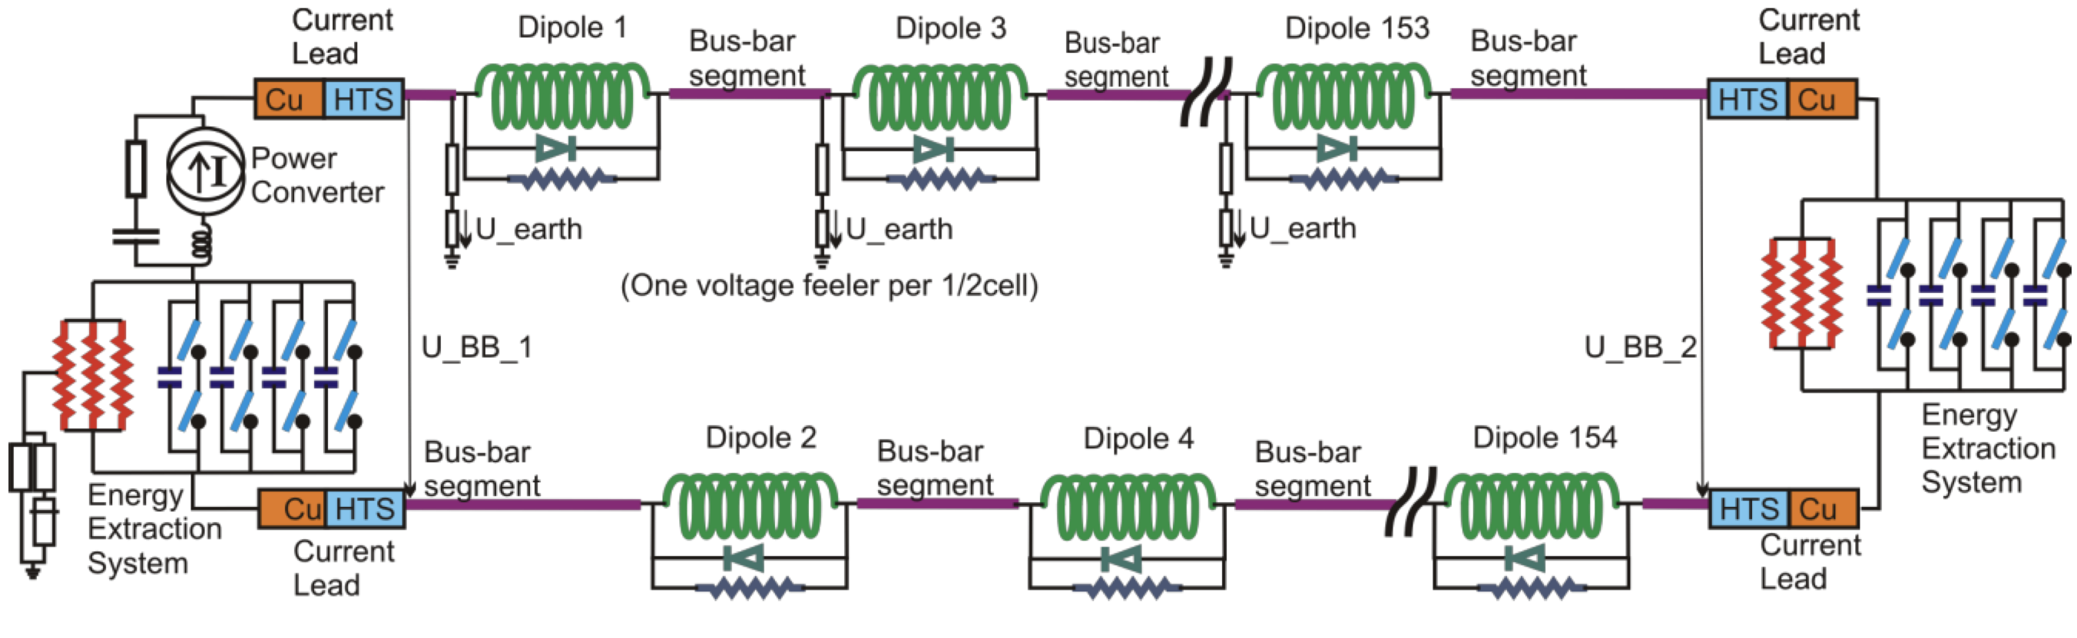
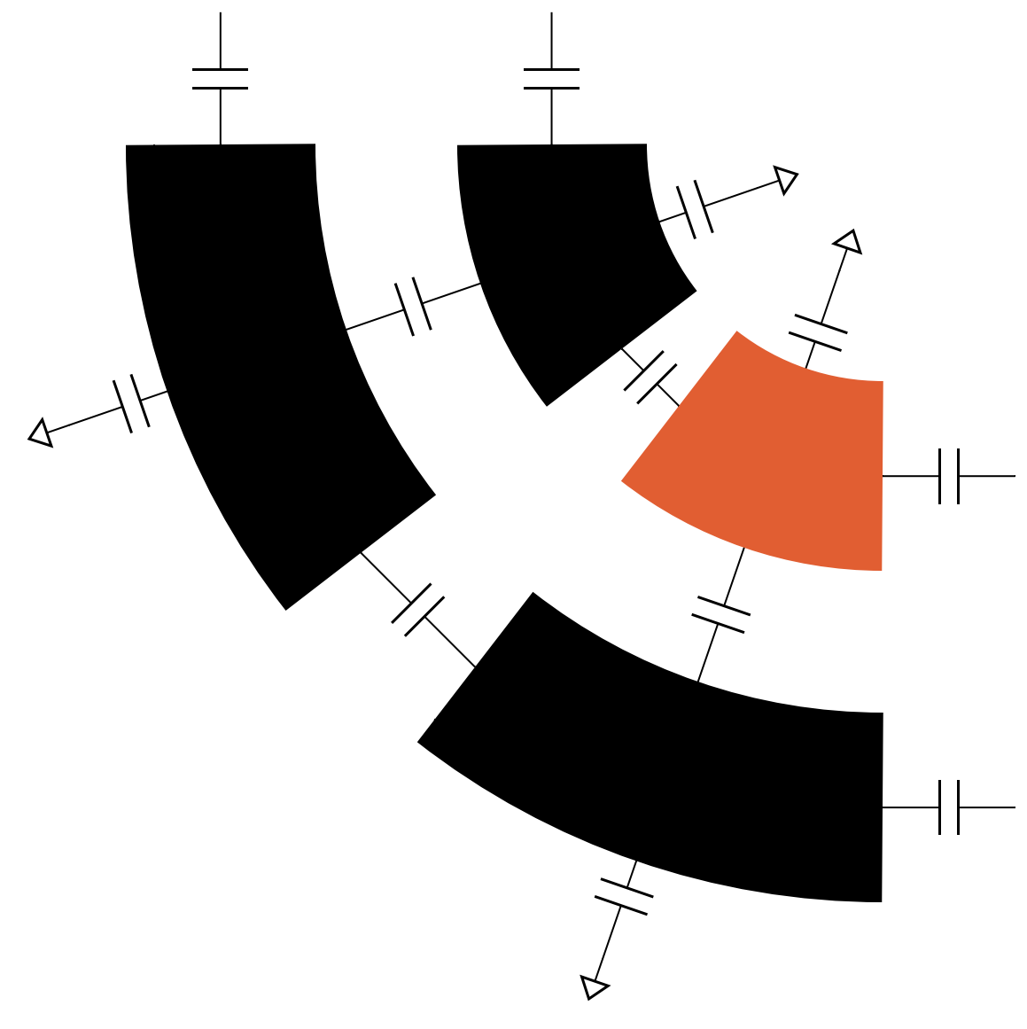
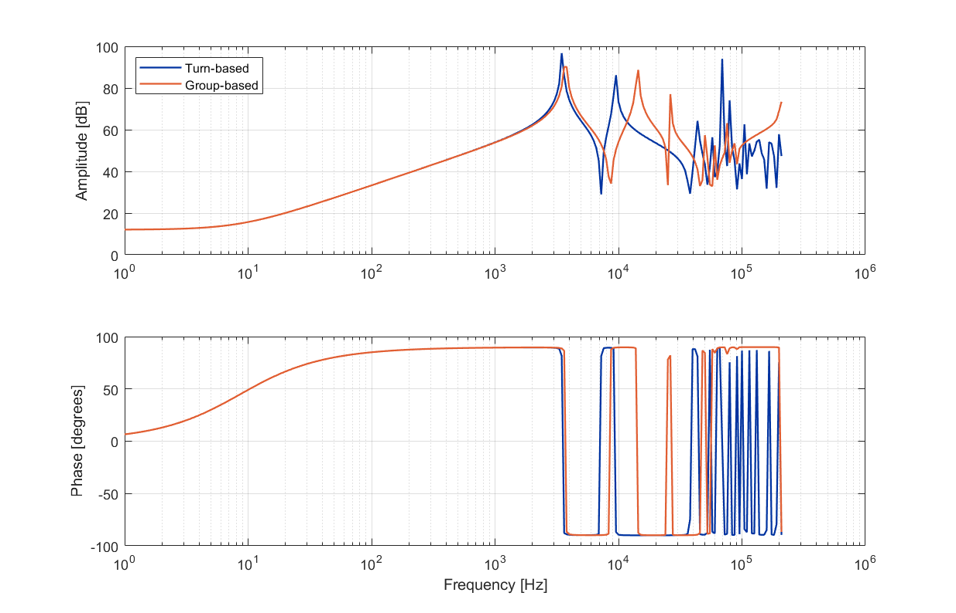
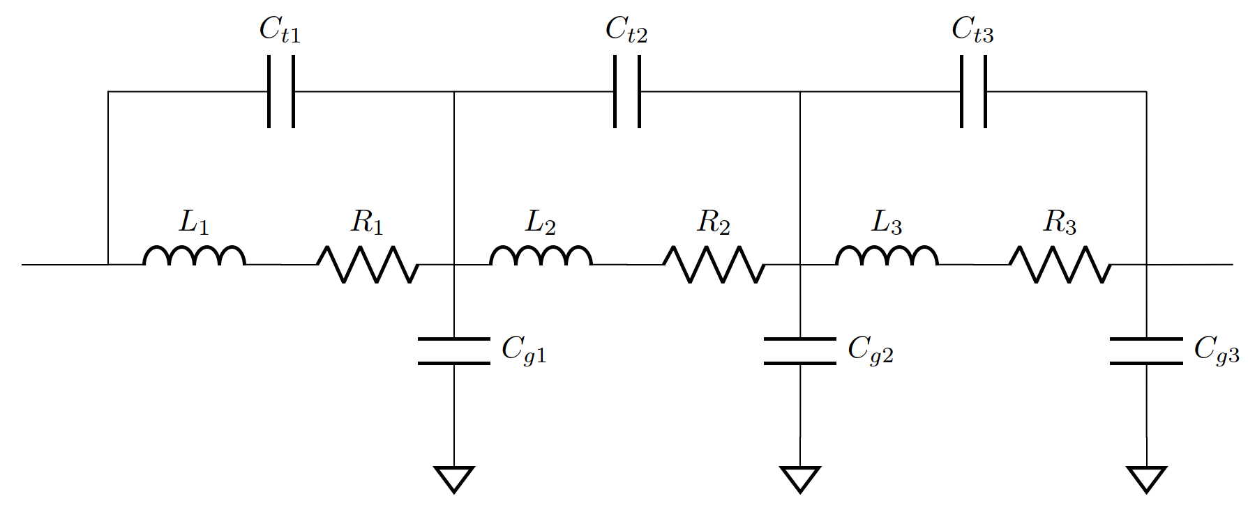
SING (STEAM Integrated Network Generator)
Circuit.cir file
ParserPSPICE
Circuit schematic
YAML file with circuit information
(SING)
Frequency-domain model generator
Magnet or circuit impedance vs frequency
R, L, C calculation
Solve
PSPICE frequency model
→ SING is used to automatically generate PSPICE and LTSPICE circuit models relying on shared sub-components. The tool was re-written in Python (ParserPSPICE) in 2022.
→ Automatic generation of frequency-domain model of a magnet in resistive or superconducting state starting from STEAM input files.

Slide 17
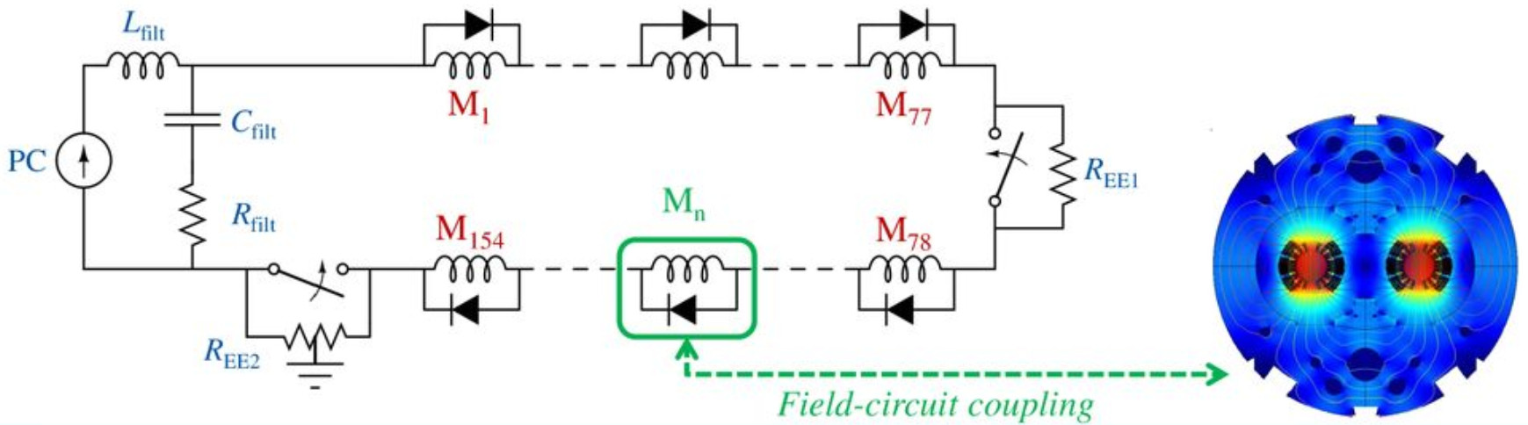
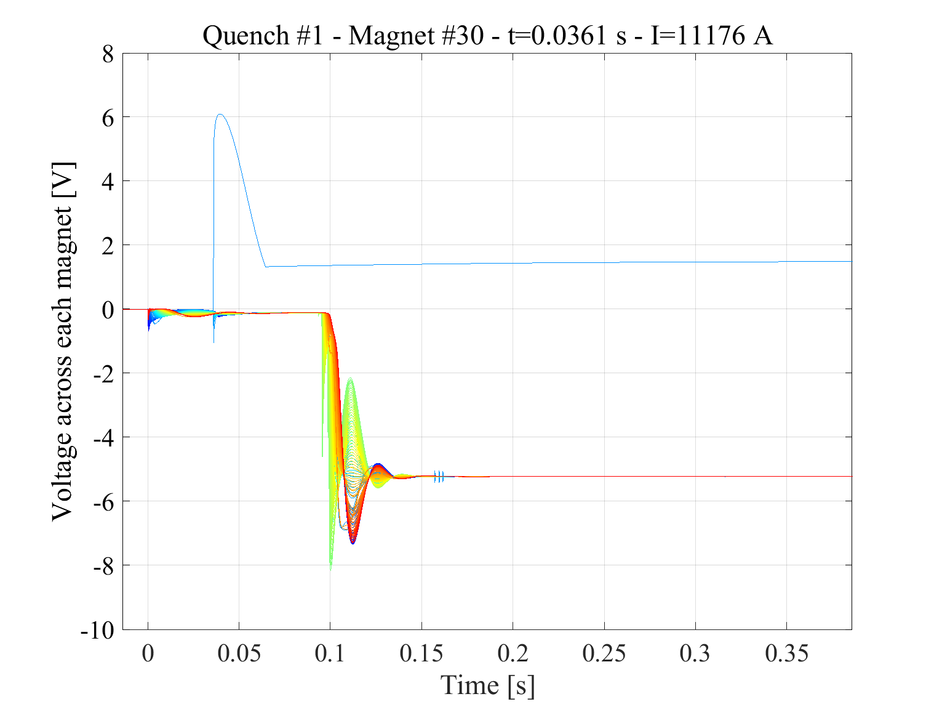
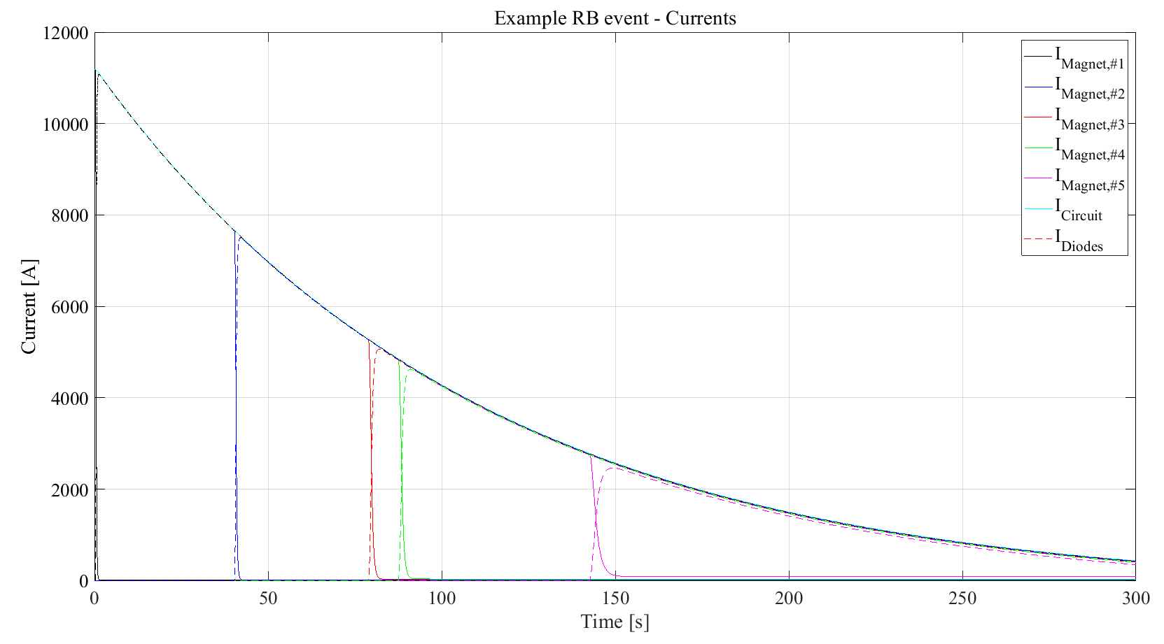
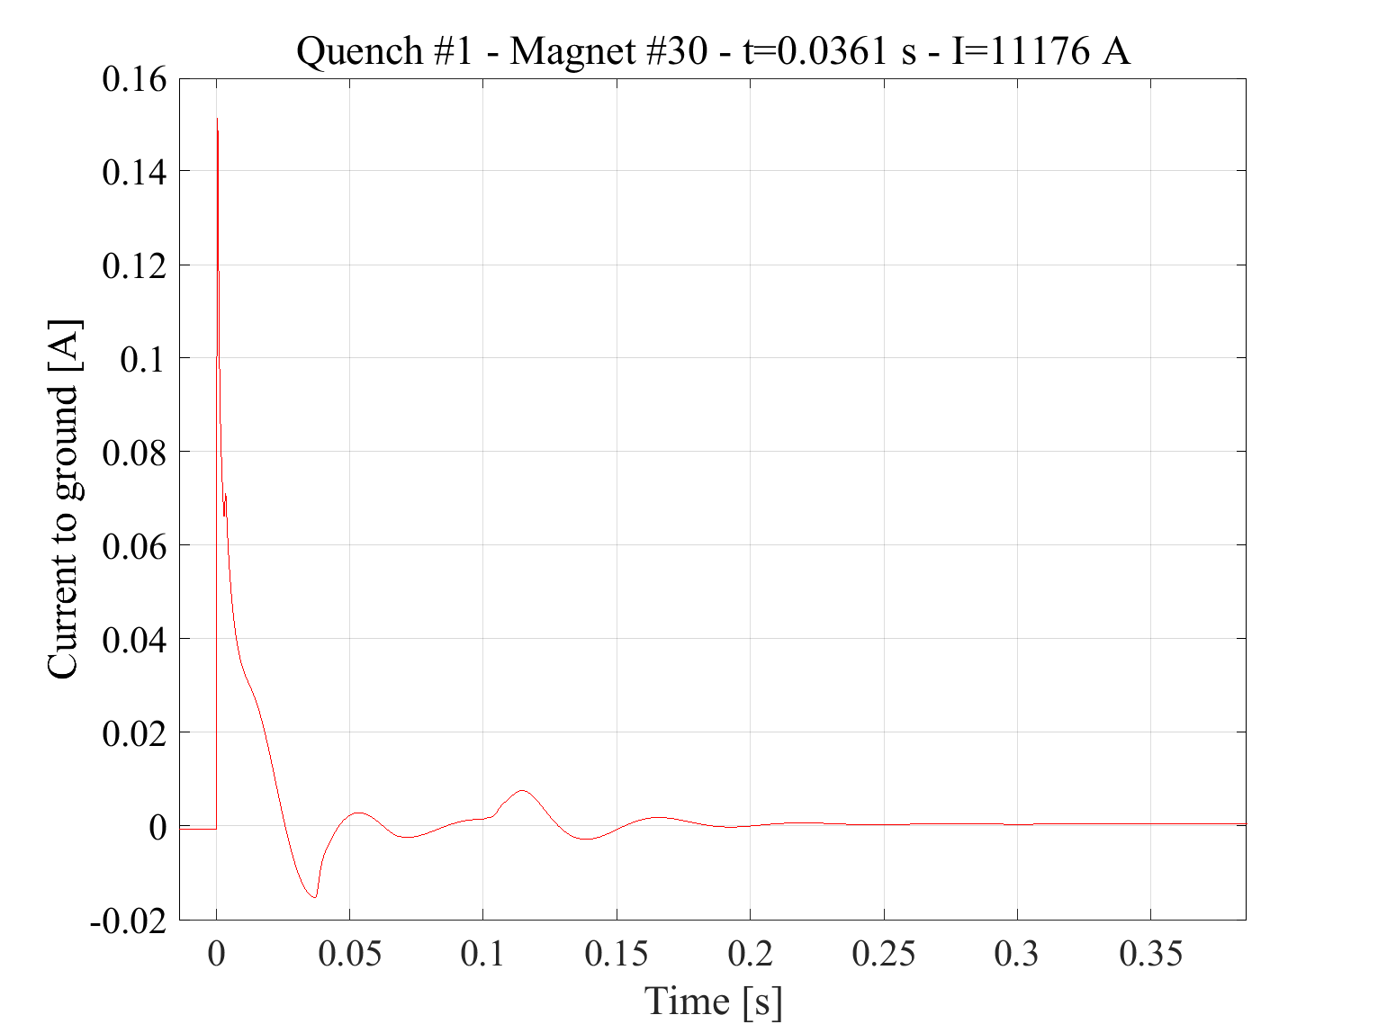
COSIM (Co-operative Simulation)
→ To run co-operative simulations of models developed in different software
→ Main use case is to couple magnet level models to circuit models

Slide 18
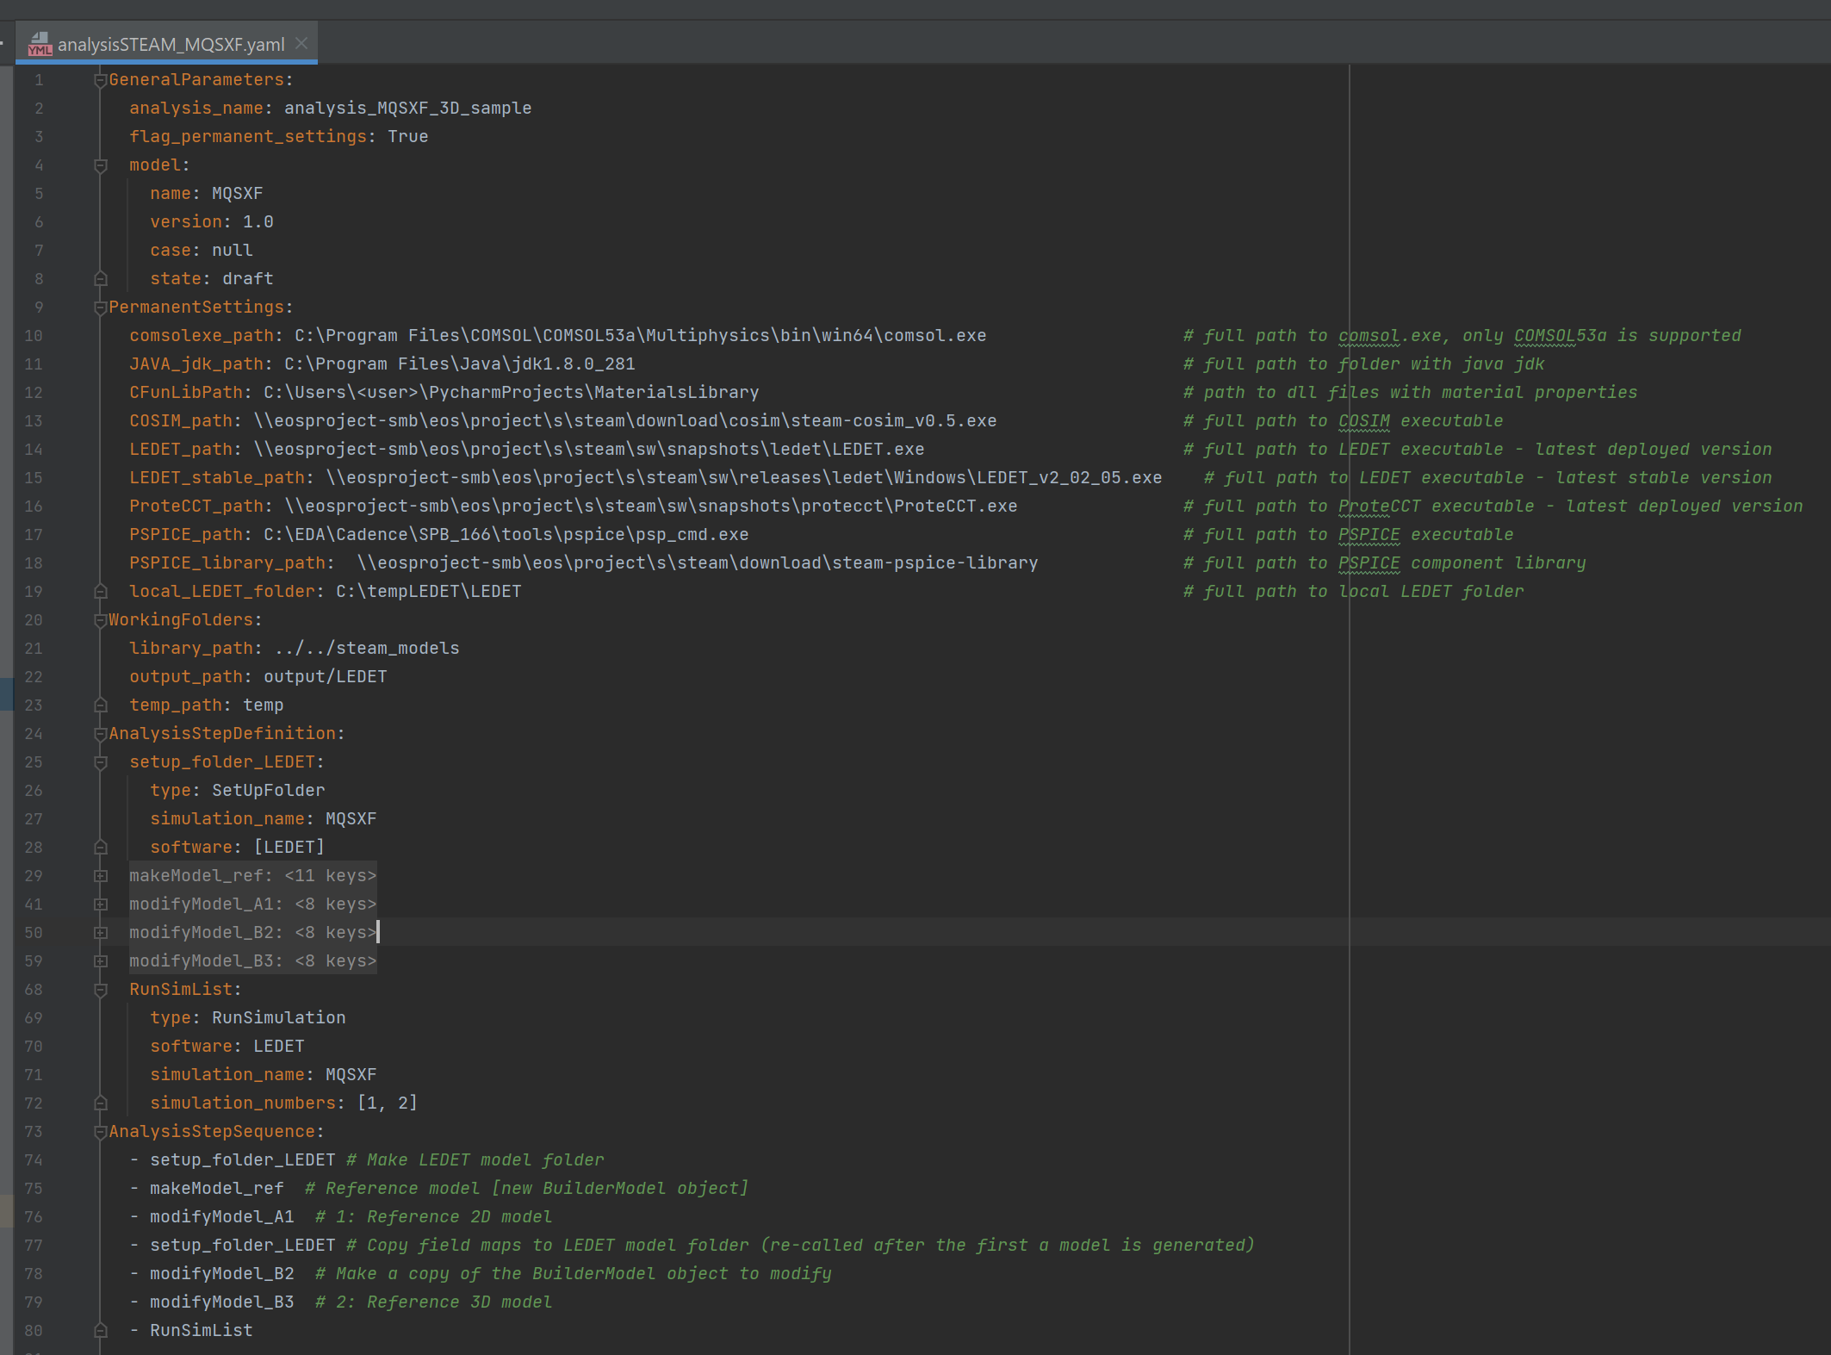
(Consecutive) Analysis
Change something in the model
and give it a new number
Change something else in the model
and give it yet another number
Setup folder
Load reference model
Run both models
→ To programmatically setup folders, change model parameters, and run models
→ Done with a dedicated yaml file per analysis to allow to keep history of what was done
→ Records which versions of software have been used for analysis
→ Greatly simplifies model setup and allows for changes to the reference models.

Slide 19

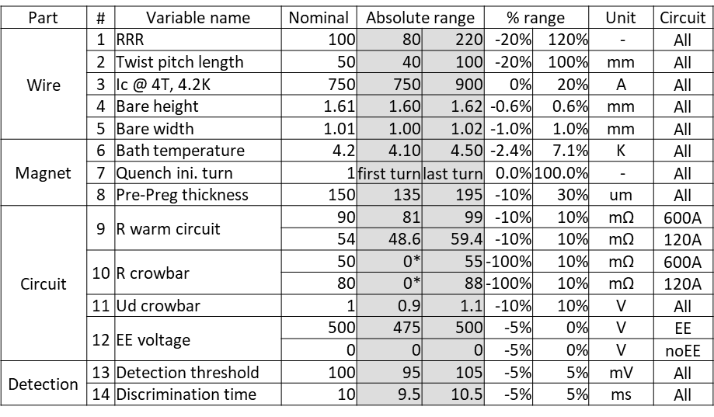
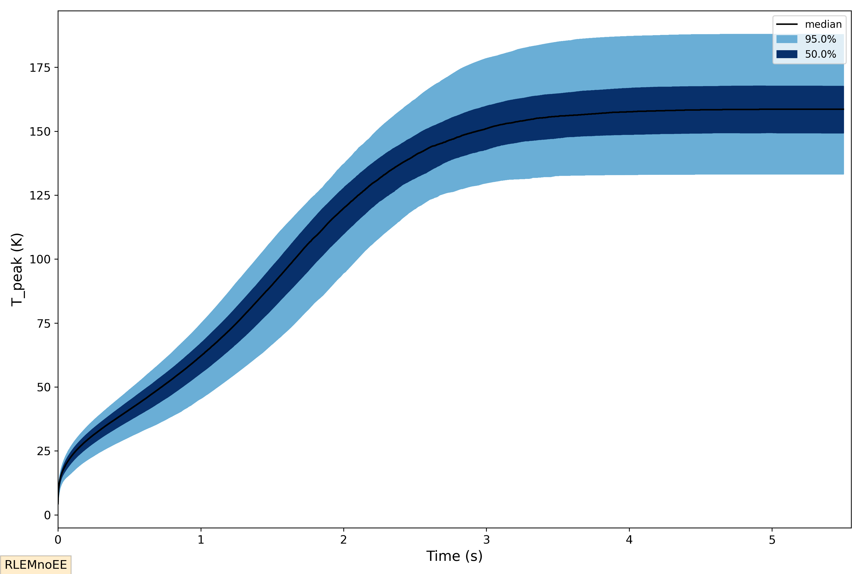
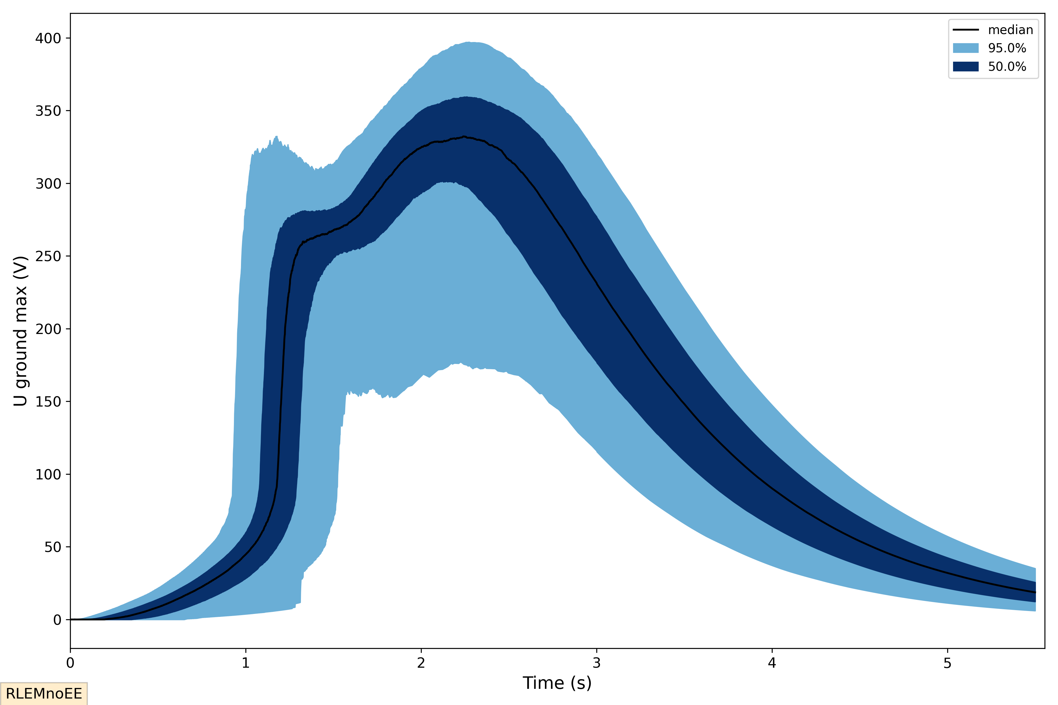
Parametric (analysis)
Example of Uncertainty Quantification
Other capabilities:
Parametric studies
Design of Experiment
Optimization
→ Benefits from text-based input files for models, virtually any input can be changed
→ Works ‘on top’ of consecutive analysis files, so complicated sequence of steps is possible (WIP)
→ Works with cooperative-simulations, so multitool parametric setups are possible (WIP)

Slide 20
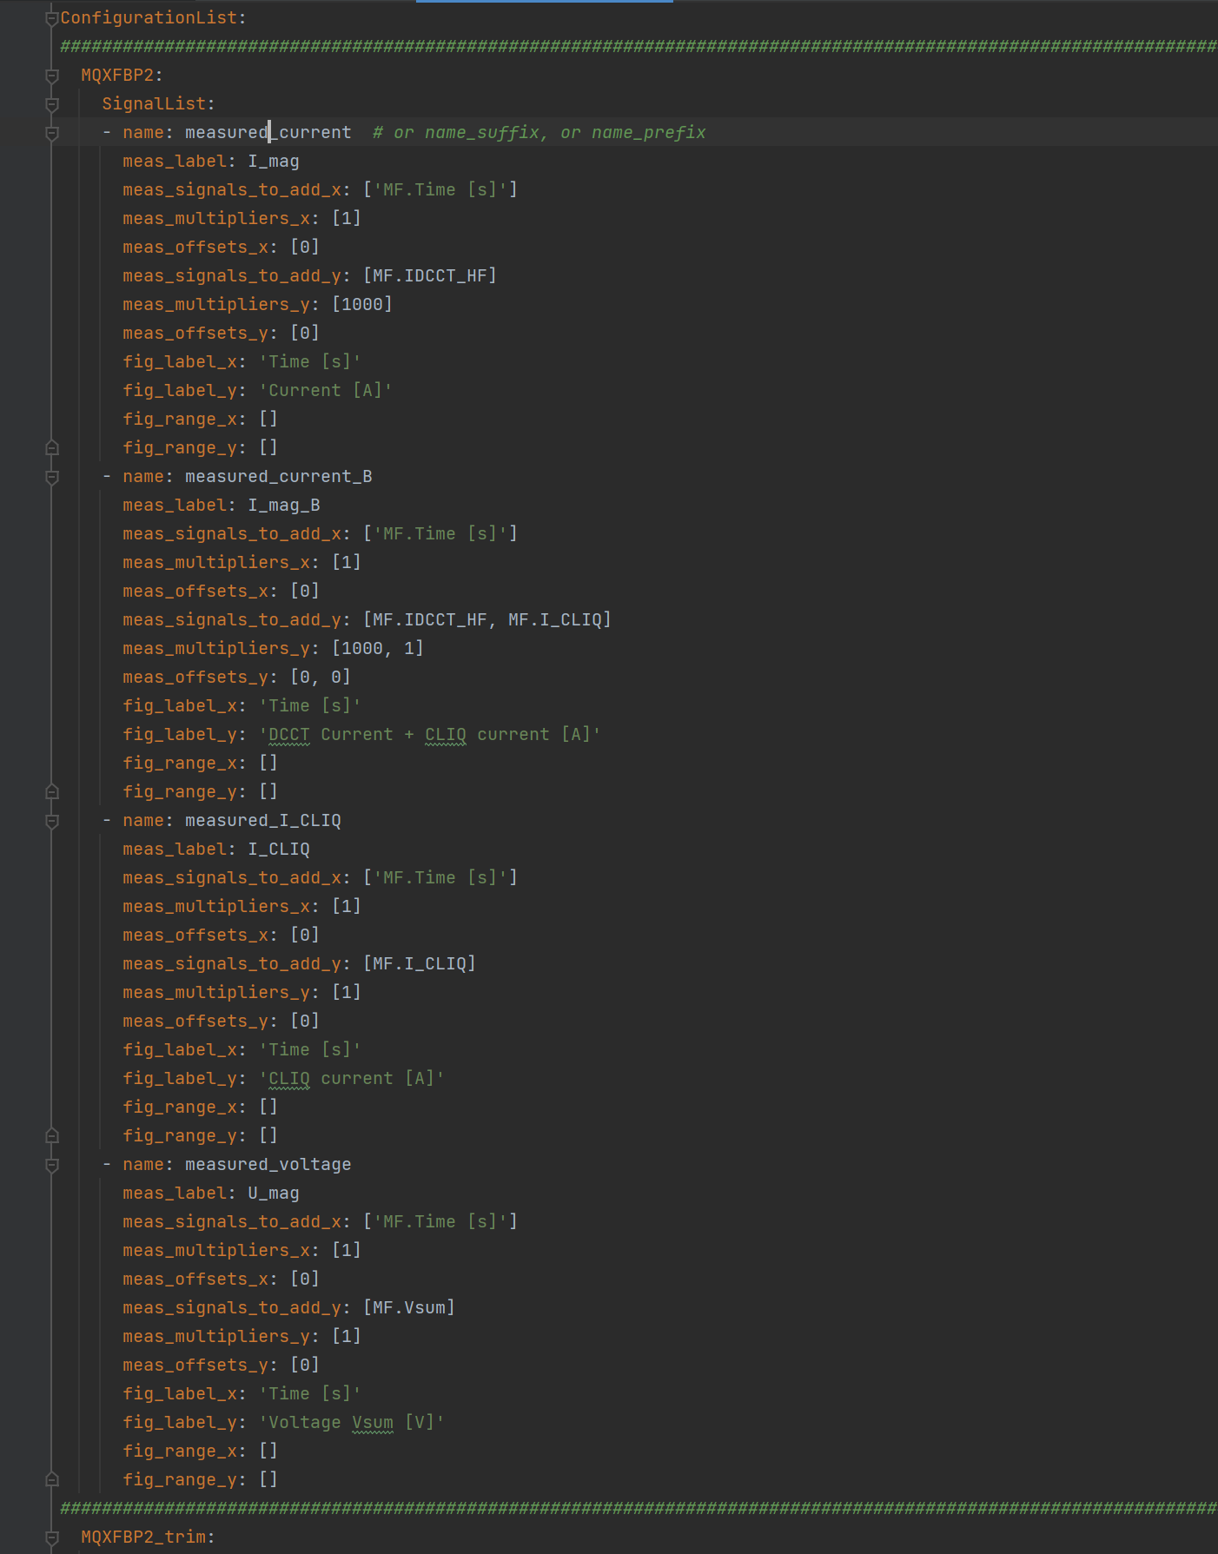
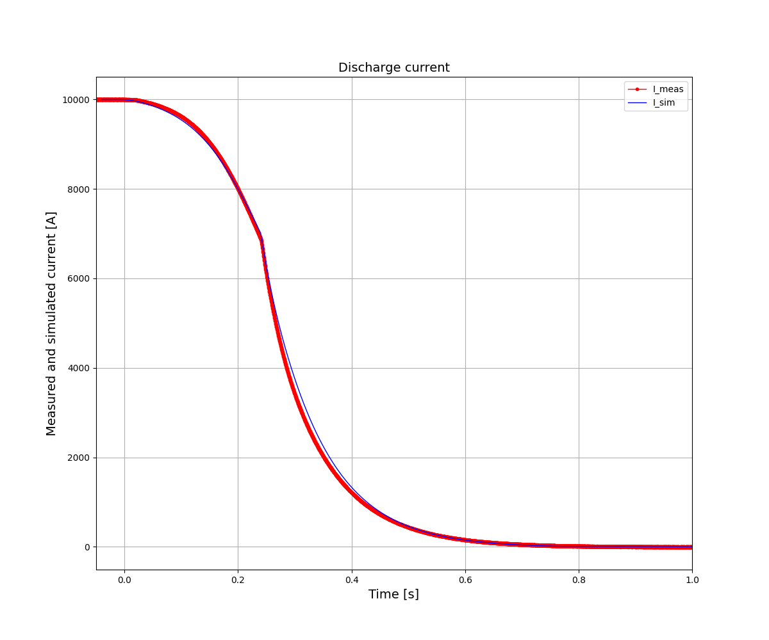
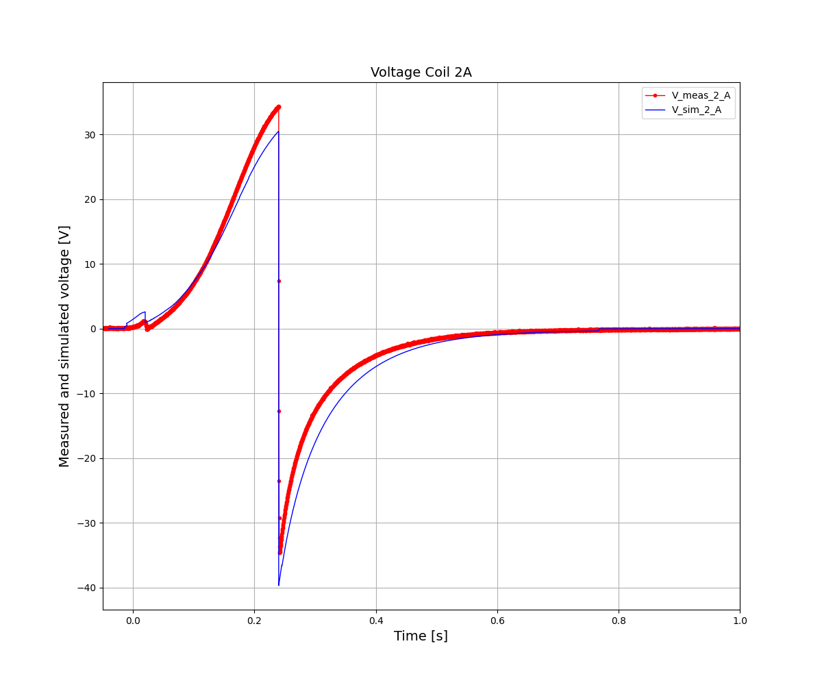
Measurements and simulations comparison
Show real example
MBRD magnet
→ Allow defining equivalent signals in measurements and simulation files
→ This is done using yaml input files for consistency with other input files
→ Simple operations of for example adding v-taps signal for a total signal are supported
→ Can be done per magnet type or modified to individual magnet and test setup

Slide 21
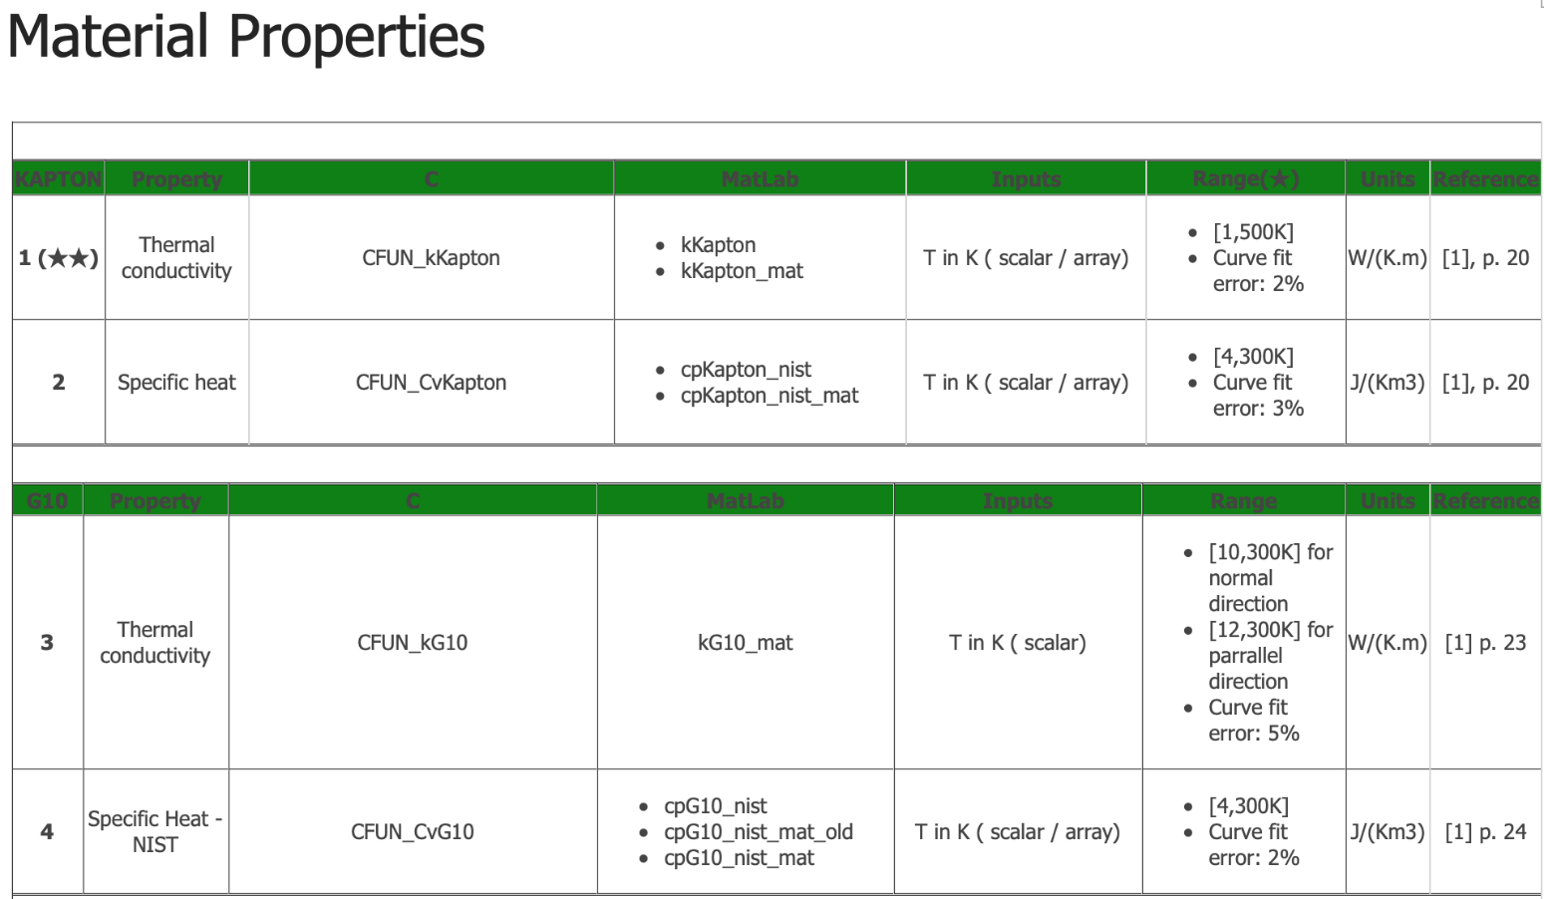
Library of Material Properties
Work has been done to allow a use the same material properties (coded in C) across tools written in Python, MATLAB and FE solvers (Comsol, GetDP i.e. FiQuS).
GetDP
C++
C
MEX
STEAM website: https://espace.cern.ch/steam/_layouts/15/start.aspx#/SitePages/Material%20Properties.aspx
https://gitlab.cern.ch/steam/steam-material-library
https://gitlab.cern.ch/steam/steam-ledet-material-library
DLL
→ We share our material property database with users to support a community of users across different labs/universities and to help model cross-checking

Slide 22
STEAM model library: change in tools and/or input files
Software | 2021 | 2022
BBQ | Manual in COMSOL | Manual in COMSOL
PyBBQ | - | Yaml + Python API
FiQuS | - | Yaml + Python API
SIGMA | Notebook + Java .jar | Notebook + Java .jar
LEDET | Notebook + Python API | Yaml + Python API
ProteCCT | Manual in Excel | Yaml + Python API
SING | Notebook + Java .jar | Yaml + Python API
COSIM | Notebook + Java .jar + Python API | Yaml + Python API (foreseen for the end of 2022)

Slide 23
STEAM framework (recap)
Input Data*
Conductor
Magnet
Circuit
(Consecutive) Analysis
Parametric (analysis)
(comparison to)
Measurements
Conductor
BBQ
FiQuS
PSPICE**
STEAM SDK
STEAM SDK
STEAM SDK
Magnet
LEDET
LEDET
STEAM SDK
Dakota***
Circuit
PyBBQ
ProteCCT
SING
Co-sim.
SIGMA
Analysis
Materials properties
PSPICE library
Parametric
Cooperative-simulation
Meas. config
COSIM
STEAM SDK
Meas. data
STEAM SDK
some functionality is under active development
* Text based (YAML) and Roxie files, and tdms files, ** Commercial circuit solver, *** Tool from Sandia Labs

Slide 24
STEAM LIBRARY

Slide 25
STEAM applications
LHC
Versioned library of validated models of all magnets and all circuits
Scripts to rapidly reproduce specific events (different initial current, quench location and time, energy-extraction timing, etc) in specific circuits (different warm resistance, energy-extraction resistance, etc)
Assist in understanding and reproducing unexpected transients during operation
LHC
HL-LHC
Versioned library of validated models of all magnets and all circuits (ready for the String test)
Parametric studies, failure analyses, and worst-case identification (hot-spot temperature, voltages to ground)
Assist in understanding and reproducing unexpected transients during testing
HFM and external collaborations
Develop quench protection models for new/less explored magnet concepts (CCT, curved CCT, …)
Develop capability to model new quench protection systems (Secondary-CLIQ, external-CLIQ, …)
Integrate HTS and non-insulated (NI) coils into the STEAM framework

Slide 26
STEAM superconducting magnet circuit library
Magnet type | Self-protected (3D) | EE + quench-back | QH | CLIQ | Co-simulation | Short-circuit | NI
Multipole | √ | √ | √ | √ | √ | √
Solenoid | √ | √ |  |  | √
CCT | √ | √ |  |  | w.i.p.
Curved CCT | w.i.p. | w.i.p. |  |  | w.i.p.
Pancakes | w.i.p. |  |  |  |  |  | w.i.p.
~60 magnet models, all validated, including the great majority of LHC and HL-LHC magnets
~50 models of circuit types, all validated, including all LHC circuit types
Magnet/circuit models in the frequency domain available as well, but very few are validated

Slide 27
LHC TRANSIENTS

Slide 28
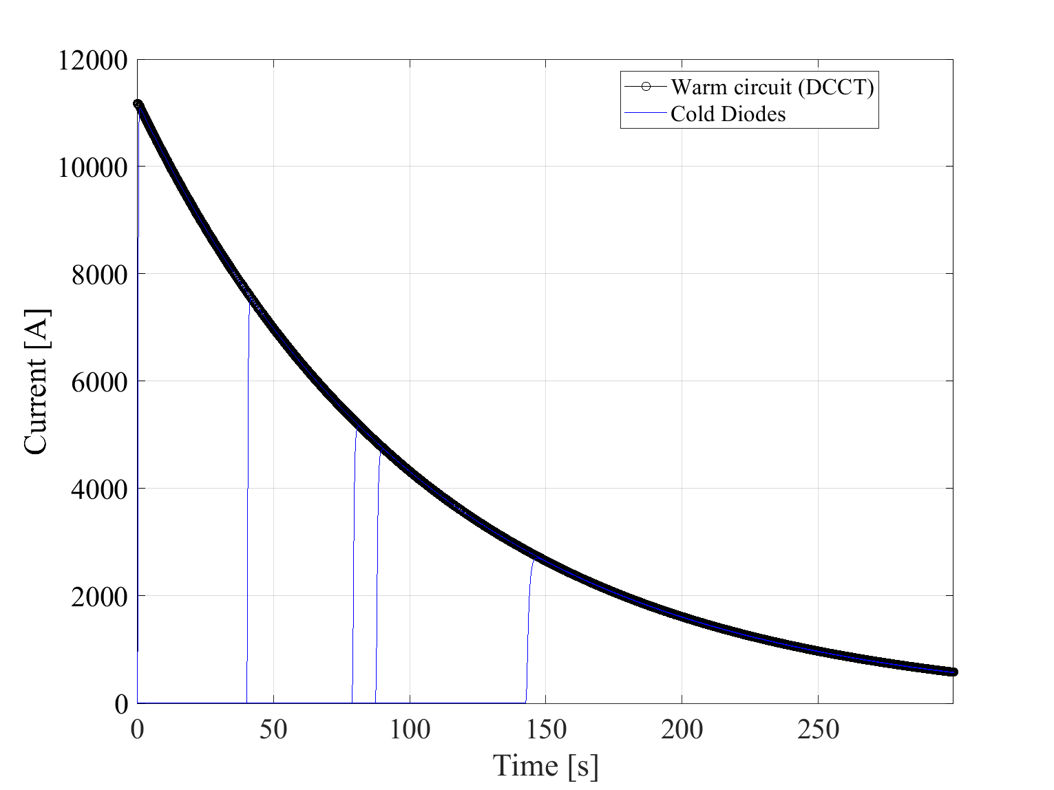
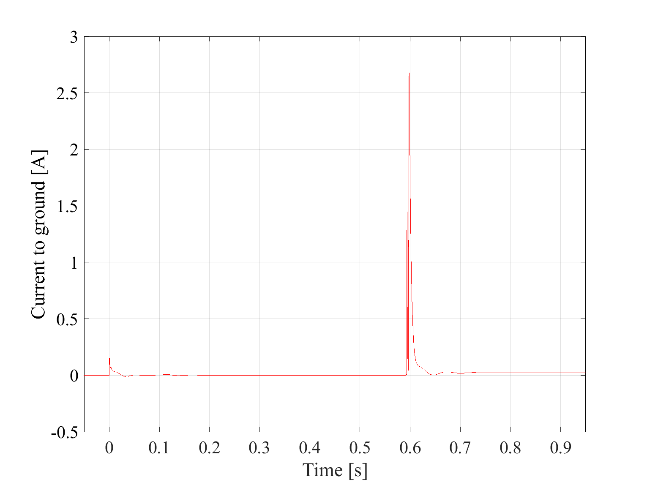
Example of simulated quenches and FPA in an RB circuit
Circuit and magnet currents
Voltages across the magnets
Earth current
Quench #1
Quench #2
Quench #3
Quench #4
Quench #5
Simulations of specific fast power abort (FPA) events in RB circuits are generated automatically based on the information provided by the LHC-SIGMON notebooks
M. Janitschke, TECH

Slide 29
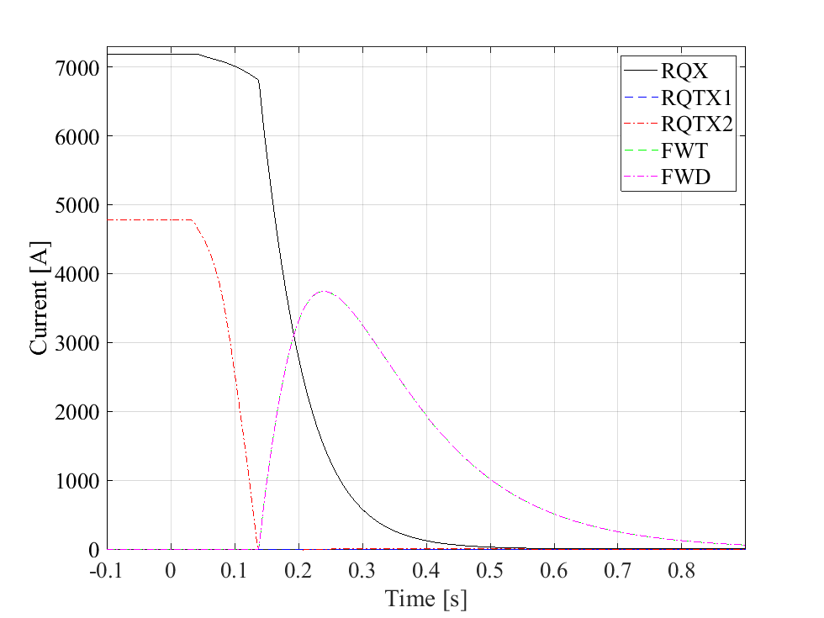
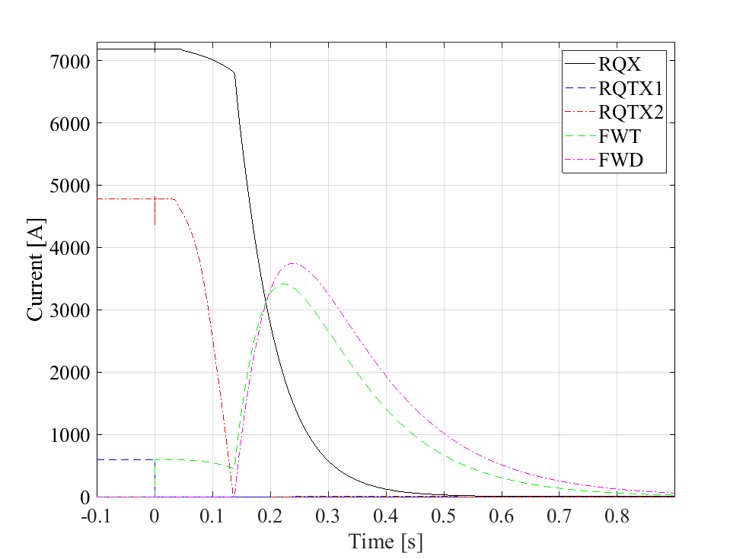
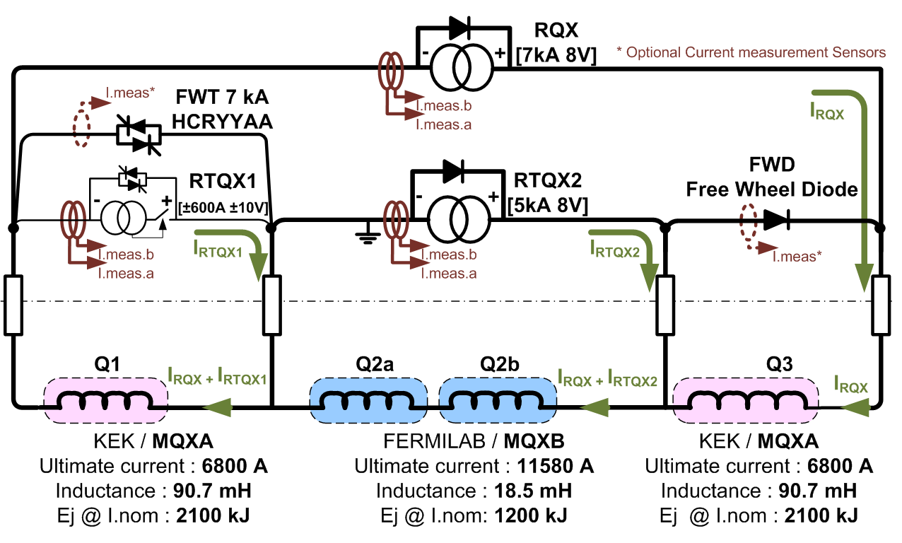
Example of simulated quench and FPA in an Inner Triplet circuit
Circuit schematic
FPA without trim current
FPA with trim current
Reference FPA curves simulated for different initial currents in the nested power converters
Currents through the magnets and free-wheel Diodes and thyristors are not measured and can be assessed only by simulations

Slide 30
Example of simulated quench and FPA in an IPQ circuit
Magnet current
Temperature in the coil turns
Voltage to ground distribution
Simulations can bring additional information regarding the magnet behavior. In this example, we see the temperature distribution at the end of the discharge (note the hotter turns in contact with QH) and the voltage to ground distribution at different times (note the periodic pattern due to magnet symmetry).
F. Murgia, TECH

Slide 31
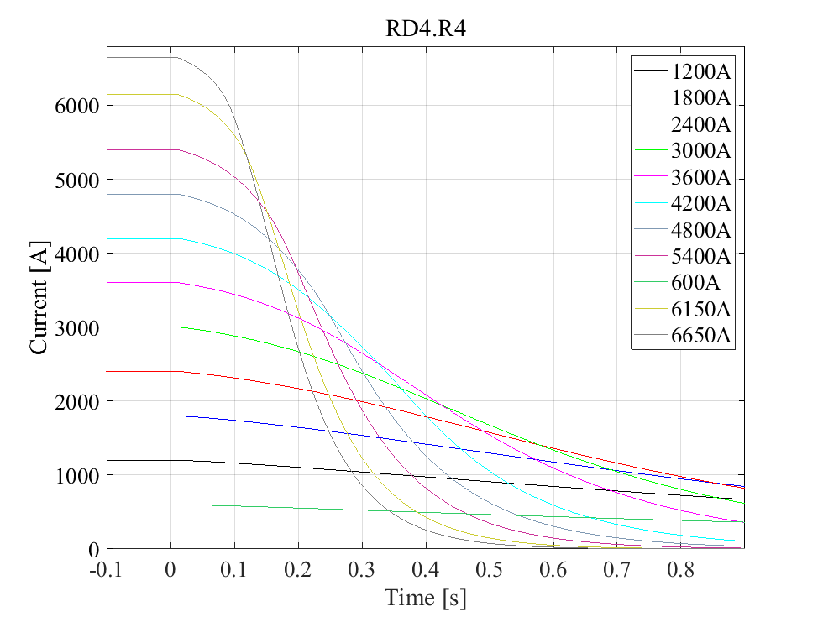
Example of simulated quench and FPA in an IPD circuit
Magnet current
Temperature in the coil turns
Temperature of the QH strips
(0.1 s offset)
Simulations can bring additional information regarding the magnet behavior. In this example, we see the temperature distribution at the end of the discharge (note the hotter turns in contact with QH) and the temperature of the QH strip (note that they get hotter than the coil).
M. Janitschke, TECH

Slide 32
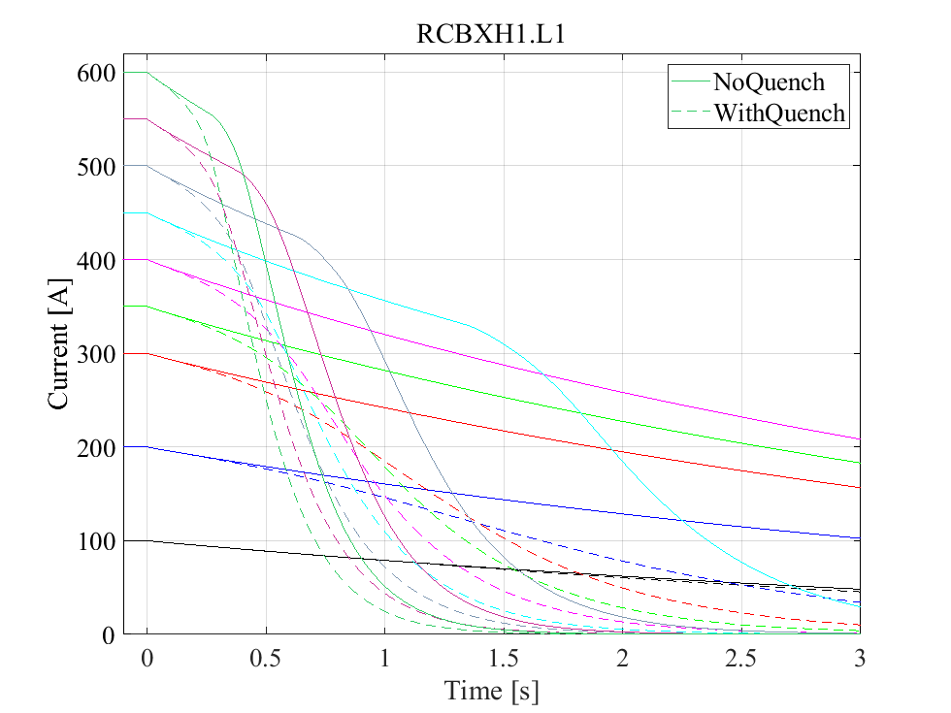
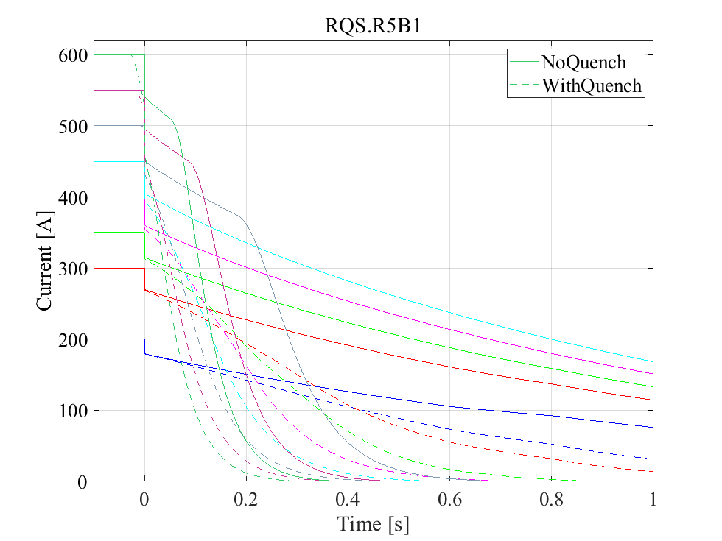
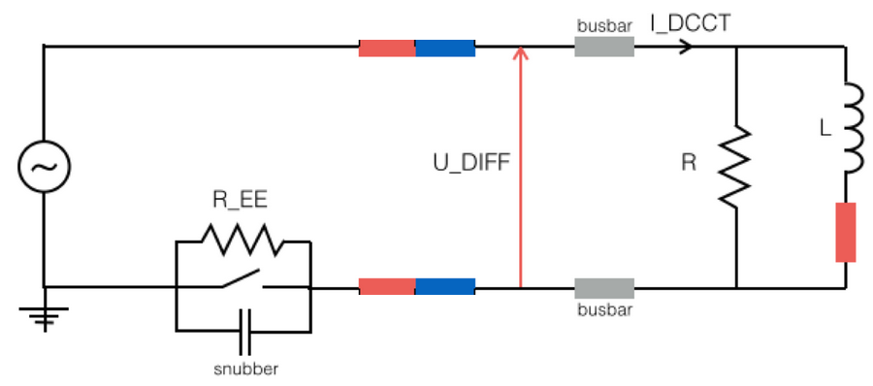
Example of simulated quench and FPA in 600 A circuits
Discharges without Energy Extraction
Discharges with Energy Extraction
Reference FPA curves simulated for all circuit types at different current levels
Simulations provide a useful reference to analyze FPA events and understand unusual events
Currents through magnets and parallel resistors (if present) are not measured
M. Janitschke, TECH

Slide 33
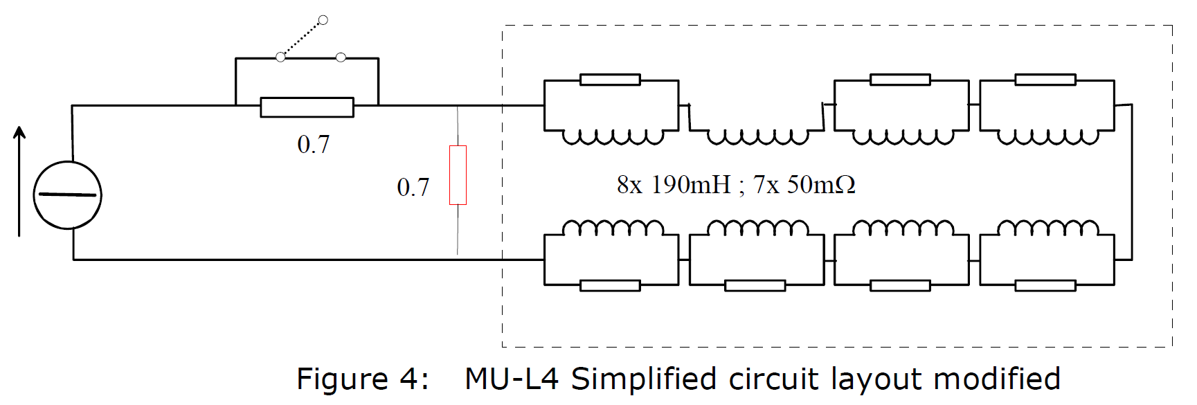
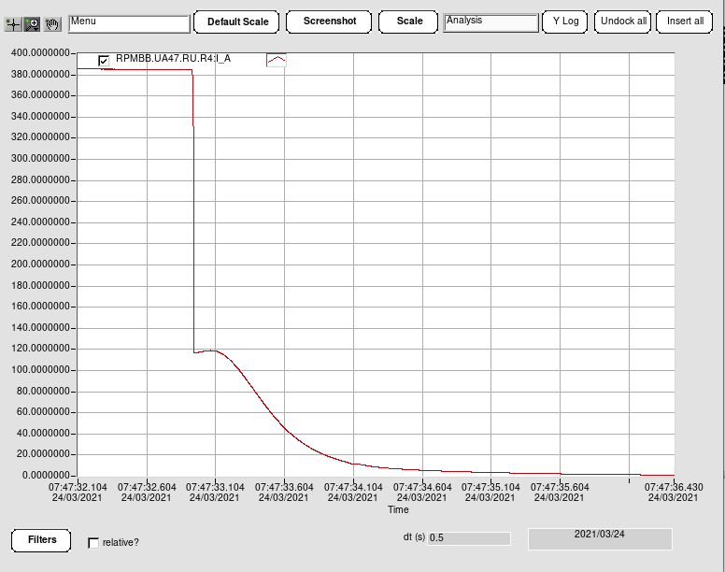
Example of simulated quench and FPA in a 600 A undulator circuit -1
DCCT
Circuit current measured by the DCCT
Very difficult to understand, let alone analyze, such a difficult transient with the available measurements
Note that the parallel resistors also act as quench heaters
From LHC Project Report 894

Slide 34
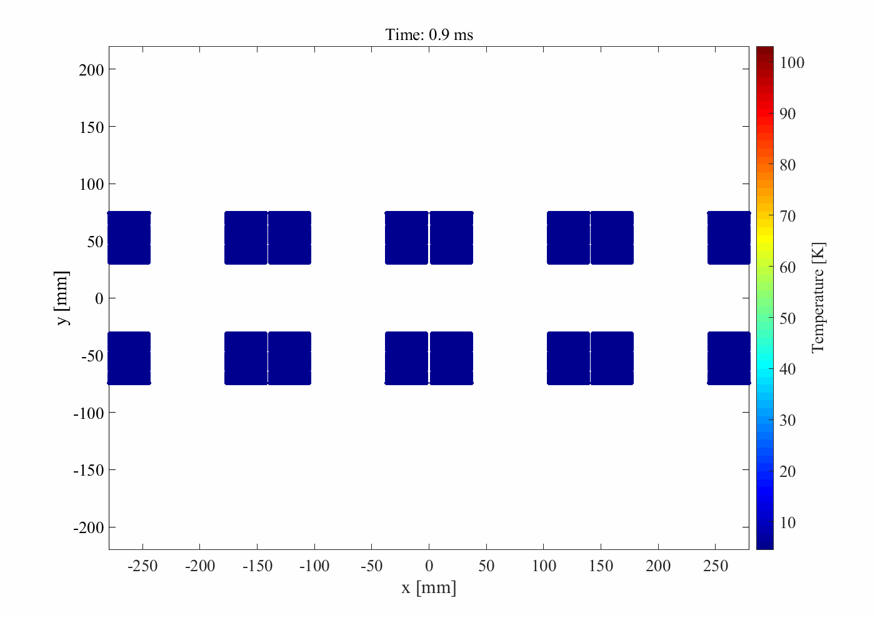
Example of simulated quench and FPA in a 600 A undulator circuit -2
Currents of 8 coils
and 7 parallel resistors
Temperature in the coil turns vs time
Evolution of the temperature in the coil turns
Parallel resistors acting as QH
Parallel resistors acting as QH
To simulate this transient, the software must include quench development, thermal diffusion from the resistors to the turns and among turns, longitudinal quench propagation, mutual coupling between coils and parallel resistors, coupling loss,…

Slide 35
Example of simulated quench and FPA in a 600 A undulator circuit -3
Time of quench for each turn
Main cause of quench
for each turn
Peak power deposition
due to coupling loss
Simulating this transient offers additional insights. In this example, we see the time and cause of quench for each turn, which brings additional understanding of the magnet+circuit behavior
In this example, coupling loss is responsible for quenching ~30% of the turns

Slide 36
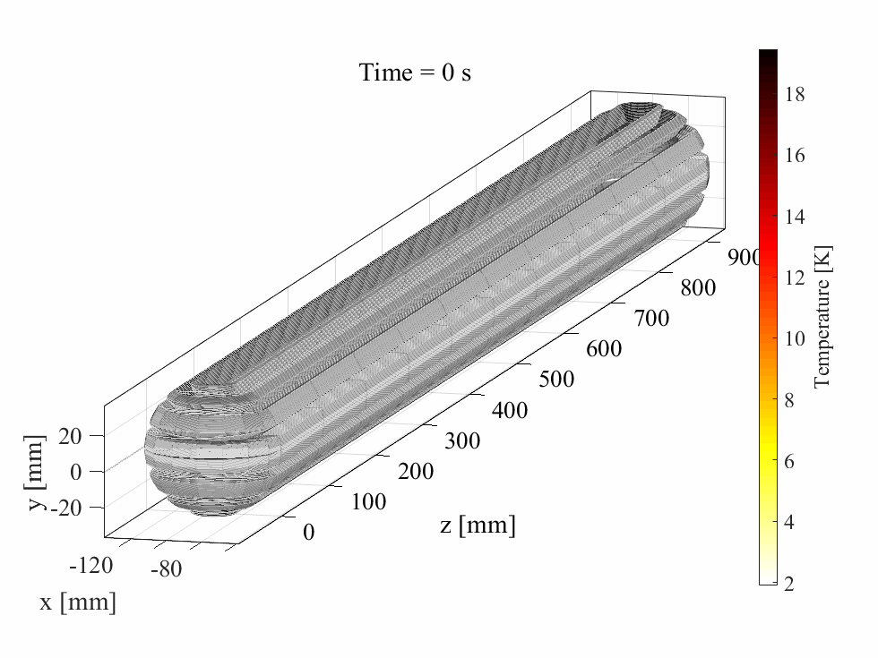
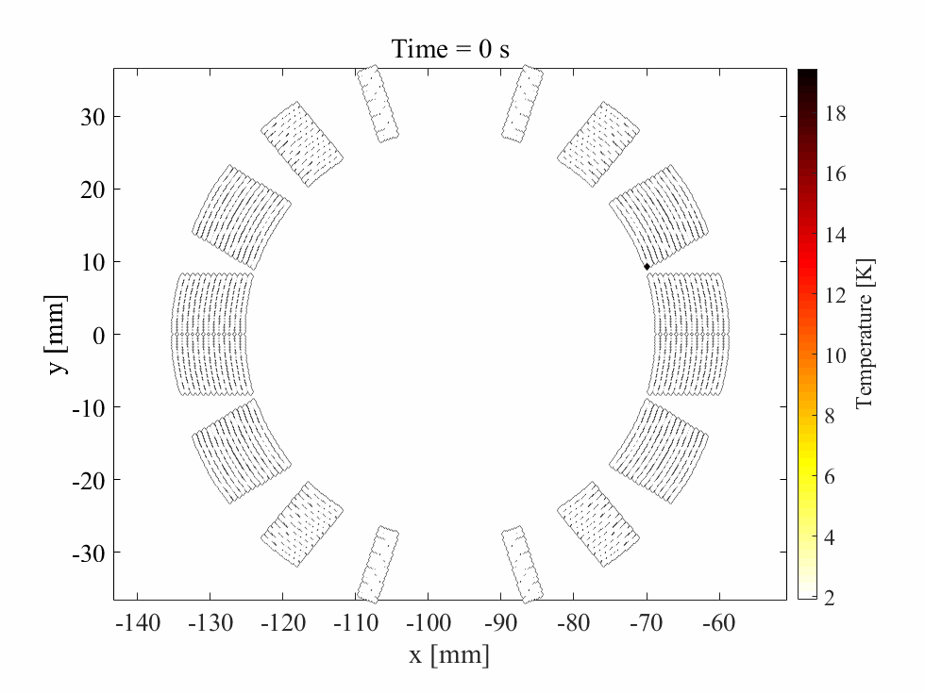
Example of simulated quench in a 120 A circuit
Magnet current and hot-spot T
Temperature evolution in the coil turns
T evolution in coil cross-section
Voltage distribution
3D model of a self-protecting magnet coil during a quench discharge
Coupling loss is included in the simulation as well
Simulation time <1 h

Slide 37
Simulated electrical, magnetic, thermal model of persistent currents
Current versus time
Average magnetization versus average field
Differential inductance versus current
Hysteresis and IFCL loss versus time
Included: average magnetization in each strand, hysteresis loss, effect of persistent currents on the magnet differential inductance

Slide 38
HL-LHC TRANSIENTS

Slide 39
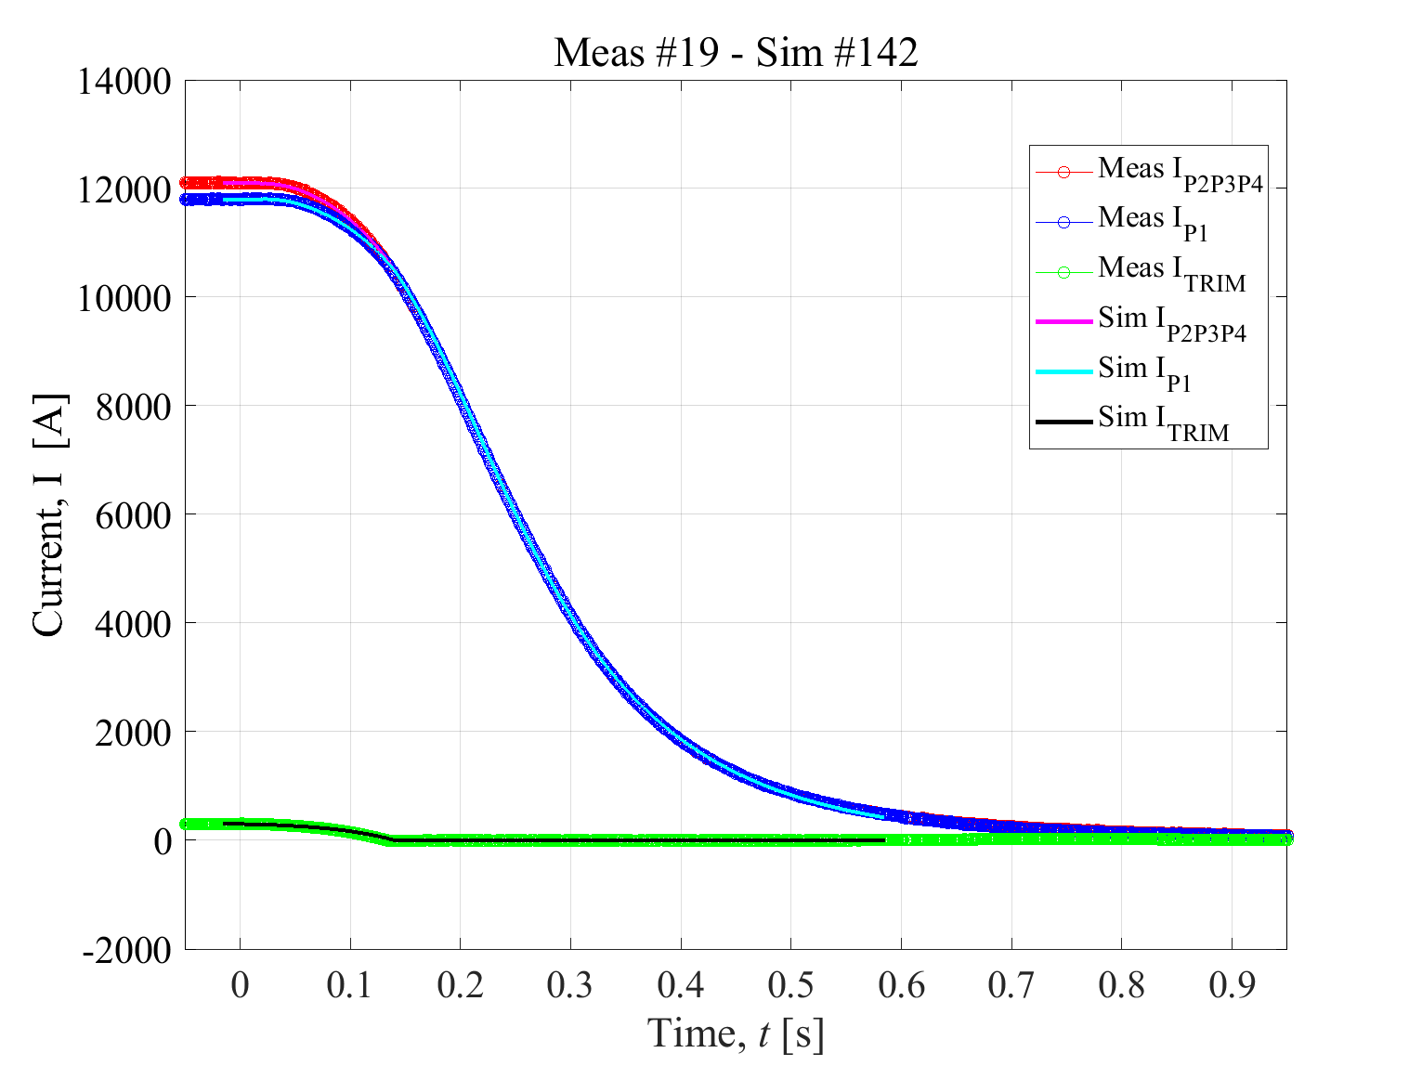


MQXFBP2 trimmed powering tests -1
Currents in the circuit
Voltages across the four coils
Voltages to ground at t=150 ms
Co-simulation between MQXF magnet model [LEDET] and electrical circuit [PSPICE]
Good agreement achieved between simulations and measurements
Thanks to F. Mangiarotti

Slide 40



MQXFBP2 trimmed powering tests -2
Currents in the circuit
Voltages across the four coils
Voltages to ground at t=150 ms
Good prediction capability demonstrated (after non-uniform RRR in the wire was modeled, see next slide)
Simulations allow assessing the peak voltages to ground when voltage taps are unavailable or too coarse
Thanks to F. Mangiarotti

Slide 41
Effect of non-uniform RRR within the Nb₃Sn/Cu wire
Wire cross-section
Coil resistance during warm-up
Extra ohmic heating due to wire Cu RRR non-uniformity
Courtesy of B. Bordini
During MQXFS7b model magnet test, resistive voltage much higher than expected was observed in one coil
The observed transients were reproduced by including in the LEDET software the option to model the wire thermal evolution assuming three Cu regions with different RRR: high RRR (~160) Cu outside the barrier, medium RRR (~80) Cu inside the barrier in the core, low RRR (<10) Cu inside the barrier between filaments.
Thanks to B. Bordini, F. Mangiarotti, G. Willering

Slide 42


HL-LHC Inner Triplet circuit simulations
Courtesy of S. Yammine
Failure analysis to identify the worst-case scenario for each circuit component (crowbars and current leads of the main and trim power converters, warm and cold Diodes, …) and allow their dimensioning
Analysis performed by combining one PSPICE circuit with 6 LEDET magnet models in a co-simulation

Slide 43


Simulations of an intermittent short-circuit in an 11 T dipole magnet
D2U
D2L
D1L
D1U
R_{short}
Analysis performed with a combination of LEDET and PSPICE magnet models
Experimental observations qualitatively reproduced with the developed model [Note: The analysis remains inconclusive: no clear evidence of a short-circuit]
Thanks to G. Willering

Slide 44
STEAM USERS

Slide 45







2nd STEAM workshop [October 2021, indico]
UPDATES ON STEAM DEVELOPMENT
PRESENTATIONS FROM STEAM USERS
HANDS-ON SESSIONS ON ALL THE TOOLS
Figures from the presentations at the workshop by D. Davis, D. Delkov, V. Ferrentino,
M. Janitschke, V. Marinozzi, M. Mentink, X. Sarasola, O. Tranum Arnegaard, M. Wozniak

Slide 46
SOME HIGHLIGHTS
FROM 2022

Slide 47











Some highlights from 2022

Slide 48
WHY STEAM
COULD BE USEFUL FOR YOU

Slide 49
Why STEAM could be useful to YOU
We can offer help to
Obtain reference cases for transients in LHC and HL-LHC magnets and circuits (quenches, ELQA high-voltage tests, power-converter switching-off, energy-extraction switch opening, transfer function measurements, suspected failures…)
Understand the behaviour of non-trivial circuits (magnet chains, parallel paths, nested magnets, etc)
Assess the impact of proposed changes to circuit hardware or operation modes
Study failure scenarios
Identify worst-case scenarios for circuit components
Attempt to reproduce unexpected events or observations
Develop simulations for R&D quench detection and protection techniques
Benchmarking simulation programs, especially when new features are developed
Provide boundary conditions for analyses of other systems
Obtain material properties in various forms
Enhanced integration between measurements and STEAM library at all levels

Slide 50
Some practical examples to continue and enhance cooperation between STEAM and CERN magnet lifetime
Design
Manufacturing
Testing
Operation
Failure cases considered when designing a magnet
Worst-case scenarios used to define electrical design criteria
Integrating new quench protection systems into the design at early stage
Assessment of new quench protection concepts
Information on wires, cables, coils, magnets, circuits is linked to models
Influence of coil electrical order on peak voltages to ground assessed
Frequency transfer measurements at different stages
Automatic simulation of each proposed test plan
Systematic validation of the simulation results
Proposed non-standard tests can be evaluated
Unexpected transients can be analyzed and reproduced
The same model that has been validated is used to understand and reproduce unexpected events
All conductor, magnet, circuit models can be linked in consistent co-simulations
Effect of hardware (EE, power supply crowbars,…) or operation changes (quench detection thresholds, EE timing,…) can be evaluated

Slide 51
A BIG THANK YOU
TO THE SM18 TEAM
FOR THEIR CONTINUOUS SUPPORT!

Slide 52
Useful links
STEAM website | http://cern.ch/steam
STEAM Workshop | https://indico.cern.ch/event/1060073/
STEAM meetings | https://indico.cern.ch/category/11772/
Section publications | https://twiki.cern.ch/twiki/bin/view/TEMPEPE/SectionPapers
Section technical notes | https://twiki.cern.ch/twiki/bin/viewauth/TEMPEPE/SectionVariousContributions
Section talks | https://twiki.cern.ch/twiki/bin/view/TEMPEPE/SectionTalks

Slide 53
ANNEX

Slide 54
Examples of what STEAM models were used for in 2021
LHC
Quench
Heaters
Assess the consequences of raising MB quench detection thresholds (worst-case analysis)
Analyse quench protection of Q1 magnet in RQX.R1 with non-conform quench heater discharge unit
Calculate the effect of quench-heater field on the beam, including the effects of beam-screen shielding and inter-filament coupling currents in the magnet coil
Simulate quench-heater protection of MQY magnet at T=1.9 K
Short
circuits
Simulate an internal short-circuit in an MB magnet (in RB, main dipole circuit)
Analyse earth current in RB circuits during quenches and FPA
Simulate powering transients of an MCBY magnet with an internal short-circuit
Frequency
domain
Reproduce the measured frequency-domain impedance of MB magnets measured in the tunnel, including the effect of neighbouring magnets
SC effects
Assess when quench-back is expected in 600 A circuits
Simulate the effects of persistent-currents on the powering transients in LHC circuits

Slide 55
Examples of what STEAM models were used for in 2021
HL-LHC
Baseline verification
Verification of baseline quench protection for various HL-LHC circuits
Parametric analyses and worst-cases for all circuit components in HL-LHC Inner Triplet circuit
Analyse quench protection of HEL larger solenoids
Uncertainty quantification by automatically performing hundreds of parametric simulations
Simulate of the effects of additional insulation layers between quench heaters and coil
Propose MQXF coil electrical order that minimizes the expected peak voltage to ground
Validation and Predictions
Systematic measurement/simulation comparison during events in various test campaigns SM18
Simulation of transients in CCT-type magnet, and validation with MCBRD prototype magnet data
Simulate proposed MQXF special trimmed powering tests
Explain the observed extra ohmic loss in coils made of conductor with non-uniform RRR
Estimate the effect of QH discharge on voltages across coils and quench-antenna coils
Frequency
domain
Frequency transfer function analysis of one MQXF coil

Slide 56
STEAM superconducting circuit library
Circuit family | Number of circuit types | Number of circuits | Circuit protection
Main dipole | 1 | 8 | QH + By-pass Diode + EE
Main quadrupole | 1 | 16 | QH + By-pass Diode + EE
Inner triplets | 1 | 8 | QH
Individually powered dipoles | 3 | 16 | QH
Individually powered quadrupoles | 7 | 78 | QH
600A - with EE | 11 | 200 | EE
600A - without EE | 10 | 192 | Self-protecting
600A undulators | 1 | 2 | EE + Parallel resistors acting as QH
80A-120A circuits | 10 | 300 | Self-protecting
60A circuits | 2 | 752 | Self-protecting
Total | 47 | 1572
EE = Energy-extraction system. QH = Quench Heaters
All LHC circuit types are modelled in the Circuit Library, with the exception of the inner triplet nested correctors.
Models of individual circuits can be generated on demand (small differences in warm resistance, EE, etc).
Models of HL-LHC magnet circuits are being prepared following the same approach.

Slide 57



Example of simulated quench and FPA in an RQ circuit
Fast power aborts at 8-12 kA
Fast power aborts at 5-7 kA
Fast power aborts at 2-4 kA
Reference FPA curves simulated for different current levels
Currents through the magnets and cold Diodes are not measured and can be assessed only by simulations
D. Pracht and M. Janitschke, TECH

Slide 58
Example of unusual transient to analyze – quench in RU.R4
Hint: Parallel resistor is also a quench heater and heats up pretty quickly…
from LHC Project Report 894
Circuit current drops suddenly...?
Then bounces back up...?

Slide 59

Some topics worked on in 2022
CCT
… as a list of abstracts accepted for ASC2022
M. Wozniak, E. Ravaioli, A. Verweij, "Co-Simulation of Quench Behaviour of HL-LHC Dipole Canted Cos-Theta Orbit Corrector Prototypes"
A. Vitrano, M. Wozniak, E. Schnaubelt, T. Mulder, E. Ravaioli, A. Verweij, "An open-source finite element quench simulation tool for superconducting magnets"
T. Mulder, E. Schnaubelt, M. Wozniak, E. Ravaioli and A. Verweij, "External Coil Coupled Loss Induced Quench (E-CLIQ) System for Protection of LTS Magnets"
E. Ravaioli, A. Verweij, M. Wozniak, "Analysis of an internal electrical short in an LHC orbit-corrector magnet with a 3D multiphysics simulation"
E. Schnaubelt, M. Wozniak, S. Schöps, "Quench Simulation of No-Insulation HTS Coils With 3D FEM Using a Thin Shell Approximation"
B. Caiffi, L. Bender, A. Bersani, S. Farinon, A. Foussat, F. Levi, F. Mangiarotti, D.Novelli, A. Pampaloni, E. Ravaioli, E. Todesco, G. Willering, "Protection Scheme Effectiveness Study for the Hi Luminosity LHC MBRD magnet"
S. Yammine,..., E. Ravaioli,..., et al., "Experimental Program of the HL-LHC Inner Triplet String Test at CERN"
E-CLIQ
HTS
LHC

