Slide 1




Status of Mucol

Slide 2
A few important dates (1/2)
29 August:
First deadline, all Beneficiaries have validated their data, RIA is now able to start drafting the Grant Agreement
6 September :
All Beneficiaries have signed the declaration of honor

Slide 3
A few important dates (2/2)
28 October:
Signature of the Grant agreement (being prepared by EU-RIA) by all the beneficiaries
By that date, all Institutes (Beneficiaries + Associates) must have signed the Consortium Agreement (being prepared by CERN’s legal office)
1st January 2023:
Start of the project
January/February 2023:
Kick-off meeting
Most probably week of 16-20 January

Slide 4
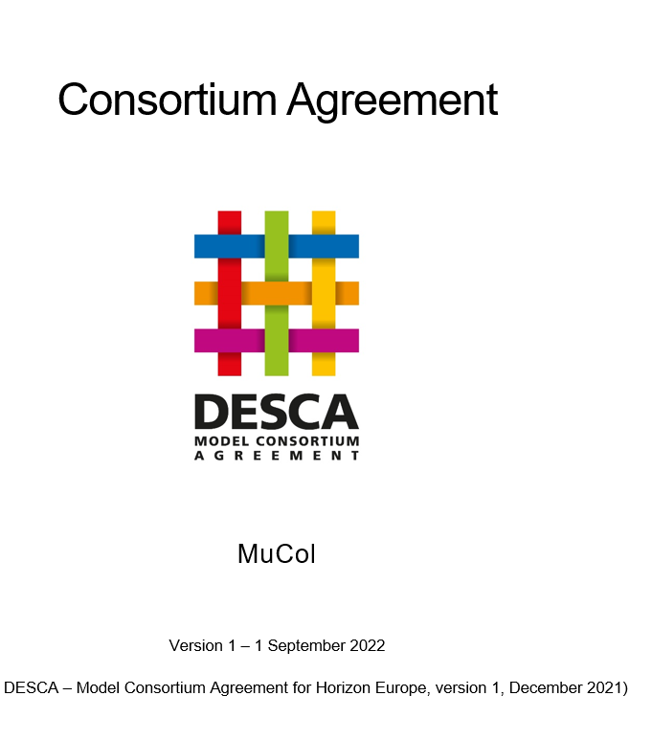
Consortium Agreement
Based on the DESCA template.
Contains provision to deal with UK situation
Requires every institute (Beneficiaries + Associates) to accept liability for the execution of the tasks they are supposed to deliver

Slide 5
Consortium Agreement
First draft ready, soon to be circulated with Institutes (today?)
Need to build an annex with tasks for each Institutes to which they commit (accepting liability).

