Slide 1


Muon Collider WP8-Task 4
Collider Complex
S.Mariotto, B.Caiffi
15-09-2022

Slide 2
Program
Set performance specifications (Dipole Field, Quadrupole Field, Tunability of Quadrupole Component, Field quality, GFR Aperture)
Select the material of the conductor (Nb3Sn, HTS, Hybrid) for the ARC and IR magnets.
Radiation damage studies to select insulation materials.
Select layout of the coil (Block, CosTheta) for the ARC and IR magnets
Select Nested/Asymmetric Coil for the ARC Magnets
Setup analytic expressions for fast evaluation of magnet parameters (Main Component, Peak Field, Field Errors, Forces).
Create a 2D optimized magnet cross-section (Roxie, Ansys)
Mechanical calculations
Margin and protection calculations
Cooling and cryogenics concept

Slide 3
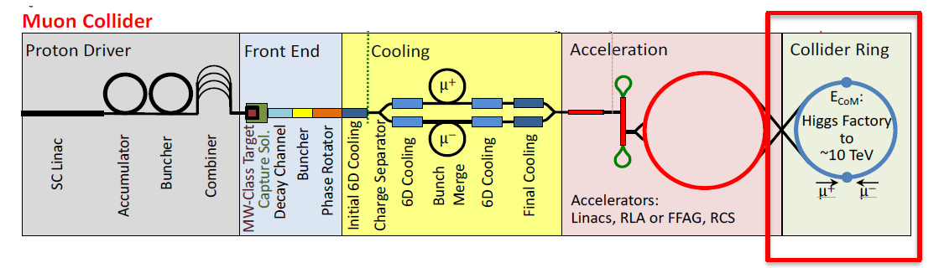

1) Set performance specifications
  Strong interaction between Lattice/Beam optics studies and SC magnets
  Beam and magnet parameters (B_{nom} , G_{nom}, Aperture, Length)
  Maximum Field of the magnets (10-16 T FCC-hh goal)
  Machine configurations: 3 TeV and 10 TeV upgrade
  Arc Magnets
  Interaction Region Magnets
Aperture=2(5 σ+Dx δ p+0.02)[m]
K.Skoufaris

Slide 4
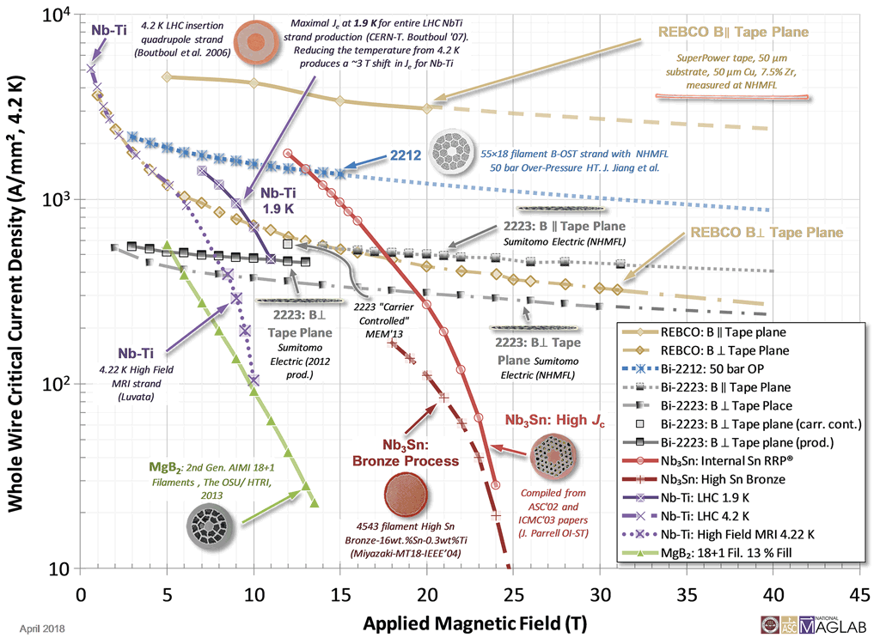
2) Select the material of the conductor
Nb3Sn
  Pros: quite mature technology
  Cons: brittle after thermal treatment, needs complex mechanical support /stress management
  Actual cost > $20 / kA-m @ 16 T 4.2 K [ref]
  Non-Cu J_{C}: 1200 A/mm² @ 16T 4.2K
  ( FCC target 1500 A/mm² @ 16T 4.2K) (presentation by Simon Hopkins, missing an official reference)
HTS
  Pros: high current density at high B, good mechanical properties
  Cons: technology not well established, low quench propagation velocity , anisotropic mechanical properties,
  Cost(REBCO): $200 / kA-m at 20 T, 4.2 K [ref]
  J: 2000 A/mm2 @ 18T 4.2T [ref]
Plots MagLab (nationalmaglab.org )

Slide 5
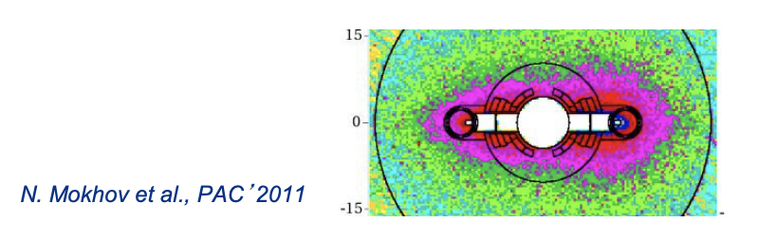
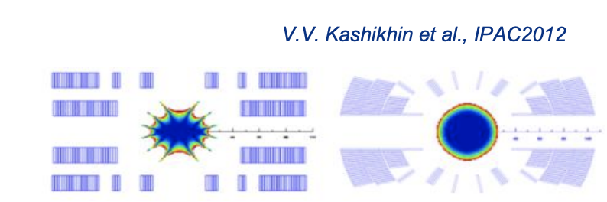
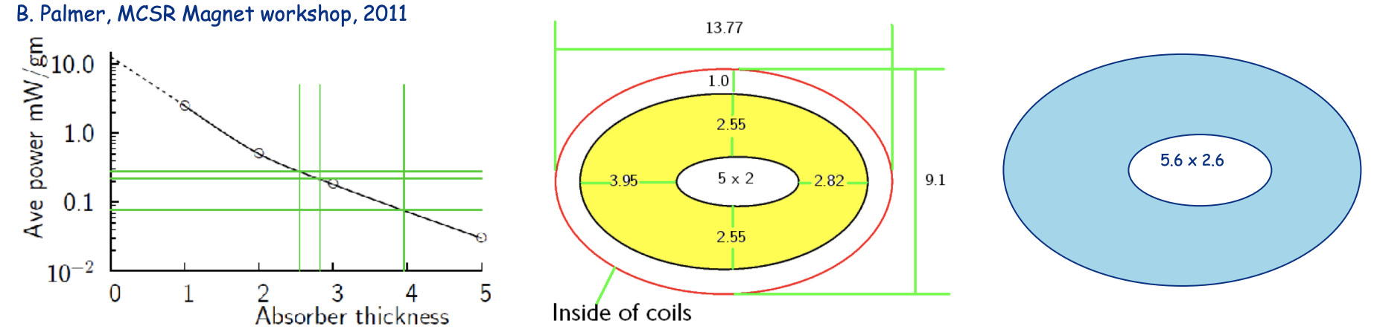
3) Radiation damage studies
Previous studies shown that the azimuthal distribution of radiation heat load is peaked in the midplane.
Different solutions must be investigated:
      Open midplane
        Pros: no absorber needed
        Cons: loss of current in the midplane region
      Elliptical W absorber
        Pros: optimal current distribution
        Cons: may require a larger aperture

Slide 6
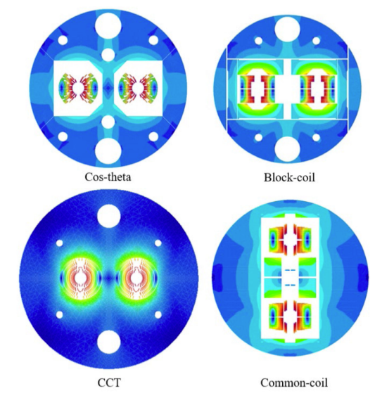
4) Select layout of the coils (Block, Cos$θ$) for ARC and IR magnets
Possible layout already investigated in other projects (e.g. FCC) are:
  Cos-theta coil:
    Pros: wound around a cylindrical mandrel, end shape already suitable for beam tube insertion
    Cons: mechanical structure can be complex due to the entanglement of the vertical and horizontal Lorentz forces components
  Block coil:
    Pros: mechanical structure simplified by the decoupling of the horizontal and longitudinal Lorentz forces
    Cons: ends must be flared to allow beam tube insertions, critical operation with the brittle Nb₃Sn
  Canted cos-theta:
    Pros: Winding placed in mandrel with grooves ( intrinsic stress management, Easy to fabricate with minimal tooling, suitable also for HTS tape)
    Cons: requires twice the cable than the other layouts
EuroCirCol study for FCC, courtesy of D.Shoerling

Slide 7
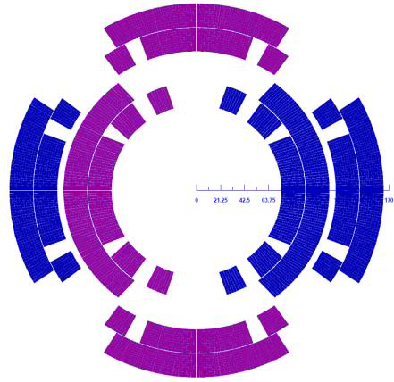
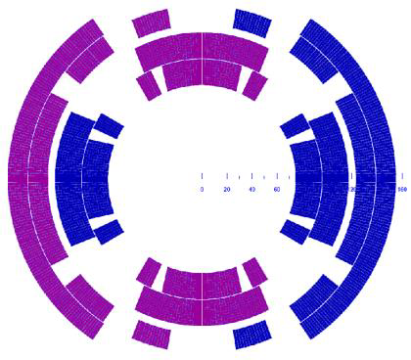
5) Select Nested/Asymmetric Coil for the ARC Magnets
A. Zlobin
T. Ogitsu
Nested
  Pros: Separate Powering Dipole/Quadrupole
  Inherit experience on Nb3Sn magnets for HiLumi and LARP-US development program
  Cons: Stress on Coil is critical (large forces where currents are opposite)
  Alignment between the two coils
  Two types of different coil to be produced (Higher Costs)
Asymmetric
  Pros: Single type of coil
  Optimized margin and field quality
  Cons: Fixed Dipole/Quadrupole ratio
  Stress on the supporting structure is not balanced

Slide 8
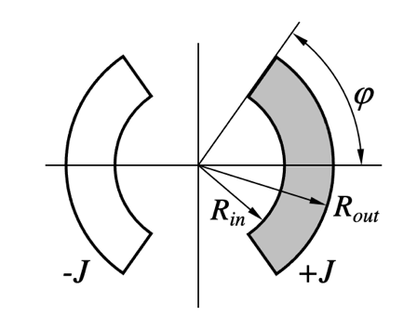
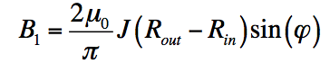
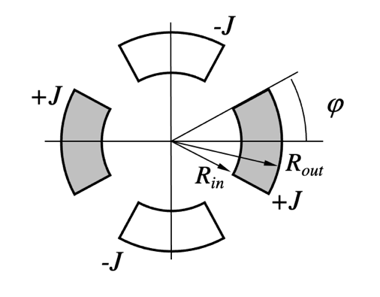
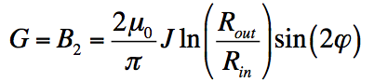
6) Setup analytic expressions for fast evaluation of magnet parameters (Main Component, Peak Field, Field Errors, Forces).
  Extensive studies already performed on NbTi and Nb3Sn type dipoles and quadrupoles. Analytical expressions of field, error, forces and energy already available for simplifield geometries.
  Scalable laws can be extensively used for cos(nθ) configurations
  Points to be addressed
  Equivalent expressions for block coil design?
  Peak Field to be evaluated numerically
  HTS magnet are different from LTS configurations
  Limiting parameters and optimal configuration of the design can be different

Slide 9
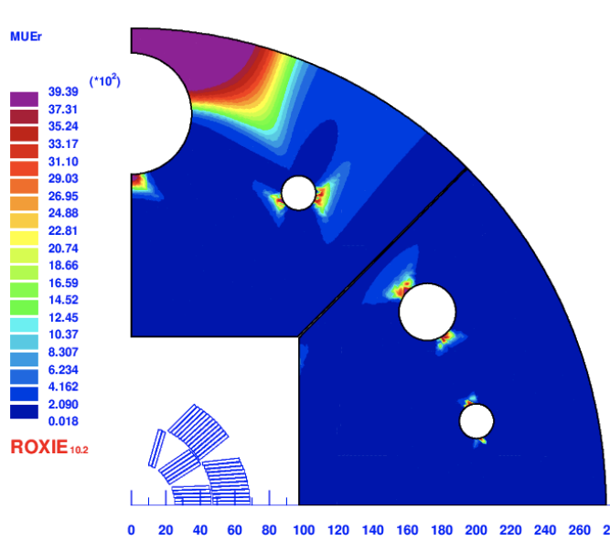
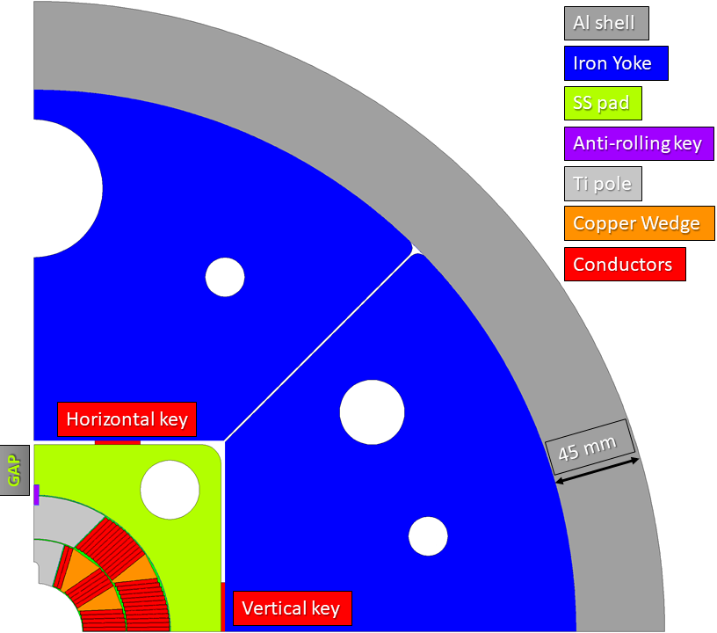
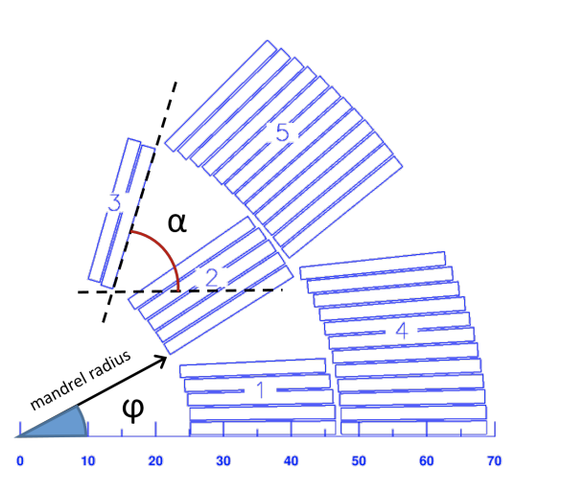
7) Create a 2D optimized magnet cross-section (Roxie, Ansys)
FE analysis will be performed to optimise the magnet cross section focusing on:
Field quality
Margin on the load line
Mechanical stresses
Optimization algorithm (genetic algorithms) will be used to find the best solution
Courtesy of A.Pampaloni.R. Valente, INFN

Slide 10
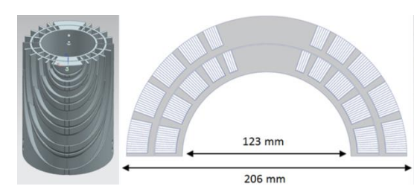
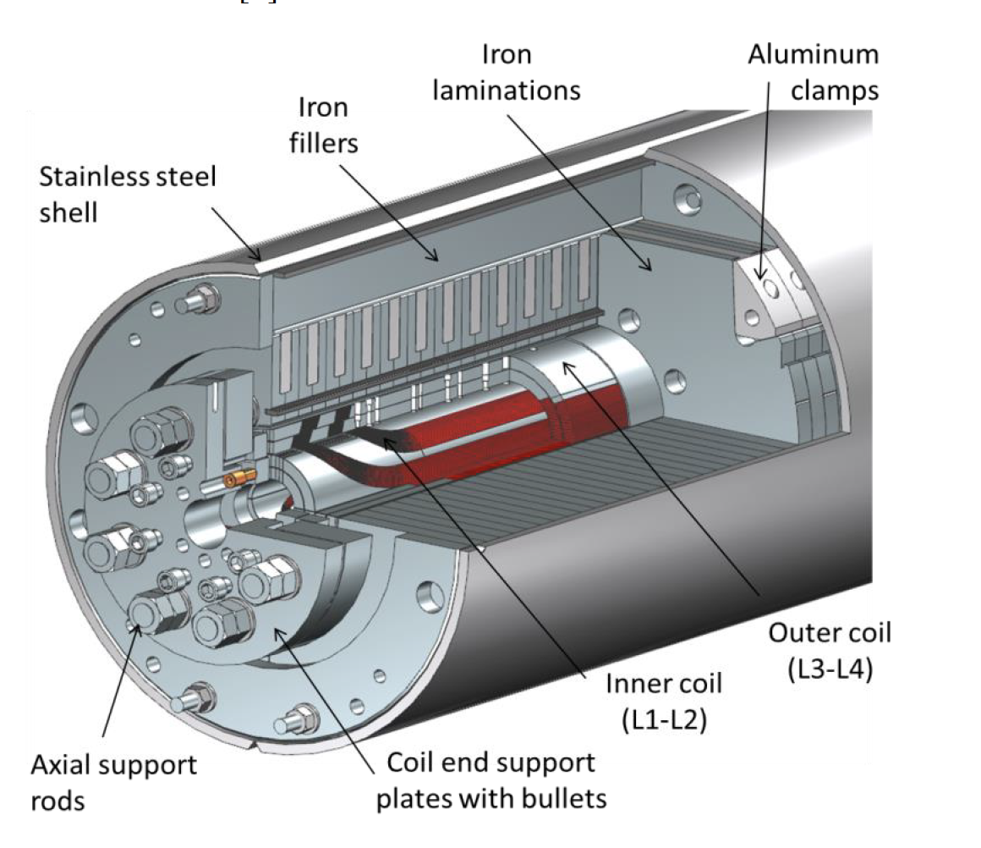
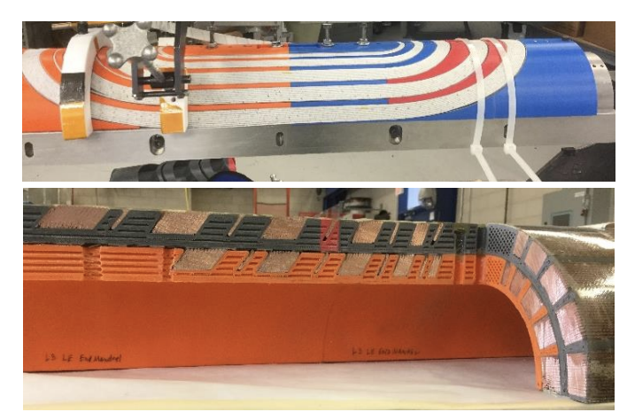
8) Mechanical calculations
According to the material chosen for the conductor, the layout (costheta, block, canted cos theta), etcc, different mechanical solution must be investigated.
E.g. for the cos-theta options, the following structures can be adopted
  Bladder&Key (e.g. FalconD , a 12 T Nb3Sn dipole under development by INFN/ASG , single aperture (60 mm) , 2-layer)
  I-Clamps (e.g. MDPCT1, a 15 T Nb3Sn dipole tested at Fermilab in 2020 (damaged in second test), single aperture (60mm), 2-layer)
  Stress management (SMCT (stress management cos-theta),under development at FNAL, using ribs instead of wedges)
  Every magnet built up to now with stress management (included CCT) experienced several training problems
SMCT
FALCOND
MPDCT1

Slide 11
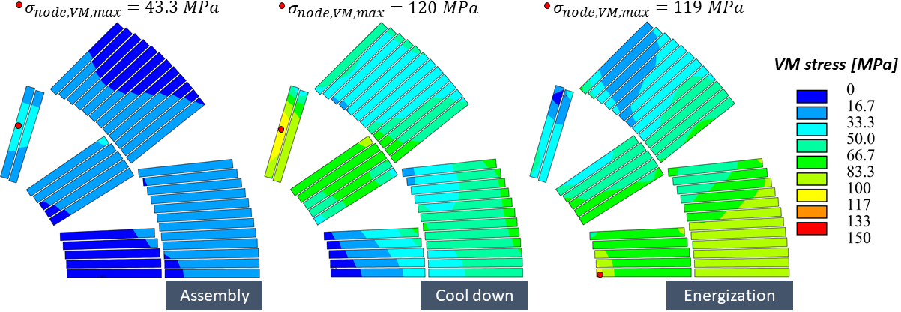
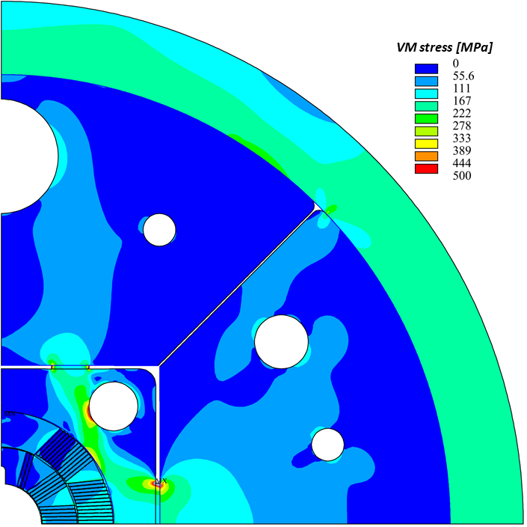
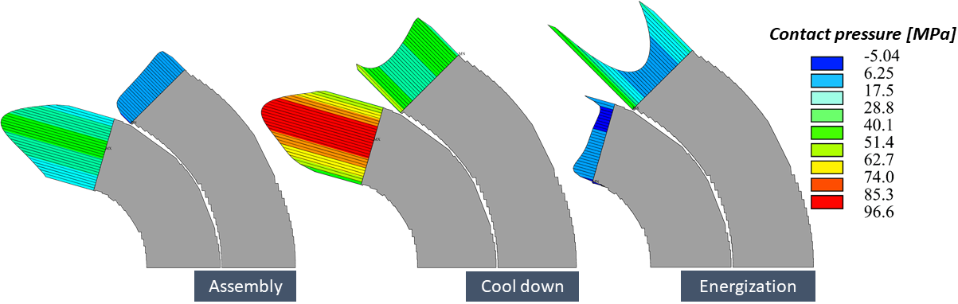
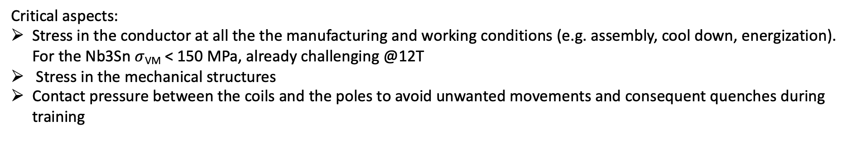
8) Mechanical calculations
Critical aspects:
Stress in the conductor at all the the manufacturing and working conditions (e.g. assembly, cool down, energization). For the Nb3Sn $σ$_{VM} < 150 MPa, already challenging @12T
Stress in the mechanical structures
Contact pressure between the coils and the poles to avoid unwanted movements and consequent quenches during training
Courtesy of A.Pampaloni INFN-GE

Slide 12
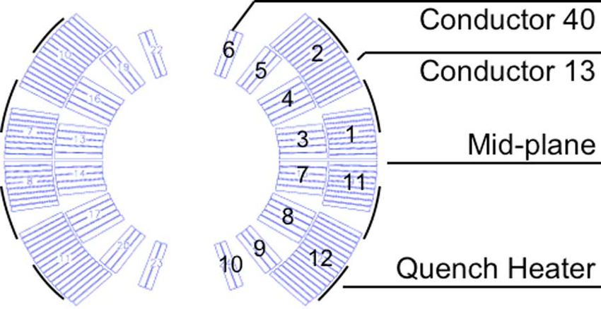
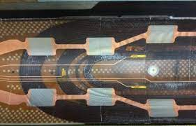
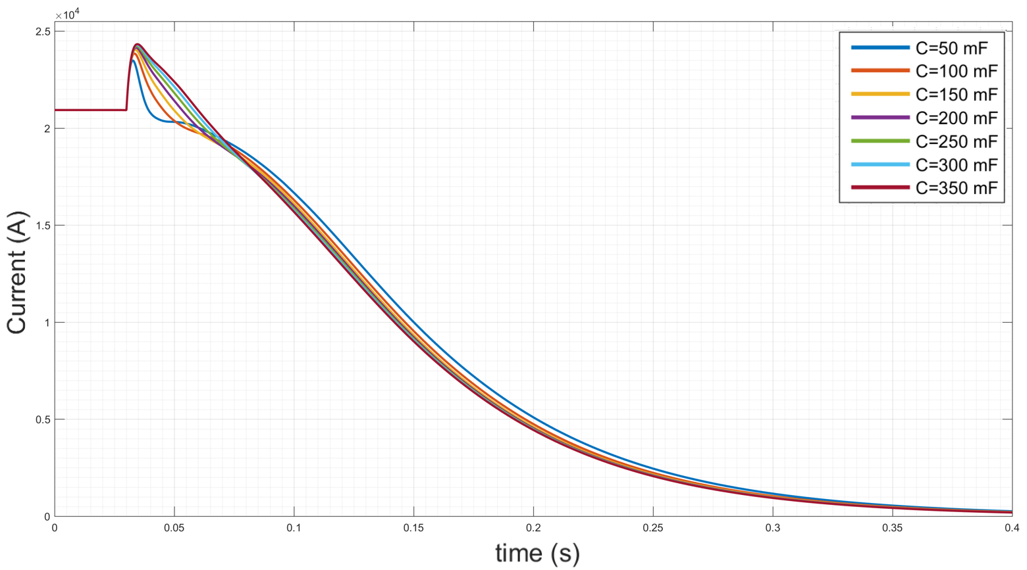
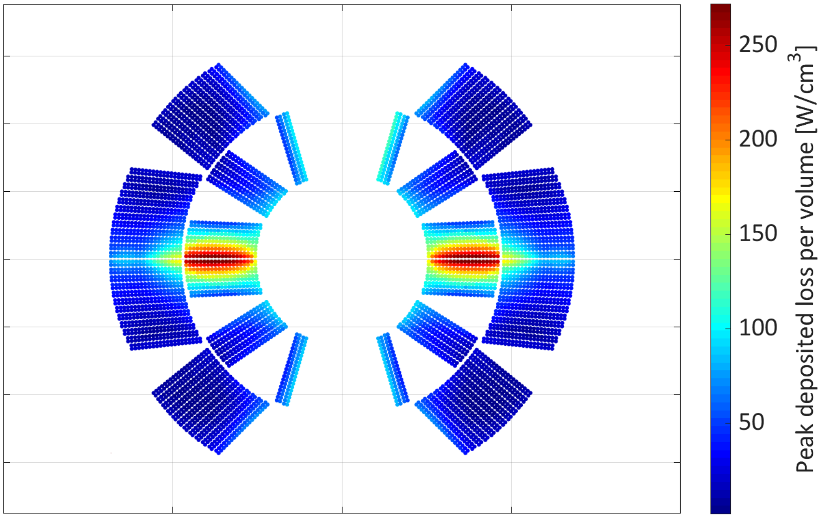
9) Margin and protection calculations
QH
Study of Material Properties extremely important for accurate modelling of the magnet performances
Critical parameters has to be set for the magnet safety (Maximum Voltage to ground, Maximum Temperature, Time Delay, Stored Energy)
Protection Scheme: Quench Heaters, CLIQ, Dump R
HTS behaviour for stability and quench propagation is a complete different beast
Slow rise of temperature
Hysteretic Losses
Eddy Currents in the substrate
NI Coils (maybe not suitable for
the field quality)
CLIQ

Slide 13
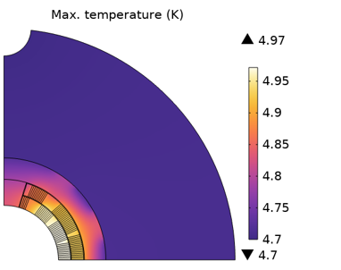
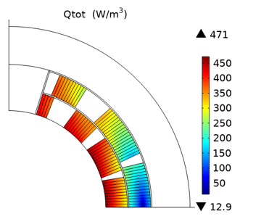
10) Cooling and cryogenics concept
Calculation of the loss in the conductors and external structure during operation
Important parameters:
Operational Temperature (1.9-4.2 K )
Field map on the coil
Materials Properties (NIST-MatPro-Cryocomp Libraries)
Contact resistances between mechanical structures and coil conductors
Energy beam deposition during magnet operation
Interaction with Radiation damage Studies
Cost Evaluation
L-He Comsumption

