Slide 1
A preliminary study of the target and capture channel for the Muon Collider
A. Portone, P. Testoni (F4E Barcelona)
L. Bottura, A. Kohlemainen (CERN)
12/10/2022

Slide 2
SUMMARY
Starting from the hybrid solution of US-MAP [1-3] with 5 resistive coils and 19 SC coils (2.4 m bore) we compute for such design field on axis, field on coils, stresses etc.
  Field on axis follows B-formula by Sayed-Berg [4] with wider plateau @ 20 T
  Coils stresses/fields seems manageable
  Large bore ➔magnetic energy (~3 GJ) and global forces
  Coupling forces between resistive and SC coil set to be managed carefully
We develop an alternative solution with 18 SC coils (HTS), 1.2 m constant bore and engineering current density similar to (1) (i.e. max(J_{E})≈40 A/mm²):
  Field on axis within 1% accuracy Sayed-Berg formula over 16 m channel length
  Magnetic energy < 1 GJ
  Advantages brought by HTS and smaller bore! However its feasibility needs verification (shielding?)

Slide 3
REFERENCES
R.J. Weggel, N. Souchlas, H.G. Kirk, V.B. Graves, K.T. McDonald, A TARGET MAGNET SYSTEM FOR A MUON COLLIDER AND NEUTRINO FACTORY, TUPS053 Proceedings of IPAC2011, San Sebastián, Spain
R.J. Weggel, N. Souchlas, H.K. Sayed, J.S. Berg, H.G. Kirk, X. Ding, V.B. Graves, K.T. McDonald, DESIGN OF MAGNETS FOR THE TARGET AND DECAY REGION OF A MUON COLLIDER/NEUTRINO FACTORY TARGET TUPFI073 Proceedings of IPAC2013, Shanghai, China
C. Rogers, Overview of target, capture and cooling complex, https://indico.cern.ch/event/1147941/
H.K. Sayed and J. S. Berg, Optimized capture section for a muon accelerator front end, PHYSICAL REVIEW SPECIAL TOPICS - ACCELERATORS AND BEAMS 17, 070102 (2014)

Slide 4
HYBRID (NC+SC) DESIGN (US-MAP):
Field, Forces and Stresses

Slide 5
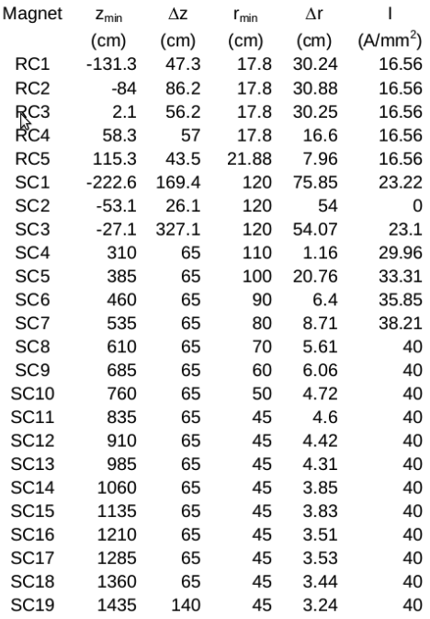
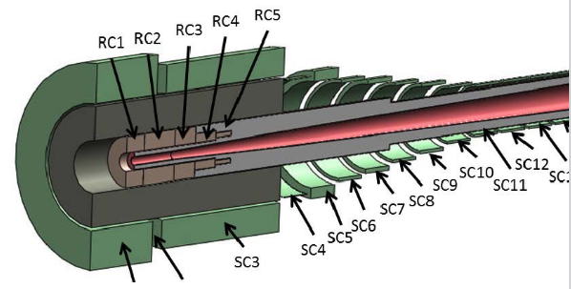
INPUT DATA
Resistive coils (5):
R_{min} = 0.178 m
Superconducting coils (19):
R_{min}^{(HF)} = 1.2 m

Slide 6
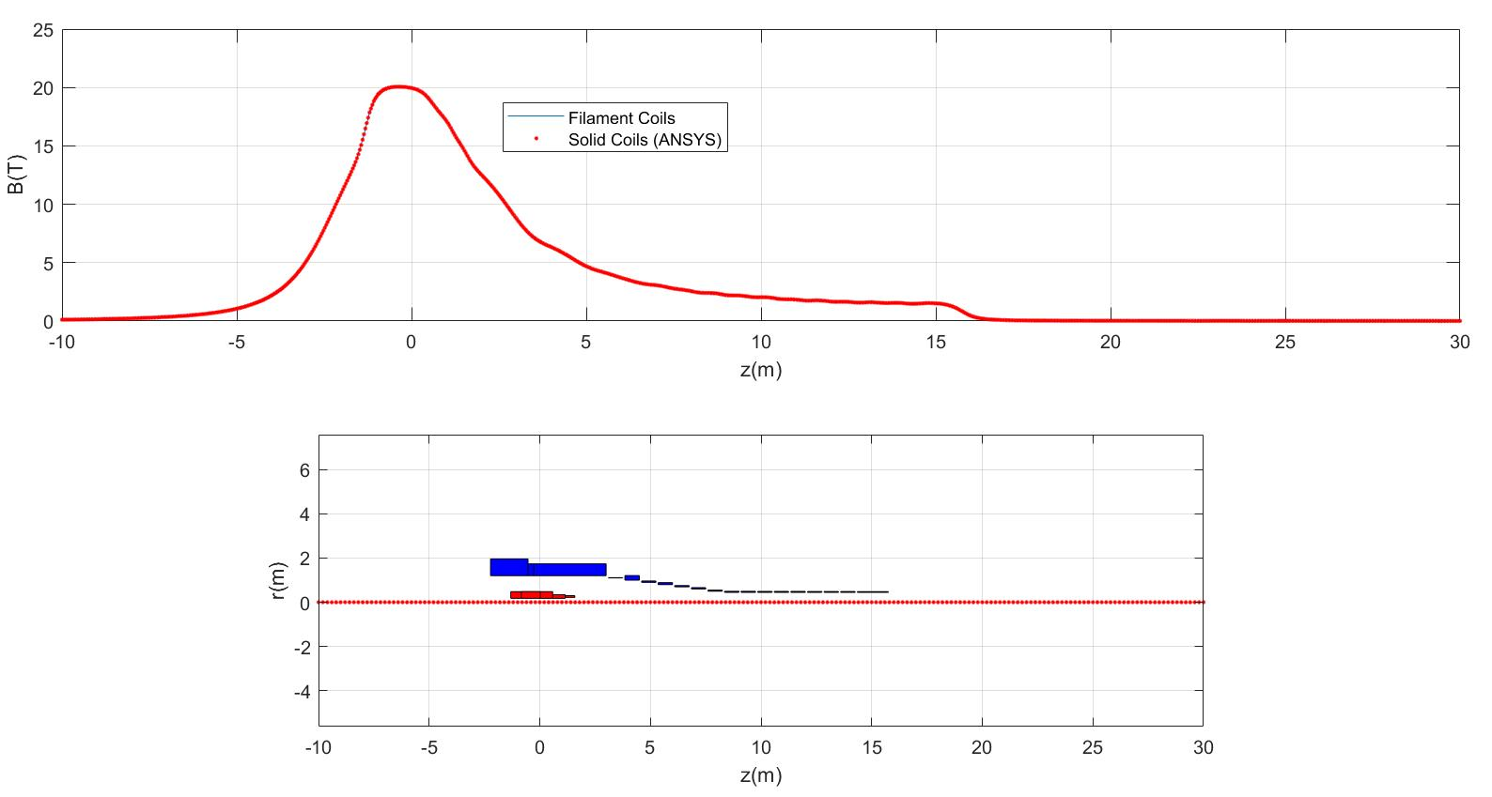
FIELD ON AXIS

Slide 7
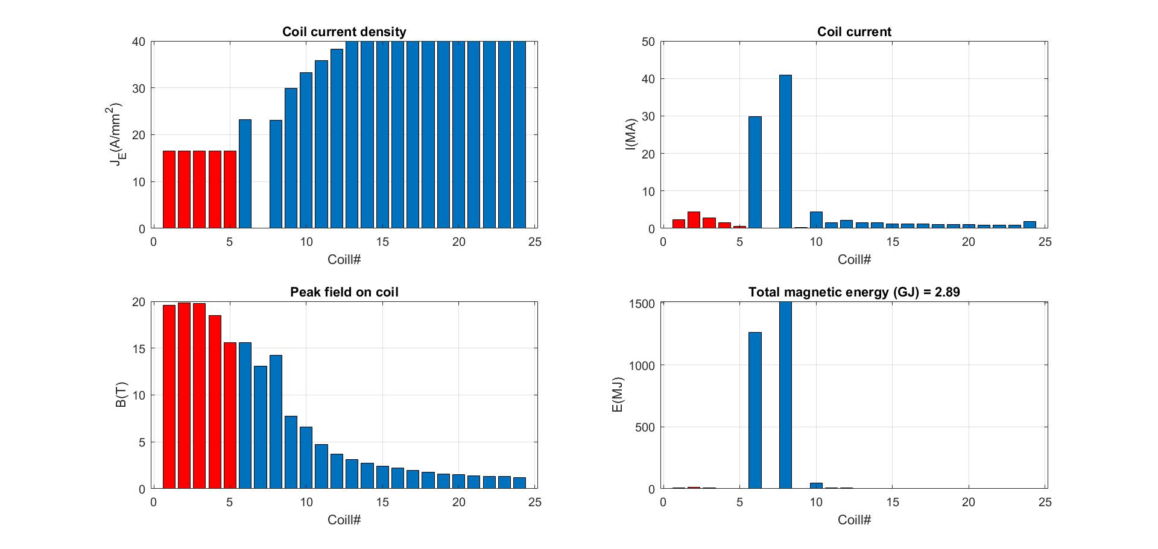
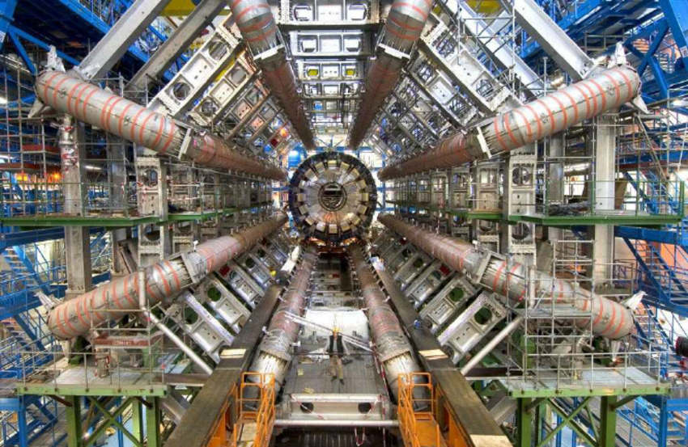
CURRENTS AND MAGNETIC ENERGY
2.89 GJ
1.05 GJ
ATLAS main toroid

Slide 8
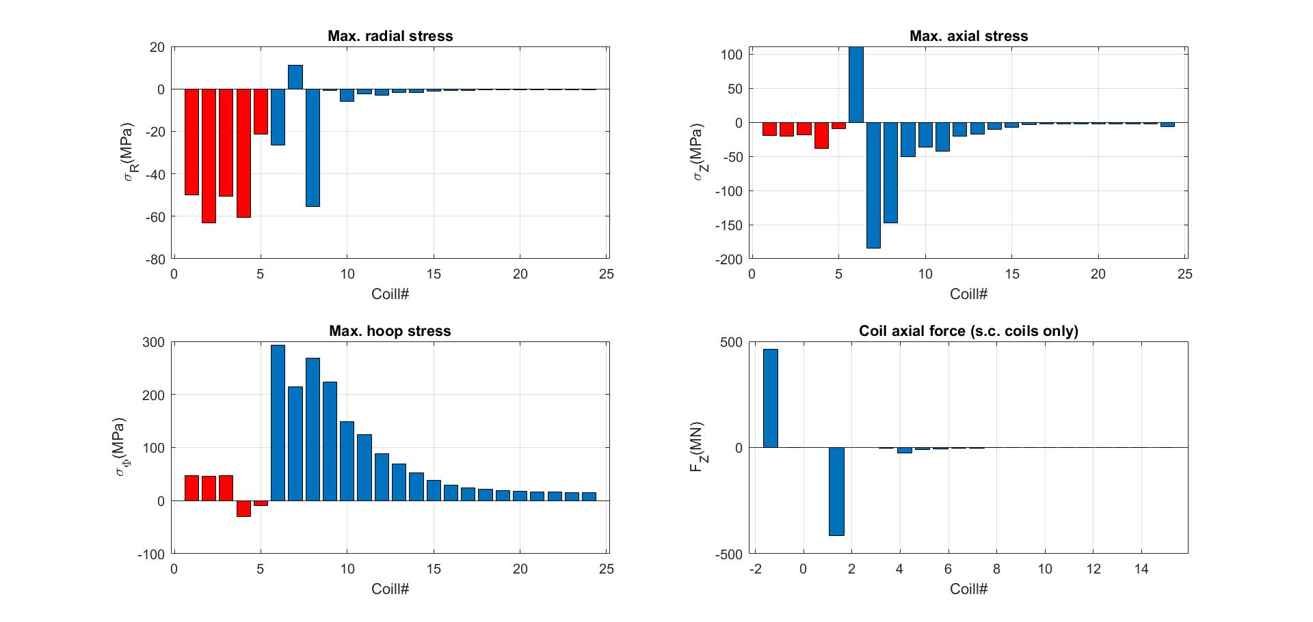
SMEARED STRESSES AND AXIAL FORCE

Slide 9
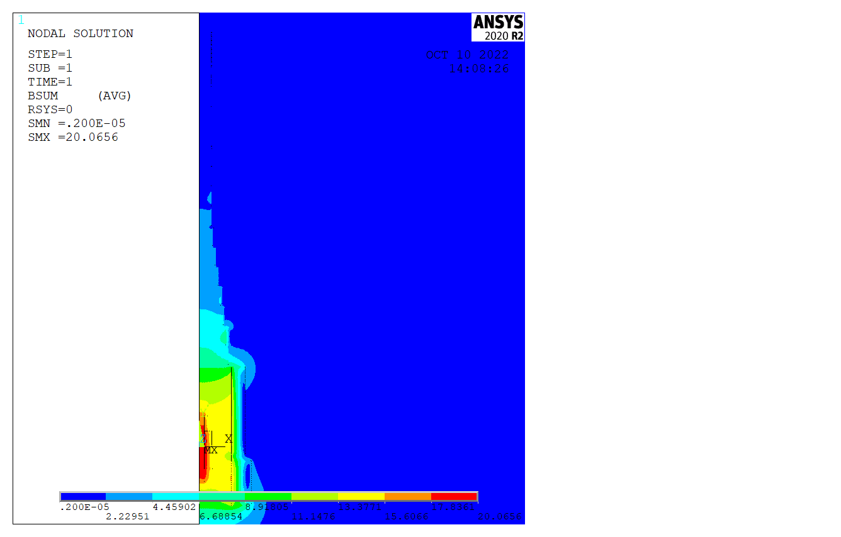
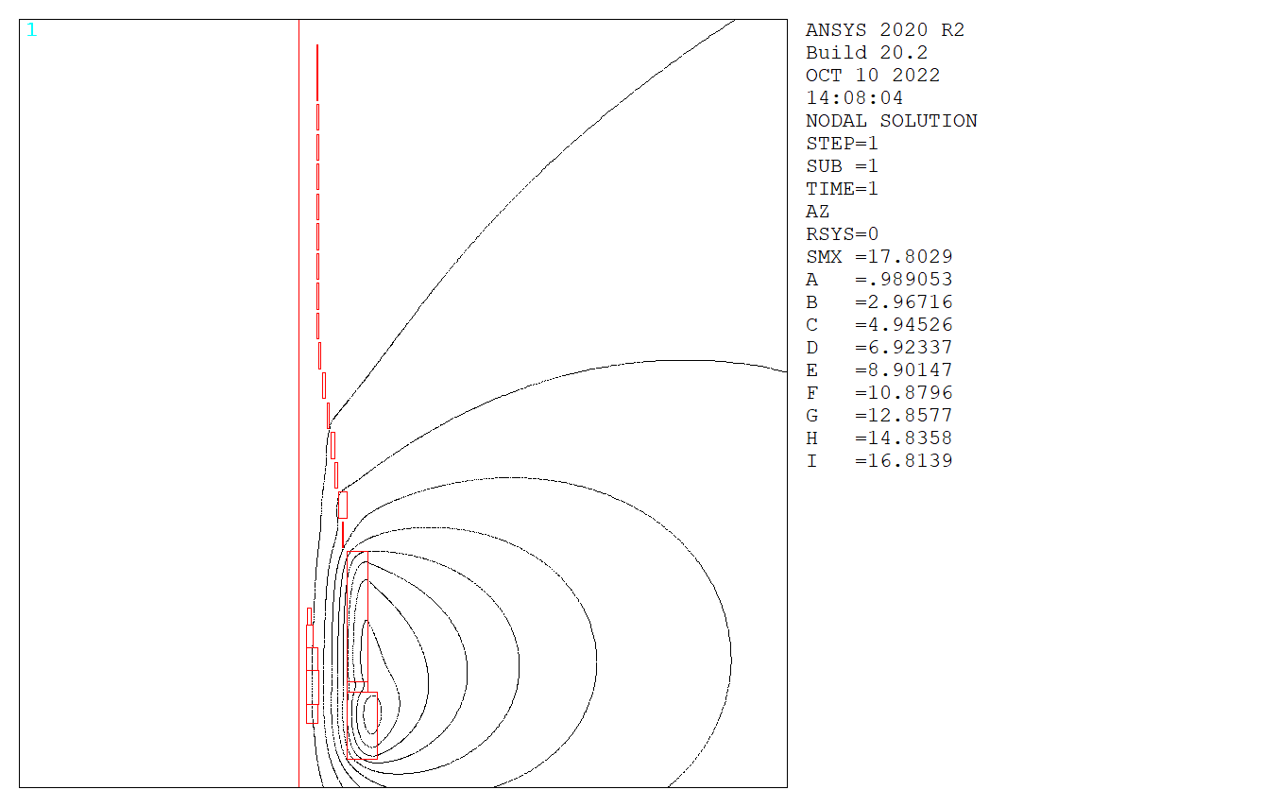
FIELD AND VECTOR POTENTIAL

Slide 10
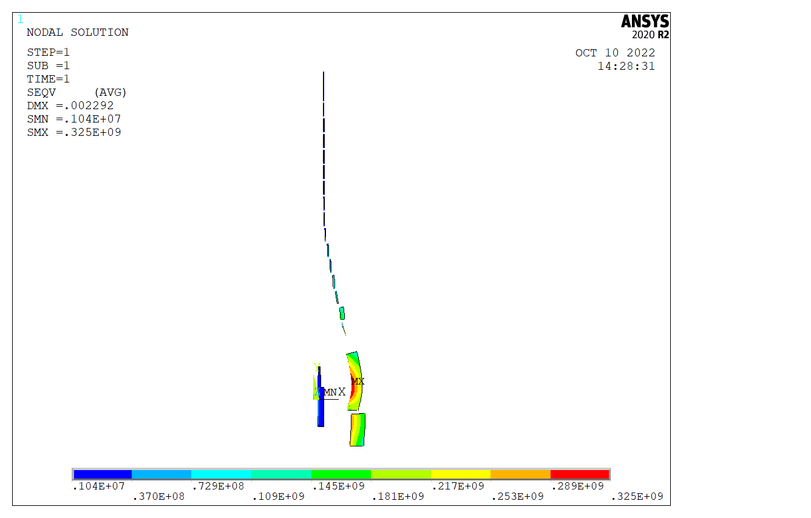
Von Mises stresses σ_{vM}

Slide 11
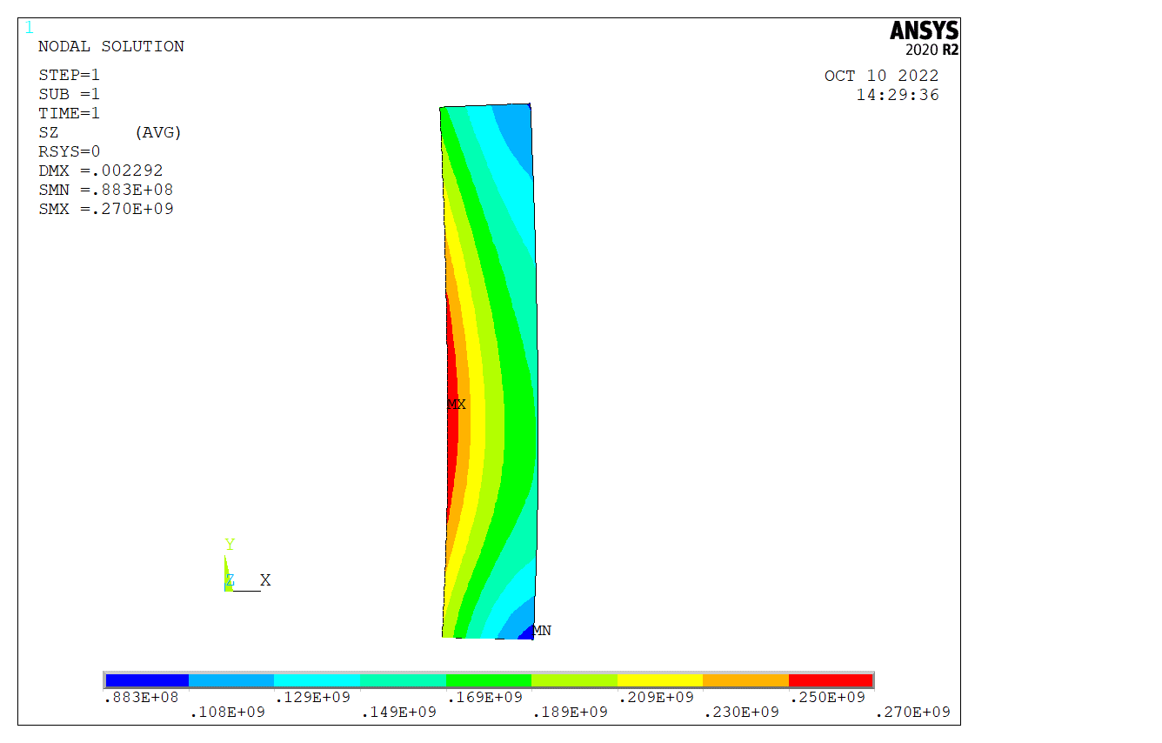
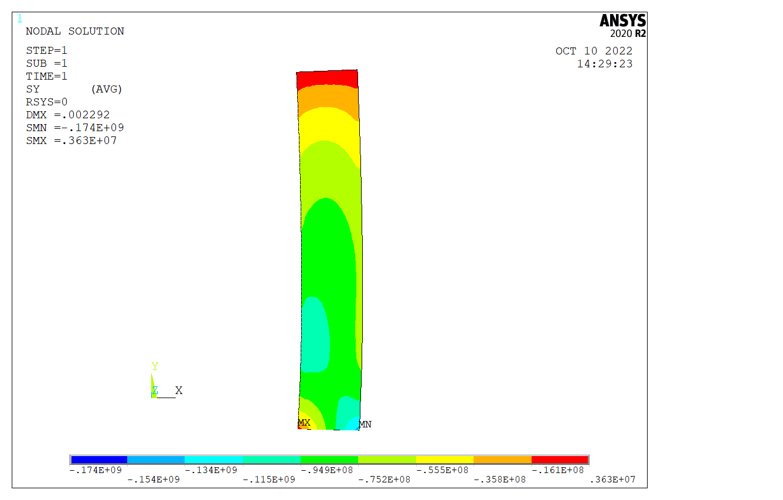
STRESSES
Hoop stresses
σ_{ϕ}
Axial stresses
σ_{Z}

Slide 12
OUTPUT DATA
 | Max B (T) | F_{R} (N) | Fz (N) | Max S_{R} (Pa) | Max S_{Z} (Pa) | Max S_{ϕ}(Pa)
Coil1 | 19.66 | 7.75E+07 | 4.20E+06 | -5.65E+07 | -2.41E+07 | 4.90E+07
Coil2 | 19.91 | 1.50E+08 | 2.08E+05 | -5.32E+07 | -2.88E+07 | 5.02E+07
Coil3 | 19.87 | 9.39E+07 | -2.07E+06 | -6.44E+07 | -3.04E+07 | 4.95E+07
Coil4 | 18.59 | 4.05E+07 | -1.30E+06 | -7.64E+07 | -3.63E+07 | -3.34E+07
Coil5 | 15.88 | 1.34E+07 | -5.35E+05 | -3.30E+07 | -1.47E+07 | -1.43E+07
Coil6 | 15.33 | 1.54E+09 | 4.64E+08 | -2.66E+07 | 1.14E+08 | 2.96E+08
Coil7 | 12.98 | 0.00E+00 | 0.00E+00 | 1.11E+07 | -1.85E+08 | 2.10E+08
Coil8 | 13.84 | 2.14E+09 | -4.14E+08 | 7.63E+07 | -1.74E+08 | 2.70E+08
Coil9 | 7.79 | 8.07E+06 | -2.59E+06 | -2.18E+07 | -4.34E+07 | 2.23E+08
Coil10 | 7.16 | 1.07E+08 | -2.64E+07 | -5.25E+06 | -3.36E+07 | 1.52E+08
Coil11 | 5.02 | 2.66E+07 | -8.57E+06 | -1.22E+06 | -4.04E+07 | 1.25E+08
Coil12 | 4.16 | 2.69E+07 | -5.75E+06 | -1.28E+06 | -1.88E+07 | 9.10E+07
Coil13 | 3.32 | 1.33E+07 | -2.74E+06 | -9.30E+05 | -1.53E+07 | 7.10E+07
Coil14 | 2.94 | 1.07E+07 | -1.67E+06 | -8.98E+05 | -9.19E+06 | 5.29E+07
Coil15 | 2.55 | 6.18E+06 | -7.66E+05 | -7.64E+05 | -6.78E+06 | 3.92E+07
Coil16 | 2.18 | 4.79E+06 | -2.95E+05 | -6.64E+05 | -4.09E+06 | 2.96E+07
Coil17 | 1.84 | 3.98E+06 | -1.57E+05 | -5.79E+05 | -3.23E+06 | 2.46E+07
Coil18 | 1.71 | 3.53E+06 | -1.47E+05 | -5.33E+05 | -3.21E+06 | 2.22E+07
Coil19 | 1.58 | 2.85E+06 | -1.04E+05 | -4.37E+05 | -2.63E+06 | 1.99E+07
Coil20 | 1.51 | 2.66E+06 | -7.65E+04 | -4.17E+05 | -2.62E+06 | 1.85E+07
Coil21 | 1.41 | 2.27E+06 | -5.70E+04 | -3.52E+05 | -2.22E+06 | 1.71E+07
Coil22 | 1.39 | 2.19E+06 | -3.05E+04 | -3.46E+05 | -2.19E+06 | 1.64E+07
Coil23 | 1.34 | 2.04E+06 | -4.42E+04 | -3.24E+05 | -2.20E+06 | 1.57E+07
Coil24 | 1.29 | 3.63E+06 | -4.53E+05 | 4.67E+05 | -6.91E+06 | 1.50E+07
Peak hoop stress:300 MPa
Peak axial force: 464 MN
Cumulative axial force:
±464 MN

Slide 13
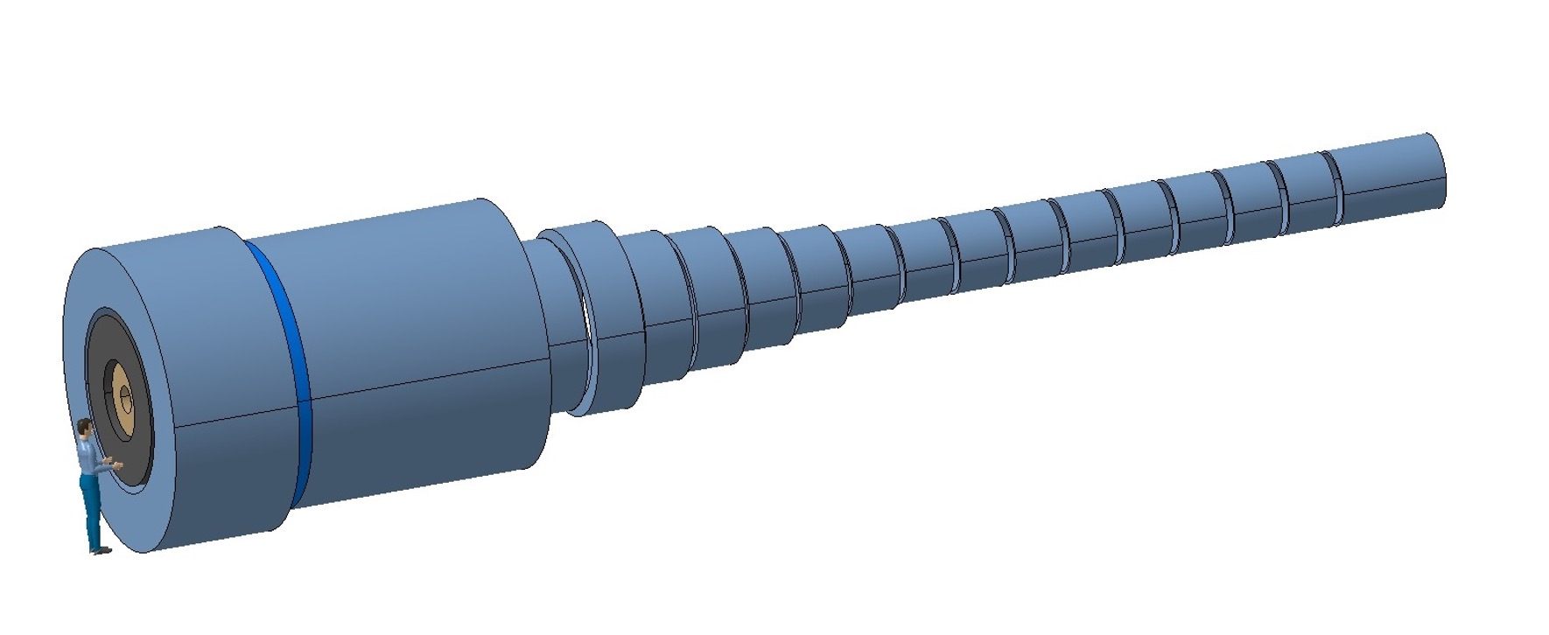
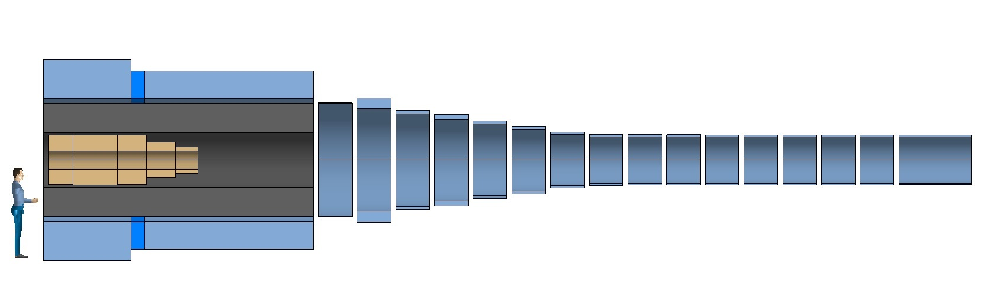
A 3D VIEW AND SOME ISSUES
Single cryostat ? Longitudinal forces are significant, require space, and result in additional heat loads
The gravity support of the warm radiation shield (approx 300 tons) should go through the cryostat
500 tons
20 tons

Slide 14
HTS (PRELIMINARY) DESIGN:
Field, Forces and Stresses

Slide 15
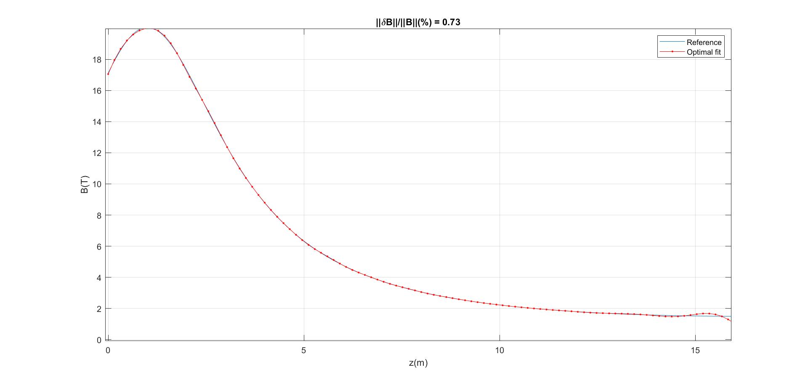
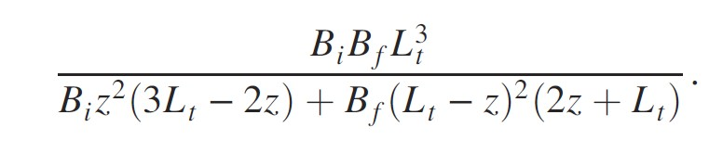
OPTIMAL FIT OF FIELD ON AXIS
Reference field formula (Sayed-Berg [4])
With B_{i}=20 T, B_{f}=1.5 T, L_{t}=15 m
-1<z(m)<15

Slide 16
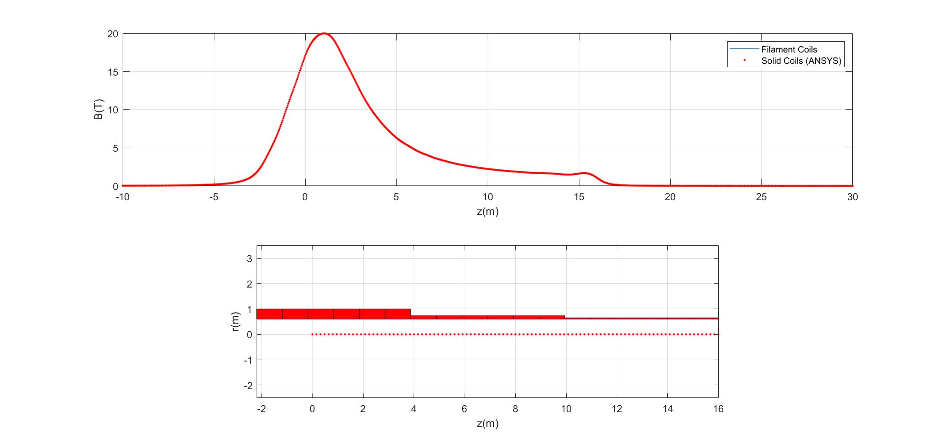
FIELD ON AXIS

Slide 17
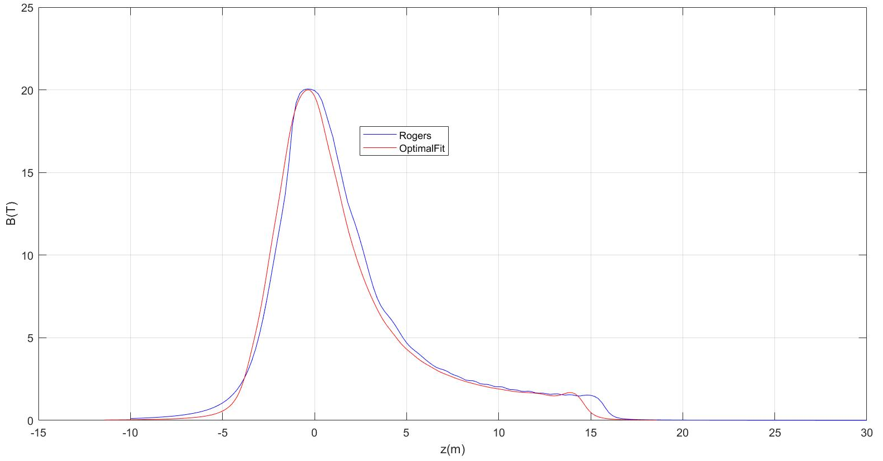
COMPARE FIELD ON AXIS
Blue = US-MAP
Red = OPT. FIT

Slide 18
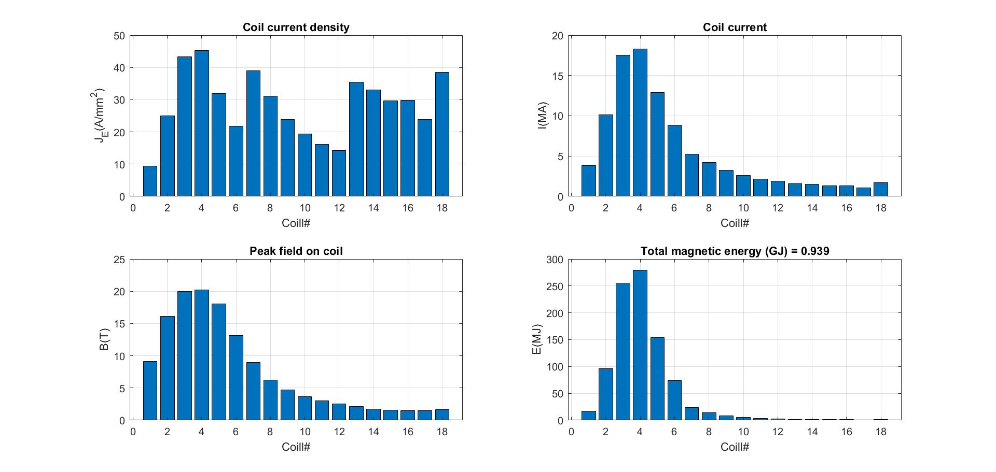

CURRENTS AND MAGNETIC ENERGY
1 GJ !!!

Slide 19
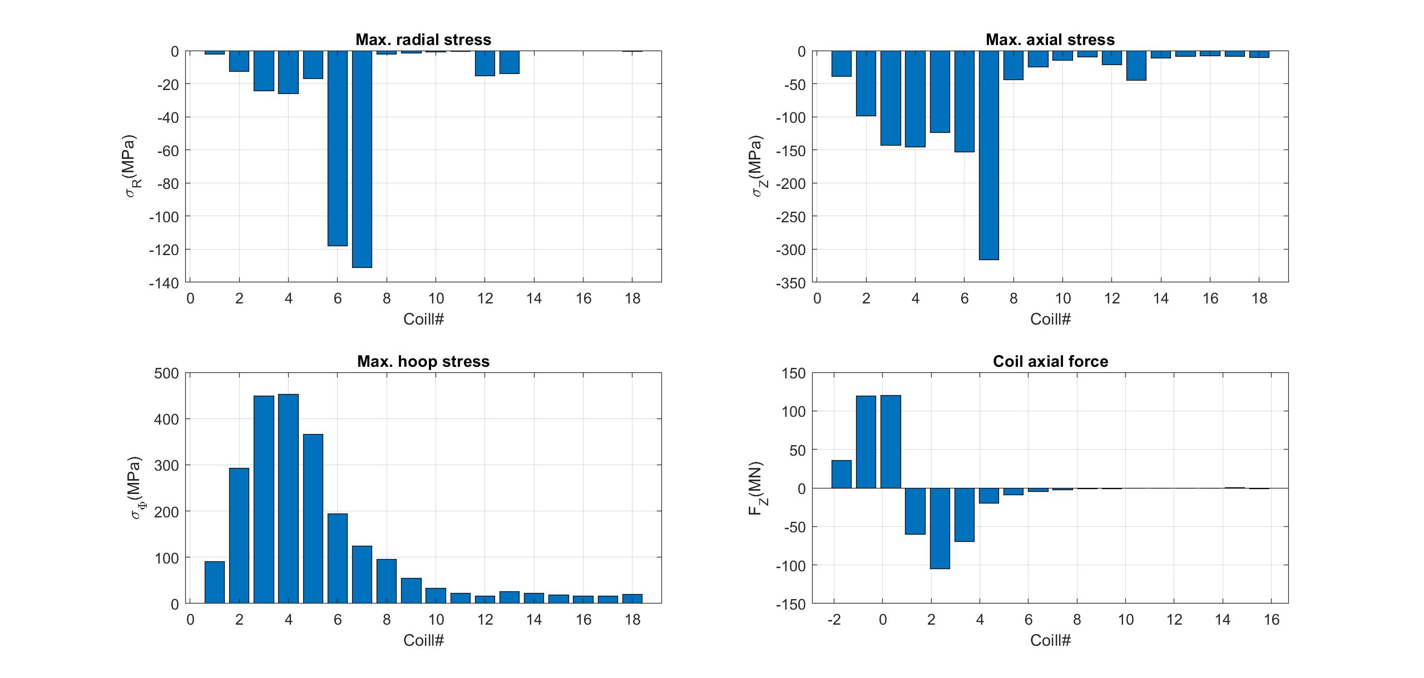
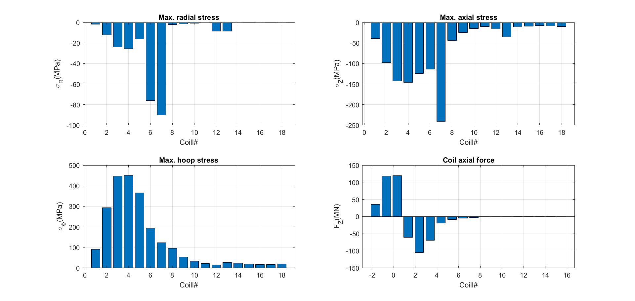
SMEARED STRESSES AND AXIAL FORCE

Slide 20
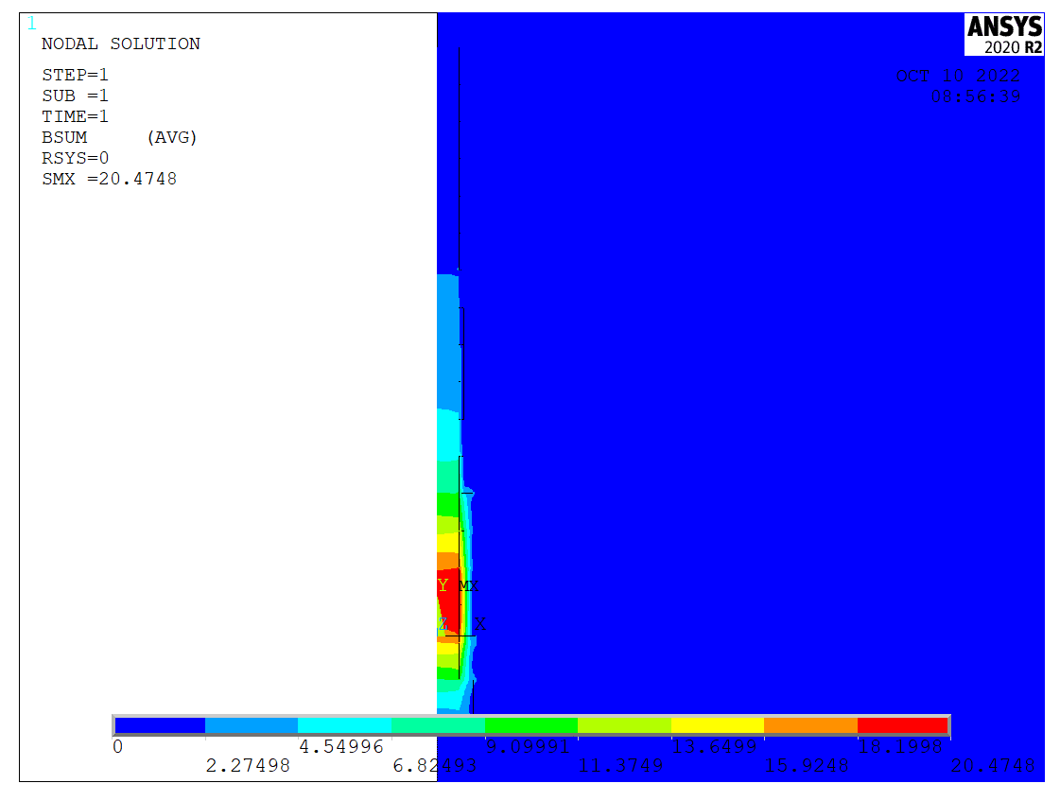
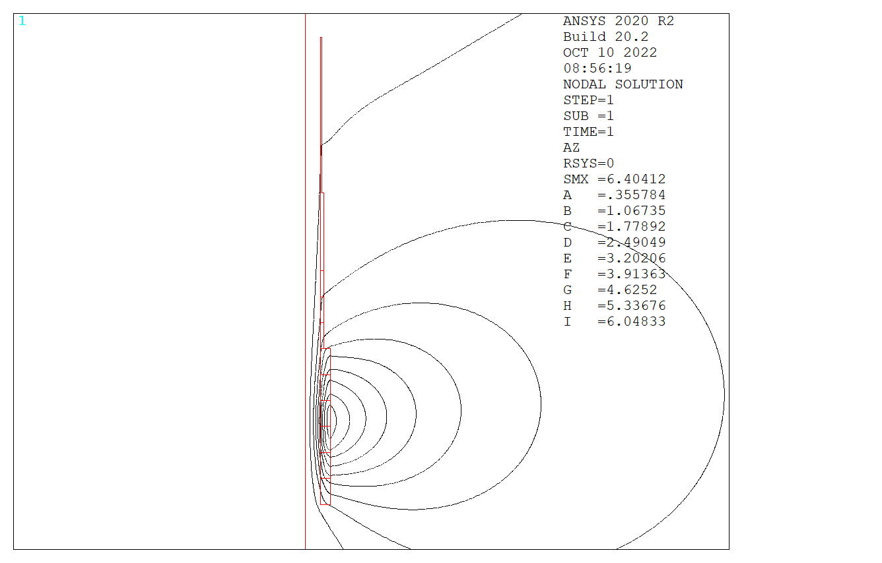
FIELD AND VECTOR POTENTIAL

Slide 21
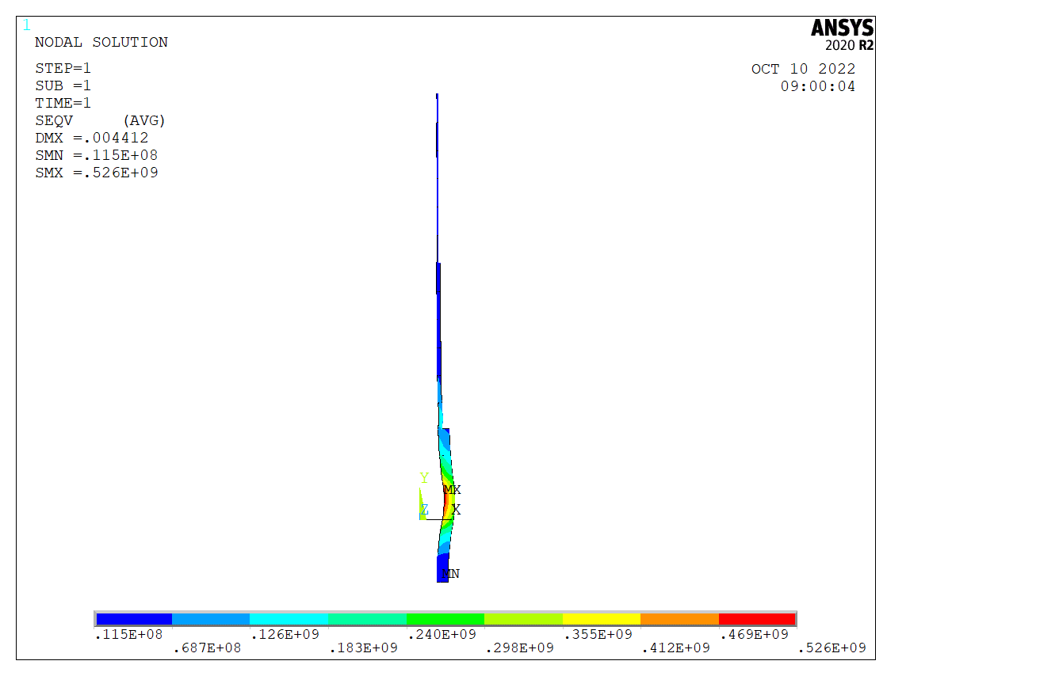
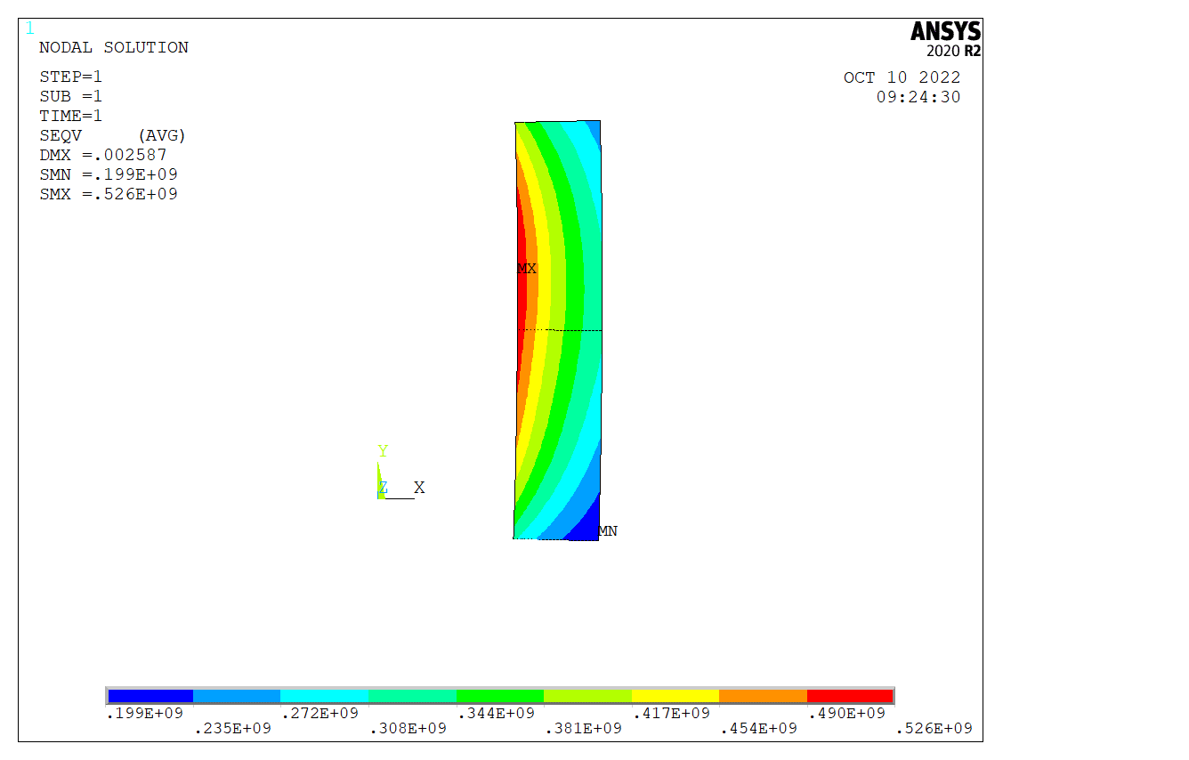
von Mises stresses σ_{vM}

Slide 22
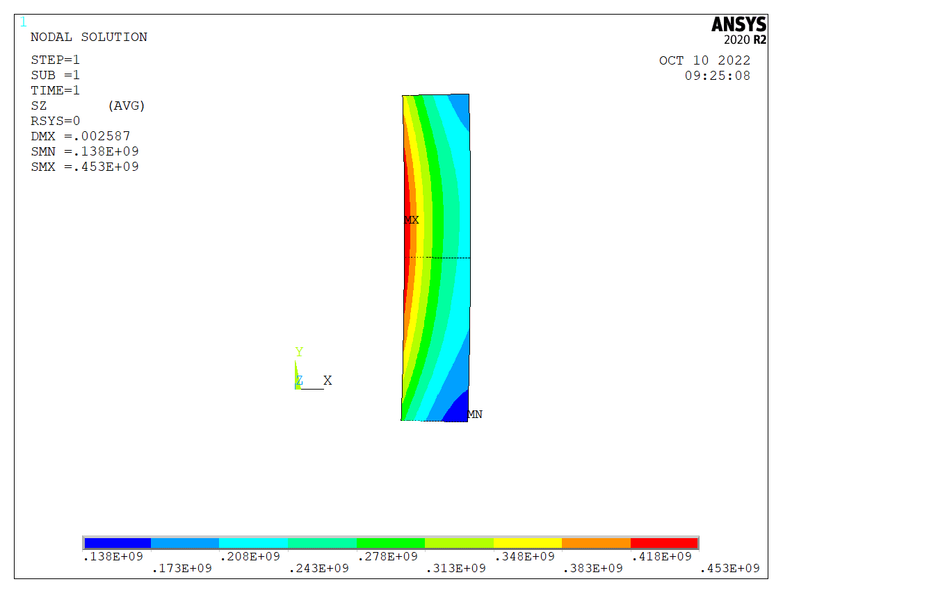
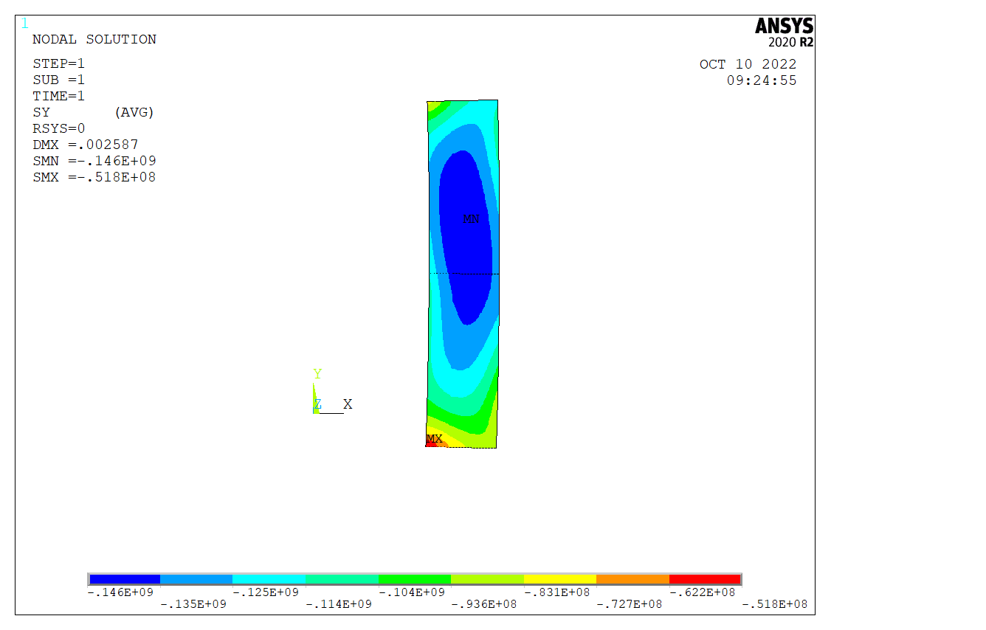
STRESSES
Hoop stresses: σ_{ϕ}
Axial stresses: σ_{Z}

Slide 23
COILS OUTPUT DATA
 | Rc(m) | Zc(m) | DR(m) | DZ(m) | I(MA)
Coil1 | 0.800 | -1.694 | 0.400 | 1.012 | 3.820
Coil2 | 0.800 | -0.682 | 0.400 | 1.012 | 10.124
Coil3 | 0.800 | 0.329 | 0.400 | 1.012 | 17.535
Coil4 | 0.800 | 1.341 | 0.400 | 1.012 | 18.321
Coil5 | 0.800 | 2.353 | 0.400 | 1.012 | 12.916
Coil6 | 0.800 | 3.365 | 0.400 | 1.012 | 8.825
Coil7 | 0.667 | 4.376 | 0.133 | 1.012 | 5.250
Coil8 | 0.667 | 5.388 | 0.133 | 1.012 | 4.203
Coil9 | 0.667 | 6.400 | 0.133 | 1.012 | 3.227
Coil10 | 0.667 | 7.412 | 0.133 | 1.012 | 2.621
Coil11 | 0.667 | 8.424 | 0.133 | 1.012 | 2.173
Coil12 | 0.667 | 9.435 | 0.133 | 1.012 | 1.909
Coil13 | 0.622 | 10.447 | 0.044 | 1.012 | 1.591
Coil14 | 0.622 | 11.459 | 0.044 | 1.012 | 1.485
Coil15 | 0.622 | 12.471 | 0.044 | 1.012 | 1.335
Coil16 | 0.622 | 13.482 | 0.044 | 1.012 | 1.343
Coil17 | 0.622 | 14.494 | 0.044 | 1.012 | 1.077
Coil18 | 0.622 | 15.506 | 0.044 | 1.012 | 1.728
Coil mass 111 tons

Slide 24
FIELD, FORCES AND SMEARED STRESSES
 | Max B (T) | F_{R} (N) | Fz (N) | Max S_{R} (Pa) | Max S_{Z} (Pa) | Max S_{ϕ}(Pa)
Coil1 | 9.23 | 5.51E+07 | 3.57E+07 | -2.04E+06 | -3.93E+07 | 9.11E+07
Coil2 | 16.22 | 2.80E+08 | 1.19E+08 | -1.26E+07 | -9.83E+07 | 2.93E+08
Coil3 | 20.14 | 6.99E+08 | 1.20E+08 | -2.42E+07 | -1.43E+08 | 4.49E+08
Coil4 | 20.34 | 7.71E+08 | -6.04E+07 | -2.61E+07 | -1.46E+08 | 4.53E+08
Coil5 | 18.16 | 4.46E+08 | -1.05E+08 | -1.68E+07 | -1.24E+08 | 3.66E+08
Coil6 | 13.25 | 2.12E+08 | -6.95E+07 | -1.18E+08 | -1.53E+08 | 1.94E+08
Coil7 | 9.08 | 9.62E+07 | -1.96E+07 | -1.31E+08 | -3.16E+08 | 1.24E+08
Coil8 | 6.39 | 5.12E+07 | -8.76E+06 | -2.25E+06 | -4.39E+07 | 9.52E+07
Coil9 | 4.84 | 2.96E+07 | -4.54E+06 | -1.44E+06 | -2.48E+07 | 5.43E+07
Coil10 | 3.76 | 1.90E+07 | -2.45E+06 | -9.13E+05 | -1.48E+07 | 3.29E+07
Coil11 | 3.05 | 1.29E+07 | -1.40E+06 | -6.20E+05 | -9.77E+06 | 2.17E+07
Coil12 | 2.56 | 9.28E+06 | -1.08E+06 | -1.54E+07 | -2.18E+07 | 1.64E+07
Coil13 | 2.24 | 6.97E+06 | -5.23E+05 | -1.38E+07 | -4.46E+07 | 2.64E+07
Coil14 | 1.86 | 5.56E+06 | -3.30E+05 | -3.01E+05 | -1.10E+07 | 2.28E+07
Coil15 | 1.69 | 4.52E+06 | -1.79E+05 | -2.50E+05 | -9.15E+06 | 1.87E+07
Coil16 | 1.58 | 4.27E+06 | -2.31E+05 | -2.47E+05 | -7.73E+06 | 1.64E+07
Coil17 | 1.59 | 3.14E+06 | 1.35E+05 | -2.44E+05 | -8.78E+06 | 1.63E+07
Coil18 | 1.74 | 4.97E+06 | -1.22E+06 | -4.17E+05 | -1.03E+07 | 2.02E+07
Peak hoop stress: 453 MPa
Peak axial force: 120 MN
Cumulative force:
±275 MN

Slide 25
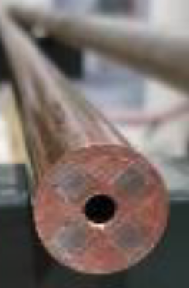
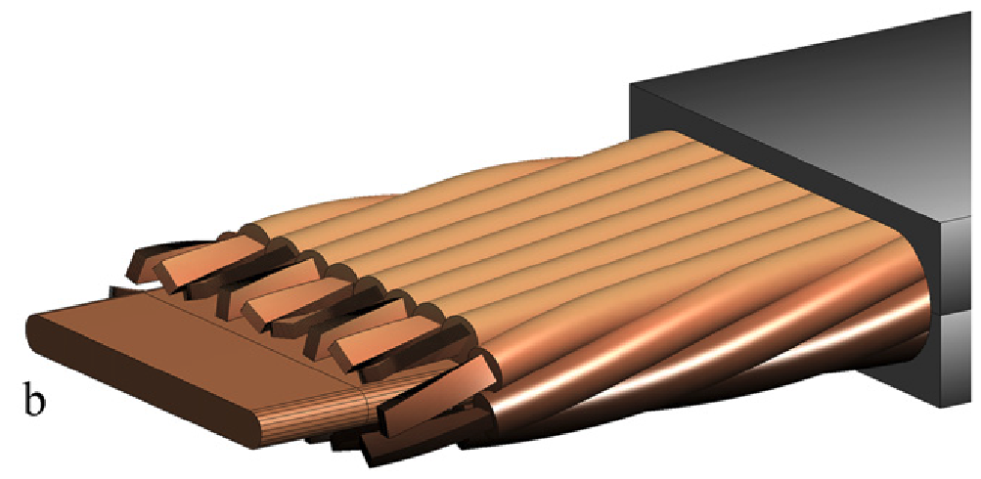
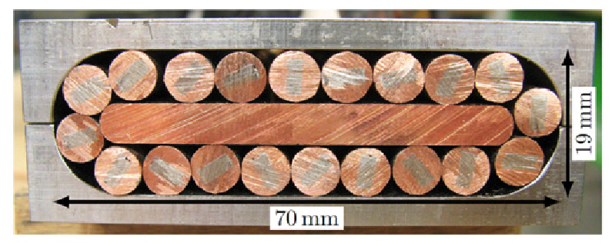
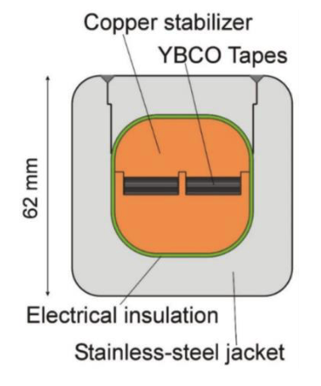
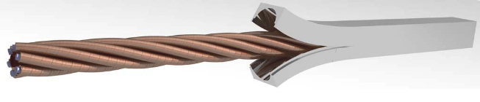
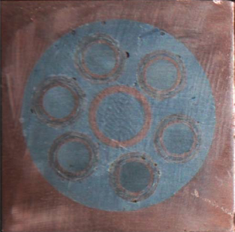
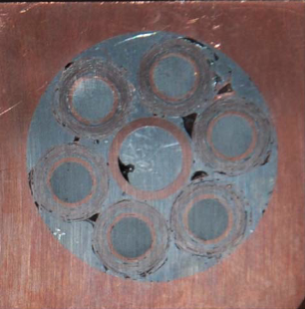
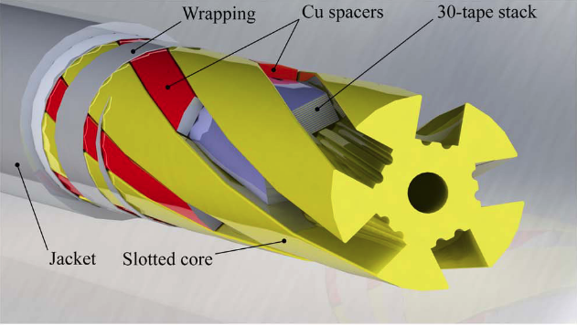
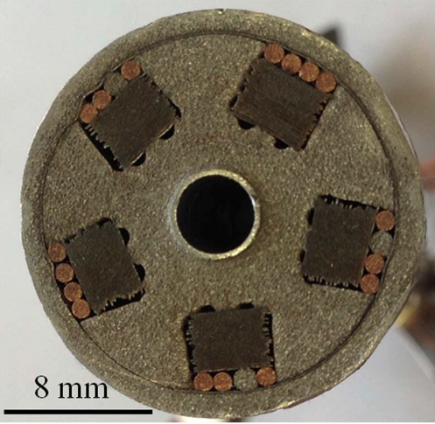
SUPERCONDUCTOR OPTIONS
STAINLESS STEEL JACKET
COPPER SLEEVE
COPPER FORMER
SOLDERED HTS STACK
COOLING CHANNEL
M. Takayasu et al., IEEE TAS, 21 (2011) 2340
Zachary S Hartwig et al 2020 Supercond. Sci. Technol. 33 11LT01
D. Uglietti et al 2015 Supercond. Sci. Technol. 28 124005
Y. Nagato et al., Nucl. Fus., 55 (2015) 053021
T. Mulder et al., IEEE TAS, 26 (2016), 4803605
G. Celentano et al., IEEE TAS, 24 (2014), 4601805

Slide 26
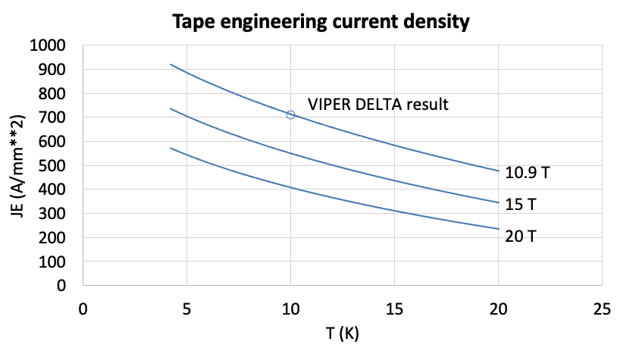
MUCOL TARGET SOLENOID CABLE
Copper diameter | 0.02 | (m)
Hole diameter | 0.006 | (m)
Jacket outer dimension | 0.035 | (m)
HTS stack width | 0.006 | (m)
HTS stack thickness | 0.006 | (m)
number of stacks | 4 | (-)
A non-Cu | 0.000144 | (m²)
A hole | 0.000028 | (m²)
A Cu | 0.000142 | (m²)
A Jacket | 0.000911 | (m²)
A cable | 0.001225 | (m²)
f non-Cu | 0.12 | (-)
f Cu | 0.12 | (-)
f Jacket | 0.74 | (-)
JE non-Cu (20 K 20 T) | 400 | (A/mm¹)
JE cable (20 K, 20 T) | 47 | (A/mm¹)
JE Cu (20 K, 20 T) | 406 | (A/mm¹)
STAINLESS STEEL JACKET
COPPER SLEEVE
COPPER FORMER
SOLDERED HTS STACK
COOLING CHANNEL
Operating current: 60 kA
Operating field: 20 T
Operating temperature: 20 K
Jacket fraction: 74 %
20
35

Slide 27
Conclusions
There are many magnetic configurations that provide a suitable B(s) profile in the target and capture section. We explored one possible choice based on:
  Modular magnetic configuration (constant bore, identical coil geometry) to simplify the magnet
  Use of HTS to provide the desired field, avoiding the resistive insert, and operating at temperature higher than liquid helium (virtual increase in COP by a factor 4)
We found that the system mass and stored magnetic energy can be reduced (by a factor 2), as well as the cumulative attractive force between coils (by a factor 1.75)
This looks interesting enough to follow-up. The suitability of this variant needs to be studied further, integrating beam, target, shielding, cryogenic and vacuum requirements

