Slide 1

Muon Collider WP7-Task 4
Collider Complex
S.Mariotto¹, B.Caiffi², D. Novellini^{2,3}
Meeting 24-11-2022
¹INFN – LASA- Milano, ²INFN – Genova
³Università La Sapienza - Roma

Slide 2
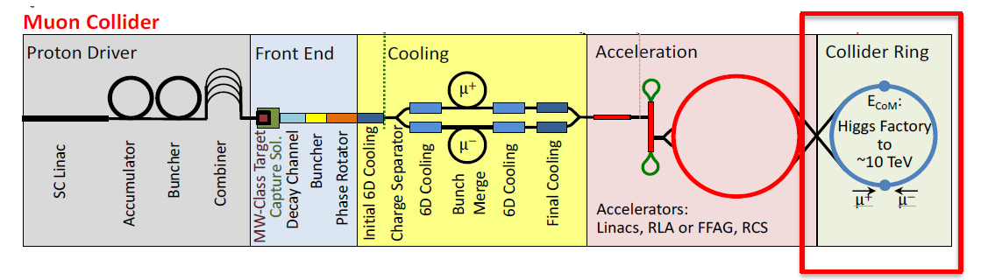
Task 7.4
Scope:
assessing realistic performance targets for the collider magnets, in close collaboration with beam physics, machine-detector interface, and energy deposition studies
produce Design Study Credible and Affordable
(contain cost, energy efficient, sustainable operation)
Partecipants:
INFN Milano
M. Statera, M. Prioli, E. De Matteis, R. Valente, S. Sorti, M. Dam
INFN Genova
B. Caiffi, A. Bersani, A. Pampaloni, F. Levi, S. Farinon, R. Musenich
UNIMI
Rossi, M. Sorbi, S. Mariotto
CERN
L. Bottura, A. Lechner, P.T.

Slide 3
Tentative proposal
Provide a design study for the 3 TeV machine collider arc magnets
  if this is an interesting option for a staged strategy
NbTi is compatible with required magnetic field
    Are combined function magnets requested also for this options?
    Nb₃Sn can also be considered, if working at 1.9 K is not an option
3 TeV machine
N.B. This technology is not scalable, magnets for 3 TeV machine or 10 TeV machine
are completely different beasts, the studies will be completely different
Provide a design study for the 10 TeV machine collider arc magnets
    Most likely, the magnetic field required will not be compatible with Nb₃Sn
    HTS is more suitable
    Working temperature will also constrain this choice: if we want to work @10K to reduce energy consumption, again HTS is the way
10 TeV machine

Slide 4
Magnet requirements
Tentative specs for first feasibility evaluation (to be revised)
(1) Field and gradient are evolving with optics
(2) Muon decay shield integration may modify bore and operating temperature
(3) Some of the technology choices are limited by the values of peak field and temperature
On-axis peak field⁽¹⁾ | 10 T
On-axis peak gradient⁽¹⁾ | 300 T/m
Bore⁽²⁾ | 150 mm
Magnetic length | 15 m
Field Quality | 10 units
Technology | LTS/HTS
Temperature range⁽²⁾ | 1.9/4.2 K (LTS) or 10 to 20 K (HTS)
Not Possible
At the same Time

Slide 5
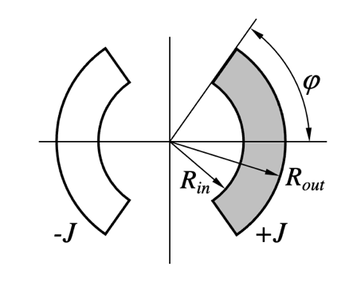
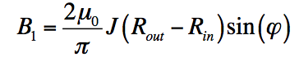
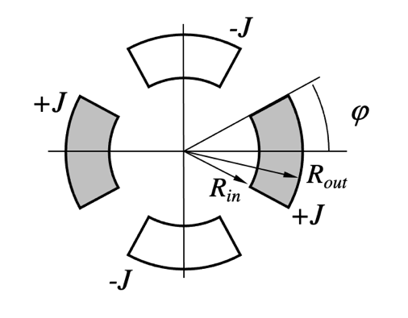
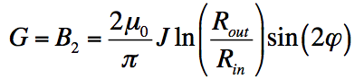
In order to provide fast feedback on the magnet requirements provided by beam optics, MDI, radiation and cryogenics teams, a set of analytic expressions will be setup at least for the main parameters (Main Component, Peak Field, Field Errors, Forces).
Fast evaluation of magnet parameters
  Analytical expressions for NbTi and Nb3Sn type dipoles and quadrupoles already exists: field, error, forces and energy
  Scalable laws can be extensively used for simplified cos(nθ) configurations
  Points to be addressed
  Equivalent expressions for block coil design?
  Peak Field to be evaluated numerically
  HTS magnet are different from LTS configurations
  Limiting parameters and optimal configuration of the design can be different
Milestone T₀ + 12/14 months
Analytical Magnet Cross-section

Slide 6
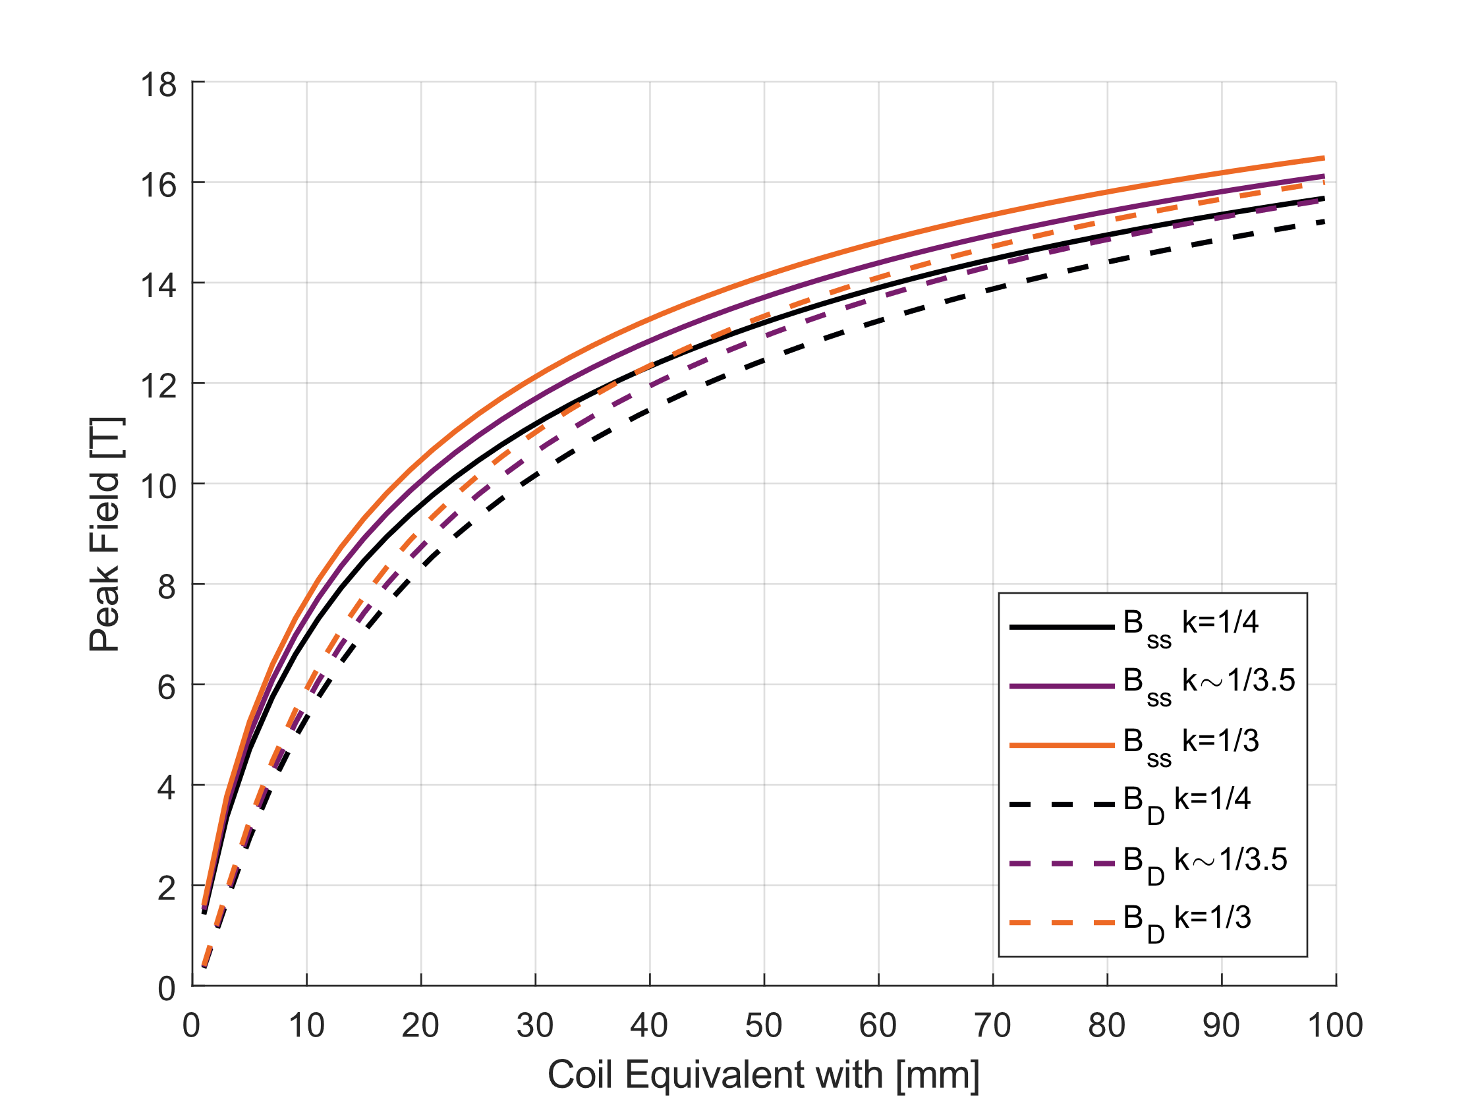
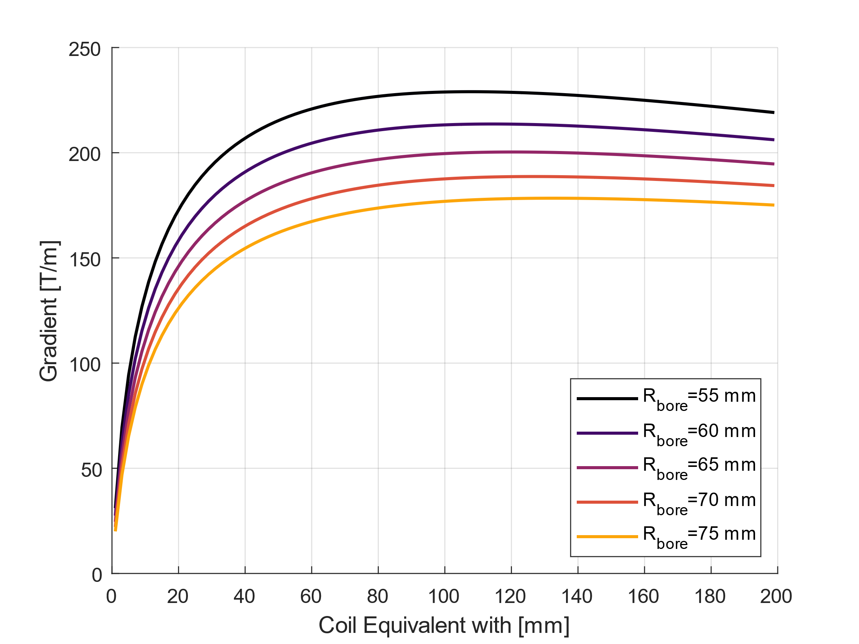
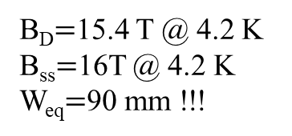
Performances of Nb3Sn
Equations taken from Ezio Todesco – Accelerator Magnets Masterclass
Dipole and Quadrupole Gradient – Maximum Values obtainable as function of the coil equivalent width
OSS: NO IRON considered $→$ +1/1.5 T on Dipole Field with same coil dimension
DIPOLE
G_{max}=175 T/m @ R=75 mm
B_{D}$=$15.4 T @ 4.2 K
B_{ss}$=$16T @ 4.2 K
W_{eq}$=$90 mm !!!
QUADRUPOLE
R_{bore}=75 mm

Slide 7
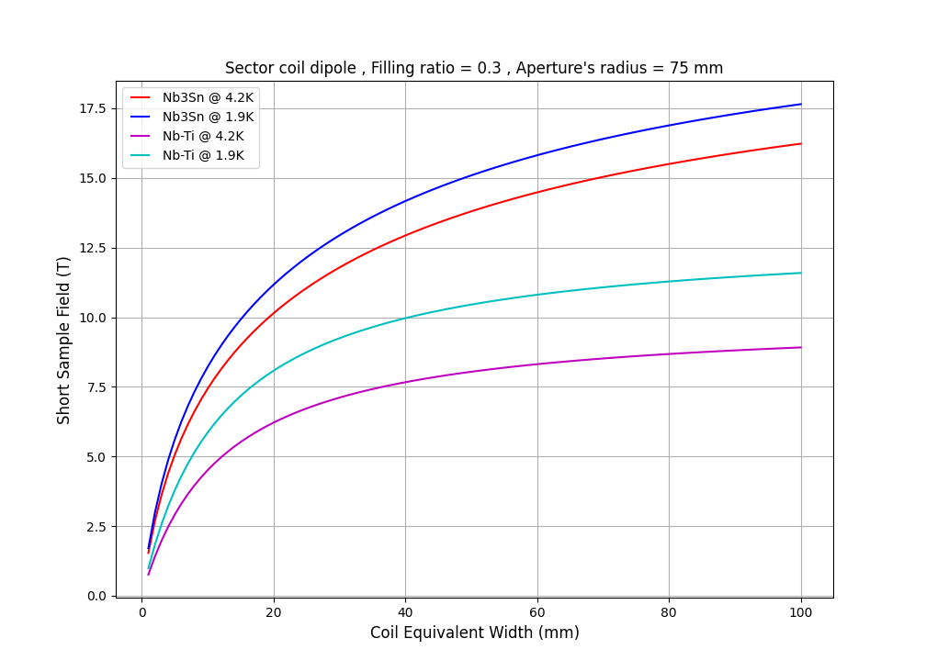
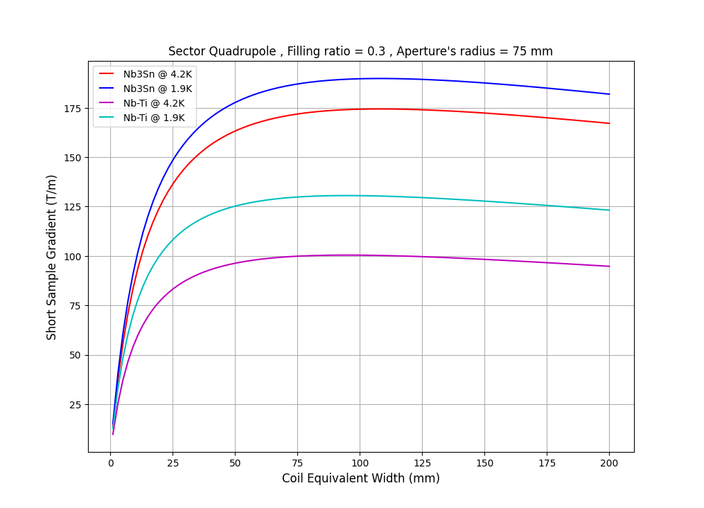
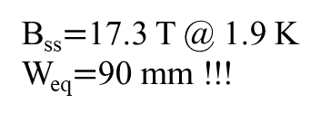
Nb3Sn vs NbTi
Second Option: consider T = 1.9 K
DIPOLE
B_{ss}$=$17.3 T @ 1.9 K
W_{eq}$=$90 mm !!!
G_{max}=185 T/m @
(T=1.9 K, R=75 mm)
R_{bore}=75 mm
QUADRUPOLE
Courtesy of D. Novellini

Slide 8
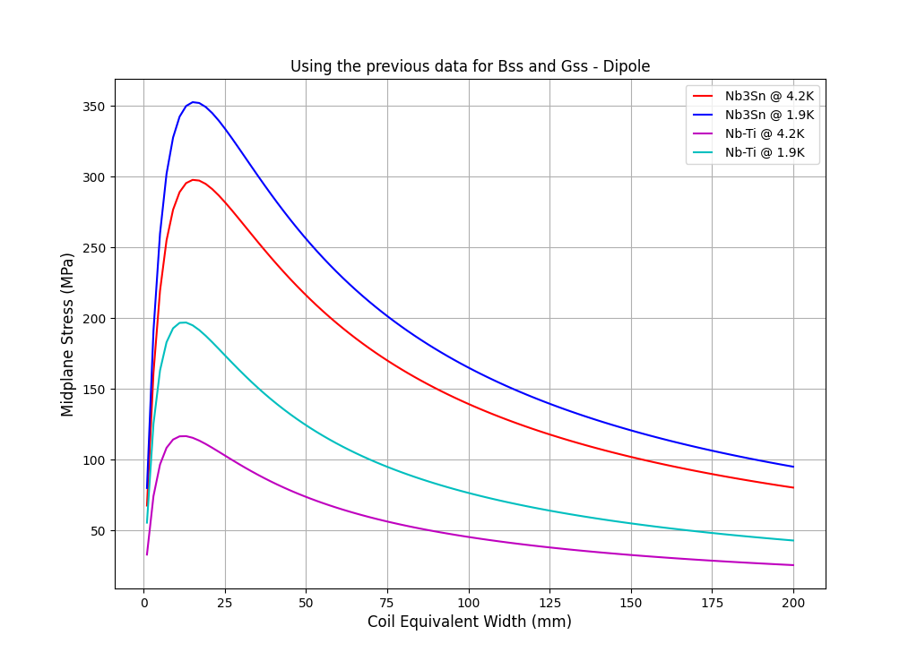
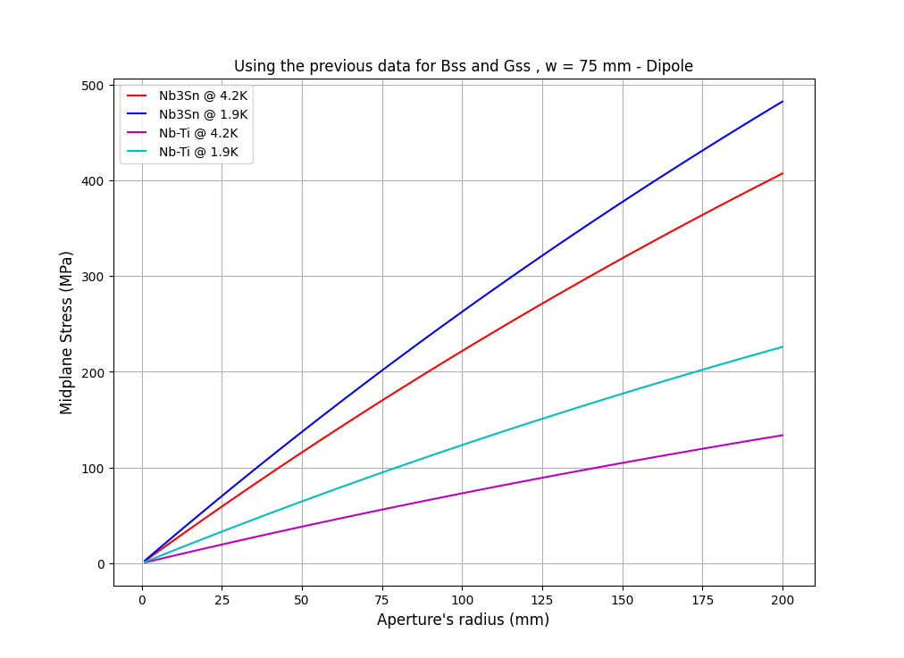
Stress Management: Dipole
Calculation of the maximum stress on coil: Nb3Sn $σ_{max}=$150 Mpa
Possible coil layout is only with Coil width $>$ 100 mm!!!!
Smaller coil aperture reduce the peak stress on conductor!
R_{bore}=75 mm
Coil width =75 mm
Courtesy of D. Novellini

Slide 9
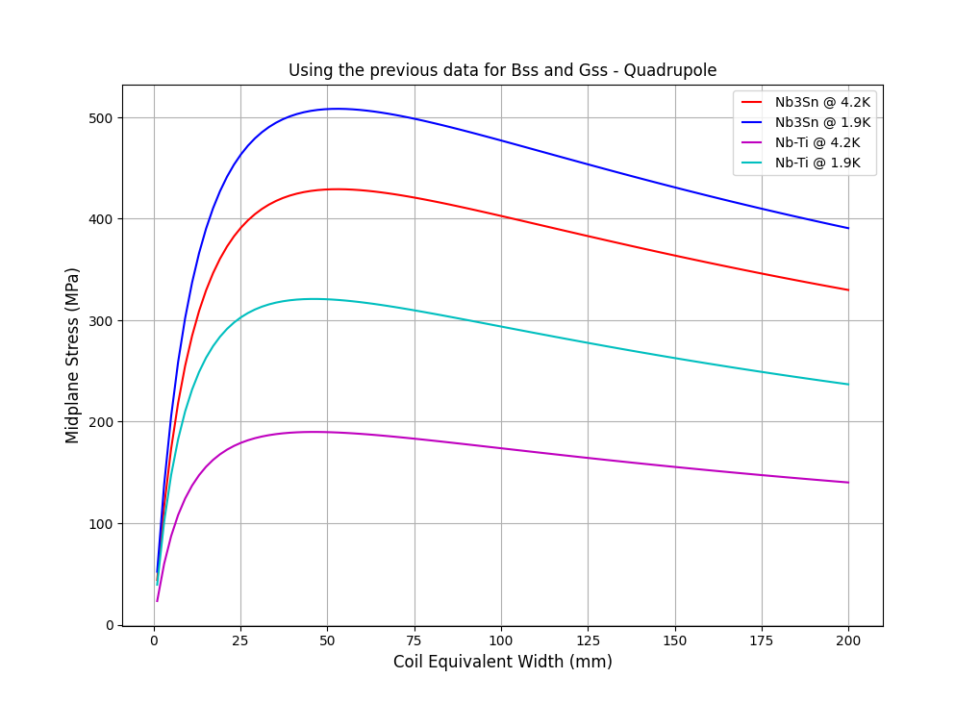
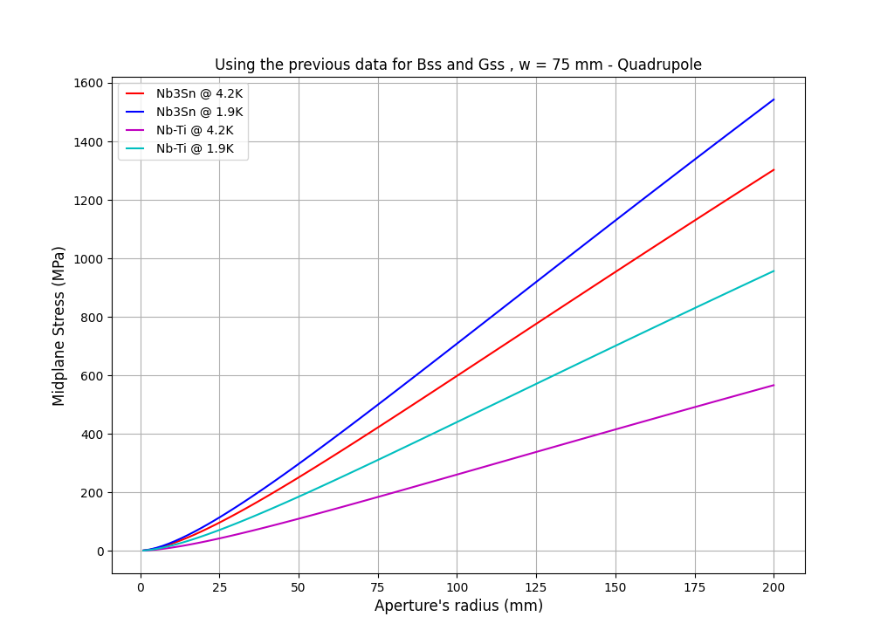
Stress Management: Quadrupole
Calculation of the maximum stress on coil: Nb3Sn $σ_{max}=$150 Mpa
Coil aperture of R=75 mm cannot be used for quadrupoles….
Smaller coil aperture reduce the peak stress on conductor!
Need to refine calculatio with Iron and grading
Hybrid or HTS coil needed
R_{bore}=75 mm
Coil width =75 mm
Courtesy of D. Novellini

Slide 10
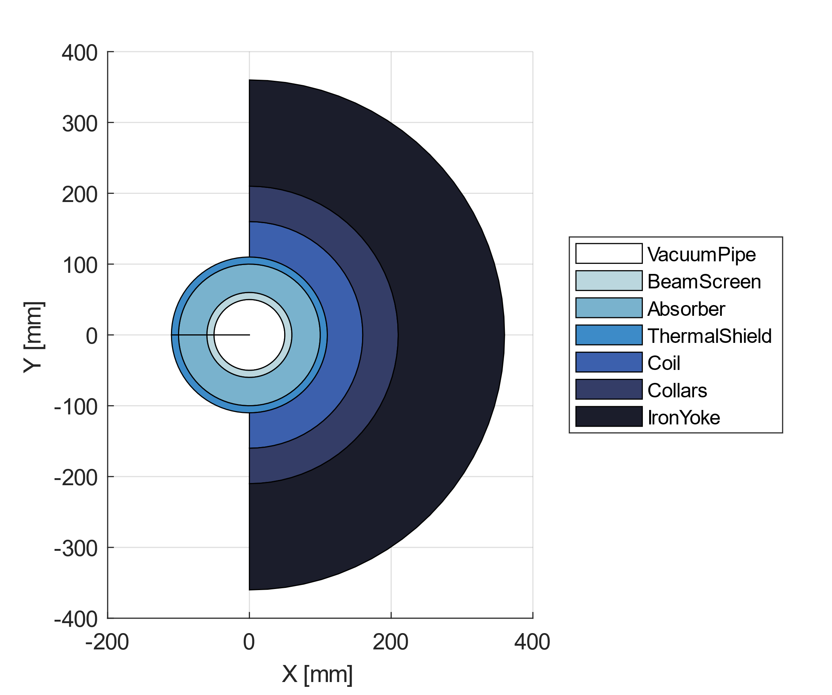
Radial Build
Anything missing?
Discussion on minimum values required for each component!
Coils radius depends on layout and type of field (combined functions or not)
Collars and Iron Yoke dimensions are second relevant point!
External dimension constraints?

Slide 11
Thank you
for your attention

