Slide 1
PH-SFT Group
Priorities and Organization for 2011 and 2012
  Follow-up to SFT Review (2009/2010)

Slide 2
Reminder: Roles and Responsibilities
John will take over as GL, managing group team organization and resources
Pere will continue to run the AF and will chair the weekly technical group meeting that steers the baseline and consolidation tasks
Fons will lead the ROOT development team.
Gabriele will lead the Simulation development team
Benedikt will lead the SPI activities
Rene will lead the new event simulation project
Vincenzo and Predrag will continue to lead the Multicore and CernVM R&D work packages

Slide 3
Remninder: Architects Forum Changes
Reinforce the strategic planning of the contents and schedule of releases for the SFT products
  Set priorities and monitor progress of the to-do list of each project
  Feedback and new requests for the services provided by the SFT group
Enlarge the current scope by incorporating simulation and analysis use cases
  We may need to adjust the experiment’s representation to cope with this enlargement

Slide 4
Project Management
Architect’s Forum
Project
Meetings
To-Do List
To-Do List
Experiments
story
Projects
story
task
task
Releases/
Services

Slide 5
User Story and Tasks
A user story is one or more sentences in the everyday or business language of the user that captures what the user wants to achieve
  User stories should be written by the customers for a software project and are their main instrument to influence the development of the software
  It should be accompanied of an acceptance test (definition of “done”)
Projects will break each user story in a number of technical tasks in order to implement the user story

Slide 6
Project Planning Tool
Requirements:
  Manage the list of tasks for each project
    Coarse granularity (minimal task size one person week)
    Support for hierarchical tasks (story→ task → subtask)
  Support the discussion with the stakeholders (AF meetings)
  Support the scheduling of tasks to releases and other deliverables
  Easy to re-prioritize, breakdown, follow progress, assign, comment, etc.
  Web based tool with world read access
Non-requirements
  Work log (record the time spend in each task)

Slide 7
Tool Evaluation
JIRA-Greenhopper (http://www.atlassian.com)
  Instances used in various projects at CERN (EN-ICE, BE-CO, GS-AIS, IT-GD). Very good feedback
  “Open-source” projects can get a free license with some conditions
  Installed trial license (30 days) (http://sftjira.cern.ch:8080)
  Does fulfill our requirements
Redmine (http://www.redmine.org)
  Flexible project management web application. Very good reports from JIRA users.
  Open source (GPL)
  It looks very promising and does fulfill our requirements
  Making our own installation

Slide 8
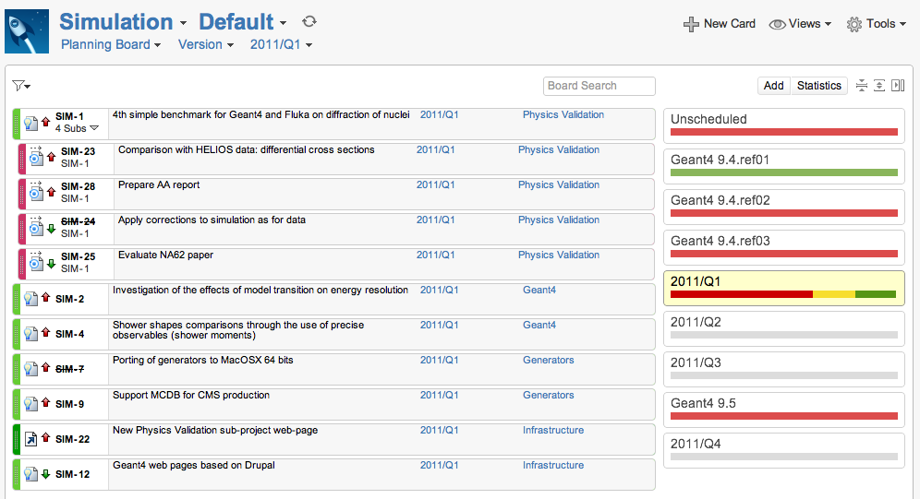
JIRA Example

Slide 9
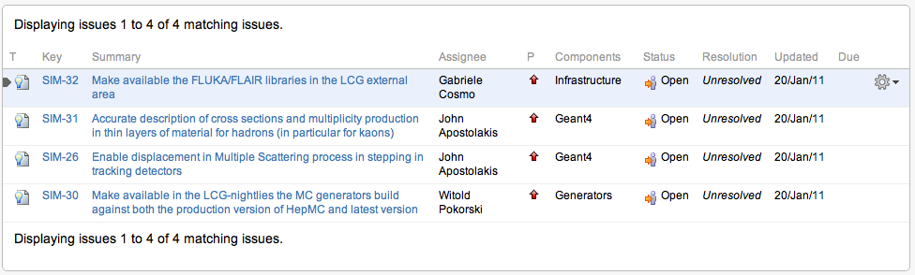
Planning example
Four requests received from LHCb for the Simulation

