Slide 1
Sigmon for HWC analysis tools: status, roadmap and impact on BE-CEM and BE-CSS
D. Wollmann
14.07.2022

Slide 2
Outline
Re-cap: What is Sigmon
Experience from HWC 2021/22
MPE goals for the development of Sigmon & input from MP3
Roadmap and timeline
Impact on BE-CEM and BE-CSS
Summary
Discussion
Topics for future meetings:
Requirements for full integration of Post Mortem in the NXCALS storage: consolidation strategy by BE-CSS and TE-MPE – End of August / Early September?
Long term support strategy on the PM system, the PM analysis framework and the LHC HWC tools from TE-MPE, BE-CSS and BE-CEM – End of September?

Slide 3
Re-cap on Signal Monitoring (SIGMON)
SIGMON was originally started to (semi-)automatically monitor the behaviour of sc. circuits in the LHC during operation.
SIGMON uses an API to access (circuit) data in the PostMortem and NXCALS.
Analysis are implemented in Python via Jupiter notebooks on SWAN and Python scripts.
Current use cases:
  Analysis and validation of HWC tests, analysis of quenches during operation (main user MP3).
  Simulation of transient effects in accelerator magnets and comparison to measurements (proof of concept by MPE-PE)
  Reliability and availability studies on sc. circuits, incl. the use of machine learning methodologies (main user MPE-CB)
  Analysis of beam losses during LHC beam dumps (main user MPE-CB)
Sigmon.web.cern.ch

Slide 4
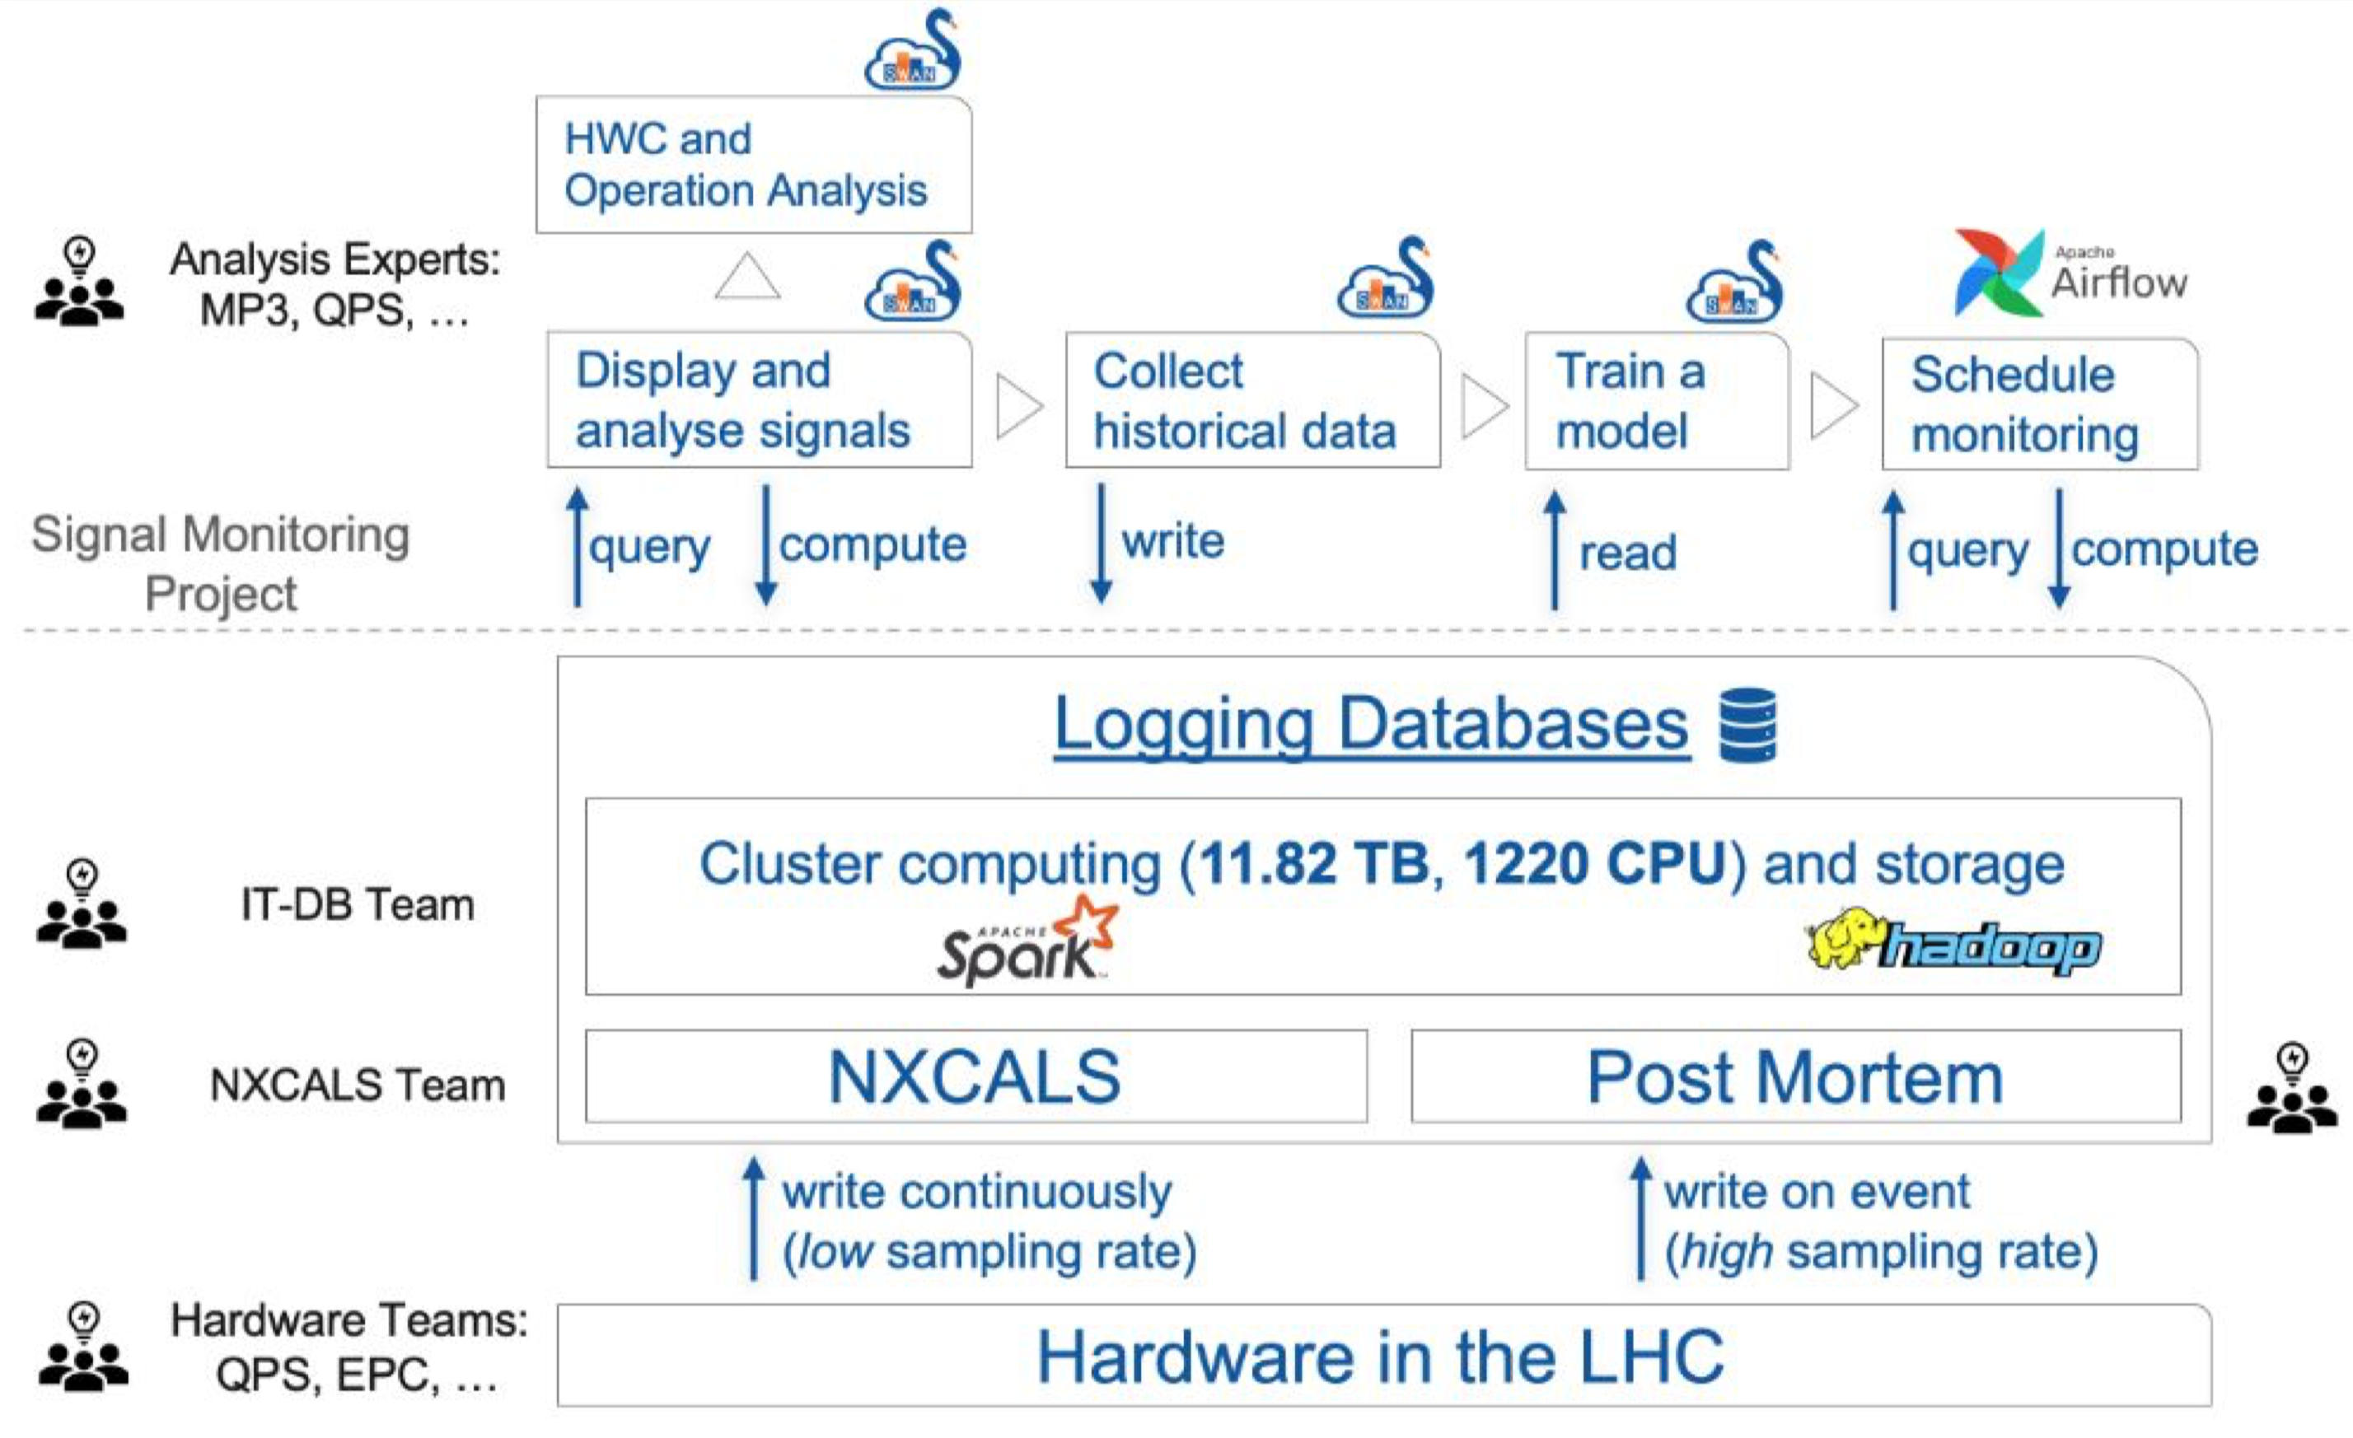
Sigmon in a nutshell

Slide 5
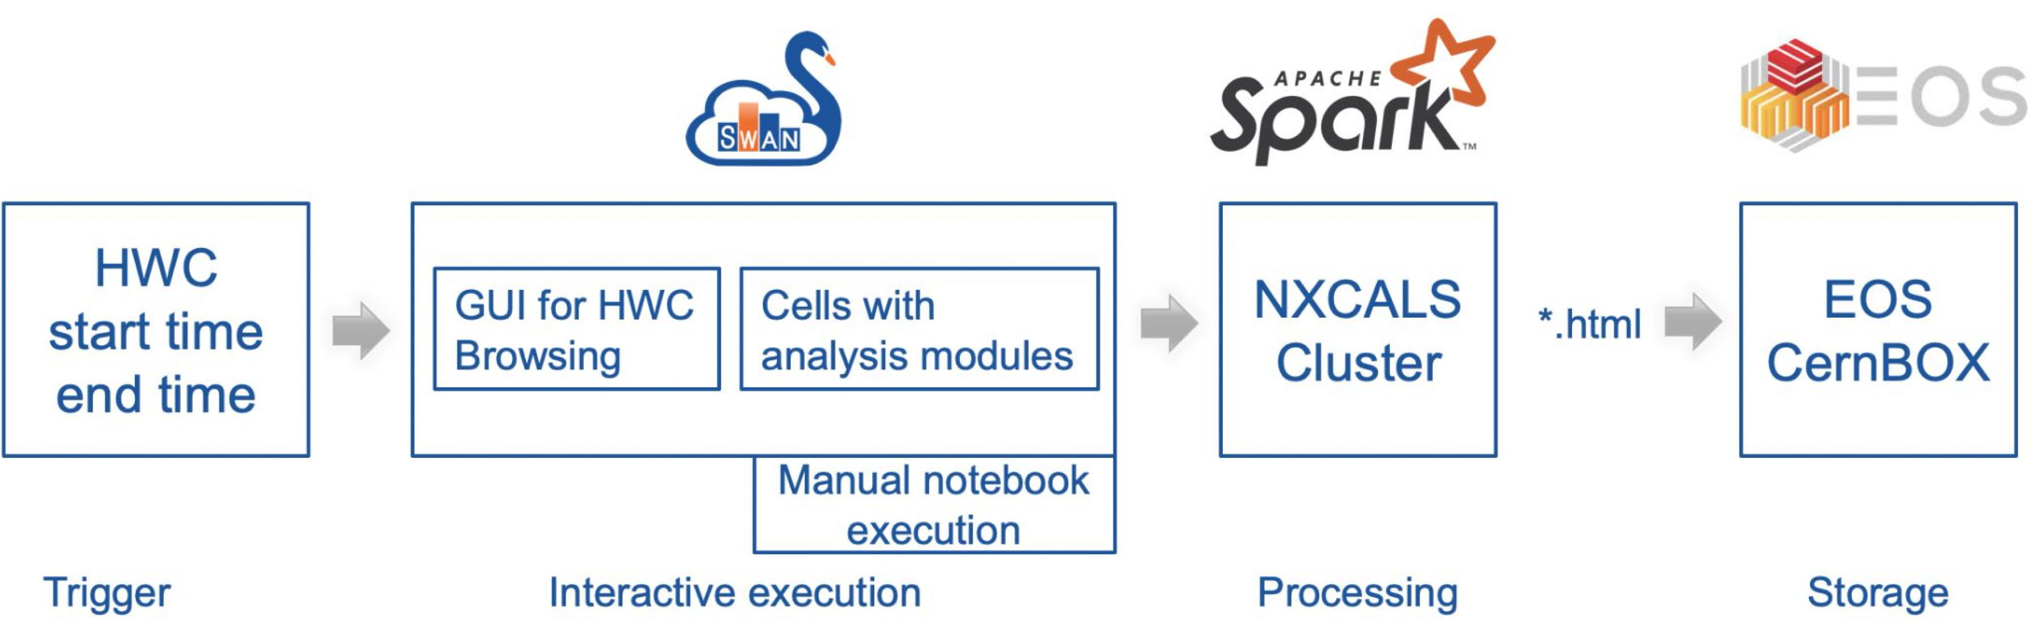
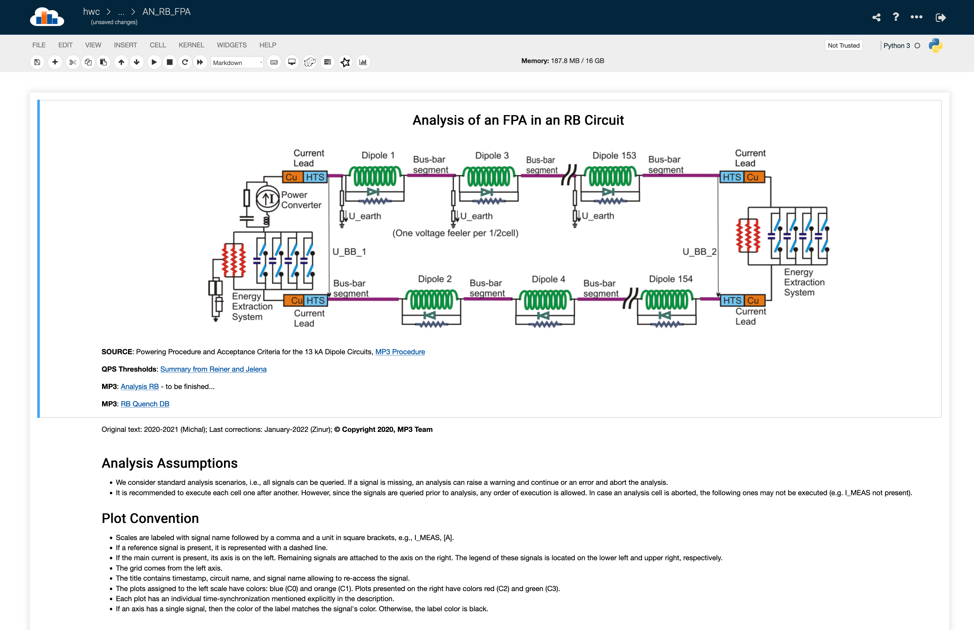
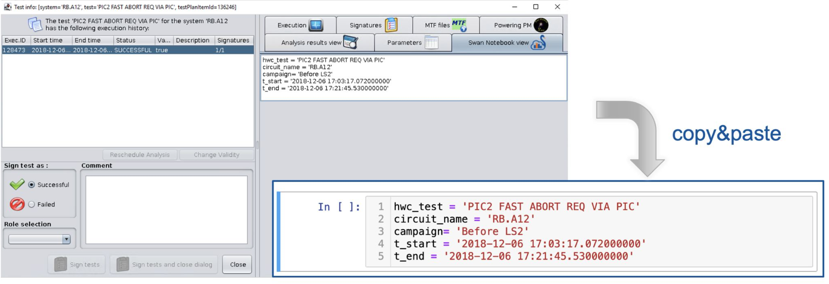
Sigmon during HWC 2021/22
64 interactive notebooks for MP3 analysis of HWC tests.
Manual integration with AccTesting.
Efficient use & continuos improvement of analyses during 2021.

Slide 6
HWC commissioning tools used by MP3
RB | RQD/F | IT | IPQ | IPD | 600A | 80-120A | 60A
PCC | PCC | PCC.T4 | PCC.4 | PCC.3 | PCC | PCC.1 | PCC.1
PIC2 | PIC2 | PIC2 | PIC2 | PIC2 | PIC2 | PIC2
PLI1.a2/b2/d2 | PLI1.b3/d2 | PNO.d12/d13 | PLI1.c3 | PLI1.c2 | PCS | PNO.d1 | PNO.d1
PLI2.s1/b2 | PLI2.s1/b3 | PLI3.f6 | PLI2.f3 | PLI2.f2 | PLI3.b1 | PNO.a1 | PNO.a1
PLI2.e2 | PLI2.e2 | PNO.d14 | PLI2.e3 | PLI3.c5 | PNO.d3 | PNO.e1
PLI2.f1 | PLI2.f1 | PNO.d15 | PNO.f4 | PNO.a8/c6 | PNO.b1*
PLIM.b2 | PLIM.b3 | PNO.a9 | PNO.a7 |  | PNO.a3
PLIS.s2 | PLIS.s2 | PNO.d16 | PNO.c4 |  | PNO.x1
PLI3.a5/d2 | PLI3.a5/b3 | PNO.d17 |  |  | PNO.x2
PNO.b2/a6 | PNO.b3/a6
FPA/ FPA_SNAP | FPA | FPA | FPA | FPA | 3xFPA-EE | FPA | FPA
QHDA | QHDA | QHDA | QHDA | QHDA
AccTesting (incl. HWC sequencer)
  eDSL based analysis tools for 60A, 80-120 A and 600 A circuits
  Java based analysis tools for energy extraction analysis
Post Mortem Event Analyser (PMEA)
  LabVIEW based tools for analysis of 60 A, 80-120 A, 600 A circuits
Post Mortem Browser
  Manual analysis of PM files from all circuits
Jupyter notebooks (SIGMON)
  Analysis notebooks for all high current circuits
SIGMON No MP3 analysis eDSL LabVIEW

Slide 7
MPE goals for the development of SIGMON & input from MP3
Homogenisation of analysis tools provided/maintained by the MPE SW team:
  Retire eDSL and Java based analysis tools (running in PM analysis framework) and replace by SIGMON analysis based tools.
Complement list of SIGMON analysis tools for HWC by tools for machine operation and continous monitoring of circuit operation.
Automation of SIGMON analysis tools.
Integration of SIGMON analysis tools with AccTesting:
  Run SIGMON analysis tools;
  Collect results;
  Collect signatures.

Slide 8
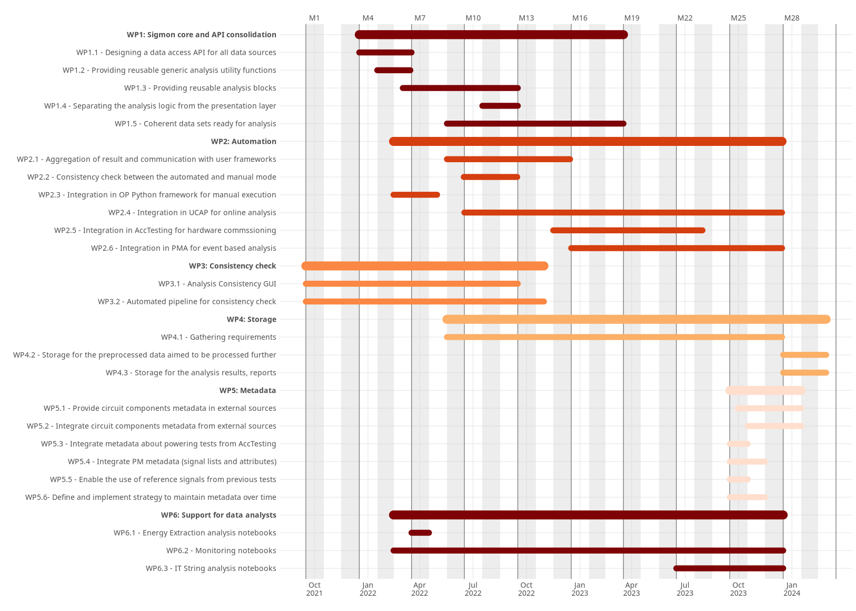
SIGMON roadmap and timeline
Consolidation of SIGMON core and API WP1: well advanced
  De-coupling of analysis notebook / script development from core;
  Enabling expert users to prepare SIGMON analysis tools with Python.
Automation of analysis WP2: started / exploratory phase
  Implement the transposition between notebook and scripts;
  Online and event based execution of SIGMON analysis tools (via UCAP or Post Mortem Analysis Framework [PMA]);
  Execution of SIGMON analysis tools in AccTesting.
Automated consistency checks WP3: proof of concept
  Validate SIGMON analysis tools for HWC with previous compains and their outcome.
Storage of analysis results WP4: not started
  From automated analyses;
  From manual/interactive analysis (notebooks)
Metadata WP5: not started
  Ensure coherent, up to date and versioned external data source with circuit and equipment configurations, components, non-conformities, reference tests etc. → layout database, controls configuration services, etc.
  Integrate metadate from the external data source in SIGMON.

Slide 9
Impact on BE-CEM and BE-CSS
Automation: implementation via UCAP or PMA in close collaboration with BE-CSS.
Metadata: integration of metadata source (layout database, CCS, etc.) via API into SIGMON in close collaboration with BE-CSS.
Transfer labVIEW analysis tools for HWC to SIGMON:
  Support from BE-CEM is required to implement the functionality of the existing automatic tools and validate the SIGMON implementation.
  Post Mortem Event Analyser (PMEA): with the above the PMEA will become obsolete. Is there any additional functionality which would need to be implemented in SIGMON or AccTesting?
Post Mortem Browser:
  SIGMON does not have a tool with a similar functionality like the PM Browser (manual analysis of signals in PM buffers, time alignment, reference signals etc) and MPE doesn’t plan to prepare one.
  Can the PM Browser be maintained for the longterm future or replaced by a similar tool by BE-CEM?

Slide 10
Summary
SIGMON has been extensively used during the HWC campaign 2021/22 by MP3.
Work is ongoing to extend the SIGMON functionalities and improve its maintainability for the future, requiring support by BE-CSS.
SIGMON will be complemented with tools for continuous monitoring of circuit operation and automated analysis, requiring support by BE-CSS.
MPE is planning to transfer all of its own legacy HWC analysis tools to SIGMON until end 2023 (eDSL, Java) → HWC after the YETS 2022/23 will depend on the current status quo.
Transfer from PMEA analysis tools to SIGMON requires the support from BE-CEM.
The PM browser or a tool with a similar functionality will be required for the longterm future under the responsibility of BE-CEM.

Slide 11
Discussion

