Slide 1

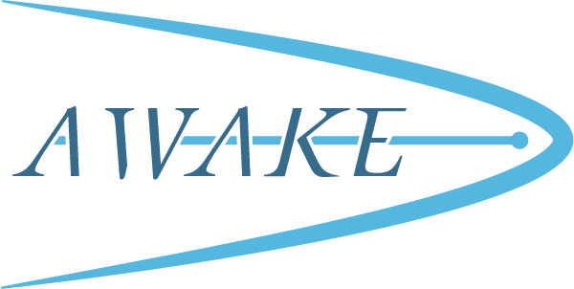


Design of the new 18 MeV electron line for AWAKE
V. Bencini, F. Velotti
ABT Engineering Forum
05/07/2022

Slide 2
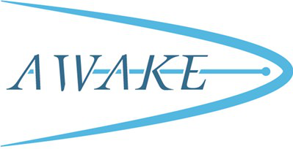
Layout constraints
Geometry constraints provided by Vincent Clerc
The design presents two 20 degrees bends (instead of 32 degrees as in the present design)
The purpose it to use all the elements presently installed on the existing injection line
Element | N
Quadrupoles | 11
Dipoles | 4
Correctors | 11
BTV | 6
BPM | 11
Courtesy of V. Clerc

Slide 3
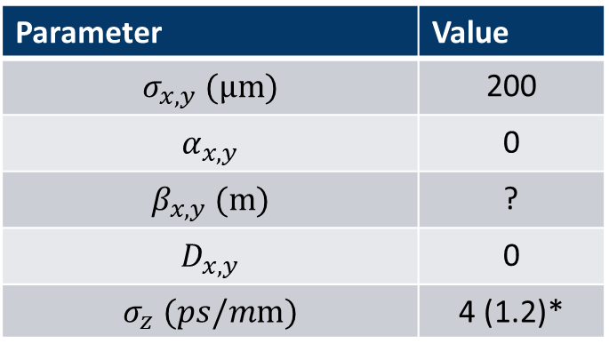
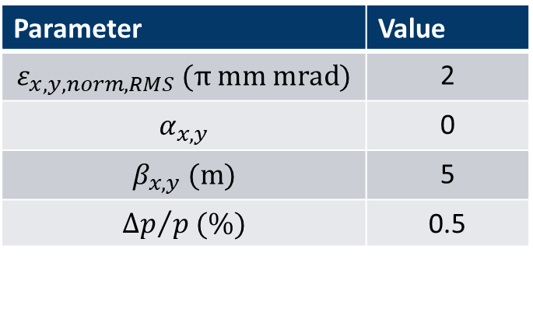
Beam constraints
Input beam
As beam input the same design parameters as the present line were considered (can be updated)
The output parameters were preliminarily discussed with Patric
* The bunch length was taken by the original design of the present line (https://accelconf.web.cern.ch/IPAC2015/papers/wepwa039.pdf)
Parameter | Value
$$ε_{x,y, norm, RMS} (π mm mrad)$$ | 2
$$α_{x,y}$$ | 0
$$β_{x,y} (m)$$ | 5
$${∆p}/{p (\%)}$$ | 0.5
Output beam
Parameter | Value
$$σ_{x,y} (μm)$$ | 200
$$α_{x,y}$$ | 0
$$β_{x,y} (m)$$ | ?
$$D_{x,y}$$ | 0
$$σ_{z} (ps/mm)$$ | 4 (1.2)*

Slide 4
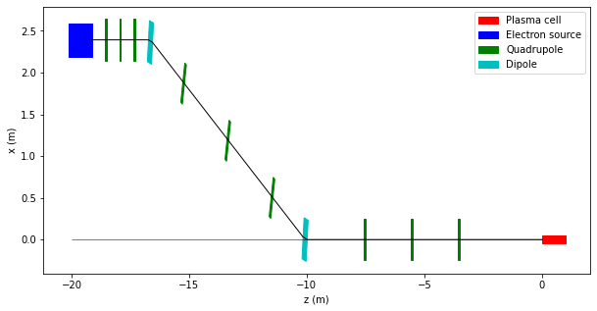
New design
The number of elements is lower than in the present line
It leaves spare elements that could be used in various ways (add an optics measurement line after the first dipole?)
For beam instrumentation:
  One BPM+corrector per quadrupole
  Two BPMs at 180 ph_adv at first dipole for momentum measurement
  …what else?
The first three quads in the line should be used to rematch the beam
Element | Old design | New deign
Quadrupoles | 11 | 9
Dipoles | 4 | 2
Correctors | 11 | 9 (min)
BTV | 6 | 6
BPM | 11 | 9 (min)
Matching
Dogleg
Common line

Slide 5
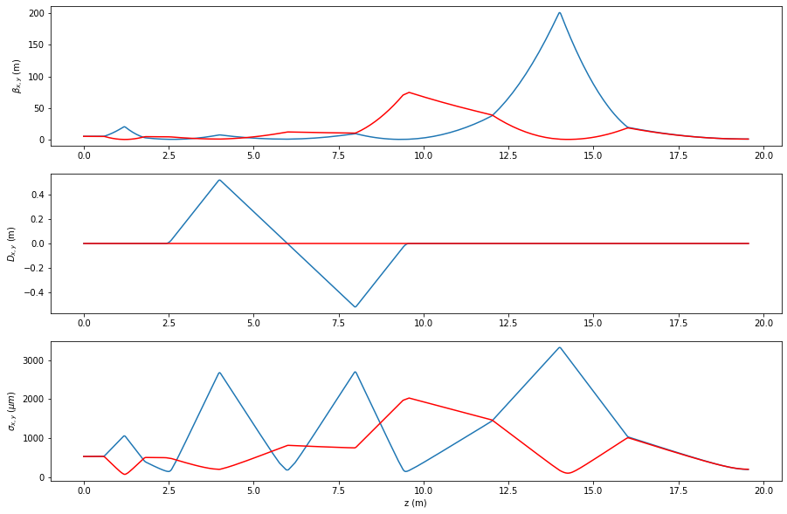
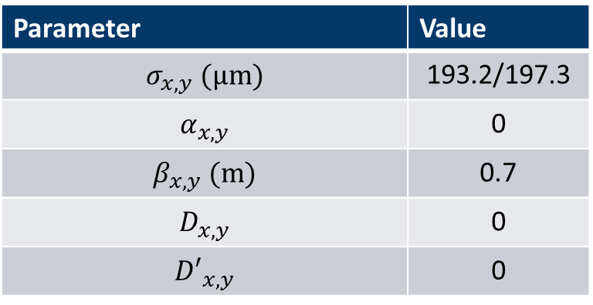
New optics
The required values can be reached
Symmetric dogleg for dispersion suppression
The aperture can be kept as it is (r=0.02m )
…any requirements?
Parameter | Value
$$σ_{x,y} (μm)$$ | 193.2/197.3
$$α_{x,y}$$ | 0
$$β_{x,y} (m)$$ | 0.7
$$D_{x,y}$$ | 0
$${D′}_{x,y}$$ | 0

Slide 6
Quick summary
Beam input and output parameters were considered to be as the one for the present 18 MeV line
Less quadrupoles and dipole are necessary for the new line
Bending only in x plane. Dispersion can be completely suppressed in both planes

Slide 7
For discussion
Optics and BI design
What are the requirements in term of optics?
  Stability and jitter
    Source
    Ripple in power converters
  Flexibility of the optics?
    Same beam size at different charges (charge range?)
    ....
Specific requirements for measurements
  Correctors hysteresis
Vacuum
  Requirements
  Costs

