Slide 1
HEP Benchmarking on HPC
David Southwick, Maria Girone, Eric Wulff, Eduard Cuba
In collaboration with HEPiX Benchmarking working group
Notes:
10 min talks
Industry focus/ benchmarking results
AI benchmark development, containerization, etc
Avoid complication w/sofia’s AI bmk work -> “WLCG is developing…
Add rest of teams

Slide 2
Background
Efficient exploitation of HPC resources presents unique challenges. Scaling workload execution adds layers of complexity not captured in traditional compute environments
Permissions:
  Environment (containerization helps)
  Monitoring (I/O, network, performance bottlenecks, etc)
Connectivity:
  isolated worker nodes
  site connectivity (big data ingress/egress)
To successfully exploit HPC resources we need to understand efficiency both in terms of compute and data access.

Slide 3
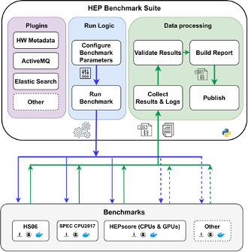
Context: Benchmarking at CERN
HEP Benchmark Suite: A benchmark orchestrator & reporting tool.
Executes an array of user-defined benchmarks & metadata collection
Refactored for HPC:
Minimal dependencies (Python3 + OCI container)
Automated result reporting (AMQ/Elastic)
Scheduler agnostic, unprivileged
Easily extendable to other sciences!
https://gitlab.cern.ch/hep-benchmarks/hep-benchmark-suite

Slide 4
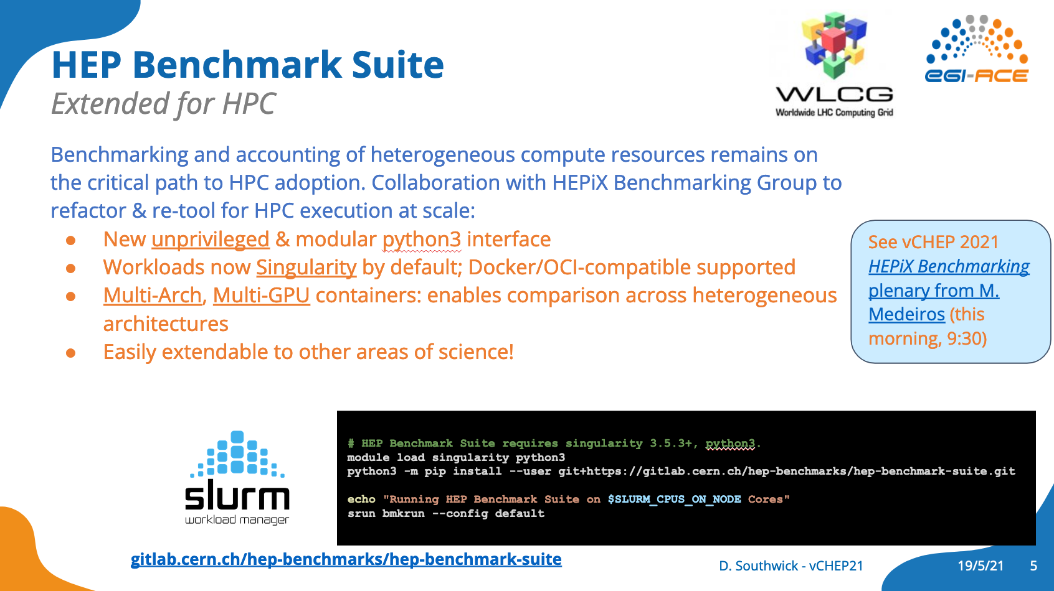
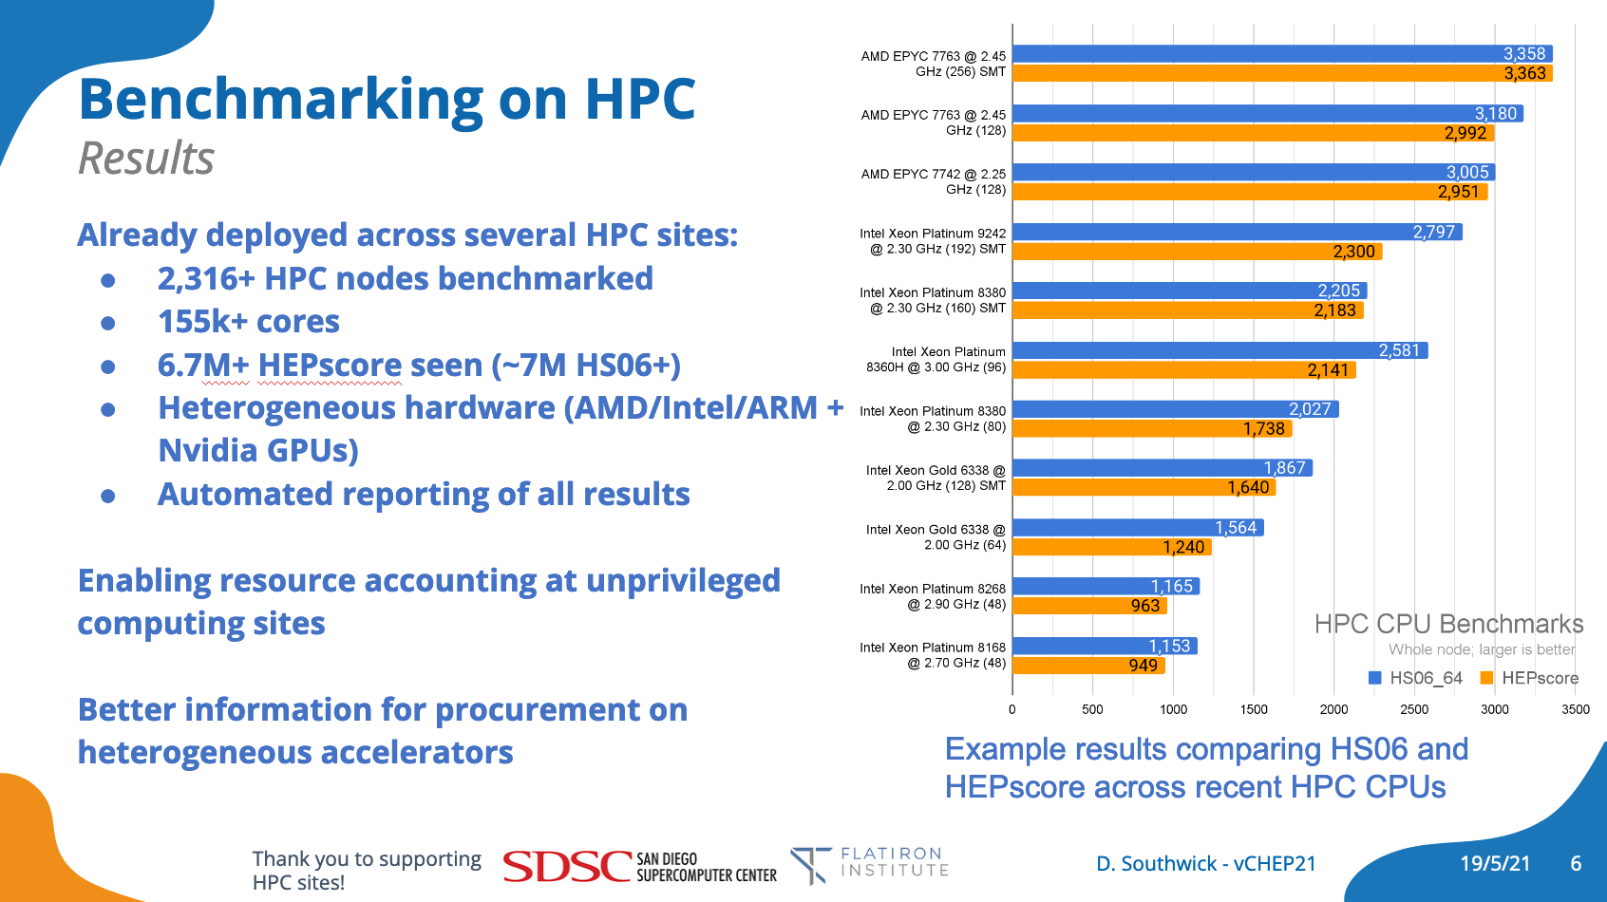
Successes at HPC centers
HEPscore (executed by the HEP-Benchmark-Suite) has already been used for large scale deployments and studies at HPC sites:
Initial experiences from vCHEP’21
200,000-core campaign with Run-2 production WLs
Scale studies of new/upcoming AMD cpus
See vCHEP’21 presentation for full details

Slide 5
What’s new?
First look of run3 workloads - many with heterogenous architectures!
First ARM, IBM POWER, GPU development workloads
GPU vs CPU vs GPU+CPU benchmarking studies
Heterogenous partition studies (ARM+GPU, POWER+GPU, etc)
ML / AI workload development (MPI scaled to ~200 GPUs)
Quality-of-Life updates:
Batch uploading (post-run: supports “secure” worker nodes)
GPU / accelerator meta-data inclusion
CVMFS-attached benchmarking campaigns
Typical HPC single node resources:
2x AMD EPYC: 256 threads
4x Nvidia V100: 20,480 cuda cores
4x Nvidia A100: 27,648 cuda cores
4x Nvidia H100: 67,584 cuda cores*
Thank you to all partner HPC sites enabling this work!
* https://www.nvidia.com/en-us/data-center

Slide 6
Conclusions
HEP already benchmarking on HPC in heterogeneous partitions
Automated reporting enables analysis for developers & operators
First ML/AI workloads as repeatable benchmark
  Containerized in similar manner to traditional CPU benchmarks
  Support (multi) GPU accelerators for training/tuning
  Examine events/second processed (same metric as HEPiX CPU jobs)
First benchmarks of HPC “support” services
  Characterize I/O requirements for generalized workflows
  Development work to increase granularity of characterization
  Automate profile generation (as much as reasonable)

Slide 7




Slide 8
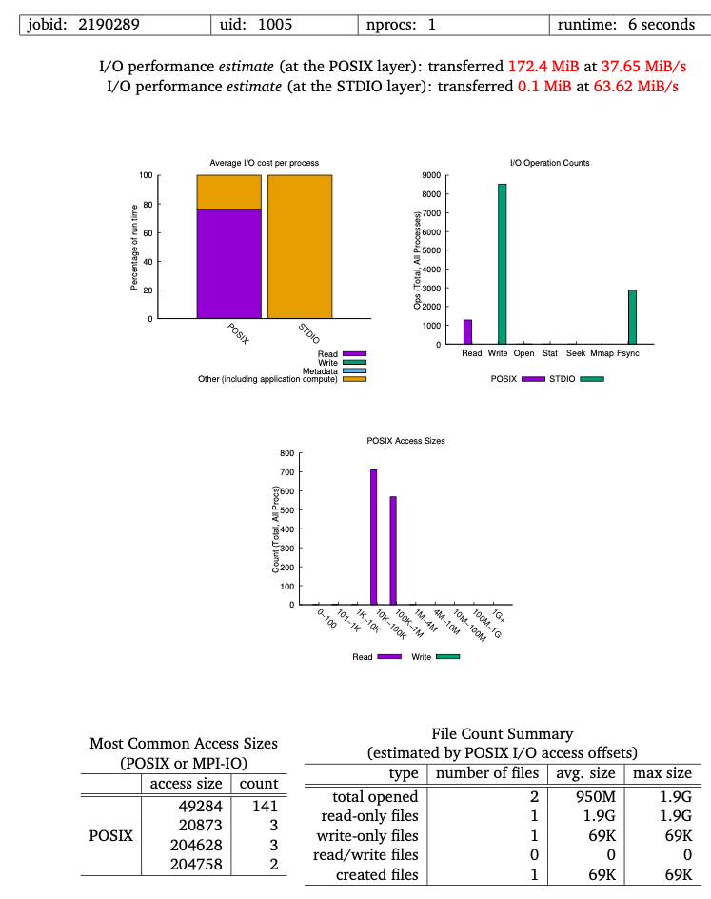
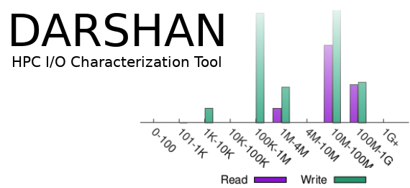
Workload I/O benchmark
Problem: Unclear how many data-driven workloads a given site may support without bottleneck shared resources
Development of a workload I/O benchmark
tune to the I/O patterns of real workloads to better inform reasonable scaling capabilities at a given HPC site
More representative than sequential throughput metrics
Uncover I/O bottlenecks (excessive file opens, read patterns, cache issues)
Under development
HPC workload
IoR
HPC benchmarks
https://github.com/hpc/ior
https://github.com/darshan-hpc/darshan

