Slide 1
Terraforming
Laura Wirtavuori & Catarina Batista

Slide 2
Why?
Thinking in planetary levels.
Understanding and working within complex systems.
Respecting planetary boundaries and constraints.
Finding resourceful and meaningful ways to create solutions.
Simplyfying complex systems.
Opportunity to challenge yourself and your team to take the time to reflect on a deeper level.
Exploring different ways to drive transformative innovation.

Slide 3
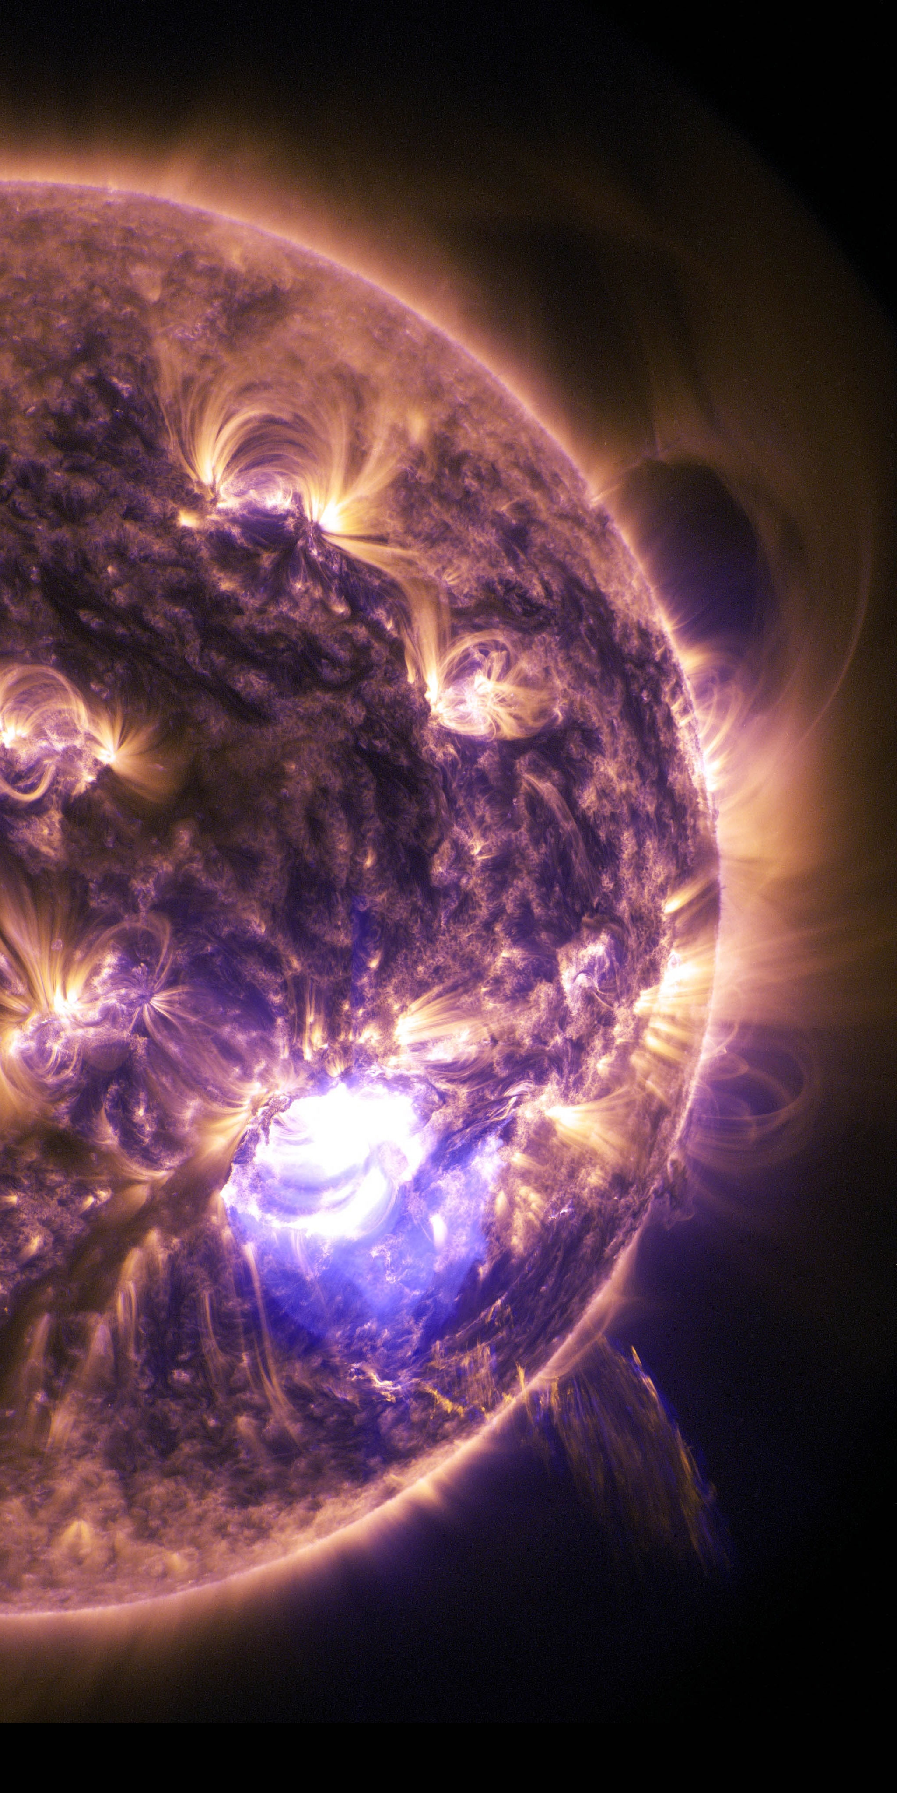
What?
You will be taken into an identified exoplanet to establish the very first settlement there.
Instructions about your first mission will be given soon.
Don’t worry about how you will get there, CERN is taking care of that for you.

Slide 4
How?
Systems and Futures | 35min
Settling in Planet X | 120min
Lunch | 90min (opportunity to visit the Globe)
Creating your constitution | 45min + 30min discussion
Break | 20 min
Mapping health on Planet X | 45min
Finding tensions and Planetary Insights | 15min
Wraping up and Reflection | 15min

Slide 5
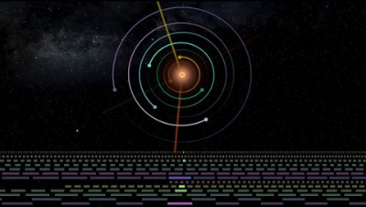

Slide 6
1. Settling in Planet X
Considering geological, atmospheric, economic, social, ethical and ecological aspects.
120min (until lunch)

Slide 7
How does Planet X look like?
What kind of geological and atmospheric elements exist?
How big is the gravity in this planet? Compared to Earth (1G).
What is the estimated surface temperature?
What are the resources available?
Who are the people you are choosing to bring with you (max. 100)? Why?
What kind of materials will you bring (max. 1000m3)? Why?
Please send your mission request and the assumptions you’ve made to exoplanet.settlement@cern.ch so it can be processed by the main ExoSB.
(120min)

Slide 8
How?
Creating your constitution | 40min + 20min discussion
Break | 15 min
Mapping health on Planet X | 40min
Finding tensions and Planetary Insights | 20min
Sharing | 15min
Wraping up and Reflection | 15min

Slide 9
2. Creating your constitution
What is the purpose of your society and what are the key principles to ensure a healthy settlement?

Slide 10
How will your settlement function?
What is classified as a healthy individual?
And a healthy community?
What are the key principles to ensure good health in your settlement?
What is the guiding purpose of this society?
How would you want to organise the group?
Consider social, ethical and environmental elements.
(40min)

Slide 11
2.Mapping Good Health on Planet X
Finding the systemic nature, what happens if we make these kinds of rules?
How do we treat the planetary limitations?

Slide 12
How does Good Health and Well-being look like in Planet X?
What could be the basic system to ensure your that your constitution is implemented?
What kind of stakeholders and intervenients are present?
How do the relationships and interconnections between them look like?
What are the inputs and outputs of the system?
Record for yourselves how you’re tweaking the system as you move along.
(40min)

Slide 13
Notes:
Singapore Gardens by the Bay – example of a complex man made eco-system

Slide 14
http://www.gardensbythebay.com.sg/en/the-gardens/sustainability-efforts.html
Notes:
Gardens by the bay – you take one element out of the system and the whole system will be impacted.
-> Include Pablo or Markus to make energy calculations

Slide 15
3. Finding tensions
Mapping pain points and their systemic connections. Crafting Planetary Insights.
Send them to exoplanet.settlement@cern.ch

Slide 16
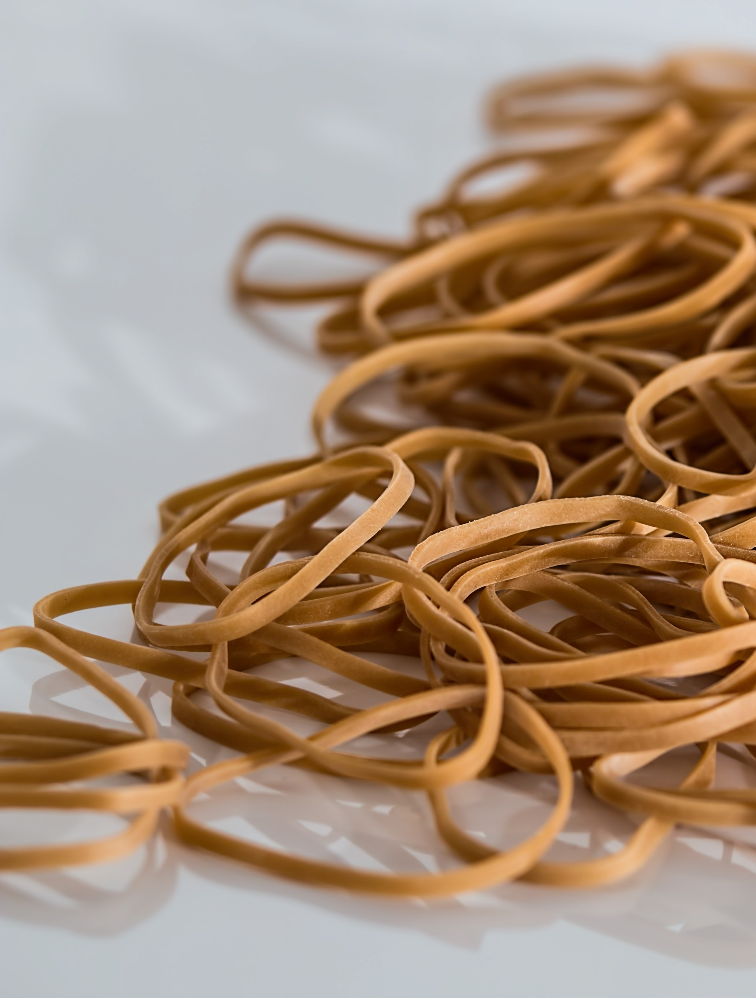
Where are the tensions in your system?
Look at your health map and reflect on it:
Are your constitution principles reflected?
Are any of them violated?
What are some of the pitfalls?
Are there any unintended consequences?
How are you respecting resource balance (inputs and outputs).

Slide 17
Example of reflections
How to ensure that everyone gets quality education?
How to ensure equality through education?
There is so much to learn, what should be taught to everyone and what should be specialization?
How do we ensure lifelong learning?
How might we ensure there are enough pedagogically skilled teachers?
How might we make education engaging?

Slide 18
How might we…?
Think about the challenges you identified in your system.
Brainstorm them in your groups and document them (sticky notes, whiteboards…)
Write them in the form of “How might we…“ questions.
These questions help us identify opportunities for design and should be broad enough to allow us to explore multiple solutions.

Slide 19
Example
How might we ensure that everyone gets the same necessary skills to become actively contributing members of society?
  How might we make education engaging?
  How might we ensure access to education throughout a human’s life?
    Ability to go get the education
    Availability of education

Slide 20

Document your Planetary Insights
Collect the tensions you identified and how you transformed them into “How might we” questions.
This might provide you some insight on how these tensions might also be relatable to planet Earth.
(20 min)
Notes:
(If we have time, we could move into ideation and prototyping)

Slide 21
Thank you!

