Slide 1
Cable Stack Compression:
DIC Observation
Óscar Sacristán

Slide 2
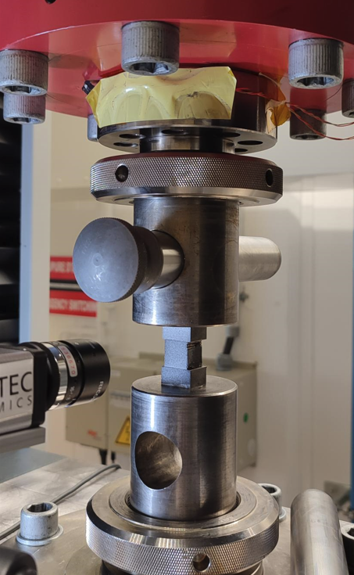
Experimental Set Up
Zwick/Roell Z400 universal testing machine with a Class 0.5 400 kN load-cell
DANTEC Q400 3D Digital Image Correlation (DIC)
  Cameras: 1x Manta MG-505B (2D)
  Resolution: 2452*2056 pixels
  Lenses: Ricoh FL-CC5028-5M with 5 m extension tubes
  Focal Length: 28 mm
  Aperture: f8
  Field of View: ≈ 20*20 mm
  Facet size: 17 pixel
  Grid Spacing: 13 pixel (42% overlap)
  Sampling Frequency: 1 Hz
Load-train as depicted in left figure
  Absence of rotule in the compression fixture
  Non controlled planarity of the planarity and roughness of the bearing surfaces
  This hinders the validity of the results, which represent a qualitative indication of the behavior of the system
Test protocol
  5 MPa Preload → Ramp to 120 MPa at 3 MPa/s →120 MPa Hold 10 s → Ramp to 5 MPa at 3 MPa/s
  All the colormaps in the next slides depict the situation at 120 MPa hold
Tested material
  Cable stack as described in EDMS 1851937
Load train used during the test

Slide 3
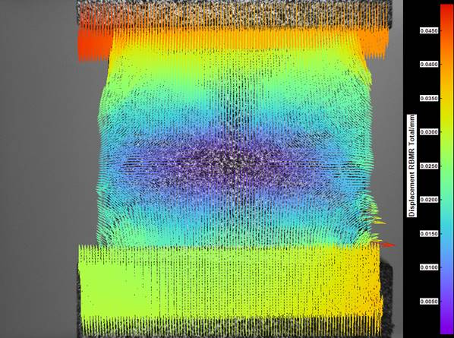
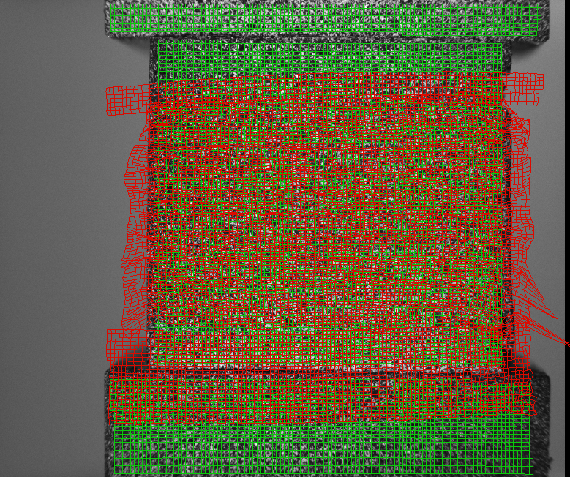
Results
Displacement Quiver Rigid Body Motion Removed (RBMR)
Displacement Grid (x80)

Slide 4
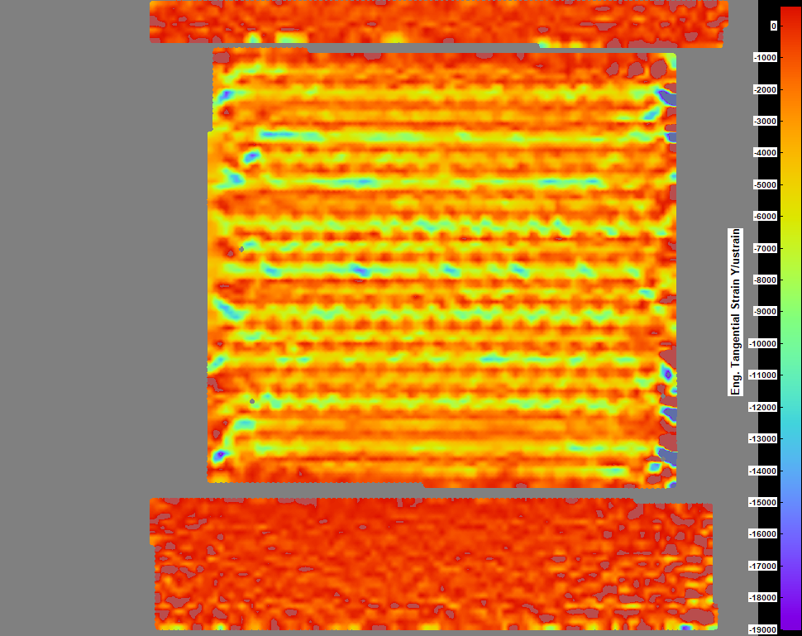
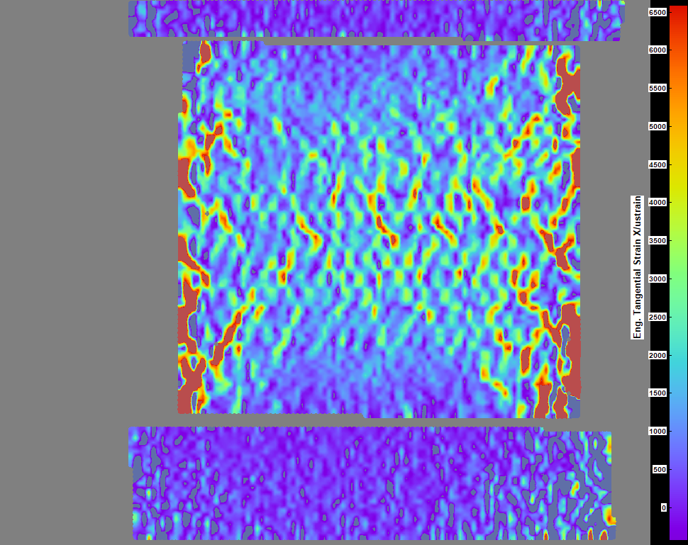
Results
Y Normal Strain
X Normal Strain

Slide 5
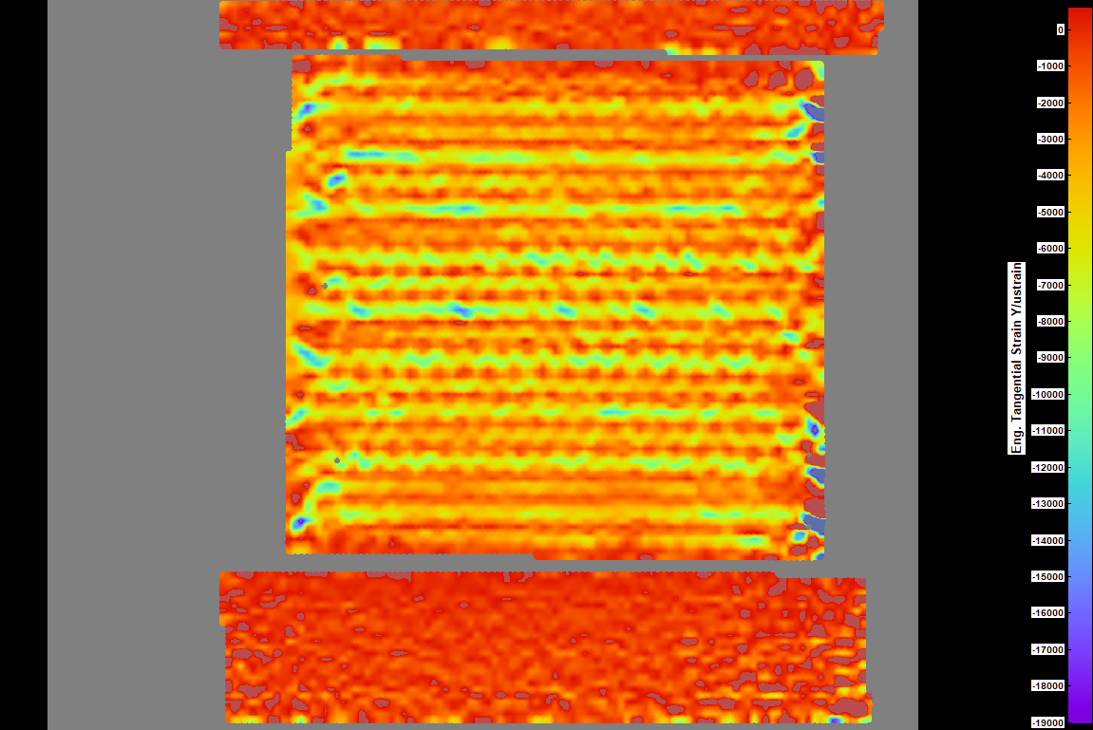
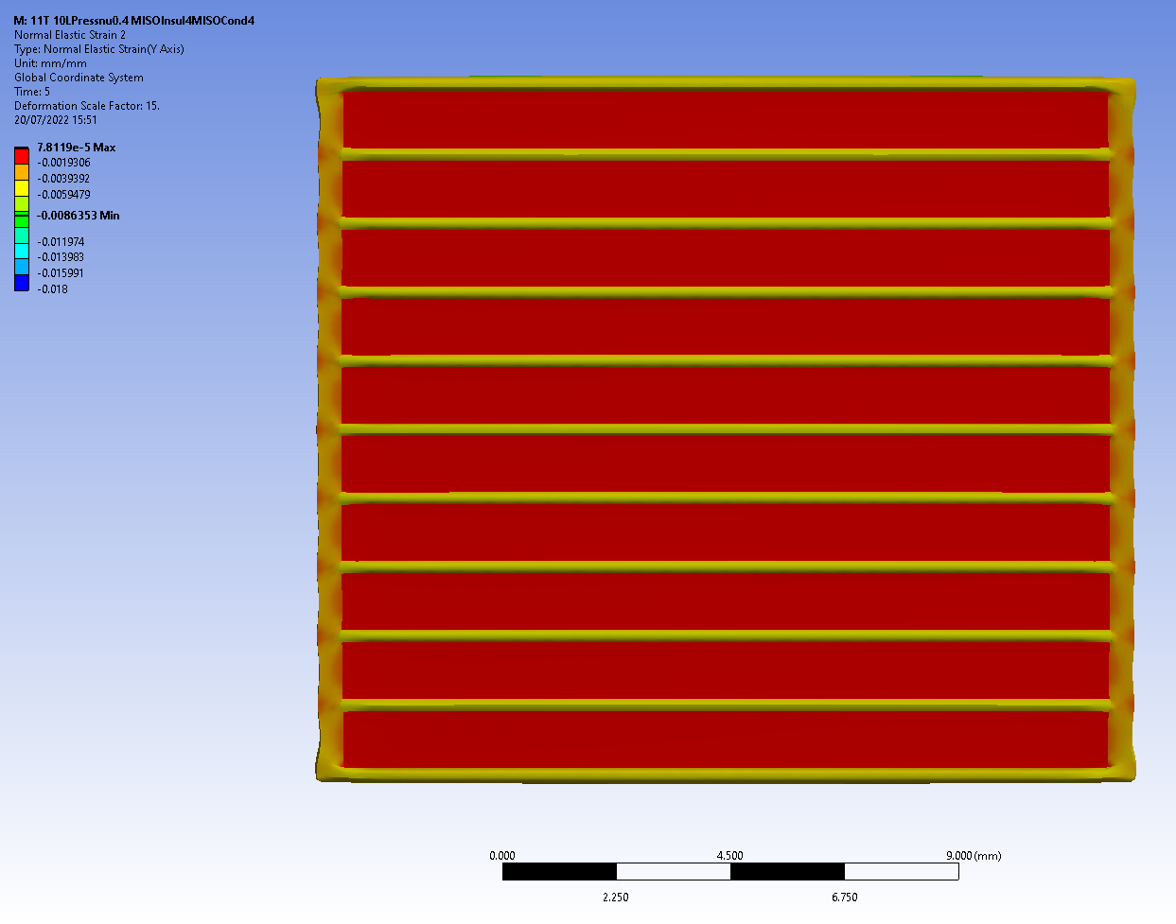
Results
Y Normal Strain (Measurement)
Y Normal Strain (FEM)

Slide 6
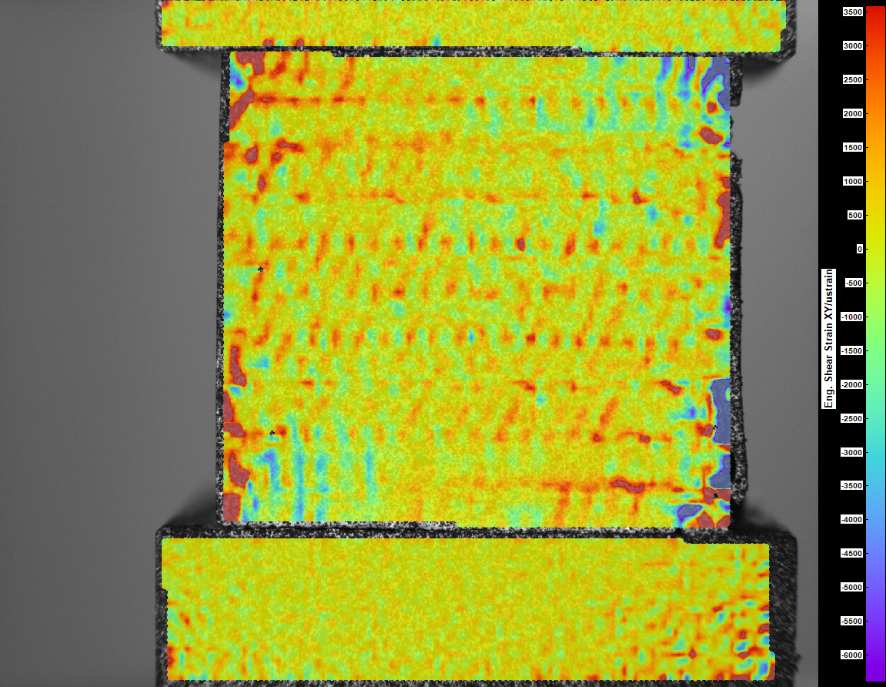
Results
Conclusions
XY Shear Strain
Despite the deficiencies in the test set-up, feasibility of the study of the strain distribution inside the coils with this technique is demonstrated
The the obtained data match reasonably well models developed under 11T mock up study
A quantitative assessment of the behavior demands the manufacturing of a dedicated set-up, better preparation, etc.
In weeks time we will gain in special resolution with more adequate lenses

Slide 7
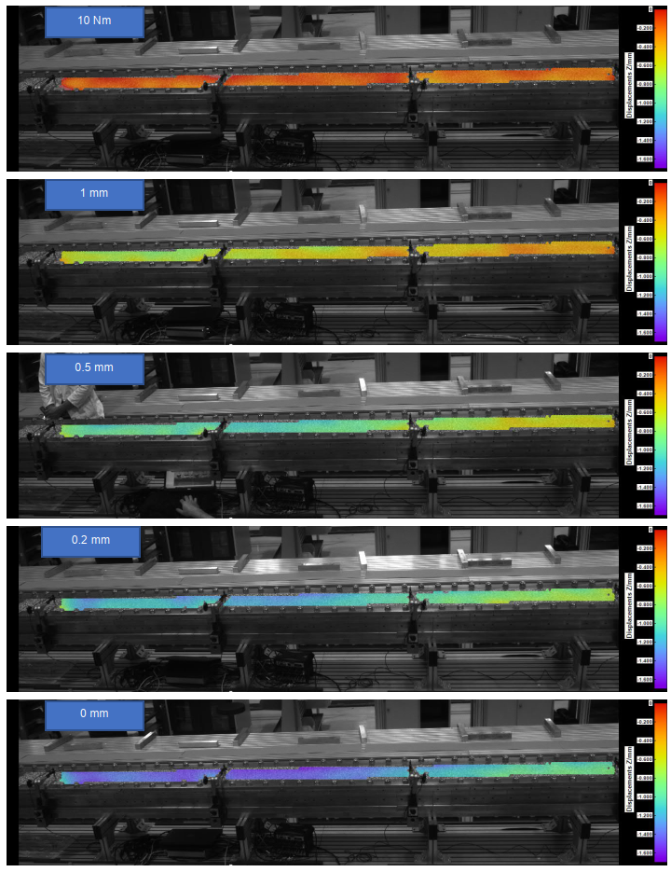
Additional Discussion on Coils Reaction/Impregnation
The laboratory has been recently consulted about the coil reaction and impregnation procedures (e.g. EDMS 2723774)
There are existing competences in thermal analysis in the lab that could help understanding those procedures
A few proposals are presented in the next slides
EDMS 2723774

Slide 8
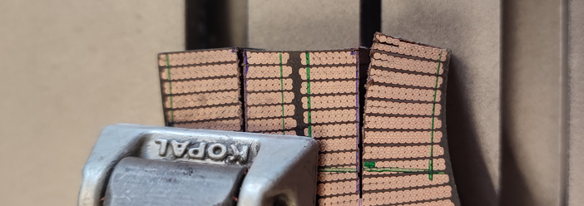
Improving Coil Reaction-Impregnation Understanding
Viscous Liquid
Viscoelastic Solid
Elastic Solid
Cable Reaction
Cable Expansion
Resin Thermal Expansion/Contraction
Resin Conversion Shrinkage
during the reaction phase, the thermal and chemical-induced strains can induce distortions in the cable geometry
during the impregnation process, the polymer matrix exhibits viscoelastic behaviour, thermal expansion, and conversion-induced shrinkage which might develop residual stresses, leading to significant distortion in the final part
it would be necessary to quantify the residual stresses and deformations induced by the manufacturing, especially to interactions between the tooling and the often complex material arrangement
this is a multi-faceted problem to be addressed by pooling expertise in physical modelling, polymer science, thermo-mechanical analysis, etc.
Notes:
Overestimation of the residual stress induced during the process can be eliminated only by considering the actual value of viscoelastic modulus evaluated at intermediate degrees of chemical conversion
Modelling of the modulus evolution is necessary for the analysis of both mechanical and non-mechanical loads developed during the manufacturing process, due to interactions between the tooling and the often complex material arrangement

Slide 9
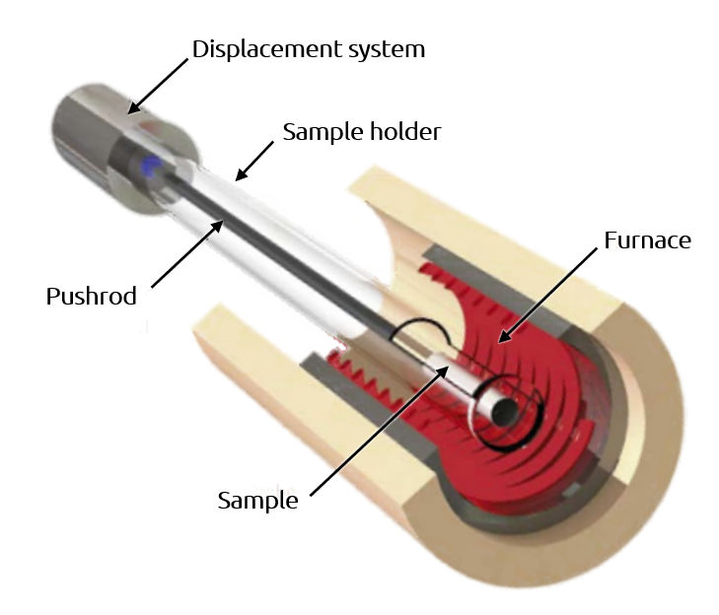
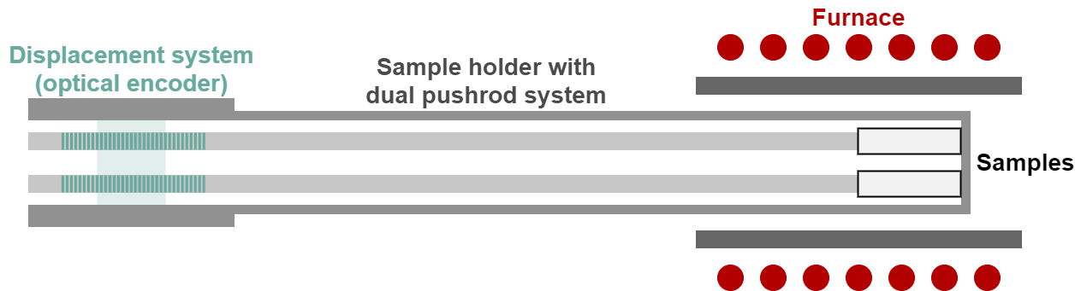
Inputs from Thermal-Analysis
Cable Reaction
Study of the volumetric changes in the cable
Horizontal pushrod dilatometry
Excellent control of temperature profile
Volumetric changes during reaction process
and subsequent cool-down to room temperature
Axial Configuration
Radial Configuration
Notes:
Resin shrinkage
CTE of the resin, and the un-reacted
and reacted strands
Viscoelastic Modulus

Slide 10
Inputs from Thermal-Analysis
Coil Impregnation
Study of the resin conversion-induced shrinkage + subsequent thermal contraction
Wide variety of methods available [Nawab2019]
Mandatory to fully understand beforehand the curing process of the resin (thorough DSC study)
Dilatometry of partially cured samples [Zarelli2008]
Dilatometry/TMA of sandwiched resin [Yu2005]
Dilatometry from liquid inside a container
Most practical from the thermal analysis point of view
Feasibility of the production of the samples to be confirmed
Needs absolutely to be paired with DSC measurements of the curing degree
Resin analysis from virgin state
A few milligrams of resin. Sensibility?
Completely novel approach
Use of a demoulding agent to prevent sample/container bond
Friction issues?
Al2O3 Slides
Adjusted Contact
Pushrod
Pushrod
Resin
Container
Notes:
Resin shrinkage
CTE of the resin, and the un-reacted
and reacted strands
Viscoelastic Modulus

Slide 11
Conclusions and Next Steps
Reaction + impregnation processes are very complex processes to understand and model
This presentation proposes a few actions from the thermal analysis standpoint to gain knowledge in the short term
Modelling the process in order to gain a comprehensive understanding of it demands pooling expertise in physical modelling, polymer science, thermo-mechanical analysis as well as the determination of other more advanced properties
This next step would necessarily involve a thorough study on testing methods in order to guarantee useful results
Mechanical properties of the strand as a function of the temperature
Complex modulus as a function of transformation of the resin
etc
Notes:
Mechanical properties of the strand as a function of the temperature
Complex modulus as a function of transformation of the resin

