Slide 2
MSC-MME Collaborative work on materials characterization
07/05/2022 - Introductory meeting

Slide 3
Concerns in the mechanical design (currently)

Slide 4
Mechanical Characterization of Nb₃Sn
Collared vs B&K structures
Behavior at interfaces
Instrumentation form design phase
Nb₃Sn magnets design
Modeling techniques in FEA
Geometrical interferences
Insulations & Epoxy resins
Stress Limits & Degradation

Slide 5
What we could tackle

Slide 6
First phase
Mechanical Characterization of Nb₃Sn
Collared vs B&K structures
Behaviour at interfaces
Instrumentation form design phase
Nb₃Sn magnets design
Modeling techniques in FEA
Geometrical interferences
Insulations & Epoxy resins
Stress Limits & Degradation

Slide 7
First phase
Mechanical characterization of Nb₃Sn
  Material vs structural effect;
  Stress-strain curves at cold;
  CTEs;
Behaviour at interfaces
  Investigation at impregnated regions (cable to wedge);
  Effect of surface irregularities;
  Effect of medium materials;
Modelling techniques in FEA
  Definition of adequate material models in 2D and 3D (RT and cold).

Slide 8
Second phase
Mechanical Characterization of Nb₃Sn
Collared vs B&K structures
Behaviour at interfaces
Instrumentation form design phase
Nb₃Sn magnets design
Modeling techniques in FEA
Geometrical interferences
Insulations & Epoxy resins
Stress Limits & Degradation

Slide 9
Second phase
Stress limits and degradation
  Identification of a proper failure criterion for impregnated cable stacks;
Insulation and epoxy resins
  Effect of different insulation materials and resins on the stress-strain curves, as well as stress limits;
Instrumentation from the design phase
  Identify a suitable instrumentation scheme to apply already on mock-ups.

Slide 10
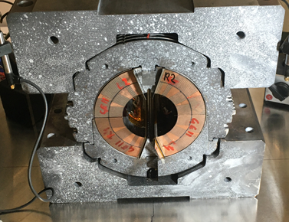
Mock-up campaign
Key insertion and behavior during transition at cold;
New mock-up campaign for 12 T robust

Slide 11
