Slide 1
Investigation and Considerations about Option #2
(install SuperFGD in ND280 w/o HA-TPC’s:
Install SFGD in ND280 – uninstall it – install Bottom TPC – install SFGD in ND280 again)

Slide 2
Option #2: considerations from WG1
Comments from Franck
To be considered the cabling/uncabling work
  not a big issue for SFGD (C.Mauger - Electronics WG)
  more complicated for ToF detector because it’s more fragile and has a lot of cables to be plugged (F.Cadoux)
It may be considered to install SFGD w/ partial ToF installation, i.e. that does not need to be removed later for Bottom-TPC installation
Be careful to avoid shocks - Typical risk during detector installation

Slide 3
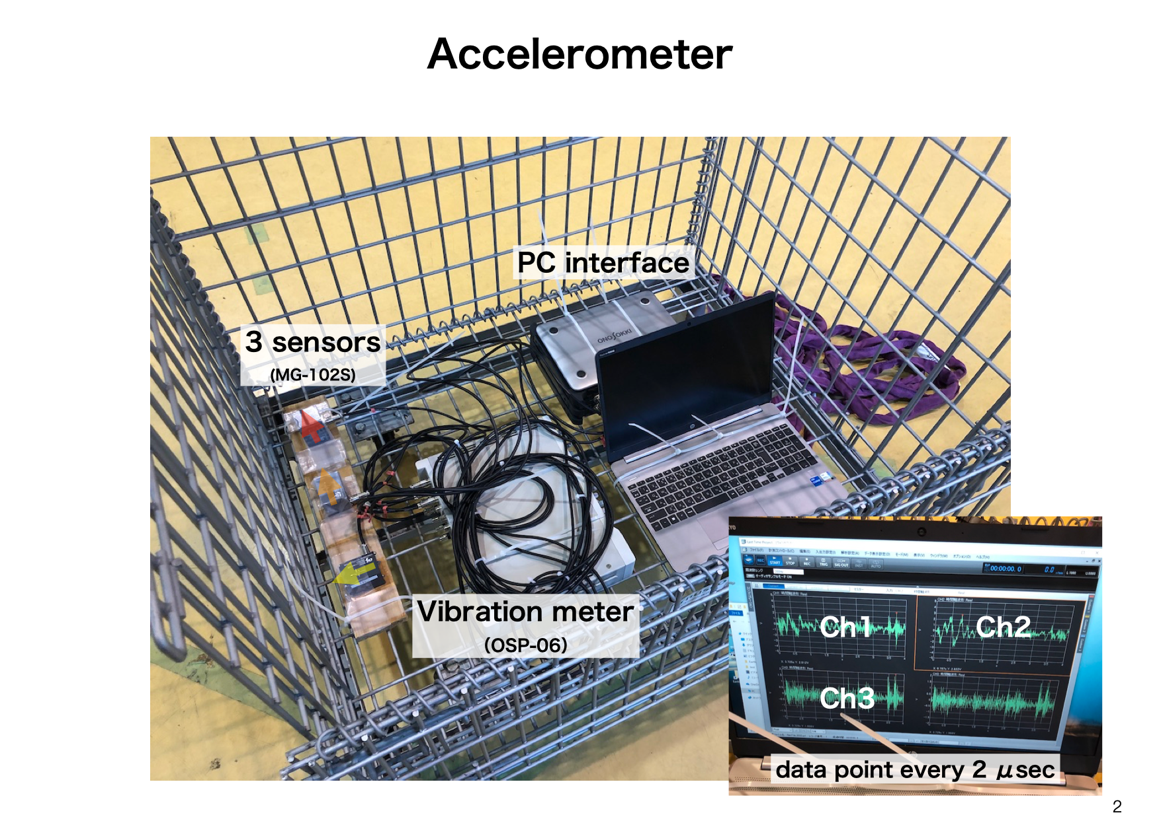
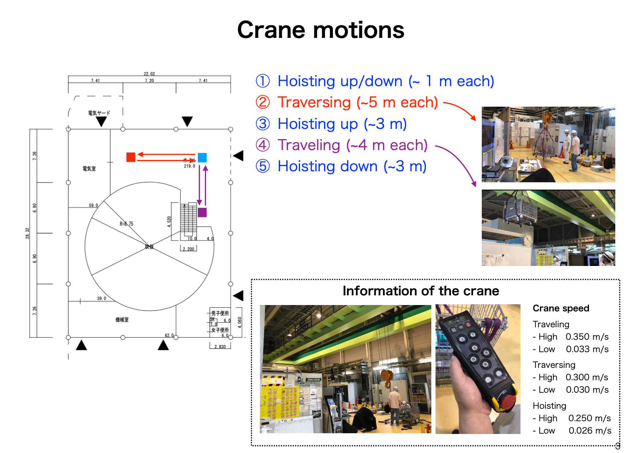
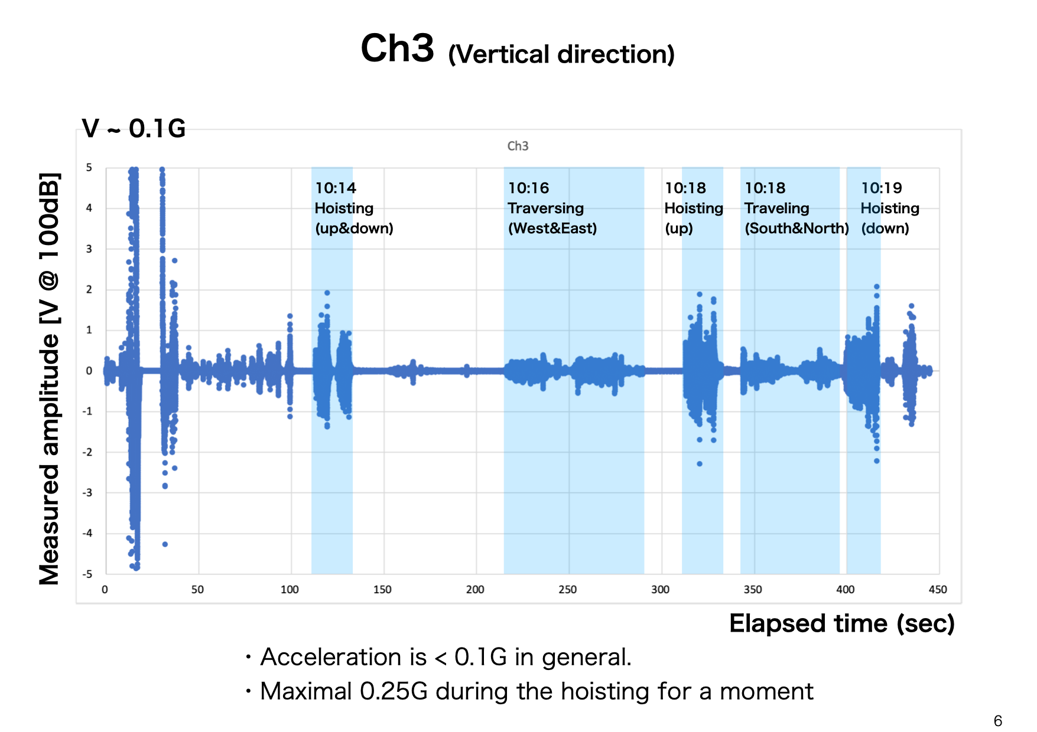
Summary: Risk assessment of the crane acceleration in the lifting
・Acceleration measurement of the crane at the NM building were performed to evaluate the risk in the lifting detector.
・Comparable with the general standard value of 0.1G in every direction.
・Lower acceleration than the seismic standard of 0.65G is confirmed.
→ Relatively small risk w.r.t. the requirement for an earthquake.
・Other risk mitigations under discussion
・A guide to the basket during the detector installation
・Transportation between buildings (NA → NM)

Slide 4
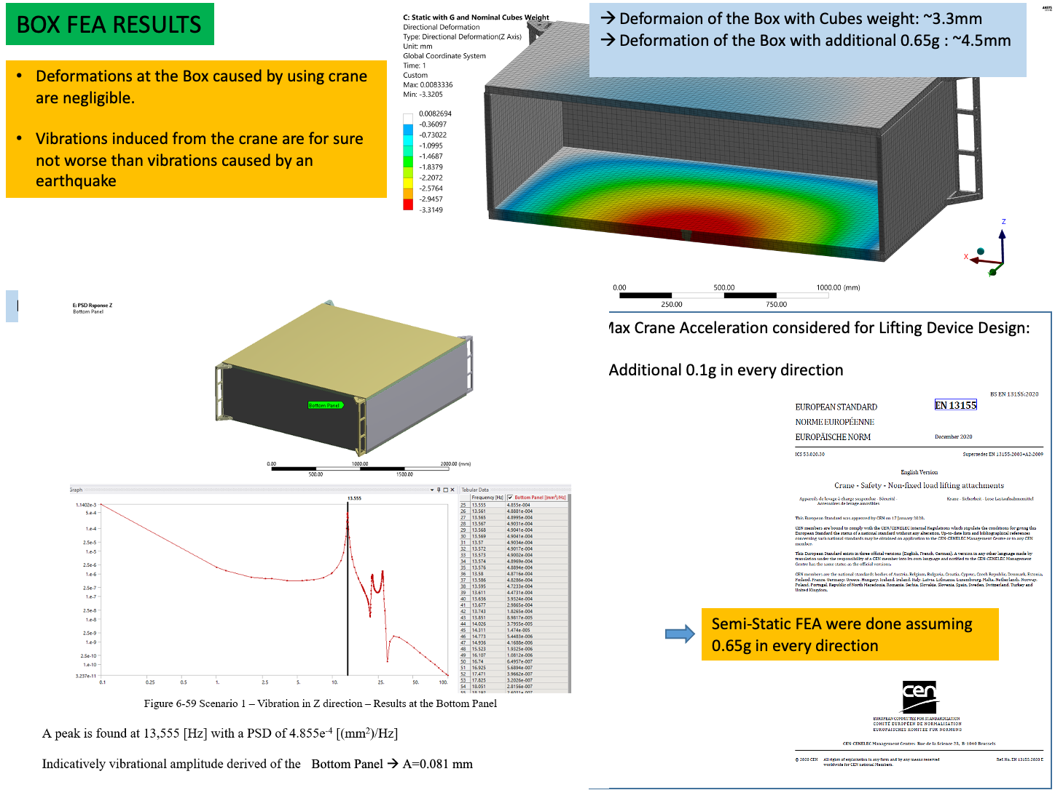
Considerations from Mechanics WG
A.Gendotti

Slide 5
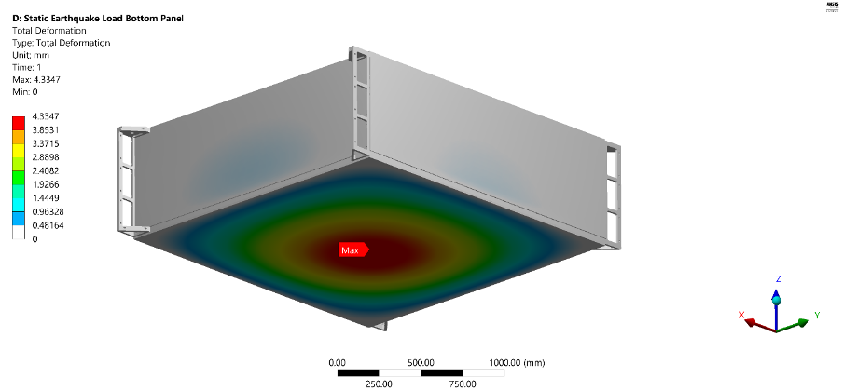
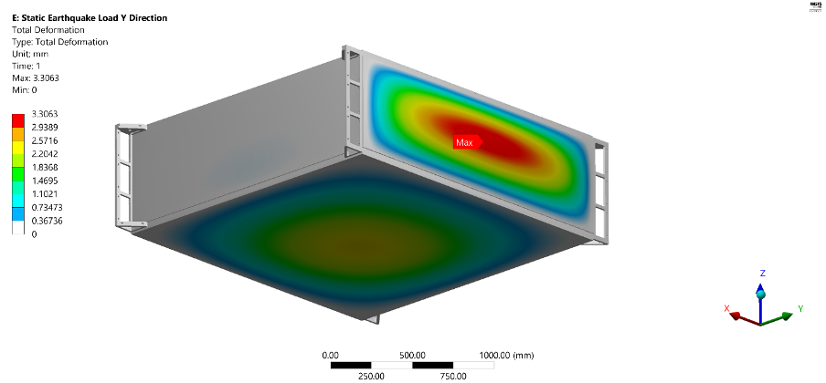
Considerations from Mechanics WG
A.Gendotti
Static FEA analysis (worst-case scenario): all cubes move together along the same direction. Very unlikely
1 G along Z (gravity)
Max deformation ~2.6mm bottom panel, smooth
1.65G along Z (gravity + earthquake)
Max deformation ~4.3mm bottom panel, smooth
Near the box holes the deformation is almost 0
Still 1G along Z (gravity) and 0.65G along Y
No change on bottom panel deformation.
Max ~3mm side panel deformation but smooth
Near the box holes the deformation is almost 0
Important consideration: the FEA static shows the worst-case scenario to be considered as a safety margin that the target (5mm max deformation) is achieved

Slide 6
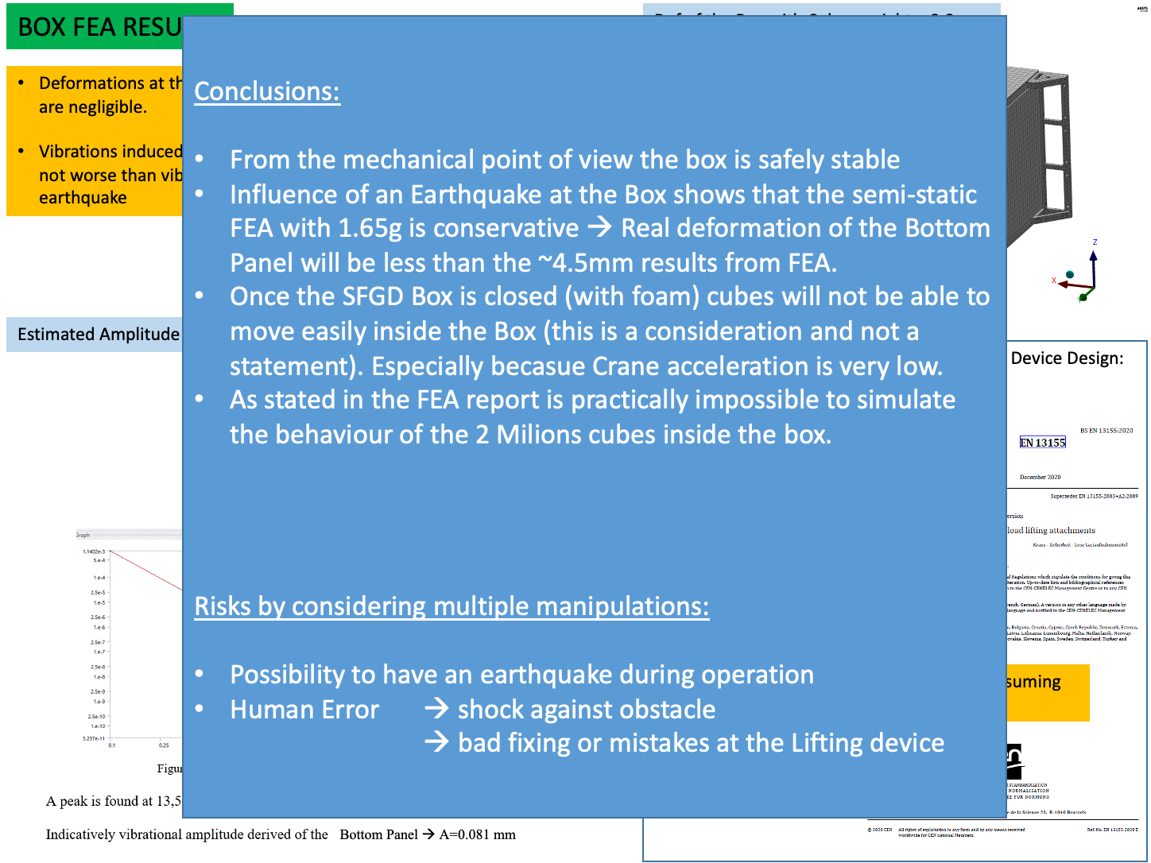
Considerations from Mechanics WG
A.Gendotti

Slide 7
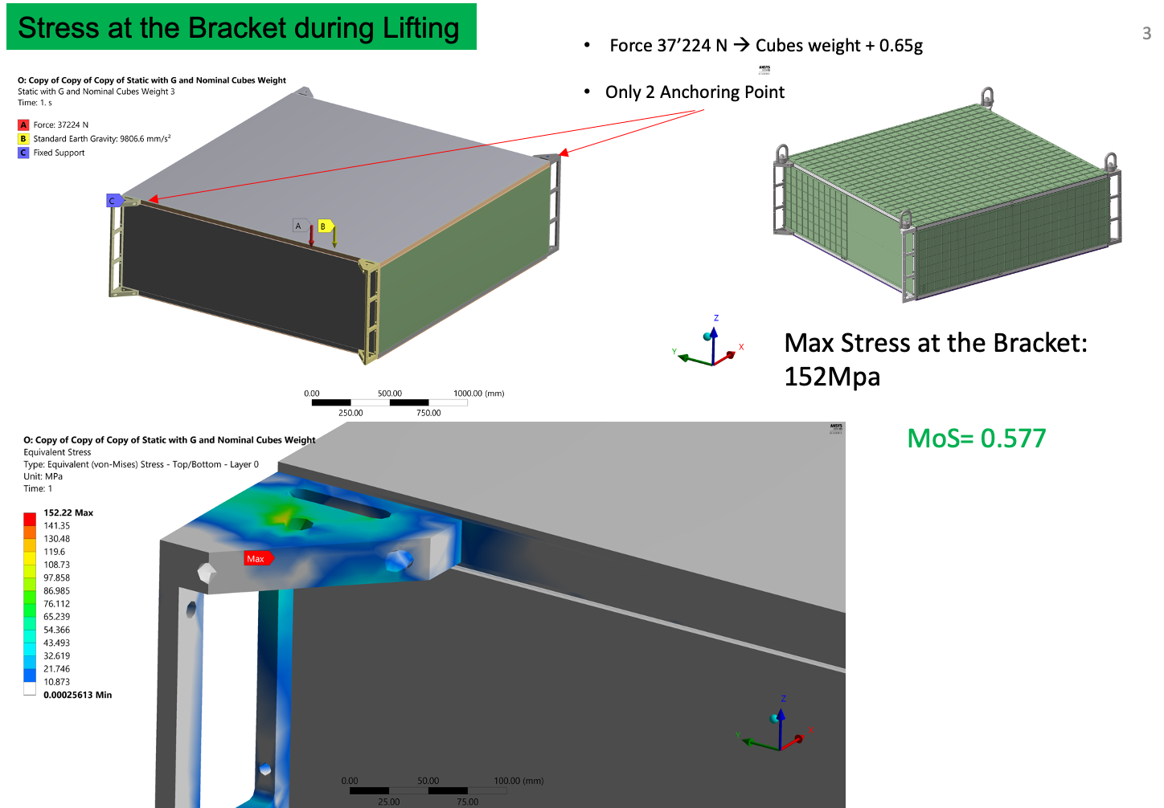
Considerations from Mechanics WG
A.Gendotti
The static FEA were done by applying the acceleration also to the side panels of 0.65G. Irrelevant the impact of the slightly different boundary conditions between lifting and basket (e.g. 2 vs 8 anchoring points), also given the fact that the static FEA is the very worst-case scenario, very unlikely to happen

Slide 8
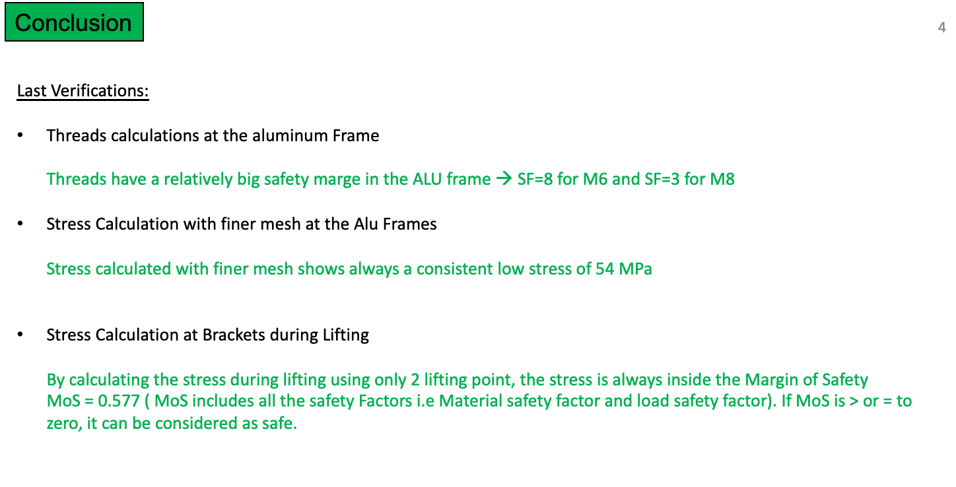
Considerations from Mechanics WG
A.Gendotti

Slide 9
Considerations from Mechanics WG
Considerations from Mechanics WG
No major problems about mechanics and sagging
Hard to say what happens about fibers inside the box as it can’t be modeled. In general, people don’t very worried about breaking fibers during the lifting
  very low crane acceleration
  conservative assumptions made about cubes in the FEA model (cubes are strong and when pressed it will be a rigid body)
  However, it’s not possible to make a precise model of cubes+fibers inside the box
Overall, the box design was done to be safe for earthquake with minimal deformation. However, it’s not possible to model fiber+cube inside box, so there could be other boundary conditions (displacement of cubes from vibrations, variation of size and hole position of the cubes, etc.) that can’t be taken into account precisely.

Slide 10
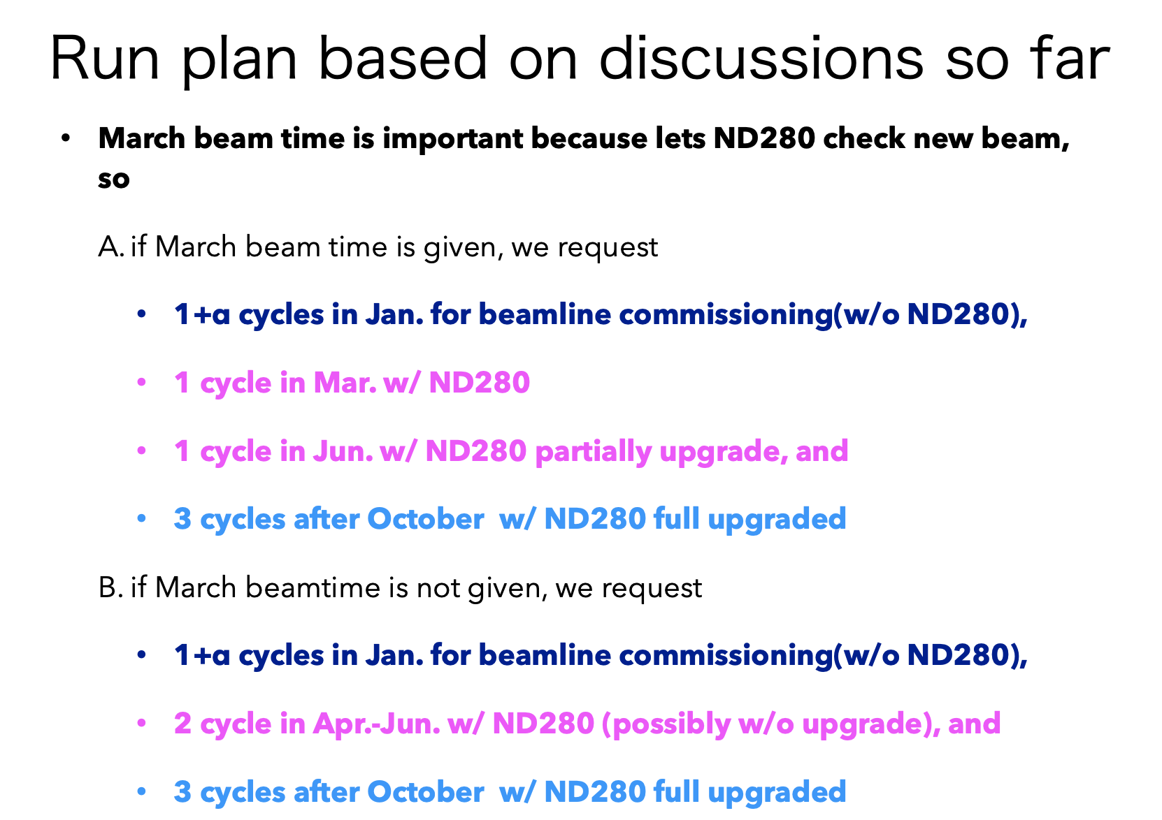
Run Plan JFY2022-2023 - (K.Sakashita-san @T2K bi-weekly 21/7/22)

