Slide 1

September 2016-October 2018
Supporting the new initiatives of CNAO and AVO-ADAM
30th anniversary of the TERA Foundation
15 September 2022
A. Garonna on behalf of the TERA technical team at CERN
Notes:
Disclaimer: please excuse the omissions (PHILA, PERLA, Centro Radiofarmacia, BISE2, etc) due to shortness of presentation and intent not to duplicate content presented by others

Slide 2
What brought me to TERA? 2007-2011

Slide 3
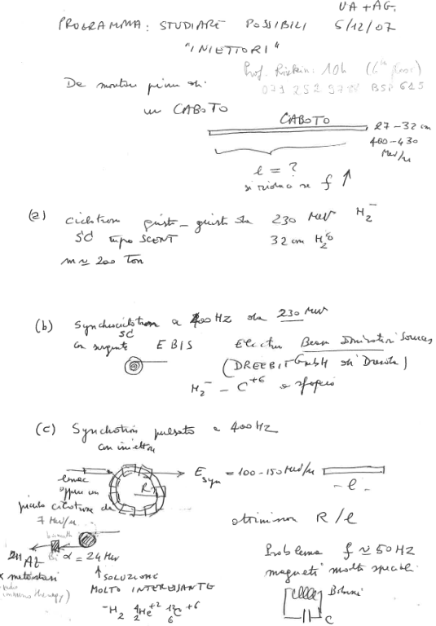
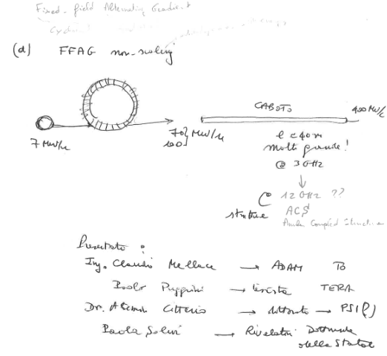
What brought me to TERA? 2007-2011

Slide 4
The technical team in 2016-2018 (1/2)

Slide 5
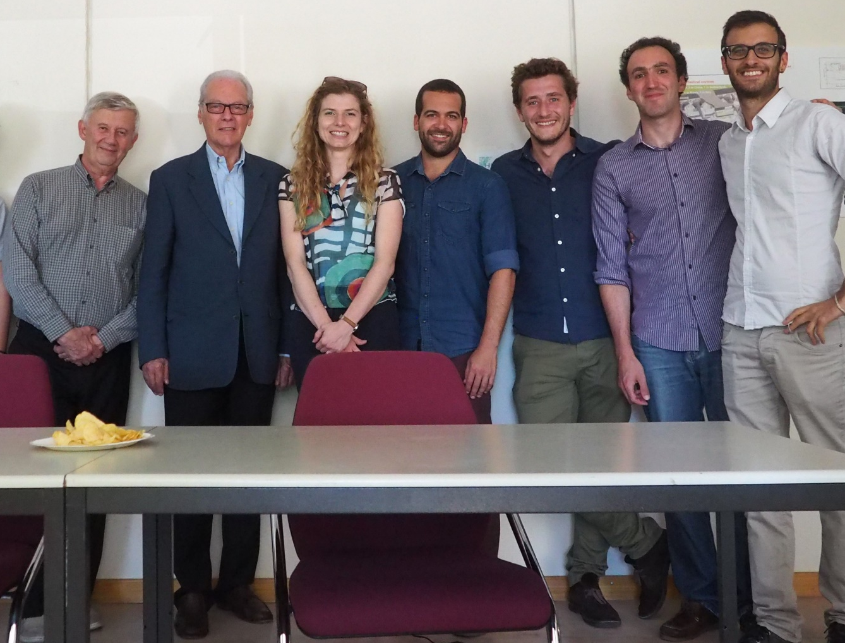
The technical team in 2016-2018 (1/2)
Left to right: G. Molinari, U. Amaldi, C. Cuccagna, P. Carrio Perez, V. Bencini, myself, E. Felcini

Slide 6
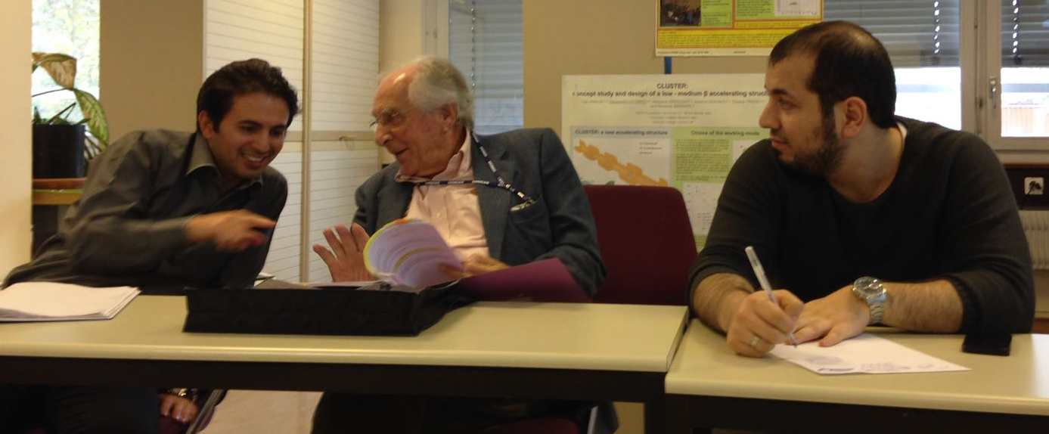
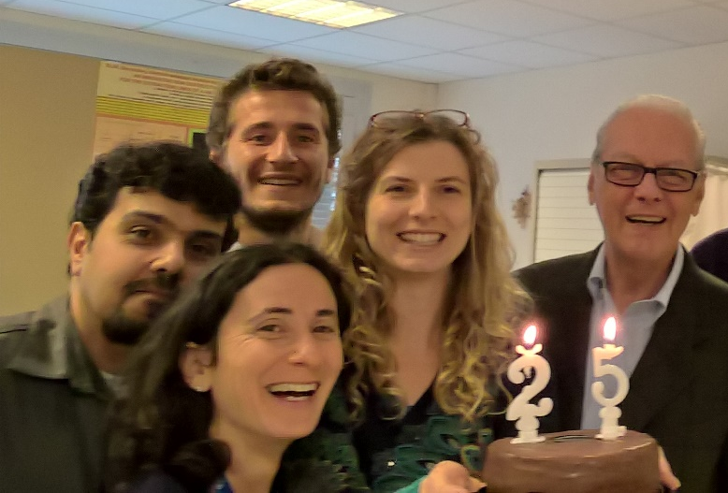



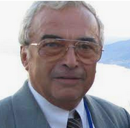
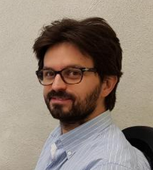
The technical team in 2016-2018 (2/2)
Left to right: M. Varasteh, P. Riboni, M. Vaziri,
Left to right: N. Alharbi, S. Allegretti, P. Pearce
E. Benedetto, D. Arlunno, V. Ljubicic, R. Maccaferri, D. Bergesio

Slide 7
CNAO Expansion

Slide 8
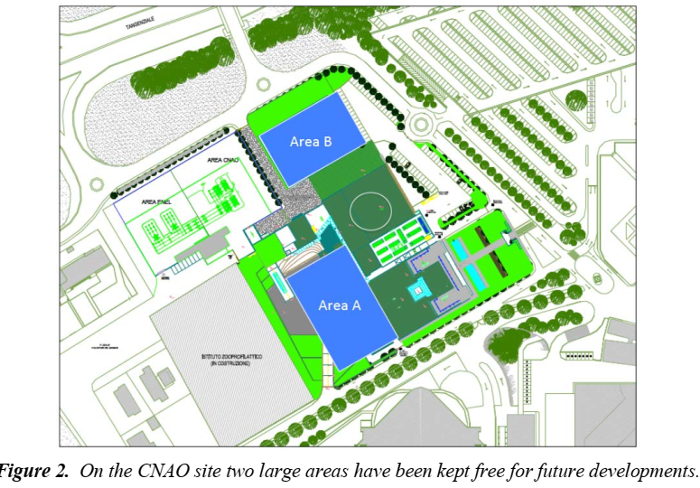
CNAO Expansion

Slide 9
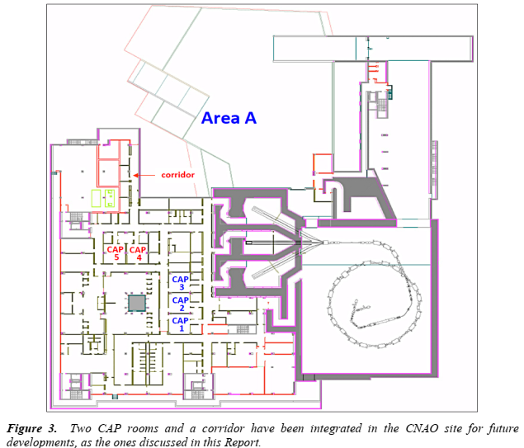
Area A
Two single-room facilities
Comparison of technical specifications from VARIAN ProBeam, Mevion S250i, IBA ProteusONE, Protom Radiance330
Carbon Ion gantry
Comparison of technical specifications of the carbon ion gantries from HIT, NIRS, Riesenrad (design), FFAG (design) along with an analysis of the relevant innovations in field
For each vendor and C-gantry, a proposal of the new facility layout was made

Slide 10
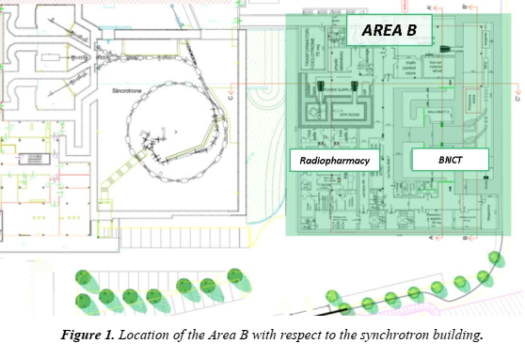
Area B
3´500 m2 dedicated to:
  Radiopharmacy (diagnostics & ¹¹C) department based on a 18 MeV cyclotron
  Nuclear Medicine Diagnostics Facility
  Boron Neutron Capture Therapy facility (accelerator & beam shaping assembly designed by Pavia University & INFN)

Slide 11
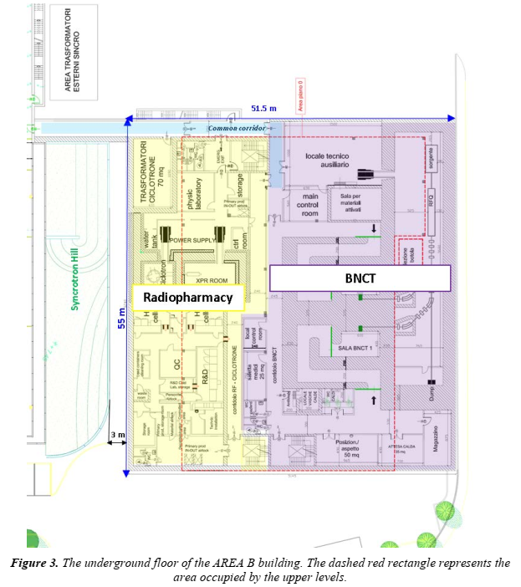
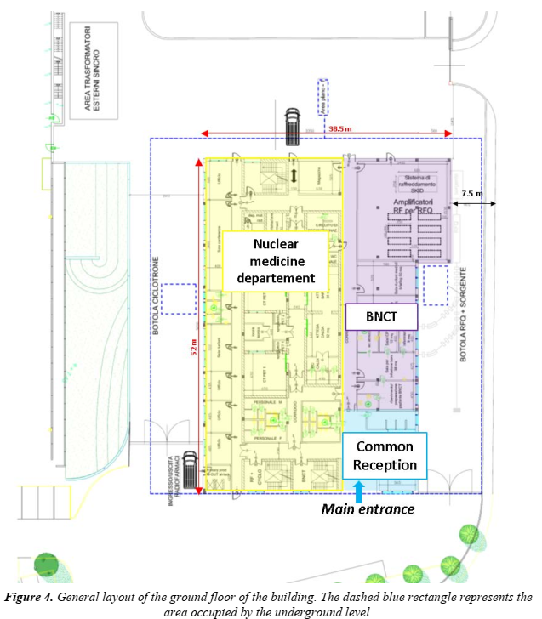
Layouts of underground and ground floors of Area B

Slide 12
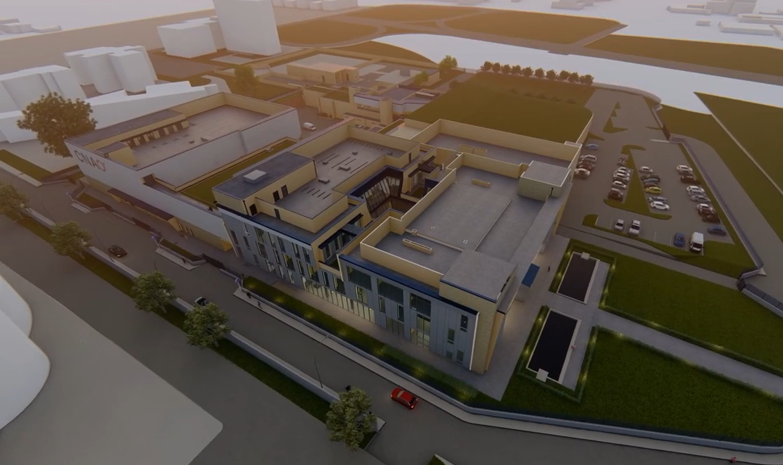
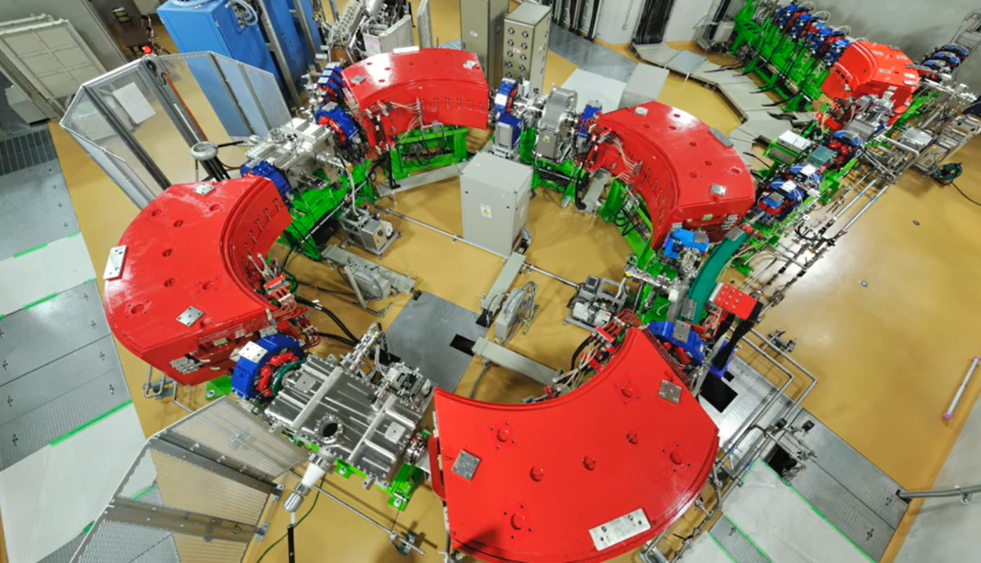
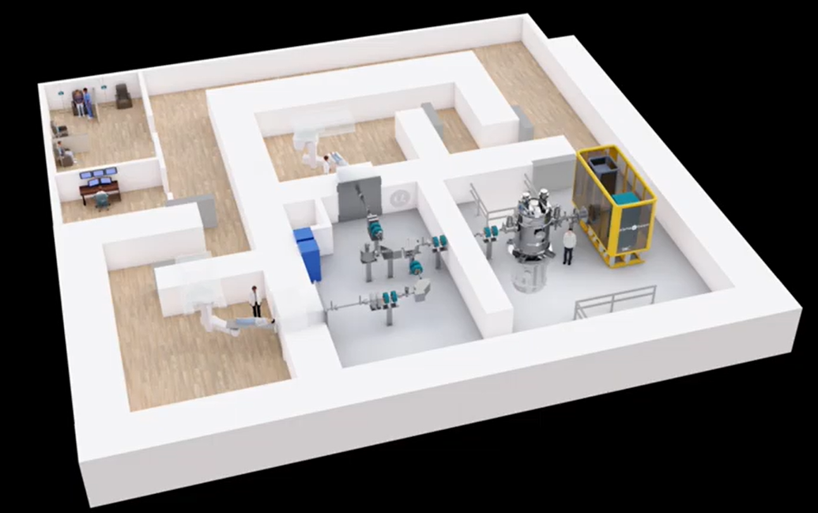
Status Update - 2022
One single-room from Hitachi
BNCT system from Tae Life Sciences

Slide 13
FASST: the most beautiful gantry in the world
Notes:
William of Ockham cites the principle of economy, Frustra fit per plura quod potest fieri per pauciora ("It is futile to do with more things that which can be done with fewer"; Thorburn, 1918, pp. 352–53; Kneale and Kneale, 1962, p. 243.)
- Rotation max speed of 0.75 rpm
- Max deviation of ±0.1° and deflection of optical axis ±0.5 mm

Slide 14
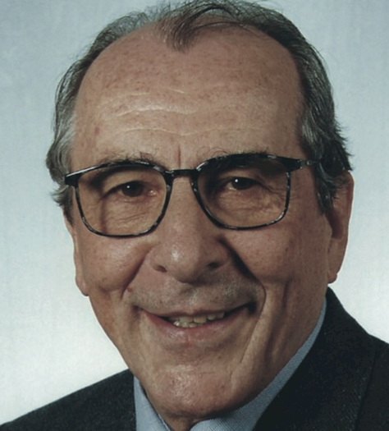
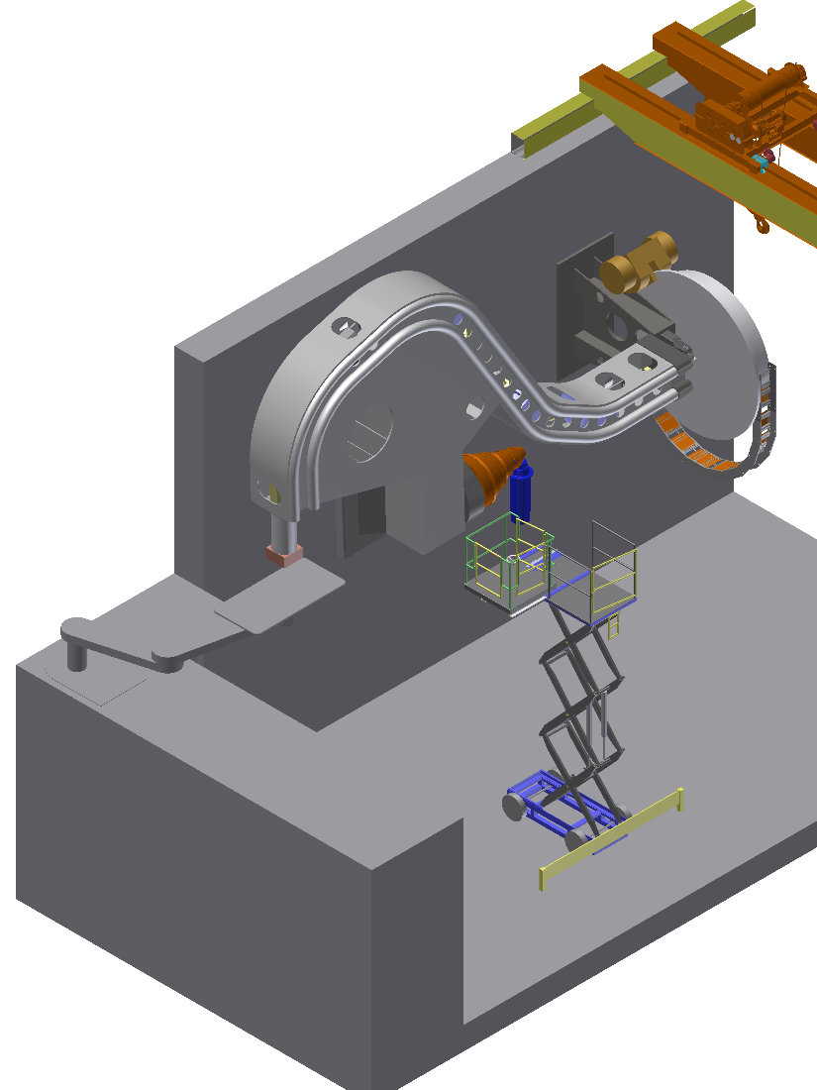
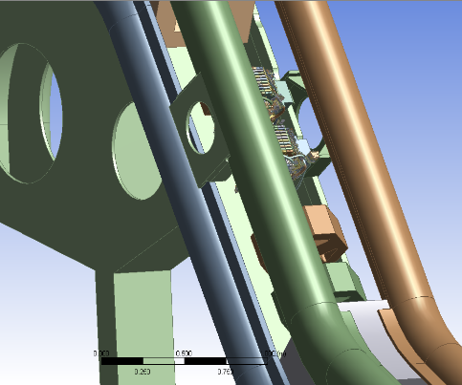
FASST: the most beautiful gantry in the world
    Pierluigi Riboni´s mechanics concept based on Occam´s razor with:
      Structure made of 4 rods
      25 t rotating mass (no counterweight) supported on the wall
      Iso-centric gantry with 220° rotation
Notes:
William of Ockham cites the principle of economy, Frustra fit per plura quod potest fieri per pauciora ("It is futile to do with more things that which can be done with fewer"; Thorburn, 1918, pp. 352–53; Kneale and Kneale, 1962, p. 243.)
- Rotation max speed of 0.75 rpm
- Max deviation of ±0.1° and deflection of optical axis ±0.5 mm

Slide 15
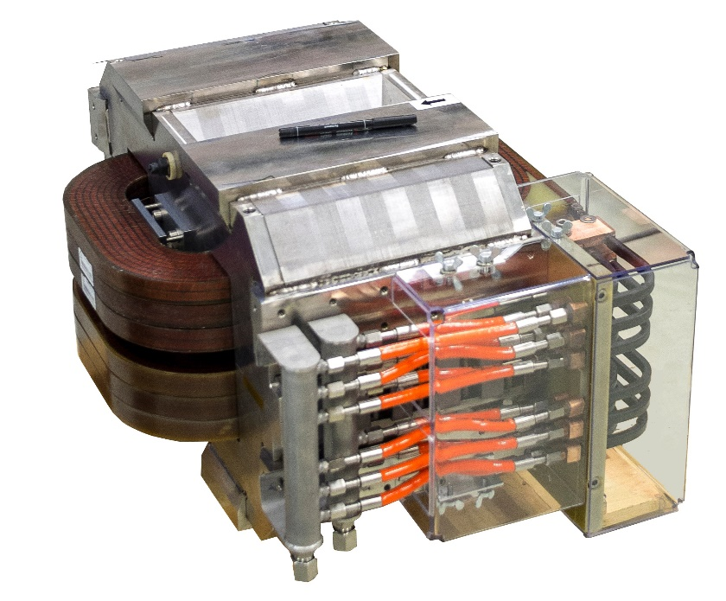
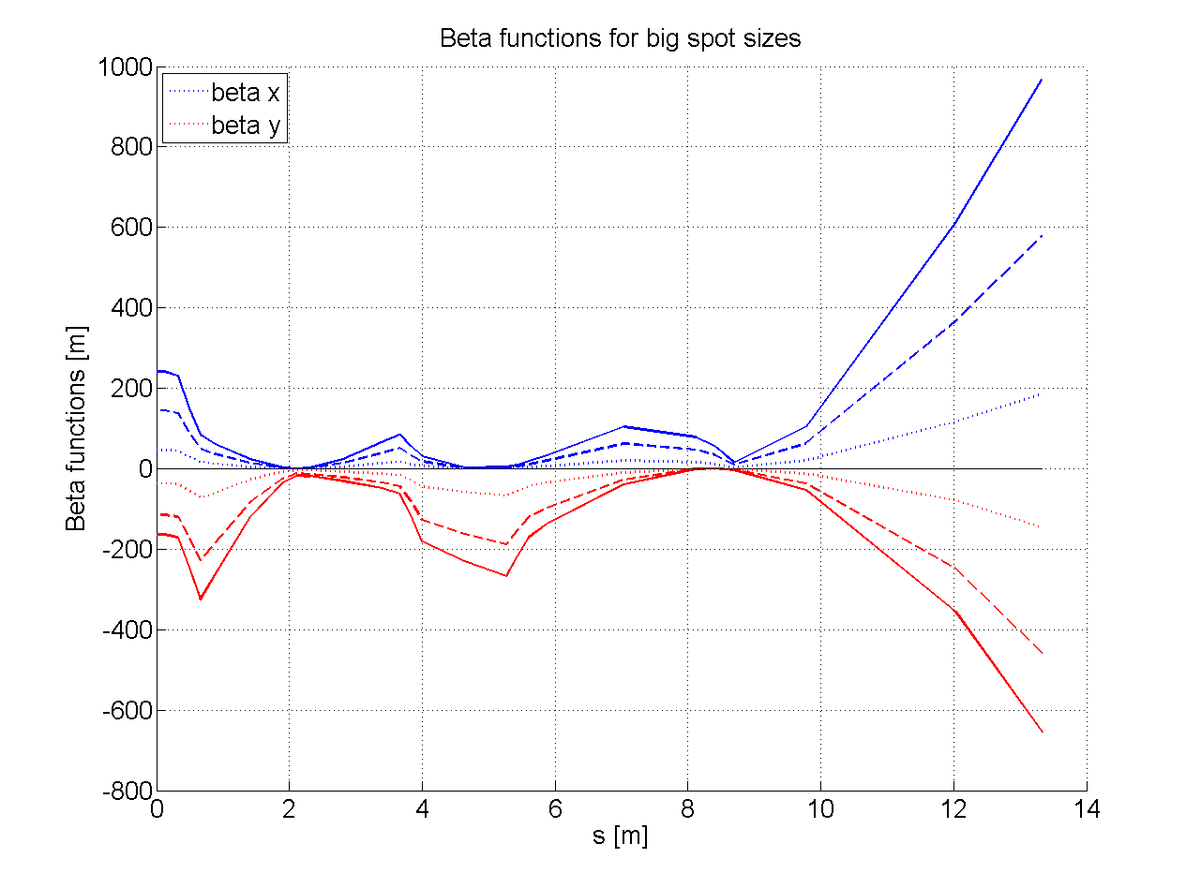
Optics Design
    compact and light design, thanks to small transverse emittances of proton beam linac & downstream scanning
    Magnets & power supplies designed for beam energy pulse-to-pulse variation at 200 Hz:
    2% current variation in 4 ms, i.e 80% of longitudinal FWHM of Bragg peak
    - One optical solution for multiple spot sizes (all energies):
    -> Telescope with rotational invariance
CERN FeCo prototype (Tommasini et al.)
Notes:
LIGHT proton beams are unique not only because of their rapid energy variations, but also
for their very small normalized emittances (Fig. 1.8): about 0.2 π mm mrad (normalized, 5-
rms), roughly ten times smaller than the emittances of the beam produced by synchrotrons
and cyclotrons. For example, the PIMMS synchrotron is characterised by an emittance of 2.6
π mm mrad (normalized, 5-rms) [PIMMS], while the standard C235 cyclotron has 19 π mm
mrad (normalized, 5-rms) [Walter2001].

Slide 16
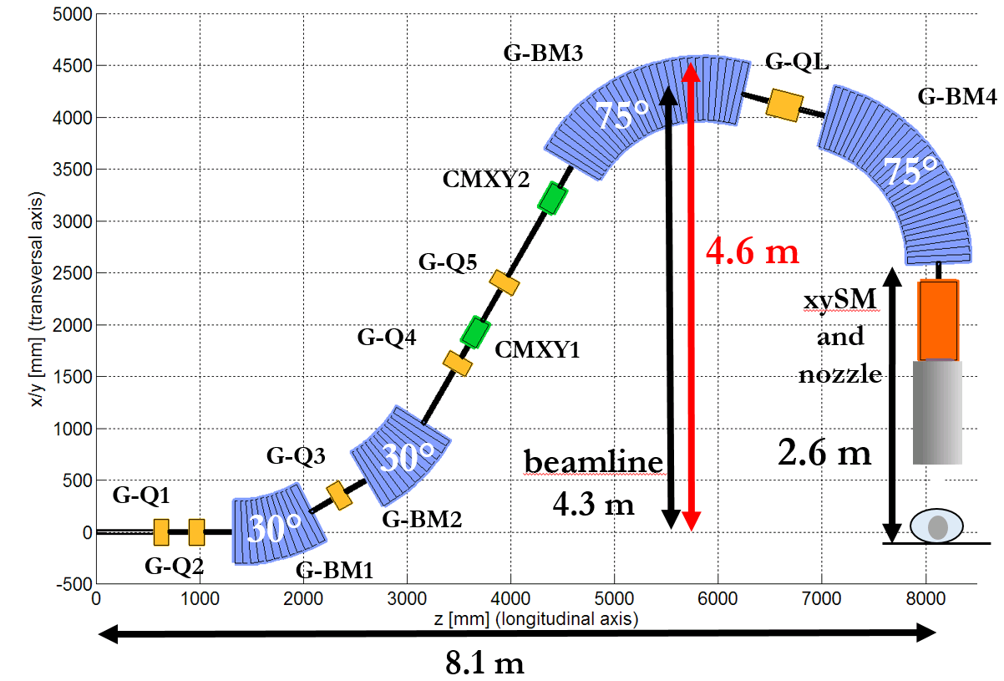
Fast Adaptive Spot Scanning Therapy
Notes:
The reason behind this choice is that,
by having two spot types, a tumour target can be “painted” twice: the central part with
“large” spots and the boundaries with “small” spots so to obtain a steeper fall-off of the dose
in a shorter time. This is another unique feature of the FASST gantry beam.

Slide 17
Unique beam properties
Two spot sizes at isocenter (in air) to obtain steeper dose fall-off in short irradiation time
Constant spot size in air for most energies to facilitate treatment planning and QA
Nozzle geometry modeled with Monte Carlo to determine the scattering effect
Large spot
Small spot

Slide 18
Following the proton from source to patient: «full Monte Carlo»

Slide 19
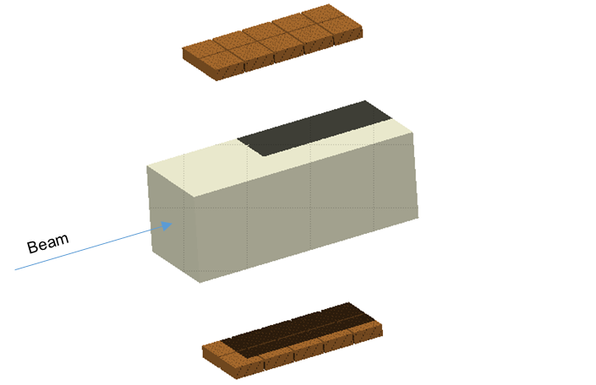
Following the proton from source to patient: «full Monte Carlo»
FULL MC SIMULATION for TULIP
In-beam PET with CABOTO and
Fast Range Verification
Secondaries production
MC
FLUKA
PET tools
LINAC
Beam transport lines
Beam interaction Dose delivery system
phantoms patient
In-beam PET
with CABOTO
Accelerator
Time structure

Slide 20
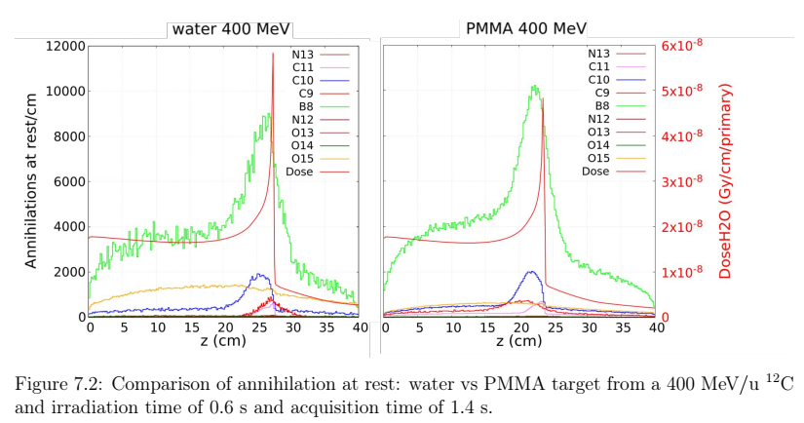
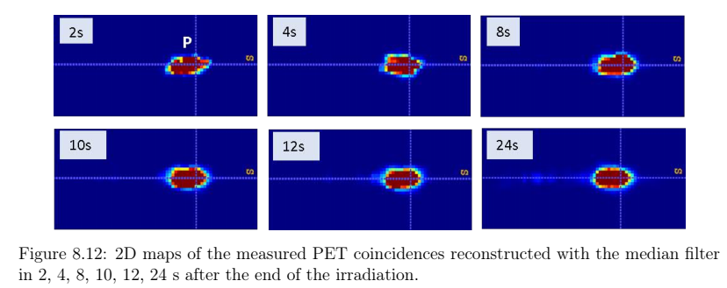
Fast range verification with in-beam PET
    Low duty cycle of carbon ion linacs
    Short half-lived β⁺ emitters production (⁸B most interesting isotope)
    Experimental/simulation data: carbon ion range can be determined with a precision of σ= 1 mm
Notes:
Production of short lived (t_{1/2}=9-800 ms) radioisotopes (¹³O, ¹²N, ⁹C, ⁸B) combined with 0.1% duty cycle of carbon ion linacs can be exploited to verify the particle range

Slide 21
What happened for me after TERA?

Slide 22
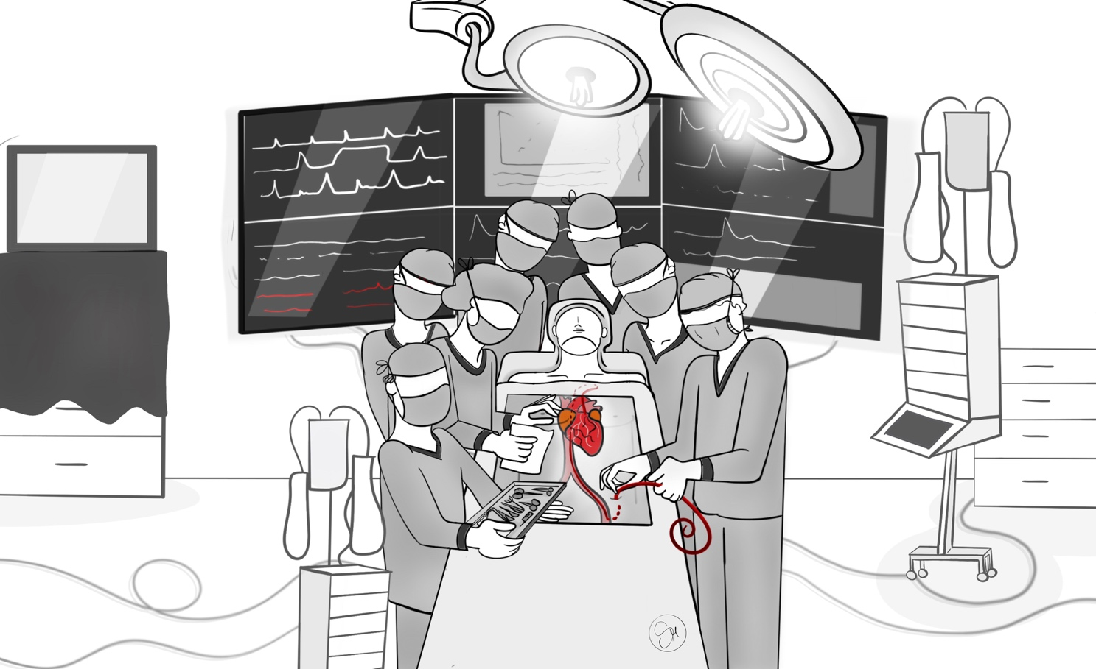
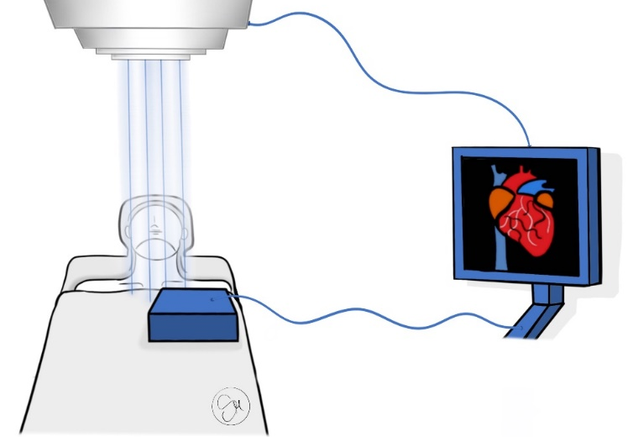

What happened for me after TERA?
Today
Tomorrow

Slide 23
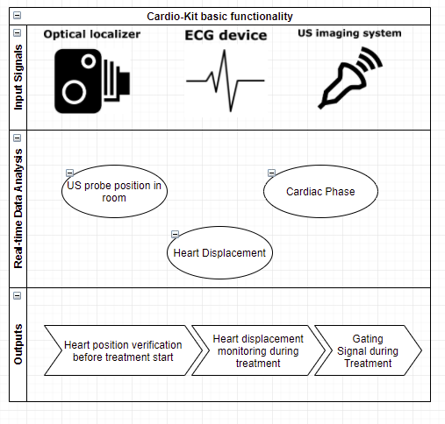
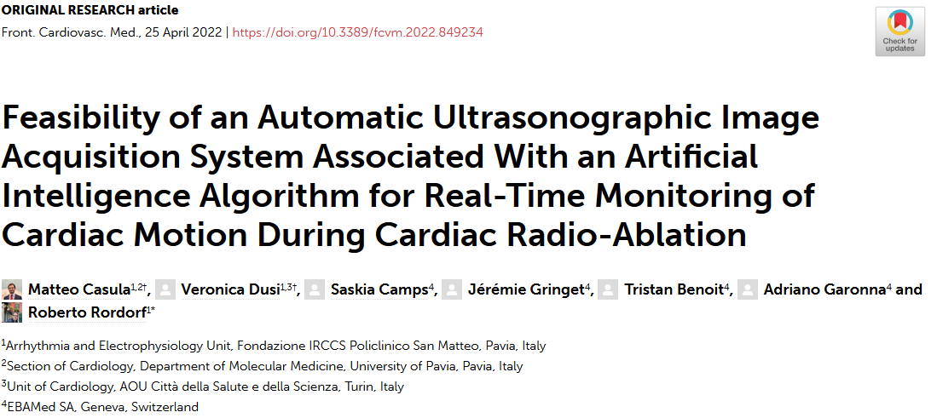
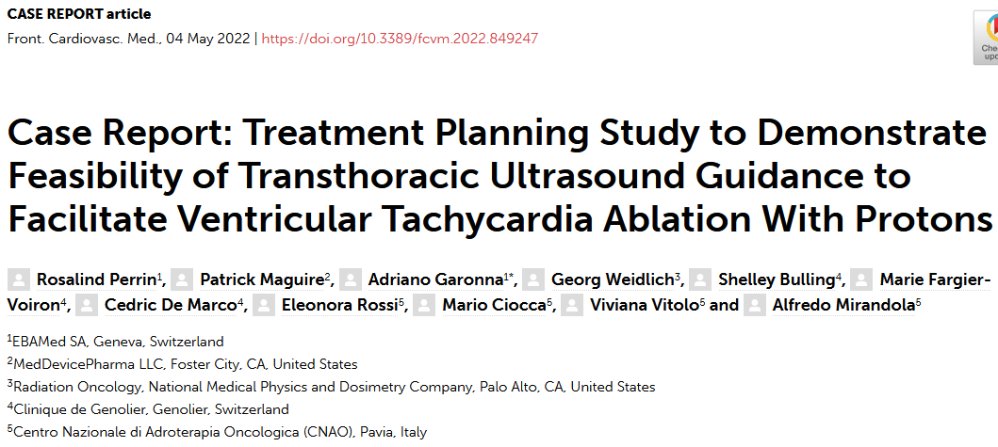
Enabling non-invasive & automated treatments of heart arrhythmias using proton beams

Slide 24
Thank you TERA and happy birthday !

Slide 25
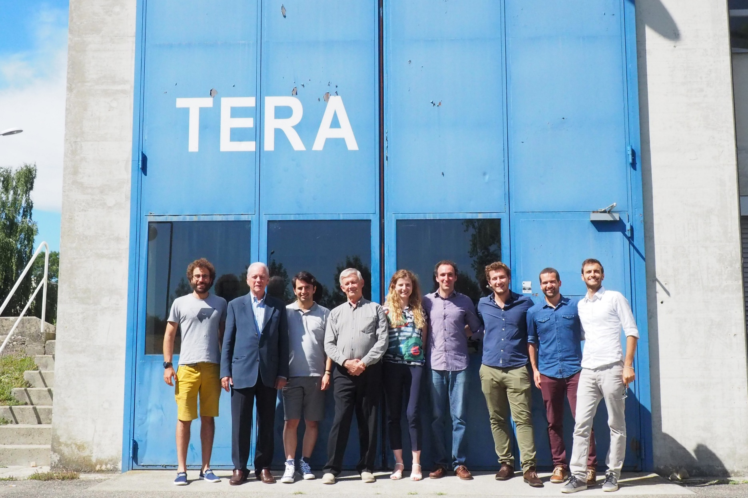
Thank you TERA and happy birthday !

