Slide 1
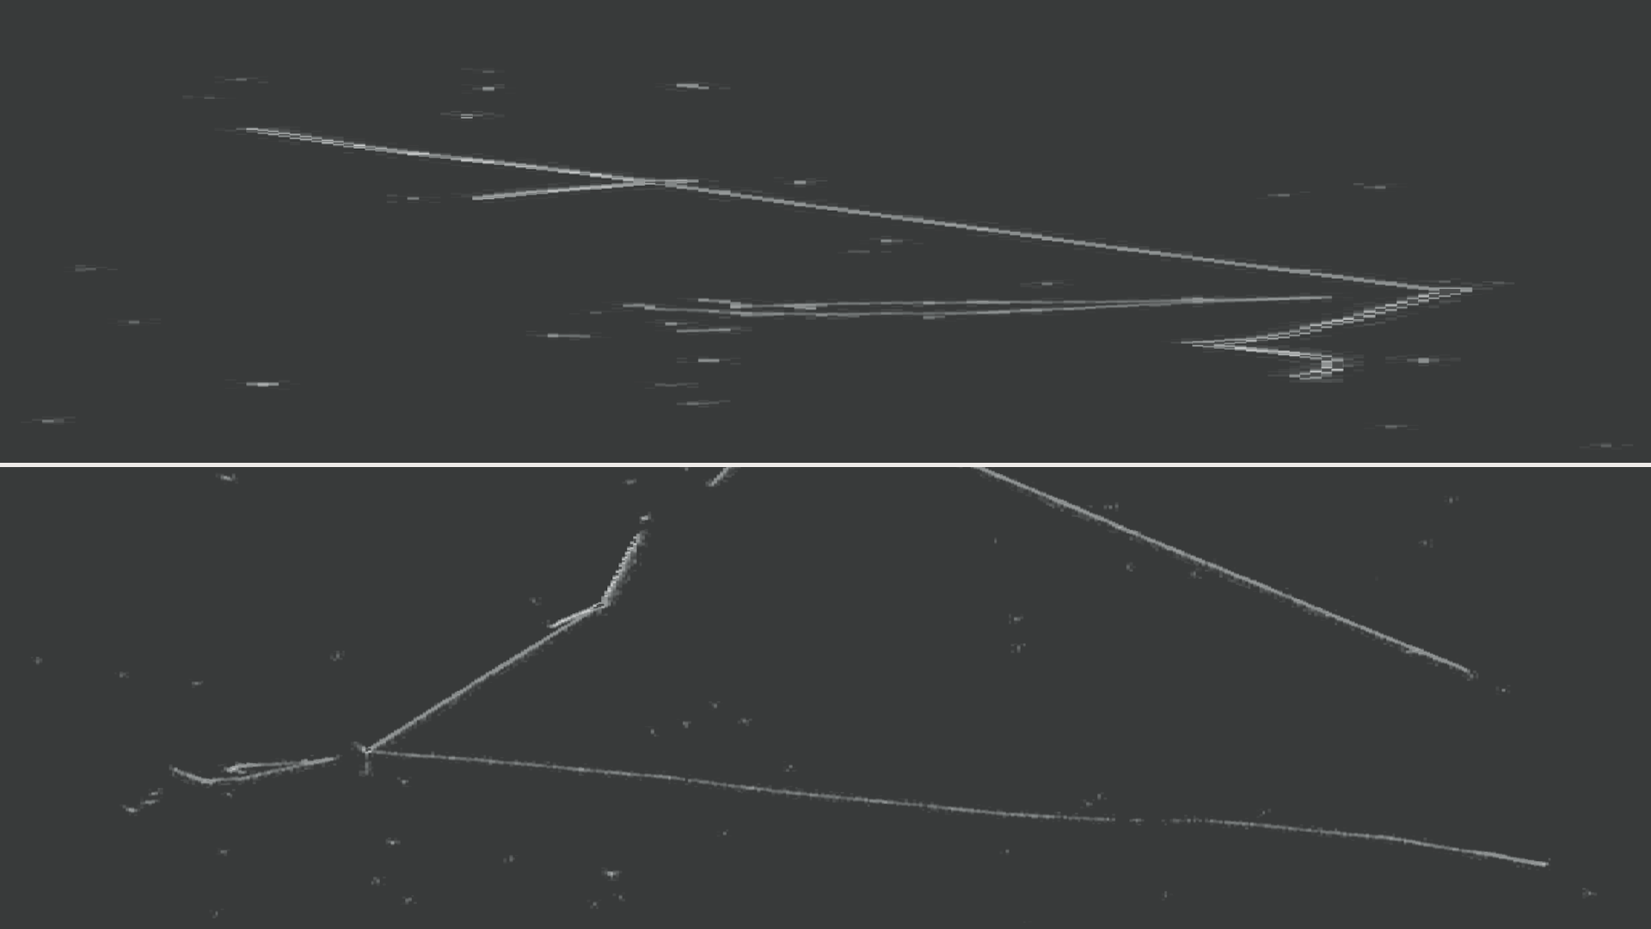


Machine-Learning-Based Reconstruction Chain for ICARUS
ICARUS CM, INFN Frascati
François Drielsma, Laura Dominé, Dae Heun Koh, Kazu Terao (SLAC)
October 6th, 2022

Slide 2
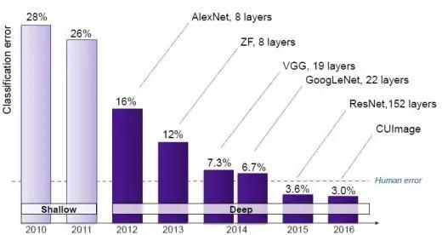
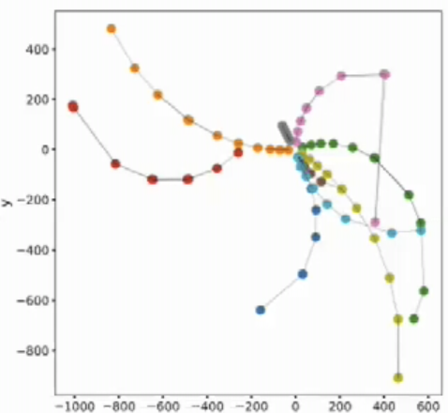
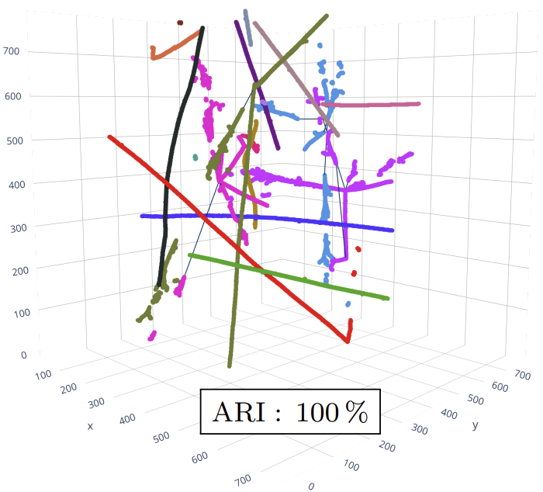
Machine Learning
Why do we care?
Machine learning (ML) is taking over, and for good reason:
Dominant in virtually every image processing task in the industry (and beyond)
Machine learning (ML) is taking over, and for good reason:
Dominant in virtually every image processing task in the industry (and beyond)
Gold standard in many high energy physics experiments today
Machine learning (ML) is taking over, and for good reason:
Dominant in virtually every image processing task in the industry (and beyond)
Gold standard in many high energy physics experiments today
DoE grant awarded to develop a reconstruction chain for LArTPCs (TPC-side)
Only demonstrably viable option to handle DUNE-ND’s level of pileup
~10 t mass
4 neutrinos
ATLAS @ LHC
Central Tracker
2103.06995
2007.01335
ML-Based Reconstruction for ICARUS, F. Drielsma (SLAC)

Slide 3
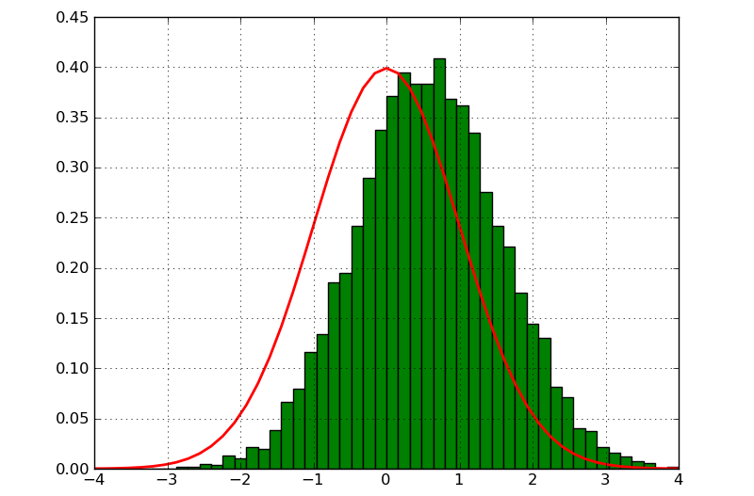
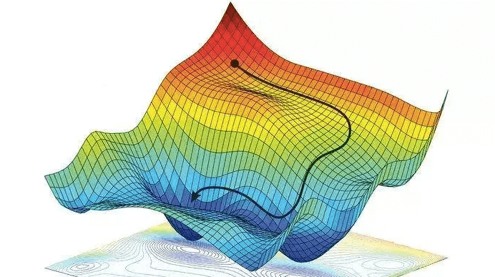
Machine Learning
What is it?
Traditional programming: handmade rules = reconstruction
Simulation x
Computation
Result F(x)
Rules F
Tune F manually to optimize distribution
Machine Learning (ML): simulation labels = basis for the rules
Need a flexible differentiable function F and a
labeled simulation which maps x→y
Simulation x
Computation
Rules F
Result y
F is a differentiable function. Optimize F automatically by minimizing ||y - F(x)||
ML-Based Reconstruction for ICARUS, F. Drielsma (SLAC)

Slide 4
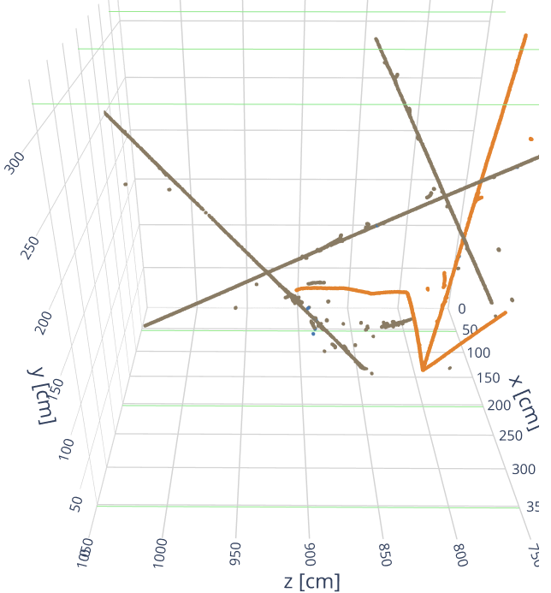
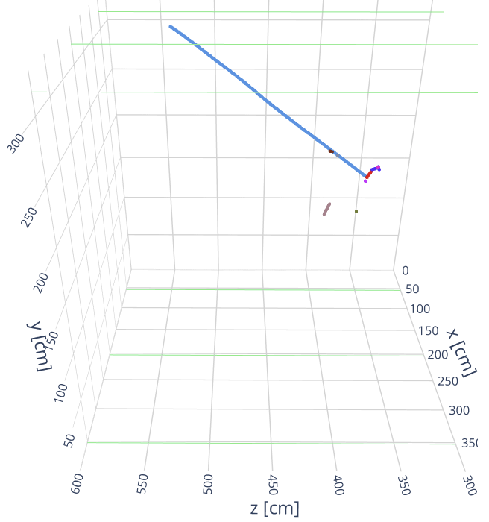
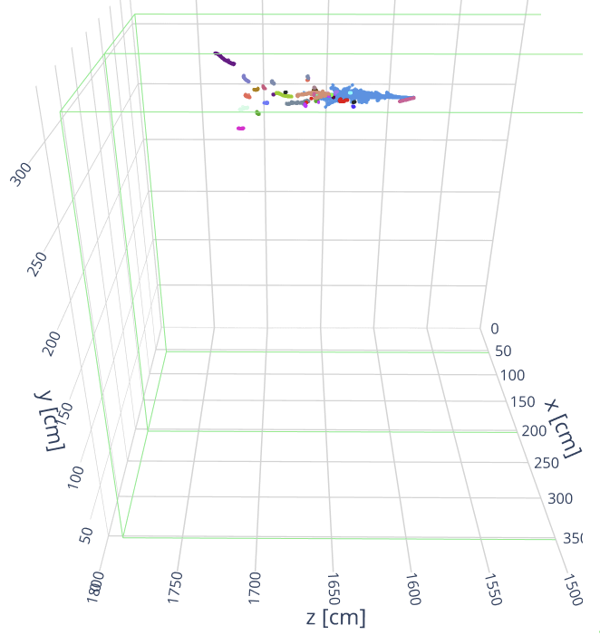
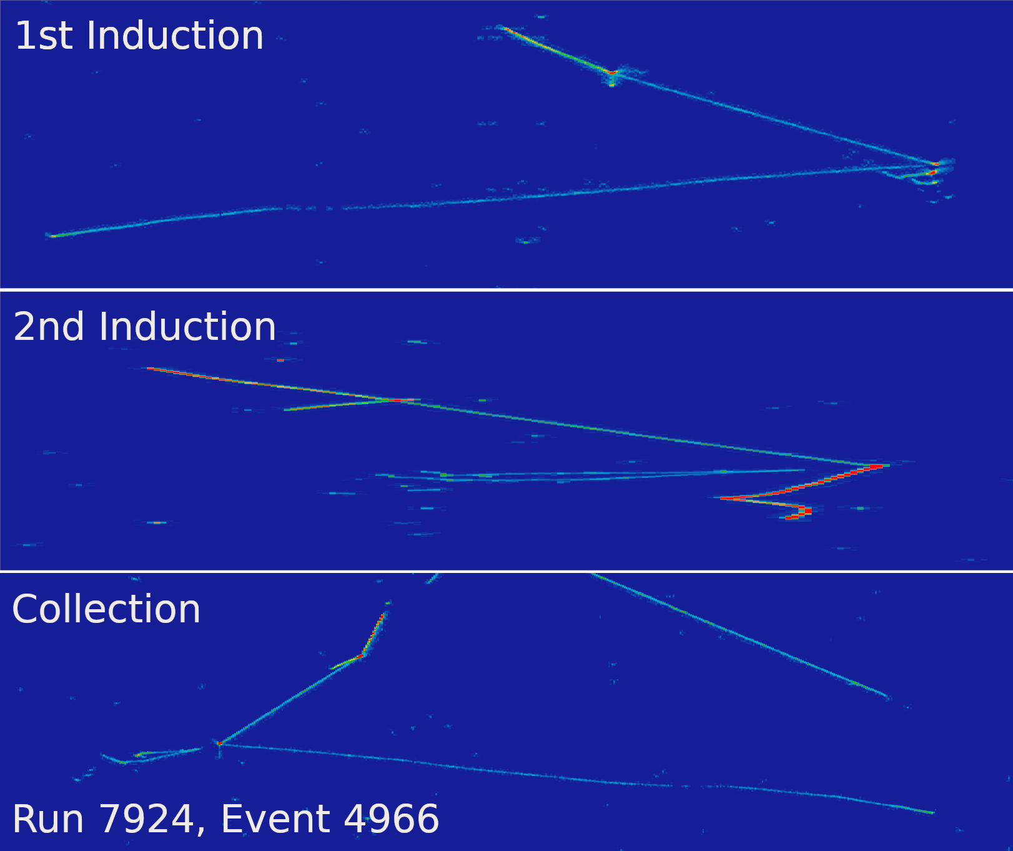
Machine Learning in ICARUS
Datasets
Generic simulated dataset used for optimization and testing:
Isotropic combination of 1 set of particles sharing a vertex + overlaid single particles
  Covers phase-space of neutrino interactions + cosmics, but…
  … stays agnostic to physics → unbiased
Generic simulated dataset used for optimization and testing:
Isotropic combination of 1 set of particles sharing a vertex + overlaid single particles
  Covers phase-space of neutrino interactions + cosmics, but…
  … stays agnostic to physics → unbiased
Specific datasets used for validation:
Simulated BNB ν_{μ} and BNB ν_{e} + hand-scanned data events (C. Farnese et al.)
Generic
BNB ν_{μ}
BNB ν_{e}
ML-Based Reconstruction for ICARUS, F. Drielsma (SLAC)

Slide 5
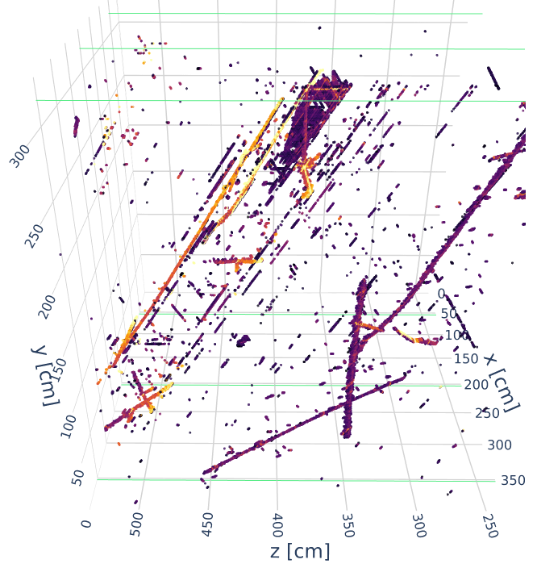
Machine Learning in ICARUS
Reconstruction Philosophy
First: combine 3 planes of hits from standard reconstruction into one single 3D image
Make all valid combinations of 2 plane hits
ML-Based Reconstruction for ICARUS, F. Drielsma (SLAC)

Slide 6
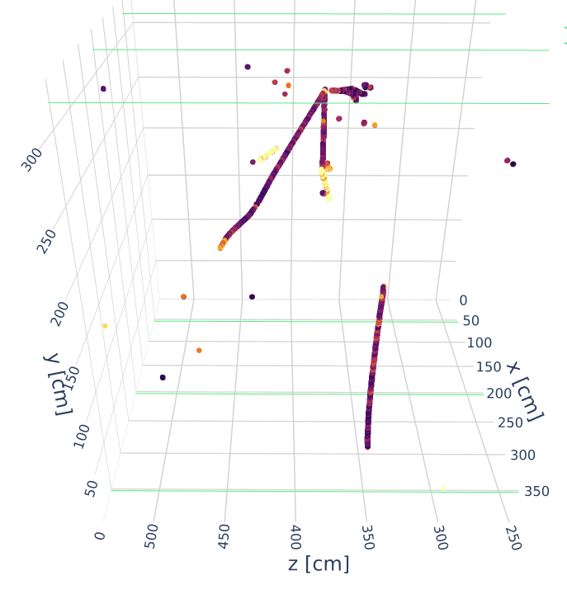
Machine Learning in ICARUS
Reconstruction Philosophy
First: combine 3 planes of hits from standard reconstruction into one single 3D image
Make all valid combinations of 2 plane hits
Remove artifacts using a Machine Learning algorithm
ML-Based Reconstruction for ICARUS, F. Drielsma (SLAC)

Slide 7
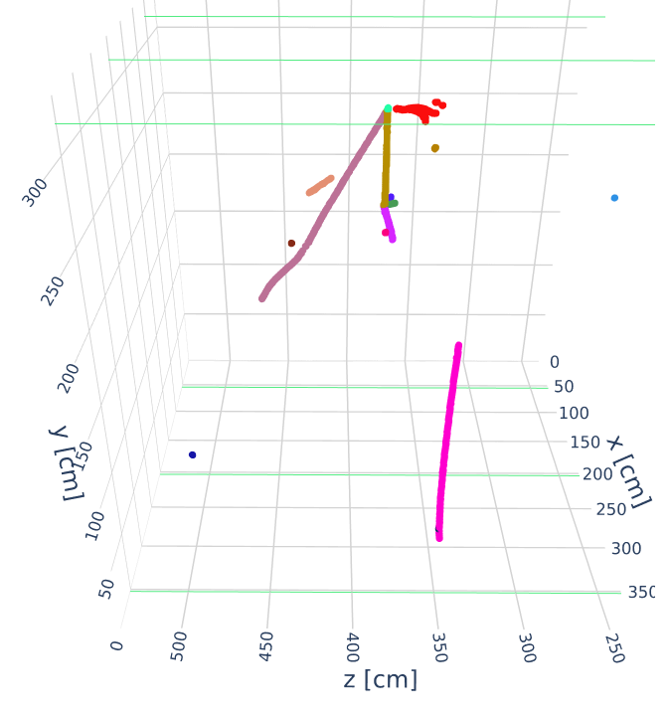
Machine Learning in ICARUS
Reconstruction Philosophy
Second: cluster image space points into individual particles
ML-Based Reconstruction for ICARUS, F. Drielsma (SLAC)

Slide 8
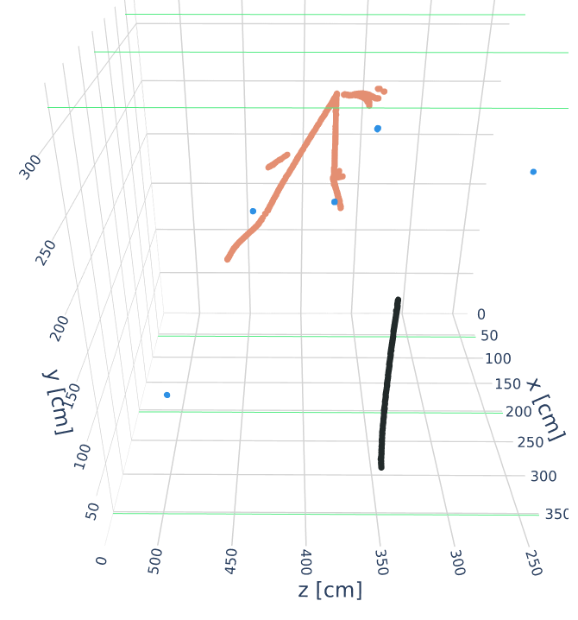
Machine Learning in ICARUS
Reconstruction Philosophy
Third: cluster particles into interactions
ML-Based Reconstruction for ICARUS, F. Drielsma (SLAC)

Slide 9
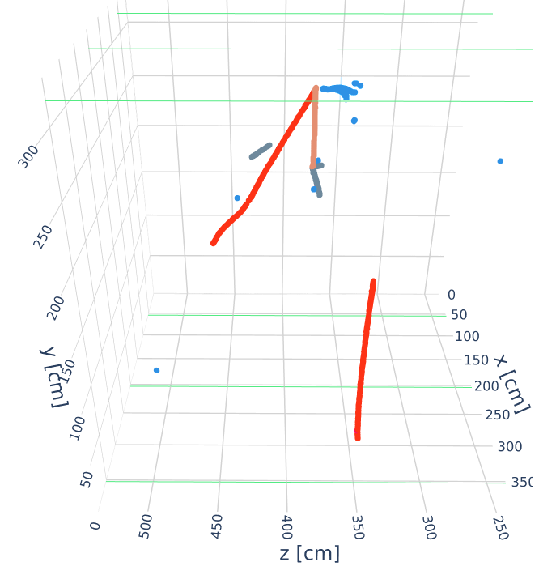
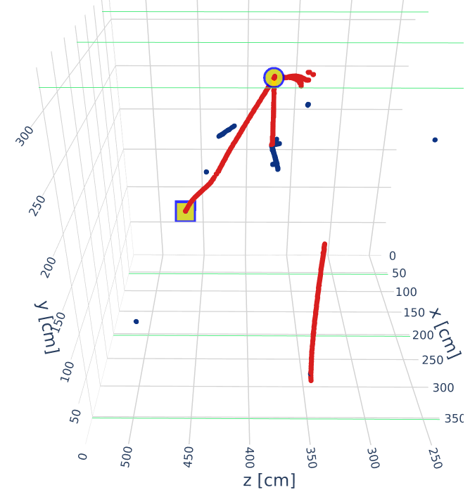
Machine Learning in ICARUS
Reconstruction Philosophy
Fourth: infer information (PID, primary, energy) of particles
Photon
Muon
Proton
Pion
⬤ Reco. Vertex
⬤ Hand-scanned Vertex
◼ Reco. Muon endpoint
◼ Hand-scanned muon endpoint
Primary
Secondary
Particle Identification
Vertex identification
ML-Based Reconstruction for ICARUS, F. Drielsma (SLAC)

Slide 10
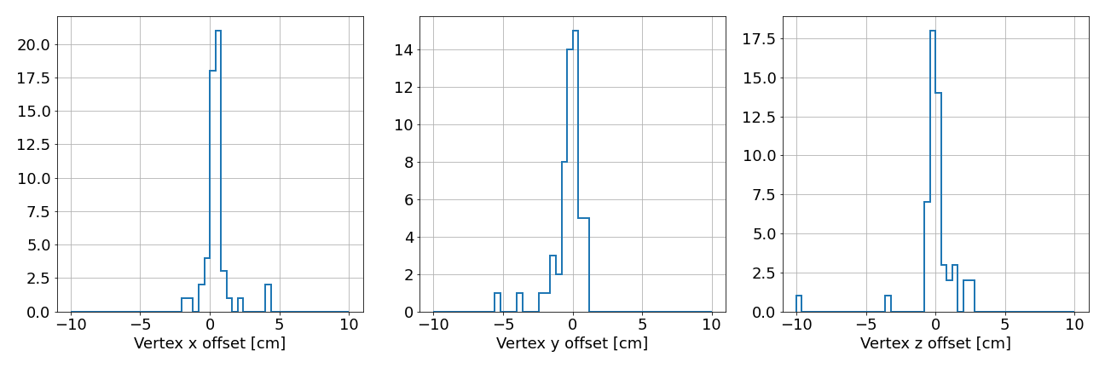
Machine Learning in ICARUS
Preliminary results on hand-scanned events
Using a small sample of 61 hand-scanned events (courtesy of C. Farnese et al.) to:
Check interaction/vertex reconstruction
52/61 “Good”
Vertices
(<10 cm away)
ML-Based Reconstruction for ICARUS, F. Drielsma (SLAC)

Slide 11
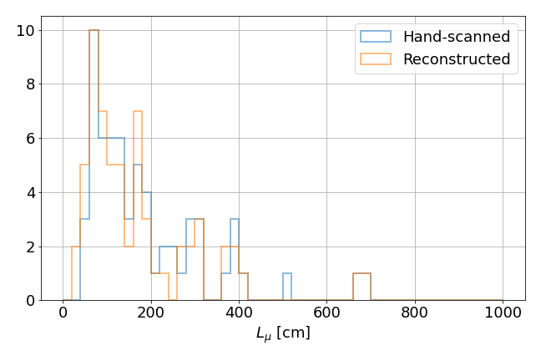
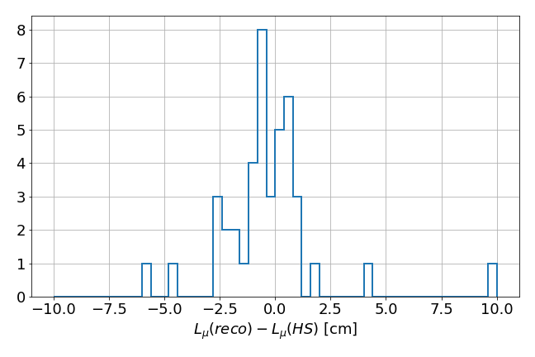
Machine Learning in ICARUS
Preliminary results on hand-scanned events
Using a small sample of 61 hand-scanned events (courtesy of C. Farnese et al.) to:
Check interaction/vertex reconstruction
Check muon length reconstruction
For more details, please join the workshop discussion on ML on Friday or
any of the weekly ICARUS ML meeting on Wed 12PM CT
52/61 “Good”
Muons
ML-Based Reconstruction for ICARUS, F. Drielsma (SLAC)

Slide 12
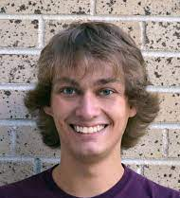


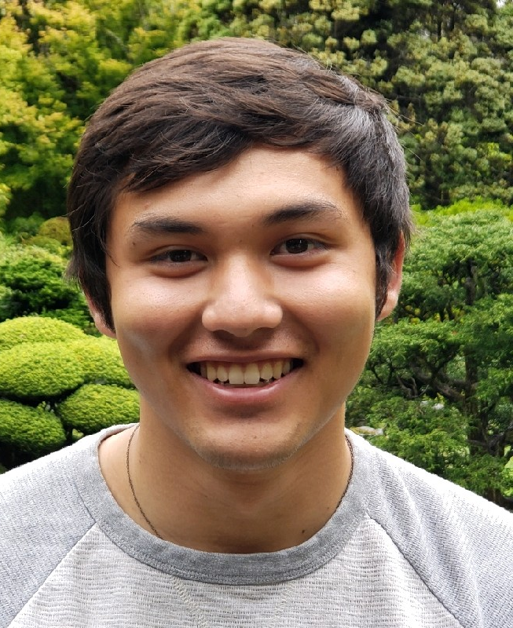
Machine Learning in ICARUS
Analyses in Progress
The Machine-Learning-based reconstruction chain already used for analysis
Four grad student talks on preliminary results
ν_{μ}-CCQE (1μ1p) selection (could be used for ν-4)
  Talk: Justin Mueller (CSU)
ν_{μ}-CC π⁰ selection and π⁰ invariant mass reconstruction
  Talk: Lane Kashur (CSU)
ν_{e}-CC selection towards a low-energy excess measurement
  Talk: Laura Dominé (SLAC)
e/γ separation towards the SBN sterile neutrino analysis
  Talk: Dan Carber (CSU)
ML-Based Reconstruction for ICARUS, F. Drielsma (SLAC)

Slide 13
Back-up slides

Slide 14
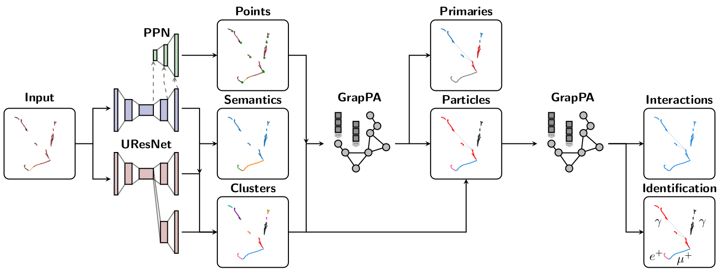
ML-Based Reconstruction Chain for LArTPCs
Full Reconstruction Chain Architecture
arXiv:2102.01033
ML-Based Reconstruction for ICARUS, F. Drielsma (SLAC)

Slide 15
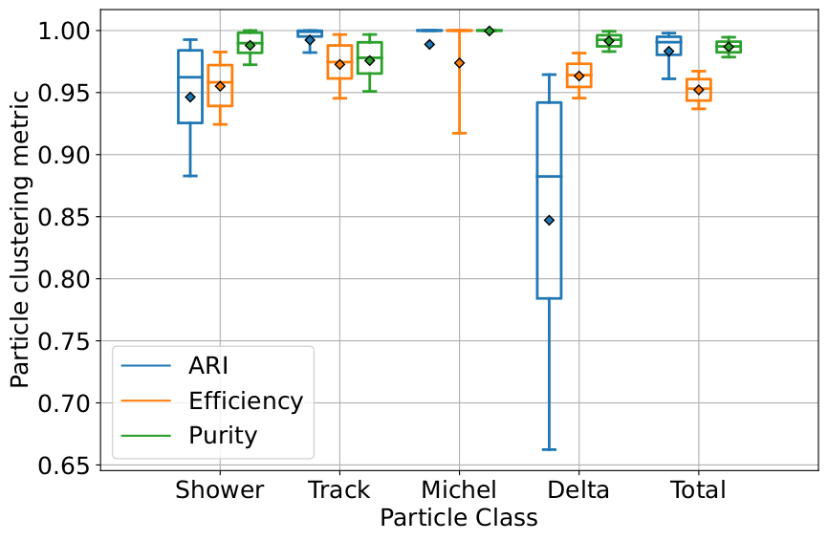
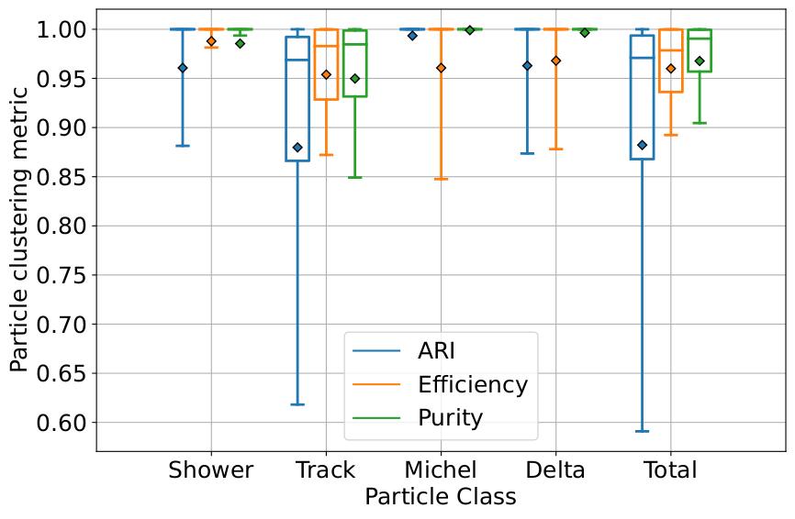
ML-Based Reconstruction Chain for LArTPCs
Particle clustering performance
Individual class particle clustering performance metrics
Generic Simulation
BNB ν_{μ}
ML-Based Reconstruction for ICARUS, F. Drielsma (SLAC)

Slide 16
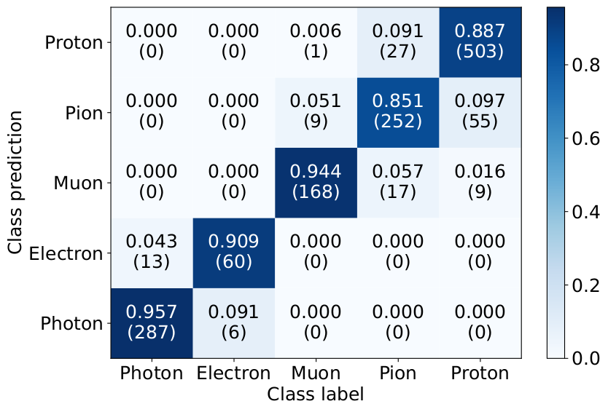
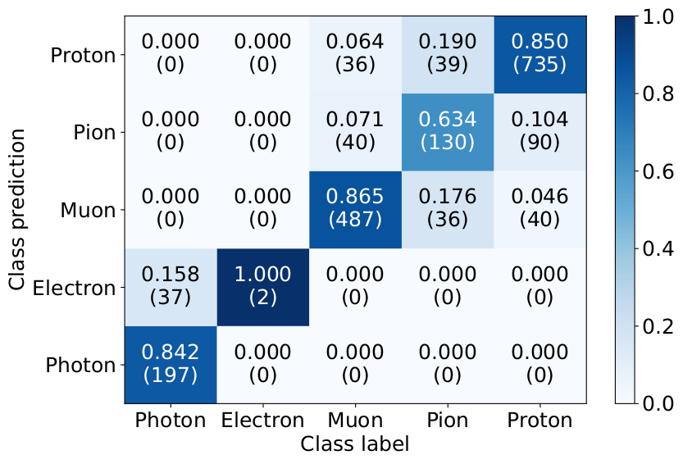
ML-Based Reconstruction Chain for LArTPCs
Particle identification performance
Particle classification accuracy
Generic Simulation
BNB ν_{μ}
ML-Based Reconstruction for ICARUS, F. Drielsma (SLAC)

