Slide 1
MARTHA - Monolithic Array of Reach Through Avalanche photo Diodes
R. Richter, A. Bähr, J. Damore,
Ch. Koffmane, R. Lehmann,
J. Ninkovic, G. Schaller,
M. Schnecke, F. Schopper, J. Treis

Slide 2
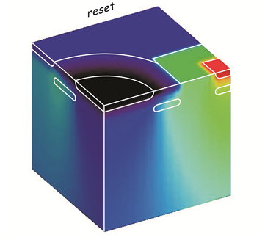
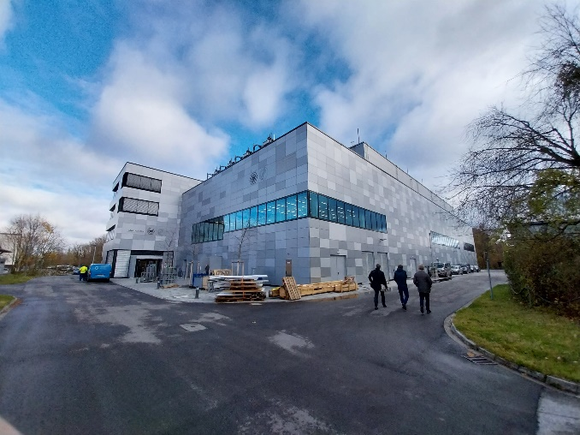
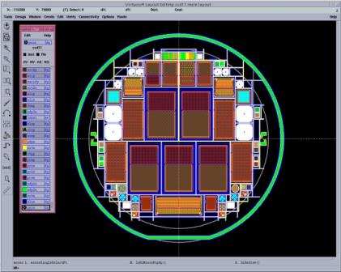
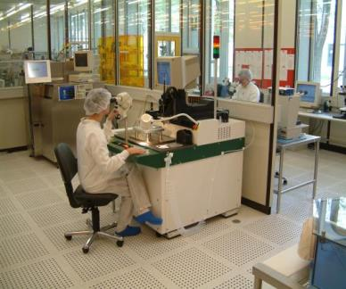
MPG HLL
New Building
  IPP Campus Garching
  currently moving
sensor
  simulation
  design
  fabrication
camera
  design
  assembly
  test
  1500 m² cleanroom area
  600 m² ISO3 & ISO4 area
  6/8 inch silicon process
Central facility of the Max Planck Society
40 scientists, engineers and technicians
+ guest scientists, and students

Slide 3
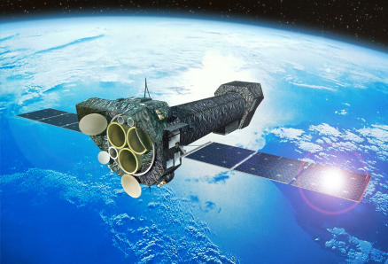
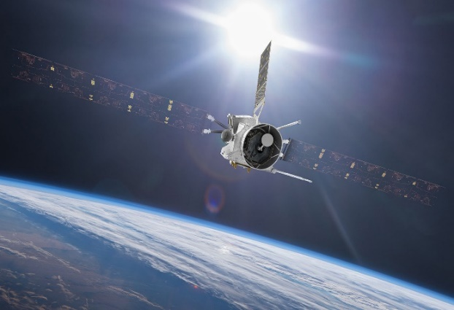
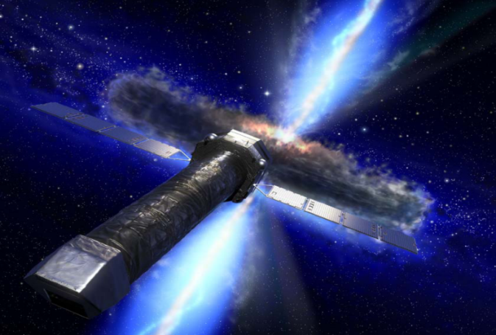
MPG HLL – some examples
DePFETs at KEK - Japan
XMM-Newton
electron (7GeV)
We also produce
-SDD (silicon drift detectors)
-Diodes
-Avalanche Diodes
-Strip Detectors
-etc.
positron (4GeV)
Vertex Detector
2 layers DEPFET
+ 4 layers DSSD
  pnCCD
  X-ray imaging spectroscopy
  curtesy ESA
DePFET for particle tracking
curtesy Belle2 collaboration
MIXS on BepiColombo
WFI on Athena
DePFET -planetary science
curtesy ESA
DePFET - X-ray imaging spectroscopy
curtesy ESA

Slide 4
Martha - APDs for soft X-Rays
left pixel
right pixel
(Soft X-ray) Photon Counting
For applications at FELs
(HLL) thin entrance window + avalanche multiplication
homogeneous gain
high k-factor (low excess noise)
n+ contact
n+ contact
p multiplication layer (ML)
p- drift region
p+ cathode

Slide 5
Martha - Interpixel isolation
left pixel
right pixel
?
Interpixel isolation requirements
Isolation
Suppress edge break down
Reduction of E-fields at interface
(oxide charge up, H-bond cracking)
n+ contact
n+ contact
p multiplication layer (ML)
p- drift region
p+ cathode

Slide 6
Strip array 50µm pitch (2D simulation)
MOS Isolation
left pixel
right pixel
Reach-through APD
50 µm pitch
MOS isolation
Based on HLL „standard“ technology
n+ contact
n+ contact
10µm
p multiplication layer (ML)
450µm
p- drift region
p+ cathode
HF region extends over pixel gaps

Slide 7
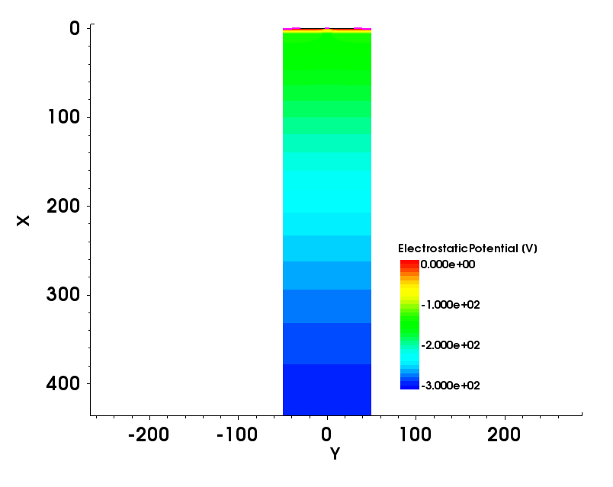
Strip Array (2D Simulation)
MOS Isolation
left pixel
right pixel
n+ contact
n+ contact
10µm
p multiplication layer (ML)
450µm
p- drift region
p+ cathode
100µm
HF region extends over pixel gaps

Slide 8
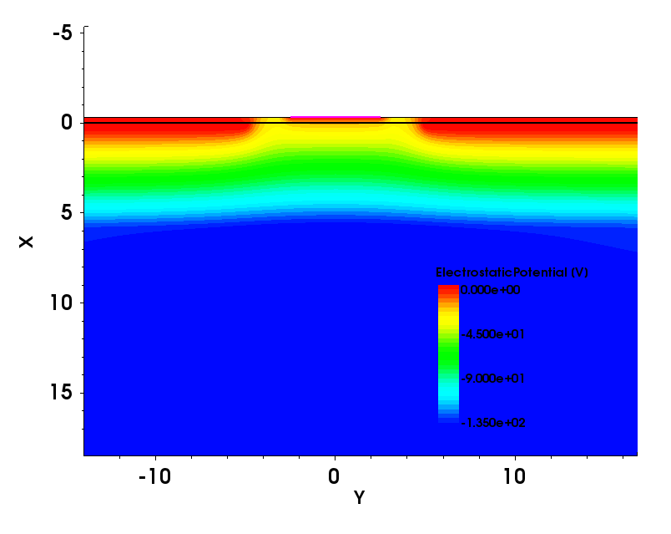
Strip Array (2D Simulation)
MOS Isolation
left pixel
right pixel
n+ contact
n+ contact
10µm
p multiplication layer (ML)
450µm
p- drift region
p+ cathode
100µm
HF region extends over pixel gaps

Slide 9
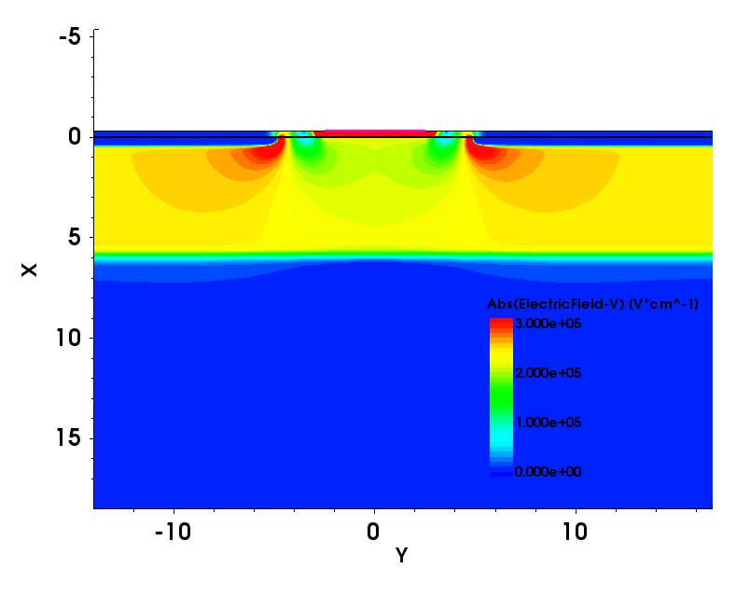
Strip Array (2D Simulation)
MOS Isolation
left pixel
right pixel
n+ contact
n+ contact
10µm
p multiplication layer (ML)
450µm
p- drift region
p+ cathode
100µm
Avalanche (breakdown) at edges
Approach not usable
HF region extends over pixel gaps

Slide 10
2D Simulation
Edge Breakdown Suppression
left pixel
right pixel
left pixel
right pixel
n+ contact
n+ contact
n+ contact
n+ contact
10µm
n field drop layer
10µm
p multiplication layer (ML)
p multiplication layer (ML)
450µm
450µm
p- drift region
p- drift region
p+ cathode
p+ cathode
100µm
100µm

Slide 11
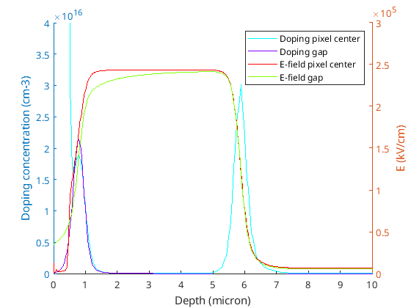
Edge Breakdown Suppression
left pixel
right pixel
deep implant (6 µm)
extend ML
n+ contact
n+ contact
n field drop layer
10µm
p multiplication layer (ML)
Field-Drop Layer
Deep Implant
450µm
p- drift region
p+ cathode
100µm
Notes:
high energy implant + low bulk doping ensures
flat ‘plate capacitor like‘ electric field distribution
Wide high field region -> lower e-field (same gain)
-> lower k factor -> lower excess noise factor

Slide 12
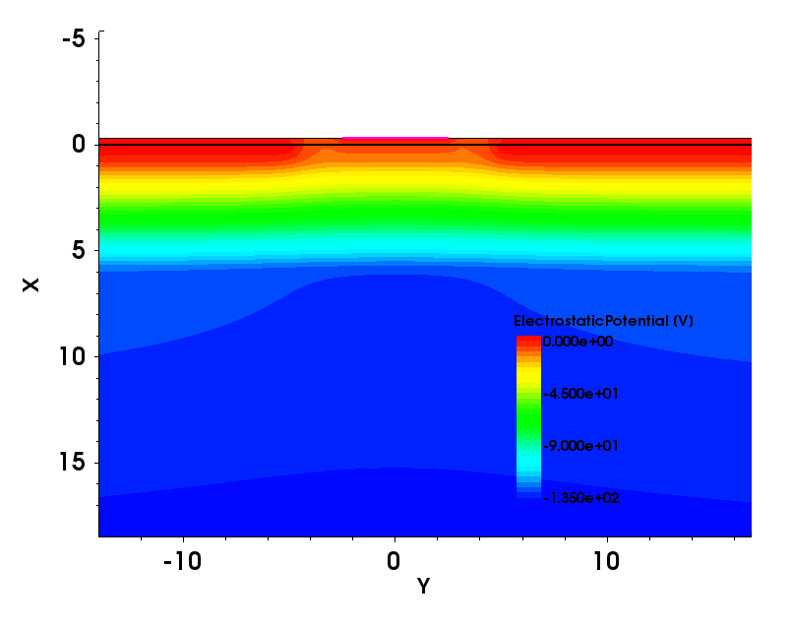
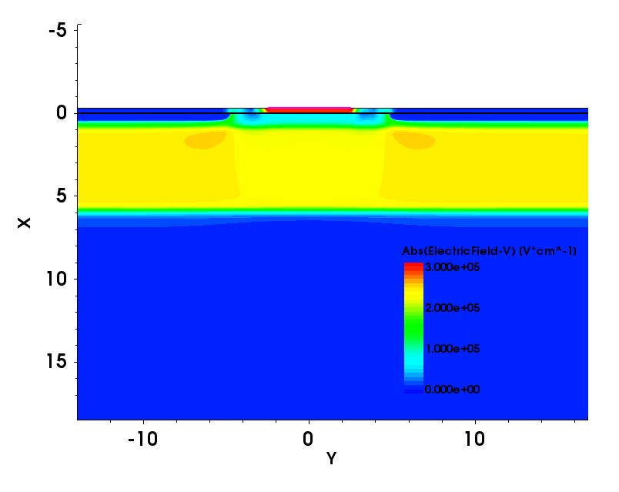
2D Simulation
Edge Breakdown Suppression
V_{MOS}=3V
HF region
extends over
pixel gaps
HF region and
field drop layer
extend over
pixel gaps

Slide 13
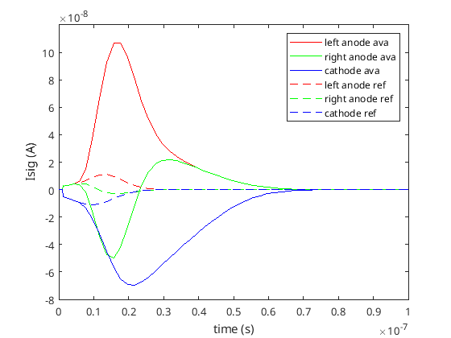
Simulated signal Evolution (Current)
left pixel
right pixel
solid - with avalanche
dashed - without avalanche
n+ contact
n+ contact
n field drop layer
10µm
p multiplication layer (ML)
450µm
p- drift region
450m
p+ cathode
100µm
generate test charge Qtest = 1.3x10⁻¹⁶ C
full signal formed faster in reference structure
(generated drift to backside)
‘anti cross talk‘

Slide 14
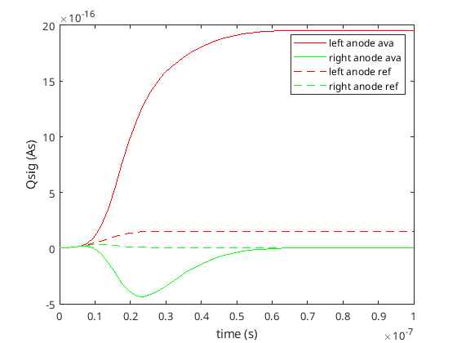
Simulated signal Evolution (charge)
left pixel
right pixel
solid - with avalanche
dashed - without avalanche
n+ contact
n+ contact
n field drop layer
10µm
p multiplication layer (ML)
450µm
p- drift region
450m
p+ cathode
100µm
generate test charge Qtest = 1.3x10⁻¹⁶ C
-> M = 14.8

Slide 15
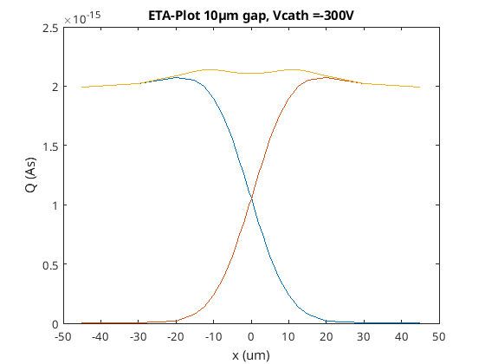
Gain in the Gap region
variation of injection position in x
left pixel
right pixel
n+ contact
n+ contact
n field drop layer
10µm
p multiplication layer (ML)
450µm
p- drift region
450m
p+ cathode
100µm
generate test charge Qtest = 1.3x10⁻¹⁶ C

Slide 16
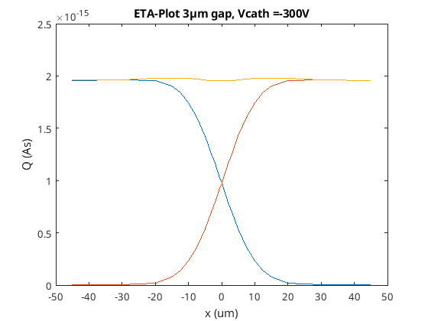
Gain in the Gap region
variation of injection position in x
left pixel
right pixel
n+ contact
n+ contact
n field drop layer
10µm
p multiplication layer (ML)
450µm
p- drift region
450m
p+ cathode
100µm
generate test charge Qtest = 1.3x10⁻¹⁶ C
reduce gap size
reduce gain inhomogeneity

Slide 17
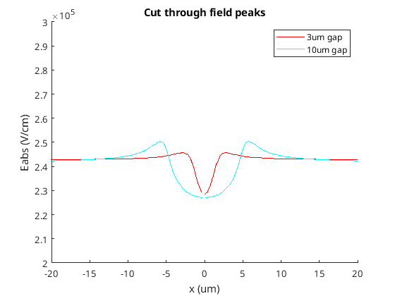
What happens in the gap region?
Gap loss gets ‘compensated’
field peaks
not at implant edges (no edge BD)

Slide 18
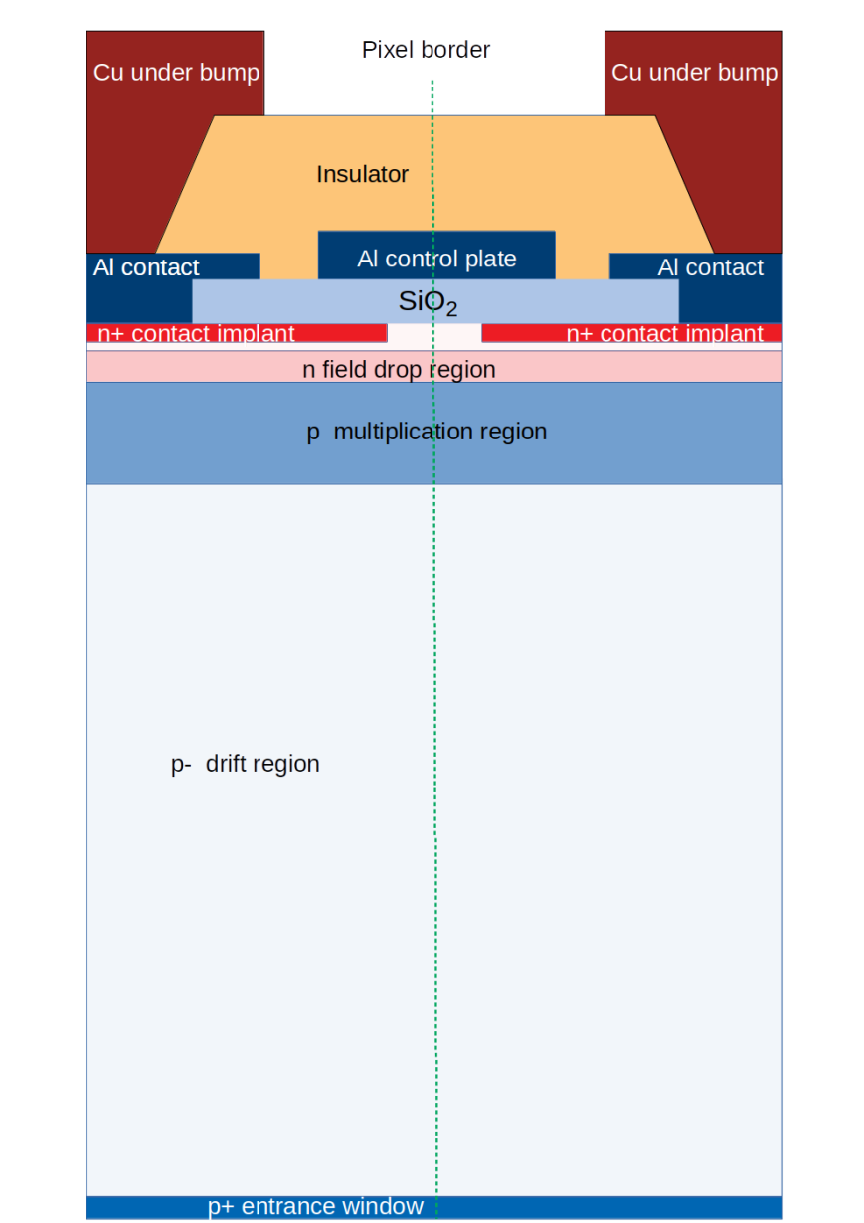
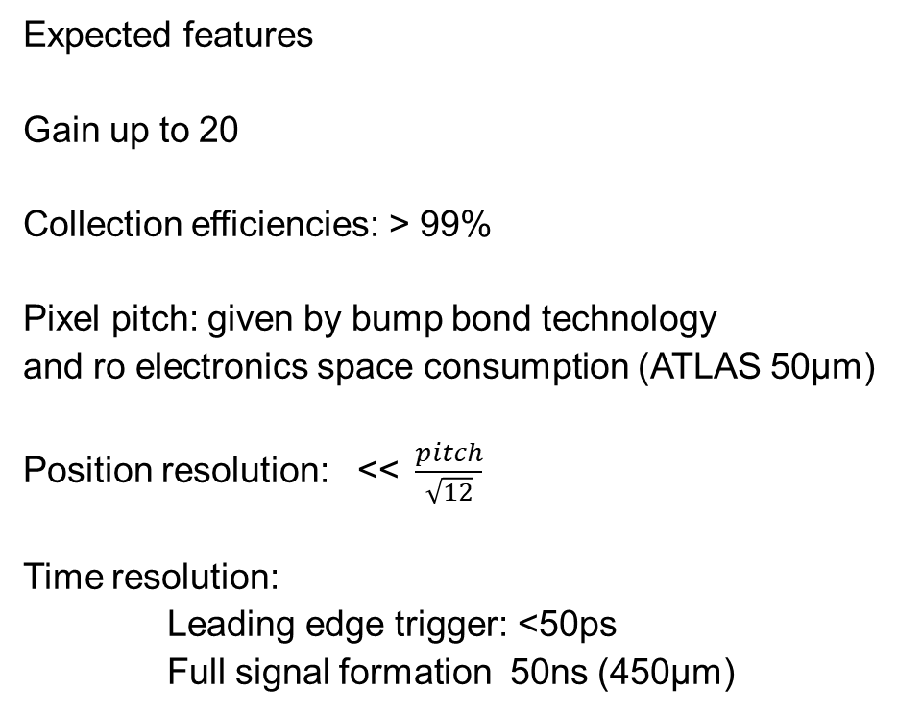
Final Array
Expected features
Gain up to 20
Collection efficiencies: > 99%
Pixel pitch: given by bump bond technology
and ro electronics space consumption (ATLAS 50µm)
Position resolution: <<$\frac{pitch}{\sqrt{12}}$
Time resolution:
Leading edge trigger: <50ps
Full signal formation 50ns (450µm)

Slide 19
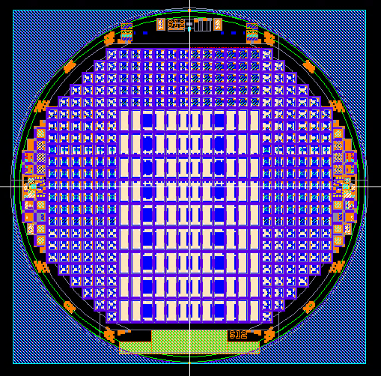
Prototype production
Aims
proof of principle
Efficiency, gain, cross talk, noise
find reliable narrow guard ring structure
(in view of buttable arrays)
Vinn_guard
n+ pixel or strips
Vbias
via CE
Vframe
MOS grid
high field
p- bulk
backside p+ entrace window
non structured, no Al
Pixel Strips Diodes MGR Diodes
production finished
tests started

Slide 20
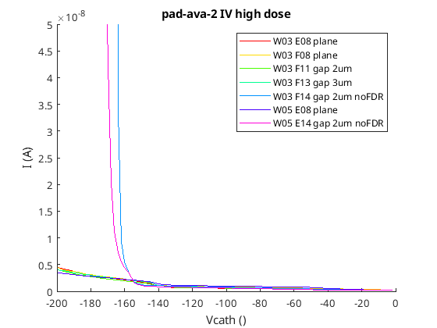
APD Diodes with and without Gaps
diodes 2x2mm²
N+
N+
N+
p multiplication layer
diode with gaps
but without FDL
N+
n field drop layer
p multiplication layer
plane diode
N+
N+
N+
diode with gaps
and FDL
n field drop layer
p multiplication layer
Edge breakdown suppression
works as intended

Slide 21
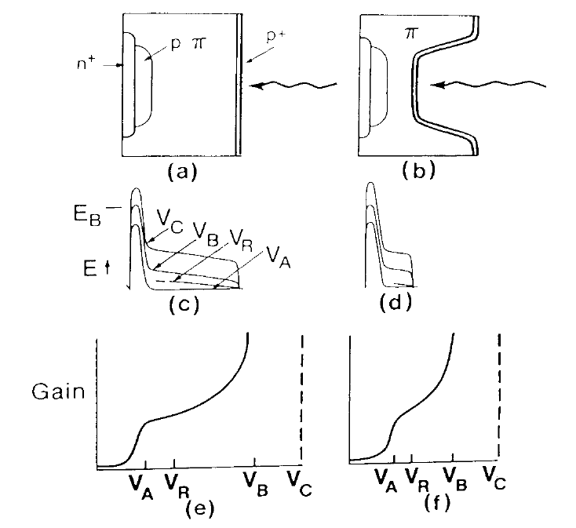
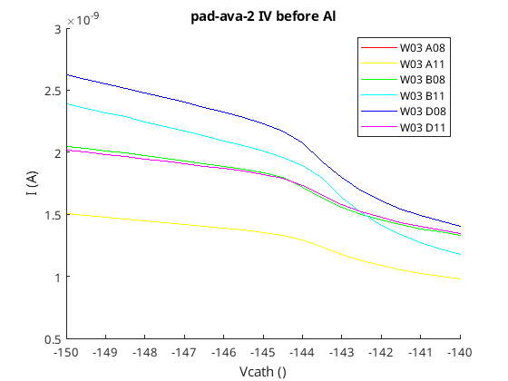
Homogeneity of high energy implantation (multiplication region)
Typical Reach-Through APD IVs
R. J. McIntyre, 1985
diodes with gaps
point of inflection V_{A}
p multiplication region fully depleted
V_{A}
no difference between diodes and gap diodes
(preliminary)

Slide 22
summary
MARTHA – a new approach for an APD pixel array
operated in RT proportional mode
no inter pixel dead space
suitable for large pixel arrays
low excess noise due to HE high field implantation
First prototyping – small APD arrays and strips
will be tested further soon

Slide 23

Outlook
next steps:
proof of concept measurements (started)
discussions with potential users and ASIC designers
MARTHA sensors can also be produced on thinned wafers
  improved timing capabilities
n+ anodes
p
high field region
p-
thin p+ cathode
t_handle_wafer ≈ 400µm
t_{APD} $≳$ 20µm
light entrance window
Notes:
t_{APD} = 20µm: drift times (triggering electrons + amplified holes) ≈ 0.5ns
ED100V: 1.46 * 10¹⁰ cm⁻² (450µm), ≈ 3 * 10¹¹ cm⁻² (20µm)
To switch on the gain from 1 to 10: ΔD_{p} < 2 * 10¹¹ cm⁻² (t_{HF} = 5.5µm) or ≈ 65V
Build a 20µm detector with M = 1 @V_{depl} and M ≈ 10 @65V overbias
play around with thicker sensors and wider t_{HF} …

Slide 24
Thanks for your attention
R. Richter, A. Bähr, J. Damore,
Ch. Koffmane, R. Lehmann,
J. Ninkovic, G. Schaller,
M. Schnecke, F. Schopper, J. Treis

Slide 25
Backup Slides

Slide 26
Pixel Capacity
expected pixel capacity
50um Pixel 3um gap: ca. 35fF
50um Pixel 10um gap: ca. 20fF

Slide 27
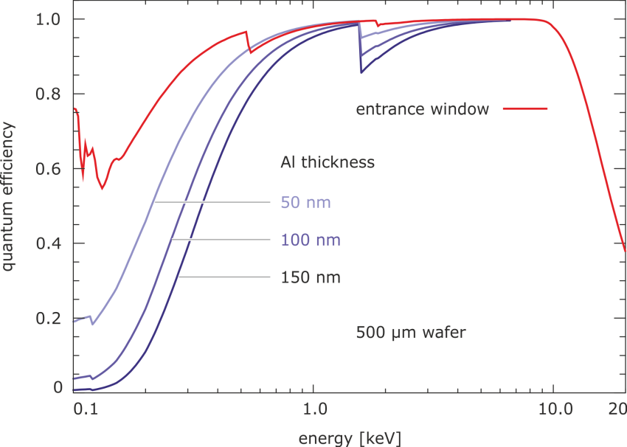
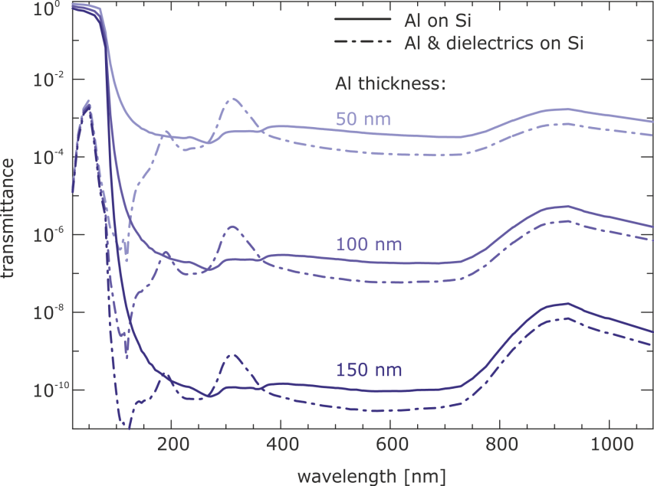
HLL thin entrance window
fully depleted
  sensitive over the complete bulk
  thickness 50 .. 450 .. 1000 µm
  thin, non-structured entrance window
  QE > 90% for 0.3 keV < E < 15 keV
  radhart @ soft X-rays (self shielding)
backside irradiation
  100 % fill factor
  optional light (& UV) filter
integrated first amplifier
  low noise
  fast readout
  emi robust

Slide 28
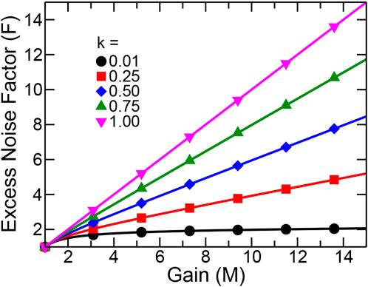
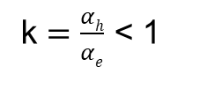
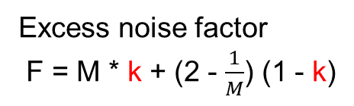
Optimization for soft X-ray detection
(low excess noise)
Excess noise factor
F = M * k + (2 - $\frac{1}{M}$) (1 - k)
deep implant (6 µm)
extend ML
k $=\frac{αh}{αe}$ < 1
A. Pilotto et. al. (2022)
The lower E the lower k
the lower the noise but the lower gain!
Notes:
high energy implant + low bulk doping ensures
flat ‘plate capacitor like‘ electric field distribution
Wide high field region -> lower e-field (same gain)
-> lower k factor -> lower excess noise factor

Slide 29
MPG HLL
At present
Siemens Campus Neuperlach Munich
New building
IPP Campus Garching
in autumn 2023 – move started
1000m² of clean room area
330m² of ISO3 area
Full 6 inch silicon process line
1500m² of clean room area
600m² of ISO3 & ISO4 area
8 inch silicon process line
Central facility of the Max Planck Society
40 scientists, engineers and technicians
+ guest scientists, and students

