Slide 1
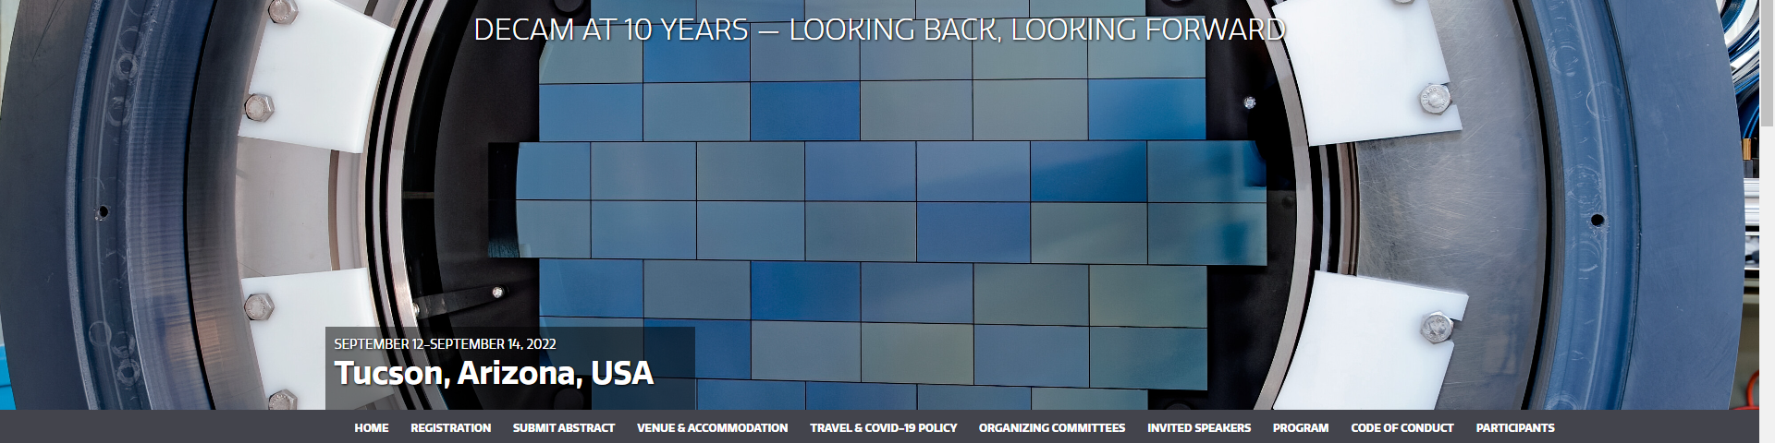
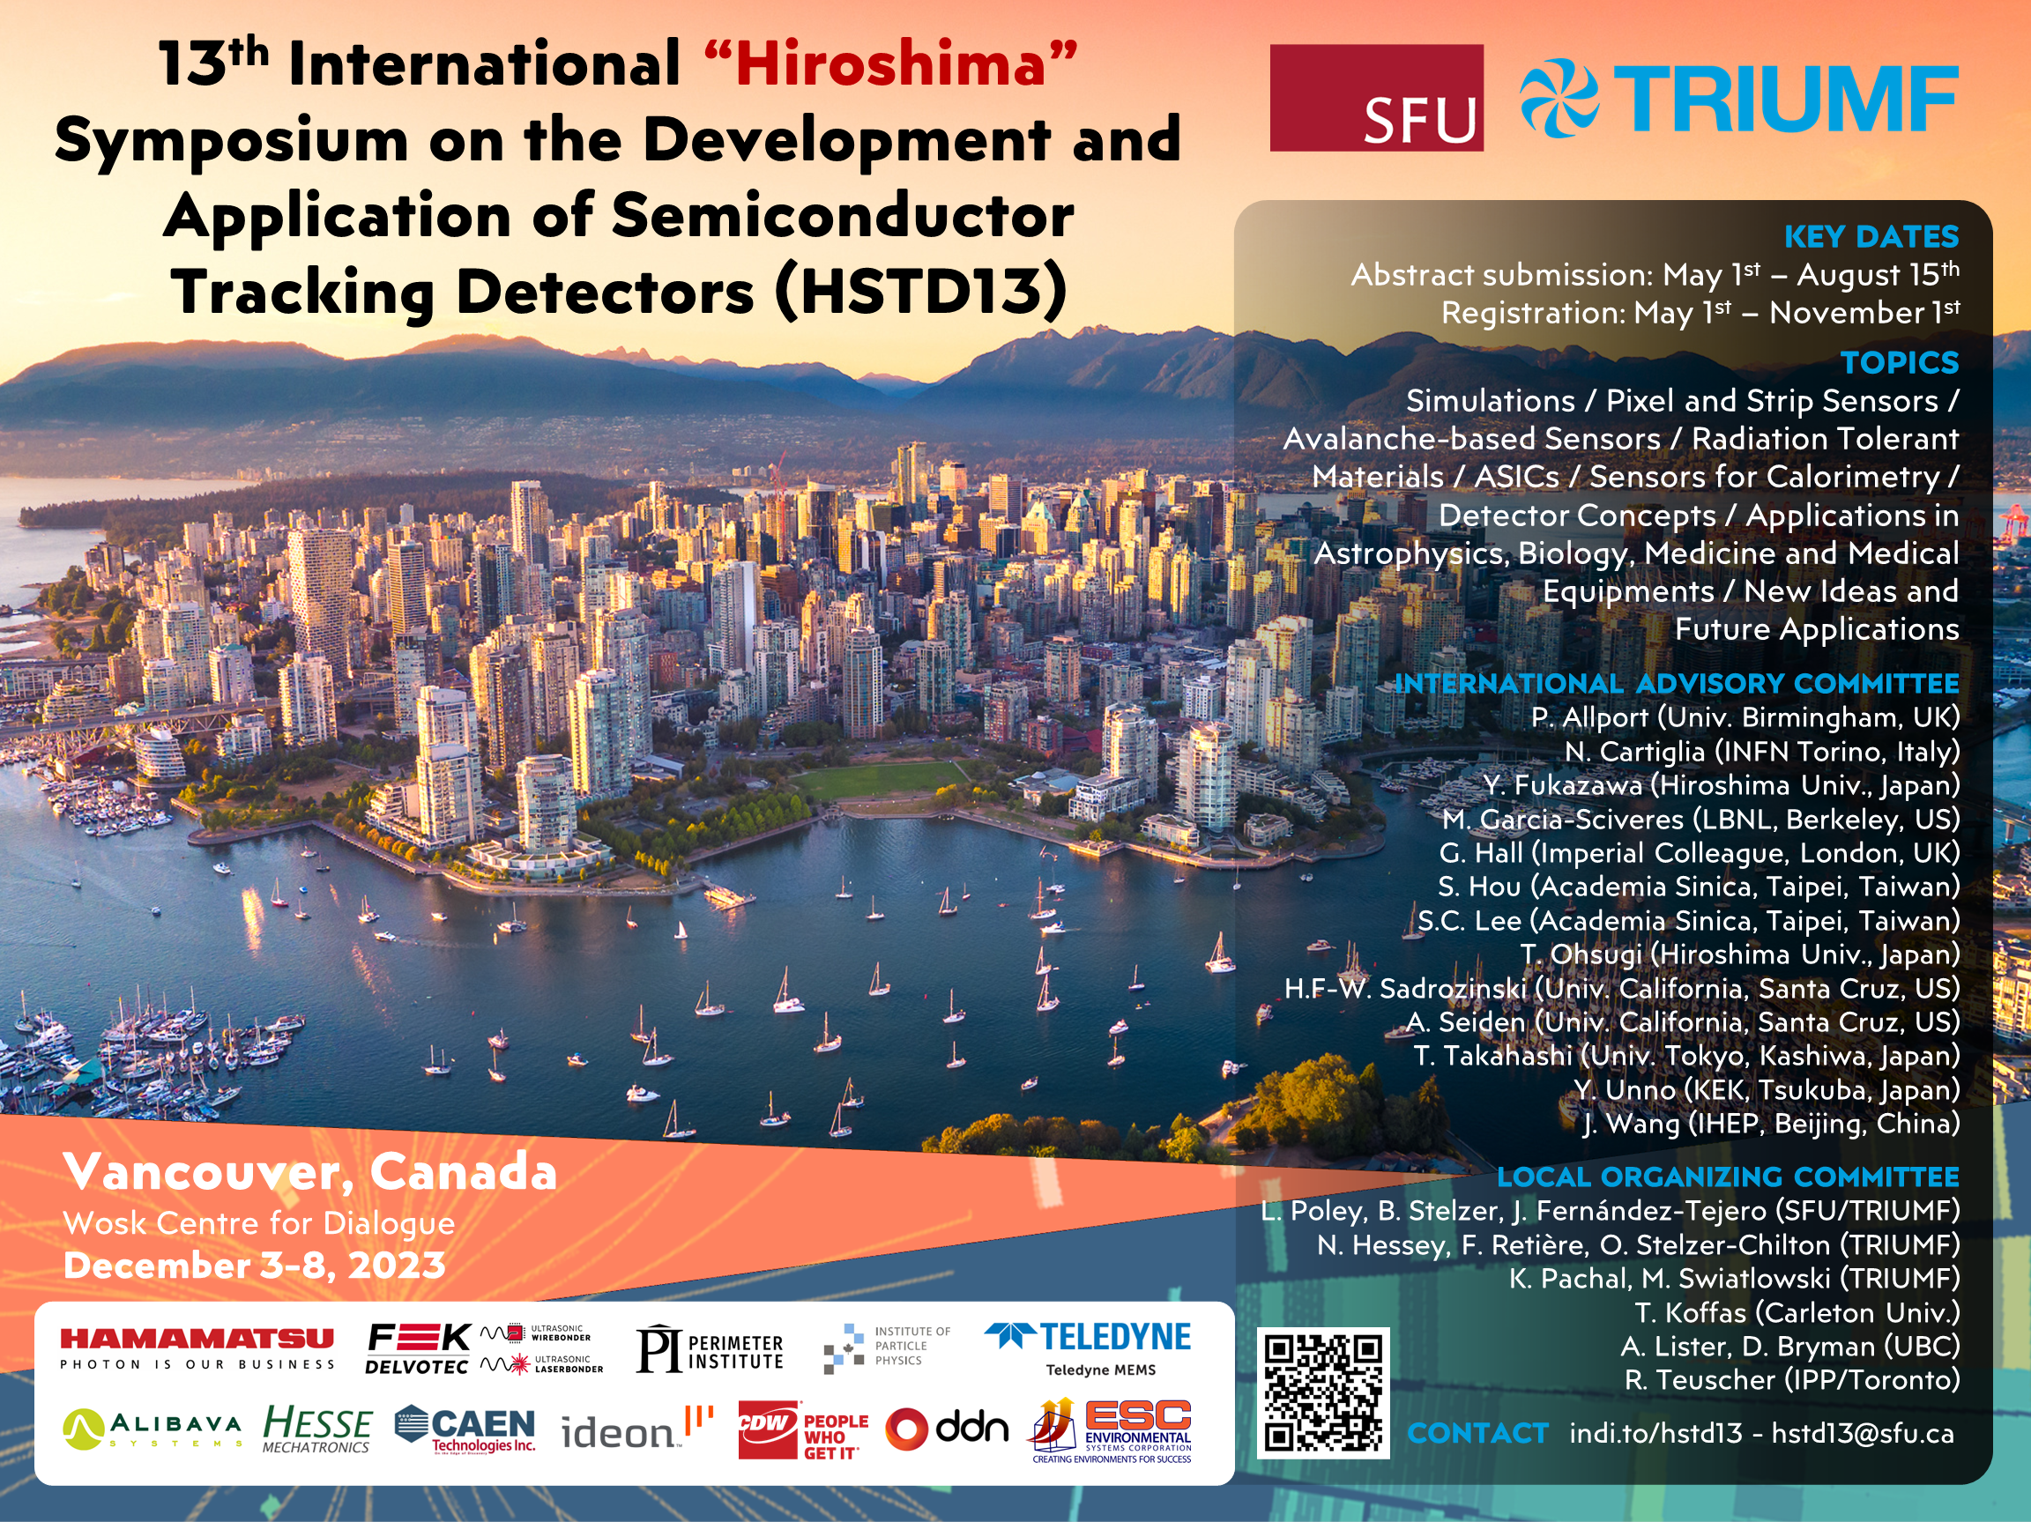
Single-electron counting, fully depleted charge-coupled devices for dark matter detection
Steve Holland
Lawrence Berkeley National Laboratory
December 7th, 2023

Slide 2

Outline
Fully depleted CCDs: basic concepts and applications in astronomy
Direct Dark Matter detection with single-counting Skipper CCDs / Multiple-amplifier sampling CCDs

Slide 3
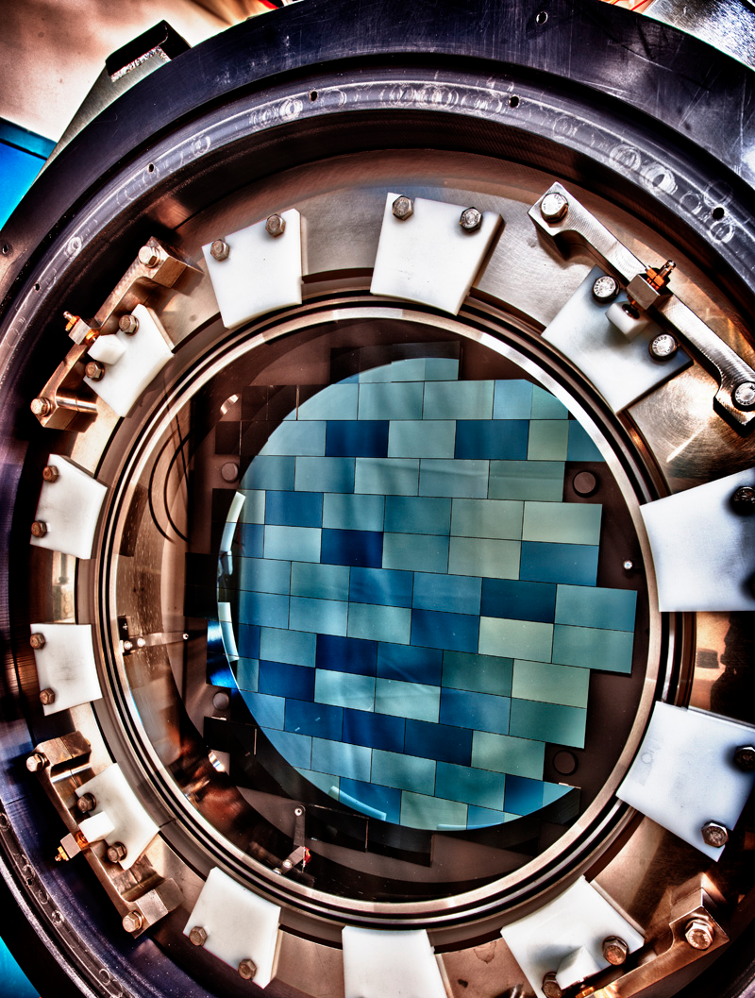
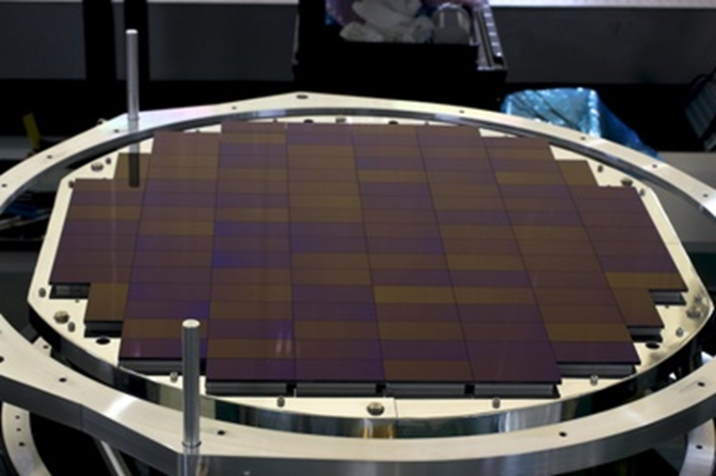
DOE Stage III Dark Energy Survey (2013-2019)
HyperSuprime CAM
870 Mpixels
200 um thick, fully depleted CCDs
Hamamatsu Corporation
Satoshi Miyazaki (PI) and Yukiko Kamata (CCD testing)
National Astronomical Observatory of Japan
Dark Energy Camera: FNAL/LBNL
570 Mpixels
250 um thick, fully depleted CCDs
Teledyne DALSA Semiconductor/LBNL
DOE Stage 3 Dark Energy project
Cryogenic operation ~ 140K
~ 100 kpixels/sec
HEP detector spinoff

Slide 4
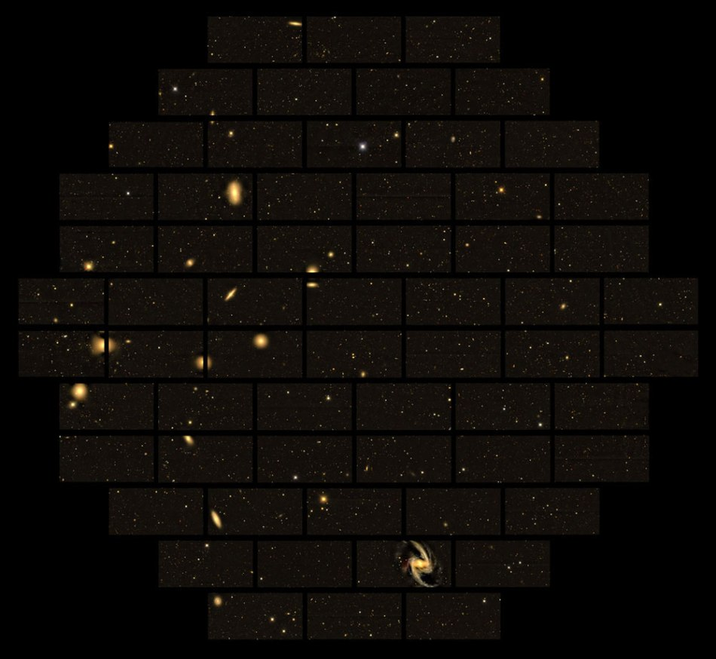
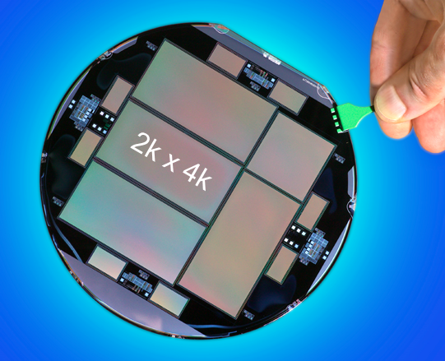
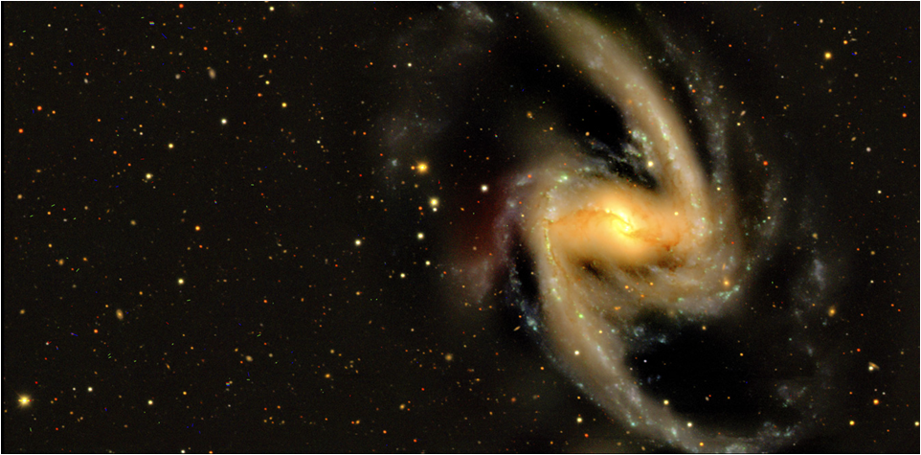
DOE Stage III Dark Energy Survey (2013-2019)
Dark Energy Camera
1st light Sept 2012
1.1M + images to date
150 mm high resistivity Si
(15 um)² pixels

Slide 5

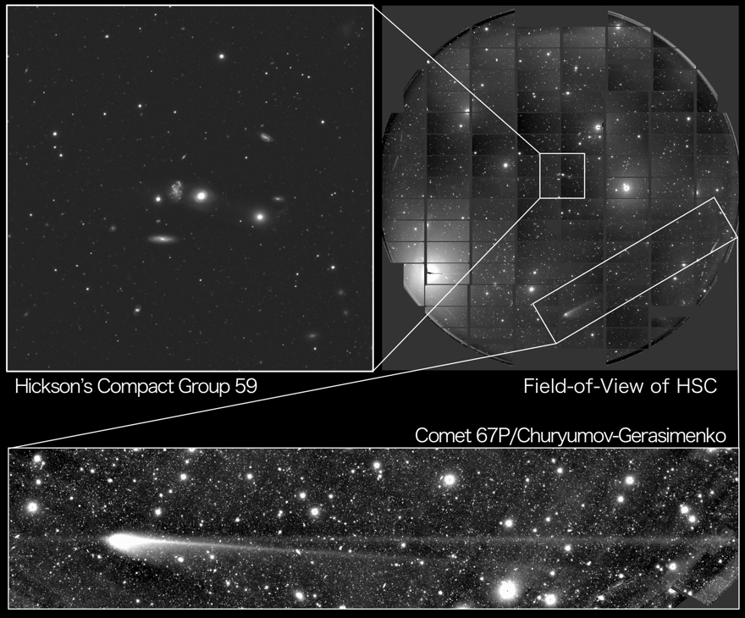
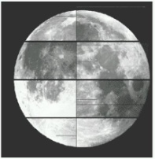
Full moon for scale
HyperSuprimeCam – 116 2k x 4k, (15 µm)²-pixel CCDs (870 Mpixels)
CCDs from Hamamatsu Corporation / Subaru 8-m Telescope

Slide 6
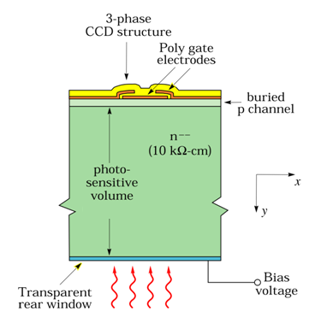
Fully depleted CCDs 101
CCD fabricated on a high-resistivity silicon substrate that is fully depleted by the application of a substrate bias
Merging of CCD / p-i-n detector
  HEP spinoff
Typical thickness for astronomy is 200 – 250 µm
Thick device results in high near-infrared response
Main advantage for astronomy
  Detect high redshift objects
Not to scale

Slide 7
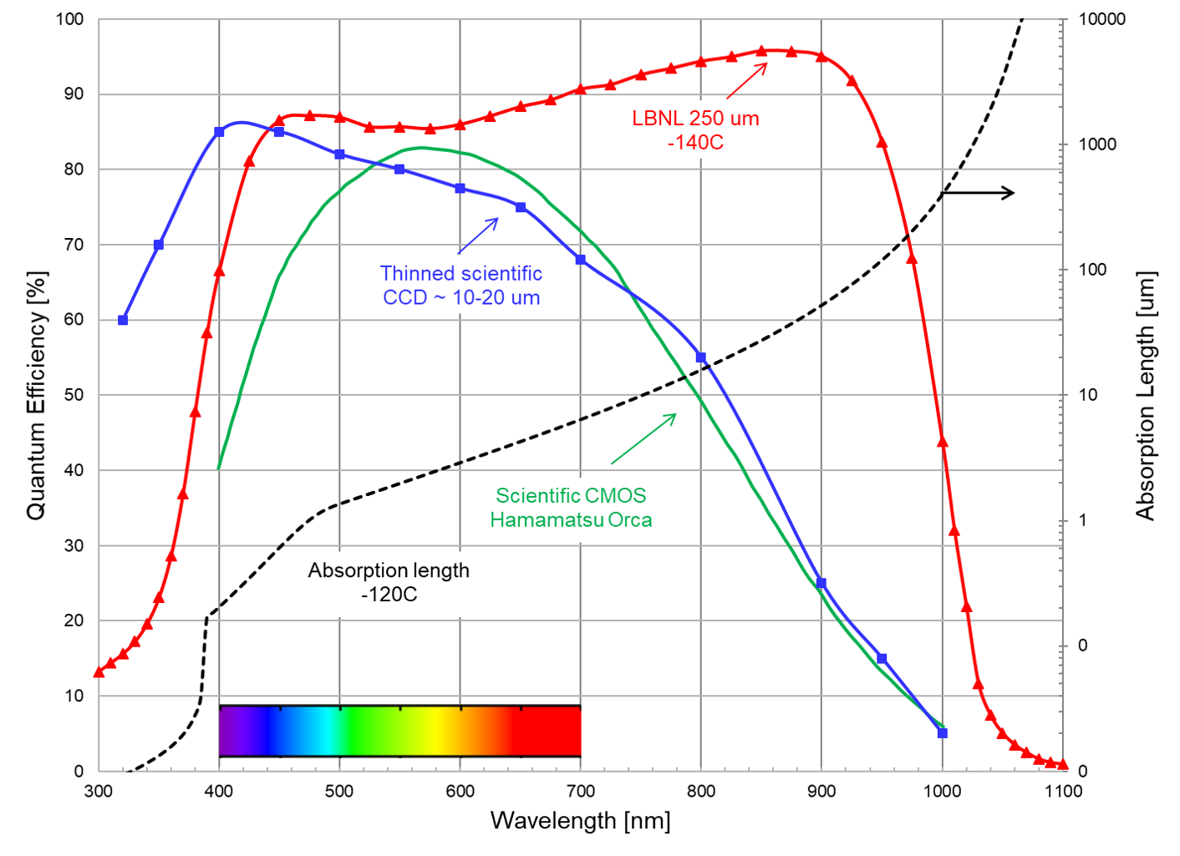
Near IR – Silicon becoming transparent, E_{ph}< Si bandgap (~ 1.1 eV)
Blue end – Strong absorption in dead layers (n⁺ of p-i-n structure)

Slide 8
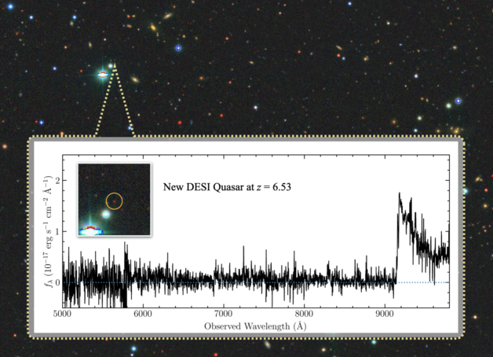
Dark Energy Spectroscopic Instrument
DOE Stage 4 Dark Energy project

Slide 9
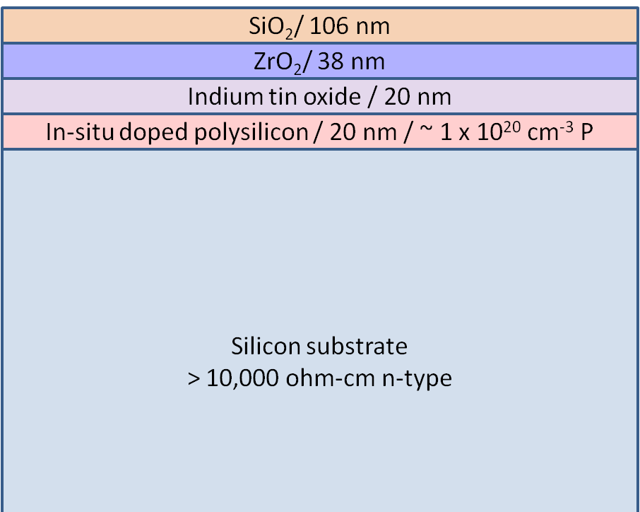
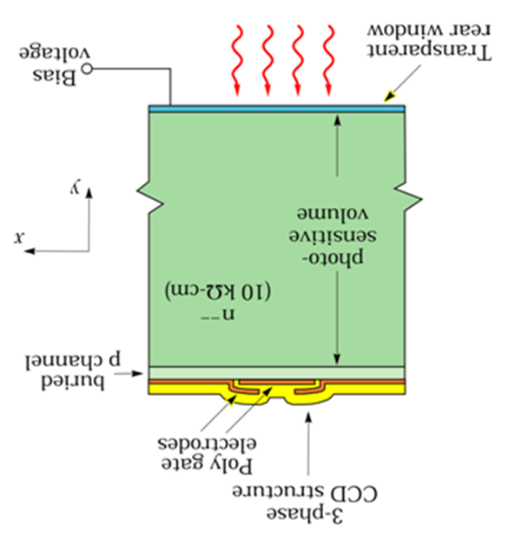
Backside layers: LBNL CCDs
TEM cross-sectional image
AR coating design by Don Groom
SiO₂
ZrO₂
ITO
n+ polysilicon
In-situ doped polysilicon
High-ρ n-type substrate
Silicon substrate

Slide 10
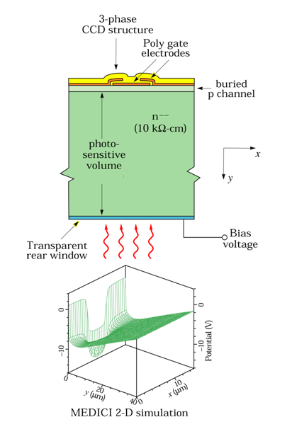
Fully depleted CCDs / 2D simulations
V_{sub} = 80V
V_{sub} = 30V
MEDICI simulations
Potential minimum (collecting phase)
Relatively insensitive to Vsub
Capacitor voltage divider effect
Wide range of V_{sub} possible

Slide 11
Fully depleted CCDs in space applications
Transiting Exoplanet Survey Satellite
Launch date April 18, 2018
4 x 4096 x 4096 (15 um)² pixels
100 um thick
Fabrication at MIT Lincoln Laboratory
Xtend soft x-ray imaging telescope
XRISM
Launch date Sept 6, 2023
4 x 1028 x 1028 (24 um)² pixels
200 um thick
Fabrication at Hamamatsu Corp
https://doi.org/10.1002/asna.20230139
https://doi.org/10.1117/12.2626894
https://doi.org/10.1117/12.2560348
https://doi.org/10.1016/j.nima.2020.164676

Slide 12
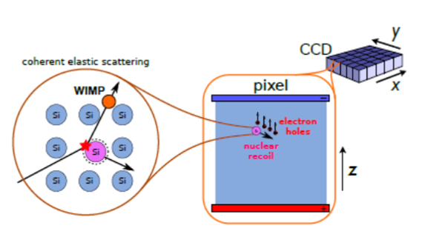
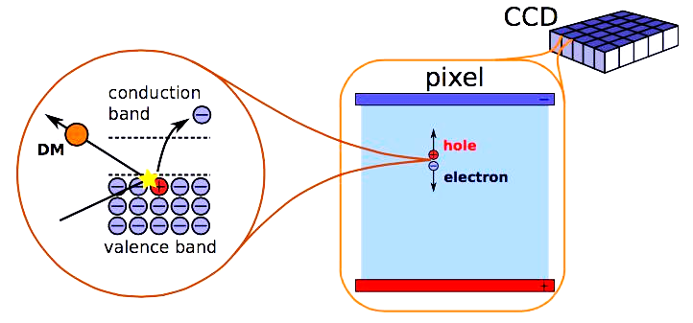
Dark Matter detection with CCDs
Proposed by Juan Estrada et al of FermiLab (2008)
    https://doi.org/10.48550/arXiv.1105.5191
  Low noise / improves low-energy detection threshold
    Si bandgap ~ 1.1 eV
  Thick CCDs for larger mass/CCD
  Expected dark-matter particle interactions
    Nuclear recoil (silicon nucleus)
    Scattering off electrons
Si

Slide 13
Dark Matter detection with CCDs
  1st underground engineering run / one 4 Mpixel DECam CCD
    https://doi.org/10.1016/j.physletb.2012.04.006
      2 e- noise (2012) now deep sub-electron (Skipper CCDs)
      250 um thick (2012) now 650-725 um (all fully depleted)
      Dark current orders of magnitude less than astronomy CCDs
      All processing at foundry
        ~ 5 – 6 um backside P layer from the gettering process
    SENSEI / DAMIC-M / OSCURA are 0.1/1/10 kg scale

Slide 14
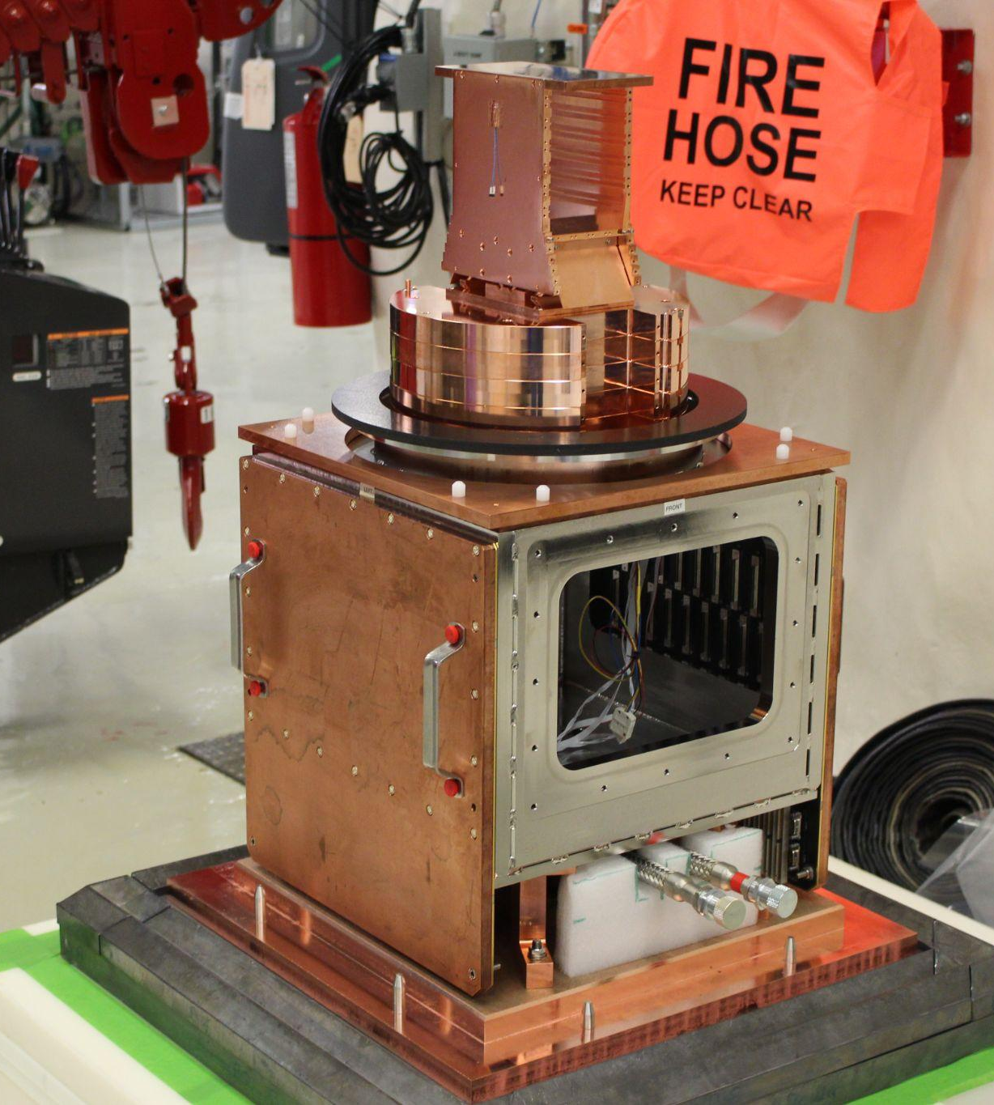
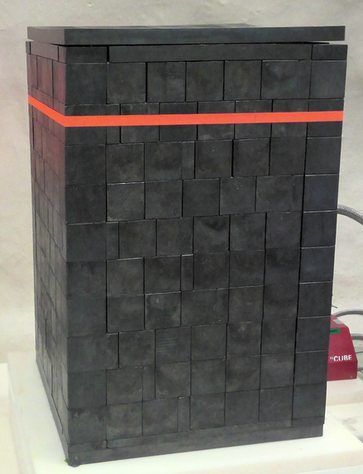
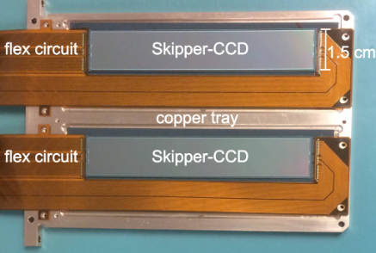
LBNL Dark Matter CCD development
Copper cryostat
Lead shield
SENSEI@SNOLAB
2 km underground
100 g scale experiment
1 lot of 25 wafers
Full fabrication at DALSA
6k x 1k / (15 um)² / 650 um thick
1st science run was
9/2022 – 4/2023

Slide 15
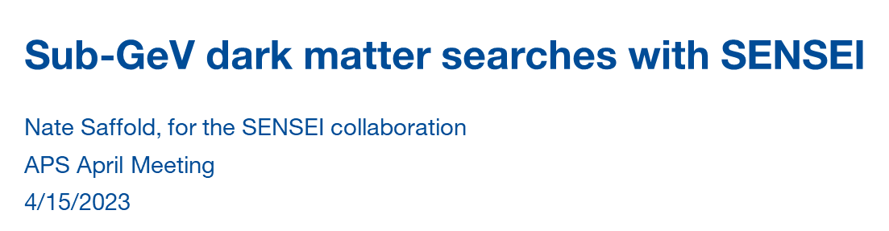
DESI (astronomy) vs SENSEI (DM)
Parameter | DESI | SENSEI¹
CCD format Thickness | 4k x 4k (15 um)² 250 um | 6k x 1k (15 um)² 650 um
Read noise | 2.5 – 3.0 e- rms | 0.13 e- rms See note 1
Dark current | ~ 1 e-/pixel-hour (133K) | ~ 1.6 x 10⁻⁴ e/pix-day (135K) See note 2
Exposure time | 15 minutes | 20 hours
Readout time | 1 minute | 7.7 hours
Note 1: Skipper CCD with 300 samples / pixel
Note 2: Cold Cu, some shielding / 100 m underground
Number quoted is the single-electron event rate
PRL 125.171802
1

Slide 16
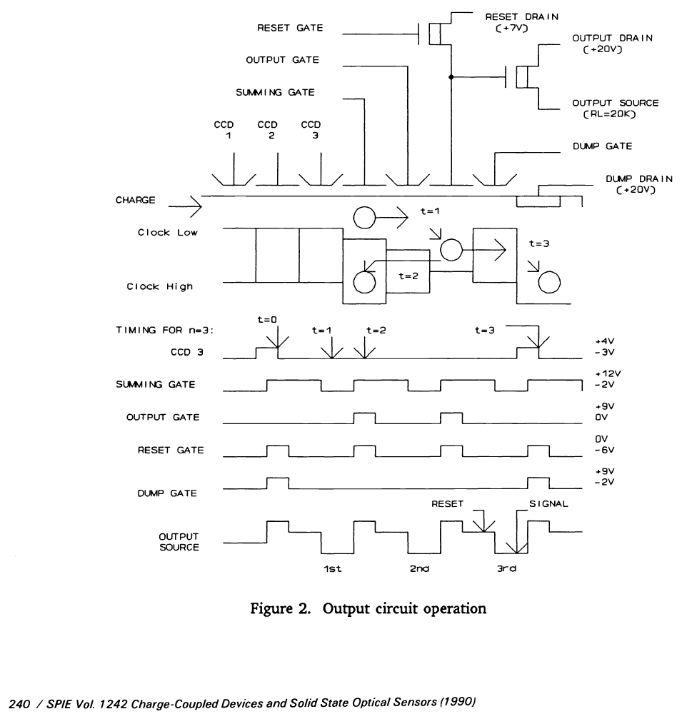
Skipper CCD operation
Invented by Jim Janesick
  U.S. patent 5250824 (1993)
Based on the floating-gate amplifier (1970’s)
https://doi.org/10.1117/12.19452
https://doi.org/10.1117/12.19457
Multiple, nondestructive reads of the charge (floating-gate)
Noise ∝ Inverse square root of the number of samples
  1990 results
    0.5 e- noise but no improvement after 256 samples

Slide 17
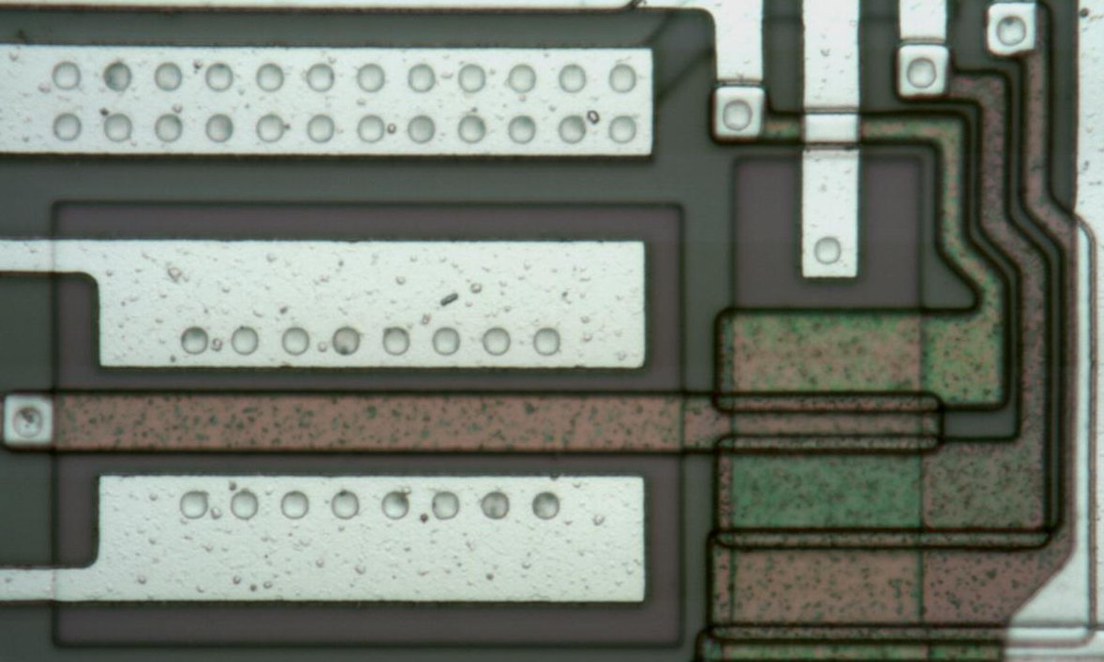
Floating-gate amplifier
LBNL implementation (floating-gate amplifier)

Slide 18
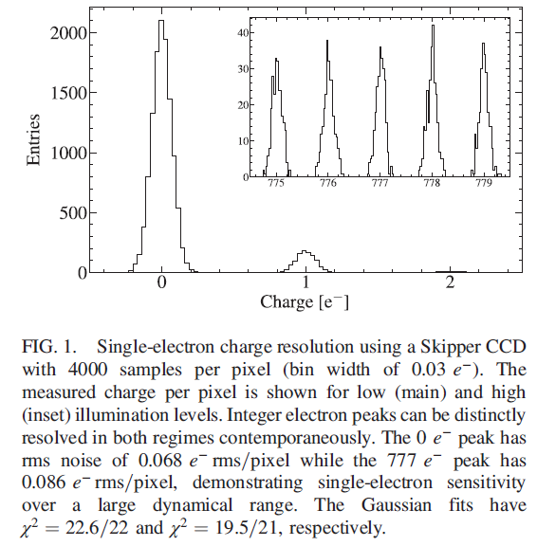
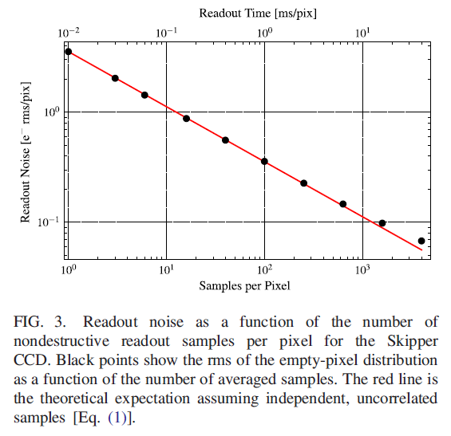
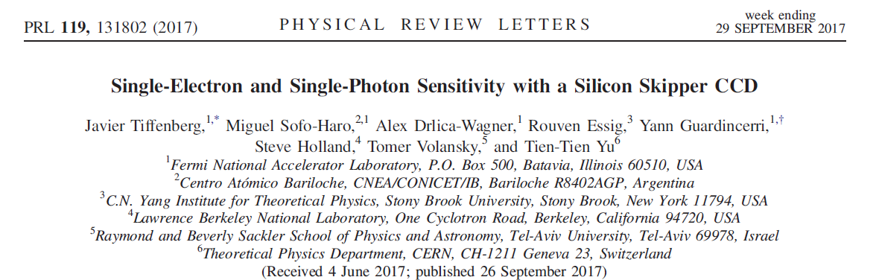
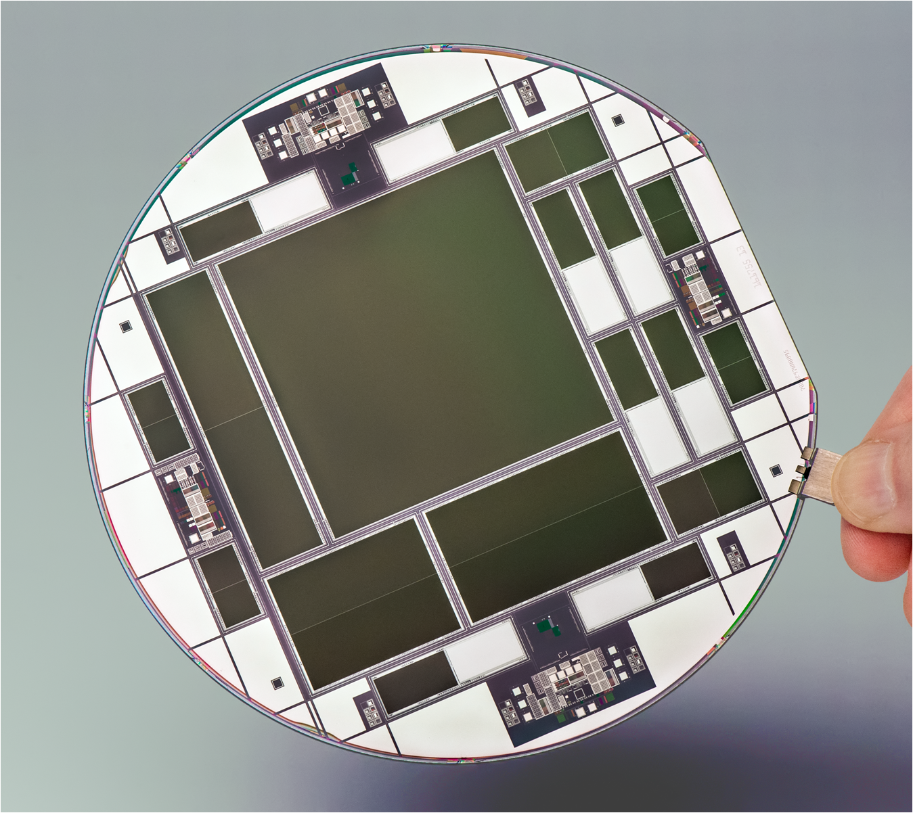
Version 2 Skipper CCD tested at FermiLab
2nd version (LDRD 2013)
  0.068 e⁻ after 4k samples (2017)
FG amplifier CCDs
https://doi.org/10.1103/PhysRevLett.119.131802

Slide 19
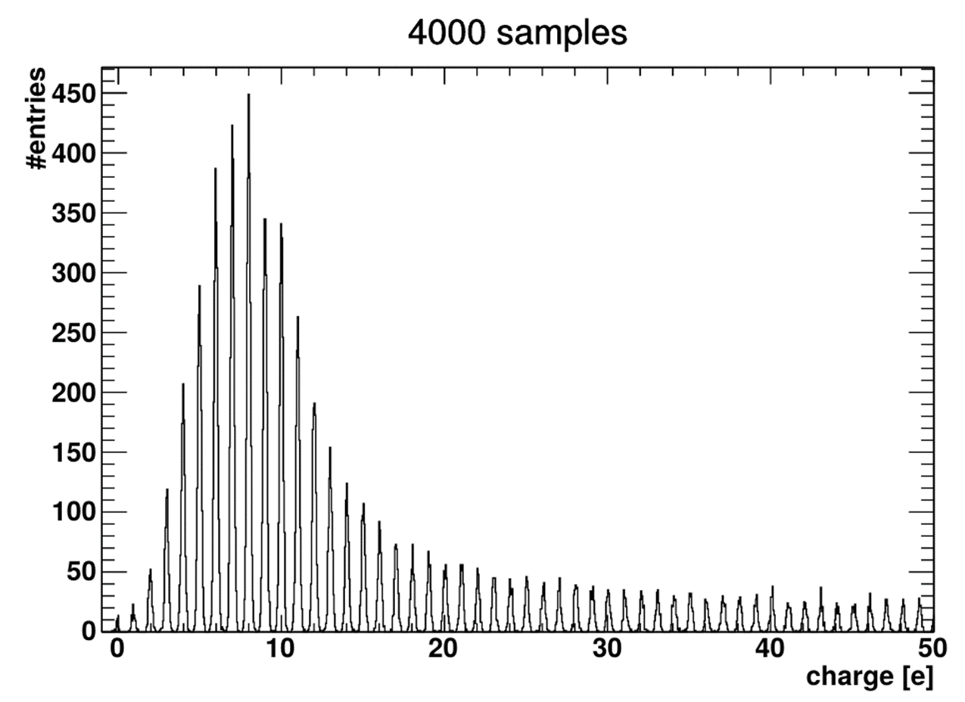
Version 2 Skipper CCD tested at FermiLab
2nd version (LDRD 2013)
  Low-level light charge histogram (FermiLab)
FG amplifier CCDs

Slide 20
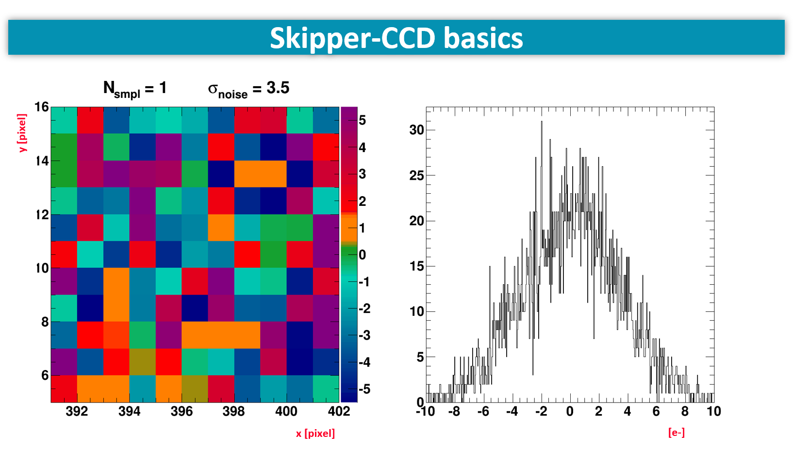
Measurements and animation from FermiLab

Slide 21
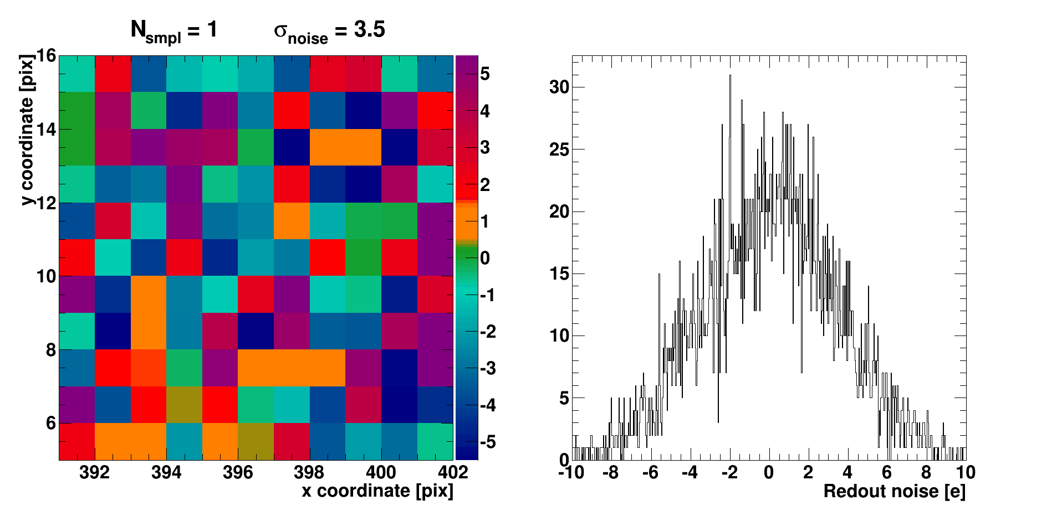
Skipper-CCD basics
y [pixel]
x [pixel]
[e-]
Measurements and animation from FermiLab

Slide 22
Dark Matter detection with CCDs
Following topics
  “Dark current” / background single-electron rates
    Astronomy versus dark matter CCDs with shielding
  Particle ID via energy deposit and spatial signature
  Depletion of thick CCDs (650 – 725 um thick)
  Faster readout Skipper CCDs for astronomy
HyperSuprime Cam
Astronomy
Lead shield
SENSEI
Dark Matter

Slide 23
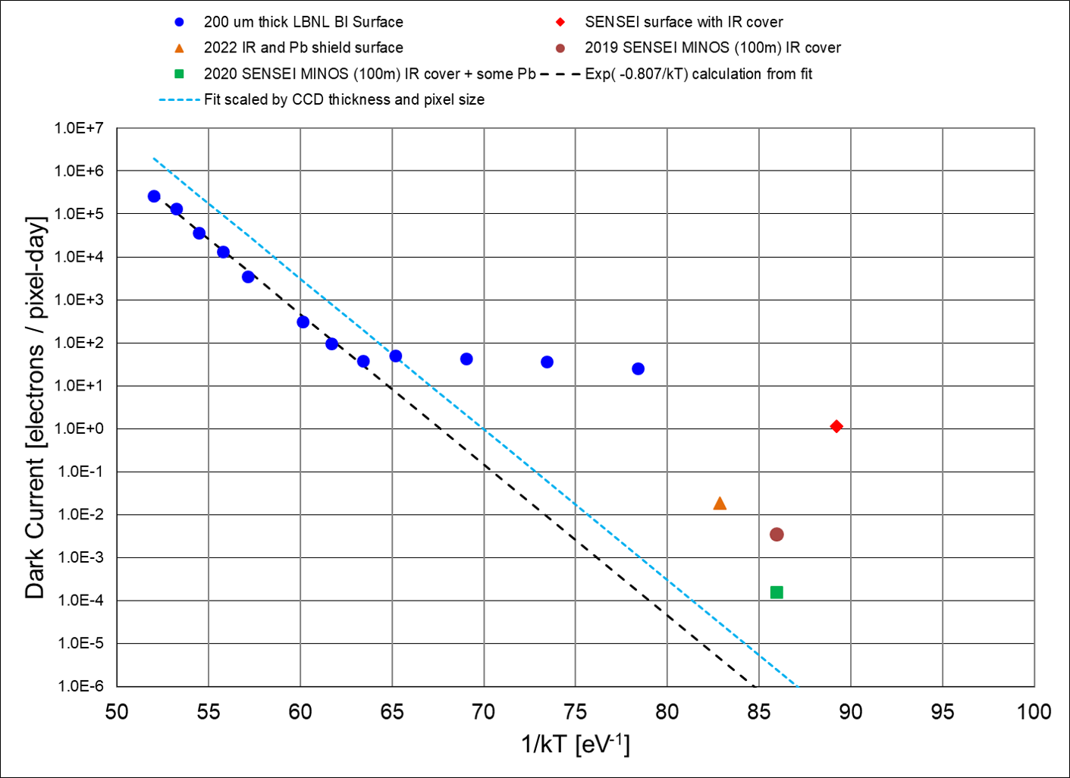
Publications
2018 Surface run prototype CCD
  PRL 121.061803
2019 Underground prototype CCD
  PRL 122.161801
2020 Underground science CCD
  PRL 125.171802
2022 Surface IR and Pb shield
  PhysRevApplied.17.044050
2022 Cherenkov / e/h recombination
  PhysRevX.12.011009
CCD DM background count rates not dominated by SHR electron-hole generation (dark current)
  IR shielding (cold Cu surrounding the CCD) / Underground / Pb shielding
  Carefully chosen, low-background radiation materials near the CCD

Slide 24
Dark Matter detection with CCDs
Following topics
  “Dark current” / background single-electron rates
    Astronomy versus dark matter CCDs with shielding
  Particle ID via energy deposit and spatial signature
  Depletion of thick CCDs (650 – 725 um thick)
  Faster readout Skipper CCDs for astronomy
HyperSuprime Cam
Astronomy
Lead shield
SENSEI
Dark Matter

Slide 25
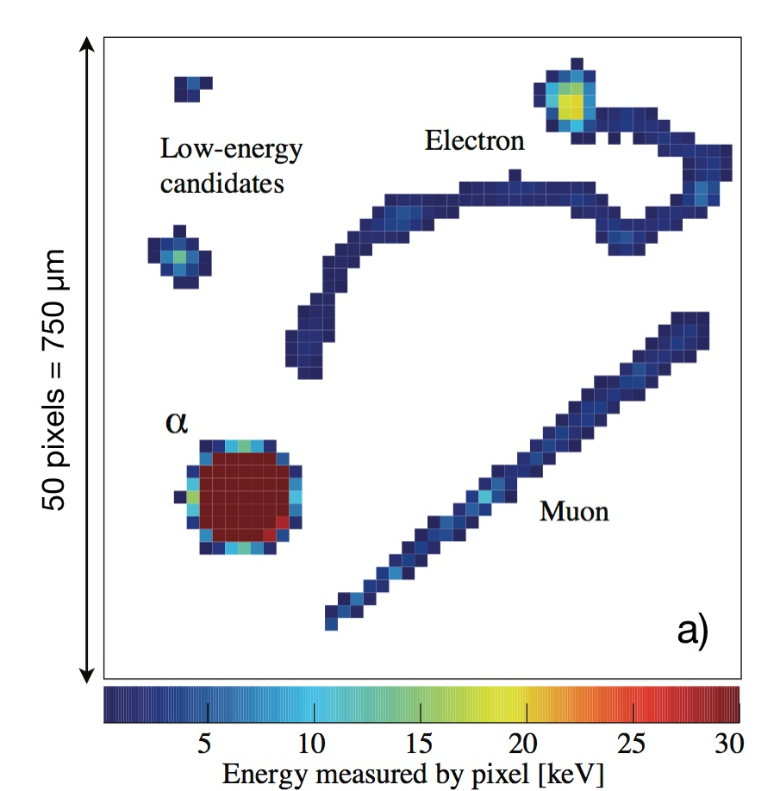
Dark Matter detection with CCDs
Fully depleted CCDs for dark-matter detection cont’
  Particle identification for background suppression
    Spatial correlation and energy measurement

Slide 26
Dark Matter detection with CCDs
Fully depleted CCDs for dark-matter detection cont’
  Radioactive contamination in the silicon substrate
    Decay chain products spatially correlated (double β event below)
              Candidate ³²Si – ³²P event
              Cosmogenic activation of silicon
              Rejected by spatial / energy / decay time correlation
https://iopscience.iop.org/article/10.1088/1748-0221/10/08/P08014

Slide 27
Dark Matter detection with CCDs
Following topics
  “Dark current” / background single-electron rates
    Astronomy versus dark matter CCDs with shielding
  Particle ID via energy deposit and spatial signature
  Depletion of thick CCDs (650 – 725 um thick)
  Faster readout Skipper CCDs for astronomy
HyperSuprime Cam
Astronomy
Lead shield
SENSEI
Dark Matter

Slide 28
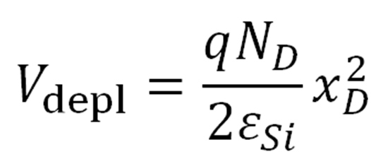
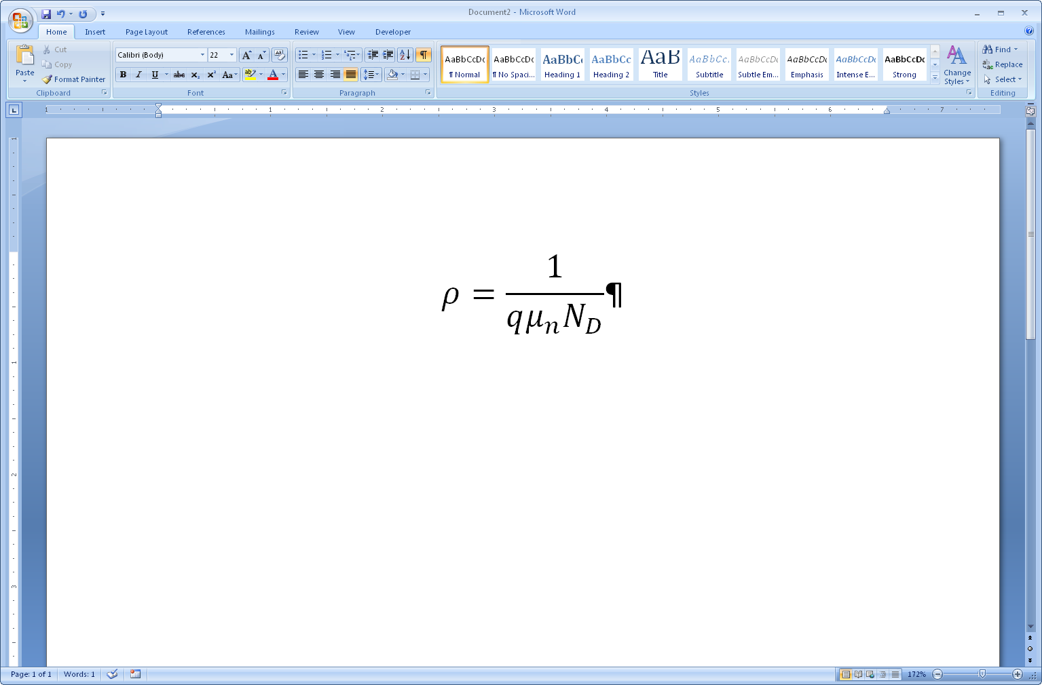
Dark Matter detection with CCDs
CCD mass is limited by the standard wafer thickness
    675 µm for 150 mm, 725 µm for 200 mm wafer
    Depletion voltage goes as (thickness)² and (resistivity)⁻¹
Two advances for thick CCDs
  Improvements in the production of float-zone silicon
    Higher resistivity / lower depletion voltage
  LBNL high-voltage compatible CCD designs
    DOI: 10.1109/TED.2009.2030631 and https://doi.org/10.1117/12.672393

Slide 29
Enabling technology: Float-zone silicon
Si Ingot
Heater
Melt
Zone
V_{depl} ~ 90 – 120V for 15 – 20 kohm-cm and 725 um thick (200 mm)

Slide 30
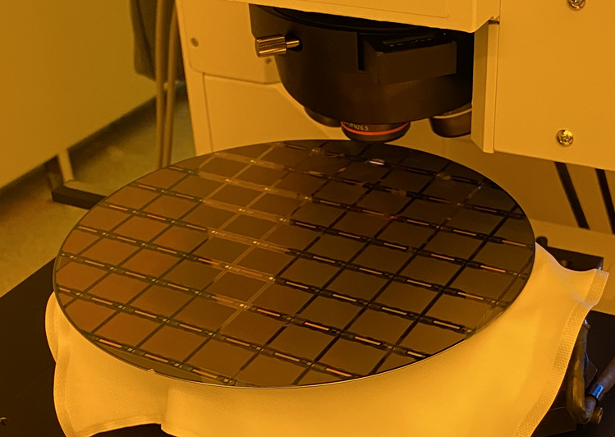
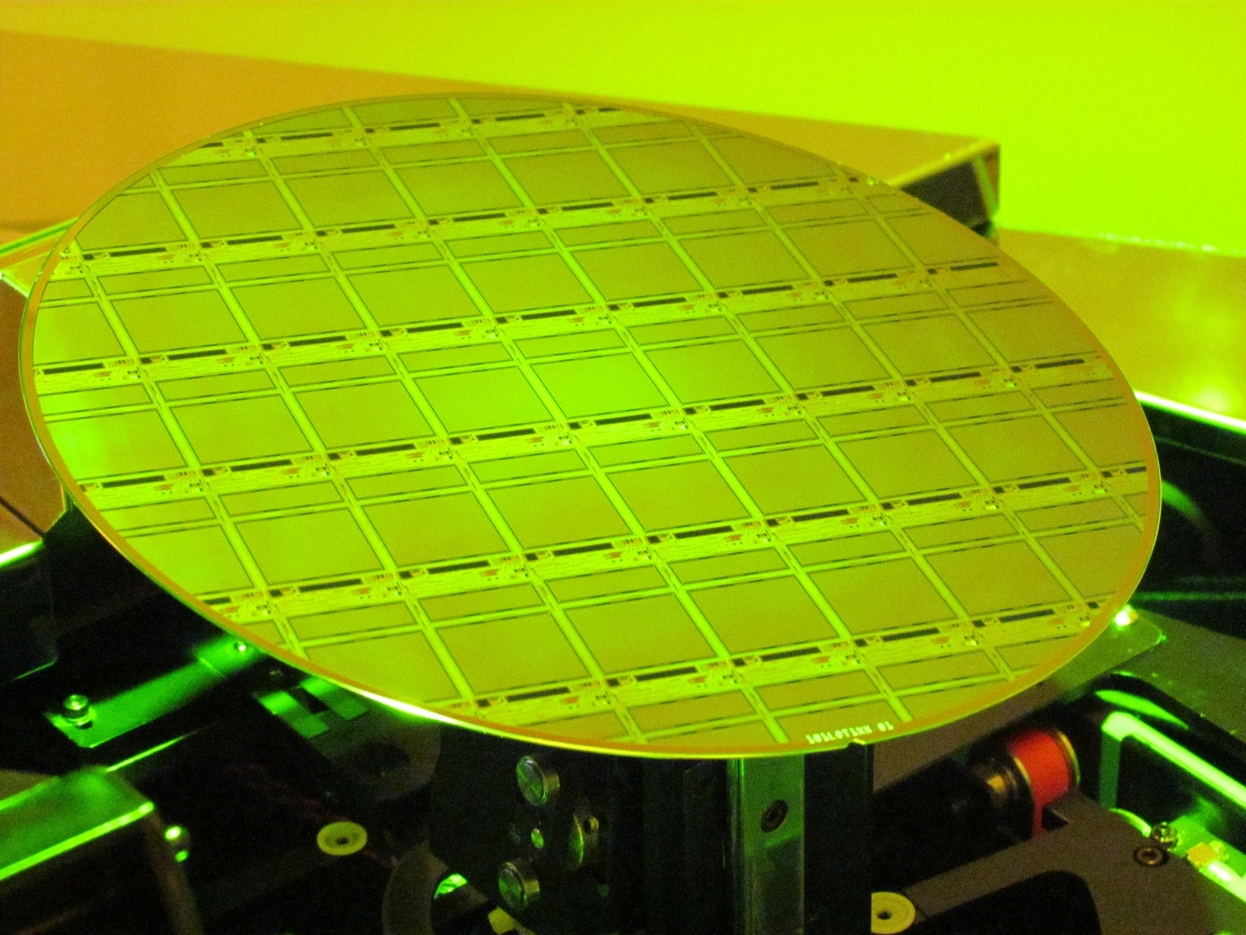
LBNL Dark Matter CCD development
OSCURA
Observatory of Skipper CCDs Unveiling Recoiling Atoms
Technology transfer of the LBNL p-channel fully depleted technology to Microchip Technology (above left) and Lincoln Laboratory (above right)
    200 mm wafers with step-and-repeat photolithography
    10 kg scale (~20k 1Mpix CCDs, 10x more pixels than Rubin/LSST)

Slide 31
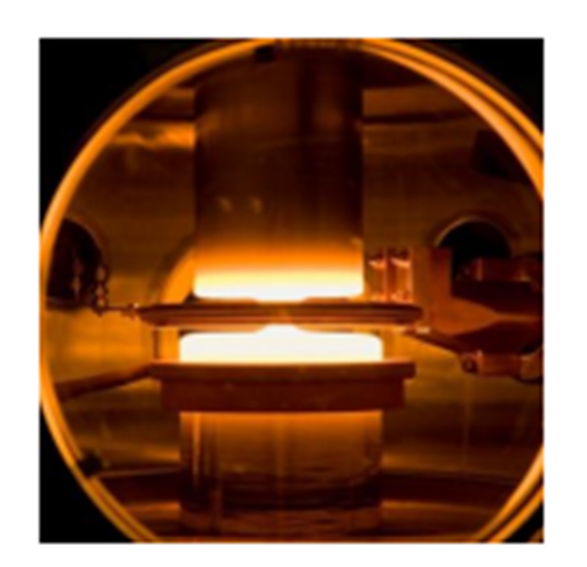
Year Acquired | Topsil Crystal # | Resistivity ρ (kΩ-cm) | Lifetime τ (ms)
2009 | 2142946 | 5.5 – 7.0 | 4.4
2009 | 2143310 | 5.0 - 6.0 | 16.3
2009 | 2144322 | 14.0 - 20.0 | 3.4
2014 | 22-0572-10 | 20.0 - 28.0 | 7.3
2015 | 33-0203-20 | 22.0 - 26.0 | 21.4
2019 | 31-1062-10 | > 10.0 | 22.4
2020 | 33-1751-30 | > 10.0 | 18.9
2020 | 32-1345-20 | 18.0 – 20.0 | 23.5
2020 | 34-1802-10 | 17.7 – 22.4 | 18.4
Enabling technology: Float-zone silicon
Si Ingot
Heater
Melt
Zone
Link to Topsil Float-Zone silicon
Blue table entries are 150-mm diameter
Red are 200-mm diameter wafers

Slide 32
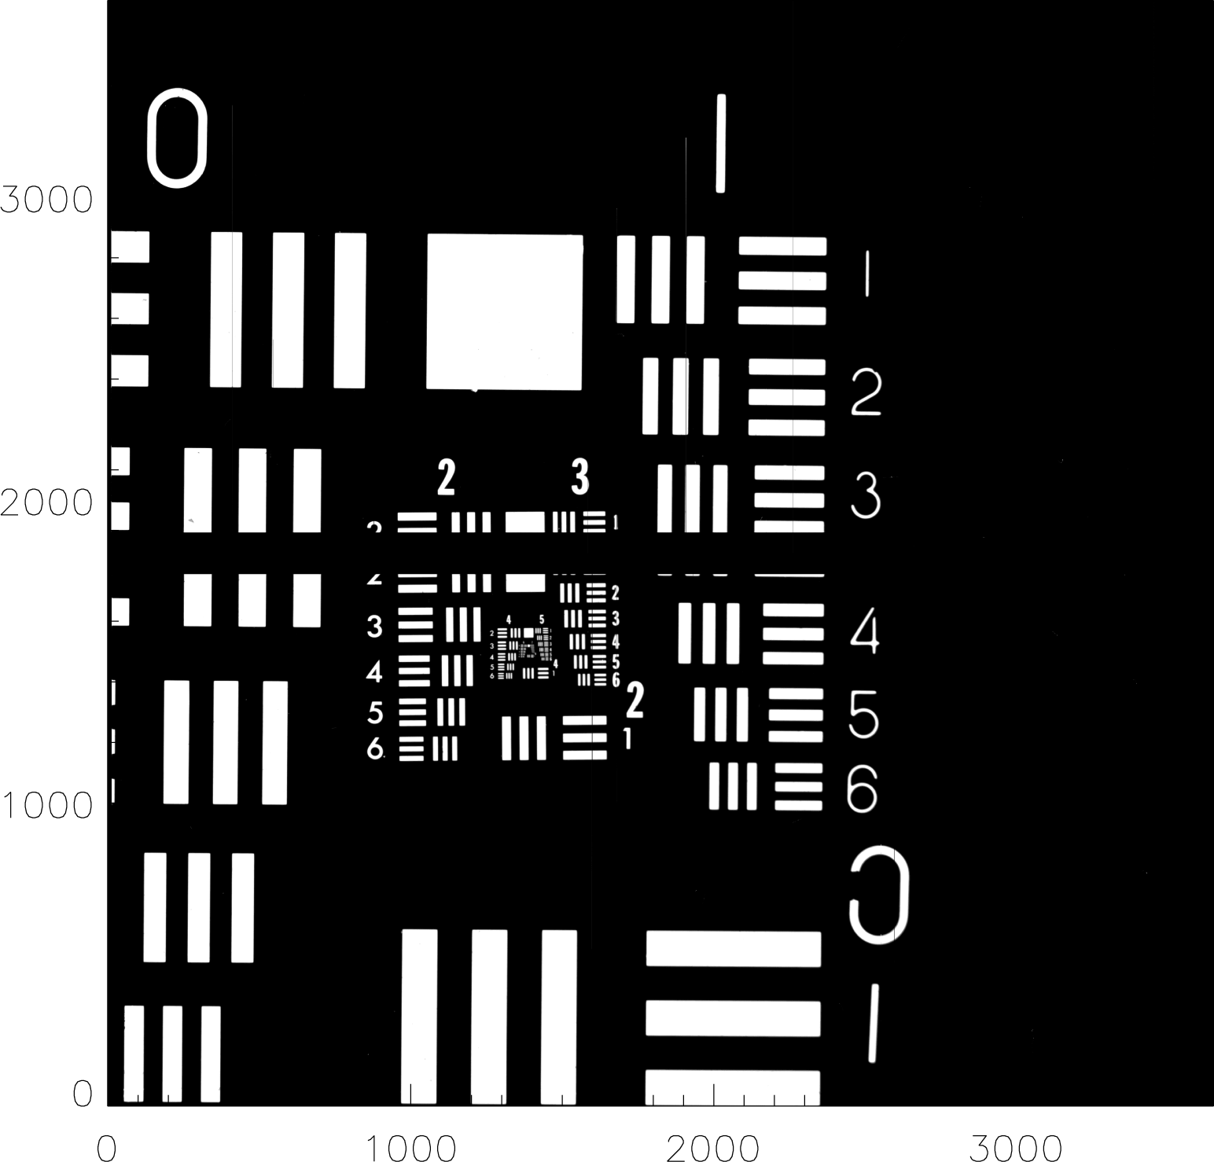
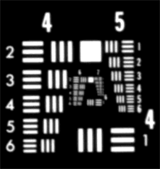
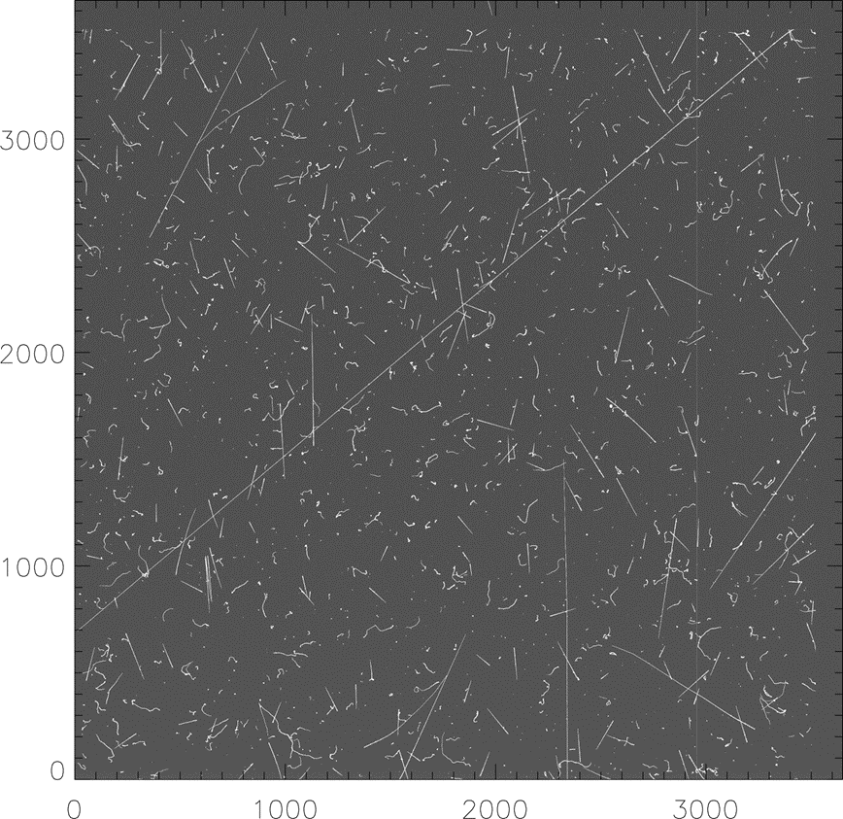
HV-compatible CCD design (SNAP)
30 minute dark exposure
650 um thick
(10.5 um)² pixels
133K
200V Vsub

Slide 33
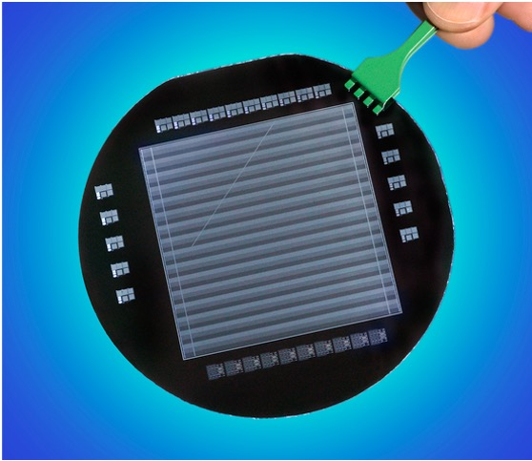
More HEP heritage
High-voltage CCD designs assisted by HEP cont’
ATLAS detector group at LBL 1995
H. Spieler, D. Nygren, C. Haber, S. Holland, N. Palaio
Prototype detector development and fabrication at LBNL

Slide 34
More HEP heritage
High-voltage CCD designs assisted by HEP cont’
  Work on n on p detectors at LBNL introduced us to concepts that were helpful for the future HV CCD effort
    E.g. P stop floating potentials had relevance to CCDs

Slide 35
More HEP heritage
High-voltage CCD designs assisted by HEP cont’
  Work on n on p detectors at LBNL introduced us to concepts that were helpful for the future HV CCD effort
    E.g. P stop floating potentials had relevance to CCDs
Parasitic Static Induction Transistor present in fully depleted CCDs

Slide 36
More HEP heritage
High-voltage CCD designs assisted by HEP
  Floating guard rings and topside substrate contact
  Standard power-semiconductor method, but our first exposure to this was via strip / pixel detector development
Topside n⁺ substrate contact beyond the depletion edge
Backside contact is not practical
  Insulating anti-reflection coatings
  Back illumination
CCD pixels
TED.2002.806476

Slide 37
Dark Matter detection with CCDs
Following topics
  “Dark current” / background single-electron rates
    Astronomy versus dark matter CCDs with shielding
  Particle ID via energy deposit and spatial signature
  Depletion of thick CCDs (650 – 725 um thick)
  Faster readout Skipper CCDs for astronomy
HyperSuprime Cam
Astronomy
Lead shield
SENSEI
Dark Matter

Slide 38
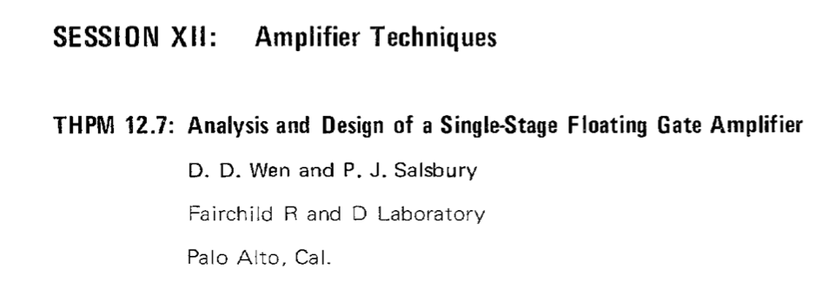
Faster readout for Skipper CCDs
Loosely based on the “Distributed amplifier concept” described in the original 1973 FG-amplifier paper

Slide 39
Faster readout for Skipper CCDs
Loosely based on the “Distributed amplifier concept” described in the original 1973 FG-amplifier paper

Slide 40
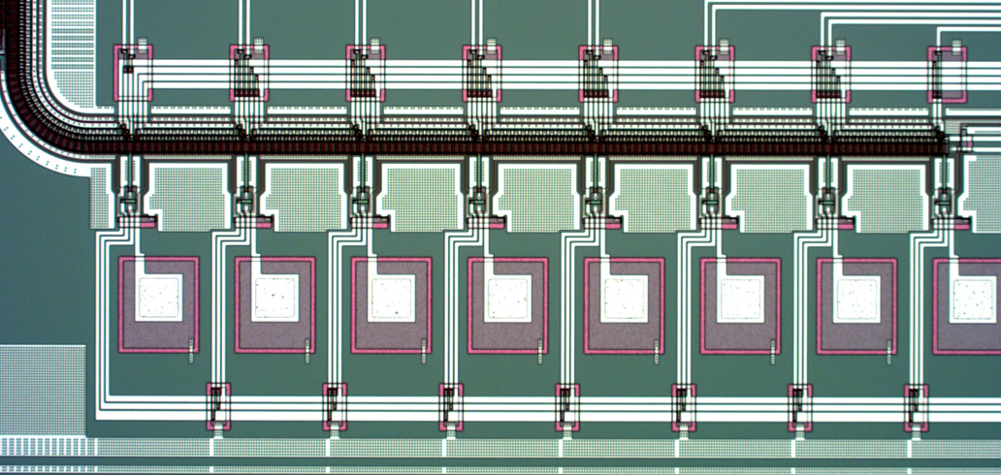
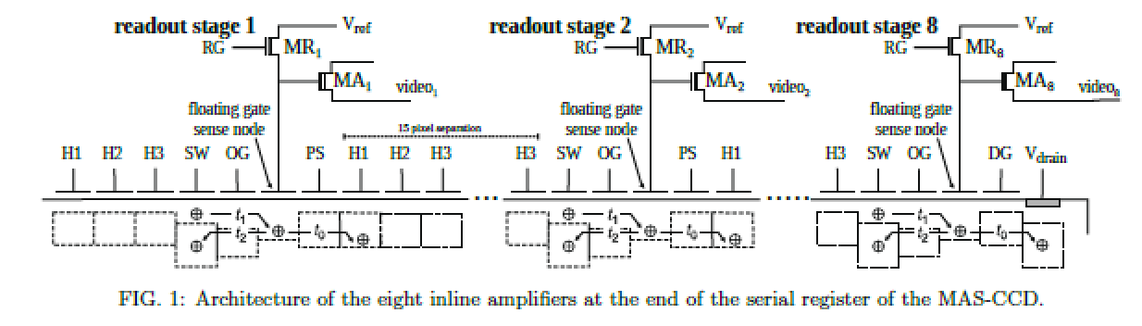
Faster readout for Skipper CCDs
Multiple-amplifier sensing CCD
8 and 16 amplifier prototypes under test

Slide 41
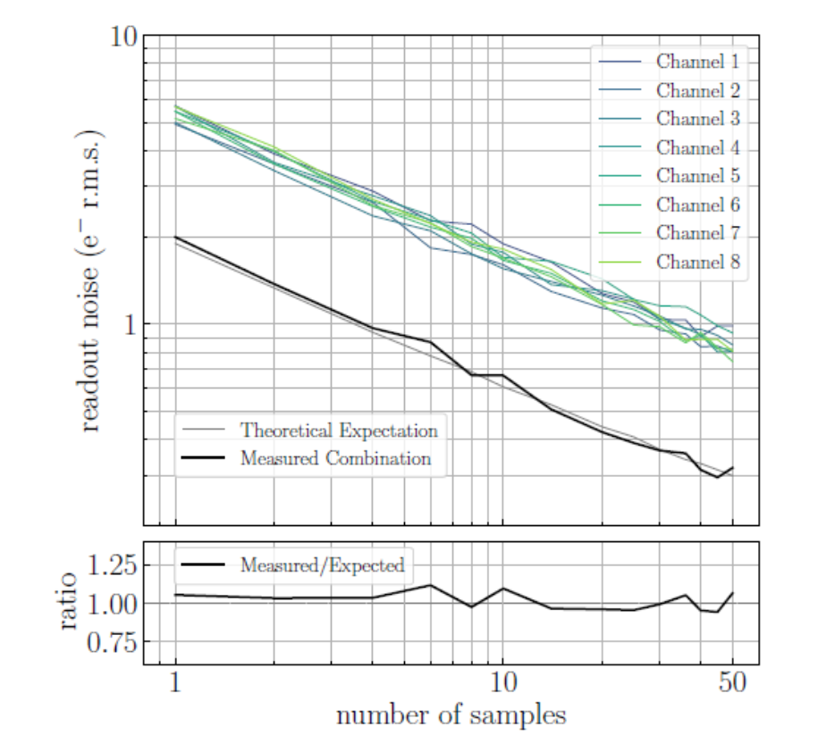
Faster readout for Skipper CCDs
  Overhead to get to the Mth amp, then conventional CCD readout
  Interest for spectroscopic astronomy applications, e.g. DESI II
    Read once per amp with ~ 1 e- after averaging (16 amplifiers)
  In progress: 16 amplifier x 4 corner layout design for 4k x 4k FD CCD
    Photolithography stitching
FNAL 8 amps
LBNL 16 amps
https://doi.org/10.48550/arXiv.2308.09822

Slide 42
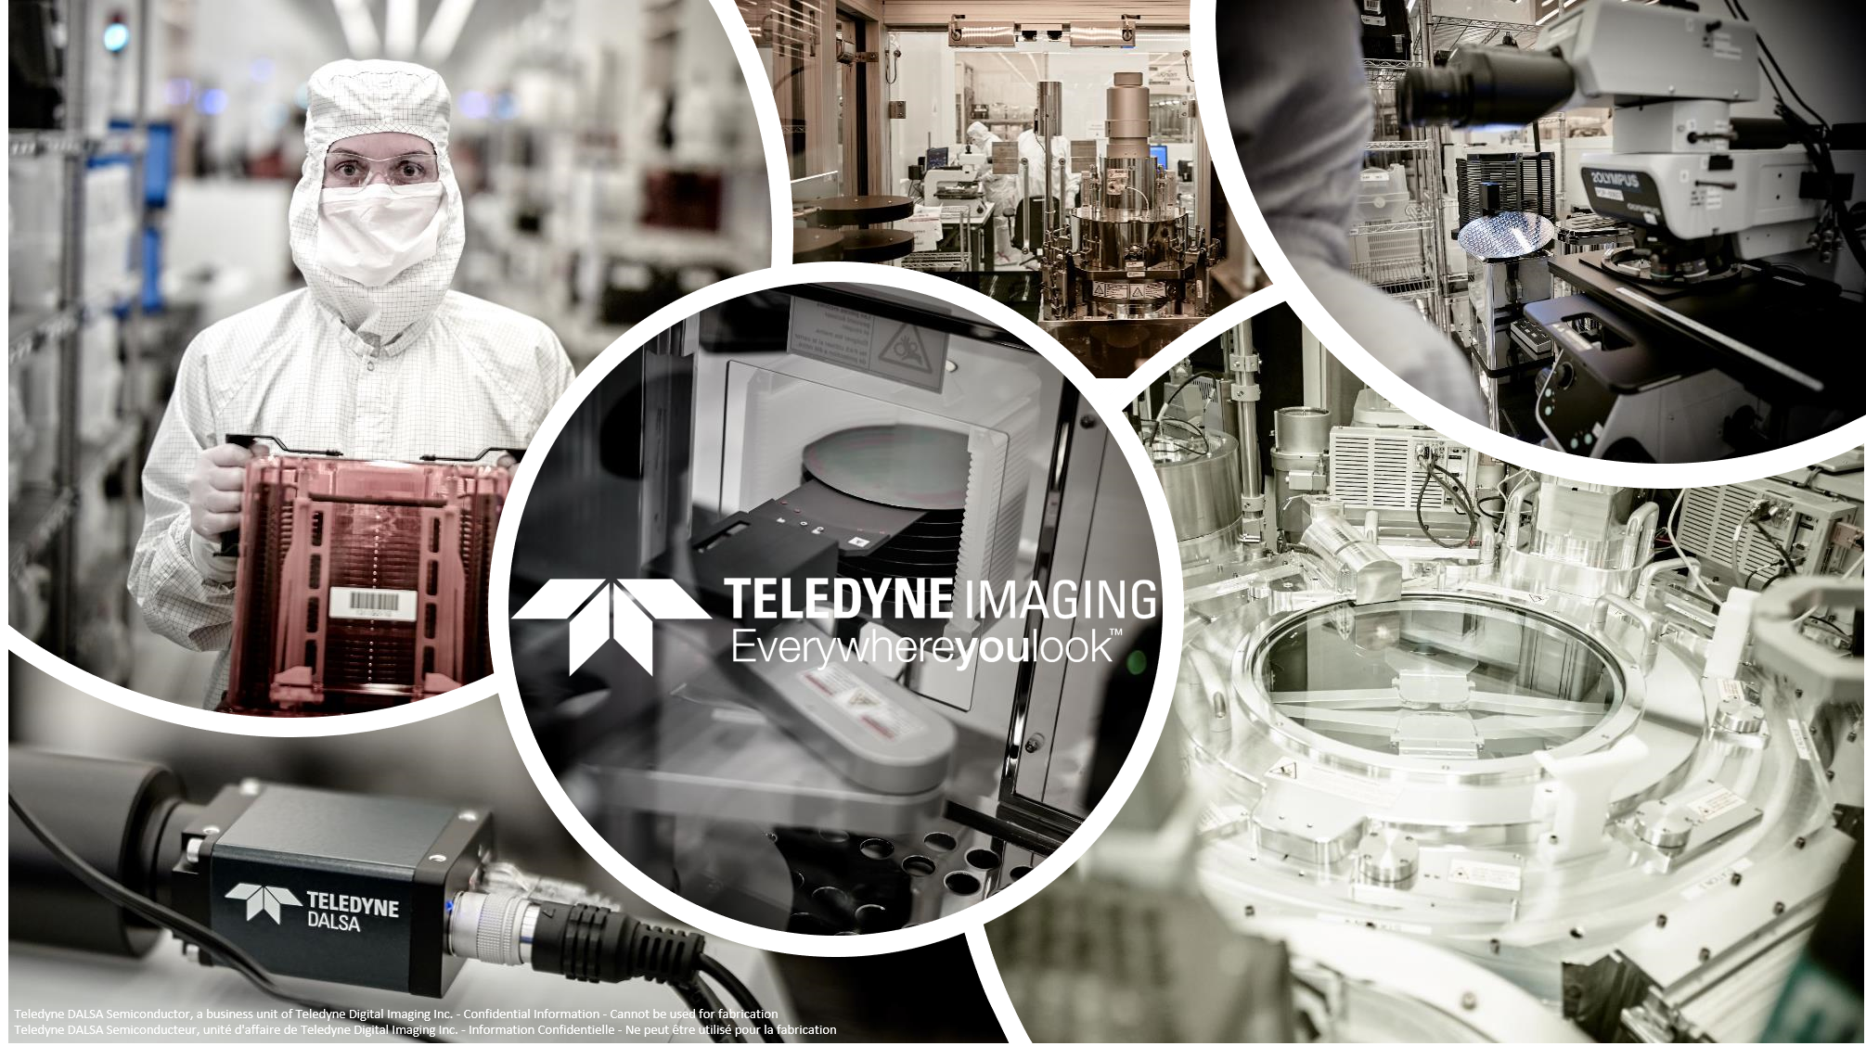
DECam: Fabrication at Teledyne DALSA Semiconductor and LBNL
Teledyne DALSA Semiconductor fabricated fully depleted CCDs for
  SENSEI and DAMIC/DAMIC-M Dark matter CCDs (all DALSA)
  Dark Energy Spectroscopic Instrument
    20 4k x 4k (15um)² pixels with LBNL, 10 with STA / U of Arizona
  ~ 1/3 of the 100 um thick, fully depleted CCDs for Rubin Observatory/LSST
      DALSA / Semiconductor Technology Associates (STA) / U Arizona
      Remainder of the Rubin CCDs from e2V

Slide 43


Slide 45
More HEP heritage
In red attendees at the LBNL Atlas SCT meeting (1995)

Slide 46
More HEP heritage
High-voltage CCD designs assisted by HEP cont’
  Collaborators in 1995
  Also Sally Seidel and Grant Gorfine (U New Mexico)
    Testing of LBNL devices at UNM

