Slide 1

Finances
E. Bains

Slide 2



HEPTech members 2022
United Kingdom
2022: 13 HEPTech members
from 12 european countries

Slide 3
HEPTech Board meeting agenda
09:30 - 09:35 | Quorum and Proxies
09:35 - 09:40 | Approval of Agenda
09:40 - 09:45 | Approval of the last Board Meeting minutes
09:45 - 10:00 | Report: Finances & Expenses
10:00 - 10:15 | Information: Event’s and Meetings Bilbao HEPTrepreneurs event series (report & feedback) Communication activities
10:15 - 10:45 | Board papers AIME Proposal Rotating Chair Communications Officer
10:45 - 11:30 | Organisations TT Highlights 3 -5 mins per organisation Discussion Topics Should we run an annual HEP TT conference? Working Group –Future of HEPTech Dates for meeting June/September
11:30 - 11:50 | Outlook for 2023
11:50 – 12:00 | AOB
9th June 2023 CERN/hybrid

Slide 4
Finances June 2023
Date | Outgoings CHF | Income CHF | Detail | Total CHF
Dec-22 |  | 32,067 | Carried over end of 2022 | 32,067
24.01.2023 | -3,551 |  | Communication Officer (CO) services Sep-Dec
21.02.2023 | -481 |  | CO travel expenses 9612993
03.04.2023 | -1,996 |  | Sponsorship European Cryogenics Days
30.03.2023 | -3,894 |  | Communication Officer (CO) services Jan-Mar
To be paid | -1,000 |  | Bilbao Event (€1000)
 |  | 19,985
 | -10,922 | 52,052 |  | 41,130

Slide 5
Budget and estimated Spend for 2023
Date | Outgoings CHF | Income CHF | Detail | Total CHF
Dec-22 |  | 32,067 | Carried over end of 2022 | 32,067
24.01.2023 | -3,551 |  | Communication Officer (CO) services Sep-Dec | 28,516
21.02.2023 | -481 |  | CO travel expenses | 28,035
03.04.2023 | -1,996 |  | Sponsorship European Cryogenics Days | 26,039
30.03.2023 | -3,894 |  | Communication Officer (CO) services Jan-Mar | 22,145
To be paid | -1,000 |  | Bilbao Event (€1000) | 21,145
 |  | 19,985 |  | 41,130
30.06.2023 | -11683 |  | Communication Officer (CO) services Sep-Dec | 29,447
 | -3,000 |  | CO expenses | 26,447
 | -1,600 |  | AIME WIGNER | 24,847
 | -2,000 |  | ELI HU visit | 22,847
Estimated remaining budget for year after commitments |  |  |  | 22,847

Slide 6
Membership 2023
Membership 2023 | Date | Income CHF | In Kind contribution
CERN | Apr-23 | 3,000
UNIVERSITY OF THE AEGEAN | Apr-23 | 1,500
INFN | Apr-23 | 3,000
ELI ERIC | Apr-23 | 1,500
WIGNER | Apr-23 | 1,500
UNIVERSITY OF SOFIA | Apr-23 | 1,500
GSI | Apr-23 | 1,500 | 1,538
ESS | Apr-23 | 3,000
STFC |  | 3,000
TECHNICAL UNIVERSITY OF KOSICE | Apr-23 |  | 1544
LIP |  |  | 1,537
NCSR Demokritos |  |  | 1,537
IFIN-HH |  |  | 1,537
Total |  | 19,500 | 6155

Slide 7
Communications and Events
Information:
Event’s and Meetings
Bilbao
HEPTrepreneurs event series (report & feedback)
Communication activities

Slide 8
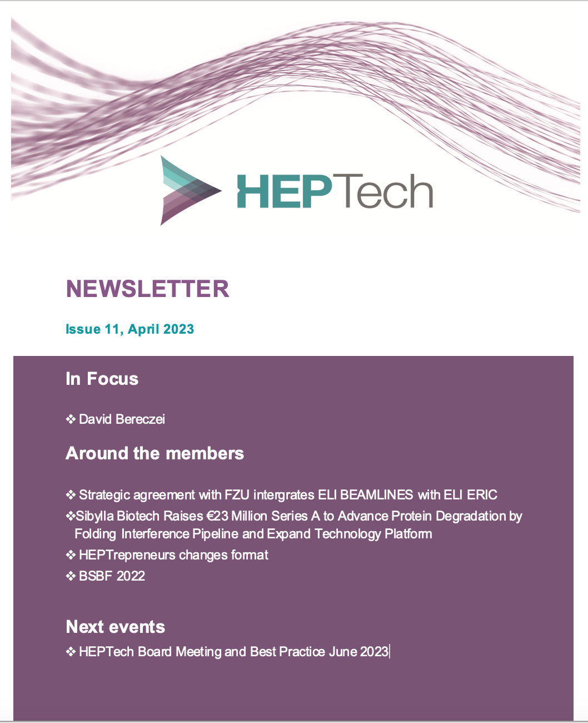
Communications
Emails (newsletters from Demokritos and INFN)
LinkedIn: Lizzy and Martina very active! Please join the page and contribute!
HEPTech Newsletter
HEPTrepreneurs information

Slide 9
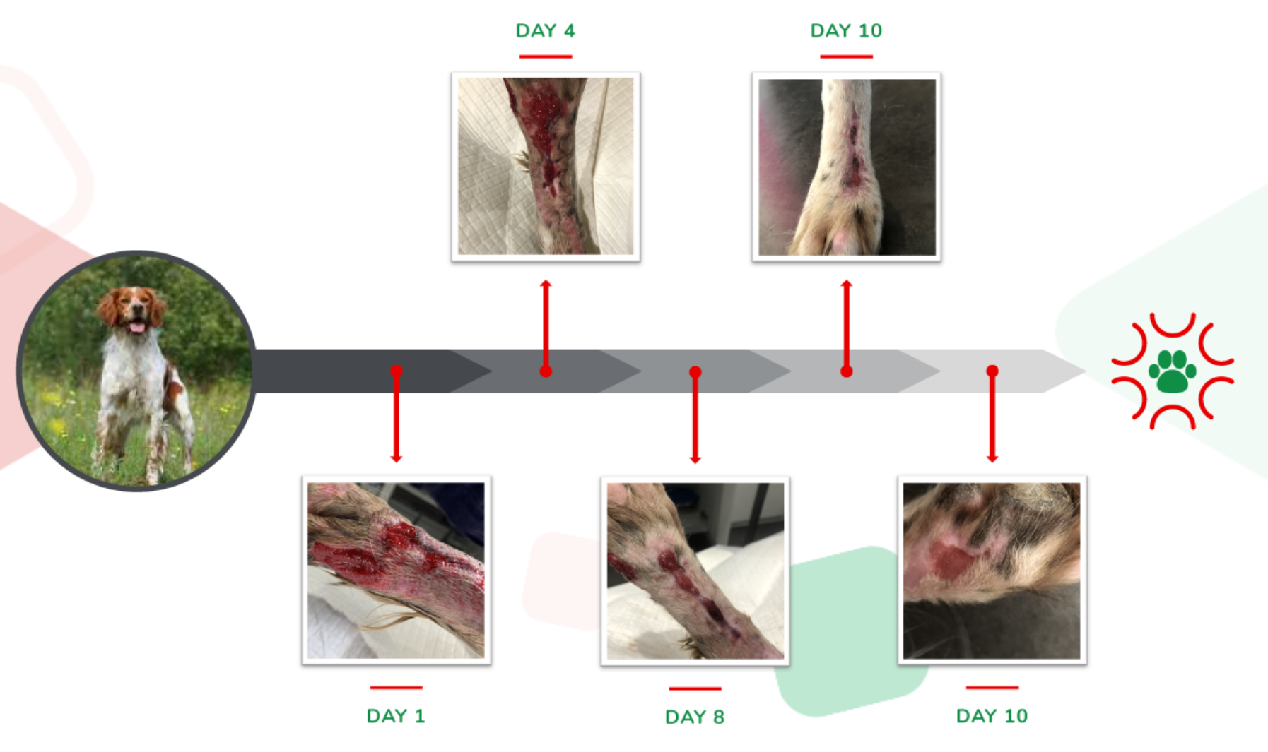
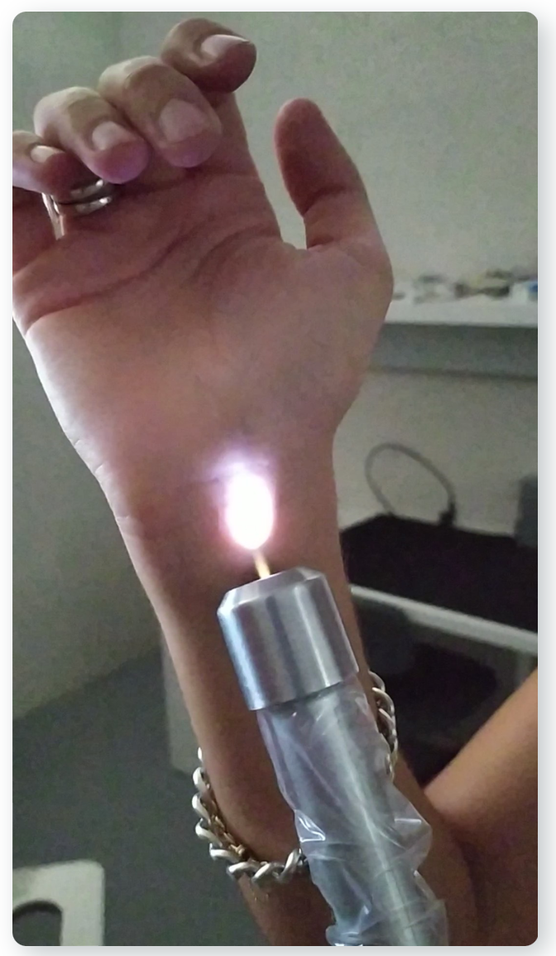
HEPTrepreneurs series
Episode 11: Ana Megia
Ex-CERN
Founder of:
Ion Biotech

Slide 10
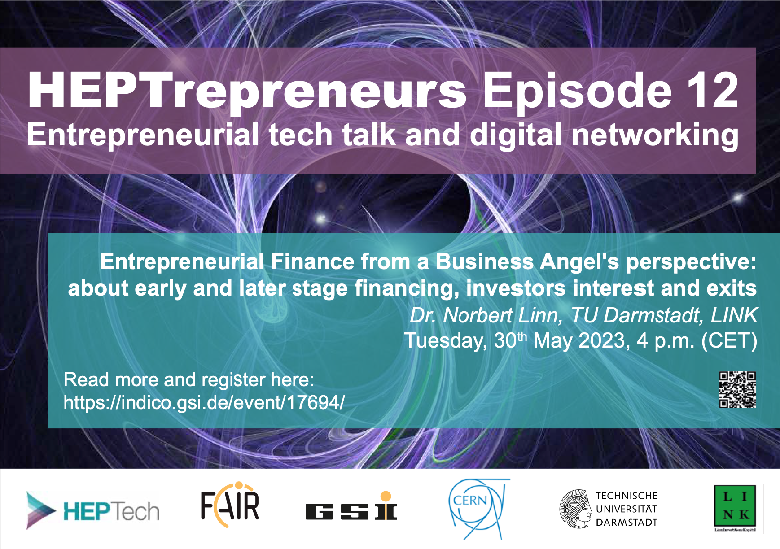
HEPTrepreneurs series
Episode 12: Dr Norbert Linn
Startup financing
Nice presentation on fundings and some insights from an Angel investor prospective

Slide 11
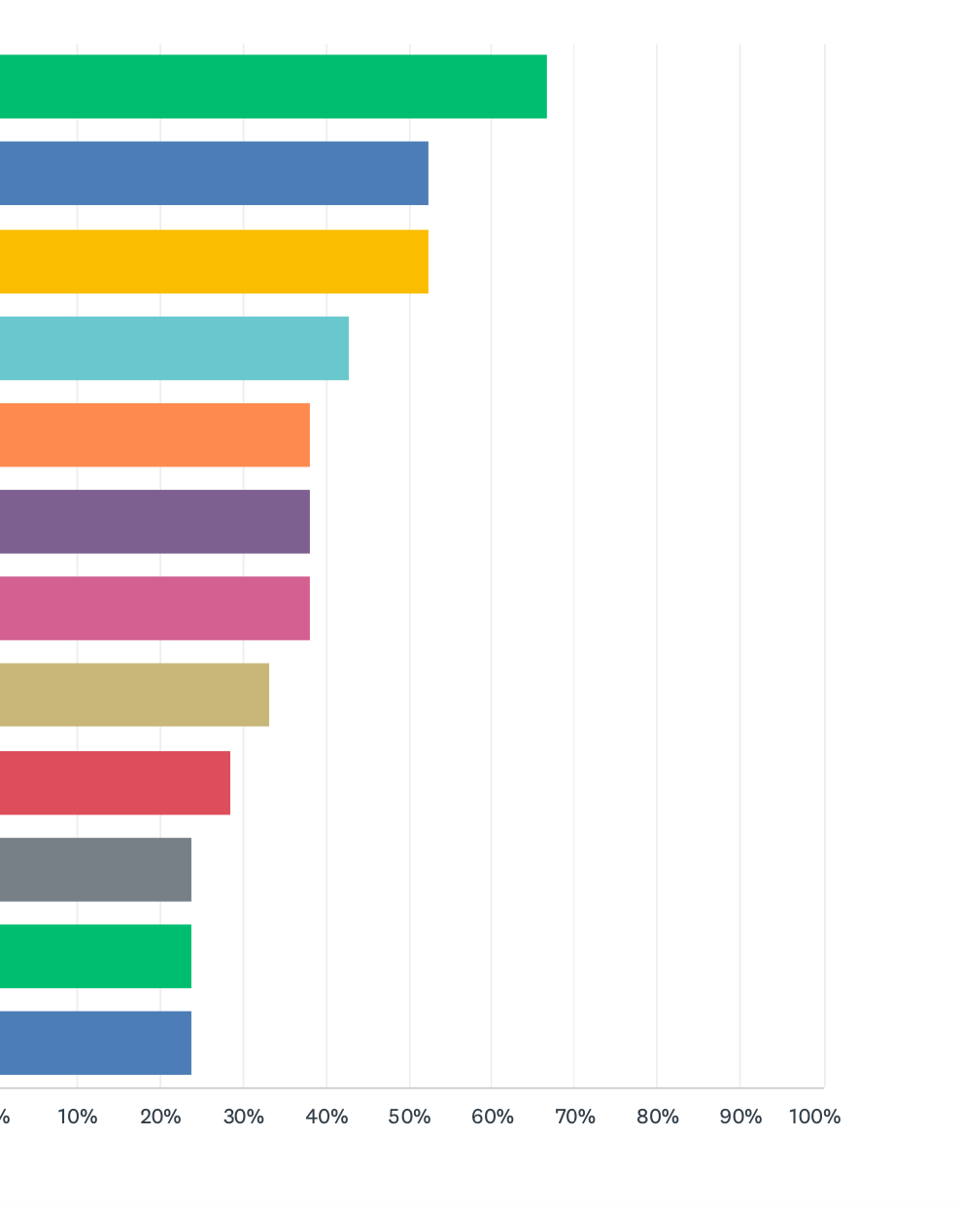
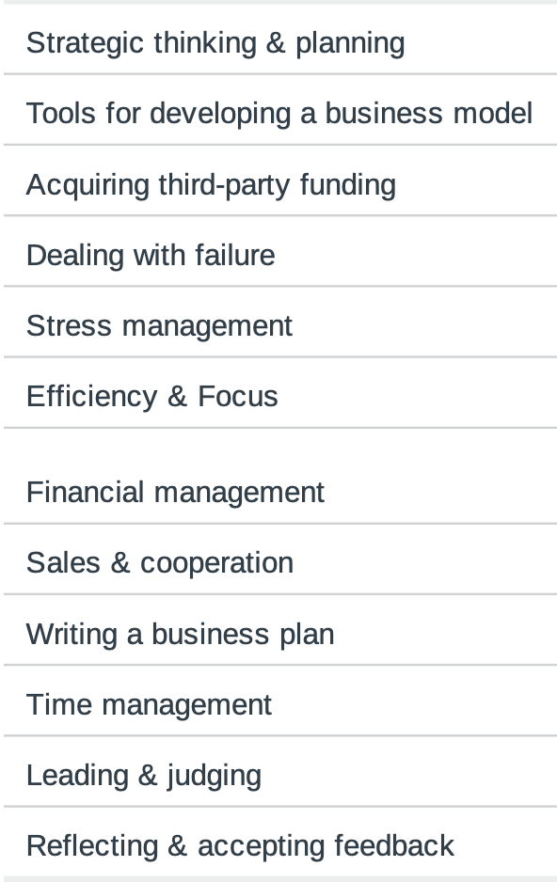
HEPTrepreneurs series
Survey
List competencies …
I would like to hear presentations on the following topics (multiple choice possible)

Slide 12
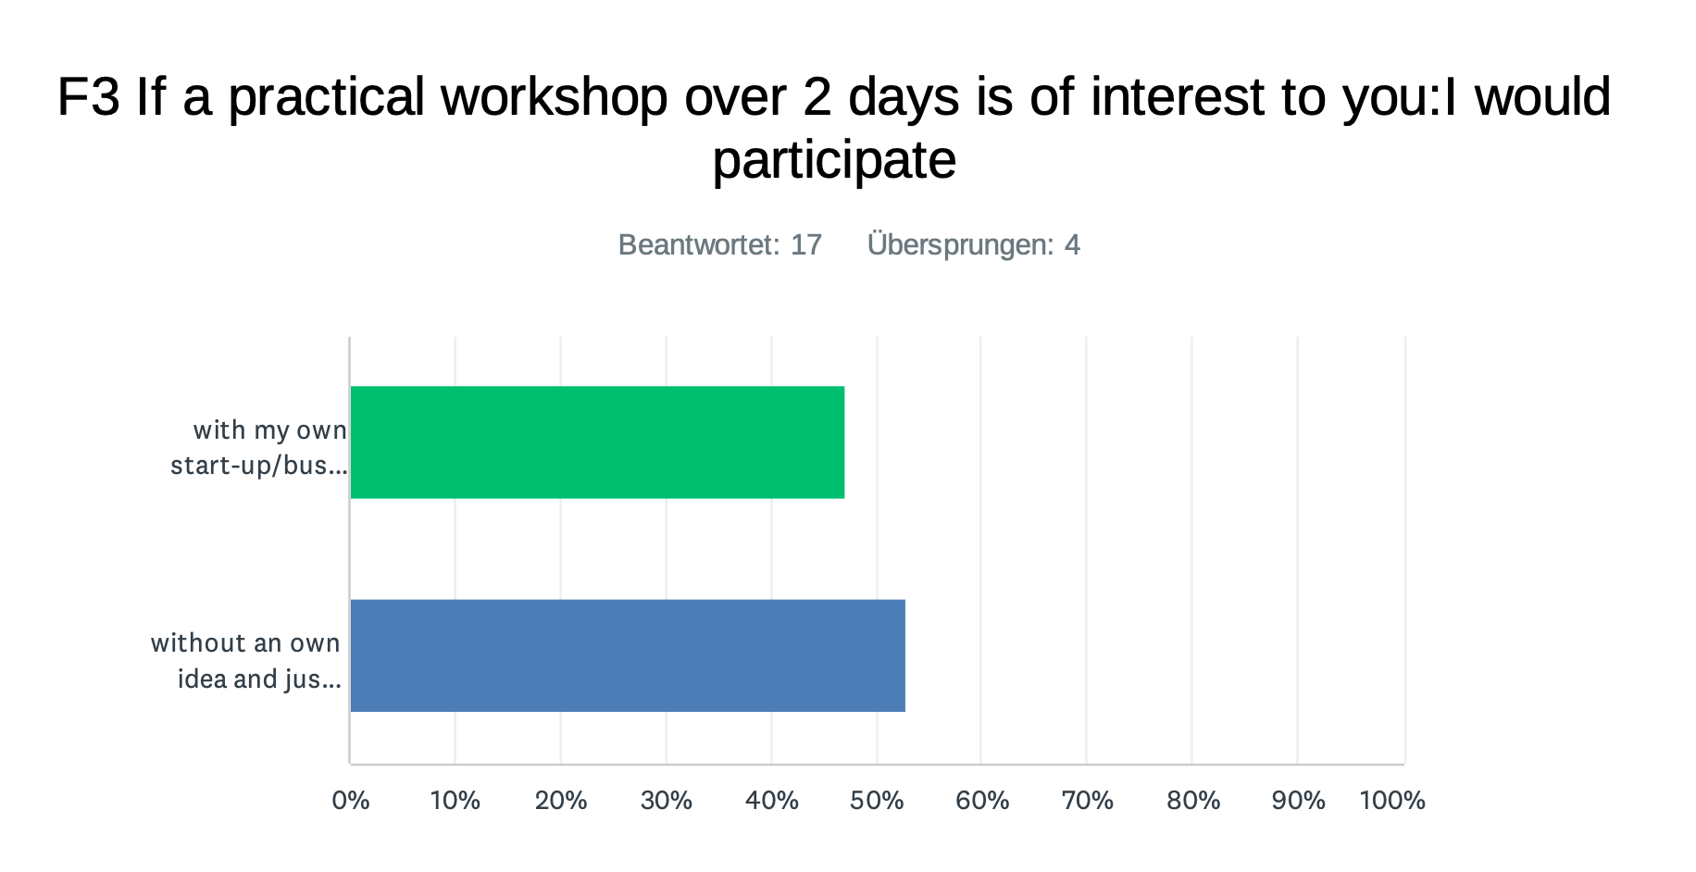
HEPTrepreneurs series
Survey

Slide 13
Board papers
AIME Proposal – Peter Levai WIGNER
Rotating Chair - Elizabeth Bain Liam Brennen
Communications Officer – Elizabeth Bain

Slide 14
AIME Proposal
The 7th Academy Industry Matching Event with an IT focus
Budapest, Hungary -24-25 October 2023 -Hybrid
by Wigner RCP, CERN, and HEPTECH.
The aim of this event is to bring together Academic researchers and Industry experts to share ideas, potential applications and foster collaborations on the crossroad of natural and artificial intelligence.
A half day scientific computing as a basket of advanced methods which may find application in the industry.
Asking for HEPTech Support to the tune of €1600

Slide 15
A fixed Rota for the HEPTech Chair
Enabling HEPTech to leverage the strengths of its institutional members to work together identify and exploit possible synergies within the network by voluntary supporting each member in their technology and knowledge transfer activities.
Benefits:
Shared Leadership: Each member of the board gets an opportunity to serve as the Chair,
Equality: The rotating chair system reflects the principle of equality among the members of the board.
Exposure: increased visibility for the Chair during their term, both in home organisations and in the wider field of particle physics with a chance to build new skills.
Balanced Decision-Making: Maintain balance and stability within the Board by distributing responsibilities and decision-making among its members.
Smooth Transitions: The annual rotation allows for a smooth transition of the position. The incoming chair can learn from their predecessors, benefitting from their experience and insights. This facilitates continuity and ensures that HEPTech can function effectively despite leadership changes.

Slide 16
Proposed Rota
Client Institute Description | KEY
SCIENCE AND TECHNOLOGY FACILITIES COUNCIL (STFC) | STFC
MTA WIGNER FIZIKAI KUTATKZPONT | WIG
UNIVERSITY OF THE AEGEAN | AEG
CERN | CERN
NCSR Demokritos | DEM
Extreme Light Infrastructure ERIC (CZ &HU) | ELIEr
FOR R&D IN PHYSICS AND NUCLEAR ENGINEERING / ELI - IFIN-HH, Horia Hulubei National Institute of Physics and Nuclear Engineering | ELINP
EUROPEAN SPALLATION SOURCE ERIC | ESS
GSI HELMHOLTZZENTRUM FUR | GSI
INFN - Sezione di Milano Bicocca | INFN
UNIVERSITY OF SOFIA - FACULTY OF PHYSICS | SOF

Slide 17
Communications Officer
There is a requirement for Communications/Administrative support, however the budget no longer runs to covering a Communications Officer.
The Communications officer and the Chair have looked at the role and believe it is possible to reduce the scope of the role by 50% therein the salary by 50%.
This will result in a new role at €7.500 for 2.5 days per month. See paper for detail.
We need to decide which option we should proceed with:
Extend Valentine’s contract for a further year to ensure continuity. At the moment there is only the chair in post so opportunities for training new staff is limited.
Advertise the post and recruit a new Communications Administrator to the post.
Discontinue the position and seek and in-kind contribution until such time as we have sufficient funds to warrant a communications officer.

Slide 18
Discussion and Members Highlights
Organisations TT Highlights 3 -5 mins per organisation
Discussion Topics
  Should we run an annual HEP TT conference/workshop, similar to that of Bilbao?
Working Group –Future of HEPTech Dates for meeting June/September

Slide 19
Outlook, AOB
Note in the minutes that the Board paper for:
EUSTAR for the Bilbao Tech Transfer
Cryogenics Day

Slide 20
Thank you for the attention!
V. Venturi - E. Bains

