Slide 2

RS08 BLM Threshold Analysis
M. D’Andrea, F. Ziliotto
BLM Threshold Working Group Meeting

Slide 3
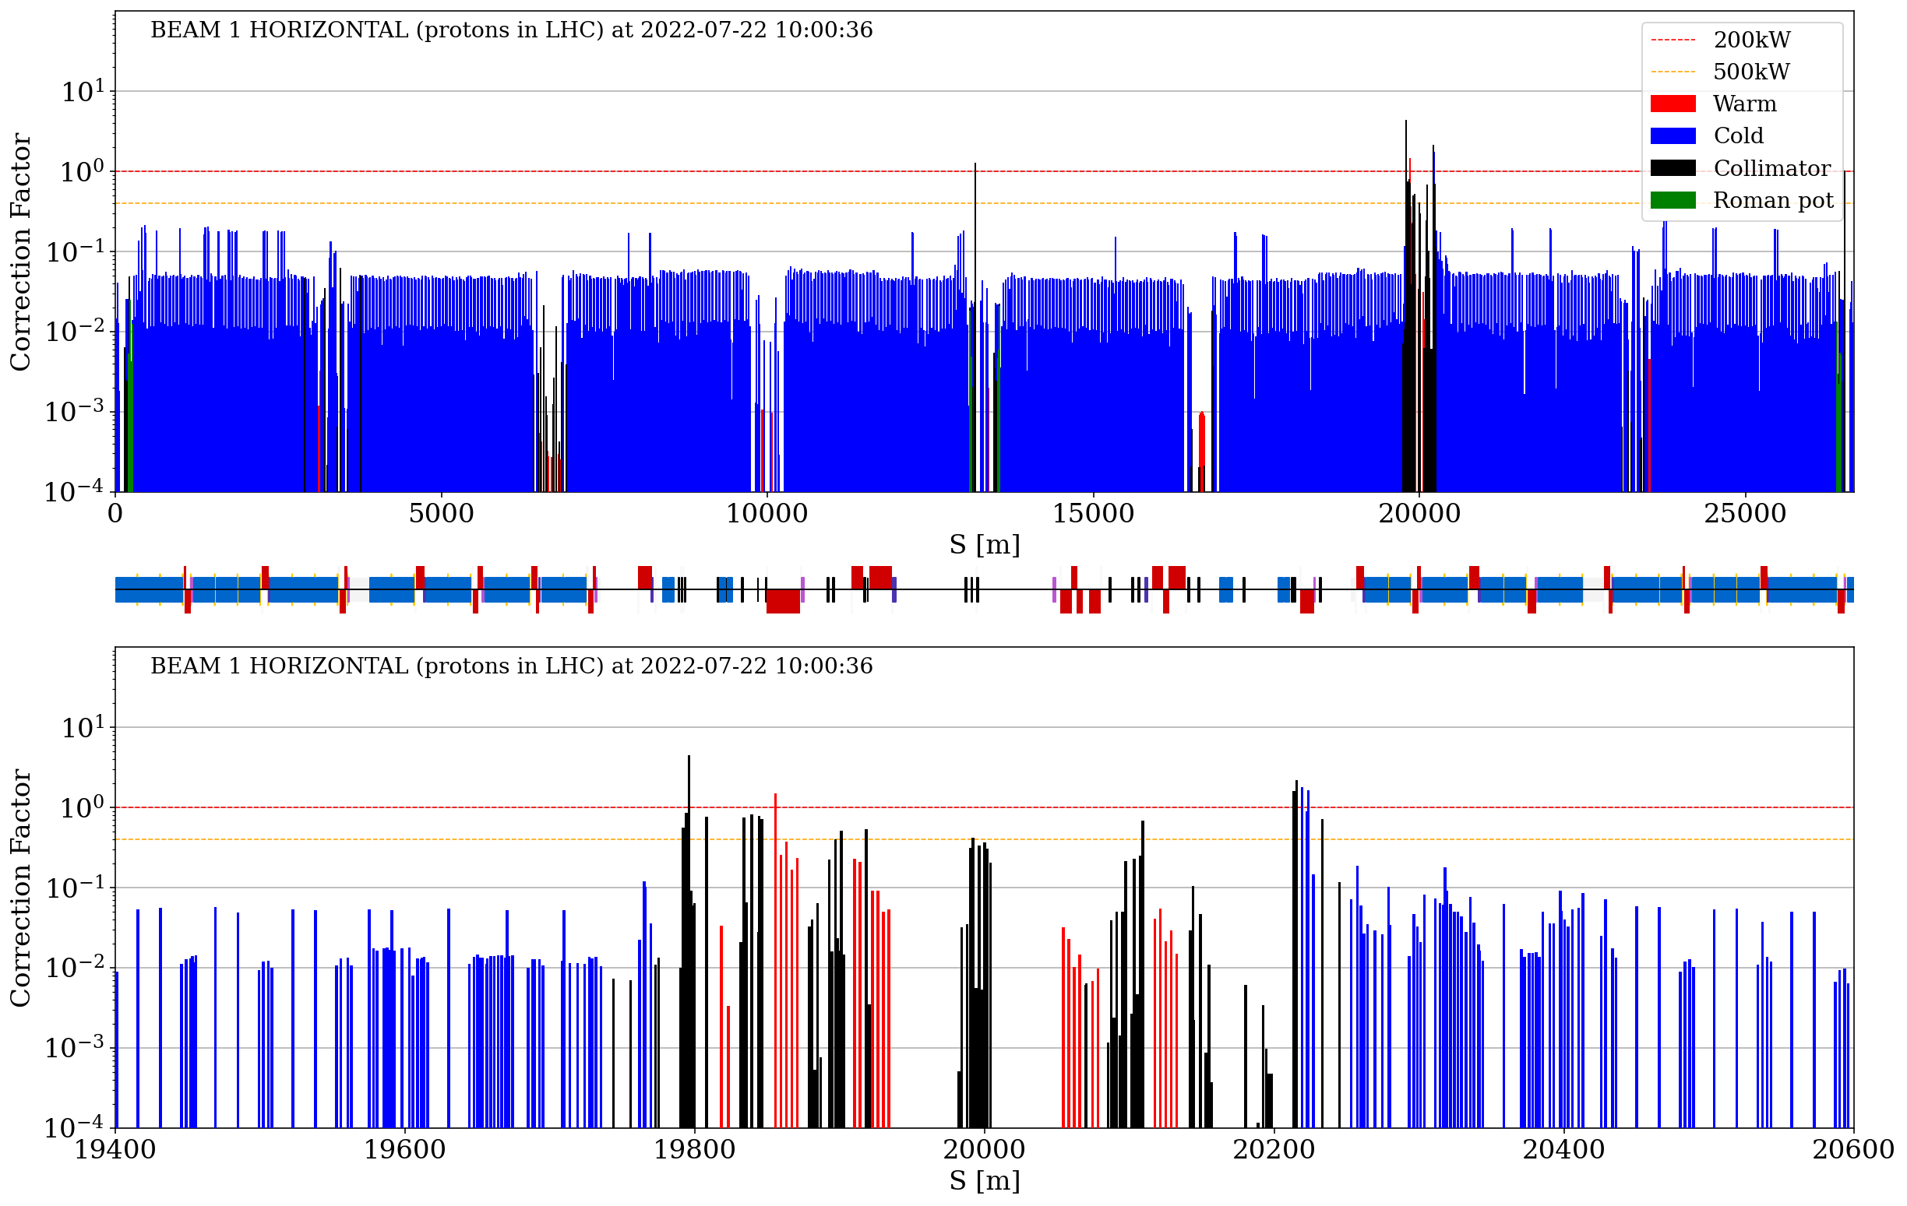
B1H – 30 cm XRP in
Courtesy of F. Ziliotto

Slide 4
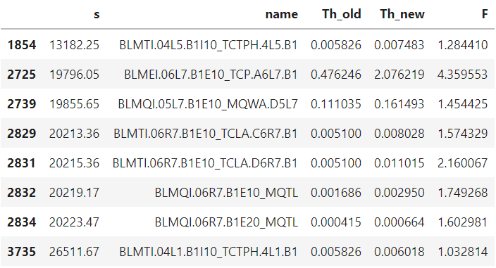
B1H – 30 cm XRP in
Courtesy of F. Ziliotto

Slide 5
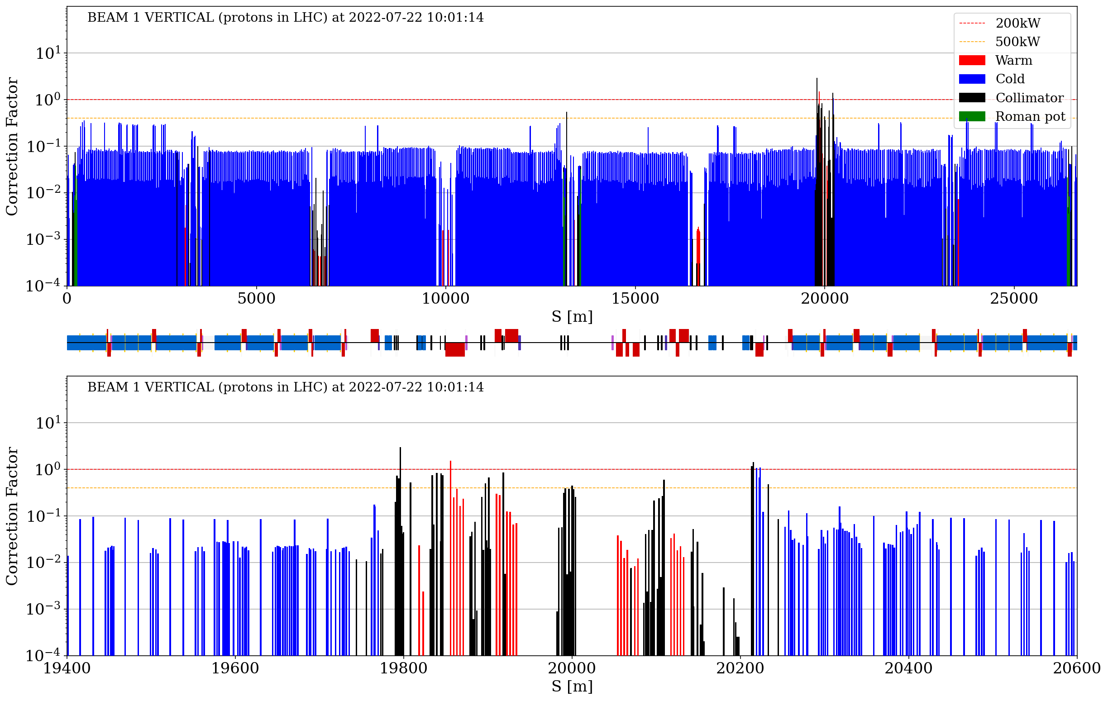
B1V – 30 cm XRP in
Courtesy of F. Ziliotto

Slide 6
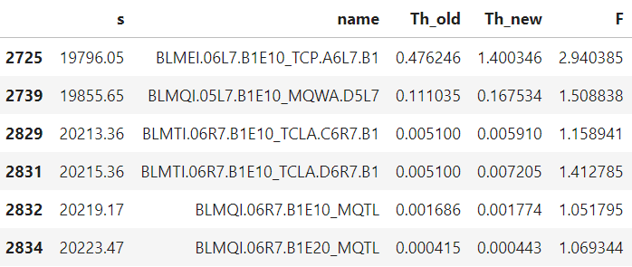
B1V – 30 cm XRP in
Courtesy of F. Ziliotto

Slide 7
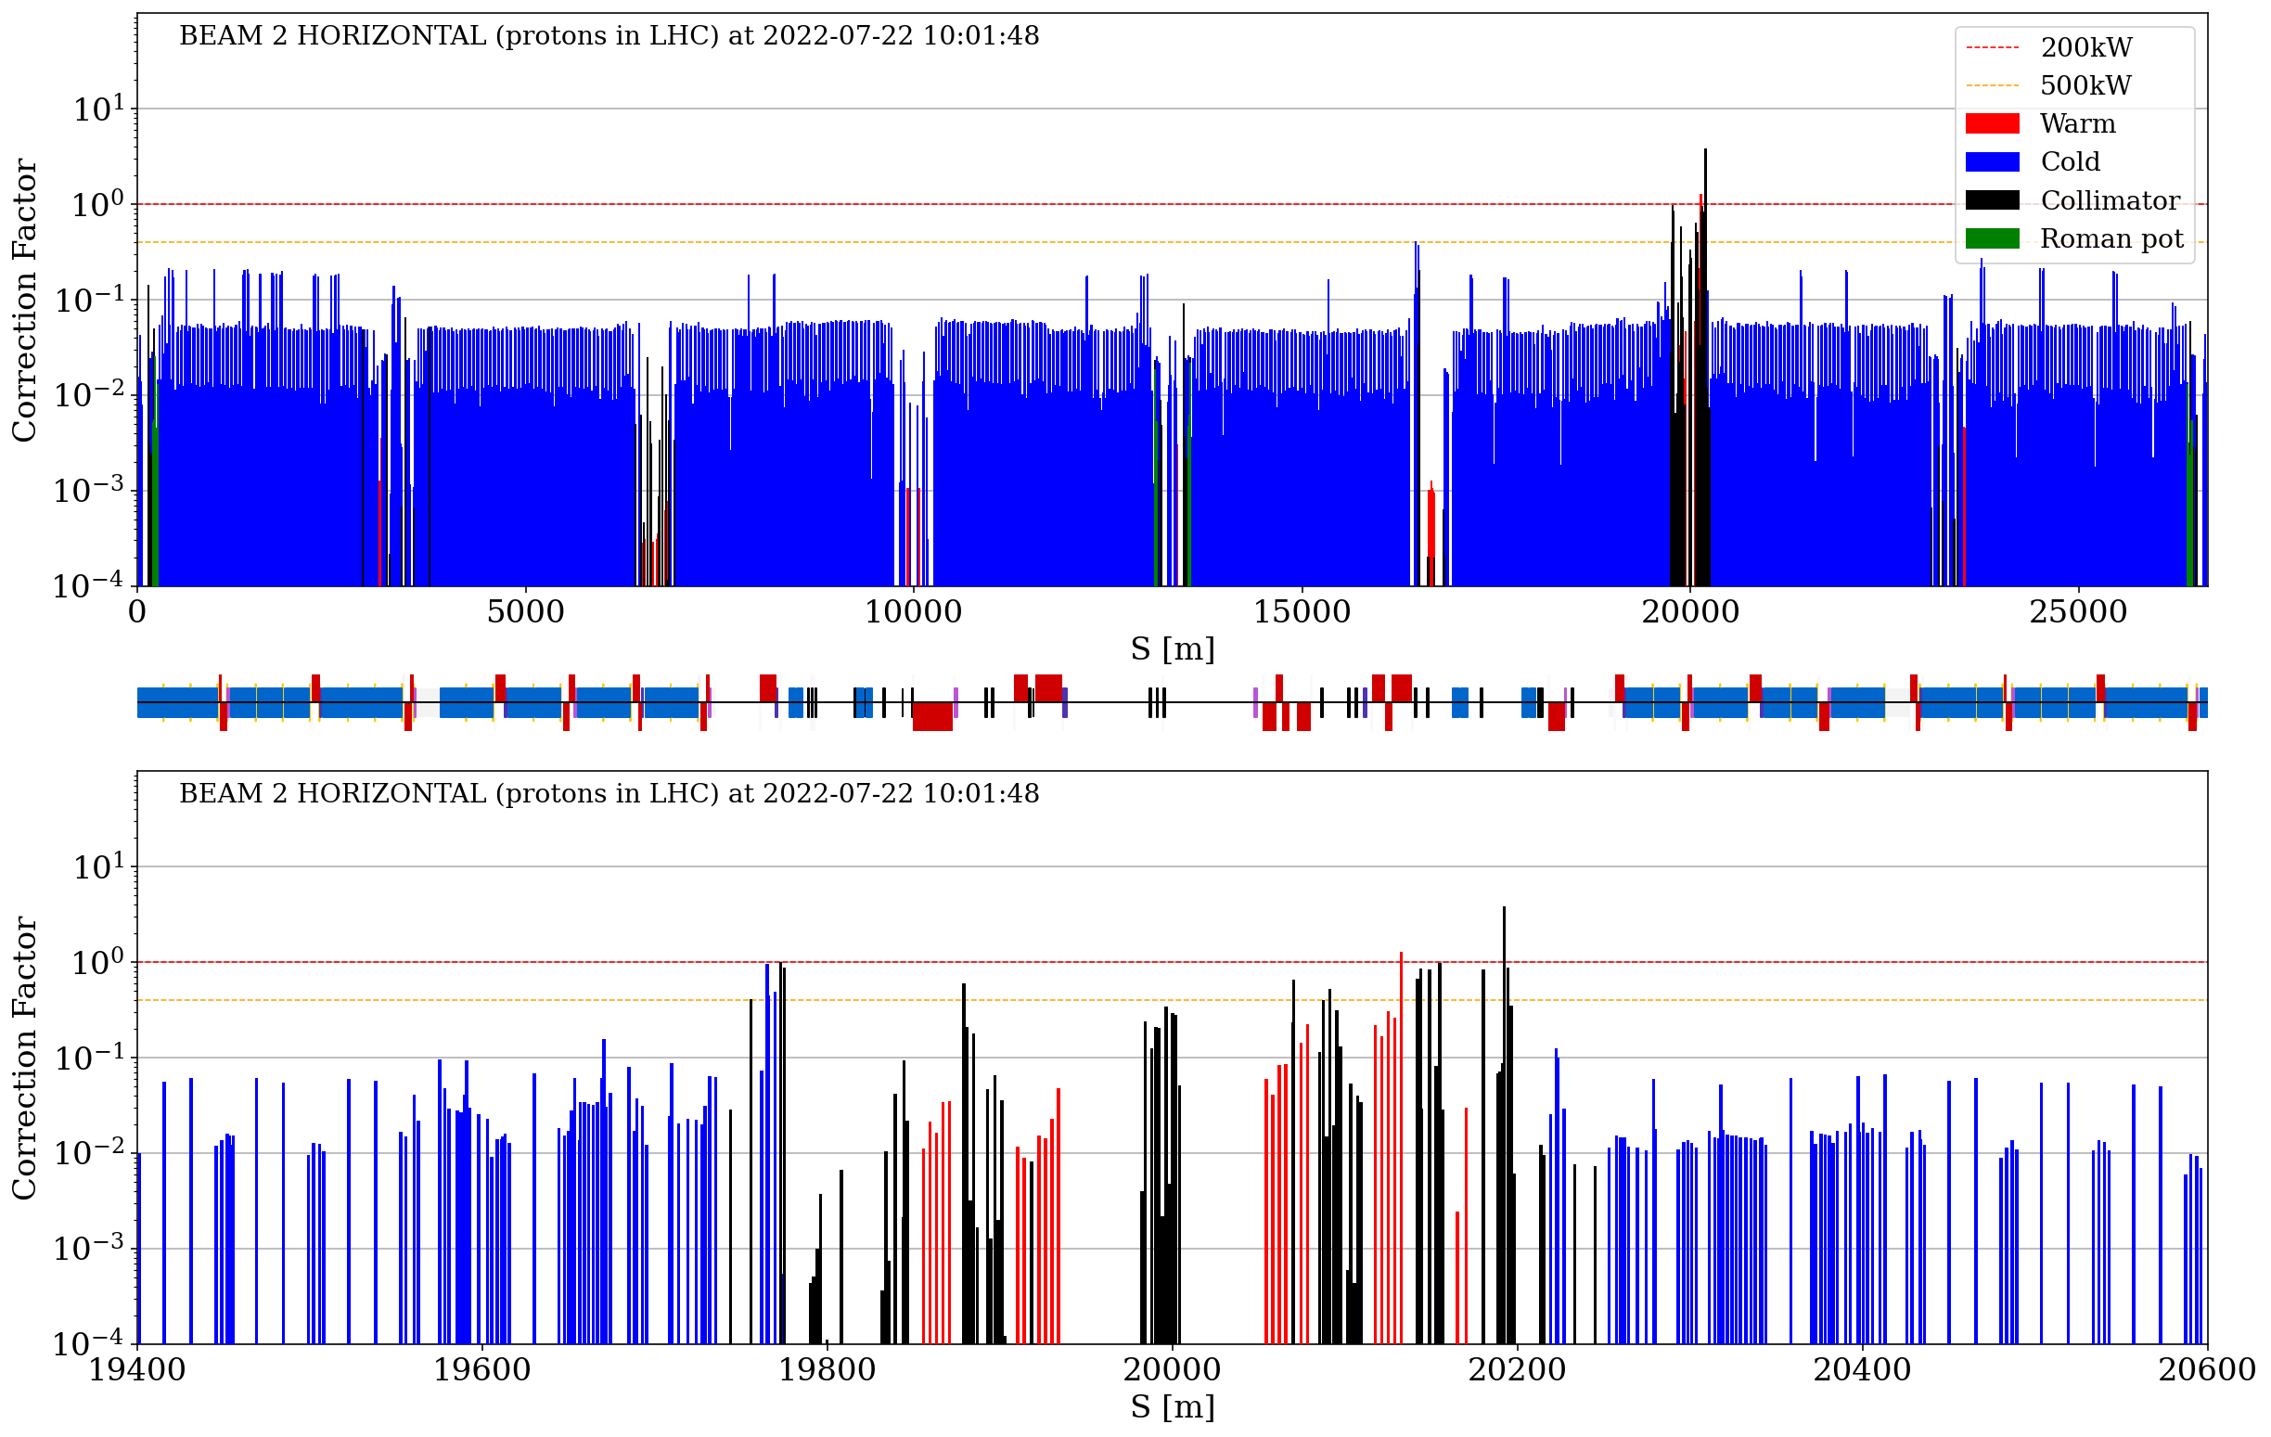
B2H – 30 cm XRP in
Courtesy of F. Ziliotto

Slide 8
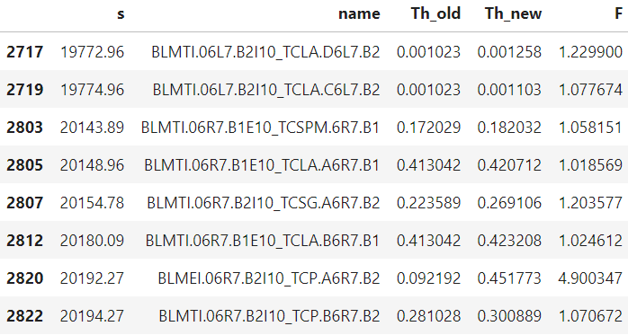
B2H – 30 cm XRP in
Courtesy of F. Ziliotto

Slide 9
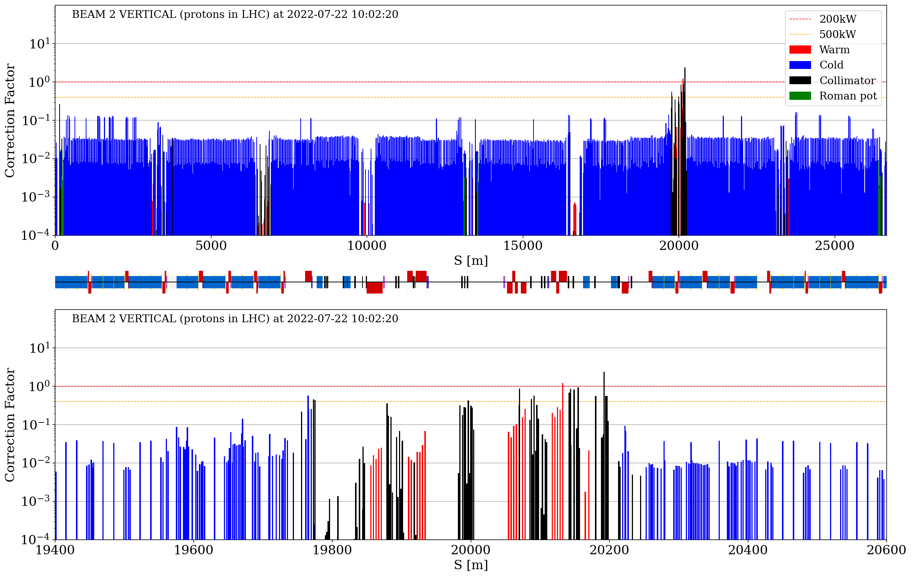
B2V – 30 cm XRP in
Courtesy of F. Ziliotto

Slide 10
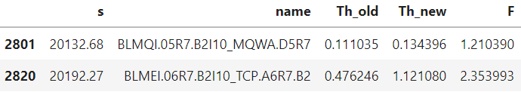
B2V – 30 cm XRP in
Courtesy of F. Ziliotto

