Slide 1

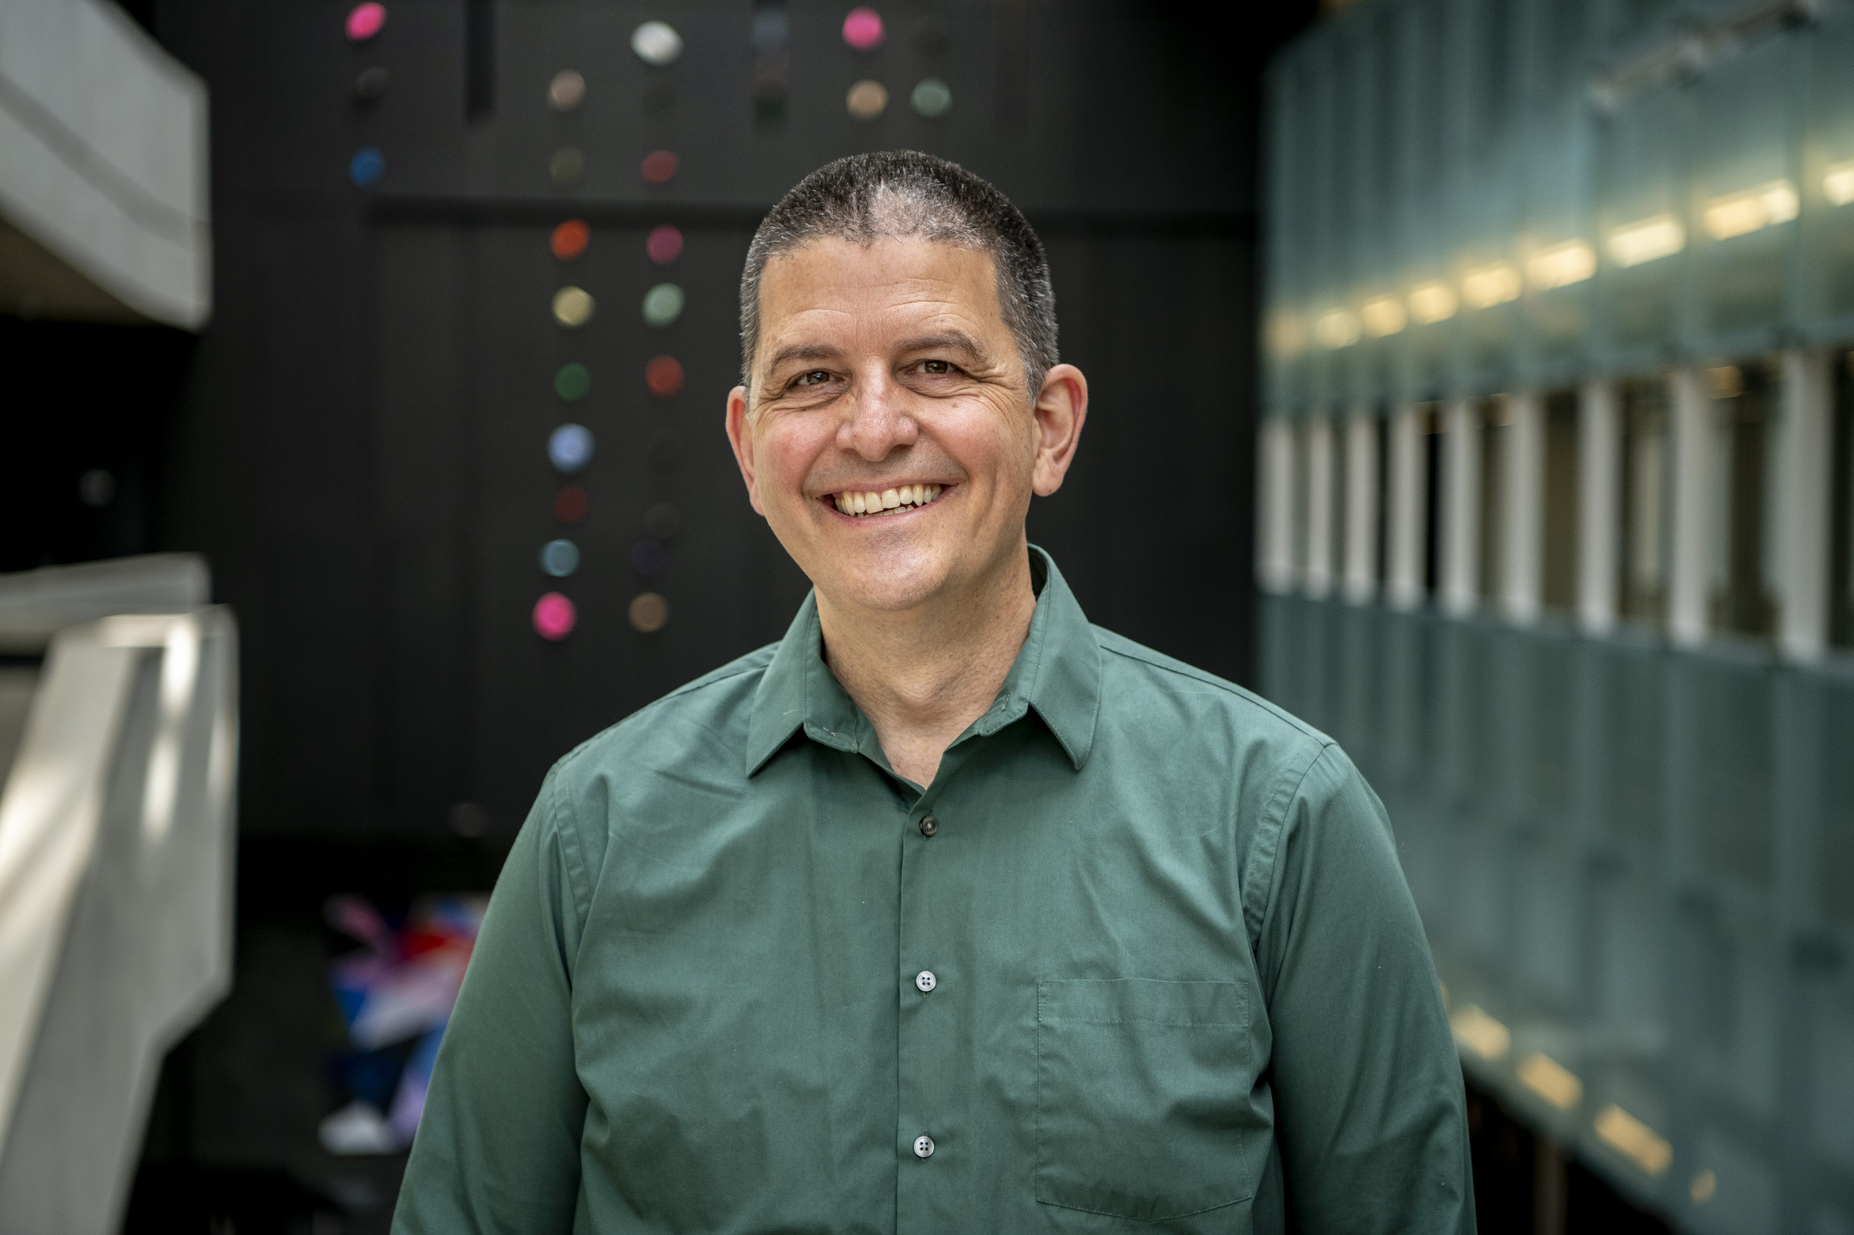
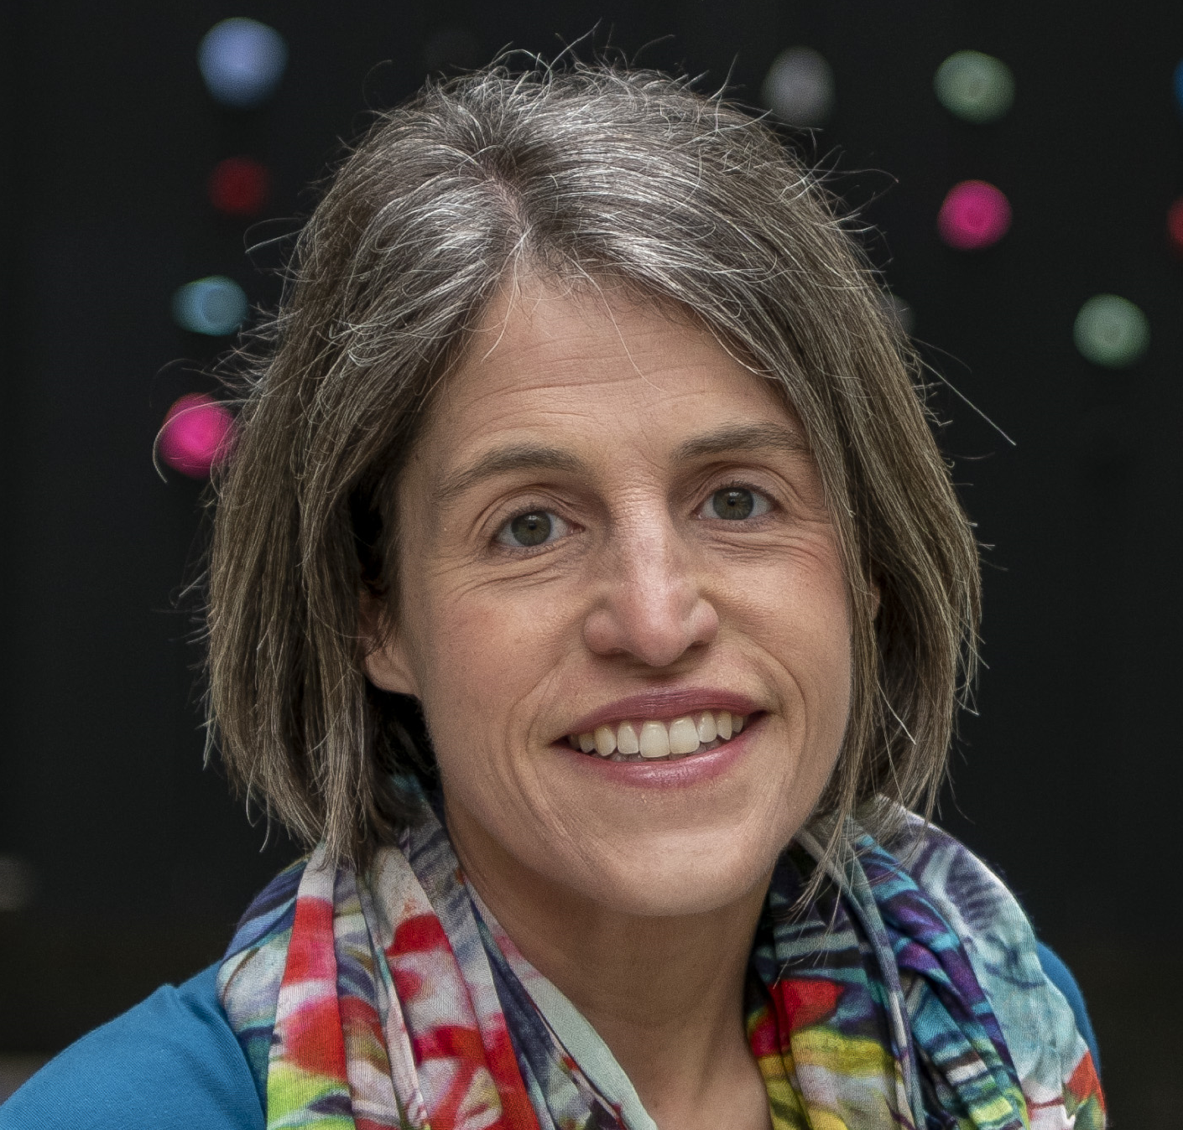
Climate Change:
Evidence, Effects, and Actions
CERN HST 2024
Dave
Kelly

Slide 2
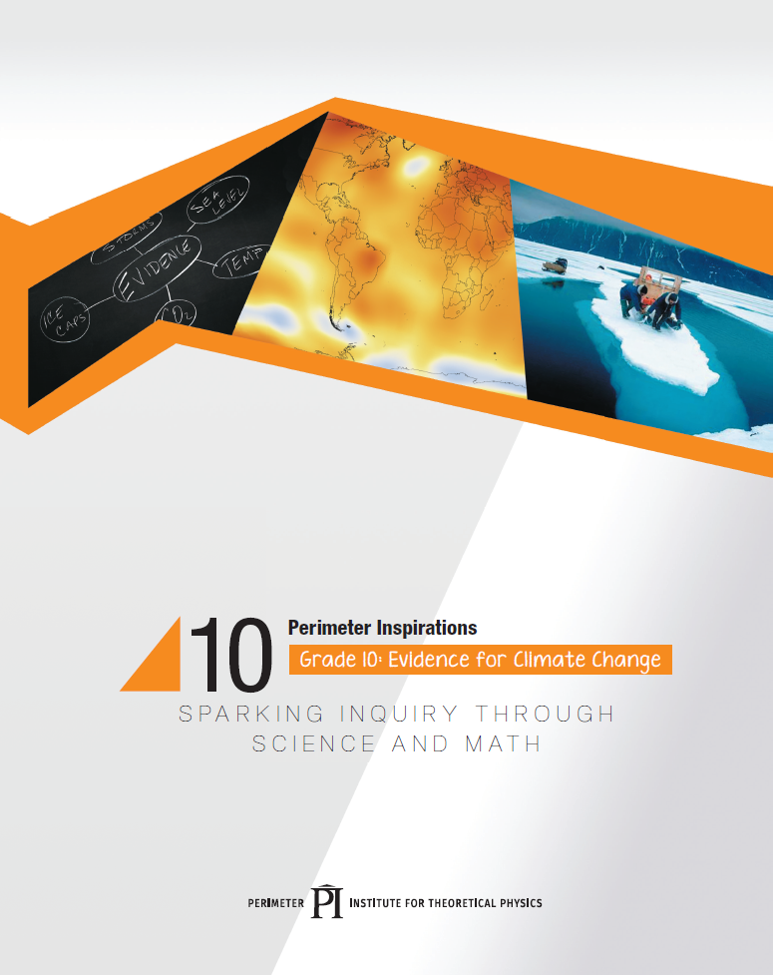
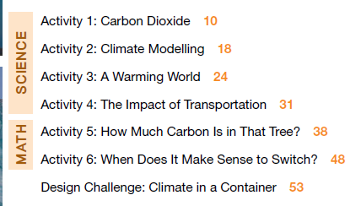
resources.perimeterinstitute.ca

Slide 3


Climate Change
It’s real…
It’s us…
It’s serious…
And the window of time to prevent dangerous impacts is closing fast.
Katharine Hayhoe, Texas Tech

Slide 4
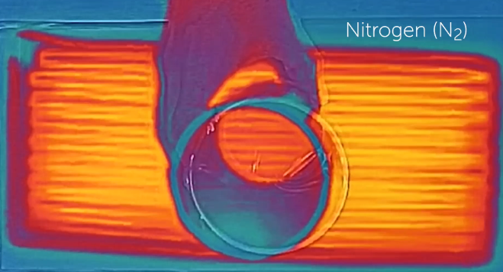
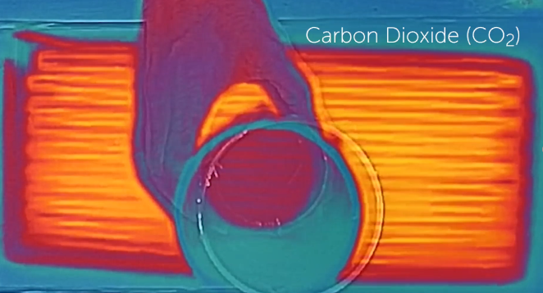
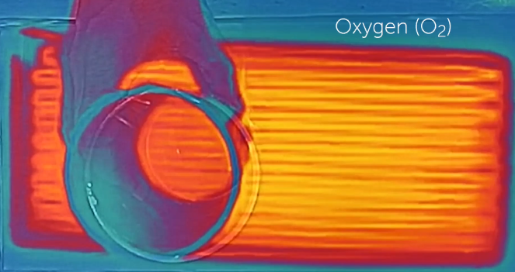
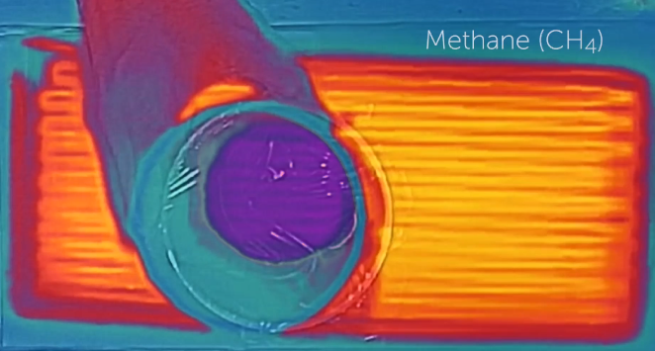
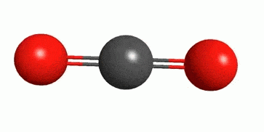
Climate Change Story
Greenhouse gases, like CO₂ and methane, absorb infrared radiation.
Notes:
Describe the experiment done in the video. Mention the SHM activity in Beyond Bohr

Slide 5
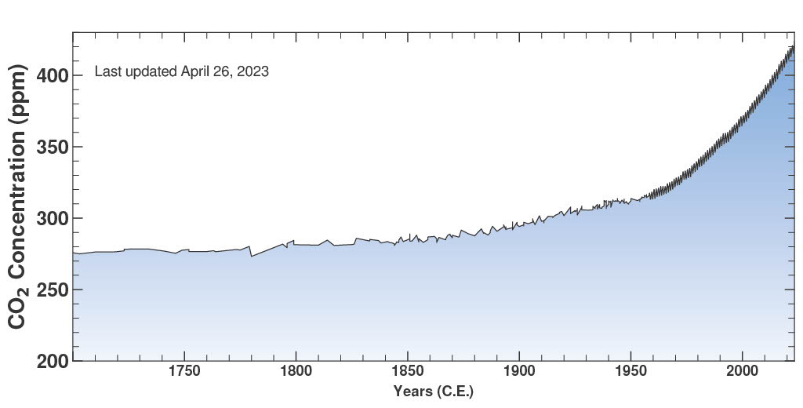
Climate Change Basics
CO₂ levels have been increasing since industrial revolution
Notes:
Describe the Keeling Curve Activity

Slide 6
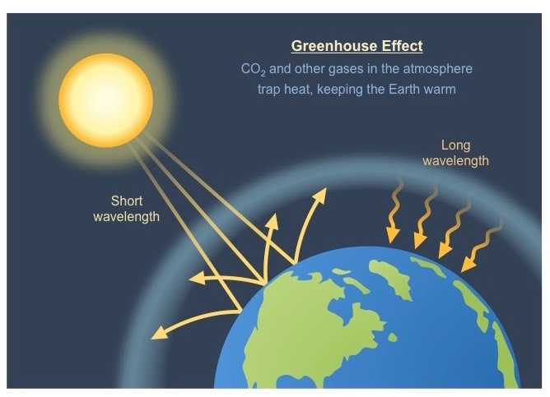
Leading to a enhanced greenhouse effect

Slide 7
Questions
What questions about climate change do you hear the most?
What is the question that you are most worried about being asked?
What is the question you have always wanted to ask?

Slide 8
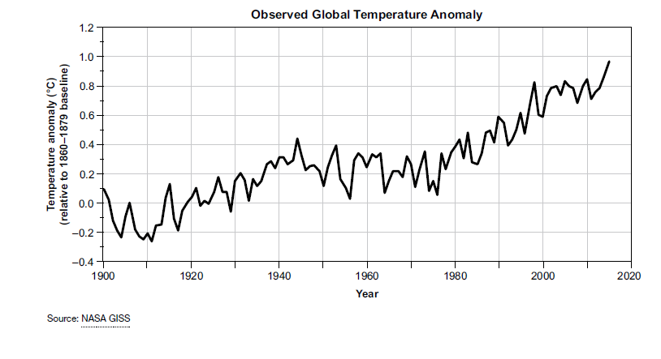
Earth is getting warmer

Slide 9
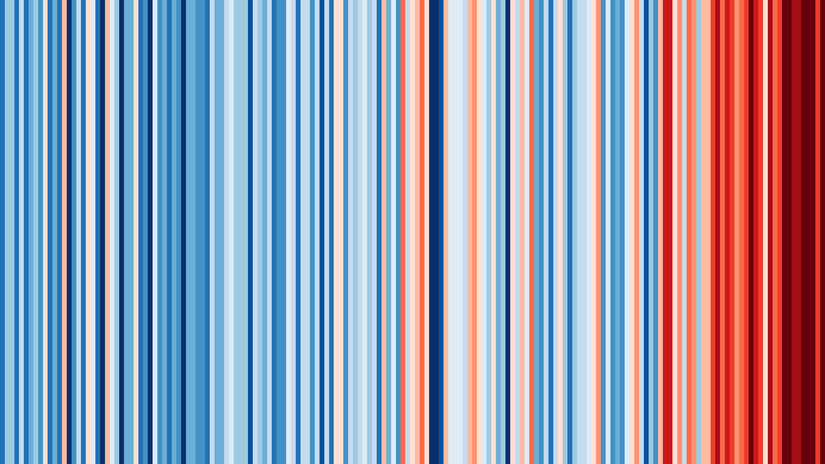
Europe (1864 – 2022)
Notes:
https://showyourstripes.info/
Berkeley Earth, NOAA, UK Met Office, MeteoSwiss, DWD
Shows anomaly from 20th century average

Slide 10
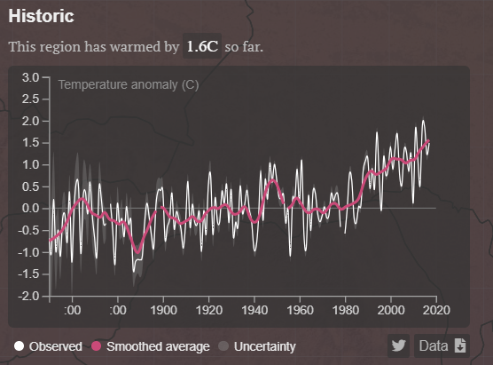
Geneva is getting warmer
https://www.carbonbrief.org/mapped-how-every-part-of-the-world-has-warmed-and-could-continue-to-warm
Notes:
Data taken from Carbon Brief (https://www.carbonbrief.org/mapped-how-every-part-of-the-world-has-warmed-and-could-continue-to-warm) Interactive Map
Based on Berkeley Earth degree by degree avg temperature. Both historical and future temperatures are shown relative to a 1951-1980 baseline period.
Discuss with your neighbours. What are the reasons that you have heard for rising temperatures?

Slide 11


A few degrees may not seem like much…
37ºC = healthy
39ºC = sick
Notes:
Students might think that 2 degrees isn’t much but…

Slide 12
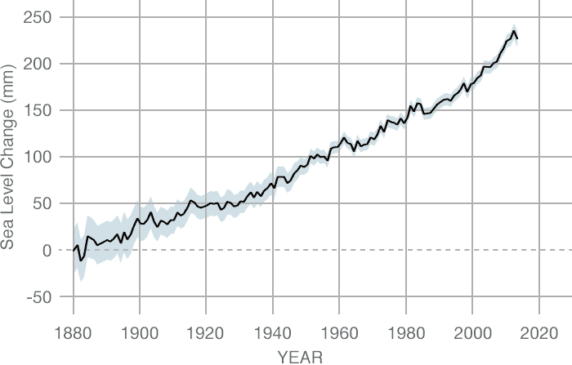
Sea Levels are rising
CREDIT: CSIRO
Notes:
Data source: Coastal tide gauge records.
Credit: CSIRO
https://climate.nasa.gov/vital-signs/sea-level/

Slide 13
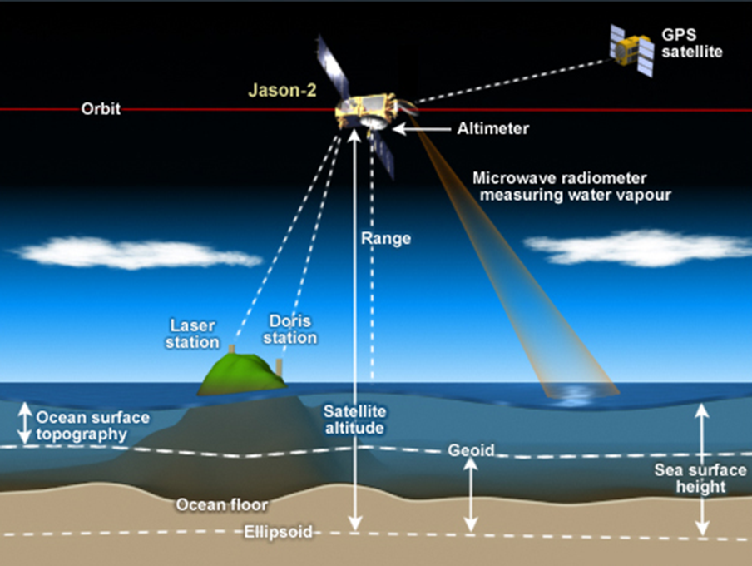
Satellite Altimetry: Measuring Sea Level
Notes:
Distribute the Satellite Altimetry card. Quick explanation for one way to measure sea levels is to bounce radar signals between satellites and sea surface

Slide 14
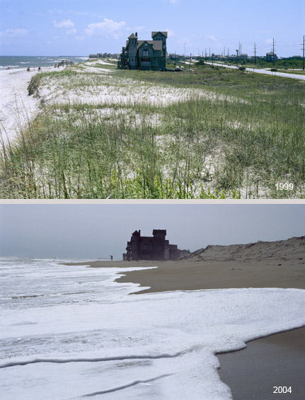
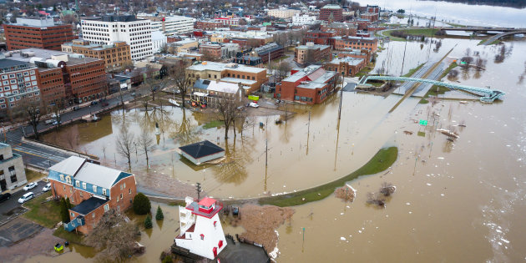
A few centimetres may not seem like much…
Notes:
Students might think that 20 cm is that big of a deal but…

Slide 15
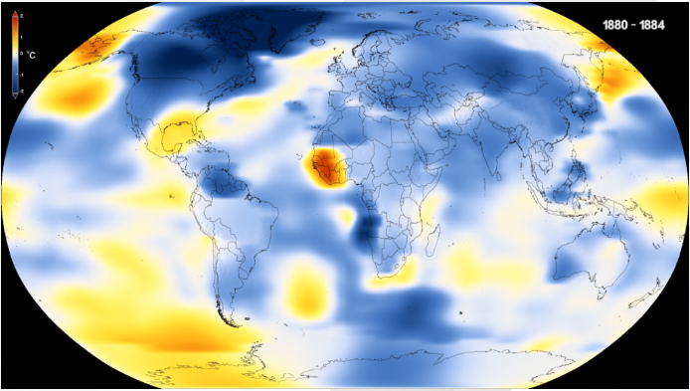
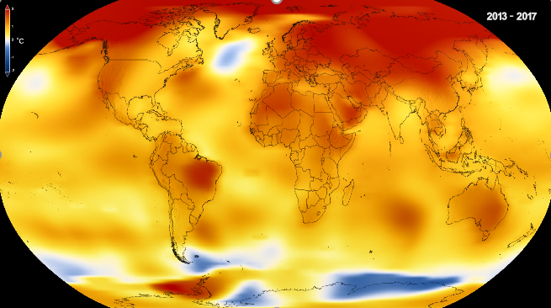
The question is: Why?
1880 2017
And what can we do about it?
Notes:
Discuss with neighbours about reasons that you have heard for the rise in temperature

Slide 16

A Climate Change demo

Slide 17
Which gases are transparent to infrared radiation?

Slide 18


Heat
Predict
Observe
Explain
Apply
Notes:
Heat
Predict
Observe
Explain
Apply

Slide 19
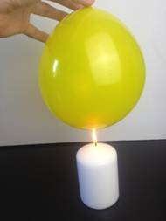
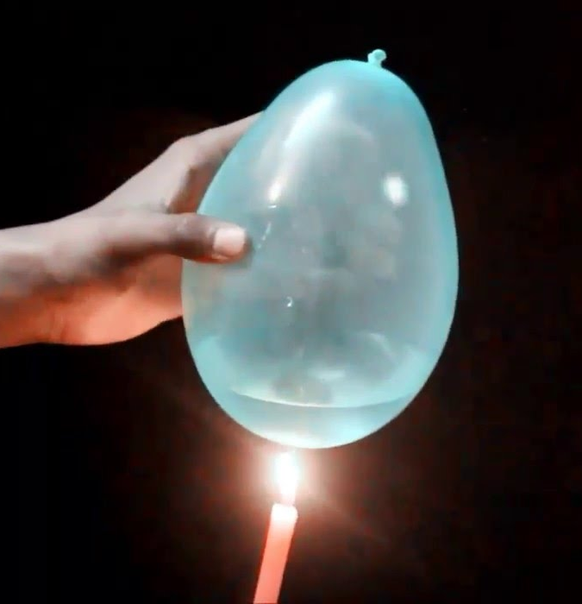

Predict: What happens to the balloons?
air
water
Will the balloons pop at the same time? If not, which will pop first? Why?
Notes:
What happens to the balloons?
How does this relate to the Earth?

Slide 20
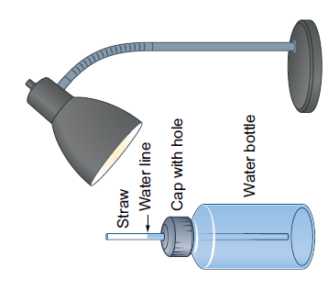
Predict: What happens when water heats up?
Will the water level rise, fall or stay the same?
Why?
Notes:
What happens when water heats up?
How does this relate to the Earth?

Slide 21
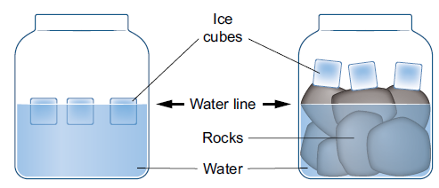
Predict: What happens when ice melts?
What will happen to the water level in each container? Why?
Notes:
What happens when ice heats up?
How does this relate to Earth?

Slide 22
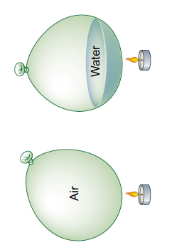
Make your 3 predictions and explanations!
Popping time
Water level
Water level

Slide 23

How do these observations relate to the Earth?
Notes:
The implications
How does this relate to the Earth?

Slide 24
Observe and Explain
water

Slide 25
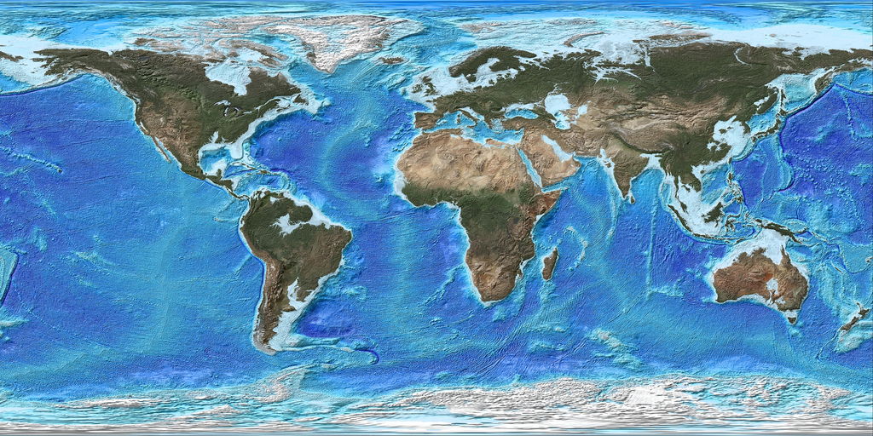
Apply:
70% of the Earth is covered by water
Notes:
70% of the Earth is covered by water

Slide 26
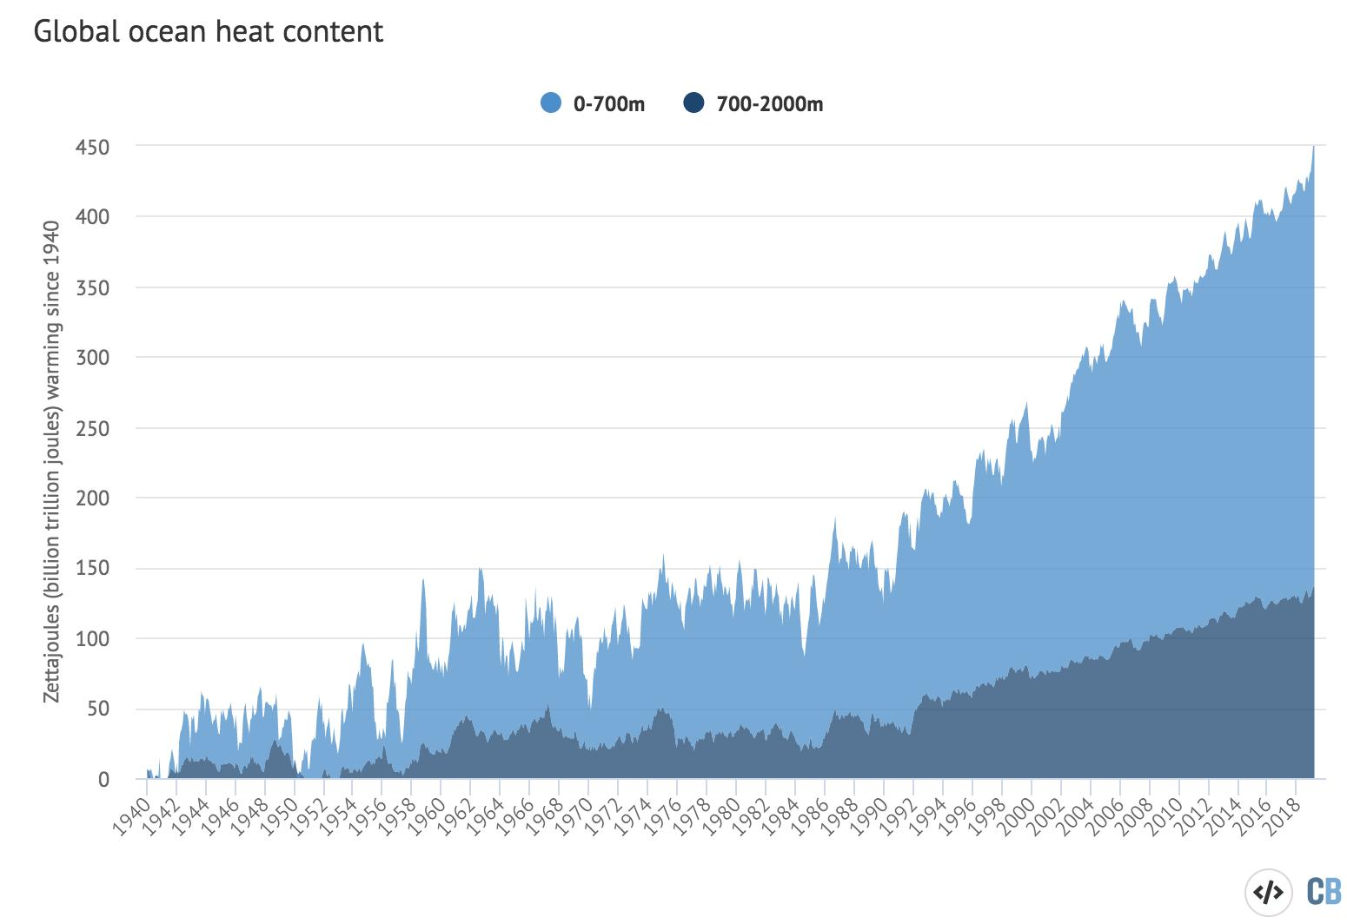
Oceans are hotter

Slide 27
What happens when water heats up?
Notes:
What happens when water heats up?
How does this relate to the Earth?

Slide 28
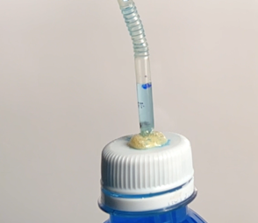
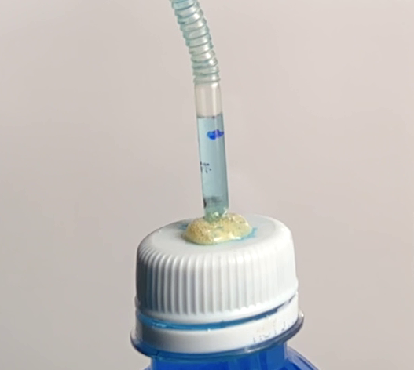
How does this relate to the Earth?
Notes:
What happens when water heats up?
How does this relate to the Earth?

Slide 29
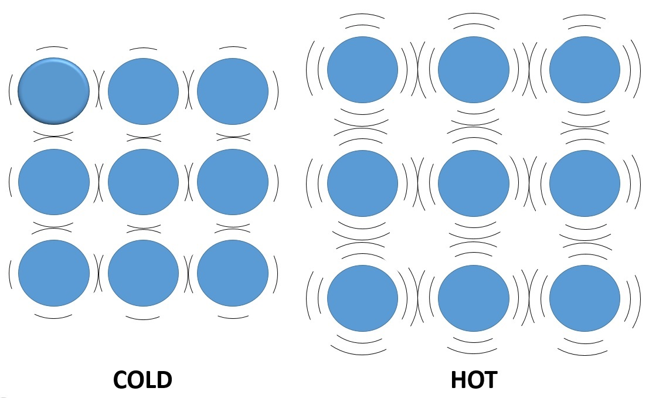
Thermal Expansion of Water

Slide 30
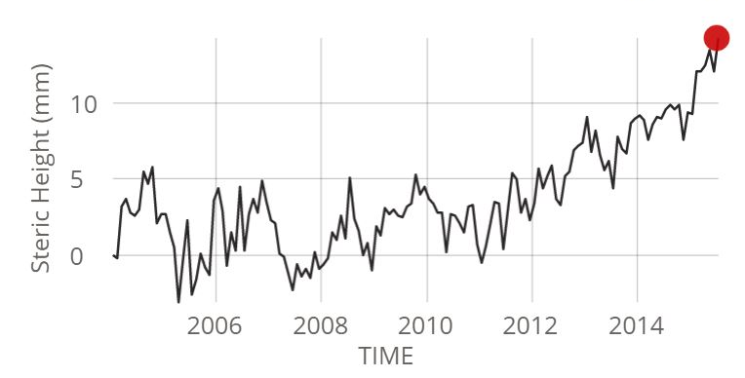
Apply:
Measuring the Ocean’s Volume

Slide 31
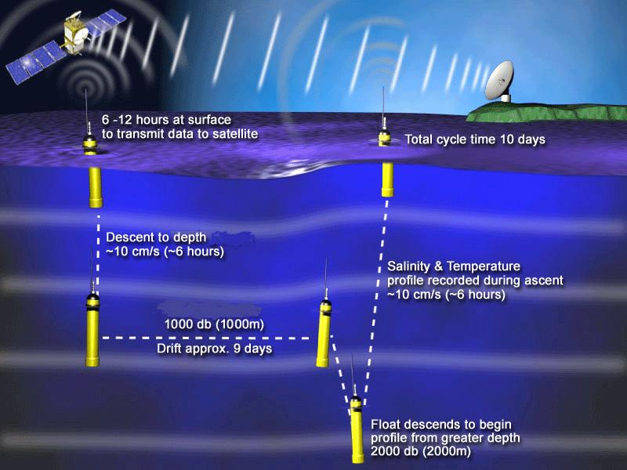
ARGO: Measuring the Ocean’s Volume
Notes:
ARGO measures salinity and temperature at two different depths

Slide 32
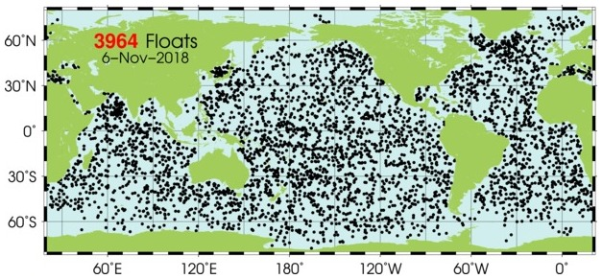
ARGO: Measuring the Ocean’s Volume
Notes:
Almost 4000 probes spread around the globe

Slide 33
Observe and Explain

Slide 34
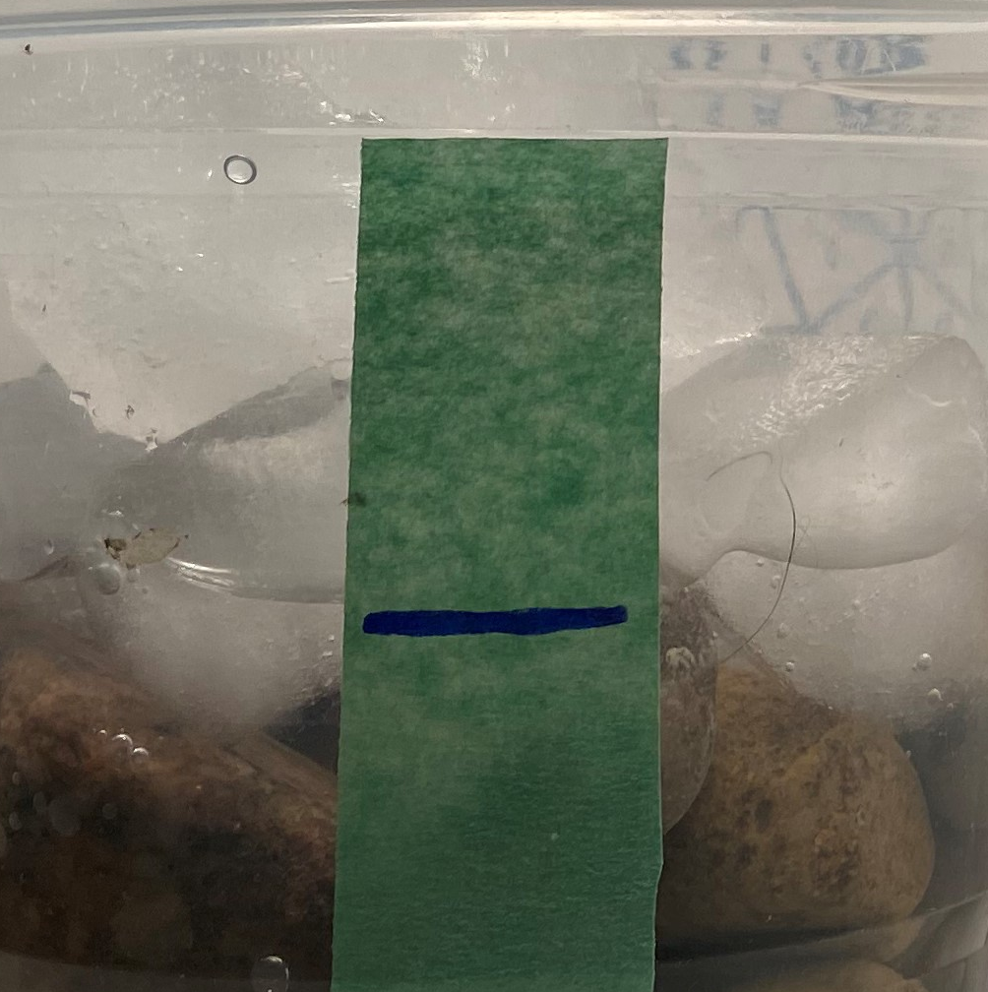
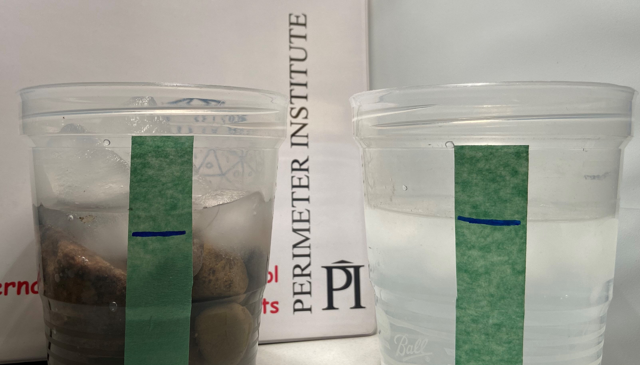
How does this relate to the Earth?
Notes:
What happens when ice heats up?
How does this relate to Earth?

Slide 35
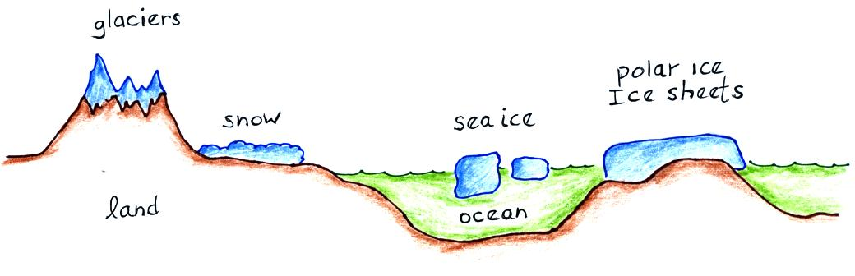
Apply:
Land Ice vs Sea Ice
Notes:
Land ice vs Sea Ice

Slide 36
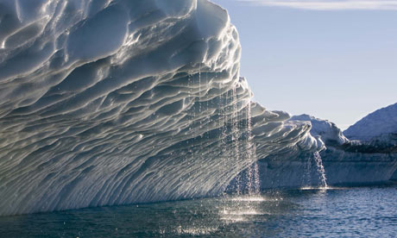
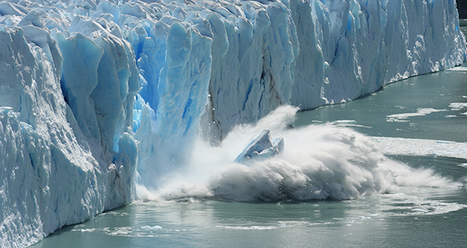
A melting iceberg does not cause a direct change in sea level
A melting glacier adds water to the ocean and causes a direct change in sea level
Notes:
A melting ice berg does not cause a direct change in sea level
A melting glacier adds water to the ocean and causes a direct change in sea level

Slide 37
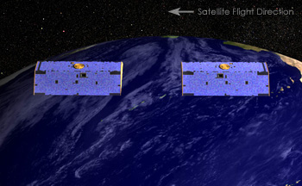
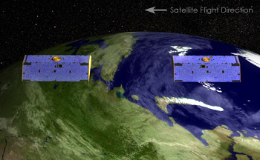
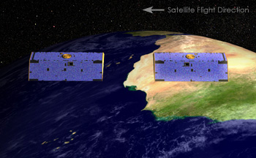
GRACE: Measuring Land Ice Mass
Notes:
Two satellites orbiting 220 km apart. Exact separation is measured using microwaves and GPS.
As lead satellite approaches more mass it accelerates slightly and moves away from trailing satellite.
GRACE can map out gravitational anomaly (and therefore mass) with great precision.

Slide 38
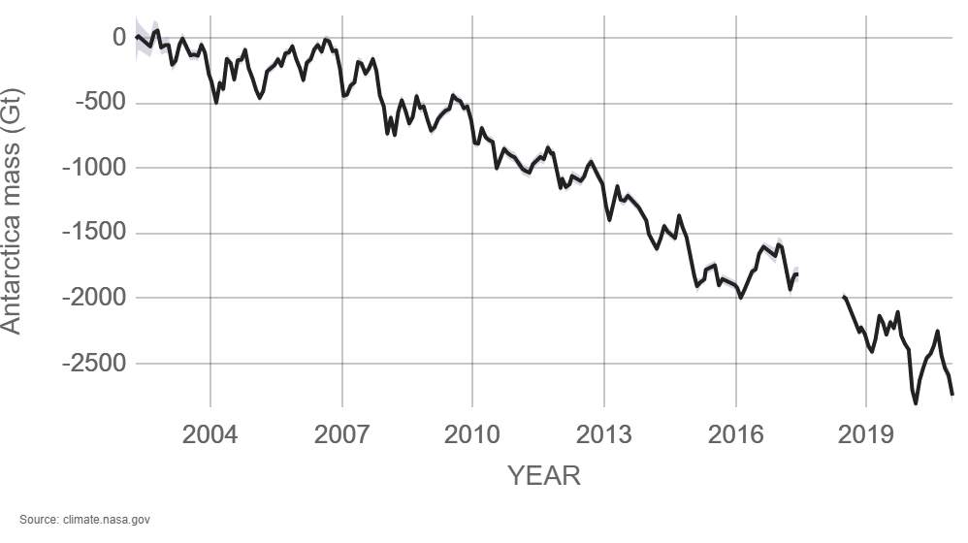
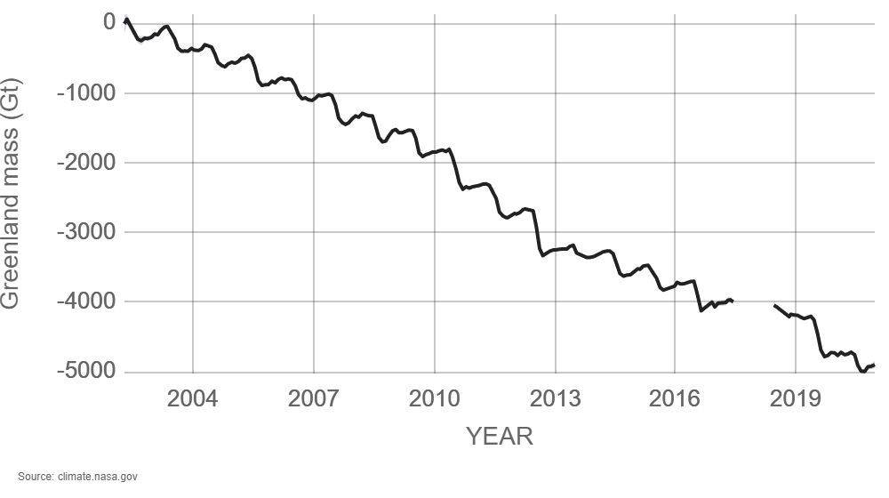
Antarctica ice mass is decreasing at 150 Gt per year
> 420 Gt per year!
Greenland ice mass is decreasing at 278 Gt per year
Notes:
Distribute/inspect GRACE postcard
Antarctica ice mass is decreasing at 150 Gigatonnes per year
Greenland ice mass is decreasing at 278 Gigatonnes per year
https://climate.nasa.gov/

Slide 39
Satellite Altimetry: Measuring Sea Level

Slide 40
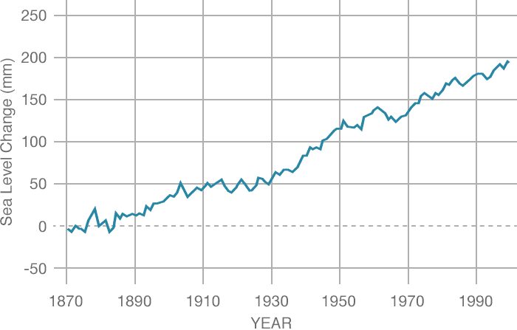
Measuring the Height of the Sea

Slide 41
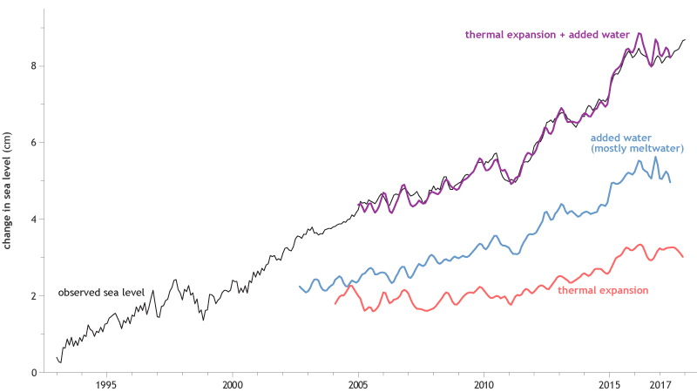



Sea Level Budget
Notes:
When we combine the sea level rise determined by ARGO (Thermal expansion) and GRACE (Added meltwater) we get the total observed sea level rise.

Slide 42
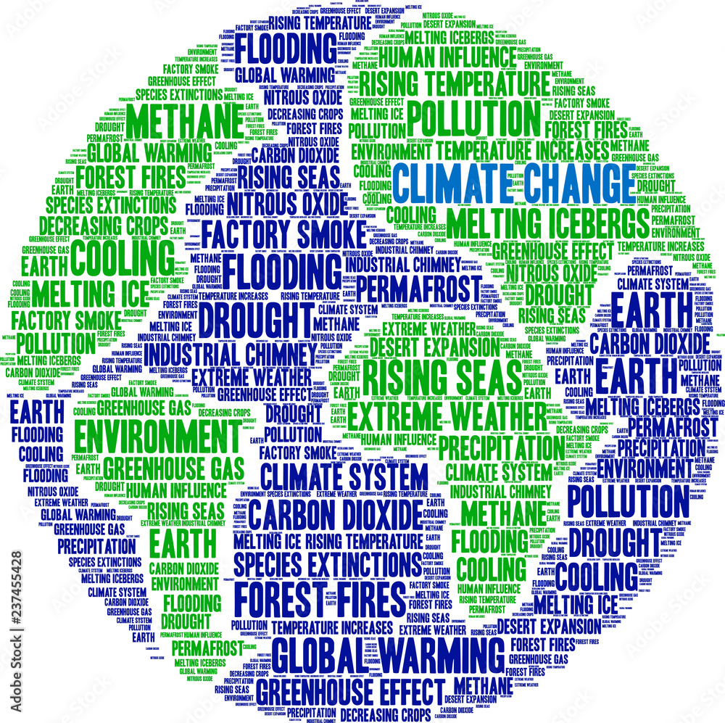
How has climate change impacted you?
Notes:
The Effects of Climate Change
More extreme weather events
https://climate.nasa.gov/effects/

Slide 43
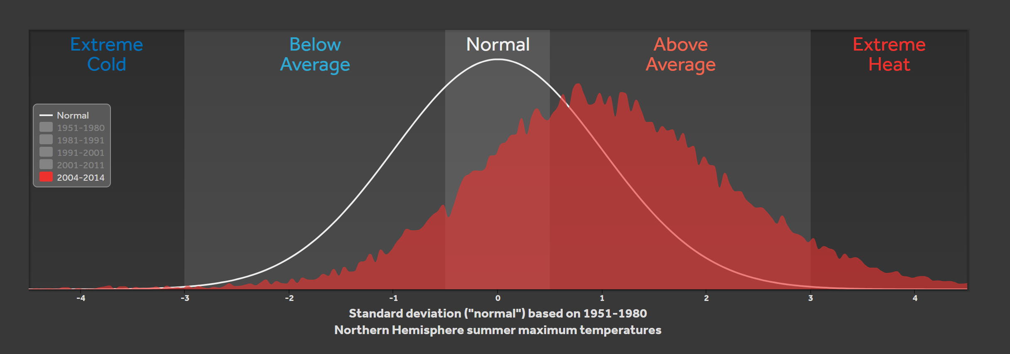
More heat waves
Notes:
The Effects of Climate Change
More heat waves
A tropical night means temperatures do not fall below 20C overnight.
Almost 600 people died in BC during the weeklong heatwave at the end of June 2021
https://www.cbc.ca/news/science/nighttime-temperatures-climate-change-1.6112778
The 11 Deadliest Heat Waves in World History
1) Europe, 2003: 71,310
2) Russia, 2010: 55,736
3) France/Belgium, 2015: 3,685
4) India/Pakistan, 2015: 3,477
5) Europe, 2006: 3,418
6) India, 1998: 2,541
7) U.S. and Canada, 1936: 1,693
8) India/Pakistan/Bangladesh, 2003: 1,472
9) U.S., 1980: 1,260
10) U.S./Canada, 2021: 1037
11) India, 2002: 1,030

Slide 44
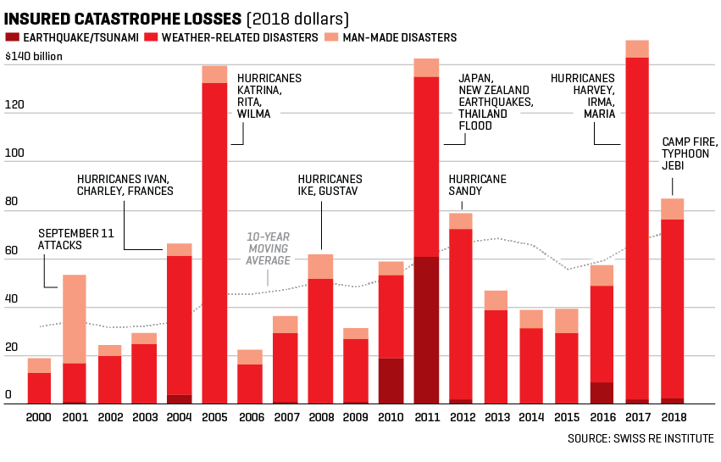
Economic costs of climate change
Notes:
Environmental Effects are listed in video.
Economic Costs of Climate Change
Deloitte Global Turning Point Report: Climate Inaction will cost world economy US$178 trillion. Accelerating towards net-zero would increase economy by US$43 trillion (over next 50 years)
According to Swiss Re will cost the world $23 trillion by 2050 (~11-14% of GDP)
After the last hurricane season dozens of gulf coast insurance companies went insolvent forcing state-chartered insurance to borrow money to cover claims:
https://www.eenews.net/articles/fla-and-la-must-borrow-millions-to-pay-insurance-claims/
The Associated Press reports that extreme weather events have inflicted $4.3tn in damages in total since 1970, with $1.7tn recorded in the US.

Slide 45
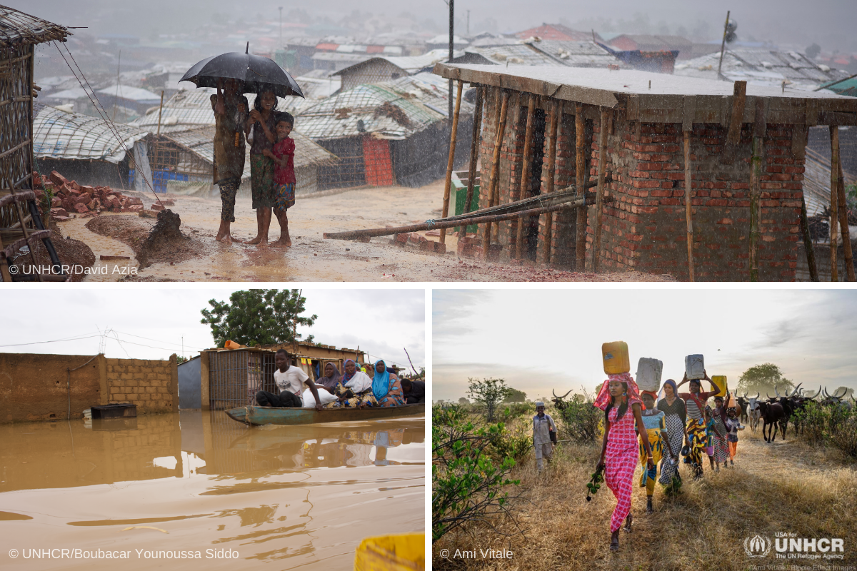
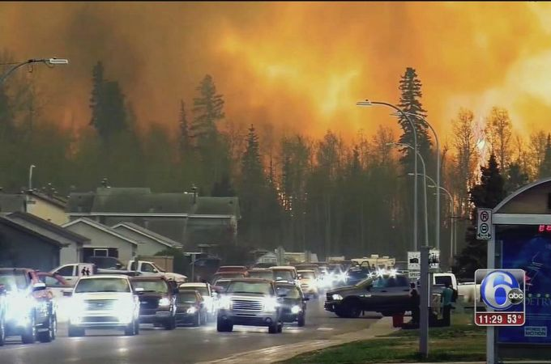
Social costs of climate change
Notes:
The Effects of Climate Change
Displaced peoples (~40% OF HUMAN POPULATION IS WITHIN 100 km of coast)
Current prediction is 150-200 million climate change refugees by 2050
In January 2020, the UN Human Rights Committee ruled that "refugees fleeing the effects of the climate crisis cannot be forced to return home by their adoptive countries."

Slide 46


What’s causing the warming?
Notes:
What’s Causing the Warming?

Slide 47


Examine the Forcing Factors
Notes:
What’s Causing the Warming?
In this activity students examine data plots for possible forcing factors.
Use JIGSAW format

Slide 48

Notes:
When we combine all of the Forcing Factors we get the grey line, which follows the observations (just like sea level→we know what is going on!)

Slide 49
Mitigation: Sources and Sinks
Reducing GHGs at the source and/or enhancing carbon sinks.
Rank the sources of GHGs (highest to lowest)
Notes:
Use IPCC categories and definitions on cards. In groups discuss and rank them.
Assign a percentage to each.

Slide 50

Notes:
There is no one source of GHGs so there cannot be one solution.
Going SOLAR? Great. Electricity contributes about 25%
Going VEGAN? Great. Agriculture contributes about 24%
Sell your CAR or stop FLYING? Sure. Transportation contributes 14%

Slide 51

Notes:
I think we need a portfolio approach to address climate change, and not put all of our greenhouse eggs in one solutions basket. I’d focus on several issues to start, including enhancing energy conservation, scaling up renewable electricity generation, reducing food waste, shifting diets to less damaging foods, improving agricultural systems, electrifying transport where possible and using sustainable fuels where not, constructing and retrofitting buildings for extreme energy efficiency, and electrifying heating and cooling systems. We should also target methane, and so-called super-pollutants, as soon as possible, to help us buy time to do the rest.
And we should look for ways to remove greenhouse gas emissions (especially those emissions that will take time to eliminate at the source) through the development of safe carbon sinks. I strongly recommend natural carbon sink solutions, like replanting forests, increasing “carbon farming” on agricultural lands, and restoring coastal ecosystems, as an excellent “no regrets” strategy to start.
Jonathon Foley (globalecoguy.org)

Slide 52
“We basically have three choices: mitigation, adaptation, and suffering. We’re going to do some of each. The question is what the mix is going to be. The more mitigation we do, the less adaptation will be required and the less suffering there will be.”
John Holdren (US climate expert)
Notes:
(responding to IPCC 4 in 2007 )

Slide 53

Mitigation
Reducing GHGs at the source and/or enhancing carbon sinks.
Notes:
First large scale project captures 4000 tons per year at a cost of about $800 per ton which is equivalent to 870 cars.
The google slideshow has the top 10 projects to be put in order:
https://docs.google.com/presentation/d/1OPideGsQfOFhUzykCkiFtHIeDUkw3lBJlEXZYm7kqYY/copy

Slide 54

Mitigation: Sources and Sinks
Reducing GHGs at the source and/or enhancing carbon sinks.
Notes:
First large-scale project captures 4000 tons per year at a cost of about $800 per ton which is equivalent to 870 cars.
State of Wyoming tried to legislate Carbon Capture for coal burning power plants. Utility companies say it is too expensive and will drive electricity rates up.

Slide 55
Project Drawdown Top 10
Rank these possible solutions for effectiveness*
*CO² reduced per dollar spent
(highest to lowest)
(based on 1.5ºC by 2100)
Notes:
Use Project Drawdown Top 10
https://drawdown.org/solutions/table-of-solutions
Online version use this Google Slideshow: https://docs.google.com/presentation/d/1UNPjdTj6Xe80DaRVUWz4ktZ25oQmtrqfHQsZP7qnmJs/copy

Slide 56
Project Drawdown Top 10
1.5°C by 2100
Onshore Wind Turbines
Utility-Scale Solar Photovoltaics
Reduced Food Waste
Plant-Rich Diets
Health and Education for Girls/Women
Tropical Forest Restoration
Improved Clean Cookstoves
Distributed Solar Photovoltaics
Refrigerant Management
Alternative Refrigerants
Notes:
This table provides the detailed results of the Plausible Scenario, which models the growth solutions on the Drawdown list based on a reasonable, but vigorous rate from 2020-2050. Results depicted represent a comparison to a reference case that assumes 2014 levels of adoption continue in proportion to the growth in global markets.
https://drawdown.org/solutions/table-of-solutions

Slide 57

Every contribution helps

Slide 58


Personal Action vs Corporate Action
It is NOT either OR but BOTH
Notes:
“All persons who participate by their actions in the ongoing schemes of cooperation that constitute these structures are responsible for them, in the sense that they are part of the process that causes them. They are not responsible, however, in the sense of having directed the process or intended its outcomes” (Young, 2006, p.114). But Young is also careful to point out that her model “does not necessarily mean that all who share responsibility have an equal responsibility. The power to influence the processes that produce unjust outcomes is an important factor that distinguishes degrees of responsibility” (p.125). For Young, our responsibility is directly proportionate to our capacity to make things right.
If you remember only one thing from this discussion of responsibility, remember this: searching for someone to blame is a waste of our time when we have such a difficult task ahead of us. Instead, we should be asking who has the power to make things right, who is impeding progress on these problems and how can we engage those most responsible for this crisis in the work of building a better world.

Slide 59
Personal action
TRANSPORT
SHOPPING
INFLUENCE
FOOD
CITIZENSHIP
ENERGY IN THE HOME
Notes:
Online: Use chat function to have teachers suggest actions that individuals can take.

Slide 60

Notes:
Figure 1. The six domains of choice for
climate action
Food, energy, transport, and shopping represent
direct emissions-related choices and constitute the
majority of individual carbon footprints. Influence
and citizenship are important, indirect domains of
choice that have a bearing on climate change. Examples
of key choices within each are represented.
From:
Choices for climate action: A review
of the multiple roles individuals play
Sam Hampton1,* and Lorraine Whitmarsh1
1Department of Psychology, University of Bath, Claverton Down, Bath BA2 7AY, UK
*Correspondence: sah53@bath.ac.uk
https://doi.org/10.1016/j.oneear.2023.08.006

Slide 61



What difference do personal actions make?
Notes:
As teachers we have a responsibility to be role models.
That means following through and showing our students what it looks like.
When my students see me on the bus or my colleagues biking up the hill to school they know we are committed.

Slide 62


Slide 63





Recognize that this is a loaded issue
Inter-generational conflict
Racial inequality
Hopelessness
Shame
Anxiety
Notes:
Use chat function to have teachers voice reactions that they have observed in the classroom before revealing this list (not exhaustive by any means)

Slide 64
Teaching Climate Change
Give room for emotional response
Give immediate and concrete steps to take
Encourage collective response, we are in this together
Model hope and intentionality
Notes:
Teaching Facts about Climate Change Isn’t Enough: https://www.scientificamerican.com/article/to-teach-students-about-climate-change-lsquo-just-the-facts-rsquo-isn-rsquo-t-enough/
https://www.thelancet.com/journals/lanplh/article/PIIS2542-5196(20)30223-0/fulltext
TIPS:
Give room for emotional response
Give immediate and concrete steps to take
Allow for collective response, they are in this together
Model hope and intentionality
How are you feeling about the future?

Slide 65

Notes:
Find relevant examples of good things that are happening.

Slide 66
Simple actions you can take:
Talk about Climate Change
Reduce your own personal footprint
  Transportation and energy choices
  Carbon offsets
  Dietary choices
Lobby for systemic change
  Political, social, economic

Slide 67

Keeling Curve activity
Notes:
https://scripps.ucsd.edu/programs/keelingcurve/wp-content/plugins/sio-bluemoon/graphs/mlo_full_record.png
What do you notice?
Consider what you saw in the video about how carbon dioxide interacts with IR light. What does this imply about the energy in the atmosphere.

Slide 68

Climate Modeling activity
Notes:
What’s Causing the Warming?

Slide 69

Impact of Transportation activity
Notes:
Students consider the impact of transportation (personal and commercial)
Discuss various scenarios to consider some of the issues surrounding transportation.

Slide 70

Math: How Much Carbon in that Tree?
Notes:
Use trig to determine height of tree. Measure circumference at chest height. Calculate amount of carbon stored in tree.
Students also do a simple carbon footprint calculation.

Slide 71

Math: Comparing Costs
Notes:
Comparing the cost to buy and operate electric vehicles with gas vehicles.

Slide 72








Climate
Resources
Notes:
Project Drawdown (https://drawdown.org/) does great research about effective solutions
Kathrine Hayhoe is a Canadian climate scientist in Texas. Follow her on Twitter and YouTube.
SkepticalScience is a fantastic website/app with a huge amount of climate information. They had an app but it seems to have been removed from Google Play Store.
https://www.carbonbrief.org/ is an excellent environmental website with lots of good, current data and analysis.
https://climate.nasa.gov/ is the official NASA Climate site
https://www.climateprediction.net/ is a large citizen science project running climate models on individual computers.
Active Hope is an excellent book with online supports and training
Climate Psychology Alliance is a group of psychologists working with climate anxiety

Slide 73



Evidence for Climate Change
Dave Fish
dfish@perimeterinstitute.ca
Kelly Foyle
kfoyle@perimeterinstitute.ca
resources.perimeterinstitute.ca

Slide 74

Notes:
13 short years later, PI is now the largest theoretical physics institute in the world.
We recently double the size of the facility, tripling capacity with the addition of the Stephen Hawking Centre at PI.
Stephen is a DVRC and a huge supporter, this is the first time he has ever lent his name to a facility

Slide 75


Slide 76







IN-CLASS RESOURCES
Experienced teachers
Perimeter researchers
Pedagogy and teaching strategies
resources.perimeterinstitute.ca
Notes:
We produce about two resources per year, each with a suite of lessons and often with a short video. Our resource centre has 21 compilations and over 100 individual resources.
The resources are written by a team of teachers and outreach scientists. All lessons are reviewed and tested by our teacher network. All science content is carefully vetted by one of our researchers to ensure not just correctness, but insight and depth.
One of our goals is to equip teachers with excellent material that they can use in their classroom.Face to face just can’t scale; how do we reach as many youth as possible in an extremely impactful way … we choose to reach them through their teachers … we know where they are, we know what they are trying to do, and we know how we can help…
Raising the research culture throughout the Region, across Ontario and Canada – joint hires, exchanges, joint-workshops, etc.
96% report “increase value of scientific skills of creativity, critical thinking, communication”
Teachers
Researchers
Professional Editorial and Design
Classroom tested;
Challenge: Finding the core concepts, must relevant to the subject, the teachers, the students.

Slide 77



Teacher Programs
www.perimeterinstitute.ca/outreach/teachers
Notes:
Perimeter Institute offers a range of programming for high school physics and science teachers. Visit our website or email outreach@perimeterinstitute.ca for current programs.

Slide 78

Perimeter Institute Teacher Courses

Slide 79

resources.perimeterinstitute.ca

Slide 80
Thank You!!
www.perimeterinstitute.ca
Dave Fish
dfish@perimeterinstitute.ca
Kelly Foyle
kfoyle@perimeterinstitute.ca

