Slide 1
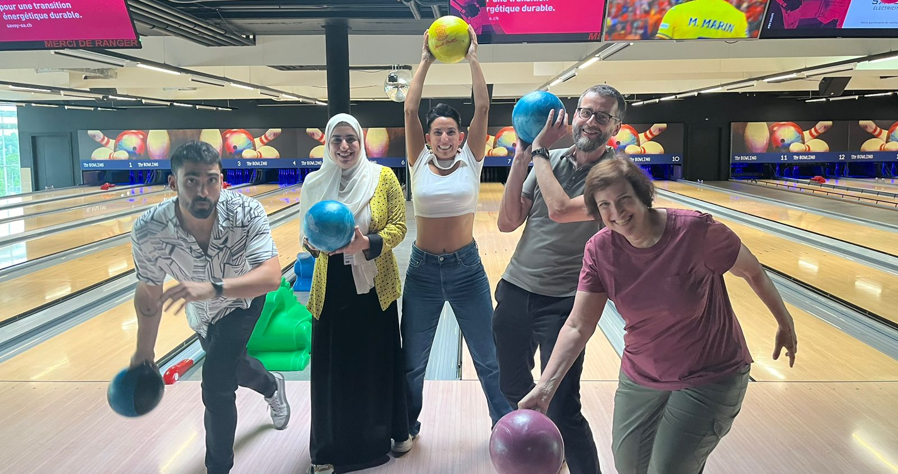
Particle Physics
HST2024 Study Group 7

Slide 2

Curriculum & Classroom Connections

Slide 3
Curriculum & Classroom Connections
Notes:
We come from different countries across the world, but we’ve found there are several similarities between the curriculums we teach at school

Slide 4
Curriculum & Classroom Connections
Electromagnetism

Slide 5
Curriculum & Classroom Connections
Electromagnetism
Mechanics

Slide 6
Curriculum & Classroom Connections
Modern Physics*
Electromagnetism
Mechanics

Slide 7
Curriculum & Classroom Connections
But where is Particle Physics?
Modern Physics*
Electromagnetism
Mechanics

Slide 8
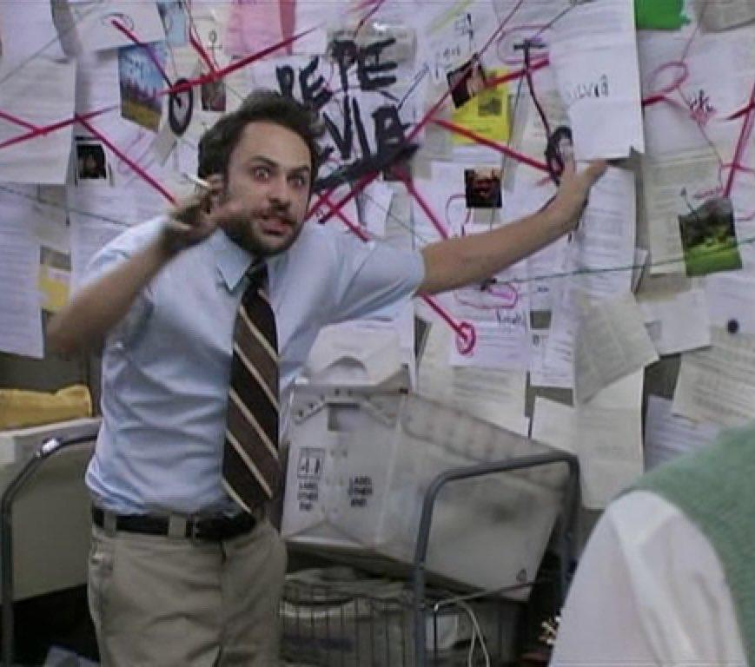
Curriculum & Classroom Connections
But where is Particle Physics?
Modern Physics*
Electromagnetism
Mechanics
We should give more room to Particle Physics and relate it with others topics

Slide 9
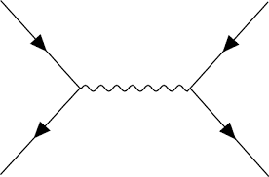
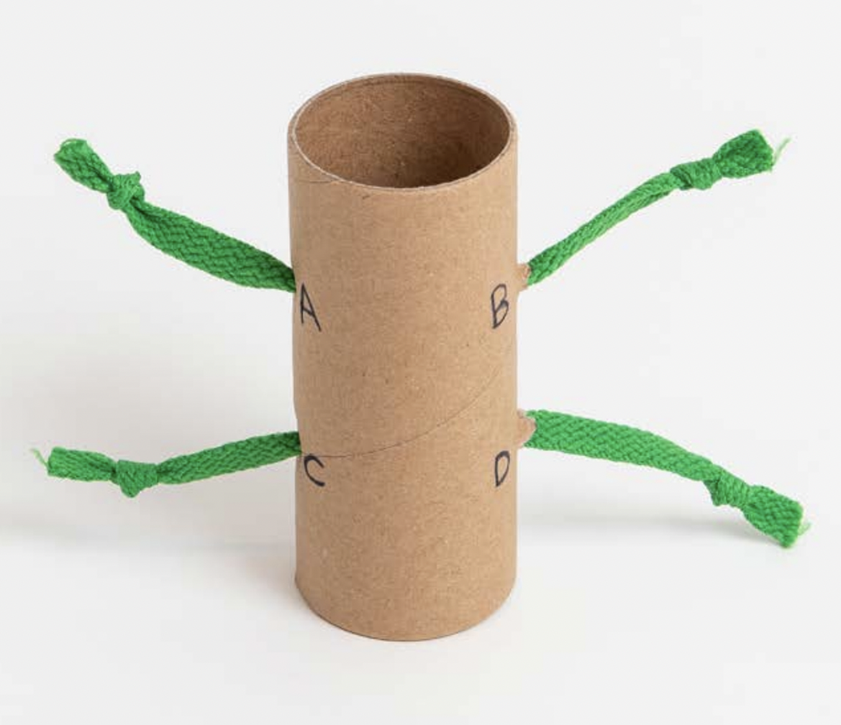

Key Ideas
We are building a model that reproduces reality, but the model is not the reality

Slide 10
Key Ideas
Fundamental particles
Charges
Interactions

Slide 11
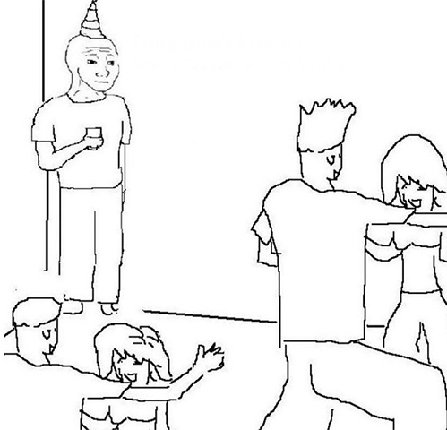
Key Ideas
Standard Model
party

Slide 12
Key Ideas
Standard Model
party
Electromagnetic interaction
Weak interaction
Strong interaction

Slide 13
Key Ideas
Gravitational interaction
Standard Model
party
Electromagnetic interaction
Weak interaction
Strong interaction

Slide 14
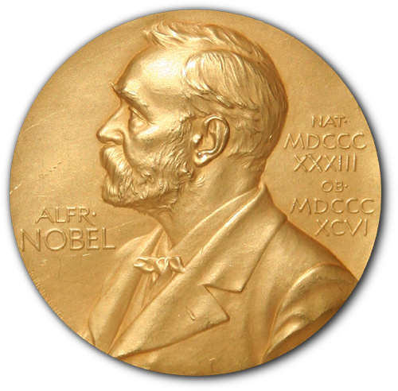
Key Ideas
Gravitational interaction
Standard Model
party
We have to build a new model that includes
all the observations
Electromagnetic interaction
Weak interaction
Strong interaction

Slide 15
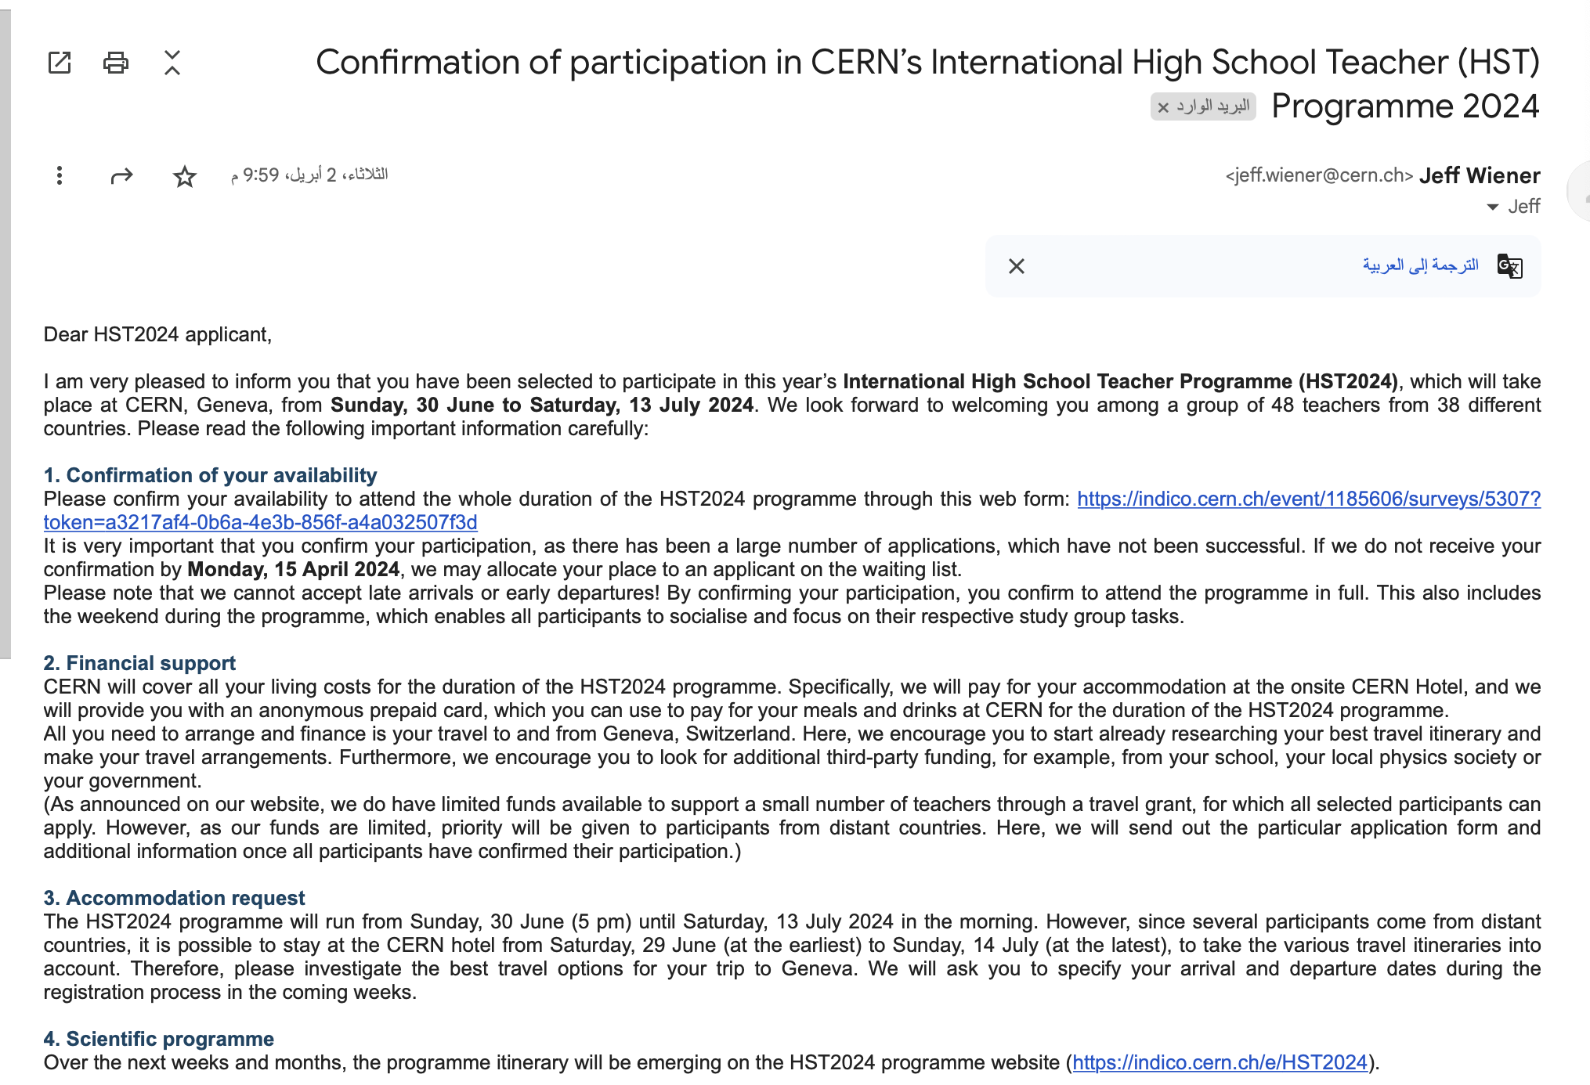
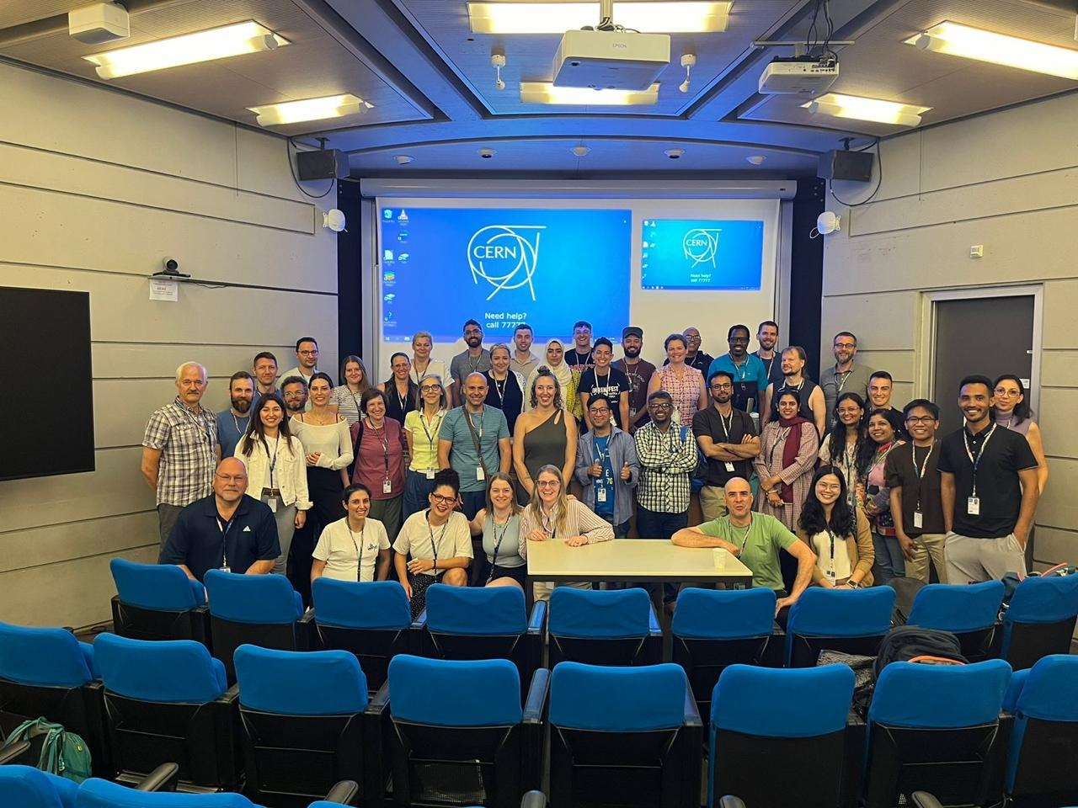
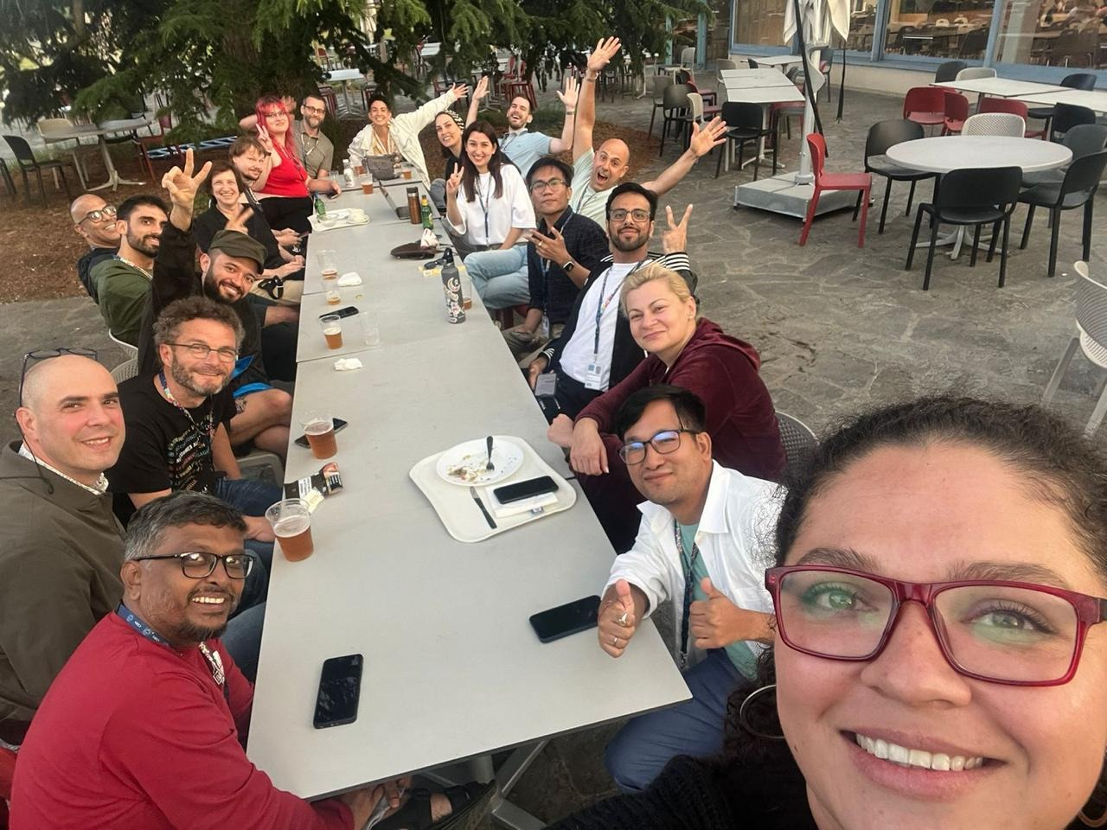
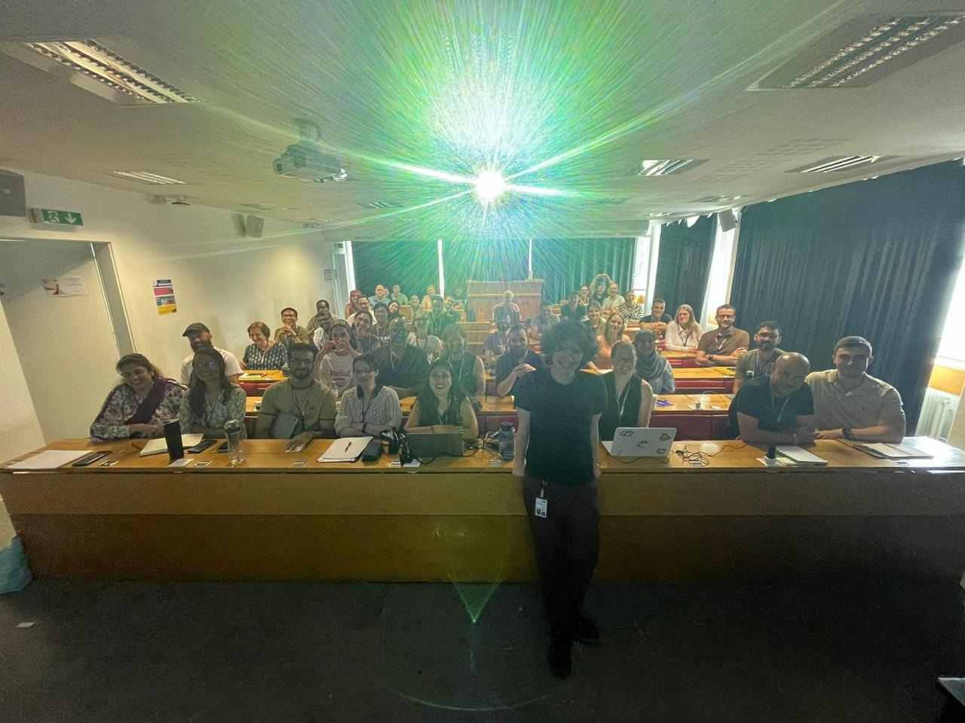
Why we are all here?

Slide 16
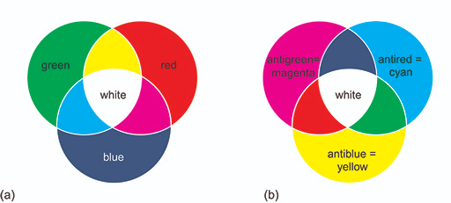
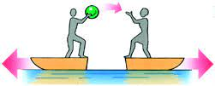
Potential Students’ Conceptions & Challenges
Visualizing things we cannot see
  The use of pictures and analogies can be helpful and dangerous at the same time.

Slide 17
Potential Students’ Conceptions & Challenges
Visualizing things we cannot see
  The use of pictures and analogies can be helpful and dangerous at the same time.
Vocabulary and correct use of words
  Examples:
    particle versus system of particles
    decay versus transformation

Slide 18


Potential Students’ Conceptions & Challenges
Visualizing things we cannot see
  The use of pictures and analogies can be helpful and dangerous at the same time.
Vocabulary and correct use of words
  Examples:
    particle versus particle system
    decay versus transformation
Relation between models and reality
- Possibility of new models in the future
- Students life will not be easy

Slide 19
Potential Students’ Conceptions & Challenges
Visualizing things we cannot see
  The use of pictures and analogies can be helpful and dangerous at the same time.
Vocabulary and correct use of words
  Examples:
    particle versus system of particles
    decay versus transformation
Relation between models and reality

Slide 20
Useful Material & Resources
CERN
  https://cern.ch/PER
  https://www.damtp.cam.ac.uk/user/tong/particle.html
  https://atlas.physicsmasterclasses.org/en/index.htm
Youtube: PBS Space Time channel
https://www.youtube.com/c/pbsspacetime
Quarknet Data Activities
  https://quarknet.org/data-portfolio
Perimeter Institute
  https://resources.perimeterinstitute.ca/collections/lessn-compilations/products/beyond-the-atom-remodelling-particle-physics?variant=17148738886
Notes:
Here is a list of resources for teachers, some we have seen this week.

Slide 21
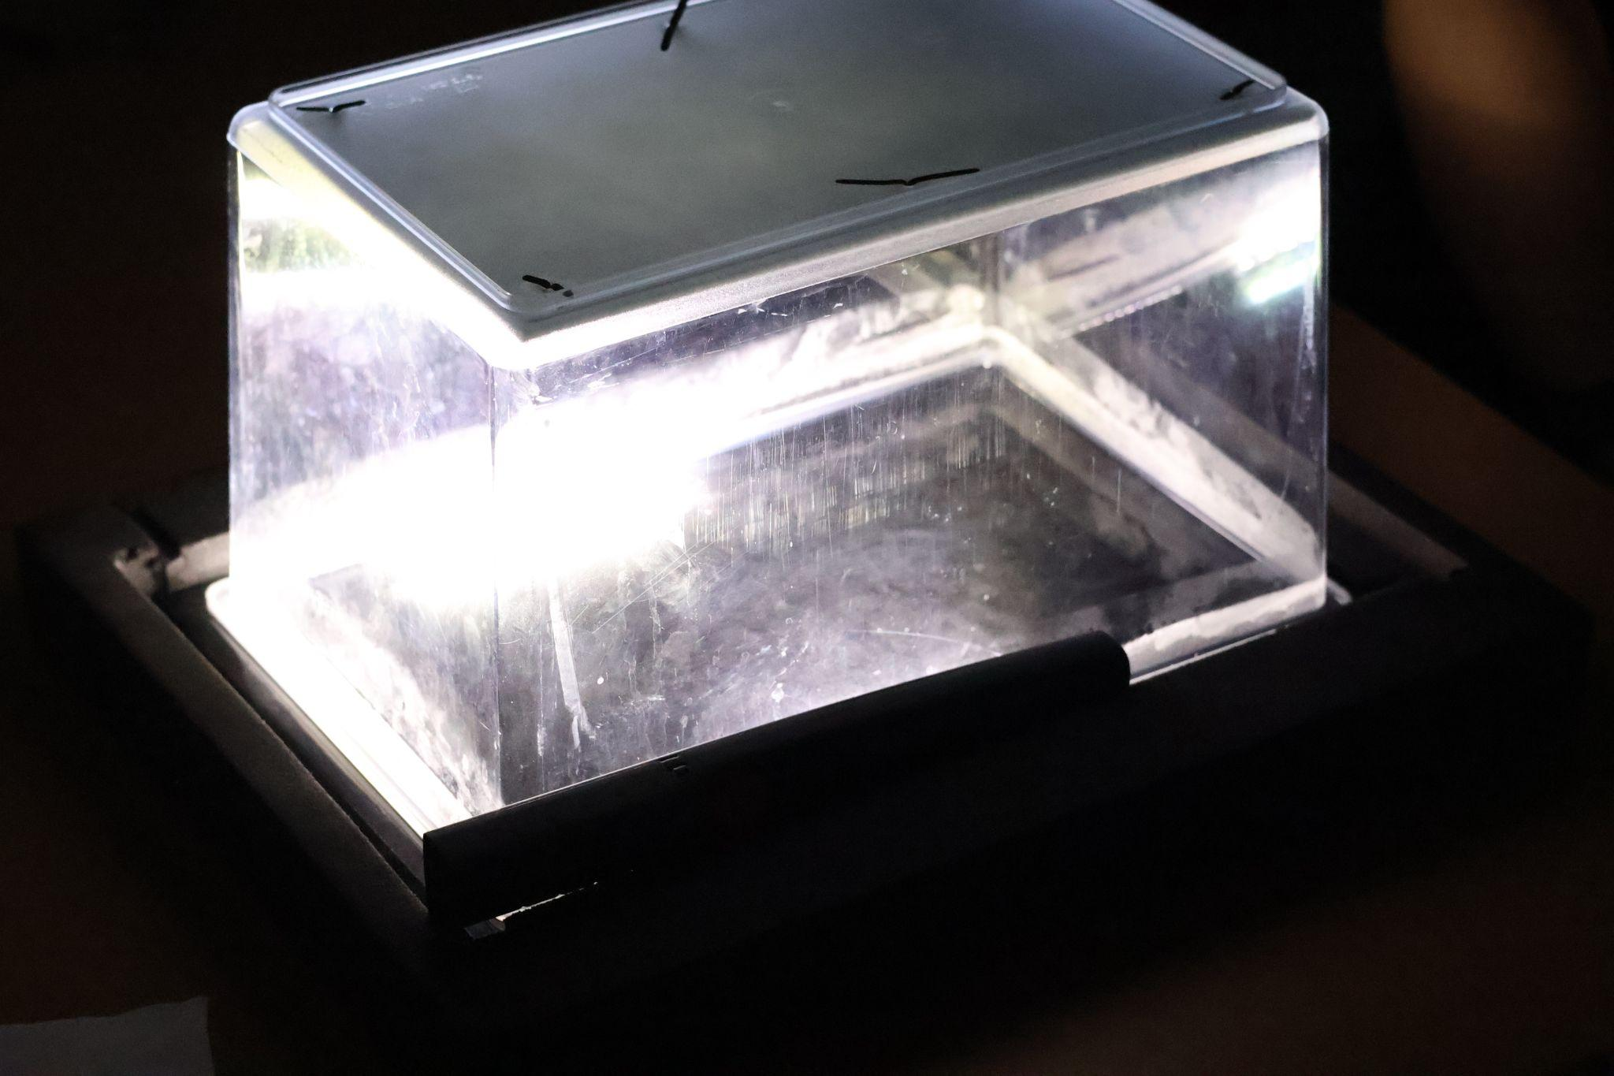
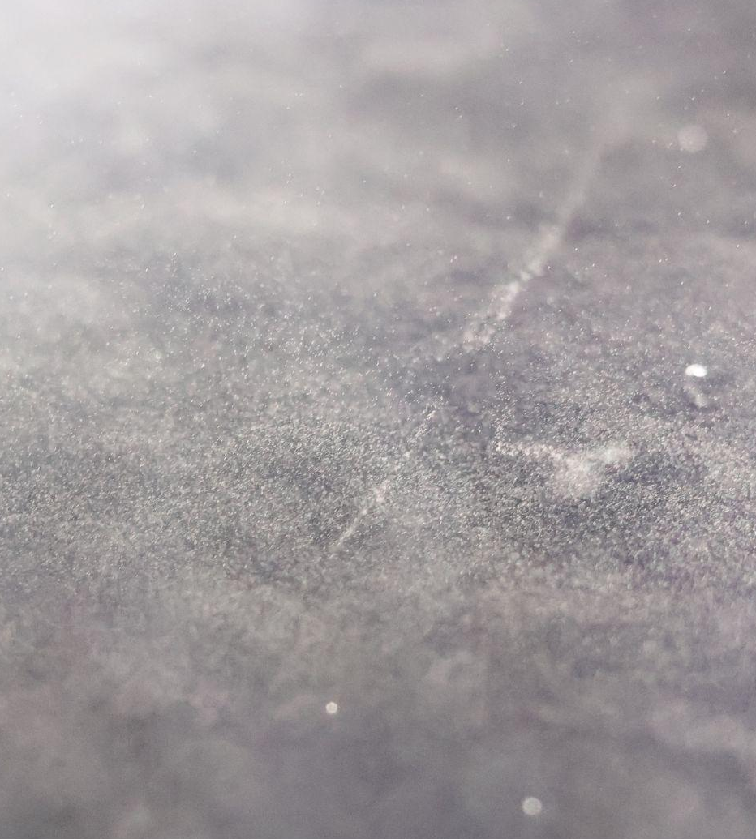
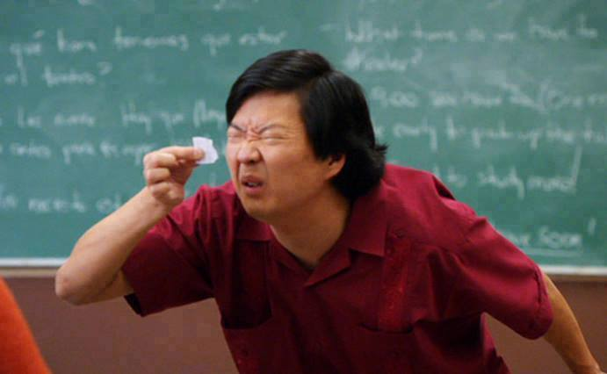
Best Practice Example
Cloud Chamber
Where we try to see
very small particles
Notes:
It’s best practice to get students engaged in their learning. Some ways include:
Some activities we used during the program

Slide 22
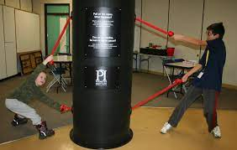
Best Practice Examples
Cloud Chamber
Black Box (PI)
Notes:
Like cloud chambers and the black box

Slide 23
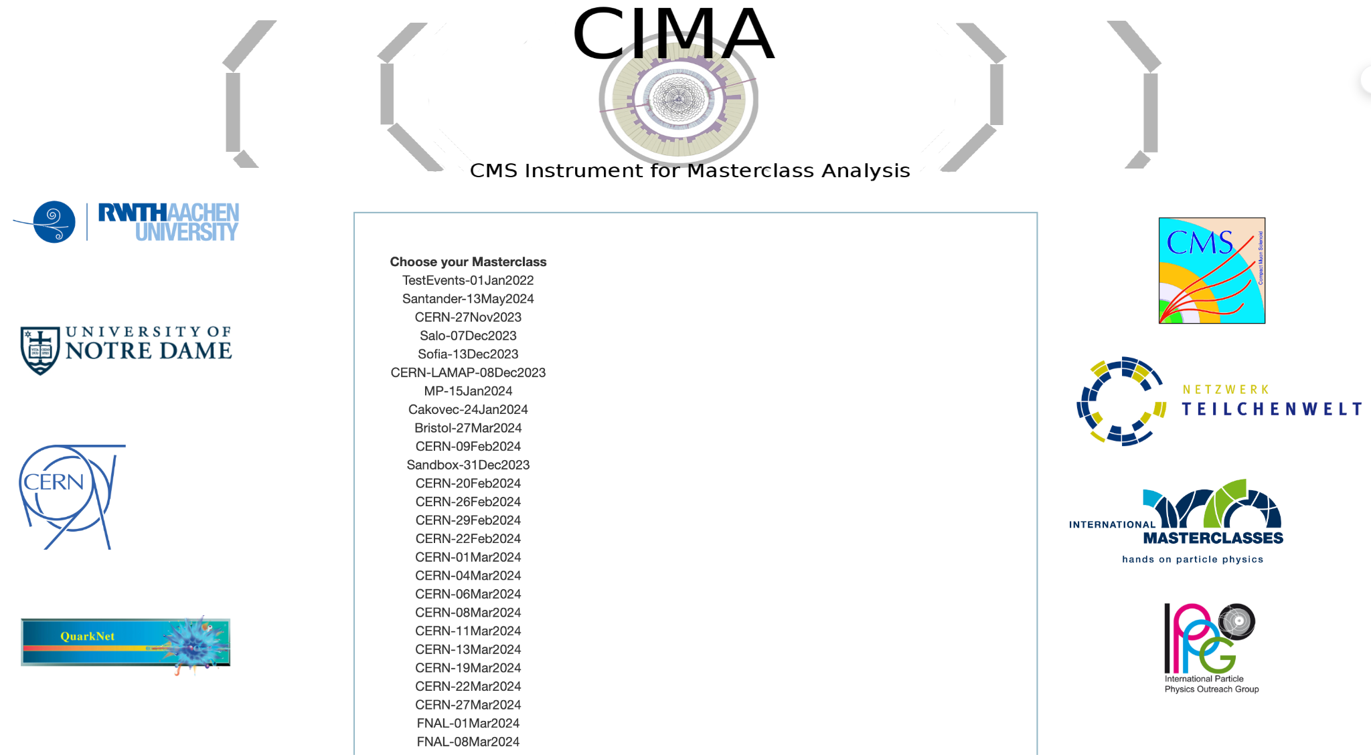
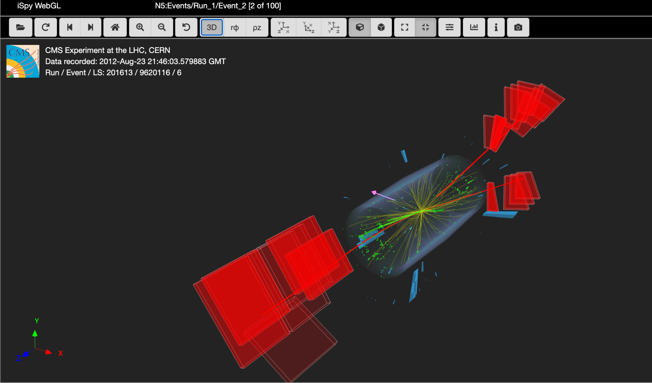
Best Practice Example
Cloud Chamber
Black Box (PI)
Masterclass - Particle Physics
Notes:
Particle physics master classes, where students use visualizations of, for example, CMS data and interact with particle physicists

Slide 24
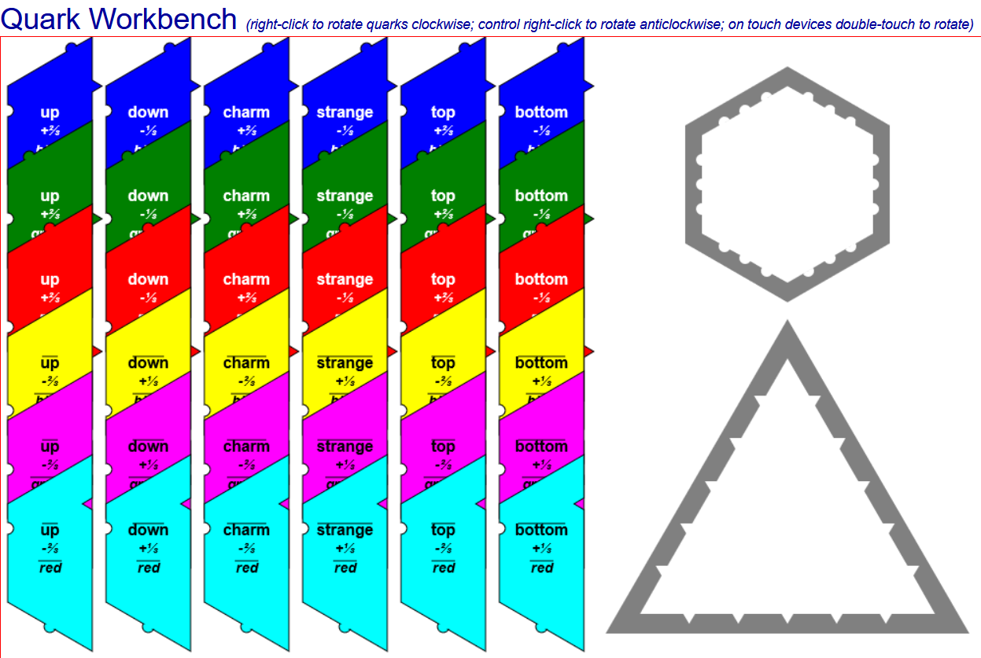
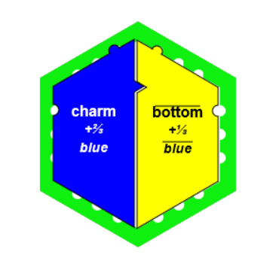
Best Practice Example
Cloud Chamber
Black Box (PI)
Masterclass - Particle Physics
Quark Workbench
Notes:
And the Quarknet “quark workbench” where students use a program that has them play around with quarks and antiquarks, learning about color charge by creating hadrons that “fit” in the shapes shown..

Slide 25

HST2024 Study Group 7
Gabriel (Brazil), Gunther (Belgium), Marina (Spain), Juhaina (Oman), Janet (USA)
One way in which our thinking has changed
The power of open
and collaborative science!

Slide 26
HST2024 Study Group 7
Gabriel (Brazil), Gunther (Belgium), Marina (Spain), Juhaina (Oman), Janet (USA)
One way in which our thinking has changed
Our Favorite Things
The power of open
and collaborative science!
Physics memes (M)
Friendship (Gu)
Cooperation (Ju)
Importance of teachers (Ga)
Cool Physics Learning (Ja)

Slide 27
Thank you for your attention!
We hope we didn’t exceed our time
so Jeff won’t be sad

Slide 28
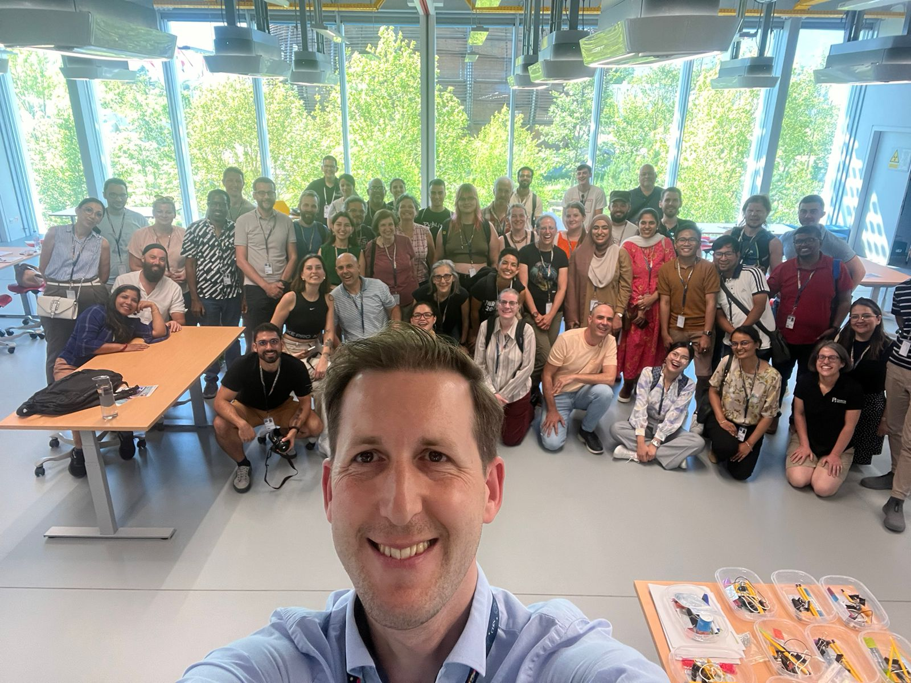
Thank you for your attention!
We hope we didn’t exceed our time
so Jeff won’t be sad

Slide 29
Thank you for your attention!
But happy instead!

Slide 30
Thank you for your attention!
Any questions?

