Slide 1
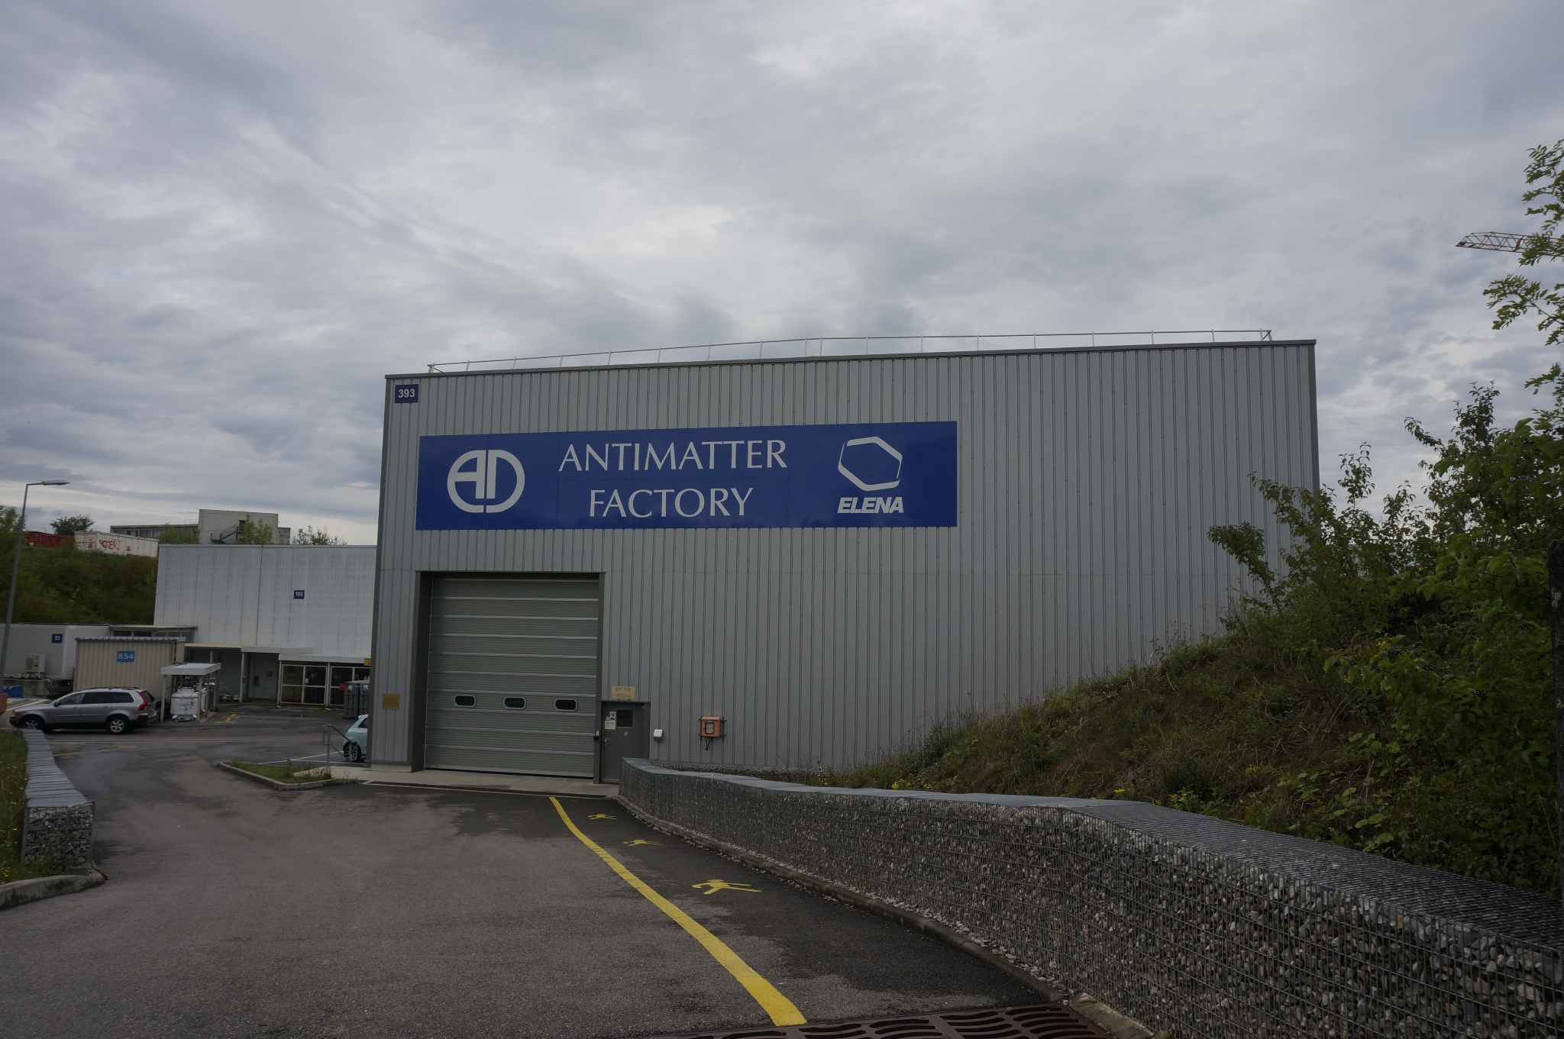
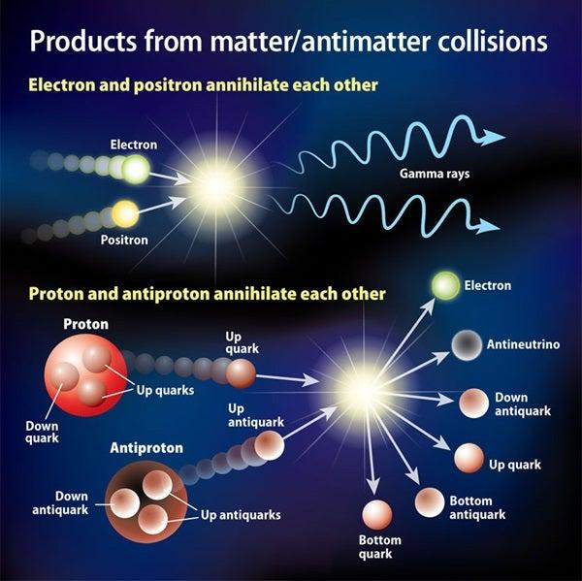
Antimatter Research
HST2024 Study Group 6
http://www.astronomy.com

Slide 2

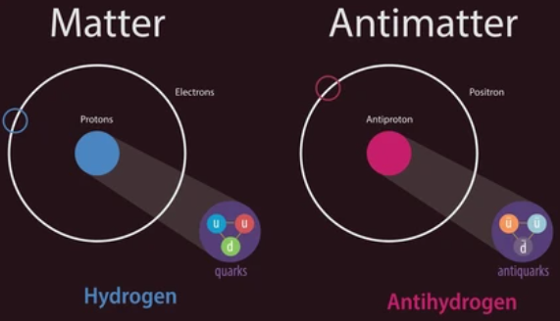

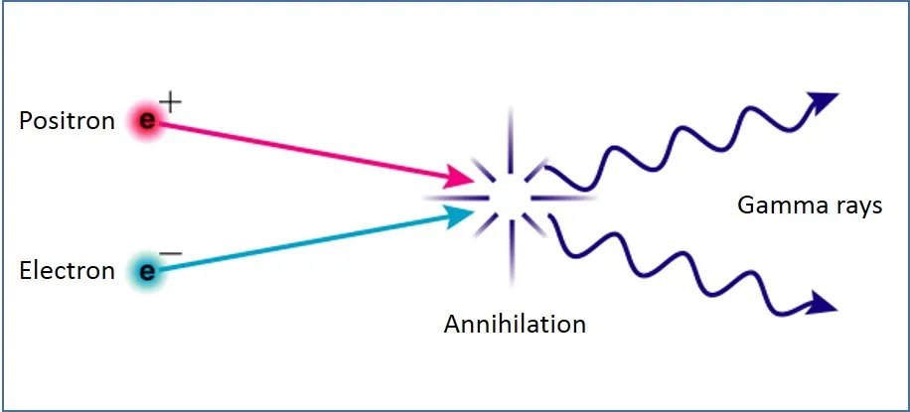
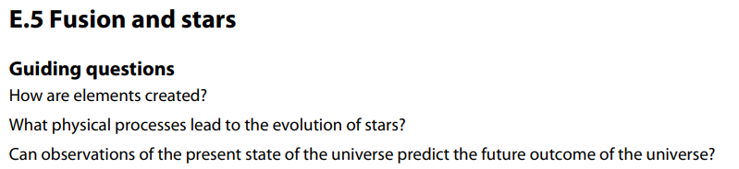
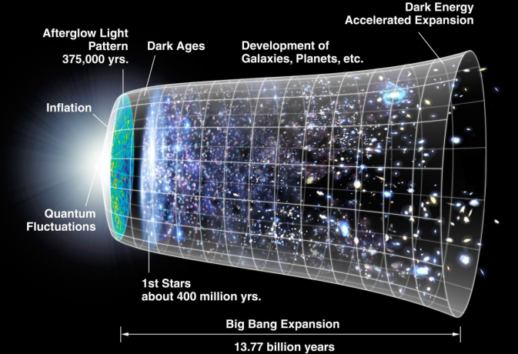
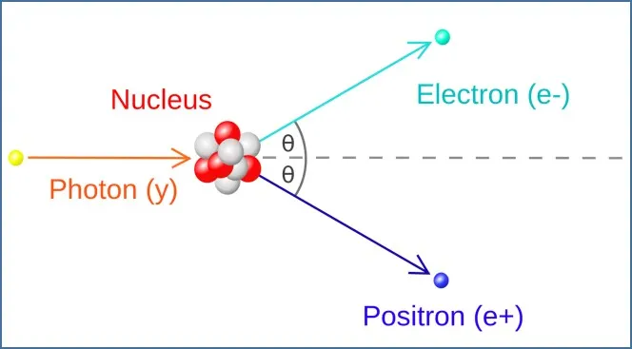

Curriculum & Classroom Connections
IBDP Physics Curriculum
E.1 Structure of the Atom
E.3 Radioactive Decay
E.5 Fusion and Stars
Turkish Physics Curriculum
U.1 Introduction to the Atom and Radioactivity
U.6 Medical imaging (Proton Emission Tomography)

Slide 3
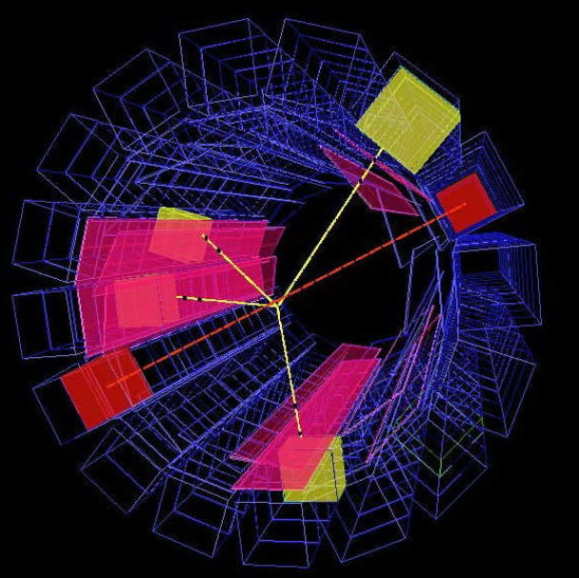
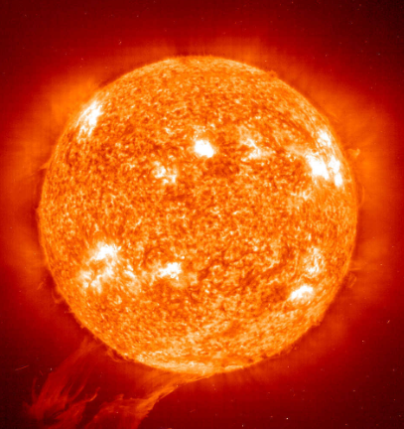
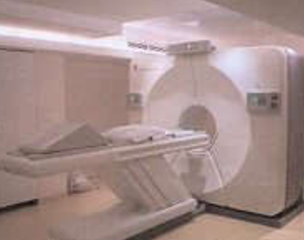
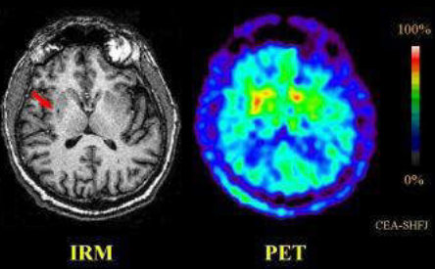
Key Ideas
Annihilation of hydrogen anti-atom seen at CERN
Conclusion
The Universe contains
Antimatter, which is
investigated at CERN
Antimatter provides important information about physical phenomena.
It also provides information about cosmological history.
It could be the key to new physics!
(primary evaporated black holes, dark matter..)
Antimatter even helps fighting tumors!
Antimatter is made of antiparticles which have same mass as particles but have opposite charge.
E.g. A positron has the same mass but the opposite charge of an electron.
Cosmic rays collide with atoms in the atmosphere to produce antimatter.
Solar flares create electron-positron pairs, up to 500g antiparticles.
Star Anti-star
If there would be anti-galaxies, made of anti-stars…
What would they look like? Stars and anti-stars emit exactly the same light… because Photons are also Anti-Photons! (no charge)
Finding an anti-helium or anti-carbon atom could solve questions about antimatter scarcity

Slide 4
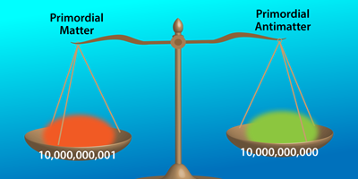
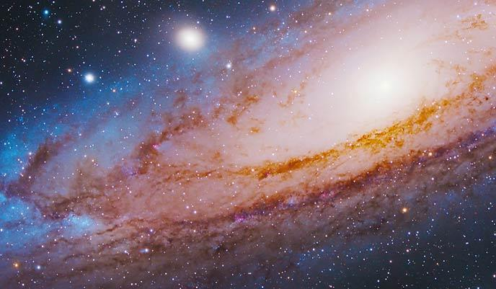
Potential Students’ Conceptions & Challenges
There is the same amount of antimatter in universe as there is matter.
Antimatter is same
as dark matter.
Antimatter is only a theoretical term (it does not exist in reality).
https://physics.aps.org/articles/v8/s17
https://astrobackyard.com/how-big-is-the-universe/

Slide 5
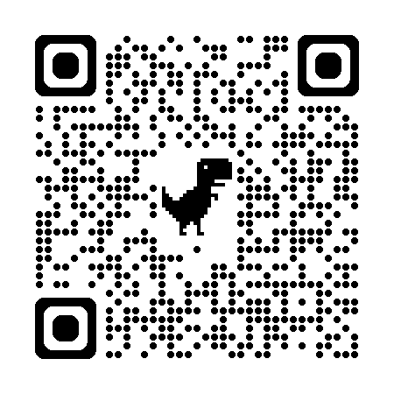
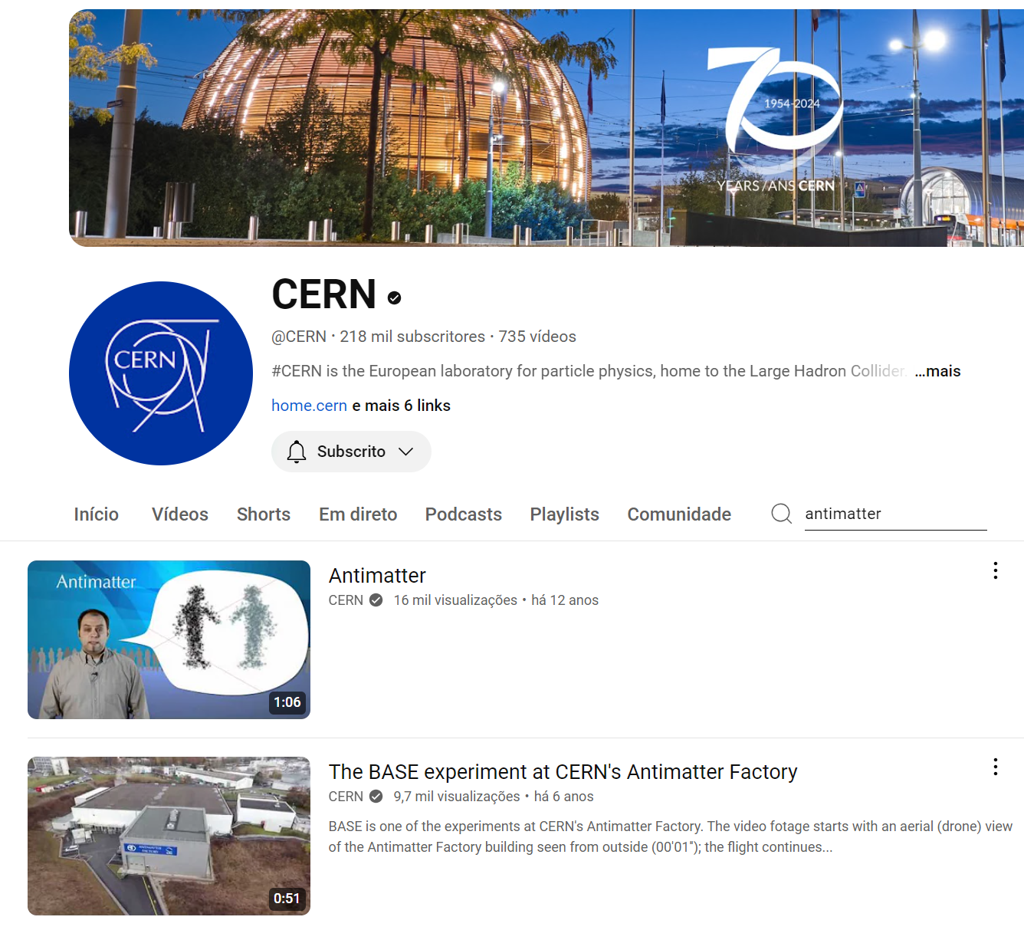
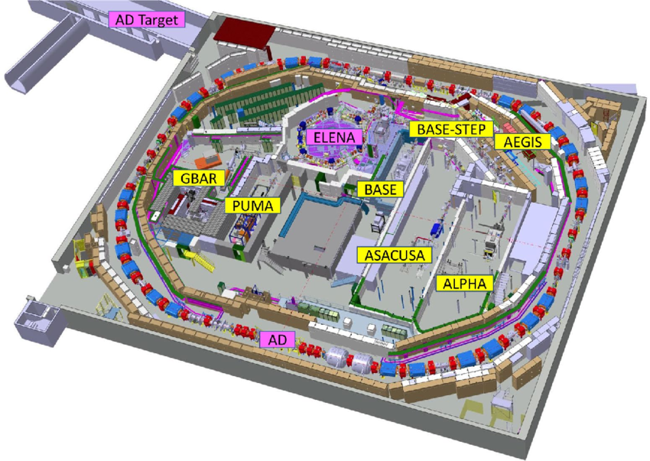
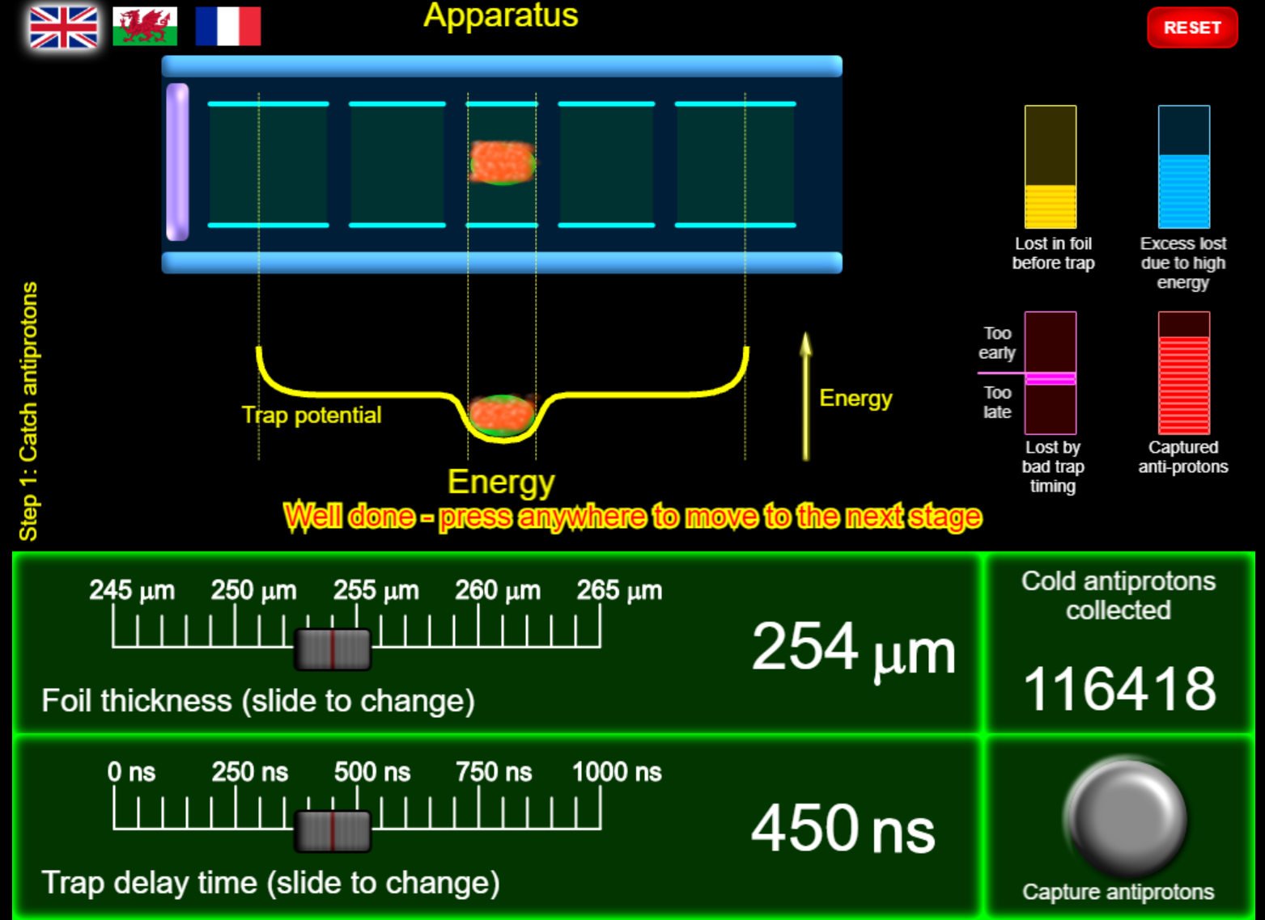
Useful Material & Resources
CERN Videos on antimatter
https://www.youtube.com/@CERN/search?query=antimatter
Virtual tour to the anti-matter factory
https://alpha.web.cern.ch/sites/default/files/360-tours/CERN-AD/HD/index.html
Hands-on anti-hydrogen trapping
https://massen.web.cern.ch/hoat/
Search resources at https://home.cern/science/physics/antimatter

Slide 6
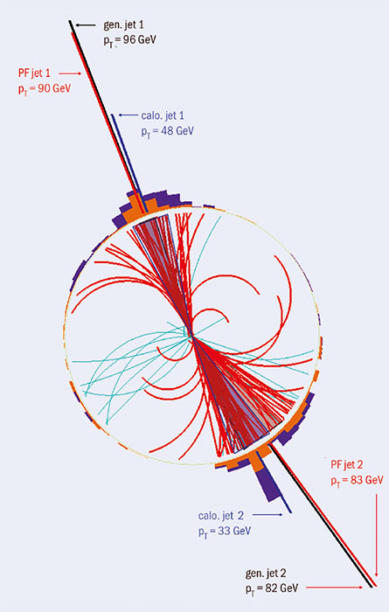
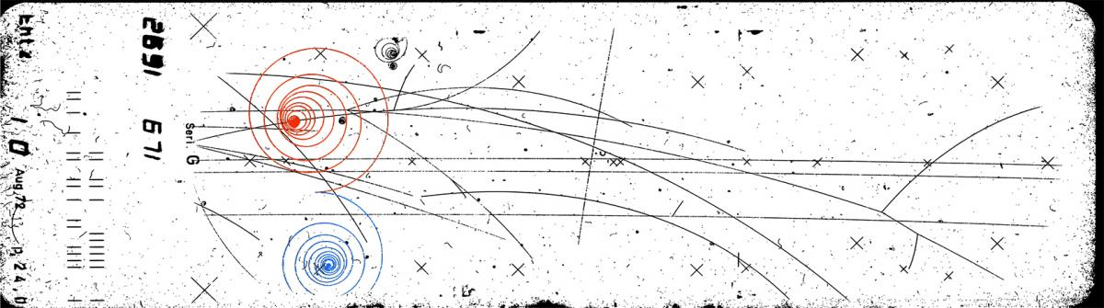
Best Practice Example
When discussing motion of charged particles in a magnetic field, we can distinguish various particles and antiparticles based on charge and mass.
Electrons and positrons will curve in the opposite directions but they will have an equal radius of curvature.
Protons and antiprotons can be distinguished similarly.
Other particles and antiparticles with shorter lifetimes can also be seen.

Slide 7

HST2024 Study Group 6
Valérie (France), Duarte (Portugal), Izel (Turkey), Tomaž (Slovenia), Ray (USA)

Slide 8
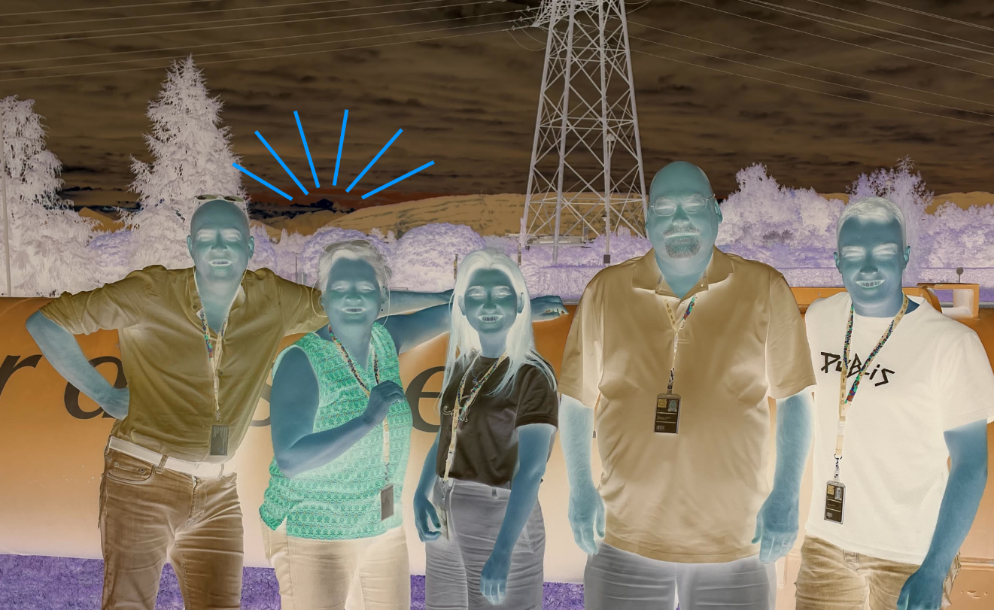
HST2024 Study Group 6
Valérie (France), Duarte (Portugal), Izel (Turkey), Tomaž (Slovenia), Ray (USA)

